Slide 1
Vectors
Vector quantity
has magnitude and direction.
is represented by an arrow.
Example: velocity, force, acceleration
Scalar quantity
has magnitude.
Example: mass, volume, speed

Slide 2
Vectors
Resultant
The sum of two or more vectors
For vectors in the same direction, add arithmetically.
For vectors in opposite directions, subtract arithmetically.
Two vectors that don’t act in the same or opposite direction:
use parallelogram rule.
Two vectors at right angles to each other
use Pythagorean Theorem: R² = V² + H².

Slide 3
Vectors
Vector components
Vertical and horizontal components of a vector are perpendicular to each othe.r
Determined by resolution.

Slide 4
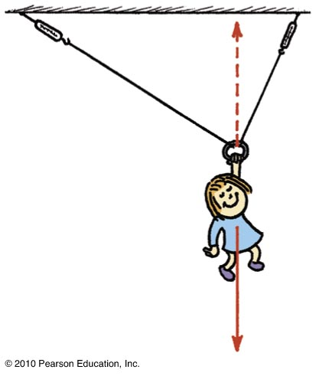
Vectors
Nellie Newton hangs from a rope as shown.
Which side has the greater tension?
There are three forces acting on Nellie:
her weight,
a tension in the left-hand side of the rope,
and a tension in the right-hand side of the rope.

Slide 5
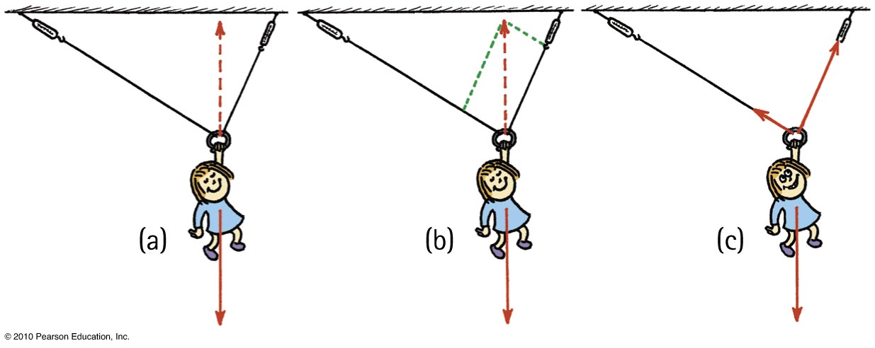
Vectors
Because of the different angles, different rope tensions will occur in each side.
Nellie hangs in equilibrium, so her weight is supported by two rope tensions, adding vectorially to be equal and opposite to her weight.
The parallelogram rule shows that the tension in the right-hand rope is greater than the tension in the left-hand rope.

