Slide 1
How Atoms Bond

Slide 2
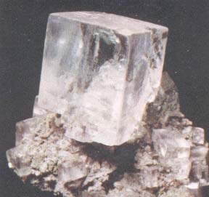
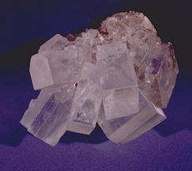
Why do halite crystals have such a distinct shape?
The shape of a crystal has to do with how the submicroscopic parts are held together.

Slide 3
What force holds atoms together?
Electrical force that acts between oppositely charged particles.
Three types of chemical bonds:
    Ionic bond
    Covalent
    Metallic bond

Slide 4
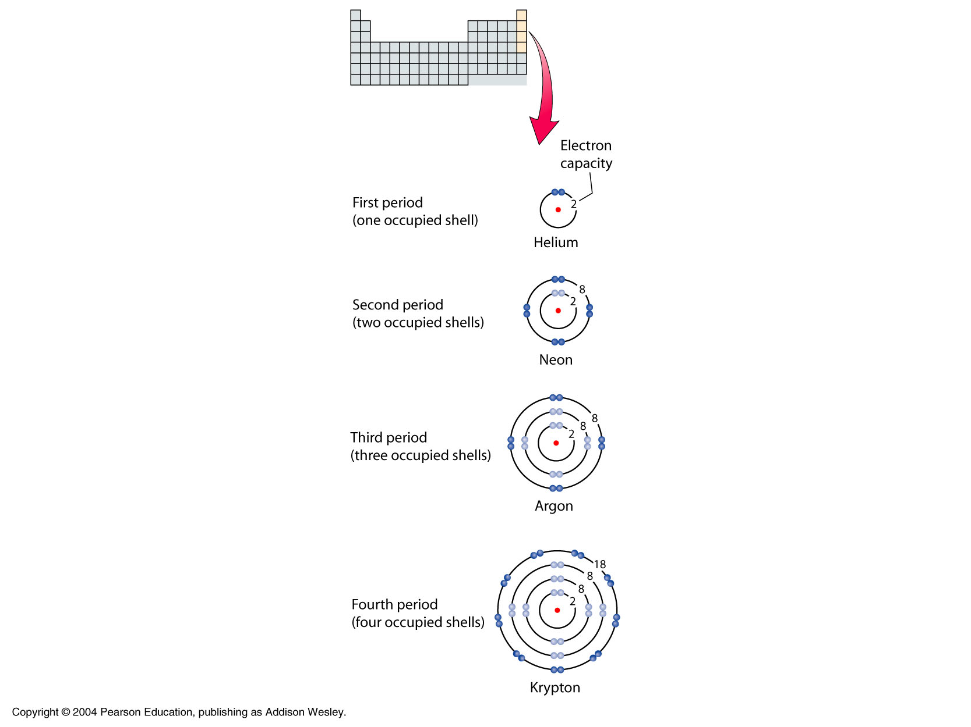
REVIEW:
Electrons are arranged in shells around the nucleus.
The electrons in the outermost shell are called valance electrons.
The valance electrons determine an atom’s ability to form chemical bonds.

Slide 5
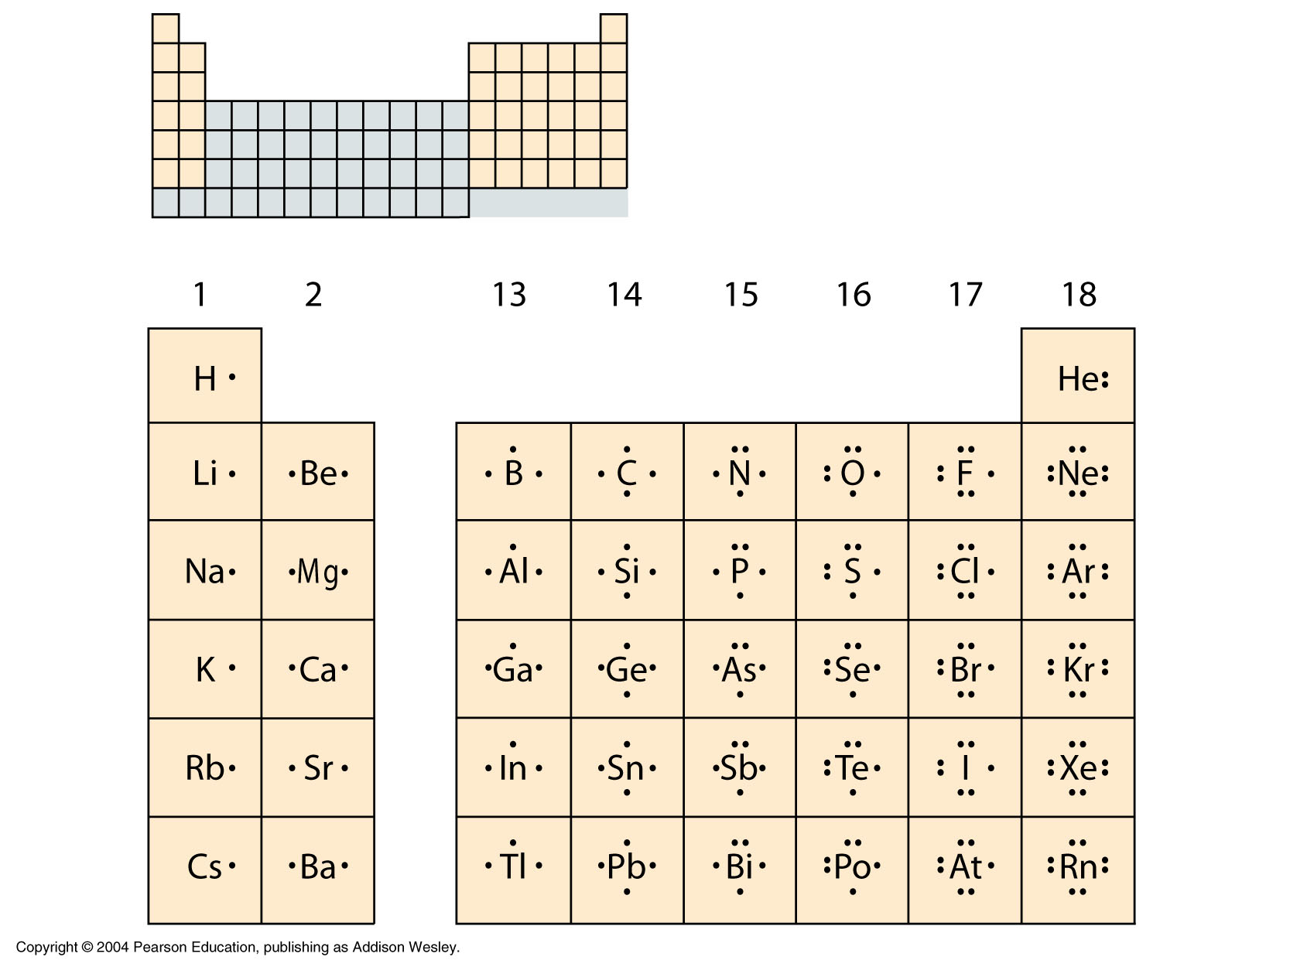
Electron-dot structure
(a.k.a. Lewis dot)
Definition:
a symbol in which the electrons in the valence shell of an atom or ion are represented by dots placed around the letter symbol of the element.

Slide 6
:
Shows:
How many valence electrons
How many valence electrons are paired
P
.
.
.
:
S
:
.
.
Paired valence electrons are relatively stable.

Slide 7
Rules for Ions
Atoms tend to lose or gain electrons that result in an outermost occupied shell filled to capacity.

Slide 8
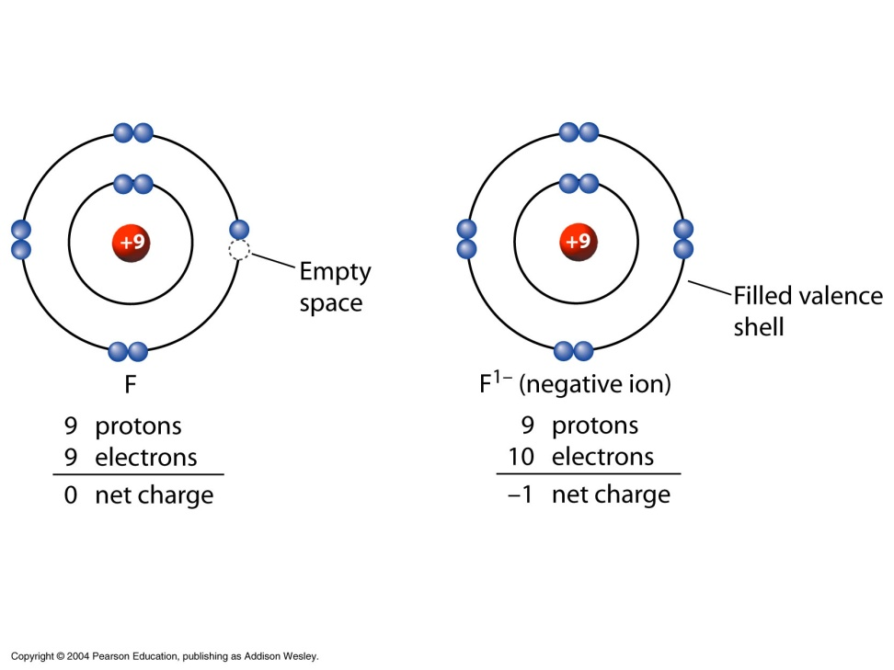
Why do some atoms form negative ions?
If fluorine gains an electron it’s outermost shell is full.

Slide 9
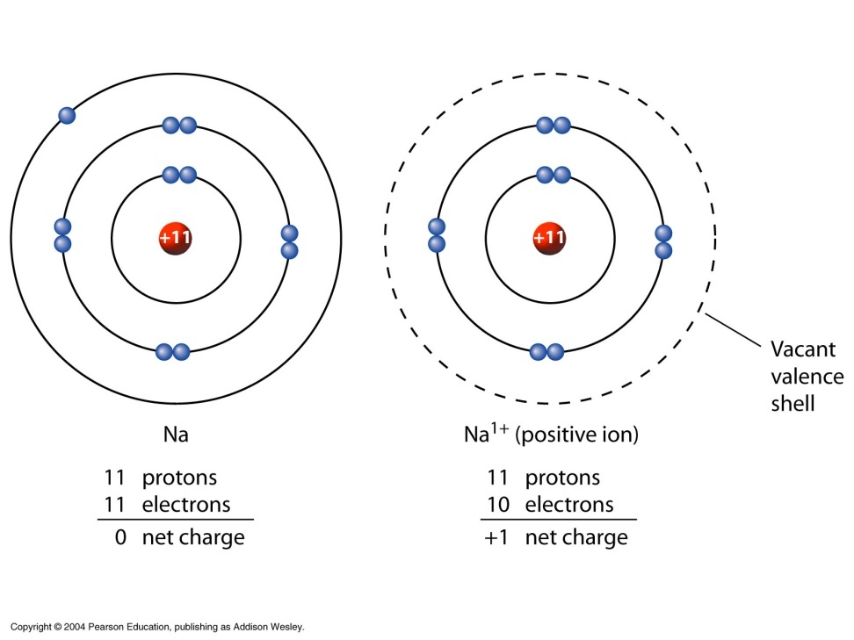
Why do some atoms form positive ions?
If sodium gives up one electron, the “new” outermost shell is filled.

Slide 10
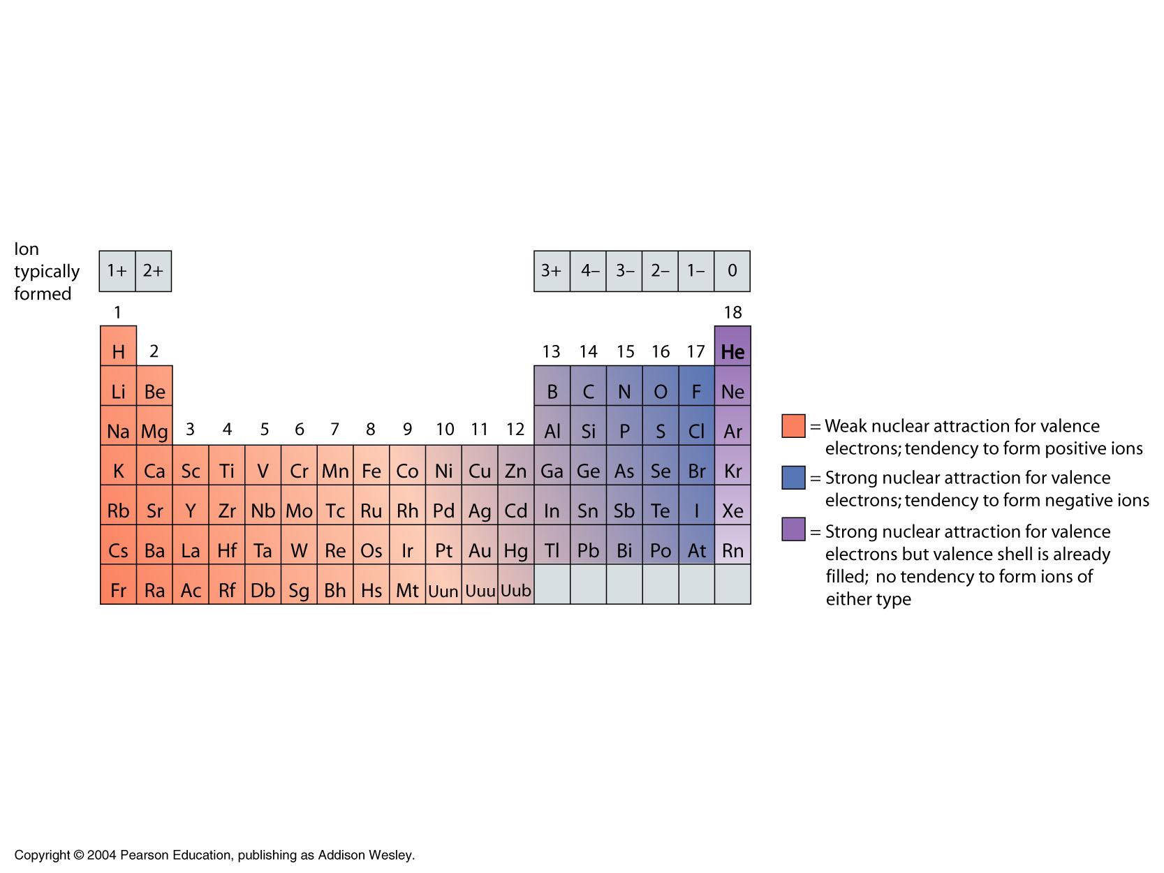
The periodic table is your guide to the types of ions that atoms tend to form.

Slide 11
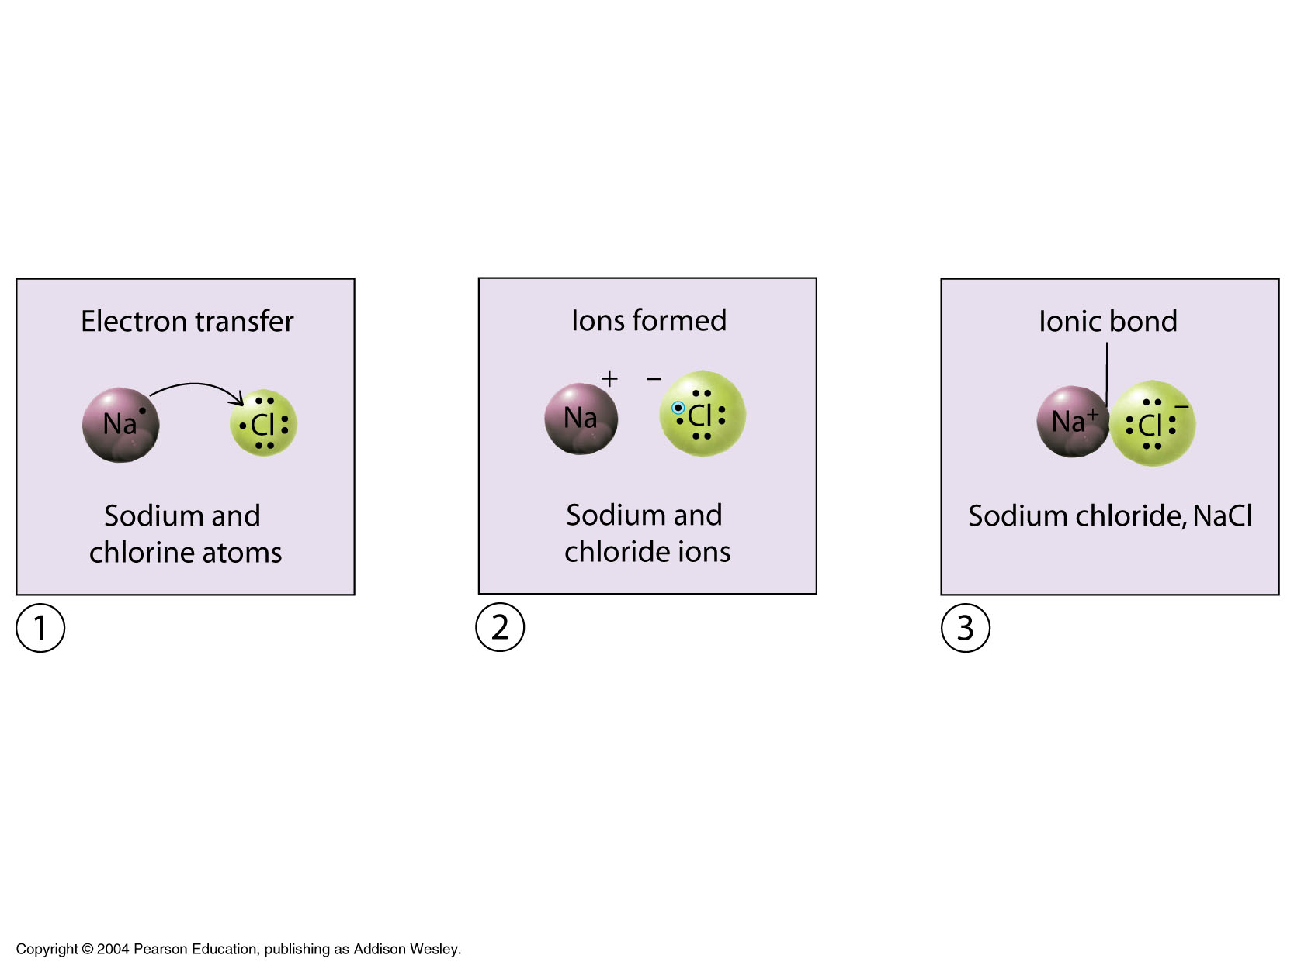
Ionic Bond
An electrically neutral Na atom loses its valence electron to electrically neutral chlorine.
Result: Two oppositely charged ions.
Ions held together by ionic bond.

Slide 12
Describing Ionic Bonds
An ionic bond is a chemical bond formed by the electrostatic attraction between positive and negative ions.
  This type of bond involves the transfer of electrons from one atom (a metal) to another (a nonmetal).
  The number of electrons lost or gained by an atom is determined by its need to fill the outermost shell.
Notes:
2

Slide 13
Ionic Compounds
A compound formed when positive ions combine with negative ions to form a neutral compound.
Composed of one metal (positive ion) and one or more non-metal (negative ion)
Ions always combine in smallest possible ratios.

Slide 14
Ionic Compounds
Chemist use a formula unit (not molecule) to represent an ionic compound.
Ionic compounds are solids with very high melting points (usually above 300°C).
Ionic compounds form a crystal lattice arrangement.

Slide 15
Examples: Write the compound that would form from the following ions.
Mg²⁺, Cl⁻ ____________
Ag³⁺, I⁻ ____________
Mg²⁺, P³⁻ ____________
Cu⁺, Cl⁻ ____________
Mn⁺², Br⁻ ____________
Mn⁺⁴, Br⁻ ____________

Slide 16
Naming Ionic Compounds
Rule: Name the ions.
Positive ions = name of element
Negative ions = name of element with –ide ending.
Examples: Lithium (Li⁺) and Chlorine (Cl⁻)
LiCl ⇨ Lithium Chlorride

Slide 17
Examples Naming Ionic Compounds
Magnesium (Mg²⁺) and Chlorine (Cl⁻)
Magnesium Chloride
Silver (Ag³⁺), Iodine (I⁻)
Silver Iodide
Magnesium (Mg²⁺) and Phosphorus (P³⁻)
Magnesium Phosphide

Slide 18
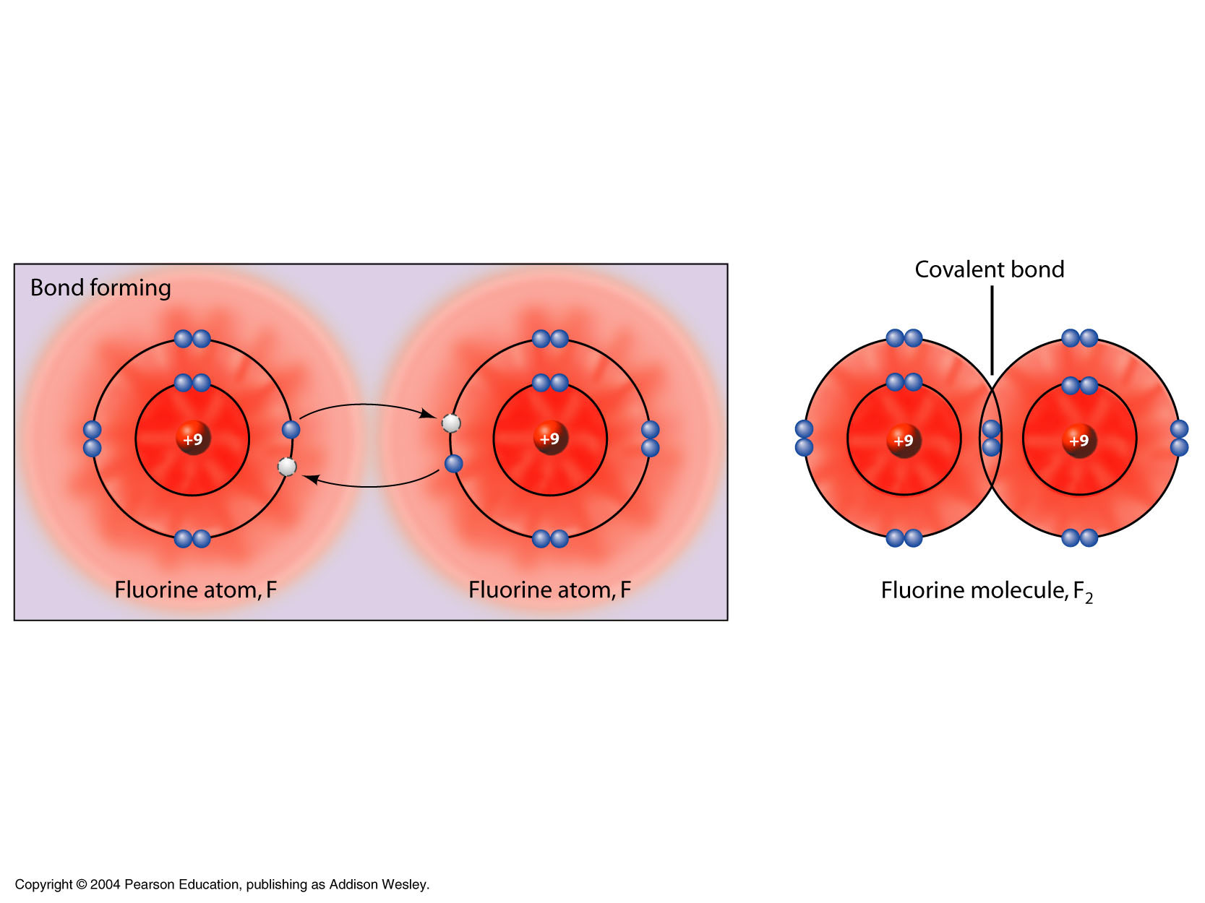
Covalent Bonds
Electrons are shared between atoms.

Slide 19
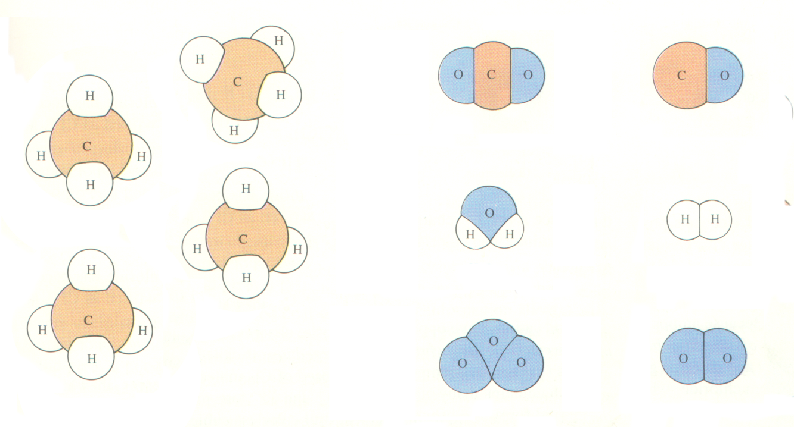
Molecular Compounds
Representative unit is a molecule.
The chemical formula is called a molecular formula.
Made up of two or more nonmetallic elements.
Can be a solid, liquid or gas.

Slide 20
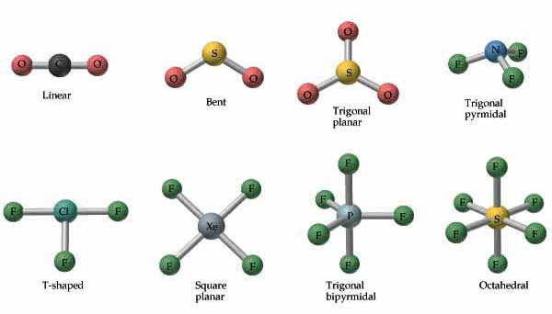

Slide 21
Naming Molecular Compounds
(or Covalent Compounds)
Only molecular compounds use prefixes.
CO carbon monoxide
CO₂ carbon dioxide
SO₂ sulfur dioxide
SO₃ sulfur trioxide

Slide 22
Comparing Ionic and Covalent Bonds

Slide 23
Types of Bonds
Classify the following substances (ionic or molecular) by the type of bond:
CaF₂
CuCl₂
NCl₃
H₂O
NH₄Cl
K₂SO₄
23

Slide 25
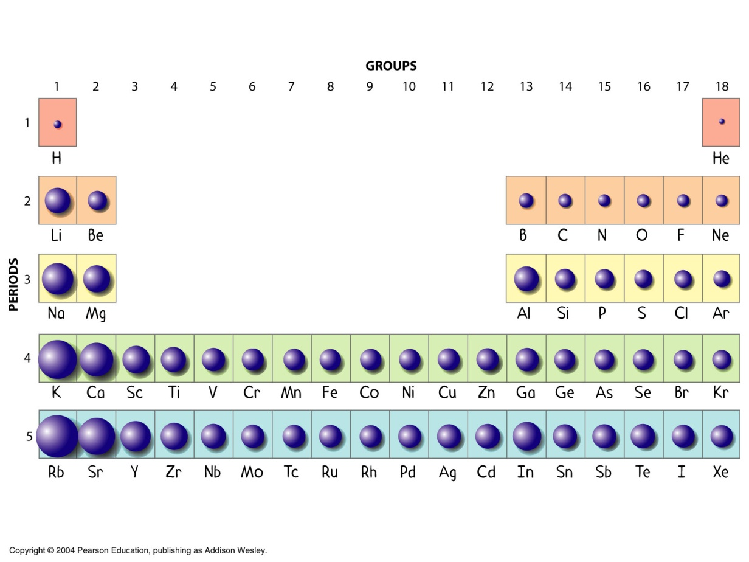
Atomic Size
Atomic size is a periodic (repeating) property.
Size decreases →

