Slide 1
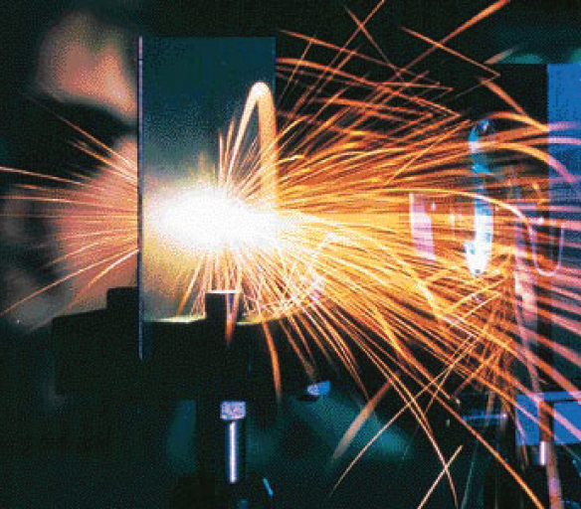

PowerPoint Lectures
to accompany
Physical Science, 9e
Chapter 4
Heat and Temperature
Copyright © The McGraw-Hill Companies, Inc. Permission required for reproduction or display.

Slide 2
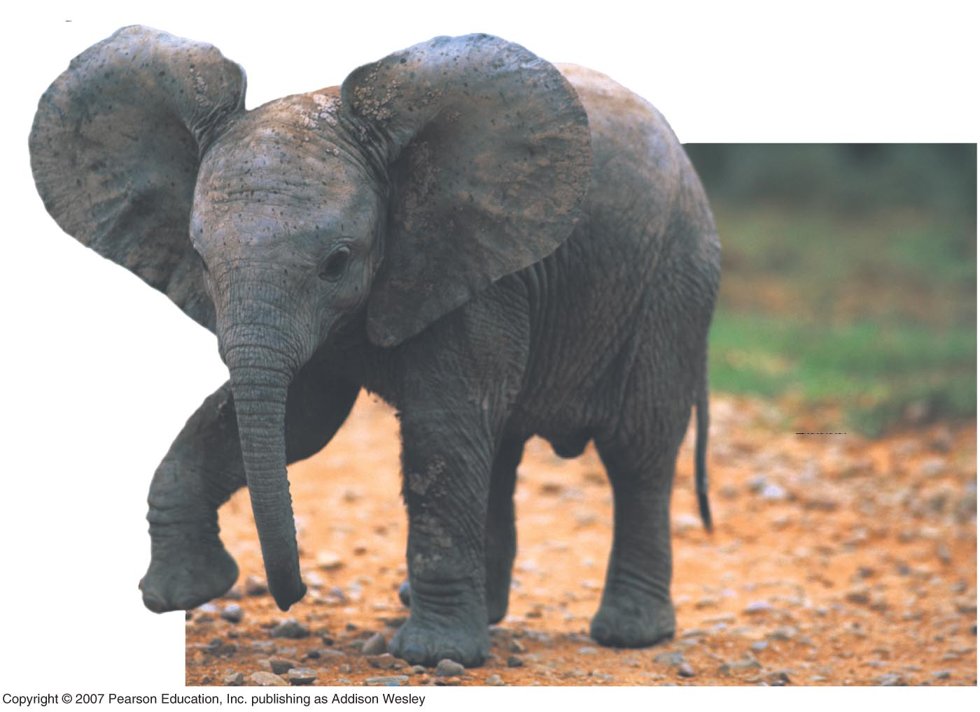
Calorimetry and Thermal Equilibrium
Physical Science 115

Slide 3
Question:
What is the difference between a hot cup of coffee and a cold cup of coffee?
Yes, temperature
But, think small. What else?
The molecules in the hot cup of coffee are moving faster—they are more energetic.
⇨More thermal energy

Slide 4
Internal Energy vs. Temperature
Internal energy and temperature have to do with kinetic energies of the molecules in substances, but they are different
To start with:
Internal energy is energy measure in joules, calories.
Temperature is measured in degrees.

Slide 5
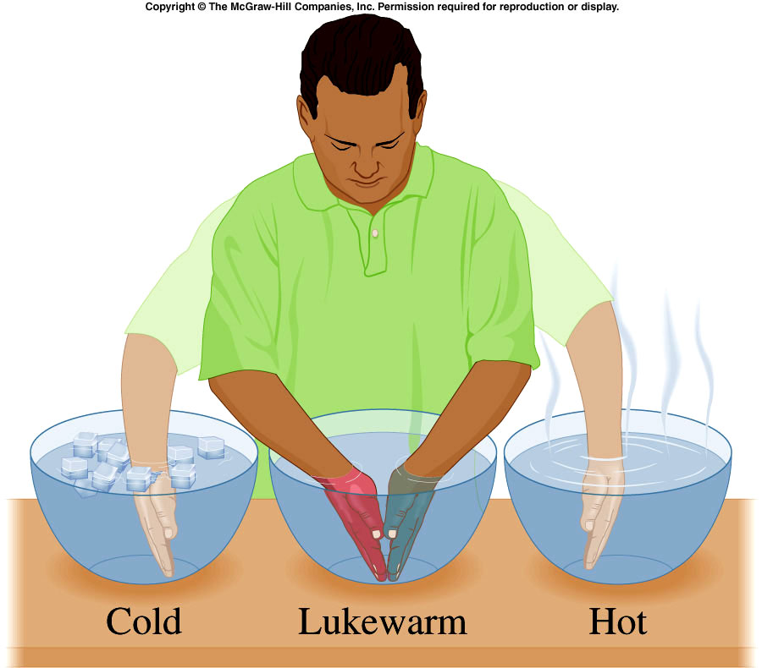
Temperature
Measuring hot and cold with our body is subjective.
A thermometer is a reliable and reproducible way to measure “hotness” and “coldness”

Slide 6
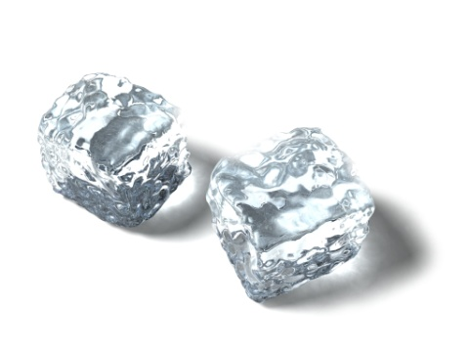
Temperature Scales
100º
100 equal spaced divisions made between reference points—centigrade thermometer
0º
0º

Slide 7
Temperature Scales
212⁰
What other numbers could we use?
32⁰
32⁰

Slide 8
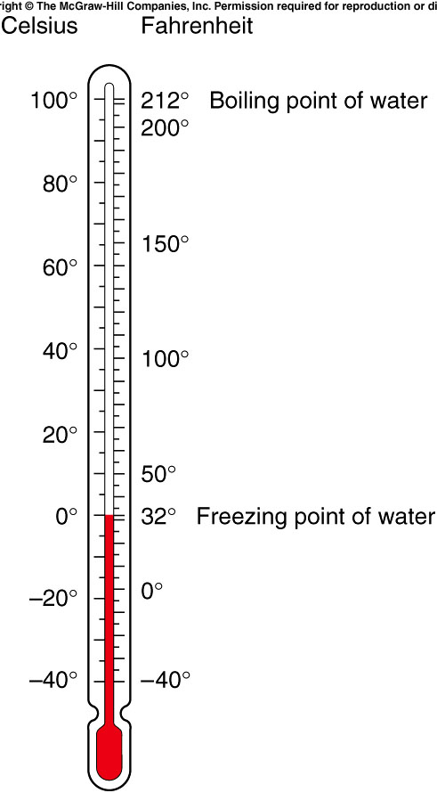
Which has the largest degrees, a Celsius thermometer or a Fahrenheit thermometer?

Slide 9
Hot Cherry Pie
Suppose you order a hot piece of pie.
Pie comes from freezer ⇨ 0⁰ C
What temperature is twice as hot?
What if pie was 10⁰ C? What would twice as hot be? No! Not 20⁰ C

Slide 10
Celsius the Village Tailor
Measure heights of all customers against the stick, which is against the wall.
No need for stick to extend to ceiling or to floor.
Stick has 273 notches between bottom and top.
The distance above the ground, “absolute zero”, is also 273 notches.
All tailors use same method, they can communicate amongst themselves.

Slide 11
One Day…
A very short woman, measures zero on scale.
She has a brother who is twice as tall, how tall is her brother?
If 0⁰ pie is twice as hot, how hot?
If 10⁰ pie is twice as hot, how hot?

Slide 12
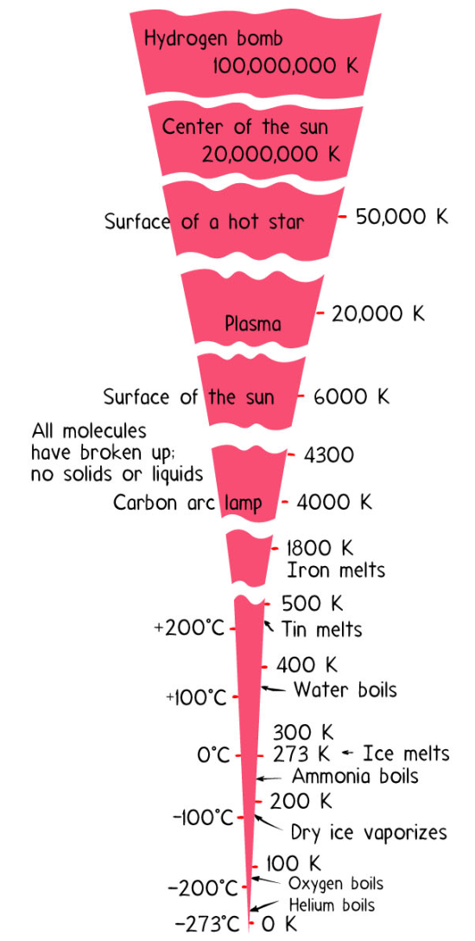
Absolute Zero
Temperature has no upper limit.
solid⇨liquid⇨gas⇨plasma
Lower limit on temperature is absolute zero.
Absolute zero—The temperature at which no more energy can be removed from a substance. It can’t get any colder.

Slide 13
Kelvin Temperature Scale
K = ºC + 273
Absolute zero = 0 K
No negative numbers on Kelvin scale.

Slide 14
Internal Energy
The total energy stored in the atoms and molecules within a substance.

Slide 15
Compare a giant iceberg to a cup of coffee…
Which has a higher temperature?
Which has more internal energy?

Slide 16
Internal Energy vs. Temperature
Internal energy and temperature have to do with kinetic energies of the molecules in substances, but they are different
To start with:
Internal energy is energy measure in joules, calories.
Temperature is measured in degrees.

Slide 17
Heat
The energy exchange between objects because of temperature difference is called heat.
“Heat flow” is redundant.

Slide 18
Calories
A calorie is the amount of heat required to change the temperature of water by 1 Celsius degree
1 Calorie = 4.18 J
1 “food calorie” = 1000 cal

Slide 19

4th of July Sparkler
Temperature = 2000⁰C
If sparks land on face, the heat received is small.
High temperature ⇨high energy per moleule.
High ratio doesn’t necessarily correspond to high heat.

Slide 20
Comparison:
Temperature, Internal Energy, and Heat
Temperature Measures average kinetic energy. | Internal Energy The energies associated with motion and position within a substance. | Heat The flow of thermal energy

Slide 21
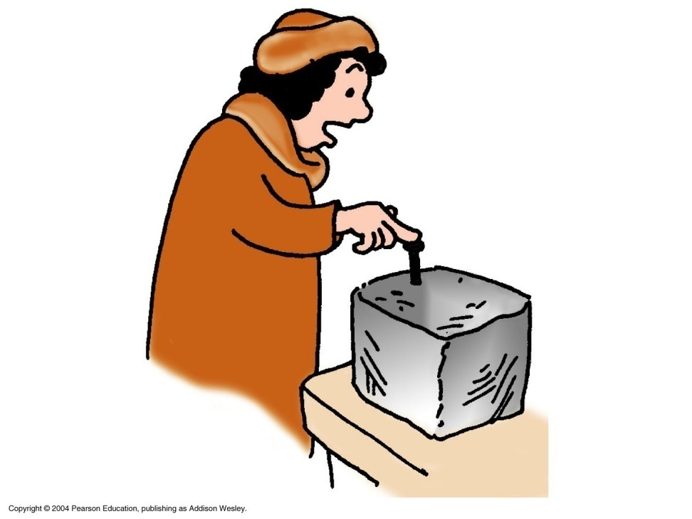
Energy Flow
When you stick a nail into ice, does cold flow from the ice to your hand, or does thermal energy flow from your hand to the ice?
Answer: Thermal energy flows from your hand to the ice.

Slide 22
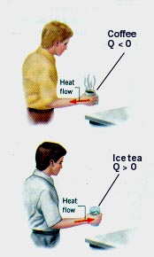
Thermal Equilibrium
Hot Coffee ⇨ “Cold” Hand
“Warm” Hand ⇨Ice Tea
Heat will flow from a hot object to a cold object until they are the same temperature.
When two objects are at the same temperature they are in thermal equilibrium.

Slide 23
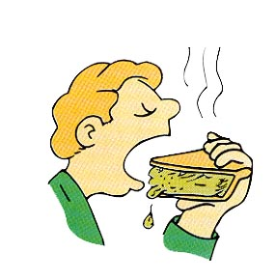
Specific Heat Capacity
Have you ever noticed that the filling is much hotter than the crust?
Different substances have different capacities for storing thermal energy.

Slide 24
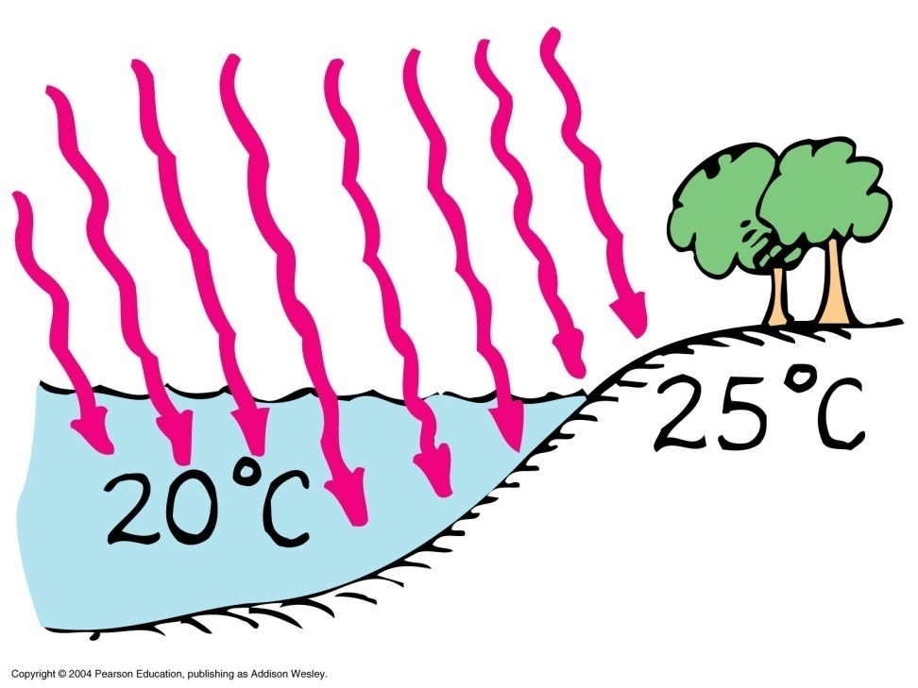
Specific Heat of Water
Water has a much higher capacity for storing energy than most all other substances.
It takes more energy to warm the water than to warm the sand.

Slide 25

Formula--Specific Heat Capacity
The quantity of heat needed to change a unit mass of the material by a unit amount in temperature.
It is a property of the material.

Slide 26
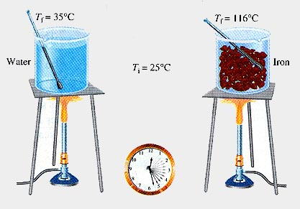
Specific Heat of Water vs. Iron
Same heat is absorbed.
Iron's ability to store heat is less than water's.
Iron's temperature rises more than does the water's.

Slide 27
Consider the difference in touching:
An empty iron frying pan that has been placed on a stove for one minute
A frying pan of water that has been on the stove for several minutes.
Which pan has the higher temperature?
Which absorbed the greater amount of energy?

Slide 28
Example
A 0.500 kg piece of metal is heated to 200.0°C and then dropped into a beaker containing 0.400 kg of water that is initially at 20.0°C. If the final equilibrium temperature of the mixed system is 22.4°C, find the specific heat of the metal.

Slide 30
Heat Transfer

Slide 31
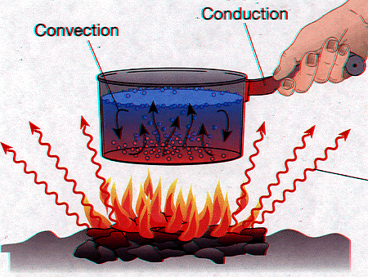
Three Types of Thermal Energy Transfer
Convection
Conduction
Radiation

Slide 32
Conduction
Conduction moves heat from one particle to the next.
It is due to collision between atoms.
Example: when the stove burner heats a pan and its contents.
Conduction allows the heat to be transferred inside and throughout a material rather than only heating the surface.

Slide 33
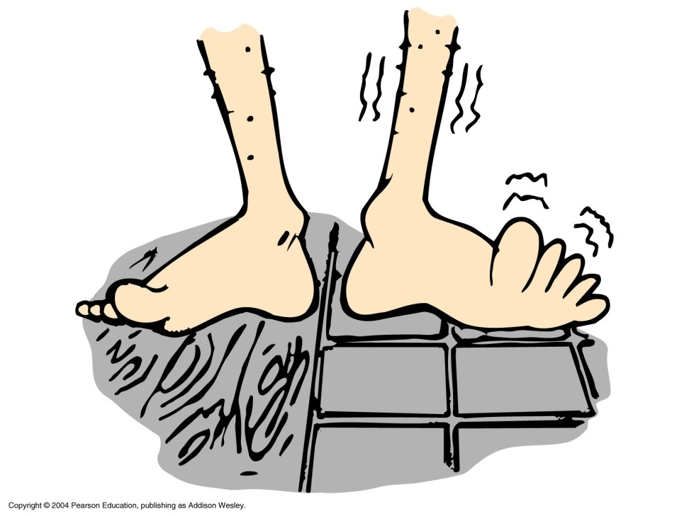
Cold Tile
Tile floor and wood floor are at the same temperature
Tile feels colder
Tile is a better heat conductor
Thermal energy moves more quickly from your feet.

Slide 34

Glass and Air are poor conductors.
Long Stem
Conduction of heat is minimized
Air is also a poor conductor.
Hand in pizza oven does not burn unless you touch metal!

Slide 35
Snow is a poor conductor of thermal energy.
Snowflakes trap air.
Provides insulation.
Blanket of snow insulates ground.
Igloo doesn’t provide thermal energy, it slows down the loss of energy.

Slide 36
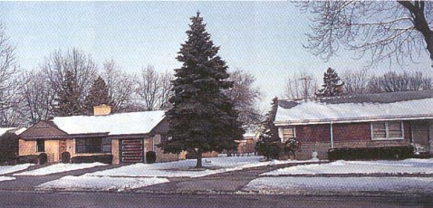
Which home has more insulation in the attic?

Slide 37
Convection
is the transfer of heat through the flow of liquids or gases
The material itself moves from one place to another.
Examples:
  Hot air rises through a chimney.
  House heating

Slide 38
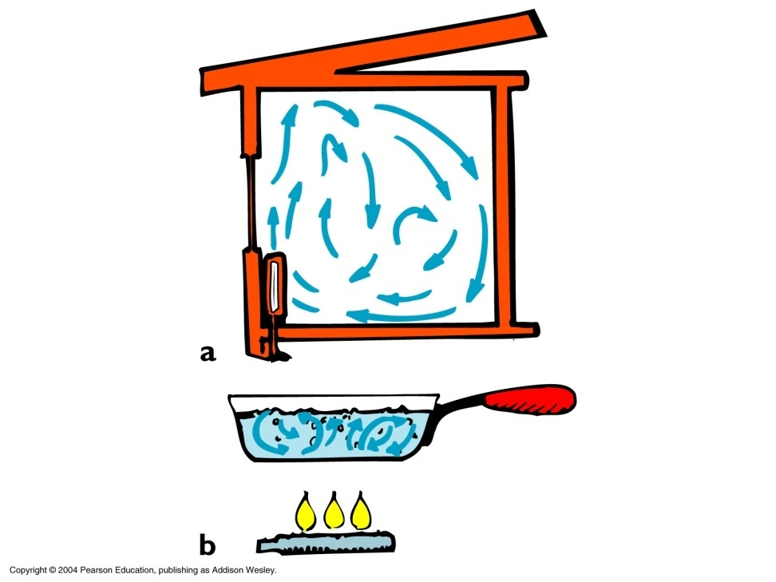
Convection Currents
Convection currents in a gas
Convection currents in a liquid

Slide 39
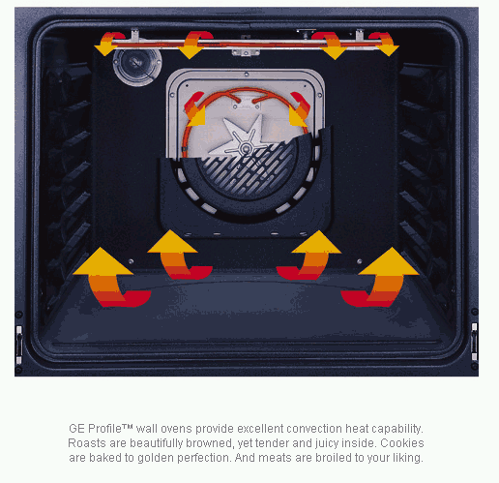
Convection Ovens
Ovens with a fan inside.
Cooking is sped up by the circulation of heated air.

Slide 40

Try this.
Blow on hand with mouth open wide.
Try again with smaller opening.
What do you notice? Why?

Slide 41
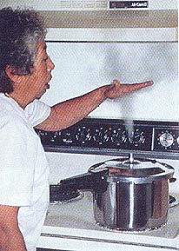
Cooling by Expansion
As gas expands, energy is spread out over greater area
Therefore, it cools.

Slide 42
Radiation
Radiation is heat transfer by the emission of electromagnetic waves which carry energy away from the emitting object.
For ordinary temperatures (less than red hot"), the radiation is in the infrared region of the electromagnetic spectrum.

Slide 43
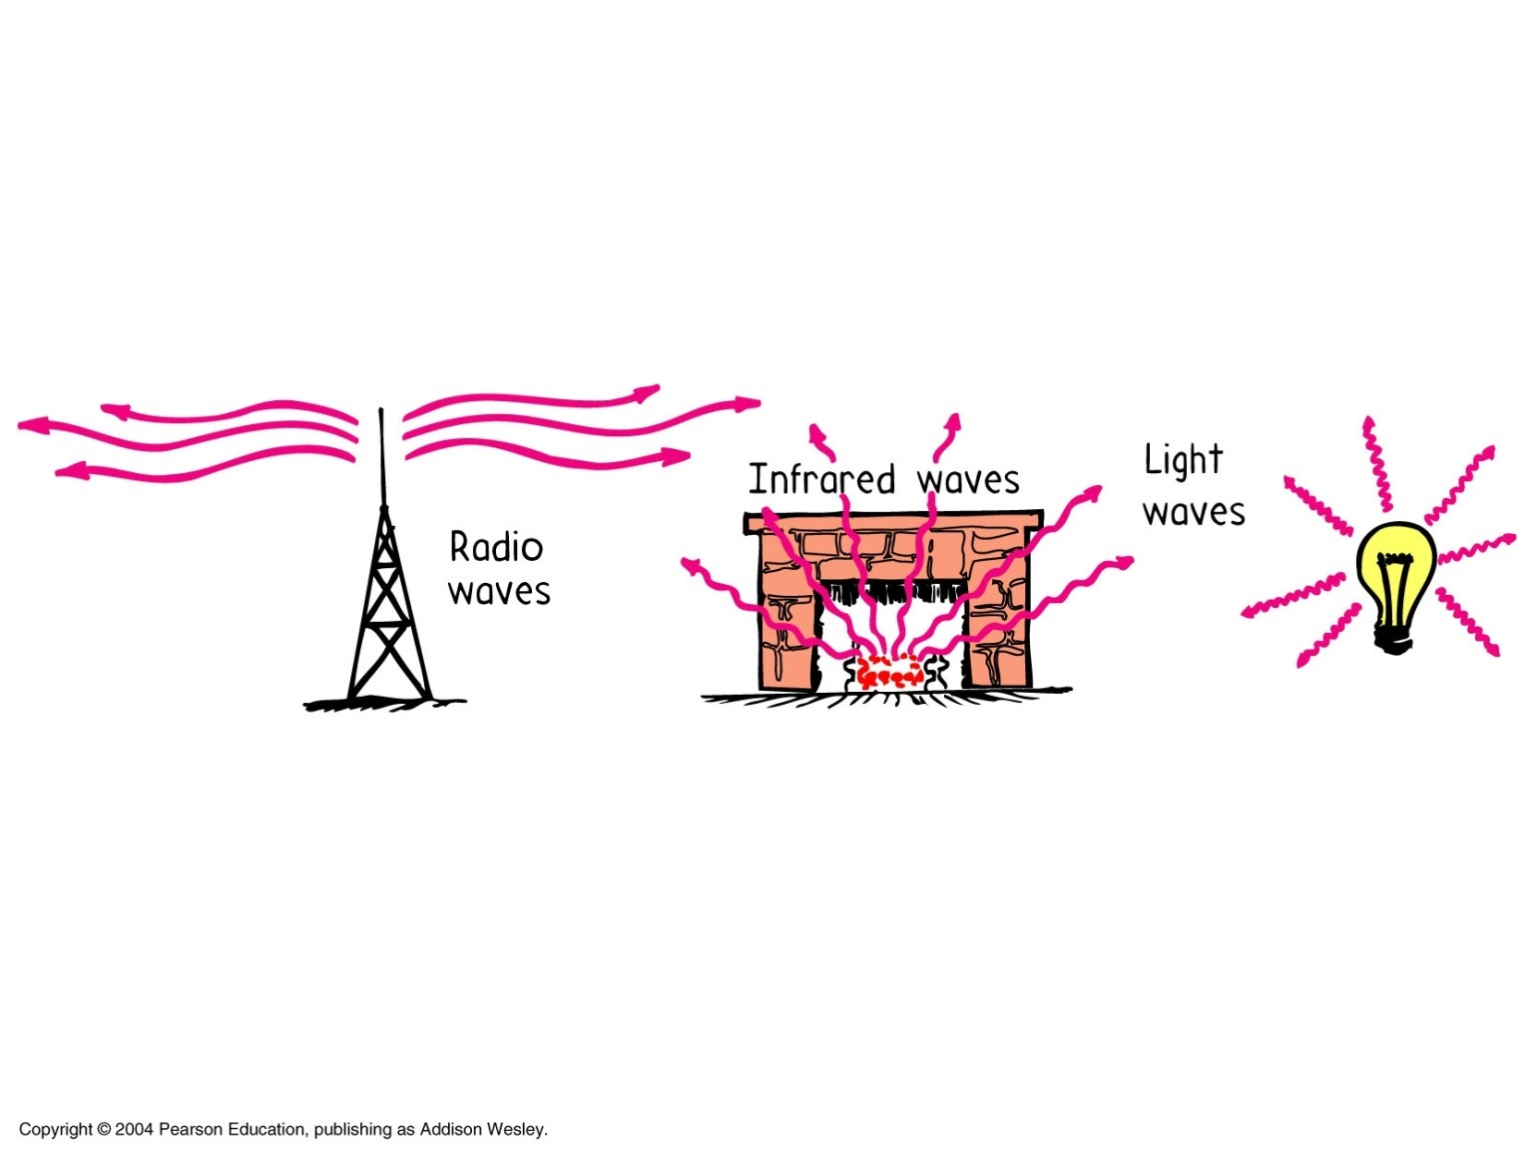
Types of Radiation

Slide 44

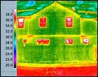
Infrared Photography

