Slide 1
Chapter 14
Cosmology

Slide 2
Cosmology
Cosmology, the study of the universe as a whole, can tell you where your matter came from and where it is going.
the phrase "cosmology" is often used to describe the non-scientific (especially philosophical, religious, metaphysical) means people used to understand their role in the universe, especially before the development of the scientific method

Slide 3
The Edge–Center Problem
An edge to the universe seems to violate common sense.
Modern observations indicate that the universe could be infinite and have no edge.
Note that you find the centers of things—galaxies, globular clusters, oceans, and pizzas—by referring to their edges.
If the universe has no edge, then it cannot have a center.

Slide 4
The Big Bang Theory
The expansion of the universe led astronomers to conclude that the universe must have begun with an event of astounding cosmic intensity.

Slide 5
Necessity of the Big Bang
If you ran your video far enough back, you would see the matter and energy of the universe compressed into a high-density, high-temperature state.
You can conclude that the expanding universe began with expansion from that condition of extremely high density and temperature.
Modern astronomers call it the big bang.

Slide 6
Necessity of the Big Bang
To find the age of the universe, you divide the distance between galaxies by the speed with which they are separating.
Then, you find out how much time was required for them to have reached their present separation.

Slide 7
Necessity of the Big Bang
For now, you can conclude that basic observations of the recession of the galaxies require that the universe began with a big bang about 14 billion years ago.
That estimated span is called the Hubble time.

Slide 8
In 1998, it was announced that the expansion of the universe is accelerating. What does this imply from the perspective of the big bang?
a. A force exists that we knew nothing about that causes the acceleration.
b. The universe must be closed.
c. The universe is finite.
d. The amount of dark matter must be greatly less than the amount of normal matter.
e. The universe must be infinitely old.

Slide 9
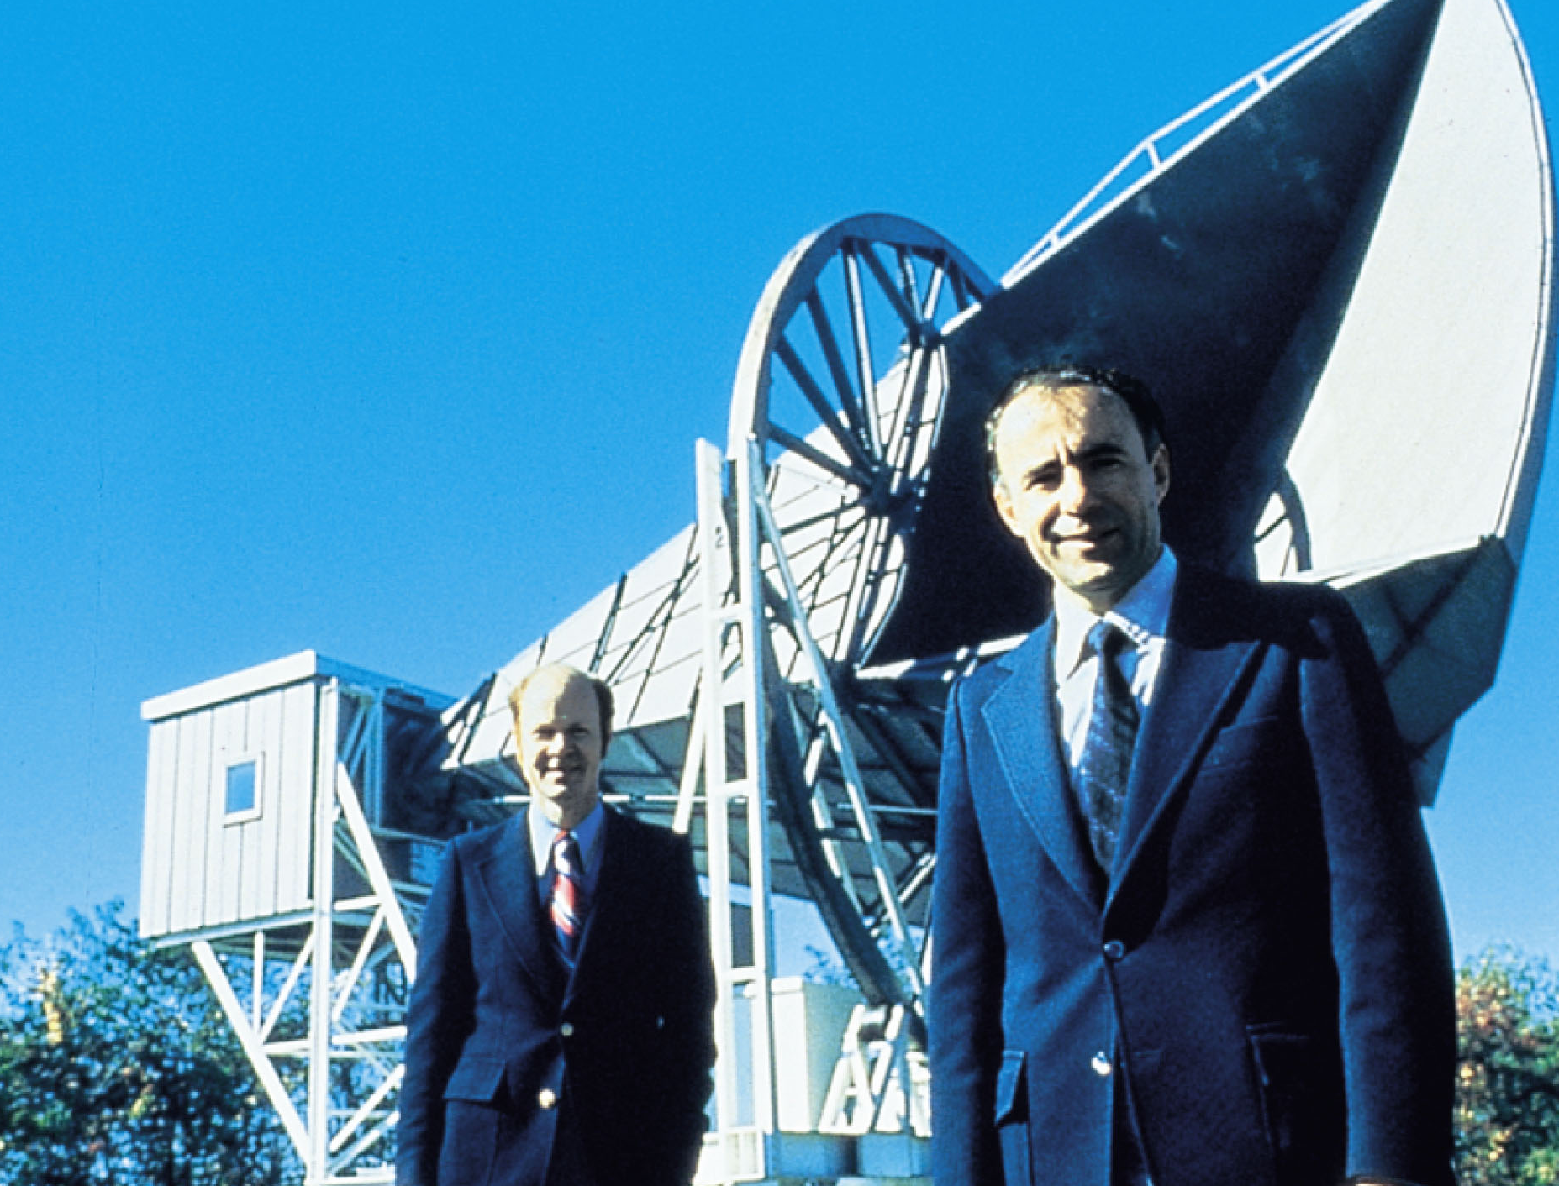
Evidence for the Big Bang: The Cosmic Background Radiation
In the mid-1960s, two Bell Laboratories physicists, Arno Penzias and Robert Wilson, were measuring the radio brightness of the sky when they discovered peculiar radio noise coming from all directions.

Slide 10
When Penzias and Wilson learned about the preceding work, they realized the radio noise they had detected—now called the cosmic microwave background (CMB)—is actually radiation from the big bang.
They received the 1978 Nobel Prize in physics for their discovery.

Slide 11
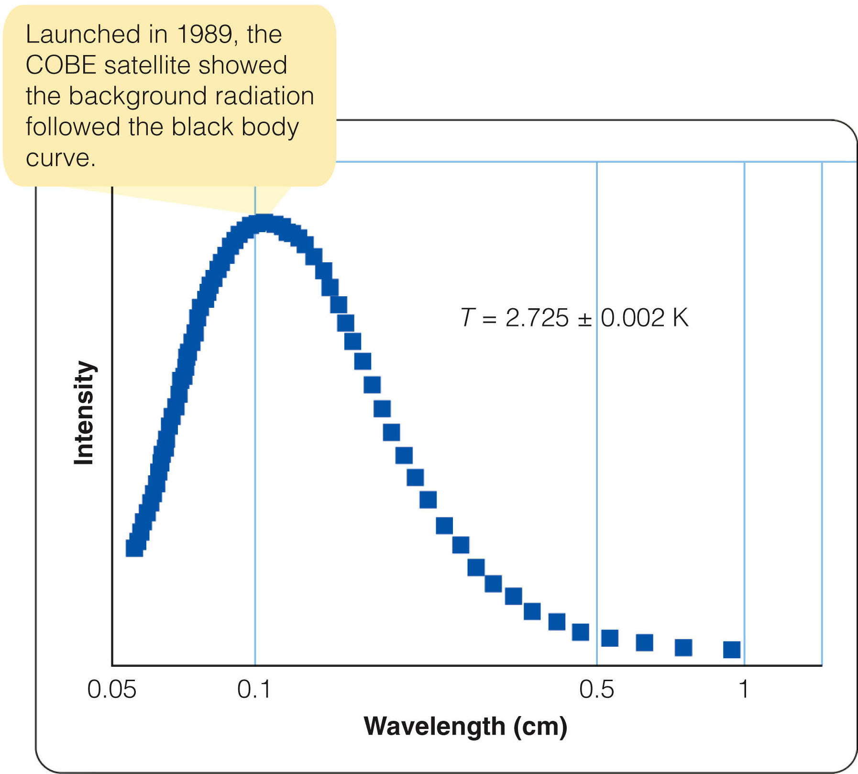
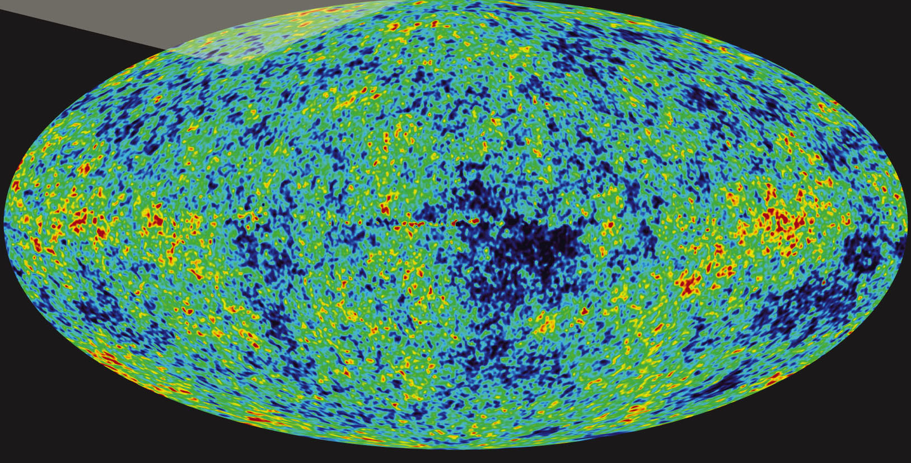
Evidence for the Big Bang: The Cosmic Background Radiation
It was not until January 1990 that satellite measurements confirmed that the CMB is blackbody radiation, with an apparent temperature of 2.725 +/- 0.002 K.
This is in good agreement with theoretical predictions.

Slide 12
Particles and Nucleosynthesis: The First Seconds and Minutes
Simple observations of the darkness of the night sky and the redshifts of the galaxies show you that the universe must have had a beginning.
Also, you have seen that the CMB is clear evidence that conditions at the beginning were hot and dense.

Slide 13
Particles and Nucleosynthesis: The First Seconds and Minutes
Suppose you could visit the universe when it was only 10-millionths of a second old.
You would find it filled with high-energy photons having a blackbody temperature well over 1 trillion (10¹²) K and a density greater than 5 x 10¹³ g/cm^{3.}
This is nearly the density of an atomic nucleus.

Slide 14
If photons have enough energy, two photons can combine and convert their energy into a pair of particles—a particle of normal matter and a particle of antimatter.
When an antimatter particle meets its matching particle of normal matter, the two particles annihilate each other and convert their mass back into energy—in the form of two gamma rays.

Slide 15
Test Your Understanding
When a proton and an antiproton collide
a. they destroy each other and produce energy in the form of gamma rays.
b. one of the protons is converted to a neutron and they form nucleus of one proton and one neutron.
c. one of the protons is converted to an electron and they form a hydrogen atom.
d. one proton is converted to a neutron and the other is converted to an electron.
e. A proton and an antiproton can not collide because the Coulomb barrier is too great.

Slide 16
In the early universe, photons had enough energy to produce proton–antiproton pairs or neutron–antineutron pairs.
When these particles collided with their antiparticles, they converted their mass back into photons.
Thus, the early universe was filled with a dynamic soup of energy flickering from photons into particles and back again.

Slide 17
That continued until the universe was about four seconds old.
At that point, the expansion had cooled the gamma rays to the point where they could no longer create electron–positron pairs.
Most of the electrons and positrons combined to form photons—and only one in a billion electrons survived.
The protons, neutrons, and electrons of which the universe is made were produced during the first four seconds of its history.

Slide 18
This soup of hot gas and radiation continued to cool.
By the time the universe was about 2 minutes old, protons and neutrons could link to form deuterium—the nucleus of a heavy hydrogen atom—and not be broken apart again.
By the end of the next minute, further reactions began converting deuterium into helium.

Slide 19
However, almost no heavier atoms could be built.
There are no stable nuclei with atomic weights of 5 or 8 (in units of the hydrogen atom).
Nuclei with these atomic weights fall apart as soon as they are created.

Slide 20
Test Your Understanding
As the universe cooled, it eventually reached a temperature of 3,000 K and protons were able to capture and hold electrons to form neutral hydrogen. This process is known as
a. ionization.
b. isotropy.
c. annihilation.
d. recombination.
e. hydration.

Slide 21
Test Your Understanding
What was the temperature of the universe when the recombination took place that produced the cosmic background radiation we observe today?
a. about 2.7 K
b. about 300 K
c. about 3000 K
d. about 3 million K
e. about 3 billion K

Slide 22
Test your Understanding
The cosmic background radiation comes from a time after the origin of the universe
a. when protons and neutrons were first formed.
b. when the big bang first began to expand.
c. the inflationary period.
d. when gamma rays had enough energy to destroy nuclei.
e. when electrons began to recombine with nuclei to form atoms.

Slide 23
Test your Understanding
Current evidence suggests that the universe is
a. flat, infinite, and neither expanding nor contracting.
b. closed, finite, and slowing its expansion.
c. open, infinite, and slowing in its expansion.
d. static with no expansion.
e. flat, infinite, and accelerating in its expansion.

Slide 24
Test Your Understanding
During the first moments of the big bang when elements could be created, nuclear fusion reactions made few heavy elements because
a. all heavy nuclei are unstable.
b. no stable nuclei exist with masses of 5 or 8 hydrogen masses.
c. the helium nucleus is unstable.
d. the temperature and density were too low.
e. no nuclei heavier than helium could form since there weren't any electrons formed.

Slide 25
Cosmic element building during the big bang had to proceed rapidly, step by step—like someone hopping up a flight of stairs.
The lack of stable nuclei at atomic weights of 5 and 8 meant there were missing steps.
The step-by-step reactions had great difficulty jumping over these gaps.
Astronomers can calculate that the big bang produced a tiny amount of lithium but no elements heavier than that.

Slide 26
By the time the universe was 3 minutes old, it had become so cool that most nuclear reactions had stopped.
By the time it was 30 minutes old, the reactions had ended completely.
About 25 percent of the mass was in the form of helium nuclei.
The rest was in the form of hydrogen nuclei (protons).

Slide 27
That is the abundance of hydrogen and helium observed today in the oldest stars.
The cosmic abundance of hydrogen and helium were essentially fixed during the first minutes of the universe.

Slide 28
Recombination and Reionization: The First Thousands and Millions of Years
As the young universe expanded, it went through three important changes.

Slide 29
Recombination and Reionization: The First Thousands and Millions of Years
The first important change occurred when the universe reached an age of roughly 50,000 years.
The density of the energy present in the form of photons became less than the density of the gas.
Before this, matter could not clump together because the intense sea of photons smoothed the gas out.

Slide 30
Recombination and Reionization: The First Thousands and Millions of Years
Once the density of the radiation fell below that of matter, the matter could begin to draw together under the influence of gravity and form the clouds that eventually became galaxies.
The expansion of the universe spread the particles of the ionized gas farther and farther apart.

Slide 31
The second important change began as the universe reached the age of about 400,000 years.
As the density decreased and the falling temperature of the universe reached 3,000 K, protons were able to capture and hold free electrons to form neutral hydrogen.
This process is called recombination—although ‘combination’ (for the first time) would be more accurate.
Recombination and Reionization: The First Thousands and Millions of Years

Slide 32
As the free electrons were gobbled up into atoms, they could no longer deflect photons.
The photons could travel easily through the gas.
So, the gas became transparent.
Also, the photons retained the blackbody temperature of 3,000 K that the gas and photons together had at the time of recombination.

Slide 33
Those photons are what are observed today as the CMB—with a large redshift that makes their temperature now about 2.7 K.
Recombination and Reionization: The First Thousands and Millions of Years

Slide 34
Recombination left the gas of the big bang neutral, hot, dense, and transparent.
At first, the universe was filled with the glow of the hot gas, which would have been partly at visible wavelengths.
As the universe expanded and cooled, however, the glow faded.
Recombination and Reionization: The First Thousands and Millions of Years

Slide 35
The universe entered what cosmologists call the dark age.
This was a period lasting hundreds of millions of years until the formation of the first stars.
During the dark age, the universe expanded in darkness.
Recombination and Reionization: The First Thousands and Millions of Years

Slide 36
Recombination and Reionization: The First Thousands and Millions of Years
The dark age ended as the first stars began to form.
The gas from which these first stars formed contained almost no metals and was, consequently, highly transparent.
Mathematical models show that the first stars formed from this metal-poor gas would have been very massive, very luminous, and very short-lived.

Slide 37
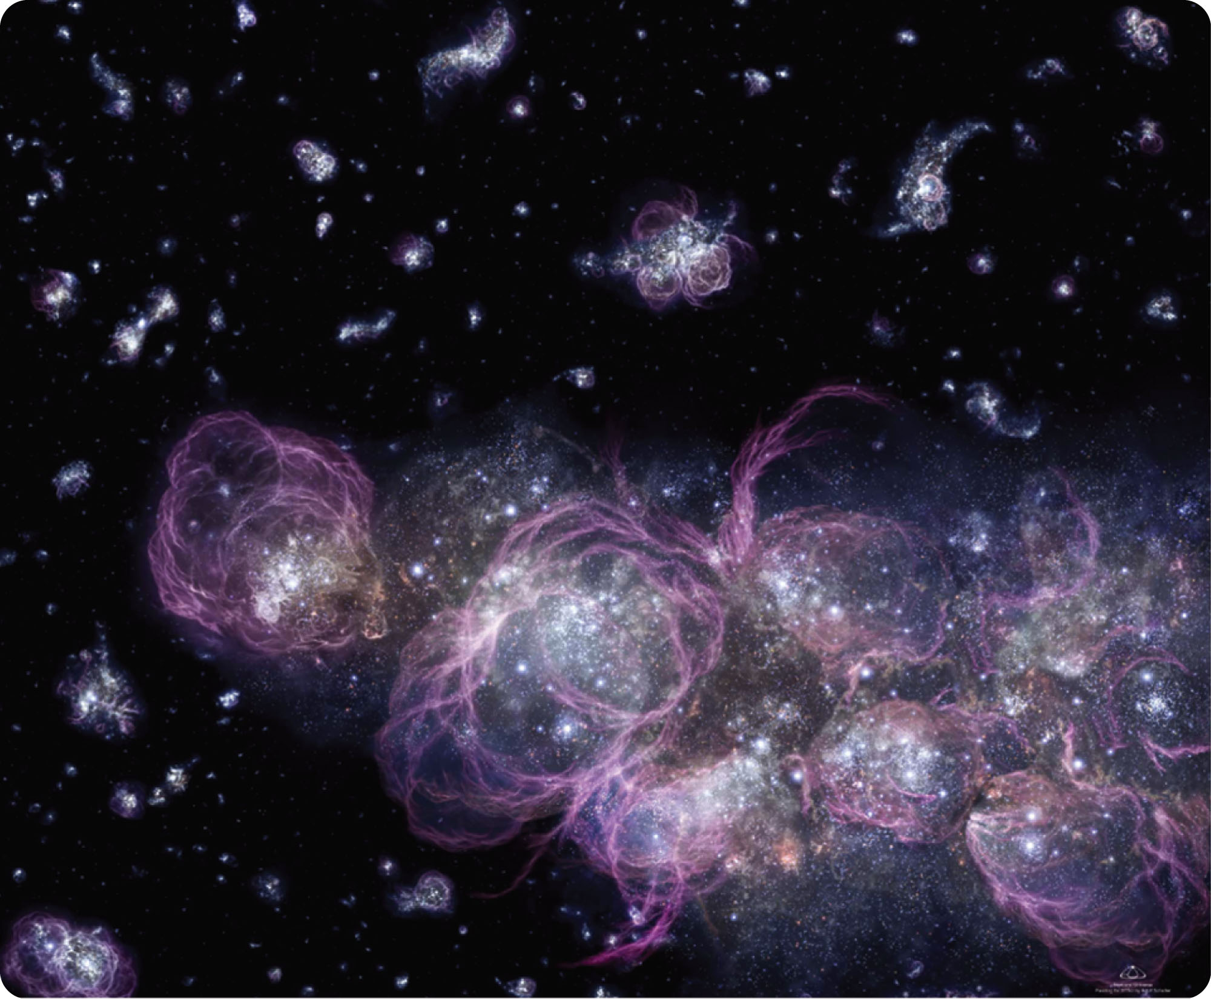
Recombination and Reionization: The First Thousands and Millions of Years
That first burst of star formation produced enough ultraviolet light to begin ionizing the gas.
Today’s astronomers, looking back to the most distant visible quasars and galaxies, can see traces of that reionization of the universe.

Slide 38
Recombination and Reionization: The First Thousands and Millions of Years
Reionization marks the end of the dark age and the beginning of the age of stars and galaxies that continues through today.

Slide 39
Looking at the Universe
The universe looks about the same whichever way you look.
That is called isotropy.

Slide 40
Looking at the Universe
The universe also seems homogeneous.
Homogeneity is the property of being the same everywhere.

Slide 41
Looking at the Universe
Isotropy and homogeneity lead to the cosmological principle.
This states that any observer in any galaxy sees that the universe has the same general properties—after accounting for relatively minor local and evolutionary variations.

Slide 42
The cosmological principle implies that there are no special places in the universe.
What you see from Milky Way is typical of what all intelligent creatures see from their respective home galaxies.

Slide 43
Test your Understanding
The assumption of isotropy states that
a. the universe looks the same at all epochs.
b. the universe looks the same from all locations over sufficiently great distances.
c. the universe looks the same in all directions over sufficiently great distances.
d. all of the above
e. none of the above

Slide 44
Test Your Understanding
The Hubble time is
a. the time it takes a galaxy moving at 1000 km/sec to move 1 Mpc.
b. the time it takes the galaxy to double its size.
c. the time since recombination occurred.
d. the time remaining before the universe stops expanding and begins to contract.
e. an estimate of the age of the universe based on the Hubble constant.

Slide 45
Test your Understanding
In 1998, it was announced that the expansion of the universe is accelerating. What does this imply from the perspective of the big bang?
a. A force exists that we knew nothing about that causes the acceleration.
b. The universe must be closed.
c. The universe is finite.
d. The amount of dark matter must be greatly less than the amount of normal matter.
e. The universe must be infinitely old.

Slide 46
Test your Understanding
Current evidence suggests that the universe is
a. flat, infinite, and neither expanding nor contracting.
b. closed, finite, and slowing its expansion.
c. open, infinite, and slowing in its expansion.
d. static with no expansion.
e. flat, infinite, and accelerating in its expansion.

Slide 47
Test your Understanding
Where did the cosmic microwave background (CMB) come from?
a. Photons emitted from the first stars
b. Photons released from hydrogen in our galaxy
c. Light scattered by dust in our Solar System
d. Photons released when electrons and nuclei combined for the first time.

