Slide 1
Introduction to the Atom and the Periodic Table
Physical Science 115

Slide 2
Atoms—The Building Block of Matter
The atom is the fundamental
building block of matter.
Notes:
Boulder …rocks, …stones, …gravel …powder… and so on and so…you would finally have the atom.

Slide 3
History of Atomic Structure
Democritus (ancient Greek philosopher)-first proposed idea of atoms
Notes:
Dalton-first theory of atom
All matter is made up of atoms
The atoms of each element are exactly alike.
Atoms in one element are different from atoms of another element.
Atoms can combine to form compounds.

Slide 4
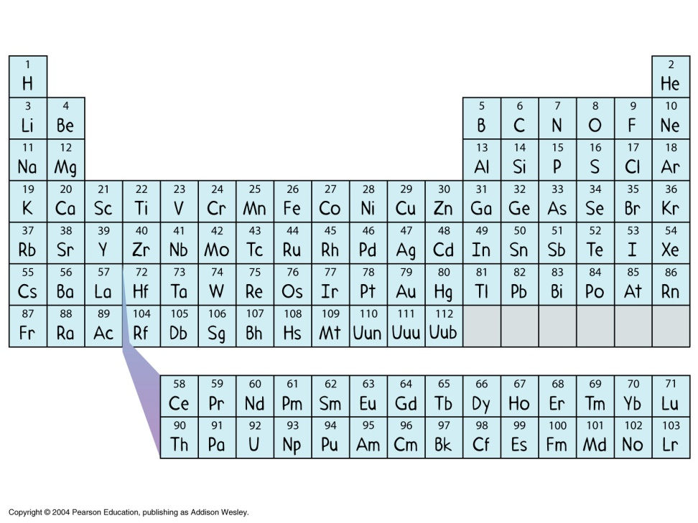
The Periodic Table
Notes:
Each element designated by its atomic symbol.
Usually from symbols name but sometimes from Latin name.
Only capitalize first letter.

Slide 5
Atoms are small.
There are as many atoms of air in your lungs at any moment as there are breaths of air in the Earth’s atmosphere.
There are more atoms in a thimble full of water than there are thimbles of water in the ocean.
There are more atoms in a single apple than there are apples that can fit inside the earth.

Slide 6
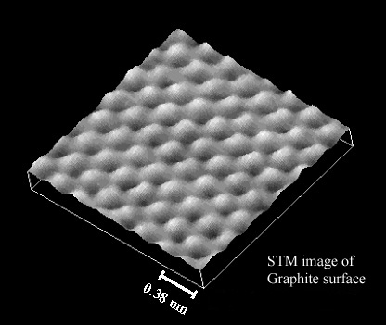
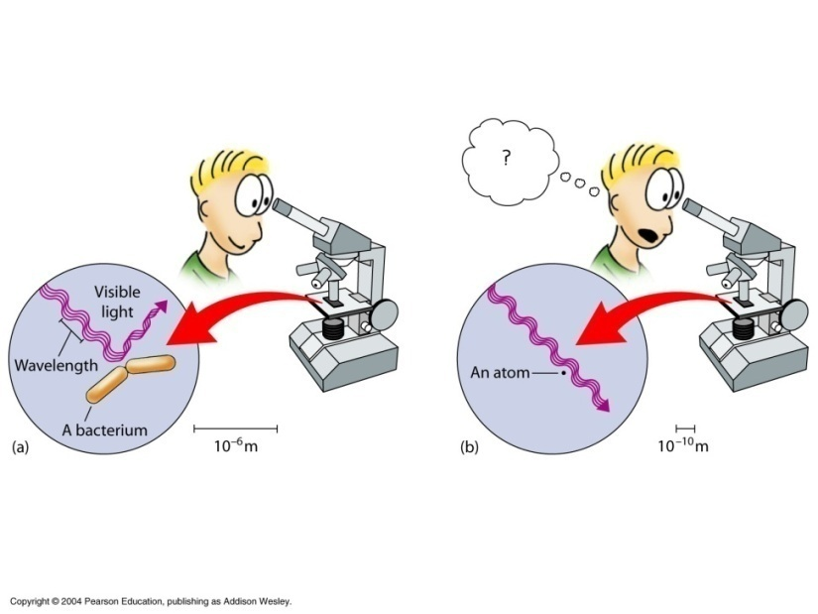
Atoms are too small to see
Notes:
Atoms are smaller than the wavelength of visible light.

Slide 7
Subatomic Particles
The proton is about 2000 times more massive than an electron.
The neutron is about 2000 times more massive than an electron.
Nucleons are protons and neutrons.

Slide 8
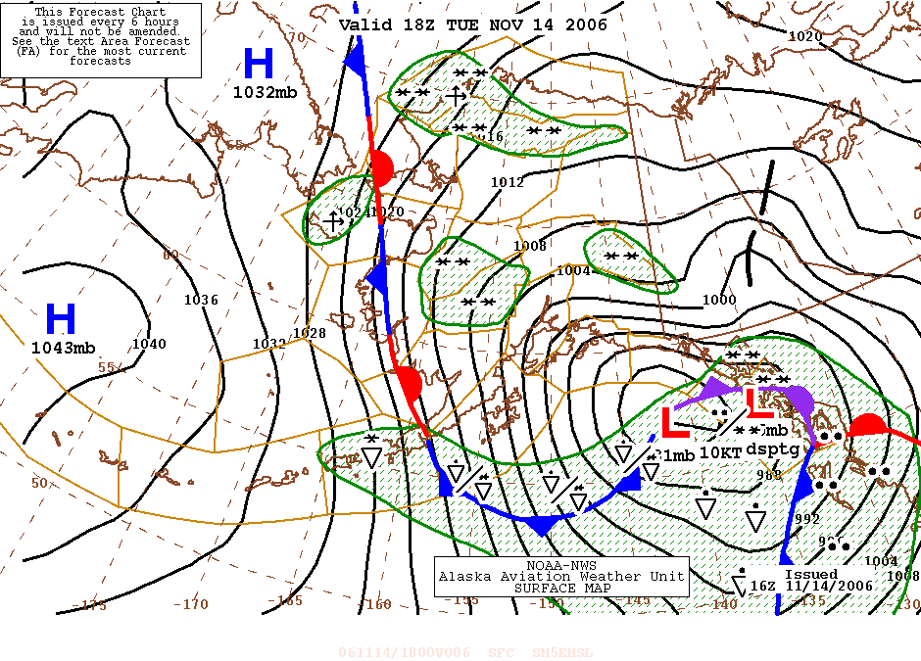
Examples of Conceptual Modes

Slide 9
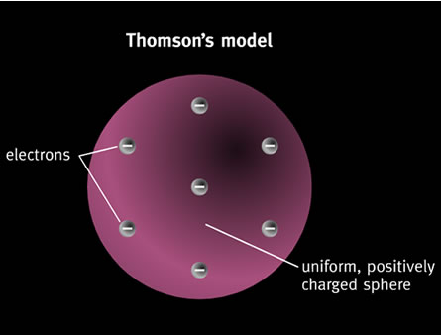
Notes:
Thompson’s Model
Atoms contain electrons
Atoms are electrically neutral
Chocolate Chip Cookie Dough

Slide 10
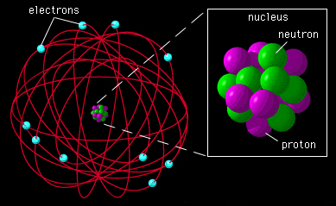
Rutherford’s Model
Notes:
The atom is mostly empty space
Matter concentrated at nucleus

Slide 11
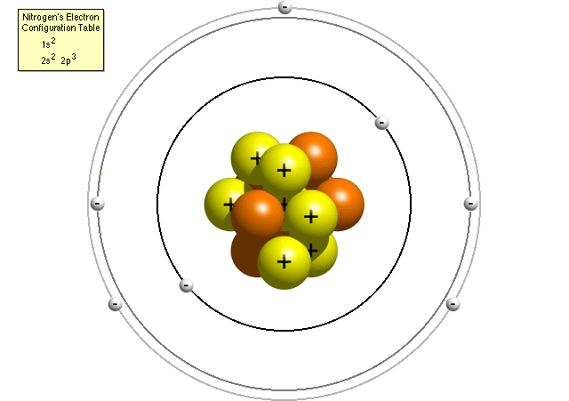
Bohr’s Model
Notes:
Electrons can have different energy levels.
Each “orbit” has its own energy.

Slide 12
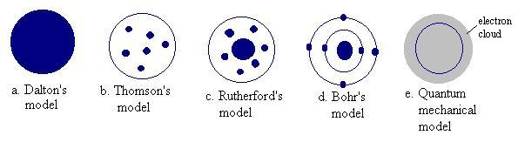

Evolution of the Atomic Model
Notes:
Bohr’s model of the atom is very useful for understanding elementary concepts in bonding and chemical reactions
However, it is fundamentally flawed and he soon helped replace it with the “Quantum Mechanical Model” of the atom which no longer views the electron as simply a “particle”, but acknowledges and depends on the wave-nature of the electron also.

Slide 13
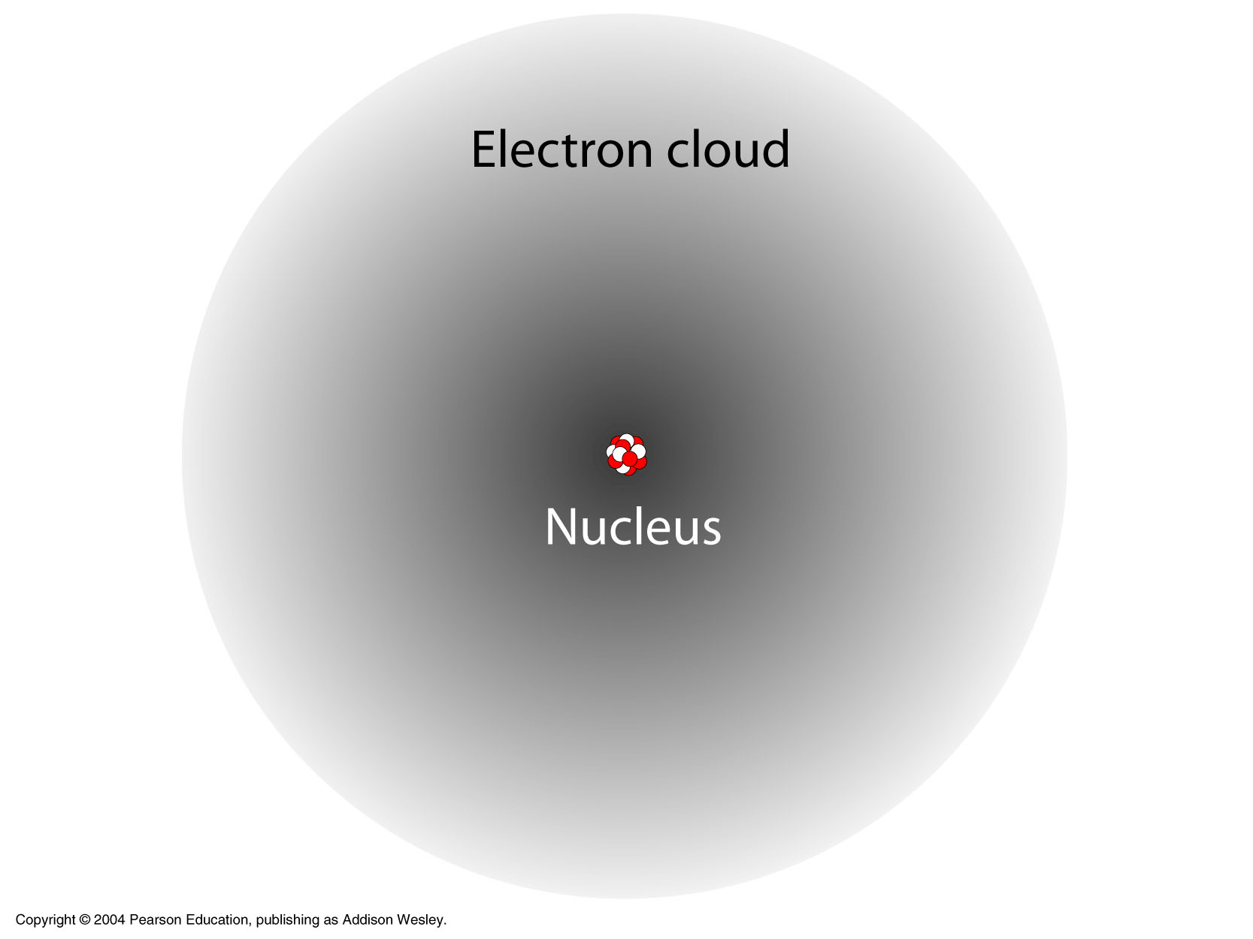
The Nucleus & The Electron Cloud

Slide 14
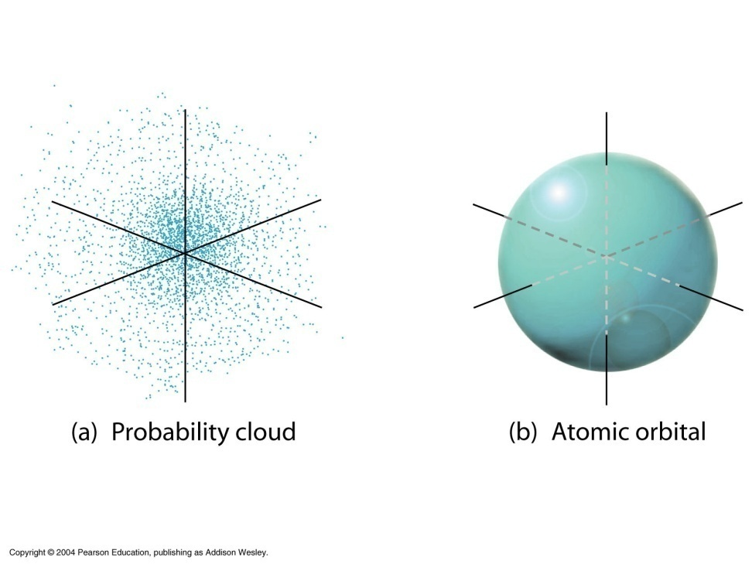



Probability Cloud
Notes:
Probability Cloud: The pattern of electron positions plotted over time to show where an electron is likely to be.
Atomic Orbital: The area in which the electron is located 90 percent of the time.

Slide 15
Electron Cloud Model
James Chadwick
  (1932) Discovered the Neutron
  The nucleus is kept together by the strong force. (A force that overcomes the electric force.)

Slide 16
The Periodic Table
Lists all known elements
  Atomic Symbol
  Atomic Number
  Atomic Masses
Much more:
  Structure of the elements and how they behave.
Notes:
The letters given in the boxes are the symbols for the elements.
The atomic number is the number of protons for each element. Fill in the atomic number for each element. H =1, He =2, Li =3, Be=3, and so on. (Check: Pb has atomic number 82)

Slide 17
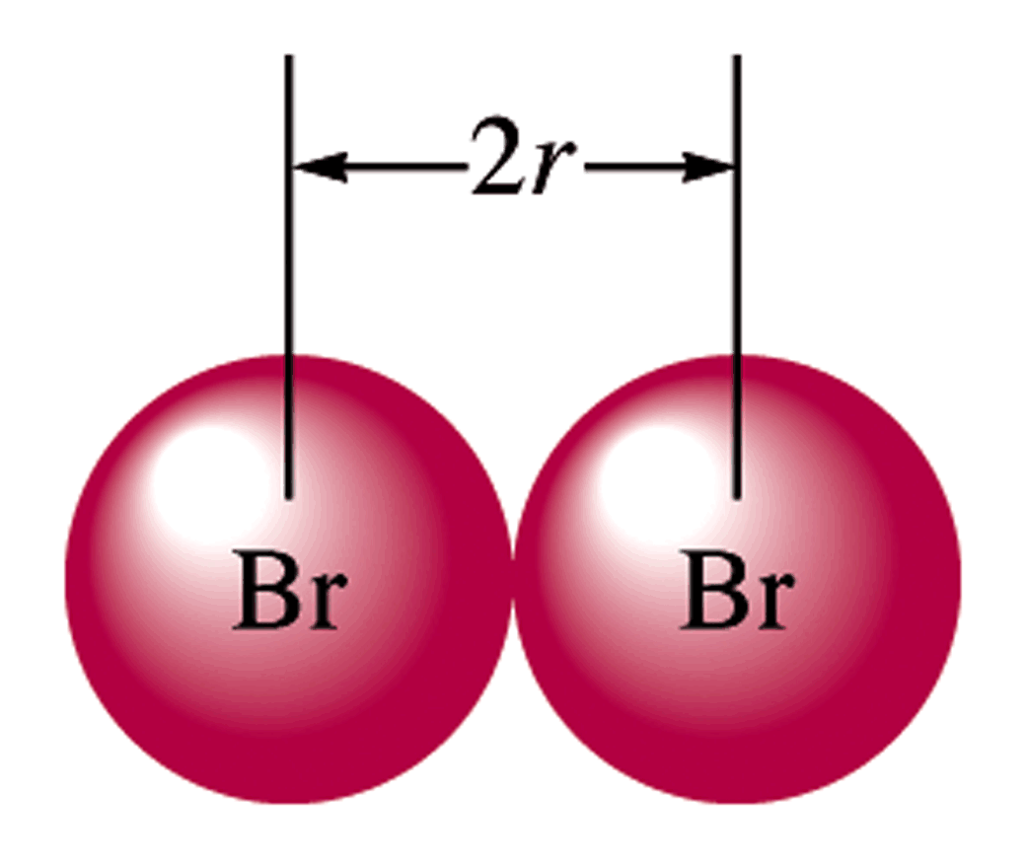
Atomic Radius
How big is an atom?
The atomic radius r is usually determined from the distances between atoms in covalent bonds.

Slide 18
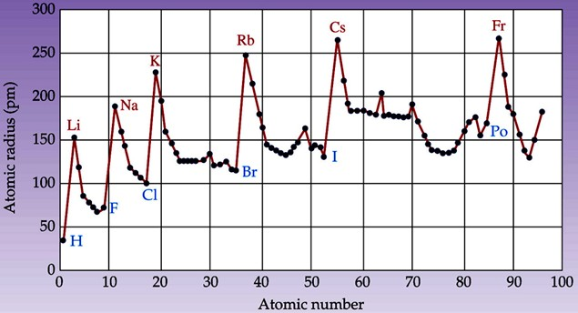
Periodicity 1

Slide 19
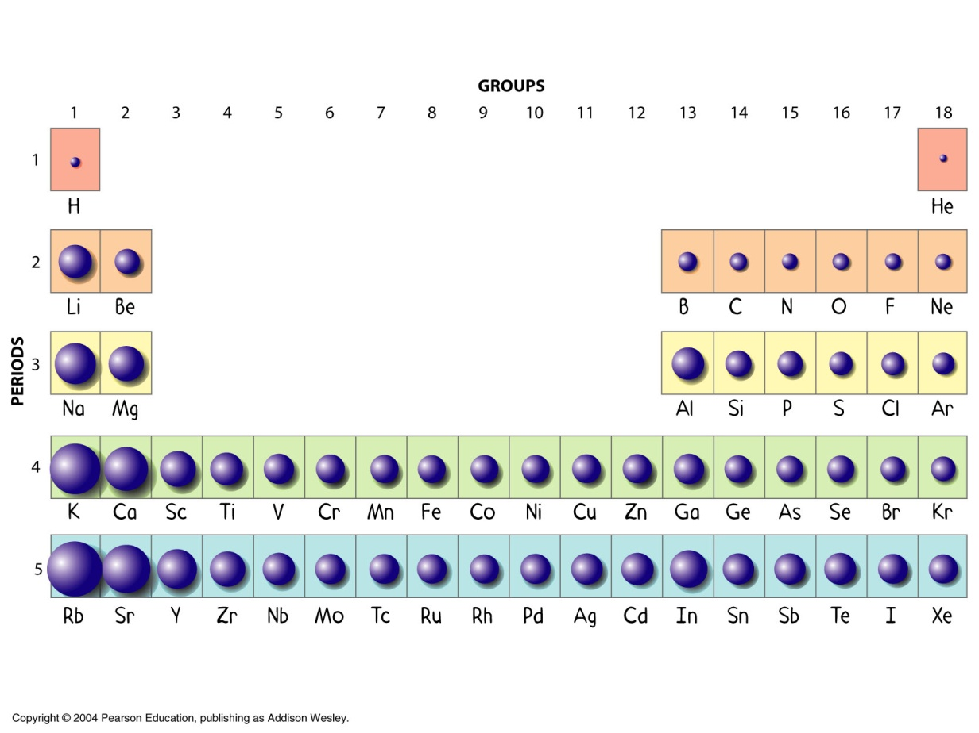
Atomic Size
Atomic size is a periodic (repeating) property.
Size decreases →

Slide 20
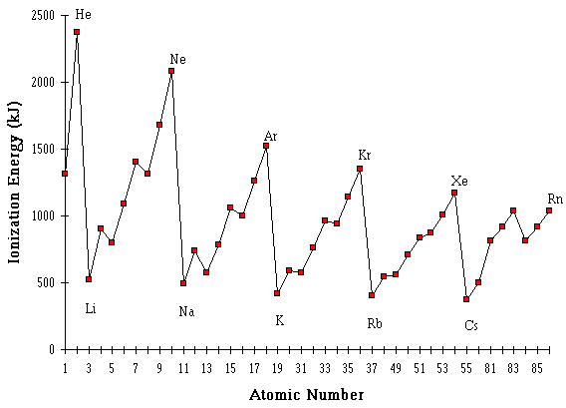
Ionization Energy vs. Atomic Number

Slide 21
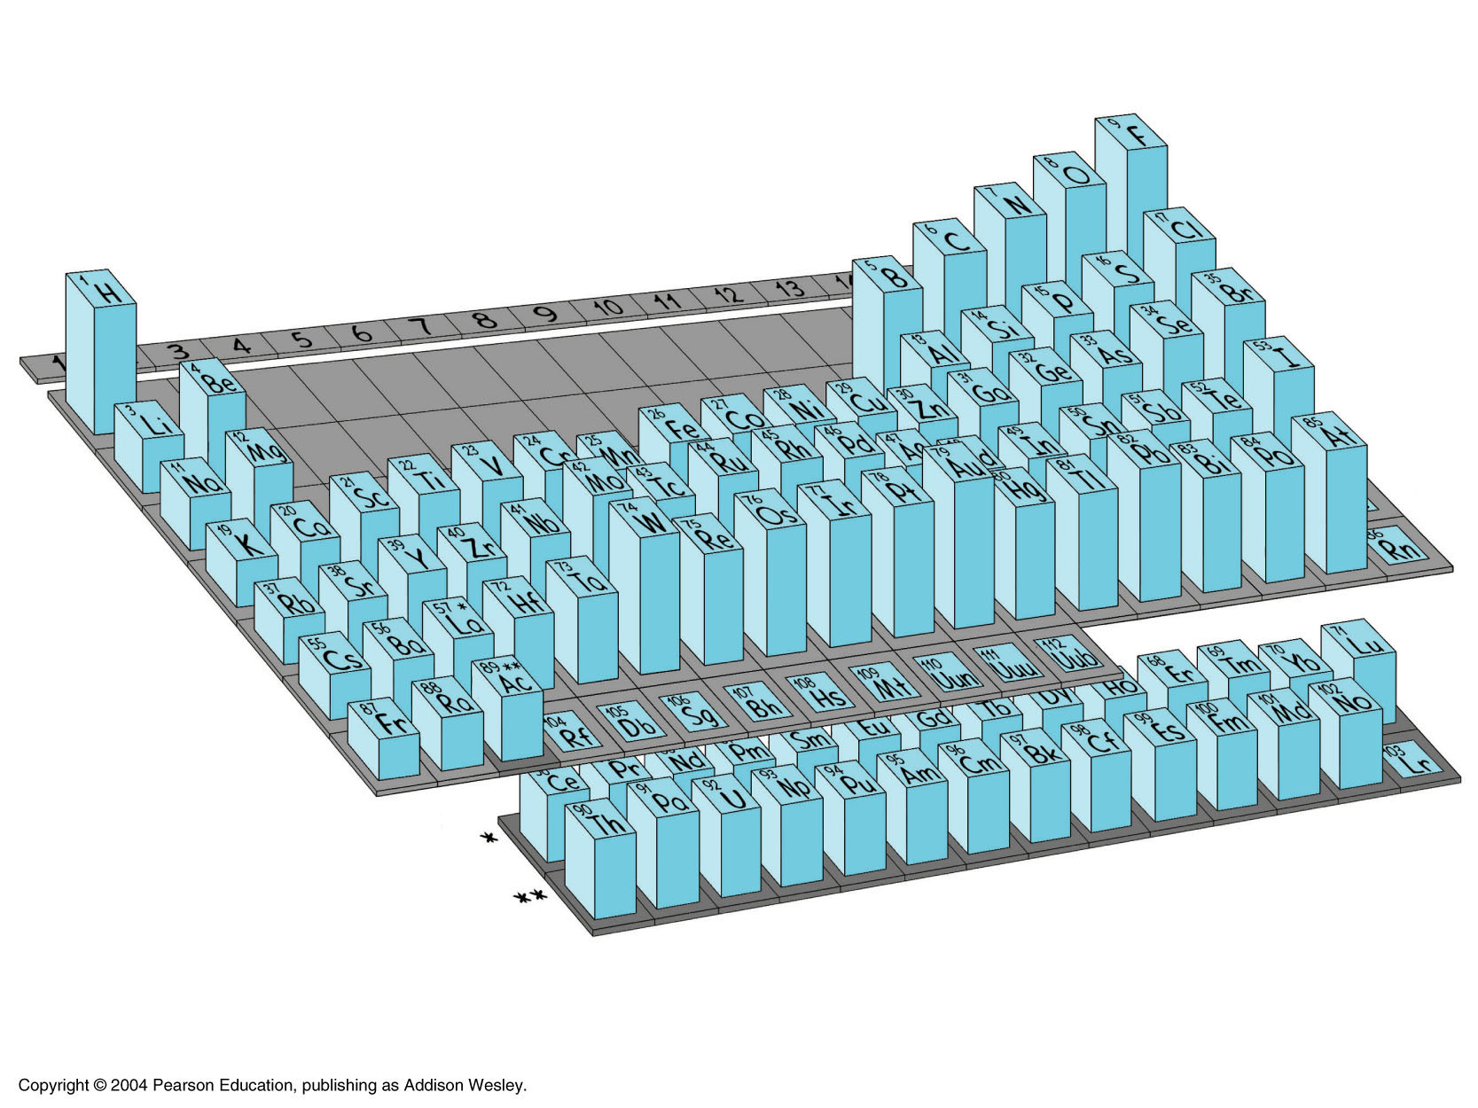
Electronegativity
The ability to attract more electrons than it has.

Slide 22
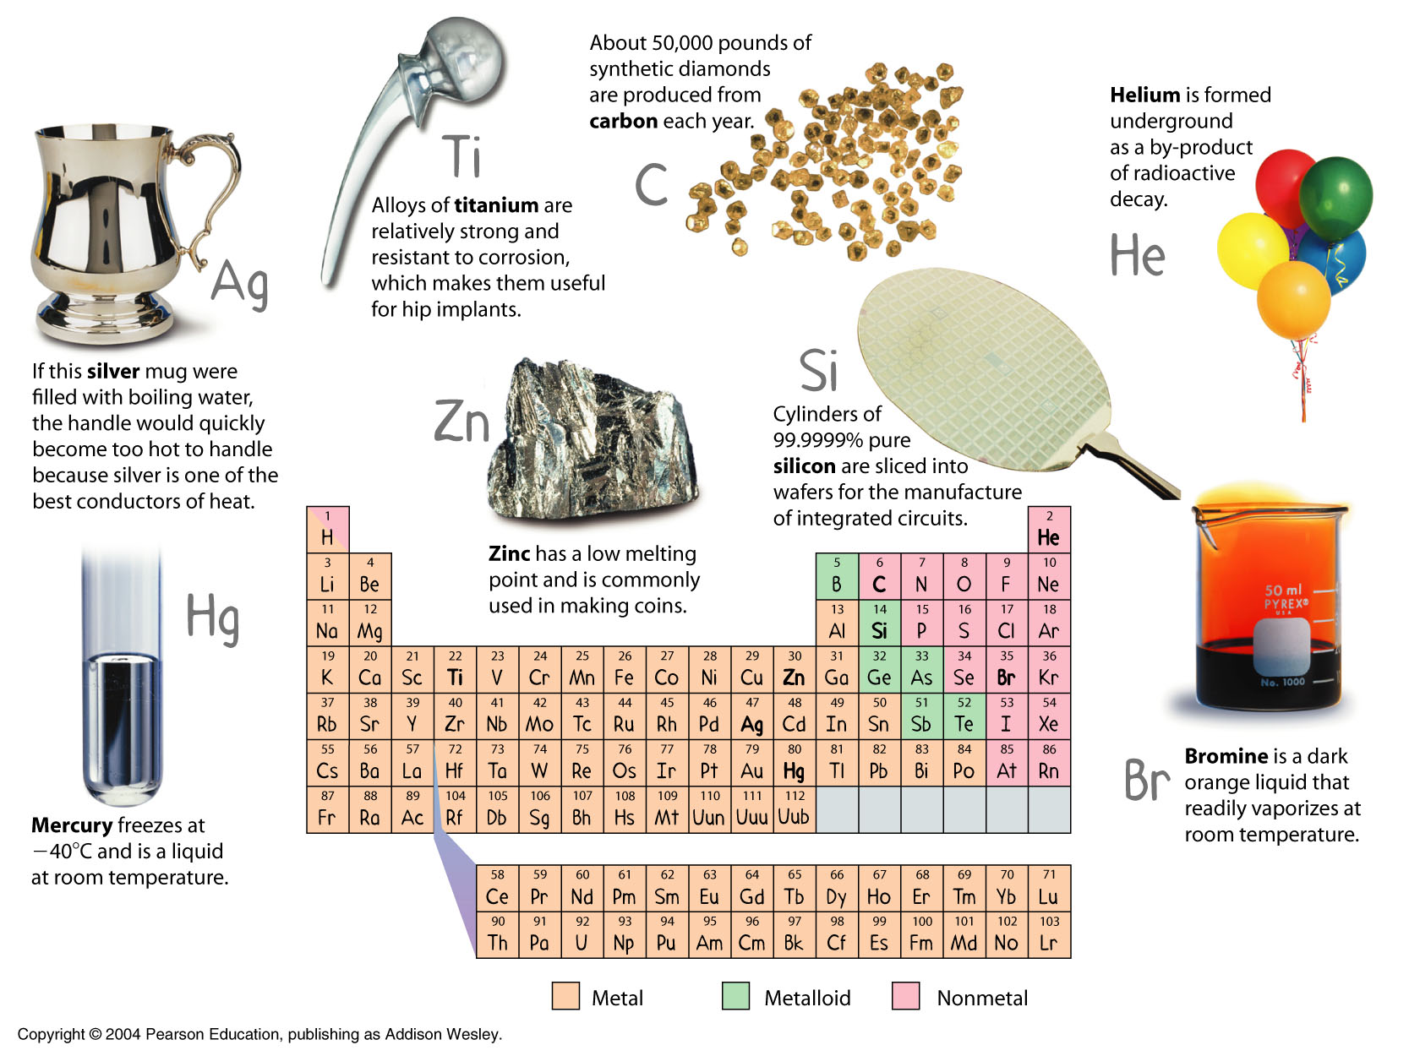

Slide 23
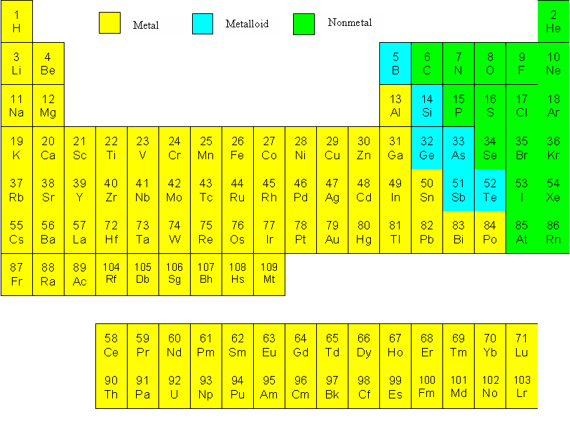
Notes:
Draw a line to separate metals from nonmetals. Metals are on the left of this line and nonmetals are on the right of this line. Most of the elements are metals.
Hydrogen is an exception. It is a nonmetal that is grouped with the metals.

Slide 25
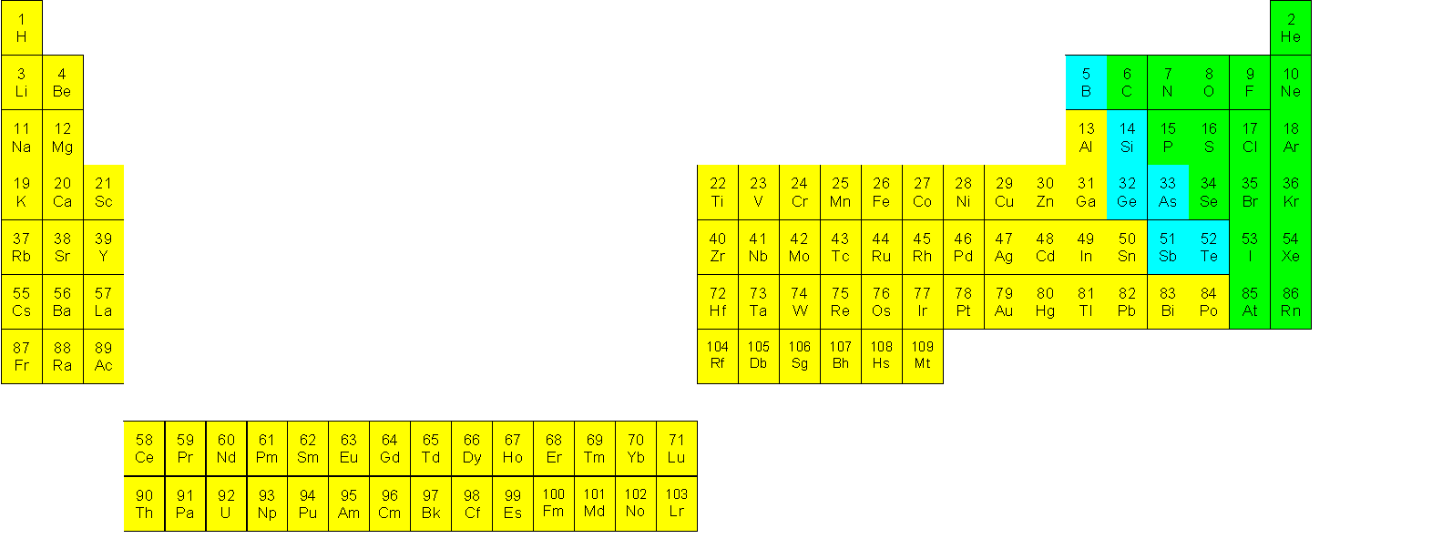

Slide 26
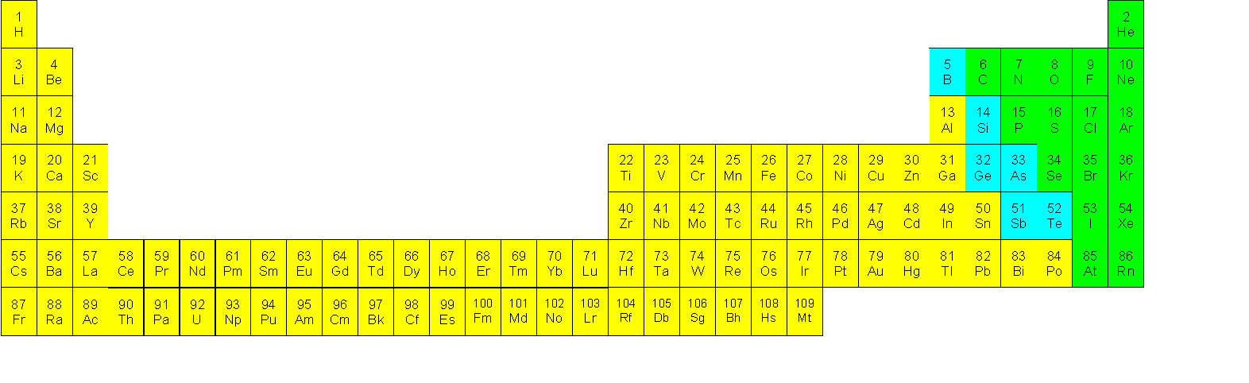
The Periodic Table
These two subsets have properties unlike the transition metals.

Slide 27
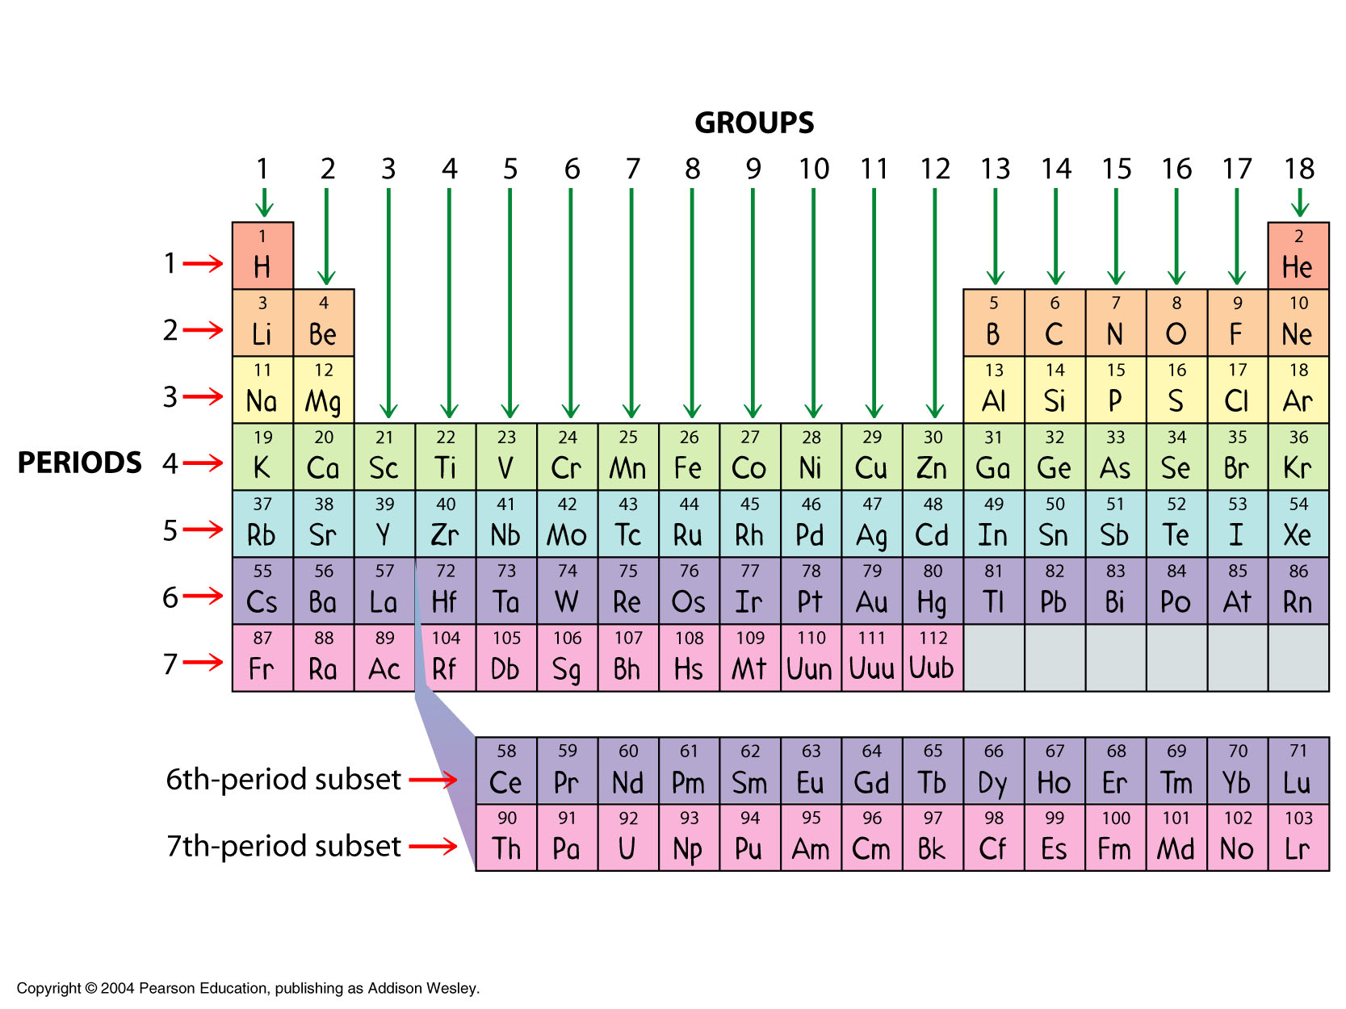
Groups and Periods
Notes:
A vertical column is called a group or family. Number each of the groups in your periodic table. Start with the leftmost column as group number 1. There are 18 total columns.
A horizontal row is called a period. Elements in the same period have the same number of electron shells.

Slide 28

Traditional Names of Families
No
Common
Names
Halogens
Nobel Gases
Alkali Metals
Alkaline-Earth Metals
Transition Metals
Inner Transition Metals

Slide 29
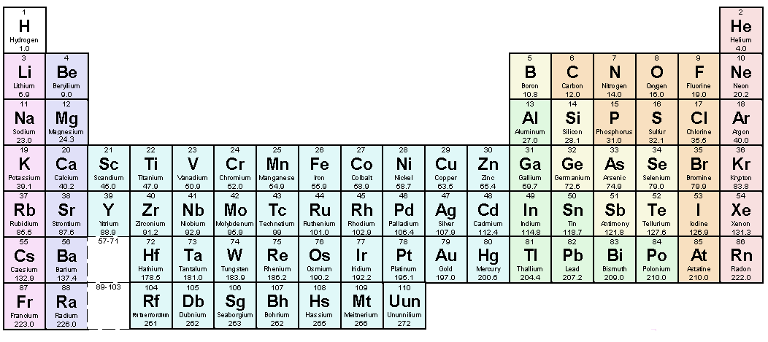
Predicting Ion Charges
Count the valence electrons, add or subtract electrons (whichever is the smaller number) to achieve a full valence level.
1+
n/a
Note that metals tend to lose electrons (become positive)
While nonmentals gain electrons (become negative)!
0
2+
3-
2-
1-

Slide 31
0
0
-1
-
+
+
+
-
+
-
-
-
0
+4
-
+2
-
-
-
+
+
+
+
+
+
+
+
+
-
+
+
-
+
+-
+
-
-
0
0
-
-2
-
-
-
-
-
-
+
+
+
-
+
+
-
+
+
-
+
-
+
+
+
+
+
-
+
+
-
+
+
+
+
+
-
-
-
-
-
-
-
-
-

Slide 32
0
0
-1
-
+
+
+
-
+
-
-
2
-
1
1
0
+4
-
+2
-
-
-
+
+
+
+
+
+
+
+
+
-
+
+
-
+
+-
+
-
4
-
4
6
0
0
-
-2
-
-
-
-
-
-
+
+
+
-
+
+
-
+
+
-
+
-
+
+
+
+
+
-
+
+
-
+
+
+
+
+
-
-
-
-
-
-
5
-
7
-
8
-

Slide 33
4
0
2
0
2
-1
-
+
+
+
-
+
-
-
2
-
1
1
7
0
8
9
+4
-
+2
-
-
-
+
+
+
+
-
+
+
+
+
-
+
+
-
+
+-
+
-
4
-
4
6
0
13
0
14
-
-2
9
-
-
-
-
-
-
+
+
+
-
+
+
-
+
+
-
+
-
+
+
+
+
+
-
+
+
-
+
+
+
+
+
-
-
-
-
-
-
5
-
7
-
8
-

Slide 34
In terms of protons and electrons, what does it mean for an atom to be electrically neutral?
Atomic Number
The number of protons each atom of an element contains.

Slide 35
Mass Number
Total number of protons and neutrons

Slide 36
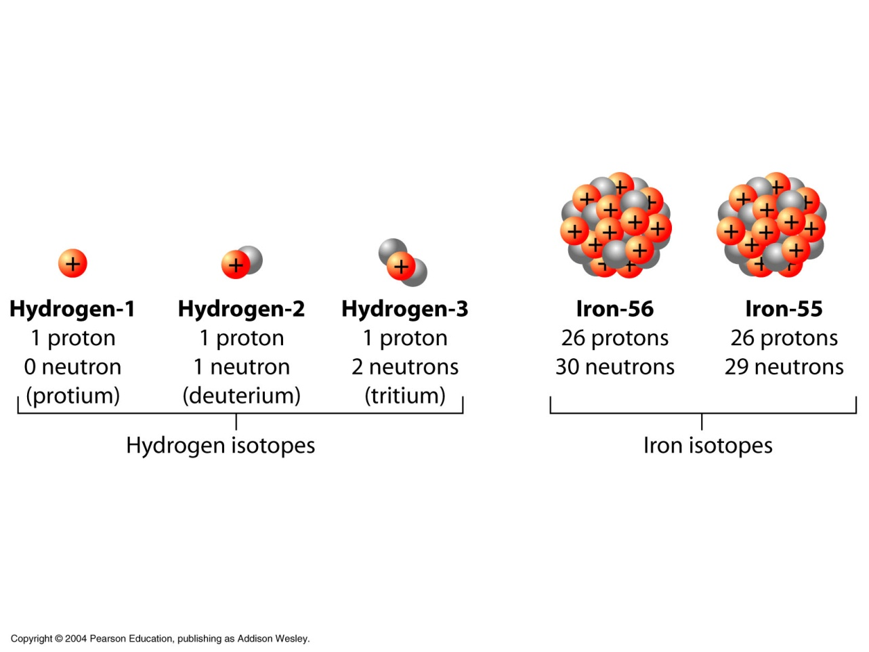
Isotopes
Isotope
Atoms of the same element that contain different numbers of neutrons

Slide 37
Isotopic Notation
Charge
Mass Number
Atomic Number

Slide 38
Other Notations
There are two different notations that mean the same thing.
Calcium-40
What is the atomic number?
What is the mass number?

Slide 39
Problem Solving
If you are given the isotopic notation and you need to find the number of protons, neutrons or electrons, do the following:
To find the number of protons:
To find the number of neutrons:
To find the number of electrons:

Slide 40
Examples
Examples: For each of the following. What is the atomic number, mass number, number of protons, number of neutrons, and number of electrons?
1) 2) 3)

Slide 41
Atomic Mass
The average atomic mass of its various isotopes

Slide 42
The Study of Spectra.
Every atom can only emit or absorb certain energies or wavelengths.

Slide 43
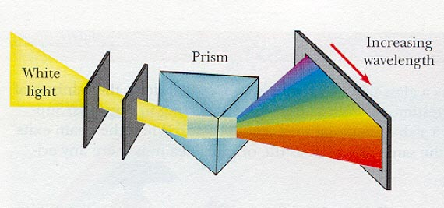
Color Separation

Slide 44
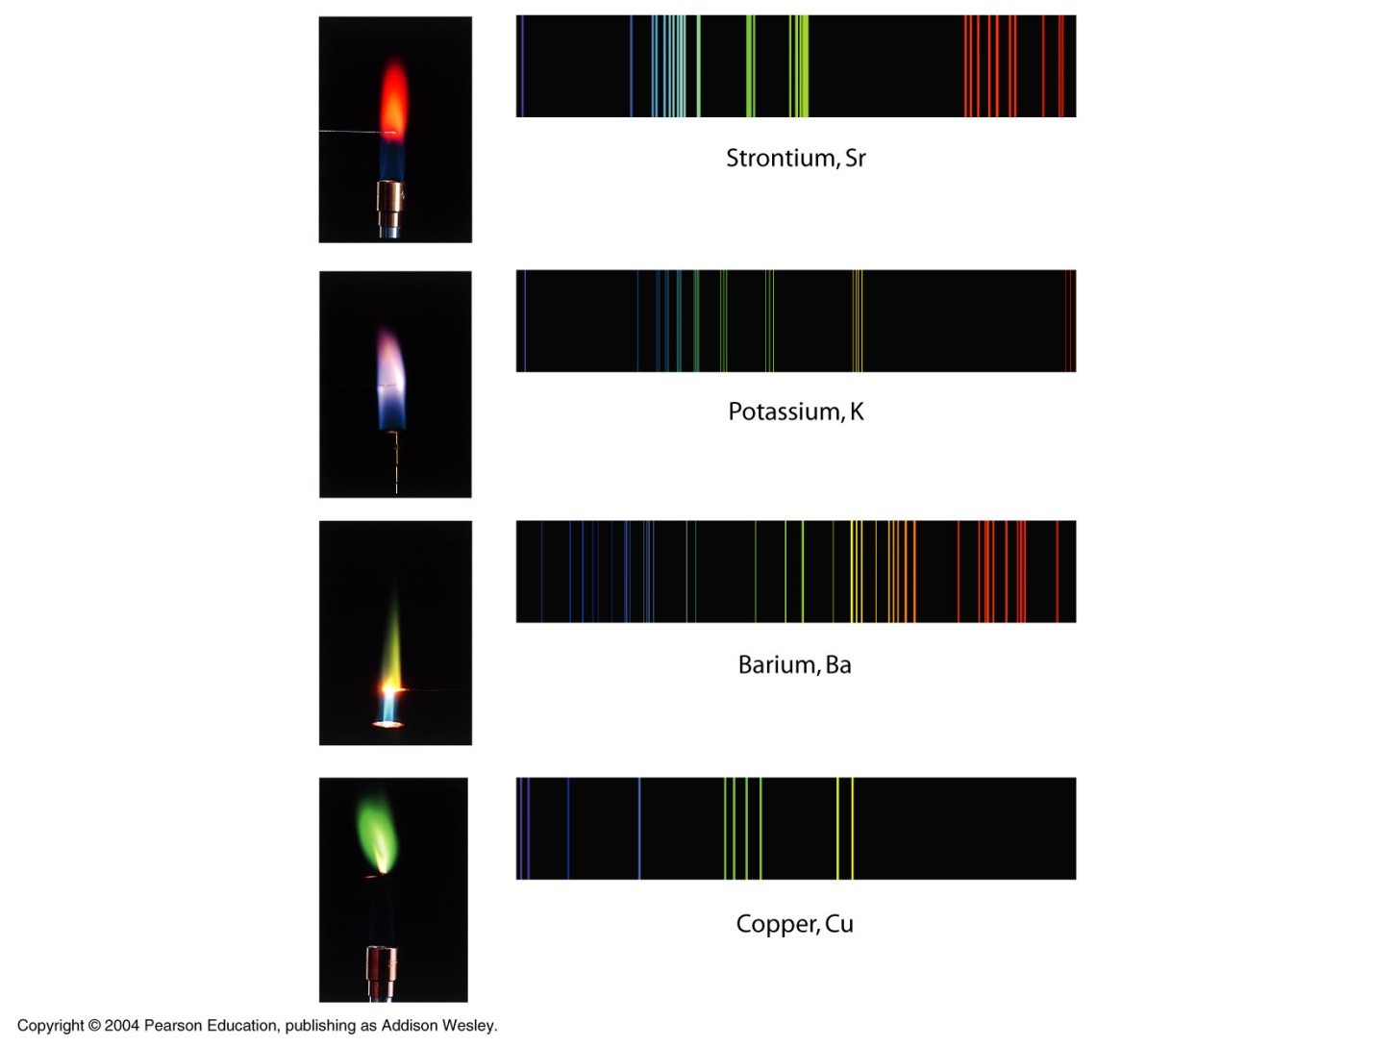
Some Emission Spectra

Slide 45
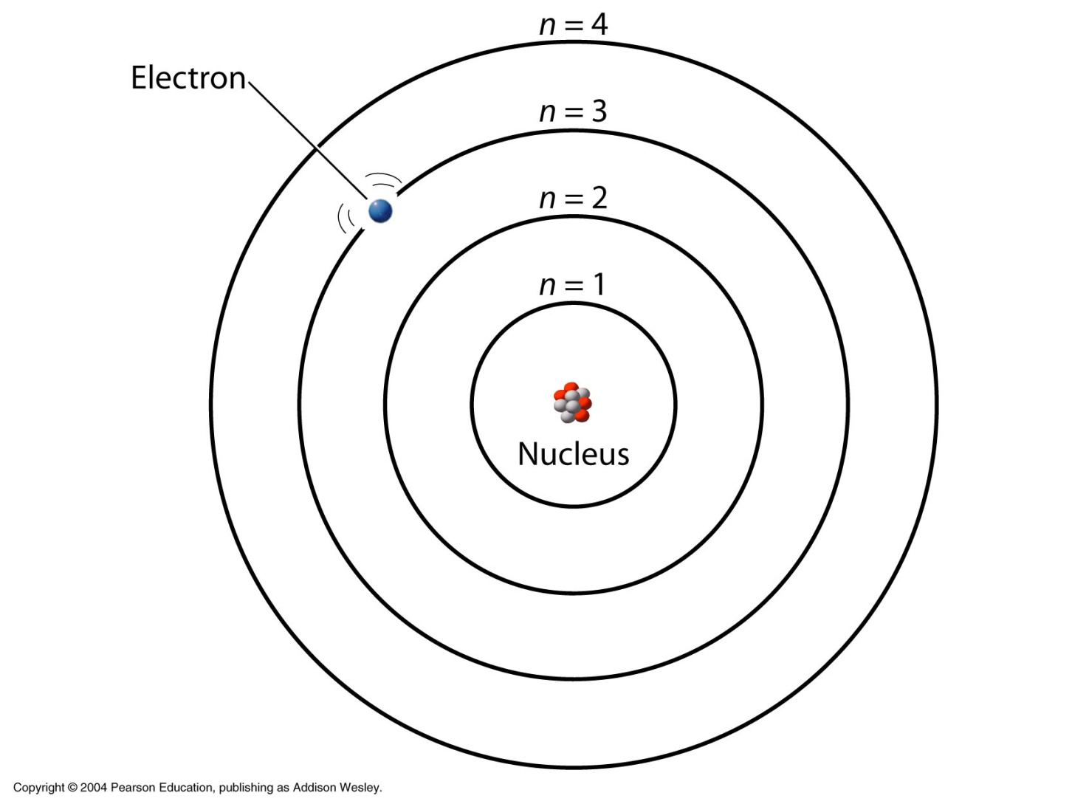
Example

Slide 47
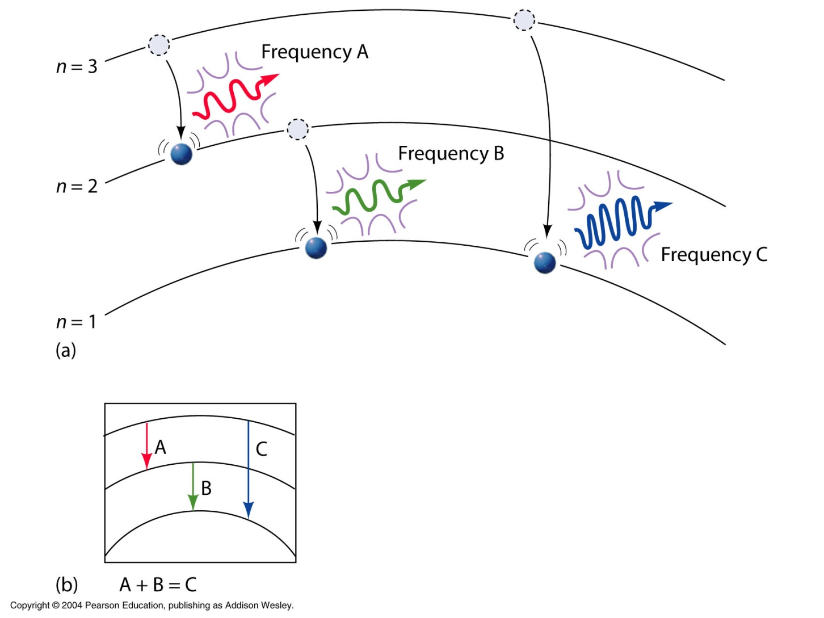
Three Possible Energy Transitions

Slide 48
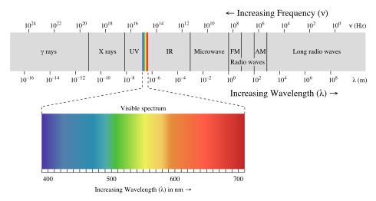
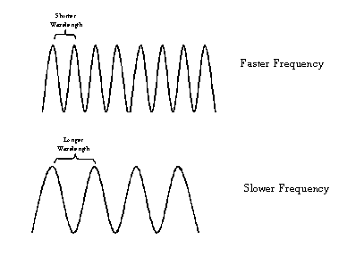
The Electromagnetic Spectrumm
Color, or frequency, is related to energy.

Slide 49
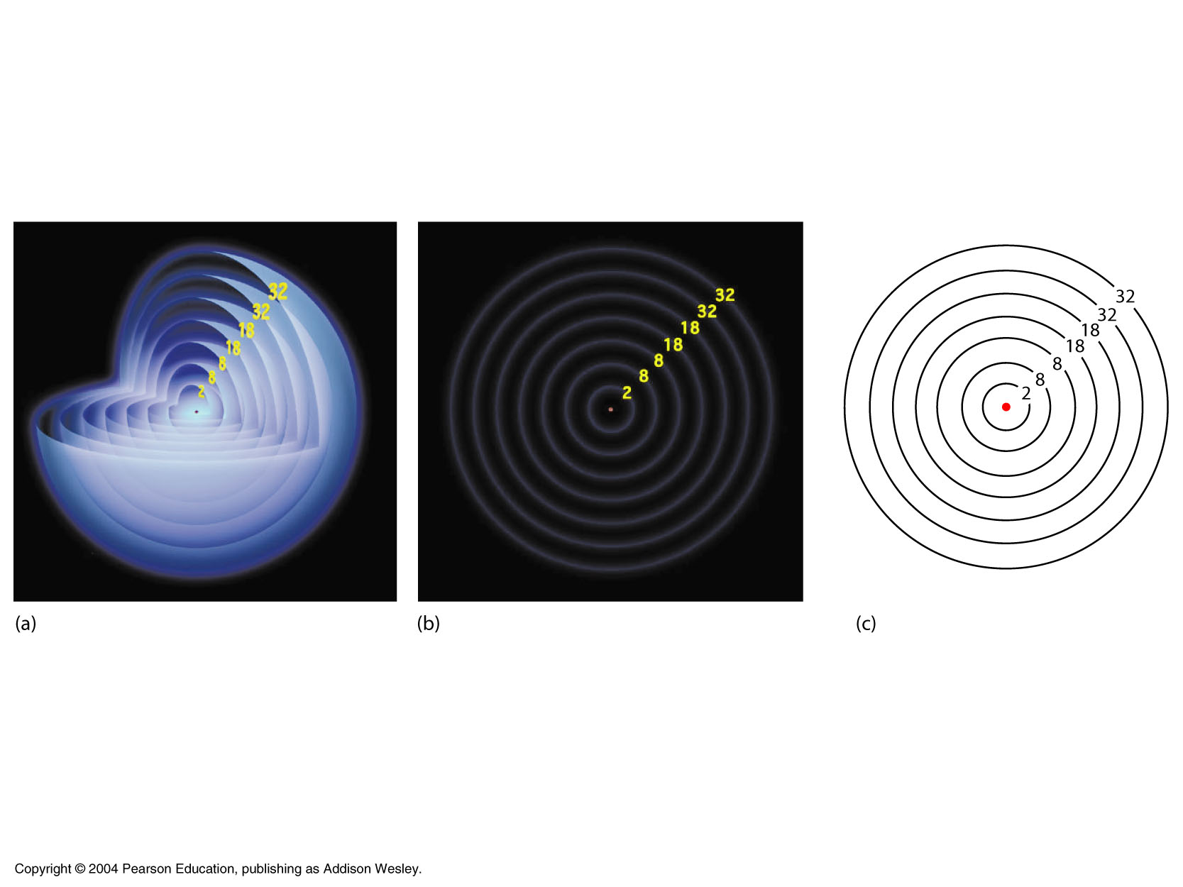
The Shell Model

Slide 50
Draw a Bohr diagram for Carbon-14
6 p
8 n

Slide 51
Draw a Bohr diagram for Oxygen-15
8 p
7 n

Slide 52
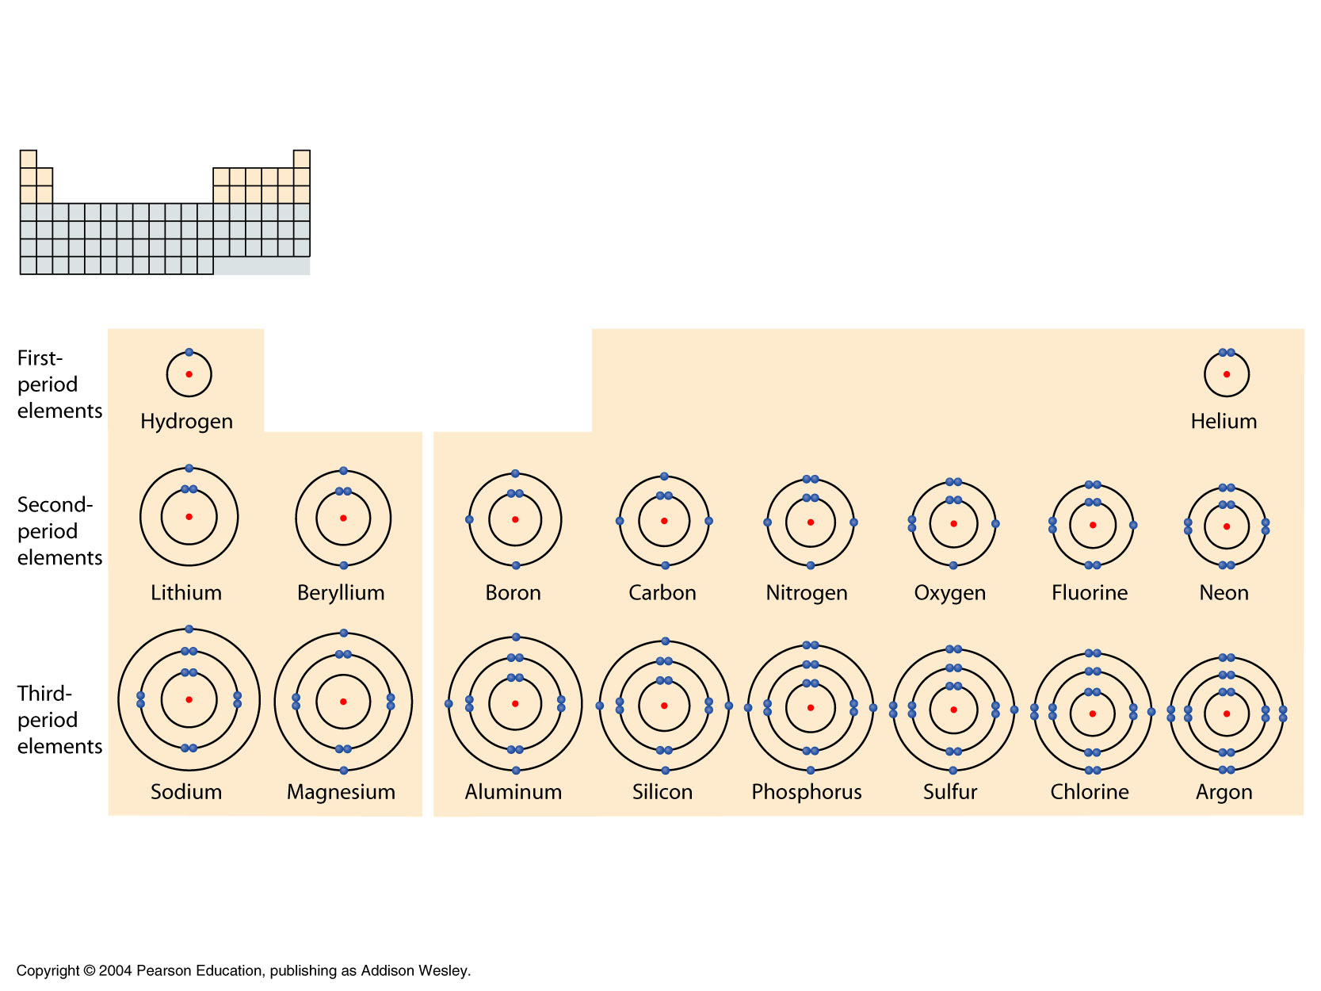
Elements in the same period have electrons in the same shells.
Elements in the same period differ from one another by the number of electrons in the outermost shell.
The periodic table and the shell model.

Slide 53
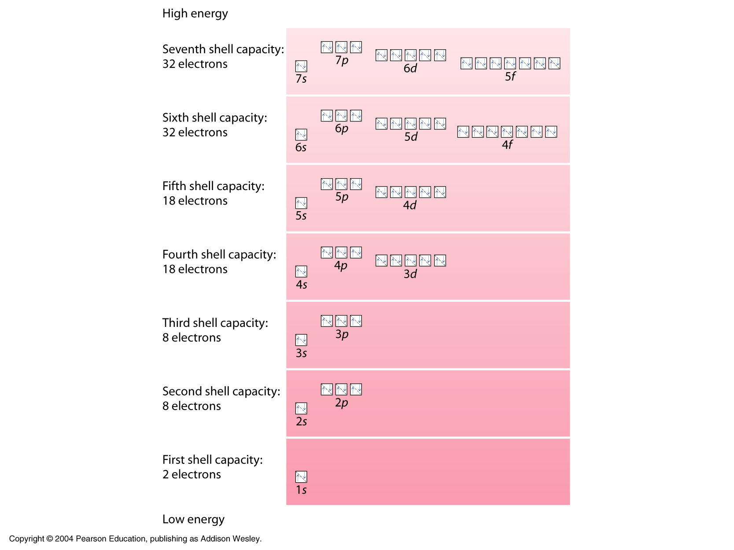
Each box represents an orbital.
Each electron is represented by an arrow.
Orbitals of similar energy are partitioned together and referred to as a “shell” of orbitals.
Notes:
Shell 1, 2, 3, 4, etc.
Orbital s, p, d, f

