Slide 1
Activity: Concept Attainment—Classification of Matter

Slide 2
Element: Consisting of one type of atom.

Slide 3
Element A
Element B

Slide 4
Atoms and Molecules
Three particles:
2 atoms of hydrogen
1 atom of oxygen
One particle:
1 molecule of water

Slide 5
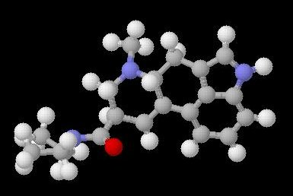
Molecules
Atoms link together to form molecules.
Compounds are made up of molecules.

Slide 6
A mixture of two elements.
A compound of two elements.
Compound

Slide 7
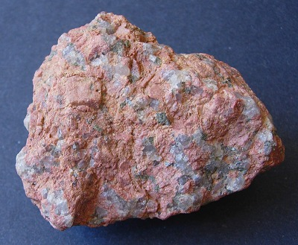
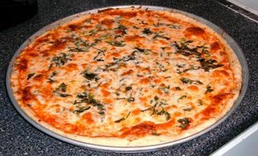
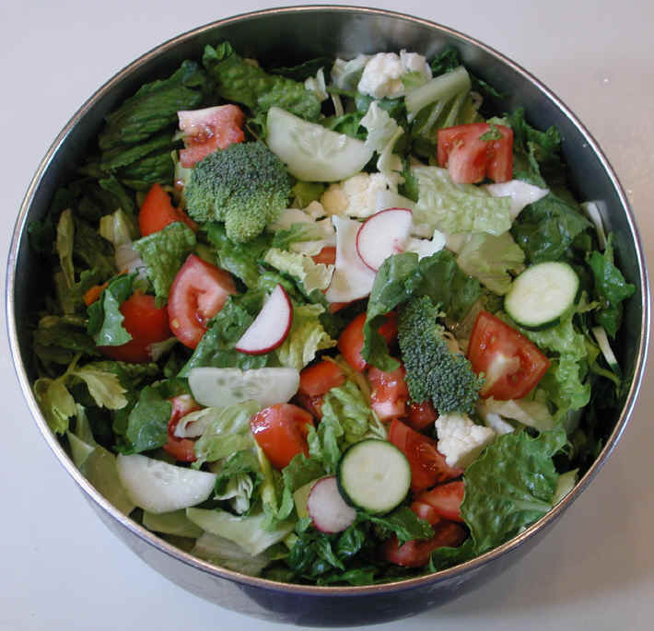
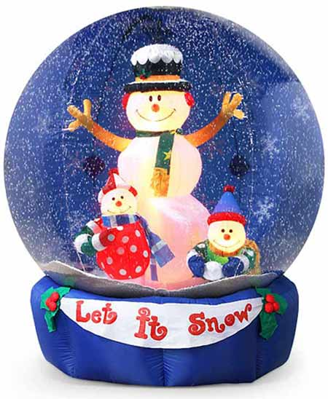
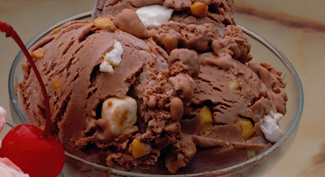
Heterogeneous Mixtures
The different components can be seen with the naked eye.

Slide 8
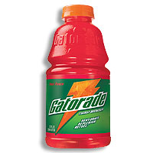
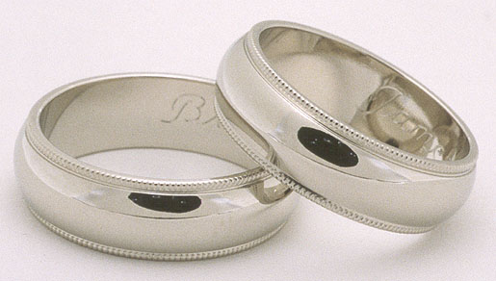
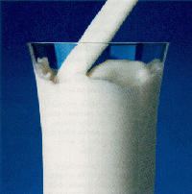
Homogeneous Mixture
White Gold
The different components are not distinguishable.

Slide 9
Substance
A sample of matter having uniform (or constant) composition.
Example: water, gold, iron

Slide 10
Compound
How is a compound broken up into its elements or other simpler compounds?
Use a chemical separation method.
What are some examples of chemical separation methods?

Slide 11
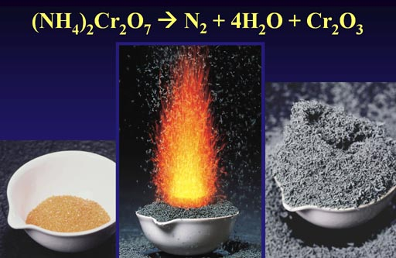
Chemical Separation Methods
Heat the compound.

Slide 12
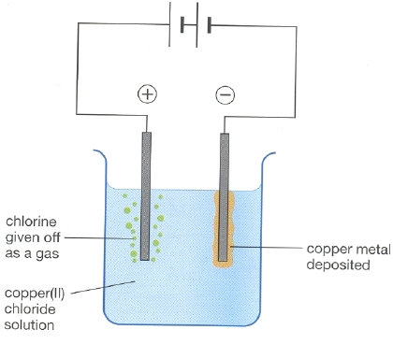
Chemical Separation Methods
Use Electrolysis which is using an electric current to decompose the compound.

Slide 13
Mixtures
How can mixtures be separated?
Use Physical Separation Methods.
What are examples of physical separation methods?

Slide 14
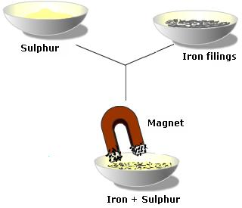
Magnetic Properties

Slide 15
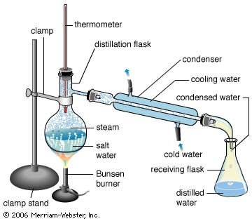
Physical Separation Methods
Distillation is the separation of mixtures by using the difference in boiling points.
A water cooled condenser is used.

Slide 16
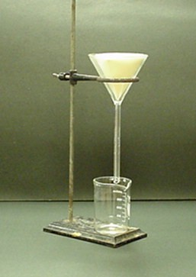
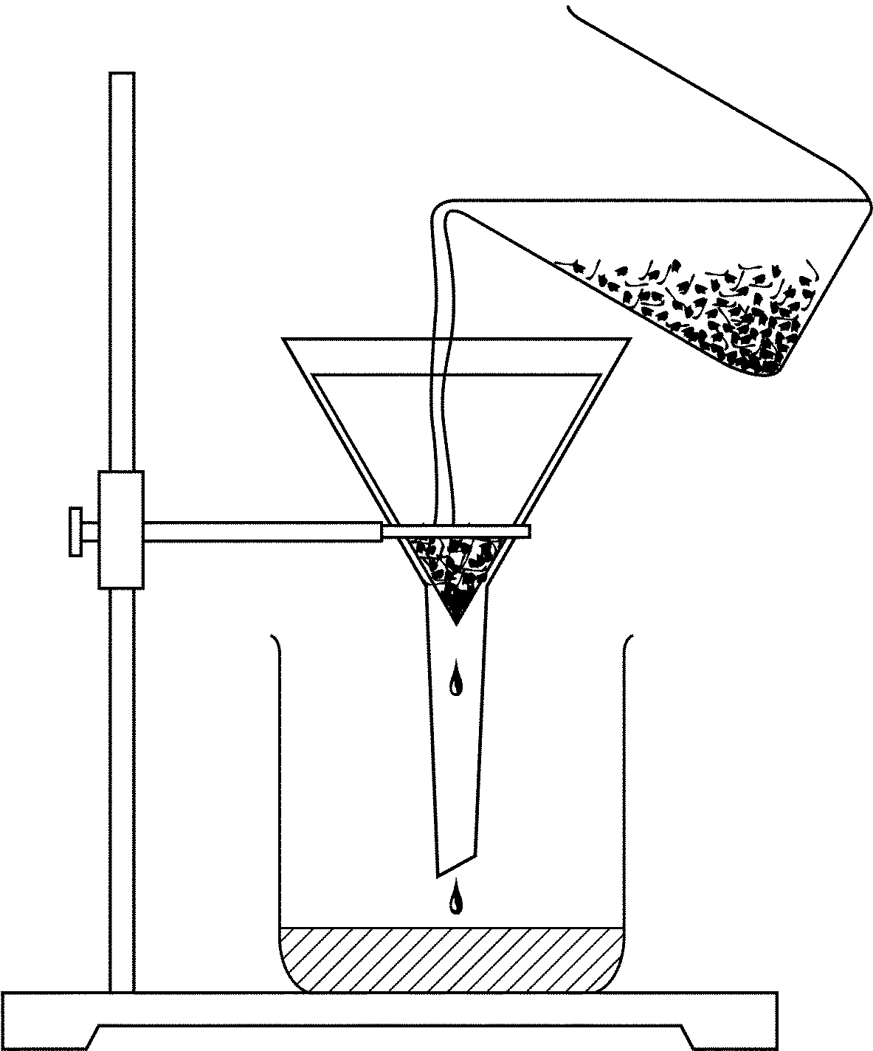
Physical Separation Methods
Filtration uses the difference in particle size to separate mixtures.
Filter papers have different size pores.

Slide 17
Physical Change
A change in which a substance changes one or more of its physical properties without transforming it into a new substance.
Chemical bonds are not broken.

Slide 18
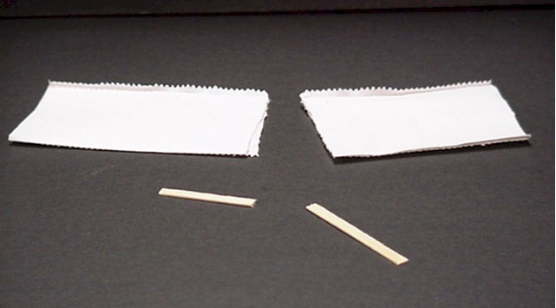
Physical Change Examples
Breaking or tearing

Slide 19
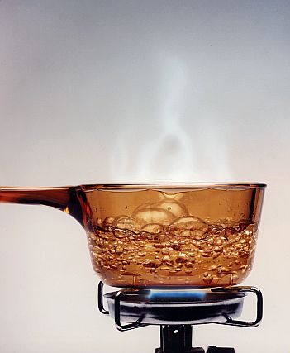
Physical Change Examples
Boiling or condensing

Slide 20
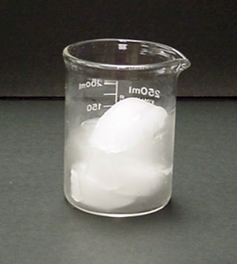
Physical Change Examples
Freezing or melting

Slide 21
Chemical Change
The change of substance into other substances through a reorganization of the atoms.
A chemical reaction must take place.
A new substance is formed.
Key words: rot, rust, decompose, ferment, corrode, grow, decay, and sprout.

Slide 22
Physical Properties
Examples:
Color
Hardness
Texture
Volume
Length
Mass

Slide 23
Physical Properties
More Examples:
Density (mass/volume ratio)
Odor
Sound
Boiling point
Melting point
Magnetism

Slide 24
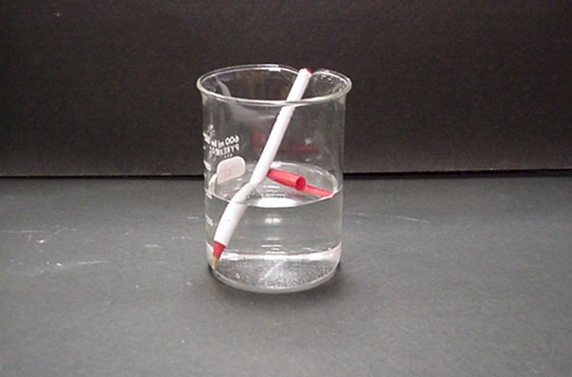
Chemical Properties
A chemical property is how something reacts.
Does the pen float is physical.
Does the pen dissolve is physical.
Does the pen react with water is chemical.

Slide 25
Examples
Determine if each of the following is a physical or a chemical property?
blue color
density
flammability
solubility
reacts with acid to form H₂
supports combustion
sour taste
melting point
reacts with water to form a gas
reacts with base to from water
hardness
boiling point
can neutralize a base
luster
odor

