Slide 1
The Law of Definite Proportions
A chemical compound always contains the same proportions of elements by mass.
In carbon dioxide, one atom of carbon reacts with two atoms of oxygen ⇒ CO₂

Slide 2
Objective of Today’s Two Experiments

Slide 3
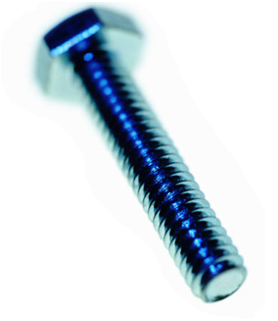
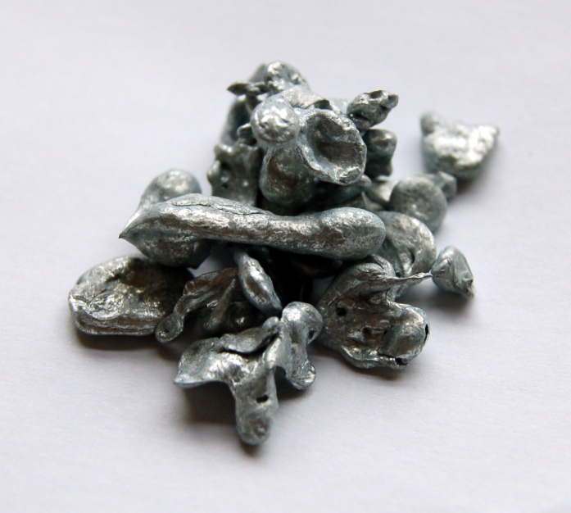
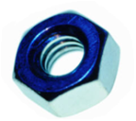
Determine mass of bolts before reaction.
Determine mass of zinc before reaction.

Slide 4
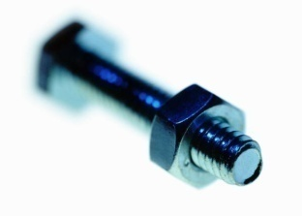
Bolts “react” with hex nuts to for form “compound"
Zinc reacts with chlorine to form a compound called zinc chloride.

Slide 5
Determine mass of bolts unreacted
Determine the amount of zinc unreacted.
Mass the piece of zinc left over in the test tube.
Use the sensitive balance.

Slide 6
Mass of “compound“ formed.
Mass of compound formed.
The compound, zinc chloride will be dissolved in water.
You will have to evaporate the water to determine the mass of compound.

Slide 7
Determine mass of bolts “reacted”
Determine mass of zinc reacted.
Subtract the mass of zinc you have left over from the mass if zinc you started with.

Slide 8
Ratio of mass of bolts “reacted” to mass of “compound”
Ratio of mass of zinc reacted to mass of compound.

