Slide 1
Chapter 15 Life on Other Worlds

Slide 2
“Did I solicit thee from darkness
to promote me?”
- John Milton PARADISE LOST

Slide 3
As a living thing, you have been promoted from darkness.
The atoms of carbon, oxygen, and other heavy elements that are necessary components of your body did not exist at the beginning of the universe.
They were created by successive generations of stars.

Slide 4
The elements from which you are made are common everywhere in the observable universe.
So, it is possible that life began on other worlds and evolved to intelligence there as well.
If so, perhaps these other civilizations will be detected from Earth.
Future astronomers may discover distant alien species completely different from any life on Earth.

Slide 5
Your goal in this chapter is to try to understand the most intriguing of puzzles—the origin and evolution of life on Earth and other worlds.

Slide 6
The Nature of Life
What is life?
Philosophers have struggled with that question for thousands of years.
It is not possible to answer it in a single chapter.

Slide 7
The Nature of Life
An attempt at a general definition of what living things do, distinguishing them from nonliving things, might be as follows.
Life is a process by which an organism extracts energy from the surroundings, maintains itself, and modifies the surroundings to promote its own survival and reproduction.

Slide 8
The Nature of Life
One very important observation is that all living things on Earth, no matter how apparently different, share certain characteristics in how they perform the process of life.

Slide 9
The Physical Basis of Life
The physical basis of life on Earth is the element carbon.
Due to the way carbon atoms bond to each other and to other atoms, they can from long, complex, stable chains that are capable of storing and transmitting information.
A large amount of information of some sort is necessary to maintain the forms and control the functions of living things.

Slide 10
The Physical Basis of Life
Carbon may not be crucial to life.
Science fiction authors have speculated that silicon could be substituted for carbon because the two elements share some chemical properties.
However, this seems unlikely because silicon chains are harder to assemble and disassemble than their carbon counterparts and can’t be as lengthy.

Slide 11
The Physical Basis of Life
Even stranger life forms have been proposed—based on electromagnetic fields and ionized gas.
None of these possibilities can be ruled out.
However, although these hypothetical life forms make for fascinating speculation, they can’t be studied systematically the way life on Earth can be.

Slide 12
The Physical Basis of Life
This chapter is concerned with the origin and evolution of life as it is on Earth, based on carbon—not because of lack of imagination, but because it is the only form of life about which we know anything.

Slide 13
The Physical Basis of Life
Even carbon-based life has its mysteries.
What makes a lump of carbon-based molecules a living thing?
An important part of the answer lies in the transmission of information from one molecule to another.

Slide 14
Information Storage and Duplication
Almost every action performed by a living cell is carried out by chemicals it manufactures.
Cells must store recipes for all these chemicals, use the recipes when they need them, and pass them on to their offspring.

Slide 15
Information Storage and Duplication
There are three important points to note about DNA.

Slide 16
Information Storage and Duplication
One, the chemical recipes of life are stored in each cell as information on DNA molecules.
These molecules resemble a ladder with rungs that are composed of chemical bases.
The recipe information is expressed by the sequence of ladder rungs, providing instructions to guide chemical reactions within the cell.

Slide 17
Information Storage and Duplication
Two, DNA instructions normally are expressed by being copied into a messenger molecule called RNA that causes molecular units called amino acids to be connected into large molecules called proteins.
Proteins serve as the cell’s basic structural molecules or as enzymes that control chemical reactions.

Slide 18
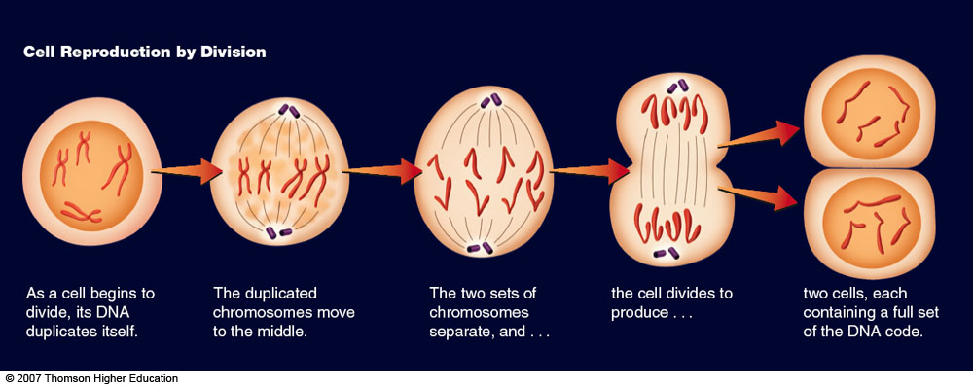
Information Storage and Duplication
Three, the instructions stored in DNA are genetic information passed along to offspring.
The DNA molecule reproduces itself when a cell divides so that each new cell contains a copy of the original information.

Slide 19
Information Storage and Duplication
To produce viable offspring, a cell must be able to make copies of its DNA.
Surprisingly, it is important for the continued existence of all life that not all the copies be exact duplicates.

Slide 20
Modifying the Information
Earth’s environment changes continuously.
To survive, species must change as their food supply, climate, or home terrain changes.
If the information stored in DNA could not change, then life would quickly go extinct.
The process by which life adjusts itself to its changing environment is called biological evolution.

Slide 21
Modifying the Information
When an organism reproduces, its offspring receives a copy of its DNA.
Sometimes external effects such as radiation alter the DNA during the parent organism’s lifetime, and sometimes mistakes are made in the copying process.
Thus, occasionally, the copy is slightly different from the original.

Slide 22
Modifying the Information
Offspring born with random alterations to their DNA are called mutants.
Most mutations make no difference.
Some, however, are fatal—killing the afflicted organisms before they can reproduce.
In rare but vitally important cases, a mutation can actually help an organism survive.

Slide 23
Modifying the Information
These changes produce variation among the members of a species.
All the squirrels in the park may look the same—but they carry a range of genetic variation.
Some may have slightly longer tails or faster-growing claws.

Slide 24
Modifying the Information
These variations make almost no difference until the environment changes.
If the environment becomes colder, a squirrel with a heavier coat of fur will, on average, survive longer and produce more offspring than its normal contemporaries.
Similarly, the offspring that inherit this beneficial variation will also live longer and have more offspring of their own.

Slide 25
Modifying the Information
These differing rates of survival and reproduction are examples of natural selection.
Over time, the beneficial variation increases in frequency, and a species can evolve until the entire population shares the trait.
In this way, natural selection adapts species to their changing environments—by selecting, from the huge array of random variations, those that would most benefit the survival of the species.

Slide 26
Modifying the Information
It is a common misconception that evolution is random, but that is not true.
The underlying variation within species is random.
Natural selection, though, is not random—because progressive changes in a species are directed by changes in the environment.

Slide 27
Life in the Universe
It is obvious that the 4.5 billion chemical bases that make up human DNA did not just come together in the right order by chance.
The key to understanding the origin of life lies in the processes of evolution.

Slide 28
Life in the Universe
The complex interplay of environmental factors with the DNA of generation after generation of organisms drove some life forms to become more sophisticated over time—until they became the unique and specialized creatures on Earth today.

Slide 29
Life in the Universe
This means that life on Earth could have begun very simply—even as simple a form as carbon chain molecules able to copy themselves.
Of course, this is a hypothesis for which you can seek evidence.
What evidence exists regarding the origin of life on Earth?

Slide 30
The Origin of Life on Earth
The oldest fossils are all the remains of sea creatures.
This indicates that life began in the sea.
However, identifying the oldest fossils is not easy.

Slide 31
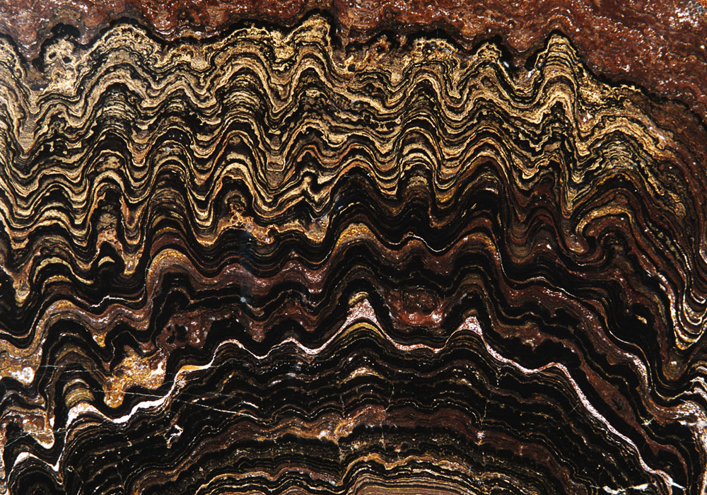
The Origin of Life on Earth
Fossils billions of years old are difficult to recognize because the earliest living things contained no easily preserved hard parts like bones or shells.
They were also microscopic.

Slide 32
The Origin of Life on Earth
Fossils from western Australia that are more than 3 billion years old contain features that experts identify as stromatolites— fossilized remains of colonies of single-celled organisms.

Slide 33
The Origin of Life on Earth
The evidence, though scarce, indicates that simple organisms lived in Earth’s oceans 3.4 billion or more years ago—less than 1.2 billion years after Earth formed.
Where did these simple organisms come from?

Slide 34
The Origin of Life on Earth
An important experiment performed by Stanley Miller and Harold Urey in 1952 sought to recreate the conditions in which life on Earth began.

Slide 35
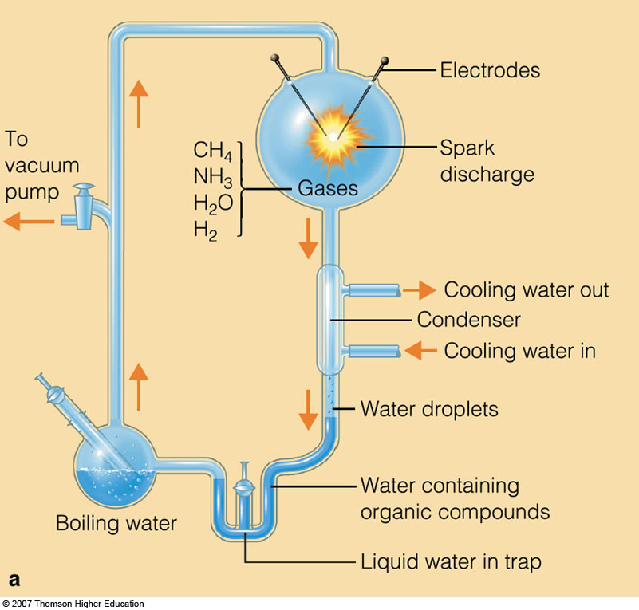
The Origin of Life on Earth
The Miller experiment consisted of a sterile, sealed glass container holding water, hydrogen, ammonia, and methane.
An electric arc inside the apparatus created sparks—to simulate the effects of lightning in Earth’s early atmosphere.

Slide 36
The Origin of Life on Earth
Miller and Urey let the experiment run for a week and then analyzed the material inside.
They found that the interaction between the electric arc and the simulated atmosphere had produced many organic molecules from the raw material of the experiment—including such important building blocks of life as amino acids.

Slide 37
The Origin of Life on Earth
When the experiment was run again using different energy sources—such as hot silica to represent molten lava spilling into the ocean—similar molecules were produced.
Even the UV radiation present in sunlight was sufficient to produce complex organic molecules.

Slide 38
The Origin of Life on Earth
According to updated models of the formation of the solar system and Earth, Earth’s early atmosphere probably consisted of carbon dioxide, nitrogen, and water vapor— instead of the mix of hydrogen, ammonia, and methane assumed by Miller and Urey.

Slide 39
The Origin of Life on Earth
When gases corresponding to the newer understanding of the early Earth atmosphere are processed in a Miller apparatus, lesser but still significant numbers of organic molecules are created.

Slide 40
The Origin of Life on Earth
The Miller experiment is important because it shows that complex organic molecules form naturally in a wide variety of circumstances.
Lightning, sunlight, and hot lava pouring into the oceans are just some of the energy sources that naturally rearrange simple common molecules into the complex molecules that make life possible.

Slide 41
The Origin of Life on Earth
If you could travel back in time, you would find Earth’s first oceans filled with a rich mixture of organic compounds called the primordial soup.
Many of these organic compounds would have been able to link up to form larger molecules.

Slide 42
The Origin of Life on Earth
For example, amino acids can link together to form proteins by joining ends and releasing a water molecule.

Slide 43
The Origin of Life on Earth
It was initially thought that this must have occurred in sun-warmed tidal pools where organic molecules were concentrated by evaporation.
However, violent episodes of volcanism and catastrophic meteorite impacts would probably have destroyed any evolving life forms at the surface.

Slide 44
The Origin of Life on Earth
So, it is now believed that the early linkage of complex molecules more likely took place on the ocean floor—perhaps near the hot springs at mid-ocean ridges.

Slide 45
The Origin of Life on Earth
These complex organic molecules were still not living things.
Even though some proteins may have contained hundreds of amino acids, they did not reproduce.
Rather, they linked and broke apart at random.

Slide 46
The Origin of Life on Earth
However, some molecules are more stable than others, and some bond together more easily than others.
So, scientists hypothesize that a process of chemical evolution eventually concentrated the various smaller molecules into the most stable larger forms.

Slide 47
The Origin of Life on Earth
Eventually, according to the hypothesis, somewhere in the oceans, after sufficient time, a molecule formed that could copy itself.
At that point, the chemical evolution of molecules became the biological evolution of living things.

Slide 48
The Origin of Life on Earth
An alternative theory for the origin of life holds that reproducing molecules may have arrived here from space.

Slide 49
The Origin of Life on Earth
Radio astronomers have found a wide variety of organic molecules in the interstellar medium.
Similar compounds have been found inside meteorites.

Slide 50
The Origin of Life on Earth
The Miller experiment showed how easy it is to create organic molecules.
So, it is not surprising to find them in space.
Although speculation is fun, the hypothesis that life arrived on Earth from space is presently more difficult to test than the hypothesis that life on Earth originated on Earth.

Slide 51
The Origin of Life on Earth
Whether the first reproducing molecules formed here on Earth or in space, the important thing is that they could have formed by natural processes.
Scientists know enough about these processes to feel confident about them—even though some of the steps remain unknown.

Slide 52
The Origin of Life on Earth
The details of the evolution of the first cells are unknown.
Nevertheless, the first reproducing molecule to surround itself with a protective membrane must have gained an important survival advantage.

Slide 53
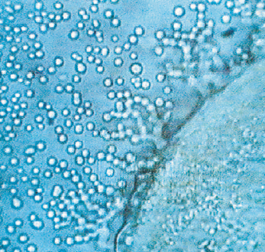
The Origin of Life on Earth
Experiments have shown that microscopic spheres the size of cells containing organic molecules form relatively easily in water.
So, the evolution of the cell membrane is not surprising.

Slide 54
The Origin of Life on Earth
The first cells must have been single-celled organisms much like modern bacteria.

Slide 55
The Origin of Life on Earth
As you learned earlier, these kinds of cells are preserved in stromatolites— mineral formations formed by layers of photosynthetic bacteria and shallow ocean sediments.

Slide 56
The Origin of Life on Earth
Stromatolites formed in rocks with radioactive ages of 3 billion years.
They still form in some places today.

Slide 57
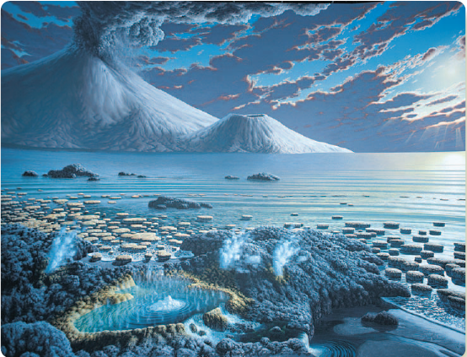
The Origin of Life on Earth
Stromatolites and other photosynthetic organisms would have begun adding oxygen, a product of photosynthesis, to Earth’s early atmosphere.

Slide 58
The Origin of Life on Earth
An oxygen abundance of only 0.1 percent would have created an ozone screen—protecting organisms from the sun’s ultraviolet radiation and later allowing life to colonize the land.

Slide 59
The Origin of Life on Earth
Over the course of eons, the natural processes of evolution gave rise to stunningly complex multicellular life forms—with their own widely differing ways of life.

Slide 60
The Origin of Life on Earth
It is a common misconception to imagine that life is too complex to have evolved from such simple beginnings.
It is possible because small variations can accumulate.
That accumulation, however, requires huge amounts of time.

Slide 61
Geologic Time
Life has existed on Earth for at least 3.4 billion years.
There is no evidence, though, of anything more than simple organisms until about 540 million years ago—when life suddenly branched into a wide variety of complex forms like the trilobites.

Slide 62
Geologic Time
This sudden increase in complexity is known as the Cambrian explosion.
It marks the beginning of the Cambrian period.

Slide 63
Geologic Time
If you represented the entire history of Earth on a scale diagram, the Cambrian explosion would be near the top of the column.

Slide 64
Geologic Time
The emergence of most animals familiar to you today—including fishes, amphibians, reptiles, birds, and mammals—would be crammed into the topmost part of the chart, above the Cambrian explosion.

Slide 65
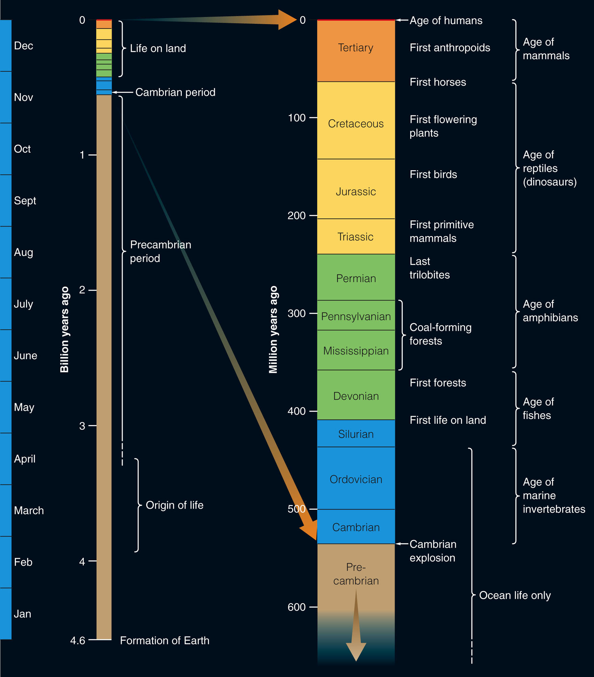
Geologic Time
If you magnify that portion of the diagram, you can get a better idea of when those events occurred in the history of life.

Slide 66
Geologic Time
Humanoid creatures have walked the Earth for about 3 million years.
This is a long time by the standard of a human lifetime—but it makes only a narrow red line at the very top of the diagram.

Slide 67
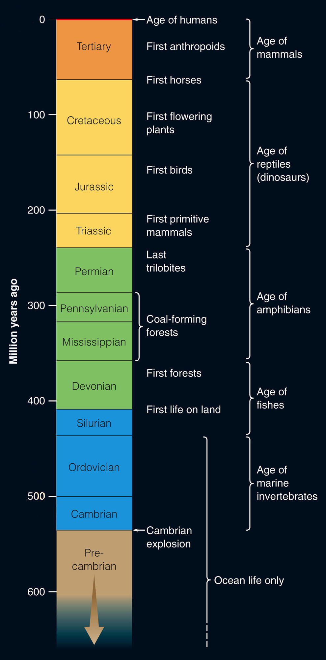
Geologic Time
All of recorded history would be a microscopically thin line at the very top of the column.

Slide 68
Geologic Time
To understand just how thin that line is, imagine that the entire 4.6-billion-year history of the Earth has been compressed onto a yearlong video.

Slide 69
Geologic Time
Imagine that you began watching the video on January 1.
You would not see any signs of life until March or early April.
The slow evolution of the first simple forms would take up the next six or seven months.

Slide 70
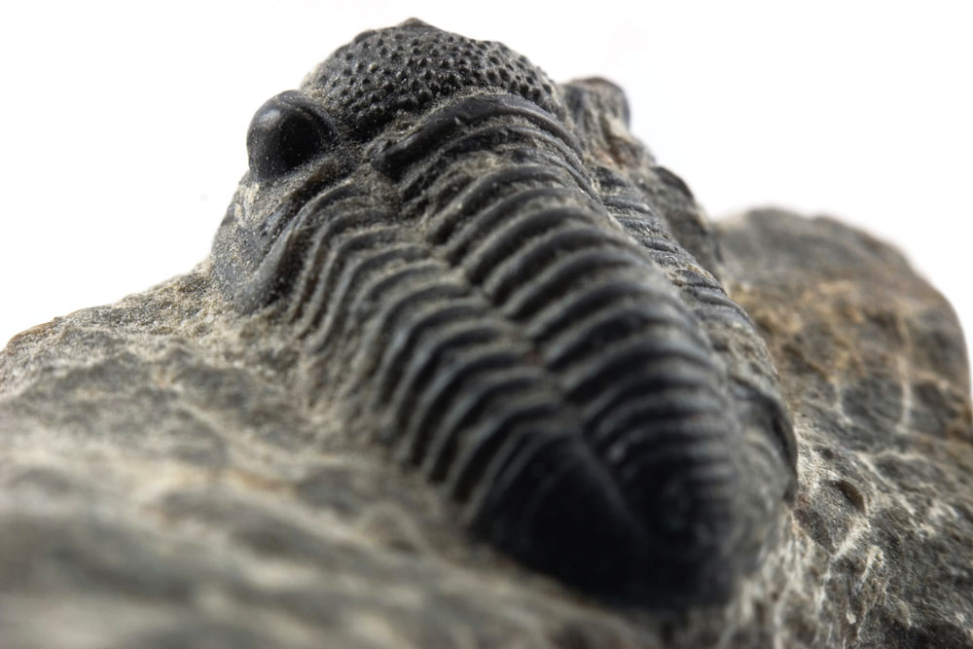
Geologic Time
Suddenly, in mid-November, you would see the trilobites and other complex organisms of the Cambrian explosion.

Slide 71
Geologic Time
You would see no life of any kind on land until November 28.
Once it appeared though, it would diversify quickly.

Slide 72
Geologic Time
By December 12, you would see dinosaurs walking the continents.
By the evening of Christmas Day, they would be gone, and mammals and birds would be on the rise.

Slide 73
Geologic Time
If you watched closely, you might see the first humanoid forms by suppertime on New Year’s Eve.
By late evening, you could see humans making the first stone tools.

Slide 74
Geologic Time
The Stone Age would last until 11:59 PM.
The first towns and cities would then appear.

Slide 75
Geologic Time
Suddenly, things would begin to happen at lighting speed.
Babylon would flourish, the Pyramids would rise, and Troy would fall.
The Christian era would begin 14 seconds before the New Year.
Rome would fall.
The Middle Ages and the Renaissance would flicker past.
The American and French revolutions would occur one second before the end of the video.

Slide 76
Geologic Time
By imagining Earth’s history as an yearlong video, you have gained some perspective on the rise of life.
Tremendous amounts of time were needed for the first simple living things to evolve in the oceans.
However, as life became more complex, new forms arose more and more quickly as the hardest problems—how to reproduce, how to take energy efficiently from the environment, how to move around—were solved.

Slide 77
Geologic Time
The easier problems—what to eat, where to live, and how to raise young—were solved in different ways by different organisms, leading to the diversity that you see today.

Slide 78
Geologic Time
Even intelligence—that which appears to set humans apart from other animals—may be a unique solution to an evolutionary problem posed to humanity’s ancient ancestors.
A smart animal is better able to escape predators, outwit its prey, and feed and shelter itself and its offspring.
So, under certain conditions, evolution is likely to select for intelligence.

Slide 79
Geologic Time
Could intelligent life arise on other worlds?
To try to answer this question, you can estimate the chances of any type of life arising on other worlds and then assess the likelihood of that life developing intelligence.

