Slide 1
Chapter 13
Galaxies: Normal and Active

Slide 2
The ability to theorize
is highly personal;
it involves art, imagination, logic,
and something more.
  - EDWIN HUBBLE
  The Realm of the Nebulae

Slide 3
Less than a century ago, astronomers did not understand that galaxies exist.
  Nineteenth-century telescopes revealed faint nebulae scattered among the stars, some of which were spiral.
  Astronomers argued about the nature of these nebulae.
  It was not until the 1920s, though, that they understood that some were other galaxies much like our own.

Slide 4
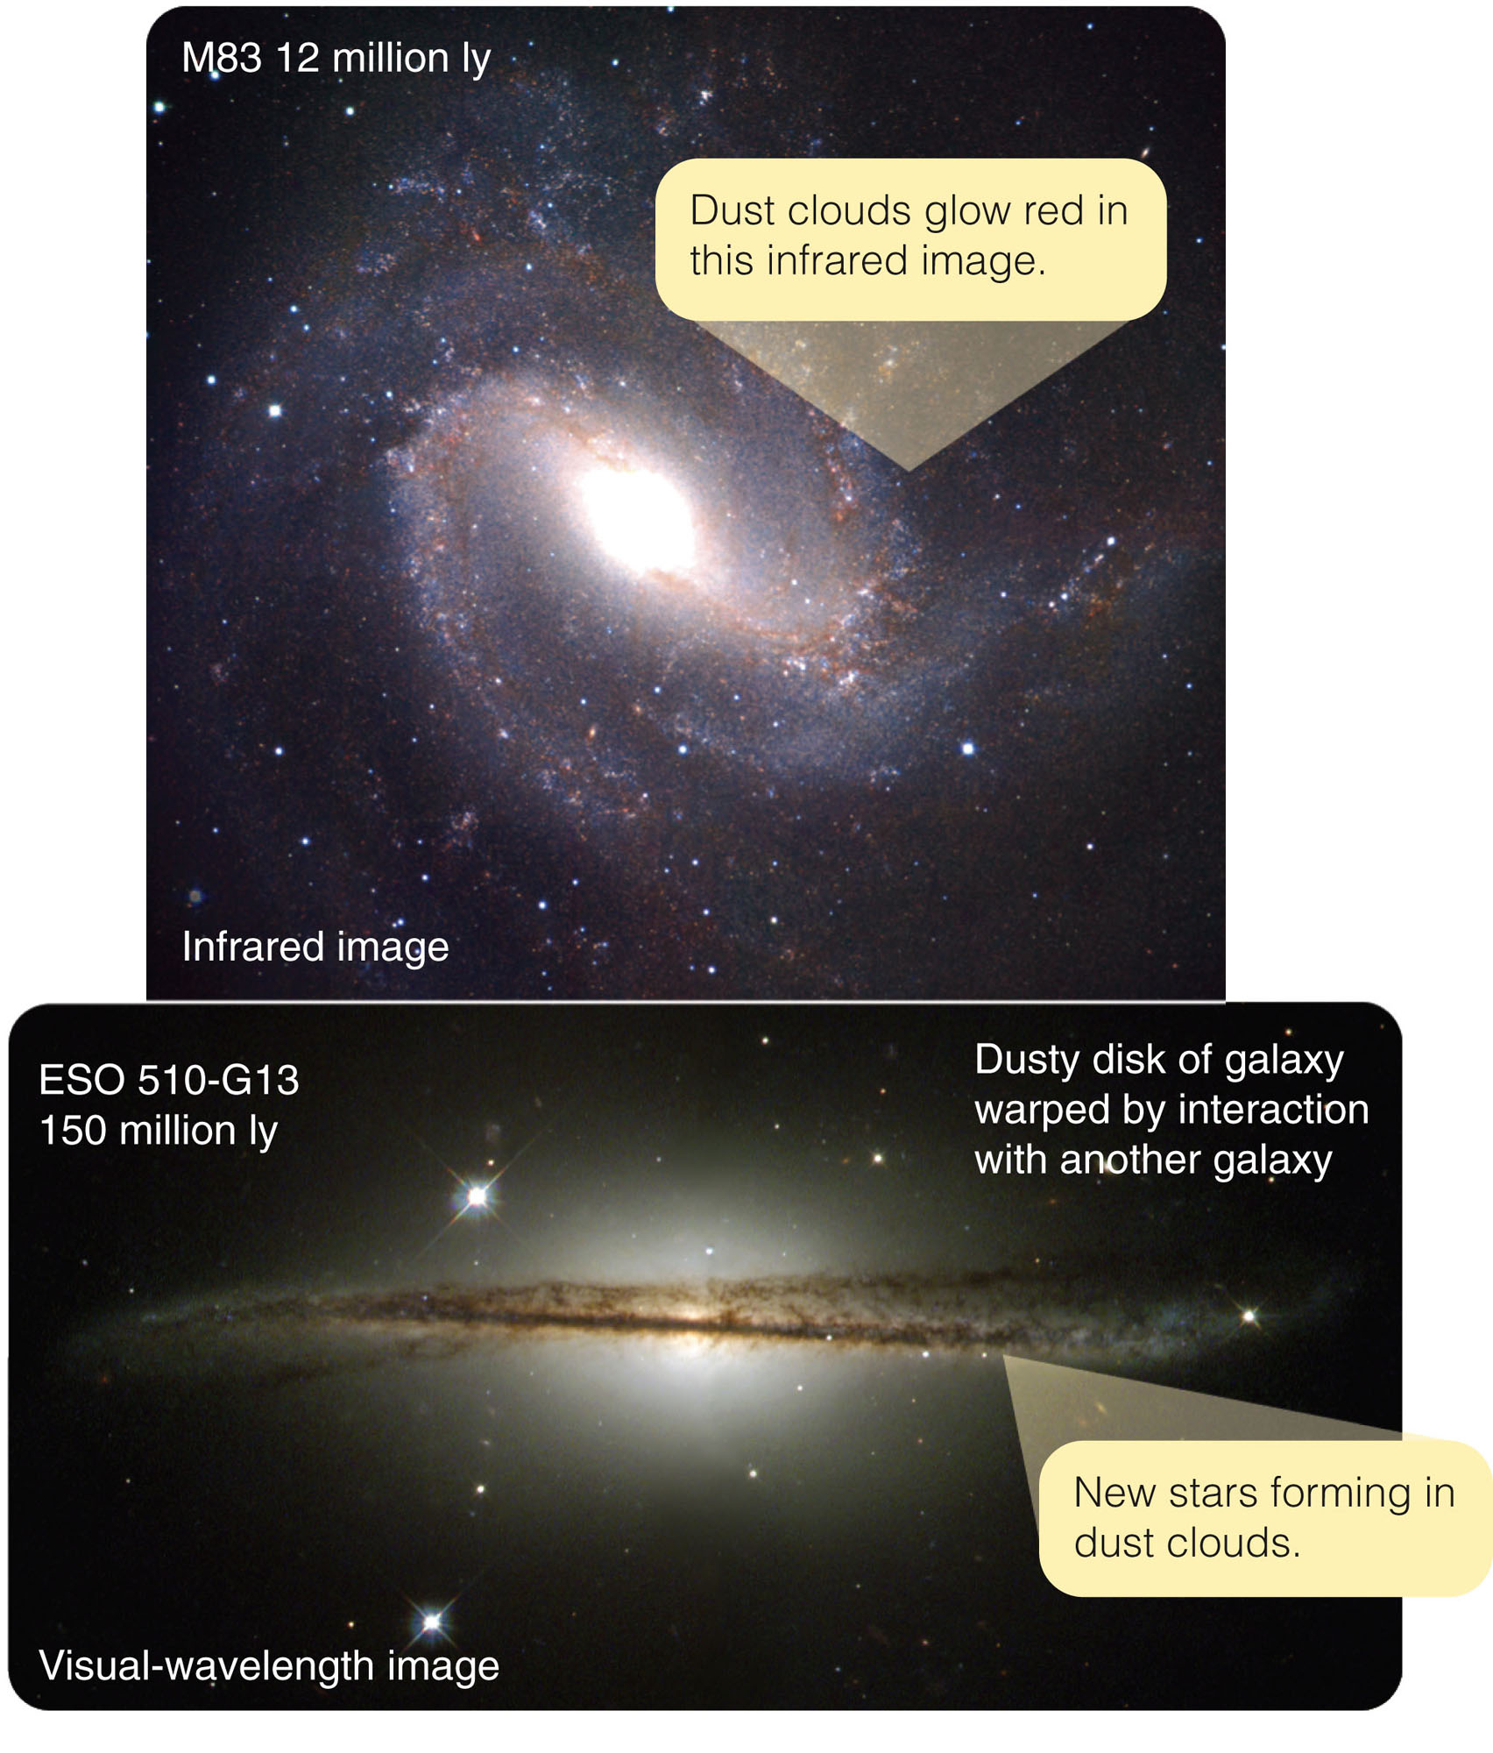
It was not until recent decades that astronomical telescopes could reveal the variety, intricacy, and beauty of the galaxies.

Slide 5
In this chapter, you will try to understand how galaxies form and evolve.
  You will discover that the amount of gas and dust in a galaxy is a critical clue.
  You will also discover that interactions between galaxies can influence their structure and evolution.

Slide 6
Before you can build theories, however, you must gather some basic data concerning galaxies.
  You must classify the different kinds of galaxies and discover their basic properties—diameter, luminosity, and mass.
  Once you know the typical properties, you will be ready to theorize about their origin and evolution.

Slide 7
You also will learn about some of the most energetic events in the universe.
  The energy pouring out of the nuclei of certain galaxies is enormously greater than mere supernova explosions.

Slide 8
The Family of Galaxies
Astronomers classify galaxies according to shape—using a system developed in the 1920s by Edwin Hubble (namesake of the Hubble Space Telescope).
  Creating a system of classification is a fundamental technique in science.

Slide 9
The Family of Galaxies
There are three important
points to note about galaxy classification.

Slide 10
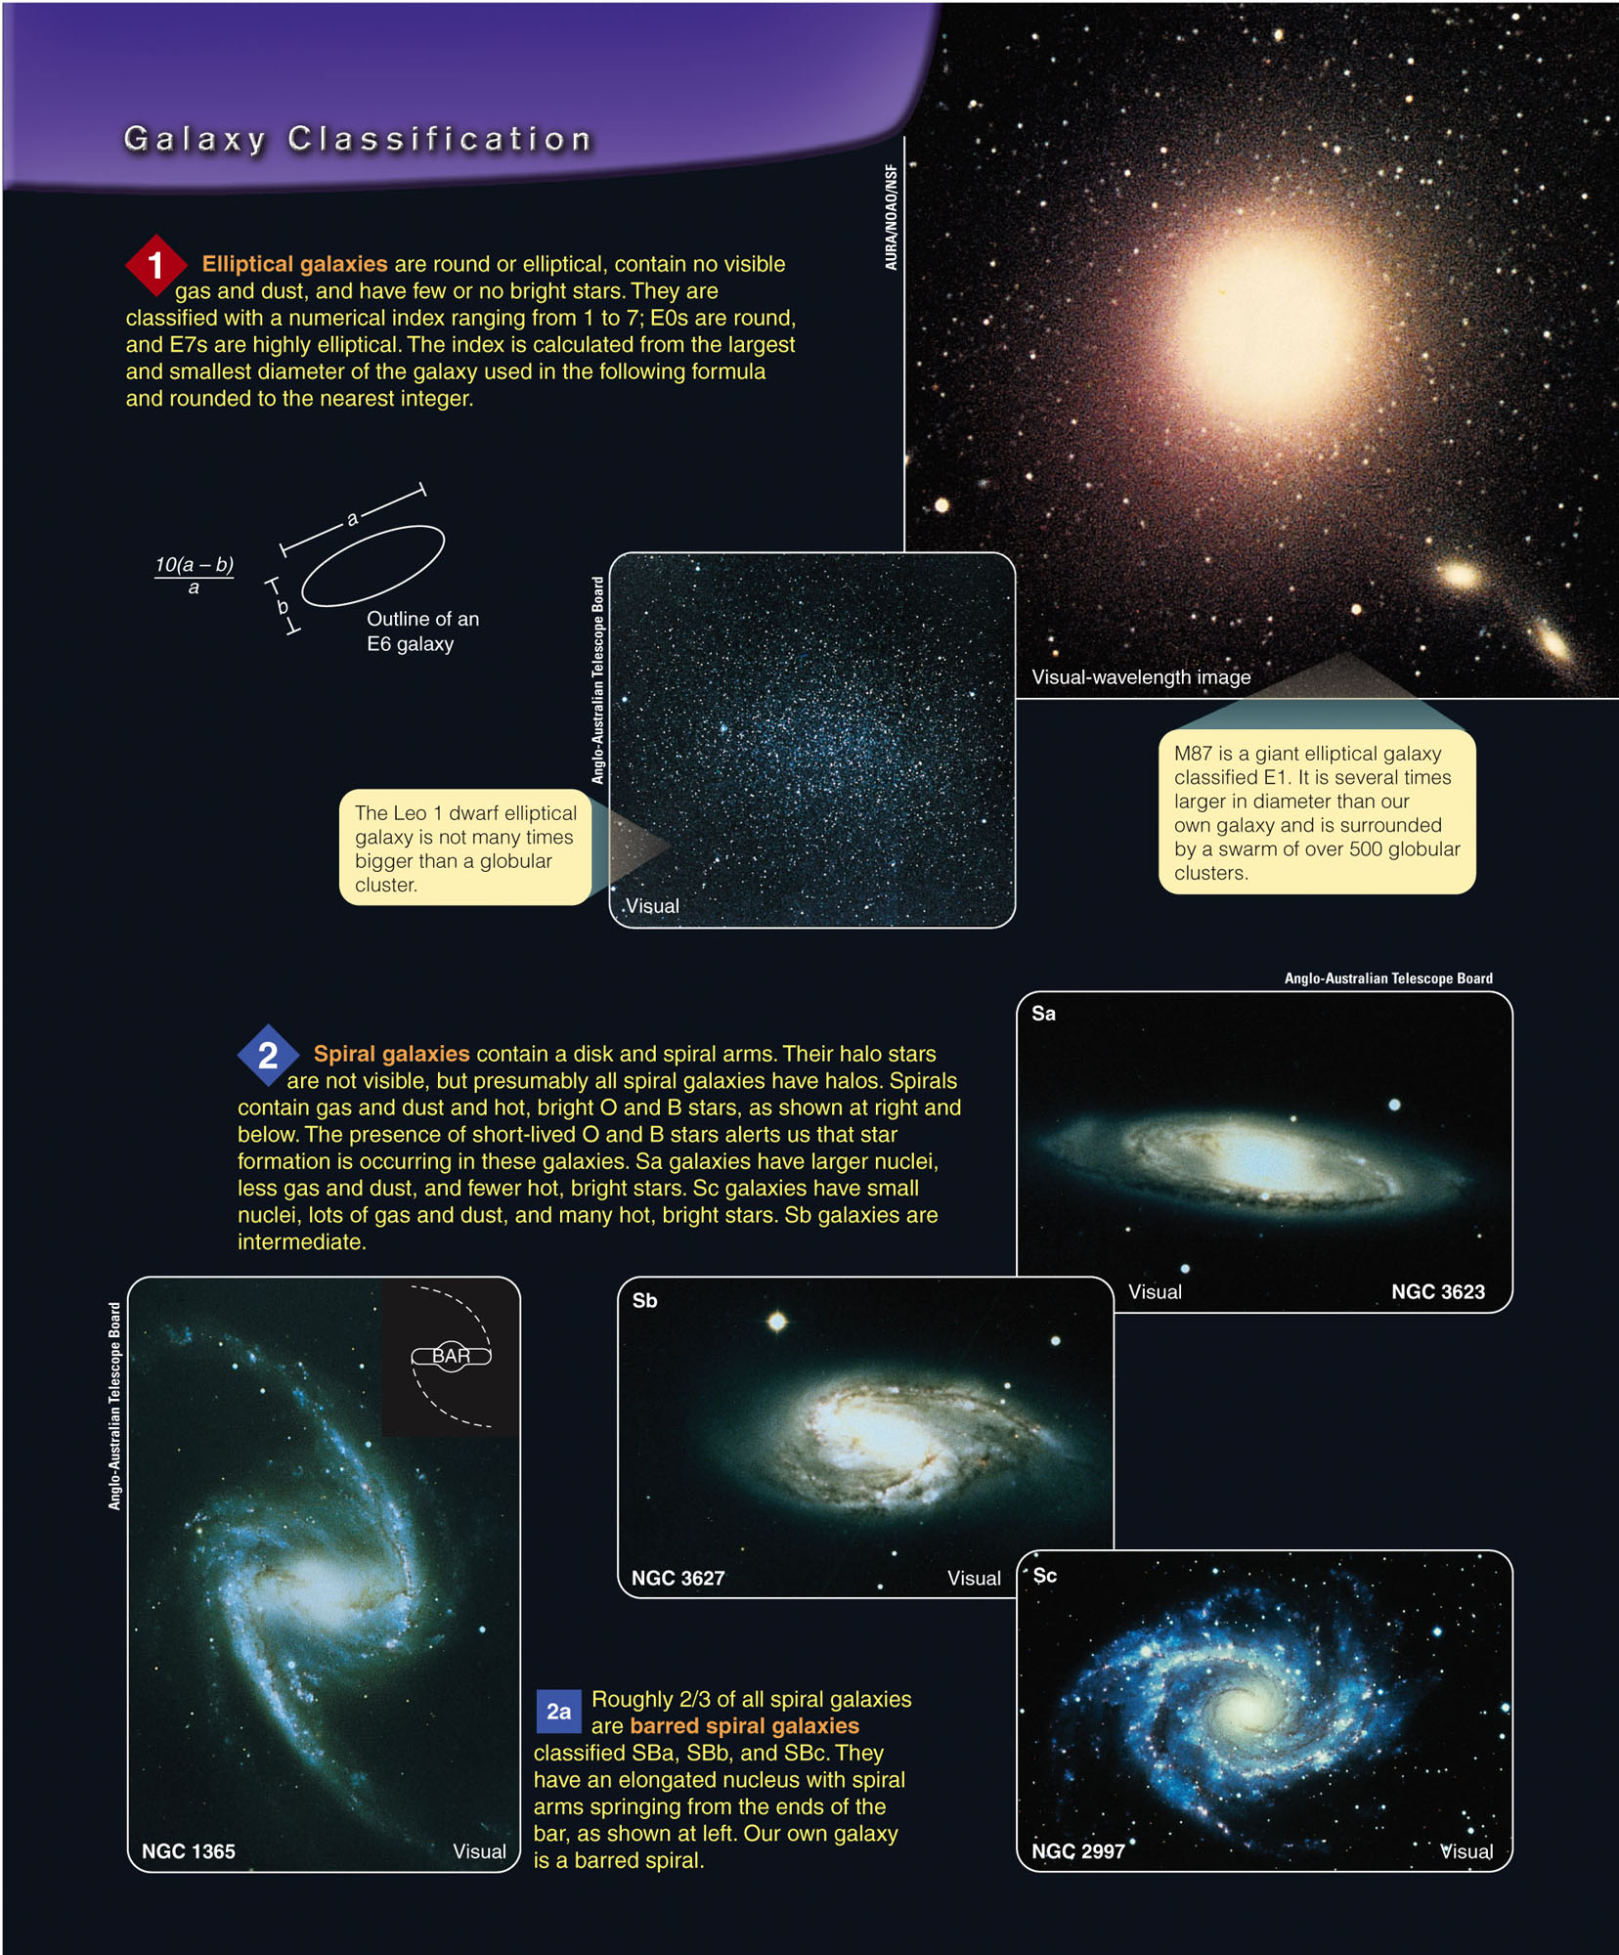
The Family of Galaxies
One, many galaxies have no disk, no spiral arms, and almost no gas and dust.
  These elliptical galaxies range from huge giants to small dwarfs.

Slide 11
The Family of Galaxies
Two, disk-shaped galaxies usually have spiral arms and contain gas and dust, although some have very little.
  Many spiral galaxies have a barred structure.

Slide 12
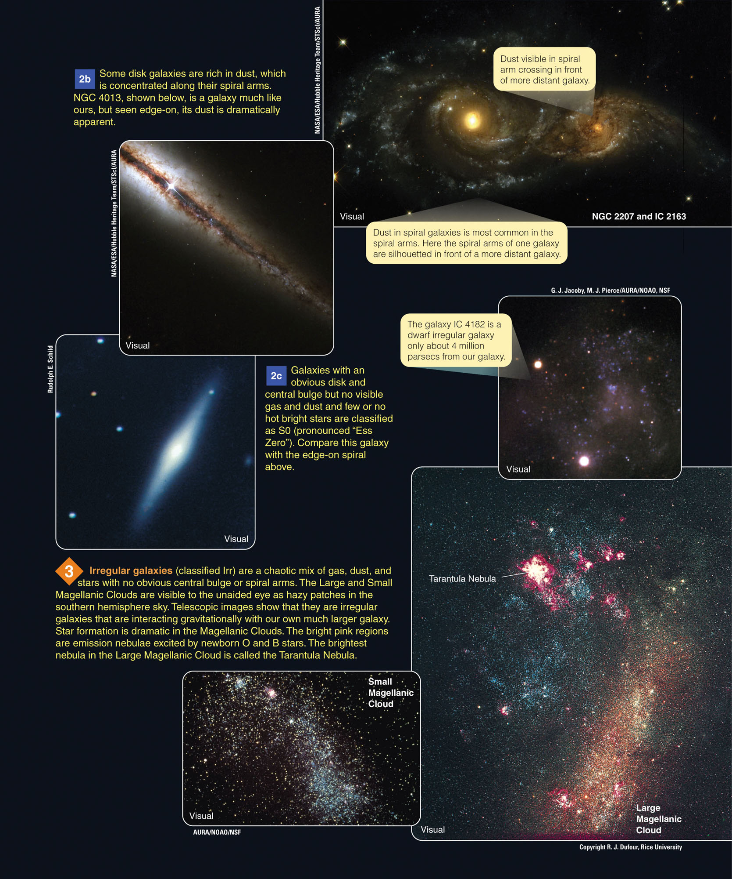
The Family of Galaxies
Three, some galaxies are highly irregular in shape and tend to be rich in gas and dust.

Slide 13
The Family of Galaxies
You might also wonder what proportion of the galaxies are elliptical, spiral, and irregular.
That is a difficult question to answer.
  In some catalogs of galaxies, about 70 percent are spiral.
  That, however, is the result of a selection effect.

Slide 14
The Family of Galaxies
Spiral galaxies contain hot, bright stars—and are thus very luminous and easy to see.
Among spiral galaxies, about two-thirds are barred spirals.
  From careful studies, astronomers can conclude that ellipticals are more common than spirals.
  The irregulars make up only about 25 percent
  of all galaxies.

Slide 15
The Family of Galaxies
Different kinds of galaxies have different colors, depending mostly on how much star formation is happening in them.

Slide 16
The Family of Galaxies
Spirals and irregulars usually contain plenty of young stars, including massive, hot, luminous O and B stars.
  They produce most of the light and give spirals and irregulars a distinct blue tint.

Slide 17
The Family of Galaxies
In contrast, elliptical galaxies usually contain few young stars.
The most luminous stars in ellipticals are red giants, which give those galaxies a red tint.

Slide 18
The Family of Galaxies
How many galaxies are there?
  A research effort called GOODS (Great Observatories Origins Deep Survey) has used various telescopes.
  These include the Hubble Space Telescope, the Chandra X-Ray Observatory, the Spitzer Space Telescope, and the XXM-Newton X-Ray Telescope.
  Also there are the largest ground-based telescopes, to study two selected areas in the northern and southern skies.

Slide 19
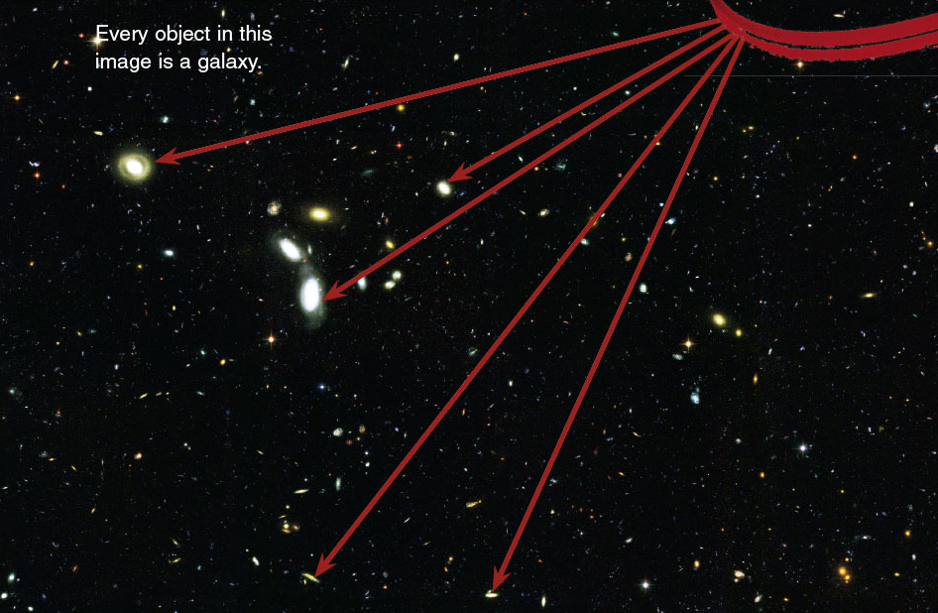
The Family of Galaxies
The GOODS deep images reveal tremendous numbers of galaxies.

Slide 20
The Family of Galaxies
There are good reasons to believe that the two regions of the sky chosen for study are typical.
  So, it seems likely that the entire sky is carpeted with galaxies.
  At least, 100 billion would be visible if today’s telescopes were used for an all-sky census.

Slide 21
Measuring the Properties of Galaxies
Beyond the edge of Milky Way, astronomers find many billions of galaxies.
  What are the properties of these star systems?
  What are the diameters, luminosities, and masses of galaxies?

Slide 22
Measuring the Properties of Galaxies
The first step in your study of galaxies is to find out how far away they are.
  Once you know a galaxy’s distance, its size and luminosity are relatively easy to find.
  Later in the section, you will see that finding their mass is more difficult.
  However, the results are quite interesting.

Slide 23
Distance
The distances to galaxies are so large that it is not convenient to express them in light-years, parsecs, or even kiloparsecs.
  Instead, astronomers use the unit megaparsec (Mpc), or 1 million pc.
  One Mpc equals 3.26 million ly, or approximately 3 x 10¹⁹ km (2 x 10¹⁹ miles).

Slide 24
Distance
To find the distance to a galaxy, astronomers must search among its stars, nebulae, and star clusters for familiar objects.
They must know the luminosity and diameter.
  Such objects are called standard candles.
  If you can find a standard candle in a galaxy, you can judge its distance.

Slide 25
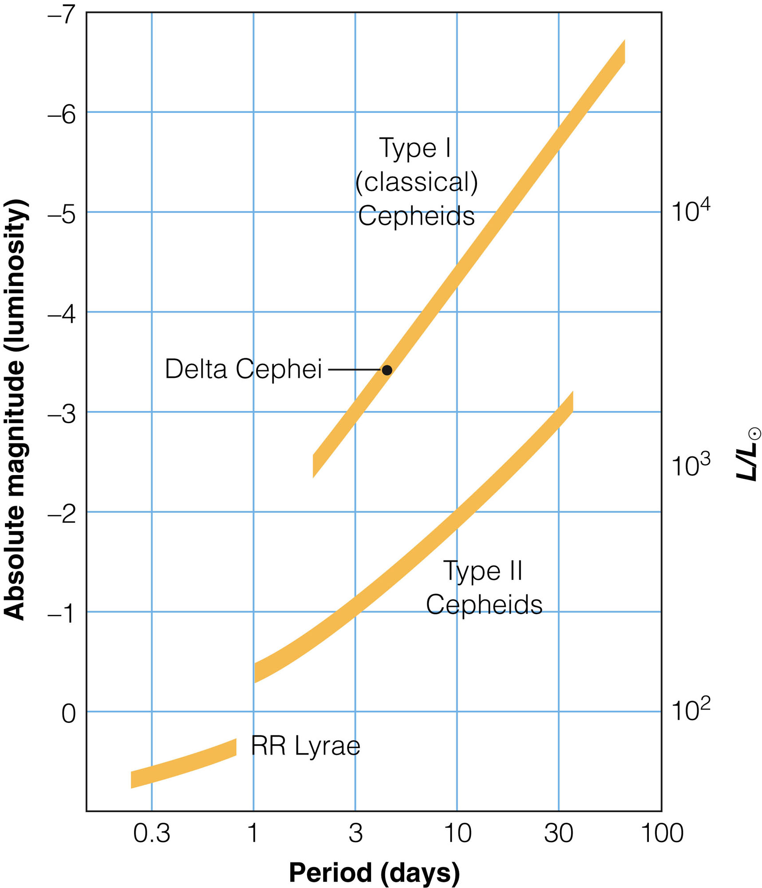
Distance
As their period is related to their luminosity, Cepheid variable stars are reliable standard candles.
  If you know the period of
  the star’s variation, you can
  use the period–luminosity
  relation to learn its absolute
  magnitude.
  By comparing its absolute
  and apparent magnitudes,
  you can find its distance.
Notes:
A Cepheid (/ˈsɛfiːɪd/ or /ˈsiːfiːɪd/) is a star that varies between a larger, brighter state and a smaller, denser one. They are very luminous variable stars, of a class that was especially massive and hot, using up their fuel early, leaving them in this pulsating condition. The strong direct relationship between a Cepheid variable's luminosity and pulsation period[1][2] secures for Cepheids their status as important distance indicators for establishing the Galactic and extragalactic distance scales.[3][4][5][6]

Slide 26
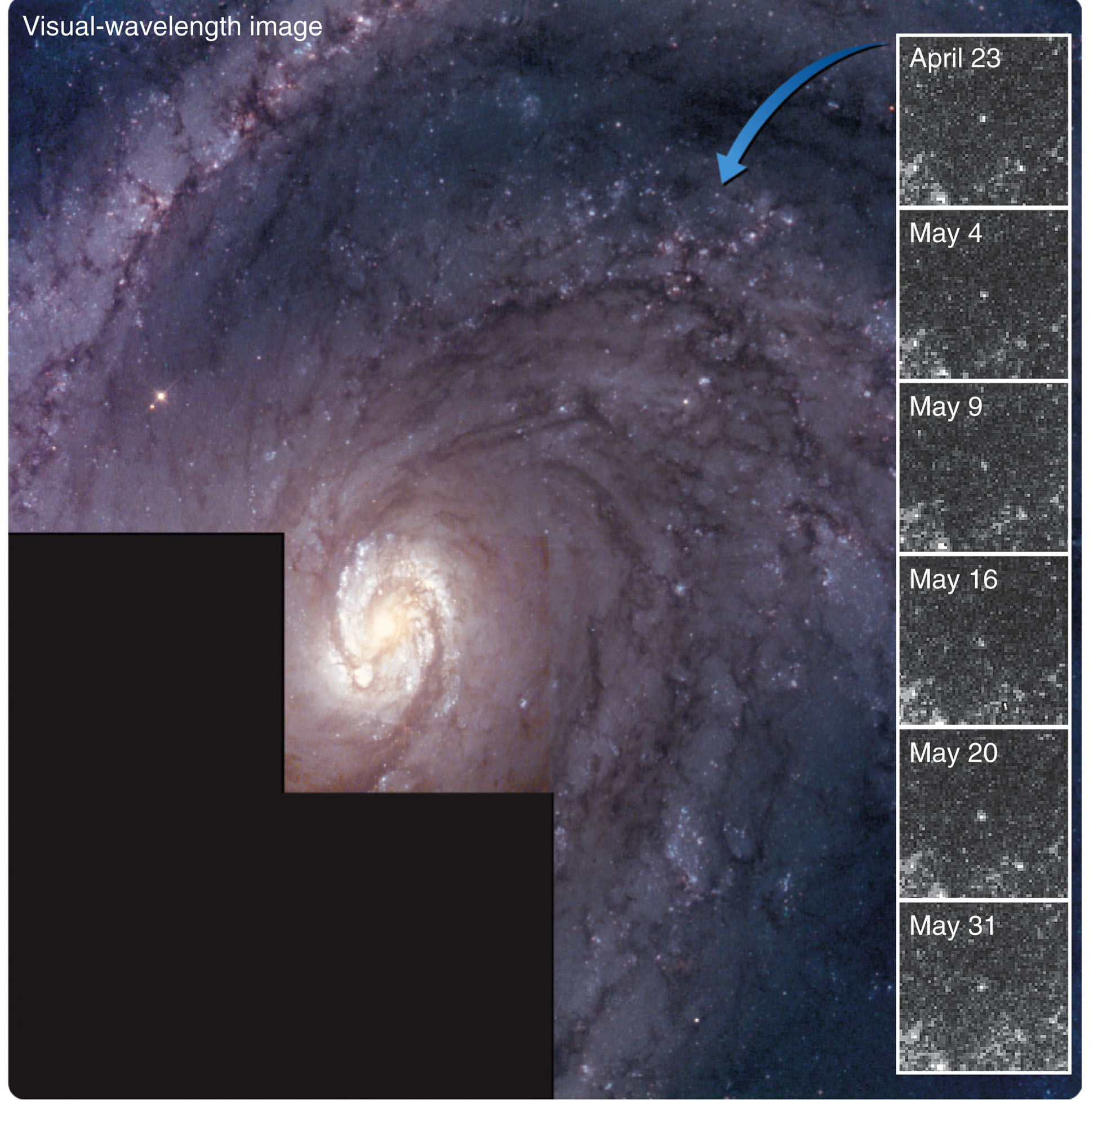
Distance
The figure shows a galaxy in which the Hubble Space Telescope detected Cepheids.

Slide 27
Distance
Even the Hubble Space Telescope cannot resolve Cepheids in galaxies much beyond 100 million ly (30 Mpc).
  So, astronomers must search for less common but brighter distance indicators, and calibrate them using nearby galaxies containing visible Cepheids.

Slide 28
Distance
When a supernova explodes in a distant galaxy, astronomers rush to observe it.
  Studies show that type Ia supernovae—caused by the collapse of a white dwarf—all reach about the same absolute magnitude at maximum.
  This makes them more like “standard bombs” than standard candles.

Slide 29
Distance
  By searching for Cepheids and other distance indicators in nearby galaxies—where type Ia supernovae have occurred—astronomers have been able to calibrate these supernovae.

Slide 30
Distance
When type Ia supernovae are seen in more distant galaxies, astronomers can measure the apparent brightness at maximum.
  They can compare that with the known luminosity of these supernovae to find their distances.

Slide 31
Distance
As type Ia supernovae are much brighter than Cepheids, they can be seen at great distances.
  The drawback is that supernovae are rare.
  None may occur during your lifetime in a galaxy you might be studying.

Slide 32
Distance
Astronomers use calibration to build a distance scale reaching from the nearest galaxies to the most distant visible galaxies.
  Often, they refer to this as the distance ladder—as each step depends on the steps below it.

Slide 33
Distance
Of course, the foundation of the scale rests on understanding the luminosities of stars.
  This ultimately rests on measurements of stellar parallax.

Slide 34
Telescopes as Time Machines
The most distant visible galaxies are little over 10 billion ly (3,000 Mpc) away.
At such distances, you see an effect akin to time travel.

Slide 35
Telescopes as Time Machines
When you look at a galaxy only a few million light-years away, you do not see it as it is now but as it was millions of years ago.
  This is when its light began the journey towards Earth.

Slide 36
Telescopes as Time Machines
When you look at a more distant galaxy, you look back into the past by an amount called the look-back time.
  This is the time in years equal to the distance
  to the galaxy in light-years.

Slide 37
Telescopes as Time Machines
The look-back time to nearby objects is usually not significant.
  The look-back time to the moon is 1.3 seconds,
  and to the sun only 8 minutes.
  To the nearest star, it is about 4 years.

Slide 38
Telescopes as Time Machines
The Andromeda Galaxy has a look-back time of about 2 million years—a mere eye blink in the lifetime of a galaxy.
When astronomers look at more distant galaxies though, the look-back time becomes an appreciable part of the age of the universe.

Slide 39
Telescopes as Time Machines
When astronomers observe the most distant visible galaxies, they are looking back over 10 billion years.
  At that time, the universe may have been significantly different.

Slide 40
The Hubble Law
Astronomers find it difficult to measure the distance to a galaxy.
They often estimate such distances using a simple relationship.
  Early in the 20th century, astronomers noticed that the lines in galaxy spectra were shifted slightly toward longer wavelengths—redshifts.
  These redshifts imply that the galaxies are receding from Earth.

Slide 41
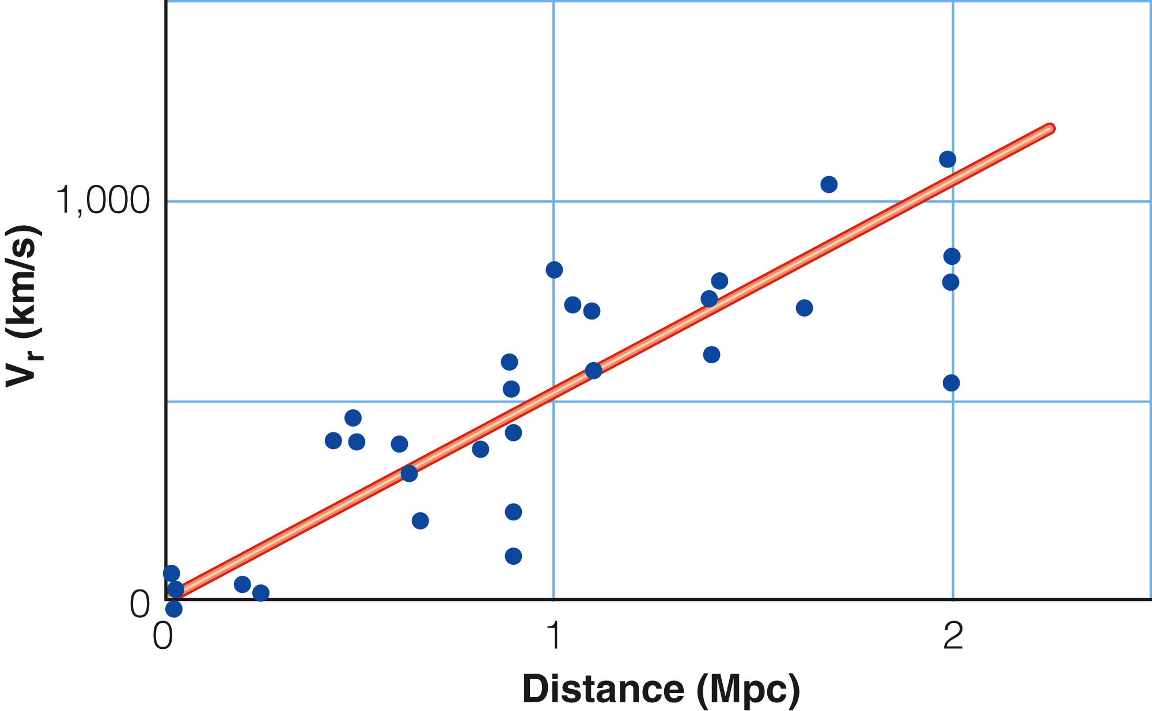
The Hubble Law
In 1929, the American astronomer Edwin Hubble published a graph that plotted the apparent velocities of recession versus distance for a number of galaxies.
  The points in the
  graph fell along a
  straight line.

Slide 42
The Hubble Law
This relation between apparent velocity of recession and distance is known as the Hubble law.
  The slope of the line is known as the Hubble constant, symbolized by H.

Slide 43
The Hubble Law
The Hubble law is important in astronomy for two reasons.
  It is taken as evidence that the universe is expanding.
  Astronomers use it to estimate the distance to galaxies.

Slide 44
The Hubble Law
The distance to a galaxy can be found by dividing its apparent velocity of recession by the Hubble constant.

Slide 45
The Hubble Law
This is a very useful calculation—because it is usually possible to obtain a spectrum of a galaxy and measure its redshift.
  You can do this even if it is too far away to have observable standard candles.
  Obviously, knowing the Hubble constant is important.

Slide 46
The Hubble Law
Edwin Hubble’s original measurement of H was too large because of errors in his measurements of the distances to galaxies.
  Later astronomers have struggled to measure this important constant.

Slide 47
The Hubble Law
The most precise measurements of the Hubble constant yield a value of H about 70 km/s/Mpc. (This is with an uncertainty of about 5 percent.)
  This means that a galaxy at a distance of 1 Mpc from the Milky Way is receding from us at a rate of 70 km/s.
  A galaxy 2 Mpc away is receding at 140 km/s.

Slide 48
The Hubble Law
The redshifts of galaxies are not really Doppler shifts.
  This is even though astronomers often express the redshifts in kilometers per second, as if they were true velocities.

Slide 49
The Hubble Law
Note that modern astronomers interpret redshifts of galaxies as caused by the expansion of the universe.
  The Hubble law allows them to estimate the distance to a galaxy from its redshift.

Slide 50
Galaxy Distances and Luminosities
The distance to a galaxy is the key to finding its diameter and its luminosity.
  With even a modest telescope and a CCD camera, you could photograph a galaxy and measure its angular diameter.
  If you knew the distance to the galaxy, you can then find its linear diameter.
  Also, if you measure the apparent brightness of the galaxy, you can use the distance to find its luminosity.

Slide 51
Galaxy Distances and Luminosities
The results of such observations show that galaxies differ dramatically in size and luminosity.
  Irregular galaxies tend to be small—1 to 25 percent the size of Milky Way—and have low luminosity.
  Although they are common, they are easy to overlook.

Slide 52
Galaxy Distances and Luminosities
Our Milky Way is large and luminous compared with most spiral galaxies.
  However, astronomers know of a few spiral galaxies that are even larger and more luminous.

Slide 53
Galaxy Distances and Luminosities
Elliptical galaxies cover a wide range of diameters and luminosities.
  The largest, called giant ellipticals, are five times the size of Milky Way.
  Many elliptical galaxies, though, dwarf ellipticals—are only 1 percent the diameter of our galaxy.

Slide 54
Galaxy Distances and Luminosities
Clearly, the diameter and luminosity of a galaxy do not determine its type.
  Some small galaxies are irregular, and some are elliptical.
  Some large galaxies are spiral, and some are elliptical.
  Other factors must influence the origin and evolution of galaxies.

Slide 55
Galaxy Masses
The mass of a galaxy is difficult to determine.
Nevertheless, it is an important quantity.
  It shows you how much matter the galaxy contains—which provides clues to the galaxy’s origin and evolution.

Slide 56
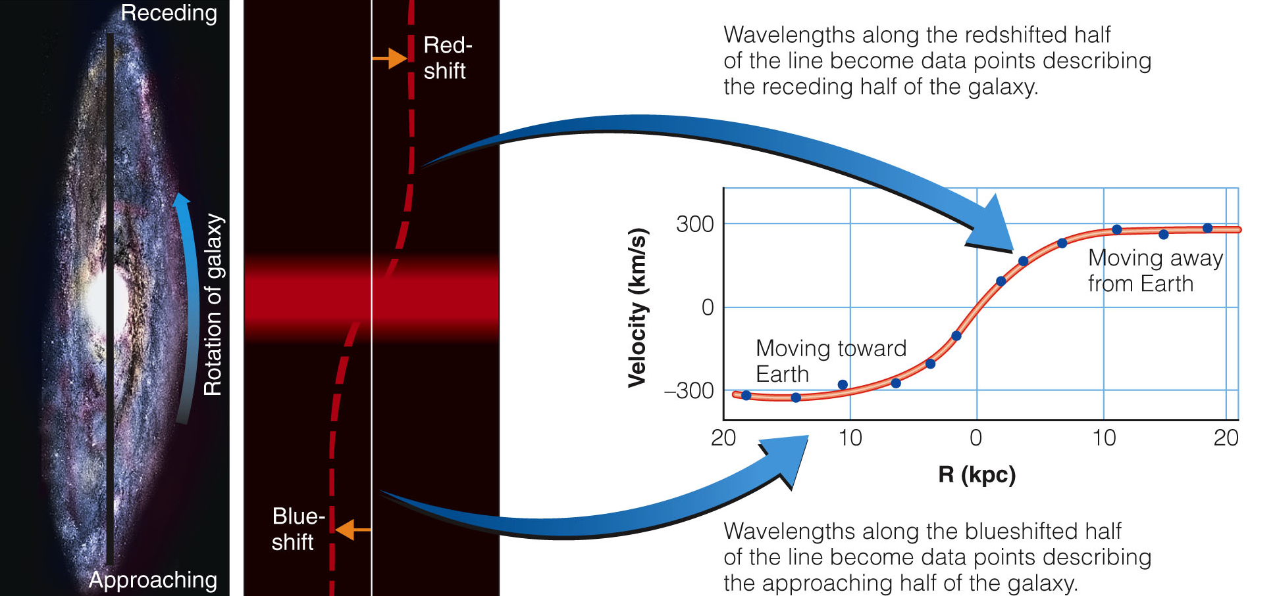
Galaxy Masses
The most precise method for measuring the mass of a galaxy is called the rotation curve method.

Slide 57
Galaxy Masses
The rotation curve method requires knowing:
  The true sizes of the orbits of stars or gas clouds within a galaxy, which in turn requires knowing the distance of that galaxy
  The orbital speeds of the stars or gas clouds, measured from the Doppler shifts of their spectral lines

Slide 58
Galaxy Masses
That is enough information to use Kepler’s third law and find the mass of the part of the galaxy contained within the star orbits with measured sizes and speeds.

Slide 59
Galaxy Masses
The rotation curve method works only for galaxies near enough to be well resolved.
  More distant galaxies appear so small that astronomers cannot measure the radial velocity
  at different points across the galaxy.
  They must use other, less precise, methods to estimate masses.

Slide 60
Galaxy Masses
The masses of galaxies cover a wide range.
  The smallest contain about 10⁻⁶ as much mass as the Milky Way.
  The largest contain as much as 50 times more than the Milky Way.

Slide 61
Dark Matter in Galaxies
Given the size and luminosity of a galaxy, astronomers can make a rough guess as to the amount of matter it should contain.
  They know how much light stars produce.
  They also know how much matter there is between the stars.
  So, it should be possible to estimate very roughly, the mass of a galaxy from its luminosity.

Slide 62
Dark Matter in Galaxies
When astronomers measure the masses of galaxies, however, they find that the measured masses are much larger than expected from the luminosities of the galaxies.

Slide 63
Dark Matter in Galaxies
Astronomer Vera Rubin found in the 1960s that this also seems to be true of most nearby galaxies.
  Measured masses of galaxies amount to 10 to 100 times more mass than you can see.

Slide 64
Dark Matter in Galaxies
Dark matter is difficult to detect, and it is even harder to explain.
  Some astronomers have suggested that dark matter consists of low-luminosity white dwarfs and brown dwarfs.
  They are scattered through the halos of galaxies.

Slide 65
Dark Matter in Galaxies
Searches for white dwarfs and brown dwarfs in the halo of our galaxy have found a few, but not enough to make up most of the dark matter.

Slide 66
Dark Matter in Galaxies
The dark matter can’t be hidden in vast numbers of black holes and neutron stars.
  Astronomers don’t see the X rays these objects would emit.
  There is 10 to 100 times more dark matter than visible matter in galaxies.
  That many black holes would produce X rays that would be easy to detect.

Slide 67
Dark Matter in Galaxies
Also, recent images from the Chandra X-ray observatory indicate:
  A collision between two galaxy clusters caused their gas and dark matter components to separate.

Slide 68
Dark Matter in Galaxies
As observations imply, the dark matter can’t be composed of familiar objects or material.
  Astronomers are forced to conclude that the dark matter is made up of unexpected forms of matter.

Slide 69
Dark Matter in Galaxies
Until recently, neutrinos were thought to be massless.
  Studies now suggest they have a very small mass.
  Thus, they may represent part of the dark matter.

Slide 70
Dark Matter in Galaxies
However, their masses are too low to make up all the dark matter.
  There must be some other undiscovered form of matter in the universe that is detectable only by its gravitational field.

Slide 71
Dark Matter in Galaxies
Dark matter remains one of the fundamental unresolved problems of modern astronomy.
  Observations of galaxies and clusters of galaxies reveal that 90 to 95 percent of the matter in the universe is dark matter.

Slide 72
Supermassive Black Holes in Galaxies
Doppler shift measurements show that the stars near the centers of many galaxies are orbiting very rapidly.

Slide 73
Supermassive Black Holes in Galaxies
To hold stars in such small,
short-period orbits, the centers of galaxies must contain masses of a million to a few billion solar masses.
  Yet, no object is visible.
  The evidence seems to require that the nuclei of galaxies contain supermassive black holes.
  You have learned that Milky Way contains a supermassive black hole at its center.
  Evidently, that is typical of galaxies.

Slide 74
Supermassive Black Holes in Galaxies
It is a common misconception that the orbits of stars throughout a galaxy are controlled by the central black hole.
  The masses of those black holes, large as they may seem, are negligible compared with a galaxy’s mass.
  The 2.6-million-solar-mass black hole at the center of Milky Way contains only a thousandth of one per cent of the total mass of the galaxy.

Slide 75
The Evolution of Galaxies
Your goal in the chapter has been to build a theory that explains the evolution of galaxies.
  Earlier, you developed a theory that described the origin of Milky Way.
  Presumably, other galaxies formed in similar ways.

Slide 76
The Evolution of Galaxies
Why did some galaxies become spiral, some elliptical, and some irregular?
  Clues to that mystery lie in the clustering of galaxies.

Slide 77
Clusters of Galaxies
The distribution of galaxies is not entirely random.
  Galaxies tend to occur in clusters ranging from a few to thousands.
  Deep photos made with the largest telescopes reveal clusters of galaxies scattered out to the limits of visibility.
  This clustering of the galaxies can help you understand their evolution.

Slide 78
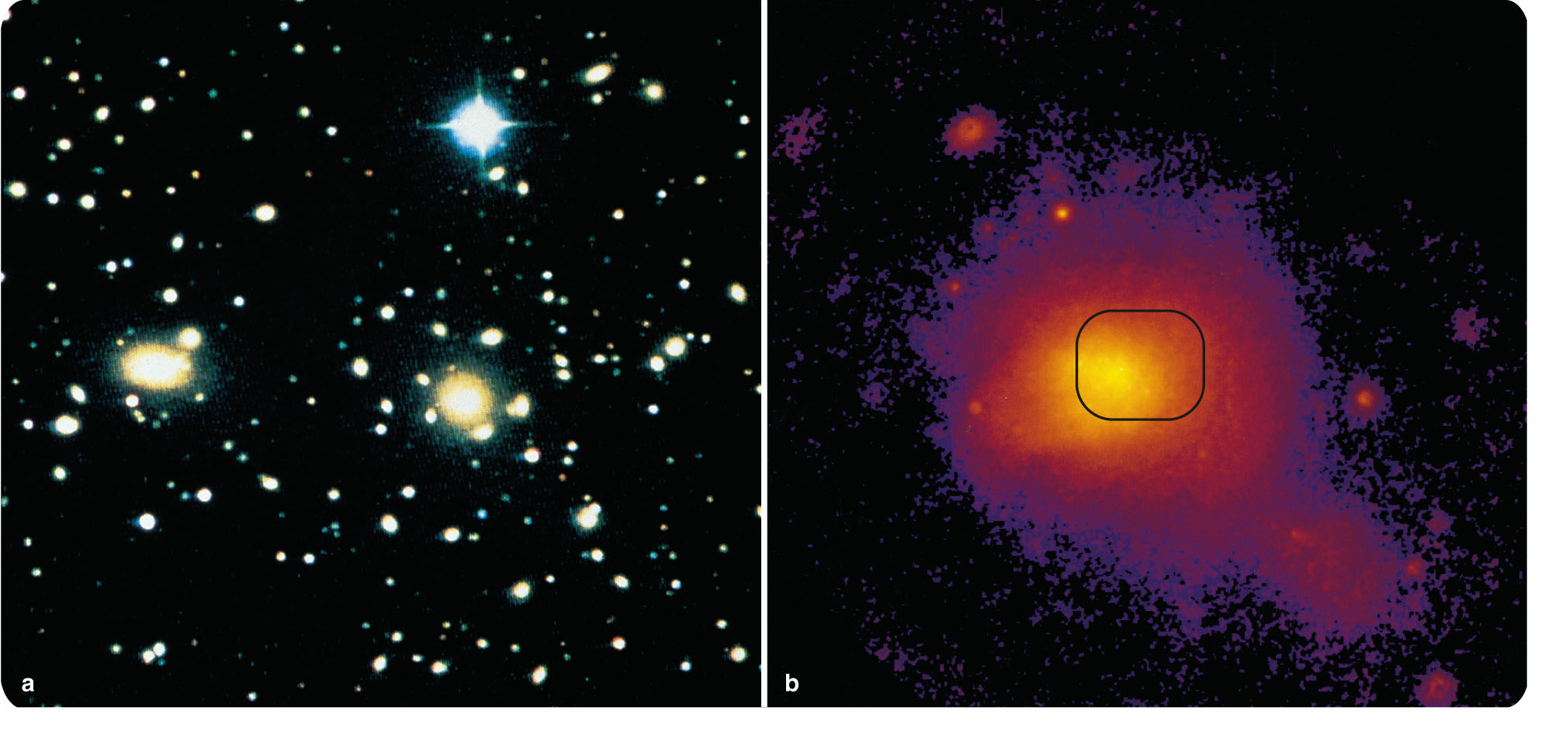
Clusters of Galaxies
For this discussion, you can sort clusters into two groups—rich and poor.
Rich galaxy clusters contain over a thousand galaxies, mostly elliptical.
  They are scattered
  through a spherical
  volume about
  3 Mpc (10⁷ ly)
  in diameter.

Slide 79
Clusters of Galaxies
The Coma cluster (located 100 Mpc from Earth in the direction of the constellation Coma Berenices) is an example of a rich cluster.
  It contains at least 1,000
  galaxies, mostly E and
  S0 types.
  Close to its center are
  a giant elliptical galaxy
  and a large S0 galaxy.

Slide 80
Clusters of Galaxies
Rich clusters often contain one or more giant elliptical galaxies at their centers.
In contrast, poor galaxy clusters contain fewer than 1,000 galaxies.
  They are irregularly shaped, and are less crowded towards the center.

Slide 81
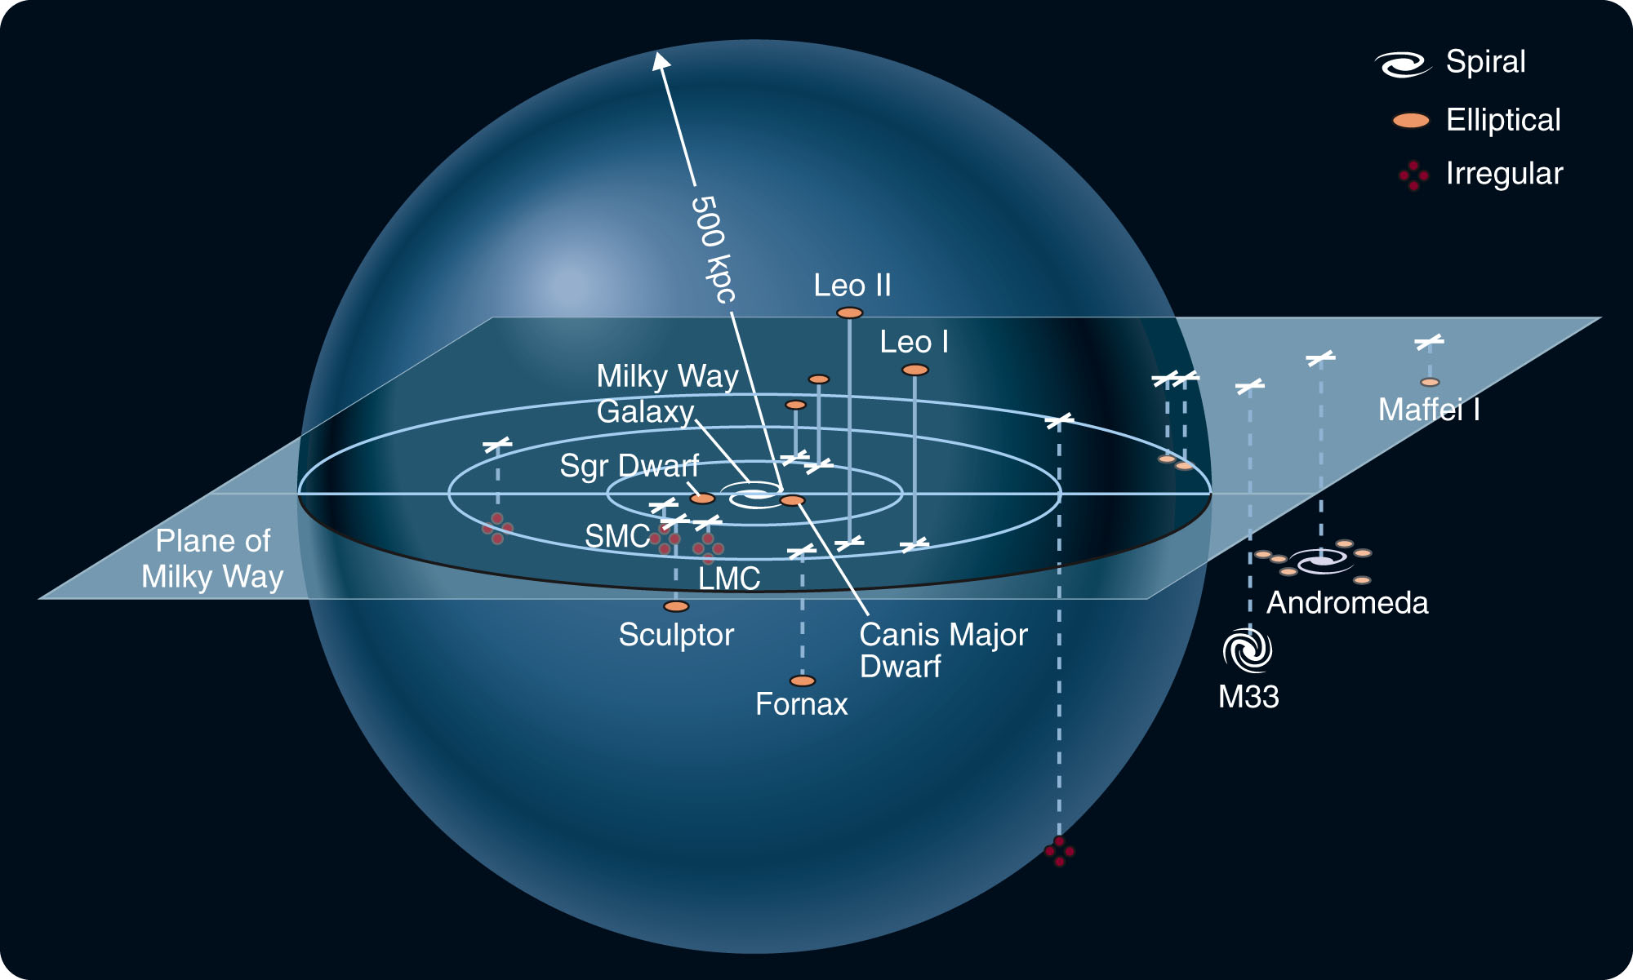
Clusters of Galaxies
Our own Local Group, which contains Milky Way, is a good example of a poor cluster.

Slide 82
Clusters of Galaxies
It contains a few dozen members scattered irregularly through a volume slightly over 1 Mpc in diameter.

Slide 83
Clusters of Galaxies
Of the brighter galaxies, 14 are elliptical, 3 are spiral, and 4 are irregular.

Slide 84
Clusters of Galaxies
Classifying clusters as either rich or poor reveals a fascinating and suggestive clue to the evolution of galaxies.
  In general, rich clusters tend to contain 80 to 90 percent E and S0 galaxies and few spirals.
  Poor clusters contain a larger percentage of spirals.
  Among isolated galaxies that are not in clusters, 80 to 90 percent are spirals.

Slide 85
Clusters of Galaxies
This suggests that a galaxy’s environment is important in determining its structure.
  This has led astronomers to suspect that the secrets of galaxy evolution lie in collisions between galaxies.

Slide 86
Colliding Galaxies
Astronomers are finding more and more evidence to show that galaxies collide, interact, and merge.
  In fact, collisions among galaxies may dominate their evolution.

Slide 87
Colliding Galaxies
You should not be surprised that galaxies collide with each other.
  The average separation between galaxies is only about 20 times their diameter.
  So, astronomically speaking, galaxies should bump into each other fairly often.

Slide 88
Colliding Galaxies
Stars, on the other hand, almost never collide—because the typical separation between stars is about 10⁷ times their diameter.
  A collision between two stars is about as likely as a collision between two gnats flitting about in a baseball stadium.

Slide 89
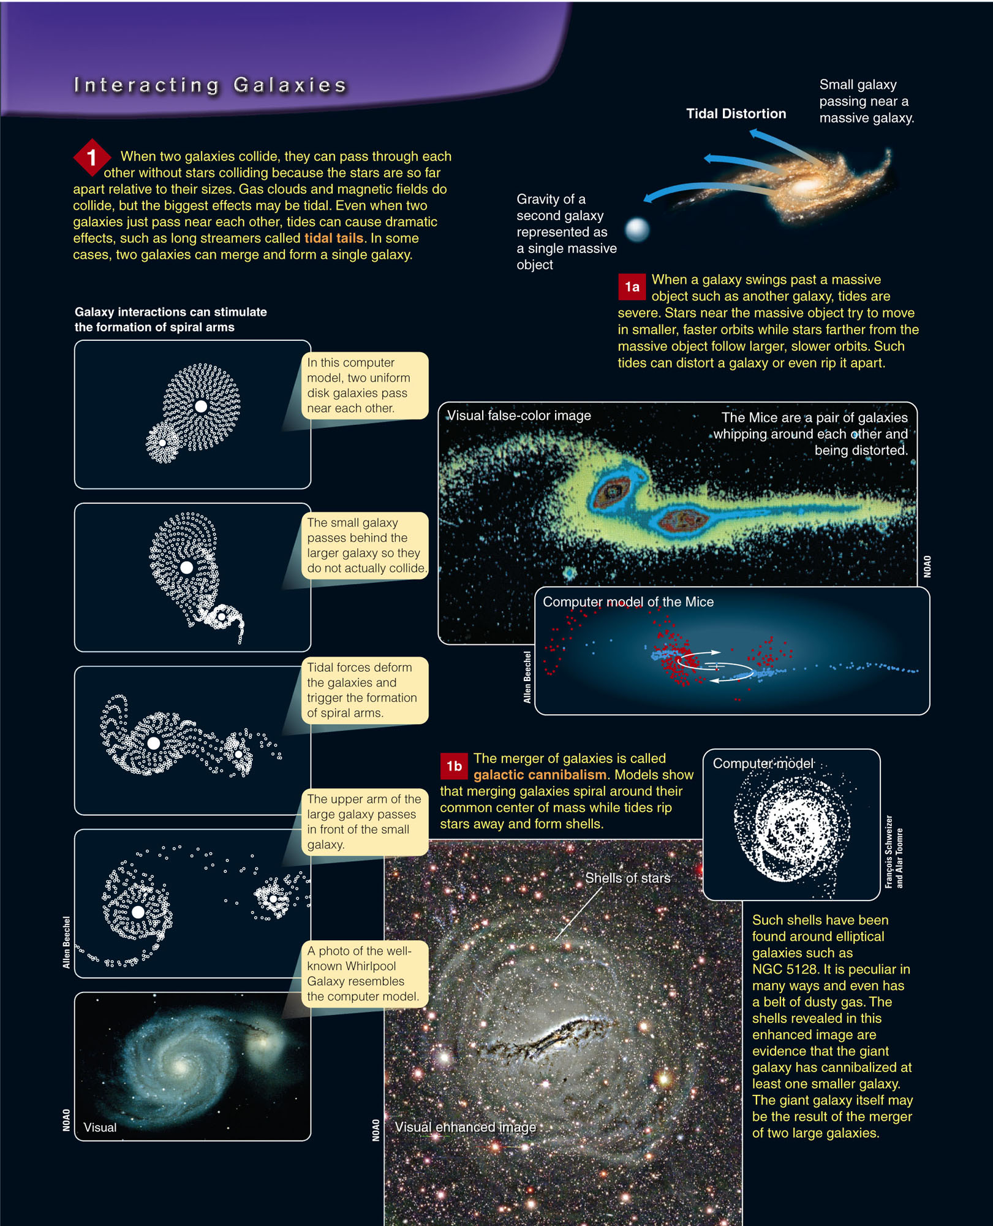
Colliding Galaxies
There are several important points to note about interacting galaxies.

Slide 90
Colliding Galaxies
One, interacting galaxies can distort each other with tides—producing tidal tails and shells of stars.
  They may even trigger the formation of spiral arms.
  Large galaxies can even
  absorb smaller galaxies.

Slide 91
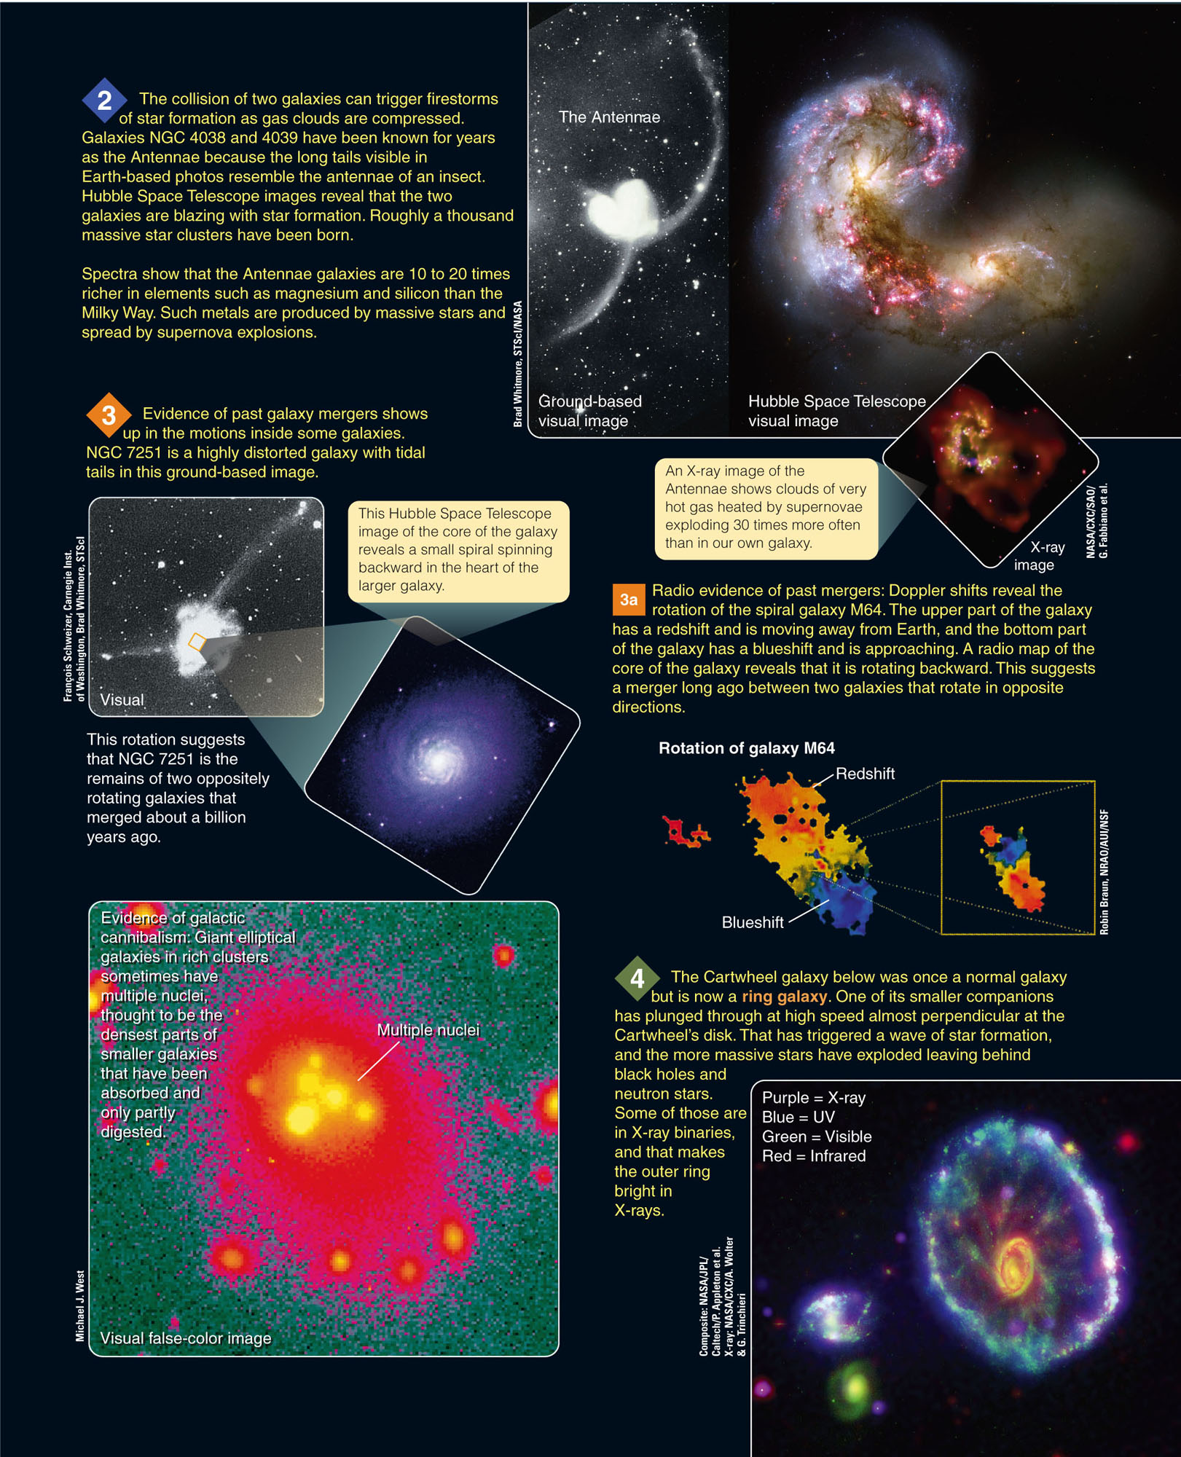
Colliding Galaxies
Two, the interactions can trigger star formation.

Slide 92
Colliding Galaxies
Three, evidence left inside galaxies in the form of motions and multiple nuclei reveals that they have suffered past interactions and mergers.

Slide 93
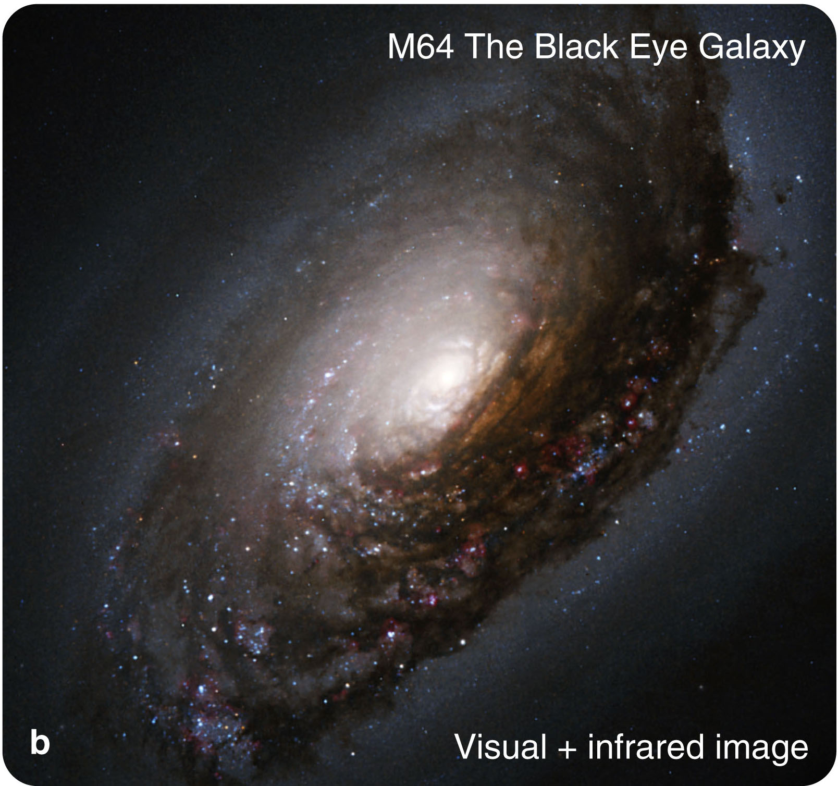
Colliding Galaxies
Four, the beautiful ring galaxies are bull’s-eyes left behind by high-speed collisions.

Slide 94
Colliding Galaxies
Evidence of galaxy mergers is all around.
  Milky Way is a cannibal galaxy—snacking on the Magellanic Clouds as they orbit around it.
  Its tides are pulling apart the Sagittarius and the Canis Major Dwarf galaxies.
  This produces great streamers of stars wrapped around Milky Way.
  Almost certainly, our galaxy has dined on other small galaxies in the past.

Slide 95
The Origin and Evolution of Galaxies
The test of any scientific understanding is whether you can put all the evidence and theory together to tell the history of the objects studied.

Slide 96
The Origin and Evolution of Galaxies
Can you describe the origin and evolution of the galaxies?
  Just a few decades ago, it would have been impossible to do so.
  However, the evidence from space telescopes and new-generation telescopes on Earth—combined with advances in computer modeling and theory—allow astronomers to outline the story of the galaxies.

Slide 97
The Origin and Evolution of Galaxies
Elliptical galaxies appear to be the product of galaxy mergers—which triggered star formation and used up all the gas and dust.
  Astronomers see star formation
  being stimulated to high levels
  in many galaxies.

Slide 98
The Origin and Evolution of Galaxies
Starburst galaxies are very luminous in the infrared.
  A collision has triggered bursts of star formation that are heating the dust.
  The warm dust reradiates the energy in the infrared.

Slide 99
The Origin and Evolution of Galaxies
The Antennae contain over 15 billion solar masses of hydrogen gas.
  It will become a starburst galaxy as their ongoing merger triggers rapid star formation.

Slide 100
The Origin and Evolution of Galaxies
A few collisions and mergers could leave a galaxy with no gas and dust from which to make new stars.

Slide 101
The Origin and Evolution of Galaxies
Astronomers now suspect that most ellipticals are formed by the merger of at least two or more galaxies:
  Dwarf ellipticals, which are too small to be formed by mergers
  Irregulars, which may be fragments left over by the merger of larger galaxies

Slide 102
The Origin and Evolution of Galaxies
In contrast, spirals seem never to have suffered major collisions.
  Their thin disks are delicate and would be destroyed by tidal forces in a collision with
  a massive galaxy.
  Also, they retain plenty of gas and dust
  and continue making stars.

Slide 103
The Origin and Evolution of Galaxies
Our Milky Way has, evidently, never merged with another large galaxy.
It has, however, a large spiral neighbor, the Andromeda Galaxy.
  Both seem to have cannibalized smaller galaxies.

Slide 104
The Origin and Evolution of Galaxies
Barred spiral galaxies may be the product of tidal interactions.
  Mathematical models show that the bars are not
  stable and eventually dissipate.
  It may take tidal interactions with other galaxies to regenerate the bars.
  As well over half of all spiral galaxies have bars, you can suspect that these tidal interactions are common.

Slide 105
The Origin and Evolution of Galaxies
Milky Way is probably a barred spiral.
  This may be the result of the interaction with its two Magellanic Cloud companions, or the more distant but very massive Andromeda Galaxy.

Slide 106
The Origin and Evolution of Galaxies
Other processes can alter galaxies.
  The S0 galaxies have disks and bulges like a spiral galaxy but no spiral arms.
  They may have lost much of their gas and dust moving through the gas trapped in the dense clusters to which they belong.

Slide 107
The Origin and Evolution of Galaxies
  For example, X-ray observations show that the Coma cluster contains thin, hot gas between the galaxies.

Slide 108
The Origin and Evolution of Galaxies
A galaxy moving through that gas would encounter a tremendous wind that could strip away its gas and dust.

Slide 109
The Origin and Evolution of Galaxies
Observations made with the largest and most sophisticated telescopes are taking astronomers back to the age of galaxy formation.
  At great distances, the look-back time is so large that they see the universe as it was soon after galaxies began to form.
  There were more spirals and fewer ellipticals.

Slide 110
The Origin and Evolution of Galaxies
The observations show that galaxies then were closer together.
  About 33 percent of all distant galaxies are in
  close pairs.
  However, only 7 percent of nearby galaxies
  are in pairs.
  The observational evidence clearly supports the hypothesis that galaxies have evolved by merger.

Slide 111
The Origin and Evolution of Galaxies
The evolution of galaxies is not a simple process.
  A good theory helps you understand how nature works.
  Astronomers are just beginning to understand the exciting and complex story of the galaxies.
  Nevertheless, it is already clear that galaxy evolution is much like a pie-throwing contest—
  and just about as neat.

