Slide 1
Life in Our Solar System
Could there be carbon-based life elsewhere in our solar system?
Liquid water seems to be a requirement of carbon-based life—necessary both for vital chemical reactions and as a medium to transport nutrients and wastes.
It is not surprising that life developed in Earth’s oceans and stayed there for billions of years before it was able to colonize the land.

Slide 2
Life in Our Solar System
Scientists are in agreement that any world harboring living things must have significant quantities of some type of liquid.
Water is a cosmically abundant substance with properties such as high heat capacity that set it apart from other common molecules that are liquid at the temperatures of planetary surfaces.

Slide 3
Life in Our Solar System
Many worlds in the solar system can be eliminated immediately as hosts for life.
Liquid water is not possible there.

Slide 4
Life in Our Solar System
The moon and Mercury are airless, and water would boil away into space immediately.

Slide 5
Life in Our Solar System
Venus has traces of water vapor in its atmosphere.
However, it is too hot for liquid water to survive on the surface.

Slide 6
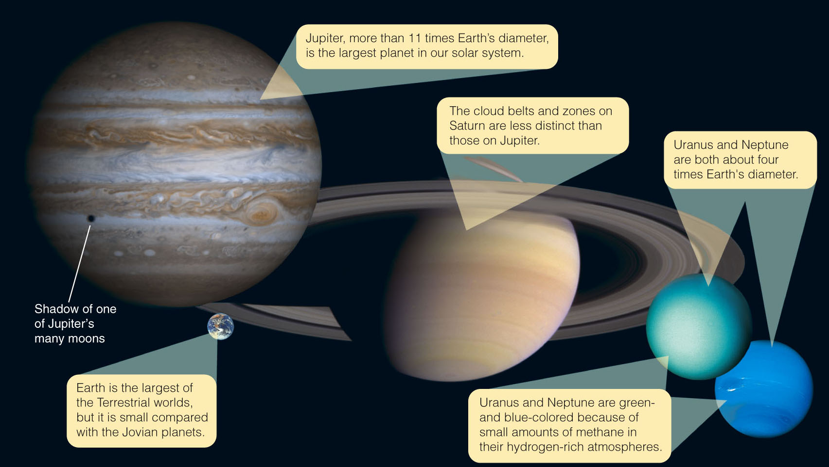
Life in Our Solar System
The Jovian planets have deep atmospheres and, at a certain level, it is likely that water condenses into liquid droplets.

Slide 7
Life in Our Solar System
However, it seems unlikely that life could have originated there.
The Jovian planets do not have solid surfaces.
Isolated water droplets could never mingle to mimic the rich primordial oceans of Earth, where organic molecules grew and interacted.
Also, powerful currents in the gas giants’ atmospheres would quickly carry any reproducing molecules that did form there into inhospitable regions of the atmosphere.

Slide 8
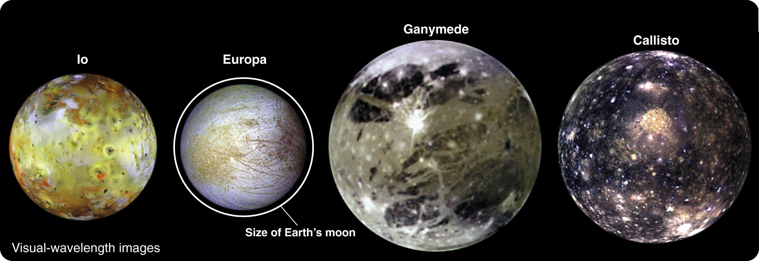
Life in Our Solar System
As you have learned, at least one of the Jovian satellites could potentially support life.

Slide 9
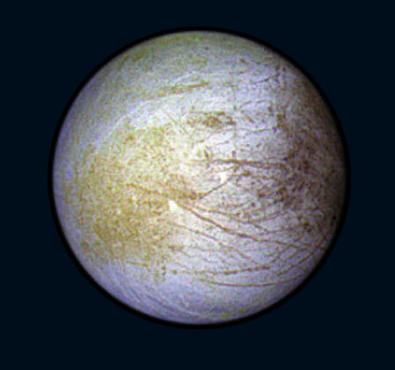
Life in Our Solar System
Jupiter’s moon Europa appears to have a liquid-water ocean below its icy crust.
Minerals dissolved in the water could provide a rich source of raw material for chemical evolution.
Europa’s ocean is kept warm and liquid now by tidal heating.

Slide 10
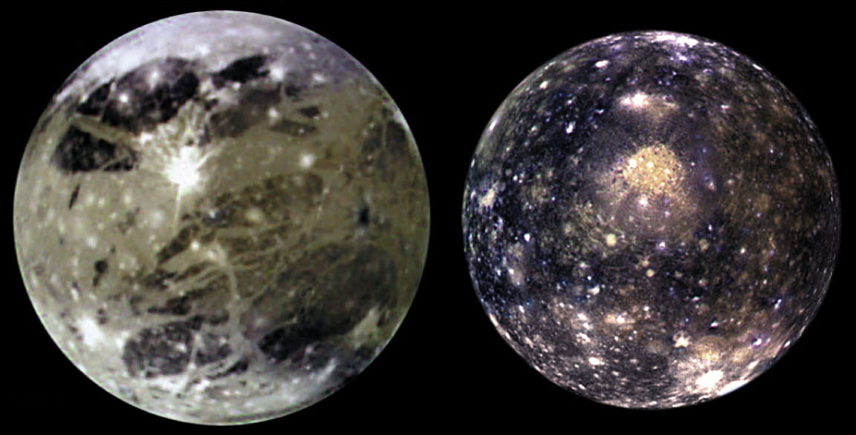
Life in Our Solar System
There also may be liquid water layers under the surfaces of Ganymede and Callisto.

Slide 11
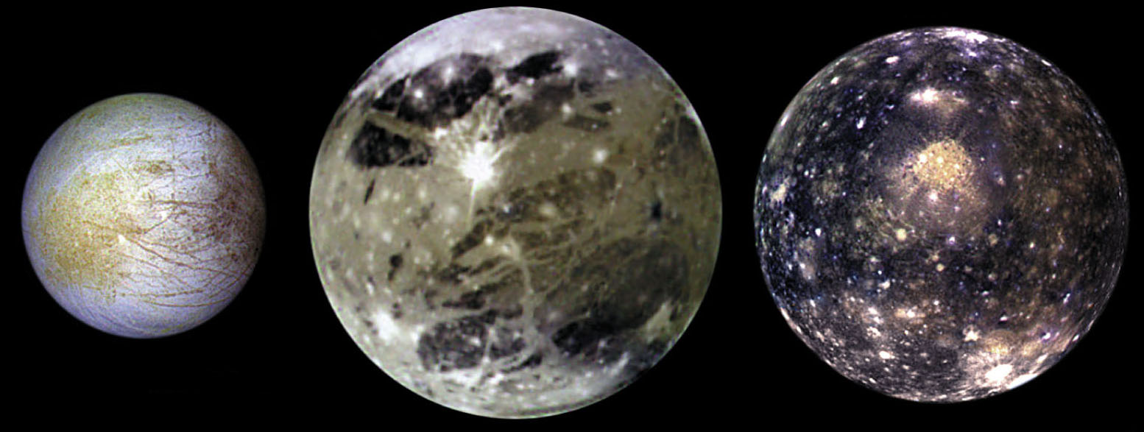
Life in Our Solar System
However, that can change as the orbits of the moons interact.
Europa, Ganymede, and Calisto may have been frozen solid at other times in their histories, destroying organisms that had developed there.

Slide 12
Life in Our Solar System
Saturn’s moon Titan is rich in organic molecules.
You have learned how sunlight converts the methane in Titan’s atmosphere into organic smog particles that settle to the surface.
The chemistry of any life that could evolve from these molecules and survive in Titan’s lakes of methane is unknown.

Slide 13
Life in Our Solar System
It is fascinating to consider possibilities.
However, Titan’s extremely low temperature of –180ºC (–290ºF) could make chemical reactions slow to the point where life processes seem unlikely.

Slide 14
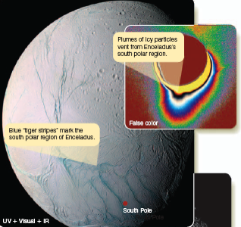
Life in Our Solar System
Observations of water venting from the south-polar region of Saturn’s moon Enceladus show that it has liquid water below its crust.
It is possible that life could exist in that water.

Slide 15
Life in Our Solar System
However, the moon is very small and has been warmed by tidal heating that may operate only occasionally.
Enceladus may not have had plentiful liquid water for the extended time necessary for the rise of life.

Slide 16
Life in Our Solar System
Mars is the most likely place for life to exist in the solar system.
As you have learned, there is a great deal of evidence that liquid water once flowed on its surface.

Slide 17
Life in Our Solar System
Even so, results from searches for signs of life on Mars are not encouraging.
The robotic spacecraft Viking 1 and Viking 2 landed on Mars in 1976 and tested soil samples for living organisms.
Some of the tests had puzzling semi-positive results that scientists hypothesize were caused by non-biological chemical reactions in the soil.
No evidence clearly indicates the presence of life or even of organic molecules in the Martian soil.

Slide 18
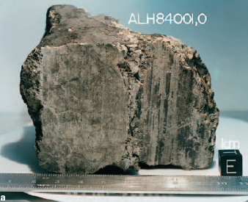
Life in Our Solar System
In 1996 there were prominent news stories regarding chemical and physical traces of life on Mars discovered inside a Martian meteorite found in Antarctica.

Slide 19
Life in Our Solar System
Scientists were excited by the announcement.
However, they immediately began testing the evidence.

Slide 20
Life in Our Solar System
Their results suggest that the unusual chemical signatures in the rock may have formed by processes that did not involve life.
Tiny features in the rock that were originally taken to be fossils of ancient Martian organisms could be non-biological mineral formations.

Slide 21
Life in Our Solar System
This is the only direct evidence yet found regarding potential life on Mars.
It remains highly controversial, though.
Conclusive evidence of life on Mars may have to wait until a geologist from Earth can scramble down dry Martian streambeds and crack open rocks looking for fossils.

Slide 22
Life in Our Solar System
There is no strong evidence for the existence of life elsewhere in the solar system.
Now, your search will take you to distant planetary systems.

Slide 23
Life in Other Planetary Systems
Could life exist in other planetary systems?
You already know that there are many different kinds of stars and that many of these stars have planetary systems.
As a first step toward answering the question, you can try to identify the kinds of stars that seem most likely to have stable planetary systems where life could evolve.

Slide 24
Life in Other Planetary Systems
If a planet is to be a suitable home for living things, it must be in a stable orbit around its sun.
This is simple in a planetary system like our own.
However, most planet orbits in binary star systems are unstable unless the component stars are very close together or very far apart.

Slide 25
Life in Other Planetary Systems
Astronomers can calculate that, in binary systems with stars separated by distances of a few AU, the planets should eventually be swallowed up by one of the stars or ejected from the system.
Half the stars in the galaxy are members of binary systems, and many of them are unlikely to support life on planets.

Slide 26
Life in Other Planetary Systems
Moreover, just because a star is single does not necessarily make it a good candidate for sustaining life.
Earth required between 0.5 and 1 billion years to produce the first cells and 4.6 billion years for intelligence to emerge.

Slide 27
Life in Other Planetary Systems
Massive stars that live only a few million years will not do.
If the history of life on Earth is at all representative, then stars more massive and luminous than about spectral type F5 are too short-lived for complex life to develop.

Slide 28
Life in Other Planetary Systems
Main-sequence stars of types G and K, and possibly some of the faint M stars, are the best candidates.

Slide 29
Life in Other Planetary Systems
The temperature of a planet is also important.
That depends on the type of star it orbits and its distance from the star.

Slide 30
Life in Other Planetary Systems
Astronomers have defined a habitable zone around a star as a region within which planets have temperatures that permit the existence of liquid water.
The sun’s habitable zone extends from around the orbit of Venus to the orbit of Mars—with Earth right in the middle.
A low-luminosity star has a small habitable zone and a high-luminosity star has a large one.

Slide 31
Life in Other Planetary Systems
Scientists on Earth are finding life in places previously judged inhospitable.
These include the bottoms of ice-covered lakes in Antarctica and far underground inside solid rock.
Life has also been found in boiling hot springs with highly acidic water.

Slide 32
Life in Other Planetary Systems
As a result, it is difficult for scientists to pin down a range of environments and state with certainty that life cannot exist outside those conditions.
You should also note that three of the environments listed as possible havens for life—Titan, Europa, and Enceladus—are in the outer solar system and lie far outside the sun’s traditional life zone.

Slide 33
Life in Other Planetary Systems
Stable planets inside the habitable zones of long-lived stars are the places where life seems most likely.
However, given the tenacity and resilience of Earth’s life forms, there might be other, seemingly inhospitable, places in the universe where life exists.

Slide 34
Intelligent Life in the Universe
Visiting extrasolar planets is, for now, impossible.
Nevertheless, if other civilizations exist, it is possible that humans can communicate with them.

Slide 35
Intelligent Life in the Universe
Nature places restrictions on such conversations.
The main problem, though, lies in the unknown life expectancy of civilizations.

Slide 36
Travel Between the Stars
The distances between stars are almost beyond comprehension.
A space shuttle would take about 150,000 years to reach the nearest star.

Slide 37
Travel Between the Stars
The obvious way to overcome these huge distances is with tremendously fast spaceships.
However, even the closest stars are many light-years away.
Nothing can exceed the speed of light.

Slide 38
Travel Between the Stars
Accelerating a spaceship close to the speed of light takes huge amounts of energy.
Even if you travel more slowly, your rocket would require massive amounts of fuel.
If you were piloting a spaceship with the mass of 100 tons (the size of a yacht) to the nearest star—4 light-years away—and you wanted to travel at half the speed of light so as to arrive in 8 years, the trip would require 400 times as much energy as the entire United States consumes in a year.

Slide 39
Travel Between the Stars
These limitations not only make it difficult for humans to leave the solar system, but they would also make it difficult for aliens to visit Earth.
Reputable scientists have studied unidentified flying objects’ (UFOs) and have never found any evidence that Earth is being visited or has ever been visited by aliens.

Slide 40
Travel Between the Stars
Humans are unlikely to ever meet aliens face-to-face.
However, communication by radio across interstellar distances takes relatively little energy.

Slide 41
Radio Communication
Nature puts restrictions on travel through space.
It also restricts astronomers’ ability to communicate with distant civilizations by radio.

Slide 42
Radio Communication
One restriction is based on simple physics.
Radio signals are electromagnetic waves and travel at the speed of light.
Due to the distances between the stars, the speed of radio waves would severely limit astronomers’ ability to carry on normal conversations with distant civilizations.
Decades could elapse between asking a question and getting an answer.

Slide 43
Radio Communication
So, rather than try to begin a conversation, one group of astronomers decided in 1974 to broadcast a simple message of greeting toward the globular cluster M13—26,000 light-years away—using the Arecibo radio telescope.
When the signal arrives 6,000 years in the future, alien astronomers may be able to decode it.

Slide 44
Radio Communication
The Arecibo beacon is an anticoded message.
That is, it is intended to be decoded by beings about whom we know nothing except that they build radio telescopes.

Slide 45
Radio Communication
The message is a string of 1,679 pulses and gaps.
Pulses represent 1s
Gaps represent 0s

Slide 46
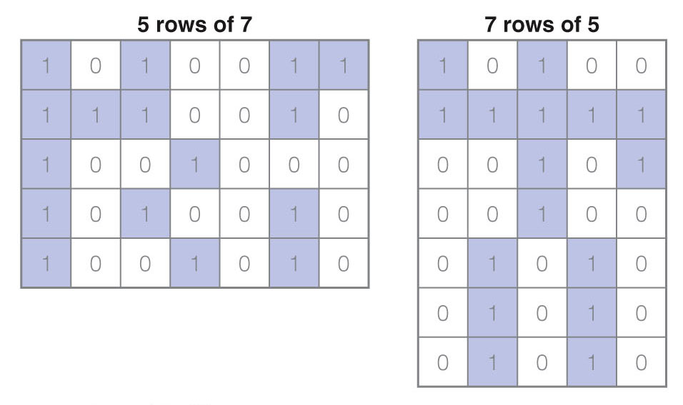
Radio Communication
The string can be arranged in only two possible ways:
23 rows of 73
73 rows of 23

Slide 47
Radio Communication
The second arrangement forms a picture containing information about life on Earth.

Slide 48
Radio Communication
Although the 1974 Arecibo beacon was the only powerful signal sent purposely from Earth to other solar systems, Earth is sending out many other signals.
Short-wave radio signals, such as TV and FM, have been leaking into space for the past 50 years or so.

Slide 49
Radio Communication
Any civilization within 50 light-years could already have detected Earth’s civilization.
This works both ways, though.
Alien signals—whether intentional messages of friendship or the blather of their equivalent to daytime TV—could be arriving at Earth now.
Astronomers all over the world are pointing radio telescopes at the most likely stars and listening for alien civilizations.

Slide 50
Radio Communication
Which channels should astronomers monitor?
Wavelengths longer than 100 cm would get lost in the background noise of Milky Way.
Wavelengths shorter than about 1 cm are absorbed in Earth’s atmosphere.
Between those wavelengths is a radio window that is open for communication.

Slide 51
Radio Communication
Even this restricted window contains millions of possible radio-frequency bands, and is too wide to monitor easily.
However, astronomers may have found a way to narrow the search.

Slide 52
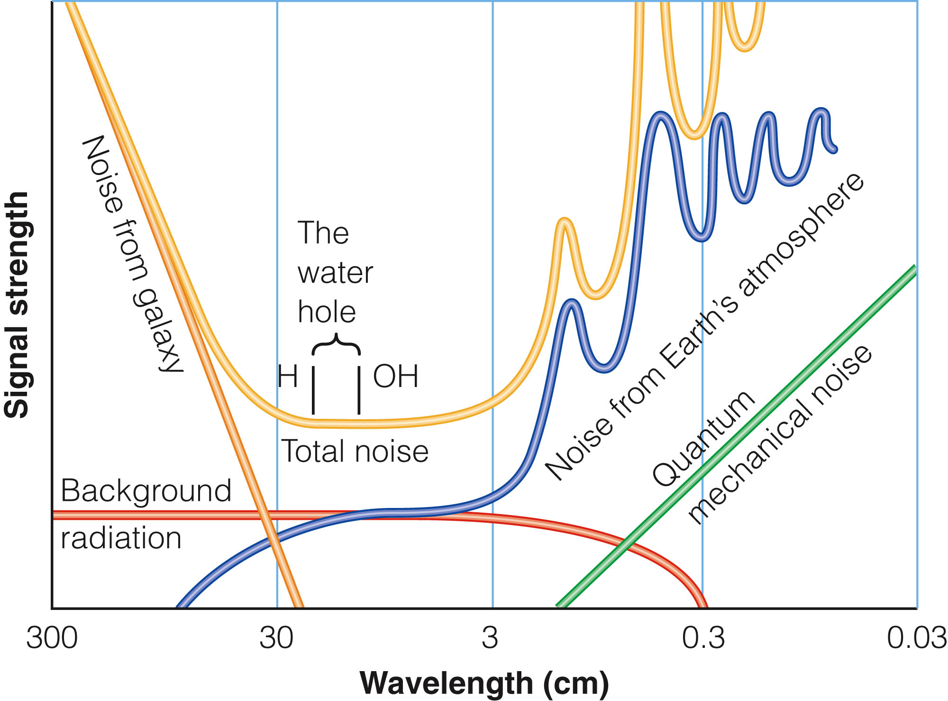
Radio Communication
Within this window lie the 21-cm spectrum line of neutral hydrogen and the 18-cm line of OH.
The interval between those lines has low background interference and is named the water hole— because H plus OH yields water.

Slide 53
Radio Communication
Any civilizations sophisticated enough to do radio astronomy must know of these lines and appreciate their significance in the same way as do Earthlings.

Slide 54
Radio Communication
A number of searches for extraterrestrial radio signals have been made, and some are now under way.
This field of study is known as SETI, Search for Extra-Terrestrial Intelligence.

Slide 55
Radio Communication
It has generated heated debate among astronomers, philosophers, theologians, and politicians.
Congress funded a NASA search for a short time.
However, it ended support in the early 1990s—because it feared public reaction.
In fact, the annual cost of a major search is only about as much as a single Air Force attack helicopter.
Much of the reluctance to fund searches probably stems from issues other than cost.

Slide 56
Radio Communication
One point to keep in mind is that the discovery of alien intelligence would cause a huge change in humans’ worldview—akin to Galileo’s discovery that the moons of Jupiter do not go around the Earth.
Some turmoil would inevitably result.

Slide 57
Radio Communication
In spite of the controversy, the search continues.
The NASA SETI project cancelled by Congress was renamed Project Phoenix and completed using private funds.
The SETI Institute, founded in 1984, managed Project Phoenix plus several other important searches.
Currently, it is building a new radio telescope array in northern California—collaborating with the University of California, Berkeley, and partly funded by Paul Allen of Microsoft.

Slide 58
Radio Communication
There is even a way for you to help with searches.
The Berkeley SETI team (separate from the SETI Institute), with the support of the Planetary Society, has recruited about 4 million owners of personal computers that are connected to the Internet.
Participants download a screen saver that searches data files from the Arecibo radio telescope for signals whenever the owner is not using the computer.
For information, locate the seti@home project at http://setiathome.ssl.berkeley.edu/.

Slide 59
Radio Communication
The search continues…
However, radio astronomers struggle to hear anything against the worsening babble of noise from human civilization.

Slide 60
Radio Communication
Wider and wider sections of the electromagnetic spectrum are being used for Earthly communication.
This, combined with stray electromagnetic noise from electronic devices, including everything from computers to refrigerators, makes hearing faint radio signals difficult.
It would be ironic if humans fail to detect signals from another world because our own world has become too noisy.

Slide 61
Radio Communication
Ultimately, the chances of success depend on the number of inhabited worlds in the galaxy.

Slide 62
How Many Inhabited Worlds?
Given enough time, the searches will find other worlds with civilizations—assuming that there are at least a few out there.
If intelligence is common, scientists should find signals relatively soon—within the next few decades.
If intelligence is rare, it may take much longer.

Slide 63
How Many Inhabited Worlds?
Simple arithmetic can give you an estimate of the number of technological civilizations in Milky Way with which you might communicate, N_{c}.
The formula proposed for discussions about N_{c} is named the Drake equation after the radio astronomer Frank Drake, a pioneer in the search for extraterrestrial intelligence.

Slide 64
How Many Inhabited Worlds?
The version of the Drake equation presented here is modified slightly from its original form.

Slide 65
How Many Inhabited Worlds?
N* is the number of stars in our galaxy, and f_{P} represents the fraction of stars that have planets.
If all single stars have planets, f_{P} is about 0.5.

Slide 66
How Many Inhabited Worlds?
The factor n_{HZ} is the average number of planets in each solar system suitably placed in the habitable zone.
This factor actually means the number of planets possessing liquid water.

Slide 67
How Many Inhabited Worlds?
Europa and Enceladus in our solar system show that liquid water can exist due to tidal heating outside the conventional habitable zone that in our system contains Earth’s orbit.
So, n_{HZ} may be larger than had been previously thought.

Slide 68
How Many Inhabited Worlds?
The factor f_{L} is the fraction of suitable planets on which life begins, and f_{I} is the fraction of those planets where life evolved to intelligence.
These factors can be roughly estimated.
However, the final factor, F_{S}, is much more uncertain.

Slide 69
How Many Inhabited Worlds?
F_{S} is the fraction of a star’s life during which the life form is communicative.

Slide 70
How Many Inhabited Worlds?
If a society survives at a technological level for only 100 years, the chances of communicating with it are small.
A society that stabilizes and remains technological for a long time, however, is much more likely to be detected.
For a star with a life span of 10 billion years, F_{S} can range from 10⁻⁸ for extremely short-lived societies to 10⁻⁴ for societies that survive for a million years.

Slide 71
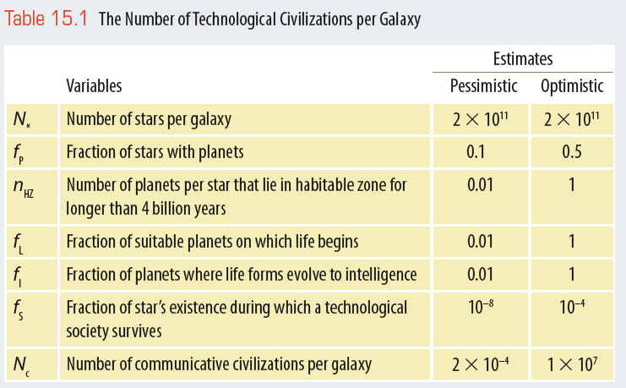
How Many Inhabited Worlds?
The table summarizes what many scientists consider a reasonable range of values for F_{S} and the other factors.

Slide 72
How Many Inhabited Worlds?
If the optimistic estimates are true, there could be a communicative civilization within a few tens of light-years of Earth.
If the pessimistic estimates are true, Earth may be the only planet that is capable of communication within thousands of the nearest galaxies.

Slide 73
What Are We?
There are over four thousand religions around the world, and nearly all hold that humans have a dual nature.
We are physical objects made of atoms, but we are also spiritual beings.
Science is unable to examine the spiritual side of existence, but it can tell us about our physical nature.

Slide 74
What Are We?
You are made of very old atoms.
The matter you are made of appeared in the big bang and was cooked into a wide range of elements inside stars.
Your atoms may have been inside at least two or three generations of stars.
Eventually, your atoms became part of a nebula that contracted to form the sun and the planets of the solar system.

Slide 75
What Are We?
Your atoms have been part of Earth for the last 4.6 billion years.
They have been recycled many times through dinosaurs, stromatolites, fish, bacteria, grass, birds, worms, and other living things.

Slide 76
What Are We?
Now, you are using your atoms but, when you are done with them, they will go back to Earth and be used again and again.
When the sun swells into a red giant star and dies in a few billion years, Earth’s atmosphere and oceans will be driven away.
Then, at least the outer few kilometers of Earth’s crust will be vaporized and blown outward to become part of the nebula around the white-dwarf remains of the sun.

Slide 77
What Are We?
Your atoms are destined to return to the interstellar medium and will become part of future generations of stars, planets, and perhaps living things.

Slide 78
What Are We?
The message of astronomy is that humans are not just observers.
We are participants and we are part of the universe.
Among all the galaxies, stars, planets, planetesimals, and bits of matter, humans are objects that can think.
That means we can understand what we are.

Slide 79
What Are We?
Is the human race the only thinking species?
If so, we bear the sole responsibility to understand and admire the universe.
The detection of signals from another civilization would demonstrate that we are not alone.
Such communication would end the self-centered isolation of humanity and stimulate a reevaluation of the meaning of human existence.

