Slide 1
Active Galaxies and Quasars
Many galaxies have powerful energy sources in their nuclei that, in some cases, produce powerful jets and other outbursts.
These are called active galaxies.

Slide 2
Active Galaxies and Quasars
By looking far away and back in time, astronomers have discovered:
The origin of active galaxy energy sources and outbursts were closely related to the formation and history of galaxies.

Slide 3
Active Galaxies and Quasars
The first type of active galaxy was discovered in the 1950s.
They were named radio galaxies because these galaxies are sources of unusually strong radio waves.

Slide 4
Active Galaxies and Quasars
By the 1970s, astronomers had put space telescopes in orbit.
They discovered that radio galaxies are generally bright at many other wavelengths.

Slide 5
Active Galaxies and Quasars
The flood of energy pouring out of active galaxies originates almost entirely in their nuclei.
They are referred to as active galactic nuclei (AGN).

Slide 6
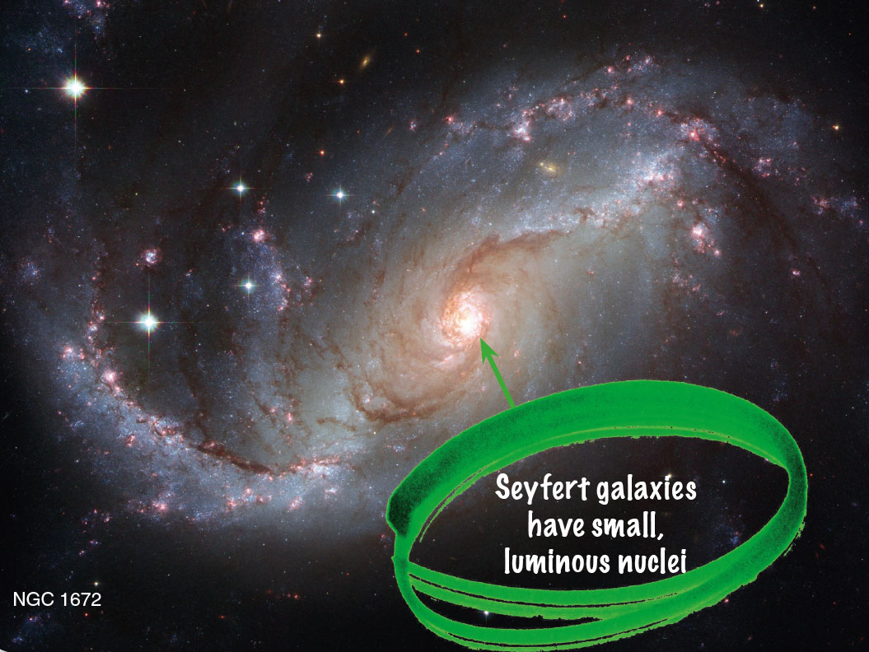
Seyfert Galaxies
In 1943, astronomer Carl K. Seyfert conducted a study of spiral galaxies.
He noted that about two percent of spirals have small, highly luminous nuclei in their bulges.

Slide 7
Seyfert Galaxies
Today, these Seyfert galaxies are recognized by the peculiar spectra of these luminous nuclei.
They contain broad emission lines of highly ionized atoms.
Emission lines suggest a hot, low-density gas.
The presence of ionized atoms is evidence that the gas is very hot.
The broad spectral lines indicate large Doppler shifts produced by high gas velocities.

Slide 8
Seyfert Galaxies
The velocities at the center of Seyfert galaxies are roughly 10,000 km/s.
This is about 30 times greater than velocities at the center of normal galaxies.
Something violent is happening in the cores of Seyfert galaxies.

Slide 9
Seyfert Galaxies
Astronomers later discovered that the brilliant nuclei of Seyfert galaxies change brightness rapidly.
This happens in only a few hours or minutes, especially at X-ray wavelengths.

Slide 10
Seyfert Galaxies
You have learned that an astronomical body cannot change its brightness significantly in a time shorter than the time it takes light to cross its diameter.
If the Seyfert nucleus can change in a few minutes, then it cannot be larger in diameter than a few light-minutes.
For comparison, the distance from Earth to the sun is 8 light minutes.

Slide 11
Seyfert Galaxies
Despite their small size, the brightest Seyfert nuclei emit a hundred times more energy than the entire Milky Way.
Something in the centers of these galaxies not much bigger than Earth’s orbit produces a galaxy’s worth of energy.

Slide 12
Seyfert Galaxies
Seyfert nuclei are three times more common in interacting pairs of galaxies than in isolated galaxies.
Also, about 25 percent have peculiar shapes—suggesting tidal interactions with other galaxies.

Slide 13
Seyfert Galaxies
This statistical evidence hints that Seyfert galaxies may have been triggered into activity by collisions or interactions with companions.

Slide 14
Seyfert Galaxies
Some Seyferts are expelling matter in oppositely directed jets.
You have learned about this geometry on smaller scales when matter flows into neutron stars and black holes and forms an accretion disk.

Slide 15
Seyfert Galaxies
All this evidence leads modern astronomers to conclude that the cores of Seyfert galaxies contain supermassive black holes.
This is a black hole with a mass as high as a billion solar masses, plus a correspondingly large accretion disk.

Slide 16
Seyfert Galaxies
The gas in the centers of Seyfert galaxies is traveling so fast it would escape from a normal galaxy.
Only very large, central masses could exert enough gravity to hold the gas inside the nuclei.
Encounters with other galaxies could throw matter into the black hole.
As you have learned, lots of energy can be liberated by matter flowing into a black hole.

Slide 17
Seyfert Galaxies
You have learned that Milky Way contains a massive central black hole.
However, the black hole seems to be on a starvation diet and is therefore relatively inactive.

Slide 18
Double-Lobed Radio Sources
Beginning in the 1950s, radio astronomers found that some sources of radio energy in the sky consisted of pairs of radio-bright regions.
When optical telescopes studied the locations of these double-lobed radio sources, they revealed galaxies located between the two lobes.

Slide 19
Double-Lobed Radio Sources
The geometry suggests that radio lobes are inflated by jets of excited gas emerging in two directions from the central galaxy.
Statistical evidence indicates that jets and radio lobes, like Seyfert nuclei, are associated with interacting galaxies.

Slide 20
Double-Lobed Radio Sources
The AGN jets seem to be related to matter falling into a central black hole via an accretion disk.
However, the details of this process are not understood.

Slide 21
Double-Lobed Radio Sources
The violence of these active galaxies is so great it can influence entire clusters of galaxies.
The Perseus galaxy cluster contains thousands of galaxies and is one of the largest objects in the universe.

Slide 22
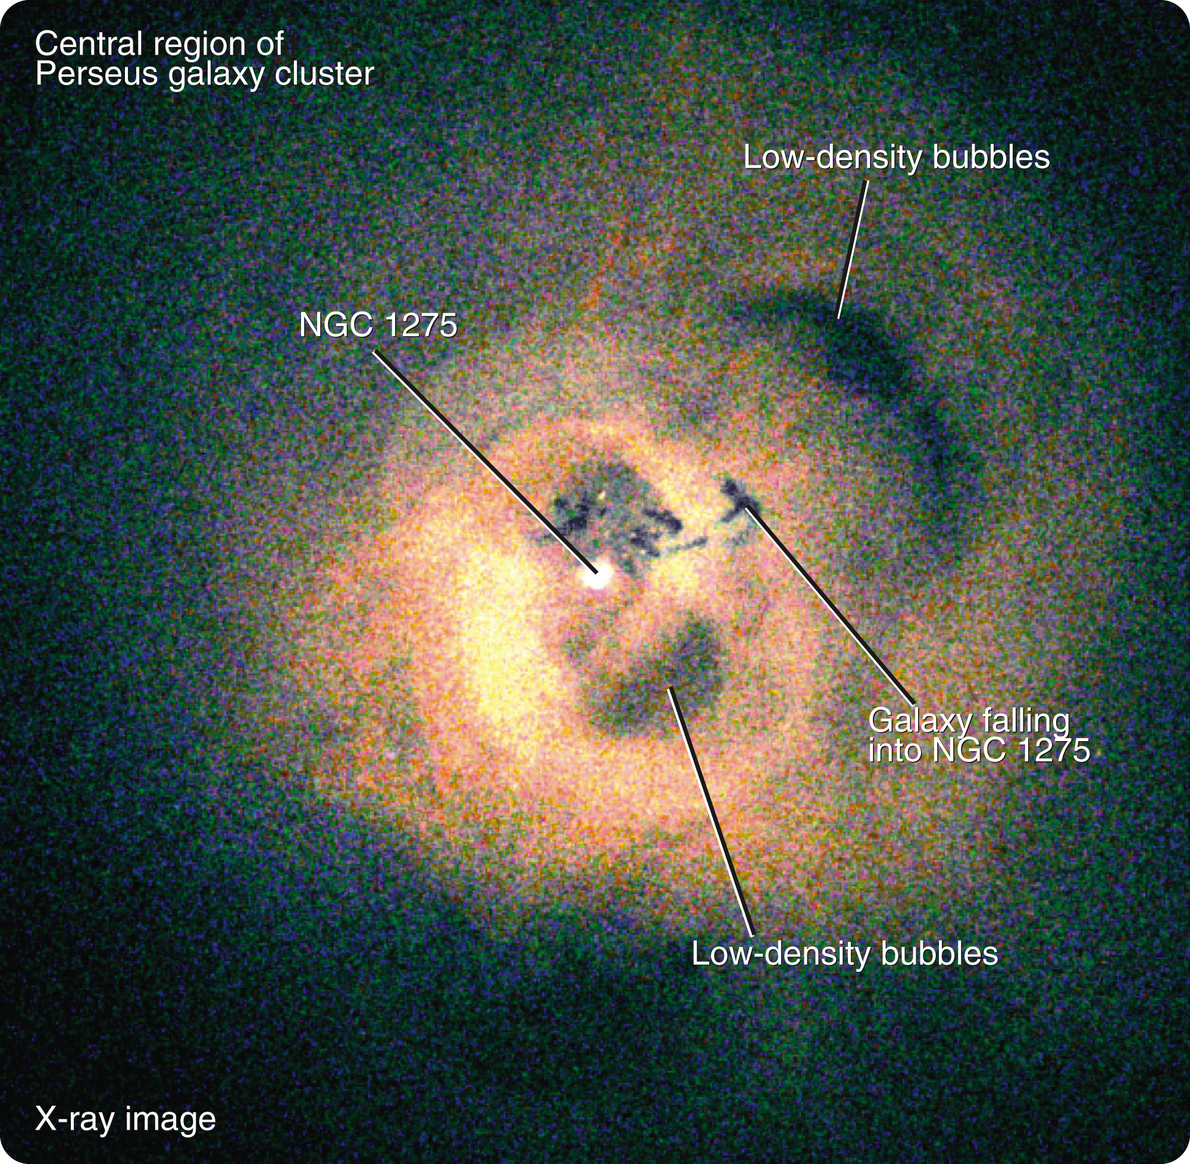
Double-Lobed Radio Sources
One of its galaxies, NGC 1275, is among the largest galaxies known.
It is pumping out jets of high-energy particles, heating the gas in the galaxy cluster, and inflating
low-density bubbles
that distort the huge
gas cloud.

Slide 23
Double-Lobed Radio Sources
The hot gas observed in galaxy clusters is heated to multimillion-degree temperatures as galaxy after galaxy goes through eruptive stages that can last for hundreds of millions of years.
NGC 1275 is erupting now, and it is so powerful and has heated the surrounding gas to such high temperatures that the gas can no longer fall in and the galaxy has probably limited its own growth.

Slide 24
Quasars
The largest telescopes detect multitudes of faint points of light with peculiar emission spectra.
These objects are called quasars—also known as quasi-stellar objects (QSOs).

Slide 25
Quasars
Astronomers now recognize quasars as extreme examples of AGN as well as some of the most distant visible objects in the universe.
However, they were a mystery when they were first identified.

Slide 26
Quasars
In the early 1960s, photos of the location of some radio sources that resembled radio galaxies revealed only single starlike points of light.
The first of these objects to be identified was 3C48.
Later, the source 3C273 was found.

Slide 27
Quasars
They were obviously not normal radio galaxies.
Even the most distant photographable galaxies look fuzzy.
These objects, however, looked like stars.
Their spectra, though, were totally unlike stellar spectra.
So, the objects were called quasi-stellar objects.

Slide 28
Quasars
For a few years, the spectra of quasars were a mystery.
A few unidentifiable emission lines were superimposed on a continuous spectrum.

Slide 29
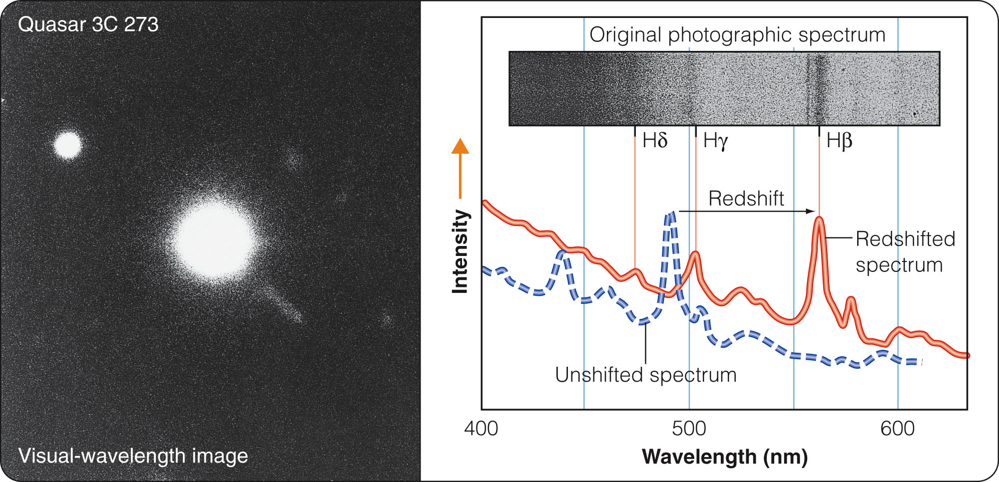
Quasars
In 1963, astronomer Maarten Schmidt calculated that, if hydrogen Balmer lines were redshifted by z = 0.158, they would fit the observed lines in 3C273’s spectrum.

Slide 30
Quasars
Other quasar spectra quickly yielded to this approach—revealing even larger redshifts.
To understand the significance of these large redshifts and the large velocities of recession they imply, you must recall the Hubble law.

Slide 31
Quasars
The large redshifts of the quasars imply that they must be at great distances, some farther away than any known galaxy.
Many quasars are evidently so far away that galaxies at those distances are very difficult to detect.

Slide 32
Quasars
Yet, the quasars are easily photographed.
Thus, quasars must have 10 to 1,000 times the luminosity of a large galaxy.
They must be ultraluminous.

Slide 33
Quasars
Soon after quasars were discovered, astronomers detected fluctuations in their brightnesses over times as short as a few hours or minutes.
The rapid fluctuations showed that they are small objects like AGN, only a few light-minutes or light- hours in diameter.

Slide 34
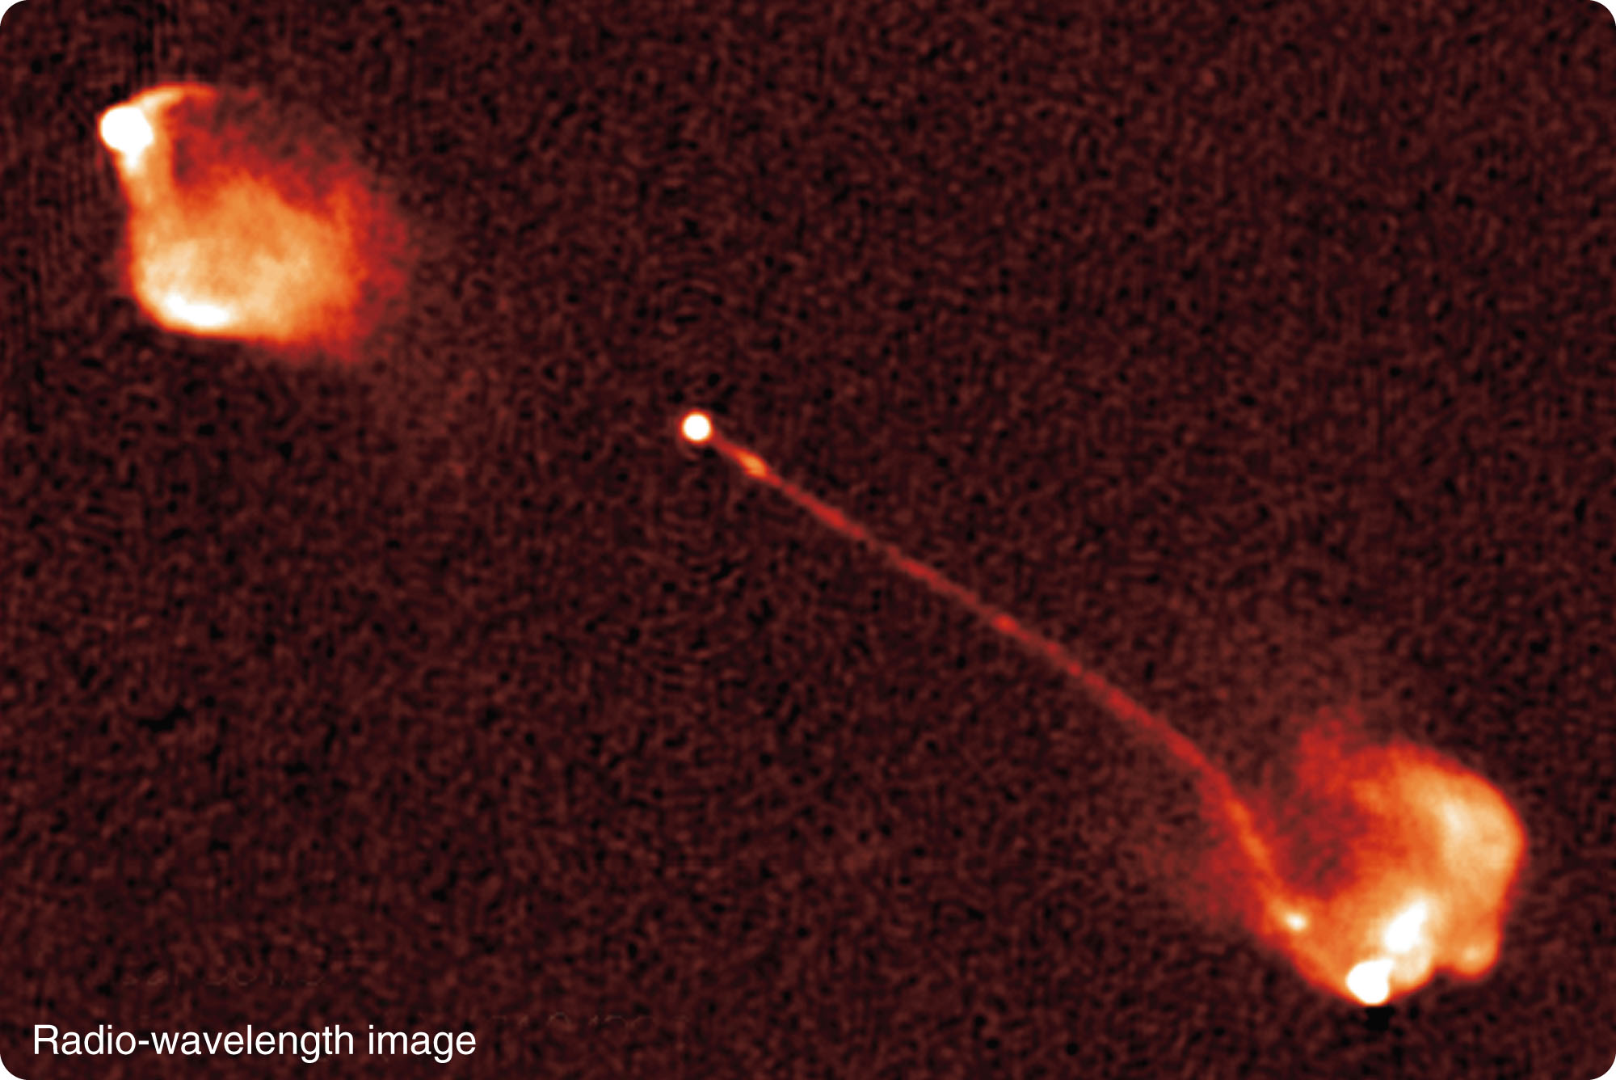
Quasars
Evidence has accumulated that quasars are the most luminous AGN, located in very distant galaxies.
For example, some quasars, like AGN, are at the centers of double radio lobes plus jets.

Slide 35
Quasars
Perhaps, you have another question about quasar distances at this point.
How can astronomers be sure that quasars really are that far away?
Astronomers faced with explaining how a small object could produce so much energy asked themselves the same question.

Slide 36
Quasars
In the early 1980s, astronomers were able to photograph faint nebulosity surrounding some quasars.
This was called quasar fuzz.
The spectra of quasar fuzz looked like the spectra of normal but very distant galaxies with the same redshift as the central quasar.

Slide 37
Quasars
In other cases, quasar light shines through the outskirts of a distant galaxy.
The quasar spectrum has extra absorption lines from gas at the redshift of the galaxy.
They are smaller than the quasar’s redshift.
This means the quasar is farther away than the galaxy containing the gas that absorbed some of the quasar’s light on its way to Earth.

Slide 38
Quasars
Both these observations confirm that galaxy and quasar redshifts indicate distances in a mutually consistent way.

Slide 39
The Search for a Unified Model
Astronomers studying galaxies are now developing a unified model of AGN and quasars.
A monster black hole is the centerpiece.

Slide 40
The Search for a Unified Model
Even a supermassive black hole is quite small compared with the galaxy.
A ten-million-solar-mass black hole would be only one-fifth the diameter of Earth’s orbit.
That means matter in an accretion disk can get very close to the black hole, orbit very fast, and grow very hot.

Slide 41
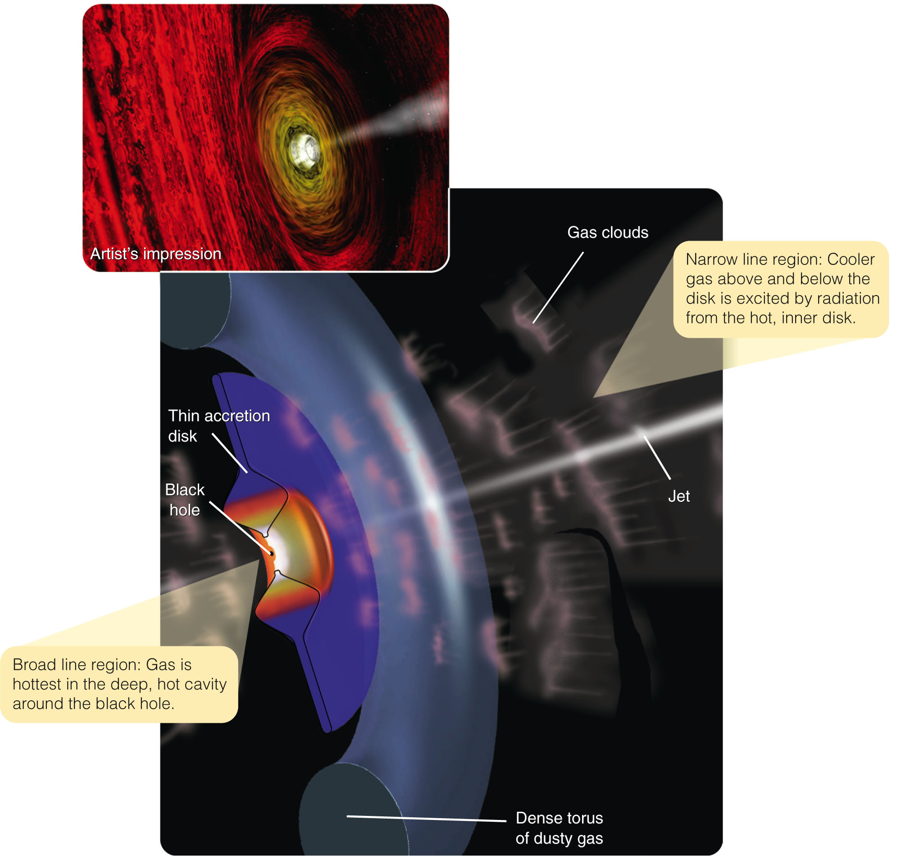
The Search for a Unified Model
Theoretical calculations indicate that the disk immediately around the black hole is ‘puffed up.’
It is also thick enough to
hide the central black hole
from some viewing angles.

Slide 42
The Search for a Unified Model
The hot inner disk seems to be the source of the jets often seen coming out of active galaxy cores.
However, the process by
which jets are generated
is not understood.

Slide 43
The Search for a Unified Model
The outer part of the disk—according to calculations—is a fat, cold torus (doughnut shape) of dusty gas.

Slide 44
The Search for a Unified Model
According to the unified model, what you see when you view the core of an AGN and QSO depends on how this accretion disk is tipped with respect
to your line of sight.

Slide 45
The Search for a Unified Model
If you view the accretion disk from the edge, you cannot see the central zone.
The thick dusty torus blocks your view.

Slide 46
The Search for a Unified Model
Instead, you see radiation emitted by gas lying above and below the central disk.
It is therefore relatively
cool.

Slide 47
The Search for a Unified Model
Also, it moves relatively slowly, with small Doppler shifts.
Thus, you see narrower spectral lines coming from this narrow line region.

Slide 48
The Search for a Unified Model
If the accretion disk is tipped slightly, you may be able to see some of the intensely hot gas in the central cavity.
This broad line region emits broad spectral lines because the gas is so hot.

Slide 49
The Search for a Unified Model
It is orbiting at high velocities.
The resulting high Doppler shifts spread out the spectral line.

Slide 50
The Search for a Unified Model
If you look directly into the central cavity around the black hole, down the dragon’s throat, you see:
A jet emerging perpendicular to the accretion disk and coming straight at you

Slide 51
The Search for a Unified Model
Model calculations indicate this would result in a very bright and highly variable source with few or no emission lines.
This is the appearance of AGN known as blazars.

Slide 52
The Search for a Unified Model
Astronomers are now using this unified model to sort out the different kinds of active galaxies and quasars—so, they can understand how they are related.

Slide 53
The Search for a Unified Model
For example, about one percent of quasars are strong radio sources.
The radio radiation may come from synchrotron radiation produced in the high-energy gas and magnetic fields in the jets.

Slide 54
The Search for a Unified Model
Here’s another example.
Using infrared cameras to see through dust, astronomers observed the core of the double-lobed radio galaxy Cygnus A.
They found an object much like a quasar.

Slide 55
The Search for a Unified Model
Astronomers have begun to refer to such hidden objects as “buried quasars.”

Slide 56
The Search for a Unified Model
The unified model is far from complete.
The detailed structure of accretion disks is poorly understood—as is the process by which the disks produce jets.
Furthermore, the spiral Seyfert galaxies are clearly different from the giant elliptical galaxies that have double radio lobes.

Slide 57
The Search for a Unified Model
Unification does not explain all the differences among active galaxies.
It is a model that provides some clues to what is happening in AGN and quasars.

Slide 58
Origin of Supermassive Black Holes
Naturally, you are wondering where these supermassive black holes came from.
That question is linked to a second question.
What makes a supermassve black hole erupt?
Answering those questions will help you understand how galaxies form.

Slide 59
Origin of Supermassive Black Holes
Evidence is accumulating that most galaxies seem to contain a supermassive black hole at their center.
Even Milky Way and the nearby Andromeda Galaxy contain central black holes.

Slide 60
Origin of Supermassive Black Holes
Only a few percent of galaxies, however, have AGN.
That must mean that most of the supermassive black holes are dormant.
Presumably, they are not being fed large amounts of matter.

Slide 61
Origin of Supermassive Black Holes
A slow trickle of matter flowing into the supermassive black hole at the center of our galaxy could explain the mild activity seen there.
However, it would take a larger meal to trigger an eruption like those seen in AGN.

Slide 62
Origin of Supermassive Black Holes
What could trigger a supermassive black hole to erupt?
The answer is something you have learned earlier—tides.
You have learned how tides twist interacting galaxies and rip matter away into tidal tails.

Slide 63
Origin of Supermassive Black Holes
Active galaxies are often distorted.
They have evidently been twisted by tidal forces as they interacted or merged with another galaxy.
Mathematical models show that those interactions can also throw stars plus clouds of interstellar gas and dust inward toward the galaxies’ centers.

Slide 64
Origin of Supermassive Black Holes
A sudden flood of matter flowing into a supermassive black hole would trigger it into eruption.

Slide 65
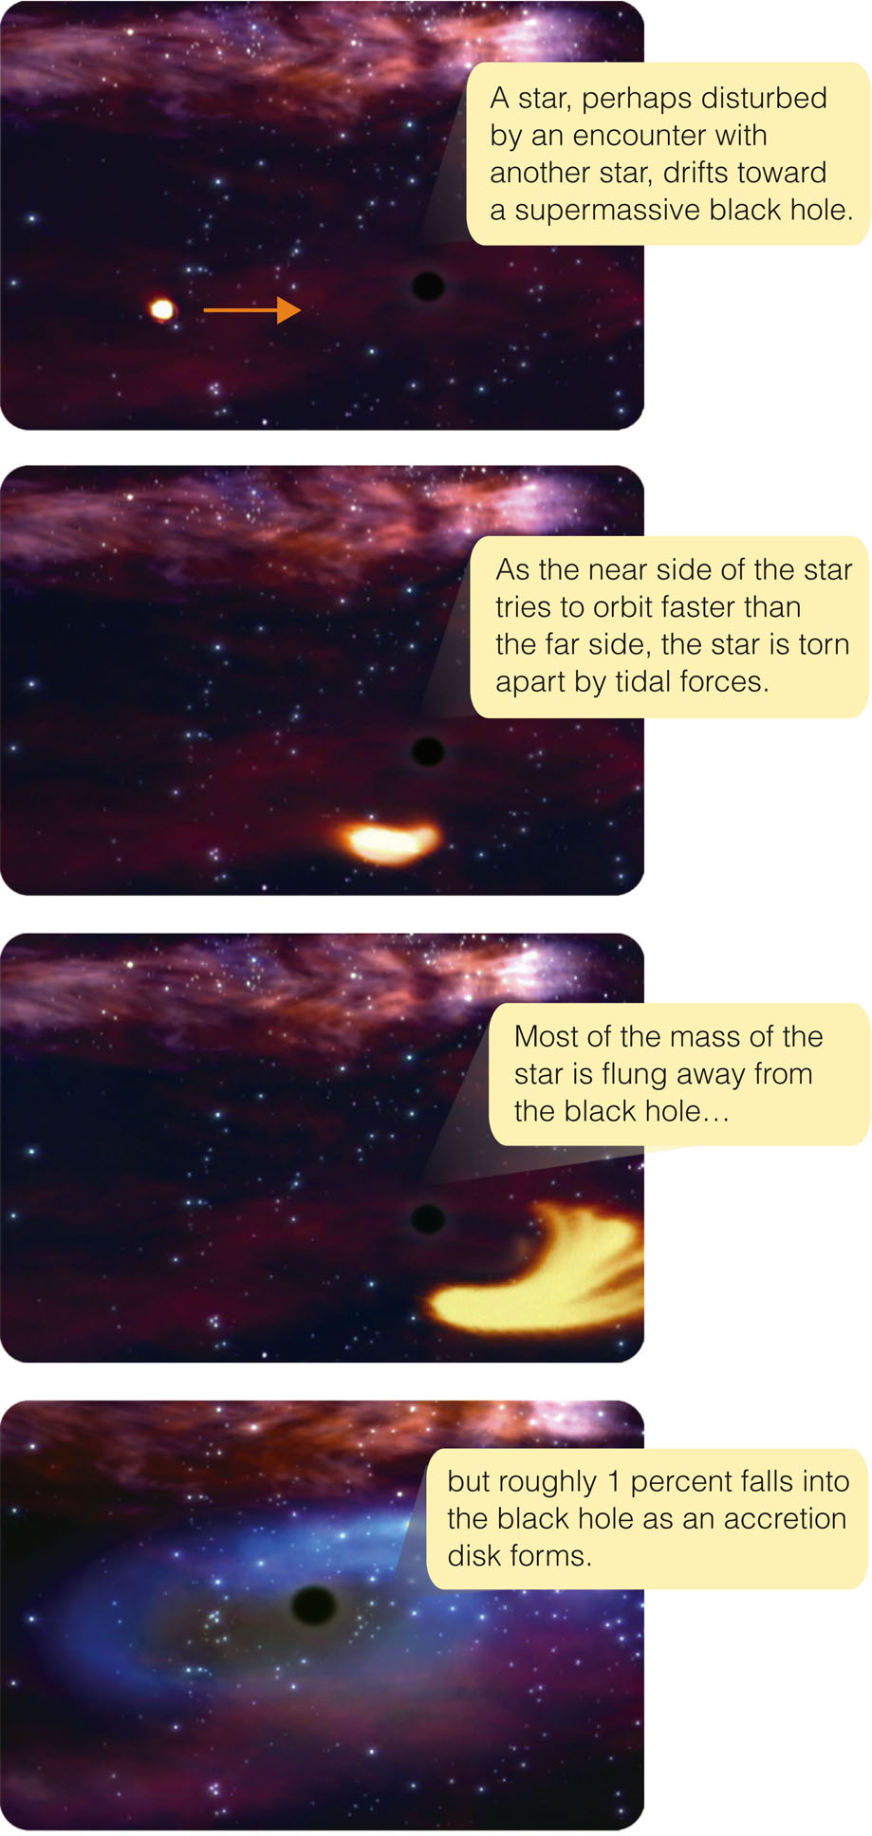
Origin of Supermassive Black Holes
The figure shows how a passing star would be shredded and partially consumed by a supermassive hole.
A steady diet of inflowing gas, dust, and an occasional star would keep an AGN powered by a supermassive black hole active.

Slide 66
Origin of Supermassive Black Holes
A few dozen supermassive black holes have been measured for their masses.
Their masses are correlated with the masses of the host galaxies’ nuclear bulges.
In each case, the mass of the black hole is about 0.5 percent the mass of the surrounding nuclear bulge.

Slide 67
Origin of Supermassive Black Holes
Apparently, a galaxy forms its nuclear bulge.
A certain fraction of the mass sinks to the center where it forms a supermassive black hole.
All that matter flowing together to form the black hole would release a tremendous amount of energy and trigger a violent eruption.

Slide 68
Origin of Supermassive Black Holes
Long ago, when galaxies were actively forming, the birth of the nuclear bulges must have triggered many AGN.
Later episodes of AGN activity could be triggered by interactions or mergers with other galaxies.

Slide 69
Quasars Through Time
The universe began 13.7 billion years ago.
Some quasars are over 10 billion light-years away.
Due to their large look-back times, they appear as they were when the universe was only 10 percent of its present age.

Slide 70
Quasars Through Time
The first clouds of gas that formed galaxies would have also made supermassive black holes at the centers of those galaxies’ nuclear bulges.
The abundance of matter flooding into these black holes could have triggered outbursts that are seen as quasars.

Slide 71
Quasars Through Time
Galaxies were closer together when the universe was young and had not expanded very much.
As they were closer together, the forming galaxies collided more often.
You have learned how collisions between galaxies could throw matter into supermassive black holes and trigger eruptions.

Slide 72
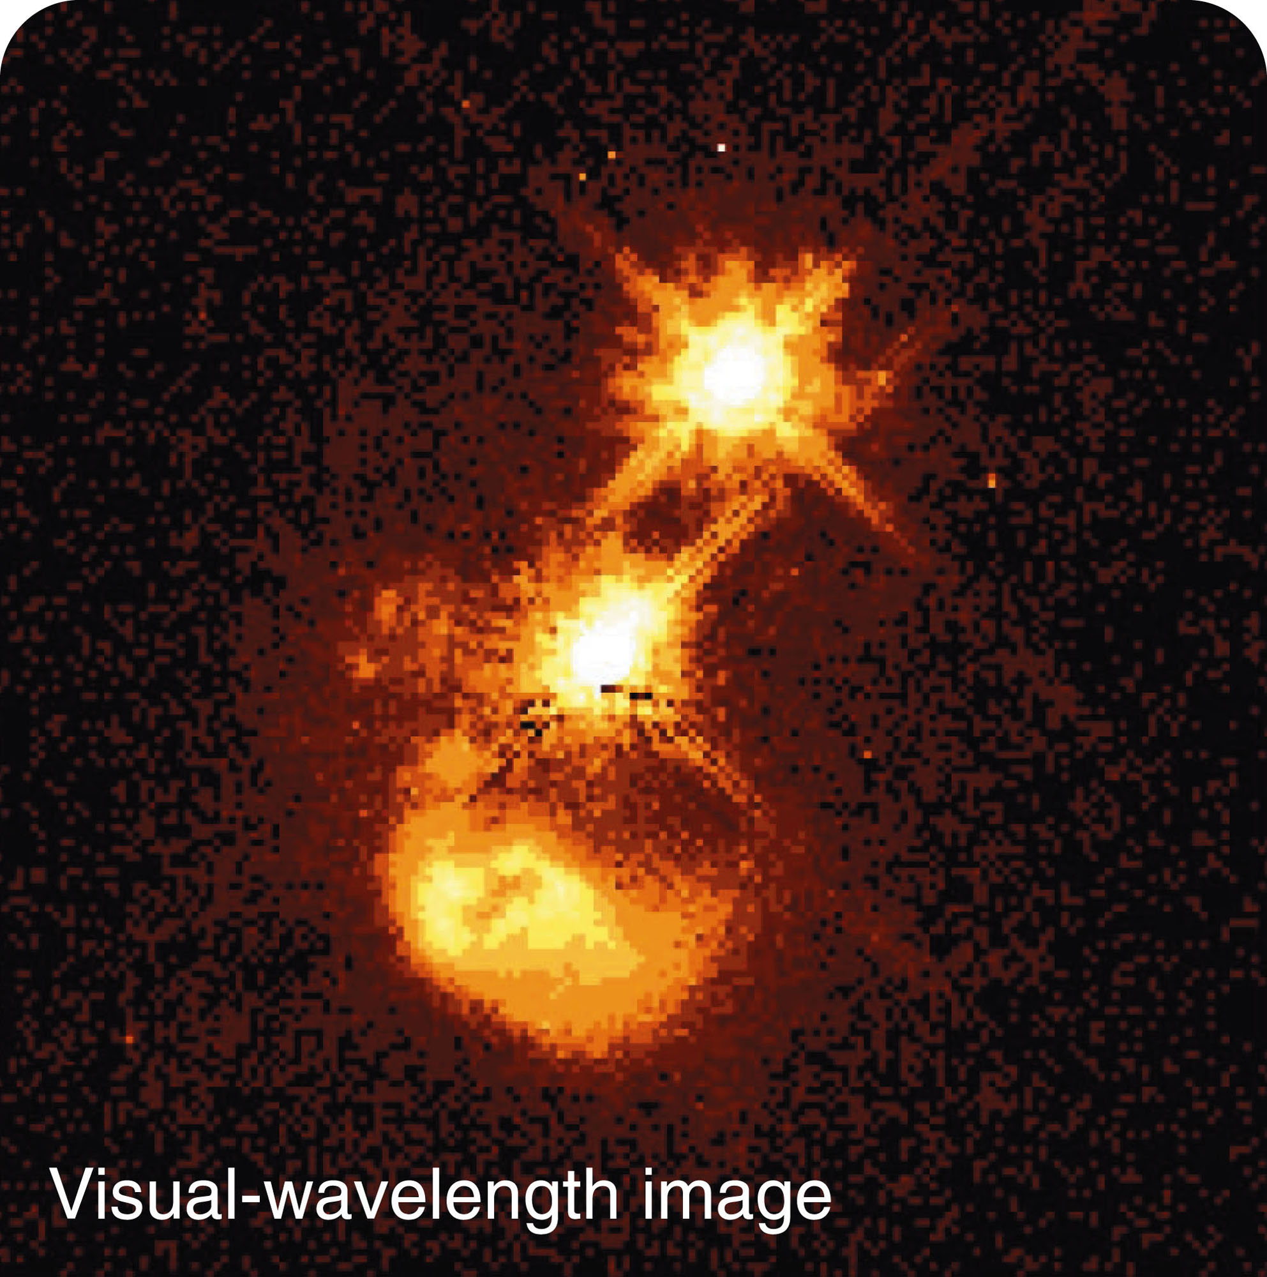
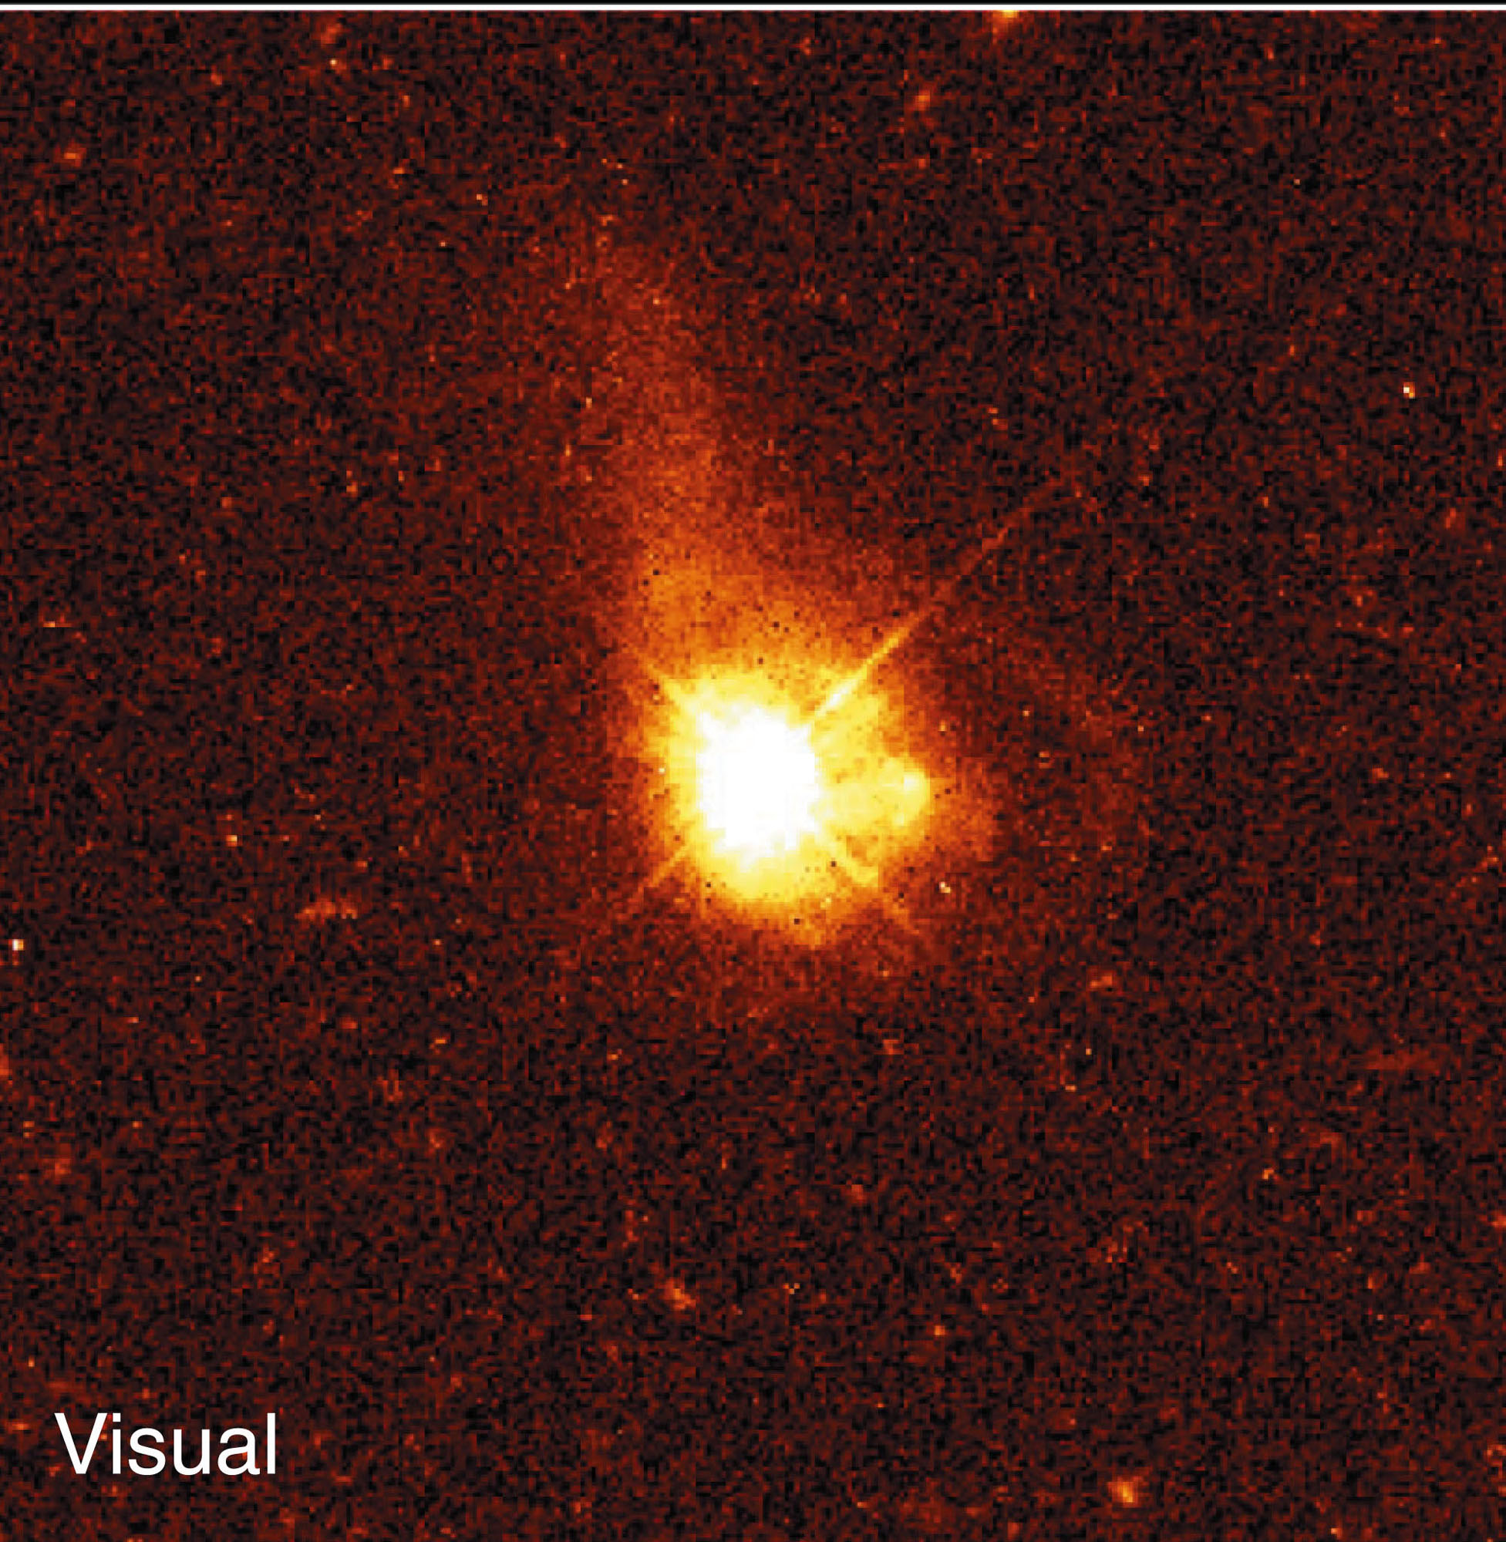
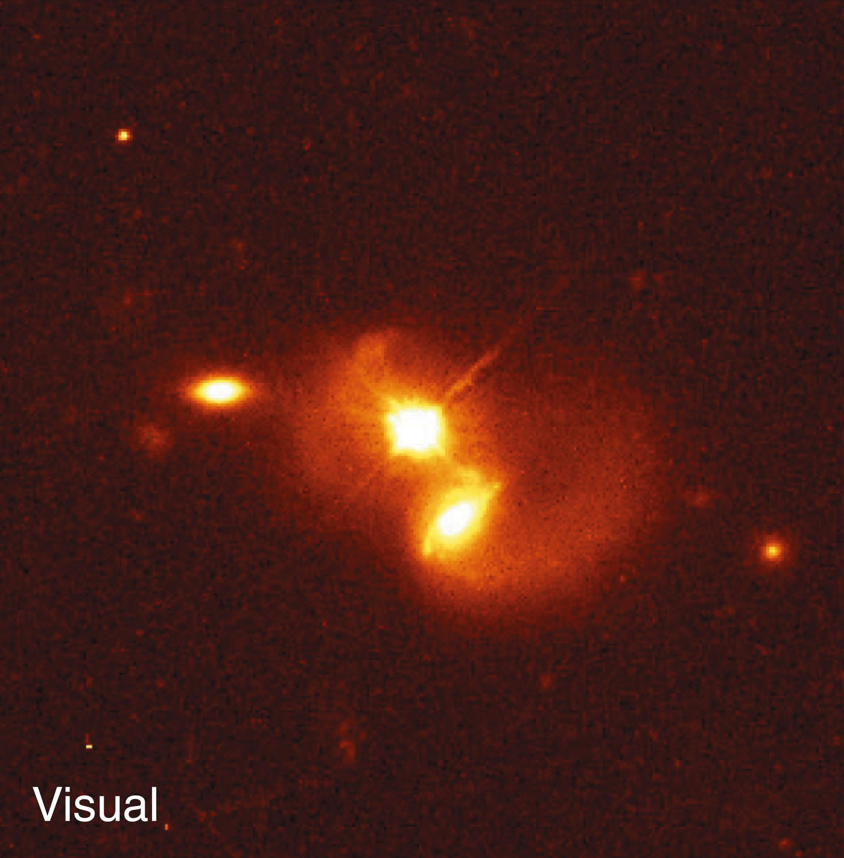
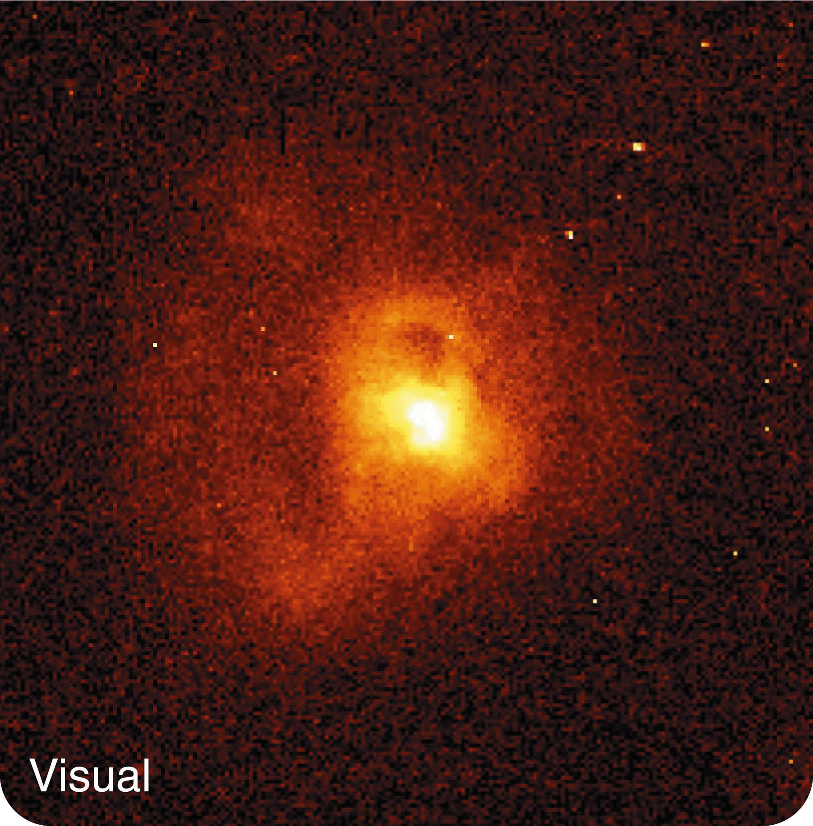
Quasars Through Time
Quasars are often located in host galaxies that are distorted as if they were interacting with other galaxies.

Slide 73
Quasars Through Time
Quasars are most common with redshifts of a little over 2 and less common with redshifts above 2.7.
The largest quasar redshifts are over 6.
Such high-redshift quasars are quite rare.

Slide 74
Quasars Through Time
Evidently, if you looked at quasars with redshifts of a little over 2, you would be looking back to an age when galaxies were actively forming, colliding, and merging.
In that age of quasars, they were about 1,000 times more common than they are now.
Even so, only a fraction of galaxies had quasars erupting in their cores at any one time.

Slide 75
Quasars Through Time
If you looked back to even higher redshifts, you would see fewer quasars.
You would be looking back to an age when the universe was so young that it had not yet begun to form many galaxies and quasars.

Slide 76
Quasars Through Time
Then, where are all the dead quasars?
There is no way to get rid of supermassive black holes.

Slide 77
Quasars Through Time
Astronomers have discovered that nearly all galaxies contain supermassive black holes.
Those black holes may have suffered quasar eruptions when the universe was younger, galaxies were closer together, and infalling gas and dust were more plentiful.

Slide 78
Quasars Through Time
However, quasar eruptions became less common as galaxies became more stable and as the abundance of gas and dust in the centers of galaxies were exhausted.

Slide 79
Quasars Through Time
Our own Milky Way is a good example.
It could have been a quasar long ago.
Today, though, its supermassive black hole is resting.

Slide 80
Quasars Through Time
Dormant black holes at the centers of galaxies today can be reawakened to become AGN by galaxy collisions.

