Slide 1
Chapter 8

Slide 2
“Stars have died that we might live.”
Preston Cloud
http://youtu.be/VOz4PkdY7aA

Slide 3
You are linked through a great chain of origins that leads backward through time to the first instant when the universe began 13.7 billion years ago.
By the time the universe was three minutes old, the protons, neutrons, and electrons in your body had come into existence.

Slide 4
Today’s Lecture
In this Chapter :
Origin of the universe in the big bang.
Formation of galaxies.
Origin of stars.
Production of the chemical elements.

Slide 5
The Big Bang theory is the prevailing cosmological model that describes the early development of the Universe. According to the theory, the Big Bang occurred approximately 13.798 ± 0.037 billion years ago, which is thus considered the age of the universe. At this time, the Universe was in an extremely hot and dense state and began expanding rapidly. After the initial expansion, the Universe cooled sufficiently to allow energy to be converted into various subatomic particles, including protons, neutrons, and electrons.

Slide 6
Though simple atomic nuclei formed within the first three minutes after the Big Bang, thousands of years passed before the first electrically neutral atoms formed. The majority of atoms that were produced by the Big Bang are hydrogen, along with helium and traces of lithium. Giant clouds of these primordial elements later coalesced through gravity to form stars and galaxies, and the heavier elements were synthesized either within stars or during supernovae.
http://www.youtube.com/watch?v=87HLPficmfE

Slide 7
Generation of stars cooked the original particles, fusing them into atoms such as carbon, nitrogen, and oxygen.
Those are common atoms in your body.
Even the calcium atoms in your bones were assembled inside stars.
Most of the iron in your body was produced by:
Carbon fusion in type Ia supernovae
Decay of radioactive atoms in the expanding matter ejected by type II supernovae
Notes:
A blindingly bright star bursts into view in a corner of the night sky — it wasn't there just a few hours ago, but now it burns like a beacon.
That bright star isn't actually a star, at least not anymore. The brilliant point of light is the explosion of a star that has reached the end of its life, otherwise known as a supernova.
Supernovas can briefly outshine entire galaxies and radiate more energy than our sun will in its entire lifetime. They're also the primary source of heavy elements in the universe.

Slide 8
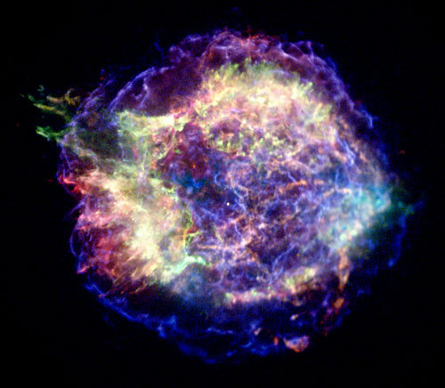
Cas A Supernova
Notes:
This Chandra X-ray photograph shows Cassiopeia A (Cas A, for short), the youngest supernova remnant in the Milky Way.

Slide 9
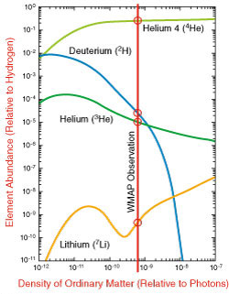
The universe began with
✤ About 75% hydrogen
✤ About 25% helium
✤ About 0.01% deuterium
✤ About 0.001% helium-3
✤ Less the 0.0000001% lithium
http://map.gsfc.nasa.gov/universe/bb_tests_ele.html
http://www.webelements.com/

Slide 10
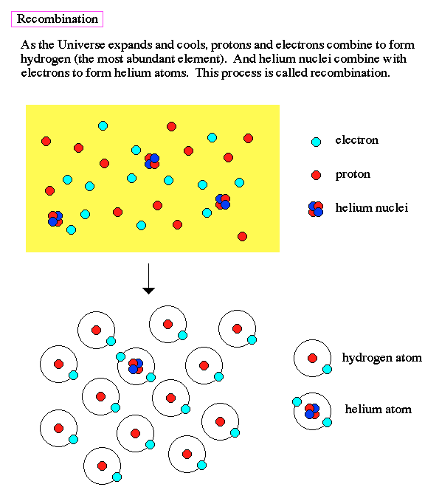
Recombination
✤ End of the Dark Ages
✤ Recombination
✤ The universe cooled enough for electrons and protons to form
atoms
✤ Photons were released
✤ The CMB was created about 370,000 years after the Big Bang

Slide 11
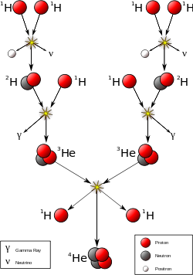

Slide 12
Test Your Understanding
The hydrogen in our solar system was created from subatomic particles in ______.
a. the Earth
b. our sun
c. Jupiter
d. the Big Bang
e. supernovas

Slide 13
Test Your Understanding
The iron in our solar system was created from smaller mass atomic nuclei in ______.
a. the Earth
b. our sun
c. Jupiter
d. the Big Bang
e. supernovas

Slide 14
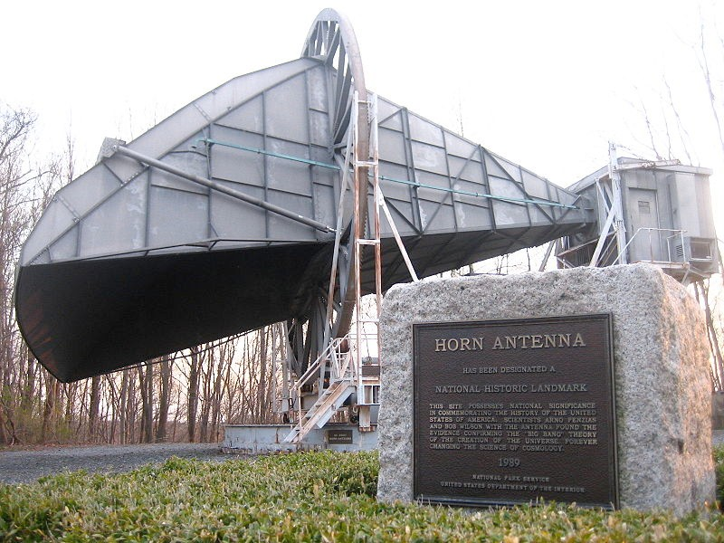
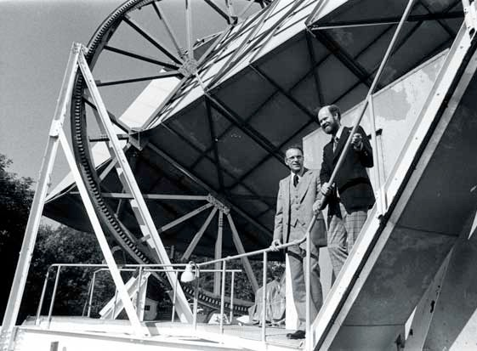
Arno Penzias & Robert Wilson
✤ Researchers with the Bell Labs in New Jersey
✤ In 1965, they discovered static coming from all over the sky
✤ They had discovered the Cosmic Microwave Background (CMB), the
remnant radiation from the Big Bang
✤ They received the Nobel Prize for their discovery in 1978
✤ Robert Dicke had predicted the existence of the CMB, and was just
getting ready to search for it with some other researchers
✤ http://www.bell-labs.com/project/feature/archives/cosmology/

Slide 15
The First Stars
Formed about 300 million years after the Big Bang
Large, unstable
Short lives
Their supernovae seeded the early universe with heavy elements
The oldest star discovered to date
✤ HE 1523-0901
13.2 billion years old
Metal poor star
1/1000th the iron of our Sun
Measured radioactive elements uranium and thorium
http://discovermagazine.com/2007/aug/raw-data-oldest-star

Slide 16
Our galaxy contains at least 100 billion stars, of which the sun is one.
The sun formed from a cloud of gas and dust about 5 billion years ago.
The atoms in your body were part of that cloud.
The solar nebula theory supposes that:
Planets form in the rotating disks of gas and dust around young stars

Slide 17
Our own planetary system formed in such a disk-shaped cloud around the sun.
When the sun became luminous enough, the remaining gas and dust were blown away into space—leaving the planets orbiting the sun.

Slide 18
According to the solar nebula hypothesis, Earth and the other planets of the solar system formed billions of years ago as the sun condensed from the interstellar medium.
The theory predicts that most stars should have planets because planet formation is a natural part of star formation.
Therefore, planets should be very common in the universe—probably more common than stars.

Slide 19
Revolution and Rotation
The planets revolve around the sun in orbits that lie close to a common plane.
The orbit of Mercury, the planet closest to the sun, is tipped 7.0° to Earth’s orbit.
The rest of the planets’ orbital planes are inclined by no more than 3.4°.
Thus, the solar system is basically ‘flat’ and disk-shaped.

Slide 20
The rotation of the sun and planets on their axes also seems related to the same overall direction of motion.
The sun rotates with its equator inclined only 7.2° to Earth’s orbit.
Most of the other planets’ equators are tipped less than 30°.
However, the rotations of Venus and Uranus are peculiar.
Compared with the other planets, Venus rotates backward.
Uranus rotates on its sides—with the equator almost perpendicular to its orbit.

Slide 21
Apparently, the preferred direction of motion in the solar system (counterclockwise as seen from the north) is also related to the rotation of a disk of material that became the planets.
All the planets revolve around the sun in that direction.
Venus and Uranus are exceptions—they rotate on their axes in that same direction.

Slide 22
Furthermore, nearly all the moons in the solar system, including Earth’s moon, orbit around their planets counterclockwise.
With only a few exceptions, most of which are understood, revolution and rotation in the solar system follow a common theme.

Slide 23
Test Your Understanding
The planets all lie in nearly the same plane resulting in a disk-like structure for the solar system. This disk-like structure is believed to exist because
a. the solar nebula from which the planets formed had a disk-like structure.
b. the bipolar flow from the young sun cleared all material out of the nebula except that in the disk.
c. Jupiter's gravity was great enough to pull all of the other planets to the plane of its orbit.
d. the Milky Way Galaxy from which the planets condensed has a disk like structure

Slide 24
Two Kinds of Planets
Perhaps the most striking clue to the solar system’s origin comes from the obvious division of the planets into two categories:
The small Earthlike worlds
The giant Jupiterlike worlds

Slide 25
There are three important points to note about these categories:
They are distinguished by their location.
The four inner planets are quite different from the outer four.
Almost every solid surface in the solar system is covered with craters.
The planets are distinguished by individual properties such as rings, clouds, and moons.
Any theory of the origin of the planets needs to explain these properties.

Slide 26
Test your Understanding
Compared to the terrestrial planets, Jovian planets
a. have a higher density.
b. have a smaller number of moons.
c. have a much larger diameter.
d. are much hotter.

Slide 27
For further clues, you can look at smaller objects that have remained largely unchanged since the birth of the solar system.
The solar system is littered with three kinds of space debris:
Asteroids
Comets
Meteoroids

Slide 28
Test your Understanding
How is the presence of space debris accounted for by solar system models?
a. Space debris is left over material from the early solar system that never formed into a planet.
b. Space debris was formed by the collision of objects after the planets formed.
c. Space debris is material that existed in our region of space before the sun formed.
d. Both a and b
e. All of the above

Slide 29
Asteroids
The asteroids, sometimes called minor planets, are small rocky worlds.
Astronomers recognize the asteroids as debris left over by a planet that failed to form at a distance of about 3 AU from the sun.
Most of them orbit the sun in a belt between the orbits of Mars and Jupiter.
Roughly 20,000 asteroids have been charted.
http://youtu.be/5wBlQ-cwxM4

Slide 30
Asteroids
Other asteroids share Jupiter’s orbit.
Some others have been found beyond the orbit of Saturn.
About 200 asteroids are more than 100 km (60 mi) in diameter.
Tens of thousands are estimated to be more than 10 km (6 mi) in diameter.
There are probably a million or more that are larger than 1 km (0.6 mi) and billions that are smaller

Slide 31
Photos returned by robotic spacecraft and space telescopes show that asteroids are generally irregular in shape and battered by impact cratering

Slide 32
Some asteroids appear to be rubble piles of broken fragments.
A few are known to be double objects or to have small moons in orbit around them.
These are understood to be evidence of multiple collisions among the asteroids

Slide 33
A few larger asteroids show signs of volcanic activity on their surfaces that may have happened when the asteroid was young.

Slide 34
Test your Understanding
The asteroid belt is found between which two planets’ orbits?
Earth and Mars
Mars and Jupiter
Jupiter and Saturn
d. Venus and Earth

Slide 35
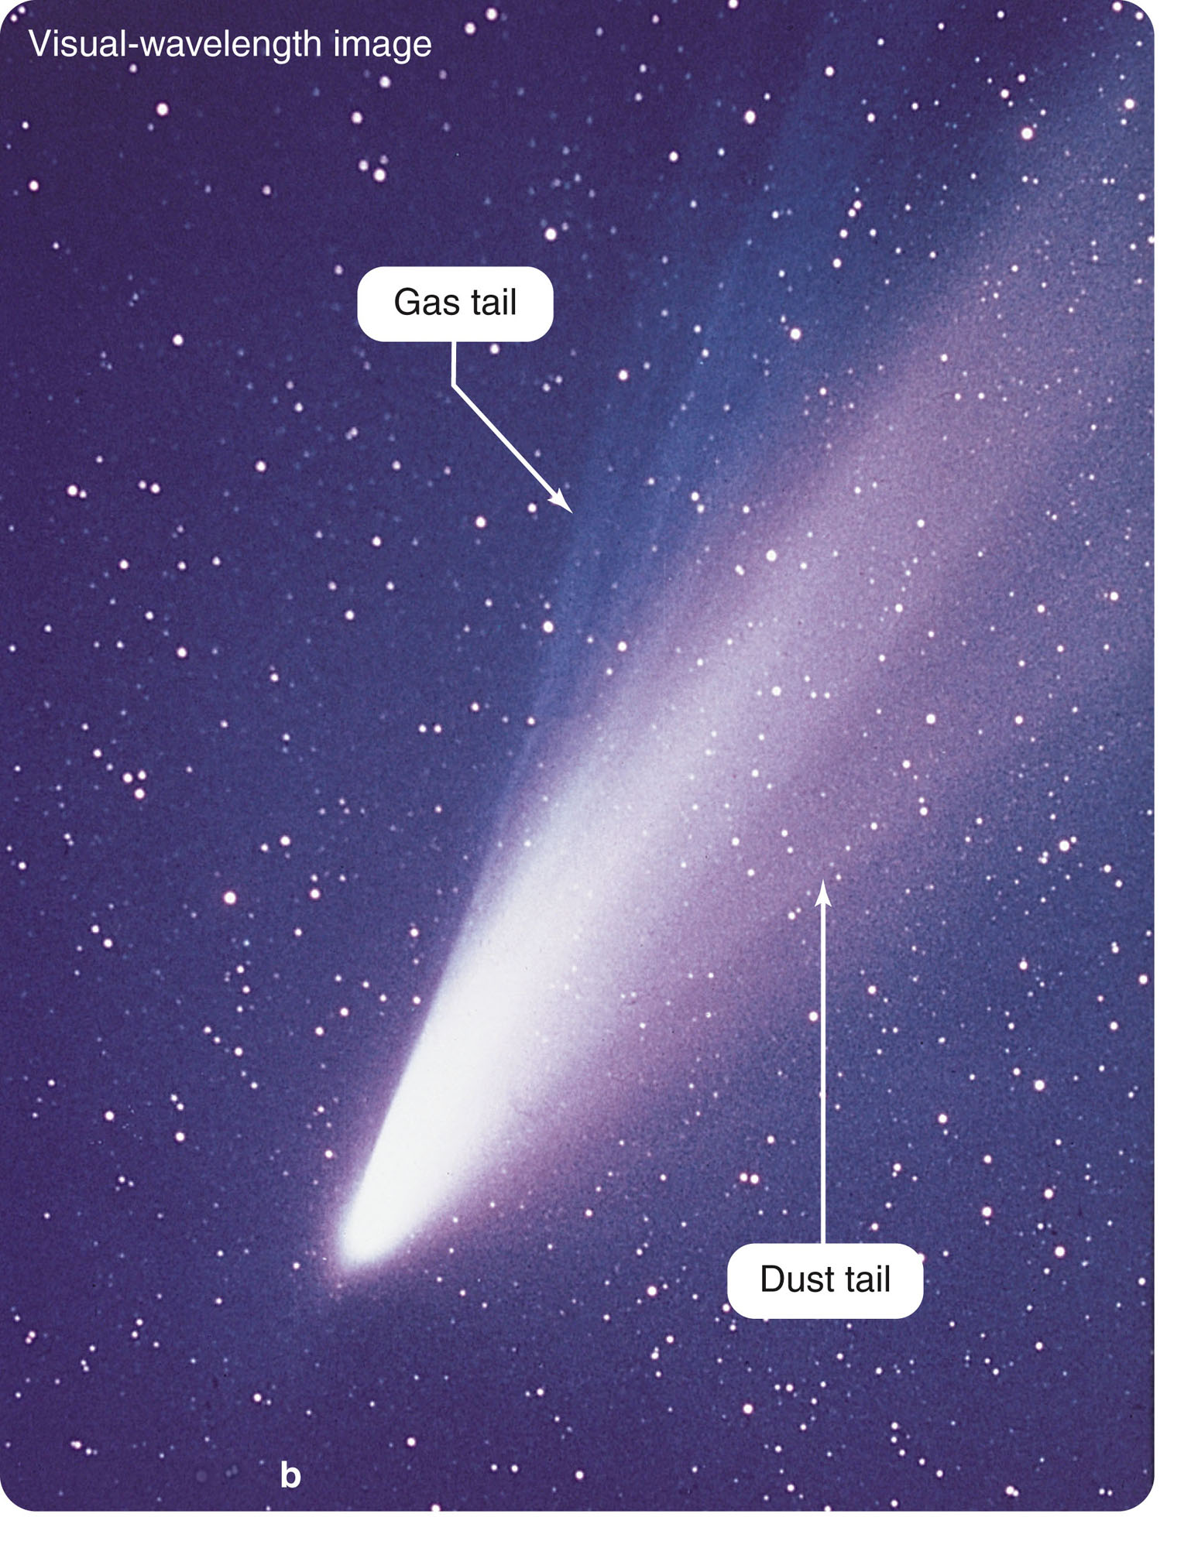
Comets
The brightest comets are impressively beautiful
objects.
However, most comets are
faint and are difficult to locate even at their
brightest.

Slide 36
A comet may take months to sweep through the inner solar system.
During this time, it appears as a glowing head with an extended tail of gas and dust.
The beautiful tail of a comet can be longer than 1 AU.
However, it is produced by an icy nucleus only a few tens of kilometers in diameter.
The nucleus remains frozen and inactive while it is far from the sun.

Slide 37
As the nucleus moves along its elliptical orbit into the inner solar system, the sun’s heat begins to vaporize the ices—releasing gas and dust. The pressure of sunlight and solar wind push the gas and dust away, forming a long tail.
The gas and dust respond differently to the forces acting on them.
So, they sometimes separate into two separate sub-tails.

Slide 38
Comet nuclei contain:
Ices of water
Other volatile compounds such as carbon dioxide, methane, and ammonia
The motion of the nucleus along its orbit, the pressure of sunlight, and the outward flow of the solar wind cause the tails to point always approximately away from the sun.
These ices are the kinds of compounds that should have condensed from the outer solar nebula.
That makes astronomers think that comets are ancient samples of the gases and dust from which the outer planets formed.
Five spacecraft flew past the nucleus of Comet Halley when it visited the inner solar system in 1985 and 1986.
Since then, spacecraft have visited the nuclei of several other comets.

Slide 39
Images show that comet nuclei are irregular in shape and very dark, with jets of gas and dust spewing from active regions on the nuclei.
In general, these nuclei are darker than a lump of coal.
This suggests that they have composition similar to certain dark, water- and carbon-rich meteorites.

Slide 40
Since 1992, astronomers have discovered roughly a thousand small, dark, icy bodies orbiting in the outer fringes of the solar system beyond Neptune.
This collection of objects is called the Kuiper belt.
It is named after the Dutch-American astronomer Gerard Kuiper, who predicted their existence in the 1950s.
There are probably 100 million bodies larger than 1 km in the Kuiper belt.
Any successful theory should explain how they came to be where they are.
Astronomers believe that some comets, those with the shortest orbital periods and orbits in the plane of the solar system, come from the Kuiper belt.

Slide 41
Meteors
Unlike the stately comets, meteors flash across the sky in momentary streaks of light.
They are commonly called “shooting stars.”
They are not stars but small bits of rock and metal falling into Earth’s atmosphere.
They burst into incandescent vapor about 80 km (50 mi) above the ground because of friction with the air.
This hot vapor condenses to form dust, which settles slowly to the ground—adding about 40,000 tons per year to the planet’s mass.

Slide 42
Technically, the word meteor refers to the streak of light in the sky.
In space, before its fiery plunge, the object is called a meteoroid.
Most meteoroids are specks of dust, grains of sand, or tiny pebbles.
Almost all the meteors you see in the sky are produced by meteoroids that weigh less than 1 g.
Only rarely is one massive enough and strong enough to survive its plunge, reach Earth’s surface, and become what is called a meteorite.

Slide 43
Meteorites can be divided into three broad categories.
Iron
Iron meteorites are solid chunks of iron and nickel.
Stony
Stony meteorites are silicate masses that resemble Earth rocks.
Stony-iron
Stony-iron meteorites are iron-stone mixtures.

Slide 44
You can find evidence of the origin of meteors through one of the most pleasant observations in astronomy.
You can watch a meteor shower, a display of meteors that are clearly related by a common origin.
http://www.youtube.com/watch?v=87HLPficmfE

Slide 45
The Perseid meteor shower occurs each year in August.
During the height of the shower, you might see as many as 40 meteors per hour.
The shower is so named because all its meteors appear to come from a point in the constellation Perseus.

Slide 46
The Age of the Solar System
According to the solar nebula theory, the planets should be about the same age as the sun.
The most accurate way to find the age of a rocky body is to bring a sample into the laboratory and determine its age by analyzing the radioactive elements it contains.

Slide 47
A few of those elements are radioactive and can decay into other elements—called daughter elements or isotopes.
The half-life of a radioactive element is the time it takes for half of the radioactive atoms to decay into the daughter elements.

Slide 48
For example, potassium-40 decays into daughter isotopes calcium-40 and argon-40 with a half-life of 1.3 billion years.
Also, uranium-238 decays with a half-life of 4.5 billion years to lead-206 and other isotopes.

Slide 49
As time passes, the abundance of a radioactive element in a rock gradually decreases, and the abundances of the daughter elements gradually increase.

Slide 50
You can estimate the original abundances of the elements in the rock from:
Rules of chemistry
Observations of rock properties in general
Thus, measuring the present abundances of the parent and daughter elements allows you to find the age of the rock. The oldest Earth rocks so far discovered and dated are tiny zircon crystals from Australia, 4.4 billion years old

Slide 51
Test your Understanding
How is radioactive dating used to determine the age of an object?
a. Both the amounts of radioactive and decay material are measured. Using these with the radioactive material’s half-life, the age can be estimated.
b. The amount of radioactive material is measured. Using this with the radioactive material’s half-life, the age can be estimated.
c. The amount of decay material is measured. Using this with the radioactive material’s half-life, the age can be estimated.
d. The amount of heat generated by radioactive dating is measured to determine age.

Slide 52
Chemical Composition of the Solar Nebula
Everything astronomers know about the solar system and star formation suggests that the solar nebula was a fragment of an interstellar gas cloud.
Such a cloud would have been mostly hydrogen with some helium and minor traces of the heavier elements.

Slide 53
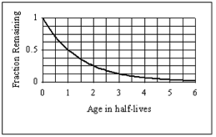
Test your Understanding
The diagram below illustrates the radioactive decay of Potassium (⁴⁰K), which has a half-life of 1.3 billion years. If a lunar rock is found that currently contains 5 grams of ⁴⁰K, and it is determined that the sample contained 20 grams when it was formed, how old is the lunar rock?
a. 6.5 billion years
b. 19.5 billion years
c. 2.6 billion years
d. 3.9 billion years
e. 4.6 billion years

Slide 54
Chemical Composition of the Solar Nebula
That is precisely what you see in the composition of the sun.
Analysis of the solar spectrum shows that the sun is mostly hydrogen, with a quarter of its mass being helium.
Only about 2 percent are heavier elements.

Slide 55
Chemical Composition of the Solar Nebula
Of course, nuclear reactions have fused some hydrogen into helium.
This, however, happens in the core and has not affected its surface composition.
Thus, the composition revealed in its spectrum is essentially the same composition of the solar nebula gases from which it formed.

Slide 56
Chemical Composition of the Solar Nebula
You can see that same solar nebula composition is reflected in the chemical compositions of the planets.

Slide 57
Chemical Composition of the Solar Nebula
The composition of the Jovian planets resembles the composition of the sun.
Furthermore, if you allowed low-density gases to escape from a blob of sun-stuff, the remaining heavier elements would resemble the composition of the other terrestrial planets—as well as meteorites.

Slide 58
Condensation of Solids
The key to understanding the process that converted the nebular gas into solid matter is:
The observed variation in density among solar system objects

Slide 59
Condensation of Solids
The four inner planets are high-density, terrestrial bodies.
The outer, Jupiter-like planets are low-density, giant planets.
This division is due to the different ways gases are condensed into solids in the inner and outer regions of the solar nebula.

Slide 60
Condensation of Solids
Even among the terrestrial planets, you find a pattern of slight differences in density.
The uncompressed densities—the densities the planets would have if their gravity did not compress them—can be calculated from the actual densities and masses of each planet.

Slide 61
Condensation of Solids
In general, the closer a planet is to the sun, the higher is its uncompressed density.
This density variation is understood to have originated when the solar system first formed solid grains.
The kind of matter that is condensed in a particular region would depend on the temperature of the gas there.

Slide 62
Condensation of Solids
In the inner regions, the temperature seems to have been 1,500 K or so.
The only materials that can form grains at this temperature are compounds with high melting points—such as metal oxides and pure metals.
These are very dense, corresponding to the composition of Mercury.

Slide 63
Condensation of Solids
Farther out in the nebula, it was cooler.
Silicates (rocky material) could condense.
These are less dense than metal oxides and metals, corresponding more to the compositions of Venus, Earth, and Mars.
Somewhere further from the sun, there was a boundary called the ice line—beyond which the water vapor could freeze to form ice.

Slide 64
Condensation of Solids
Not much farther out, compounds such as methane and ammonia could condense to form other ices.
Water vapor, methane, and ammonia were abundant in the solar nebula.
So, beyond the ice line, the nebula was filled with a blizzard of ice particles.
Those ices have low densities like the Jovian planets.

Slide 65
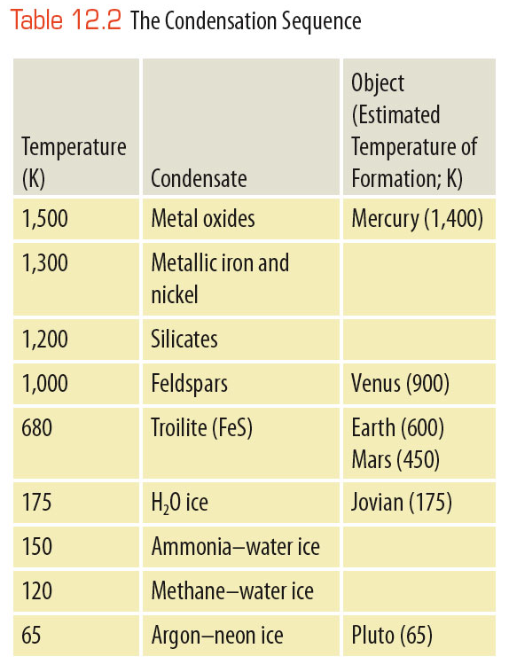
Condensation of Solids
The sequence in which the different materials condense from the gas as you move away from the sun is called the condensation sequence.
It suggests that the planets, forming at different distances from the sun, accumulated from different kinds of materials.

Slide 66
Condensation of Solids
The original chemical composition of the solar nebula should have been roughly the same throughout the nebula.

Slide 67
Condensation of Solids
The important factor was temperature.
The inner nebula was hot, and only metals and rock could condense there.
The cold outer nebula could form lots of ices in addition to metals and rocks.
The ice line seems to have been between Mars and Jupiter—it separates the formation of the dense terrestrial planets from that of the low-density Jovian planets.

Slide 68
Test Your Understanding
The first small solid grains or flakes formed in our solar system by the process of ____, the addition of material to an object an atom or molecule at a time.
a. Accretion
b. Sublimation
c. Hydration
d. Condensation
e. Vaporization

Slide 69
Formation of Planetesimals
In the development of a planet, three groups of processes operate to collect solid bits of matter—rock, metal, or ices—into larger bodies called planetesimals.
Eventually, they build the planets.
The study of planet building is the study of three groups of processes:
Condensation
Accretion
Gravitational collapse

Slide 70
Formation of Planetesimals
According to the solar nebula theory, planetary development in the solar nebula began with the growth of dust grains.
These specks of matter, whatever their composition, grew from microscopic size by two processes—condensation and accretion.

Slide 71
Formation of Planetesimals
A particle grows by condensation when it adds matter, one atom or molecule at a time, from a surrounding gas.
Snowflakes, for example, grow by condensation in Earth’s atmosphere.
In the solar nebula, dust grains were continuously bombarded by atoms of gas—and some of these stuck to the grains.

Slide 72
Formation of Planetesimals
Accretion is the sticking together of solid particles.
You may have seen accretion in action if you have walked through a snowstorm with big, fluffy flakes.
If you caught one of those “flakes” on your mitten and looked closely, you saw that it was actually made up of many tiny, individual flakes.
They had collided as they fell and accreted to form larger particles.

Slide 73
Formation of Planetesimals
Model calculations indicate that, in the solar nebula, the dust grains were on the average no more than a few centimeters apart.
So, they collided frequently and accreted into larger particles.

Slide 74
Formation of Planetesimals
There is no clear distinction between a very large grain and a very small planetesimal.
However, you can consider an object a planetesimal when its diameter approaches a kilometer or so, like the size of a typical small asteroid or comet.

Slide 75
Formation of Planetesimals
Objects larger than a centimeter were subject to new processes that tended to concentrate them.
For example, collisions with the surrounding gas and with each other would have caused growing planetesimals to settle into a thin disk.
This is estimated to have been only about 0.01 AU thick in the central plane of the rotating nebula.
This concentration of material would have made further planetary growth more rapid.

Slide 76
Formation of Planetesimals
Computer models show that the rotating disk of particles should have been gravitationally unstable.
It would have been disturbed by spiral density waves—much like those found in spiral galaxies.
This would have further concentrated the planetesimals and helped them coalesce into objects up to 100 km (60 mi) in diameter.

Slide 77
Formation of Planetesimals
Through these processes, the nebula became filled with trillions of solid particles ranging in size from pebbles to small planets.
As the largest began to exceed 100 km in diameter, new processes began to alter them.
A new stage of planet building began, the formation of protoplanets

Slide 78
Growth of Protoplanets
The coalescing of planetesimals eventually formed protoplanets—massive objects destined to become planets.
As these larger bodies grew, new processes began making them grow faster and altered their physical structure.

Slide 79
Growth of Protoplanets
If planetesimals collided at orbital velocities, it is unlikely that they would have stuck together.
The average orbital velocity in the solar system is about 10 km/s (22,000 mph).
Head-on collisions at this velocity would have vaporized the material.

Slide 80
Growth of Protoplanets
However, the planetesimals were all moving in the same direction in the nebular plane and didn’t collide head-on.
Instead, they merely rubbed shoulders at low relative velocities.
Such gentle collisions would have been more likely to fuse them than to shatter them.

Slide 81
Growth of Protoplanets
The largest planetesimals would grow the fastest—they had the strongest gravitational field.
Also, they easily attract additional material.
Computer models indicate that these planetesimals grew quickly to protoplanetary dimensions, sweeping up more and more material.

Slide 82
Growth of Protoplanets
Protoplanets had to begin growing by accumulating solid material.
This is because they did not have enough gravity to capture and hold large amounts of gas.

Slide 83
Growth of Protoplanets
In the warm solar nebula, the atoms and molecules of gas were traveling at velocities much larger than the escape velocities of modest-size protoplanets.
Thus, in their early development, the protoplanets could grow only by attracting solid bits of rock, metal, and ice.

Slide 84
Growth of Protoplanets
Once a protoplanet approached a mass of 15 Earth masses or so, it could begin to grow by gravitational collapse.
This is the rapid accumulation of a large amount of infalling gas.

Slide 85
Growth of Protoplanets
In its simplest form, the theory of terrestrial protoplanet growth supposes that all the planetesimals had about the same chemical composition.

Slide 86
Growth of Protoplanets
The planetesimals accumulated gradually to form a planet-size ball of material that was of homogeneous composition throughout.

Slide 87
Growth of Protoplanets
As a planet formed, heat began to accumulate in its interior from the decay of short-lived radioactive elements.
This heat eventually melted the planet and allowed it to differentiate.
Differentiation is the separation of material according to density.

Slide 88
Growth of Protoplanets
When the planet melted, the heavy metals such as iron and nickel settled to the core.
The lighter silicates floated to the surface to form a low-density crust.

Slide 89
Growth of Protoplanets
This process depends on the presence of short-lived radioactive elements whose rapid decay would have released enough heat to melt the interior of planets.

Slide 90
Growth of Protoplanets
Astronomers know such elements were present because very old rock from meteorites contains daughter isotopes such as magnesium-26.
– That isotope is produced by the decay of aluminum-26 in a reaction that has a half-life of only 0.74 million years.

Slide 91
Growth of Protoplanets
The aluminum-26 and similar short-lived radioactive isotopes are gone now.
However, they must have been produced in a supernova explosion that occurred no more than a few million years before the formation of the solar nebula.
In fact, many astronomers suspect that this supernova explosion compressed nearby gas and triggered the formation of stars—one of which became the sun.
Thus, our solar system may exist because of a supernova explosion that occurred about 4.6 billion years ago. If planets formed and were later melted by radioactive decay, gases released from the planet’s interior would have formed an atmosphere.
The creation of a planetary atmosphere from a planet’s interior is called outgassing.

Slide 92
Growth of Protoplanets
Models of the formation of Earth indicate that the local planetesimals would not have included much water.
So, some astronomers now think that Earth’s water and some of its present atmosphere accumulated late in the formation of the planets.
Then, Earth swept up volatile-rich planetesimals forming in the cooling solar nebula.

Slide 93
Growth of Protoplanets
Such icy planetesimals may have formed in the outer parts of the solar nebula.
They have been scattered by encounters with the Jovian planets in a bombardment of comets.

Slide 94
Growth of Protoplanets
According to the solar nebula theory, the Jovian planets began growing by the same processes that built the terrestrial planets.
The outer solar nebula not only contained solid bits of metals and silicates—it also included abundant ices.
The Jovian planets grew rapidly and quickly became massive enough to grow by gravitational collapse—drawing in large amounts of gas from the solar nebula.

Slide 95
Growth of Protoplanets
Ices could not condense as solids at the locations of the terrestrial planets.
So, those planets developed slowly and never became massive enough to grow by gravitational collapse.

Slide 96
Growth of Protoplanets
The Jovian planets must have grown to their present size in about 10 million years.
Astronomers calculate that the sun then became hot and luminous enough to blow away the gas remaining in the solar nebula.

Slide 97
Growth of Protoplanets
The terrestrial planets grew from solids and not from the gas.
So, they continued to grow by accretion from solid debris left behind when the gas was blown away.

Slide 98
Growth of Protoplanets
Model calculations indicate the process of planet formation was almost completely finished by the time the solar system was 30 million years old.

Slide 99
Test your Understanding
An extrasolar planet is
a. a planet that orbits our sun that we have not yet discovered.
b. one not needed for the formation of our solar system which is kept in a special area just in case.
c. a planet found orbiting around a star other than the sun.
d. another name for an asteroid.
e. a planet extra close to our sun.

Slide 100
Test your Understanding
____ are located beyond the asteroid belt (3 AU) from the sun, have extremely large masses and very low densities.
a. Comets
b. Extrasolar planets
c. Asteroids
d. Terrestrial planets
e. Jovian planets

Slide 101
Test your Understanding
The first solid grains of ______ formed in hot regions near the sun. Much farther from the sun the first grains (or rather flakes) of ________also formed by a similar process as the close-in grains, _______.
a. water ice; iron; accretion
b. iron: water ice; accretion
c. water ice; iron; condensation
d. iron; water ice; condensation

Slide 102
Test your Understanding
After the first solid grains formed in our solar system, these particles could then grow by the process of ____, the collision and sticking of one particle with another to continue the formation of planetesimals. Each of these has many atoms or molecules.
a. Accretion
b. Sublimation
c. Hydration
d. Condensation
e. Vaporization

Slide 103
Test your Understanding
Protoplanets
a. grew in size primarily by accretion.
b. grew in size primarily by condensation.
c. are still visible today as the terrestrial planets.
d. grew in size by collecting the particles in the solar wind.
e. grew in size by the collision and coalescing of planetesimals.

Slide 104
Test your Understanding
____ is the separation of material in a newly formed planet or asteroid according to density. This happens when the object becomes molten.
a. Accretion
b. Differentiation
c. Condensation
d. Outgassing
e. Sublimation

Slide 105
Test your Understanding
A newly formed planet or large asteroid becomes molten due to ______.
a. the last infalling objects
b. decay of radioactive element isotopes
c. Both of the above
d. None of the above. Newly formed planets remain solid inside

Slide 106
Test your Understanding
Accretion is
a. the adding of material to an object an atom or molecule at a time.
b. the adding of material to an object by collection of solid particles.
c. the release of gas from rocks as they are heated.
d. the largest of the Galilean satellites.
e. caused by the bombardment of the solar wind.

Slide 107
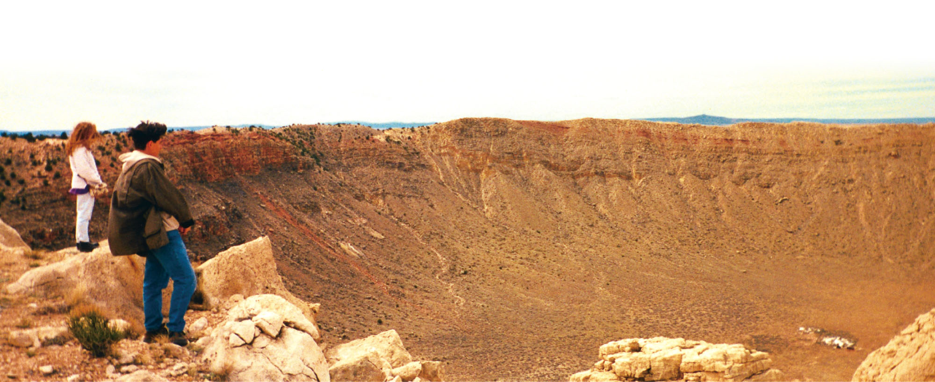
Continuing Bombardment of the Planets
Astronomers have good reason to believe that comets and asteroids can hit planets.

Slide 108
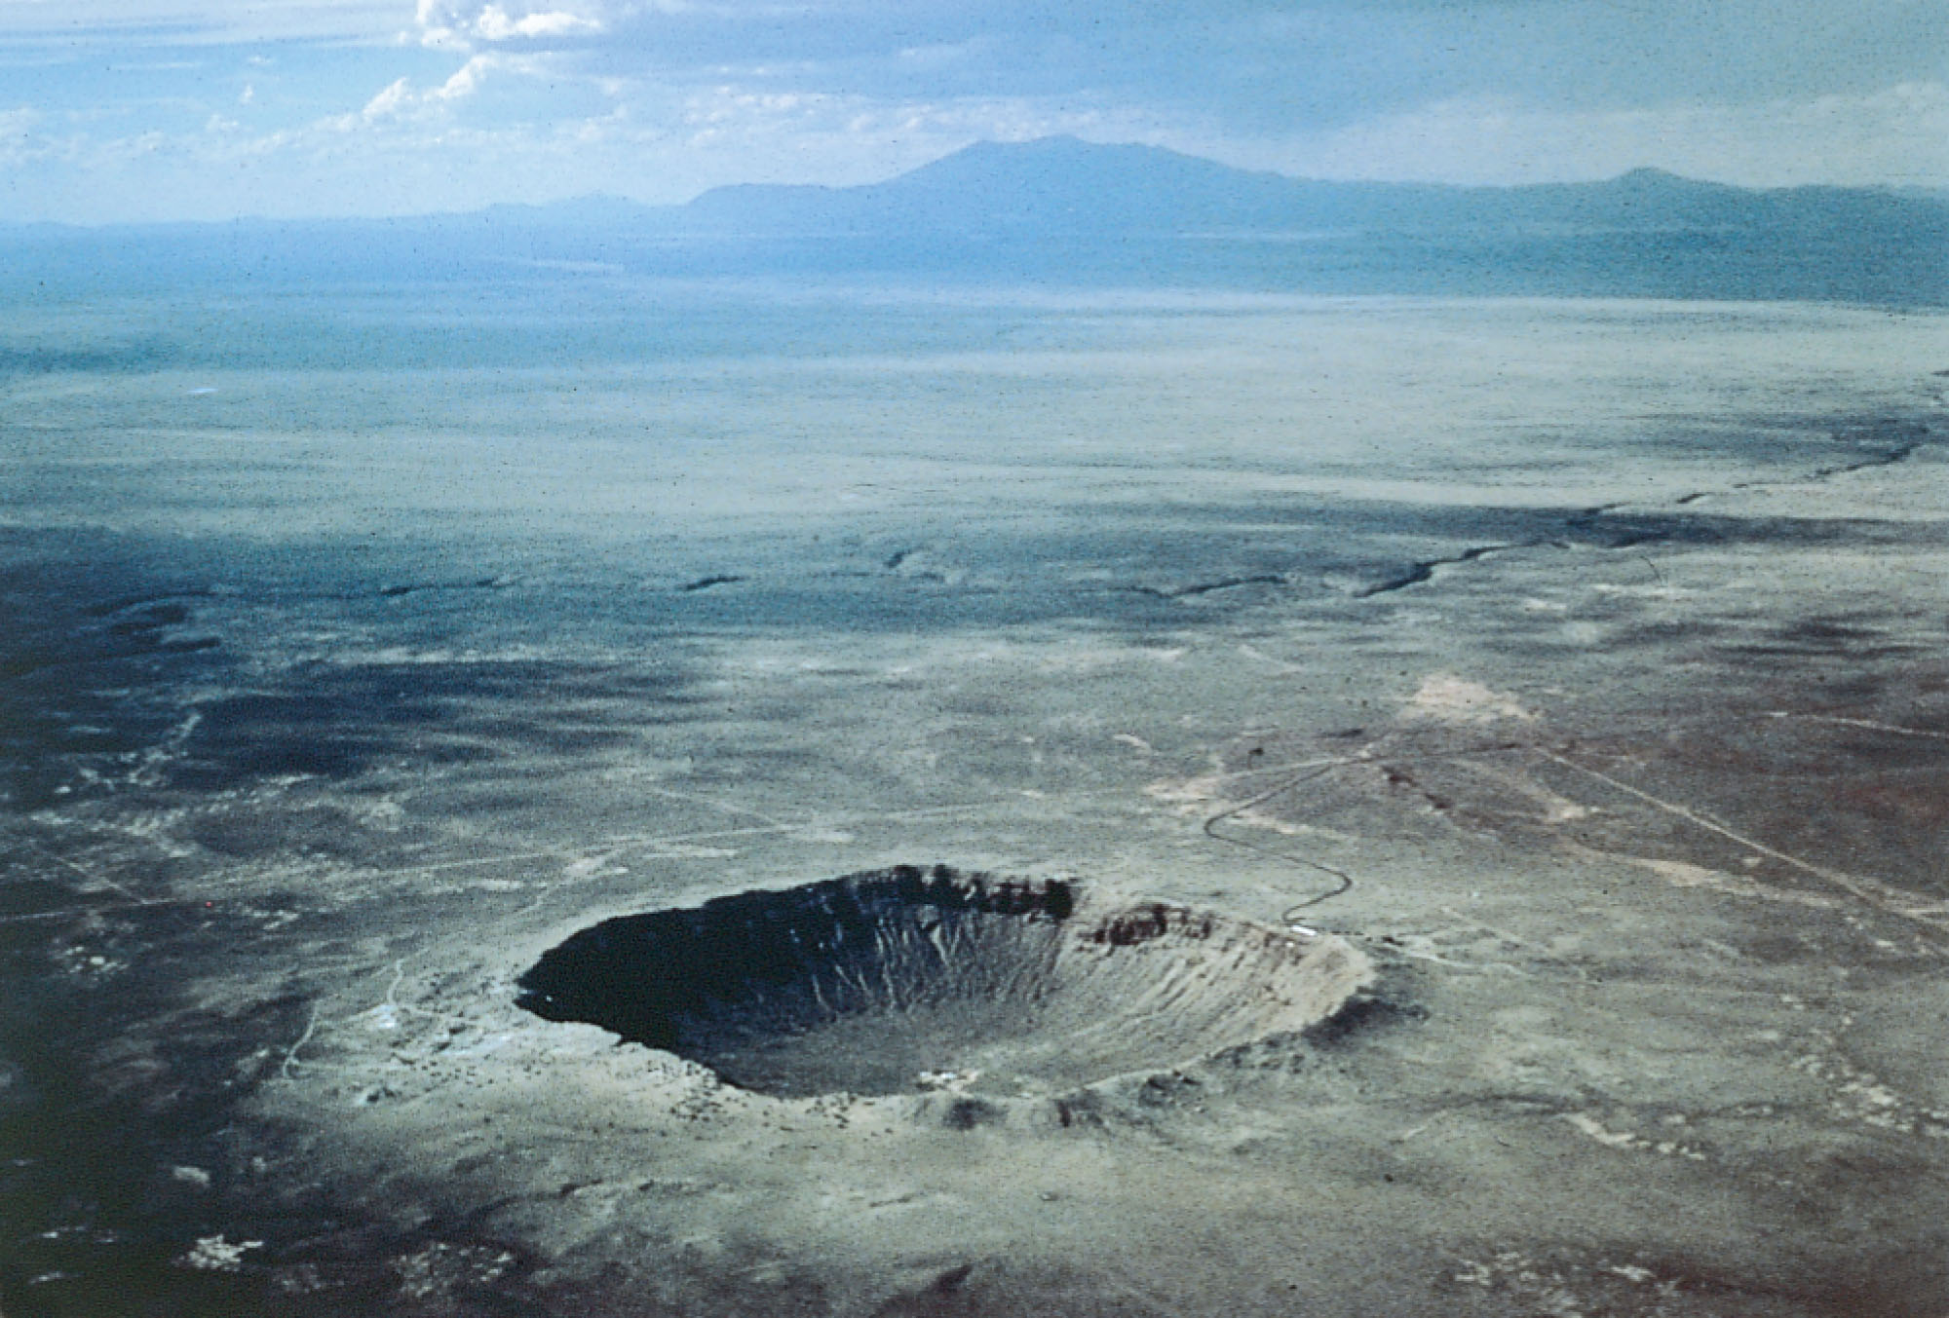
Continuing Bombardment of the Planets
Meteorites hit Earth every day, and occasionally a large one can form a crater.
Earth is marked by about 150 known meteorite craters.

Slide 109
Continuing Bombardment of the Planets
In a sense, this bombardment represents the slow continuation of the accretion of the planets.
Earth’s moon, Mercury, Venus, Mars, and most of the moons in the solar system are covered with craters.

Slide 110
Continuing Bombardment of the Planets
A few of these craters have been formed recently by the steady rain of meteorites that falls on all the planets in the solar system.
However, most of the craters you see appear to have been formed roughly 4 billion years ago as the last of the debris in the solar nebula was swept up by the planets.
This is called the heavy bombardment.

Slide 111
Continuing Bombardment of the Planets
65 million years ago, at the end of the Cretaceous period, over 75 percent of the species on Earth, including the dinosaurs, went extinct.

Slide 112
Continuing Bombardment of the Planets
Scientists have found a thin layer of clay all over the world that was laid down at that time.
It is rich in the element iridium—common in meteorites, but rare in Earth’s crust.
This suggests that a large impact altered Earth’s climate and caused the worldwide extinction.

Slide 113
Continuing Bombardment of the Planets
Mathematical models indicate that a major impact would eject huge amounts of pulverized rock high above the atmosphere.

Slide 114
Continuing Bombardment of the Planets
As this material fell back, Earth’s atmosphere would be turned into a glowing oven of red-hot meteorites streaming through the air.
This heat would trigger massive forest fires around the world.
Soot from such fires has been found in the final Cretaceous clay layers.

Slide 115
Continuing Bombardment of the Planets
Once the firestorms are cooled, the remaining dust in the atmosphere would block sunlight and produce deep darkness for a year or more— killing off most plant life.

Slide 116
Continuing Bombardment of the Planets
Other effects, such as acid rain and enormous tsunamis (tidal waves), are also predicted by the models.

Slide 117
Continuing Bombardment of the Planets
Geologists have located a crater at least 150 km in diameter centered near the village of Chicxulub in the northern Yucatán region of Mexico.

Slide 118
Continuing Bombardment of the Planets
Although the crater is completely covered by sediments, mineral samples show that it contains shocked quartz typical of impact sites and that it is the right age.

Slide 119
Continuing Bombardment of the Planets
The impact of an object 10 to 14 km in diameter formed the crater about 65 million years ago, just when the dinosaurs and many other species died out.
Most Earth scientists now believe that this is the scar of the impact that ended the Cretaceous period.

Slide 120
Continuing Bombardment of the Planets
Earthlings watched in awe during six days in the summer of 1994 as 20 or more fragments from the head of comet Shoemaker-Levy 9 slammed into Jupiter.
This produced impacts equaling millions of megatons of TNT.

Slide 121
Continuing Bombardment of the Planets
Each impact created a fireball of hot gases and left behind dark smudges that remained visible for months afterward.

Slide 122
Continuing Bombardment of the Planets
Such impacts on Jupiter probably occur once every century or two.
Major impacts on Earth occur less often because Earth is smaller, but they are inevitable.

Slide 123
Continuing Bombardment of the Planets
We are sitting ducks.
All of human civilization is spread out over Earth’s surface and exposed to anything that falls out of the sky.
Meteorites, asteroids, and comets bombard Earth, producing impacts that vary from dust settling on rooftops to blasts capable of destroying all life.

Slide 124
Continuing Bombardment of the Planets
In this case, the scientific evidence is conclusive and highly unwelcome.
Statistically, you are quite safe.
The chance that a major impact will occur during your lifetime is so small that it is hard to estimate.

Slide 125
Continuing Bombardment of the Planets
However, the consequences of such an impact are so severe that humanity should be preparing.
One way to prepare is to find those NEOs (Near Earth Objects) that could hit this planet, map their orbits in detail, and identify any that are dangerous.

Slide 126
The Jovian Problem
The solar nebula theory has been very successful in explaining the formation of the solar system.
However, there are some problems.
The Jovian planets are the troublemakers.
The gas and dust disks around newborn stars don’t last long.

Slide 127
The Jovian Problem
Earlier, you saw images of dusty gas disks around the young stars in the Orion nebula.
Those disks are being evaporated by the intense ultraviolet radiation from hot stars within the nebula.

Slide 128
The Jovian Problem
Astronomers estimate that most stars form in clusters containing some massive stars.
So, this evaporation process must happen to most disks.
Even if a disk did not evaporate quickly, model calculations predict that the gravitational influence of the crowded stars in a cluster should quickly strip away the outer parts of the disk.

Slide 129
The Jovian Problem
This is a troublesome observation.
It seems to mean that planet-forming disks around young stars are unlikely to last longer than a few million years, and many must evaporate within 100,000 years or so.
That’s not long enough to grow a Jovian planet by the processes in the solar nebula theory.
Yet, Jovian planets are common in the universe.

Slide 130
The Jovian Problem
A modification to the solar nebula theory has come from mathematical models of the solar nebula.

Slide 131
The Jovian Problem
The results show that the rotating gas and dust of the solar nebula may have become unstable and formed outer planets by direct gravitational collapse.
That is, massive planets may have been able to form from the gas without first forming a dense core by accretion.
Jupiters and Saturns form in these calculated models within a few hundred years.

Slide 132
The Jovian Problem
If the Jovian planets formed in this way, they could have formed quickly—before the solar nebula disappeared.

Slide 133
The Jovian Problem
This new insight into the formation of the outer planets may help explain the formation of Uranus and Neptune.
They are so far from the sun that accretion could not have built them rapidly.
It is hard to understand how they could have reached their present mass in a region where the material should have been sparse and orbital speeds are slow.

Slide 134
Test your Understanding
Outgassing is
a. the adding of material to an object an atom or molecule at a time.
b. the adding of material to an object by collection of solid particles.
c. the release of gas from rocks as they are heated.
d. the largest of the Galilean satellites.
e. caused by the bombardment of the solar wind.

Slide 135
Growth of Protoplanets
In its simplest form, the theory of terrestrial protoplanet growth supposes that all the planetesimals had about the same chemical composition.

Slide 136
Growth of Protoplanets
The planetesimals accumulated gradually to form a planet-size ball of material that was of homogeneous composition throughout.

Slide 137
Growth of Protoplanets
As a planet formed, heat began to accumulate in its interior from the decay of short-lived radioactive elements.
This heat eventually melted the planet and allowed it to differentiate.
Differentiation is the separation of material according to density.

Slide 138
Growth of Protoplanets
When the planet melted, the heavy metals such as iron and nickel settled to the core.
The lighter silicates floated to the surface to form a low-density crust.

Slide 139
Growth of Protoplanets
This process depends on the presence of short-lived radioactive elements whose rapid decay would have released enough heat to melt the interior of planets.

Slide 140
Growth of Protoplanets
Astronomers know such elements were present because very old rock from meteorites contains daughter isotopes such as magnesium-26.
– That isotope is produced by the decay of aluminum-26 in a reaction that has a half-life of only 0.74 million years.

Slide 141
Growth of Protoplanets
The aluminum-26 and similar short-lived radioactive isotopes are gone now.
However, they must have been produced in a supernova explosion that occurred no more than a few million years before the formation of the solar nebula.

Slide 142
Growth of Protoplanets
In fact, many astronomers suspect that this supernova explosion compressed nearby gas and triggered the formation of stars—one of which became the sun.
Thus, our solar system may exist because of a supernova explosion that occurred about 4.6 billion years ago.

Slide 143
Growth of Protoplanets
If planets formed and were later melted by radioactive decay, gases released from the planet’s interior would have formed an atmosphere.
The creation of a planetary atmosphere from a planet’s interior is called outgassing.

Slide 144
Growth of Protoplanets
Models of the formation of Earth indicate that the local planetesimals would not have included much water.
So, some astronomers now think that Earth’s water and some of its present atmosphere accumulated late in the formation of the planets.
Then, Earth swept up volatile-rich planetesimals forming in the cooling solar nebula.

Slide 145
Growth of Protoplanets
Such icy planetesimals may have formed in the outer parts of the solar nebula.
They have been scattered by encounters with the Jovian planets in a bombardment of comets.

Slide 146
Growth of Protoplanets
According to the solar nebula theory, the Jovian planets began growing by the same processes that built the terrestrial planets.
The outer solar nebula not only contained solid bits of metals and silicates—it also included abundant ices.
The Jovian planets grew rapidly and quickly became massive enough to grow by gravitational collapse—drawing in large amounts of gas from the solar nebula.

Slide 147
Growth of Protoplanets
Ices could not condense as solids at the locations of the terrestrial planets.
So, those planets developed slowly and never became massive enough to grow by gravitational collapse.

Slide 148
Growth of Protoplanets
The Jovian planets must have grown to their present size in about 10 million years.
Astronomers calculate that the sun then became hot and luminous enough to blow away the gas remaining in the solar nebula.

Slide 149
Growth of Protoplanets
The terrestrial planets grew from solids and not from the gas.
So, they continued to grow by accretion from solid debris left behind when the gas was blown away.

Slide 150
Growth of Protoplanets
Model calculations indicate the process of planet formation was almost completely finished by the time the solar system was 30 million years old.

Slide 151
Continuing Bombardment of the Planets
Astronomers have good reason to believe that comets and asteroids can hit planets.

Slide 152
Continuing Bombardment of the Planets
Meteorites hit Earth every day, and occasionally a large one can form a crater.
Earth is marked by about 150 known meteorite craters.

Slide 153
Continuing Bombardment of the Planets
In a sense, this bombardment represents the slow continuation of the accretion of the planets.
Earth’s moon, Mercury, Venus, Mars, and most of the moons in the solar system are covered with craters.

Slide 154
Continuing Bombardment of the Planets
A few of these craters have been formed recently by the steady rain of meteorites that falls on all the planets in the solar system.

Slide 155
Continuing Bombardment of the Planets
However, most of the craters you see appear to have been formed roughly 4 billion years ago as the last of the debris in the solar nebula was swept up by the planets.
This is called the heavy bombardment.

Slide 156
Continuing Bombardment of the Planets
65 million years ago, at the end of the Cretaceous period, over 75 percent of the species on Earth, including the dinosaurs, went extinct.

Slide 157
Continuing Bombardment of the Planets
Scientists have found a thin layer of clay all over the world that was laid down at that time.
It is rich in the element iridium—common in meteorites, but rare in Earth’s crust.
This suggests that a large impact altered Earth’s climate and caused the worldwide extinction.

Slide 158
Continuing Bombardment of the Planets
Mathematical models indicate that a major impact would eject huge amounts of pulverized rock high above the atmosphere.

Slide 159
Continuing Bombardment of the Planets
As this material fell back, Earth’s atmosphere would be turned into a glowing oven of red-hot meteorites streaming through the air.
This heat would trigger massive forest fires around the world.
Soot from such fires has been found in the final Cretaceous clay layers.

Slide 160
Continuing Bombardment of the Planets
Once the firestorms are cooled, the remaining dust in the atmosphere would block sunlight and produce deep darkness for a year or more— killing off most plant life.

Slide 161
Continuing Bombardment of the Planets
Other effects, such as acid rain and enormous tsunamis (tidal waves), are also predicted by the models.

Slide 162
Continuing Bombardment of the Planets
Geologists have located a crater at least 150 km in diameter centered near the village of Chicxulub in the northern Yucatán region of Mexico.

Slide 163
Continuing Bombardment of the Planets
Although the crater is completely covered by sediments, mineral samples show that it contains shocked quartz typical of impact sites and that it is the right age.

Slide 164
Continuing Bombardment of the Planets
The impact of an object 10 to 14 km in diameter formed the crater about 65 million years ago, just when the dinosaurs and many other species died out.
Most Earth scientists now believe that this is the scar of the impact that ended the Cretaceous period.

Slide 165
Continuing Bombardment of the Planets
Earthlings watched in awe during six days in the summer of 1994 as 20 or more fragments from the head of comet Shoemaker-Levy 9 slammed into Jupiter.
This produced impacts equaling millions of megatons of TNT.

Slide 166
Continuing Bombardment of the Planets
Each impact created a fireball of hot gases and left behind dark smudges that remained visible for months afterward.

Slide 167
Continuing Bombardment of the Planets
Such impacts on Jupiter probably occur once every century or two.
Major impacts on Earth occur less often because Earth is smaller, but they are inevitable.

Slide 168
Continuing Bombardment of the Planets
We are sitting ducks.
All of human civilization is spread out over Earth’s surface and exposed to anything that falls out of the sky.
Meteorites, asteroids, and comets bombard Earth, producing impacts that vary from dust settling on rooftops to blasts capable of destroying all life.

Slide 169
Continuing Bombardment of the Planets
In this case, the scientific evidence is conclusive and highly unwelcome.
Statistically, you are quite safe.
The chance that a major impact will occur during your lifetime is so small that it is hard to estimate.

Slide 170
Continuing Bombardment of the Planets
However, the consequences of such an impact are so severe that humanity should be preparing.
One way to prepare is to find those NEOs (Near Earth Objects) that could hit this planet, map their orbits in detail, and identify any that are dangerous.

Slide 171
The Jovian Problem
The solar nebula theory has been very successful in explaining the formation of the solar system.
However, there are some problems.
The Jovian planets are the troublemakers.
The gas and dust disks around newborn stars don’t last long.

Slide 172
The Jovian Problem
Earlier, you saw images of dusty gas disks around the young stars in the Orion nebula.
Those disks are being evaporated by the intense ultraviolet radiation from hot stars within the nebula.

Slide 173
The Jovian Problem
Astronomers estimate that most stars form in clusters containing some massive stars.
So, this evaporation process must happen to most disks.

Slide 174
The Jovian Problem
Even if a disk did not evaporate quickly, model calculations predict that the gravitational influence of the crowded stars in a cluster should quickly strip away the outer parts of the disk.

Slide 175
The Jovian Problem
This is a troublesome observation.
It seems to mean that planet-forming disks around young stars are unlikely to last longer than a few million years, and many must evaporate within 100,000 years or so.
That’s not long enough to grow a Jovian planet by the processes in the solar nebula theory.
Yet, Jovian planets are common in the universe.

Slide 176
The Jovian Problem
A modification to the solar nebula theory has come from mathematical models of the solar nebula.

Slide 177
The Jovian Problem
The results show that the rotating gas and dust of the solar nebula may have become unstable and formed outer planets by direct gravitational collapse.
That is, massive planets may have been able to form from the gas without first forming a dense core by accretion.
Jupiters and Saturns form in these calculated models within a few hundred years.

Slide 178
The Jovian Problem
If the Jovian planets formed in this way, they could have formed quickly—before the solar nebula disappeared.

Slide 179
The Jovian Problem
This new insight into the formation of the outer planets may help explain the formation of Uranus and Neptune.
They are so far from the sun that accretion could not have built them rapidly.
It is hard to understand how they could have reached their present mass in a region where the material should have been sparse and orbital speeds are slow.

