Slide 2
Chapter 13
Galaxies: Normal and Active

Slide 3
In this chapter, you will try to understand how galaxies form and evolve.
  You will discover that the amount of gas and dust in a galaxy is a critical clue.
  You will also discover that interactions between galaxies can influence their structure and evolution.

Slide 4
The Family of Galaxies
Astronomers classify galaxies according to shape—using a system developed in the 1920s by Edwin Hubble (namesake of the Hubble Space Telescope).
  Creating a system of classification is a fundamental technique in science.

Slide 5
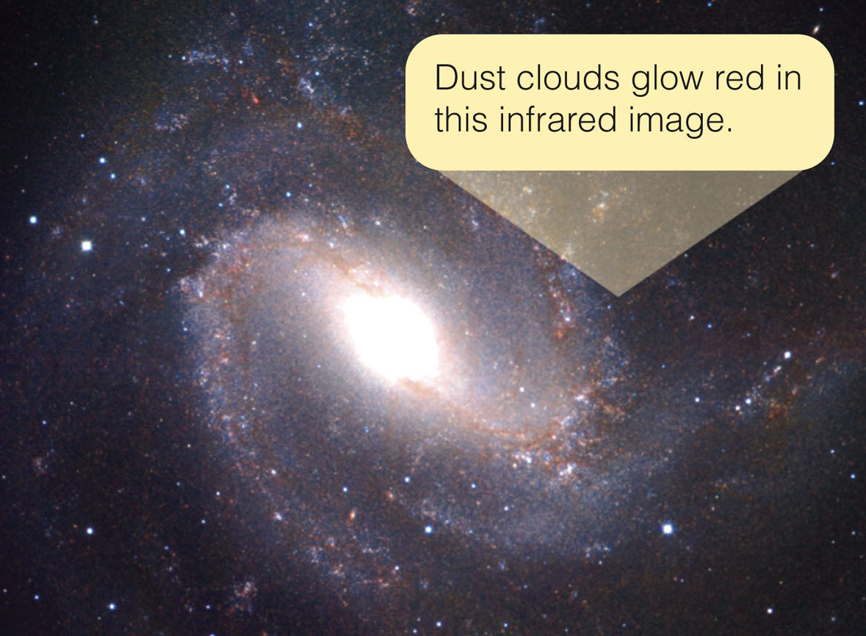
The Family of Galaxies
There are three important
points to note about galaxy classification.

Slide 6
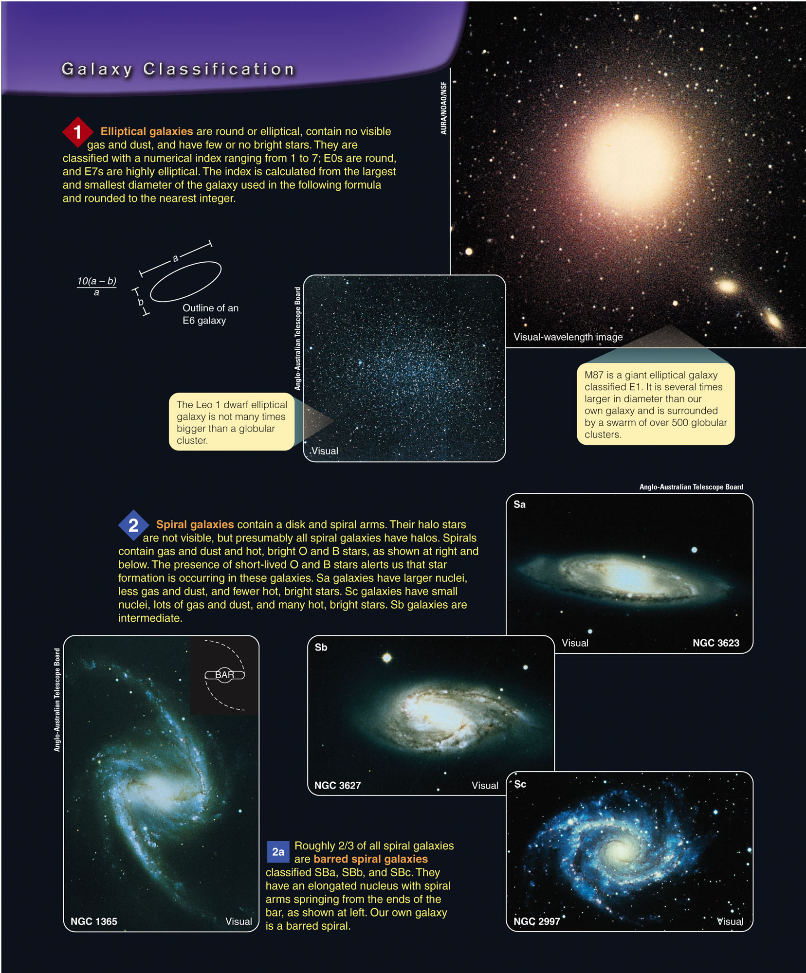
The Family of Galaxies
One, many galaxies have no disk, no spiral arms, and almost no gas and dust.
  These elliptical galaxies range from huge giants to small dwarfs.

Slide 7
The Family of Galaxies
Two, disk-shaped galaxies usually have spiral arms and contain gas and dust, although some have very little.
  Many spiral galaxies have a barred structure.
Notes:
Barred structure:A barred spiral galaxy is a spiral galaxy with a central bar-shaped structure composed of stars. Bars are found in approximately two-thirds of all spiral galaxies.^{[1]} Bars generally affect both the motions of stars and interstellar gas within spiral galaxies and can affect spiral arms as well.

Slide 8
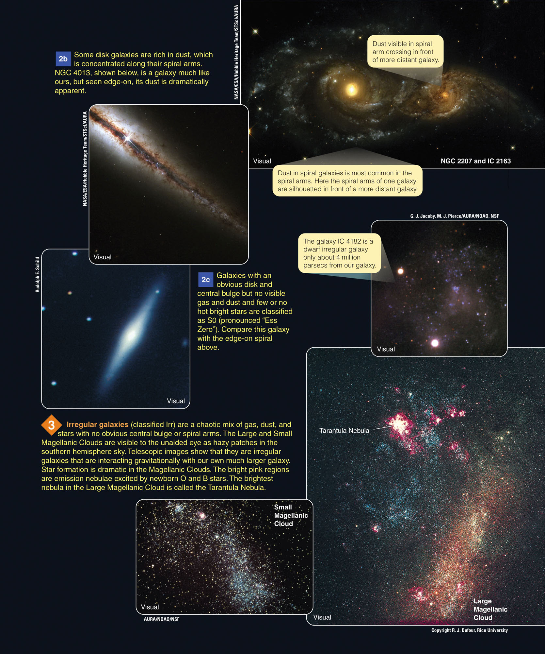
The Family of Galaxies
Three, some galaxies are highly irregular in shape and tend to be rich in gas and dust.

Slide 9
The Family of Galaxies
Spiral galaxies contain hot, bright stars—and are thus very luminous and easy to see.
Among spiral galaxies, about two-thirds are barred spirals.
  From careful studies, astronomers can conclude that ellipticals are more common than spirals.
  The irregulars make up only about 25 percent
  of all galaxies.

Slide 10
The Family of Galaxies
Different kinds of galaxies have different colors, depending mostly on how much star formation is happening in them.

Slide 11
The Family of Galaxies
Spirals and irregulars usually contain plenty of young stars, including massive, hot, luminous O and B stars.
  They produce most of the light and give spirals and irregulars a distinct blue tint.

Slide 12
The Family of Galaxies
In contrast, elliptical galaxies usually contain few young stars.
The most luminous stars in ellipticals are red giants, which give those galaxies a red tint.

Slide 13
The Family of Galaxies
How many galaxies are there?
  A research effort called GOODS (Great Observatories Origins Deep Survey) has used various telescopes.
  These include the Hubble Space Telescope, the Chandra X-Ray Observatory, the Spitzer Space Telescope, and the XXM-Newton X-Ray Telescope.
  Also there are the largest ground-based telescopes, to study two selected areas in the northern and southern skies.

Slide 14
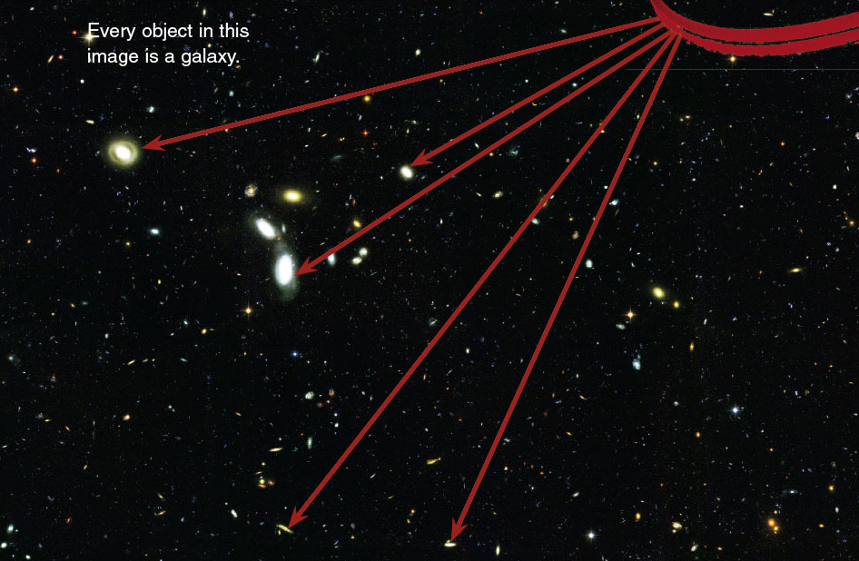
The Family of Galaxies
The GOODS deep images reveal tremendous numbers of galaxies.

Slide 15
The Family of Galaxies
There are good reasons to believe that the two regions of the sky chosen for study are typical.
  So, it seems likely that the entire sky is carpeted with galaxies.
  At least, 100 billion would be visible if today’s telescopes were used for an all-sky census.

Slide 16
Measuring the Properties of Galaxies
Beyond the edge of Milky Way, astronomers find many billions of galaxies.
  What are the properties of these star systems?
  What are the diameters, luminosities, and masses of galaxies?

Slide 17
Distance
The distances to galaxies are so large that it is not convenient to express them in light-years, parsecs, or even kiloparsecs.
  Instead, astronomers use the unit megaparsec (Mpc), or 1 million pc.
  One Mpc equals 3.26 million ly, or approximately 3 x 10¹⁹ km (2 x 10¹⁹ miles).

Slide 18
Distance
To find the distance to a galaxy, astronomers must search among its stars, nebulae, and star clusters for familiar objects.
They must know the luminosity and diameter.
  Such objects are called standard candles.
  If you can find a standard candle in a galaxy, you can judge its distance.

Slide 19
Distance
When a supernova explodes in a distant galaxy, astronomers rush to observe it.
  Studies show that type Ia supernovae—caused by the collapse of a white dwarf—all reach about the same absolute magnitude at maximum.
  This makes them more like “standard bombs” than standard candles.

Slide 20
Distance
When type Ia supernovae are seen in more distant galaxies, astronomers can measure the apparent brightness at maximum.
  They can compare that with the known luminosity of these supernovae to find their distances.

Slide 21
Distance
Astronomers use calibration to build a distance scale reaching from the nearest galaxies to the most distant visible galaxies.
  Often, they refer to this as the distance ladder—as each step depends on the steps below it.

Slide 22
Distance
Of course, the foundation of the scale rests on understanding the luminosities of stars.
  This ultimately rests on measurements of stellar parallax.

Slide 23
Telescopes as Time Machines
The most distant visible galaxies are little over 10 billion ly (3,000 Mpc) away.
When you look at a galaxy only a few million light-years away, you do not see it as it is now but as it was millions of years ago.
  This is when its light began the journey towards Earth.

Slide 24
Telescopes as Time Machines
When you look at a more distant galaxy, you look back into the past by an amount called the look-back time.
  This is the time in years equal to the distance
  to the galaxy in light-years.

Slide 25
Telescopes as Time Machines
The look-back time to nearby objects is usually not significant.
  The look-back time to the moon is 1.3 seconds,
  and to the sun only 8 minutes.
  To the nearest star, it is about 4 years.

Slide 26
Telescopes as Time Machines
The Andromeda Galaxy has a look-back time of about 2 million years—a mere eye blink in the lifetime of a galaxy.
When astronomers look at more distant galaxies though, the look-back time becomes an appreciable part of the age of the universe.

Slide 27
Telescopes as Time Machines
When astronomers observe the most distant visible galaxies, they are looking back over 10 billion years.
  At that time, the universe may have been significantly different.

Slide 28
The Hubble Law
Astronomers find it difficult to measure the distance to a galaxy.
They often estimate such distances using a simple relationship.
  Early in the 20th century, astronomers noticed that the lines in galaxy spectra were shifted slightly toward longer wavelengths—redshifts.
  These redshifts imply that the galaxies are receding from Earth.

Slide 29
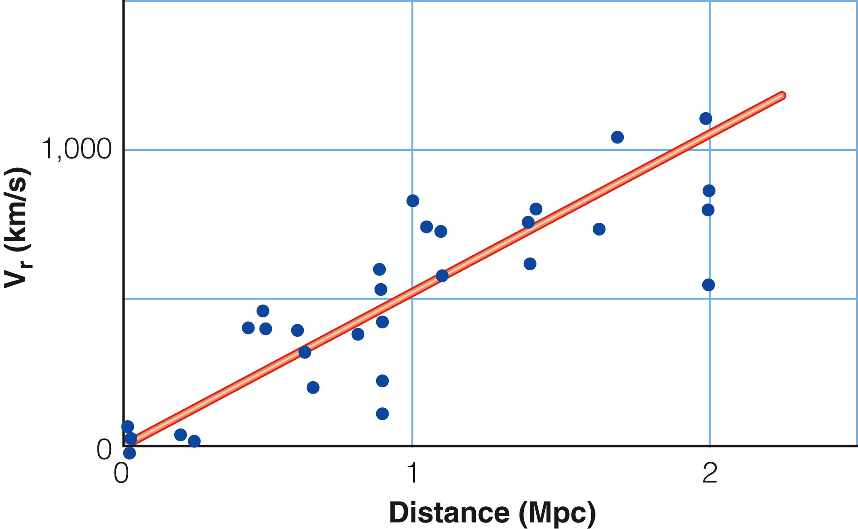
The Hubble Law
In 1929, the American astronomer Edwin Hubble published a graph that plotted the apparent velocities of recession versus distance for a number of galaxies.
  The points in the
  graph fell along a
  straight line.

Slide 30
The Hubble Law
This relation between apparent velocity of recession and distance is known as the Hubble law.
  The slope of the line is known as the Hubble constant, symbolized by H.

Slide 31
The Hubble Law
The Hubble law is important in astronomy for two reasons.
  It is taken as evidence that the universe is expanding.
  Astronomers use it to estimate the distance to galaxies.

Slide 32
The Hubble Law
The distance to a galaxy can be found by dividing its apparent velocity of recession by the Hubble constant.

Slide 33
The Hubble Law
This is a very useful calculation—because it is usually possible to obtain a spectrum of a galaxy and measure its redshift.
  You can do this even if it is too far away to have observable standard candles.
  Obviously, knowing the Hubble constant is important.

Slide 34
The Hubble Law
Edwin Hubble’s original measurement of H was too large because of errors in his measurements of the distances to galaxies.
  Later astronomers have struggled to measure this important constant.

Slide 35
The Hubble Law
The most precise measurements of the Hubble constant yield a value of H about 70 km/s/Mpc. (This is with an uncertainty of about 5 percent.)
  This means that a galaxy at a distance of 1 Mpc from the Milky Way is receding from us at a rate of 70 km/s.
  A galaxy 2 Mpc away is receding at 140 km/s.

Slide 36
The Hubble Law
Note that modern astronomers interpret redshifts of galaxies as caused by the expansion of the universe.
  The Hubble law allows them to estimate the distance to a galaxy from its redshift.

Slide 37
Galaxy Distances and Luminosities
The distance to a galaxy is the key to finding its diameter and its luminosity.
  With even a modest telescope and a CCD camera, you could photograph a galaxy and measure its angular diameter.
  If you knew the distance to the galaxy, you can then find its linear diameter.
  Also, if you measure the apparent brightness of the galaxy, you can use the distance to find its luminosity.
Notes:
A charge-coupled device is a device for the movement of electrical charge, usually from within the device to an area where the charge can be manipulated

Slide 38
Galaxy Distances and Luminosities
The results of such observations show that galaxies differ dramatically in size and luminosity.
  Irregular galaxies tend to be small—1 to 25 percent the size of Milky Way—and have low luminosity.
  Although they are common, they are easy to overlook.

Slide 39
Galaxy Distances and Luminosities
Our Milky Way is large and luminous compared with most spiral galaxies.
  However, astronomers know of a few spiral galaxies that are even larger and more luminous.

Slide 40
Galaxy Distances and Luminosities
Elliptical galaxies cover a wide range of diameters and luminosities.
  The largest, called giant ellipticals, are five times the size of Milky Way.
  Many elliptical galaxies, though, dwarf ellipticals—are only 1 percent the diameter of our galaxy.

Slide 41
Galaxy Distances and Luminosities
Clearly, the diameter and luminosity of a galaxy do not determine its type.
  Some small galaxies are irregular, and some are elliptical.
  Some large galaxies are spiral, and some are elliptical.
  Other factors must influence the origin and evolution of galaxies.

Slide 42
Galaxy Masses
The mass of a galaxy is difficult to determine.
Nevertheless, it is an important quantity.
  It shows you how much matter the galaxy contains—which provides clues to the galaxy’s origin and evolution.

Slide 43
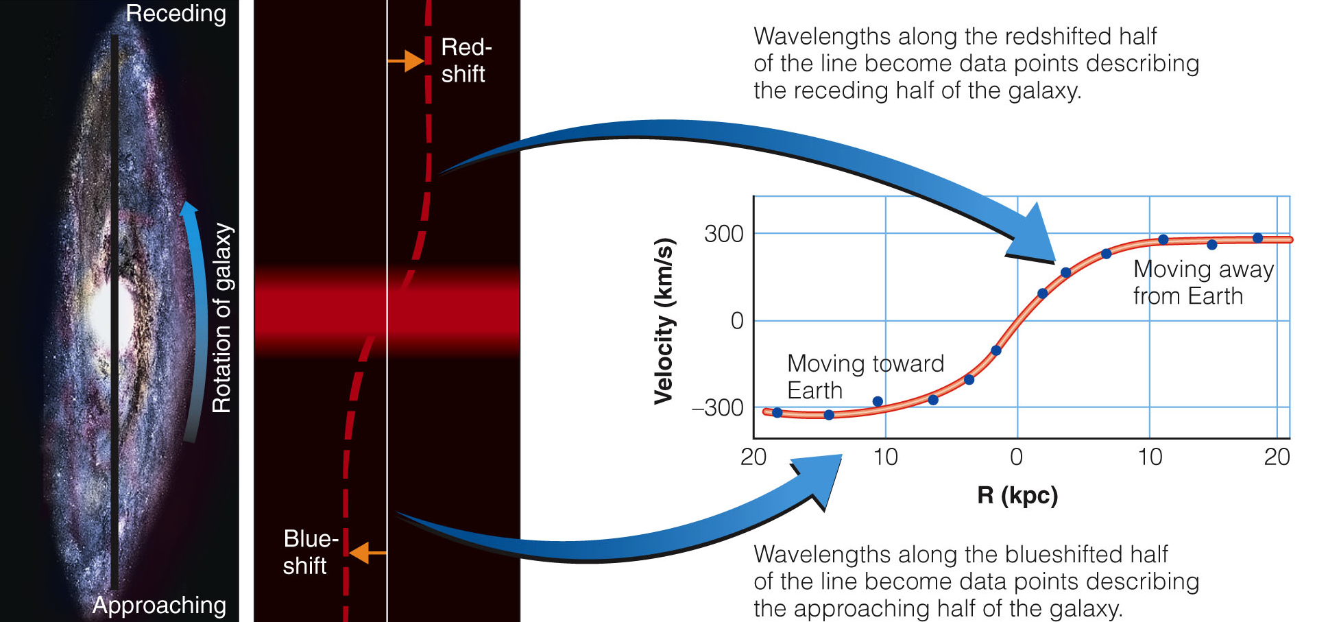
Galaxy Masses
The most precise method for measuring the mass of a galaxy is called the rotation curve method.

Slide 44
Galaxy Masses
The rotation curve method requires knowing:
  The true sizes of the orbits of stars or gas clouds within a galaxy, which in turn requires knowing the distance of that galaxy
  The orbital speeds of the stars or gas clouds, measured from the Doppler shifts of their spectral lines

Slide 45
Galaxy Masses
That is enough information to use Kepler’s third law and find the mass of the part of the galaxy contained within the star orbits with measured sizes and speeds.

Slide 46
Galaxy Masses
The rotation curve method works only for galaxies near enough to be well resolved.
  More distant galaxies appear so small that astronomers cannot measure the radial velocity
  at different points across the galaxy.
  They must use other, less precise, methods to estimate masses.

Slide 47
Galaxy Masses
The masses of galaxies cover a wide range.
  The smallest contain about 10⁻⁶ as much mass as the Milky Way.
  The largest contain as much as 50 times more than the Milky Way.

Slide 48
Dark Matter in Galaxies
Given the size and luminosity of a galaxy, astronomers can make a rough guess as to the amount of matter it should contain.
  They know how much light stars produce.
  They also know how much matter there is between the stars.
  So, it should be possible to estimate very roughly, the mass of a galaxy from its luminosity.

Slide 49
Dark Matter in Galaxies
When astronomers measure the masses of galaxies, however, they find that the measured masses are much larger than expected from the luminosities of the galaxies.

Slide 50
Dark Matter in Galaxies
Astronomer Vera Rubin found in the 1960s that this also seems to be true of most nearby galaxies.
  Measured masses of galaxies amount to 10 to 100 times more mass than you can see.

Slide 51
Dark Matter in Galaxies
Dark matter is difficult to detect, and it is even harder to explain.
  Some astronomers have suggested that dark matter consists of low-luminosity white dwarfs and brown dwarfs.
  They are scattered through the halos of galaxies.

Slide 52
Dark Matter in Galaxies
Searches for white dwarfs and brown dwarfs in the halo of our galaxy have found a few, but not enough to make up most of the dark matter.

Slide 53
Dark Matter in Galaxies
The dark matter can’t be hidden in vast numbers of black holes and neutron stars.
  Astronomers don’t see the X rays these objects would emit.
  There is 10 to 100 times more dark matter than visible matter in galaxies.
  That many black holes would produce X rays that would be easy to detect.

Slide 54
Dark Matter in Galaxies
Also, recent images from the Chandra X-ray observatory indicate:
  A collision between two galaxy clusters caused their gas and dark matter components to separate.

Slide 55
Dark Matter in Galaxies
As observations imply, the dark matter can’t be composed of familiar objects or material.
  Astronomers are forced to conclude that the dark matter is made up of unexpected forms of matter.

Slide 56
Dark Matter in Galaxies
Until recently, neutrinos were thought to be massless.
  Studies now suggest they have a very small mass.
  Thus, they may represent part of the dark matter.

Slide 57
Dark Matter in Galaxies
However, their masses are too low to make up all the dark matter.
  There must be some other undiscovered form of matter in the universe that is detectable only by its gravitational field.

Slide 58
Dark Matter in Galaxies
Dark matter remains one of the fundamental unresolved problems of modern astronomy.
  Observations of galaxies and clusters of galaxies reveal that 90 to 95 percent of the matter in the universe is dark matter.

Slide 59
Supermassive Black Holes in Galaxies
Doppler shift measurements show that the stars near the centers of many galaxies are orbiting very rapidly.

Slide 60
Supermassive Black Holes in Galaxies
To hold stars in such small,
short-period orbits, the centers of galaxies must contain masses of a million to a few billion solar masses.
  Yet, no object is visible.
  The evidence seems to require that the nuclei of galaxies contain supermassive black holes.
  You have learned that Milky Way contains a supermassive black hole at its center.
  Evidently, that is typical of galaxies.

Slide 61
Supermassive Black Holes in Galaxies
It is a common misconception that the orbits of stars throughout a galaxy are controlled by the central black hole.
  The masses of those black holes, large as they may seem, are negligible compared with a galaxy’s mass.
  The 2.6-million-solar-mass black hole at the center of Milky Way contains only a thousandth of one per cent of the total mass of the galaxy.

Slide 62
The Evolution of Galaxies
Your goal in the chapter has been to build a theory that explains the evolution of galaxies.
  Earlier, you developed a theory that described the origin of Milky Way.
  Presumably, other galaxies formed in similar ways.

Slide 63
The Evolution of Galaxies
Why did some galaxies become spiral, some elliptical, and some irregular?
  Clues to that mystery lie in the clustering of galaxies.

Slide 64
Clusters of Galaxies
The distribution of galaxies is not entirely random.
  Galaxies tend to occur in clusters ranging from a few to thousands.
  Deep photos made with the largest telescopes reveal clusters of galaxies scattered out to the limits of visibility.
  This clustering of the galaxies can help you understand their evolution.

Slide 65
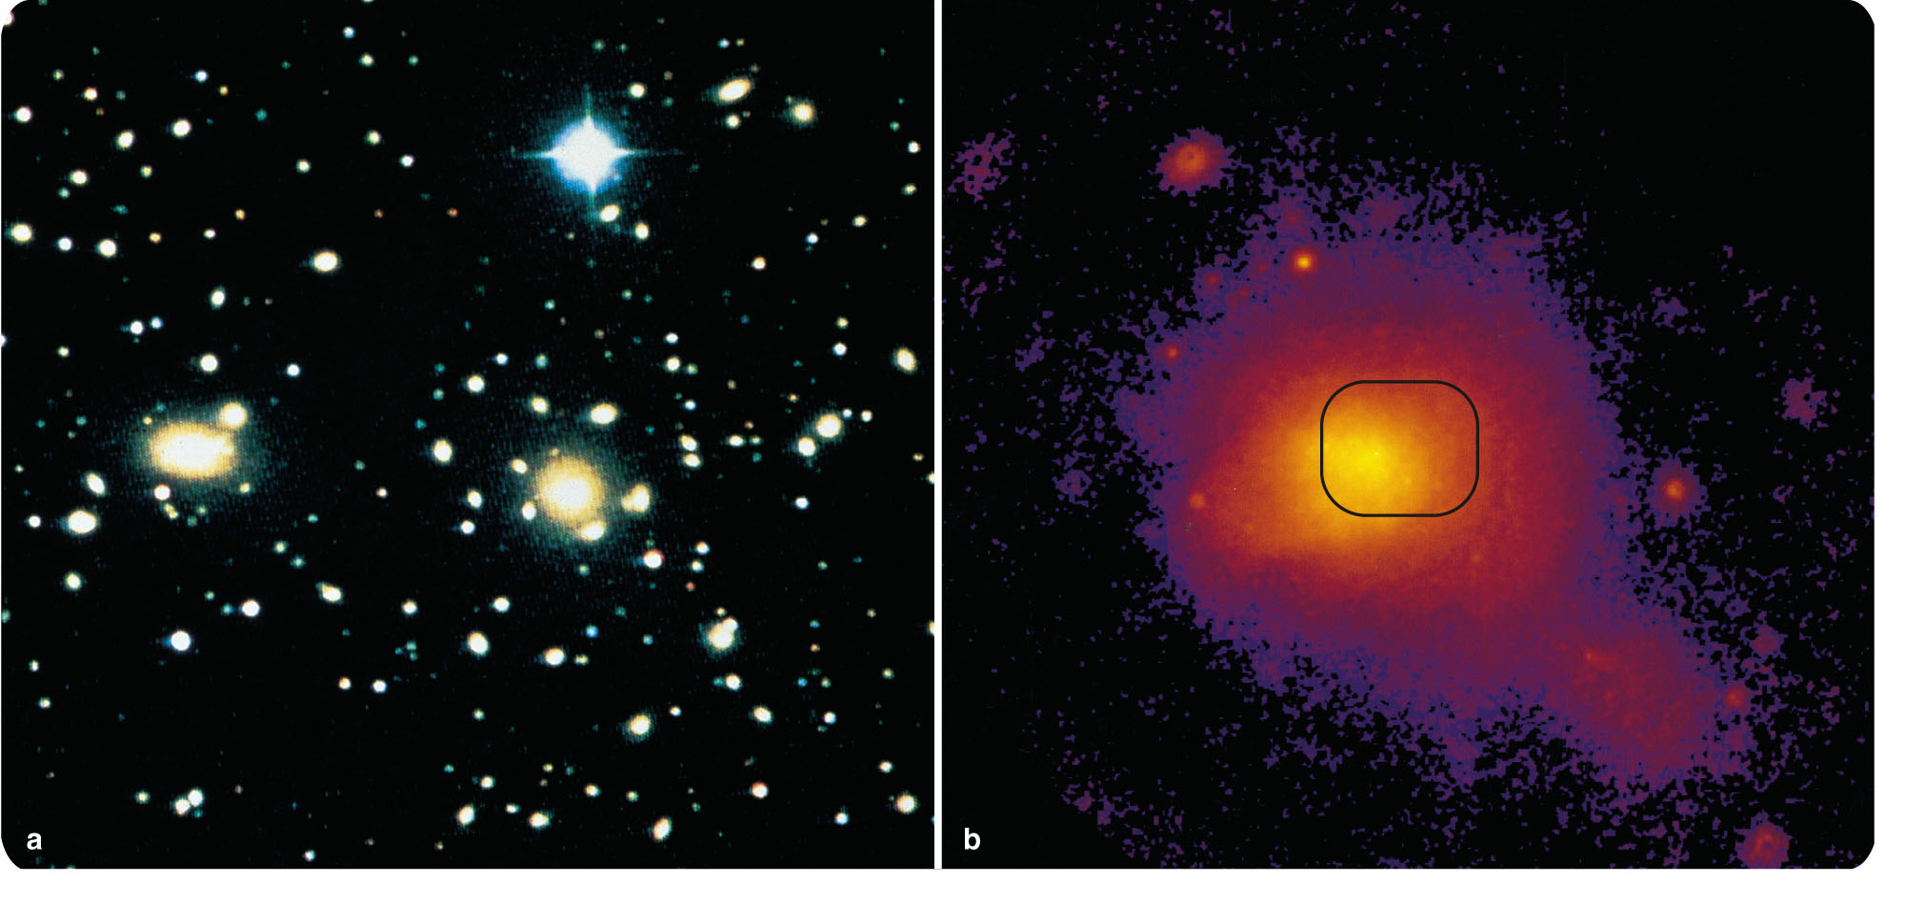
Clusters of Galaxies
For this discussion, you can sort clusters into two groups—rich and poor.
Rich galaxy clusters contain over a thousand galaxies, mostly elliptical.
  They are scattered
  through a spherical
  volume about
  3 Mpc (10⁷ ly)
  in diameter.

Slide 66
Clusters of Galaxies
The Coma cluster (located 100 Mpc from Earth in the direction of the constellation Coma Berenices) is an example of a rich cluster.
  It contains at least 1,000
  galaxies, mostly E and
  S0 types.
  Close to its center are
  a giant elliptical galaxy
  and a large S0 galaxy.

Slide 67
Clusters of Galaxies
Rich clusters often contain one or more giant elliptical galaxies at their centers.
In contrast, poor galaxy clusters contain fewer than 1,000 galaxies.
  They are irregularly shaped, and are less crowded towards the center.

Slide 68
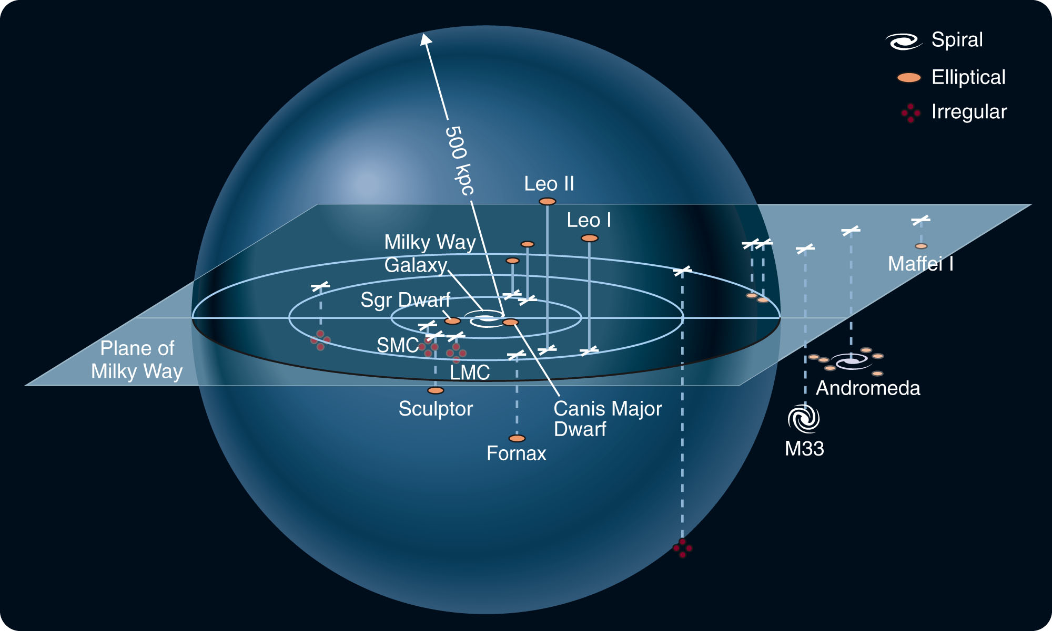
Clusters of Galaxies
Our own Local Group, which contains Milky Way, is a good example of a poor cluster.

Slide 69
Clusters of Galaxies
It contains a few dozen members scattered irregularly through a volume slightly over 1 Mpc in diameter.

Slide 70
Clusters of Galaxies
Of the brighter galaxies, 14 are elliptical, 3 are spiral, and 4 are irregular.

Slide 71
Clusters of Galaxies
Classifying clusters as either rich or poor reveals a fascinating and suggestive clue to the evolution of galaxies.
  In general, rich clusters tend to contain 80 to 90 percent E and S0 galaxies and few spirals.
  Poor clusters contain a larger percentage of spirals.
  Among isolated galaxies that are not in clusters, 80 to 90 percent are spirals.

Slide 72
Clusters of Galaxies
This suggests that a galaxy’s environment is important in determining its structure.
  This has led astronomers to suspect that the secrets of galaxy evolution lie in collisions between galaxies.

Slide 73
Colliding Galaxies
Astronomers are finding more and more evidence to show that galaxies collide, interact, and merge.
  In fact, collisions among galaxies may dominate their evolution.

Slide 74
Colliding Galaxies
You should not be surprised that galaxies collide with each other.
  The average separation between galaxies is only about 20 times their diameter.
  So, astronomically speaking, galaxies should bump into each other fairly often.

Slide 75
Colliding Galaxies
Stars, on the other hand, almost never collide—because the typical separation between stars is about 10⁷ times their diameter.
  A collision between two stars is about as likely as a collision between two gnats flitting about in a baseball stadium.

Slide 76
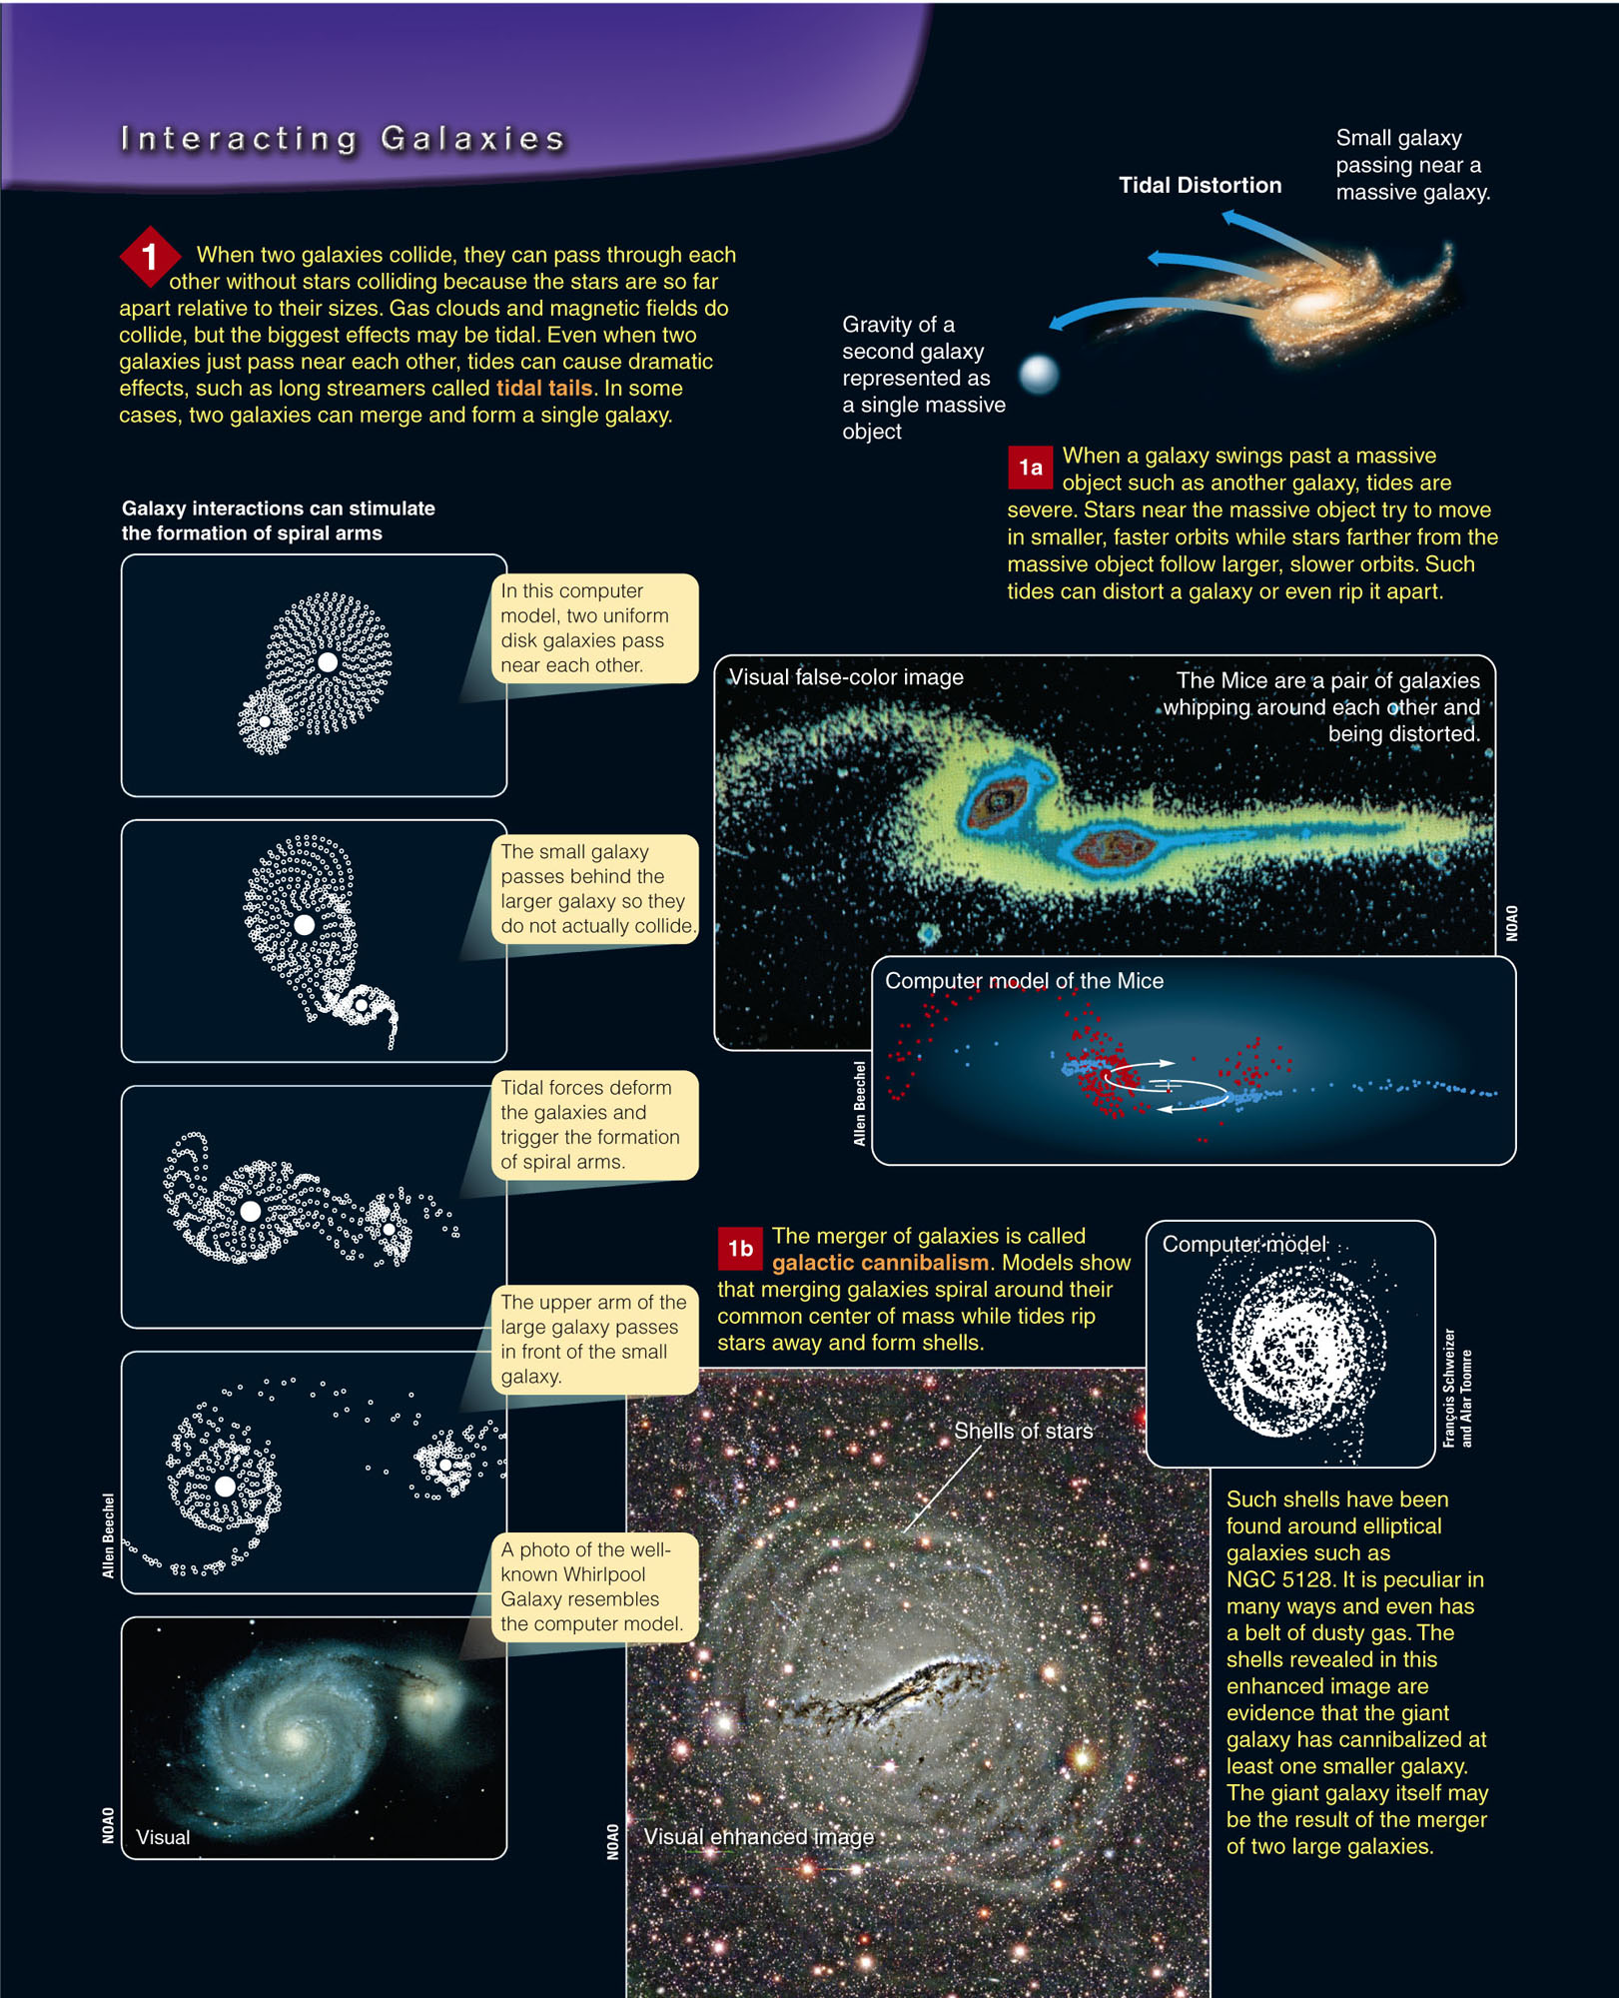
Colliding Galaxies
There are several important points to note about interacting galaxies.

Slide 77
Colliding Galaxies
One, interacting galaxies can distort each other with tides—producing tidal tails and shells of stars.
  They may even trigger the formation of spiral arms.
  Large galaxies can even
  absorb smaller galaxies.

Slide 78
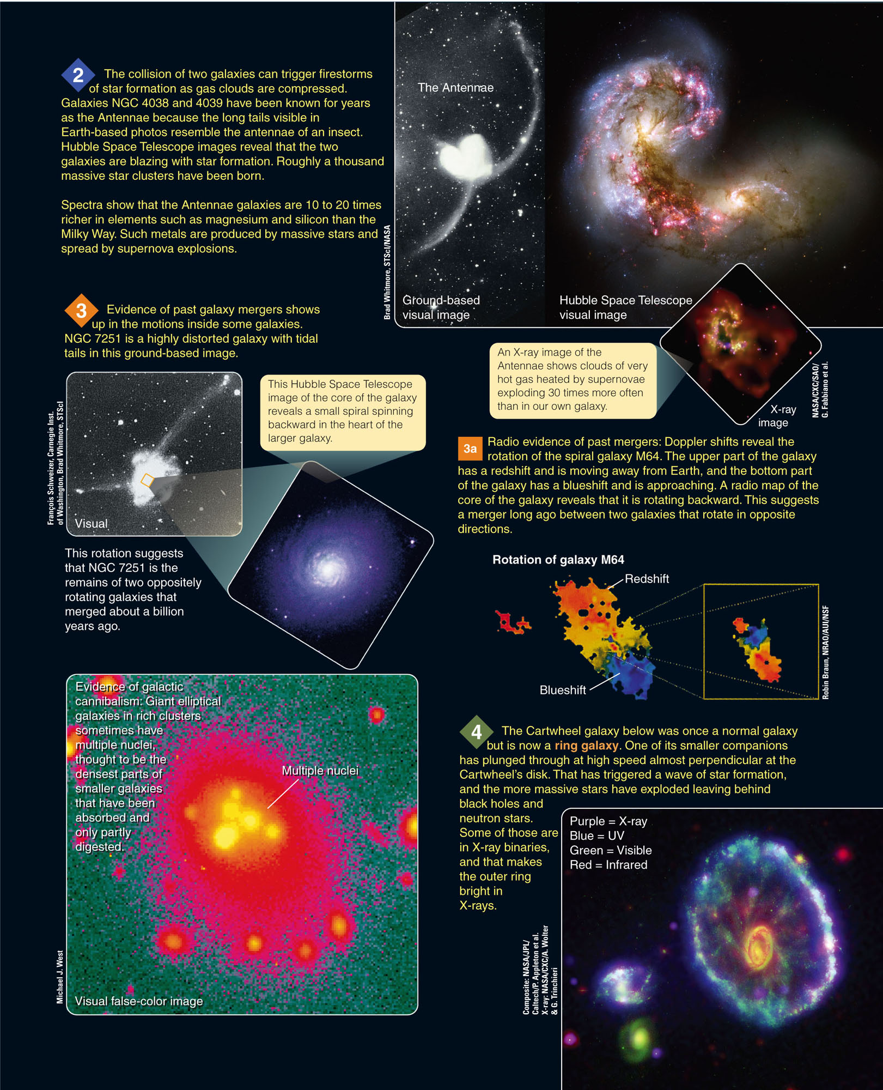
Colliding Galaxies
Two, the interactions can trigger star formation.

Slide 79
Colliding Galaxies
Three, evidence left inside galaxies in the form of motions and multiple nuclei reveals that they have suffered past interactions and mergers.

Slide 80
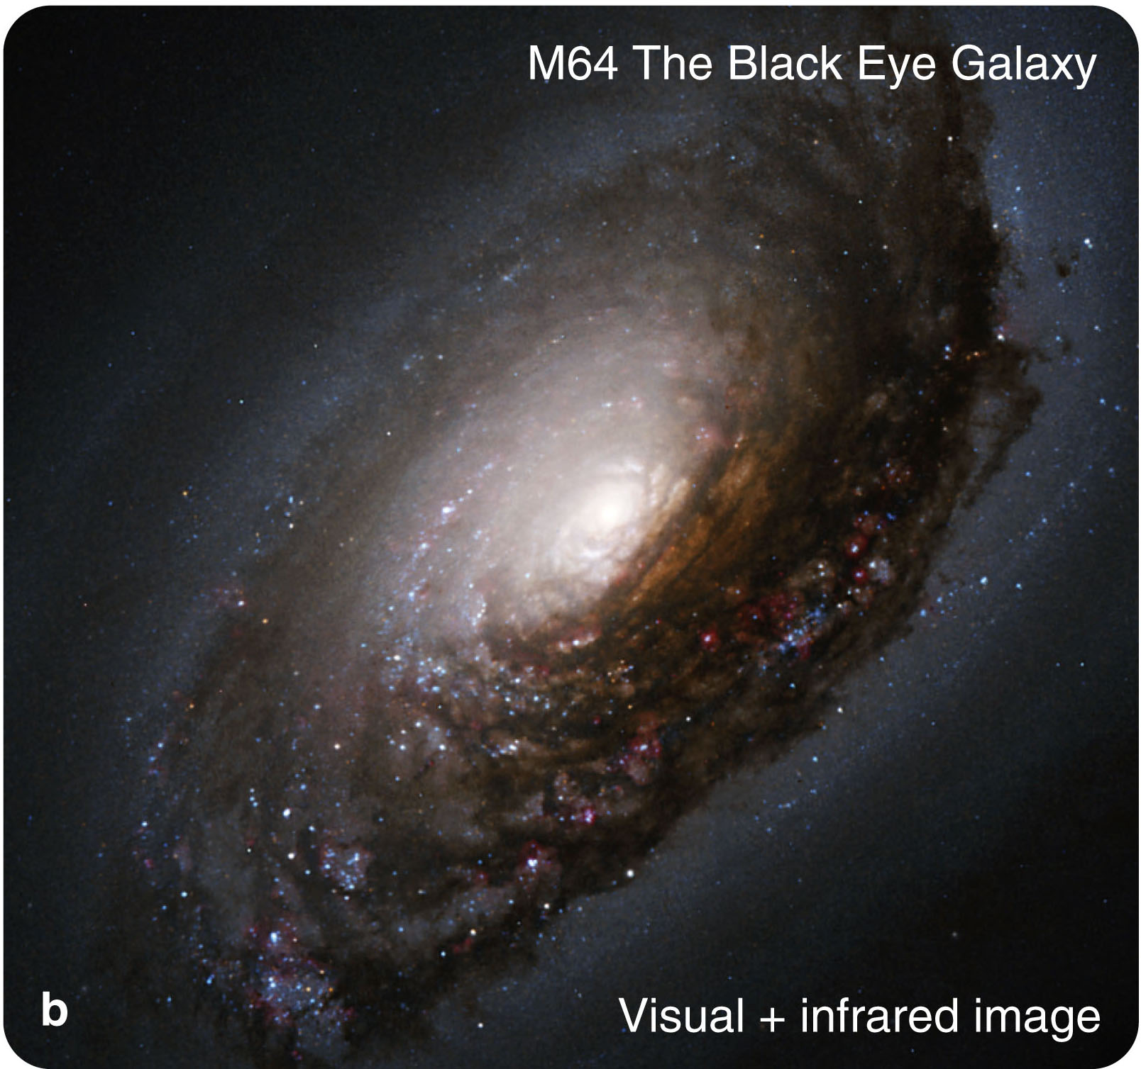
Colliding Galaxies
Four, the beautiful ring galaxies are bull’s-eyes left behind by high-speed collisions.

Slide 81
Colliding Galaxies
Evidence of galaxy mergers is all around.
  Milky Way is a cannibal galaxy—snacking on the Magellanic Clouds as they orbit around it.
  Its tides are pulling apart the Sagittarius and the Canis Major Dwarf galaxies.
  This produces great streamers of stars wrapped around Milky Way.
  Almost certainly, our galaxy has dined on other small galaxies in the past.

Slide 82
The Origin and Evolution of Galaxies
The test of any scientific understanding is whether you can put all the evidence and theory together to tell the history of the objects studied.

Slide 83
The Origin and Evolution of Galaxies
Can you describe the origin and evolution of the galaxies?
  Just a few decades ago, it would have been impossible to do so.
  However, the evidence from space telescopes and new-generation telescopes on Earth—combined with advances in computer modeling and theory—allow astronomers to outline the story of the galaxies.

Slide 84
The Origin and Evolution of Galaxies
Elliptical galaxies appear to be the product of galaxy mergers—which triggered star formation and used up all the gas and dust.
  Astronomers see star formation
  being stimulated to high levels
  in many galaxies.

Slide 85
The Origin and Evolution of Galaxies
Starburst galaxies are very luminous in the infrared.
  A collision has triggered bursts of star formation that are heating the dust.
  The warm dust reradiates the energy in the infrared.

Slide 86
The Origin and Evolution of Galaxies
The Antennae contain over 15 billion solar masses of hydrogen gas.
  It will become a starburst galaxy as their ongoing merger triggers rapid star formation.

Slide 87
The Origin and Evolution of Galaxies
A few collisions and mergers could leave a galaxy with no gas and dust from which to make new stars.

Slide 88
The Origin and Evolution of Galaxies
Astronomers now suspect that most ellipticals are formed by the merger of at least two or more galaxies:
  Dwarf ellipticals, which are too small to be formed by mergers
  Irregulars, which may be fragments left over by the merger of larger galaxies

Slide 89
The Origin and Evolution of Galaxies
In contrast, spirals seem never to have suffered major collisions.
  Their thin disks are delicate and would be destroyed by tidal forces in a collision with
  a massive galaxy.
  Also, they retain plenty of gas and dust
  and continue making stars.

Slide 90
The Origin and Evolution of Galaxies
Our Milky Way has, evidently, never merged with another large galaxy.
It has, however, a large spiral neighbor, the Andromeda Galaxy.
  Both seem to have cannibalized smaller galaxies.

Slide 91
The Origin and Evolution of Galaxies
Barred spiral galaxies may be the product of tidal interactions.
  Mathematical models show that the bars are not
  stable and eventually dissipate.
  It may take tidal interactions with other galaxies to regenerate the bars.
  As well over half of all spiral galaxies have bars, you can suspect that these tidal interactions are common.

Slide 92
The Origin and Evolution of Galaxies
Milky Way is probably a barred spiral.
  This may be the result of the interaction with its two Magellanic Cloud companions, or the more distant but very massive Andromeda Galaxy.

Slide 93
The Origin and Evolution of Galaxies
Other processes can alter galaxies.
  The S0 galaxies have disks and bulges like a spiral galaxy but no spiral arms.
  They may have lost much of their gas and dust moving through the gas trapped in the dense clusters to which they belong.

Slide 94
The Origin and Evolution of Galaxies
  For example, X-ray observations show that the Coma cluster contains thin, hot gas between the galaxies.

Slide 95
The Origin and Evolution of Galaxies
A galaxy moving through that gas would encounter a tremendous wind that could strip away its gas and dust.

Slide 96
The Origin and Evolution of Galaxies
Observations made with the largest and most sophisticated telescopes are taking astronomers back to the age of galaxy formation.
  At great distances, the look-back time is so large that they see the universe as it was soon after galaxies began to form.
  There were more spirals and fewer ellipticals.

Slide 97
The Origin and Evolution of Galaxies
The observations show that galaxies then were closer together.
  About 33 percent of all distant galaxies are in
  close pairs.
  However, only 7 percent of nearby galaxies
  are in pairs.
  The observational evidence clearly supports the hypothesis that galaxies have evolved by merger.

Slide 98
The Origin and Evolution of Galaxies
The evolution of galaxies is not a simple process.
  A good theory helps you understand how nature works.
  Astronomers are just beginning to understand the exciting and complex story of the galaxies.
  Nevertheless, it is already clear that galaxy evolution is much like a pie-throwing contest—
  and just about as neat.

Slide 99
Active Galaxies and Quasars
Many galaxies have powerful energy sources in their nuclei that, in some cases, produce powerful jets and other outbursts.
  These are called active galaxies.

Slide 100
Active Galaxies and Quasars
By looking far away and back in time, astronomers have discovered:
  The origin of active galaxy energy sources and outbursts were closely related to the formation and history of galaxies.

Slide 101
Active Galaxies and Quasars
The first type of active galaxy was discovered in the 1950s.
  They were named radio galaxies because these galaxies are sources of unusually strong radio waves.

Slide 102
Active Galaxies and Quasars
By the 1970s, astronomers had put space telescopes in orbit.
  They discovered that radio galaxies are generally bright at many other wavelengths.

Slide 103
Active Galaxies and Quasars
The flood of energy pouring out of active galaxies originates almost entirely in their nuclei.
  They are referred to as active galactic nuclei (AGN).

Slide 104
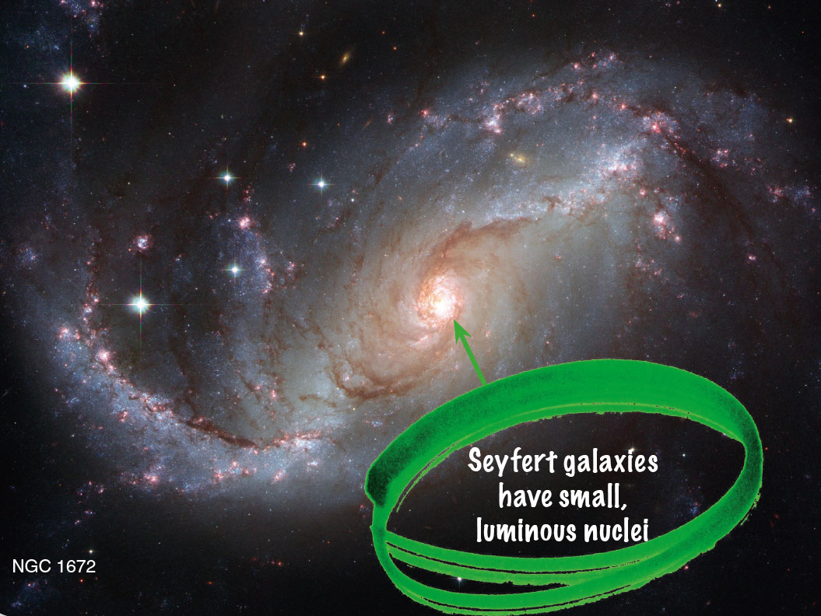
Seyfert Galaxies
In 1943, astronomer Carl K. Seyfert conducted a study of spiral galaxies.
  He noted that about two percent of spirals have small, highly luminous nuclei in their bulges.

Slide 105
Seyfert Galaxies
Today, these Seyfert galaxies are recognized by the peculiar spectra of these luminous nuclei.
  They contain broad emission lines of highly ionized atoms.
  Emission lines suggest a hot, low-density gas.
  The presence of ionized atoms is evidence that the gas is very hot.
  The broad spectral lines indicate large Doppler shifts produced by high gas velocities.

Slide 106
Seyfert Galaxies
The velocities at the center of Seyfert galaxies are roughly 10,000 km/s.
This is about 30 times greater than velocities at the center of normal galaxies.
  Something violent is happening in the cores
  of Seyfert galaxies.

Slide 107
Seyfert Galaxies
Astronomers later discovered that the brilliant nuclei of Seyfert galaxies change brightness rapidly.
  This happens in only a few hours or minutes, especially at X-ray wavelengths.

Slide 108
Seyfert Galaxies
You have learned that an astronomical body cannot change its brightness significantly in a time shorter than the time it takes light to cross its diameter.
  If the Seyfert nucleus can change in a few minutes, then it cannot be larger in diameter than a few
  light-minutes.
  For comparison, the distance from Earth to the
  sun is 8 light minutes.

Slide 109
Seyfert Galaxies
Despite their small size, the brightest Seyfert nuclei emit a hundred times more energy than the entire Milky Way.
  Something in the centers of these galaxies not much bigger than Earth’s orbit produces a galaxy’s worth of energy.

Slide 110
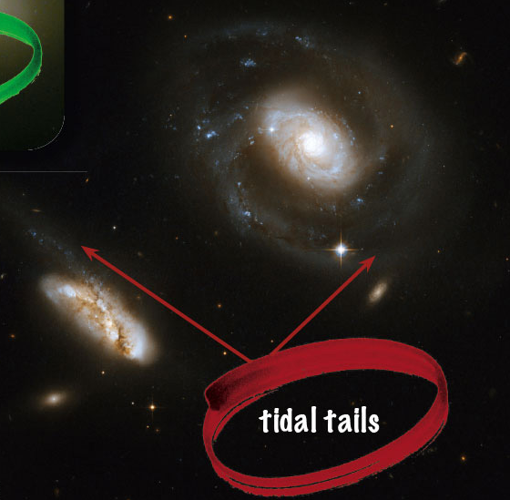
Seyfert Galaxies
Seyfert nuclei are three times more common in interacting pairs of galaxies than in isolated galaxies.
  Also, about 25 percent have peculiar shapes—suggesting tidal interactions with other galaxies.

Slide 111
Seyfert Galaxies
This statistical evidence hints that Seyfert galaxies may have been triggered into activity by collisions or interactions with companions.

Slide 112
Seyfert Galaxies
Some Seyferts are expelling matter in oppositely directed jets.
  You have learned about this geometry on smaller scales when matter flows into neutron stars and black holes and forms an accretion disk.

Slide 113
Seyfert Galaxies
All this evidence leads modern astronomers to conclude that the cores of Seyfert galaxies contain supermassive black holes.
  This is a black hole with a mass as high as a billion solar masses, plus a correspondingly large accretion disk.

Slide 114
Seyfert Galaxies
The gas in the centers of Seyfert galaxies is traveling so fast it would escape from a normal galaxy.
  Only very large, central masses could exert enough gravity to hold the gas inside the nuclei.
  Encounters with other galaxies could throw matter into the black hole.
  As you have learned, lots of energy can be liberated by matter flowing into a black hole.

Slide 115
Seyfert Galaxies
You have learned that Milky Way contains a massive central black hole.
  However, the black hole seems to be on a starvation diet and is therefore relatively inactive.

Slide 116
Double-Lobed Radio Sources
Beginning in the 1950s, radio astronomers found that some sources of radio energy in the sky consisted of pairs of radio-bright regions.
  When optical telescopes studied the locations of these double-lobed radio sources, they revealed galaxies located between the two lobes.

Slide 117
Double-Lobed Radio Sources
The geometry suggests that radio lobes are inflated by jets of excited gas emerging in two directions from the central galaxy.
  Statistical evidence indicates that jets and radio lobes, like Seyfert nuclei, are associated with interacting galaxies.

Slide 118
Double-Lobed Radio Sources
The AGN jets seem to be related to matter falling into a central black hole via an accretion disk.
  However, the details of this process are not understood.

Slide 119
Double-Lobed Radio Sources
The violence of these active galaxies is so great it can influence entire clusters of galaxies.
The Perseus galaxy cluster contains thousands of galaxies and is one of the largest objects in the universe.

Slide 120
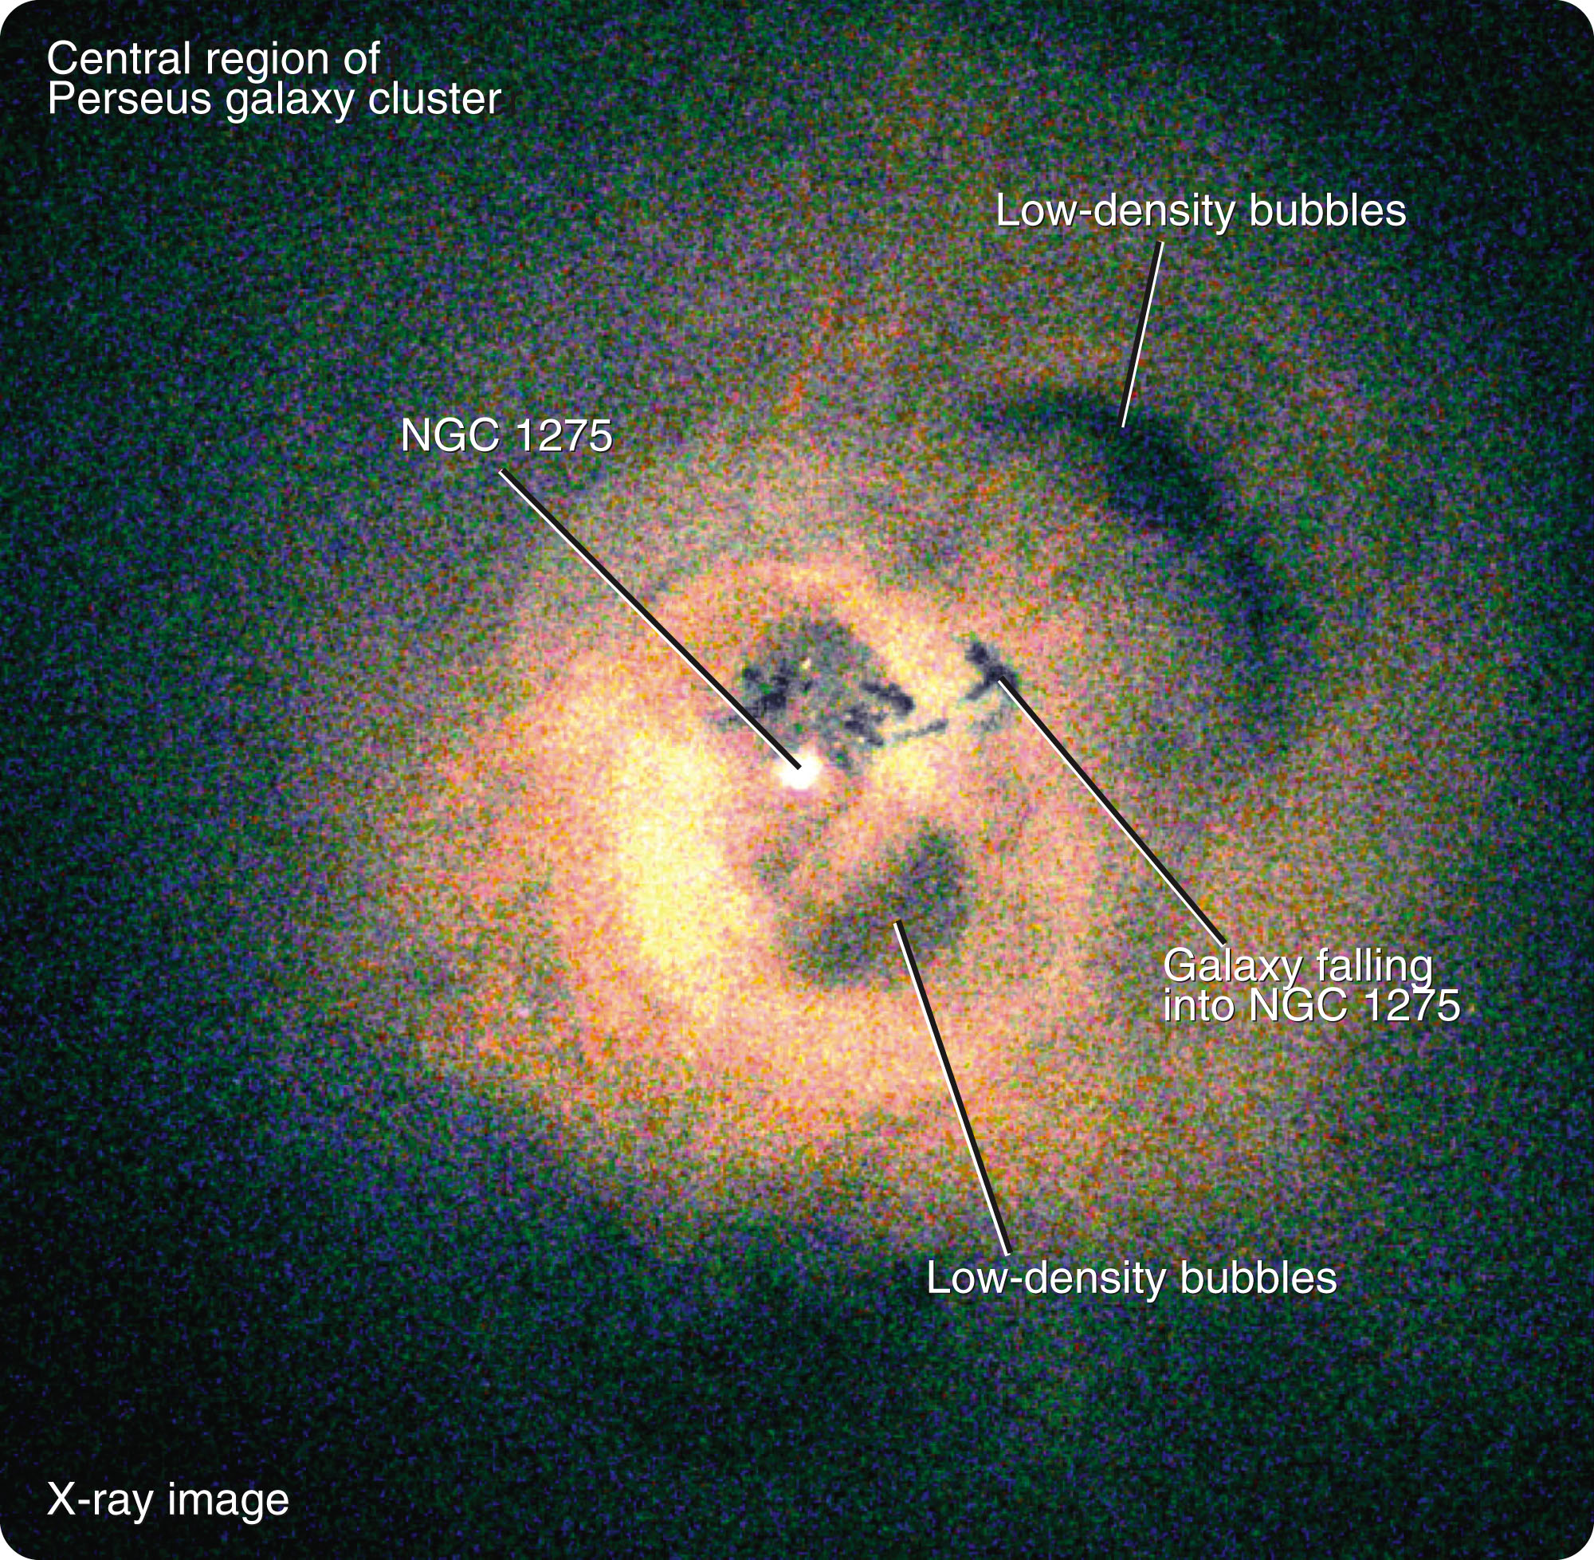
Double-Lobed Radio Sources
One of its galaxies, NGC 1275, is among the largest galaxies known.
It is pumping out jets of high-energy particles, heating the gas in the galaxy cluster, and inflating
low-density bubbles
that distort the huge
gas cloud.

Slide 121
Double-Lobed Radio Sources
The hot gas observed in galaxy clusters is heated to multimillion-degree temperatures as galaxy after galaxy goes through eruptive stages that can last for hundreds of millions of years.
NGC 1275 is erupting now, and it is so powerful and has heated the surrounding gas to such high temperatures that the gas can no longer fall in and the galaxy has probably limited its own growth.

Slide 122
Quasars
The largest telescopes detect multitudes of faint points of light with peculiar emission spectra.
  These objects are called quasars—also known as quasi-stellar objects (QSOs).

Slide 123
Quasars
Astronomers now recognize quasars as extreme examples of AGN as well as some of the most distant visible objects in the universe.
  However, they were a mystery when they were first identified.

Slide 124
Quasars
In the early 1960s, photos of the location of some radio sources that resembled radio galaxies revealed only single starlike points of light.
  The first of these objects to be identified was 3C48.
  Later, the source 3C273 was found.

Slide 125
Quasars
They were obviously not normal radio galaxies.
  Even the most distant photographable galaxies look fuzzy.
  These objects, however, looked like stars.
  Their spectra, though, were totally unlike stellar spectra.
  So, the objects were called quasi-stellar objects.

Slide 126
Quasars
For a few years, the spectra of quasars were a mystery.
  A few unidentifiable emission lines were superimposed on a continuous spectrum.

Slide 127
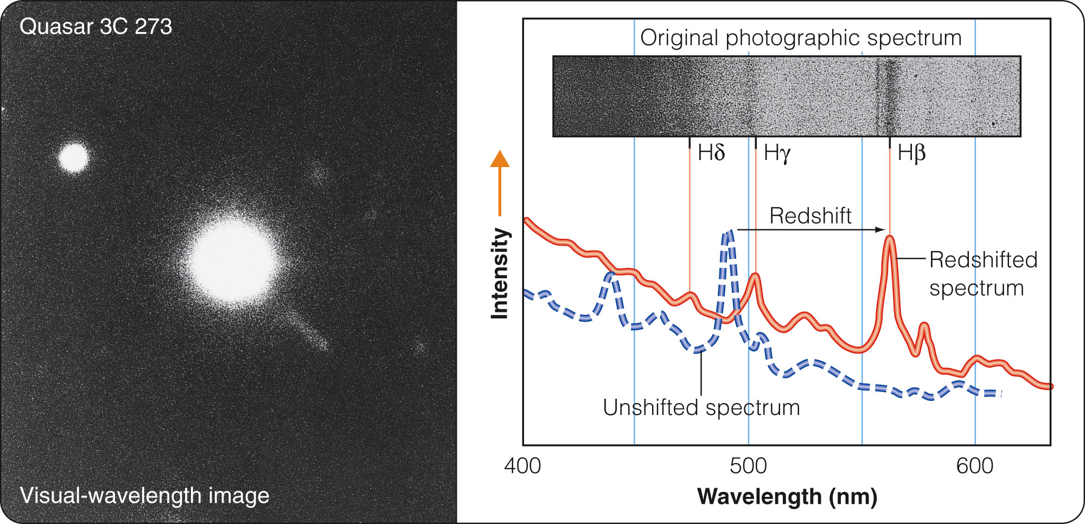
Quasars
In 1963, astronomer Maarten Schmidt calculated that, if hydrogen Balmer lines were redshifted by z = 0.158, they would fit the observed lines in 3C273’s spectrum.

Slide 128
Quasars
Other quasar spectra quickly yielded to this approach—revealing even larger redshifts.
  To understand the significance of these large redshifts and the large velocities of recession they imply, you must recall the Hubble law.

Slide 129
Quasars
The large redshifts of the quasars imply that they must be at great distances, some farther away than any known galaxy.
  Many quasars are evidently so far away that galaxies at those distances are very difficult to detect.

Slide 130
Quasars
Yet, the quasars are easily photographed.
  Thus, quasars must have 10 to 1,000 times
  the luminosity of a large galaxy.
  They must be ultraluminous.

Slide 131
Quasars
Soon after quasars were discovered, astronomers detected fluctuations in their brightnesses over times as short as a few hours or minutes.
  The rapid fluctuations showed that they are small objects like AGN, only a few light-minutes or light-
  hours in diameter.

Slide 132
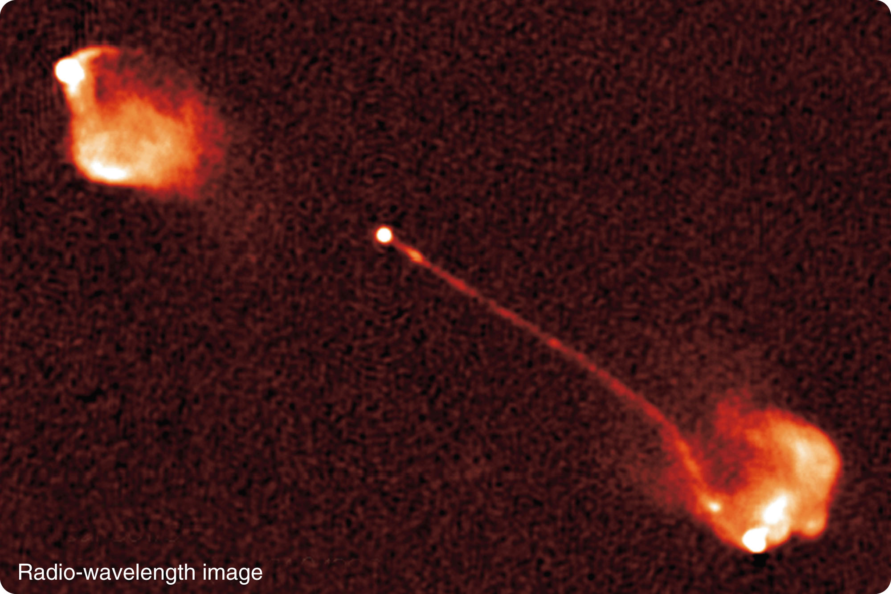
Quasars
Evidence has accumulated that quasars are the most luminous AGN, located in very distant galaxies.
  For example, some quasars, like AGN, are at the centers of double radio lobes plus jets.

Slide 133
Quasars
Perhaps, you have another question about quasar distances at this point.
How can astronomers be sure that quasars really are that far away?
  Astronomers faced with explaining how a small object could produce so much energy asked themselves the same question.

Slide 134
Quasars
In the early 1980s, astronomers were able to photograph faint nebulosity surrounding some quasars.
This was called quasar fuzz.
  The spectra of quasar fuzz looked like the spectra of normal but very distant galaxies with the same redshift as the central quasar.

Slide 135
Quasars
In other cases, quasar light shines through the outskirts of a distant galaxy.
  The quasar spectrum has extra absorption lines from gas at the redshift of the galaxy.
  They are smaller than the quasar’s redshift.
  This means the quasar is farther away than the galaxy containing the gas that absorbed some of the quasar’s light on its way to Earth.

Slide 136
Quasars
Both these observations confirm that galaxy and quasar redshifts indicate distances in a mutually consistent way.

Slide 137
The Search for a Unified Model
Astronomers studying galaxies are now developing a unified model of AGN and quasars.
  A monster black hole is the centerpiece.

Slide 138
The Search for a Unified Model
Even a supermassive black hole is quite small compared with the galaxy.
  A ten-million-solar-mass black hole would be only one-fifth the diameter of Earth’s orbit.
  That means matter in an accretion disk can get very close to the black hole, orbit very fast, and grow very hot.

Slide 139
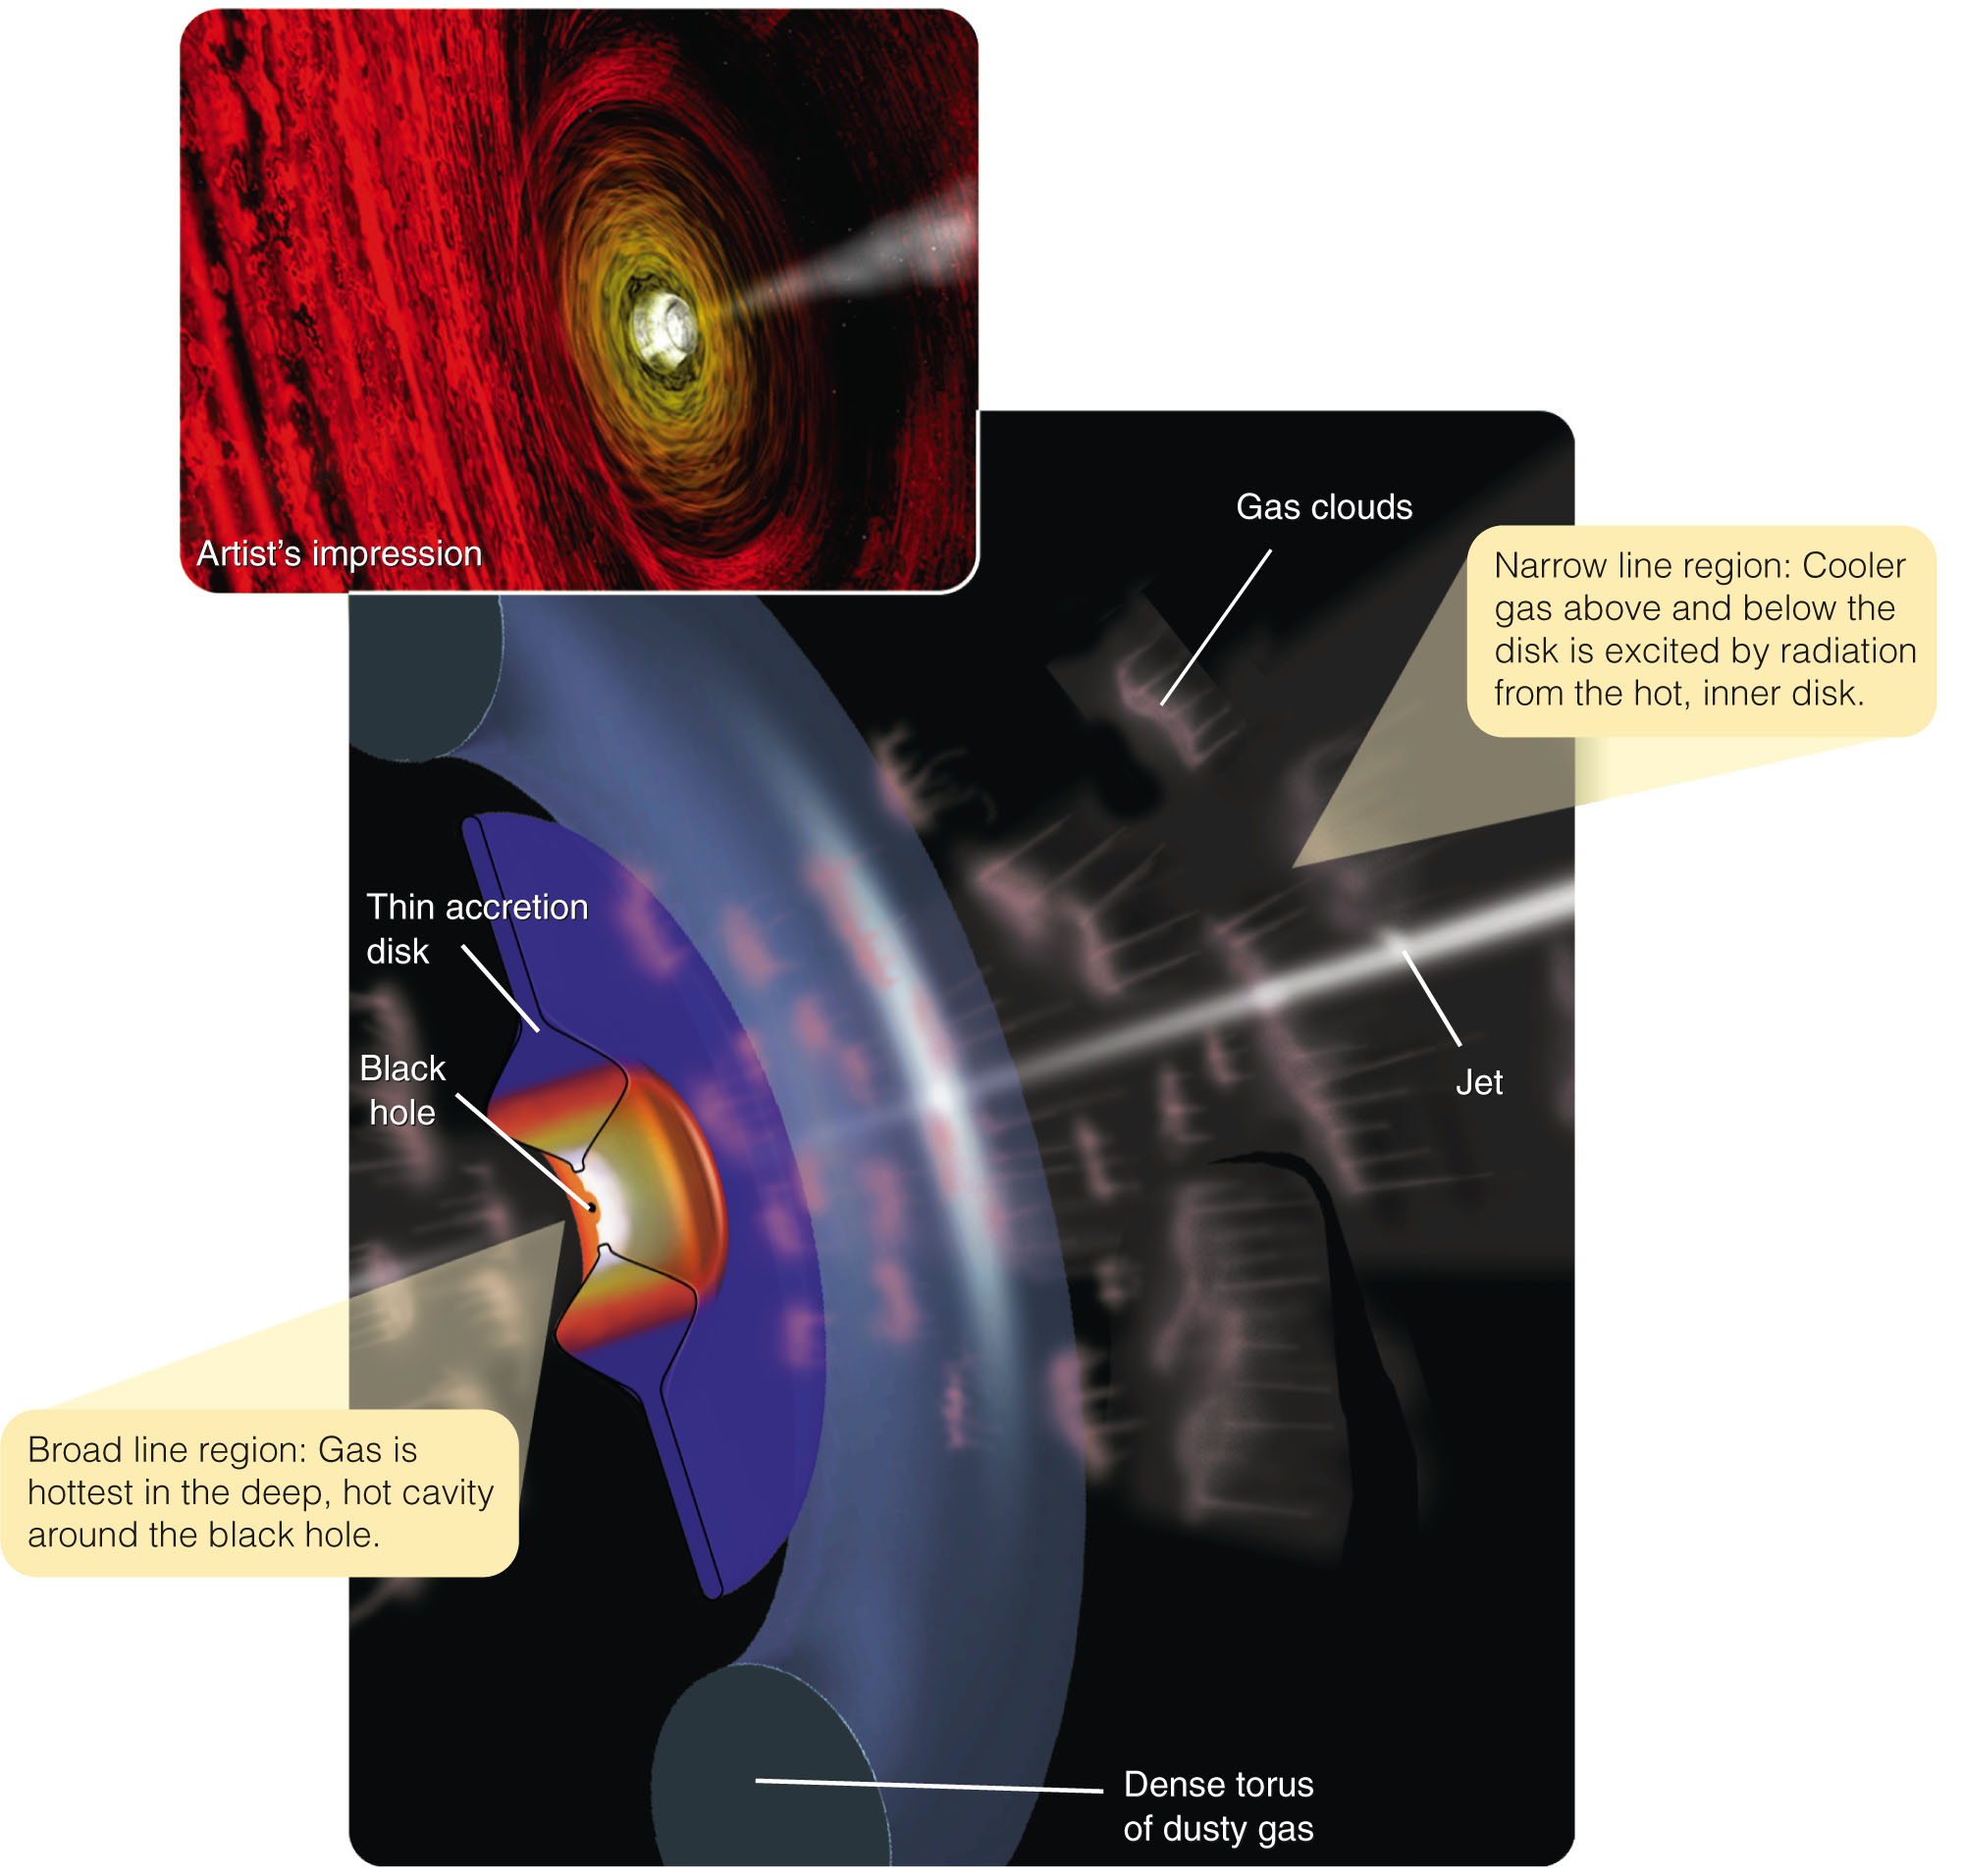
The Search for a Unified Model
Theoretical calculations indicate that the disk immediately around the black hole is ‘puffed up.’
  It is also thick enough to
  hide the central black hole
  from some viewing angles.

Slide 140
The Search for a Unified Model
The hot inner disk seems to be the source of the jets often seen coming out of active galaxy cores.
  However, the process by
  which jets are generated
  is not understood.

Slide 141
The Search for a Unified Model
The outer part of the disk—according to calculations—is a fat, cold torus (doughnut shape) of dusty gas.

Slide 142
The Search for a Unified Model
According to the unified model, what you see when you view the core of an AGN and QSO depends on how this accretion disk is tipped with respect
to your line of sight.

Slide 143
The Search for a Unified Model
If you view the accretion disk from the edge, you cannot see the central zone.
  The thick dusty
  torus blocks
  your view.

Slide 144
The Search for a Unified Model
Instead, you see radiation emitted by gas lying above and below the central disk.
  It is therefore relatively
  cool.

Slide 145
The Search for a Unified Model
Also, it moves relatively slowly, with small Doppler shifts.
  Thus, you see narrower spectral lines coming from this narrow line region.

Slide 146
The Search for a Unified Model
If the accretion disk is tipped slightly, you may be able to see some of the intensely hot gas in the central cavity.
  This broad line
  region emits
  broad spectral
  lines because
  the gas is so
  hot.

Slide 147
The Search for a Unified Model
It is orbiting at high velocities.
  The resulting high Doppler shifts spread out the spectral line.

Slide 148
The Search for a Unified Model
If you look directly into the central cavity around the black hole, down the dragon’s throat, you see:
  A jet emerging
  perpendicular
  to the accretion
  disk and coming
  straight at you

Slide 149
The Search for a Unified Model
Model calculations indicate this would result in a very bright and highly variable source with few or no emission lines.
  This is the
  appearance of
  AGN known as
  blazars.

Slide 150
The Search for a Unified Model
Astronomers are now using this unified model to sort out the different kinds of active galaxies and quasars—so, they can understand how they are related.

Slide 151
The Search for a Unified Model
For example, about one percent of quasars are strong radio sources.
  The radio radiation may come from synchrotron radiation produced in the high-energy gas and magnetic fields in the jets.

Slide 152
The Search for a Unified Model
Here’s another example.
  Using infrared cameras to see through dust, astronomers observed the core of the double-lobed radio galaxy Cygnus A.
  They found an object much like a quasar.

Slide 153
The Search for a Unified Model
Astronomers have begun to refer to such hidden objects as “buried quasars.”

Slide 154
The Search for a Unified Model
The unified model is far from complete.
  The detailed structure of accretion disks is poorly understood—as is the process by which the disks produce jets.
  Furthermore, the spiral Seyfert galaxies are clearly different from the giant elliptical galaxies that have double radio lobes.

Slide 155
The Search for a Unified Model
Unification does not explain all the differences among active galaxies.
  It is a model that provides some clues to what is happening in AGN and quasars.

Slide 156
Origin of Supermassive Black Holes
Naturally, you are wondering where these supermassive black holes came from.
That question is linked to a second question.
What makes a supermassve black hole erupt?
  Answering those questions will help you
  understand how galaxies form.

Slide 157
Origin of Supermassive Black Holes
Evidence is accumulating that most galaxies seem to contain a supermassive black hole at their center.
  Even Milky Way and the nearby Andromeda Galaxy contain central black holes.

Slide 158
Origin of Supermassive Black Holes
Only a few percent of galaxies, however, have AGN.
  That must mean that most of the supermassive black holes are dormant.
  Presumably, they are not being fed large
  amounts of matter.

Slide 159
Origin of Supermassive Black Holes
A slow trickle of matter flowing into the supermassive black hole at the center of our galaxy could explain the mild activity seen there.
  However, it would take a larger meal to trigger an eruption like those seen in AGN.

Slide 160
Origin of Supermassive Black Holes
What could trigger a supermassive black hole to erupt?
The answer is something you have learned earlier—tides.
  You have learned how tides twist interacting
  galaxies and rip matter away into tidal tails.

Slide 161
Origin of Supermassive Black Holes
Active galaxies are often distorted.
  They have evidently been twisted by tidal forces as they interacted or merged with another galaxy.
  Mathematical models show that those interactions can also throw stars plus clouds of interstellar gas and dust inward toward the galaxies’ centers.

Slide 162
Origin of Supermassive Black Holes
A sudden flood of matter flowing into a supermassive black hole would trigger it into eruption.

Slide 163
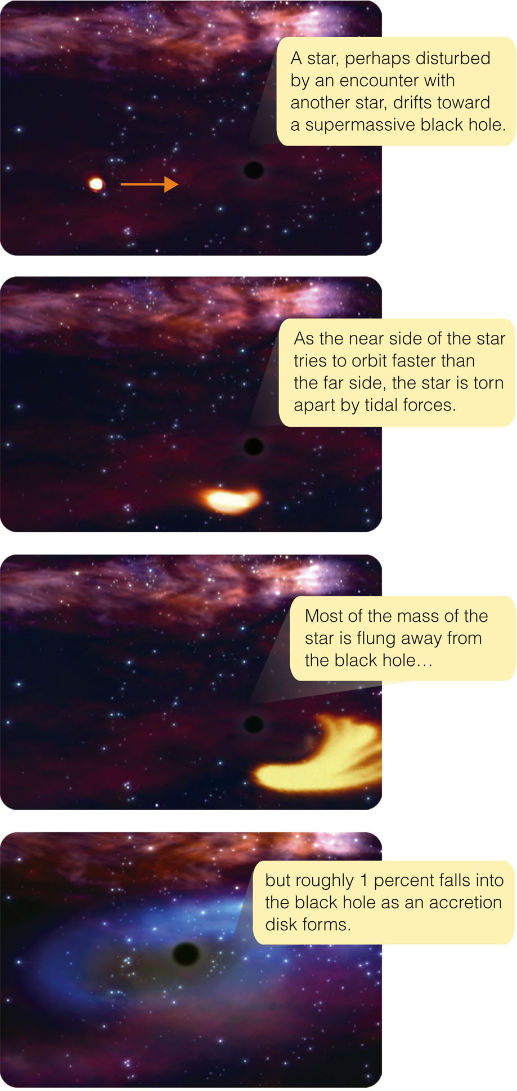
Origin of Supermassive Black Holes
The figure shows how
a passing star would be
shredded and partially
consumed by a
supermassive hole.
  A steady diet of inflowing gas,
  dust, and an occasional star
  would keep an AGN powered
  by a supermassive black hole
  active.

Slide 164
Origin of Supermassive Black Holes
A few dozen supermassive black holes have been measured for their masses.
Their masses are correlated with the masses of the host galaxies’ nuclear bulges.
  In each case, the mass of the black hole is about 0.5 percent the mass of the surrounding nuclear bulge.

Slide 165
Origin of Supermassive Black Holes
Apparently, a galaxy forms its nuclear bulge.
A certain fraction of the mass sinks to the center where it forms a supermassive black hole.
  All that matter flowing together to form the black hole would release a tremendous amount of
  energy and trigger a violent eruption.

Slide 166
Origin of Supermassive Black Holes
Long ago, when galaxies were actively forming, the birth of the nuclear bulges must have triggered many AGN.
Later episodes of AGN activity could be triggered by interactions or mergers with other galaxies.

Slide 167
Quasars Through Time
The universe began 13.7 billion years ago.
Some quasars are over 10 billion light-years away.
  Due to their large look-back times, they appear as they were when the universe was only 10 percent
  of its present age.

Slide 168
Quasars Through Time
The first clouds of gas that formed galaxies would have also made supermassive black holes at the centers of those galaxies’ nuclear bulges.
  The abundance of matter flooding into these black holes could have triggered outbursts that are seen as quasars.

Slide 169
Quasars Through Time
Galaxies were closer together when the universe was young
and had not expanded very much.
  As they were closer together, the forming galaxies collided more often.
  You have learned how collisions between galaxies could throw matter into supermassive black holes and trigger eruptions.

Slide 170
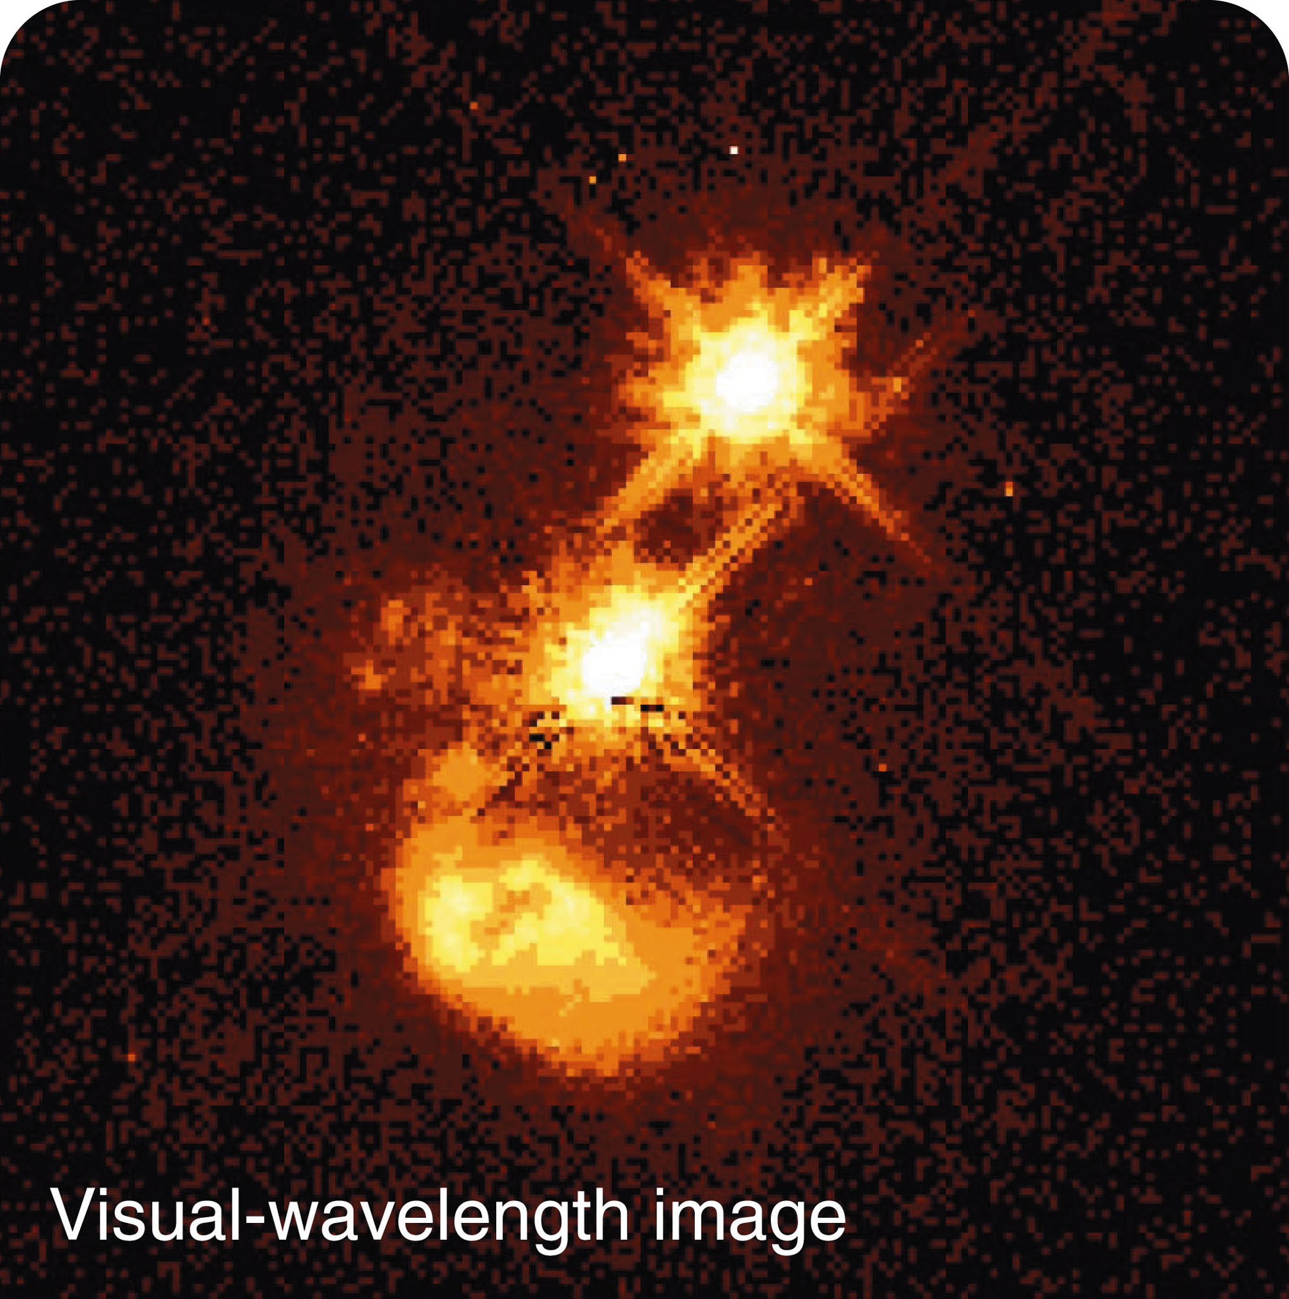
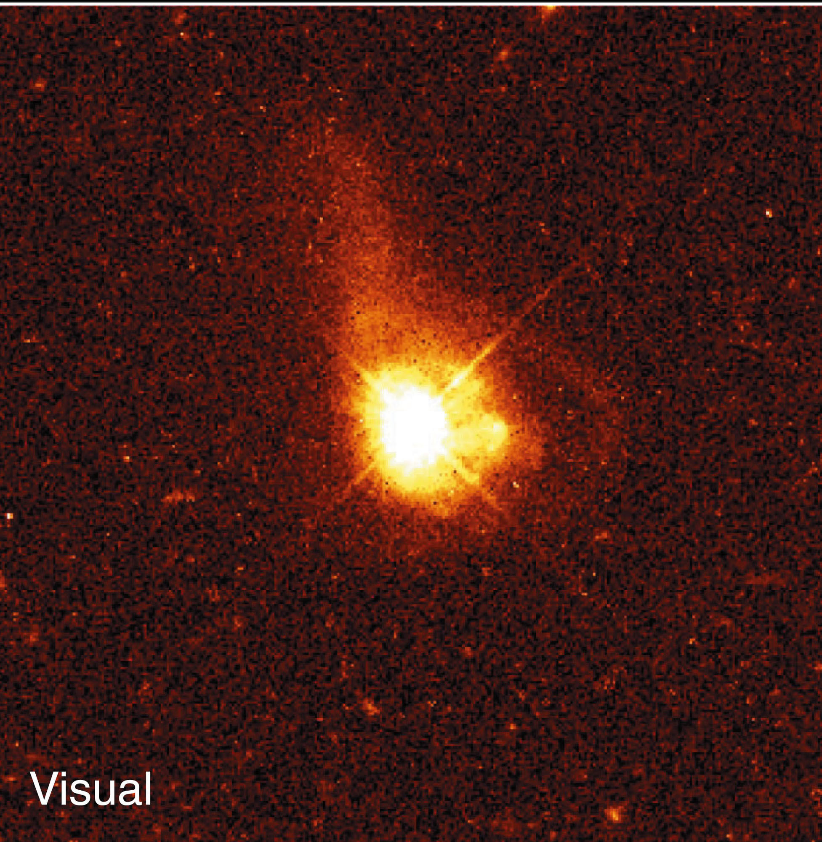
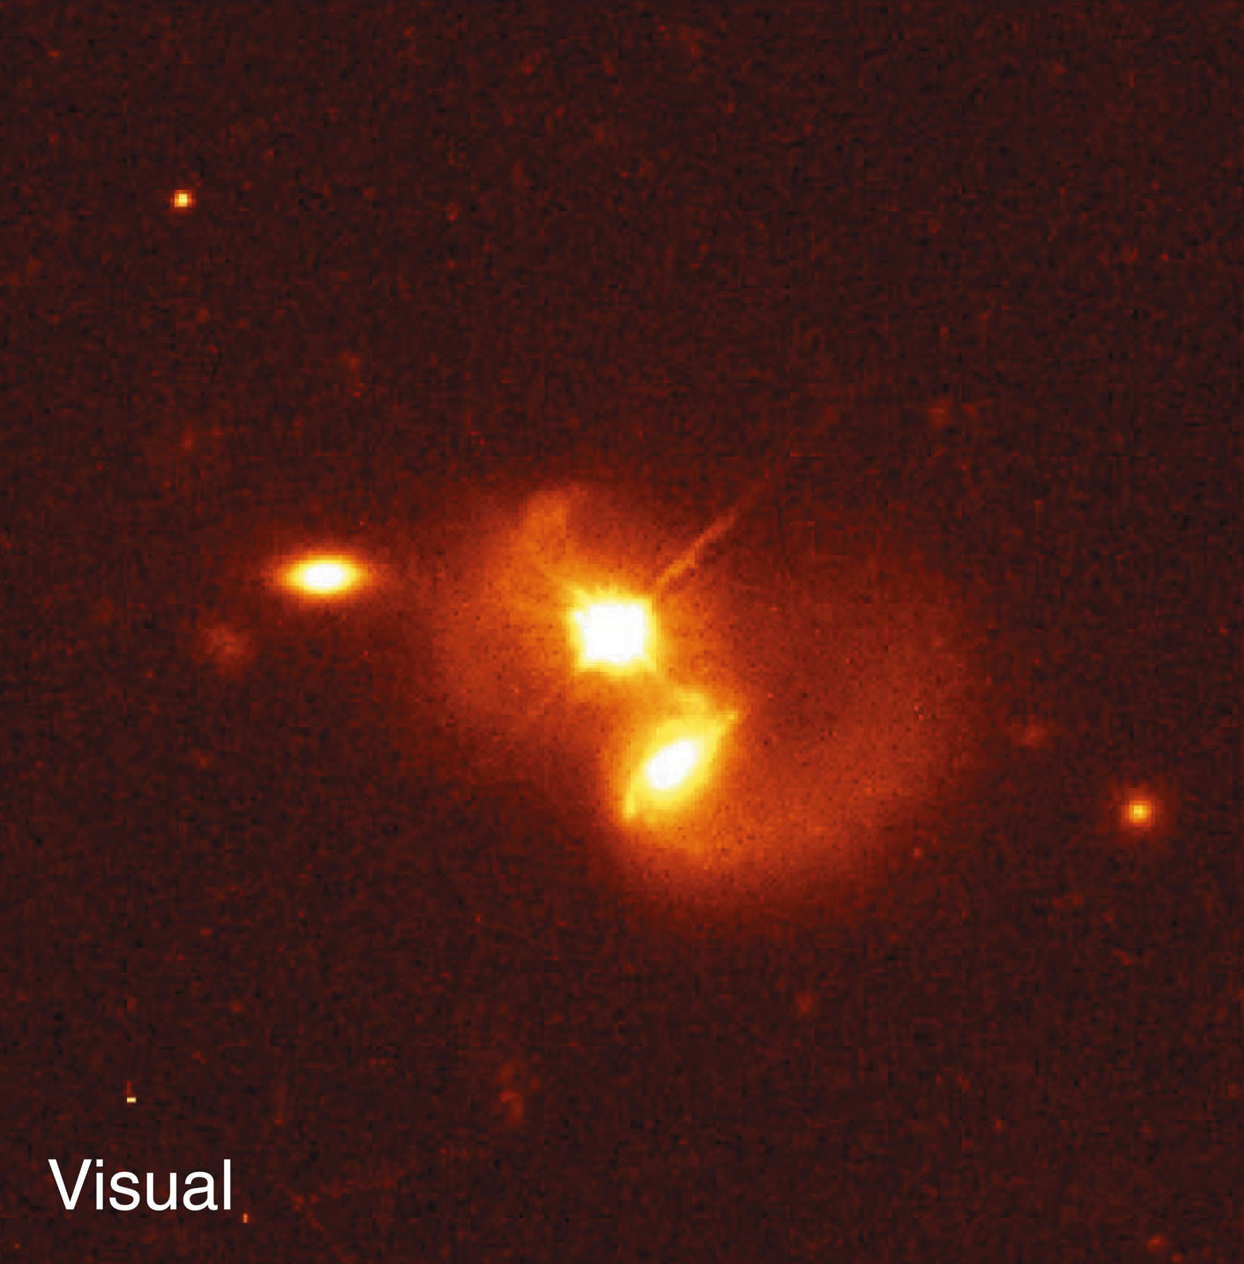
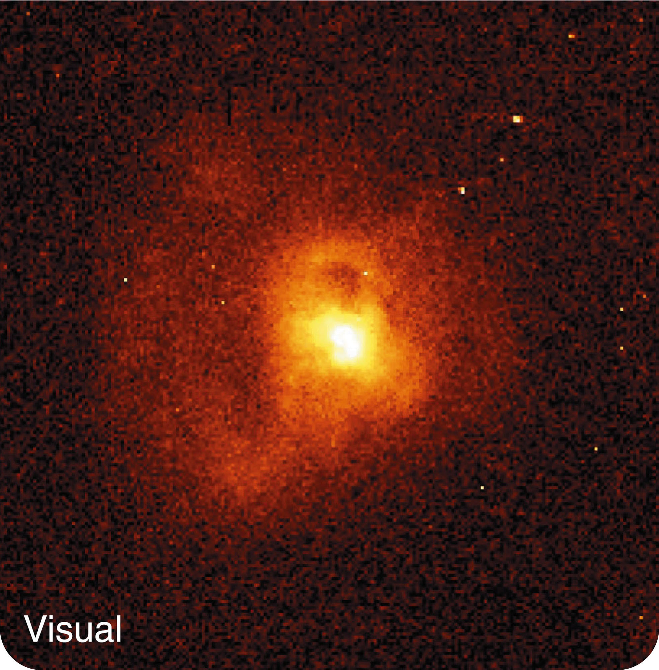
Quasars Through Time
  Quasars are often located in host galaxies that are distorted as if they were interacting with other galaxies.

Slide 171
Quasars Through Time
Quasars are most common with redshifts of a little over 2 and less common with redshifts above 2.7.
The largest quasar redshifts are over 6.
  Such high-redshift quasars are quite rare.

Slide 172
Quasars Through Time
Evidently, if you looked at quasars with redshifts of a little over 2, you would be looking back to an age when galaxies were actively forming, colliding, and merging.
  In that age of quasars, they were about 1,000 times more common than they are now.
  Even so, only a fraction of galaxies had quasars erupting in their cores at any one time.

Slide 173
Quasars Through Time
If you looked back to even higher redshifts, you would see fewer quasars.
  You would be looking back to an age when the universe was so young that it had not yet begun to form many galaxies and quasars.

Slide 174
Quasars Through Time
Then, where are all the dead quasars?
  There is no way to get rid of supermassive black holes.

Slide 175
Quasars Through Time
Astronomers have discovered that nearly all galaxies contain supermassive black holes.
  Those black holes may have suffered quasar eruptions when the universe was younger, galaxies were closer together, and infalling
  gas and dust were more plentiful.

Slide 176
Quasars Through Time
  However, quasar eruptions became less common as galaxies became more stable and as the abundance of gas and dust in the centers of galaxies were exhausted.

Slide 177
Quasars Through Time
Our own Milky Way is a good example.
  It could have been a quasar long ago.
  Today, though, its supermassive black hole is resting.

Slide 178
Quasars Through Time
Dormant black holes at the centers of galaxies today can be reawakened to become AGN by galaxy collisions.

