Slide 1
Chapter 10 Structure and Formation of Stars

Slide 2
Extra Credit
Due Wednesday 11/27/13
Choose one star and write one page about the external properties of “your” star:
Diameter
Luminosity
Mass
Surface temperature
Atmospheric density
Composition

Slide 3
Stellar Structure
Stars are simple, elegant power sources held together by their own gravity and balanced by the support of their internal heat and pressure.
This comprises the variation in temperature, density, pressure, and other such aspects between the surface of a star and its center

Slide 4
Stellar Structure
It will be easier to think about stellar structure if you imagine that the star is divided into concentric shells—such as those in an onion.
You can then discuss the temperature, pressure, and density in each shell.
Of course, these helpful shells exist only in the imagination—stars have no separable layers.

Slide 5
The four laws of stellar structure are summarized in the table.
Properly understood, they can inform you how stars are born, how they live, and how they die.

Slide 6
The Laws of Conservation of Mass and Energy
The law of conservation of mass is a basic law of nature that can be applied to the structure of stars.
It states that the total mass of a star must equal the sum of the masses of its shells.
The law of conservation of energy is another basic law of nature.
It states that the amount of energy flowing out of the top of a layer in the star must be equal to the amount of energy coming in at the bottom plus whatever energy is generated within the layer.

Slide 7
Hydrostatic Equilibrium
In a star that is stable, the deeper layers must support the weight of all the layers above.
As the inside of a star is made up of gas, the weight pressing down on a layer must be balanced by the gas pressure in the layer.
If the pressure is too low, the weight from above will compress and push down the layer.
If the pressure is too high, the layer will expand and lift the layers above.

Slide 8
Hydrostatic Equilibrium
This balance between weight and pressure is called hydrostatic equilibrium.
Hydro (from the Greek word for water) informs you the material is a fluid—which, by definition, includes the gases of a star.
Static informs you the fluid is stable—neither expanding nor contracting.

Slide 9
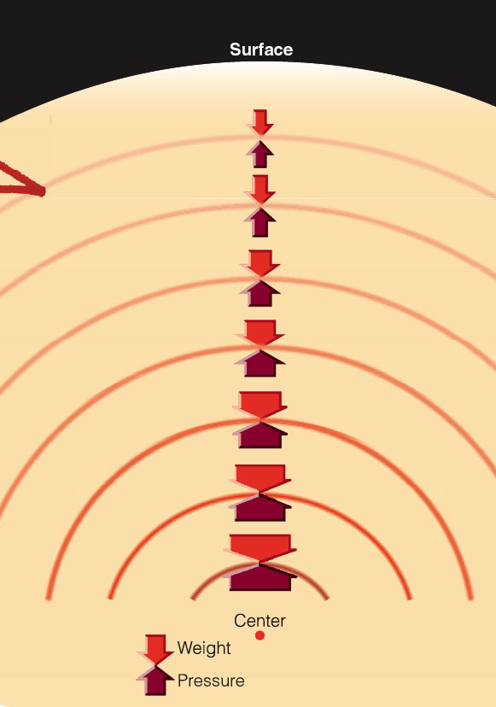
Hydrostatic Equilibrium
The figure shows this hydrostatic balance in the imaginary layers of a star.
The weight pressing down on each layer is shown by lighter red arrows, which grow larger with increasing depth because the weight grows larger.
The pressure in each layer is shown by darker red arrows, which must grow larger with increasing depth to support the weight.

Slide 10
Hydrostatic Equilibrium
The pressure in a gas depends on the temperature and density of the gas.
Near the surface, there is little weight pressing down—so, the pressure need not be high for stability.
Deeper in the star, the pressure must be higher—which means that the temperature and density of the gas must also be higher.
Hydrostatic equilibrium informs you that stars must have high temperature, pressure, and density inside to support their own weight and be stable.

Slide 11
Energy Transport
The surface of a star radiates light and heat into space—and would quickly cool if that energy were not replaced.
As the inside of the star is hotter than the surface, energy must flow outward to the surface, where it radiates away.
This flow of energy through each shell determines its temperature—which, as you have learned, determines how much weight that shell can balance.

Slide 12
Energy Transport
The law of energy transport states that energy must flow from hot regions to cooler regions by conduction, convection, or radiation.

Slide 13
Energy Transport
Radiation is the principal means of energy transport in the interiors of most stars.
Photons are absorbed and reemitted in random directions over and over as energy works its way from the hot interior toward the cooler surface.

Slide 14
Energy Transport
The flow of energy by radiation depends on how difficult it is for photons to move through the gas.
The opacity of the gas—its resistance to the flow of radiation—depends strongly on its temperature.
A hot gas is more transparent than a cool gas.

Slide 15
Energy Transport
If the opacity is high, radiation cannot flow through the gas easily—and it backs up like water behind a dam.
When enough heat builds up, the gas begins to churn as hot gas rises upward and cool gas sinks downward.

Slide 16
Energy Transport
This heat-driven circulation of a fluid is convection, the third way energy can move in a star.
The rising wisp of smoke above a candle flame is carried by convection.
Energy is carried upward in convection currents as rising hot gas and also as sinking cool gas.

Slide 17
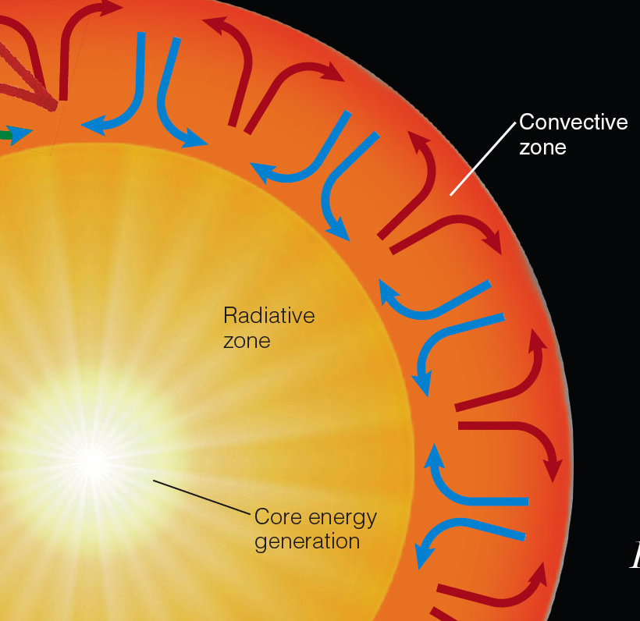
Energy Transport
The figure shows a cross-section of the sun in which zones of radiative and convective energy transport are indicated.

Slide 18
Stellar Models
The laws of stellar structure can be written as mathematical equations.
By solving the equations, astronomers can make a mathematical model of the inside of a star.

Slide 19
Stellar Models
To start one of these models requires knowing the type of information you learned earlier about the external properties of a star:
Diameter
Luminosity
Mass
Surface temperature
Atmospheric density
Composition

Slide 20
Stellar Models
If you want to build a model of a star, you can divide the star into, say, 100 concentric shells and then write down the four equations of stellar structure for each shell.
You would then have 400 equations that would have 400 unknowns, namely, the temperature, density, mass, and energy flow in each shell.

Slide 21
Stellar Models
For instance, to look into a star’s future, you could use a model to determine how fast the star uses its fuel in each shell.
As the fuel is consumed, the chemical composition of the gas changes and the amount of energy generated declines.
By calculating the rate of these changes, you could predict what the star will look like at some point in the future.
You could repeat the process over and over and step-by-step follow the evolution of the star as it ages

Slide 22
Nuclear Fusion in the Sun and Stars
The sun is a normal star, and it is powered by nuclear reactions that occur near its center.
The energy produced keeps the interior hot and the gas is totally ionized.
That is, the electrons are not attached to atomic nuclei.
The gas is a soup of rapidly moving particles colliding with each other at high velocity.

Slide 23
Nuclear Binding Energy
There are only four known forces in nature—the force of gravity, the electromagnetic force, and the strong and weak nuclear forces.
The weak force is involved in the radioactive decay of certain kinds of nuclear particles.
The strong force binds together atomic nuclei.
Thus, nuclear energy originates in the strong nuclear force.

Slide 24
Nuclear Binding Energy
Stars make energy in nuclear fusion reactions that combine light nuclei into heavier nuclei.
The most common reaction, including that in the sun, fuses hydrogen nuclei (single protons) into helium nuclei (two protons and two neutrons).
As the nuclei produced are more tightly bound than the original nuclei, energy is released.

Slide 25
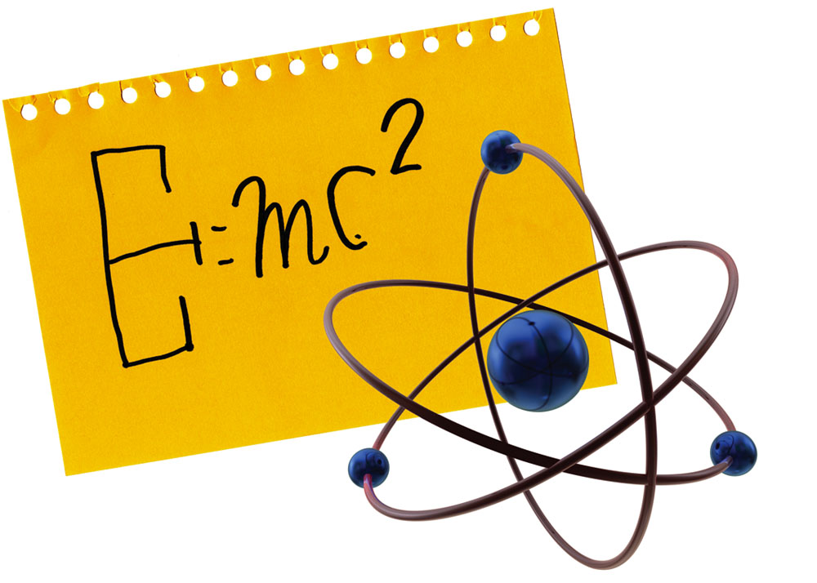
Hydrogen Fusion
The sun fuses four hydrogen nuclei to make one helium nucleus.
As one helium nucleus contains 0.7 percent less mass than four hydrogen nuclei, some mass vanishes in the process.
That mass is converted to energy.
You can figure out how much by using Einstein’s famous equation, E = mc².

Slide 26
Hydrogen Fusion
For example, converting 1 kg (2.2 lb) of matter completely into energy would produce an enormous amount of energy—9 x 10¹⁶ Joules.
This is comparable to the amount of energy a big city like Philadelphia uses in a year.

Slide 27
Hydrogen Fusion
The sun has a voracious appetite and needs 10³⁸ reactions per second, transforming 5 million tons of mass into energy every second, just to replace the energy pouring into space from its surface.
It might sound as if the sun is losing mass at a furious rate.
However, during its entire 10-billion-year lifetime, the sun will convert less than 0.07 percent of its mass into energy.

Slide 28
Hydrogen Fusion
Fusion reactions can occur only when the nuclei of two atoms get very close to each other.
As atomic nuclei carry positive charges, they repel each other with an electrostatic force called the Coulomb force.
Physicists commonly refer to this repulsion between nuclei as the Coulomb barrier.

Slide 29
Hydrogen Fusion
Nuclear reactions in the sun take place only near the center—where the gas is hot and dense.
A high temperature ensures that collisions between nuclei are violent enough to overcome the Coulomb barrier.
A high density ensures that there are enough collisions, and thus enough reactions, to produce enough energy to keep the sun stable.

Slide 30
Hydrogen Fusion
You can symbolize this process with a simple nuclear reaction:
4 ¹H → ⁴He + energy
¹H represents a proton, the nucleus of a hydrogen atom.
⁴He represents the nucleus of a helium atom.
The superscripts indicate the total number of protons and neutrons in each nucleus.

Slide 31
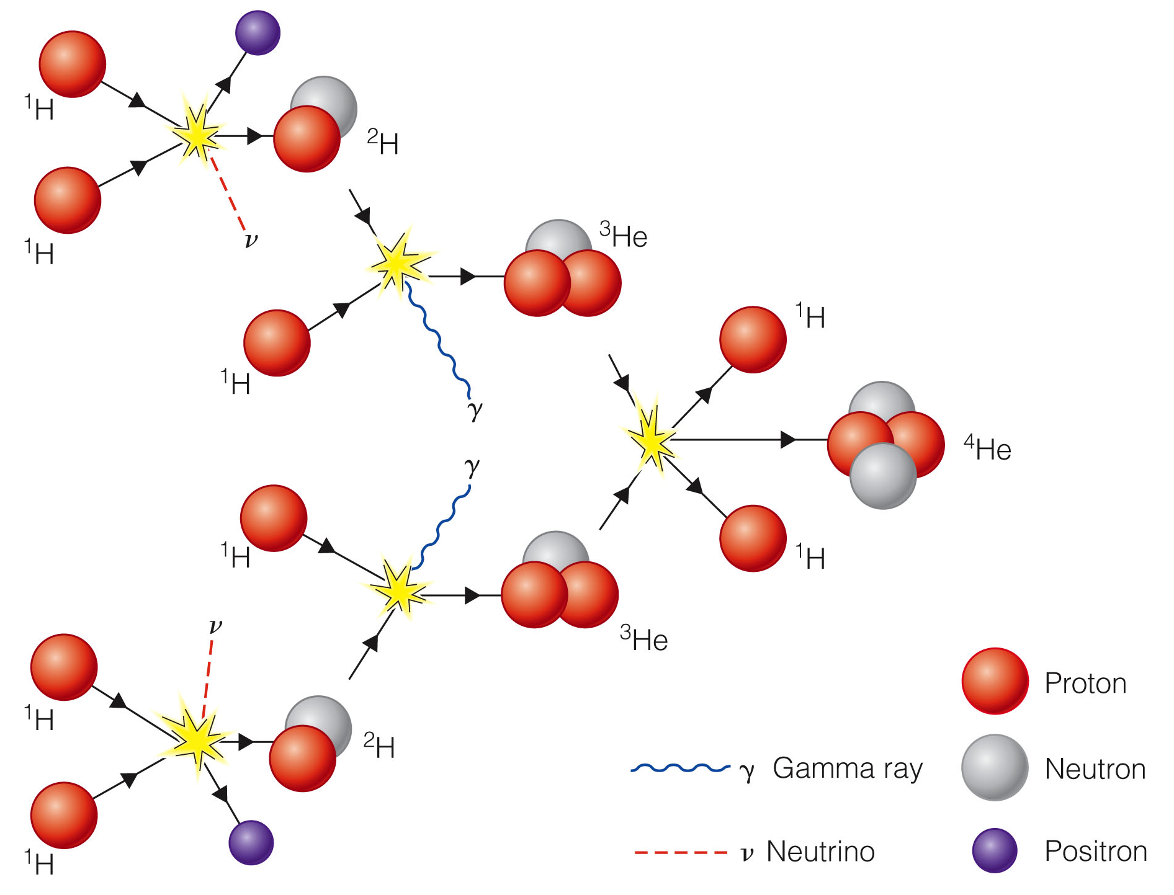
Hydrogen Fusion
The proton-proton chain is a series of three nuclear reactions that builds a helium nucleus by adding protons one at a time.
This process is
efficient at
temperatures
above 10,000,000 K.
The sun, for example,
manufactures its energy
in this way

Slide 32
Hydrogen Fusion
All main-sequence stars fuse hydrogen into helium to generate energy.
The sun and smaller stars fuse hydrogen by the proton–proton chain.
Upper-main-sequence stars, more massive than the sun, fuse hydrogen by a more efficient process called the CNO (carbon-nitrogen-oxygen) cycle.

Slide 33
Hydrogen Fusion
The CNO cycle begins with a carbon nucleus, transforms it first into a nitrogen nucleus, then into an oxygen nucleus, and then back to a carbon nucleus.
The carbon is unchanged in the end.
However, along the way, four hydrogen nuclei are fused to make a helium nucleus plus energy—just as in the proton–proton chain.

Slide 34
Hydrogen Fusion
Temperatures higher than 16,000,000 K are required to make the CNO cycle work.
The center of the sun is not quite hot enough for this reaction.
In stars more massive than about 1.1 solar masses, the cores are hot enough, and the CNO cycle dominates over the slower proton–proton chain.

Slide 35
Hydrogen Fusion
In both the proton–proton chain and the CNO cycle, energy appears in the form of gamma rays, positrons, and neutrinos.

Slide 36
Hydrogen Fusion
The gamma rays are photons that are absorbed by the surrounding gas before they can travel more than a few centimeters.
This heats the gas.
The positrons produced in the first reaction combine with free electrons.
Both particles vanish, converting their mass into more gamma rays.
Thus, the positrons also help keep the center of the star hot.

Slide 37
Hydrogen Fusion
The neutrinos travel at nearly the speed of light and almost never interact with other particles.
The average neutrino could pass unhindered through a lead wall a light-year thick.
Thus, the neutrinos do not help heat the gas but race out of the star, carrying away roughly 2 percent of the energy produced.

Slide 38
Neutrinos from the Sun’s Core
Nuclear reactions in the sun’s core produce floods of neutrinos that rush off into space.
If you could detect these neutrinos, you could probe the sun’s interior.
As they almost never interact with atoms, neutrinos are extremely hard to detect.
You never feel the flood of over 10¹² solar neutrinos that flows through your body every second.
Even at night, neutrinos from the sun rush through Earth as if it weren’t there, up through your bed, through you, and onward into space.

Slide 39
Neutrinos from the Sun’s Core
Certain nuclear reactions, however, can be triggered by a neutrino of the right energy.
Beginning in the 1960s, astronomers found several ways to detect solar neutrinos.

Slide 40
The Pressure–Temperature Thermostat
In a star, the nuclear reactions generate just enough energy to balance the inward pull of gravity.
Consider what would happen if they produced too much energy.
As the star balances gravity by generating energy, the extra energy flowing out of the star would force it to expand.
The expansion would lower the central temperature and density and slow the nuclear reactions until the star regained stability.

Slide 41
The Pressure–Temperature Thermostat
Thus, the star has a built-in regulator that keeps the nuclear reactions from occurring too rapidly.
The same thermostat keeps the reactions from dying down.
Suppose the nuclear reactions began making too little energy.
Then, the star would contract slightly—increasing the central temperature and density and increasing the nuclear energy generation.

Slide 42
The Mass–Luminosity Relation
Observations of the temperature and luminosity of stars show that main-sequence stars obey a simple rule.
The more massive a star is, the more luminous it is.

Slide 43
The Mass–Luminosity Relation
To understand the mass–luminosity relation, you must consider both the law of hydrostatic equilibrium, which states that pressure balances weight, and the pressure–temperature thermostat, which regulates energy production.

Slide 44
The Mass–Luminosity Relation
A star that is more massive than the sun has more weight pressing down on its interior.
So, the interior must have a high pressure to balance that weight.
That means the massive star’s automatic pressure–temperature thermostat must keep the gas in its interior hot and the pressure high.

Slide 45
Brown Dwarfs
The mass–luminosity relation also shows you why the main sequence has a lower end—a minimum mass.
Objects with masses less than about 0.08 of the sun’s mass cannot raise their central temperature high enough to begin hydrogen fusion.
Called brown dwarfs, such objects are only about ten times the diameter of Earth—about the same size as Jupiter—and may still be warm from the processes of formation.
However, they do not generate energy by hydrogen fusion.
They have contracted as much as they can and are slowly cooling off.

Slide 46
Brown Dwarfs
Brown dwarfs fall in the gap between low-mass M stars and massive planets like Jupiter.
They would look dull orange or red to your eyes—which is why they are labeled ‘brown’—because they emit most of their energy in the infrared.
The warmer brown dwarfs fall in spectral class L and the cooler in spectral class T.

Slide 47
Brown Dwarfs
As they are so small and cool, brown dwarfs are very low-luminosity objects and difficult to find.
Nevertheless, hundreds are known, and they may be as common as M stars.

Slide 48
The Life of a Main-Sequence Star
While a star is on the main sequence, it is stable—so, you might think its life would be totally uneventful.
However, a main-sequence star balances its gravity by fusing hydrogen.
As the star gradually uses up its fuel, that balance must change.
Thus, even stable main-sequence stars are changing as they consume their hydrogen fuel.

Slide 49
The Life of a Main-Sequence Star
Each newly made helium nucleus can exert the same pressure as a hydrogen nucleus.
As the gas has fewer nuclei, though, its total pressure is less.
This unbalances the gravity–pressure stability, and gravity squeezes the core of the star more tightly.
As the core contracts, its temperature increases and the nuclear reactions run faster—releasing more energy.
This additional energy flowing outward forces the outer layers to expand.
Therefore, as a main-sequence star slowly turns hydrogen into helium in its core, the core contracts and heats up while the outer parts of the star become larger, the star becomes more luminous, and its surface cools down.

Slide 50
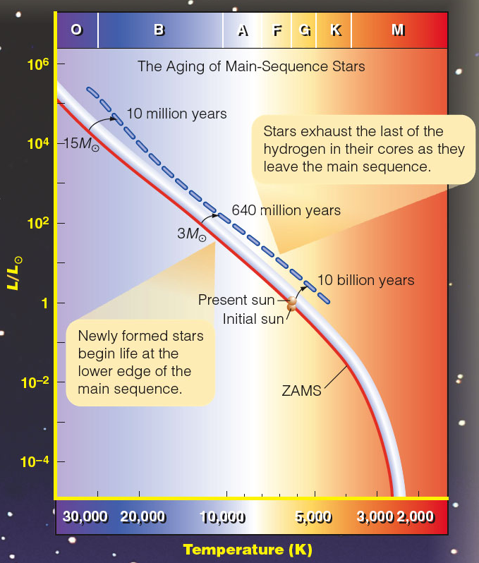
The Life of a Main-Sequence Star
Stars begin their stable lives fusing hydrogen on the lower edge of the band, known as the zero-age main sequence (ZAMS).

Slide 51
The Life of a Main-Sequence Star
However, gradual changes in luminosity and surface temperature move them upward and slightly to the right.

Slide 52
The Life of a Main-Sequence Star
By the time they reach the upper edge of the main sequence, they have exhausted nearly all the hydrogen in their centers.

Slide 53
The Life of a Main-Sequence Star
If you precisely measure and plot the luminosity and temperature of main-sequence stars on the diagram, you will find them at various positions within the main-sequence band.

Slide 54
The Life of a Main-Sequence Star
That indicates how much hydrogen has been converted to helium in their cores.

Slide 55
The Life of a Main-Sequence Star
Therefore, you can use the position of a star in the band, combined with stellar evolution models, as one way to estimate the star’s age.

Slide 56
The Life of a Main-Sequence Star
The sun is a typical main-sequence star.
As it undergoes these gradual changes, Earth will suffer.

Slide 57
The Life of a Main-Sequence Star
When the sun began its main-sequence life about 5 billion years ago, it was only about 70 percent as luminous as it is now.
By the time it leaves the main sequence in another 5 billion years, it will have twice its present luminosity.
Long before that, the rising luminosity will raise Earth’s average temperature, melt the polar caps, modify Earth’s climate, and ultimately drive away the oceans and atmosphere.

Slide 58
The Life of a Main-Sequence Star
Life on Earth will probably not survive these changes.
Nevertheless, you have a billion years or more to prepare.
The average star spends 90 percent of its life on the main sequence.
This explains why 90 percent of all true stars are main-sequence stars.
You are most likely to see a star during that long, stable period while it is on the main sequence.

Slide 59
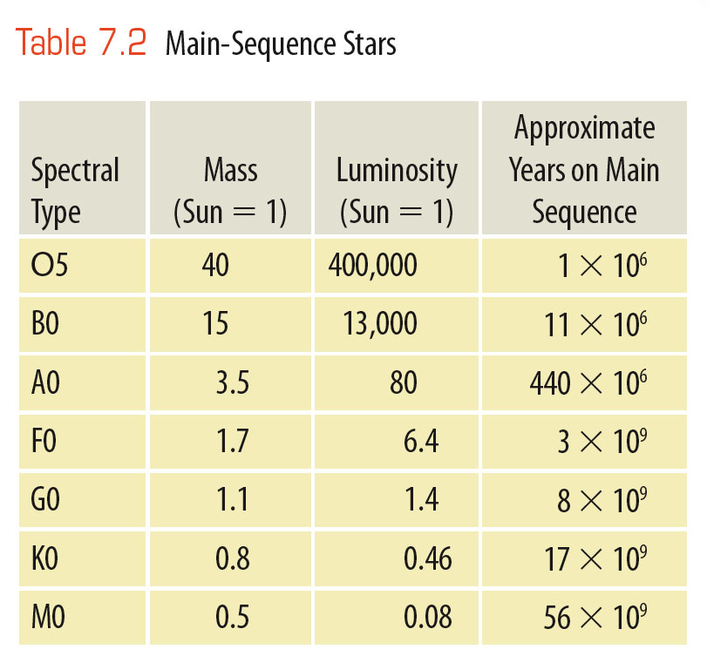
The Life of a Main-Sequence Star
The number of years a star spends on the main sequence depends on its mass.
Massive stars consume fuel rapidly and live short lives.
In contrast, low-mass stars conserve their fuel and shine for billions of years. For example,
a 25-solar-mass star will
exhaust its hydrogen and die
in only about 7 million years.
The sun has enough fuel to last
about 10 billion years.
The red dwarfs, although they
have little fuel, use it up very
slowly and may be able to
survive for 100 billion years
or more.

Slide 60
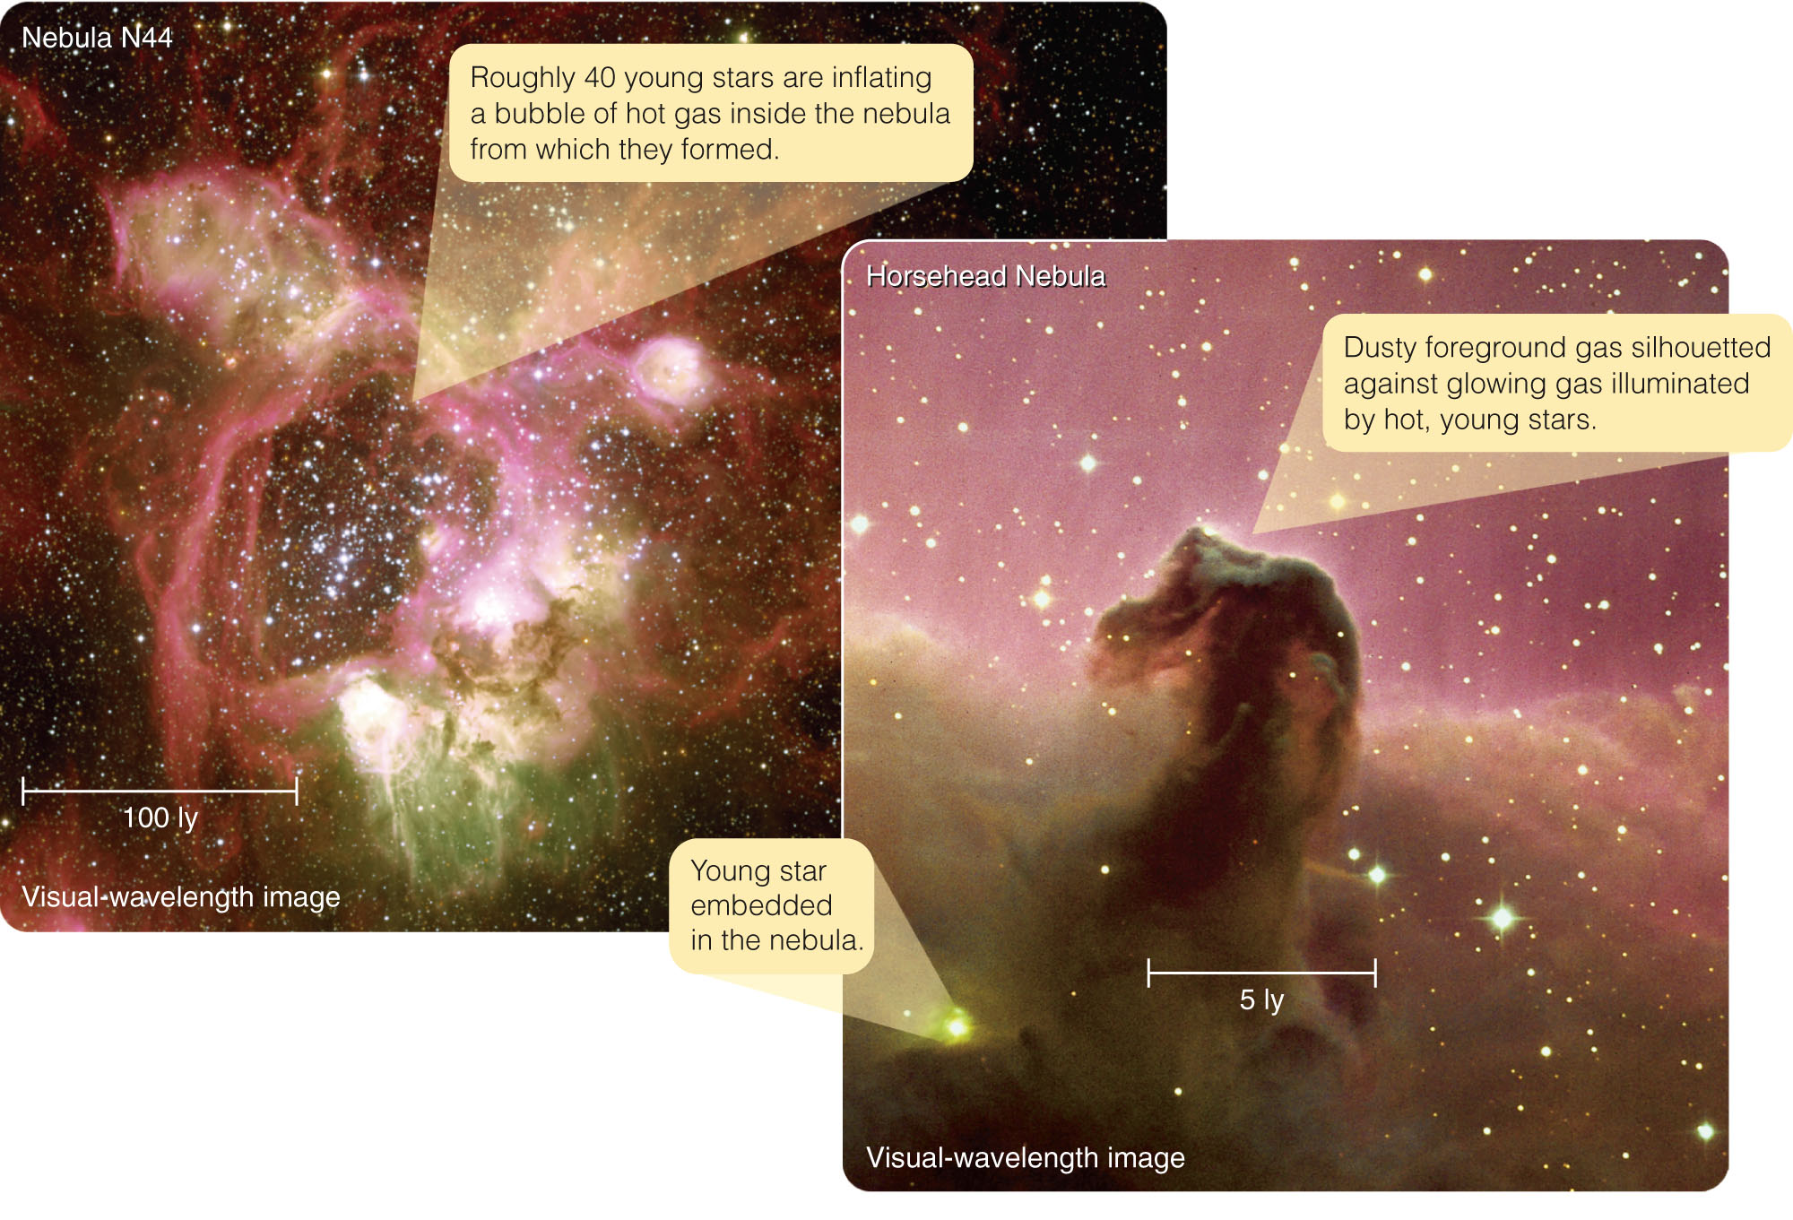
The Birth of Stars
Where you find the youngest groups of stars as well as stars with very short lifetimes, you also find large clouds of gas illuminated by the hottest and brightest of the new stars.

Slide 61
The Birth of Stars
This should lead you to suspect that stars form from such clouds.

Slide 62
The Interstellar Medium
In fact, if you glance at Orion’s sword on a winter evening, you can see the Great Nebula in Orion—a glowing cloud of gas and dust.

Slide 63
The Interstellar Medium
That cloud and others show that the space between the stars is filled with low-density gas and dust called the interstellar medium (ISM).
About 75 percent of the mass of the gas is hydrogen.
25 percent is helium.
There are also traces of carbon, nitrogen, oxygen, calcium, sodium, and heavier atoms.
This is very similar to the composition of the sun and other stars.

Slide 64
The Interstellar Medium
Roughly 1 percent of the ISM’s mass is made up of microscopic dust called interstellar dust.
The dust particles are about the size of the particles in cigarette smoke.
The dust seems to be made mostly of carbon and silicates (rocklike minerals) mixed with or coated with frozen water plus some organic compounds.

Slide 65
The Interstellar Medium
This interstellar material is not uniformly distributed through space.
It consists of a complex tangle of cool, dense clouds pushed and twisted by currents of hot, low-density gas.
Although the cool clouds contain only 10 to 1,000 atoms/cm³ (fewer than in any laboratory vacuum on Earth), astronomers refer to them as dense clouds in contrast with the hot, low-density gas that fills the spaces between clouds.
That thin gas contains only about 0.1 atom/cm³.

Slide 66
The Interstellar Medium
In some cases, the interstellar medium is easily visible as clouds of gas and dust—as in the case of the Great Nebula in Orion.
Astronomers call such a cloud a nebula— from the Latin word for cloud.
Such nebulae give clear evidence of an interstellar medium.

Slide 67
The Interstellar Medium
There are three kinds of nebulae.
There are three important points to note about nebulae.
One, very hot stars can excite clouds of gas and dust to emit
light.
This reveals that the
clouds contain mostly
hydrogen gas at very low
densities.

Slide 68
The Interstellar Medium
Two, where dusty clouds reflect the light of slightly cooler stars, you see evidence that the dust in the clouds is made up of very small particles.
Three, some dense clouds of gas and dust are detectable only where they are silhouetted against background regions filled with stars or bright nebulae.

Slide 69
The Interstellar Medium
If a cloud is less dense, the starlight may be able to penetrate it, and stars can be seen through the cloud.
However, the stars look dimmer because the dust in the cloud scatters some of the light.

Slide 70
The Interstellar Medium
As shorter wavelengths are scattered more easily than longer wavelengths, the redder photons are more likely to make it through the cloud.

Slide 71
The Interstellar Medium
Thus, the stars look slightly redder than they should for their respective spectral types.
This effect is called interstellar reddening.
The same process makes the setting sun look redder.

Slide 72
The Interstellar Medium
Although you have been imagining individual nebulae, the thin gas and dust of the interstellar medium also fills the spaces between the nebulae.

Slide 73
The Interstellar Medium
Observations at nonvisible wavelengths provide valuable evidence about the interstellar medium.

Slide 74
The Interstellar Medium
Infrared observations can directly detect dust in the interstellar medium.
Although the dust grains are very small and very cold, there are huge numbers of grains in a cloud, and each grain emits infrared radiation at long wavelengths.
Some molecules in the cold gas emit in the infrared—so, infrared observations can detect very cold clouds of gas.

Slide 75
The Interstellar Medium
Also, infrared light penetrates ISM dust better than shorter-wavelength radiation.
So, astronomers can use infrared cameras to look into and through interstellar clouds that are opaque to visible light.

Slide 76
The Interstellar Medium
X-ray observations can detect regions of very hot gas apparently produced by exploding stars.

Slide 77
The Interstellar Medium
Radio observations reveal the emissions of specific molecules in the interstellar medium—the equivalent of emission lines in visible light.
Such studies show that some of the atoms in space have linked together to form molecules.

Slide 78
The Interstellar Medium
There is no shortage of evidence concerning the interstellar medium.
Clearly, space is not empty.
From the correlation between young stars and clouds of gas and dust, you can suspect that stars form from these clouds.

Slide 79
Formation of Stars from the Interstellar Medium
To study the formation of stars, you can continue comparing theory with evidence.

Slide 80
Formation of Stars from the Interstellar Medium
The theory of gravity predicts that the combined gravitational attraction of the atoms in a cloud of gas will shrink the cloud, pulling every atom toward the center.
Thus, you might expect that every cloud would eventually collapse and become a star.

Slide 81
Formation of Stars from the Interstellar Medium
However, the thermal energy in the cloud resists collapse.
Although interstellar clouds are very cold, even at a temperature of only 10 K, the average hydrogen atom moves about 0.33 km/s (740 mph).
That much thermal motion would make the cloud drift apart if gravity were too weak to hold it together.

Slide 82
Formation of Stars from the Interstellar Medium
Other factors can help a cloud resist its own gravity.
Observations show that clouds are turbulent with currents of gas pushing through and colliding with each other.
Also, magnetic fields in clouds may resist being squeezed.
The thermal motion of the atoms, turbulence in a cloud, and magnetic fields resist gravity—and only the densest clouds are likely to contract.

Slide 83
Formation of Stars from the Interstellar Medium
The densest interstellar clouds contain from 10³ to 10⁵ atoms/cm³ and have temperatures as low as 10 K.
They include a few hundred thousand to a few million solar masses.
In such dense clouds, hydrogen can exist as molecules (H₂) rather than as atoms.
These very densest parts of the ISM are called molecular clouds, and the largest are called giant molecular clouds.

Slide 84
Formation of Stars from the Interstellar Medium
Although hydrogen molecules cannot be detected by radio telescopes, the clouds can be mapped by the emission lines of carbon monoxide (CO) molecules that are present in small amounts in the gas.

Slide 85
Formation of Stars from the Interstellar Medium
Stars can form inside molecular clouds when the densest parts of the clouds become unstable and contract under the influence of their own gravity.
Most clouds, though, do not appear to be gravitationally unstable and will not contract to form stars on their own.

Slide 86
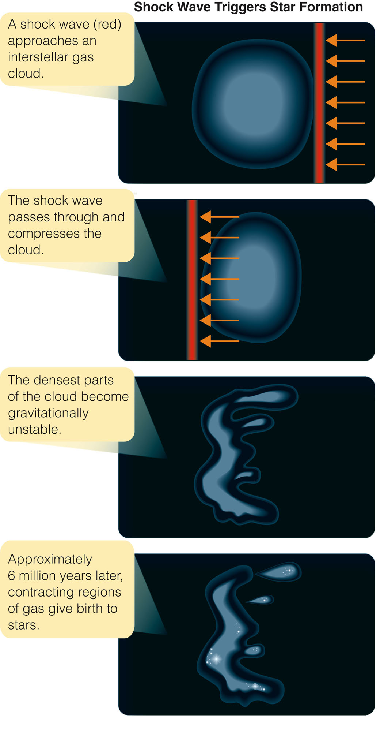
Formation of Stars from the Interstellar Medium
However, a stable cloud colliding with a shock wave —the astronomical equivalent of a sonic boom—can be compressed and disrupted into fragments.

Slide 87
Formation of Stars from the Interstellar Medium
Theoretical calculations show that some of these fragments can become dense enough to collapse under the influence of their own gravity and form stars.

Slide 88
Formation of Stars from the Interstellar Medium
Supernova explosions (exploding stars) produce shock waves that compress the interstellar medium.
Recent observations show young stars forming at the edges of such shock waves.

Slide 89
Formation of Stars from the Interstellar Medium
Another source of shock waves may be the birth of very hot stars.
A massive star is so luminous and hot that it emits vast amounts of ultraviolet photons.

Slide 90
Formation of Stars from the Interstellar Medium
When such a star is born, the sudden blast of light, especially ultraviolet radiation, can ionize and drive away nearby gas—forming a shock wave that could compress nearby clouds and trigger further star formation.

Slide 91
Formation of Stars from the Interstellar Medium
Even the collision of two interstellar clouds can produce a shock wave and trigger star formation.

Slide 92
Formation of Stars from the Interstellar Medium
The dominant trigger of star formation in Milky Way, though, may be the spiral pattern itself.
As interstellar clouds encounter these spiral arms, the clouds are compressed, and star formation can be triggered.

Slide 93
Formation of Stars from the Interstellar Medium
Once begun, star formation can spread like a grass fire.
Both high-mass and low-mass stars form together.
When the massive stars form, however, their intense radiation or eventual supernova explosions push back the surrounding gas and compress it.
This compression can trigger the formation of more stars, some of which will be massive.
Thus, a few massive stars can drive a continuing cycle of star formation in a giant molecular cloud.

Slide 94
Formation of Stars from the Interstellar Medium
A collapsing cloud of gas does not form a single object.
Due to instabilities, the cloud breaks into fragments—producing perhaps thousands of stars.

Slide 95
Formation of Stars from the Interstellar Medium
Stars held in a stable group by their combined gravity are called a star cluster.

Slide 96
Formation of Stars from the Interstellar Medium
A stellar association is a group of stars that are not gravitationally bound to one another.
The stars in an association drift away from each other in a few million years.

Slide 97
Formation of Stars from the Interstellar Medium
The youngest associations are rich in young stars, including O and B stars.
O and B stars have lifetimes so short in astronomical terms that they must be located close to their birthplaces.
These stars serve as brilliant signposts pointing to regions of star formation.

Slide 98
The Formation of Protostars
You might be wondering how the unimaginably cold gas of an interstellar cloud can heat up to form a star.
The answer is gravity.

Slide 99
The Formation of Protostars
Once part of a cloud is triggered to collapse, gravity draws each atom toward the center.
At first, the atoms fall unopposed—they hardly ever collide with each other.
In this free-fall contraction, the atoms pick up speed as they fall, until—by the time the gas becomes dense enough for the atoms to collide often—they are traveling very fast.

Slide 100
The Formation of Protostars
Collisions convert the inward velocities of the atoms into random motions.
You have learned that temperature is a measure of the random velocities of the atoms in a gas.
Thus, the temperature of the gas goes up.

Slide 101
The Formation of Protostars
The initial collapse of the gas forms a dense core of gas.
As more gas falls in, a warm protostar develops—buried deep in the dusty gas cloud that continues to contract, although much more slowly than free-fall.

Slide 102
The Formation of Protostars
A protostar is an object that will eventually become a star.
Theory predicts that protostars are luminous red objects larger than main-sequence stars, with temperatures ranging from a few hundred to a few thousand degrees K.

Slide 103
The Formation of Protostars
Throughout its contraction, the protostar converts its gravitational energy into thermal energy.
Half of this thermal energy radiates into space.
The remaining half, though, raises the internal temperature.

Slide 104
The Formation of Protostars
As the internal temperature climbs, the gas becomes ionized—changing into a mixture of positively charged atomic nuclei and free electrons.
When the center gets hot enough, nuclear reactions begin generating enough energy to replace the radiation leaving the surface of the star.
The protostar then halts its contraction and becomes a stable, main-sequence star.

Slide 105
The Formation of Protostars
The time a protostar takes to contract from a cool interstellar gas cloud to a main-sequence star depends on its mass.
The more massive the star, the stronger its gravity and the faster it contracts.

Slide 106
The Formation of Protostars
The sun took about 30 million years to reach the main sequence.
In contrast, a 15-solar-mass star can contract in only 160,000 years.
Conversely, a star of 0.2 solar mass takes 1 billion years to reach the main sequence.

Slide 107
Observations of Star Formation
By understanding what the interstellar medium is like and by understanding how the laws of physics work, astronomers have been able to work out the story of how stars must form.
You can’t, however, accept a scientific theory without testing it.
That means you must compare the theory with the evidence.

Slide 108
Observations of Star Formation
The protostar stage is predicted to be less than 0.1 percent of a star’s total lifetime.
Although that is a long time in human terms, you cannot expect to find many stars in that stage.
Furthermore, protostars form deep inside clouds of dusty gas that absorb any light the protostar might emit.

Slide 109
Observations of Star Formation
Only when the protostar is hot enough to drive away its enveloping cloud of gas and dust does it become easy to observe at wavelengths your eye can see.

Slide 110
Observations of Star Formation
Although astronomers cannot easily observe protostars at visible wavelengths, protostars can be detected in the infrared.
Protostars are cooler than stars and radiate as blackbodies predominantly at infrared wavelengths.
The dust of the surrounding interstellar cloud absorbs light from the protostar and grows warm, and that warm dust also radiates large amounts of infrared radiation.

Slide 111
Observations of Star Formation
Infrared radiation also can penetrate the dust to reach Earth.
Thus, infrared observations reveal many bright sources of radiation that are protostars buried in interstellar clouds.

Slide 112
Observations of Star Formation
You can be sure that star formation is going on right now—because astronomers find regions containing massive stars with lifetimes so short they must still be in their birthplaces.

Slide 113
Observations of Star Formation
Observations of small very dense zones of gas and dust called Bok globules within larger nebulae probably represent the very first stages of star formation.

Slide 114
Observations of Star Formation
Observations of jets coming from hidden protostars show that protostars are often surrounded by disks of gas and dust.
These jets appear to produce small flickering nebulae called Herbig–Haro objects.

Slide 115
Observations of Star Formation
The same regions contain many stars with temperatures and luminosities that correspond to model predictions of the properties of very young stars.

Slide 116
Observations of Star Formation
These include T Tauri stars, protostars with about the mass of the sun that show signs of active chromospheres as you might expect from young rapidly rotating stars with strong magnetic dynamos.
T Tauri stars are also often surrounded by thick disks of gas and dust that are very bright at infrared wavelengths.

Slide 117
Observations of Star Formation
These observations all confirm the theoretical models of contracting protostars.
Although star formation still holds many puzzles, the general process seems clear.
In at least some cases, interstellar gas clouds are compressed by passing shock waves, and the clouds’ gravity, acting unopposed, draws the matter inward to form protostars.

Slide 118
Observations of Star Formation
Now, you know how to make a star.
Just find some way to compress more than 0.08 solar masses of ISM material into a small enough region of space.
Gravity will do the rest of the job.

Slide 119
The Orion Nebula
On a clear winter night, you can see with your naked eye the Great Nebula of Orion as a fuzzy wisp in Orion’s sword.
With binoculars or a small telescope, it is striking.
Through a large telescope, it is breathtaking.

Slide 120
The Orion Nebula
At the center lie four brilliant blue-white stars known as the Trapezium—the brightest of a cluster of a few hundred stars.
Surrounding the stars are the glowing filaments of a nebula more than 8 pc across.

Slide 121
The Orion Nebula
Like a great thundercloud illuminated from within, the churning currents of gas and dust suggest immense power.
However, the significance of the Orion Nebula lies hidden—figuratively and literally—beyond the visible nebula.
The region is ripe with star formation.

Slide 122
Evidence of Young Stars
You should not be surprised to find star formation in Orion.
The constellation is a brilliant landmark in the winter sky—because it is marked by hot, blue stars.
These stars are bright in our sky not because they are nearby, but because they are tremendously luminous.
These O and B stars cannot live more than a few million years.
So, you can conclude that they must have been born astronomically recently, near where they are seen now.

Slide 123
Evidence of Young Stars
Furthermore, the constellation contains large numbers of T Tauri stars—which are known to be young.
Orion is rich with young stars.

Slide 124
Evidence of Young Stars
The history of star formation in the constellation Orion is written in its stars.
The stars at Orion’s west shoulder are about 12 million years old.
Those of Orion’s belt are about 8 million years old.
The stars of the Trapezium are no older than 2 million years.

Slide 125
Evidence of Young Stars
Apparently, star formation began near the west shoulder.
The massive stars that formed there triggered the formation of the stars you see in Orion’s belt.
That star formation may have triggered the formation of the stars in the Great Nebula.
Like a grass fire, star formation has swept across Orion from northwest to southeast.

Slide 126
Evidence of Young Stars
There are several points to note about star formation in the Orion Nebula.

Slide 127
Evidence of Young Stars
First, the nebula you see is only a small part of a vast, dusty molecular cloud.
You see the nebula because the stars born within it have ionized the gas and driven it outward— breaking out of the much larger molecular cloud.

Slide 128
Evidence of Young Stars
Two, a single very hot star is almost entirely responsible for ionizing the gas.

Slide 129
Evidence of Young Stars
Three, infrared observations reveal clear evidence of active star formation deeper in the molecular cloud just to the northwest of the Trapezium.

Slide 130
Evidence of Young Stars
Finally, many stars visible in the nebula are surrounded by disks of gas and dust.
Such disks do not last long and are clear evidence that the stars are very young.

Slide 131
Evidence of Young Stars
Observations of stars in the Orion Nebula show that some of the gas and dust in the cloud from which a star forms settles into a disk.
You should make special note of these disks—because planets may form in them.

