Slide 1
Chapter 12

Slide 2
Final Exam Update Dec. 11th,2013
Three parts:
Part I : test SLO 5 questions.
Part II: test SLO 5 questions
Part III: Ch. 10,11,12,13,14

Slide 3
The Discovery of the Galaxy
It was not until early in the 20th century that astronomers understood that they lived inside a great wheel of stars and that the universe is filled with other such star systems.
Drawing on the Greek word for milk, they called them galaxies.

Slide 4
Star Clusters and the Center of the Galaxy
A young astronomer named Harlow Shapley (1885–1972) began the discovery of the true nature of Milky Way.
He noticed that different kinds of star clusters have different distributions in the sky.

Slide 5
Star Clusters and the Center of the Galaxy
There are two types of star clusters.
Open clusters which are concentrated along Milky Way.
Globular clusters which are widely scattered.

Slide 6
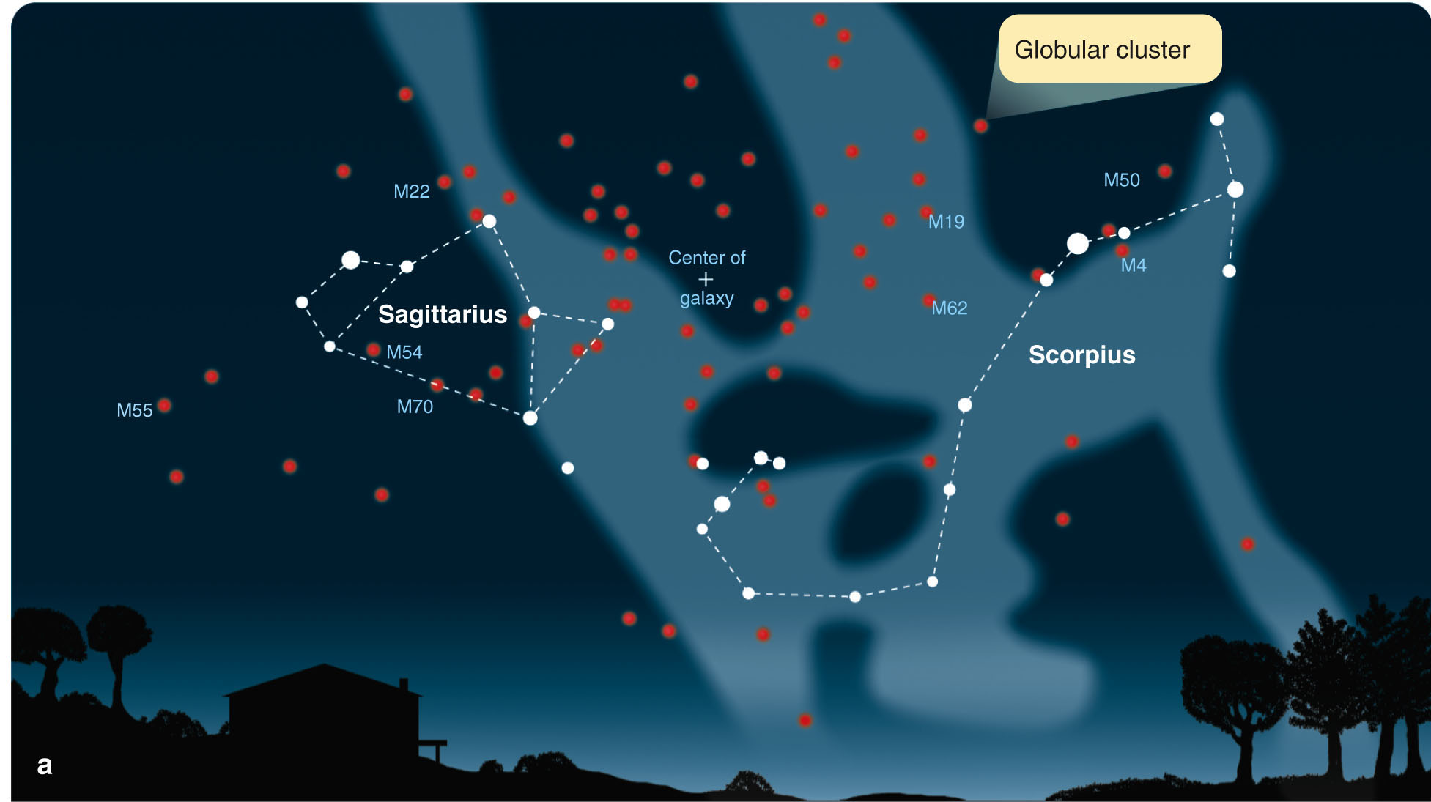
Star Clusters and the Center of the Galaxy
It was noticed that the globular clusters were more common toward the constellations Sagittarius and Scorpius.

Slide 7
Star Clusters and the Center of the Galaxy
If so, we could study the size and extent of the galaxy by studying the globular clusters.
To do that, It is needed to measure the distances to as many globular clusters as possible.

Slide 8
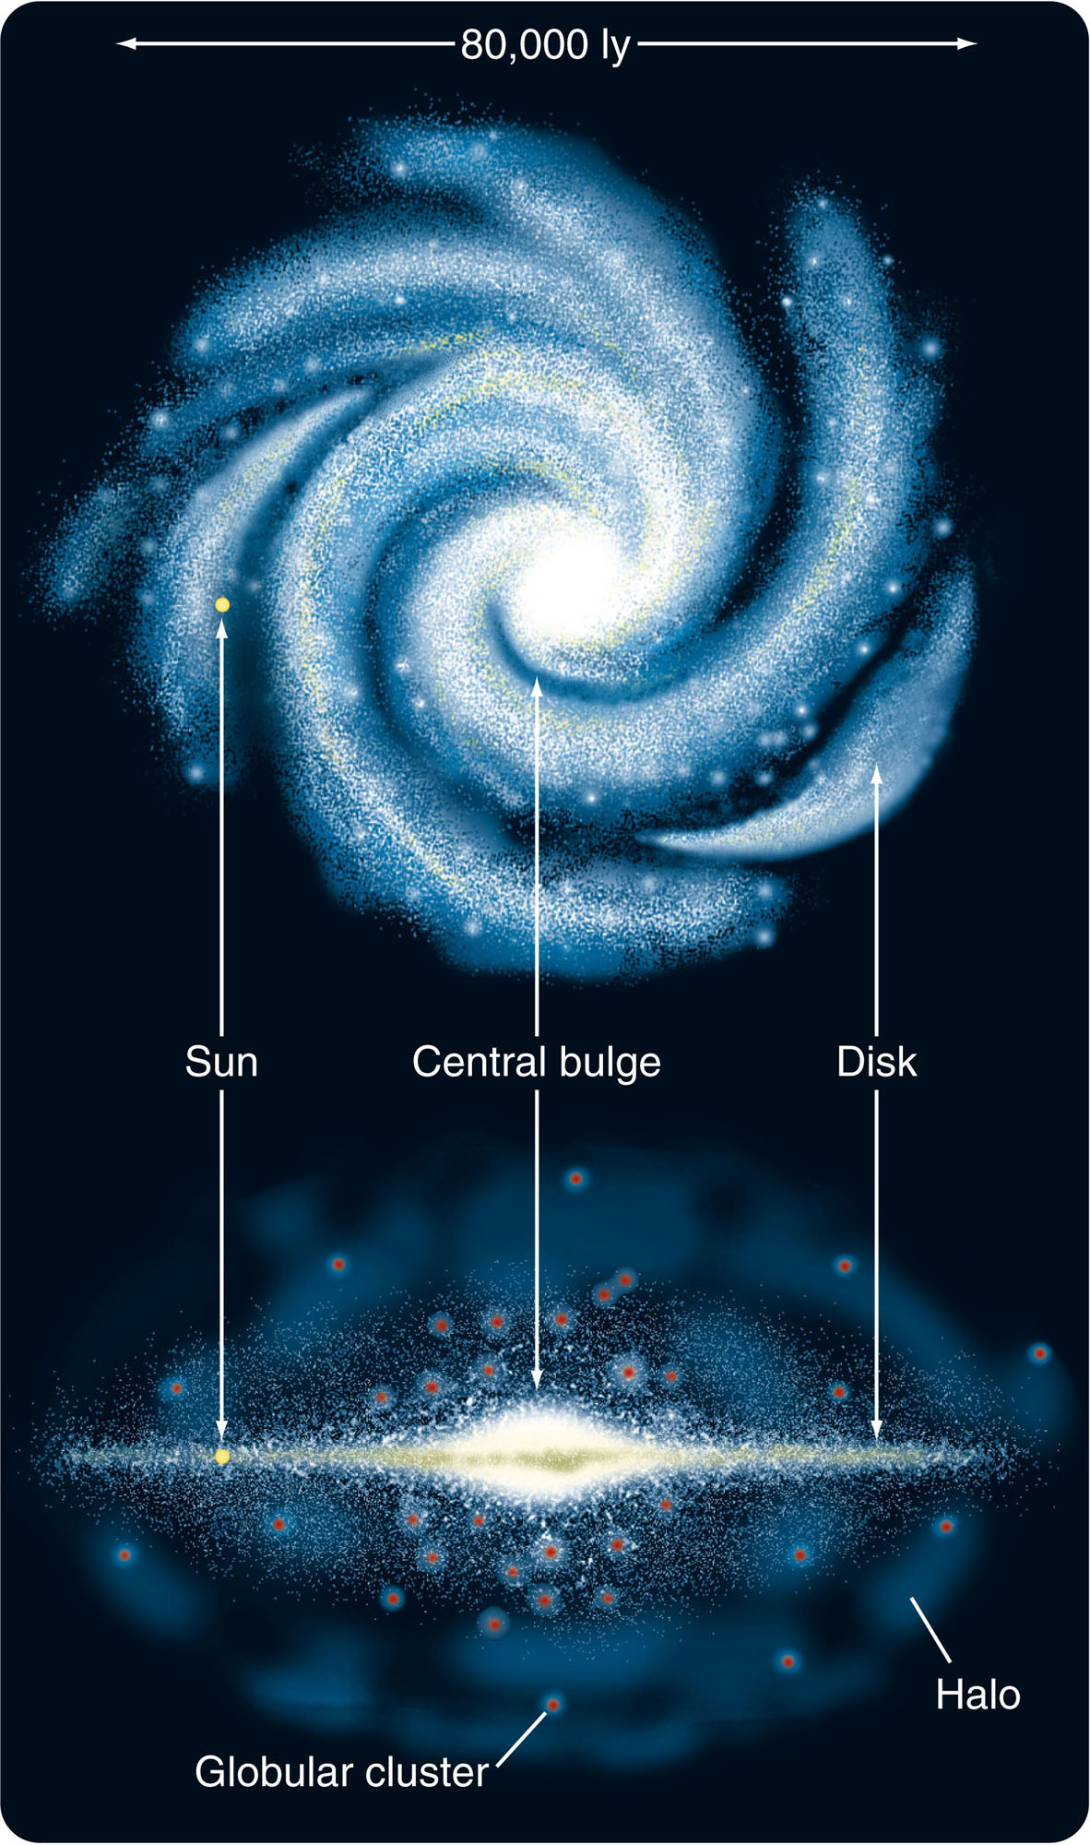
An Analysis of the Galaxy
Our galaxy, like many others, contains two primary components—a disk and a sphere.

Slide 9
An Analysis of the Galaxy
The disk component consists of all matter confined to the plane of rotation—that is, everything in the disk itself.
This includes stars, open star clusters, and nearly all the galaxy’s gas and dust.

Slide 10
An Analysis of the Galaxy
As the disk contains lots of gas and dust, it is the site of most of the star formation in the galaxy.
So, it is illuminated by recently formed brilliant, blue, massive stars and has an overall relatively blue color.

Slide 11
An Analysis of the Galaxy
The best studies suggest the sun is about 8.5 kpc from the center.
1 kpc is a kiloparsec, or 1,000 pc.

Slide 12
An Analysis of the Galaxy
The sun and Earth seem to be about two-thirds of the way from the center to the edge.
So, the diameter of our galaxy appears to be about 25 kpc or about 80,000 ly.
However, that isn’t known to better than 10 percent precision.

Slide 13
An Analysis of the Galaxy
The most striking features of the disk component are the spiral arms—long curves of bright stars, star clusters, gas, and dust.
Such spiral arms are easily visible in other galaxies.
Also, you will see later how astronomers found that our own galaxy has a spiral pattern.

Slide 14
An Analysis of the Galaxy
The second component of the galaxy is the spherical component.
This includes all matter in the galaxy scattered in a roughly spherical distribution around the center.
This includes a large halo and the nuclear bulge.

Slide 15
An Analysis of the Galaxy
The halo is a spherical cloud of thinly scattered stars and globular star clusters.
It contains only about 2 percent as many stars as the disk of the galaxy and has very little gas and dust.
Thus, with no raw material available, no new stars are forming in the halo.

Slide 16
An Analysis of the Galaxy
The central bulge is the dense cloud of stars that surrounds the center of the galaxy.
It has a radius of about 2 kpc and is slightly flattened.

Slide 17
An Analysis of the Galaxy
The bulge seems to contain little gas and dust.
Thus, there is little star formation.
Most of the stars in the nuclear bulge are old, cool stars—like those in the halo.

Slide 18
Speed of Light
299,792,458 meters per second
186,282.4 miles per second
670,616,640 miles per hour
Around the equator of the earth
0.13 seconds
From the earth to the moon
1.255 seconds
From the sun to the earth
8.3 minutes

Slide 19
Light year
5.879 x 1012 miles
✤ 5,879,000,000,000 miles
✤ 9.461 x 1012 km
✤ 9,461,000,000,000 km
63,240 astronomical units
0.3066 parsecs
1 parsec = 206,260 AU or 3.26 light years
Entire sky = 360°
One degree = 60 minutes (60’)
One minute = 60 seconds (60”)

Slide 20
Milky-Way Size and Mass
100,000 light years in diameter
✤ 6,000,000,000,000,000,000 miles
1,000 light years thick
About 400 billion stars
5.8 x 1011 solar masses
One solar mass = 4.3 x 1030 pounds
✤ 24.94 x 1041 pounds
✤ 2.494 x 1042 pounds✤ 2,494,000,000,000,000,000,000,000,000,000,000,000,000,000 pounds

Slide 21
Sagittarius A*
(A-star)
The supermassive black hole at the center of the Milky Way
About 3.5 million solar masses
http://www.youtube.com/watch?v=XhHUNvEKUY8

Slide 22
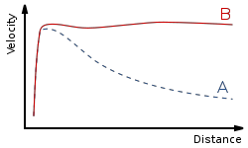
Dark Matter
Rotation curve of a typical spiral galaxy:
predicted (A) and observed (B). Dark matter can explain the 'flat' appearance
of the velocity curve out to a large radius

Slide 23
Dark Matter
The orbital speeds of stars rotating around the Milky Way do not match the amount visible mass
Speed of rotation does not slow down as much as expected away from the center of the Milky Way

Slide 24
Globular Clusters
◆ Spherical cluster of stars
◆ Found in the halo of the Milky Way
◆ Swarming orbits around center of mass
◆ All born about the same time
◆ Mostly old star
◆ Except for some blue stragglers that appear to be much younger
◆ Blue stragglers are formed by collisions of stars in globular clusters
◆ 158 globular clusters currently known
◆ Some dozens waiting to be found

Slide 25
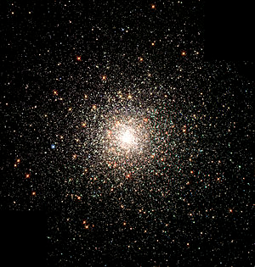
M80
The Messier 80 globular cluster in the constellation Scorpius is located about 28,000 light-years from the Sun and contains hundreds of thousands of stars.

Slide 26
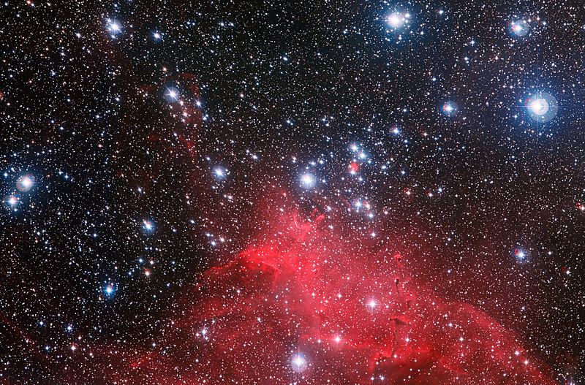
Open Clusters
◆ Irregular grouping of stars
◆ Born about the same time
◆ Not gravitationally bound
◆ Will over millions of years, move away from each other

Slide 27
The Local Group
Group of galaxies gravitationally bound to the Milky Way
54 members in all
Large Magellanic Cloud
Small Magellanic Cloud
Andromeda Galaxy (M31)
Triangulum Galaxy (M33)

Slide 28
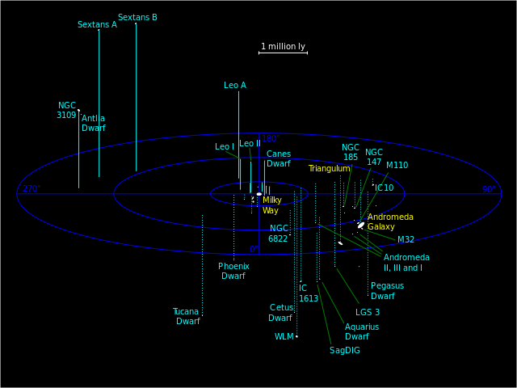

Slide 29
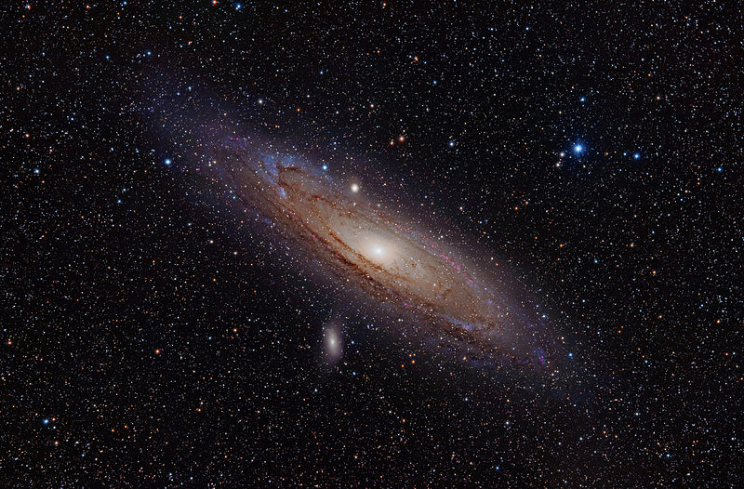
Andromeda Galaxy-M31
a spiral galaxy approximately 2.5
million light-years (2.4×10¹⁹ km) from Earth[4] in the
Andromeda constellation.

Slide 30
Milkomeda
The Milky Way and the Andromeda galaxy are heading toward each other at about a million mph
Will meet in about 3 billion years
Complete merge in about 5 billion years
Stars will miss each other
Gas and dust will form new stars
Result: an elliptical galaxy
http://www.galaxydynamics.org/tflops/tflops.mpg

Slide 31
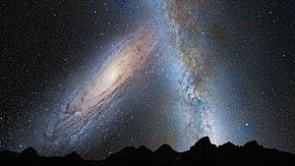
http://en.wikipedia.org/wiki/Milkomeda

