Slide 1
Chapter 6
The Terrestrial Planets

Slide 2
Outline:
The four stages of planetary Development.
The solid Earth : Interior, Magnetic Field, and earth’s active crust.
The atmosphere :
its origin
Human effects on earth’s atmosphere.

Slide 3
Four stages of planets’ formation
3. Floating Stage: The planet was flooded by molten rocks and later by water which filled the lowlands.
4. Surface evolution: continues due to geological process and erosion.

Slide 4
The Earth’s Interior
The density of the entire earth is 5.52 g/cm
3• The crust is much less dense, and the interior is made up of very heavy elements.
• The heat in the interior of the earth may be:
• left over from the formation of the planet.
• Decay of radioactive material.

Slide 5
Earth had already passed through its 4 stages:
1. Differentiation - the separation of material according to density.
- For Earth, the heavy iron and nickel settles in the center, producing a dense metallic core. Silicates have went outward to form a thin, fragile crust. It is from the densest (core), less dense (mantle) to the low-densest (crust), where the densest materials were able to sink to the core because Earth's interior was melted.
- This differentiation had occurred due to the melting of Earth's interior caused by heat from the combination of radioactive decay plus energy released by in-falling matter during the planet's formation. Once the interior of Earth melted, the densest materials sank to the core.

Slide 6
2. Cratering - when the crust formed
- Earth was heavily bombarded by craters in the debris-filled early solar system.
3. Flooding - the flooding of the crater basins by lava, water, or both.
4. Slow Surface Evolution
Terrestrial planets pass through these stages.
However, differences in masses, temperature, and composition emphasize some stages over others—producing surprisingly different worlds.

Slide 7
The comparison of one planet with another is called comparative planetology.
It is one of the best ways to analyze the worlds in our solar system.
You will learn much more by comparing planets than you could by studying them individually.
In this chapter, you will visit five Earthlike worlds.
This preliminary section will be your guide to important features and comparisons.

Slide 8
Five Worlds
You are about to visit Earth, Earth’s moon, Mercury, Venus, and Mars.
It may surprise you that the moon is on your itinerary.
After all, it is just a natural satellite orbiting Earth and isn’t one of the planets.

Slide 9
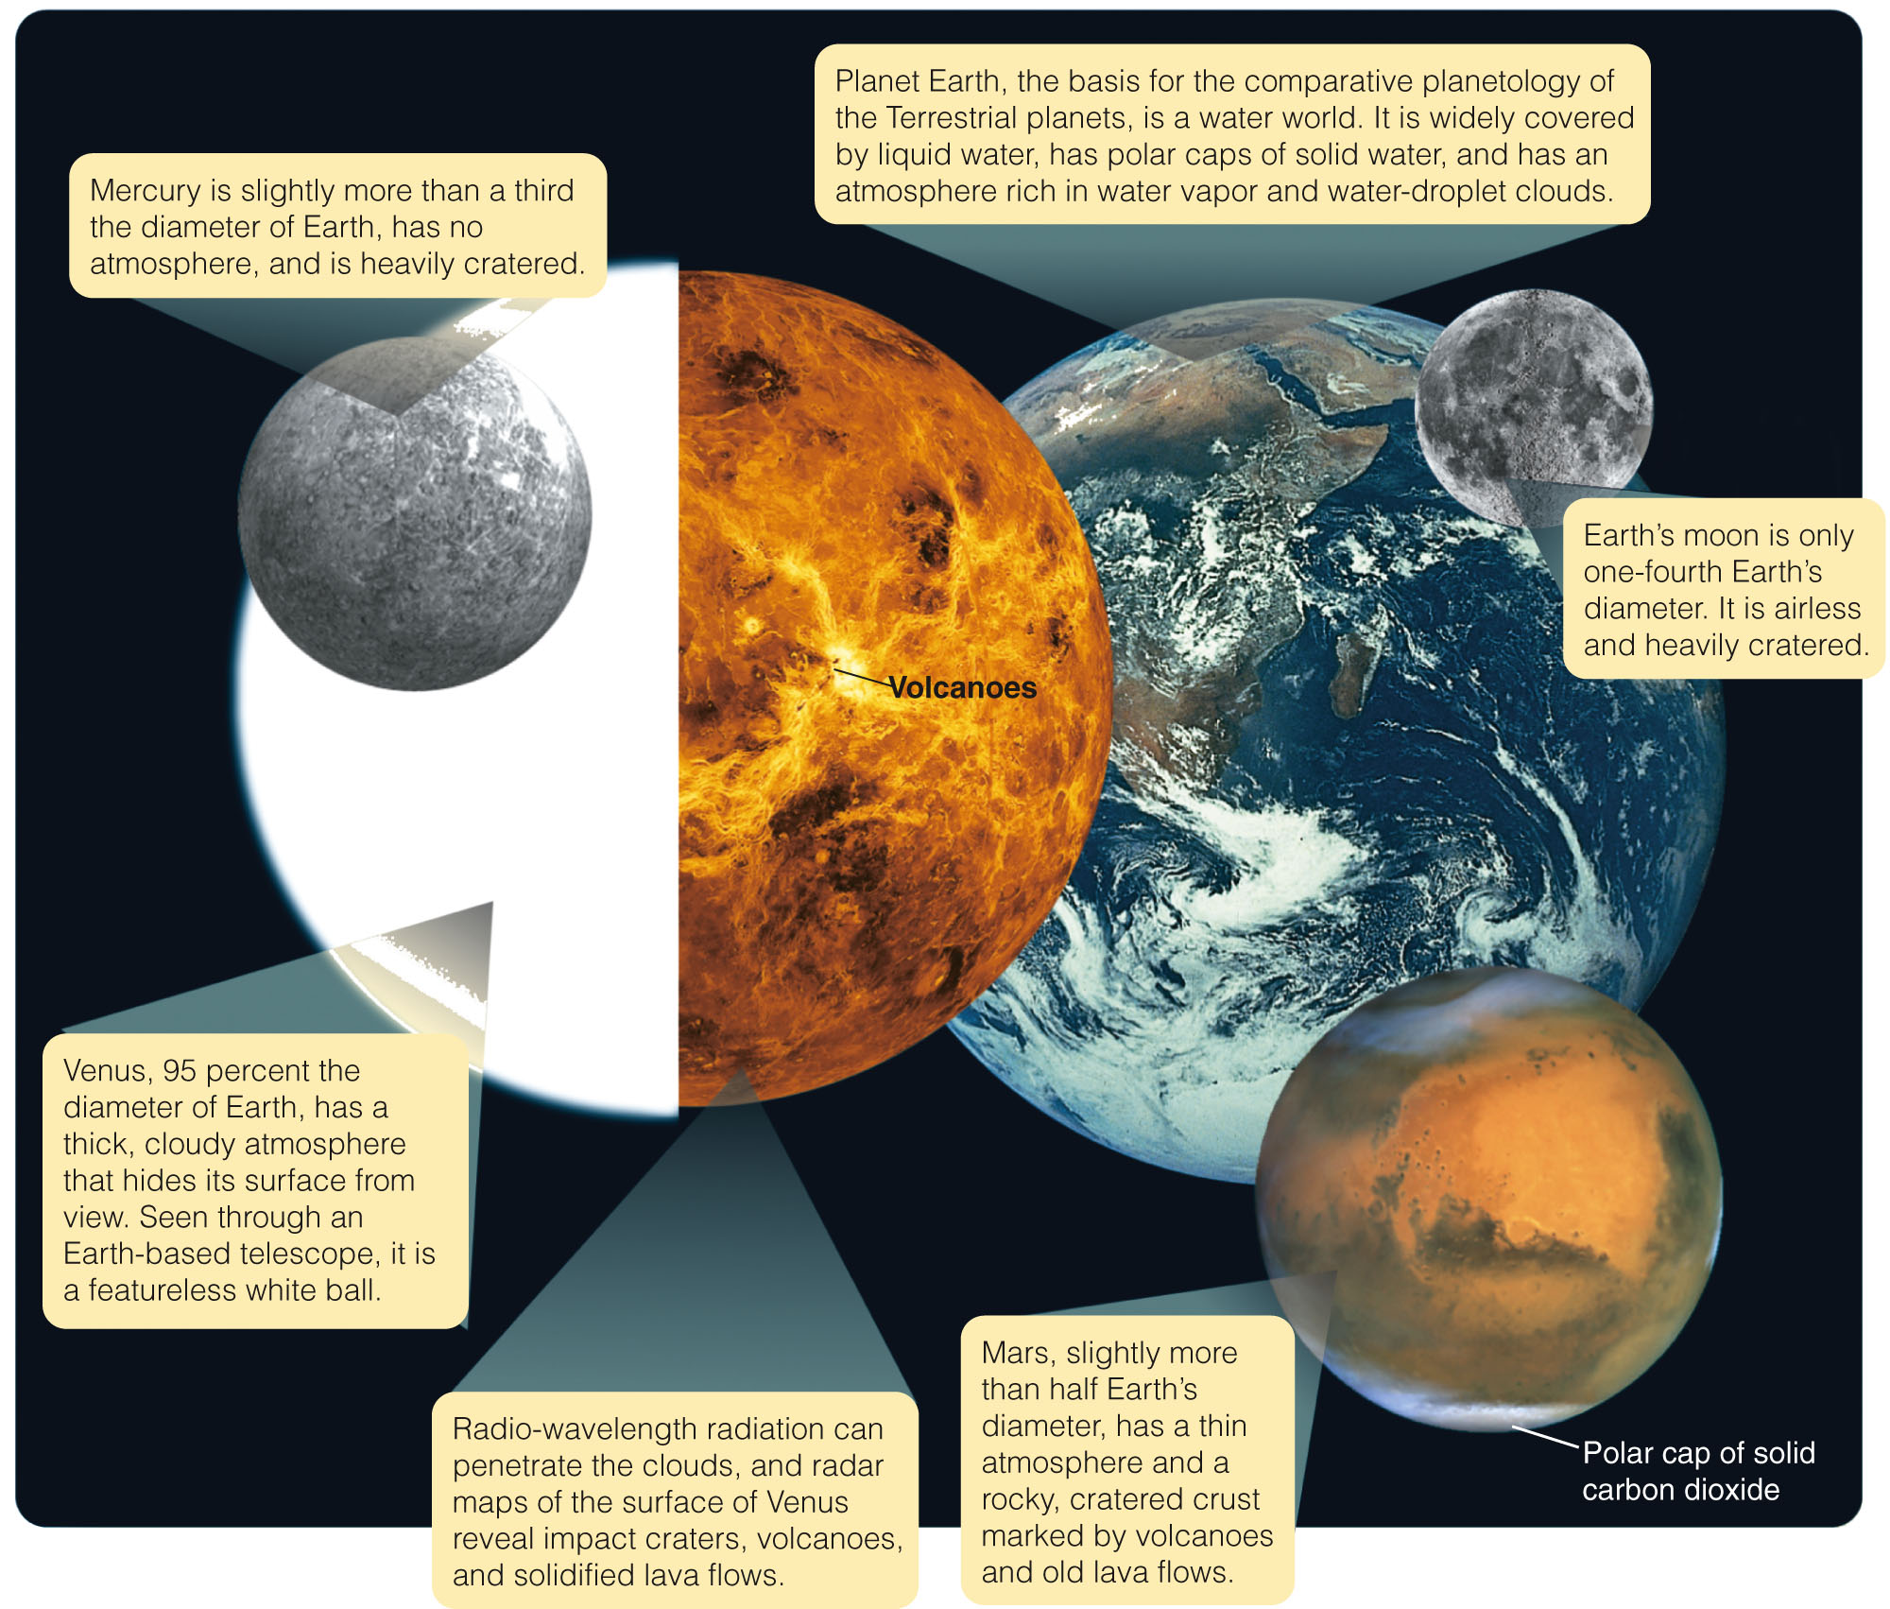
Five Worlds
The figure compares the five worlds you are about to study.
Notes:
Put figure 8-1.

Slide 10
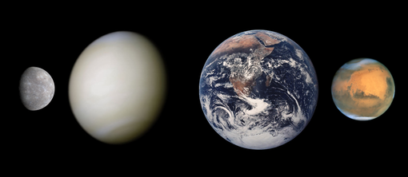
The terrestrial planets Mercury, Venus, Earth and Mars in true colors, sizes to scale

Slide 11
Five Worlds
The first feature to notice is diameter.
The moon is small.
Mercury is not much bigger.
Earth and Venus are large and similar in size to each other.
Mars, though, is a medium-sized world.

Slide 12
Five Worlds
You will discover that size is a critical factor in determining a world’s personality.
Small worlds tend to be internally cold and geologically dead.
However, larger worlds can be geologically active.

Slide 13
Formation of planets
• Earth formed 4.6 billion years ago from the inner solar nebula.
• Four stages of planets’ formation:1. Differentiation Stage: divided into layers High-density metal cores, thick mantle of dense rocks. Rocky, low-density crusts.
2. Cratering Stage: The planet is heavily bombarded by leftover planetesimals and fragments.

Slide 14
All terrestrial planets have approximately the same type of structure: a central metallic core, mostly iron, with a surrounding silicate mantle. The Moon is similar, but has a much smaller iron core. Io and Europa are other satellites that have internal structure similar to terrestrial planets. Terrestrial planets can have canyons, craters, mountains, volcanoes, and other surface structures. Terrestrial planets possess secondary atmospheres, generated through internal volcanism or comet impacts, in contrast to the gas giants, whose atmospheres are primary, captured directly from the original solar nebula

Slide 15
Core, Mantle, and Crust
The terrestrial worlds are made up of rock and metal.
They are all differentiated:
Rocky, low-density crusts
High-density metal cores
Mantles composed of dense rock between the cores and crusts

Slide 16
Core, Mantle, and Crust
As you have learned, when the planets formed, their surfaces were subjected to heavy bombardment by leftover planetesimals and fragments.
The cratering rate then was as much as 10,000 times what it is at present.
You will see lots of craters on these worlds—especially on Mercury and the moon.

Slide 17
Core, Mantle, and Crust
Notice that cratered surfaces are old.
For example, if a lava flow covered up some cratered landscape to make a new surface after the end of the heavy bombardment, few craters could be formed afterward on that surface.
This is because most of the debris in the solar system was gone.
So, when you see a smooth plain on a planet, you can guess that the surface is younger than the cratered areas.

Slide 18
Core, Mantle, and Crust
One important way you can study a planet is by following the energy.
The heat in the interior of a planet may be left over from the formation of the planet.
It may also be heat generated by radioactive decay.
In any case, it must flow outward toward the cooler surface where it is radiated into space.

Slide 19
Core, Mantle, and Crust
In flowing outward, the heat can cause phenomena such as:
Convection currents in the mantle
Magnetic fields
Plate motions
Quakes
Faults
Volcanism
Mountain building

Slide 20
Core, Mantle, and Crust
Heat flowing upward through the cooler crust makes a large world like Earth geologically active.
In contrast, the moon and Mercury—both worlds—cooled fast.
So, they have little heat flowing outward now and are relatively inactive.
When you look at Mercury and the moon, you can see their craters, plains, and mountains.

Slide 21
Atmospheres
You might ponder two questions.
One, why do some worlds have atmospheres while others do not?
You will discover that both size and temperature are important.

Slide 22
Atmospheres
The second question is more complex.
Where did these atmospheres come from?
To answer the question, you will have to study the geological history of these worlds.

Slide 23
Earth’s Atmosphere
When you think about Earth’s atmosphere, you should consider three questions.
How did it form?
How has it evolved?
How are we changing it?

Slide 24
Earth’s Atmosphere
Also, the final stages of planet building may have seen Earth and other planets accreting planetesimals rich in volatile materials—such as water, ammonia, and carbon dioxide.
Thus, the primary atmosphere must have been rich in carbon dioxide, nitrogen, and water vapor.
The atmosphere you breathe today is a secondary atmosphere produced later in Earth’s history.

Slide 25
Earth’s Atmosphere
Earth’s first atmosphere—its primary atmosphere—was once thought to contain gases from the solar nebula, such as hydrogen and methane.
Modern studies, however, indicate that the planets formed hot.
So, gases such as carbon dioxide, nitrogen, and water vapor would have been cooked out of (been outgassed from) the rock and metal.

Slide 26
Earth’s Atmosphere
Also, the final stages of planet building may have seen Earth and other planets accreting planetesimals rich in volatile materials—such as water, ammonia, and carbon dioxide.
Thus, the primary atmosphere must have been rich in carbon dioxide, nitrogen, and water vapor.
The atmosphere you breathe today is a secondary atmosphere produced later in Earth’s history.

Slide 27
Earth’s Atmosphere
Soon after Earth formed, it began to cool.
Once it cooled enough, oceans began to form, and carbon dioxide began to dissolve in the water.
Carbon dioxide is highly soluble in water—which explains the easy manufacture of carbonated beverages.
As the oceans removed carbon dioxide from the atmosphere, it reacted with dissolved compounds in the ocean water—to form silicon dioxide, limestone, and other mineral sediments.
Thus, the oceans transferred the carbon dioxide from the atmosphere to the seafloor and left air richer in other gases, especially nitrogen.

Slide 28
Earth’s Atmosphere
This removal of carbon dioxide is critical to Earth’s history.
This is because an atmosphere rich in carbon dioxide can trap heat—by the greenhouse effect.
When visible-wavelength sunlight shines through the glass roof of a greenhouse, it heats the interior.
Infrared radiation from the warm interior can’t get out through the glass.
Heat is trapped in the greenhouse.

Slide 29
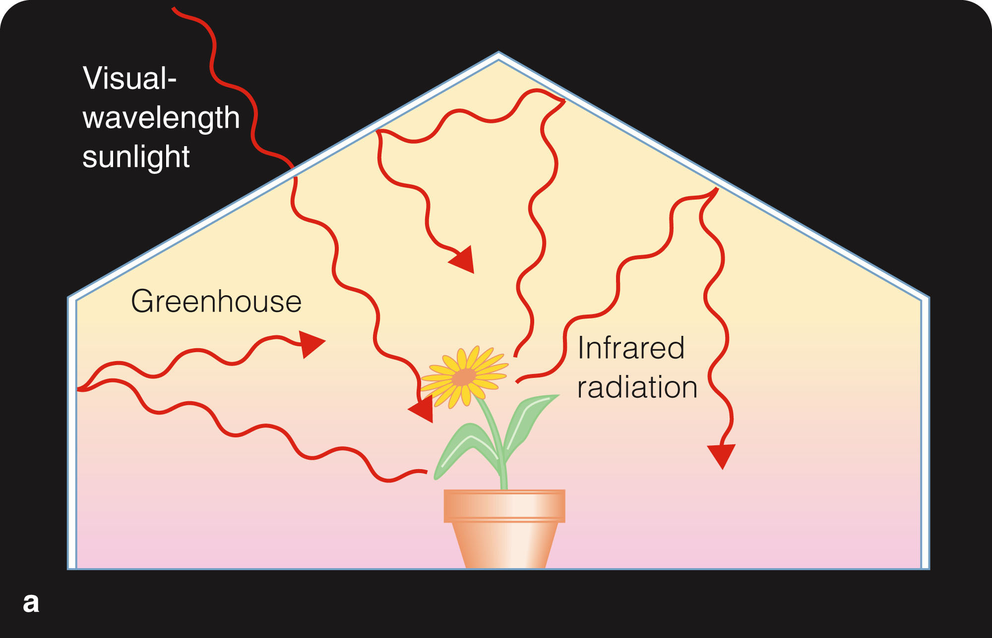
Earth’s Atmosphere
The temperature climbs until the glass itself grows warm enough to radiate heat away as fast as sunlight enters.
Of course, a real greenhouse also retains its heat because the walls prevent the warm air from mixing with the cooler air outside.
This is also called the ‘parked car effect’—for obvious reasons.

Slide 30
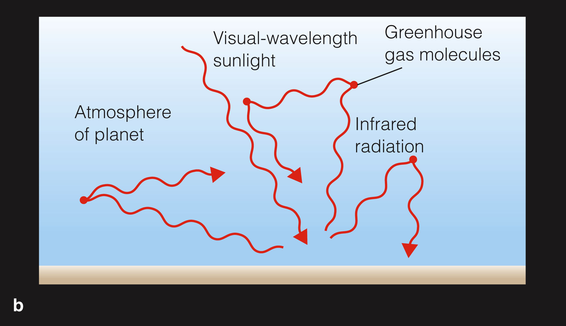
Earth’s Atmosphere
Like the glass roof of a greenhouse, a planet’s atmosphere can allow sunlight to enter and warm the surface.

Slide 31
Earth’s Atmosphere
Carbon dioxide and other greenhouse gases such as water vapor and methane are opaque to infrared radiation.
So, an atmosphere containing enough of these gases can trap heat and raise the temperature of a planet’s surface.

Slide 32
Earth’s Atmosphere
It is a common misconception that the greenhouse effect is always bad.
However, without the effect, Earth would be colder by at least 30 K (54 F).
The planetwide average temperature would be far below freezing.
The problem is that human civilization is adding greenhouse gases to those that are already in the atmosphere.

Slide 33
Earth’s Atmosphere
For 4 billion years, Earth’s oceans and plant life have been absorbing carbon dioxide and burying it—in the form of carbonates such as limestone and in carbon-rich deposits of coal, oil, and natural gas.
However, in the last century or so, human civilization has been:
Digging up those fuels
Burning them for energy
Releasing the carbon back into the atmosphere as carbon dioxide

Slide 34
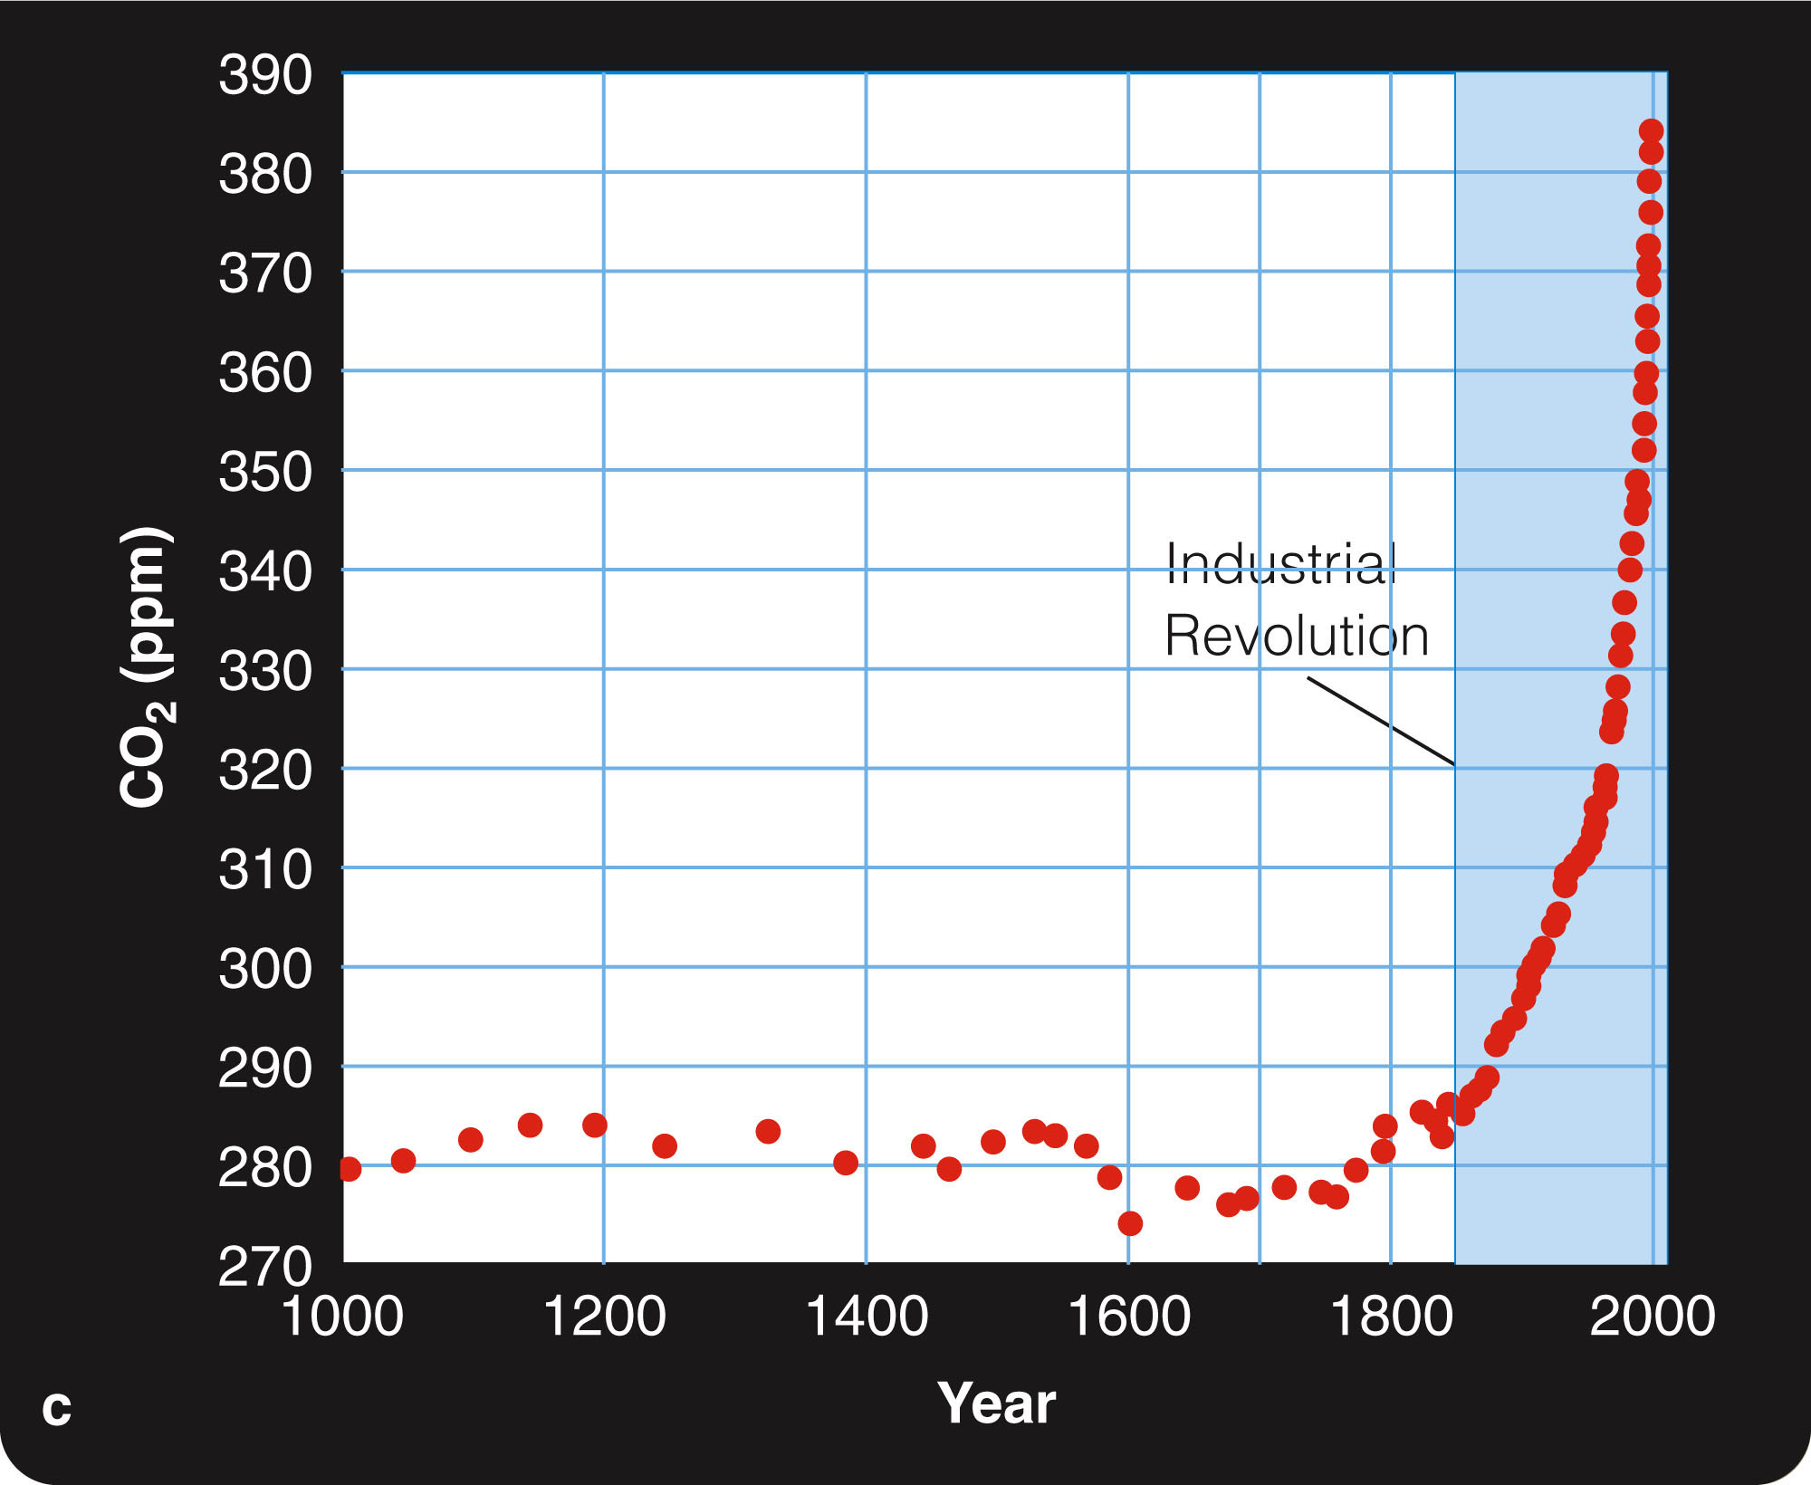
Earth’s Atmosphere
This process is steadily increasing the carbon dioxide concentration in the atmosphere and warming Earth’s climate.
This is known as global warming.

Slide 35
Global Warming
Global warming is a critical issue.
This is not just because it affects agriculture.
It is also changing climate patterns that will warm some areas and cool other areas.
In addition, the warming is melting what had been permanently frozen ices in the polar caps—causing sea levels to rise.
A rise of just a few feet will flood major land areas.
When you visit Venus, you will see a planet dominated by the greenhouse effect.

Slide 36
Oxygen in Earth’s Atmosphere
When Earth was young, its atmosphere had no free oxygen.
Oxygen is very reactive and quickly forms oxides in the soil.
So, plant life is needed to keep a steady supply of oxygen in the atmosphere.
Photosynthesis makes energy for the plant—by absorbing carbon dioxide and releasing free oxygen.

Slide 37
Oxygen in Earth’s Atmosphere
Ocean plants began to manufacture oxygen faster than chemical reactions could remove it about 2 to 2.5 billion years ago.
Atmospheric oxygen then increased rapidly.
As there is oxygen in the atmosphere now, there is also a layer of ozone (O₃) at altitudes of 15 to 30 km.

Slide 38
Oxygen in Earth’s Atmosphere
Many people hold the common misconception that ozone is bad—because they hear it mentioned as part of smog.
Indeed, breathing ozone is bad for you.
However, the ozone layer is needed in the upper atmosphere.
This layer protects you from harmful UV photons.

Slide 39
Oxygen in Earth’s Atmosphere
However, certain compounds called chlorofluorocarbons (CFCs), used in refrigeration and industry, can destroy ozone when they leak into the atmosphere.
Since the late 1970s, the ozone concentration has been falling.
The intensity of harmful ultraviolet radiation at Earth’s surface has been increasing year by year.

Slide 40
Oxygen in Earth’s Atmosphere
Note that ozone depletion is an Earth environmental issue that is separate from global warming.
This poses an immediate problem for public health on Earth.
However, it is also of interest astronomically.
When you visit Mars, you will see the effects of an atmosphere without ozone.

Slide 41
Atmospheres
The atmospheres of at least the inner planets has evolved since they formed. This is clearest for the Earth. The Earth’s original atmosphere was probably similar to Venus in composition, consisting of carbon dioxide and nitrogen. The evolution of photosynthesis converted carbon dioxide in the Earth’s atmosphere to oxygen, increasing the amount of O2 in it from an initial 0.01% to its current 22% level.

Slide 42
Each of the planets has a different atmosphere, although there are clear similarities between the atmospheres of the four terrestrial planets and the four gas giant planets. The terrestrial planets are rich in heavier gases and gaseous compounds, such as carbon dioxide, nitrogen, oxygen, ozone, and argon. In contrast, the gas giant atmospheres are composed mostly of hydrogen and helium.

Slide 43
Here is basic information on the atmosphere of each planet. Mercury has a very thin, almost undetectable atmosphere composed of sodium and potassium gas. These elements were likely blown from the surface of Mercury by the solar wind.
The atmosphere of Venus is composed mainly of carbon dioxide with minor amounts of nitrogen and trace amounts of nitrogen, helium, neon, and argon. The surface of Venus, though, is completely hidden by a cloudy atmosphere even thicker than Earth’s.

Slide 44
The Earth's atmosphere primarily composed of nitrogen and oxygen. Minor gases include and carbon dioxide, ozone, argon, and helium.
Mars' atmosphere is a thin layer composed mainly of carbon dioxide. Nitrogen, argon, and small traces of oxygen and water vapor are also present.

Slide 45
Earth: Planet of Extremes
Earth is an active planet.
It has a molten interior and heat flowing outward to power volcanism, earthquakes, and an active crust.
Almost 75 percent of its surface is covered by liquid water.
The atmosphere contains a significant amount of oxygen.
From what you know of the formation of Earth, you would expect it to have differentiated.

Slide 46
Earth’s Interior
Earth’s mass divided by its volume gives you its average density—about 5.5 g/cm³.
However, the density of Earth’s rocky crust is only about half that.
Clearly, a large part of Earth’s interior must be made of material denser than rock.

Slide 47
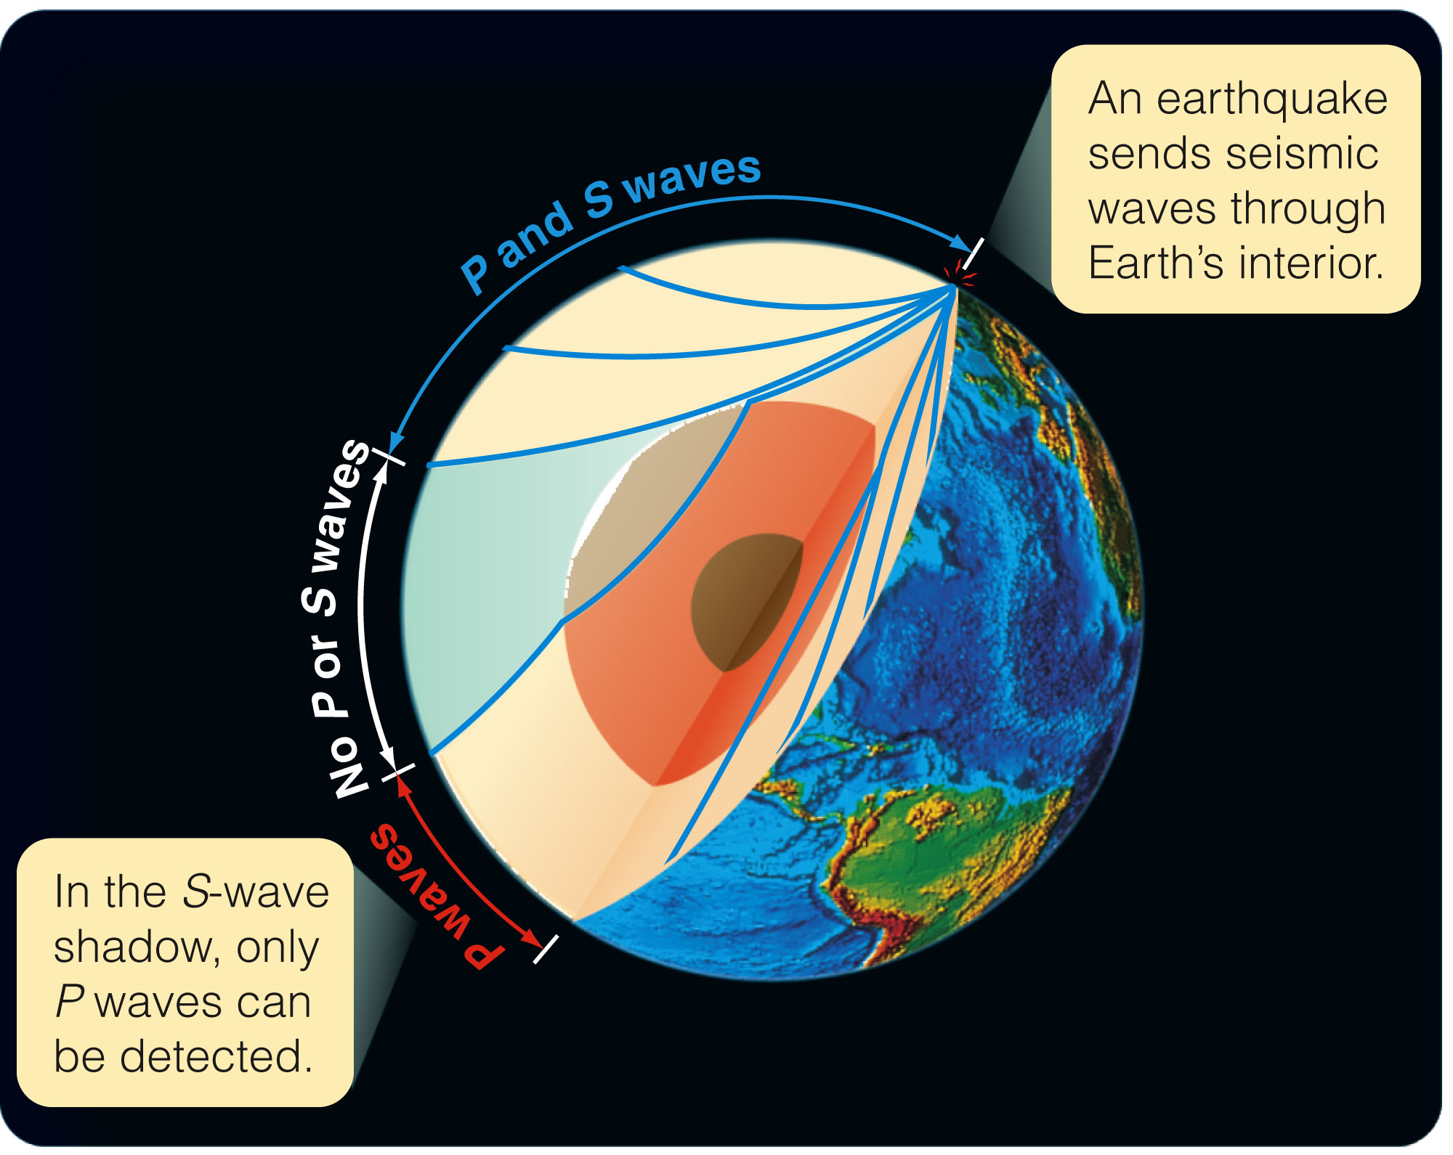
Earth’s Interior
Each time an earthquake occurs, seismic waves travel through the interior and register on seismographs all over the world.
Analysis of these waves shows that Earth’s interior is divided into:
A metallic core
A dense rocky mantle
A thin, low-density crust

Slide 48
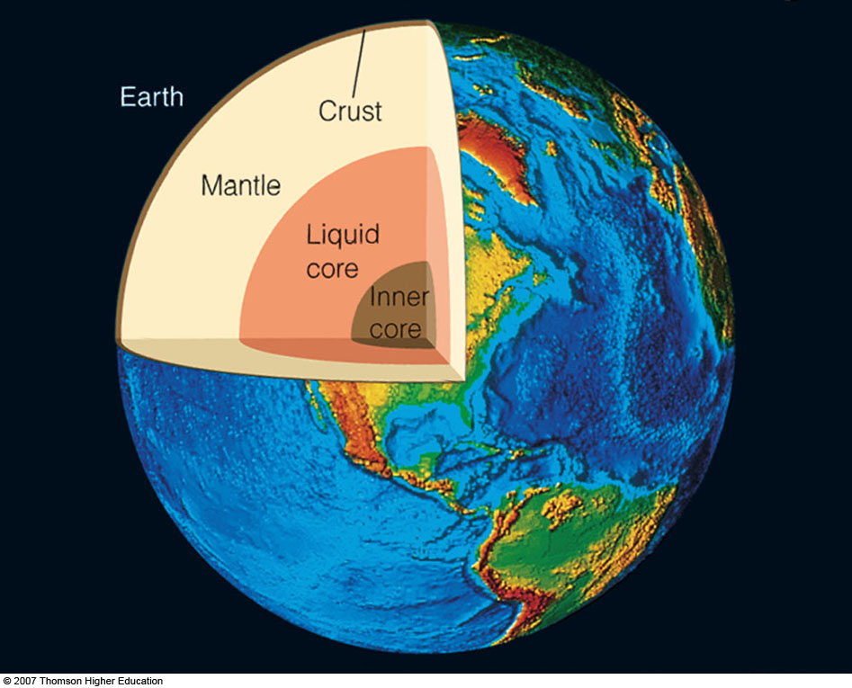
Earth’s Interior
The core has a density of 14 g/cm³, greater than lead.
Models indicate it is composed of iron and nickel at a temperature of roughly 6,000 K.
The core is as hot as the surface of the sun.
However, high pressure keeps the metal a solid near the middle of the core and a liquid in its outer parts.

Slide 49
Earth’s Interior
Two kinds of seismic waves show that the outer core is liquid.
P waves travel like sound waves, and they can penetrate a liquid.
S waves travel as a side-to-side vibration that can travel along
the surface of a liquid but not
through it.
So, Earth scientists can deduce
the size of the liquid core—by observing where S waves get through and
where they don’t.

Slide 50
Earth’s Interior
Earth’s magnetism gives you further clues about the core.
The presence of a magnetic field is evidence that part of Earth’s core must be a liquid metal.
Convection currents stir the molten liquid.
As the liquid is a very good conductor of electricity and is rotating as Earth rotates, it generates a magnetic field through the dynamo effect.
This is a different version of the process that creates the sun’s magnetic field.

Slide 51
Earth’s Interior
Earth’s mantle is a deep layer of dense rock between the molten core and the solid crust.
Models indicate the mantle material has the properties of a solid but is capable of flowing slowly.
Just below Earth’s crust, where the
pressure is less than at greater
depths, the mantle flows most easily.

Slide 52
Earth’s Interior
Earth’s rocky crust is made up of low-density rocks.
It is thickest under the continents—up to 60 km (35 mi) thick.
It is thinnest under the oceans—only about 10 km (6 mi) thick.

Slide 53
Earth’s Active Crust
Earth’s crust is composed of lower-density rock that floats on the mantle.
The image of rock floating may seem odd.
However, the mantle rock is denser than crust rocks.
Also, just below the crust, the mantle rock tends to be more fluid.
So, sections of low-density crust do indeed float on the mantle—like great lily pads floating on a pond.

Slide 54
Earth’s Active Crust
The motion of the crust and the erosive action of water make Earth’s crust highly active and changeable.
There are three important points to note about the active Earth.

Slide 55
Earth’s Active Crust
One, the motion of crust plates produces much of the geological activity on Earth.
Earthquakes, volcanism, and mountain building are linked to motions of the crust and the location of plate boundaries.

Slide 56
Earth’s Active Crust
While you are thinking about volcanoes, you can correct a common misconception.
The molten rock that emerges from volcanoes comes from pockets of melted rock in the upper mantle and lower crust—not from the molten core.

Slide 57
Earth’s Active Crust
Two, the continents on Earth’s surface have moved and changed over periods of hundreds of millions of years.
A hundred million years is only 0.1 billion years, 1⁄45 of the age of Earth.
So, sections of Earth’s crust are in geological rapid motion.

Slide 58
Earth’s Active Crust
Three, most of the geological features you know—mountain ranges, the Grand Canyon, and even the outline of the continents—are recent products of Earth’s active surface.

Slide 59
Earth’s Active Crust
Earth’s surface is constantly renewed.
The oldest Earth materials known are small crystals called zircons from western Australia.
These are 4.3 billion years old.
Most of the crust is much younger than that.

Slide 60
Earth’s Active Crust
The mountains and valleys around you are probably no more than a few tens or hundreds of millions of years old.

Slide 61
Earth’s Magnetic Field
Dynamo Effect (how Earth's magnetic field is created)
the theory that Earth's magnetic field is generated by the currents in its melting core. - It is said that the liquid core is stirred by convection. - Earth's rotation brings this motion closer that circulates in a way that generates electric currents throughout the core.

Slide 62
Eccentricity (e)
a number between 1 and 0 that describes the shape of an ellipse, the distance from one focus to the center of the ellipse divided by the semimajor axis.
Oblate
the flattening of a spherical body/planet at the poles, usually caused by rotation
Albedo
the ratio of the light reflected from an object to the light that hits the object. 0 = perfectly black 1 = perfectly white

Slide 63
Moon's Characteristics
Equatorial diameter: 3.48 x 10³ km (2162.4 miles) Mass: 7.35 x 10²² kg Average density: 3.36 g/cm³ [3.3 g/cm³ uncompressed] Surface gravity: 0.17 Earth gravity Escape velocity: 2.4 km/s Surface temperature: -170⁰ to 130⁰ C (-275⁰ to 265⁰ F) Average albedo: 0.07

Slide 64
You could visit two kinds of terrain on the moon.
The dark gray areas visible from Earth are the smooth lunar lowlands—which, drawing on the Latin word for seas, earlier astronomers named maria.
You could also visit the lighter-colored mountainous lunar highlands.

Slide 65
The moon looks quite bright in the night sky seen from Earth.
In fact, the albedo of the moon is only 0.06—that is, it reflects only 6 percent of the light that hits it.
The moon looks bright only in contrast to the night sky.
It is, in reality, a dark gray world.

Slide 66
Lunar Geology
Wherever you go on the moon, you will find craters.
The highlands are marked heavily by craters.
In contrast, the smooth lowlands contain few craters.

Slide 67
The Moon
Impact Cratering: 1. Impact craters have certain distinguishing characteristics, such as their shape and the way the impacts ejected material across the lunar surface. 2. There s a great range of sizes from giant basins to microscopic pits. 3. Most of the craters on the moon are old; they were formed long ago when the solar system was young.

Slide 68
Lunar Maria
large, dark plains of the lunar lowlands (dark gray areas visible from Earth by naked eye) formed by volcanic eruptions of dark lava. Latin for "seas," early astronomers thought these dark areas on the moon were filled with water. 16% of the moon's surface is covered in Maria. The lunar Maria is one of the moon's terrains.

Slide 69
Impact Cratering of the Moon (what caused the craters on the moon)
The craters on the moon were formed by the impact of meteorites striking the moon traveling about 10 to 70 km/s, and can hit with the energy of many nuclear bombs. 1. Craters have certain distinguishing characteristics, such as shape and the ejecta, rays, and secondary craters around them.

Slide 70
- ejecta - Pulverized rock scattered by meteorite impacts on a planetary surface. 2. Lunar impact craters range from tiny pits formed by micrometeorites (small meteorites) to giant multiringed basins (the larges craters one or more inner rings concentric with the outer rim). 3. Most of the craters on the moon are old; they were formed long ago when the solar system was young.

Slide 71
Lunar Geology
Twelve Apollo astronauts visited both the moon’s Maria and highlands in six expeditions between 1969 and 1972.

Slide 72
Lunar Geology
Most rocks they found, both in the highlands and the maria, were typical of hardened lava.
The maria are actually ancient
basalt lava flows.

Slide 73
Lunar Geology
The highlands, in contrast, are composed of low-density rock containing minerals.
For example, anorthosite—a light-colored rock that contributes to the highlands’ bright contrast with the dark Maria—would be among the first material to solidify and float to the top of molten rock.

Slide 74
The Origin of the Moon
Astronomers had come up with 3 different hypothesis for the origin of the moon: 1. Fission hypothesis - the moon broke from a rapidly spinning young Earth. 2. Condensation hypothesis - Earth and its moon condensed from the same cloud of matter in the solar nebula.

Slide 75
3. Capture hypothesis - the moon formed elsewhere in the solar nebula and was later captured by Earth. Later in the 1970s, a new theory about the origin of the moon was proposed: - Large-Impact hypothesis.

Slide 76
Large-Impact Hypothesis
origin of the moon. A LARGE body the size of mars smashed into the earth and effected DEBRIS into a disk around the earth where it formed out moon The theory that the moon formed from debris ejected during a collision between Earth and a large planetesimal.

Slide 77
The History of Earth’s Moon
The escape velocity is low.
So, it has been unable to hold any atmosphere.
It cooled rapidly as its internal heat flowed outward into space.

Slide 78
Mercury's Characteristics
Equatorial diameter 4.89 x 10³ km Mass 3.31 x 10²³ kg Average density: 5.44 g/cm³ [5.4 g/cm³ uncompressed] Surface gravity: 0.38 Earth gravity Escape velocity: 4.3 km/s Surface temperature: -170⁰ to 430⁰ C (-275⁰ to 800⁰F) Average albedo: 0.1 Oblateness: 0

Slide 79
Mercury
Like Earth’s moon, Mercury is small and nearly airless.
You will find it is a cratered, dead world too.
This is because it cooled too quickly to develop plate tectonics.

Slide 80
Spacecraft at Mercury
Mercury orbits so close to the sun that it is difficult to observe from Earth.
So, little was known about the planet.
In 1974-1975, the Mariner
10 spacecraft flew past Mercury
three times.

Slide 81
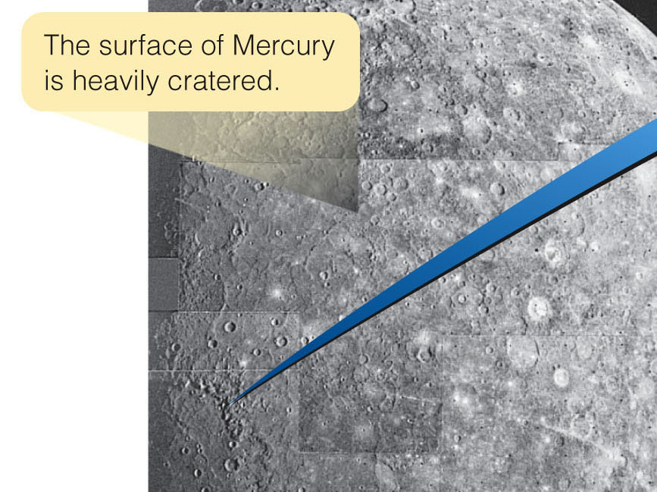
Spacecraft at Mercury
It revealed a planet with a heavily cratered surface—much like that of Earth’s moon.

Slide 82
A new spacecraft called MESSENGER made three flybys of Mercury in 2008 and 2009.
It took impressively high-resolution images and measurements of the parts of the planet not covered by Mariner 10’s cameras.
MESSENGER is scheduled to go into orbit around Mercury in 2011 and begin a yearlong closeup study.

Slide 83
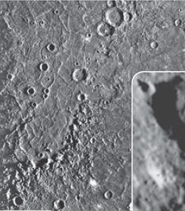
Spacecraft at Mercury
Analysis shows that large areas have been flooded by lava and then cratered.
The largest impact feature on Mercury is the Caloris Basin.
This is a multiringed area 1,300 km (800 miles) in diameter.

Slide 84
Spacecraft at Mercury
Mercury is quite dense.
Models indicate that it must have a large metallic core.
In fact, the metallic core occupies about 70 percent of the radius of the planet.
Essentially, Mercury is a metal planet with a thin rock mantle.
Notes:
Edit image.

Slide 85
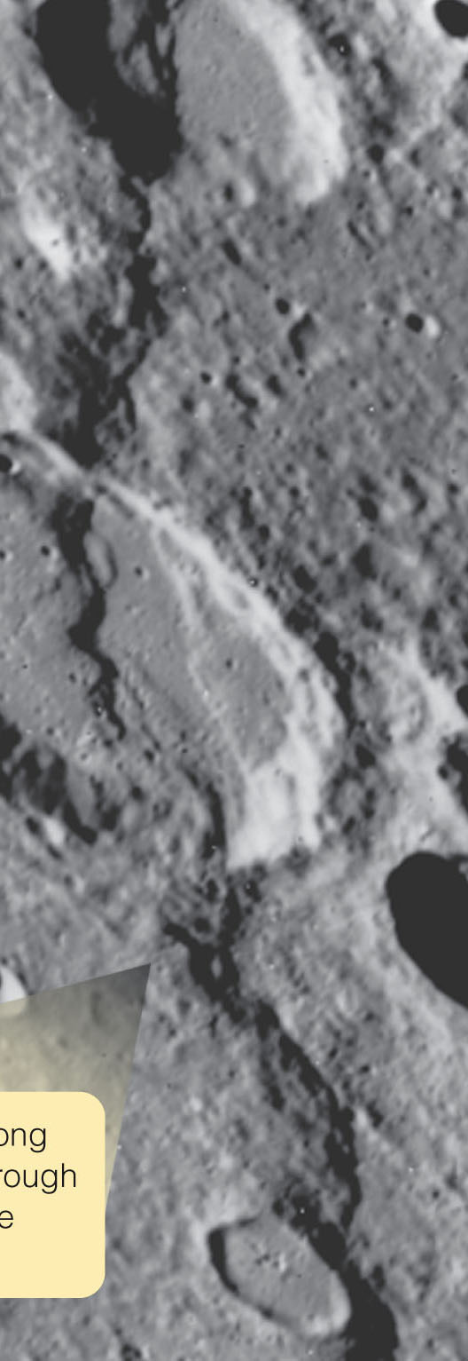
Spacecraft at Mercury
Mariner 10 photos revealed long, curving ridges up to 3 km (2 mi) high and 500 km (300 mi) long.
The ridges even cut through craters—indicating that they formed after most of the heavy bombardment.
Planetary scientists understand these ridges as evidence that the entire crust of Mercury compressed and shrank long ago.

Slide 86
A History of Mercury
Like Earth’s moon, Mercury is small.
This has determined much of its history.
It is too small to retain an atmosphere.
It has also lost much of its internal heat.
Thus, it is not geologically active.
Notes:
Edit image.

Slide 87
Venus
You might expect Venus to be much like Earth.
It is 95 percent Earth’s diameter.
It has a similar average density.
It is only 30 percent closer to the sun.
Unfortunately, the surface of Venus is perpetually hidden below thick clouds.

Slide 88
Venus
Only in the last few decades have planetary scientists discovered that Venus is a hot desert world of volcanoes, lava flows, and impact craters lying at the bottom of a deep hot atmosphere.
No spacesuit will allow you to visit the surface of Venus.

Slide 89
The Atmosphere of Venus
In composition, temperature, and density, the atmosphere of Venus is more Hades than Heaven.
The air is unbreathable, very hot, and very dense.
U.S. and Soviet space probes have descended into the atmosphere.
In some cases, they have even landed on the surface.

Slide 90
The Atmosphere of Venus
The atmosphere is roughly 96 percent carbon dioxide.
The rest is mostly nitrogen, with some argon, sulfur dioxide, and small amounts of sulfuric acid, hydrochloric acid, and hydrofluoric acid.
There is only a tiny amount of water vapor.
On the whole, the composition is deadly unpleasant and most certainly smells bad too.

Slide 91
The Atmosphere of Venus
The surface temperature is hot enough to melt lead.
You can understand that because the thick atmosphere creates a severe greenhouse effect.
Sunlight filters down through the clouds and warms the surface.
Infrared radiation cannot escape because the carbon dioxide gas is opaque to infrared.

Slide 92
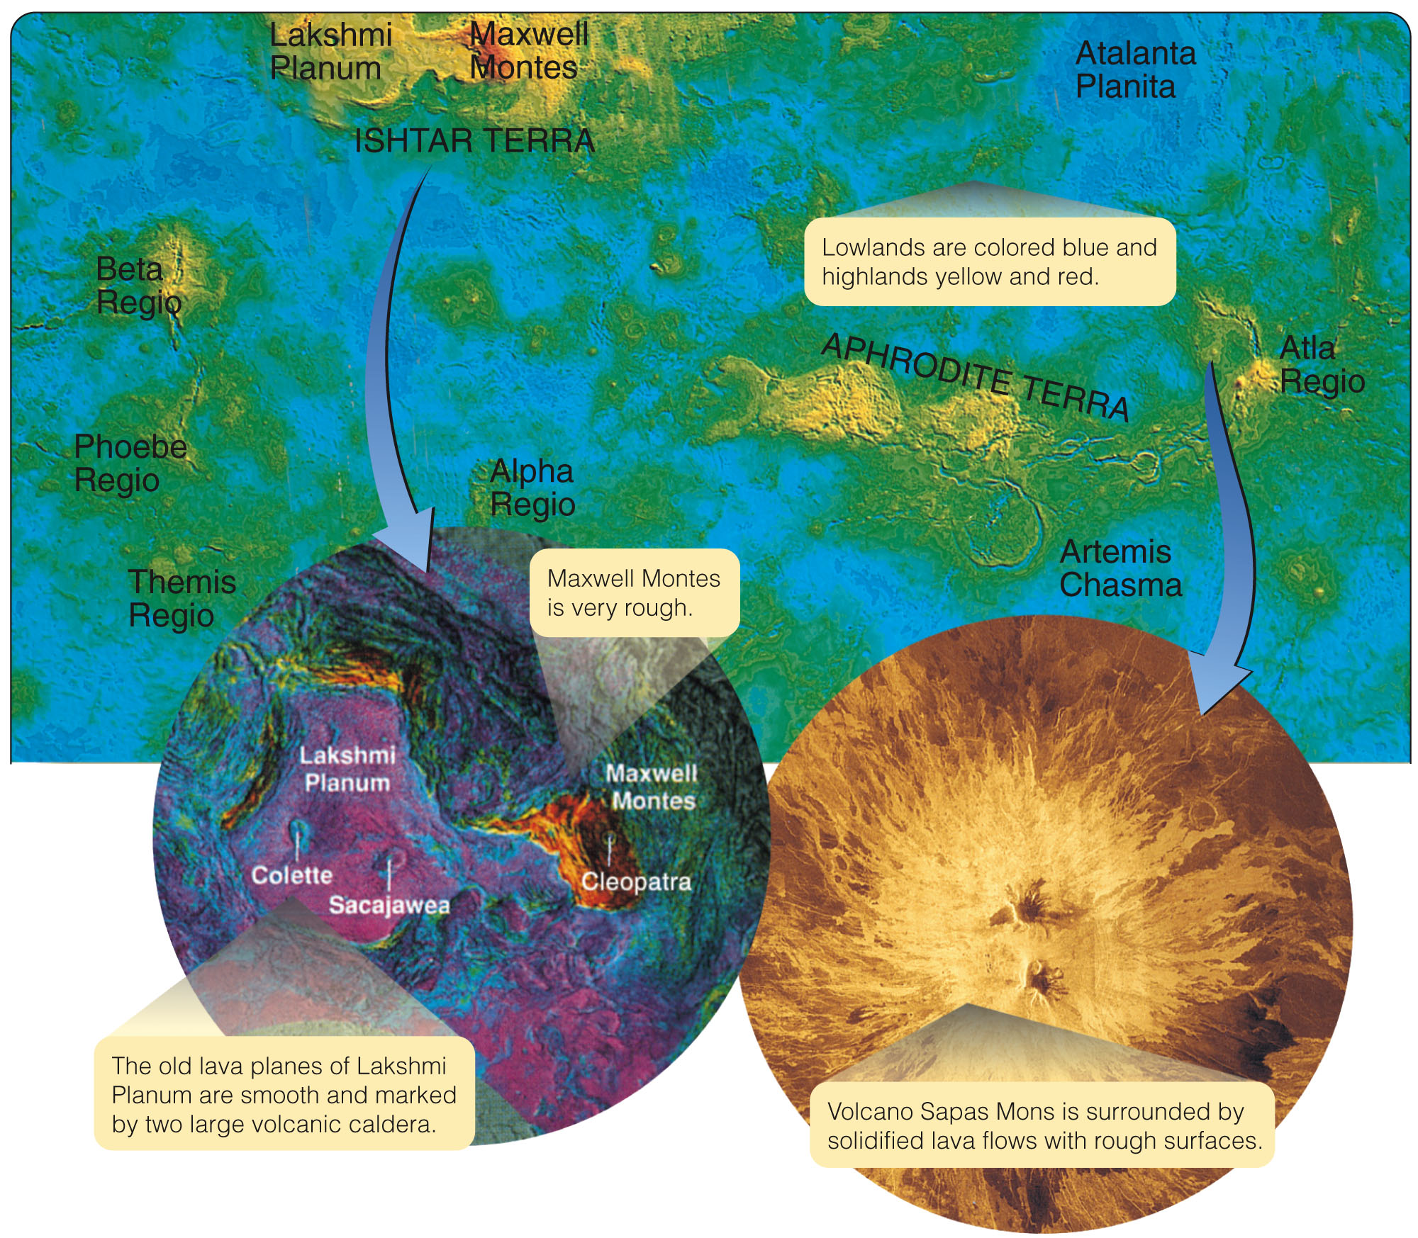
The Surface of Venus
Although the thick clouds on Venus are opaque to visible and infrared light, they are transparent to radio waves.
Orbiting spacecraft
mapped Venus by radar.
This revealed
details as small
as 100 meters in
diameter.

Slide 93
The Surface of Venus
Radar maps show that Venus is similar to Earth in one way, but strangely different in other ways.
Nearly 75 percent of Earth’s surface is covered by low-lying, basaltic seafloors.
85 percent of Venus is covered by basaltic lowlands.

Slide 94
The Surface of Venus
Of course, on Venus, the lowlands are not seafloors.
Also, the remaining highlands are not the well-defined continents you see on Earth.
Earth is dominated by plate tectonics.
Something different is happening on Venus

Slide 95
The Surface of Venus
The highland area Ishtar Terra (named for the Babylonian goddess of love) is about the size of Australia.
At its eastern edge, the mountain Maxwell Montes thrusts up 12 km (Everest is 8.8 km high).

Slide 96
The History of Venus
Calculations show that Venus and Earth have outgassed about the same amount of carbon dioxide.
Earth’s oceans, though, have dissolved it and converted it to sediments such as limestone.
If all the carbon in Earth’s sediments and crust were dug up and converted back to carbon dioxide, our atmosphere would be about as dense as the air on Venus.
This suggests that the main difference between Earth and Venus is the lack of water on Venus.

Slide 97
The History of Venus
Venus may have had small oceans when it was young and much more Earthlike conditions than at present.
However, being closer to the sun, it was warmer, and the carbon dioxide in the atmosphere created a greenhouse effect that made the planet even warmer.
That process could have dried up any oceans that did exist and prevented Venus from purging its atmosphere of carbon dioxide.
In fact, evidence from the composition of Venus’s atmosphere indicates that an ocean’s worth of water has been vaporized and lost.

Slide 98
The History of Venus
As carbon dioxide continued to be outgassed, the greenhouse effect grew even more severe.
Thus, planetary scientists conclude that Venus was trapped in a runaway greenhouse effect.
The intense heat at the surface may have affected the geology of Venus.
It may have made the crust drier and more flexible—so that it was unable to break into moving plates as on Earth.

Slide 99
The History of Venus
There is no sign of plate tectonics.
However, there is evidence that convection currents below the crust are deforming the crust to:
Make coronae
Push up mountains such as Maxwell
Create some folded mountains—like those around Ishtar Terra—by minor horizontal crust motions

Slide 100
Mars
If you ever visit another world, Mars may be your best choice.
You will need a heated, pressurized spacesuit, but Mars is not as inhospitable as the moon.
It is also more interesting—with weather, complex geology, craters, volcanoes, and signs that water once flowed over its surface.

Slide 101
The Atmosphere of Mars
The Martian air contains:
95 percent carbon dioxide
3 percent nitrogen
2 percent argon
That is similar to the composition of air on Venus.
However, the Martian atmosphere is very thin.
It is less than 1 percent as dense as Earth’s atmosphere.
It is 1/10,000 as dense as Venus’s.

Slide 102
The Atmosphere of Mars
There is very little water in the Martian atmosphere.
Liquid water cannot survive on the surface of Mars because the air pressure is too low.
Any liquid water would immediately boil away.
The polar caps appear to be composed of frozen water ice coated over by carbon dioxide (dry ice).
Whatever water is present on Mars is frozen either within the polar caps or as permafrost in the soil.

Slide 103
The Atmosphere of Mars
Although the present atmosphere of Mars is very thin, you will see evidence that the climate once permitted liquid water to flow over the surface.
So, it must have had a thicker atmosphere.
Being a terrestrial planet, it should have outgassed significant amounts of carbon dioxide, nitrogen, and water vapor.
As it was small, however, it could not hold onto its atmosphere.
There are various reasons for this.

Slide 104
The Atmosphere of Mars
The escape velocity on Mars is only 5 km/s—less than half of Earth’s.
So, it was easier for rapidly moving gas molecules to escape into space.
Another factor is the temperature of a planet.
If Mars had been colder, the gas molecules in its atmosphere would have been traveling more slowly.
Thus, they would not have escaped as easily.

Slide 105
The Atmosphere of Mars
Another factor is the planet’s lack of an ozone layer to screen out UV radiation.
Sunlight UV photons can break atmospheric molecules up into smaller fragments.
For example, can be broken by UV into hydrogen and oxygen.
The hydrogen then easily escapes into space.
The oxygen easily combines chemically with rocks and soil.

Slide 106
The Atmosphere of Mars
Mars may have had a substantial atmosphere when it was young.
However, it gradually lost much of that—by both direct escape and UV destruction.
With a thin atmosphere that does not provide much greenhouse warming nor permit liquid water to persist on the surface, Mars is now a cold, dry world.

Slide 107
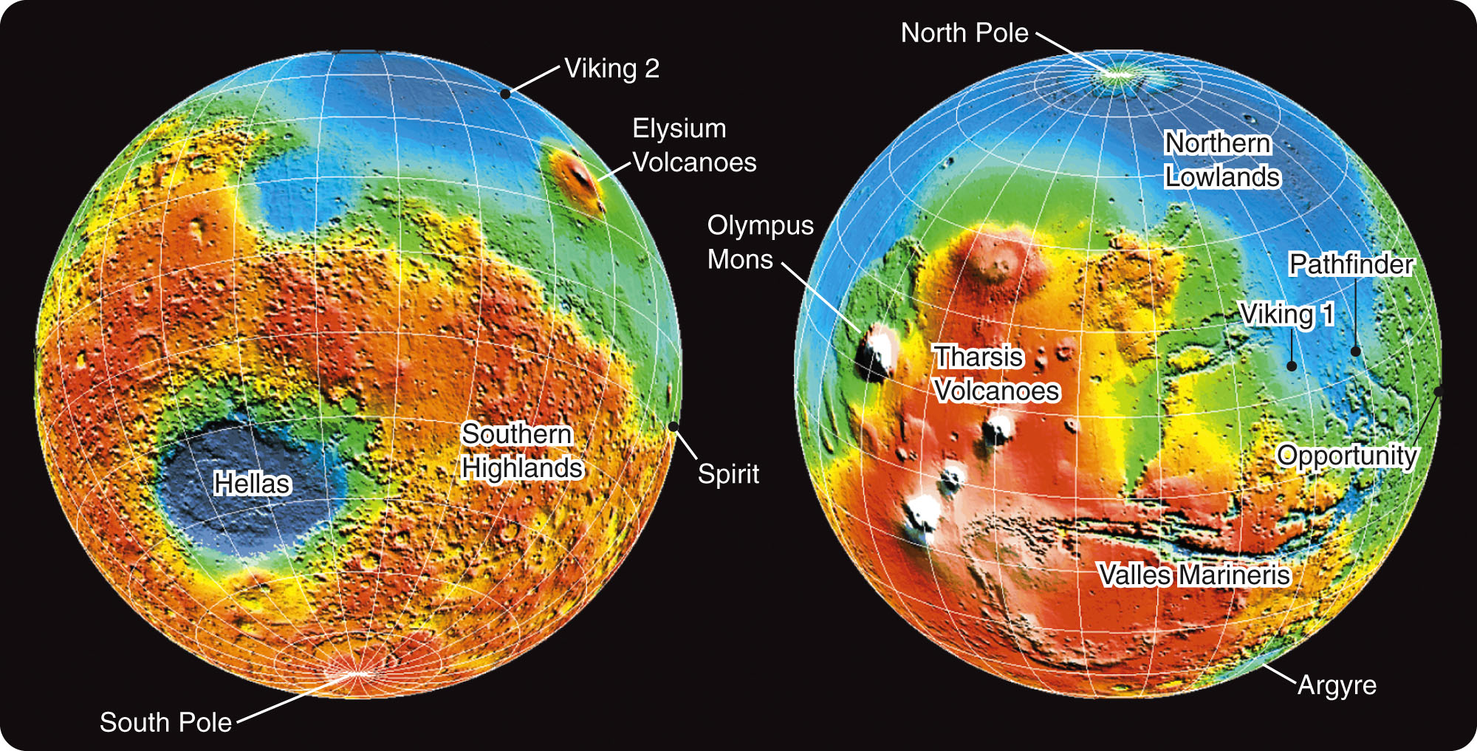
Exploring the Surface of Mars
Data recorded by orbiting satellites show:
The southern hemisphere is a heavily cratered highland region up to 4 billion years old.
The northern hemisphere is mostly a much younger lowland plain with few craters.

Slide 108
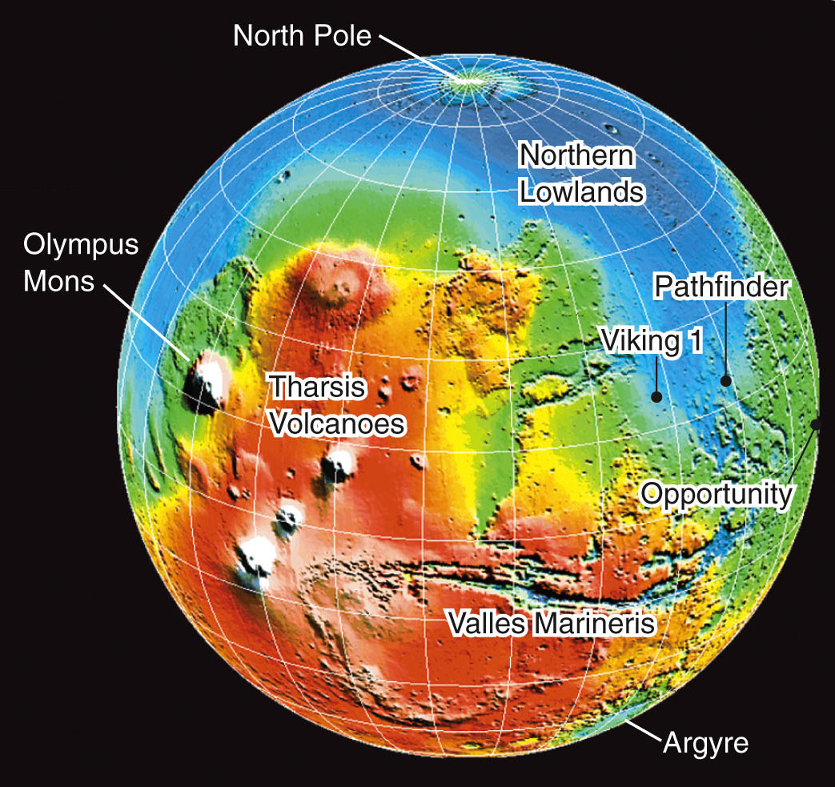
Exploring the Surface of Mars
Volcanism is dramatically evident in the Tharsis region.
This is a highland region of volcanoes and lava flows bulging 10 km (6 mi) above the surrounding surface.

Slide 109
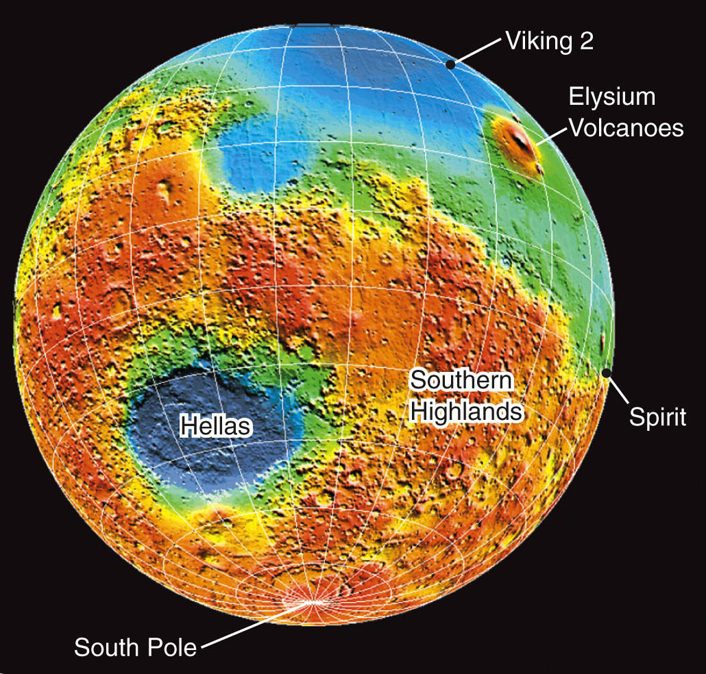
Exploring the Surface of Mars
A similar uplifted volcanic plain is the Elysium region.
It is more heavily cratered and eroded.
Also, it appears to be older than the Tharsis bulge.

Slide 110
Exploring the Surface of Mars
The lack of many impact craters suggests that some volcanoes have been active within the last few hundred million years and maybe even more recently.

Slide 111
Exploring the Surface of Mars
All the volcanoes on Mars are shield volcanoes.
These are very broad mountains with gentle slopes.
On Earth, they are produced by hot spots penetrating upward through the crust.
Shield volcanoes are not related to plate tectonics.
In fact, the large shield volcanoes on Mars provide evidence that plate tectonics has not been significant on that planet.

Slide 112
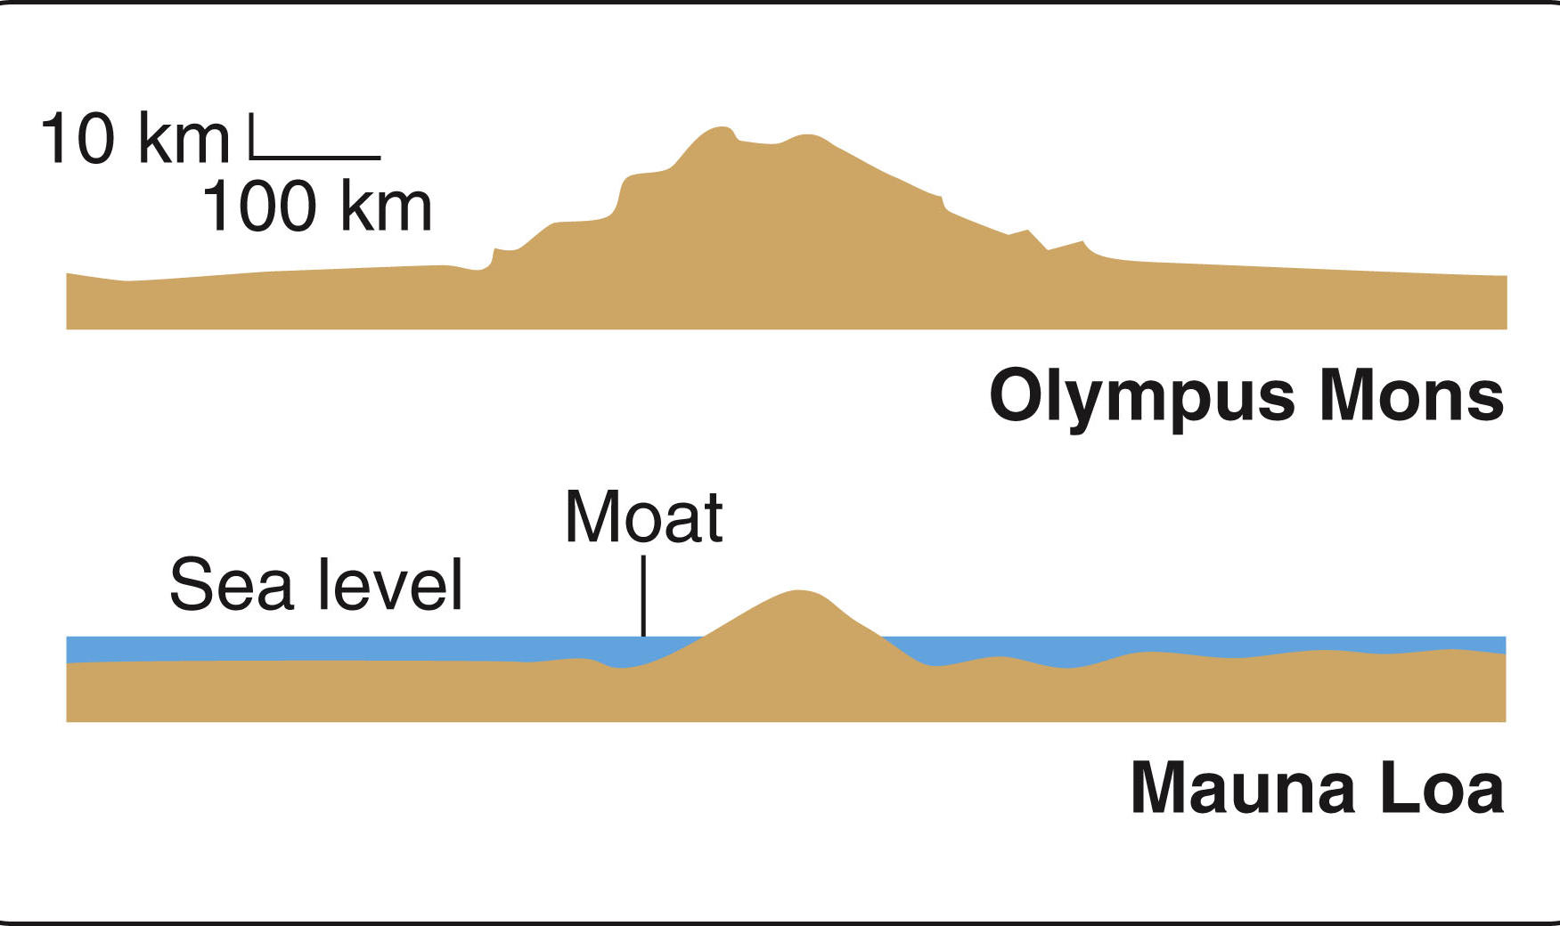
Exploring the Surface of Mars
The largest shield volcano on Mars is Olympus Mons.
It is 600 km (almost 400 mi) in diameter at its base.
It rises 21 km (13 mi) high.

Slide 113
Exploring the Surface of Mars
In comparison, the largest volcano on Earth—also a shield volcano—is Mauna Loa in Hawaii.
It rises only 10 km (6 mi) above its base on the seafloor.

Slide 114
Searching for Water on Mars
You cannot expect surface water on Mars now.
This is because of its low atmospheric pressure and low temperature.
However, observations from orbiting spacecraft have revealed landforms that suggest the effects of flowing water.
Rovers on the surface have turned up proof positive of surface water.

Slide 115
Searching for Water on Mars
In 1976, the two Viking spacecraft reached orbit around Mars and photographed its surface.
The photos revealed two water-related features.

Slide 116
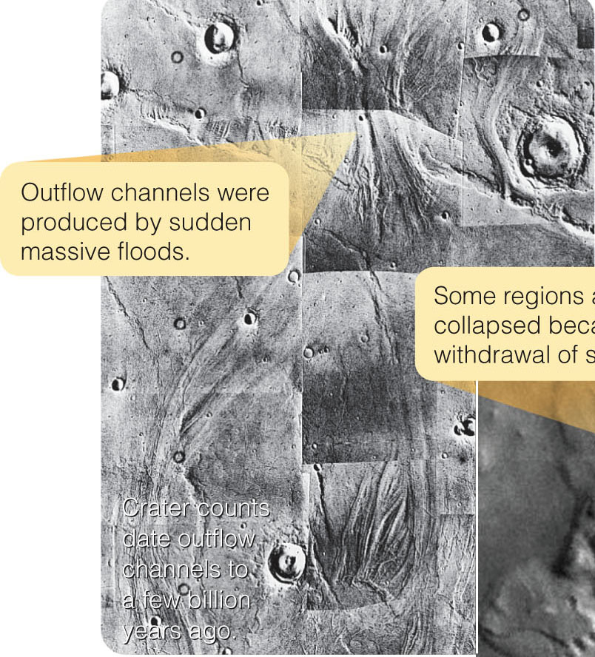
Searching for Water on Mars
Outflow channels appear to have been cut by massive floods carrying as much as 10,000 times the water flowing down the Mississippi River.
In a matter of hours or days, such floods swept away geological features and left scarred land.

Slide 117
Searching for Water on Mars
Spacecraft in orbit around Mars have used remote instruments to detect large amounts of water frozen in the soil.
A radar study has found frozen water extending at least a kilometer beneath both polar caps.

Slide 118
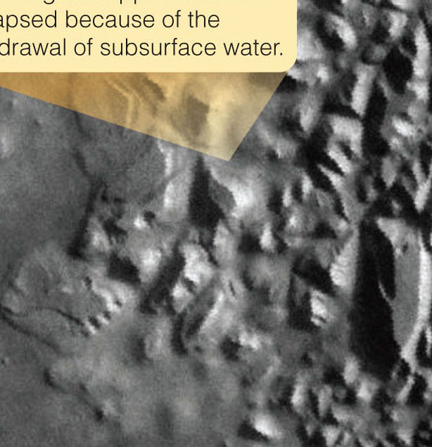
Searching for Water on Mars
Images made from orbit also show regions of jumbled terrain and gullies leading down slopes.
This suggests that water has
flowed onto the surface from
underground
sources, perhaps
melting of subsurface
ice.

Slide 119
Searching for Water on Mars
Rovers named Spirit and Opportunity landed in January 2004.
They carried sophisticated instruments to explore the rocky surface.
Both rovers landed in areas suspected of having had water on their surfaces.
Both made exciting discoveries.

Slide 120
Searching for Water on Mars
Using close-up cameras, they found small spherical concretions of hematite—dubbed ‘blueberries.’
These must have formed in water.

Slide 121
Searching for Water on Mars
In other places, they found layers of sediments with ripple marks and crossed layers showing deposits.
The deposits must have formed in moving water.
Chemical analysis revealed minerals in the soil such as sulfates that are left behind when standing water evaporates.

Slide 122
The History of Mars
The planet began by differentiating into a crust, mantle, and core.
Studies of its rotation reveal that it has a dense core but no planetwide magnetic field.
The core must have cooled quickly and shut off the dynamo effect that would have produced a field.
The crust of Mars is now quite thick—as revealed by the mass of Olympus Mons volcano.
It was thinner in the past, though.

Slide 123
The History of Mars
Cratering may have broken or at least weakened the crust—triggering lava flows that flooded some basins.

Slide 124
The History of Mars
Mantle convection may have pushed up the Tharsis and Elysium volcanic regions and broken the crust to form Valles Marineris.
Moving crustal plates, though, never dominated
Mars.
There are no
folded mountain
ranges and no sign
of plate boundaries.

Slide 125
The History of Mars
The small planet cooled rapidly, and the crust grew thick and immobile.

Slide 126
The History of Mars
The last stage of planetary development has been one of slow decline.
Volcanoes may still occasionally erupt.
However, the little planet has lost much of its internal heat—and most volcanism occurred long ago.
At some point in its history, water was abundant enough to flow over the surface in great floods and may have filled an ocean.
However, the age of liquid water must have ended over 3 billion years ago.

Slide 127
The History of Mars
The climate on Mars has changed as the atmosphere gradually became thinner.
Atmospheric gases and water were lost to space.
The volcanic activity that could have replaced them had nearly stopped.
The water remaining on Mars today is frozen in the polar caps or in the soil.
However, water being the first necessity of life, its presence long ago is exciting.
Someday, an astronaut may scramble down an ancient Martian streambed, turn over a rock, and find a fossil.

Slide 128
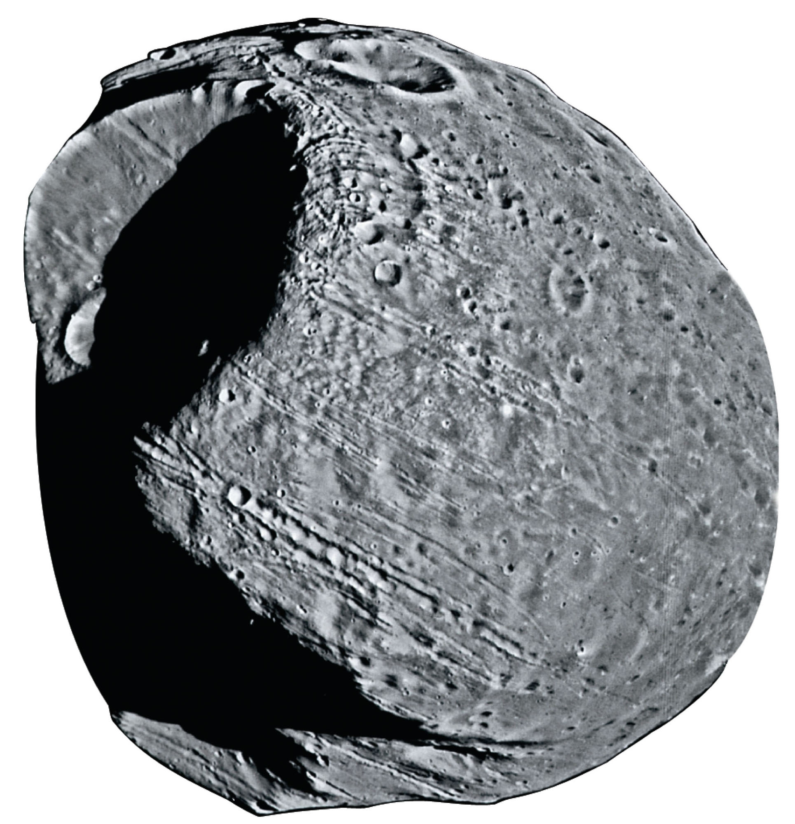
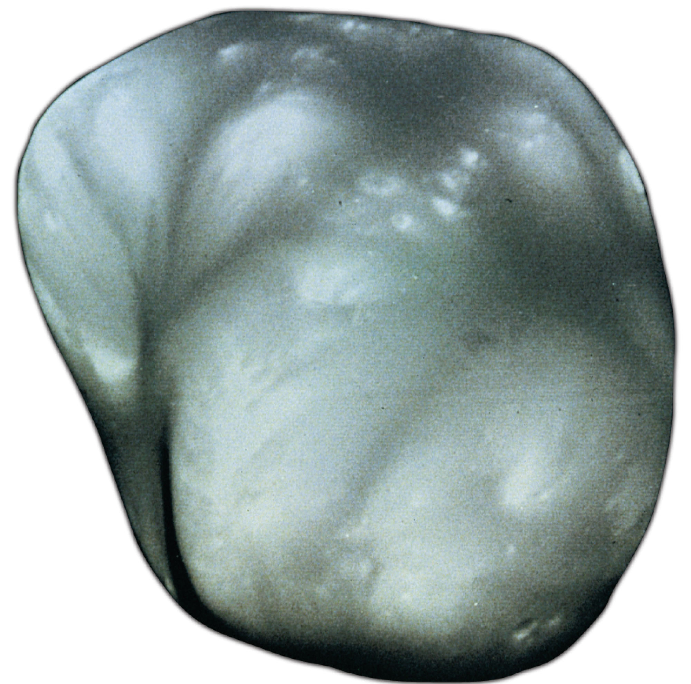
The Moons of Mars
Unlike Mercury or Venus, Mars has moons.
Phobos is 28 x 23 x 20 km in diameter.
Deimos is 16 x 12 x 10 km in diameter.
Small and irregular in shape, they are almost certainly captured asteroids.

Slide 129
The Moons of Mars
In fact, they are not just small—they are tiny.
An athletic astronaut who could jump 2 m (6 ft) high on Earth could jump almost 3 km (2 miles) on Phobos.

Slide 130
The Moons of Mars
However they formed, they are so small that any interior heat would have leaked away very quickly.
Also, there is no evidence of any internally driven geologic activity on either object.

Slide 131
The Moons of Mars
Some futurists suggest that the first human missions to Mars may not land on the planet’s surface.
Instead, they could build a colony on Phobos or Deimos.
These plans involve speculation that these moon and other asteroids may have water in deep interior rocks that colonists could use.

