Slide 1
Chapter 14 Modern Cosmology

Slide 2
Look at your thumb.
The matter in it was present in the fiery beginning of the universe.

Slide 3
Cosmology, the study of the universe as a whole, can tell you where your matter came from and where it is going.

Slide 4
Cosmology is a mind-bendingly weird subject.
You can enjoy it for its strange ideas and theories.
It is fun to think about space stretching like a rubber sheet, invisible energy pushing the universe to expand faster and faster, and the origin of vast walls of galaxy clusters.

Slide 5
Notice that this is better than speculation—it is all supported by evidence.
Cosmology, however strange it may seem, is a serious and logical attempt to understand how the universe works.
It leads to wonderful insights into how you came to be a part of it.

Slide 6
Introduction to the Universe
Everyone has an impression of the universe as a vast depth filled with galaxies.
As you begin exploring the universe, you need to sort out your expectations so they do not mislead you.

Slide 7
Introduction to the Universe
The first step is to deal with an expectation so obvious that most people, for the sake of a quiet life, don’t even think about it.

Slide 8
The Edge–Center Problem
In your daily life, you are accustomed to boundaries.
Rooms have walls, athletic fields have boundary lines, countries have borders, and oceans have shores.
It is natural to think of the universe having an edge.
That idea, however, can’t be right.

Slide 9
The Edge–Center Problem
If the universe had an edge, imagine going to that edge.
What would you find there?
A wall?
A great empty space?
Nothing?

Slide 10
The Edge–Center Problem
A true edge would have to be more than just an end of the distribution of matter.
It would have to be an end of space itself.
Then, what would happen if you tried to reach past or move past that edge?

Slide 11
The Edge–Center Problem
An edge to the universe seems to violate common sense.
Modern observations indicate that the universe could be infinite and have no edge.
Note that you find the centers of things—galaxies, globular clusters, oceans, and pizzas—by referring to their edges.
If the universe has no edge, then it cannot have a center.

Slide 12
The Edge–Center Problem
It is a common misconception to imagine that the universe has a center.
As you study cosmology, you must take care to avoid thinking that there is a center of the universe.

Slide 13
The Necessity of a Beginning
Of course, you have noticed that the night sky is dark.
That is an important observation—because reasonable assumptions about the universe can lead to the conclusion that the night sky should glow blindingly bright.
This conflict between observation and theory is called Olbers’s paradox after Heinrich Olbers, an Austrian physician and astronomer, who publicized the problem in 1826.

Slide 14
The Necessity of a Beginning
Olbers was not the first to pose the question.
However, it is named after him because modern cosmologists were not aware of the earlier discussions.
You will be able to answer Olbers’s question and understand why the night sky is dark by revising your assumptions about the universe.

Slide 15
The Necessity of a Beginning
The point Olber made seems simple.
Suppose you assume that the universe is infinite and filled with stars. (The clumping of stars into galaxies can be shown mathematically to make no essential difference.)
If you look in any direction, your line of sight must eventually reach the surface of a star.

Slide 16
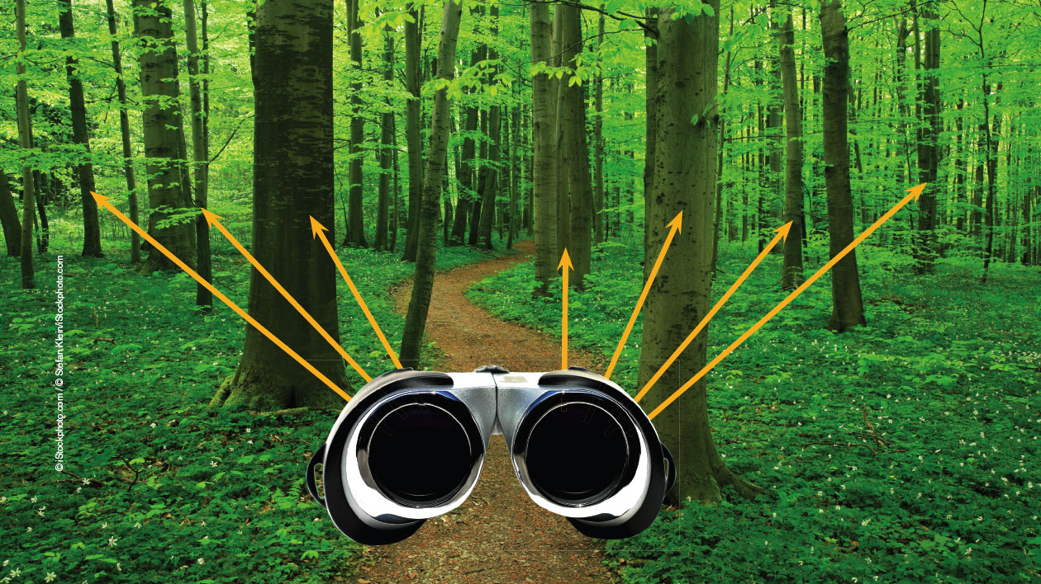
The Necessity of a Beginning
You can consider the analogy of lines of sight in a forest.
When you are deep in a forest, every line of sight terminates on a tree trunk, and you cannot see out of the forest.

Slide 17
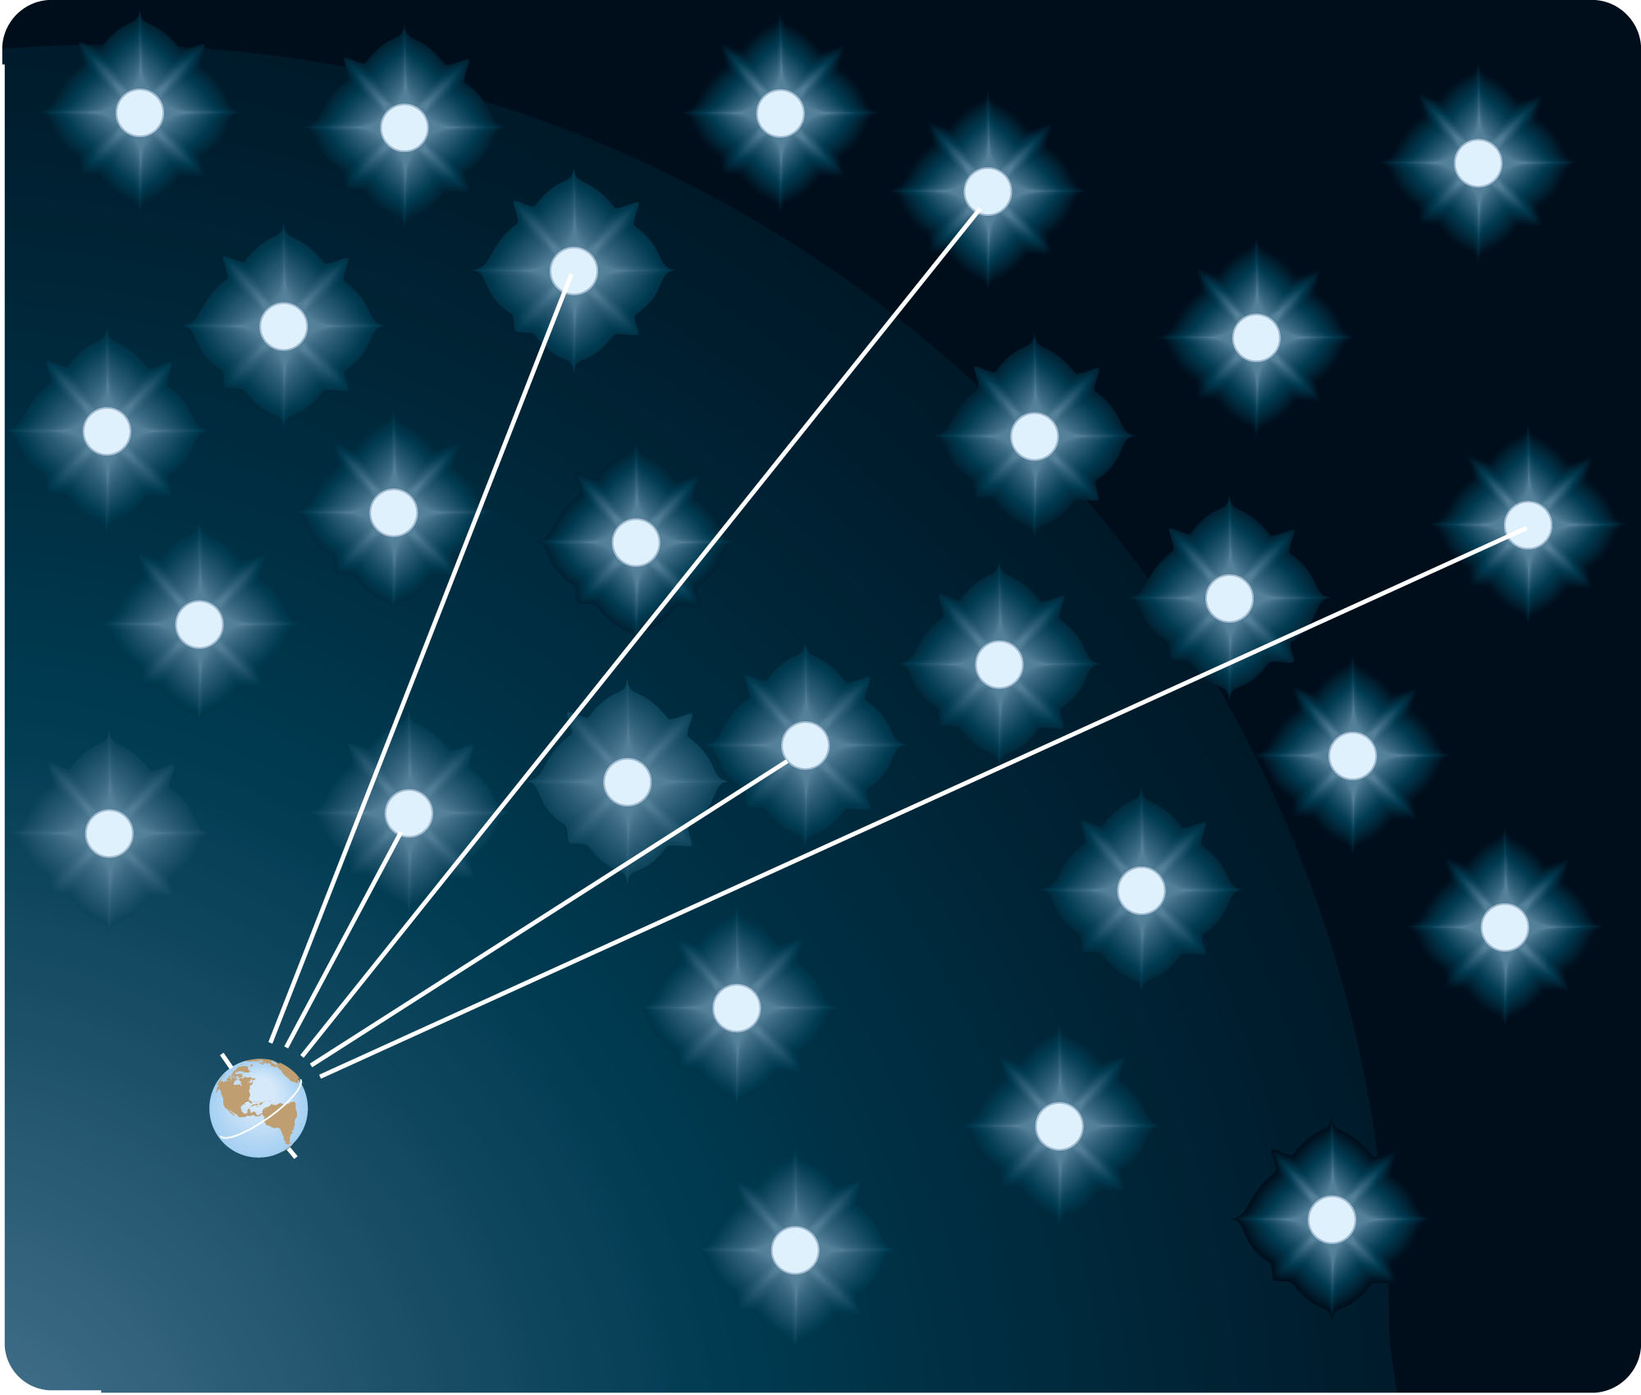
The Necessity of a Beginning
By analogy, every line of sight from Earth out into space should eventually terminate on the surface of a star.
So, the entire sky should be as bright as the surface of an average star.

Slide 18
The Necessity of a Beginning
It is like suns crowded “shoulder to shoulder”—covering the sky from horizon to horizon.
It should not get dark at night.

Slide 19
The Necessity of a Beginning
Today, cosmologists believe they understand why the sky is dark.
Olbers’s paradox makes an incorrect prediction because it is based on an hidden assumption.
The universe may be infinite in size but it is not eternal—it is not infinitely old.

Slide 20
The Necessity of a Beginning
That answer to Olbers’s question was first suggested by Edgar Allan Poe in 1848.
He proposed that the night sky was dark because the universe was not infinitely old, but instead began at some time in the past.

Slide 21
The Necessity of a Beginning
The more distant stars are so far away that light from them has not reached Earth yet.
That is, if you look far enough, the look-back time is greater than the age of the universe.
The night sky is dark because the universe had a beginning.

Slide 22
The Necessity of a Beginning
This is a powerful idea—as it clearly illustrates the difference between the universe and the observable universe.
The universe is everything that exists.
The observable universe is the part that you can see.

Slide 23
The Necessity of a Beginning
The universe is about 14 billion years old.
In that case, the observable universe has a radius of about 14 billion light-years.
The observable universe is finite.
The universe as a whole could be infinite.

Slide 24
Cosmic Expansion
In 1929, Edwin P. Hubble published his discovery that the sizes of galaxy redshifts are proportional to galaxy distance.
Nearby galaxies have small redshifts, but more distant galaxies have larger redshifts.
These redshifts imply that the galaxies are receding from each other.

Slide 25
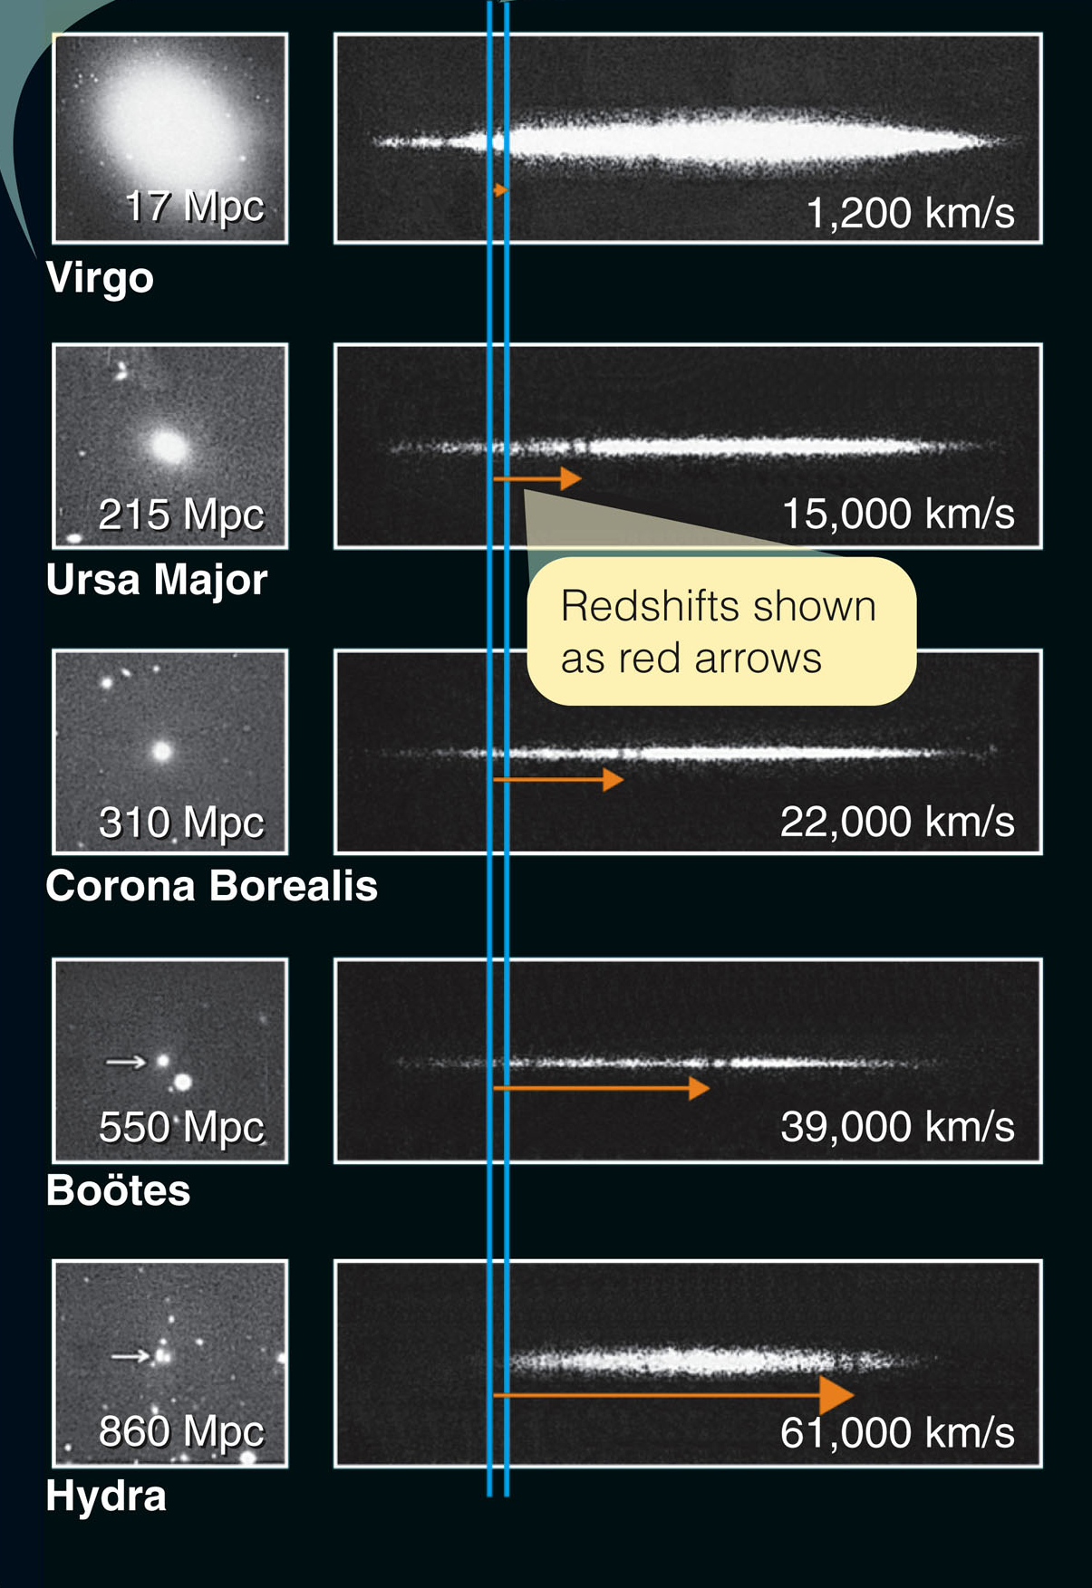
Cosmic Expansion
The figure shows spectra of galaxies in galaxy clusters at various distances.
The Virgo cluster is relatively nearby.
Its redshift is small.

Slide 26
Cosmic Expansion
The Hydra cluster is very distant.
Its redshift is so large that the two dark lines formed by ionized calcium are shifted from near-ultraviolet wavelengths well into the visible part of the spectrum.

Slide 27
Cosmic Expansion
The expansion of the universe does imply that Earth is at the center.

Slide 28
Cosmic Expansion
To understand why, consider an analogy in which you imagine baking raisin bread.
As the dough rises, it pushes the raisins away from each other uniformly at velocities that are proportional to their distances from each other.

Slide 29
Cosmic Expansion
Two raisins that were originally close to each other are pushed apart slowly.
Two raisins that were far apart, having more dough between them, are pushed apart faster.

Slide 30
Cosmic Expansion
If bacterial astronomers lived on a raisin in your raisin bread, they could observe the redshifts of the other raisins and derive a bacterial Hubble law.
They would conclude that their universe was expanding uniformly.

Slide 31
Cosmic Expansion
It does not matter which raisin the bacterial astronomers lived on.
They would get the same Hubble law.
No raisin has a special viewpoint.
Similarly, astronomers in any galaxy will see the same law of expansion.
No galaxy has a special viewpoint.

Slide 32
Cosmic Expansion
The raisin bread analogy to the expanding universe no longer works when you consider the crust, the edge, of the bread.
The universe cannot have an edge or a center.
So, there can be no center to the expansion.

Slide 33
The Big Bang Theory
The expansion of the universe led astronomers to conclude that the universe must have begun with an event of astounding cosmic intensity.

Slide 34
Necessity of the Big Bang
Imagine that you have a video of the expanding universe—and you run it backward.
You would see the galaxies moving toward each other.
There is no center to the expansion of the universe.
So, you would not see galaxies approaching a single spot.

Slide 35
Necessity of the Big Bang
Rather, you would see the space between galaxies disappearing.
The distances between all galaxies would decrease—without the galaxies themselves moving.
Eventually, the galaxies would begin to merge.

Slide 36
Necessity of the Big Bang
If you ran your video far enough back, you would see the matter and energy of the universe compressed into a high-density, high-temperature state.
You can conclude that the expanding universe began with expansion from that condition of extremely high density and temperature.
Modern astronomers call it the big bang.

Slide 37
Necessity of the Big Bang
How long ago did the universe begin?
You can estimate the age of the universe with a simple calculation.
If you must drive to a city 100 miles away and you can travel 50 miles per hour, you divide distance by rate of travel and learn the travel time—in this example, 2 hours.

Slide 38
Necessity of the Big Bang
To find the age of the universe, you divide the distance between galaxies by the speed with which they are separating.
Then, you find out how much time was required for them to have reached their present separation.

Slide 39
Necessity of the Big Bang
For now, you can conclude that basic observations of the recession of the galaxies require that the universe began with a big bang about 14 billion years ago.
That estimated span is called the Hubble time.

Slide 40
Necessity of the Big Bang
Your instinct is to think of the big bang as a historical event, like the Gettysburg Address—something that happened long ago and can no longer be observed.
However, the look-back time makes it possible to observe the big bang directly.
Notes:
The Gettysburg Address is a speech by U.S. President Abraham Lincoln, one of the best-known in American history.^{[4]} It was delivered by Lincoln during the American Civil War, on the afternoon of Thursday, November 19, 1863, at the dedication of the Soldiers' National Cemetery in Gettysburg, Pennsylvania, four and a half months after the Union armies defeated those of the Confederacy at the Battle of Gettysburg.

Slide 41
Necessity of the Big Bang
The look-back time to nearby galaxies is only a few million years.
The look-back time to more distant galaxies is a large fraction of the age of the universe.
If you look between and beyond the distant galaxies, back to the time of the big bang, you should be able to detect the hot gas that filled the universe long ago.

Slide 42
Necessity of the Big Bang
Again, do not think of an edge or a center when you think of the big bang.
It is a very common misconception that the big bang was an explosion and that the galaxies are flying away from a center.

Slide 43
Necessity of the Big Bang
Your imagination tries to visualize the big bang as a localized event.
You must, however, keep firmly in mind that the big bang did not occur at a single place but filled the entire volume of the universe.

Slide 44
Necessity of the Big Bang
You cannot point to any particular place and say, “The big bang occurred over there.”
At the time of the big bang, all the galaxies, stars, and atoms in the observable universe were confined to a very small volume.
That hot, dense state—the big bang—occurred everywhere, including right where you are now.

Slide 45
Necessity of the Big Bang
The matter of which you are made was part of the big bang.
So, you are inside the remains of that event.
The universe continues to expand around you.

Slide 46
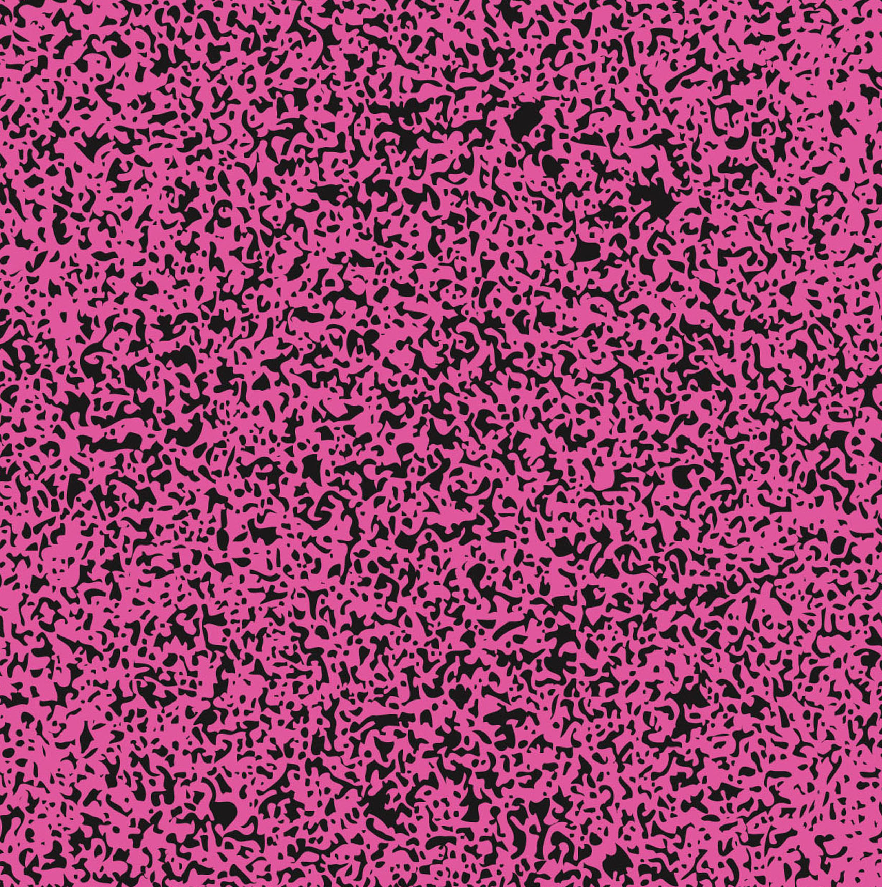
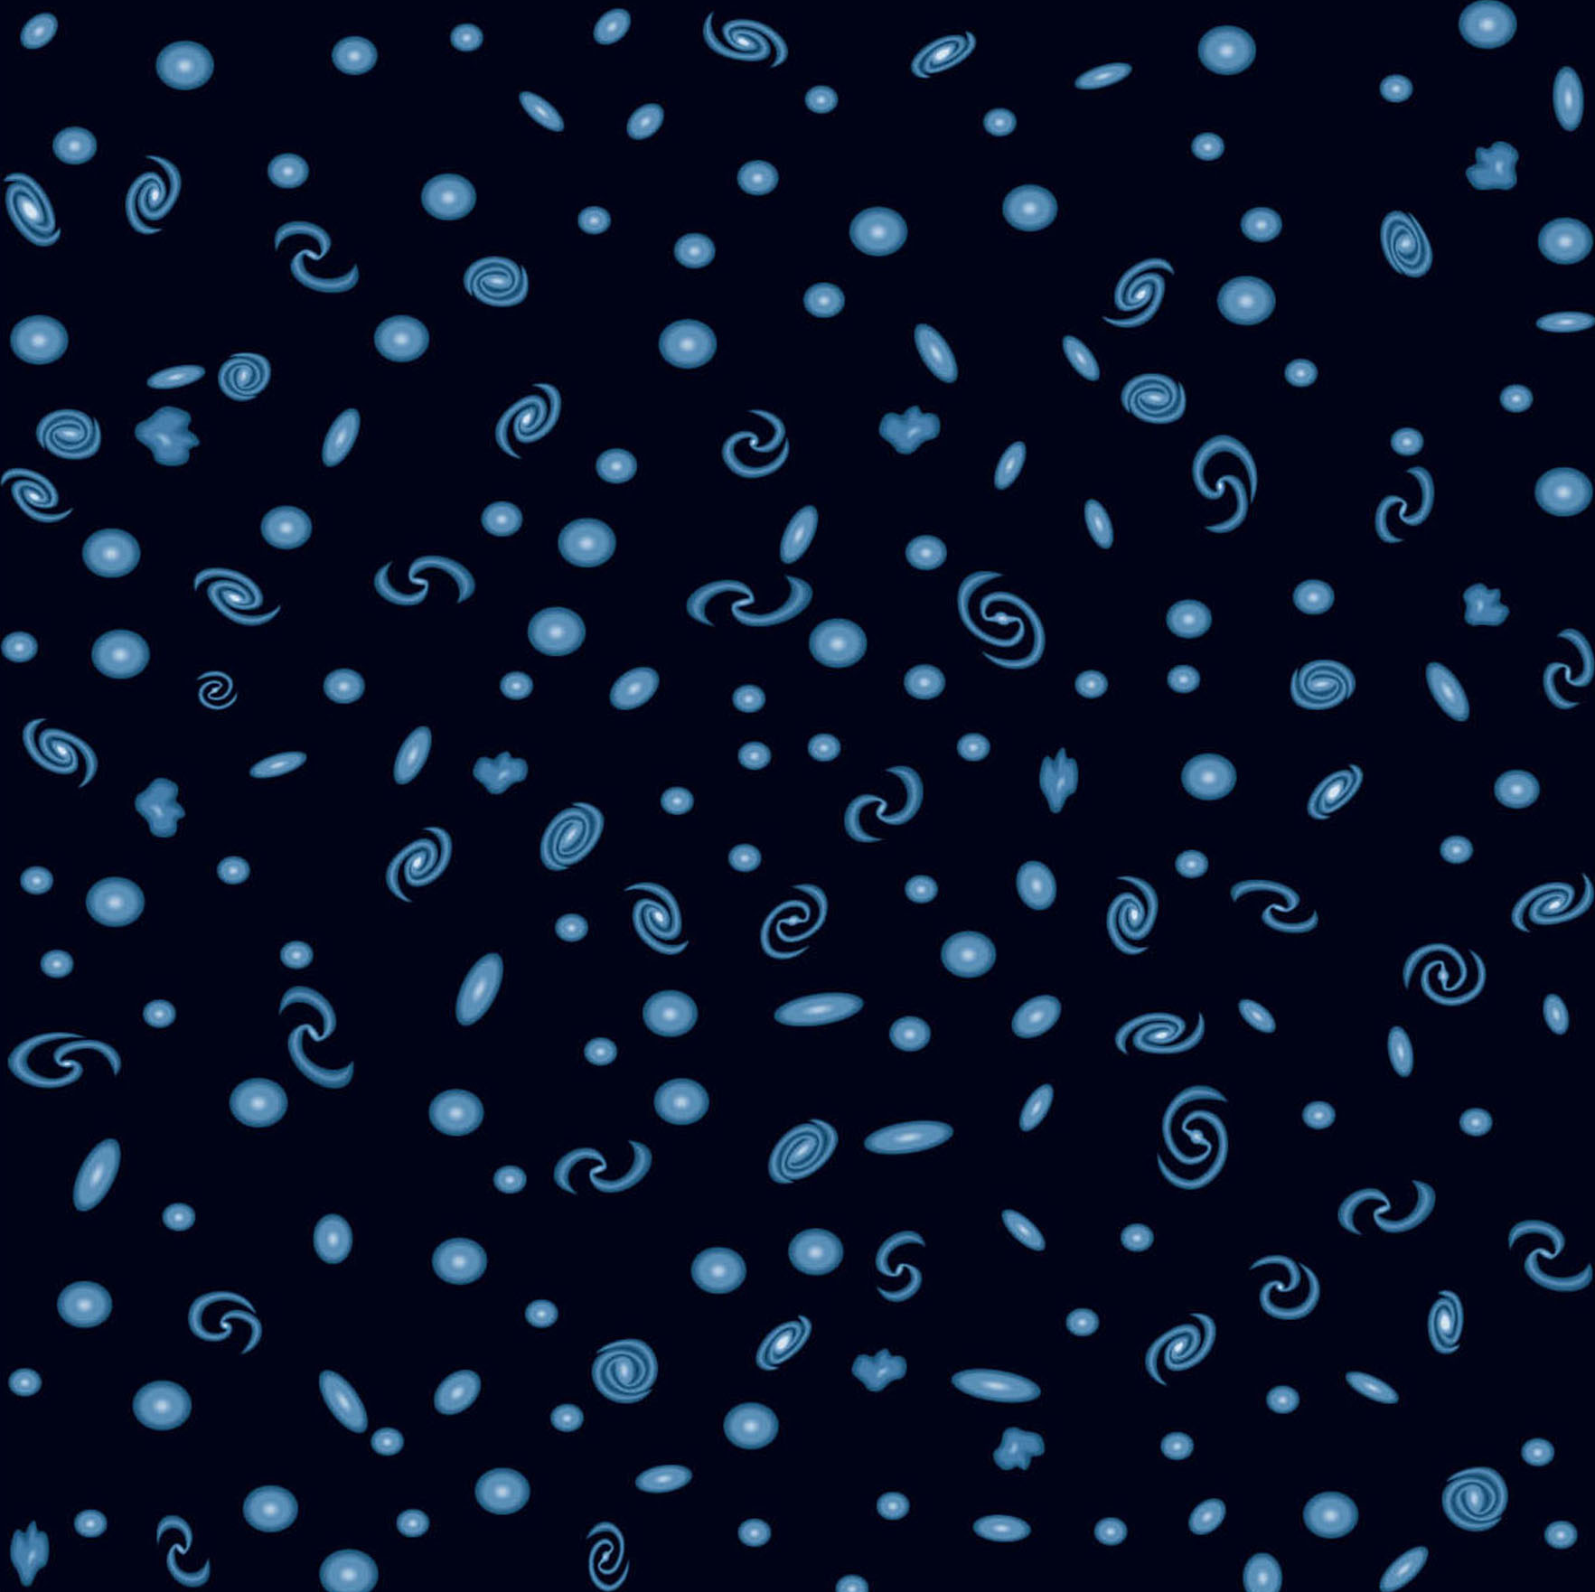
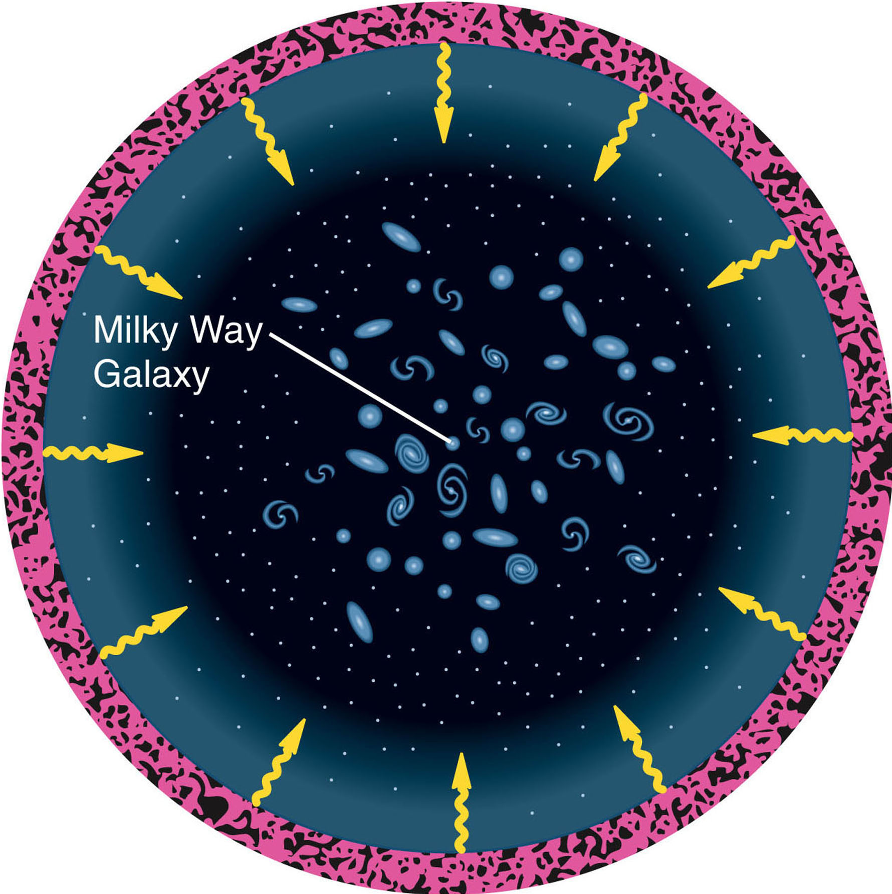
Necessity of the Big Bang
In whatever direction astronomers look, at great distances, they can see back to the age when the universe was filled with dense, hot gas.

Slide 47
Evidence for the Big Bang: The Cosmic Background Radiation
The radiation that comes from this great distance has a tremendous redshift.
The most distant visible objects are faint galaxies and quasars, with redshifts up to about 8, meaning the light from them arrives at Earth with wavelength 9 times longer than when it started the journey.
In contrast, the radiation from the hot gas of the big bang is calculated to have a redshift of about 1,100.

Slide 48
Evidence for the Big Bang: The Cosmic Background Radiation
Thus, the light emitted by the big bang gases arrives at Earth as far-infrared radiation and short-wave-length radio waves.
You can’t see it with your eyes, but it should be detectable with infrared and radio telescopes.
Amazingly, the big bang can still be detected by the radiation it emitted.

Slide 49
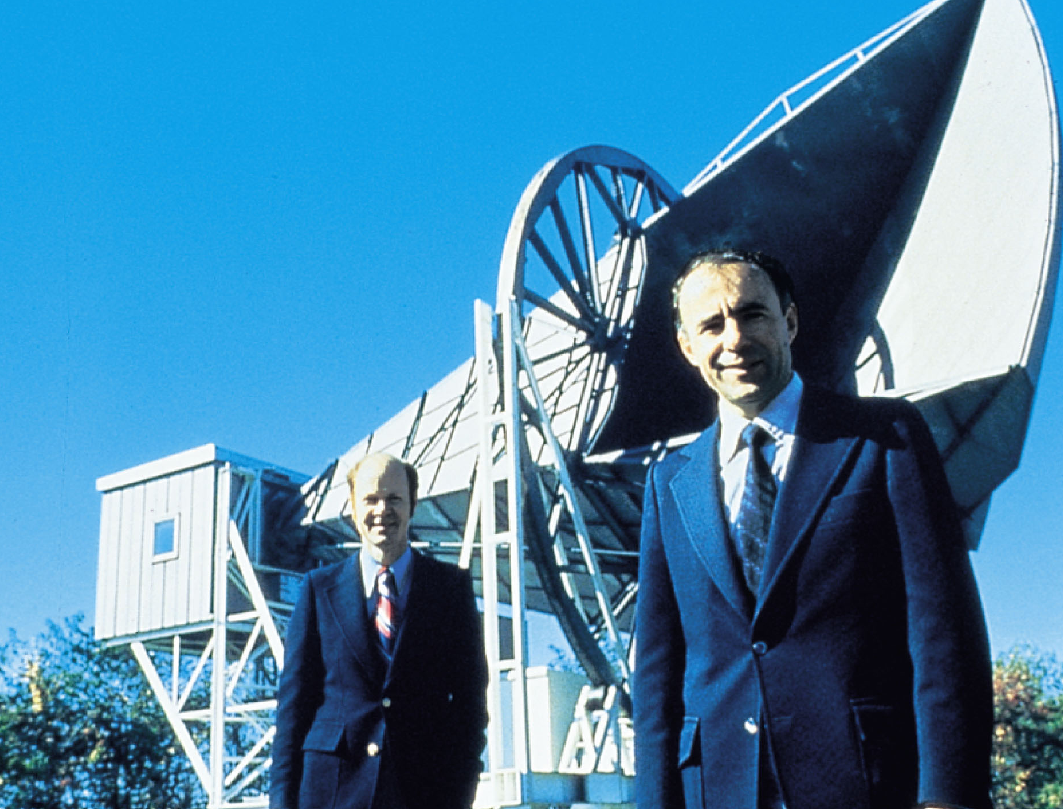
Evidence for the Big Bang: The Cosmic Background Radiation
In the mid-1960s, two Bell Laboratories physicists, Arno Penzias and Robert Wilson, were measuring the radio brightness of the sky when they discovered peculiar radio noise coming from all directions.

Slide 50
Evidence for the Big Bang: The Cosmic Background Radiation
In the 1940s, physicists George Gamow and Ralph Alpher had predicted that the big bang would have emitted blackbody radiation that should now be in the far-infrared and radio parts of the spectrum.

Slide 51
Evidence for the Big Bang: The Cosmic Background Radiation
In the early 1960s, physicist Robert Dicke and his team at Princeton began building a receiver to detect that radiation.

Slide 52
Evidence for the Big Bang: The Cosmic Background Radiation
When Penzias and Wilson learned about the preceding work, they realized the radio noise they had detected—now called the cosmic microwave background (CMB)—is actually radiation from the big bang.
They received the 1978 Nobel Prize in physics for their discovery.

Slide 53
Evidence for the Big Bang: The Cosmic Background Radiation
The detection of the background radiation was tremendously exciting.
Astronomers, though, wanted confirmation.

Slide 54
Evidence for the Big Bang: The Cosmic Background Radiation
Critical observations in the far-infrared checking whether the CMB really has a blackbody spectrum could not be made from the ground.

Slide 55
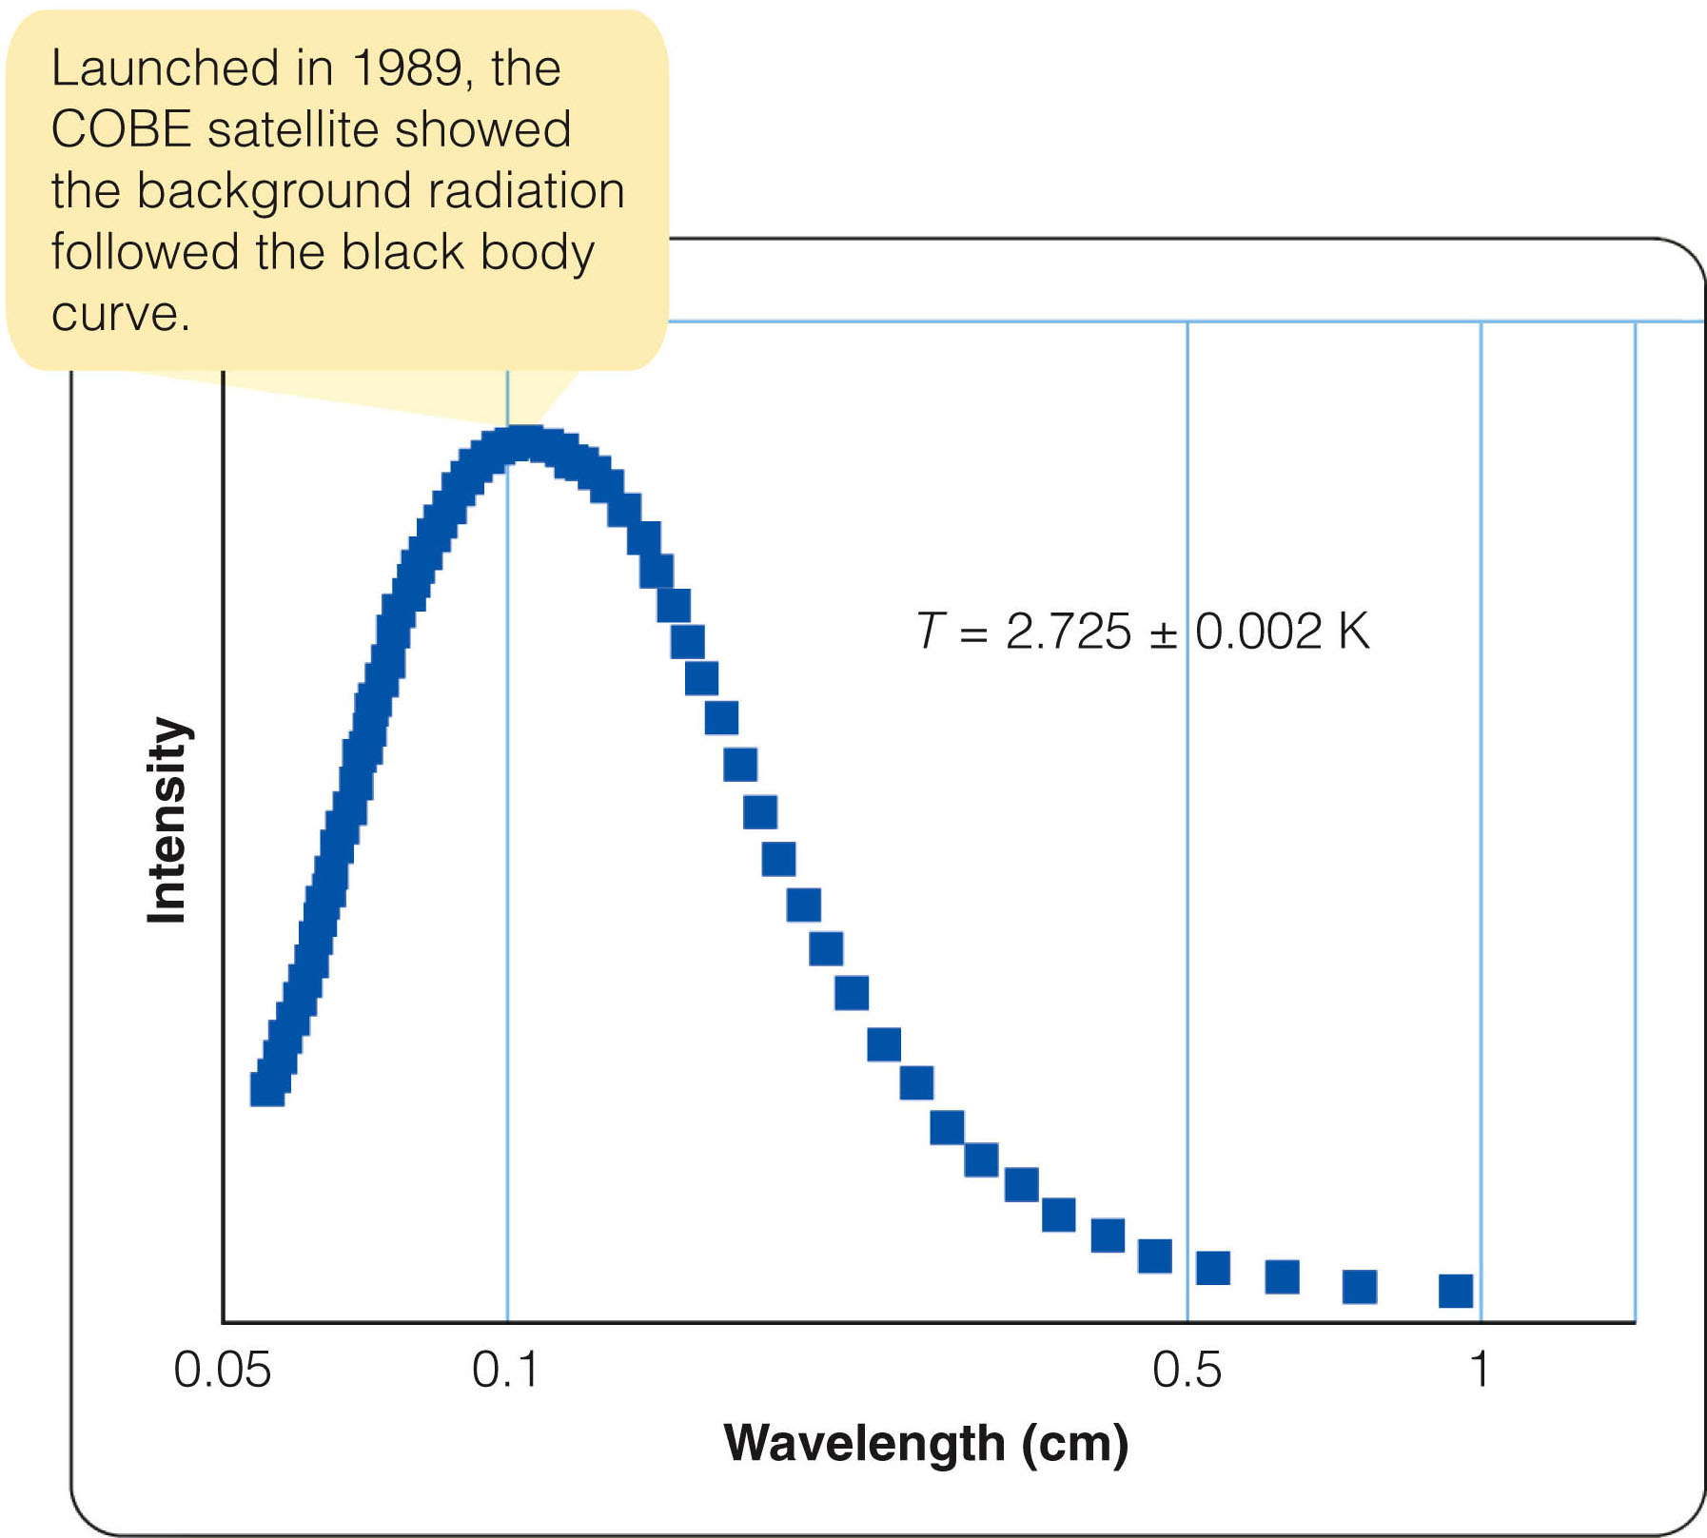
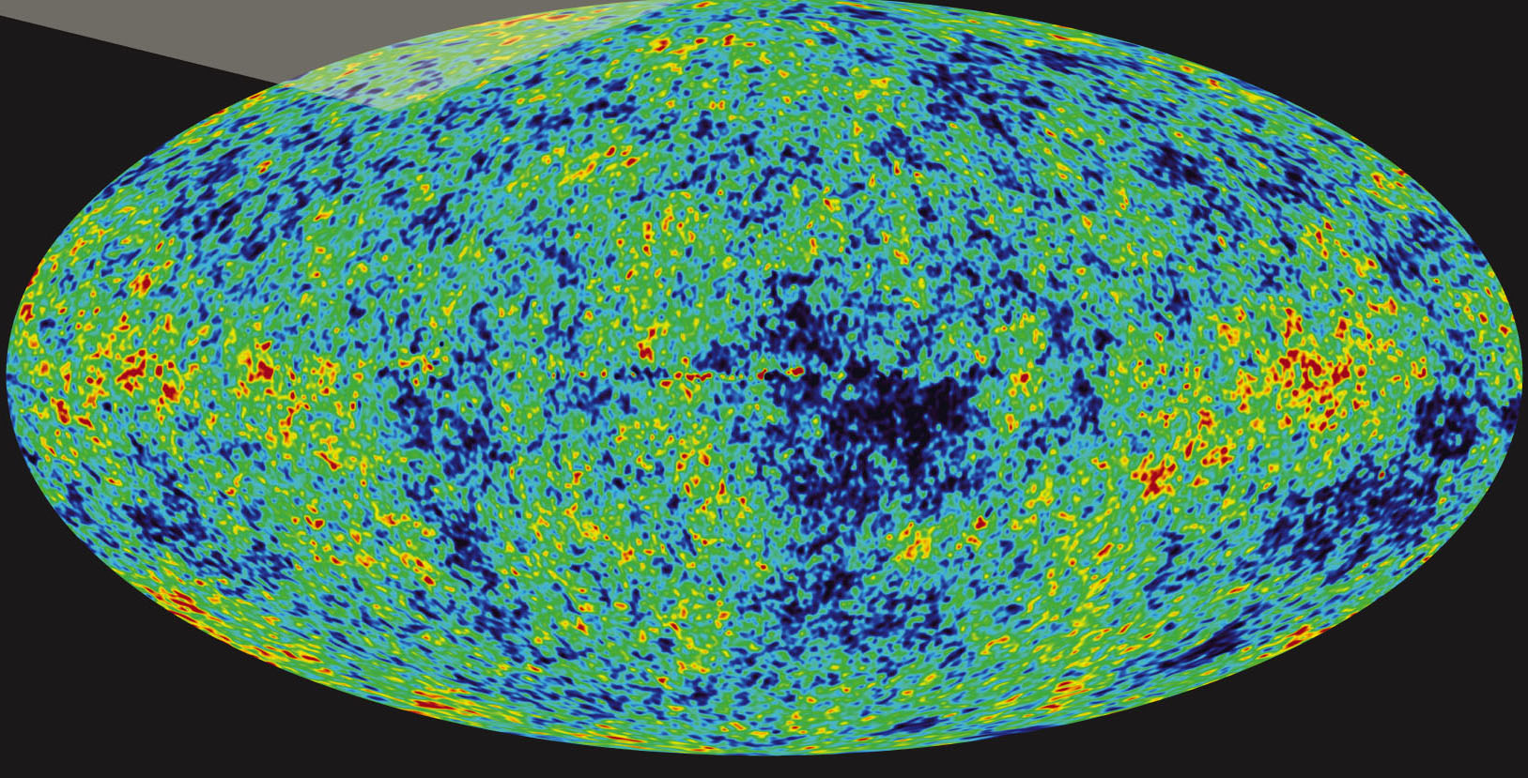
Evidence for the Big Bang: The Cosmic Background Radiation
It was not until January 1990 that satellite measurements confirmed that the CMB is blackbody radiation, with an apparent temperature of 2.725 +/- 0.002 K.
This is in good agreement with theoretical predictions.

Slide 56
Evidence for the Big Bang: The Cosmic Background Radiation
It may seem strange that the hot gas of the big bang seems to have a temperature of only 2.7 degrees above absolute zero.
However, it has a tremendous redshift.
Observers on Earth see light that has a redshift of about 1,100.
That is, the wavelengths of the photons are about 1,100 times longer than when they were emitted.

Slide 57
Evidence for the Big Bang: The Cosmic Background Radiation
The gas clouds that emitted the photons had a temperature of about 3,000 K.
Also, they emitted black body radiation with a λ_{max} of about 1,000 nm.

Slide 58
Evidence for the Big Bang: The Cosmic Background Radiation
The expansion of the universe has redshifted the wavelengths about 1,100 times longer.
So, λ_{max} is now about 1 million nm (1 mm).
That is why the hot gas of the big bang seems to be 1,100 times cooler now—about 2.7 K.

Slide 59
Particles and Nucleosynthesis: The First Seconds and Minutes
Simple observations of the darkness of the night sky and the redshifts of the galaxies show you that the universe must have had a beginning.
Also, you have seen that the CMB is clear evidence that conditions at the beginning were hot and dense.

Slide 60
Particles and Nucleosynthesis: The First Seconds and Minutes
Theorists can combine these observations with knowledge from physics how atoms and subatomic particles behave—to work out the story of how the big bang occurred.

Slide 61
Particles and Nucleosynthesis: The First Seconds and Minutes
Cosmologists cannot begin their history of the big bang at time zero.
No one understands the physics of matter and energy under such extreme conditions.
Nevertheless, they can come amazingly close.

Slide 62
Particles and Nucleosynthesis: The First Seconds and Minutes
Suppose you could visit the universe when it was only 10-millionths of a second old.
You would find it filled with high-energy photons having a blackbody temperature well over 1 trillion (10¹²) K and a density greater than 5 x 10¹³ g/cm^{3.}
This is nearly the density of an atomic nucleus.

Slide 63
Particles and Nucleosynthesis: The First Seconds and Minutes
If photons have enough energy, two photons can combine and convert their energy into a pair of particles—a particle of normal matter and a particle of antimatter.
When an antimatter particle meets its matching particle of normal matter, the two particles annihilate each other and convert their mass back into energy—in the form of two gamma rays.

Slide 64
Particles and Nucleosynthesis: The First Seconds and Minutes
In the early universe, photons had enough energy to produce proton–antiproton pairs or neutron–antineutron pairs.
When these particles collided with their antiparticles, they converted their mass back into photons.
Thus, the early universe was filled with a dynamic soup of energy flickering from photons into particles and back again.

Slide 65
Particles and Nucleosynthesis: The First Seconds and Minutes
While all this went on, the expansion of the universe cooled the radiation.
By the time the universe was 0.0001 second old, its blackbody temperature had fallen to 10¹² K.

Slide 66
Particles and Nucleosynthesis: The First Seconds and Minutes
At that point, the average energy of the gamma-ray photons had fallen below the energy equivalent to the mass of a proton or a neutron.
So, the gamma rays could no longer produce such heavy particles, and the creation of protons and neutrons stopped.
These particles combined with their antiparticles and quickly converted most of the mass into photons.

Slide 67
Particles and Nucleosynthesis: The First Seconds and Minutes
From this, you might guess that all the protons and neutrons would have been annihilated with their antiparticles.
However, for reasons that are poorly understood, a small excess of normal particles apparently existed.
For every billion protons annihilated by antiprotons, one survived with no antiparticle to destroy it.
Thus, you live in a world of normal matter—antimatter is very rare.

Slide 68
Particles and Nucleosynthesis: The First Seconds and Minutes
The gamma rays did not have enough energy to produce protons and neutrons after the universe fell below 10¹² K.
However, electron-positron pairs, having lower mass, could still be produced.

Slide 69
Particles and Nucleosynthesis: The First Seconds and Minutes
That continued until the universe was about four seconds old.
At that point, the expansion had cooled the gamma rays to the point where they could no longer create electron–positron pairs.
Most of the electrons and positrons combined to form photons—and only one in a billion electrons survived.
The protons, neutrons, and electrons of which the universe is made were produced during the first four seconds of its history.

Slide 70
Particles and Nucleosynthesis: The First Seconds and Minutes
This soup of hot gas and radiation continued to cool.
By the time the universe was about 2 minutes old, protons and neutrons could link to form deuterium—the nucleus of a heavy hydrogen atom—and not be broken apart again.
By the end of the next minute, further reactions began converting deuterium into helium.

Slide 71
Particles and Nucleosynthesis: The First Seconds and Minutes
However, almost no heavier atoms could be built.
There are no stable nuclei with atomic weights of 5 or 8 (in units of the hydrogen atom).
Nuclei with these atomic weights fall apart as soon as they are created.

Slide 72
Particles and Nucleosynthesis: The First Seconds and Minutes
Cosmic element building during the big bang had to proceed rapidly, step by step—like someone hopping up a flight of stairs.
The lack of stable nuclei at atomic weights of 5 and 8 meant there were missing steps.
The step-by-step reactions had great difficulty jumping over these gaps.
Astronomers can calculate that the big bang produced a tiny amount of lithium but no elements heavier than that.

Slide 73
Particles and Nucleosynthesis: The First Seconds and Minutes
By the time the universe was 3 minutes old, it had become so cool that most nuclear reactions had stopped.
By the time it was 30 minutes old, the reactions had ended completely.
About 25 percent of the mass was in the form of helium nuclei.
The rest was in the form of hydrogen nuclei (protons).

Slide 74
Particles and Nucleosynthesis: The First Seconds and Minutes
That is the abundance of hydrogen and helium observed today in the oldest stars.
The cosmic abundance of hydrogen and helium were essentially fixed during the first minutes of the universe.

Slide 75
Particles and Nucleosynthesis: The First Seconds and Minutes
The hydrogen nuclei in water molecules in your body have survived unchanged since they formed during the first moments of the big bang.
Heavier elements were built by nucleosynthesis inside later generations of massive stars.

Slide 76
Recombination and Reionization: The First Thousands and Millions of Years
At first, the universe was so hot that the gas was totally ionized.
The electrons were not attached to nuclei.

Slide 77
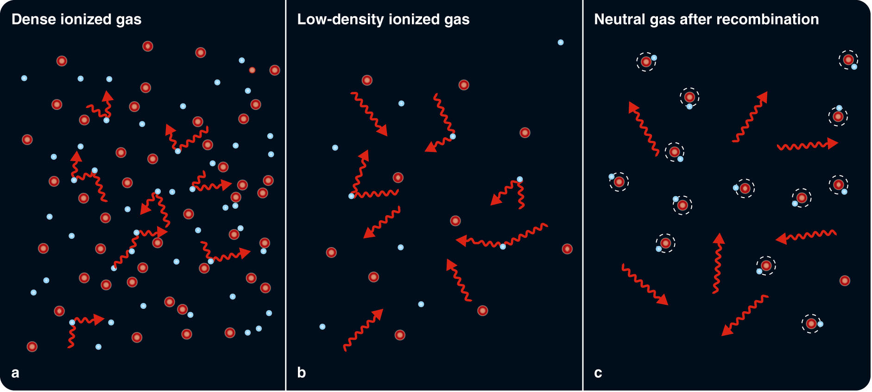
Recombination and Reionization: The First Thousands and Millions of Years
Free electrons interact with photons so easily that a photon could not travel very far before it encountered an electron and was deflected.

Slide 78
Recombination and Reionization: The First Thousands and Millions of Years
The radiation and matter interacted continuously with each other and cooled together as the universe expanded.

Slide 79
Recombination and Reionization: The First Thousands and Millions of Years
As the young universe expanded, it went through three important changes.

Slide 80
Recombination and Reionization: The First Thousands and Millions of Years
The first important change occurred when the universe reached an age of roughly 50,000 years.
The density of the energy present in the form of photons became less than the density of the gas.
Before this, matter could not clump together because the intense sea of photons smoothed the gas out.

Slide 81
Recombination and Reionization: The First Thousands and Millions of Years
Once the density of the radiation fell below that of matter, the matter could begin to draw together under the influence of gravity and form the clouds that eventually became galaxies.
The expansion of the universe spread the particles of the ionized gas farther and farther apart.

Slide 82
Recombination and Reionization: The First Thousands and Millions of Years
The second important change began as the universe reached the age of about 400,000 years.
As the density decreased and the falling temperature of the universe reached 3,000 K, protons were able to capture and hold free electrons to form neutral hydrogen.
This process is called recombination—although ‘combination’ (for the first time) would be more accurate.

Slide 83
Recombination and Reionization: The First Thousands and Millions of Years
As the free electrons were gobbled up into atoms, they could no longer deflect photons.
The photons could travel easily through the gas.
So, the gas became transparent.
Also, the photons retained the blackbody temperature of 3,000 K that the gas and photons together had at the time of recombination.

Slide 84
Recombination and Reionization: The First Thousands and Millions of Years
Those photons are what are observed today as the CMB—with a large redshift that makes their temperature now about 2.7 K.

Slide 85
Recombination and Reionization: The First Thousands and Millions of Years
Recombination left the gas of the big bang neutral, hot, dense, and transparent.
At first, the universe was filled with the glow of the hot gas, which would have been partly at visible wavelengths.
As the universe expanded and cooled, however, the glow faded.

Slide 86
Recombination and Reionization: The First Thousands and Millions of Years
The universe entered what cosmologists call the dark age.
This was a period lasting hundreds of millions of years until the formation of the first stars.
During the dark age, the universe expanded in darkness.

Slide 87
Recombination and Reionization: The First Thousands and Millions of Years
The dark age ended as the first stars began to form.
The gas from which these first stars formed contained almost no metals and was, consequently, highly transparent.
Mathematical models show that the first stars formed from this metal-poor gas would have been very massive, very luminous, and very short-lived.

Slide 88
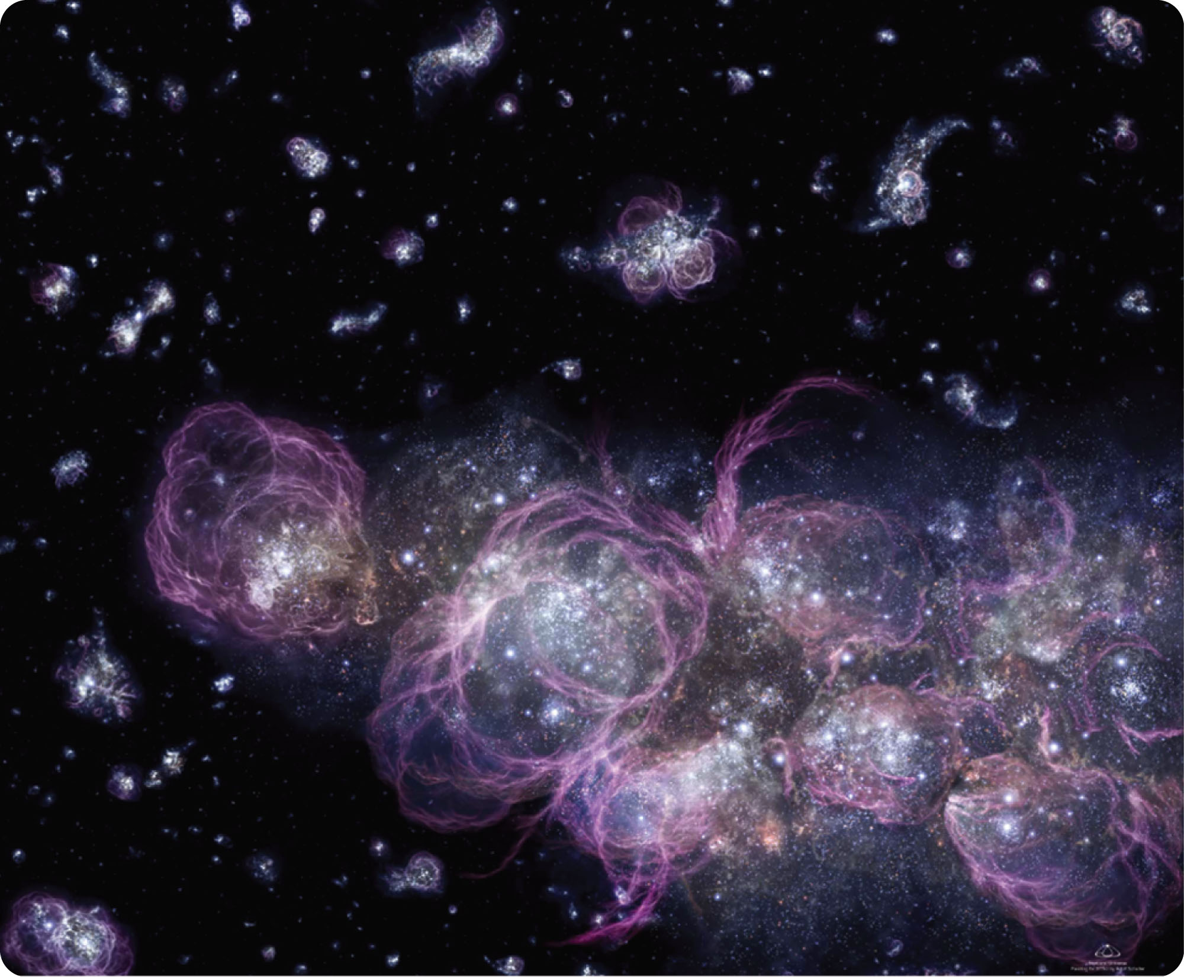
Recombination and Reionization: The First Thousands and Millions of Years
That first burst of star formation produced enough ultraviolet light to begin ionizing the gas.
Today’s astronomers, looking back to the most distant visible quasars and galaxies, can see traces of that reionization of the universe.

Slide 89
Recombination and Reionization: The First Thousands and Millions of Years
Reionization marks the end of the dark age and the beginning of the age of stars and galaxies that continues through today.

Slide 90
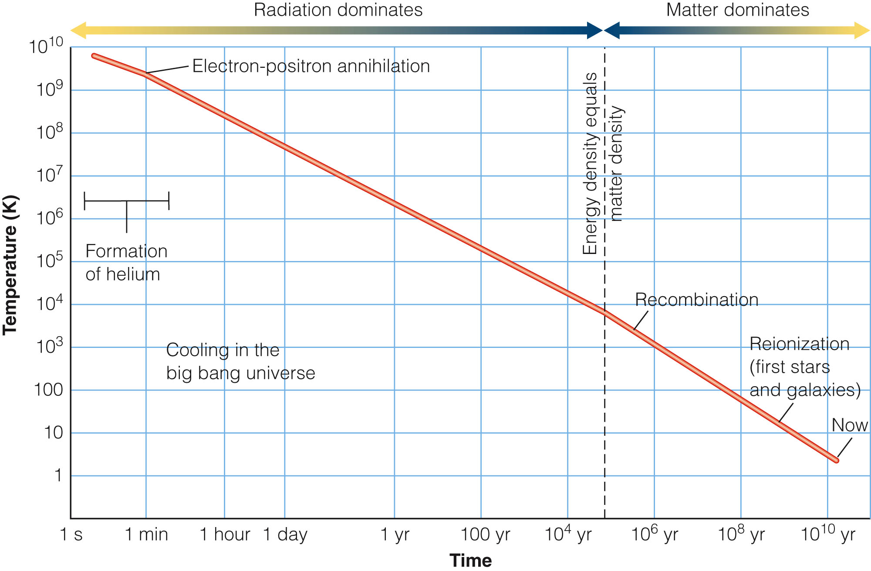
Recombination and Reionization: The First Thousands and Millions of Years
The figure summarizes the story of the big bang—from the formation of helium in the first three minutes through energy–matter equality, recombination, and finally reionization of the gas.

Slide 91
Recombination and Reionization: The First Thousands and Millions of Years
It may seem amazing that mere humans trapped on Earth can draw such a diagram.
However, it is based on evidence and on the best understanding of how matter and energy interact.

Slide 92
Space and Time, Matter and Energy
How can the big bang have happened everywhere?
To solve the puzzle, you must put what seem to be reasonable expectations on hold and look carefully at how space and time behave on cosmic scales.

Slide 93
Looking at the Universe
The universe looks about the same whichever way you look.
That is called isotropy.

Slide 94
Looking at the Universe
Of course, there are local differences.
If you look toward a galaxy cluster, you see more galaxies.

Slide 95
Looking at the Universe
Furthermore, the background radiation is almost perfectly uniform across the sky.

Slide 96
Looking at the Universe
The universe also seems homogeneous.
Homogeneity is the property of being the same everywhere.

Slide 97
Looking at the Universe
Of course, there are local variations.
Some regions contain more galaxies and some less.
Also, if the universe evolves, at large look-back times, you see galaxies at an earlier stage.

Slide 98
Looking at the Universe
If you account for these well-understood variations, then the universe seems to be, on average, the same everywhere.
This is harder to check because you can’t actually go to the locations of distant galaxies and check in detail that things are about the same there as here.
However, all astronomical observations indicate that is so.

Slide 99
Looking at the Universe
Isotropy and homogeneity lead to the cosmological principle.
This states that any observer in any galaxy sees that the universe has the same general properties—after accounting for relatively minor local and evolutionary variations.

Slide 100
Looking at the Universe
The cosmological principle implies that there are no special places in the universe.
What you see from Milky Way is typical of what all intelligent creatures see from their respective home galaxies.

Slide 101
Looking at the Universe
Furthermore, the principle is another way of saying that the universe has no center or edge.
Such locations would be special places.
The principle states there are no special places.

