Slide 1
Star Clusters and the Center of the Galaxy
Shapley finally plotted the direction and distance to the globular clusters.
He found that they form a great swarm that is not centered on the sun.

Slide 2
Star Clusters and the Center of the Galaxy
Consider the analogy of a bunch of tall buildings that are all together in one direction away from you.
You might conclude that downtown is over there, and you are in the suburbs.
Evidently, the center was in Sagittarius—and it was very far away.
The star system was much bigger than anyone had suspected.

Slide 3
Star Clusters and the Center of the Galaxy
You live not at the center of a small star system, but in the suburbs of a very big wheel of stars, a galaxy.

Slide 4
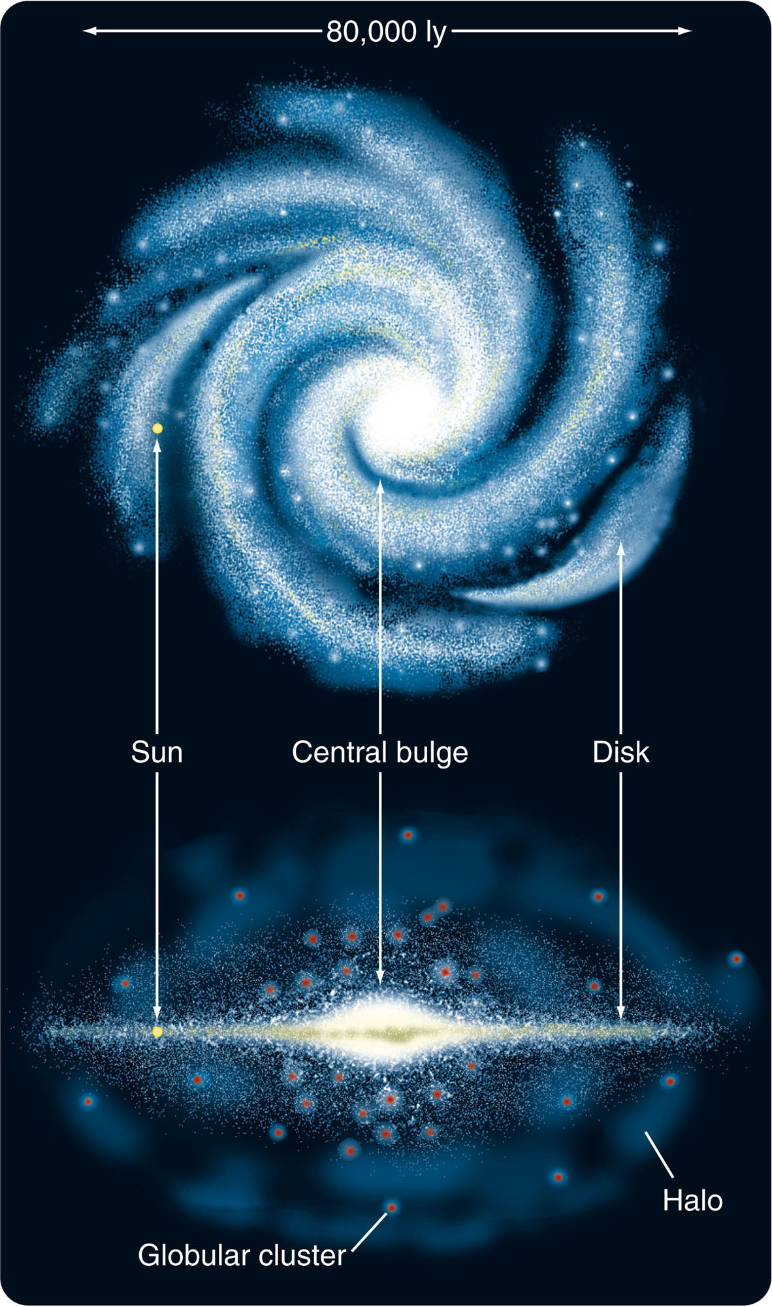
An Analysis of the Galaxy
Our galaxy, like many others, contains two primary components—a disk and a sphere.

Slide 5
An Analysis of the Galaxy
The disk component consists of all matter confined to the plane of rotation—that is, everything in the disk itself.
This includes stars, open star clusters, and nearly all the galaxy’s gas and dust.

Slide 6
An Analysis of the Galaxy
As the disk contains lots of gas and dust, it is the site of most of the star formation in the galaxy.
So, it is illuminated by recently formed brilliant, blue, massive stars and has an overall relatively blue color.

Slide 7
An Analysis of the Galaxy
The diameter of the disk and the position of the sun are also difficult to determine.
Gas and dust block the view in the plane of the galaxy—so, astronomers cannot see to the center or to the edge easily.
Also, the outer edge of the disk is not well defined.

Slide 8
An Analysis of the Galaxy
The best studies suggest the sun is about 8.5 kpc from the center.
1 kpc is a kiloparsec, or 1,000 pc.

Slide 9
An Analysis of the Galaxy
The sun and Earth seem to be about two-thirds of the way from the center to the edge.
So, the diameter of our galaxy appears to be about 25 kpc or about 80,000 ly.
However, that isn’t known to better than 10 percent precision.

Slide 10
An Analysis of the Galaxy
That is the diameter of the luminous part of the galaxy—the part you would see from a distance.
You will learn later that strong evidence shows that our galaxy is much larger than this—but that the outer parts are not luminous.

Slide 11
An Analysis of the Galaxy
Observations made at other wavelengths can also help astronomers see through the dust and gas.
Infrared photons have wavelengths long enough to be unaffected by the dust.

Slide 12
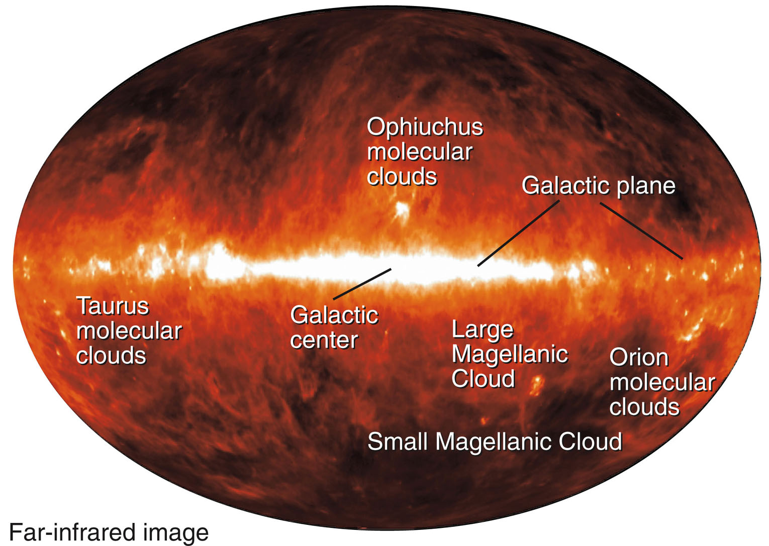
An Analysis of the Galaxy
Thus, a map of the sky at long infrared wavelengths reveals the disk of the galaxy.

Slide 13
An Analysis of the Galaxy
The most striking features of the disk component are the spiral arms—long curves of bright stars, star clusters, gas, and dust.
Such spiral arms are easily visible in other galaxies.
Also, you will see later how astronomers found that our own galaxy has a spiral pattern.

Slide 14
An Analysis of the Galaxy
The second component of the galaxy is the spherical component.
This includes all matter in the galaxy scattered in a roughly spherical distribution around the center.
This includes a large halo and the nuclear bulge.

Slide 15
An Analysis of the Galaxy
The halo is a spherical cloud of thinly scattered stars and globular star clusters.
It contains only about 2 percent as many stars as the disk of the galaxy and has very little gas and dust.
Thus, with no raw material available, no new stars are forming in the halo.

Slide 16
An Analysis of the Galaxy
In fact, the halo stars are mostly old, cool giants or dim lower-main sequence stars.

Slide 17
An Analysis of the Galaxy
Recent careful studies reveal that they are old white dwarfs that are difficult to detect.
Nevertheless, astronomers can map the halo of the galaxy by studying the more easily detected giant stars.

Slide 18
An Analysis of the Galaxy
The central bulge is the dense cloud of stars that surrounds the center of the galaxy.
It has a radius of about 2 kpc and is slightly flattened.

Slide 19
An Analysis of the Galaxy
It is hard to observe because thick dust in the disk scatters and absorbs radiation of visible wavelengths.
However, observations at longer wavelengths can penetrate the dust.

Slide 20
An Analysis of the Galaxy
The bulge seems to contain little gas and dust.
Thus, there is little star formation.
Most of the stars in the nuclear bulge are old, cool stars—like those in the halo.

Slide 21
The Mass of the Galaxy
The vast numbers of stars in the disk, halo, and nuclear bulge lead to a basic question.
How massive is the galaxy?

Slide 22
The Mass of the Galaxy
Every star in the galaxy follows an orbit around the center of mass of the galaxy.
In the disk, the stars follow parallel, circular orbits.
Astronomers say the disk of the galaxy rotates.

Slide 23
The Mass of the Galaxy
That rotation can allow you an estimate of the mass of the galaxy.
So, any discussion of the mass of the galaxy is also a discussion of the rotation of the galaxy and the orbits of the stars within the galaxy.

Slide 24
The Mass of the Galaxy
Astronomers can find the orbits of stars by finding how they move.
Of course, the Doppler effect reveals a star’s radial velocity.

Slide 25
The Mass of the Galaxy
In addition, if astronomers can measure the distance to a star and its proper motion, they can find the velocity of the star perpendicular to the radial direction.
Combining all this information, astronomers can find the shape of the star’s orbit.

Slide 26
The Mass of the Galaxy
In addition, if astronomers can measure the distance to a star and its proper motion, they can find the velocity of the star perpendicular to the radial direction.
Combining all this information, astronomers can find the shape of the star’s orbit.

Slide 27
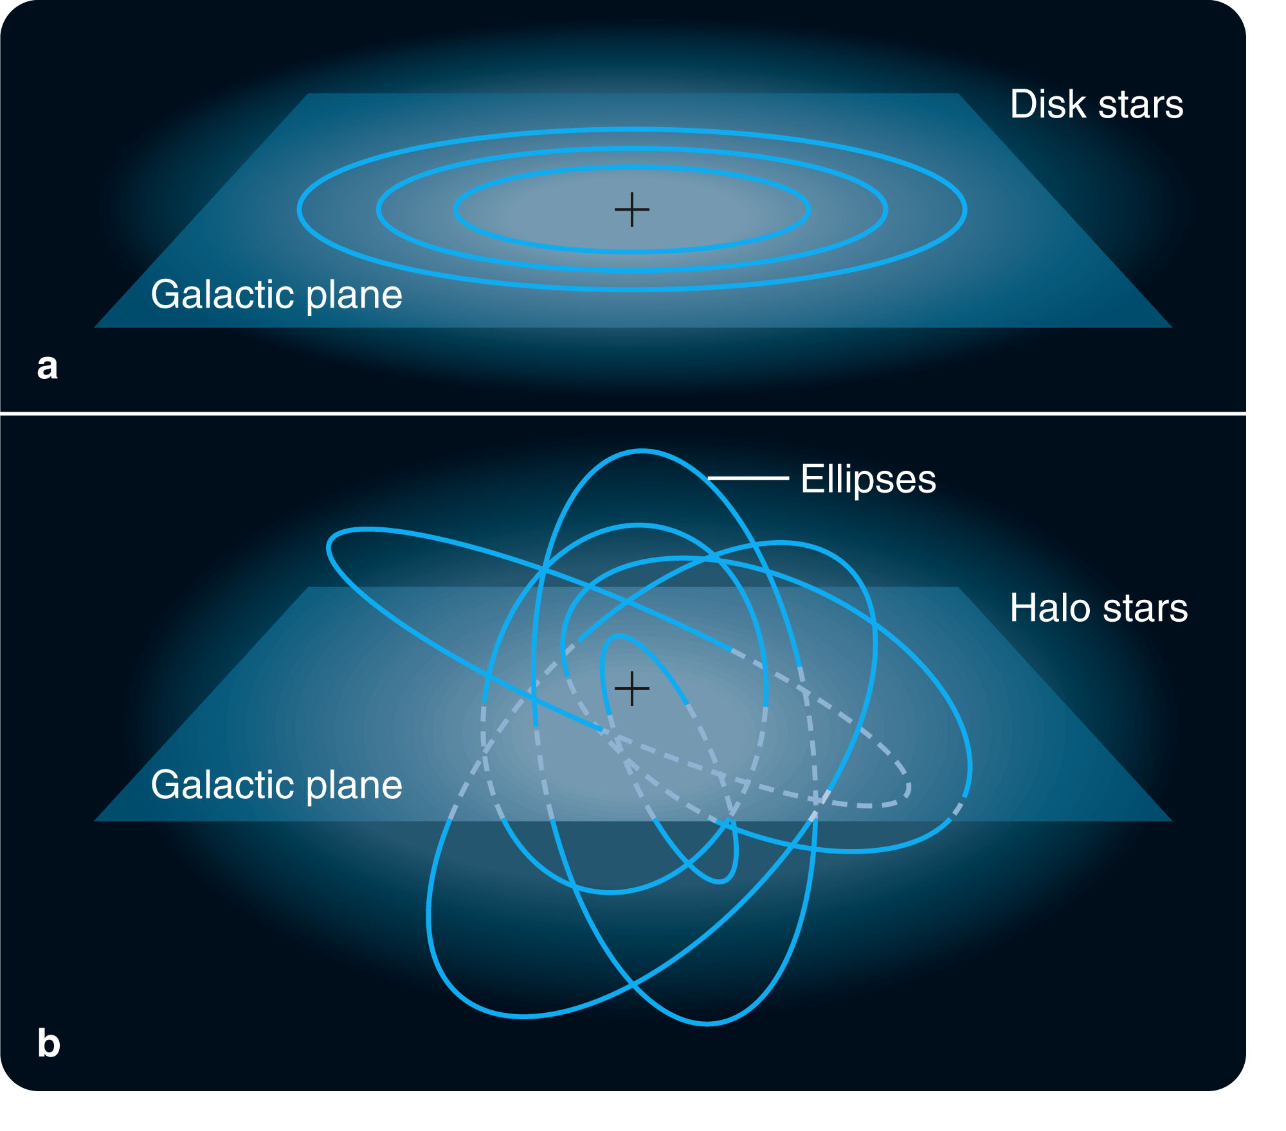
The Mass of the Galaxy
The orbital motions of the stars in the halo are strikingly different from those in the disk.
In the halo, each star and globular cluster follows its own randomly tipped elliptical orbit.

Slide 28
The Mass of the Galaxy
These orbits carry the stars and clusters far out into the spherical halo—where they move slowly.
When they fall back into the inner part of the galaxy, though, their velocities increase.

Slide 29
The Mass of the Galaxy
Motions in the halo do not resemble a general rotation.
They are more like the random movements of a swarm of bees.

Slide 30
The Mass of the Galaxy
In contrast, the stars in the disk of the galaxy move in the same direction in nearly circular orbits that lie in the plane of the galaxy.
The sun is a disk star and follows a nearly circular orbit around the galaxy that always remains within the disk.

Slide 31
The Mass of the Galaxy
You can use the sun’s orbital motion to find the mass of the galaxy inside the sun’s orbit.
By observing the radial velocity of other galaxies around the sky, astronomers can tell that the sun moves about 220 km/s in the direction of Cygnus.
It carries Earth and the other planets of our solar system along with it.

Slide 32
The Mass of the Galaxy
As its orbit is a circle with a radius of 8 kpc, you can divide the circumference of the orbit by the velocity.
You will find that the sun completes a single orbit in about 220 million years.

Slide 33
The Mass of the Galaxy
If you think of the sun and the center of mass of our galaxy as two objects orbiting each other, you can find the mass of the galaxy.
Milky Way must have a mass of about 100 billion solar masses.

Slide 34
The Mass of the Galaxy
The measured motion of the stars shows that the disk does not rotate as a solid body.
Each star follows its own orbit.
Stars in some regions have shorter or longer orbital periods than the sun.
This is called differential rotation.

Slide 35
The Mass of the Galaxy
It is difficult to determine a precise edge to the visible galaxy.
However, it seems clear that large amounts of matter are located beyond what seems to be the limit of the galaxy’s luminous matter.

Slide 36
The Mass of the Galaxy
The evidence is clear that extra mass lies in an extended halo sometimes called a dark halo.
It may extend up to 10 times farther than the edge of the visible disk and could contain up to two trillion solar masses.
Some small fraction of this mass is made up of low-luminosity stars and white dwarfs.
Most of the matter, though, is not producing light.

Slide 37
The Mass of the Galaxy
Astronomers call it dark matter and conclude that it must be some as yet unknown form of matter.
It is one of the fundamental problems of modern astronomy.

Slide 38
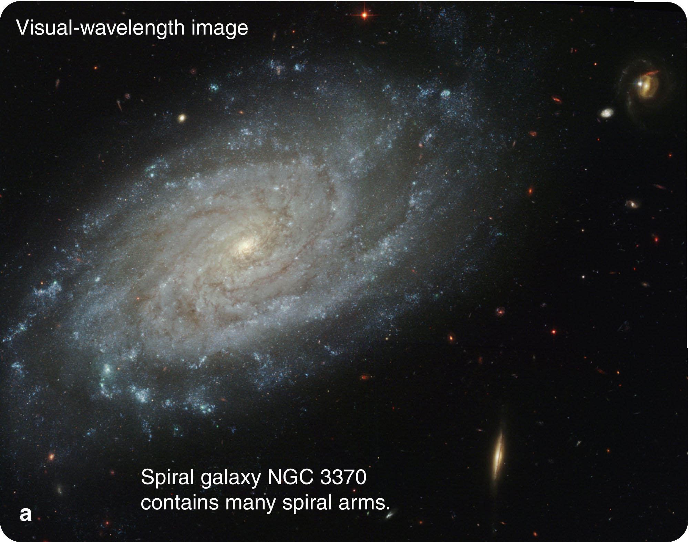
Spiral Arms and Star Formation
The most striking feature of galaxies like Milky Way is the system of spiral arms that wind outward through the disk.
These arms contain swarms of hot, blue stars, clouds of dust and gas, and clusters of young stars.
These young objects hint that the spiral arms involve star formation.

Slide 39
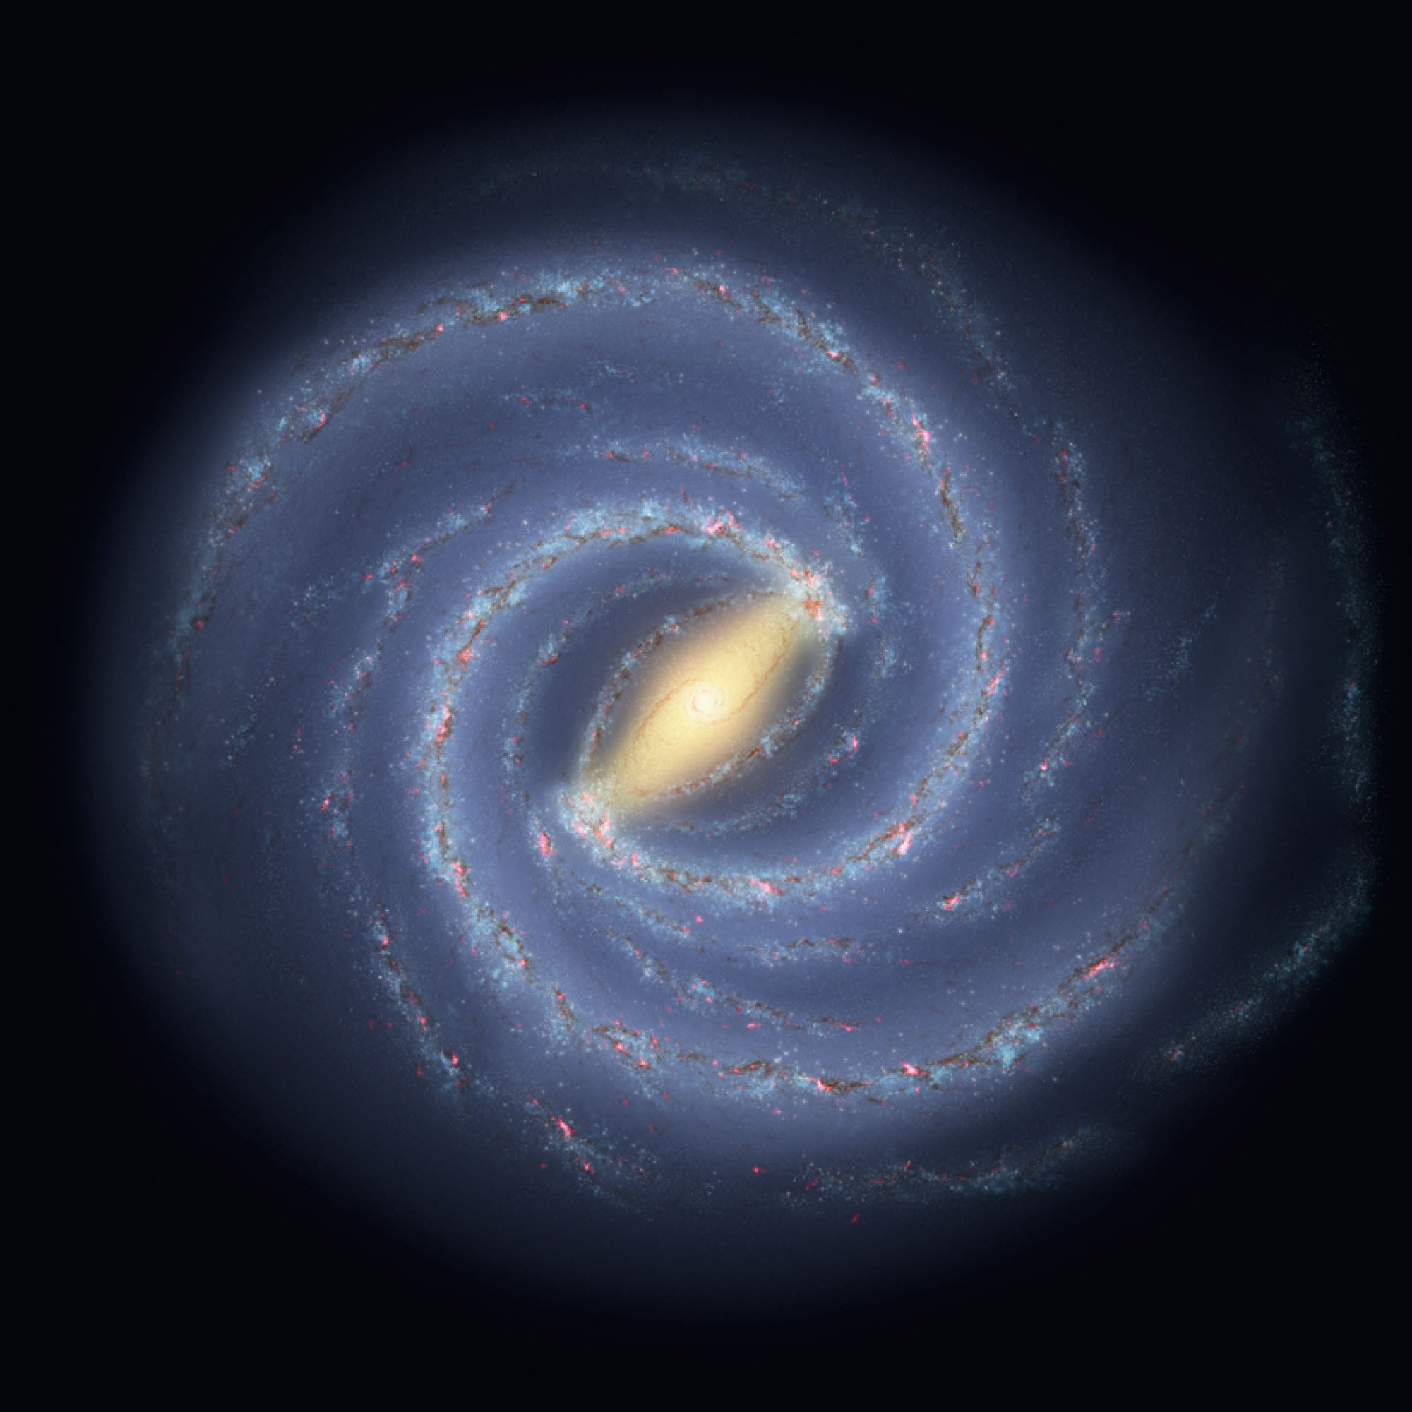
Tracing the Spiral Arms
The newest models suggest that the nuclear bulge in our galaxy is elongated into a bar.

Slide 40
Tracing the Spiral Arms
Spiral tracers show that the arms contain young objects.
That suggests active star formation.
Radio maps confirm this suspicion by showing that the material needed to make stars is abundant in spiral arms.

Slide 41
The Age of Milky Way
To begin, you should ask yourself how old the galaxy is.
That question is easy to answer because you already know how to find the age of star clusters.
However, there are uncertainties that make that easy answer hard to interpret.

Slide 42
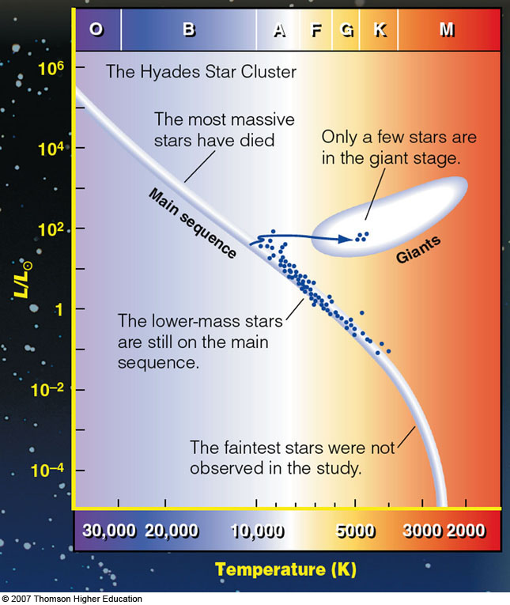
The Age of Milky Way
The oldest open clusters have ages of about 9 billion years.
These ages are determined by analyzing the turnoff point in the cluster H–R diagram and are somewhat uncertain.
Nevertheless, from open clusters, you can get a rough age for the disk of our galaxy of at least 9 billion years.

Slide 43
The Age of Milky Way
Globular clusters have faint turnoff points in their H-R diagrams and are clearly old.

Slide 44
The Age of Milky Way
Finding their ages is difficult, though.
Clusters differ slightly in chemical composition—which must be accounted for in calculating the stellar models from which ages are determined.
Also, to find the age of a cluster, astronomers must know the distance to the cluster.

Slide 45
The Age of Milky Way
Globular cluster ages seem to average about 11 billion years.
The oldest are a bit over 13 billion years old.
So, the halo of our galaxy must be at least 13 billion years old, older than the disk.

Slide 46
Stellar Populations
In the 1940s, astronomers realized that there were two types of stars in the galaxy.
The stars they were accustomed to studying is located in the disk—such as the stars near the sun.
These they called population I stars.

Slide 47
Stellar Populations
The second type—called population II stars—are usually found in the halo, in globular clusters, or in the nuclear bulge.
In other words, the two stellar populations are associated with the two components of the galaxy.

Slide 48
Stellar Populations
The stars of the two populations fuse nuclear fuels and evolve in nearly identical ways.
They differ only in the abundance of atoms heavier than helium—atoms that astronomers refer to collectively as metals.
Note that this is definitely not the way the word metal is commonly used by nonastronomers.

Slide 49
Stellar Populations
Population I stars are metal-rich—containing 2 to 3 percent metals.
Population II stars are metal-poor—containing only about 0.1 percent metals or less.
The metal content of the star defines its population.

Slide 50
Stellar Populations
Population I stars, sometimes called disk population stars, have circular orbits in the plane of the galaxy.
They are relatively young stars that formed within the last few billion years.
The sun is a population I star.

Slide 51
Stellar Populations
Population II stars belong to the spherical component and are sometimes called the halo population stars.
These stars have randomly tipped orbits with a wide range of shapes.
A few follow circular orbits, but most follow elliptical orbits.
These stars are all lower-mass main-sequence stars or giants and are old stars.
The metal-poor globular clusters are part of the halo population.

Slide 52
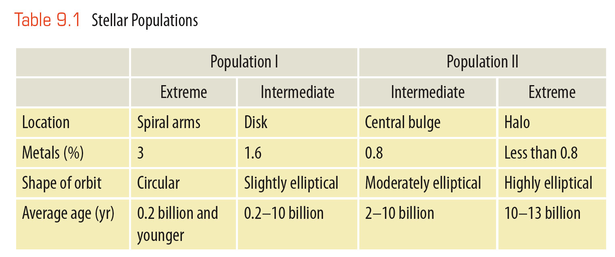
Stellar Populations
Since the discovery of stellar populations, astronomers have realized that there is a gradation between populations.

Slide 53
Stellar Populations
Why do the disk and halo stars have different metal abundances?
The two types of star must have formed at different stages in the life of the galaxy—at times when the chemical composition of the galaxy differed.

Slide 54
Stellar Populations
That is a clue to the history of the galaxy.
To use the clue, though, you must first discuss the cycle of element building.

Slide 55
The Element-Building Cycle
The atoms of which you are made were created in a process that spanned a number of generations of stars.
The process that built the chemical elements over the history of our galaxy led to the possibility of Earth and life on Earth.

Slide 56
The Element-Building Cycle
You have learned how elements heavier than helium but lighter than iron are built up by nuclear reactions inside evolving stars.

Slide 57
The Element-Building Cycle
Atoms more massive than iron are made by the short-lived nuclear reactions that occur during a supernova explosion.
This explains why lower-mass atoms—such as carbon, nitrogen, and oxygen—are so common.
This also explains why atoms more massive than iron—such as gold, silver, platinum, and uranium—are so rare, and often valuable.

Slide 58
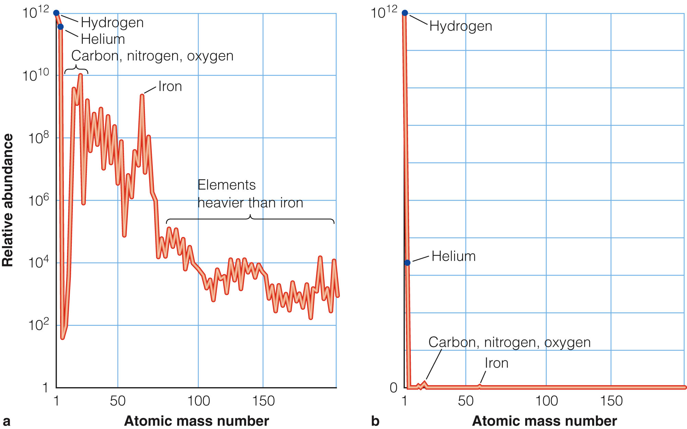
The Element-Building Cycle
The figure shows the abundance of the chemical elements.
The graph has an exponential scale.
To get a feeling for the true abundance of the elements, you should draw this graph using a linear scale.

Slide 59
The Element-Building Cycle
Using a linear scale, you can see how rare the elements heavier than helium really are.

Slide 60
The Element-Building Cycle
Most of the matter in stars is hydrogen and helium.
Other elements, including carbon, nitrogen, oxygen, and the rest of what astronomers call metals, were cooked up inside stars.

Slide 61
The Element-Building Cycle
When the galaxy first formed, there should have been no metals.
The stars had not yet manufactured any.

Slide 62
The Element-Building Cycle
Judging from the composition of stars in the oldest clusters, the gas from which the galaxy condensed must have contained about 90 percent hydrogen atoms and 10 percent helium atoms.
The hydrogen and helium came from the big bang that began the universe.

Slide 63
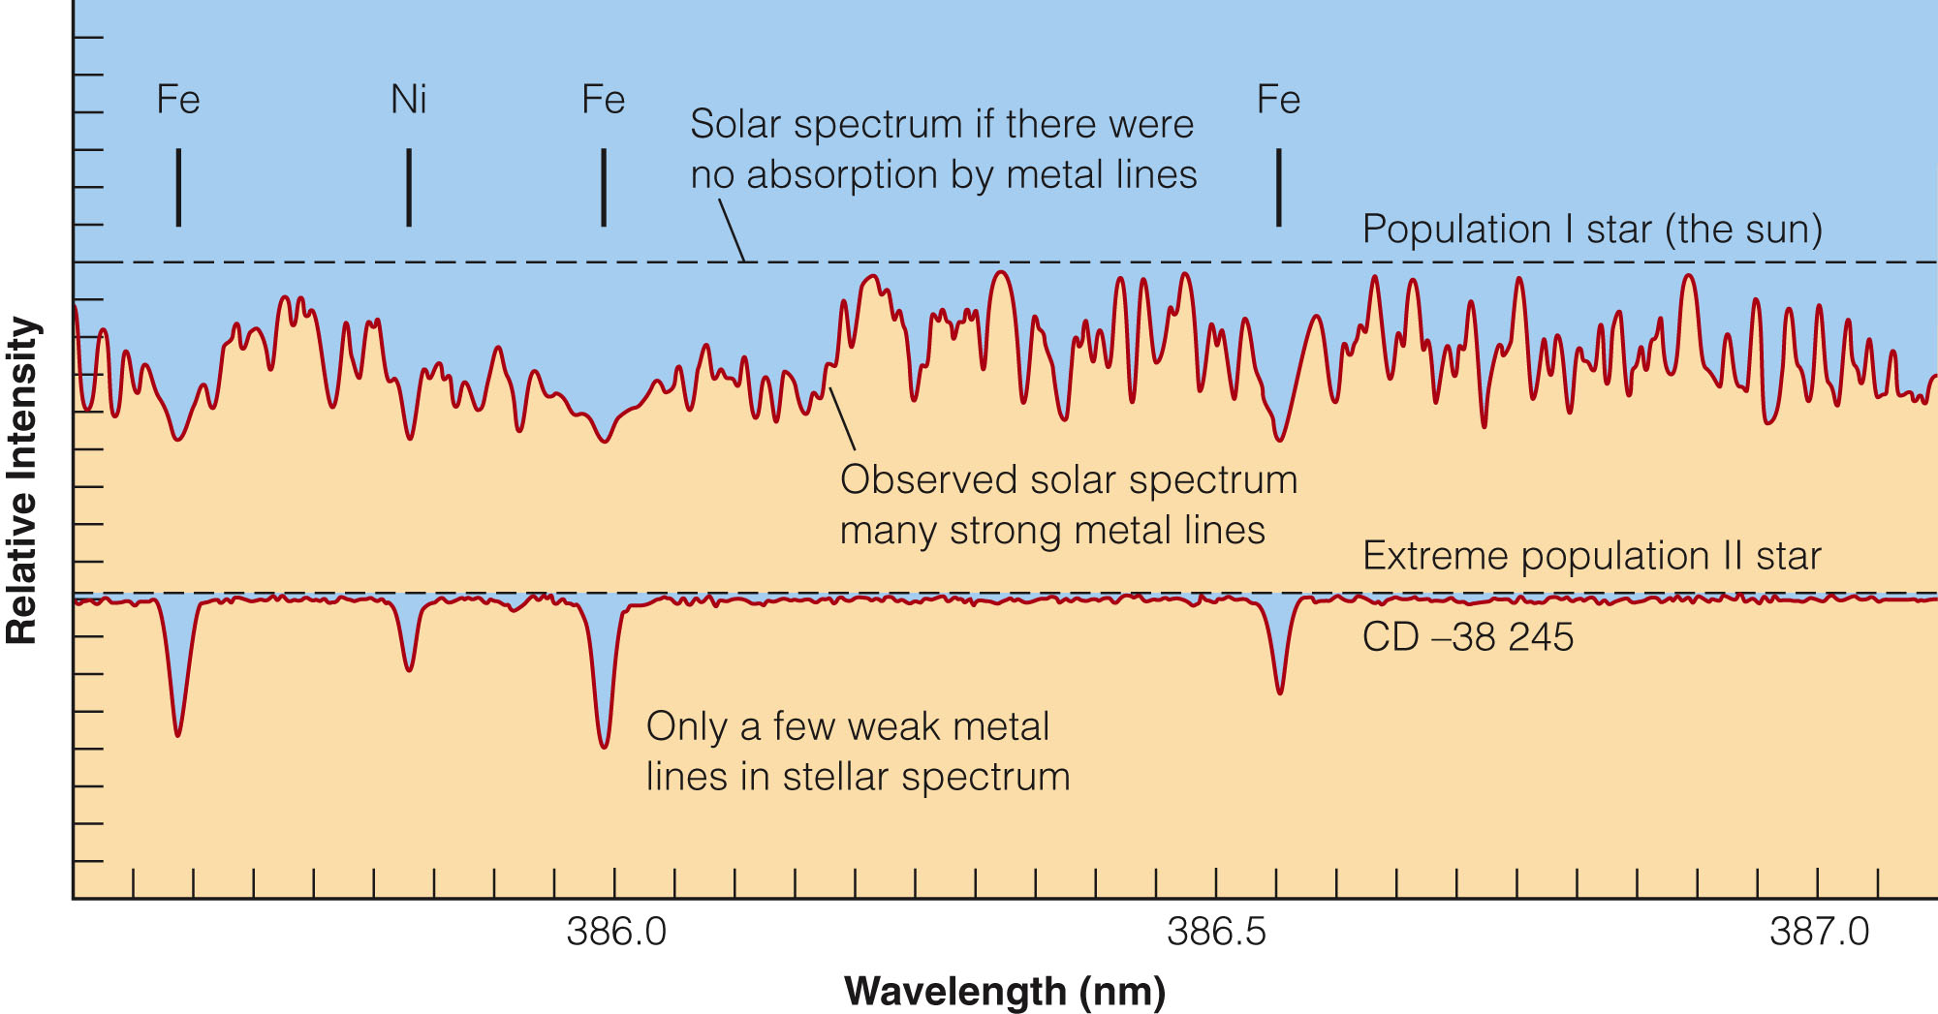
The Element-Building Cycle
The first stars to form from this gas were metal-poor.
Now, 13 billion years later, their spectra still show few metal lines.

Slide 64
The Element-Building Cycle
Of course, they may have manufactured many atoms heavier than helium.
As the stars’ interiors are not mixed, those heavy atoms stay trapped at the centers of the stars where they were produced and do not affect the spectra.
The population II stars in the halo are the survivors of an earlier generation of stars that formed in the galaxy.

Slide 65
The Element-Building Cycle
Most of the first stars evolved and died.
The various types of star death throes, including supernovae, enriched the interstellar gas with metals.
Succeeding generations of stars formed from gas clouds that were more enriched.
Each generation added to the enrichment with its death.

Slide 66
The Element-Building Cycle
By the time the sun formed, roughly 5 billion years ago, the element-building process had added about 1.6 percent metals.

Slide 67
The Element-Building Cycle
Since then, metal abundance has increased further.
Stars forming now incorporate 2 to 3 percent metals and become extreme population I stars.
Thus, metal abundance varies between populations—due to the production of heavy atoms in successive generations of stars as the galaxy aged.

Slide 68
The Element-Building Cycle
The oxygen atoms you are breathing, the carbon atoms in your flesh, the calcium atoms in your bones were all created in the interiors of red and yellow giant stars.
They were hot enough to sustain fusion reactions beyond helium.

Slide 69
The Element-Building Cycle
The gold and silver atoms in your jewelry and dental fillings, the iodine in medicine, the mercury (quicksilver) atoms in old-fashioned thermometers were all created during supernova explosions.
Those are the only places in the universe hot enough to make these types of atoms.

Slide 70
The History of Milky Way Galaxy
In the 1950s, astronomers began to develop a hypothesis, sometimes called the monolithic collapse model, to explain the formation of the galaxy.
Recent observations, however, are forcing a reevaluation of that traditional hypothesis.

Slide 71
The History of Milky Way Galaxy
The traditional hypothesis suggests that the galaxy formed from a single large cloud of gas over 13 billion years ago.

Slide 72
The History of Milky Way Galaxy
Stars and star clusters that formed from these fragments went into randomly shaped and randomly tipped orbits.

