Slide 1
White Dwarfs
As you have just learned, medium-mass stars die by ejecting gas into space and contracting into white dwarfs.
When you surveyed the stars, you learned that white dwarfs are the second most common kind of star. (Only red dwarfs are more abundant.)
The billions of white dwarfs in our galaxy must be the remains of medium-mass stars.

Slide 2
White Dwarfs
The first white dwarf discovered was the faint companion to the well-known star Sirius.
Sirius, the brightest star in the sky, is a visual binary star, the most luminous member of which is Sirius A.
The white dwarf, Sirius B, is 10,000 times fainter than Sirius A.

Slide 3
White Dwarfs
The orbital motions of the stars reveal that the white dwarf ’s mass is 0.98 solar mass.
Its blue-white color informs you that its surface is hot—about 45,000 K.

Slide 4
White Dwarfs
Although it is very hot, it has a very low luminosity.
So, it must have a small surface area.
In fact, it is about the size of Earth.

Slide 5
White Dwarfs
Dividing its mass by its volume reveals that it is very dense—about 2 x 10⁶ g/cm³.
On Earth, a teaspoonful of Sirius B material would weigh more than 11 tons.
Thus, basic observations and simple physics lead to the conclusion that white dwarfs are astonishingly dense.

Slide 6
White Dwarfs
A normal star is supported by energy flowing outward from its core.
A white dwarf, however, cannot generate energy by nuclear fusion.
It has exhausted its hydrogen and helium fuels and produced carbon and oxygen.

Slide 7
White Dwarfs
As the star collapses into a white dwarf, it converts gravitational energy into thermal energy.
Its interior becomes very hot.
However, it cannot get hot enough to fuse carbon into heavier elements.

Slide 8
White Dwarfs
The contraction of a white dwarf compresses the gases in its interior to such high densities that quantum mechanical laws become important—and the electrons in the gas cannot get closer together.
Such a gas is termed degenerate matter.

Slide 9
White Dwarfs
Unlike a normal star, which is supported by ordinary gas pressure, a white dwarf is supported against its own gravity by the resistance to compression of a degenerate gas.

Slide 10
White Dwarfs
Clearly, a white dwarf is not a true star.
It generates no nuclear energy.
It is almost completely degenerate matter.
Except for a thin layer at its surface, it contains no gas.

Slide 11
White Dwarfs
Instead of calling it a ‘star,’ you can call it a compact object.
The next sections of the chapter discuss two other types of compact object—neutron stars and black holes.

Slide 12
White Dwarfs
Perhaps the most interesting thing astronomers have learned about white dwarfs has come from mathematical models.
The equations predict that degenerate electron pressure cannot support an object with more than about 1.4 solar masses.
A white dwarf with that mass would have such strong gravity that its radius would shrink to zero.

Slide 13
White Dwarfs
This is called the Chandrasekhar limit.
It is named after Subrahmanyan Chandrasekhar, the astronomer who calculated it.
The Chandrasekhar limit seems to imply that a star more massive than 1.4 solar masses could not become a white dwarf—unless it got rid of the extra mass in some way.

Slide 14
The Fate of the Sun and the End of Earth
Evolutionary models of the sun suggest that it may survive for another 6 billion years or so.
In about 5 billion years, it will exhaust the hydrogen in its core, begin burning hydrogen in a shell, and swell into a red giant star about 30 times its present radius.

Slide 15
The Fate of the Sun and the End of Earth
Later, helium fusion will ignite in the core and the sun will become a horizontal branch star.
Once the helium fuel is exhausted in its core, helium fusion will begin in a shell, and the sun will expand again.
That second red giant version of the sun will be about as large as the orbit of Earth.
Before that, the sun’s increasing luminosity will certainly evaporate Earth’s oceans, drive away the atmosphere, and even vaporize much of Earth’s crust.

Slide 16
Novae
Modern astronomers know that a nova is not a new star but an old star flaring up.
After a nova fades, astronomers can photograph the spectrum of the remaining faint point of light.
Invariably, they find a normal star and a white dwarf in a close binary system.
A nova is evidently an explosion involving a white dwarf.

Slide 17
Novae
Observational evidence can reveal how nova explosions occur.
As the explosion begins, spectra show blueshifted absorption lines.
This informs you that the gas is dense and coming toward you at a few thousand kilometers per second.

Slide 18
Nuclear Fusion in Massive Stars
Stars on the upper main sequence have too much mass to die as white dwarfs.
However, their evolution begins much like that of their lower-mass cousins.
They consume the hydrogen in their cores, ignite hydrogen shells, and become giants or, for the most massive stars, supergiants.
Their cores contract and fuse helium first in the core and then in a shell, producing a carbon–oxygen core.

Slide 19
Nuclear Fusion in Massive Stars
Unlike medium-mass stars, massive stars finally can get hot enough to ignite carbon fusion at a temperature of about 1 billion Kelvin.
Carbon fusion produces more oxygen plus neon.
As soon as the carbon is exhausted in the core, the core contracts and carbon ignites in a shell.

Slide 20
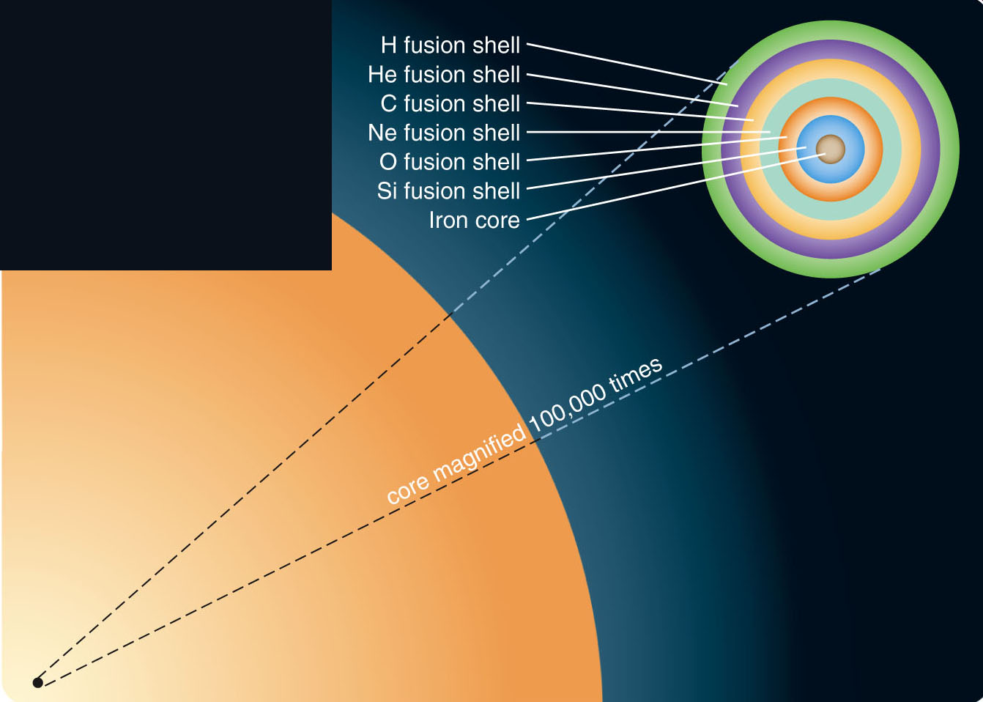
Nuclear Fusion in Massive Stars
This pattern of core ignition and shell ignition continues with a series of heavier nuclei as fusion fuel.
Thus, the star develops a layered structure.
There is a hydrogen-fusion shell surrounding a helium-fusion shell surrounding a carbon-fusion shell, and so on.

Slide 21
Nuclear Fusion in Massive Stars
At higher temperatures than carbon fusion, nuclei of oxygen, neon, and magnesium fuse to make silicon and sulfur.
At even higher temperatures, silicon can fuse to make iron.

Slide 22
Nuclear Fusion in Massive Stars
The fusion of the nuclear fuels in this series goes faster and faster as the massive star evolves rapidly.
The amount of energy released per fusion reaction decreases as the mass of the types of atoms involved increases.
To support its weight, a star must fuse oxygen much faster than it fused hydrogen.

Slide 23
Nuclear Fusion in Massive Stars
Also, there are fewer nuclei in the core of the star by the time heavy nuclei begin to fuse.
Four hydrogen nuclei make one helium nucleus.
Three helium nuclei make one carbon nucleus.
So, there are 12 times fewer nuclei of carbon available for fusion than there were hydrogen nuclei.

Slide 24
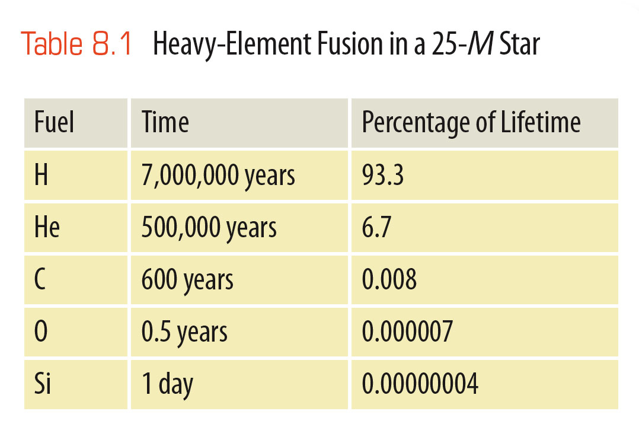
Nuclear Fusion in Massive Stars
Thus, the heavy elements are used up, and fusion goes very quickly in massive stars.
Hydrogen fusion can last 7 million years in a 25-solar-mass star.
The same star will fuse its oxygen in 6 months and its silicon in just one day.

Slide 25
Supernova Explosions of Massive Stars
Theoretical models of evolving stars, combined with nuclear physics, allow astronomers to describe what happens inside a massive star when the last nuclear fuels are exhausted.
It begins with iron nuclei and ends in cosmic violence.

Slide 26
Supernova Explosions of Massive Stars
Silicon fusion produces iron—the most tightly bound of all atomic nuclei.

Slide 27
Supernova Explosions of Massive Stars
Nuclear fusion releases energy only when less tightly bound nuclei combine into a more tightly bound nucleus.
Once the gas in the core of the star has been converted to iron, there are no further nuclear reactions that can release energy.
The iron core is a dead end in the evolution of a massive star.

Slide 28
Supernova Explosions of Massive Stars
As a star develops an iron core, energy production declines, and the core contracts.
Nuclear reactions involving iron begin.
However, they remove energy from the core—causing it to contract even further.
Once this process starts, the core of the star collapses inward in less than a tenth of a second.

Slide 29
Supernova Explosions of Massive Stars
In fact, for a short time, the core produces more energy per second than all the stars in all the visible galaxies in the universe.
99 percent of that energy is in the form of neutrinos.
This flood of neutrinos carries large amounts of energy out of the core—allowing it to collapse further.

Slide 30
Supernova Explosions of Massive Stars
The models also predict that the collapsing core of the star must quickly become a neutron star or a black hole, while the envelope of the star is blasted outward.

Slide 31
Supernova Explosions of Massive Stars
The supernova seen from Earth is the brightening of the star as its distended envelope is blasted outward by the shock wave.
As months pass, the cloud of gas expands, thins, and fades.

Slide 32
Supernova Explosions of Massive Stars
The supernova seen from Earth is the brightening of the star as its distended envelope is blasted outward by the shock wave.
As months pass, the cloud of gas expands, thins, and fades.

Slide 33
Supernova Explosions of Massive Stars
The rate at which it fades informs astronomers more about the death throes of the star.
The rate at which it fades matches the rate at which these radioactive nickel and cobalt decay.
So, the explosion must produce great abundances of those atoms.
The radioactive cobalt decays into iron.
So, destruction of iron in the core of the star is followed by the production of iron through nuclear reactions in the expanding outer layers.

Slide 34
Types of Supernovae
In studying supernovae in other galaxies, astronomers have noticed that there are a number of different types.

Slide 35
Types of Supernovae
Type I supernovae have no hydrogen lines in their spectra.
Astronomers have thought of at least two ways a supernova could occur without involving much hydrogen.
Type II supernovae have spectra containing hydrogen lines.
They appear to be produced by the collapse and explosion of a massive star.

Slide 36
Types of Supernovae
A type Ia supernova is believed to occur when a white dwarf in a binary system receives enough mass to exceed the Chandrasekhar limit and collapse.
The collapse of a white dwarf is different from the collapse of a massive star because the core of the white dwarf contains usable fuel.

Slide 37
Types of Supernovae
As the collapse begins, the temperature and density shoot up, and the carbon–oxygen core begins to fuse in violent nuclear reactions.
In a few seconds the carbon–oxygen interior is entirely consumed.
The outermost layers are blasted away in a violent explosion that—at its brightest—is about six times more luminous than a type II supernova.

Slide 38
Types of Supernovae
The white dwarf is entirely destroyed.
No neutron star or black hole is left behind.
This explains why no hydrogen lines are seen in the spectrum of a type Ia supernova explosion—white dwarfs contain very little hydrogen.

Slide 39
Types of Supernovae
The less common type Ib supernova is believed to occur when a massive star in a binary system loses its hydrogen-rich outer layers to its companion star.
The remains of the massive star could develop an iron core and collapse—producing a supernova explosion that lacked hydrogen lines in its spectrum.

Slide 40
Observations of Supernovae
In AD 1054, Chinese astronomers saw a ‘guest star’ appear in the constellation known in the Western tradition as Taurus the Bull.
The star quickly became so bright that it was visible in the daytime.
After a month, it slowly faded, taking almost two years to vanish from sight.

Slide 41
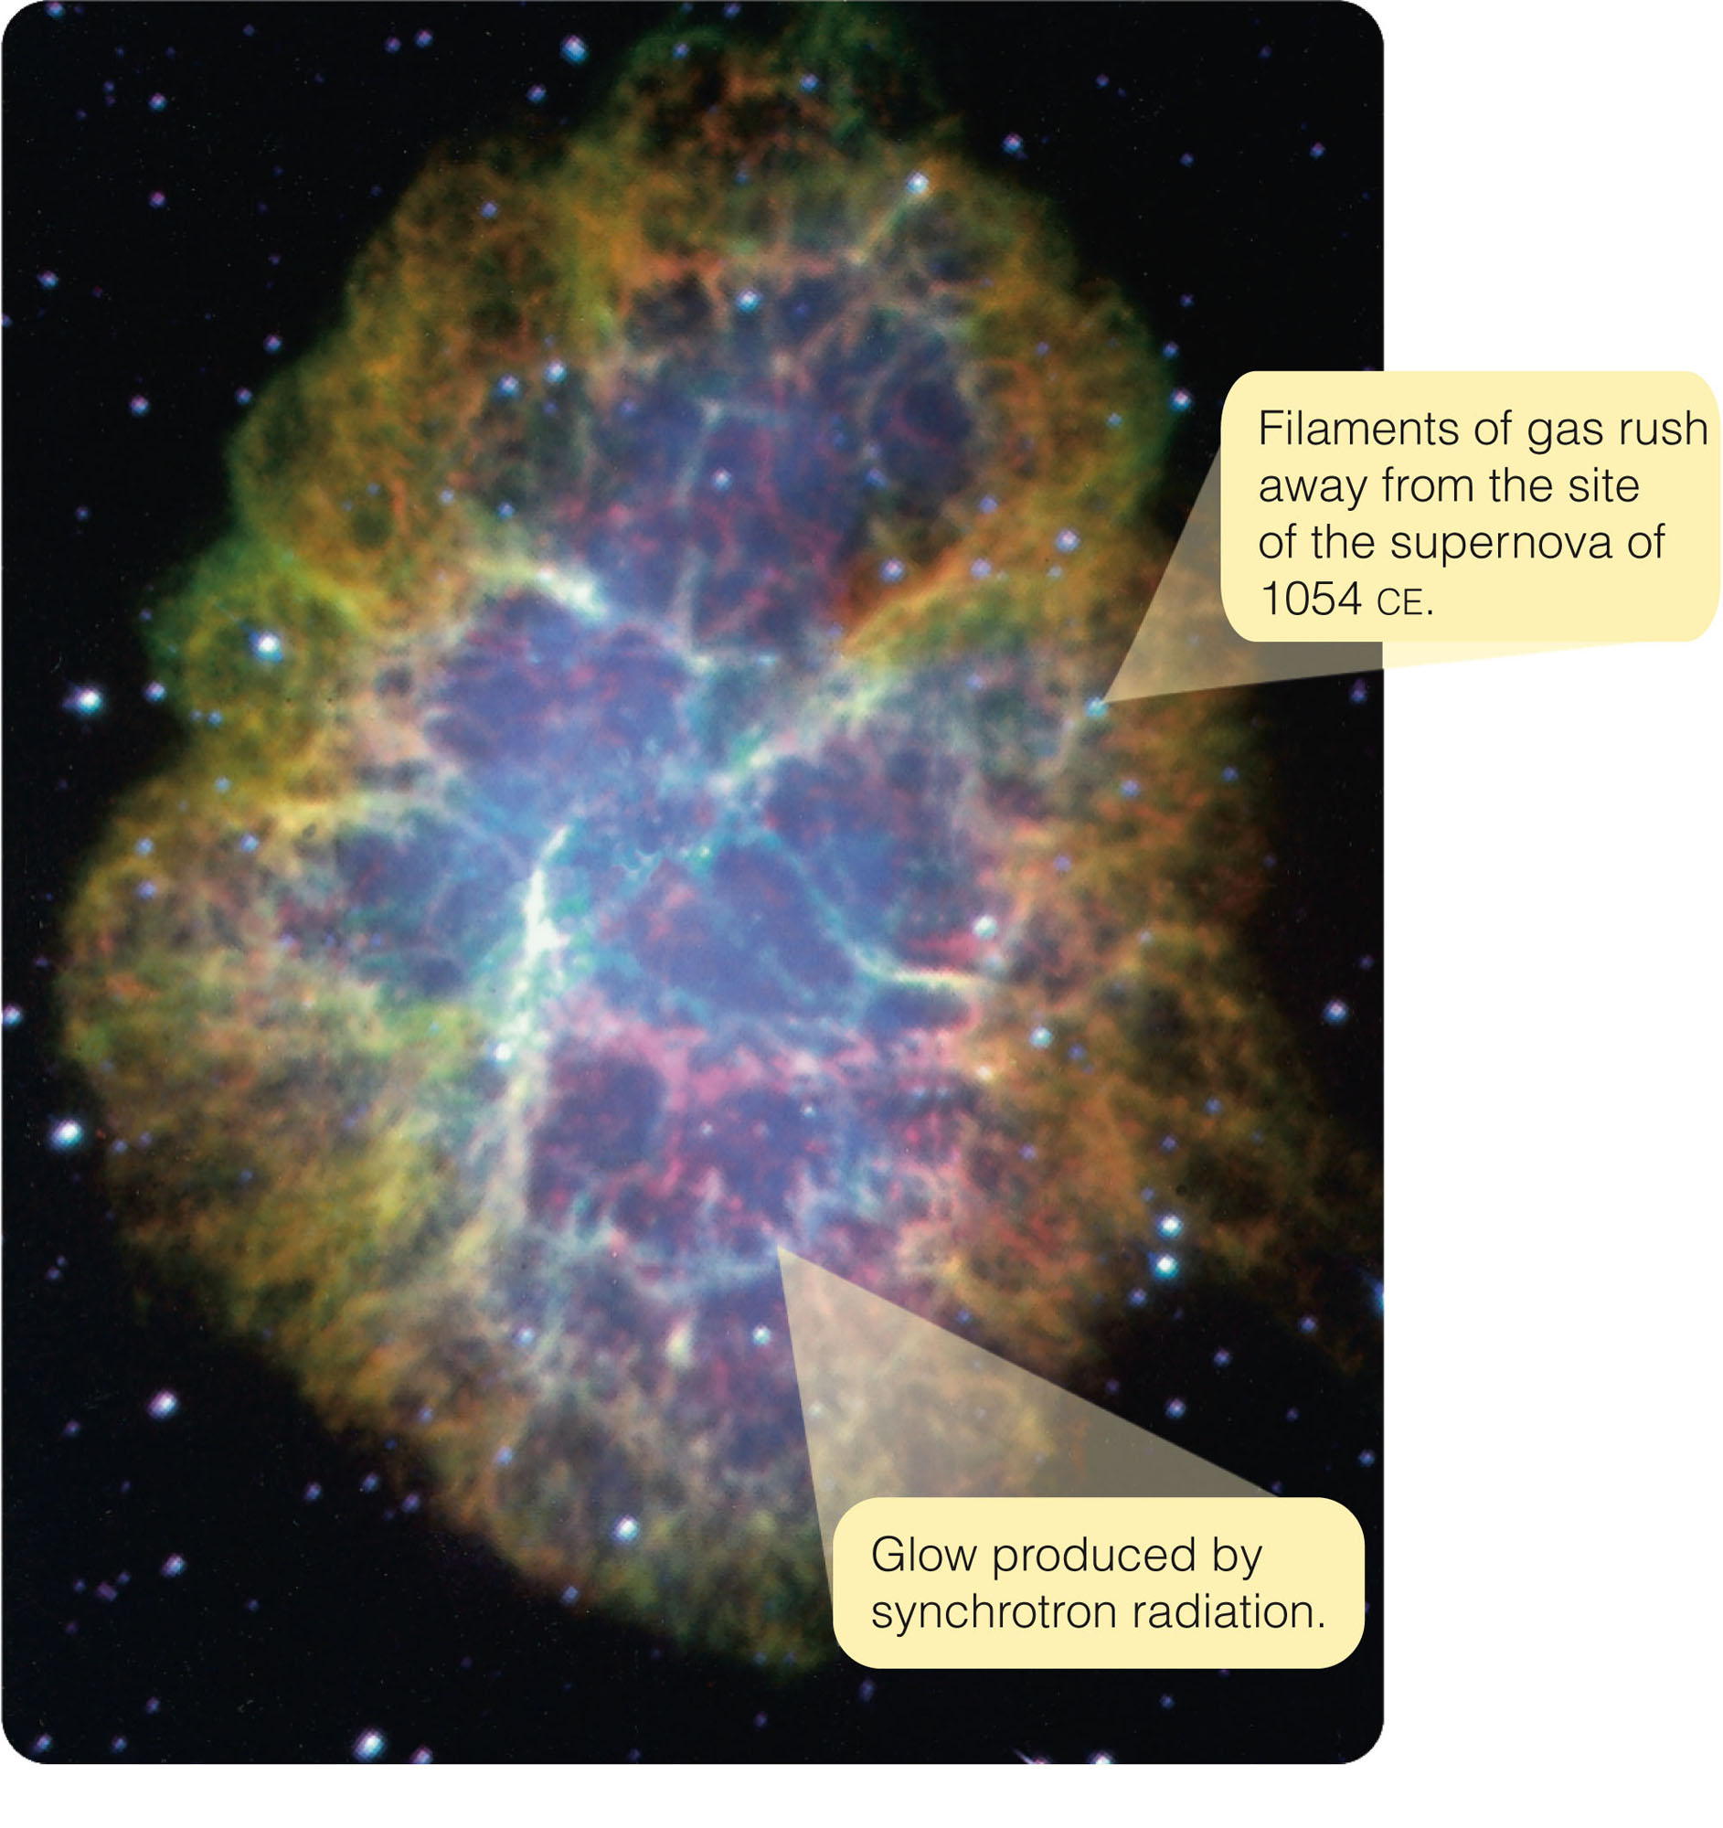
Observations of Supernovae
When modern astronomers turned their telescopes to the location of the guest star, they found a peculiar nebula— now known as the Crab Nebula.

Slide 42
Observations of Supernovae
The Crab Nebula is called so for its many-legged shape.
The ‘legs’ are filaments of gas that are moving away from the site of the explosion at about 1,400 km/s.

Slide 43
Observations of Supernovae
Comparing the nebula’s radius, 1.35 pc, with its velocity of expansion reveals that the nebula began expanding nine or ten centuries ago.
That is just when the
guest star made its visit.
Clearly, the nebula is the remains of the
supernova seen
in AD 1054.

Slide 44
Observations of Supernovae
Supernovae are rare—only a few have been seen with the naked eye in recorded history.
Arab astronomers saw one in AD 1006.
The Chinese saw one in AD 1054.
European astronomers observed two—one in AD 1572 (Tycho’s supernova) and one in AD 1604 (Kepler’s supernova).
In addition, the guest stars of AD 185, 386, 393, and 1181 may have been supernovae.

Slide 45
Observations of Supernovae
In the centuries following the invention of the astronomical telescope in 1609, no supernova was bright enough to be visible to the naked eye.

Slide 46
Observations of Supernovae
Type Ia supernovae, caused by the collapse of white dwarfs, are more luminous at maximum brightness.
They decline rapidly at first and then more slowly.
Type II supernovae, produced by the collapse of massive stars, are not as bright at maximum.
They decline in a more irregular way.

Slide 47
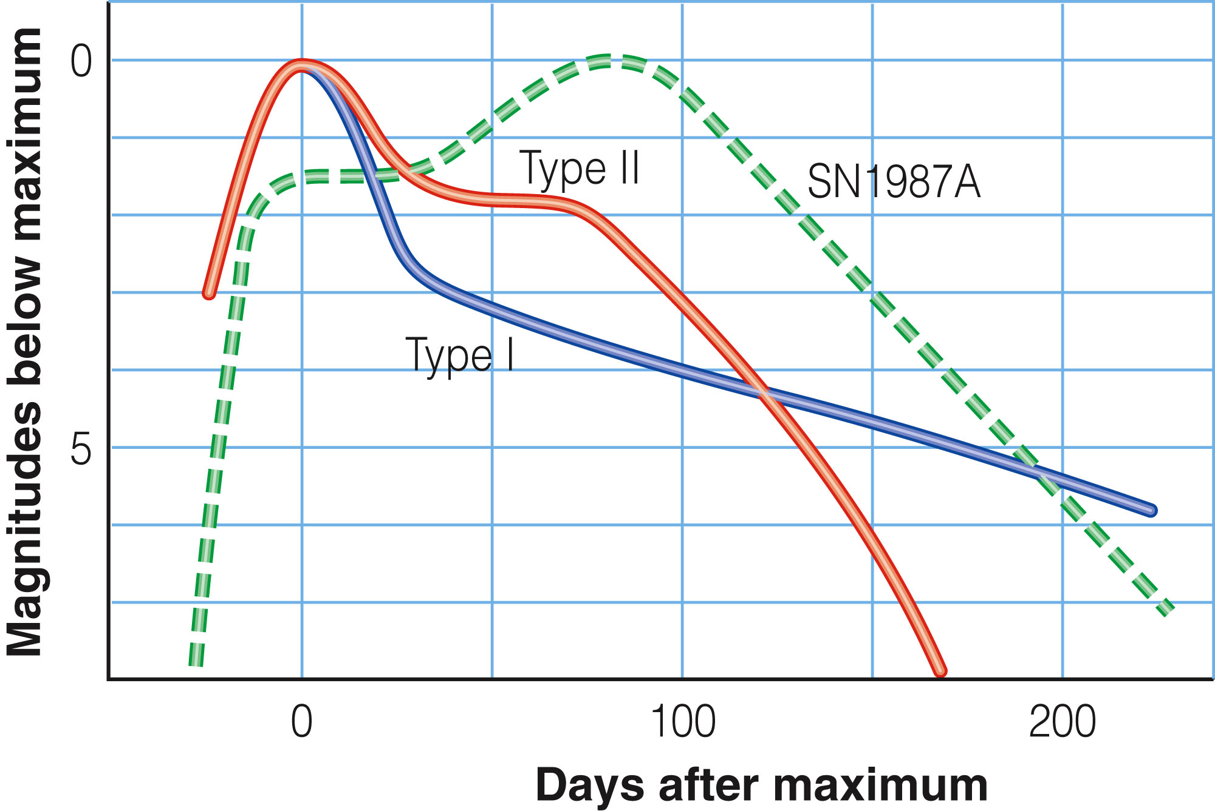
Observations of Supernovae
SN1987A was a type II supernova.
Its light curve is not typical, though.

Slide 48
Observations of Supernovae
Models indicate that most type II supernovae are caused by the collapse of red supergiants.
However, SN1987A was produced by the explosion of a hot, blue supergiant.
Astronomers hypothesize that the star was once a red supergiant but later contracted and heated up slightly—becoming smaller, hotter, and bluer before it exploded.

Slide 49
Observations of Supernovae
Although the supernova explosion fades to obscurity in a year or two, an expanding shell of gas marks the site of the explosion.
The gas—originally expelled at 10,000 to 20,000 km/s—may carry away a fifth of the mass of the exploding star.

Slide 50
Observations of Supernovae
The collision of the expanding gas with the surrounding interstellar medium can sweep up even more gas and excite it to produce a supernova remnant.
This comprises the nebulous remains of a supernova explosion.

Slide 51
Observations of Supernovae
When a star dies, it leaves behind one of three final types of final remnant:
White dwarf
Neutron star
Black hole

Slide 52
Observations of Supernovae
These objects are often called compact objects.
They are small monuments to the power of gravity.
Almost all the energy available has been squeezed out of compact objects.
You find them in their final, high-density states.

Slide 53
Neutron Stars
A neutron star contains a little over 1 solar mass compressed to a radius of about 10 km.
Its density is so high that the matter is stable only as a fluid of pure neutrons.

Slide 54
Theoretical Prediction of Neutron Stars
If the collapsing core is more massive than the Chandrasekhar limit of 1.4 solar masses, then the weight is too great to be supported by degenerate electron pressure.
The core cannot become a stable white dwarf.

Slide 55
Theoretical Prediction of Neutron Stars
The collapse would force protons to combine with electrons and become neutrons.
The envelope of the star would be blasted away in a supernova explosion.
The core of the star would be left behind as a small, tremendously dense sphere of neutrons.
Zwicky called this a ‘neutron star.’

Slide 56
Theoretical Prediction of Neutron Stars
Mathematical models predict that a neutron star will be only 10 or so kilometers in radius and have a density of about 10¹⁴ g/cm³.

Slide 57
Theoretical Prediction of Neutron Stars
This is roughly the density of atomic nuclei.
You can think of a neutron star as matter with all the empty space squeezed out of it.
On Earth, a sugar-cube-sized lump of this material would weigh 100 million tons—the mass of a small mountain.

Slide 58
Theoretical Prediction of Neutron Stars
Simple physics predicts that neutron stars should:
Spin rapidly—perhaps 100 to 1,000 rotations per second
Be hot—with surface temperatures of millions of degrees K
Have strong magnetic fields—up to a trillion times stronger than the sun’s or Earth’s magnetic fields

Slide 59
Theoretical Prediction of Neutron Stars
For example, the collapse of a massive star’s core would greatly increase its spin rate by conservation of angular momentum.
Other processes during core collapse should create high temperature and magnetic field strength.

Slide 60
Theoretical Prediction of Neutron Stars
The most widely accepted results suggest that a neutron star can’t be more massive than 2 to 3 solar masses.
An object more massive than that can’t be supported by degenerate neutron pressure.
So, it would collapse—presumably becoming a black hole.

Slide 61
Theoretical Prediction of Neutron Stars
What size stars will end their lives with supernova explosions that leave behind neutron star corpses?
Theoretical calculations suggest that stars that begin life on the main sequence with 8 to about 15 solar masses will end up as neutron stars.
Stars more massive than about 15 solar masses are believed to form black holes when they die.

Slide 62
The Discovery of Pulsars
The short pulses and the discovery of the pulsar in the Crab Nebula are strong evidence that pulsars are neutron stars.

Slide 63
The Discovery of Pulsars
In a sense, the name pulsar is inaccurate.
A pulsar does not pulse (vibrate).

Slide 64
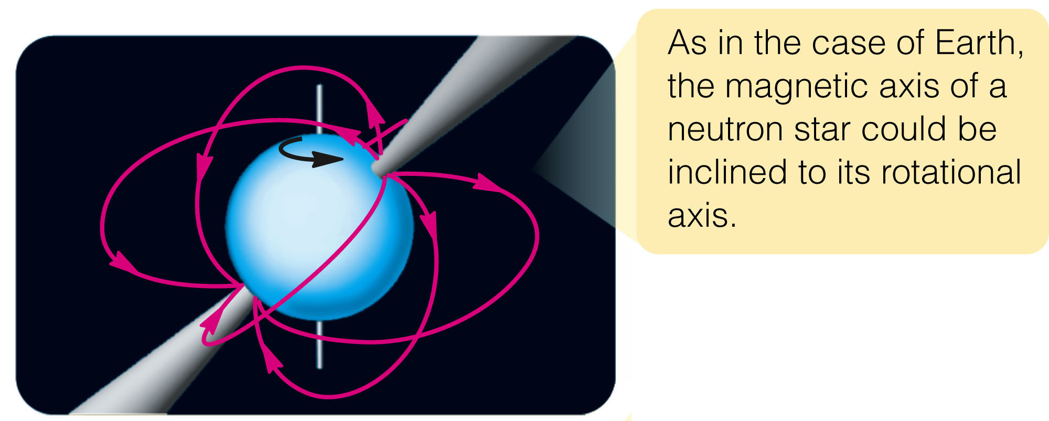
The Discovery of Pulsars
Rather, it emits beams of radiation that sweep around the sky as the neutron star rotates—like a rotating lighthouse light.
The modern model of a pulsar has been called the lighthouse model.

Slide 65
The Evolution of Pulsars
Supernova remnants last only about 50,000 years before they mix into the interstellar medium and disappear.
So, most pulsars have long outlived the remnants in which they were originally embedded.
You can expect that a young neutron star should emit especially strong beams of radiation powered by its rapid rotation.

Slide 66
Black Holes
The physics of black holes is difficult to discuss without sophisticated mathematics.
However, simple logic is sufficient to predict that they should exist.
The problem is to use their predicted properties and try to confirm that they exist.

Slide 67
Black Holes
What objects observed in the heavens could be real black holes?
More difficult than the search for neutron stars is the quest for black holes.
Nevertheless, it has met with success.

Slide 68
Black Holes
To begin, you must consider a simple question.
How fast must an object travel to escape from the surface of a celestial body?
The answer will lead to black holes.

Slide 69
Escape Velocity
Escape velocity is the initial velocity an object needs to escape from a celestial body.
It depends on two things:
Mass of the celestial body
Distance from the center of mass to the escapee’s starting point

Slide 70
Escape Velocity
If the celestial body has a large mass, its gravity is strong, and you need a high velocity to escape from its surface.
If you begin your journey farther from the center of mass, the velocity needed is less.

Slide 71
Escape Velocity
For example, to escape from Earth, a spaceship would have to leave Earth’s surface at 11 km/s (25,000 mph).
However, if you could launch spaceships from the top of a tower 1,000 miles high, the escape velocity would be only 8.8 km/s (20,000 mph).

Slide 72
Escape Velocity
An object massive enough and/or small enough could have an escape velocity greater than the speed of light.
Relativity says that nothing can travel faster than the speed of light.
So, even photons would be unable to escape.
This small, massive object could never be seen—light could not leave it.

Slide 73
Schwarzschild Black Holes
If the core of a star collapses and contains more than about 3 solar masses, no force can stop the collapse.

Slide 74
Schwarzschild Black Holes
When the object reaches the size of a white dwarf, the collapse continues—because degenerate electrons cannot support that much weight.
It also cannot stop when it reaches the even smaller size of a neutron star—because degenerate neutrons also cannot support that weight.
No force remains to stop the object from collapsing to zero radius.

Slide 75
Schwarzschild Black Holes
As an object collapses, its density and the strength of its surface gravity increase.
If it collapses to zero radius, its density becomes infinite.
Mathematicians call such a point a singularity.

Slide 76
Schwarzschild Black Holes
In physical terms, it is difficult to imagine an object of zero radius.
Some theorists believe that a singularity is impossible and that the laws of quantum physics must somehow halt the collapse at some subatomic radius roughly 10²⁰ times smaller than a proton.
Astronomically, it seems to make little difference.

Slide 77
Schwarzschild Black Holes
If the contracting core of a star becomes small enough, the escape velocity in the region around it is so large that no light can escape.
You can receive no information about the object or about the region of space near it.

Slide 78
Schwarzschild Black Holes
Such a region is called a black hole.
Note that the term black hole refers to a volume of space—not just the singularity at the region’s center.

Slide 79
Schwarzschild Black Holes
It is a common misconception to think of black holes as giant vacuum cleaners that will suck up everything in the universe.
A black hole is just a gravitational field.
At a reasonably large distance, its gravity is no greater than that of a normal object of similar mass.
If the sun were replaced by a 1-solar-mass black hole, the planets’ orbits would not change at all.

