Slide 1
Stellar Mass
Mass is the one characteristic that determines everything about a star
Temperature
Color
Brightness
Size
Length of its life
End of its life
White dwarf
Neutron star
Black hole

Slide 2
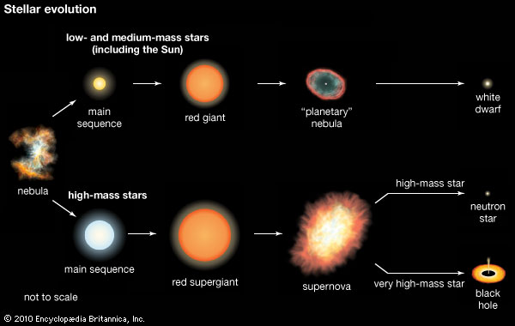

Slide 3
Astronomers occasionally see what seems to be a new star in the sky that grows brighter, then fades away after a few weeks or a year.

Slide 4
A nova—an apparently new star in the sky—is produced by an eruption around a stellar remnant.
A supernova—a particularly luminous and longlasting nova—is caused by the violent, explosive death of a star.
Modern astronomers find a few novae each year.
However, supernovae are so rare that only one or two happen each century in our galaxy.

Slide 5
You have learned that stars resist their own gravity by generating energy through nuclear fusion.
This energy keeps their interiors hot.
The resulting high pressure balances gravity and prevents the star from collapsing.

Slide 6
However, stars have limited fuel.
When they exhaust their fuel, gravity wins—the stars die.
The mass of a star is critical in determining its fate.
Massive stars use up their nuclear fuel at a furious rate and die after only a few million years.
In contrast, the lowest-mass stars use their fuel sparingly and may be able to live hundreds of billions of years.
Stars with different masses lead dramatically different lives and die in different ways

Slide 7
Stars with about the same mass as the sun
Remnant less then 1.44 solar masses
Planetary nebula, white dwarf
High mass stars, greater than about 10 solar masses
Remnant between about 1.44 and 3 solar masses
Supernova, neutron star
High mass stars, greater than about 10 solar masses
Remnant greater than about 3 solar masses
Supernova, black hole
http://www.umich.edu/~gs265/star.htm

Slide 8
Low mass stars
✤ Red dwarfs 0.1 the mass of the sun
Will burn for trillions of years
Not enough mass to burn helium
Will not become a planetary nebula
Will just become a white dwarf
✤ No such stars, yet, the universe is too young

Slide 9
Giant Stars
A main-sequence star generates its energy by nuclear fusion reactions that combine hydrogen to make helium.
A star remains on the main sequence for a time span equal to 90 percent of its total existence as an energy-generating star.

Slide 10
Giant Stars
When the hydrogen is exhausted, however, the star begins to evolve rapidly.
It swells into a giant star and then begins to fuse helium into heavier elements.
However, it can remain in this giant stage for only about 10 percent of its total lifetime—then, it must die.
The giant-star stage is the first step in the death of a star.

Slide 11
Expansion into a Giant
The nuclear reactions in a main-sequence star’s core produce helium.
Helium can fuse into heavier elements only at temperatures higher than 100,000,000 K.
No main-sequence star has a core that hot.
So, helium accumulates at the star’s center—like ashes in a fireplace.

Slide 12
Expansion into a Giant
Initially, this helium ash has little effect on the star.
As hydrogen is exhausted and the stellar core becomes almost pure helium, the star’s ability to generate nuclear energy is reduced.
As the energy generated at the center is what opposes gravity and supports the star, the core begins to contract as soon as energy generation starts to decline.

Slide 13
Expansion into a Giant
The core of helium ash cannot generate nuclear energy.
Nevertheless, it can grow hotter—because it contracts and converts gravitational energy into thermal energy.
The rising temperature heats the unprocessed hydrogen just outside the core—hydrogen that was never previously hot enough to fuse.

Slide 14
Expansion into a Giant
When the temperature of the surrounding hydrogen becomes high enough, hydrogen fusion begins in a spherical layer—called a shell—surrounding the exhausted core of the star.
Like a grass fire burning outward from an exhausted campfire, the hydrogen-fusion shell creeps outward.
It leaves behind helium ash and increases the mass of the helium core.

Slide 15
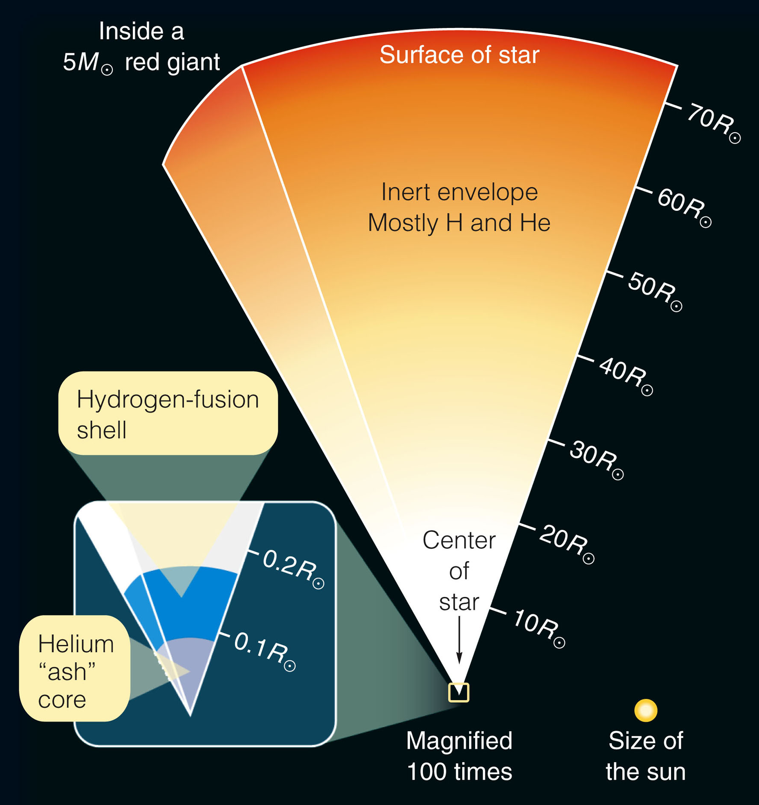
Expansion into a Giant
The flood of energy produced by the hydrogen-fusion shell pushes toward the surface.
It heats the outer layers of the star—forcing them to expand dramatically.

Slide 16
Expansion into a Giant
Stars like the sun become giant stars of 10 to 100 times the sun’s present diameter.
The most massive stars become supergiant stars as much as 1,000 times larger than the sun.

Slide 17
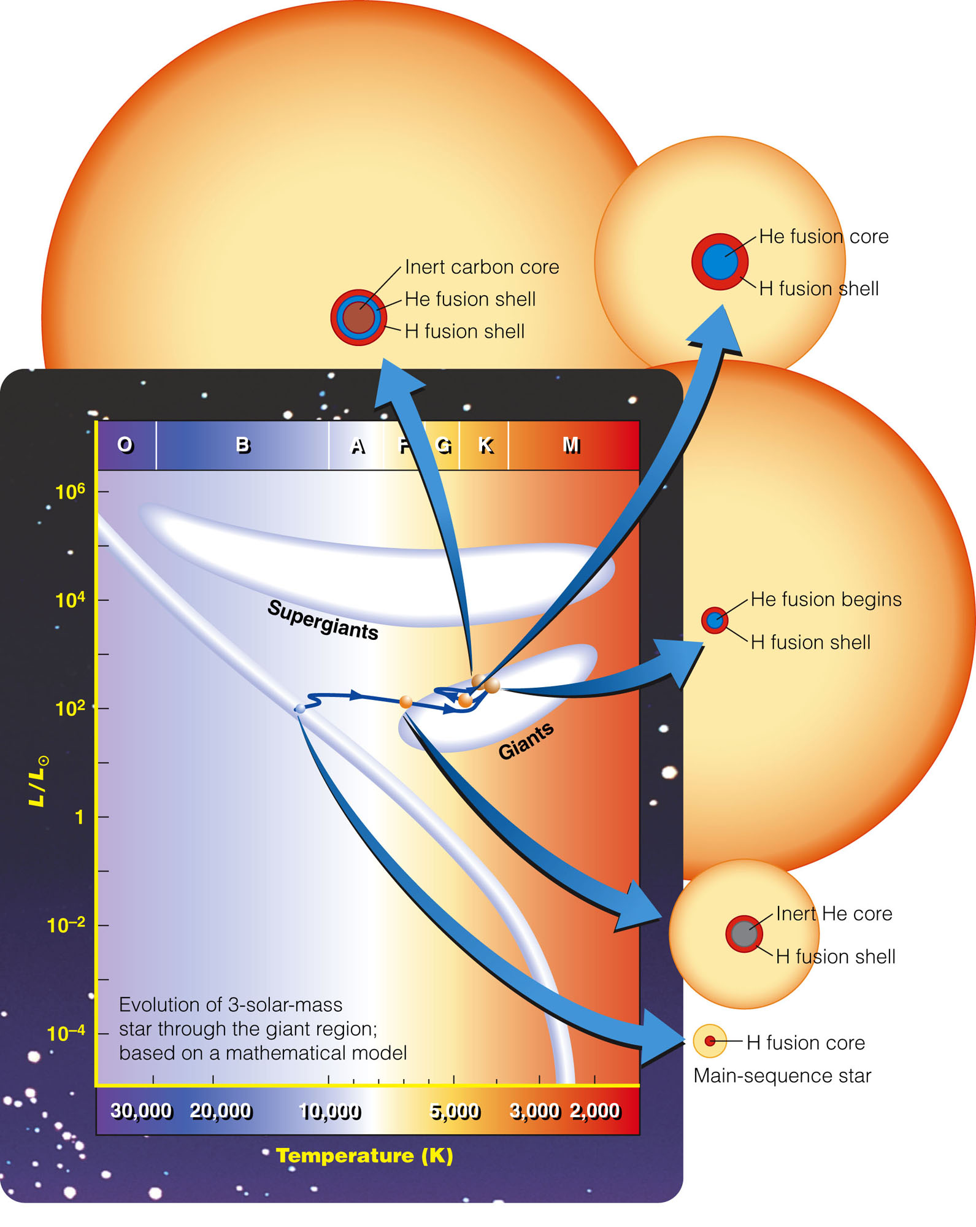
Expansion into a Giant
The expansion of a star to giant or supergiant size cools the star’s outer layers.
So, the stars move toward the upper right in the H-R diagram.

Slide 18
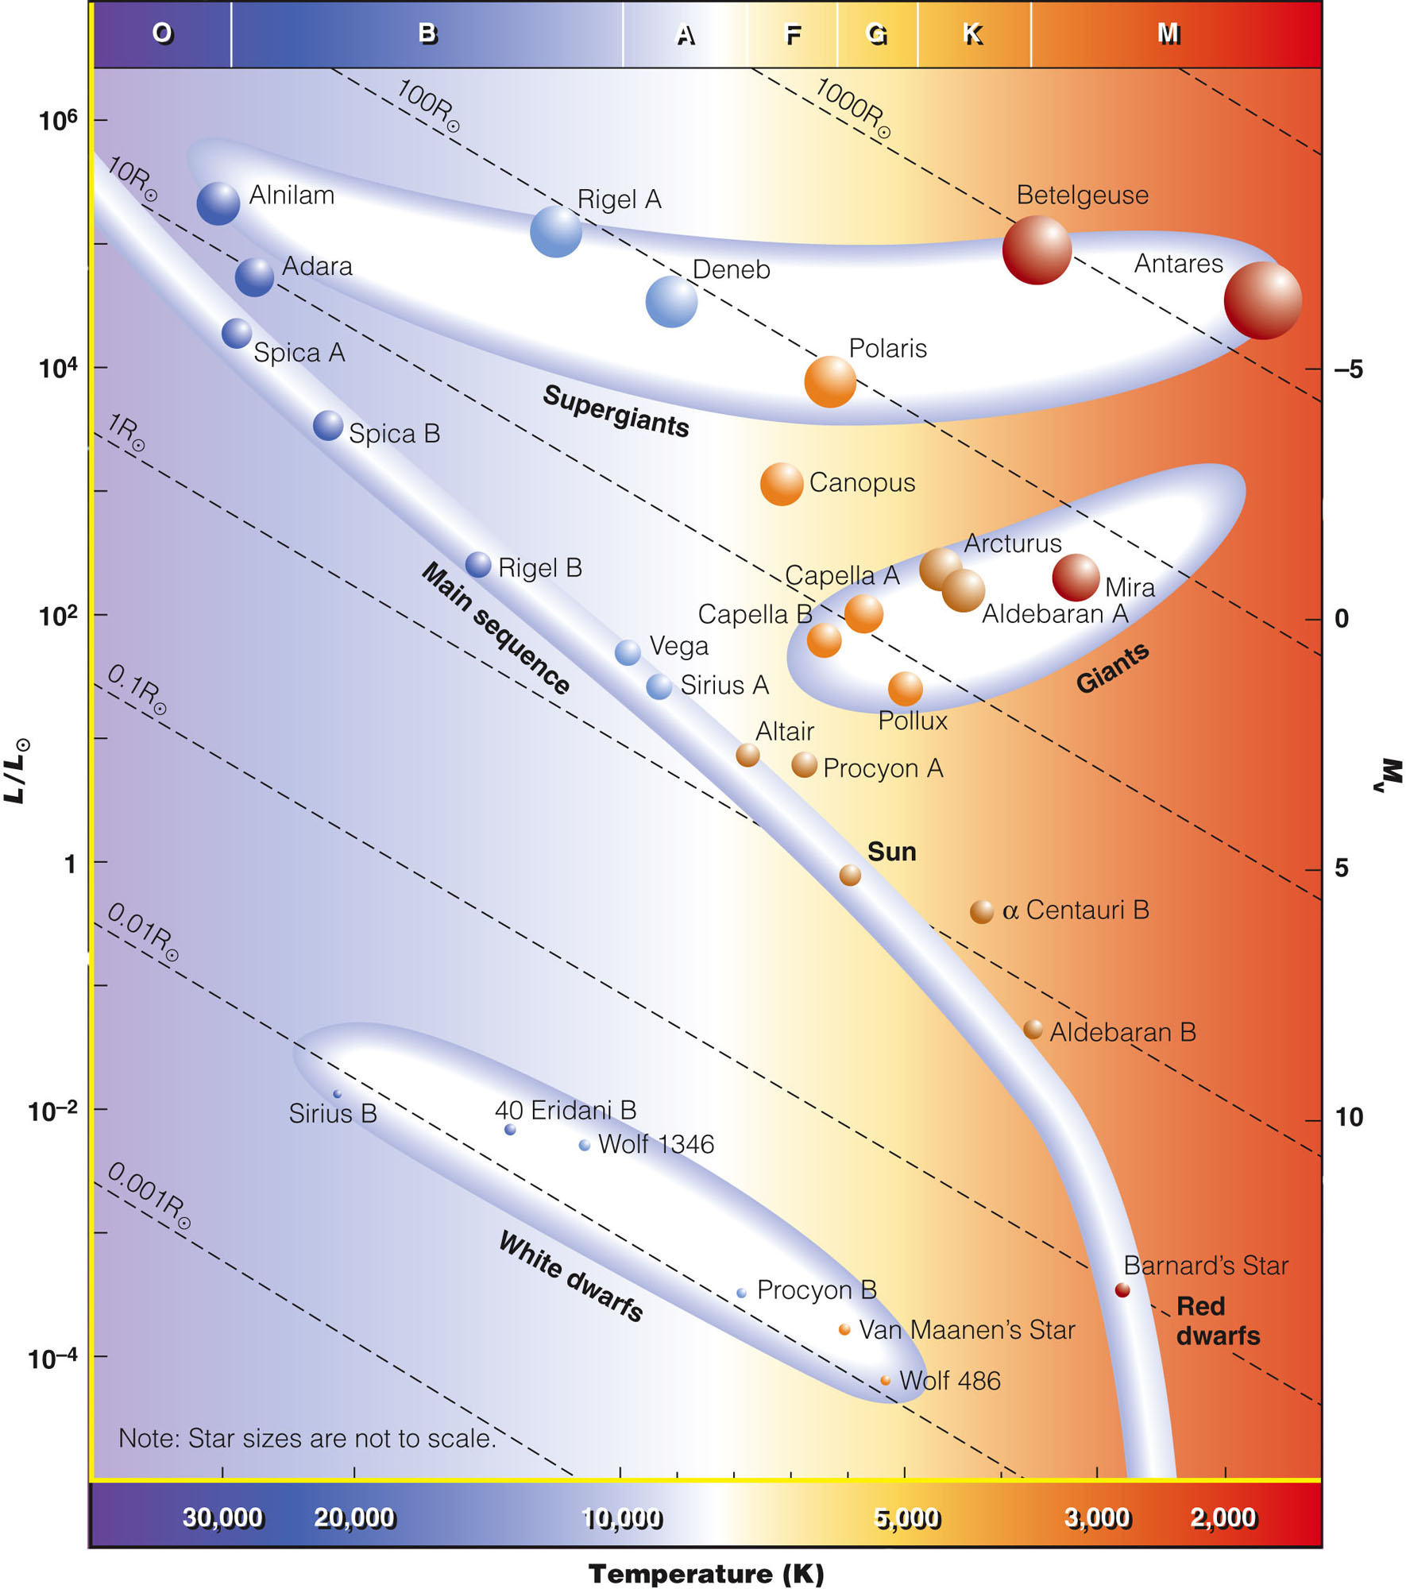
Expansion into a Giant
Notice that some of the most familiar stars—such as Aldebaran, Betelgeuse and Polaris—are giants or supergiants.

Slide 19
Expansion into a Giant
The energy output of the hydrogen-fusion shell can force the envelope of the star to expand.
However, it cannot stop the contraction of the helium core.
As the core is not hot enough to fuse helium, gravity squeezes it to a relatively tiny size.

Slide 20
Helium Fusion
As a star becomes a giant, fusing hydrogen in a shell, the inert core of helium ash contracts and grows hotter.
When the core finally reaches a temperature of 100,000,000 K, helium nuclei can begin fusing to make carbon nuclei.

Slide 21
Helium Fusion
The ignition of helium in the core changes the structure of the star.
The star now makes energy in two different locations and two different processes:
Helium fusion in the core
Hydrogen fusion in the surrounding shell

Slide 22
Helium Fusion
The energy flowing outward from the core halts the contraction of the core.
At the same time, the star’s envelope contracts and grows hotter.

Slide 23
Helium Fusion
The point representing the star in the H–R diagram moves downward—corresponding to lower luminosities.
It also moves to the left— corresponding to higher surface temperatures.

Slide 25
Helium Fusion
It moves to a region above the main sequence called the horizontal branch.
Astronomers sometimes refer to these stars as ‘yellow giants.’

Slide 26
Helium Fusion
Helium fusion produces carbon and oxygen that accumulate in an inert core.
Once again, the core contracts and heats up, and a helium-fusion shell ignites below the hydrogen-fusion shell.
The star now makes energy in two fusion shells.
So, it quickly expands, and its surface cools once again.

Slide 27
Helium Fusion
The point representing the star in the H-R diagram moves back to the right—completing a loop to become a red giant again.

Slide 28
Helium Fusion
The rule is as follows.
If the core of a post-main-sequence star is ‘dead’ (has no nuclear reactions), the star is a red giant.
If the core is ‘alive’ (has fusion reactions), the star is a yellow giant.

Slide 29
Helium Fusion
Now, you can understand why giant stars are so rare.
A star spends about 90 percent of its lifetime on the main sequence and only 10 percent as a giant star.
At any moment you look, only a fraction of the visible stars will be passing through the red and yellow giant stages.

Slide 30
Helium Fusion
What happens to a star after helium fusion depends on its mass.
In any event, though, it cannot survive long.
It must eventually collapse and end its career as a star.
The remainder of the chapter will trace the details of the process of stellar death.

Slide 31
Helium Fusion
Before you begin that story, you must ask the most important question in science.
What is the evidence?

Slide 32
Helium Fusion
What evidence shows that stars actually evolve as theories predict?
You can find the answers in observations of star clusters.

Slide 33
Star Clusters: Evidence of Evolution
Astronomers look at star clusters and say, “Aha! Evidence to solve a mystery.”
The stars in a star cluster all formed at about the same time and from the same cloud of gas.
So, they must be about the same age and composition.

Slide 34
Star Clusters: Evidence of Evolution
Each star cluster freeze-frames and makes visible a moment in stellar evolution.
The differences you see among stars in one cluster must arise from differences in their masses.

Slide 35
Star Clusters: Evidence of Evolution
There are three important points to note about star clusters.

Slide 36
Star Clusters: Evidence of Evolution
One, there are two kinds of clusters.
However, they are similar in the way their stars evolve.

Slide 37
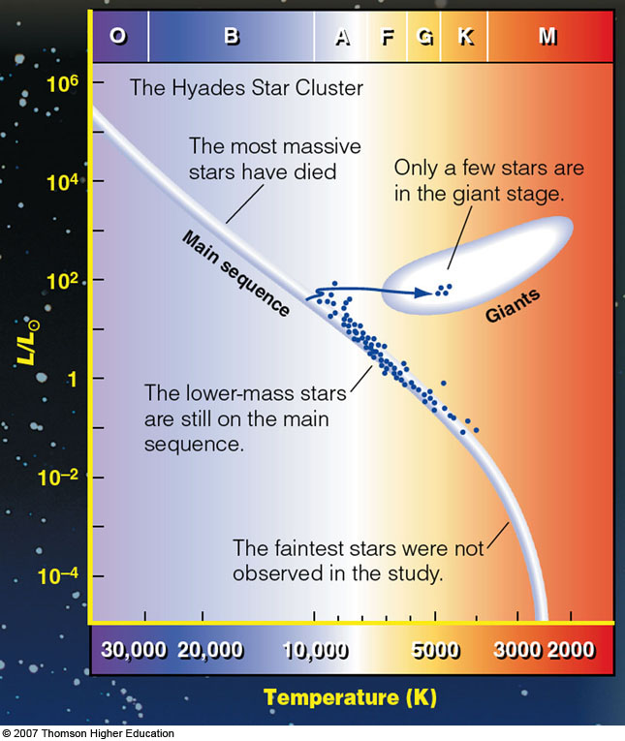
Star Clusters: Evidence of Evolution
Two, you can estimate the age of a cluster by observing the distribution of the points that represent its stars in the H-R diagram.

Slide 38
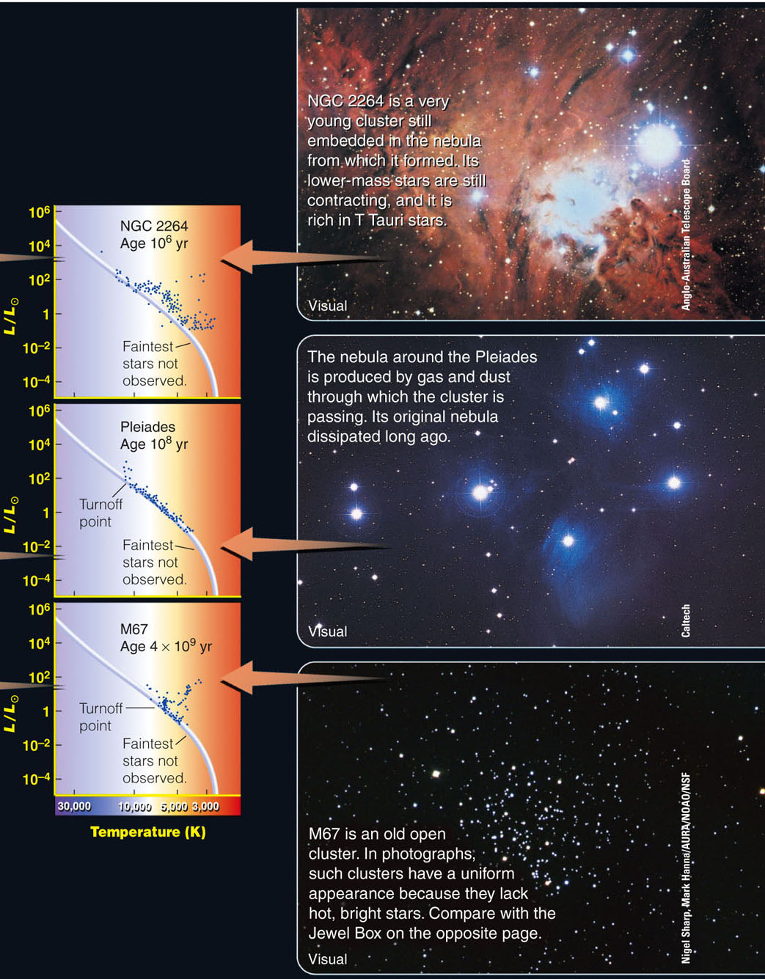
Star Clusters: Evidence of Evolution
Three, the shape of the H-R diagram of a cluster is governed by the evolutionary path the stars take.

Slide 39
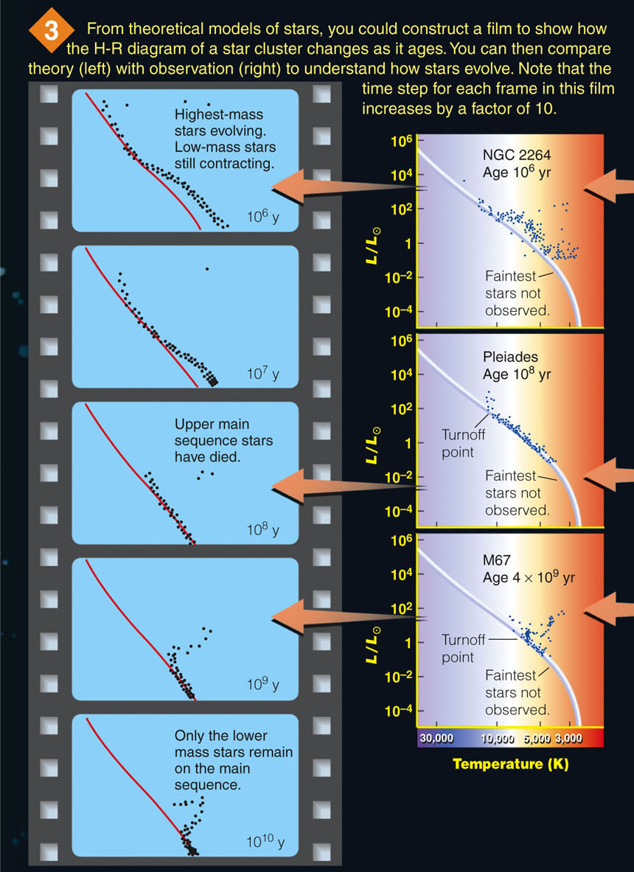
Star Clusters: Evidence of Evolution
By comparing clusters of different ages, you can visualize how stars evolve—almost as if you were watching a film of a star cluster evolving over billions of years.

Slide 40
Star Clusters: Evidence of Evolution
Were it not for star clusters, astronomers would have little confidence in the theories of stellar evolution.

Slide 41
Star Clusters: Evidence of Evolution
Star clusters make that evolution visible and assure astronomers that they really do understand how stars are born, live, and die.

Slide 42
The Deaths of Low-Mass Stars
Contracting stars heat up by converting gravitational energy into thermal energy.
Low-mass stars have little gravitational energy.
So, when they contract, they can’t get very hot.
This limits the fuels they can ignite.

Slide 43
The Deaths of Low-Mass Stars
You have learned that protostars less massive than 0.08 solar mass cannot get hot enough to ignite hydrogen.
This section will concentrate on stars more massive than 0.08 solar mass but no more than about 4 times the mass of the sun.

Slide 44
The Deaths of Low-Mass Stars
Structural differences divide the lower-main-sequence stars into two subgroups:
Very-low-mass red dwarfs
Medium-mass stars such as the sun

Slide 45
The Deaths of Low-Mass Stars
The critical difference between the two groups is:
Extent of interior convection

Slide 46
Red Dwarfs
The red dwarfs are stars less massive than about 0.4 solar mass.
They have two important differences from more massive stars.

Slide 47
Red Dwarfs
One, as they have very small masses, they have very little weight to support.
Their pressure–temperature thermostats are set low, and they consume their hydrogen fuel very slowly.
You have learned that the discussion of the life expectancies of stars predicted that red dwarfs have very long lives.

Slide 48
Red Dwarfs
Two, they are completely convective.
That is, they are stirred by circulating currents of hot gas rising from the interior and cool gas sinking inward—extending all the way from their cores to their surfaces.
The interiors of these stars are mixed like a pot of soup that is constantly stirred as it cooks.

Slide 49
Red Dwarfs
Hydrogen is consumed and helium accumulates uniformly throughout the star.
Thus, the star is not limited only to the fuel in its core.
It can use all its hydrogen to prolong its life on the main sequence.

Slide 50
Red Dwarfs
As a red dwarf is mixed by convection, it cannot develop an inert helium core surrounded by unprocessed hydrogen.
So, it never ignites a hydrogen shell and cannot become a giant star.
Rather, nuclear fusion converts hydrogen into helium.
However, the helium does not fuse into heavier elements because the star can never get hot enough.

Slide 51
Red Dwarfs
What astronomers know about stellar evolution indicates that these red dwarfs should use up nearly all their hydrogen and live very long lives on the lower main sequence.
They could survive for a hundred billion years or more.

Slide 52
Red Dwarfs
Of course, astronomers can’t test this part of their theories because the universe is only about 13.7 billion years old.
So, not a single red dwarf has died of old age anywhere in the universe.
Every red dwarf that has ever been born is still glowing today.

Slide 53
Medium-Mass (Sunlike) Stars
Stars like the sun can ignite hydrogen and helium and become giants.
However, if they contain less than 4 solar masses, they cannot get hot enough to ignite carbon—the next fuel after helium.
Note that this mass limit is uncertain—as are many of the masses quoted here.
The evolution of stars is highly complex, and such parameters are difficult to specify.

Slide 54
Medium-Mass (Sunlike) Stars
There are two keys to the evolution of these sunlike stars:
Lack of complete mixing
Mass loss

Slide 55
Medium-Mass (Sunlike) Stars
The interiors of medium-mass stars are not completely mixed because, unlike the red dwarf stars, they are not completely convective.

Slide 56
Medium-Mass (Sunlike) Stars
The helium ash accumulates in an inert helium core surrounded by unprocessed hydrogen.
When this core contracts, the unprocessed hydrogen ignites in a shell and swells the star into a red giant.
When the helium core finally ignites, the star becomes a yellow giant.

Slide 57
Medium-Mass (Sunlike) Stars
When the core fills up with carbon–oxygen ash, that is the end of fusion for stars in the medium-mass range.
This is because they have masses too low to make their cores hot enough to ignite carbon or oxygen fusion.
The carbon–oxygen core is the dead end for these stars.

Slide 58
Medium-Mass (Sunlike) Stars
All of this discussion is based on theoretical models of stars and a general understanding of how stars evolve.
Does it really happen?

Slide 59
Medium-Mass (Sunlike) Stars
Astronomers need observational evidence to confirm this theoretical discussion.
The gas that is expelled from these giant stars gives visible evidence that sunlike stars have gone through these stages of nucleosynthesis and do indeed die in this way.

Slide 60
Planetary Nebulae
When a medium-mass star like the sun becomes a distended giant, its atmosphere becomes cool and thus more opaque—light has to push against it to escape.
At the same time, the fusion shells become thin and unstable, and they begin to flare—which pushes the atmosphere outward.

Slide 61
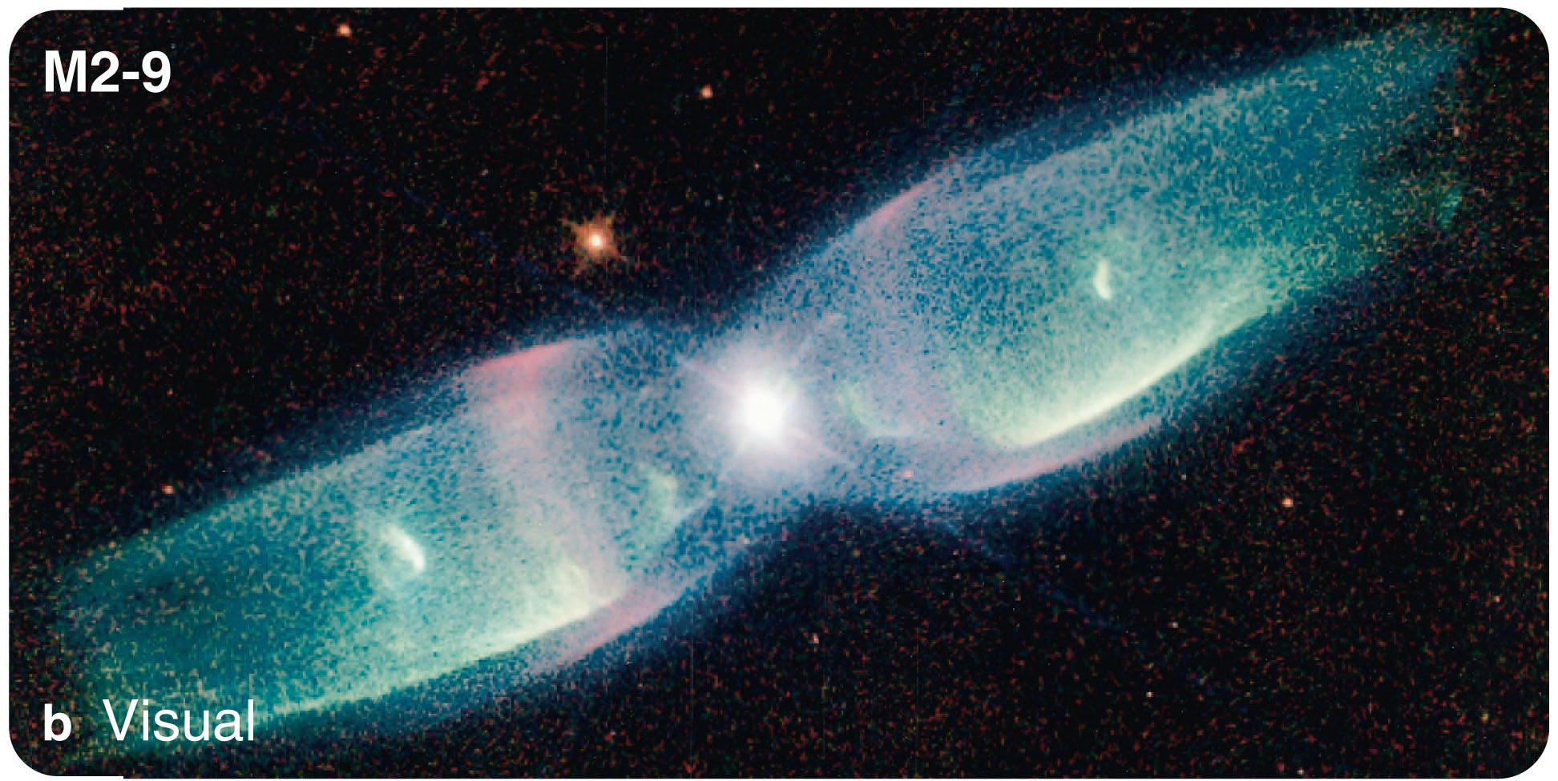
Planetary Nebulae
An aging giant can expel its outer atmosphere in repeated surges to form one of the most interesting objects in astronomy:
A planetary nebula

Slide 62
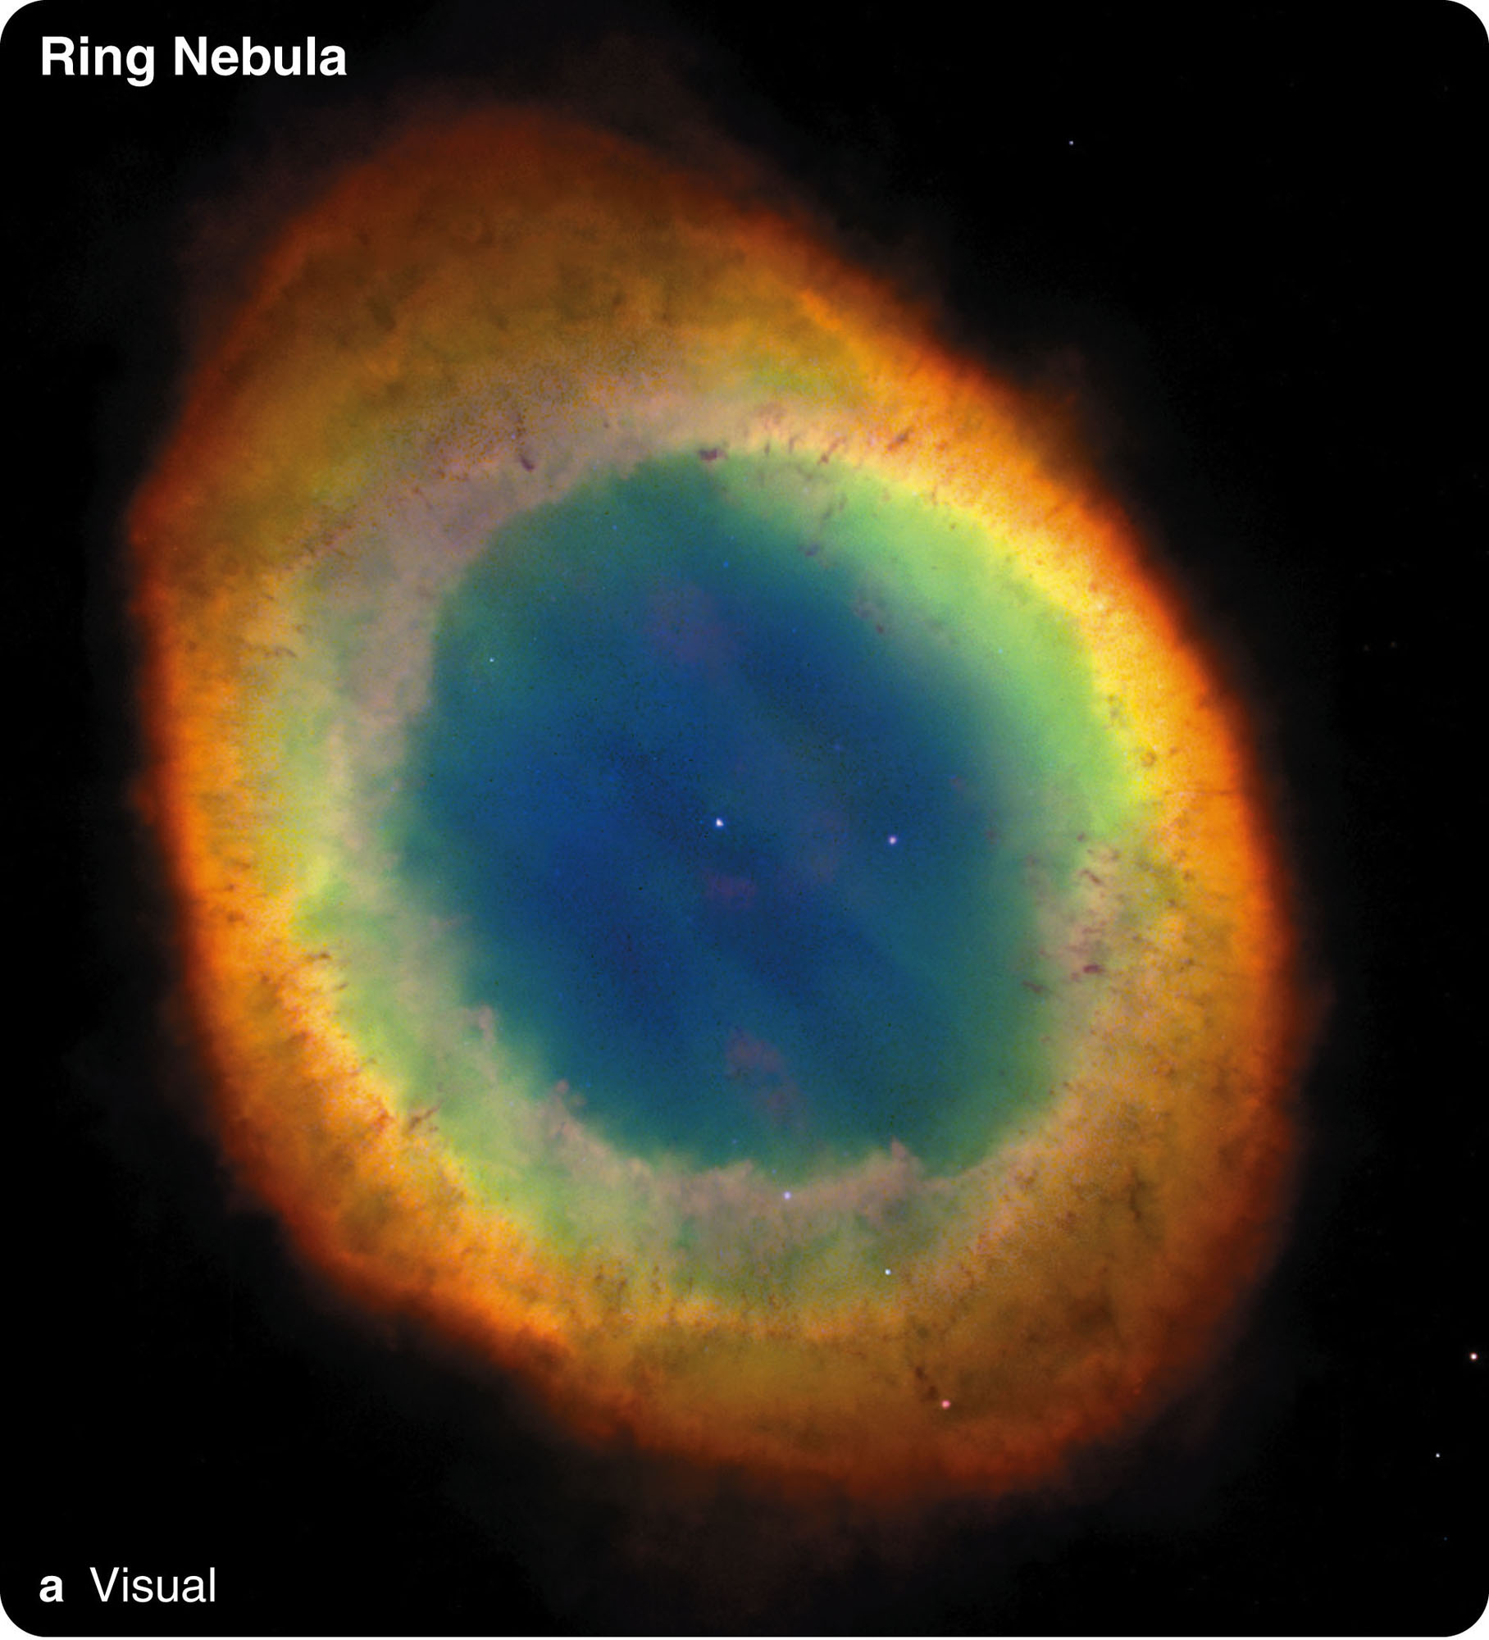
Planetary Nebulae
A planetary nebula is called so because the first ones discovered looked like the greenish-blue disk of a planet such as Uranus or Neptune.
However, it has nothing to do with a planet.
It is composed of ionized gases expelled by a dying star.

Slide 63
Planetary Nebulae
You can understand what planetary nebulae are like by using simple observations and theoretical methods such as:
Kirchhoff ’s laws
Doppler effect

Slide 64
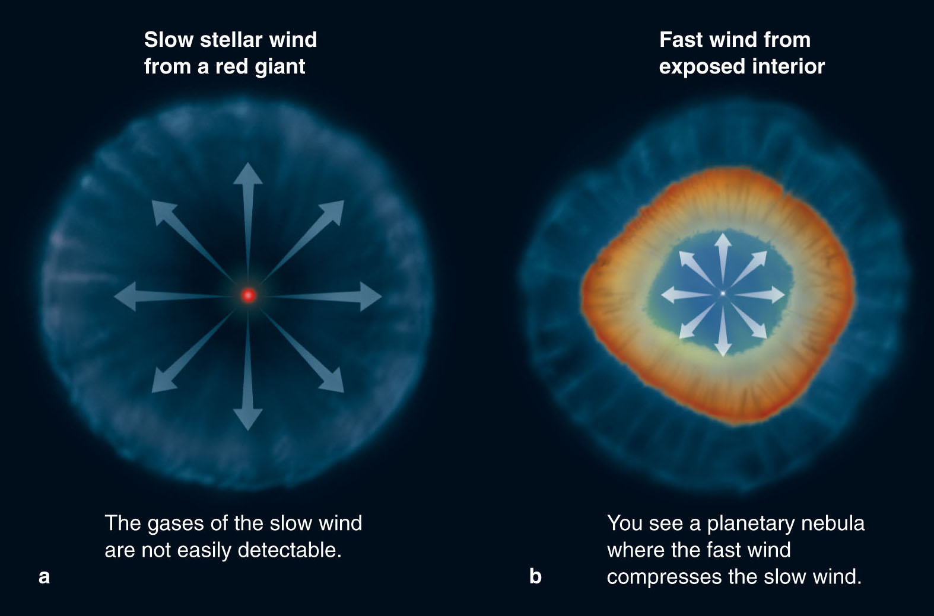
Planetary Nebulae
Real nebulae are quite complex.
However, a simple model of a slow stellar wind followed by a fast wind explains their structures fairly well and provides a way to organize the observed phenomena.

Slide 65
Planetary Nebulae
The complexities and asymmetries seen in planetary nebulae may be due to repeated expulsions of expanding shells and oppositely directed jets—much like bipolar flows observed coming from protostars.

Slide 66
Planetary Nebulae
Observations and stellar evolution models indicate:
The central star of a planetary nebula star finally must contract and become a white dwarf.

Slide 67
White Dwarfs
As you have just learned, medium-mass stars die by ejecting gas into space and contracting into white dwarfs.
When you surveyed the stars, you learned that white dwarfs are the second most common kind of star. (Only red dwarfs are more abundant.)
The billions of white dwarfs in our galaxy must be the remains of medium-mass stars.

Slide 68
White Dwarfs
The first white dwarf discovered was the faint companion to the well-known star Sirius.
Sirius, the brightest star in the sky, is a visual binary star, the most luminous member of which is Sirius A.
The white dwarf, Sirius B, is 10,000 times fainter than Sirius A.

Slide 69
White Dwarfs
The orbital motions of the stars reveal that the white dwarf ’s mass is 0.98 solar mass.
Its blue-white color informs you that its surface is hot—about 45,000 K.

Slide 70
White Dwarfs
Although it is very hot, it has a very low luminosity.
So, it must have a small surface area.
In fact, it is about the size of Earth.

Slide 71
White Dwarfs
Dividing its mass by its volume reveals that it is very dense—about 2 x 10⁶ g/cm³.
On Earth, a teaspoonful of Sirius B material would weigh more than 11 tons.
Thus, basic observations and simple physics lead to the conclusion that white dwarfs are astonishingly dense.

Slide 72
White Dwarfs
A normal star is supported by energy flowing outward from its core.
A white dwarf, however, cannot generate energy by nuclear fusion.
It has exhausted its hydrogen and helium fuels and produced carbon and oxygen.

Slide 73
White Dwarfs
As the star collapses into a white dwarf, it converts gravitational energy into thermal energy.
Its interior becomes very hot.
However, it cannot get hot enough to fuse carbon into heavier elements.

Slide 74
White Dwarfs
The contraction of a white dwarf compresses the gases in its interior to such high densities that quantum mechanical laws become important—and the electrons in the gas cannot get closer together.
Such a gas is termed degenerate matter.

Slide 75
White Dwarfs
It takes on two properties that are important in understanding the structure and evolution of dying stars.
A degenerate gas is millions of times harder to compress than solid steel.
The pressure in the gas no longer depends on the temperature.

Slide 76
White Dwarfs
Unlike a normal star, which is supported by ordinary gas pressure, a white dwarf is supported against its own gravity by the resistance to compression of a degenerate gas.

Slide 77
White Dwarfs
Clearly, a white dwarf is not a true star.
It generates no nuclear energy.
It is almost completely degenerate matter.
Except for a thin layer at its surface, it contains no gas.

Slide 78
White Dwarfs
Instead of calling it a ‘star,’ you can call it a compact object.
The next sections of the chapter discuss two other types of compact object—neutron stars and black holes.

Slide 79
White Dwarfs
A white dwarf’s future is bleak.
As it radiates energy into space, its temperature gradually falls.
It cannot shrink any smaller, though, because its degenerate electrons cannot get closer together.

Slide 80
White Dwarfs
This degenerate matter is a very good thermal conductor.
So, heat flows to the surface and escapes into space.
The white dwarf gets fainter and cooler—moving downward and to the right in the H-R diagram.

Slide 81
White Dwarfs
As the white dwarf contains a tremendous amount of heat, it needs billions of years to radiate that heat through its small surface area.
The coolest white dwarfs in our galaxy are about the temperature of the sun.

Slide 82
White Dwarfs
Perhaps the most interesting thing astronomers have learned about white dwarfs has come from mathematical models.
The equations predict that degenerate electron pressure cannot support an object with more than about 1.4 solar masses.
A white dwarf with that mass would have such strong gravity that its radius would shrink to zero.

Slide 83
White Dwarfs
This is called the Chandrasekhar limit.
It is named after Subrahmanyan Chandrasekhar, the astronomer who calculated it.
The Chandrasekhar limit seems to imply that a star more massive than 1.4 solar masses could not become a white dwarf—unless it got rid of the extra mass in some way.

Slide 84
White Dwarfs
Can stars lose substantial amounts of mass?
Observations provide clear evidence that young stars have strong stellar winds, and aging giants and supergiants also lose mass.
This suggests that stars more massive than the Chandrasekhar limit can eventually end up as white dwarfs—if they reduce their mass under the limit.

Slide 85
White Dwarfs
Theoretical models show that stars that begin life with as much as 8 solar masses could lose mass fast enough to collapse to form white dwarfs with masses below 1.4 solar masses.
With mass loss, a wide range of medium-mass stars can eventually die as white dwarfs.

Slide 86
The Fate of the Sun and the End of Earth
Astronomy is about you.
Although the chapter has been dealing with the deaths of medium-mass stars, it has also been discussing the future of Earth.
The sun is a medium-mass star and must eventually die by becoming a giant, possibly producing a planetary nebula, and collapsing into a white dwarf.
That will spell the end of Earth.

Slide 87
The Fate of the Sun and the End of Earth
Evolutionary models of the sun suggest that it may survive for another 6 billion years or so.
In about 5 billion years, it will exhaust the hydrogen in its core, begin burning hydrogen in a shell, and swell into a red giant star about 30 times its present radius.

Slide 88
The Fate of the Sun and the End of Earth
Later, helium fusion will ignite in the core and the sun will become a horizontal branch star.
Once the helium fuel is exhausted in its core, helium fusion will begin in a shell, and the sun will expand again.
That second red giant version of the sun will be about as large as the orbit of Earth.
Before that, the sun’s increasing luminosity will certainly evaporate Earth’s oceans, drive away the atmosphere, and even vaporize much of Earth’s crust.

Slide 89
The Fate of the Sun and the End of Earth
Astronomers are still uncertain about some of the details, but computer models that include tidal effects predict:
the expanding sun eventually will engulf and destroy Mercury, Venus, and Earth.
While it is a giant star, the sun will have a strong wind and lose a substantial fraction of its mass into space.

Slide 90
The Fate of the Sun and the End of Earth
The atoms that were once in Earth will be part of the expanding nebula around the sun.
Your atoms will be part of that nebula.
If the white dwarf remnant sun becomes hot enough, it will ionize the expelled gas and light it (and you) up as a planetary nebula.
Models of the sun’s evolution are not precise enough to predict whether its white dwarf remnant will become hot enough soon enough to light up its expelled gas and create a planetary nebula before that gas disperses.

Slide 91
The Fate of the Sun and the End of Earth
Whether the expelled gas lights up or not, it would include atoms that were once part of Earth.
Some research also suggests that a star needs a close binary companion to speed up its spin in order to create a planetary nebula.
The sun, of course, has no close stellar companion.

Slide 92
The Fate of the Sun and the End of Earth
This is an area of active research, and there are as yet no firm conclusions.
There is no danger that the sun will explode as a nova;
it has no binary companion.
And, as you will see, the sun is definitely not massive enough to die the violent supernova death of the most massive stars.

Slide 93
The Evolution of Binary Systems
Stars in binary systems can evolve independently of each other if they orbit at a large distance from each other.
In this situation, one of the stars can swell into a giant and collapse without disturbing its companion.

Slide 94
The Evolution of Binary Systems
However, some binary stars are as close to each other as 0.1 AU.
When one of those stars begins to swell into a giant, its companion can suffer in peculiar ways.

Slide 95
Mass Transfer and Accretion Disks
Binary stars can sometimes interact by transferring mass from one star to the other.
Of course, the gravitational field of each star holds its mass together.

Slide 96
Mass Transfer and Accretion Disks
However, the gravitational fields of the two stars, combined with the rotation of the binary system, define a dumbbell-shaped volume—called the Roche lobes—around the pair of stars.

Slide 97
Mass Transfer and Accretion Disks
Matter inside a star’s Roche lobe is gravitationally bound to the star.
However, matter outside the lobe can be transferred to the other star or lost completely from the system.

Slide 98
Mass Transfer and Accretion Disks
If the stars are close together, the Roche lobes are relatively small and can interfere with the evolution of the stars.

Slide 99
Mass Transfer and Accretion Disks
When an evolving star in a close binary system expands so far that it fills its Roche lobe, matter can flow from that star’s lobe into the other lobe and onto the other star.

Slide 100
Mass Transfer and Accretion Disks
Matter flowing from one star to another cannot fall directly into the star.
Due to conservation of angular momentum, it must flow into a whirling disk around the star.

Slide 101
Mass Transfer and Accretion Disks
Angular momentum is the tendency of a rotating object to continue rotating.
All rotating objects possess some angular momentum.
In the absence of external forces, an object maintains (conserves) its total angular momentum.

Slide 102
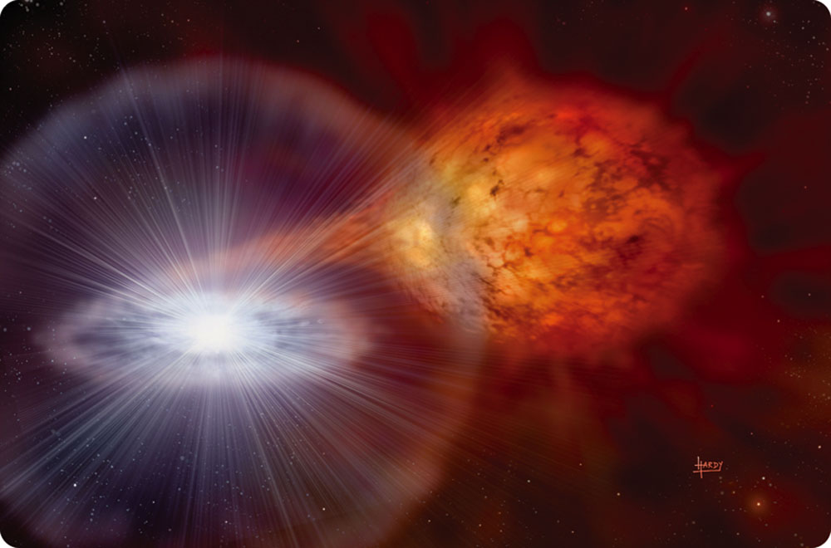
Mass Transfer and Accretion Disks
Mass transferred from one star to another in a binary must conserve its angular momentum.
Thus, it must flow into a rapidly rotating whirlpool called an accretion disk around the second star.

Slide 103
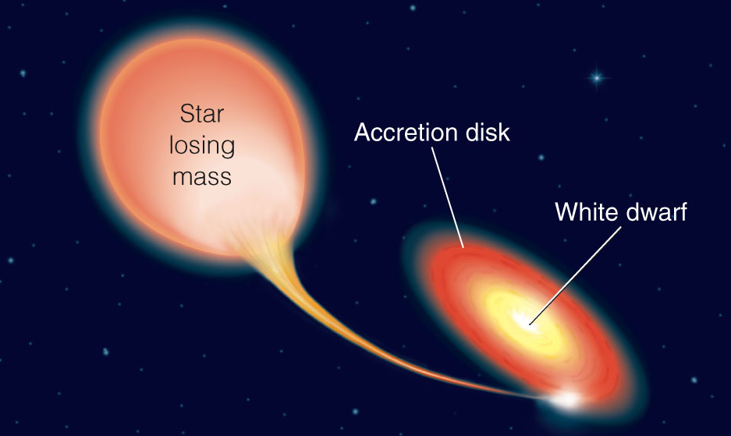
Mass Transfer and Accretion Disks
The gas in the disk grows very hot due to friction and tidal forces.
Eventually, it falls onto the second star.
If that second star is a compact object, the gas in the disk can become very compressed.

Slide 104
Mass Transfer and Accretion Disks
The gas temperature can exceed a million K, producing X rays.
In addition, the matter accumulating on the white dwarf can eventually cause a violent explosion called a nova.

Slide 105
Novae
Modern astronomers know that a nova is not a new star but an old star flaring up.
After a nova fades, astronomers can photograph the spectrum of the remaining faint point of light.
Invariably, they find a normal star and a white dwarf in a close binary system.
A nova is evidently an explosion involving a white dwarf.

Slide 106
Novae
Observational evidence can reveal how nova explosions occur.
As the explosion begins, spectra show blueshifted absorption lines.
This informs you that the gas is dense and coming toward you at a few thousand kilometers per second.

Slide 107
Novae
Nova explosions occur when mass transfers from a normal star into an accretion disk around the white dwarf.
As the matter loses its angular momentum in the disk, it settles inward onto the surface of the white dwarf and forms a layer of unused nuclear fuel—mostly hydrogen.
As the layer deepens, it becomes denser and hotter until the hydrogen fuses in a sudden explosion that blows the surface off of the white dwarf.

Slide 108
Novae
Although the expanding cloud of debris contains less than 0.0001 solar mass, it is hot and its expanding surface area makes it very luminous.
Nova explosions can be 100,000 times more luminous than the sun.
As the debris cloud expands, cools, and thins over a period of weeks and months, the nova fades from view.

Slide 109
Novae
The explosion of its surface hardly disturbs the white dwarf and its companion star.
Mass transfer quickly resumes, and a new layer of fuel begins to accumulate.

Slide 110
Novae
How fast the fuel builds up depends on the rate of mass transfer.
Accordingly, you can expect novae to repeat each time an explosive layer accumulates.
Many novae take thousands of years to build an explosive layer.
Some take only decades.

Slide 111
The Deaths of Massive Stars
Massive stars live spectacular lives and destroy themselves in violent explosions.

Slide 112
Nuclear Fusion in Massive Stars
Stars on the upper main sequence have too much mass to die as white dwarfs.
However, their evolution begins much like that of their lower-mass cousins.
They consume the hydrogen in their cores, ignite hydrogen shells, and become giants or, for the most massive stars, supergiants.
Their cores contract and fuse helium first in the core and then in a shell, producing a carbon–oxygen core.

Slide 113
Nuclear Fusion in Massive Stars
Unlike medium-mass stars, massive stars finally can get hot enough to ignite carbon fusion at a temperature of about 1 billion Kelvin.
Carbon fusion produces more oxygen plus neon.
As soon as the carbon is exhausted in the core, the core contracts and carbon ignites in a shell.

Slide 114
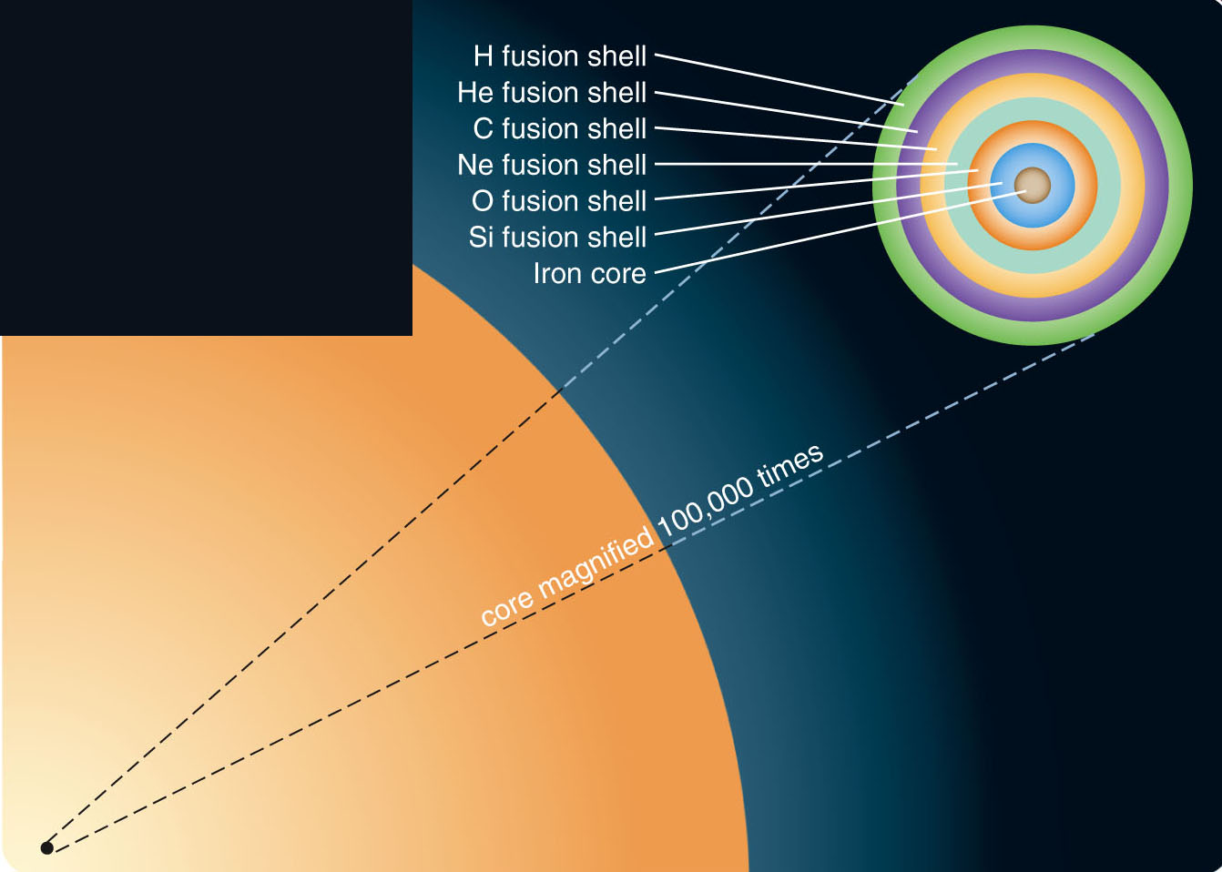
Nuclear Fusion in Massive Stars
This pattern of core ignition and shell ignition continues with a series of heavier nuclei as fusion fuel.
Thus, the star develops a layered structure.
There is a hydrogen-fusion shell surrounding a helium-fusion shell surrounding a carbon-fusion shell, and so on.

Slide 115
Nuclear Fusion in Massive Stars
At higher temperatures than carbon fusion, nuclei of oxygen, neon, and magnesium fuse to make silicon and sulfur.
At even higher temperatures, silicon can fuse to make iron.

Slide 116
Nuclear Fusion in Massive Stars
The fusion of the nuclear fuels in this series goes faster and faster as the massive star evolves rapidly.
The amount of energy released per fusion reaction decreases as the mass of the types of atoms involved increases.
To support its weight, a star must fuse oxygen much faster than it fused hydrogen.

Slide 117
Nuclear Fusion in Massive Stars
Also, there are fewer nuclei in the core of the star by the time heavy nuclei begin to fuse.
Four hydrogen nuclei make one helium nucleus.
Three helium nuclei make one carbon nucleus.
So, there are 12 times fewer nuclei of carbon available for fusion than there were hydrogen nuclei.

Slide 118
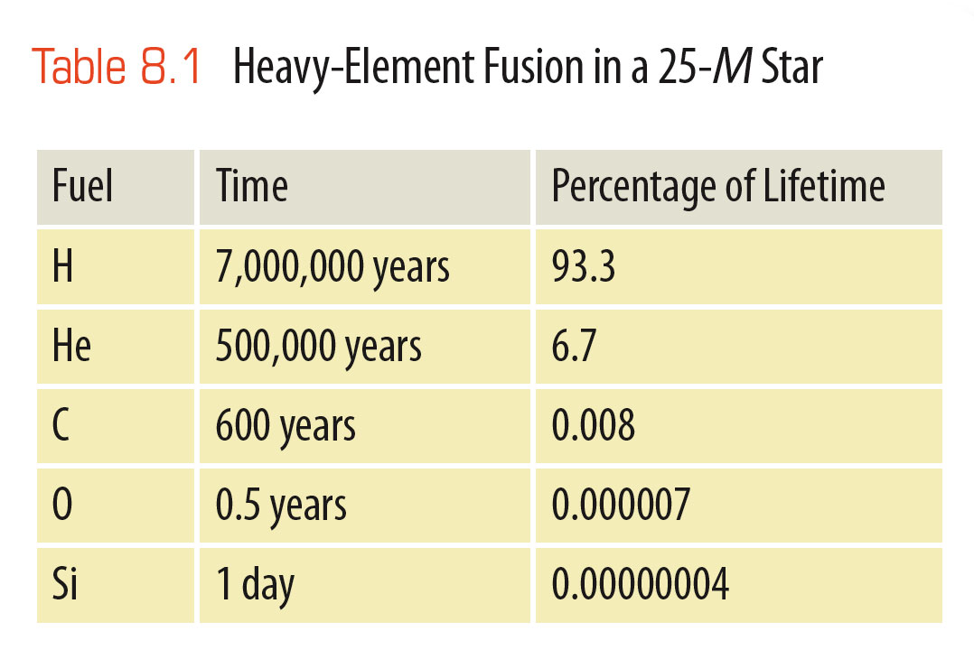
Nuclear Fusion in Massive Stars
Thus, the heavy elements are used up, and fusion goes very quickly in massive stars.
Hydrogen fusion can last 7 million years in a 25-solar-mass star.
The same star will fuse its oxygen in 6 months and its silicon in just one day.

Slide 119
Supernova Explosions of Massive Stars
Theoretical models of evolving stars, combined with nuclear physics, allow astronomers to describe what happens inside a massive star when the last nuclear fuels are exhausted.
It begins with iron nuclei and ends in cosmic violence.

Slide 120
Supernova Explosions of Massive Stars
Silicon fusion produces iron—the most tightly bound of all atomic nuclei.

Slide 121
Supernova Explosions of Massive Stars
Nuclear fusion releases energy only when less tightly bound nuclei combine into a more tightly bound nucleus.
Once the gas in the core of the star has been converted to iron, there are no further nuclear reactions that can release energy.
The iron core is a dead end in the evolution of a massive star.

Slide 122
Supernova Explosions of Massive Stars
As a star develops an iron core, energy production declines, and the core contracts.
Nuclear reactions involving iron begin.
However, they remove energy from the core—causing it to contract even further.
Once this process starts, the core of the star collapses inward in less than a tenth of a second.

Slide 123
Supernova Explosions of Massive Stars
The collapse of a giant star’s core after iron fusion starts is calculated to happen so rapidly that the most powerful computers are unable to predict the details.
Thus, models of supernova explosions contain many approximations.
Nevertheless, the models predict exotic nuclear reactions in the collapsing core that should produce a flood of neutrinos.

Slide 124
Supernova Explosions of Massive Stars
In fact, for a short time, the core produces more energy per second than all the stars in all the visible galaxies in the universe.
99 percent of that energy is in the form of neutrinos.
This flood of neutrinos carries large amounts of energy out of the core—allowing it to collapse further.

Slide 125
Supernova Explosions of Massive Stars
The models also predict that the collapsing core of the star must quickly become a neutron star or a black hole, while the envelope of the star is blasted outward.

Slide 126
Supernova Explosions of Massive Stars
To understand how the inward collapse of the core can produce an outward explosion, think about a traffic jam.

Slide 127
Supernova Explosions of Massive Stars
The collapse of the innermost part of the degenerate core allows the rest of the core to fall inward.
This creates a tremendous traffic jam, as all the nuclei fall toward the center.

Slide 128
Supernova Explosions of Massive Stars
The position of the traffic jam—called a shock wave—begins to move outward as more in-falling material encounters the jam.
The torrent of neutrinos, as well as energy flowing out of the core in sudden violent convective turbulence, help drive the shock wave outward.
Within a few hours, the shock wave bursts outward through the surface of the star and blasts it apart.

Slide 129
Supernova Explosions of Massive Stars
The supernova seen from Earth is the brightening of the star as its distended envelope is blasted outward by the shock wave.
As months pass, the cloud of gas expands, thins, and fades.

Slide 130
Supernova Explosions of Massive Stars
The rate at which it fades informs astronomers more about the death throes of the star.
The rate at which it fades matches the rate at which these radioactive nickel and cobalt decay.
So, the explosion must produce great abundances of those atoms.
The radioactive cobalt decays into iron.
So, destruction of iron in the core of the star is followed by the production of iron through nuclear reactions in the expanding outer layers.

Slide 131
Types of Supernovae
In studying supernovae in other galaxies, astronomers have noticed that there are a number of different types.

Slide 132
Types of Supernovae
Type I supernovae have no hydrogen lines in their spectra.
Astronomers have thought of at least two ways a supernova could occur without involving much hydrogen.
Type II supernovae have spectra containing hydrogen lines.
They appear to be produced by the collapse and explosion of a massive star.

Slide 133
Types of Supernovae
A type Ia supernova is believed to occur when a white dwarf in a binary system receives enough mass to exceed the Chandrasekhar limit and collapse.
The collapse of a white dwarf is different from the collapse of a massive star because the core of the white dwarf contains usable fuel.

Slide 134
Types of Supernovae
As the collapse begins, the temperature and density shoot up, and the carbon–oxygen core begins to fuse in violent nuclear reactions.
In a few seconds the carbon–oxygen interior is entirely consumed.
The outermost layers are blasted away in a violent explosion that—at its brightest—is about six times more luminous than a type II supernova.

Slide 135
Types of Supernovae
The white dwarf is entirely destroyed.
No neutron star or black hole is left behind.
This explains why no hydrogen lines are seen in the spectrum of a type Ia supernova explosion—white dwarfs contain very little hydrogen.

Slide 136
Types of Supernovae
The less common type Ib supernova is believed to occur when a massive star in a binary system loses its hydrogen-rich outer layers to its companion star.
The remains of the massive star could develop an iron core and collapse—producing a supernova explosion that lacked hydrogen lines in its spectrum.

Slide 137
Types of Supernovae
Astronomers working with the largest and fastest computers are using modern theory to try to understand supernova explosions.

Slide 138
Types of Supernovae
The companion to theory is observation.
So, you should ask what observational evidence supports this story of supernova explosions.

Slide 139
Observations of Supernovae
In AD 1054, Chinese astronomers saw a ‘guest star’ appear in the constellation known in the Western tradition as Taurus the Bull.
The star quickly became so bright that it was visible in the daytime.
After a month, it slowly faded, taking almost two years to vanish from sight.

Slide 140
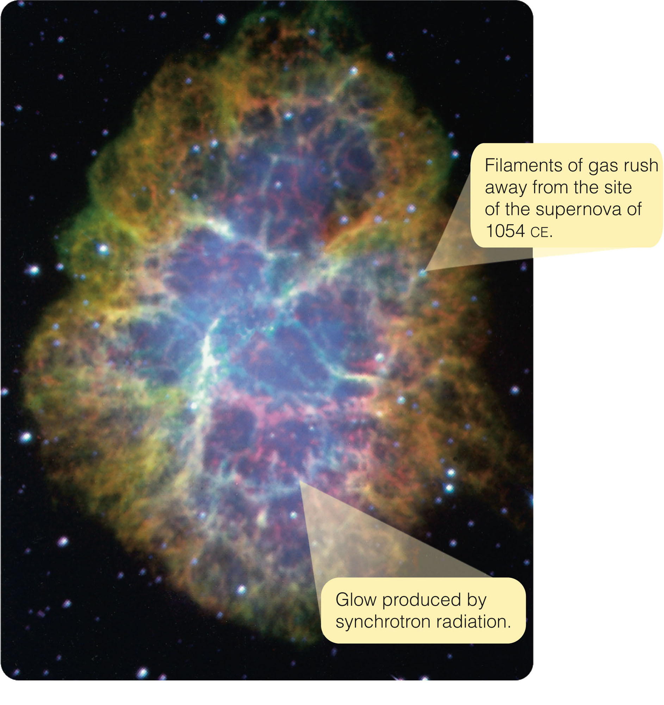
Observations of Supernovae
When modern astronomers turned their telescopes to the location of the guest star, they found a peculiar nebula— now known as the Crab Nebula.

Slide 141
Observations of Supernovae
The Crab Nebula is called so for its many-legged shape.
The ‘legs’ are filaments of gas that are moving away from the site of the explosion at about 1,400 km/s.

Slide 142
Observations of Supernovae
Comparing the nebula’s radius, 1.35 pc, with its velocity of expansion reveals that the nebula began expanding nine or ten centuries ago.
That is just when the
guest star made its visit.
Clearly, the nebula is the remains of the
supernova seen
in AD 1054.

Slide 143
Observations of Supernovae
The blue glow is produced by synchrotron radiation.
This form of electromagnetic radiation—unlike blackbody radiation—is produced by rapidly moving electrons spiraling through magnetic
fields.
It is common in the nebula produced by supernovae.

Slide 144
Observations of Supernovae
In the case of the Crab Nebula, the electrons travel so fast they emit visual wavelengths.
However, in most such nebulae, the electrons move slower, and the radiation is at radio wavelengths.

Slide 145
Observations of Supernovae
Supernovae are rare—only a few have been seen with the naked eye in recorded history.
Arab astronomers saw one in AD 1006.
The Chinese saw one in AD 1054.
European astronomers observed two—one in AD 1572 (Tycho’s supernova) and one in AD 1604 (Kepler’s supernova).
In addition, the guest stars of AD 185, 386, 393, and 1181 may have been supernovae.

Slide 146
Observations of Supernovae
In the centuries following the invention of the astronomical telescope in 1609, no supernova was bright enough to be visible to the naked eye.

Slide 147
Observations of Supernovae
Then, in the early morning hours of February 24, 1987, astronomers around the world were startled by the discovery of a naked-eye supernova still growing brighter in the southern sky.

Slide 148
Observations of Supernovae
The supernova—known officially as SN1987A—is only 53,000 pc away in the Large Magellanic Cloud, a small satellite galaxy to Milky Way.

Slide 149
Observations of Supernovae
This first naked-eye supernova in 383 years has given astronomers a ringside seat for the most spectacular event in stellar evolution.

Slide 150
Observations of Supernovae
One observation of SN1987A is critical in that it confirms the theory of core collapse.
At 2:35 AM EST on February 23, 1987—nearly 4 hours before the supernova was first seen—a blast of neutrinos swept through Earth.
Instruments buried in a salt mine under Lake Erie and in a lead mine in Japan—designed for another purpose—recorded 19 neutrinos in less than 15 seconds.

Slide 151
Observations of Supernovae
Neutrinos are so difficult to detect that the 19 neutrinos actually detected mean that some 10¹⁷ neutrinos must have passed through the detectors in those 15 seconds.
Furthermore, the neutrinos were arriving from the direction of the supernova.

Slide 152
Observations of Supernovae
Thus, astronomers conclude:
The burst of neutrinos was released when the iron core collapsed.
The supernova was first seen at visual wavelengths hours later—when the shock wave blasted the star’s surface into space.

Slide 153
Observations of Supernovae
Most supernovae are seen in distant galaxies.
Careful observations allow astronomers to compare types.

Slide 154
Observations of Supernovae
Type Ia supernovae, caused by the collapse of white dwarfs, are more luminous at maximum brightness.
They decline rapidly at first and then more slowly.
Type II supernovae, produced by the collapse of massive stars, are not as bright at maximum.
They decline in a more irregular way.

Slide 155
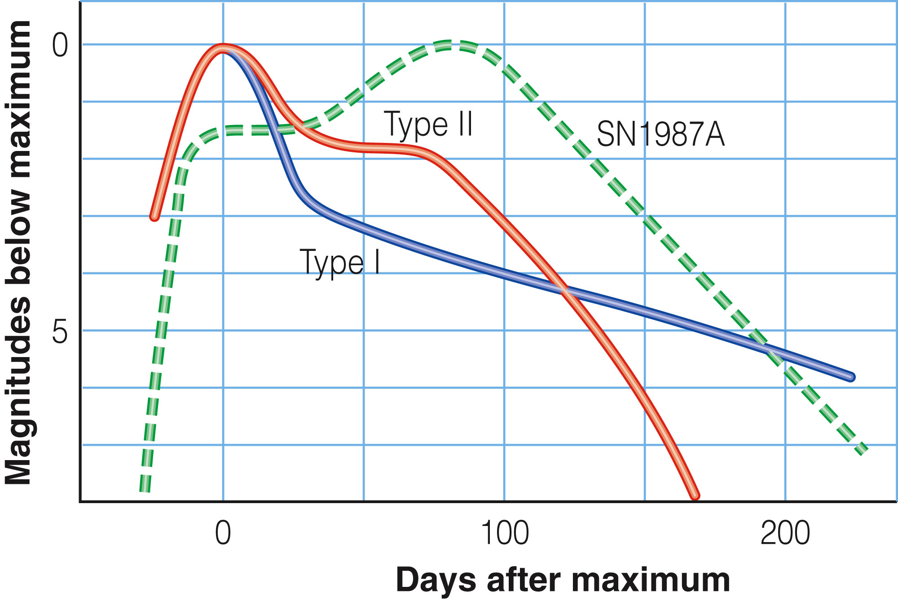
Observations of Supernovae
SN1987A was a type II supernova.
Its light curve is not typical, though.

Slide 156
Observations of Supernovae
Models indicate that most type II supernovae are caused by the collapse of red supergiants.
However, SN1987A was produced by the explosion of a hot, blue supergiant.
Astronomers hypothesize that the star was once a red supergiant but later contracted and heated up slightly—becoming smaller, hotter, and bluer before it exploded.

Slide 157
Observations of Supernovae
Although the supernova explosion fades to obscurity in a year or two, an expanding shell of gas marks the site of the explosion.
The gas—originally expelled at 10,000 to 20,000 km/s—may carry away a fifth of the mass of the exploding star.

Slide 158
Observations of Supernovae
The collision of the expanding gas with the surrounding interstellar medium can sweep up even more gas and excite it to produce a supernova remnant.
This comprises the nebulous remains of a supernova explosion.

Slide 159
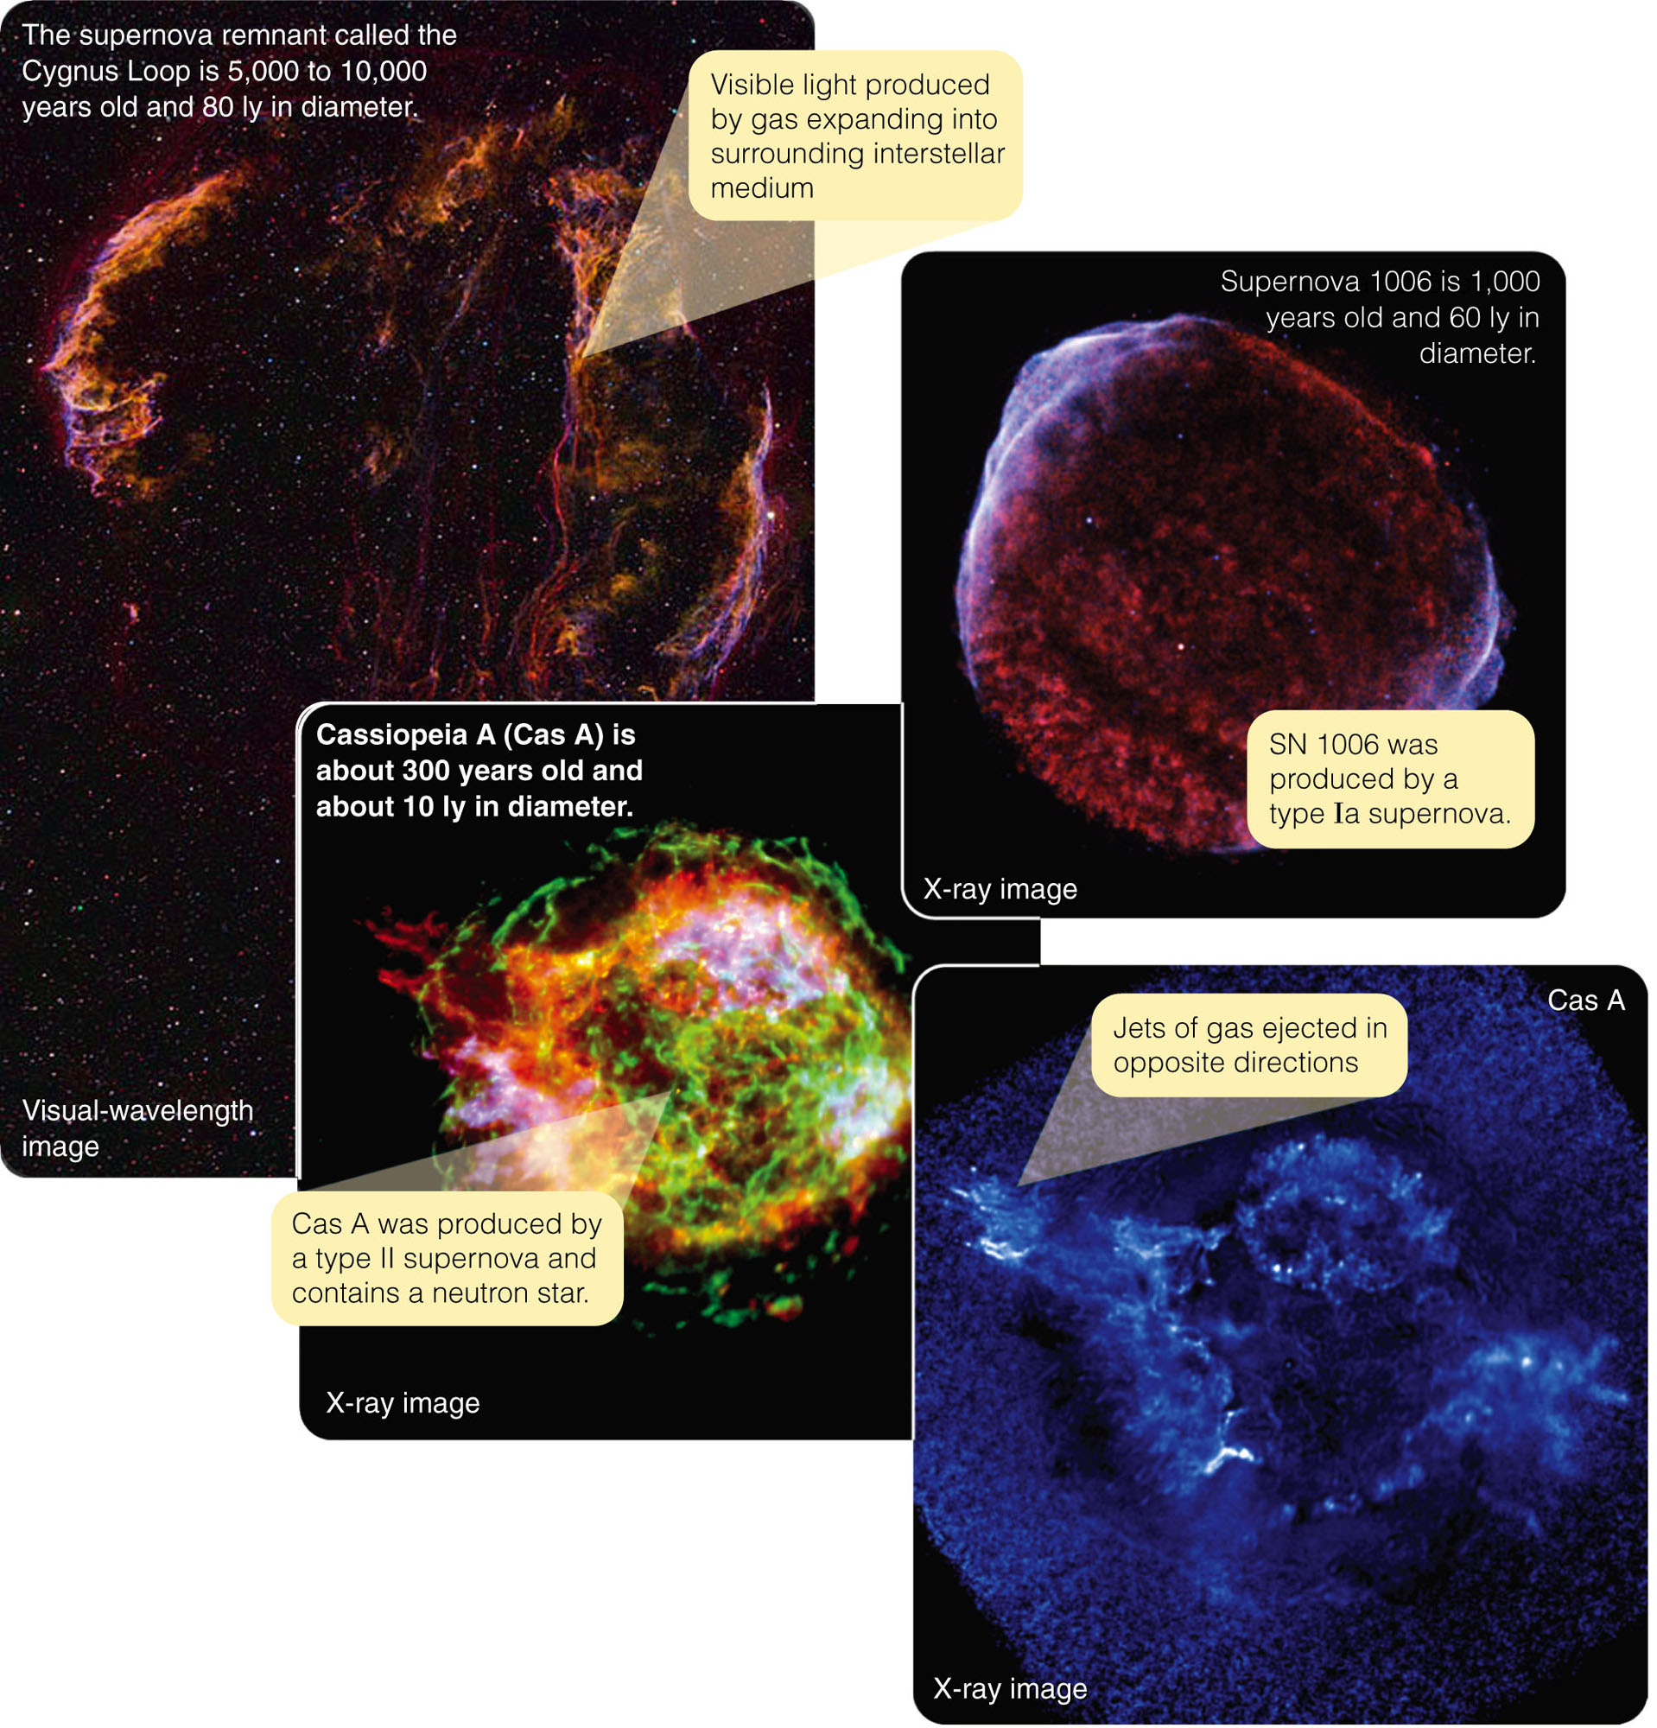
Observations of Supernovae
Images of various supernova remnants are displayed.
Images made at other than visible wavelengths are depicted in false color.

Slide 160
Observations of Supernovae
Supernova remnants look quite delicate and do not survive very long.
After a few tens of thousands of years, they gradually mix with the interstellar medium and vanish.
The Crab Nebula is a young remnant—only about 950 years old and about 8.8 ly in diameter.
Older remnants can be larger.

Slide 161
Observations of Supernovae
Some supernova remnants are visible only at radio and X-ray wavelengths.
They have become too tenuous to emit detectable light.
However, the collision of the expanding hot gas with the interstellar medium can generate radio and X-ray radiation.
You have learned that the compression of the interstellar medium by expanding supernova remnants can also trigger star formation.

Slide 162
Observations of Supernovae
Gravity always wins.
However a star lives, theory predicts it must eventually die.

Slide 163
Observations of Supernovae
When a star dies, it leaves behind one of three final types of final remnant:
White dwarf
Neutron star
Black hole

Slide 164
Observations of Supernovae
These objects are often called compact objects.
They are small monuments to the power of gravity.
Almost all the energy available has been squeezed out of compact objects.
You find them in their final, high-density states.

Slide 165
Neutron Stars
A neutron star contains a little over 1 solar mass compressed to a radius of about 10 km.
Its density is so high that the matter is stable only as a fluid of pure neutrons.

Slide 166
Neutron Stars
Two questions should occur to you immediately.
How could any theory predict such a wondrously unbelievable star?
Do such neutron stars really exist?

Slide 167
Theoretical Prediction of Neutron Stars
The subatomic particles called neutrons were discovered in a laboratory in 1932.
Physicists quickly realized that, because neutrons spin much like electrons, a gas of neutrons could become degenerate and therefore nearly incompressible.

Slide 168
Theoretical Prediction of Neutron Stars
Just two years later, in 1934, two astronomers, Walter Baade and Fritz Zwicky, suggested:
Some of the most luminous novae in the historical record were not regular novae.
Rather, they were caused by the collapse plus explosion of a massive star in a cataclysm they named a ‘supernova.’

Slide 169
Theoretical Prediction of Neutron Stars
If the collapsing core is more massive than the Chandrasekhar limit of 1.4 solar masses, then the weight is too great to be supported by degenerate electron pressure.
The core cannot become a stable white dwarf.

Slide 170
Theoretical Prediction of Neutron Stars
The collapse would force protons to combine with electrons and become neutrons.
The envelope of the star would be blasted away in a supernova explosion.
The core of the star would be left behind as a small, tremendously dense sphere of neutrons.
Zwicky called this a ‘neutron star.’

Slide 171
Theoretical Prediction of Neutron Stars
Mathematical models predict that a neutron star will be only 10 or so kilometers in radius and have a density of about 10¹⁴ g/cm³.

Slide 172
Theoretical Prediction of Neutron Stars
This is roughly the density of atomic nuclei.
You can think of a neutron star as matter with all the empty space squeezed out of it.
On Earth, a sugar-cube-sized lump of this material would weigh 100 million tons—the mass of a small mountain.

Slide 173
Theoretical Prediction of Neutron Stars
Simple physics predicts that neutron stars should:
Spin rapidly—perhaps 100 to 1,000 rotations per second
Be hot—with surface temperatures of millions of degrees K
Have strong magnetic fields—up to a trillion times stronger than the sun’s or Earth’s magnetic fields

Slide 174
Theoretical Prediction of Neutron Stars
For example, the collapse of a massive star’s core would greatly increase its spin rate by conservation of angular momentum.
Other processes during core collapse should create high temperature and magnetic field strength.

Slide 175
Theoretical Prediction of Neutron Stars
Despite their high temperature, neutron stars should be difficult to detect.
This is due to their tiny size.

Slide 176
Theoretical Prediction of Neutron Stars
What is the maximum mass for a stable neutron star?
In other words, is there an upper limit to the mass of neutron stars like the Chandrasekhar limit that defines the maximum mass of a white dwarf star?

Slide 177
Theoretical Prediction of Neutron Stars
That is difficult to answer.
Physicists don’t know enough about the properties of pure neutron material.
It can’t be made in a laboratory, and theoretical calculations in this case are very difficult.

Slide 178
Theoretical Prediction of Neutron Stars
The most widely accepted results suggest that a neutron star can’t be more massive than 2 to 3 solar masses.
An object more massive than that can’t be supported by degenerate neutron pressure.
So, it would collapse—presumably becoming a black hole.

Slide 179
Theoretical Prediction of Neutron Stars
What size stars will end their lives with supernova explosions that leave behind neutron star corpses?
Theoretical calculations suggest that stars that begin life on the main sequence with 8 to about 15 solar masses will end up as neutron stars.
Stars more massive than about 15 solar masses are believed to form black holes when they die.

Slide 180
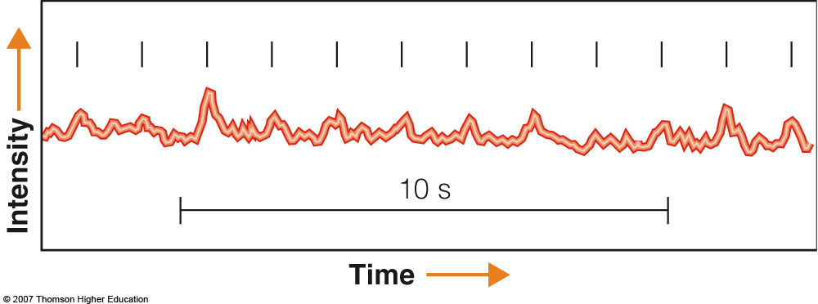
The Discovery of Pulsars
In November 1967, Jocelyn Bell, a graduate student at Cambridge University in England, found a peculiar pattern in the data from a radio telescope.
Unlike other radio signals from celestial bodies, this was a series of regular pulses.

Slide 181
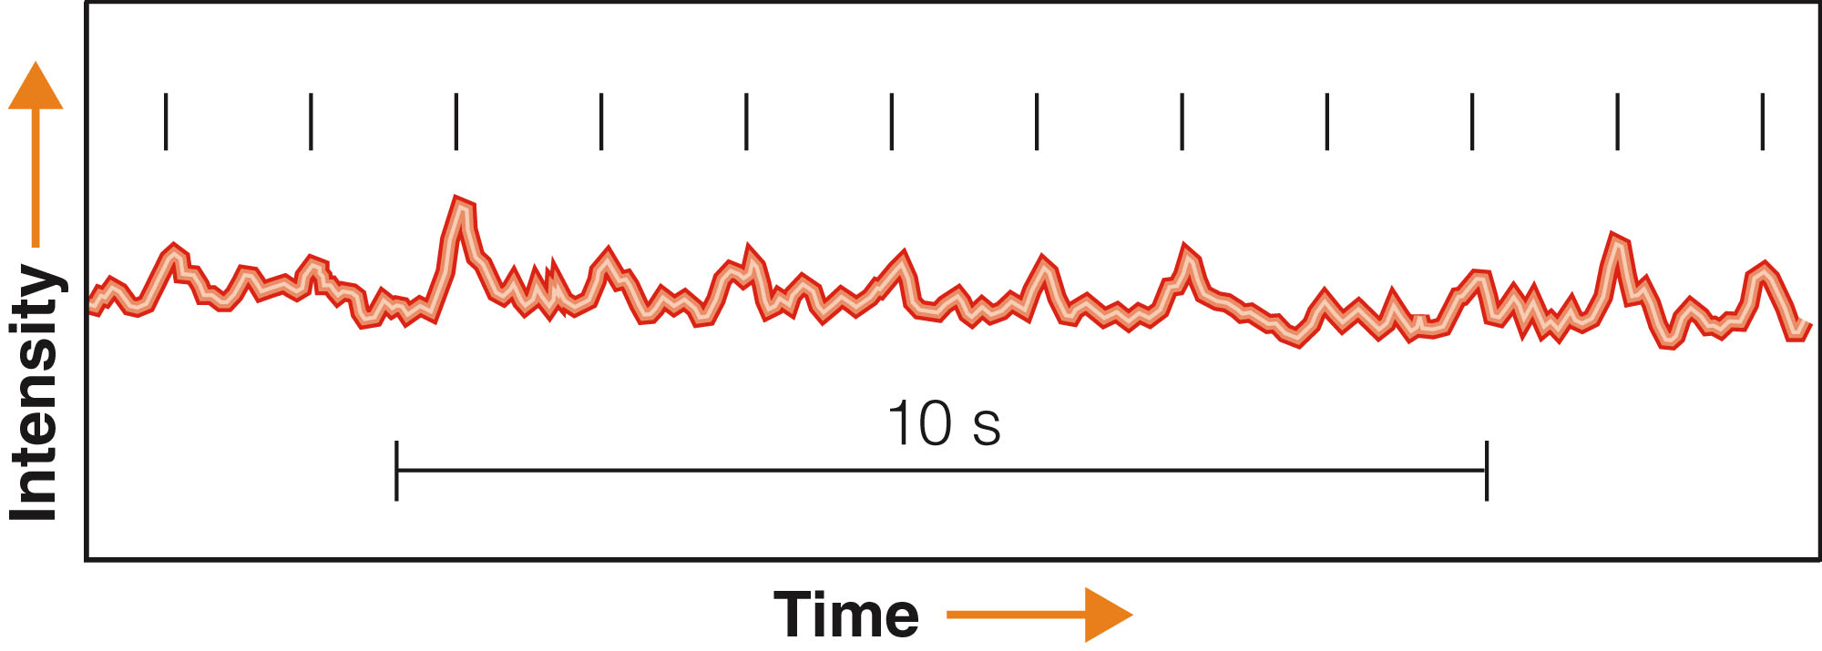
The Discovery of Pulsars
At first, she and the leader of the project, Anthony Hewish, thought the signal was interference.
However, they found it day after day at the same celestial latitude and longitude.
Clearly, it was celestial in origin.

Slide 182
The Discovery of Pulsars
Another possibility, that it came from a distant civilization, led them to consider naming it LGM—Little Green Men.
Within a few weeks, however, the team found three more objects in other parts of the sky pulsing with different periods.
The objects were clearly natural.

Slide 183
The Discovery of Pulsars
The team dropped the name LGM in favor of pulsar—a contraction of ‘pulsing star.’
The pulsing radio source Bell had observed with her radio telescope was the first known pulsar.
Hewish received the Nobel Prize in physics for this work.
Bell has been remarkably gracious about that.

Slide 184
The Discovery of Pulsars
As more pulsars were found, astronomers argued over their nature.
The pulses, which typically last only about 0.001 second, gave astronomers an important clue.

Slide 185
The Discovery of Pulsars
The pulse length places an upper limit on the size of the object producing the pulse.
This is a very important principle in astronomy.
An object cannot change its brightness significantly in an interval shorter than the time light takes to cross its diameter.

Slide 186
The Discovery of Pulsars
If pulses from pulsars are no longer than 0.001 seconds, then the objects cannot be larger than 0.001 light seconds, or 300 km (190 mi) in diameter.
This makes them smaller than white dwarfs.
That makes neutron stars the only reasonable explanation.

Slide 187
The Discovery of Pulsars
The missing link between pulsars and neutron stars was found in late 1968—when astronomers discovered a pulsar at the heart of the Crab Nebula.
The nebula is a supernova remnant.
This agrees nicely with Zwicky and Baade’s prediction that some supernovae should produce a neutron star.

Slide 188
The Discovery of Pulsars
The short pulses and the discovery of the pulsar in the Crab Nebula are strong evidence that pulsars are neutron stars.

Slide 189
The Discovery of Pulsars
In a sense, the name pulsar is inaccurate.
A pulsar does not pulse (vibrate).

Slide 190
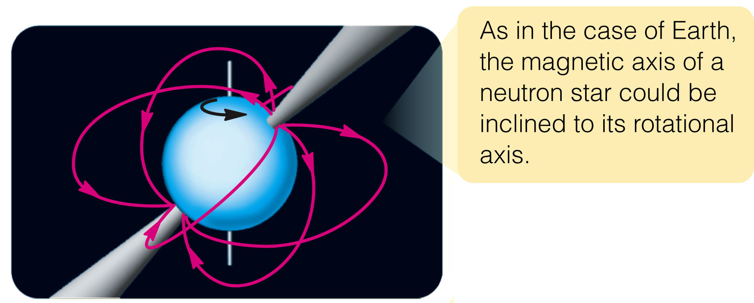
The Discovery of Pulsars
Rather, it emits beams of radiation that sweep around the sky as the neutron star rotates—like a rotating lighthouse light.
The modern model of a pulsar has been called the lighthouse model.

Slide 191
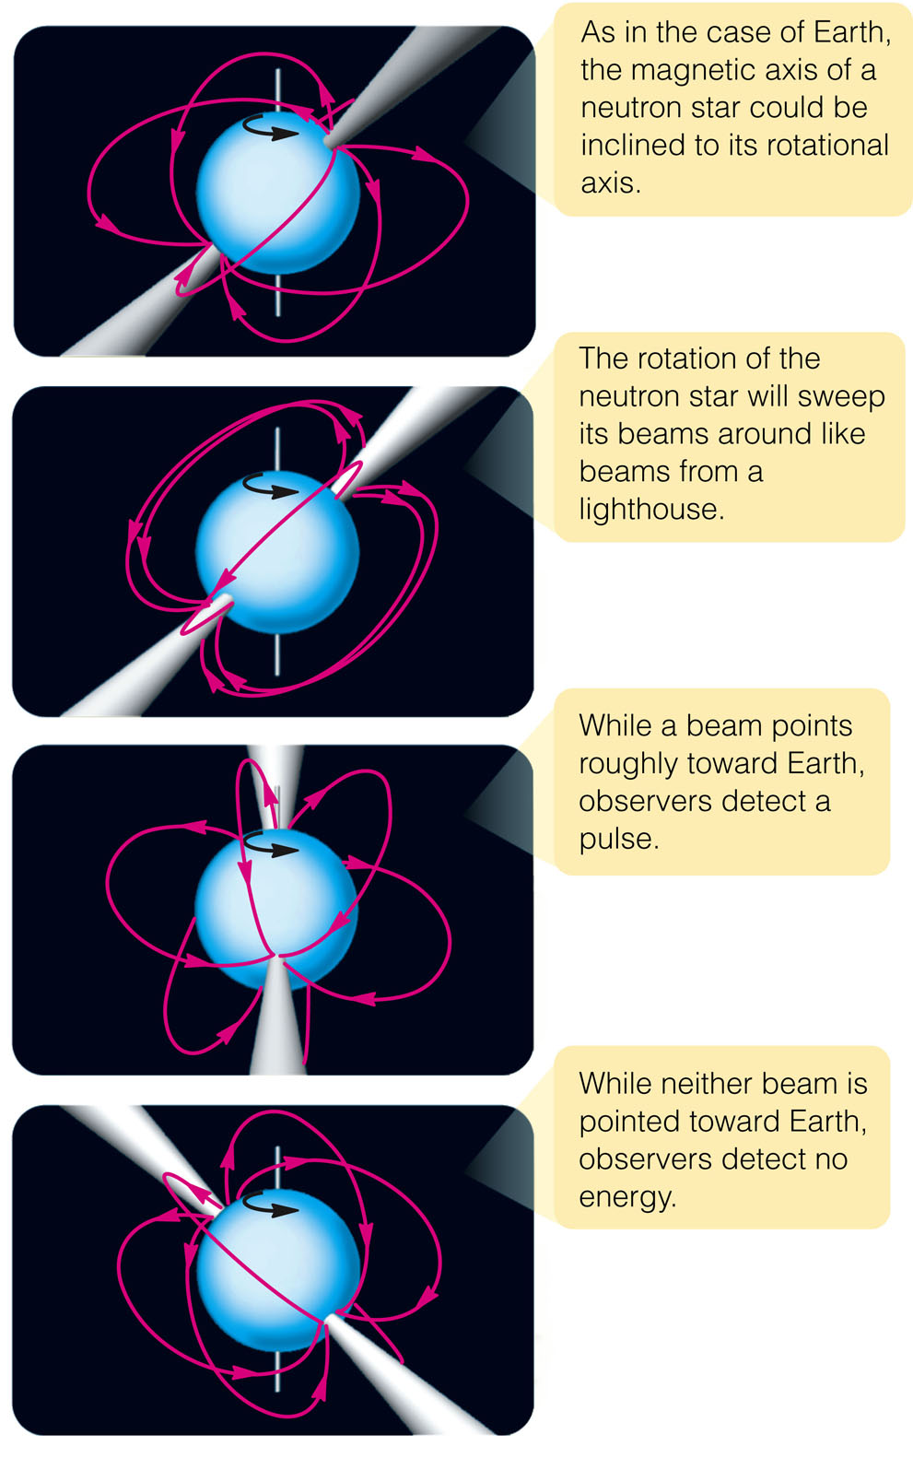
The Discovery of Pulsars
The mechanism that produces the beams involves extremely high energies and strong electric and magnetic fields.
However, it is not fully understood.

Slide 192
The Discovery of Pulsars
Over 1,000 pulsars are now known.
There may be many more that are undetected because their beams never point toward Earth.

Slide 193
The Evolution of Pulsars
Neutron stars are not simple objects.
Modern astronomers need knowledge of frontier physics to understand them.
Nevertheless, the life story of pulsars can be worked out to some extent.

Slide 194
The Evolution of Pulsars
When a pulsar first forms, it may be spinning as many as 100 times a second.
The energy it radiates into space ultimately comes from its energy of rotation.
So, as it blasts beams of radiation outward, its rotation slows.

Slide 195
The Evolution of Pulsars
Judging from their pulse periods and rates at which they slow down, the average pulsar is apparently only a few million years old—and the oldest has an age of about 10 million years.
Presumably, neutron stars older than that rotate too slowly to generate detectable radio beams.

Slide 196
The Evolution of Pulsars
Supernova remnants last only about 50,000 years before they mix into the interstellar medium and disappear.
So, most pulsars have long outlived the remnants in which they were originally embedded.
You can expect that a young neutron star should emit especially strong beams of radiation powered by its rapid rotation.

Slide 197
The Evolution of Pulsars
The Crab Nebula provides an example of such a system.
Only about 950 years old and spinning 30 times per second, the Crab pulsar is so powerful that astronomers can detect photons of radio, infrared, visible, X-ray, and gamma-ray wavelengths from it.

Slide 198
The Evolution of Pulsars
The explosion of Supernova 1987A in February 1987 probably formed a neutron star.
You can draw this conclusion because a burst of neutrinos was detected passing through Earth.
Theory predicts that the collapse of a massive star’s core into a neutron star would produce such a burst of neutrinos.

Slide 199
The Evolution of Pulsars
The neutron star initially should be hidden at the center of the expanding shells of gas ejected into space by the supernova explosion.
However, as the gas continues to expand and become thinner, you can expect that astronomers might eventually be able to detect it.

Slide 200
The Evolution of Pulsars
As of now, no neutron star has been detected in the SN1987A remnant.
Nevertheless, astronomers continue to watch the site—hoping to find the youngest pulsar known.

Slide 201
Binary Pulsars
One reason pulsars are so fascinating is the extreme conditions found in spinning neutron stars.

Slide 202
Binary Pulsars
To see even more extreme natural processes, you have only to look at the pulsars that are members of binary systems.

Slide 203
Binary Pulsars
These pulsars are of special interest because, by studying them, astronomers can learn more about:
The neutron star
The behavior of matter in unusual circumstances

Slide 204
Binary Pulsars
Binary pulsars can be sites of tremendous violence.
This is because of the strength of gravity at the surface of a neutron star.

Slide 205
Binary Pulsars
Matter falling onto a neutron star can release titanic amounts of energy.
If you dropped a single marshmallow onto the surface of a neutron star from a distance of 1 AU, it would hit with an impact equivalent to a 3-megaton nuclear bomb.
Even a small amount of matter flowing from a companion star to a neutron star can generate high temperatures and release X rays and gamma rays.

Slide 206
Binary Pulsars
As an example of such an active system, examine Hercules X-1.
It emits pulses of X rays with a period of about 1.2 seconds.
Every 1.7 days, though, the pulses vanish for a few hours.
Hercules X-1 seems to contain a 2-solar-mass star and a neutron star that orbit each other with a period of 1.7 days.

Slide 207
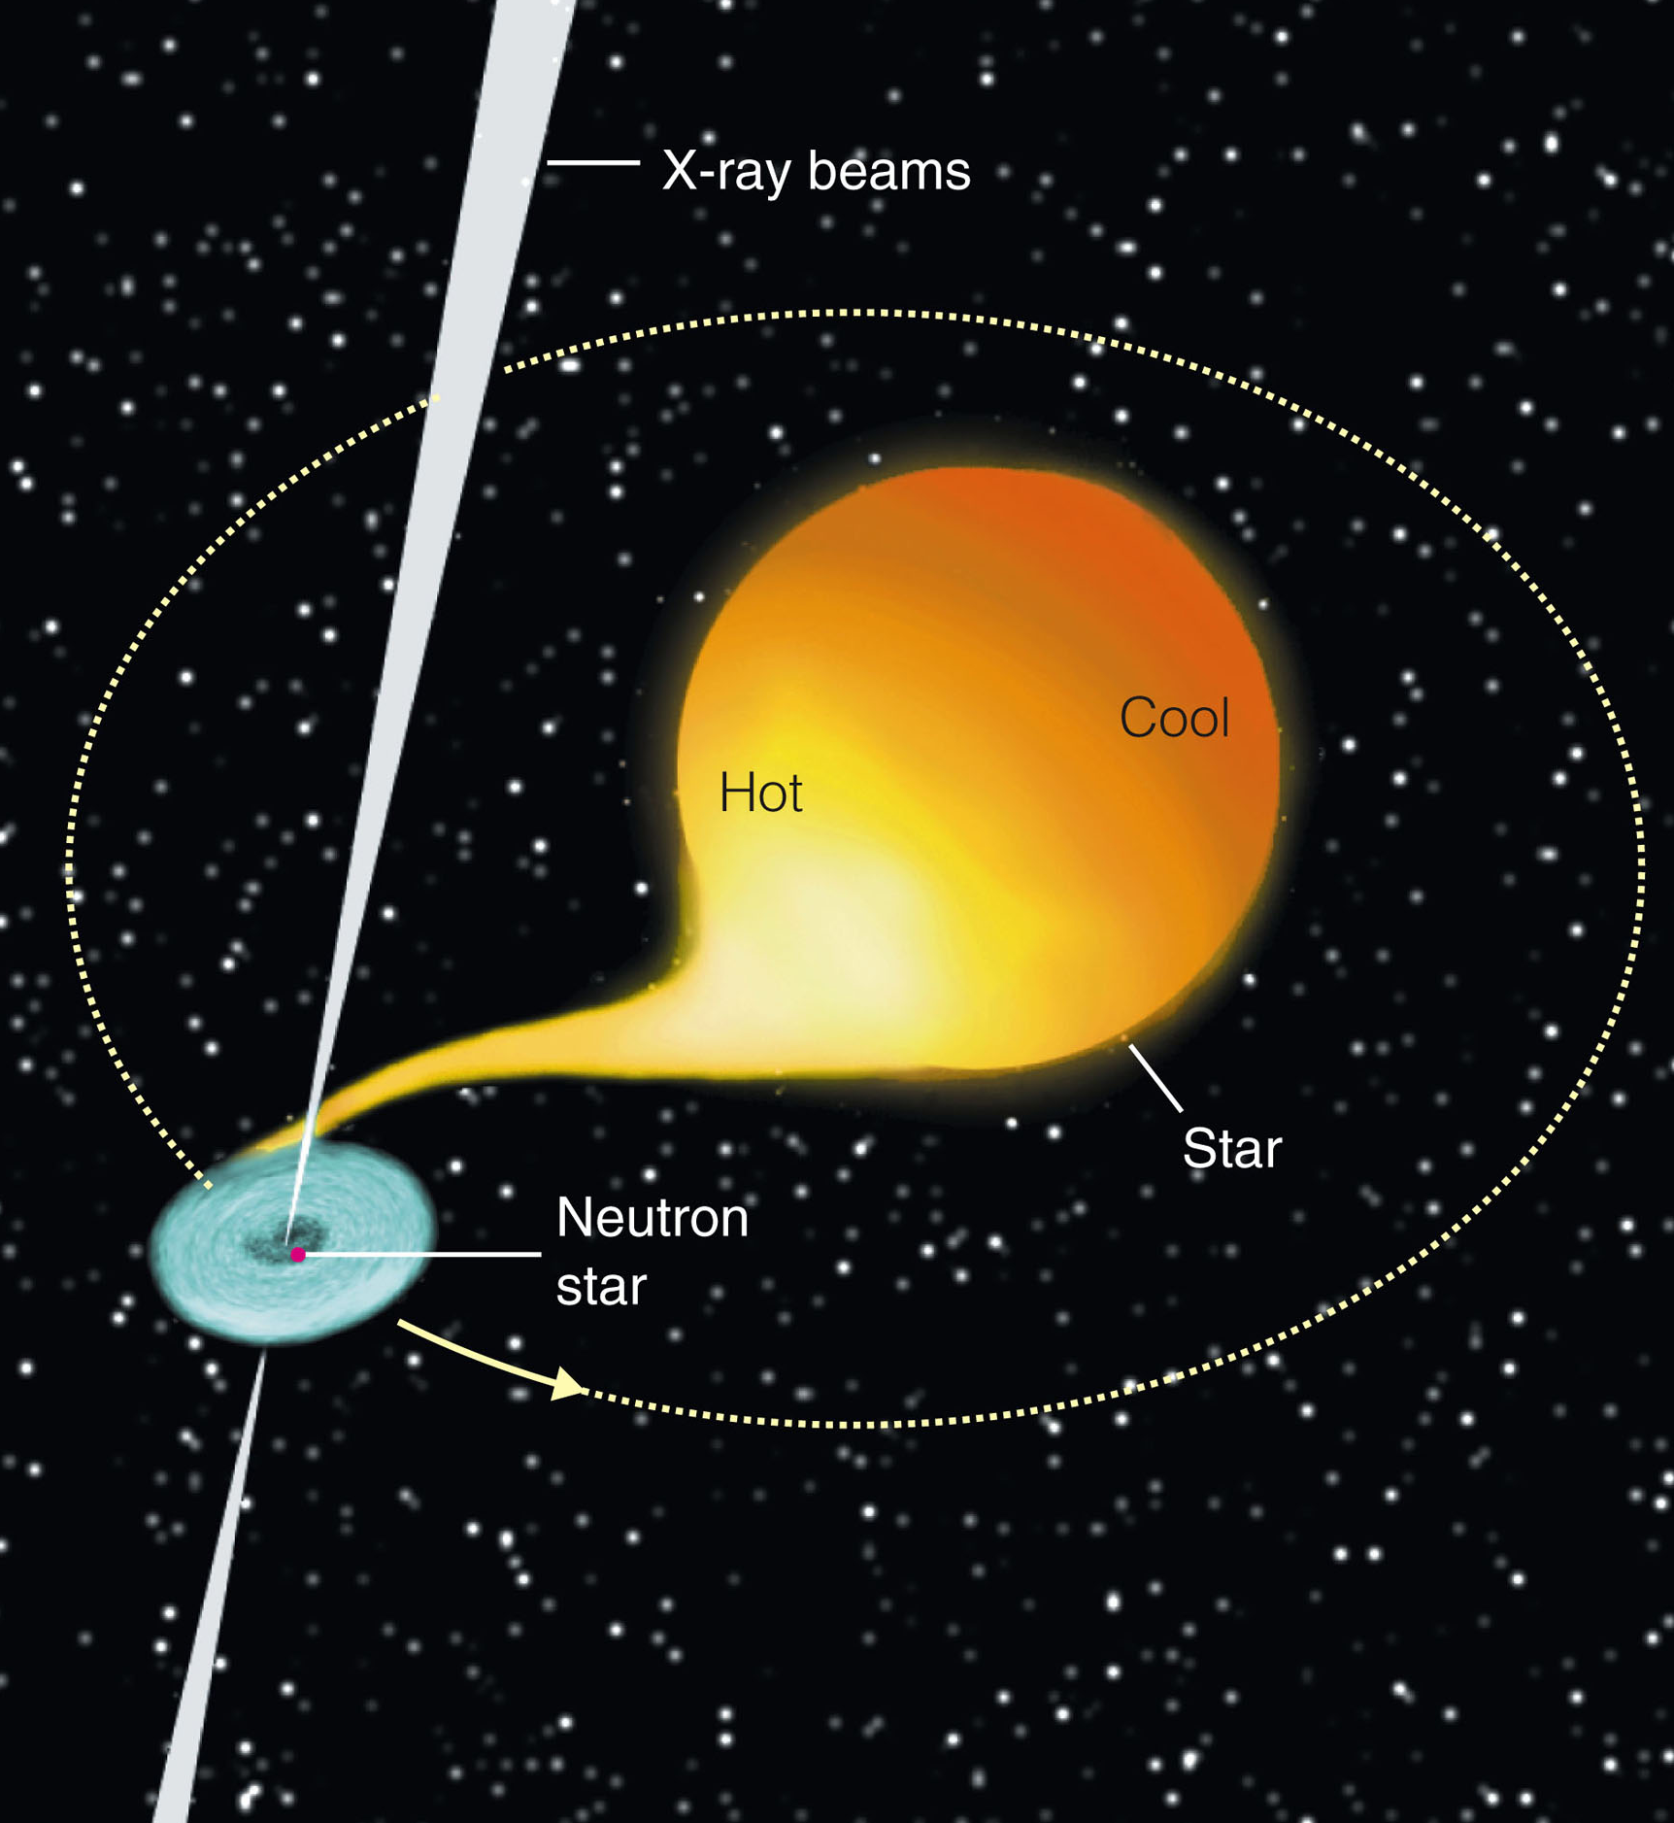
Binary Pulsars
Matter flowing from the normal star into an accretion disk around the neutron star can reach temperatures of millions of degrees and emits a powerful X-ray glow.
Some of this is in beams that sweep around with the rotating neutron star.

Slide 208
Binary Pulsars
Earth receives a pulse of X rays each time a beam points this way.
The X rays shut off completely every 1.7 days.
This occurs when the neutron star is eclipsed behind the normal star.

Slide 209
Binary Pulsars
Hercules X-1 is a complex system with many different high-energy processes going on simultaneously.
This quick analysis only serves to illustrate how complex and powerful such binary systems are during mass transfer.

Slide 210
Binary Pulsars
A binary system in which both objects are neutron stars was discovered in 1974 by radio astronomers Joseph Taylor and Russell Hulse.
They noticed that the pulse period of the pulsar PSR1913+16 grew longer and then shorter in a cycle that takes 7.75 hours.
They realized that must be the binary orbital period of the pulsar.

Slide 211
Binary Pulsars
They analyzed the system with the same techniques used to study spectroscopic binary stars.
They found that PSR1913+16 consists of two neutron stars separated by a distance roughly equal to the radius of our sun.
The masses of the two neutron stars are each about 1.4 solar masses.
This is in good agreement with models of neutron stars and how they are created.

Slide 212
Binary Pulsars
A nice surprise was hidden in the motion of PSR1913+16.
In 1916, Einstein published his general theory of relativity that described gravity as a curvature of space-time.
Einstein realized that any rapid change in a gravitational field should spread outward at the speed of light—as gravitational radiation.

Slide 213
Binary Pulsars
Gravity waves themselves have not been detected yet.
Yet, Taylor and Hulse were able to show that the orbital period of the binary pulsar is slowly growing shorter.
This was because the stars are gradually spiraling toward each other exactly at the rate expected if they radiate orbital energy away as gravitational radiation.
They won the Nobel Prize in 1993 for their work with binary pulsars.

Slide 214
The Fastest Pulsars
This discussion of pulsars suggests that newborn pulsars should blink rapidly and old pulsars should blink slowly.
However, a few that blink the fastest may be quite old.

Slide 215
The Fastest Pulsars
A number of millisecond pulsars have been found.
They are called so because their pulse periods are almost as short as a millisecond (0.001 s).

Slide 216
The Fastest Pulsars
The energy stored in a neutron star rotating at this rate is equal to the total energy of a supernova explosion.
These pulsars generally have weak magnetic fields consistent with advanced age.
Hence, it seemed difficult at first to understand their rapid rotation.

Slide 217
The Fastest Pulsars
Astronomers hypothesized that an old neutron star could gain rotational energy from a companion star in a binary system.
Some of the millisecond pulsars are caught in the act of receiving matter from companions in a fashion that should speed the pulsar’s rotation to the observed high rates.
So, the hypothesis seems to be confirmed.

Slide 218
The Fastest Pulsars
“Show me,” say scientists.
In the case of neutron stars, the evidence seems very strong.
Of course, you can never prove that a hypothesis or theory is absolutely true.
The evidence for neutron stars, however, is so strong that astronomers have great confidence that they really do exist.

Slide 219
The Fastest Pulsars
Other theories that describe how they emit beams of radiation and how they form and evolve are less certain.
However, continuing observations at many wavelengths are expanding the understanding of these last embers of massive stars.
In fact, precise observations have turned up objects no one expected.

Slide 220
Pulsar Planets
As a pulsar’s period is so precise, astronomers can detect tiny variations by comparison with atomic clocks.

Slide 221
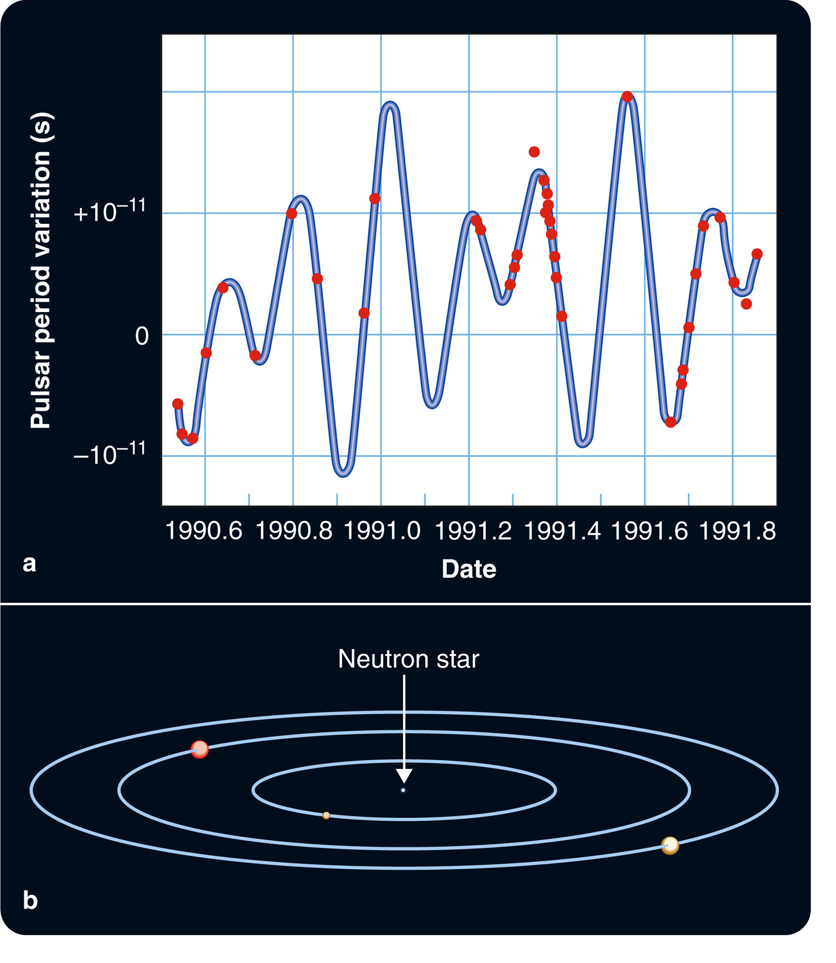
Pulsar Planets
When astronomers checked pulsar PSR1257+12, they found variations in the period of pulsation analogous to the variations caused by the orbital motion of the binary pulsar—but much smaller.

Slide 222
Pulsar Planets
When the variations were interpreted as Doppler shifts, it became evident that the pulsar was being orbited by at least two objects—with planetlike masses of about 4 and 3 Earth masses.

Slide 223
Pulsar Planets
The gravitational tugs of the planets make the pulsar wobble about the center of mass of the system by about 800 km.
That produces the tiny changes in period that are observed.

Slide 224
Pulsar Planets
Astronomers greeted this discovery with both enthusiasm and skepticism.
As usual, they looked for ways to test the hypothesis.
Simple gravitational theory predicts that the planets should interact and slightly modify each other’s orbit.
When the data were analyzed, that interaction was found—further confirming the hypothesis that the variations in the period of the pulsar are caused by planets.

Slide 225
Pulsar Planets
In fact, further observations and analyses revealed the presence of two more planets—one about twice the mass of Earth’s moon and the other only 3 percent the mass of Earth’s moon.
This illustrates the astonishing precision of studies based on pulsar timing.

Slide 226
Pulsar Planets
Astronomers wonder how a neutron star can have planets.
The inner three planets that orbit PSR1257+12 are closer to the pulsar than Venus is to the sun.
Any planets that orbit a star would be lost or vaporized when the star exploded.
Furthermore, a star about to explode as a supernova would be a large giant or a supergiant.
Planets only a few AU distant would be inside such a large star and could not survive.

Slide 227
Pulsar Planets
It seems more likely that these planets are the remains of a stellar companion that was devoured by the neutron star.
In fact, PSR1257+12 is very fast—162 pulses per second.
This suggests that it was spun up in a binary system.

Slide 228
Black Holes
The physics of black holes is difficult to discuss without sophisticated mathematics.
However, simple logic is sufficient to predict that they should exist.
The problem is to use their predicted properties and try to confirm that they exist.

Slide 229
Black Holes
What objects observed in the heavens could be real black holes?
More difficult than the search for neutron stars is the quest for black holes.
Nevertheless, it has met with success.

Slide 230
Black Holes
To begin, you must consider a simple question.
How fast must an object travel to escape from the surface of a celestial body?
The answer will lead to black holes.

Slide 231
Escape Velocity
Escape velocity is the initial velocity an object needs to escape from a celestial body.
It depends on two things:
Mass of the celestial body
Distance from the center of mass to the escapee’s starting point

Slide 232
Escape Velocity
If the celestial body has a large mass, its gravity is strong, and you need a high velocity to escape from its surface.
If you begin your journey farther from the center of mass, the velocity needed is less.

Slide 233
Escape Velocity
For example, to escape from Earth, a spaceship would have to leave Earth’s surface at 11 km/s (25,000 mph).
However, if you could launch spaceships from the top of a tower 1,000 miles high, the escape velocity would be only 8.8 km/s (20,000 mph).

Slide 234
Escape Velocity
An object massive enough and/or small enough could have an escape velocity greater than the speed of light.
Relativity says that nothing can travel faster than the speed of light.
So, even photons would be unable to escape.
This small, massive object could never be seen—light could not leave it.

Slide 235
Escape Velocity
This was first noted by British astronomer Reverend John Mitchell in 1783—long before Einstein and relativity.

Slide 236
Schwarzschild Black Holes
If the core of a star collapses and contains more than about 3 solar masses, no force can stop the collapse.

Slide 237
Schwarzschild Black Holes
When the object reaches the size of a white dwarf, the collapse continues—because degenerate electrons cannot support that much weight.
It also cannot stop when it reaches the even smaller size of a neutron star—because degenerate neutrons also cannot support that weight.
No force remains to stop the object from collapsing to zero radius.

Slide 238
Schwarzschild Black Holes
As an object collapses, its density and the strength of its surface gravity increase.
If it collapses to zero radius, its density becomes infinite.
Mathematicians call such a point a singularity.

Slide 239
Schwarzschild Black Holes
In physical terms, it is difficult to imagine an object of zero radius.
Some theorists believe that a singularity is impossible and that the laws of quantum physics must somehow halt the collapse at some subatomic radius roughly 10²⁰ times smaller than a proton.
Astronomically, it seems to make little difference.

Slide 240
Schwarzschild Black Holes
If the contracting core of a star becomes small enough, the escape velocity in the region around it is so large that no light can escape.
You can receive no information about the object or about the region of space near it.

Slide 241
Schwarzschild Black Holes
Such a region is called a black hole.
Note that the term black hole refers to a volume of space—not just the singularity at the region’s center.

Slide 242
Schwarzschild Black Holes
If the core of an exploding star collapsed to create a black hole, the expanding outer layers of the star could produce a supernova remnant.
The core, though, would vanish without a trace.

Slide 243
Schwarzschild Black Holes
Albert Einstein’s mathematical theory of space and time, the general theory of relativity, treats space and time as a single entity—space-time.
His equations showed that gravity could be described as a curvature of space-time.

Slide 244
Schwarzschild Black Holes
Almost immediately, astronomer Karl Schwarzschild found a way to solve the equations to describe the gravitational field around a single, nonrotating, electrically neutral lump of matter.
That solution contained the first general relativistic description of a black hole.
Nonrotating, electrically neutral black holes are now known as Schwarzschild black holes.

Slide 245
Schwarzschild Black Holes
In recent decades, theorists such as Roy P. Kerr and Stephen W. Hawking have found ways to apply the sophisticated mathematical equations of the general theory of relativity and quantum mechanics to black holes that are rotating and have electrical charges.
For this discussion, the differences are minor.
You may proceed as if all black holes were Schwarzschild black holes.

Slide 246
Schwarzschild Black Holes
Schwarzschild’s solution shows that, if matter is packed into a small enough volume, then space-time curves back on itself.
Objects can still follow paths that lead into the black hole, but no path leads out.
So, nothing can escape—not even light.
Consequently, the inside of the black hole is totally beyond the view of an outside observer.

Slide 247
Schwarzschild Black Holes
The event horizon is the boundary between the isolated volume of space-time and the rest of the universe.

Slide 248
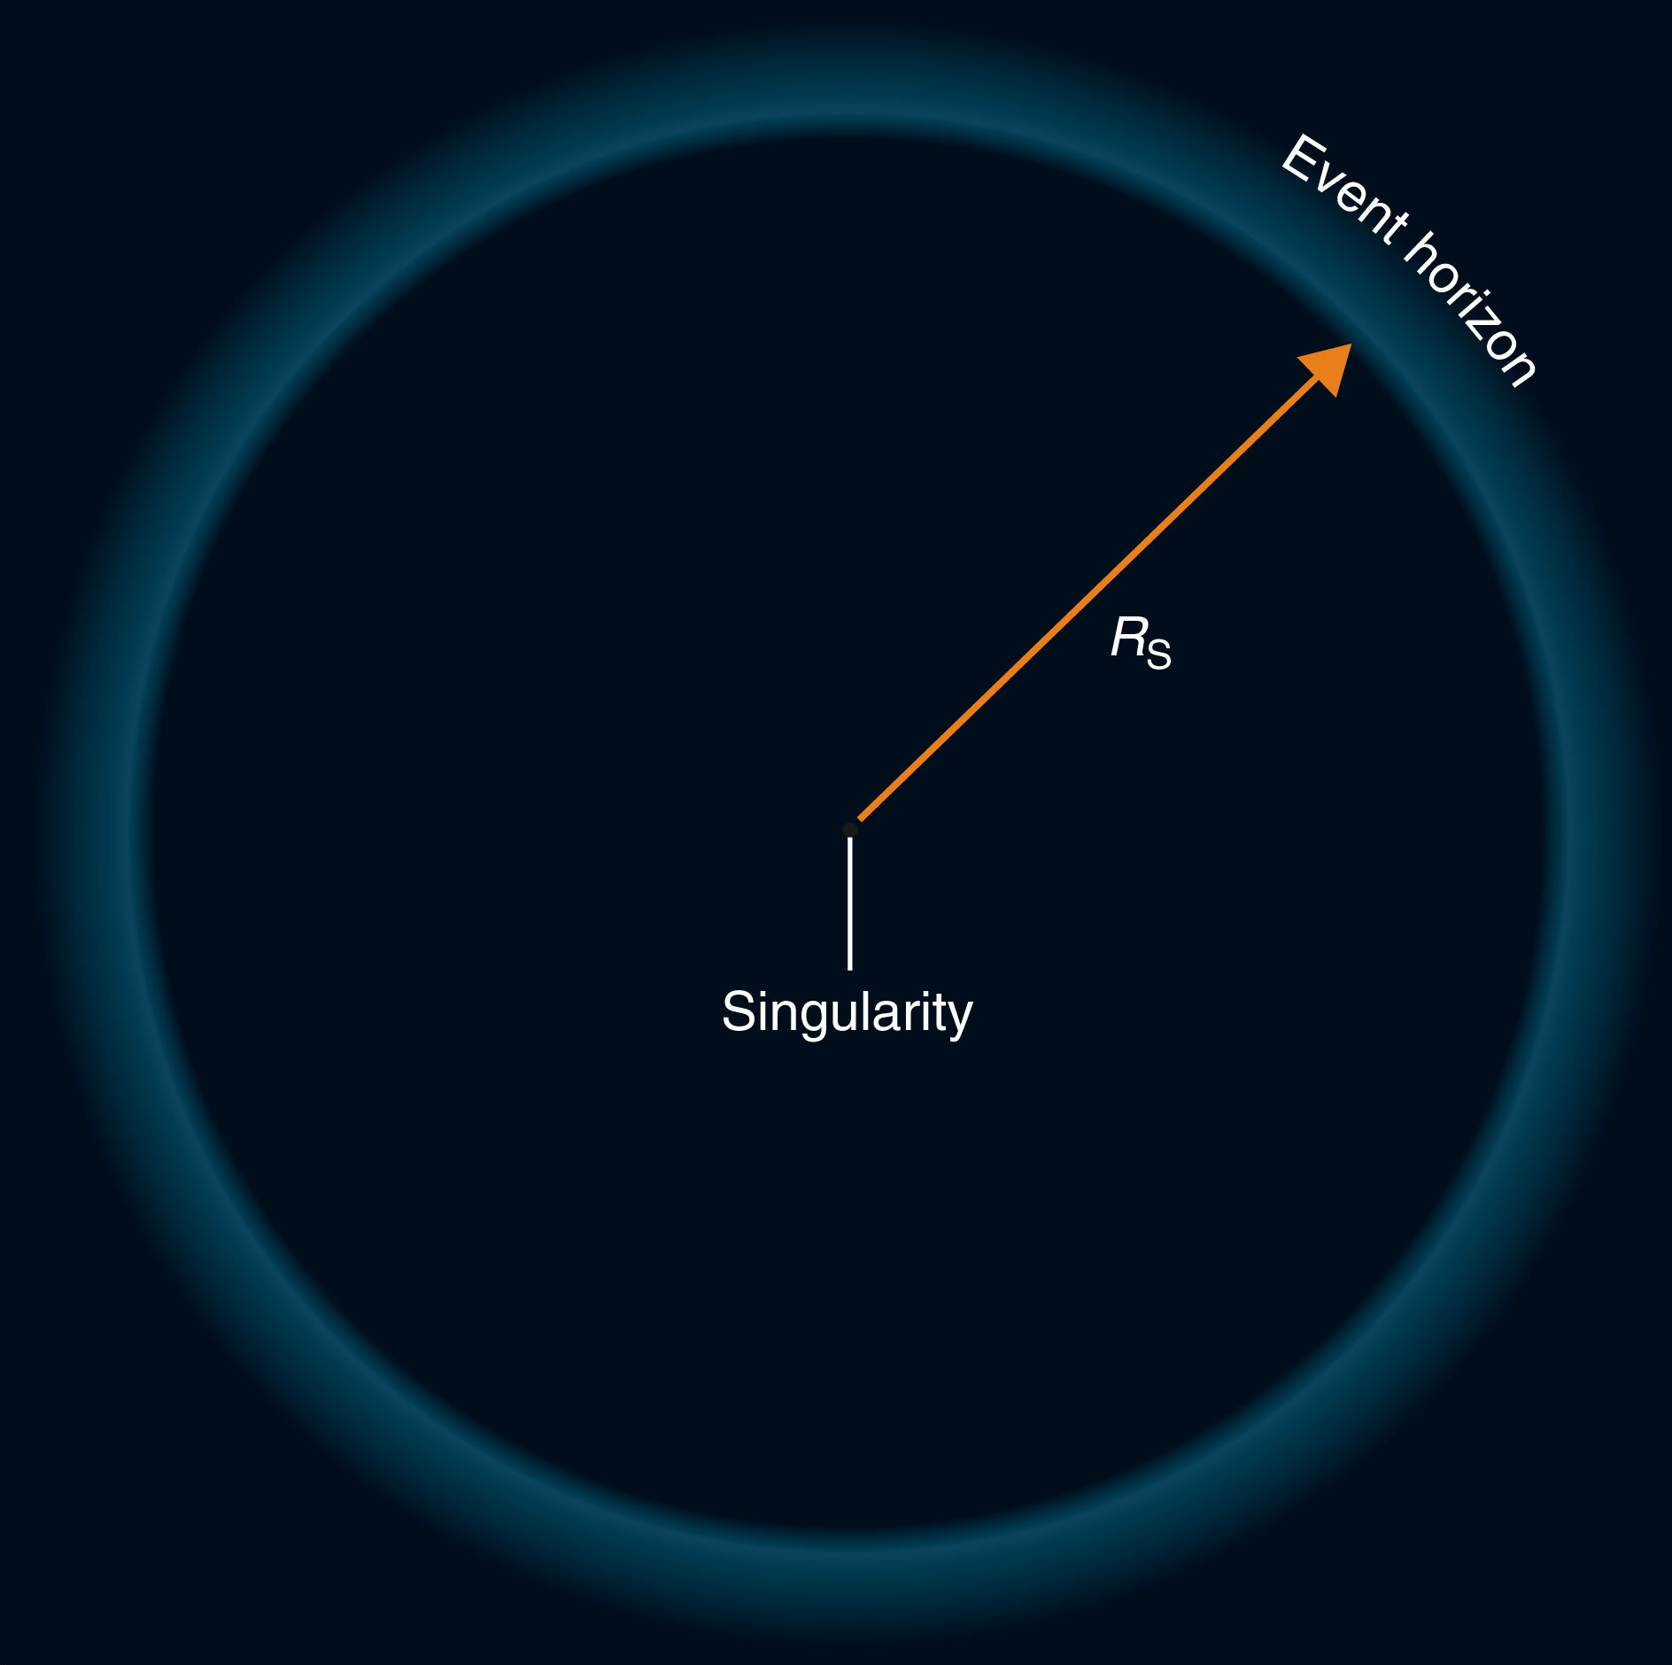
Schwarzschild Black Holes
The radius of the event horizon is called the Schwarzschild radius, R_{S}.
This is the radius within which an object must shrink to become a black hole and the point of no return for any object falling in later.

Slide 249
Schwarzschild Black Holes
Schwarzschild’s work was highly mathematical.
However, his conclusion is quite simple.
The size of a black hole—its Schwarzschild radius—is simply proportional to its mass.

Slide 250
Schwarzschild Black Holes
Thus, a 3-solar-mass black hole will have a Schwarzschild radius of about 9 km, a 10-solar-mass black hole will have a Schwarzschild radius of 30 km, and so on.
Note that even a very massive black hole would not be very large—just a few miles across.

Slide 251
Schwarzschild Black Holes
It is a common misconception to think of black holes as giant vacuum cleaners that will suck up everything in the universe.
A black hole is just a gravitational field.
At a reasonably large distance, its gravity is no greater than that of a normal object of similar mass.
If the sun were replaced by a 1-solar-mass black hole, the planets’ orbits would not change at all.

Slide 252
Schwarzschild Black Holes
The gravity of a black hole becomes extreme only when you approach very close to it.
The figure illustrates this by representing gravitational fields as curvature of the fabric of space-time.

Slide 253
Schwarzschild Black Holes
Physicists like to graph the strength of gravity around a black hole as curvature in a flat sheet.
The graphs look like funnels in which the depth of the funnel indicates the strength of the gravitational field.

Slide 254
Schwarzschild Black Holes
However, black holes are not shaped like funnels.
They are spheres or spheroids.

Slide 255
Leaping into a Black Hole
Before you can search for real black holes, you must understand what theory predicts about the behavior of a black hole.

Slide 256
Leaping into a Black Hole
To explore that idea, you can imagine that you leap, feet-first, into a Schwarzschild black hole.

Slide 257
Leaping into a Black Hole
If you were to leap into a black hole of a few solar masses from a distance of 1 AU, the gravitational pull would not be very large—you would fall slowly at first.
The longer you fell and the closer you came to the centre, the faster you would travel.
Your wristwatch would show you that you fell for about 2 months before you reached the event horizon.

Slide 258
Leaping into a Black Hole
Your friends who stayed behind would see something different.
They would see you falling more slowly as you came closer to the event horizon.
This is because, as explained by general relativity, time slows down in curved space-time.
This is known as time dilation.

Slide 259
Leaping into a Black Hole
In fact, your friends would never actually see you cross the event horizon.
To them, you would fall more and more slowly until you seemed hardly to move.
Generations later, your descendants could focus their telescopes on you—and see you still inching closer to the event horizon.
You, however, would have sensed no slowdown and would conclude that you had crossed the event horizon after about 2 months.

Slide 260
Leaping into a Black Hole
Another relativistic effect would make it difficult to see you with normal telescopes.
As light travels out of a gravitational field, it loses energy, and its wavelength grows longer.
This is known as the gravitational redshift.
Although you would notice no effect as you fell toward the black hole, your friends would need to observe at longer and longer wavelengths in order to detect you.

Slide 261
Leaping into a Black Hole
While these relativistic effects seem merely peculiar, other effects would be quite unpleasant.

Slide 262
Leaping into a Black Hole
If you were falling feet-first toward the event horizon of a black hole, you would feel your feet—which would be closer to the black hole—being pulled in more strongly than your head.
This is a tidal force.

Slide 263
Leaping into a Black Hole
At first, the tidal force would be minor.
As you fell closer, however, it would become very large.

Slide 264
Leaping into a Black Hole
Another tidal force would compress you as your left side and your right side both fell toward the center of the black hole.

Slide 265
Leaping into a Black Hole
For any black hole with a mass like that of a star, the tidal forces would crush you laterally and stretch you longitudinally—long before you reached the event horizon.
Needless to say, this would render you inoperative as a thoughtful observer.

Slide 266
Leaping into a Black Hole
Sometimes, science fiction books, movies, and TV shows suggest:
You could travel through the universe by jumping into a black hole in one place and popping out of another somewhere far across space.

Slide 267
Leaping into a Black Hole
That might make for good science fiction.
Tidal forces, though, would make it an unpopular form of transportation—even if it worked.
You would certainly lose your luggage.

Slide 268
Leaping into a Black Hole
You now know how to find a black hole.
Look for a strong source of X rays that may be from matter just before disappearing as it approaches the event horizon.

Slide 269
The Search for Black Holes
An isolated black hole is totally invisible—nothing can escape from the event horizon.
However, a black hole into which matter is flowing would be a source of X rays.

Slide 270
The Search for Black Holes
Of course, X rays can’t escape from inside the event horizon.
However, X rays emitted by the heated matter flowing into the black hole can escape—if the X rays were emitted before the matter crossed the event horizon.

Slide 271
The Search for Black Holes
An isolated black hole in space will not have much matter flowing into it.
A black hole in a binary system, though, might receive a steady flow of matter transferred from the companion star.

Slide 272
The Search for Black Holes
Thus, you can search for black holes by searching among X-ray binaries.

Slide 273
The Search for Black Holes
X-ray binaries such as Hercules X-1 contain a neutron star.
Also, they emit X rays much as a binary containing a black hole should.
You can, however, tell the difference in two ways.

Slide 274
The Search for Black Holes
If the compact object emits pulses, it is a neutron star.
Otherwise, you must depend on the mass of the object.
If the mass of the compact object is greater than 3 solar masses, it cannot be a neutron star.
You can conclude that it must be a black hole.

Slide 275
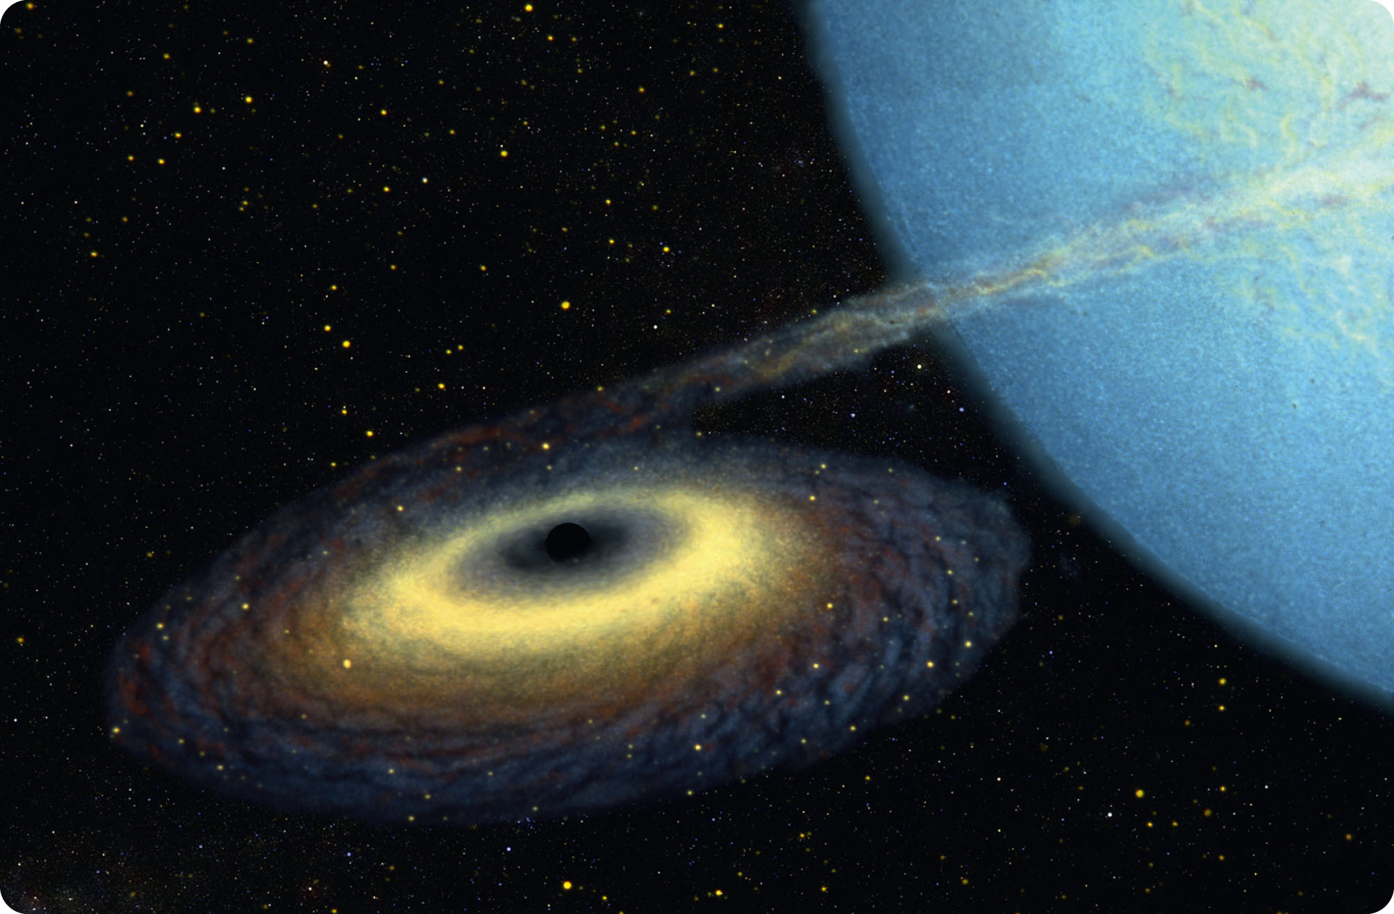
The Search for Black Holes
The first X-ray binary suspected of harboring a black hole was Cygnus X-1.
It contains a supergiant B0 star and a compact object orbiting each other with a period of 5.6 days.

Slide 276
The Search for Black Holes
Matter flows from the B0 star as a strong stellar wind.
Some of that matter enters a hot accretion disk around the compact object.

Slide 277
The Search for Black Holes
The disk is about 5 times larger in diameter than the orbit of Earth’s moon.
The inner few hundred kilometers of the disk have a temperature of about 2 million Kelvin—hot enough to radiate X rays.

Slide 278
The Search for Black Holes
The compact object is invisible.
However, Doppler shifts in the spectrum reveal the motion of the B0 star around the center of mass of the binary.

Slide 279
The Search for Black Holes
From the geometry of the orbit, astronomers were able to calculate the mass of the object.
It is at least 3.8 solar masses— well above the maximum for a neutron star.

Slide 280
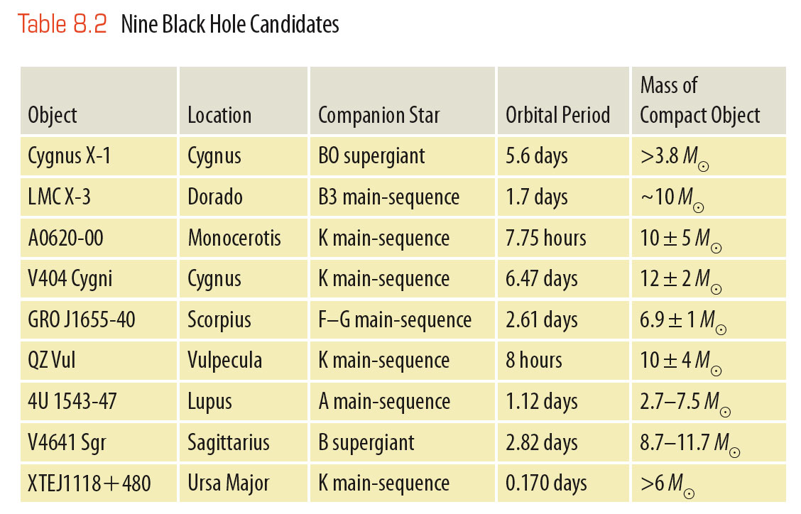
The Search for Black Holes
As X-ray telescopes have found more X-ray objects, the list of black hole candidates has grown to a few dozen.
A few of these objects are shown in the table.

Slide 281
The Search for Black Holes
Each candidate is a compact object surrounded by a hot accretion disk in a close X-ray binary system without regular pulsations.

Slide 282
The Search for Black Holes
Some of the binary systems are easier to analyze than others.
In the end, though, it has become clear that some of these objects are too massive to be neutron stars.

Slide 283
The Search for Black Holes
Absolute proof is not possible in science.
Nevertheless, the evidence is now overwhelming.
Black holes really do exist.

Slide 284
The Search for Black Holes
Another way to confirm that black holes are real is to search for evidence of their distinguishing characteristic—event horizons.
That search has been successful too.

Slide 285
The Search for Black Holes
In one study, astronomers selected twelve X-ray binary systems.
Of these, six seemed to contain neutron stars and six were believed to contain black holes.
Using X-ray telescopes, the astronomers could see flares of energy as blobs of matter fell into the accretion disks and spiraled inward.

Slide 286
The Search for Black Holes
In the six systems believed to contain neutron stars, the astronomers could also detect bursts of energy when the blobs of matter finally fell onto the surfaces of the neutron stars.

Slide 287
The Search for Black Holes
In the six systems believed to contain black holes, however, the blobs of matter spiraled inward through the accretion disks and vanished without final bursts of energy.
Evidently, those blobs of matter had approached the event horizons and become undetectable due to time dilation and gravitational redshift.
This is dramatic evidence that event horizons are real.

Slide 288
Energy from Compact Objects: Jets
It is a common misconception that it is impossible to get any energy out of a black hole.
Pause here to learn how a compact object and an accretion disk can eject powerful jets.

Slide 289
Energy from Compact Objects: Jets
Whether a compact object is a black hole or a neutron star, it has a strong gravitational field.
Any matter flowing into that field is accelerated inward.

Slide 290
Energy from Compact Objects: Jets
As it must conserve angular momentum, it flows into an accretion disk made so hot by friction that the inner regions can emit X rays and gamma rays.
Somehow, the spinning disk can emit powerful beams of gas and radiation along its axis of rotation.

Slide 291
Energy from Compact Objects: Jets
The process isn’t well understood.
It seems to involve magnetic fields that get caught in the accretion disk and are twisted into tightly wound tubes.
The tubes squirt gas and radiation out of the disk and confine it in narrow beams.

Slide 292
Energy from Compact Objects: Jets
The process is similar to the bipolar outflows ejected by protostars.
Only, it is much more powerful.

Slide 293
Energy from Compact Objects: Jets
One example of the process is an X-ray binary called SS433.
Its optical spectrum shows sets of spectral lines that are Doppler-shifted by about one-fourth the speed of light.
One set is shifted to the red and one to the blue.

Slide 294
Energy from Compact Objects: Jets
Apparently, SS433 is a binary system in which a compact object—probably a black hole—pulls matter from its companion star and forms an extremely hot accretion disk.
Jets of high-temperature gas blast away in beams aimed in opposite directions.

Slide 295
Energy from Compact Objects: Jets
SS433 is a prototype that illustrates how the gravitational field around a compact object can produce powerful beams of radiation and matter.

Slide 296
Energy from Compact Objects: Gamma-Ray Bursts
During the 1960s, the United States put a series of satellites in orbit.
This was to watch for bursts of gamma rays coming from Earth indicating nuclear weapons tests that would be violations of an international treaty.

Slide 297
Energy from Compact Objects: Gamma-Ray Bursts
The experts were startled.
The satellites detected about one gamma-ray burst coming from space per day.

Slide 298
Energy from Compact Objects: Gamma-Ray Bursts
The Compton Gamma Ray Observatory launched in 1991 discovered that gamma-ray bursts were occurring all over the sky and not from any particular region.

Slide 299
Energy from Compact Objects: Gamma-Ray Bursts
Starting in 1997, new satellites in orbit were able to:
Detect gamma-ray bursts
Determine their location in the sky
Immediately alert astronomers on the ground

Slide 300
Energy from Compact Objects: Gamma-Ray Bursts
When telescopes swiveled to image the locations of the bursts, they detected fading glows that resembled supernovae.
That has led to the conclusion that some relatively long gamma-ray bursts are produced by a kind of super nova explosion called a hypernova.

Slide 301
Energy from Compact Objects: Gamma-Ray Bursts
Theoretical calculations indicate that a star more massive than some threshold around 15 or 20 solar masses will collapse and become a black hole when its nuclear fuel is exhausted.

Slide 302
Energy from Compact Objects: Gamma-Ray Bursts
Models show that the collapsing star would conserve angular momentum and spin very rapidly.
That would slow the collapse of the equatorial parts of the star.

Slide 303
Energy from Compact Objects: Gamma-Ray Bursts
The poles of the star would fall in quickly.
That would focus beams of intense radiation and ejected gas blasting out along the axis of rotation,
resulting in a hypernova.

Slide 304
Energy from Compact Objects: Gamma-Ray Bursts
If either of the beams happens to point in the right direction, Earth would receive a powerful gamma-ray burst.

Slide 305
Energy from Compact Objects: Gamma-Ray Bursts
The evidence seems clear that at least some of the gamma-ray bursts are produced by hypernovae.

Slide 306
Energy from Compact Objects: Gamma-Ray Bursts
Massive stars explode as hypernovae only rarely in any one galaxy.
Nevertheless, the gamma-ray bursts they produce are so powerful that astronomers can detect these explosions among a vast number of galaxies.

Slide 307
Energy from Compact Objects: Gamma-Ray Bursts
Other gamma-ray bursts may be produced by the merger of two neutron stars or a neutron star and a black hole.
Still others may be produced by sudden shifts in the crusts of highly magnetized neutron stars.

Slide 308
Energy from Compact Objects: Gamma-Ray Bursts
Incidentally, if a gamma-ray burst occurred only 1,600 ly from Earth, the gamma rays would shower Earth with radiation equivalent to a 10,000-megaton nuclear blast.
The largest bombs ever made were a few tens of megatons in size.

Slide 309
Energy from Compact Objects: Gamma-Ray Bursts
The rays could create enough nitric oxide in the atmosphere to produce intense acid rain and would destroy the ozone layer—exposing life on Earth to deadly levels of solar ultraviolet radiation.
Gamma-ray bursts can occur relatively near Earth as often as every few 100 million years.
They could be one of the causes of the mass extinctions that show up in the fossil record.

