Slide 1
Chapter 9
Stars

Slide 2
This chapter concentrates on five goals:
Knowing how far away stars are
How much energy they emit
What their surface temperatures are
How big they are
How much mass they contain

Slide 3
Star Distances
Distance is the most important, and the most difficult, measurement in astronomy.
Parallax
You have learned that parallax is the term that refers to the common experience of an apparent shift in the position of a foreground object due to a change in the location of the observer’s viewpoint.

Slide 4
If you take a photo of a nearby star and then wait six months, Earth will have moved halfway around its orbit.
You can then take another photo of the star from a slightly different location in space.
When you examine the photos, you will discover that a star is not in exactly the same place in the two photos

Slide 5
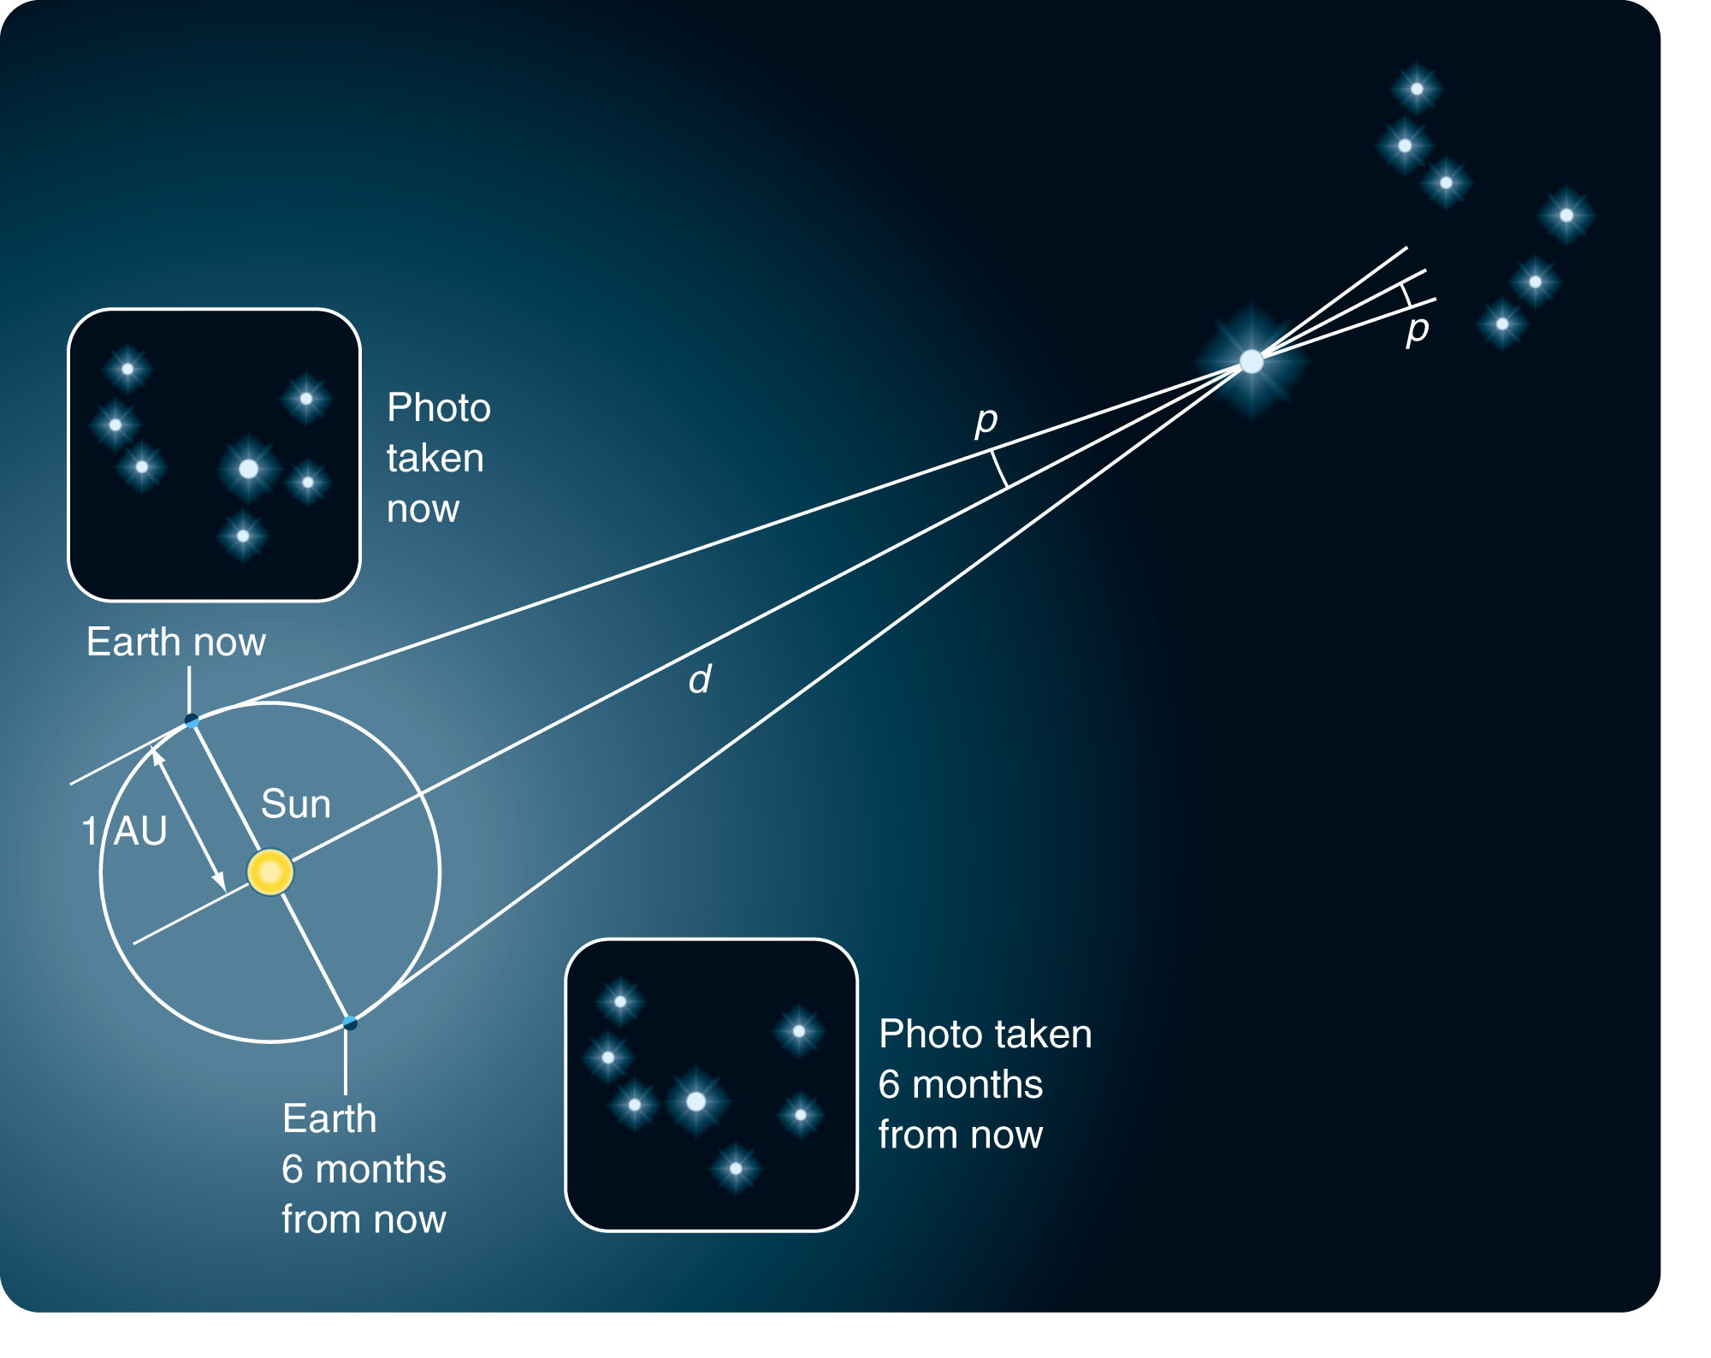

Slide 6
The Astronomer’s Triangulation Method
As the stars are so distant, their parallaxes are very small angles—usually expressed in arc seconds.
The quantity that astronomers call stellar parallax (p) is defined as half the total shift of the star.
In other words, it is the shift seen across a baseline of 1 AU rather than 2 AU.

Slide 7
Astronomers measure the parallax.
Surveyors measure the angles at the ends of the baseline.
Both measurements show the same thing—the shape and size of the triangle and thus the distance.
Measuring the parallax p is very difficult because it is such a small angle.
The nearest star, Alpha Centauri, has a parallax of only 0.76 arc seconds.
More distant stars have even smaller parallaxes

Slide 8
The distances to the stars are so large that it is not convenient to use kilometers or astronomical units.
When you measure distance via parallax, it is better to use the unit of distance called a parsec (pc).
The word parsec was created by combining parallax and arc second.

Slide 9
One parsec equals the distance to an imaginary star that has a parallax of 1 arc second.
A parsec is 206,265 AU—roughly 3.26 ly.
Parsec units are used more often than light-years by astronomers because parsecs are more directly related to the process of measurement of star distances.
However, there are instances in which the light-year is also useful

Slide 10
Parallax would be easier to measure if
a. Earth's orbit was larger.
b. the stars were farther away.
c. Earth moved faster along its orbit.
d. all of these
e. none of these

Slide 11
Star Apparent Brightness, Intrinsic Brightness, and Luminosities
Your eyes tell you that some stars look brighter than others.
Also, you have learned about the apparent magnitude scale that refers to stellar apparent brightness.

Slide 12
However, the scale informs you only how bright stars appear to you on Earth.
To know the true nature of a star, you must know its intrinsic brightness.
This is a measure of the amount of energy the star emits.
An intrinsically very bright star might appear faint if it is far away.
Thus, to know the intrinsic brightness of a star, you must take into account its distance.

Slide 13
Astronomers and physicists define flux as the energy in Joules (J) per second falling on 1 square meter.
A Joule is about the amount of energy released when an apple falls from a table onto the floor. A flux of 1 Joule per second is also known as 1 Watt.
The wattage of a light bulb gives you its intrinsic brightness.
Compare that with the apparent brightness of a light bulb, which depends on its distance from you.

Slide 14
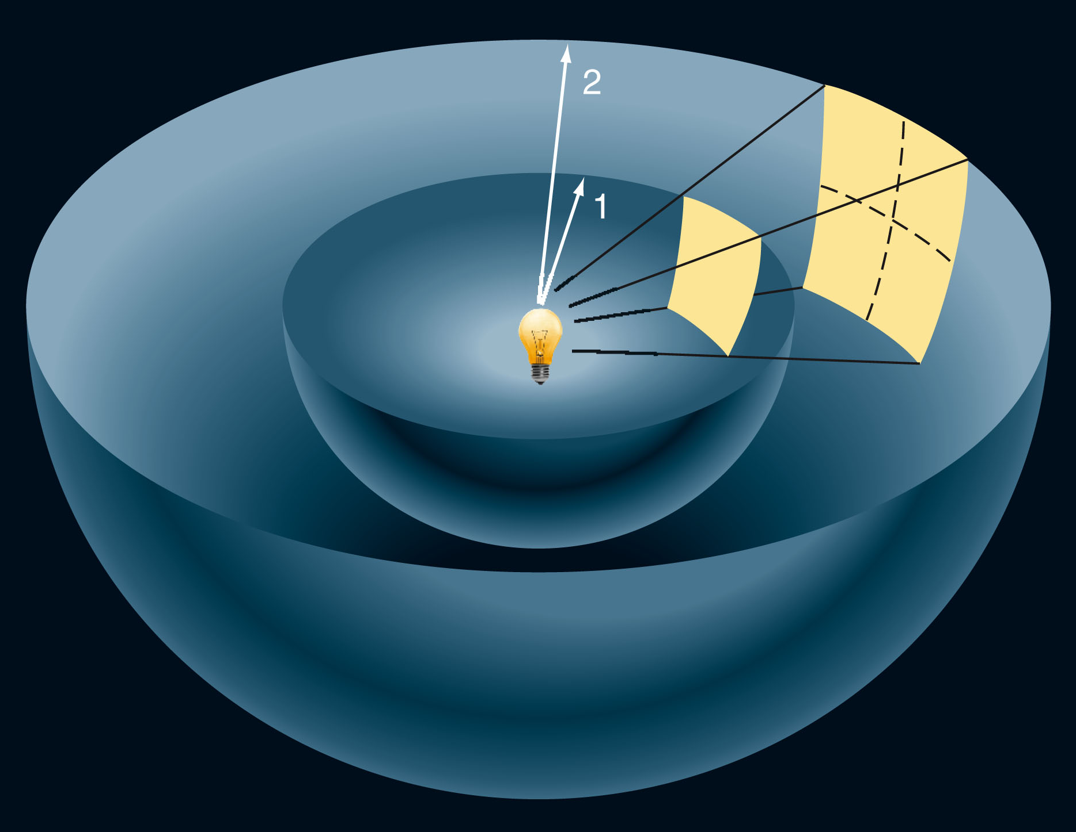
the flux you receive from a light source is inversely proportional to the square of the distance to the source.
This is known as the inverse square relation.

Slide 15
Absolute Visual Magnitude
If, however, you know the distance to a star, you can use the inverse square relation to calculate the brightness the star would have at some standard distance.

Slide 16
Astronomers use 10 pc as the standard distance.
They refer to the intrinsic brightness of the star as its absolute visual magnitude (M_{V}). This is the apparent visual magnitude that the star would have if it were 10 pc away.
The subscript V informs you it is a visual magnitude—referring to only the wavelengths of light your eye can see.

Slide 17
Absolute visual magnitude is
a. the apparent magnitude of a star observed from Earth.
b. the luminosity of a star observed from a distance of 1000 pc.
c. the apparent magnitude of a star observed from a distance of 10 pc.
d. the luminosity of a star observed from Earth.
e. c and d

Slide 18
Other magnitude systems are based on other parts of the electromagnetic spectrum—such as infrared and ultraviolet radiation.
The sun’s absolute magnitude is easy to calculate—because its distance and apparent magnitude are well known.
The absolute visual magnitude of the sun is about 4.8.
In other words, if the sun were only 10 pc (33 ly) from Earth, it would have an apparent magnitude of 4.8.
It would look no brighter to your eye than the faintest star in the handle of the Little Dipper.

Slide 19
Luminosity
The second goal for the chapter is to find out how much energy the stars emit.
With the knowledge of the absolute magnitudes of the stars, you can now compare stars using our sun as a standard.
The intrinsically brightest stars have absolute magnitudes of about –8.
This means that, if such a star were 10 pc away from Earth, you would see it nearly as bright as the moon.
Such stars emit over 100,000 times more visible light than the sun.

Slide 20
Absolute visual magnitude refers to visible light.
However, you want to know the total output—including all types of radiation.
Hot stars emit a great deal of ultraviolet radiation that you can’t see.
Cool stars emit plenty of infrared radiation.

Slide 21
Luminosity
To add in the energy you can’t see, astronomers make a mathematical correction that depends on the temperature of the star.
With that correction, they can find the total electromagnetic energy output of a star.
They refer to this as its luminosity (L).

Slide 22
Luminosity
Astronomers know the luminosity of the sun because they can send satellites above Earth’s atmosphere and measure the amount of energy arriving from the sun.
Also, they add up radiation of every wavelength, including the types blocked by the atmosphere.

Slide 23
Luminosity
Of course, they also know the distance from Earth to the sun very accurately—which is necessary to calculate luminosity.
The luminosity of the sun is about 4x10²⁶ Watts (Joules per second).

Slide 24
Luminosity
You can express a star’s luminosity in two ways.
For example, you can say that the star Capella (Alpha Aurigae) is 100 times more luminous than the sun.
You can also express this in real energy units by multiplying by the luminosity of the sun.
The luminosity of Capella is 4x10²⁸ Watts.

Slide 25
Luminosity
When you look at the night sky, the stars look much the same.
Yet, your study of distances and luminosities reveals an astonishing fact.
Some stars are almost a million times more luminous than the sun, and some are almost a million times less luminous.
Clearly, the family of stars is filled with interesting characters.

Slide 26
A star's luminosity depends only on the star's
a. distance and diameter.
b. temperature and distance.
c. distance.
d. temperature and diameter.
e. apparent magnitude.

Slide 27
Star Temperatures
Your third goal in the chapter is to learn about the temperatures of stars.

Slide 28
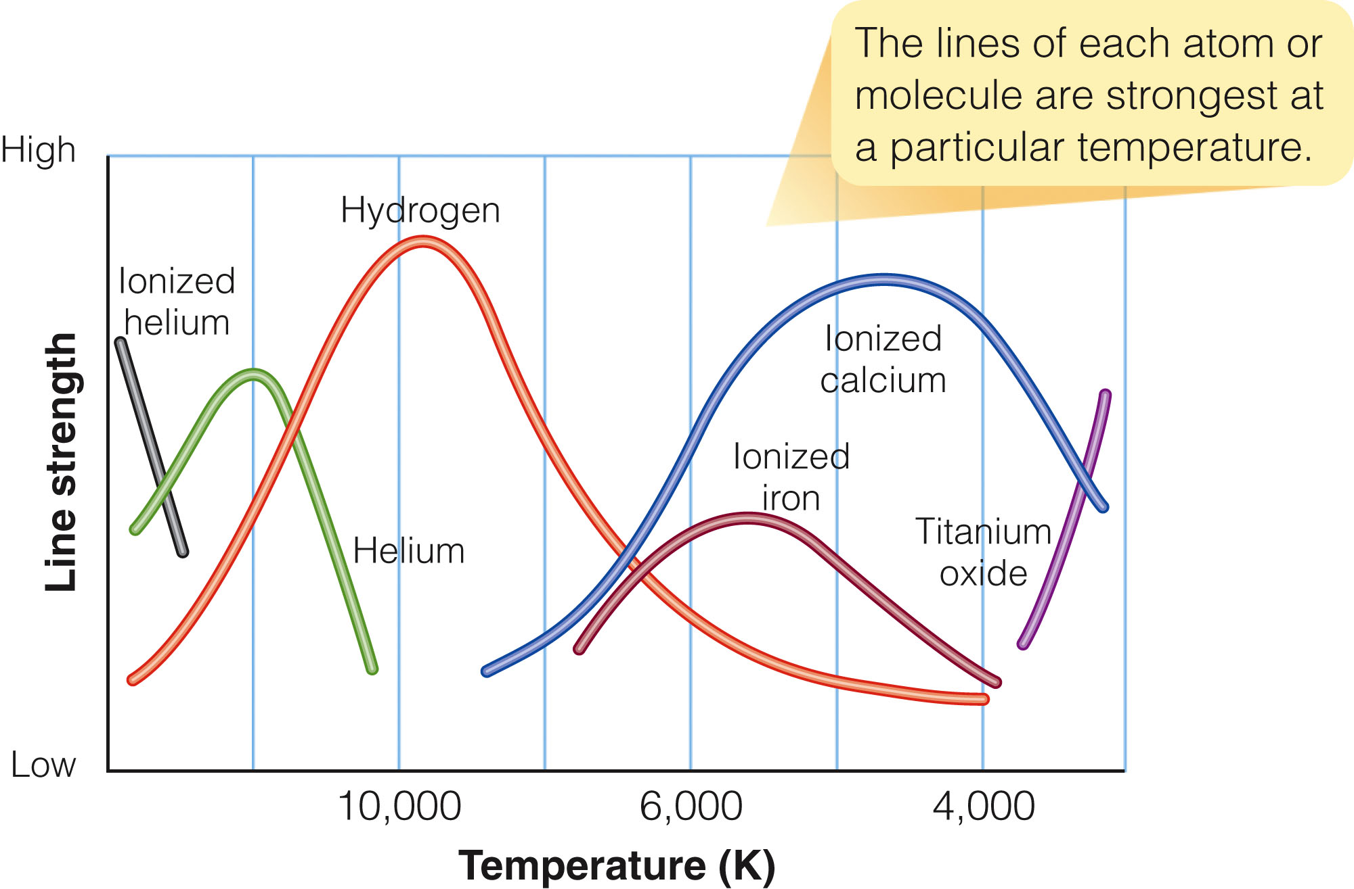
Star Temperatures
The surprising fact is that stellar spectral lines can be used as a sensitive star thermometer.

Slide 29
Spectral Lines and Temperature
From the study of blackbody radiation, you know that temperatures of stars can be estimated from their color—red stars are cool, and blue stars are hot.
However, the relative strengths of various spectral lines give much greater accuracy in measuring star temperatures.

Slide 30
Spectral Lines and Temperature
You have also learned that, for stars, the term surface refers to the photosphere.
This is the limit of our vision into the star from outside.
This is not, however, an actual solid surface.

Slide 31
Spectral Lines and Temperature
Stars typically have surface temperatures of a few thousand or tens of thousands of degrees Kelvin.
As you will discover later, the centers of stars are much hotter than their surfaces—many millions of degrees.
The spectra, though, inform only about the outer layers from which the light you see originates.

Slide 32
Spectral Lines and Temperature
As you have learned, hydrogen Balmer absorption lines are produced by hydrogen atoms with electrons initially in the second energy level.

Slide 33
Spectral Lines and Temperature
The strength of these spectral lines can be used to gauge the temperature of a star.
This is because, from lab experiments with gasses and radiation and also from theoretical calculations, scientists know of various things.

Slide 34
Spectral Lines and Temperature
One, if the surface of a star is as cool as the sun or cooler, there are few violent collisions between atoms to excite the electrons.
Most atoms will have their electrons in the ground (lowest) state.
These atoms can’t absorb photons in the Balmer series.
Thus, you should expect to find weak hydrogen Balmer absorption lines in the spectra of very cool stars.

Slide 35
Spectral Lines and Temperature
Two, in the surface layers of stars hotter than about 20,000 K, there are many violent collisions between atoms.
These excite electrons to high energy levels or knock the electrons completely out of most atoms—so they become ionized.
In this case, few hydrogen atoms will have electrons in the second energy level to form Balmer absorption lines.
So, you should also find weak hydrogen Balmer absorption lines in the spectra of very hot stars.

Slide 36
Spectral Lines and Temperature
Finally, at an intermediate temperature—roughly 10,000 K—the collisions have the correct amount of energy to excite large numbers of electrons into the second energy level.
With many atoms excited to the second level, the gas absorbs Balmer wavelength photons well—producing strong hydrogen Balmer lines.

Slide 37
Spectral Lines and Temperature
Thus, the strength of the hydrogen Balmer lines depends on the temperature of the star’s surface layers.
Both hot and cool stars have weak Balmer lines.
Medium-temperature stars have strong Balmer lines.

Slide 38
Spectral Lines and Temperature
The figure shows the relationship between gas temperature and strength of spectral lines for hydrogen and other substances.

Slide 40
Spectral Lines and Temperature
Each type of atom or molecule produces spectral lines that are weak at high and low temperatures and strong at some intermediate temperature.
The temperature at which the lines reach maximum strength is different for each type of atom or molecule.

Slide 41
Astronomers can determine a star’s temperature by comparing the strengths of its spectral lines with the predicted strengths.
From stellar spectra, astronomers have found that the hottest stars have surface temperatures above 40,000 K and the coolest about 2,000 K.
Compare these with the surface temperature of the sun—which is about 5,800 K.

Slide 42
Learning to recognize the pattern of spectral lines produced in the atmospheres of stars of different temperatures means there is no need to do a full analysis every time each type of spectrum is encountered.
Time can be saved by classifying stellar spectra rather than analyzing each spectrum individually.

Slide 43
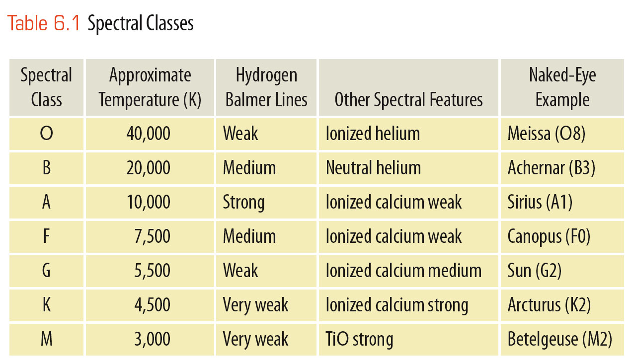
Temperature Spectral Classification
Astronomers classify stars by the lines and bands in their spectra.
For example, if it has weak Balmer lines and lines of ionized helium, it must be an O star.

Slide 45
Temperature Spectral Classification
The star classification system now used by astronomers was devised at Harvard during the 1890s and 1900s.
One of the astronomers there, Annie J. Cannon, personally inspected and classified the spectra of over 250,000 stars. The spectra were first classified in groups labeled A through Q.
Later, some groups were dropped, merged with others, or reordered.

Slide 46
The final classification includes seven main spectral classes or types that are still used today:
O, B, A, F, G, K, and M
This set of star types—called the spectral sequence—is important because it is a temperature sequence.
The O stars are the hottest.
The temperature continues to decrease down to the M stars, the coolest.

Slide 47
For further precision, astronomers divide each spectral class into 10 subclasses.
For example, spectral class A consists of the subclasses A0, A1, A2, . . . A8, and A9.
Next come F0, F1, F2, and so on.
These finer divisions define a star’s temperature to a precision of about 5 percent.
Thus, the sun is not just a G star.
It is a G2 star, with a temperature of 5,800 K.

Slide 48
Generations of astronomy students have remembered the spectral sequence by using various mnemonics.
Oh Boy, An F Grade Kills Me.
Only Bad Astronomers Forget Generally Known Mnemonics.
Recently, astronomers have added two more spectral classes—L and T.
These represent objects cooler than stars—called brown dwarfs.

Slide 49
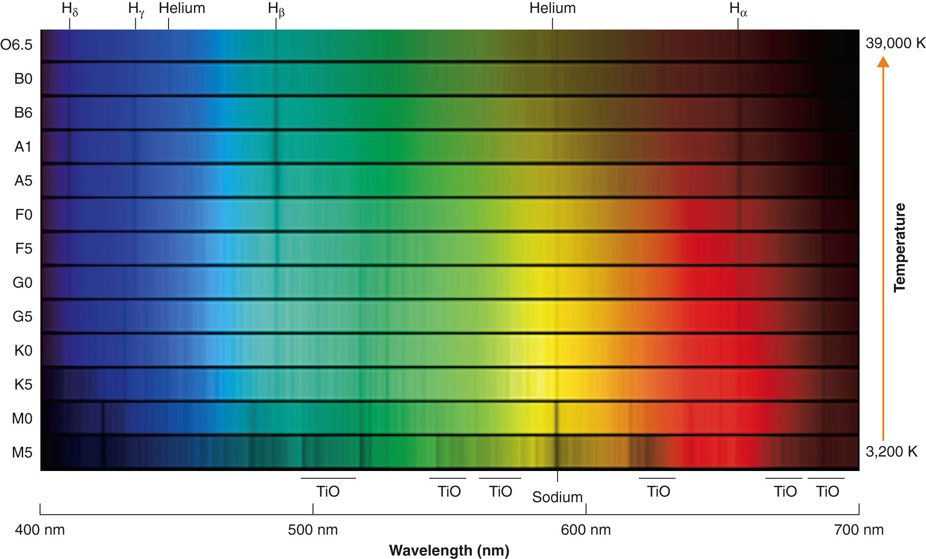
The figure shows color images of 13 stellar spectra—ranging from the hottest at the top to the coolest at the bottom.
Notice how spectral features change gradually from hot to cool stars.

Slide 51
Temperature Spectral Classification
Although these spectra are attractive, astronomers rarely work with spectra as color images.

Slide 52
Star Sizes
Your fourth goal in the chapter is to learn about the sizes of stars.

Slide 53
Star Sizes
Do stars all have the same diameter as the sun, or are some larger and some smaller?
You certainly can’t see their sizes through a telescope.
The images of the stars are much too small for you to resolve their disks and measure their diameters.
There is a way, however, to find out how big stars really are.

Slide 54
Luminosity, Temperature, and Diameter
The luminosity of a glowing object like a star is determined by its surface area and temperature.
For example, you can eat dinner by candlelight because the candle flame has a small surface area.
Although it is very hot, it cannot radiate much heat because it is small—it has a low luminosity.

Slide 55
Luminosity, Temperature, and Diameter
However, if the candle flame were 12 feet tall, it would have a very large surface area from which to radiate.
Although it might be the same temperatures as a normal candle flame, its luminosity would drive you from the table.

Slide 56
Luminosity, Temperature, and Diameter
Similarly, a star’s luminosity is proportional to its surface area.
A hot star may not be very luminous if it has a small surface area—but it could be highly luminous if it were larger.
Even a cool star could be luminous if it had a large surface area.
You can use stellar luminosities to determine the diameters of stars—if you can separate the effects of temperature and surface area.

Slide 57
Luminosity, Temperature, and Diameter
The Hertzsprung-Russell (H-R) diagram is a graph that separates the effects of temperature and surface area on stellar luminosities.
Thus, it enables astronomers to sort the stars according to their diameters.

Slide 58
Luminosity, Temperature, and Diameter
The diagram is named after its originators:
Ejnar Hertzsprung in the Netherlands
Henry Norris Russell in the United States

Slide 59
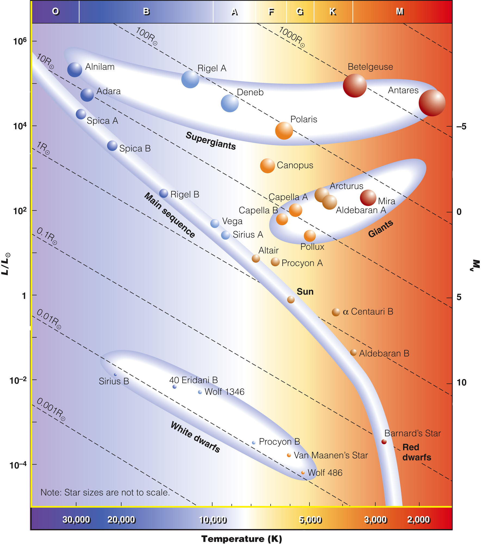
Luminosity, Temperature, and Diameter
The H-R diagram can help you understand different kinds of stars.
An H-R diagram has luminosity on the vertical axis and temperature on the horizontal axis.
A star is represented by a point on the graph that shows its luminosity and temperature.

Slide 60
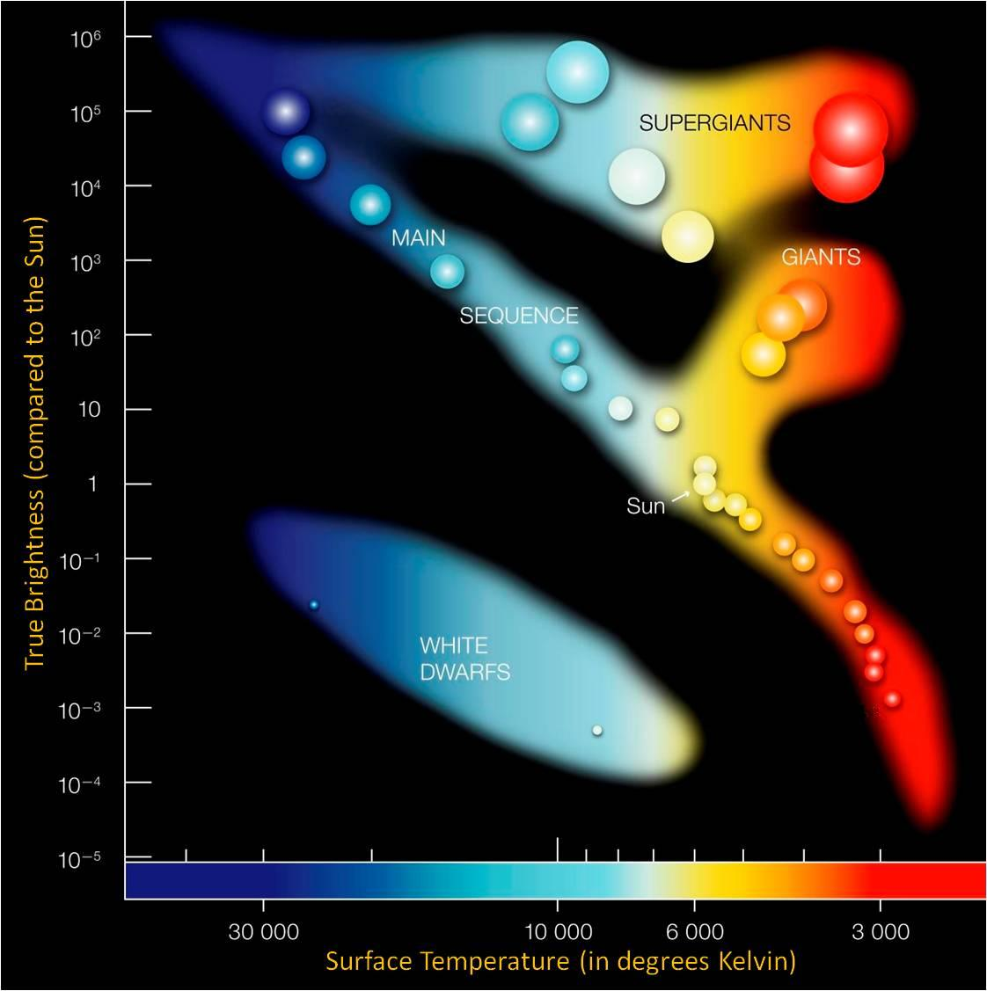

Slide 62
Luminosity, Temperature, and Diameter
Note that, in astronomy, the symbol Θ refers to the sun.
Thus, L_{Θ} refers to the luminosity of the sun, T_{Θ} refers to the temperature of the sun, and so on.
The diagram also contains a scale of spectral types across the top.
The spectral type of a star is determined by its temperature.
So, you can use either spectral type or temperature as the horizontal axis of the diagram.

Slide 63
Luminosity, Temperature, and Diameter
Astronomers use H-R diagrams so often that they usually skip the words “the point that represents the star.”
Rather, they will say that a star is located in a certain place in the diagram.
Of course, they mean the point that represents the luminosity and temperature of the star and not the star itself.

Slide 64
Luminosity, Temperature, and Diameter
The location of a star in the H-R diagram has nothing to do with the location of the star in space.
Furthermore, a star may move in the diagram as it ages and its luminosity and temperature change—but it has nothing to do with the star’s motion.

Slide 65
Luminosity, Temperature, and Diameter
The location of a point representing a star reveals a lot about the star.
Points near the top represent very luminous stars.
Points near the bottom represent very-low-luminosity stars.

Slide 66
Luminosity, Temperature, and Diameter
Also, points near the right edge represent very cool stars.
Points near the left edge represent very hot stars.

Slide 67
Luminosity, Temperature, and Diameter
In this figure, notice how color has been used to represent temperature.
Cool stars are red.
Hot stars are blue.

Slide 68
Luminosity, Temperature, and Diameter
The main sequence is the region of the diagram running from upper left to lower right.
It includes roughly 90 percent of all normal stars—represented by a curved line with dots for stars plotted along it.

Slide 69
Luminosity, Temperature, and Diameter
As you might expect, the hot main-sequence stars are more luminous than the cool main-sequence stars.

Slide 70
Luminosity, Temperature, and Diameter
In addition to temperature, size is important in determining the luminosity of a star.

Slide 71
Luminosity, Temperature, and Diameter
Some cool stars lie above the main sequence.
Although they are cool, they are luminous.
So, they must be larger—have more surface area—than main-sequence stars of the same temperature.

Slide 72
Luminosity, Temperature, and Diameter
These are called giant stars.
They are roughly 10 to 100 times larger than the sun.
The supergiant stars at the top of the diagram are as large as 1,000 times the sun’s diameter.

Slide 73
Luminosity, Temperature, and Diameter
In contrast, red dwarfs at the lower end of the main sequence are not only cool but also small, giving them low luminosities.

Slide 74
Luminosity, Temperature, and Diameter
In contrast, the white dwarfs lie in the lower left of the diagram.
Although some are among the hottest stars known, they are so small they have very little surface area from which to radiate.
That limits them to low luminosities.

Slide 75
Luminosity, Temperature, and Diameter
A simple calculation can be made to draw precise lines of constant radius across the diagram—based on the luminosities and temperatures at each point.

Slide 76
Luminosity, Temperature, and Diameter
For example, locate the line labeled 1R_{Θ} (1 solar radius).
Notice that it passes through the point representing the sun.
Any star whose point is located along this line has a radius equal to the sun’s radius.

Slide 77
Luminosity, Temperature, and Diameter
Notice also that the lines of constant radius slope downward to the right.
This is because cooler stars are always fainter than hotter stars of the same size, following the Stefan-Boltzman Law.

Slide 78
Luminosity, Temperature, and Diameter
These lines of constant radius show dramatically that the supergiants and giants are much larger than the sun.

Slide 79
Luminosity, Temperature, and Diameter
In contrast, white dwarf stars fall near the line labeled 0.01 R_{Θ}.
They all have about the same radius—approximately the size of Earth!

Slide 80
Luminosity, Temperature, and Diameter
Notice the great range of sizes.
The largest stars are 100,000 times larger than the tiny white dwarfs.
If the sun were a tennis ball, the white dwarfs would be grains of sand, and the largest supergiant stars would be as big as football fields.

Slide 81
In an H-R Diagram, stars with the smallest radius are found in the ____ of the diagram.
a. center
b. upper left corner
c. upper right corner
d. lower left corner
e. lower right corner

Slide 82
In the H-R diagram, 90 percent of all stars are
a. in the giant region.
b. in the supergiant region.
c. among the B stars.
d. among the G stars.
e. on the main sequence.

Slide 83
We know that giant stars are larger in diameter than the sun because
a. they are more luminous but have about the same temperature.
b. they are less luminous but have about the same temperature.
c. they are hotter but have about the same luminosity.
d. they are cooler but have about the same luminosity.
e. they have a larger absolute magnitude than the sun.

Slide 84
Red giant stars are
I. more luminous than the sun.
II. larger in diameter than the sun.
III. cooler than B stars.
IV. located above the main sequence stars in the H-R diagram.
a. I & II
b. II & IV
c. I, II, & IV
d. II, III, & IV
e. I, II, III, & IV

Slide 85
The most common stars are
a. supergiants.
b. giants.
c. upper (more luminous) main sequence stars.
d. white dwarfs.
e. lower (less luminous) main sequence stars.

Slide 86
Luminosity Spectral Classification
A star’s spectrum also contains clues to whether it is a main-sequence star, a giant, or a supergiant.
The larger a star is, the less dense its atmosphere is.
The widths of spectral lines are partially determined by the density of the gas.
If the atoms collide often in a dense gas, their energy levels become distorted, and the spectral lines are broadened.

Slide 87
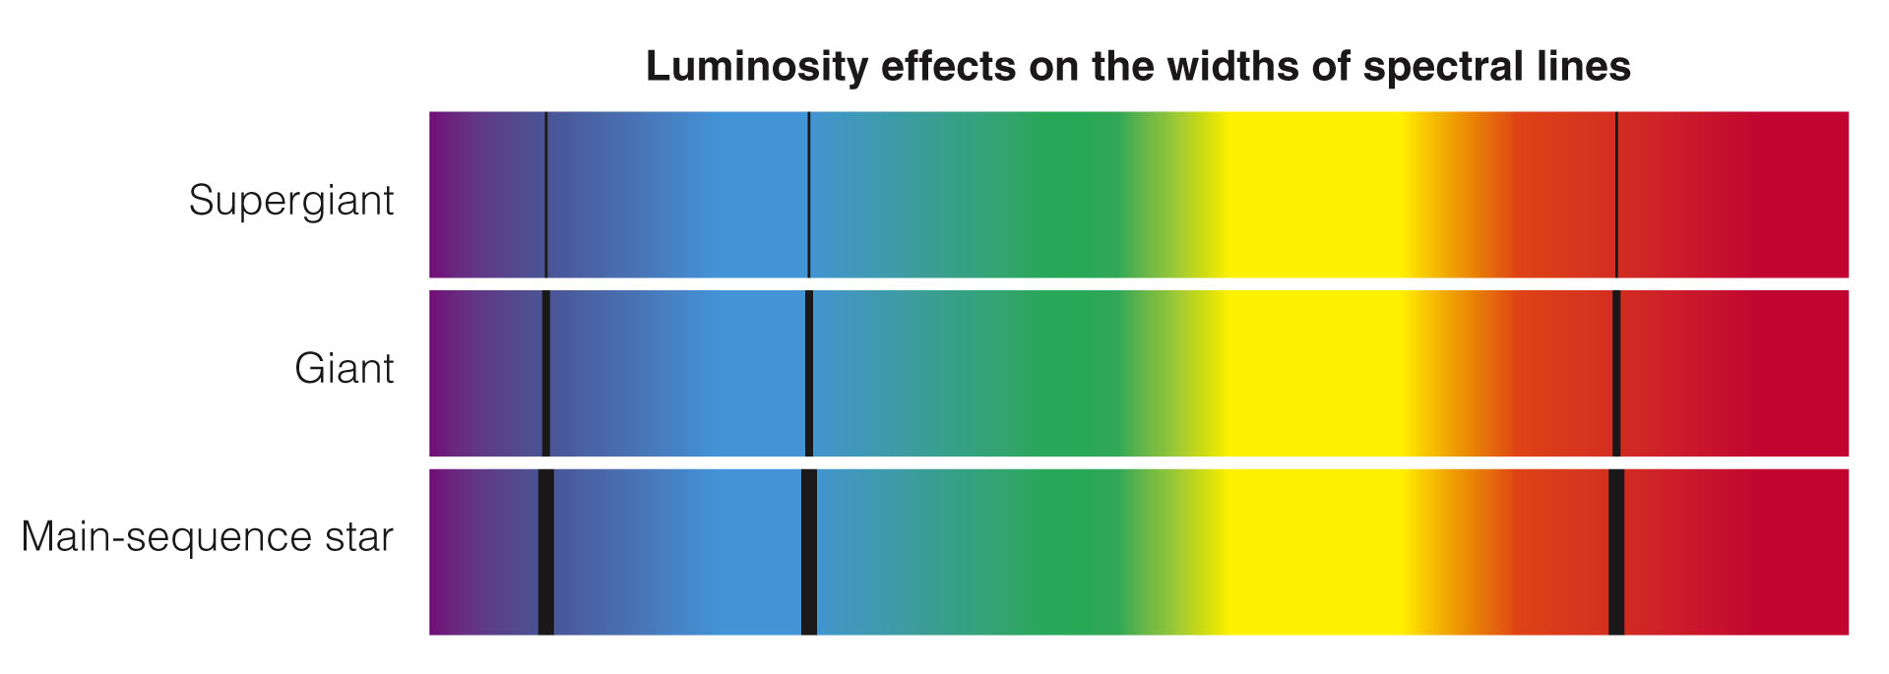
Luminosity Spectral Classification
In the spectrum of a main-sequence star, the hydrogen Balmer lines are broad.
The star’s atmosphere is dense and the hydrogen atoms collide often.

Slide 88
Luminosity Spectral Classification
In the spectrum of a giant star, the lines are narrower.
The giant star’s atmosphere is less dense and the hydrogen atoms collide less often.

Slide 89
Luminosity Spectral Classification
In the spectrum of a supergiant star, the lines are very narrow.

Slide 90
Luminosity Spectral Classification
Thus, an astronomer can look closely at a star’s spectrum and tell roughly how big it is.

Slide 91
Luminosity Spectral Classification
Size categories are called luminosity classes—because the size of the star is the dominating factor in determining luminosity.
Supergiants, for example, are very luminous because they are very large.

Slide 92
Compared with the spectral lines in the solar spectrum, lines in a supergiant star’s spectrum are
a. more narrow.
b. broader.
c. weaker.
d. stronger.
e. b & c

Slide 93
Luminosity Spectral Classification
The luminosity classes are represented by the Roman numerals I through V.
Adhara (Epsilon Canis Majoris) is a bright giant (II).
Capella (Alpha Aurigae) is a giant (III).
Altair (Alpha Aquilae) is a subgiant (IV).
The sun is a main-sequence star (V).

Slide 94
Luminosity Spectral Classification
Supergiants are further subdivided into types Ia and Ib.
For example, you can distinguish between a bright supergiant (Ia) such as Rigel (Beta Orionis) and a regular supergiant (Ib) such as Polaris, the North Star (Alpha Ursa Minoris).
The luminosity class notation appears after the spectral type—as in G2 V for the sun.

Slide 95
Luminosity Spectral Classification
White dwarfs don’t enter into this classification.
Their spectra are very different from the other types of stars.
Luminosity classification is subtle and not too accurate.
Nevertheless, it is an important technique because it provides clues to distance.

Slide 96
Luminosity Spectral Classification
Most stars are too distant to have measurable parallaxes.
Nevertheless, astronomers can find the distances to these stars—if they can record the stars’ spectra and determine their luminosity classes.

Slide 97
Luminosity Spectral Classification
From spectral type and luminosity class, astronomers can estimate the star’s absolute magnitude, compare with its apparent magnitude, and compute its distance.
Although this process finds distance and not true parallax, it is called spectroscopic parallax.

Slide 98
Luminosity Spectral Classification
For example, consider Betelgeuse (Alpha Orionis).
It is classified M2 Ia.
Its apparent magnitude averages about 0.0 (Betelgeuse is somewhat variable).

Slide 99
Luminosity Spectral Classification
Plotting it in an H-R diagram, you will find that a temperature class of M2 and a luminosity class of Ib (supergiant) corresponds to a luminosity of about 30,000 L_{Θ}.

Slide 100
Luminosity Spectral Classification
That information, combined with the star’s apparent brightness, allows astronomers to estimate that Betelgeuse is about 190 pc from Earth.
The Hipparcos satellite finds the actual distance to be 131 pc.
So, the distance from the spectroscopic parallax technique is only approximate.

Slide 101
Luminosity Spectral Classification
Spectroscopic parallax does give a good first estimate of the distances of stars so far away that their parallax can’t easily be measured.

Slide 102
Masses of Stars—Binary Stars
Your fifth goal in the chapter is to find out how much matter stars contain—that is, to know their masses.

Slide 103
Masses of Stars—Binary Stars
Gravity is the key to determining mass.
Matter produces a gravitational field.
Astronomers can figure out how much matter a star contains if they watch an object such as another star move through the star’s gravitational field.

Slide 104
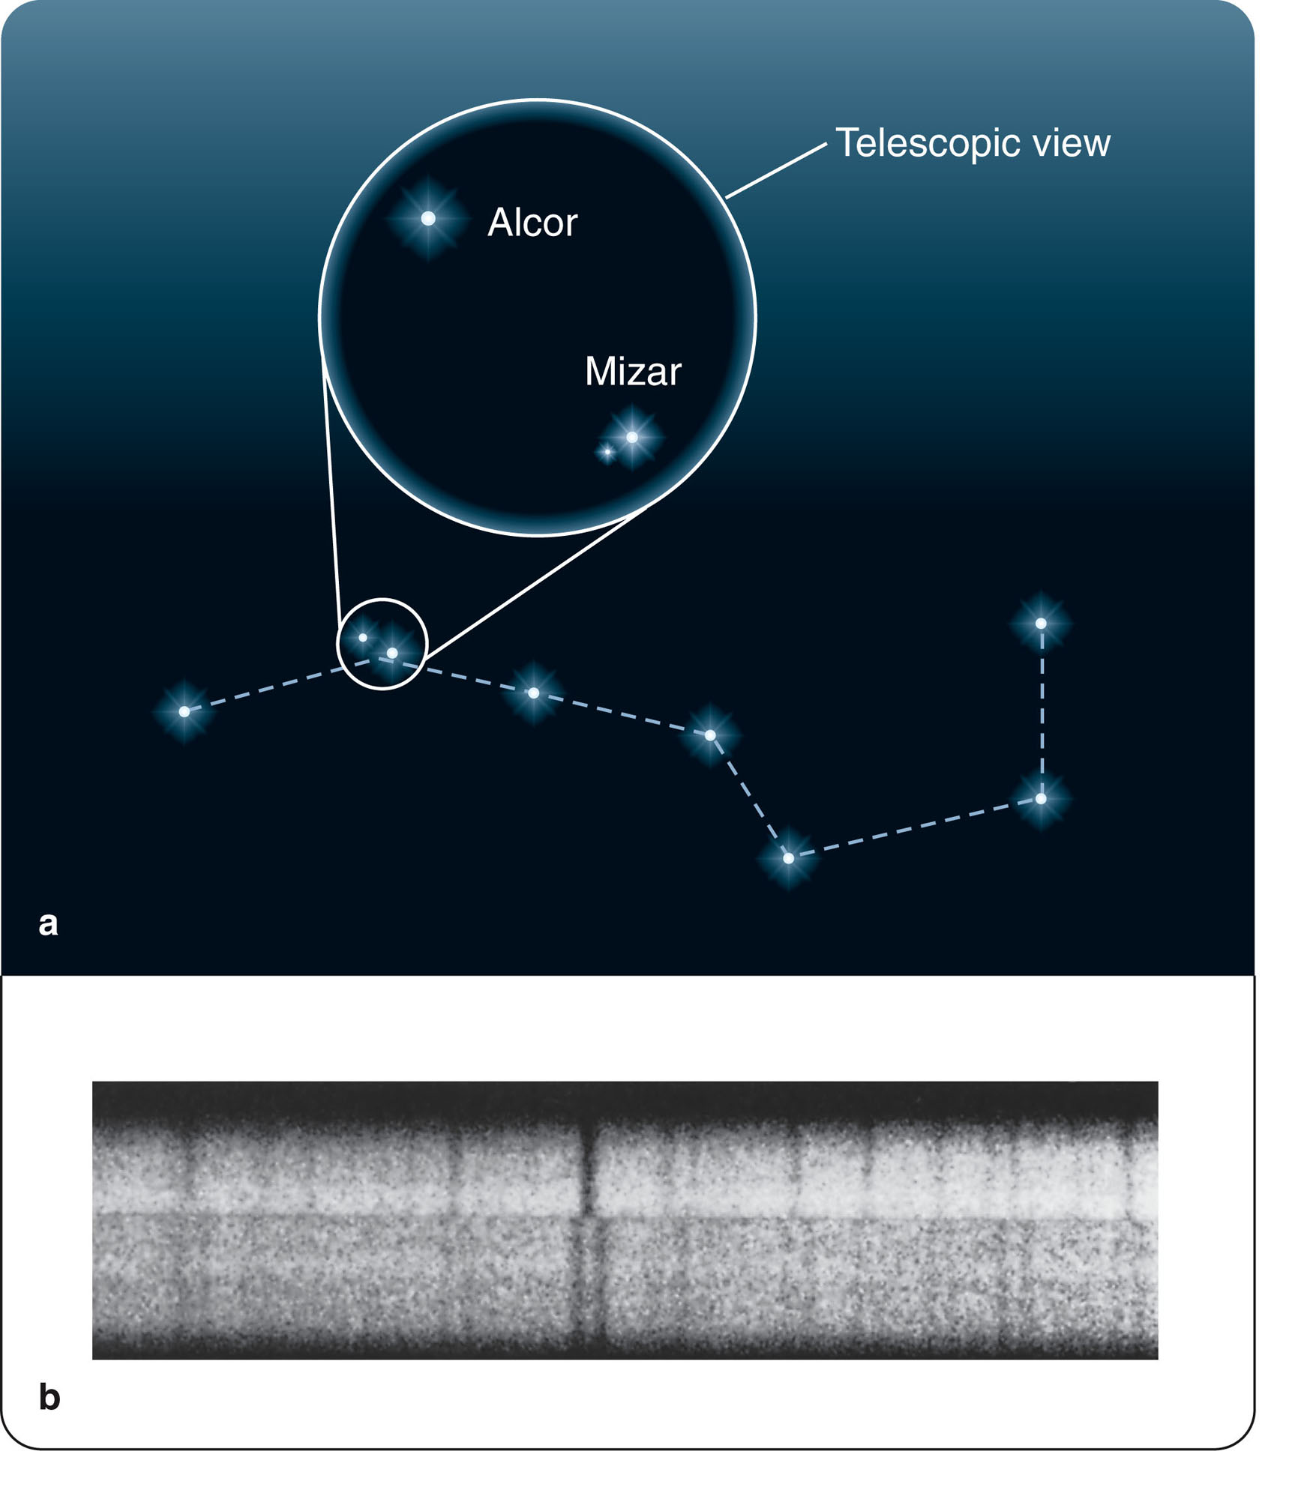
Masses of Stars—Binary Stars
Finding the masses of stars involves studying binary stars.
These are pairs of stars that orbit each other.

Slide 105
Masses of Stars—Binary Stars
Many of the familiar stars in the sky are actually pairs of stars orbiting each other.
Binary systems are common.
More than half of all stars are members of binary star systems.

Slide 106
Masses of Stars—Binary Stars
Few, however, can be analyzed completely.
Many are so far apart that their periods are much too long for practical mapping of their orbits.
Others are so close together they are not visible as separate stars.

Slide 107
Binary Stars in General
The key to finding the mass of a binary star is an understanding of orbital motion.

Slide 108
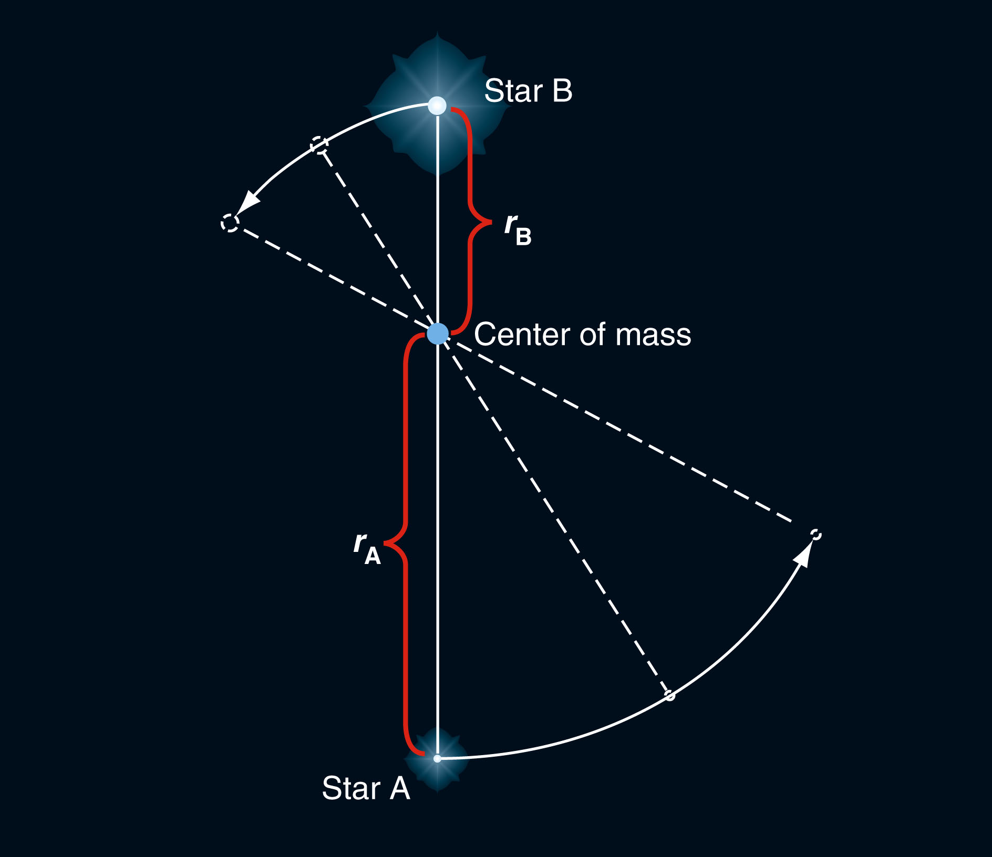
Binary Stars in General
Each star in a binary system moves in its own orbit around the system’s center of mass—the balance point of the system.

Slide 109
Binary Stars in General
If one star is more massive than its companion, then the massive star is closer to the center of mass and travels in a smaller orbit.
In contrast, the lower-mass star whips around in a larger orbit.

Slide 110
Binary Stars in General
The ratio of the masses of the stars in the binary system portrayed in the figure is M_{A}/M_{B.}
This equals r_{B}/r_{A}, the inverse of the ratio of the radii of the orbits.
For example, if one star has an orbit twice as large as the other star’s orbit, then it must be half as massive.

Slide 111
Binary Stars in General
Getting the ratio of the masses is easy.
However, that doesn’t give you the individual masses of the stars.
That takes one more step.

Slide 112
Binary Stars in General
To find the total mass of a binary star system, you must know the size of the orbits and the orbital period—the length of time the stars take to complete one orbit.
The smaller the orbits are and the shorter the orbital period is, the stronger the stars’ gravity must be to hold each other in orbit.

Slide 113
Binary Stars in General
From the sizes of the orbits and the orbital period, astronomers can figure out how much mass the stars contain in total.
Combining that information with the ratio of the masses found from the relative sizes of the orbits reveals the individual masses of the stars.

Slide 114
Binary Stars in General
Finding the mass of a binary star system is easier said than done.

Slide 115
Binary Stars in General
One difficulty is that the true sizes of the star orbits must be measured in units like meters or astronomical units in order to find the masses of the stars in units like kilograms or solar masses.
Measuring the true sizes of the orbits, in turn, requires knowing the distance to the binary system.

Slide 116
Binary Stars in General
Therefore, the only stars whose masses astronomers know for certain are in binary systems with orbits that have been determined and distances from Earth that have been measured.

Slide 117
Binary Stars in General
Another complication is that the orbits of the two stars may be elliptical.
Also, the plane of their orbits can be tipped at an angle to your line of sight—distorting the apparent shapes of the orbits.

Slide 118
Binary Stars in General
Notice that finding the masses of binary stars requires a number of steps to get from what can be observed to what astronomers really want to know, the masses.
Constructing such sequences of steps is an important part of science.

Slide 119
Three Kinds of Binary Systems
There are many different kinds of binary stars.
However, three types are especially important for determining stellar masses.

Slide 120
Three Kinds of Binary Systems
In a visual binary system, the two stars are separately visible in the telescope.

Slide 121
Three Kinds of Binary Systems
Astronomers can watch the stars orbit each other over years or decades.
From that, they can find the orbital period and—if the distance of the system from Earth can be found—the size of the orbits.
That is enough to find the masses of the stars.

Slide 122
Three Kinds of Binary Systems
Many visual binaries have such large orbits their orbital periods are hundreds or thousands of years.
Astronomers have not yet seen them complete an entire orbit.

Slide 123
Three Kinds of Binary Systems
Also, many binary stars orbit so close to each other they are not visible as separate stars.
Such systems can’t be analyzed as a visual binary.

Slide 124
Three Kinds of Binary Systems
If the stars in a binary system are close together, a telescope view—limited by diffraction and by the atmospheric blurring called seeing—shows a single point of light.

Slide 125
Three Kinds of Binary Systems
Only by looking at a spectrum—which is formed by light from both stars and contains spectral lines from both—can astronomers tell that there are two stars present and not one.
Such a system is a spectroscopic binary system.

Slide 126
Three Kinds of Binary Systems
Familiar examples of spectroscopic binary systems are the stars Mizar and Alcor in the handle of the Big Dipper.

Slide 127
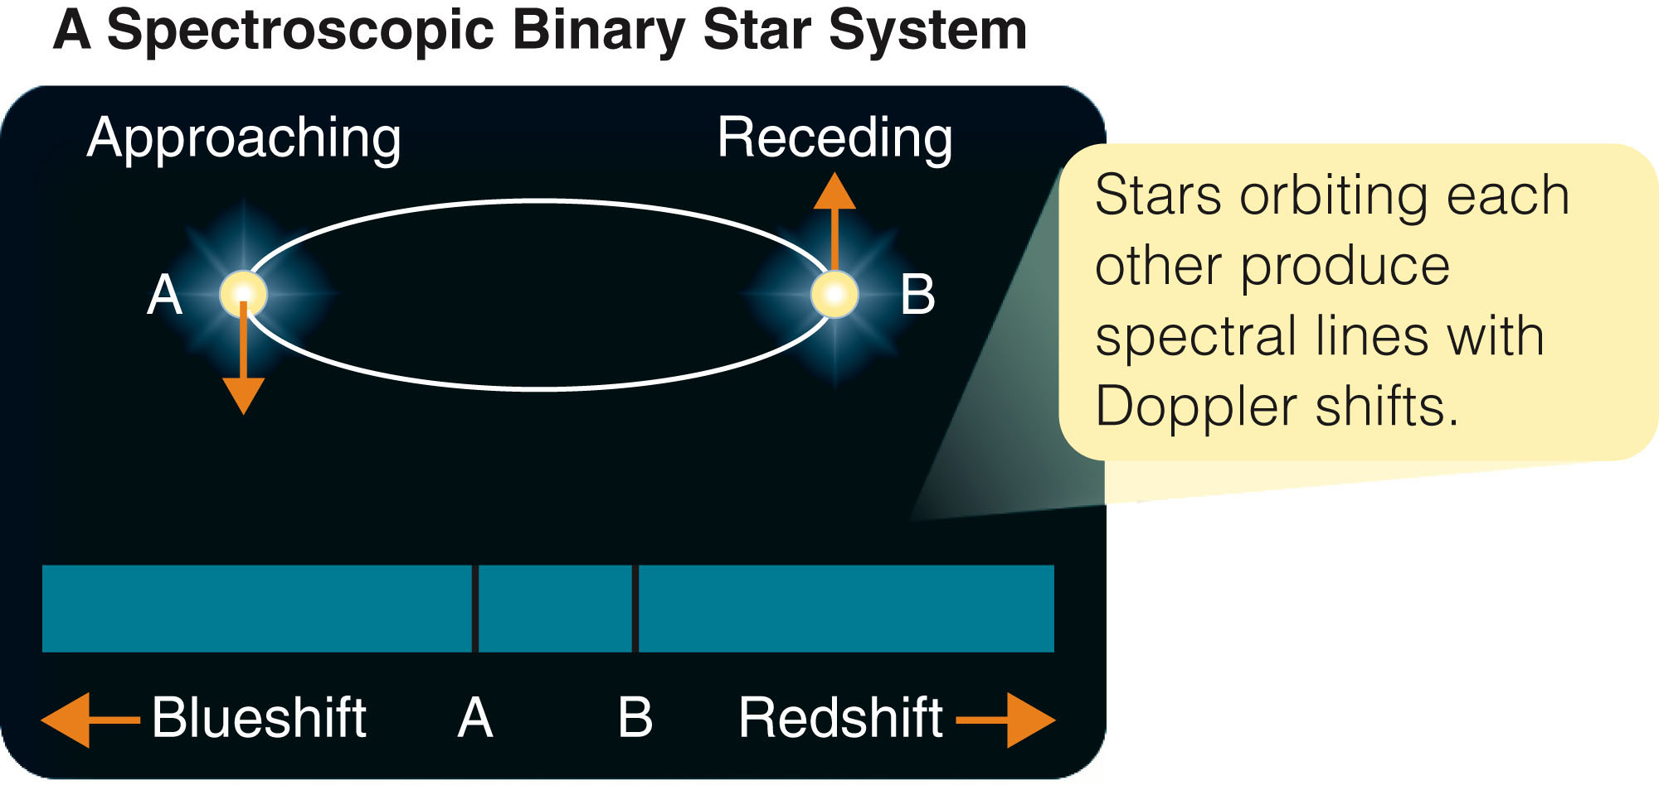
Three Kinds of Binary Systems
The figure shows a pair of stars orbiting each other.
The circular orbit appears elliptical because you see it nearly edge-on.
If this were a true spectroscopic binary system, you would not see the separate stars.

Slide 128
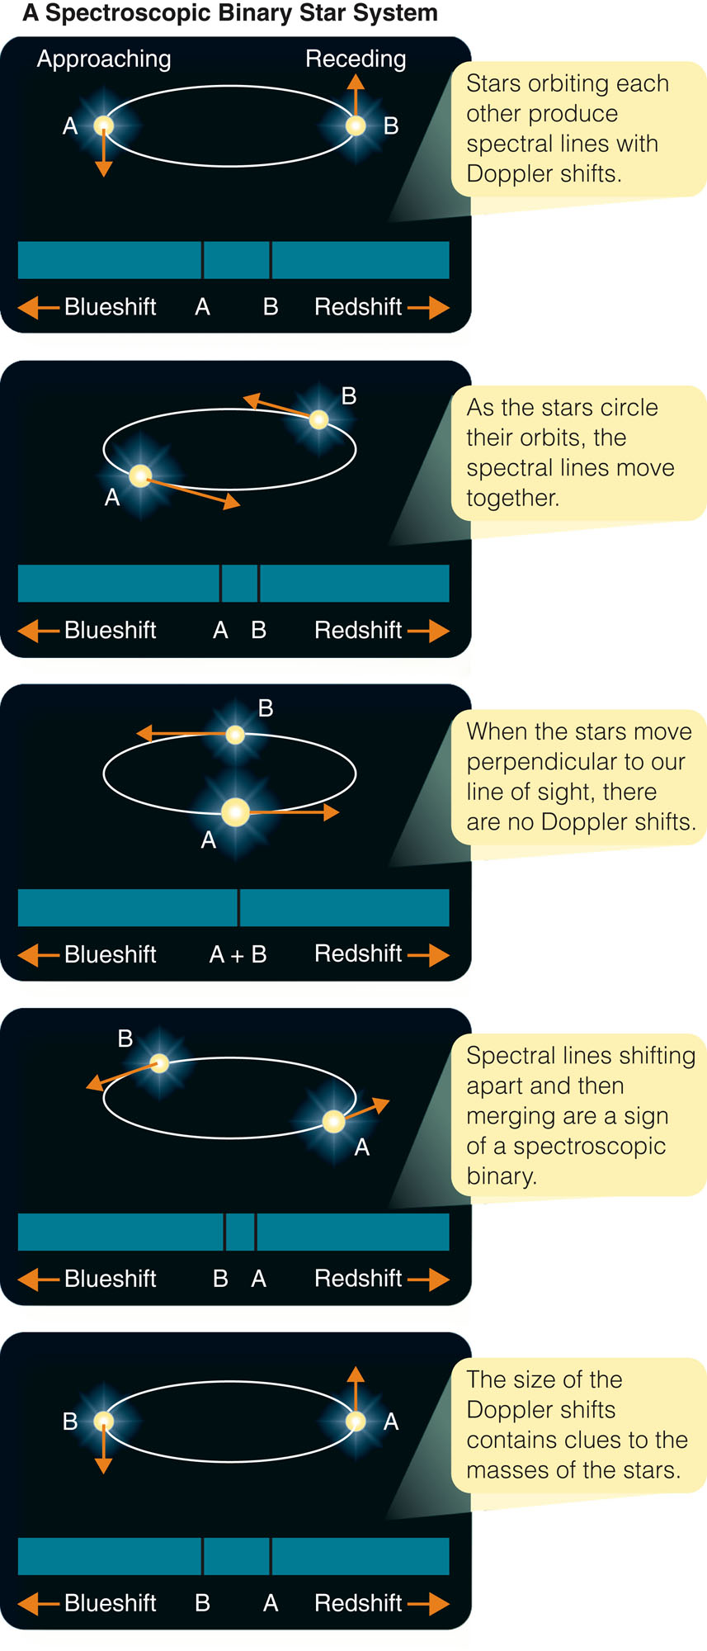
Three Kinds of Binary Systems
Nevertheless, the Doppler shift would show you there were two stars orbiting each other.

Slide 129
Three Kinds of Binary Systems
As the two stars move in their orbits, they alternately approach toward and recede from Earth.

Slide 130
Three Kinds of Binary Systems
Their spectral lines are Doppler shifted alternately toward blue and then red wavelengths.

Slide 131
Three Kinds of Binary Systems
Noticing pairs of spectral lines moving back and forth across each other would alert you that you were observing a spectroscopic binary.

Slide 132
Three Kinds of Binary Systems
Although spectroscopic binaries are very common, they are not as useful as visual binaries.
Astronomers can find the orbital period easily—but they can’t find the true size of the orbits, because there is no way to find the angle at which the orbits are tipped.
That means they can’t find the true masses of a spectroscopic binary.
All they can find is a lower limit to the masses.

Slide 133
Three Kinds of Binary Systems
If the plane of the orbits is nearly edge-on to Earth, then the stars can cross in front of each other as seen from Earth.
When one star moves in front of the other, it blocks some of the light, and the star is eclipsed.
Such a system is called an eclipsing binary system.

Slide 134
Three Kinds of Binary Systems
Seen from Earth, the two stars are not visible separately.
The system looks like a single point of light.
However, when one star moves in front of the other star, part of the light is blocked, and the total brightness of the point of light decreases.

Slide 135
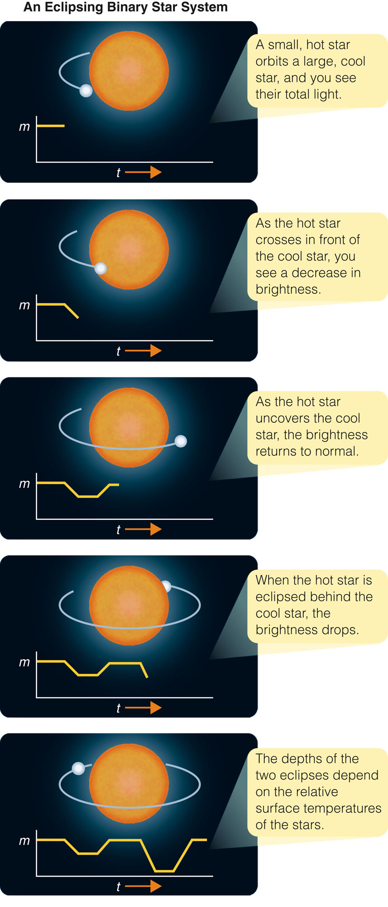
Three Kinds of Binary Systems
The figures show a smaller star moving in an orbit around a larger star—first eclipsing the larger star and then being eclipsed as it moves behind.

Slide 136
Three Kinds of Binary Systems
The resulting variation in the brightness of the system is shown as a graph of brightness versus time—a light curve.

Slide 137
Three Kinds of Binary Systems
The light curves of eclipsing binary systems contain plenty of information about the stars.
However, they can be difficult to analyze.
The figures show an idealized example of such a system.

Slide 138
Three Kinds of Binary Systems
Once the light curve of an eclipsing binary system has been accurately observed, astronomers can construct a chain of inference that leads to the masses of the stars.

Slide 139
Three Kinds of Binary Systems
They can find the orbital period easily and can get spectra showing the Doppler shifts of the two stars.
They can find the orbital speed because they don’t have to correct for the inclination of the orbits.
You know the orbits are nearly edge-on, or there would not be eclipses.
From that, astronomers can find the size of the orbits and the masses of the stars.

Slide 140
Three Kinds of Binary Systems
Earlier in the chapter, luminosity and temperature were used to calculate the radii of stars.
However, eclipsing binary systems give a way to check those calculations—by measuring the sizes of a few stars directly.
The light curve shows how long it takes for the stars to cross in front of each other.
Multiplying these time intervals by the orbital speeds gives the diameters of the stars.

Slide 141
Three Kinds of Binary Systems
There are complications due to the inclination and eccentricity of orbits.
Often, though, these effects can be taken into account.
So, observations of an eclipsing binary system can directly give you not only the masses of its stars but also their diameters.

Slide 142
Three Kinds of Binary Systems
From the study of binary stars, astronomers have found that the masses of stars range from roughly 0.1 solar masses to nearly 100 solar masses.
The most massive stars ever found in a binary system have masses of 83 and 82 solar masses.

Slide 143
Three Kinds of Binary Systems
A few other stars are believed to be more massive—100 solar masses to 150 solar masses.
However, they do not lie in binary systems.
So, astronomers must estimate their masses.

Slide 144
Typical Stars
You have achieved the five goals set at the start of the chapter.
You know how to find the distances, luminosities, temperatures, diameters, and masses of stars.

Slide 145
Typical Stars
Now, you can put those data together to paint a family portrait of the stars.
As in human family portraits, both similarities and differences are important clues to the history of the family.

Slide 146
Luminosity, Mass, and Density
The H-R diagram is filled with patterns that give you clues as to how stars are born, how they age, and how they die.
When you add your data, you see traces of those patterns.

Slide 147
Luminosity, Mass, and Density
If you label an H-R diagram with the masses of the stars determined by observations of binary star systems, you will discover that the main- sequence stars are ordered by mass.

Slide 148
Luminosity, Mass, and Density
The most massive main-sequence stars are the hot stars.
Going down the main sequence, you will find lower-mass stars.
The lowest-mass stars are the coolest, faintest main-sequence stars.

Slide 149
Luminosity, Mass, and Density
Stars that do not lie on the main sequence are not in order according to mass.
Some giants and supergiants are massive, whereas others are no more massive than the sun.
All white dwarfs have about the same mass —usually in the narrow range of 0.5 to about 1.0 solar masses.

Slide 150
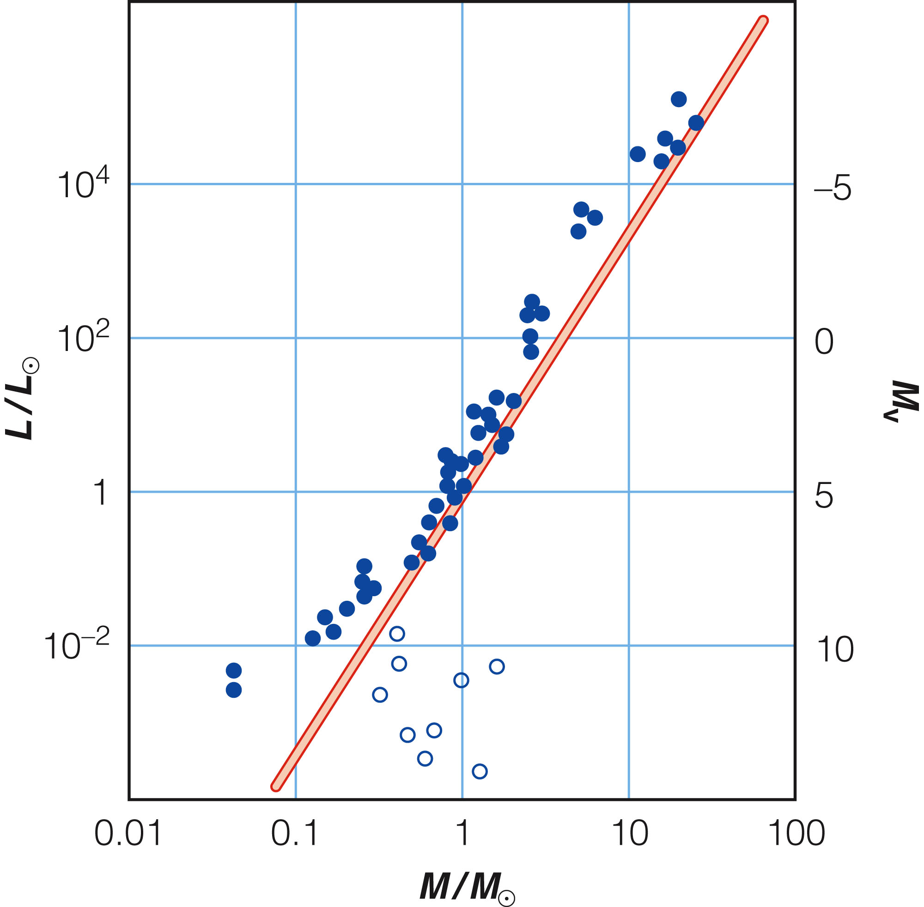
Luminosity, Mass, and Density
Due to the systematic ordering of mass along the main sequence, these main-sequence stars obey a mass-luminosity relation.
The more massive a star is, the more luminous it is.

Slide 151
Luminosity, Mass, and Density
In fact, the mass-luminosity relation can be expressed as follows.
Luminosity is proportional to mass to the 3.5 power.
For example, a star with a mass of 4.0 M_{Θ} can be expected to have a luminosity of about 4^{3.5} or 128 L_{Θ}.

Slide 152
Luminosity, Mass, and Density
Giants and supergiants do not follow the mass-luminosity relation very closely.
White dwarfs do not follow it at all.

Slide 153
Luminosity, Mass, and Density
Though mass alone does not reveal any pattern among giants, supergiants, and white dwarfs, density does.
Once you know a star’s mass and diameter, you can calculate its average density by dividing its mass by its volume.

Slide 154
Luminosity, Mass, and Density
Stars are not uniform in density.
They are most dense at their centers and least dense near their surface.
The center of the sun is about 100 times as dense as water.
In contrast, its density near the photosphere is about 3,400 times less dense than Earth’s atmosphere at sea level.

Slide 155
Luminosity, Mass, and Density
A star’s average density is intermediate between its central and surface densities.
The sun’s average density is approximately 1 g/cm³—about the density of water.
Main-sequence stars have average densities similar to the sun’s density.

Slide 156
Luminosity, Mass, and Density
As you learned earlier in the discussion about luminosity classification, giant stars are much larger in diameter than the main-sequence stars but not much larger in mass.
So, giants have low average densities—ranging from 0.1 to 0.01 g/cm³.

Slide 157
Luminosity, Mass, and Density
The enormous supergiants have still lower densities—ranging from 0.001 to 0.000001 g/cm³.
These densities are thinner than the air we breathe.
If you could insulate yourself from the heat, you could fly an airplane through these stars.
Only near the center would you be in any danger—we can calculate that the material there is very dense.

Slide 158
Luminosity, Mass, and Density
The white dwarfs have masses about equal to the sun’s, but are very small—only about the size of Earth.
Thus, the matter is compressed to densities of 3,000,000 g/cm³ or more.
On Earth, a teaspoonful of this material would weigh about 15 tons.

Slide 159
Luminosity, Mass, and Density
Density divides stars into three groups.
Most stars are main-sequence stars with densities similar to the sun’s.
Giants and supergiants are very-low density stars.
White dwarfs are high-density stars.

Slide 160
Surveying the Stars
If you want to know what the average person thinks about a certain subject, you take a survey.
If you want to know what the average star is like, you can survey the stars.
Such surveys reveal important relationships among the family of stars.

Slide 161
Surveying the Stars
Over the years, many astronomers have added their results to the growing collection of data on star distances, luminosities, temperatures, sizes, and masses.
They can now analyze those data to search for relationships between these and other parameters.
As the 21st century begins, astronomers are deeply involved in massive surveys.

Slide 162
Surveying the Stars
Powerful computers to control instruments and analyze data make such immense surveys possible.
For example, the Sloan Digital Sky Survey will eventually map a quarter of the sky—measuring the position and brightness of 100 million stars and galaxies.
Also, the Two Micron All Sky Survey (2MASS) has mapped the entire sky at three near-infrared wavelengths.

Slide 163
Surveying the Stars
A number of other sky surveys are underway.
Astronomers will ‘mine’ these mountains of data for decades to come.

Slide 164
Surveying the Stars
What could you learn about stars from a survey of the stars near the sun?
The evidence astronomers have is that the sun is in a typical place in the universe.
Therefore, such a survey could reveal general characteristics of the stars.

Slide 165
Surveying the Stars
There are three important points to note about the family of stars.

Slide 166
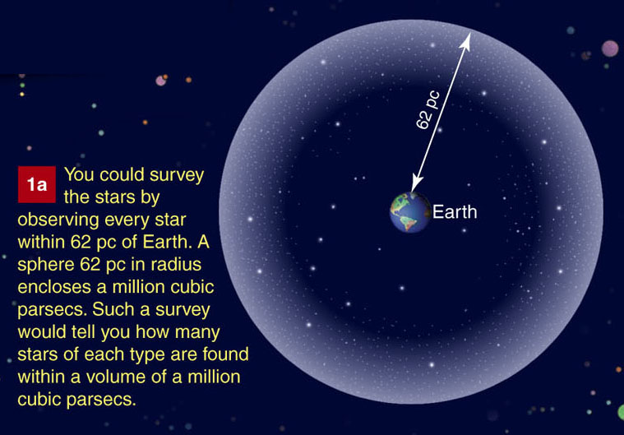
Surveying the Stars
One, taking a survey is difficult because you must be sure to get an honest sample.
If you don’t survey enough stars, your results can be biased.

Slide 167
Surveying the Stars
Two, M dwarfs and white dwarfs are so faint that they are difficult to find even near Earth.
They may be undercounted in surveys.

Slide 168
Surveying the Stars
Finally, luminous stars—although they are rare—are easily visible even at great distances.
Typical nearby stars have lower luminosity than our sun.

Slide 169
Surveying the Stars
The night sky is a beautiful carpet of stars.
Some are giants and supergiants, and some are dwarfs.
The family of stars is rich in its diversity.

Slide 170
Surveying the Stars
Pretend space is like a very clear ocean in which you are swimming.
When you look at the night sky, you are seeing mostly ‘whales’—the rare very large and luminous stars, mostly far away.
If instead you cast a net near your location, you would mostly catch ‘sardines’—very-low-luminosity M dwarfs that make up most of the stellar population of the universe.

Slide 171
Surveying the Stars
This chapter set out to find the basic properties of stars.
Once you found the distance to the stars, you were able to find their luminosities.
Knowing their luminosities and temperatures gives you their diameters.
Studying binary stars gives you their masses.
These are all rather mundane data.

Slide 172
Surveying the Stars
However, you have now discovered a puzzling situation.
The largest and most luminous stars are so rare you might joke that they hardly exist.
The average stars are such small low-mass things they are hard to see even if they are near Earth in space.

Slide 173
Surveying the Stars
Why does nature make stars in this peculiar way?
To answer that question, you must explore the birth, life, and death of stars.

