Slide 1
Chapter 3 Astronomy History

Slide 2
Before Copernicus, the world seemed filled with mysterious influences.
After Newton, scientists understood that the world is described by natural laws that are open to human study.
The mysteries of nature are mysteries because they are unknown—not because they are unknowable.

Slide 3
Astronomy Before Copernicus
To understand why Copernicus’s model was so important, you first need to backtrack to ancient Greece and meet the two great authorities of ancient astronomy:
Aristotle, the brilliant philosopher
Claudius Ptolemy, a later follower of Aristotle’s principles

Slide 4
Astronomy Before Copernicus
First, you should remember that the terms solar system, galaxy, and universe have very different meanings.
You know now that our solar system is your very local neighborhood—much smaller than the Milky Way Galaxy.
Milky Way, in turn, is tiny compared with the observable universe.

Slide 5
Aristotle’s Universe
Philosophers of the ancient world attempted to deduce truth about the universe by reasoning from first principles.
A first principle was something that seemed obviously true to everyone and, supposedly, needed no further examination.

Slide 6
Aristotle’s Universe
That may strike you as peculiar.
Modern thinkers tend to observe how things work and then, from that evidence, make principles and conclusions that can always be reexamined.
Before the Renaissance, however, reasoning from evidence—what you might call ‘scientific thinking’ was not widespread.

Slide 7
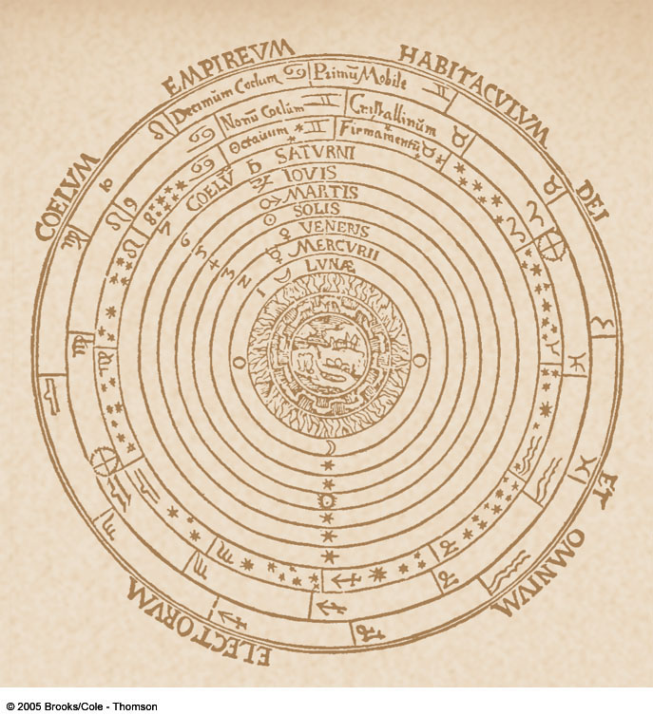
Aristotle’s Universe
There are three important ideas to note about the ancient universe.
One, ancient philosophers and astronomers accepted without
question that:
Heavenly objects
must move on circular paths at constant speeds.
Earth is motionless at the center of the universe

Slide 8
Aristotle’s Universe
Two, as viewed by you from Earth, the planets seem to follow complicated paths in the sky.
These include episodes of ‘backward’ motion that are difficult to explain in terms of motion on circular paths at constant speeds.

Slide 9
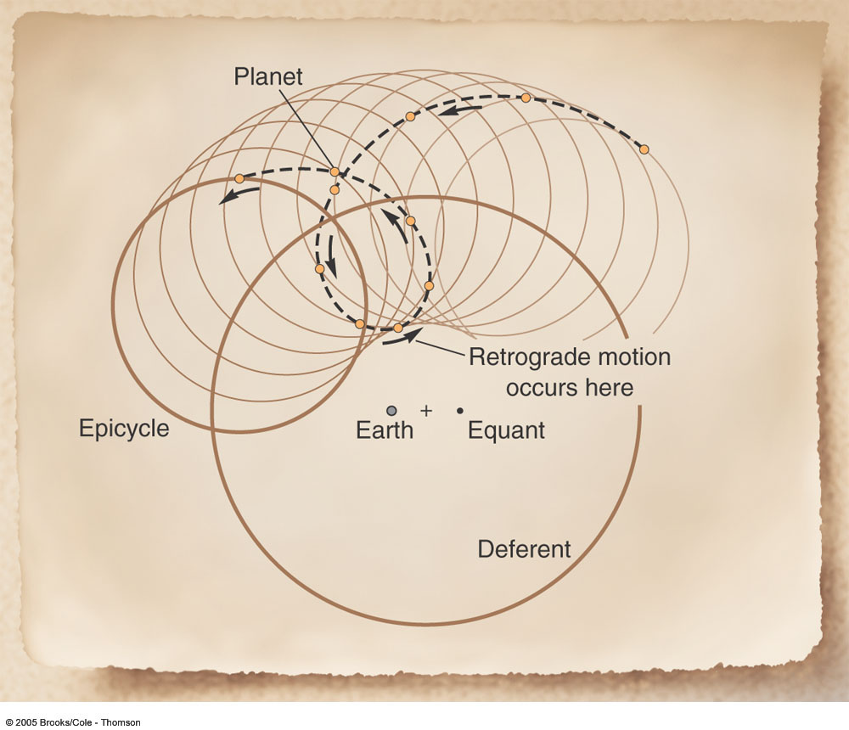
Aristotle’s Universe
Third, you can see how Ptolemy created an elaborate geometrical and mathematical model to explain details of the observed motions of the planets, while
assuming Earth is
motionless at the center of the universe.

Slide 10
Aristotle’s Universe
Aristotle lived in Greece from 384 to 322 BC.
He believed as a first principle that the heavens were perfect.
As the sphere and circle were considered the only perfect geometrical figures, he also believed that all motion in the perfect heavens must be caused by the rotation of spheres carrying objects around in uniform circular motion.

Slide 11
Aristotle’s Universe
Claudius Ptolemy, a mathematician who lived roughly 500 years after Aristotle, believed in the basic ideas of Aristotle’s universe.
He was, however, interested in practical rather than philosophical questions.
For him, first principles took second place to accuracy.
Ptolemy set about making an accurate mathematical description of the motions of the planets.
He weakened the first principles of Aristotle by moving Earth a little off-center in the model and inventing a way to slightly vary the planets’ speeds.
This made his model (published around AD 140) a better match to the observed motions.

Slide 12
Aristotle’s Universe
Aristotle’s universe, as embodied in the mathematics of Ptolemy’s model, dominated ancient astronomy.
At first, the Ptolemaic model predicted positions of the planets with fair accuracy.
As centuries passed, though, errors accumulated.
Islamic and later European astronomers had to update the model.
They adjusted the sizes and locations of the circles and changed the rates of motion.

Slide 13
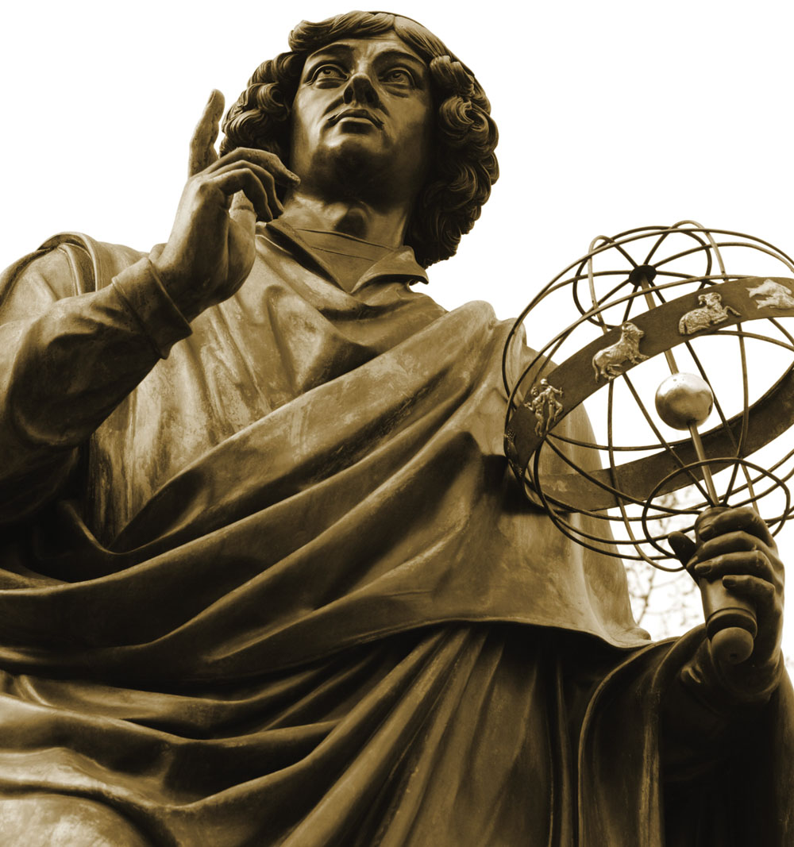
Nicolaus Copernicus
Nicolaus Copernicus (originally, Mikolaj Kopernik) was born in 1473 in what is now Poland.
At the time of his birth, and throughout his life, astronomy was based on Ptolemy’s model of Aristotle’s universe.

Slide 14
Copernicus’s Model
As a result of this connection to the Church and his fear of persecution, he hesitated to publish his revolutionary ideas that challenged the Ptolemaic model and the geometry of heaven and hell.
What were these revolutionary ideas?
Copernicus believed that the sun and not Earth was the center of the universe and that Earth rotated on its axis and revolved around the sun.

Slide 15
Copernicus’s Model
Copernicus apparently began doubting Ptolemy’s geocentric model during his college days.
A heliocentric model had been discussed occasionally before Copernicus’s time.
Copernicus, however, was the first person to produce a detailed model with substantial justifying arguments.

Slide 16
De Revolutionibus
In 1542, he finally sent the manuscript off to be printed.
However, he died in 1543 before the printing was over.
The most important idea in the book was placing the sun at the center of the universe.
That single innovation had an impressive consequence.
The retrograde motion of the planets was immediately explained in a straightforward way without the epicycles that Ptolemy used.

Slide 17
De Revolutionibus
In Copernicus’s model, Earth moves faster along its orbit than the planets that lie farther from the sun.
Consequently, it periodically overtakes and passes these planets.

Slide 18
De Revolutionibus
Copernicus’s model was simple and straightforward compared with the multiple off-center circles of the Ptolemaic model.

Slide 19
De Revolutionibus
However, De Revolutionibus failed to disprove the geocentric model immediately for one critical reason.
The Copernican model could not predict the positions of the planets any more accurately than the Ptolemaic model could.

Slide 20
De Revolutionibus
You should notice the difference between the Copernican model and the Copernican hypothesis.
The Copernican model is inaccurate.
It includes uniform circular motion and thus does not precisely describe the motions of the planets.
However, the Copernican hypothesis that the solar system is heliocentric is correct.
The planets circle the sun, not Earth.

Slide 21
De Revolutionibus
In the Ptolemaic model, Mercury and Venus had to be treated differently from the rest of the planets.
Their epicycles had to remain centered on the Earth-sun line.
In Copernicus’s model, all the planets were treated the same.
They all followed orbits that circled the sun at the center.

Slide 22
Tycho Brahe, Johannes Kepler, and Planetary Motion
As astronomers struggled to understand the place of Earth, they also faced the problem of planetary motion.
How exactly do the planets move?

Slide 23
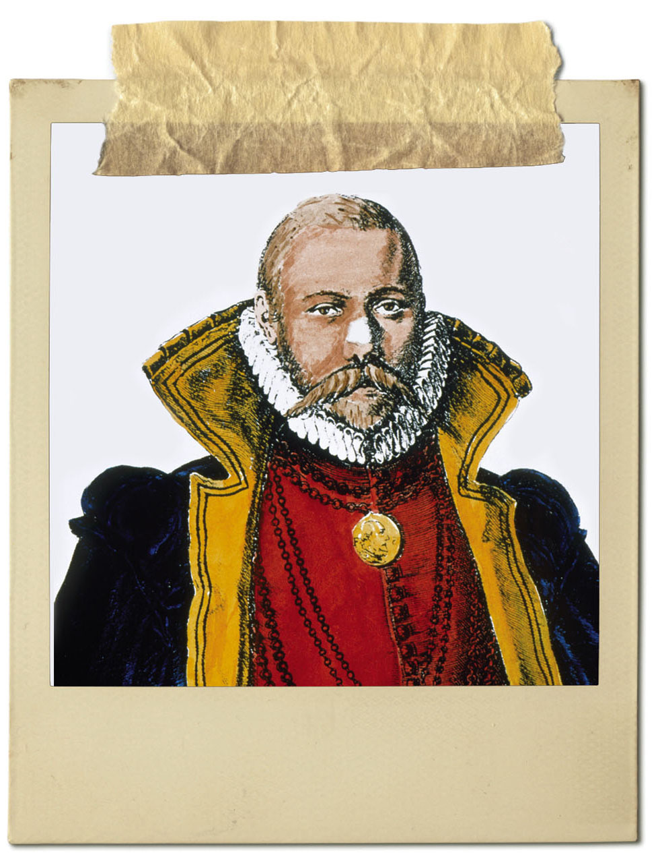
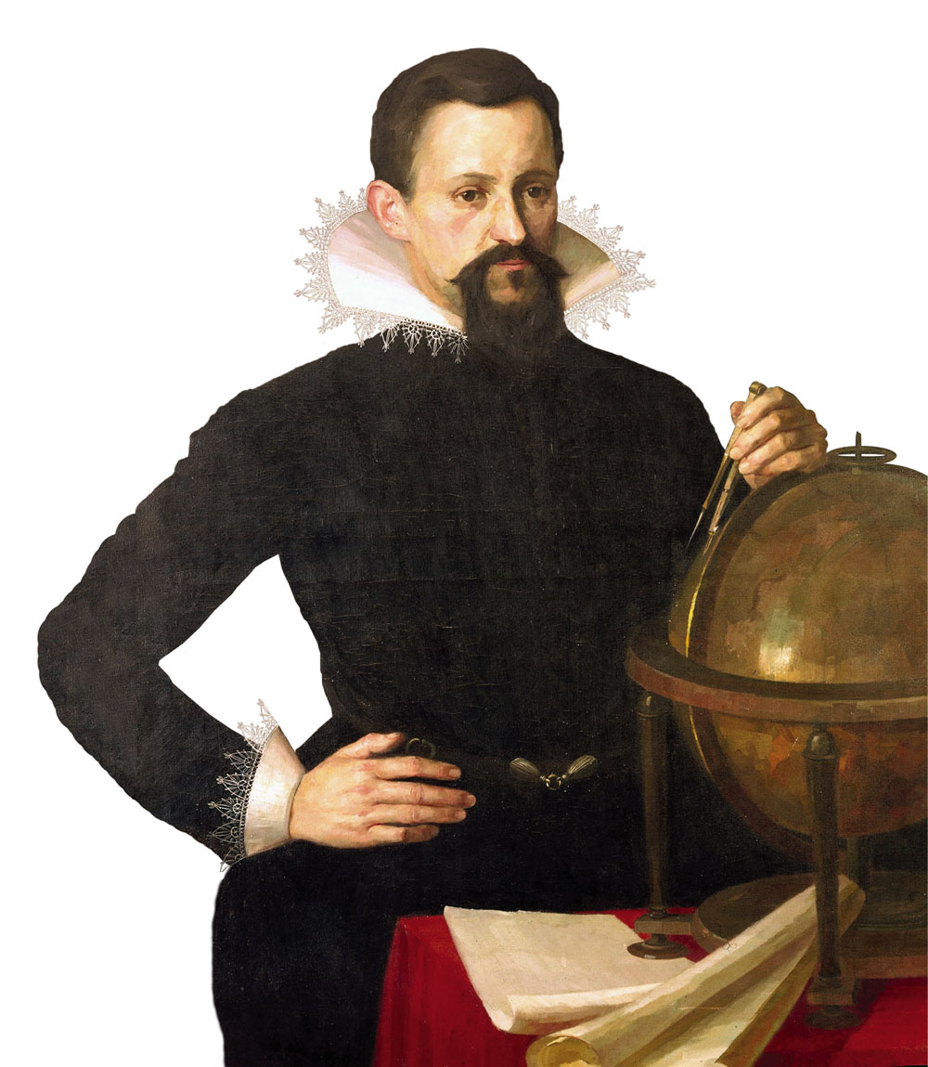
Tycho Brahe, Johannes Kepler, and Planetary Motion
That problem was solved by two people:
A nobleman who built a fabulous observatory
A poor commoner with a talent for mathematics

Slide 24
Tycho Brahe
Tycho lived before the invention of the telescopes.
So, his observatory was equipped with wonderful instruments for measuring the positions of the sun, moon, and planets using the naked eye and peep sights.
For 20 years, Tycho and his assistants measured the positions of the stars and planets.

Slide 25
Tycho Brahe
Just before Tycho died in 1601, he asked Rudolph II to make Kepler the Imperial Mathematician.
Thus, the newcomer, Kepler, became Tycho’s replacement
—though at one-sixth
Tycho’s salary.

Slide 26
Johannes Kepler
Tycho’s sudden death in 1601 left Kepler in a position to use Tycho’s extensive records of observations to analyze the motions of the planets.
Kepler began by studying the motion of Mars—trying to deduce from the observations how the planet actually moved.
By 1606, he had solved the mystery.
The orbit of Mars is an ellipse—not a circle.
Thus, he abandoned the ancient belief in the circular motion of the planets.

Slide 27
Johannes Kepler
While still a college student, he had become a believer in the Copernican hypothesis.
During his last year of study, he accepted a teaching job in the town of Graz, in what is now Austria, which allowed him to continue his studies in mathematics and astronomy.

Slide 28
Johannes Kepler
By 1596, the same year Tycho arrived in Prague, Kepler had learned enough to publish a book called The Forerunner of Dissertations on the Universe, Containing the Mystery of the Universe.
The book, like nearly all scientific works of that age, was written in Latin and is now known as Mysterium Cosmographicum.

Slide 29
Johannes Kepler
By modern standards, the book contains almost nothing of value.
It begins with a long appreciation of Copernicus’s model and then goes on to mystical speculation on the reason for the spacing of the planets’ orbits.

Slide 30
Johannes Kepler
The second half of the book, though, has one virtue.
As Kepler tried to understand planet orbits, he demonstrated that he was a talented mathematician and that he had become well versed in astronomy.
He sent copies to Tycho and to Galileo, who both recognized Kepler’s talent—in spite of the mystical parts of the book.

Slide 31
Johannes Kepler
Life was unsettled for Kepler in Graz because of the persecution of Protestants in that region.
So, when Tycho Brahe invited him to Prague in 1600, Kepler went eagerly, ready to work with the famous astronomer.

Slide 32
Johannes Kepler
Tycho’s sudden death in 1601 left Kepler in a position to use Tycho’s extensive records of observations to analyze the motions of the planets.
Kepler began by studying the motion of Mars—trying to deduce from the observations how the planet actually moved.

Slide 33
Johannes Kepler
By 1606, he had solved the mystery.
The orbit of Mars is an ellipse—not a circle.
Thus, he abandoned the ancient belief in the circular motion of the planets.

Slide 34
Johannes Kepler
However, the mystery was even more complex.
The planets do not move at uniform speeds along their elliptical orbits.
Kepler recognized that they move faster when close to the sun and slower when farther away.

Slide 35
Johannes Kepler
Thus, Kepler abandoned both uniform motion and circular motion and, thereby, finally solved the problem of planetary motion.
Later, he discovered that the radii of the planets’ orbits are related to the planets’ orbital periods.
Kepler published his results in 1609 and 1619 in books called, respectively, Astronomia Nova (New Astronomy) and Harmonice Mundi (The Harmony of the World).

Slide 36
Kepler’s Three Laws of Planetary Motion
Although Kepler dabbled in the philosophical arguments of the day, he was a mathematician.
His triumph was the solution of the problem of the motion of the planets.

Slide 37
Kepler’s Three Laws of Planetary Motion
The key to his solution was the ellipse.
An ellipse is a figure drawn around two points—called the foci—in such a way that the distance from one focus to any point on the ellipse and back to the other focus equals a constant.

Slide 38
Kepler’s Three Laws of Planetary Motion
This makes it easy to draw ellipses with two thumbtacks and a loop of string.
First, press the thumbtacks into a board.
Then, loop the string about the tacks.
Next, place a pencil in the loop.
If you keep the string taut as you move the pencil, it traces out an ellipse.

Slide 39
Kepler’s Three Laws of Planetary Motion
The geometry of an ellipse is described by two simple numbers.
The semi-major axis, a, is half of the longest diameter.
The eccentricity, e, is half the distance between the foci divided by the semi-major axis.
The eccentricity of an ellipse gives you its shape.
If e is nearly equal to one, the ellipse is very elongated.
If e is close to zero, the ellipse is more circular.

Slide 40
Kepler’s Three Laws of Planetary Motion
Kepler used ellipses to describe the motion of the planets in three fundamental rules that have been tested and confirmed so many times that astronomers now refer to them as ‘natural laws.’
They are commonly called Kepler’s laws of planetary motion.

Slide 41
Kepler’s Three Laws of Planetary Motion
Kepler’s first law states that the orbits of the planets around the sun are ellipses with the sun at one focus.
Thanks to the precision of Tycho’s observations and the sophistication of Kepler’s mathematics, Kepler was able to recognize the elliptical shape of the orbits even though they are nearly circular.

Slide 42
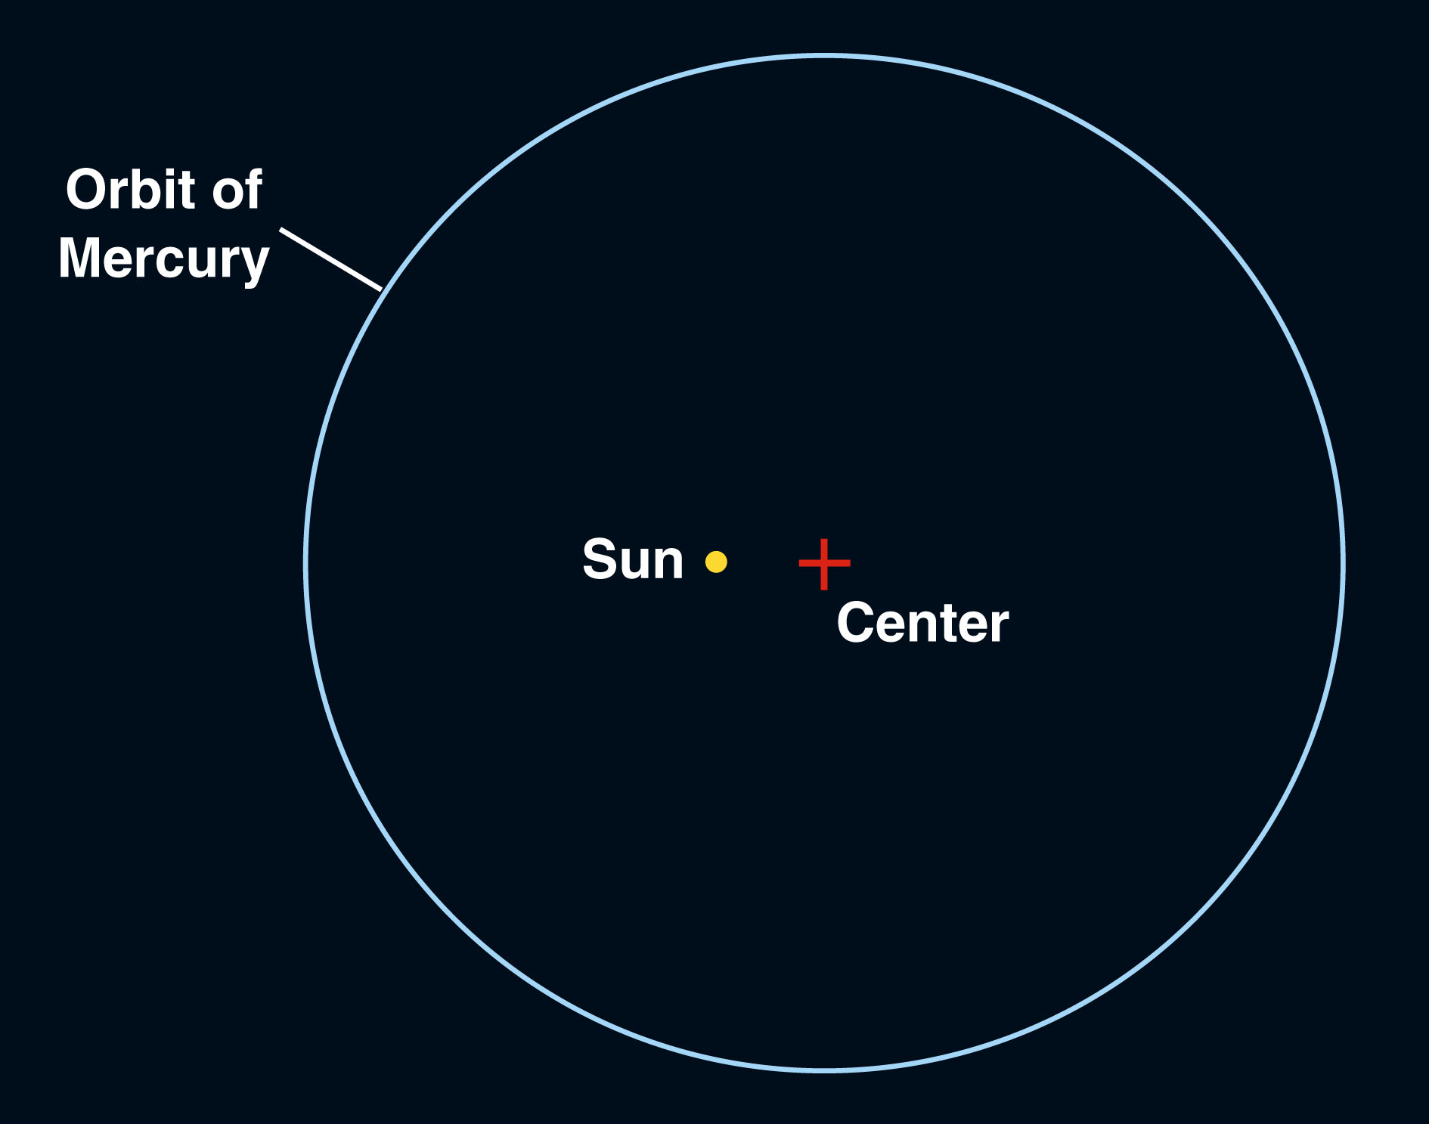
Kepler’s Three Laws of Planetary Motion
Of the planets known to Kepler, Mercury has the most elliptical orbit.
However, even it
deviates only
slightly from a
circle.

Slide 43
Kepler’s Three Laws of Planetary Motion
Kepler’s second law states that a line from the planet to the sun sweeps over equal areas in equal intervals of time.
This means that, when the planet is closer to the sun and the line connecting it to the sun is shorter, the planet moves more rapidly to sweep over the same area that is swept over when the planet is farther from the sun.
Notes:
http://www.physicsclassroom.com/class/circles/u6l4a.cfm

Slide 44
Kepler’s Three Laws of Planetary Motion
Thus, the planet in the figure would move from point A’ to point B’ in one month—sweeping over the area shown.
However, when the planet is farther from the sun, one month’s motion would be shorter—from A to B.

Slide 45
Kepler’s Three Laws of Planetary Motion
The time that a planet takes to travel around the sun once is its orbital period, P.
Its average distance from the sun equals the semi-major axis of its orbit, a.

Slide 46
Kepler’s Three Laws of Planetary Motion
Kepler’s third law states that the two quantities, orbital period and semi-major axis, are related.
Orbital period squared is proportional to the semi-major axis cubed.

Slide 47
Kepler’s Three Laws of Planetary Motion
For example, Jupiter’s average distance from the sun (which equals the semi-major axis of its orbit) is 5.2 AU.
The semi-major axis cubed would be about 140.6.
So, the period must be the square root of 140.6—roughly 11.8 years.

Slide 48
Kepler’s Three Laws of Planetary Motion
It is important to notice that Kepler’s three laws are empirical.
That is, they describe a phenomenon without explaining why it occurs.
Kepler derived them from Tycho’s extensive observations without referring to any first principles, fundamental assumptions, or theory.
In fact, Kepler never knew what held the planets in their orbits or why they continued to move around the sun in the ways he discovered.

Slide 49
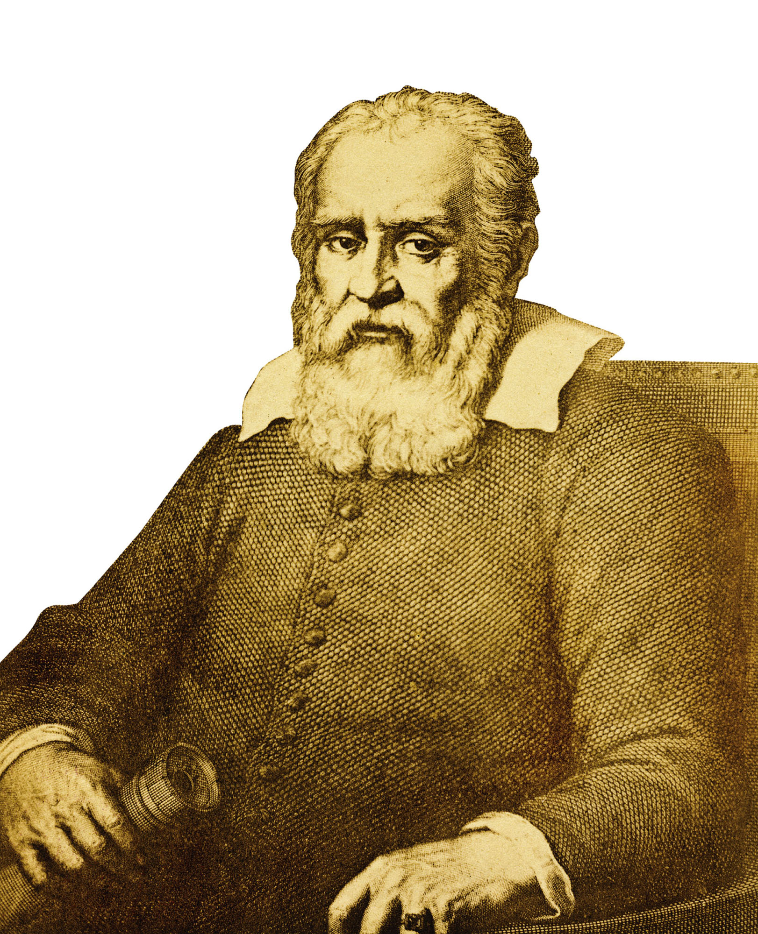
Galileo Galilei
Galileo Galilei was born in the Italian city of Pisa in 1564 and studied medicine at the university there.
However, his true love was mathematics.
Eventually, he became professor of mathematics at the university at Padua, where he remained for
18 years.

Slide 50
Galileo Galilei
During this time, Galileo seems to have adopted the Copernican model.
However, he admitted in a 1597 letter to Kepler that, at that time, he did not support it publicly—fearing criticism.

Slide 51
Galileo Galilei
Most people know two ‘facts’ about Galileo.
Both are wrong.
He did not invent the telescope.
He was not condemned by the Inquisition for believing that Earth moved around the sun.

Slide 52
Galileo Galilei
As you learn about Galileo, you will discover that what was on trial were not just his opinions about the place of the Earth but also the methods of science itself.

Slide 53
Telescopic Observations
It was the telescope that drove Galileo to publicly defend the heliocentric model.
Galileo did not invent the telescope.
It was apparently invented around 1608 by lens makers in Holland.
Galileo, hearing descriptions in the fall of 1609, was able to build working telescopes in his workshop.

Slide 54
Telescopic Observations
Also, Galileo was not the first person to look at the sky through a telescope.
However, he was the first to observe the sky carefully and apply his observations to the main theoretical problem of the day:
The place of Earth

Slide 55
Telescopic Observations
What Galileo saw through his telescopes was so amazing he rushed a small book into print, Sidereus Nuncius (The Starry Messenger).
In the book, he reported two major discoveries about the solar system.

Slide 56
Telescopic Observations
First, the moon was not perfect.
It had mountains and valleys on its surface.
Galileo used the shadows to calculate the height of the mountains.
Aristotle’s philosophy held that the moon was perfect.
Galileo, however, showed that it was not only imperfect but was even a world like Earth.

Slide 57
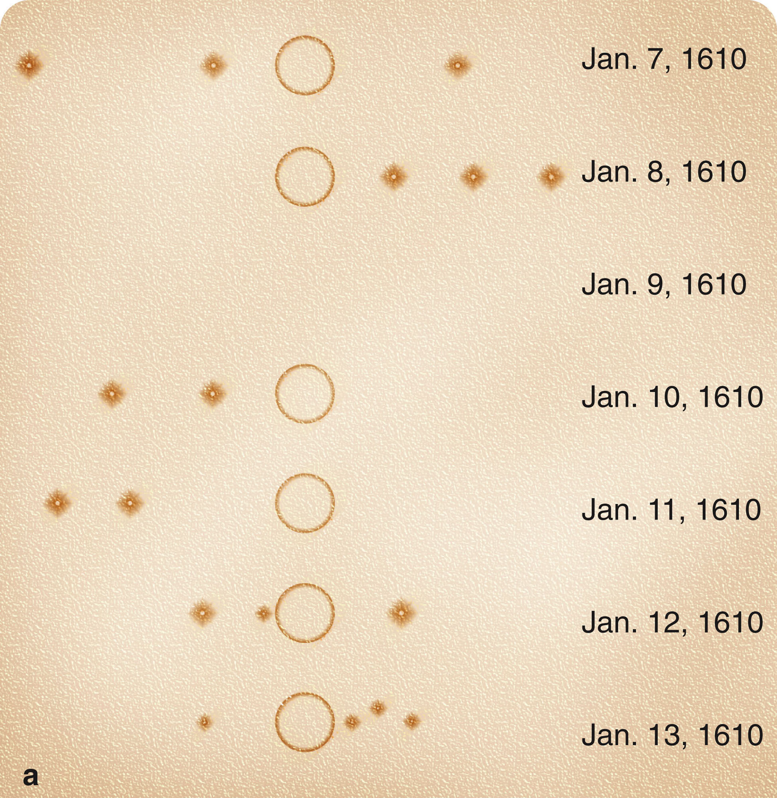
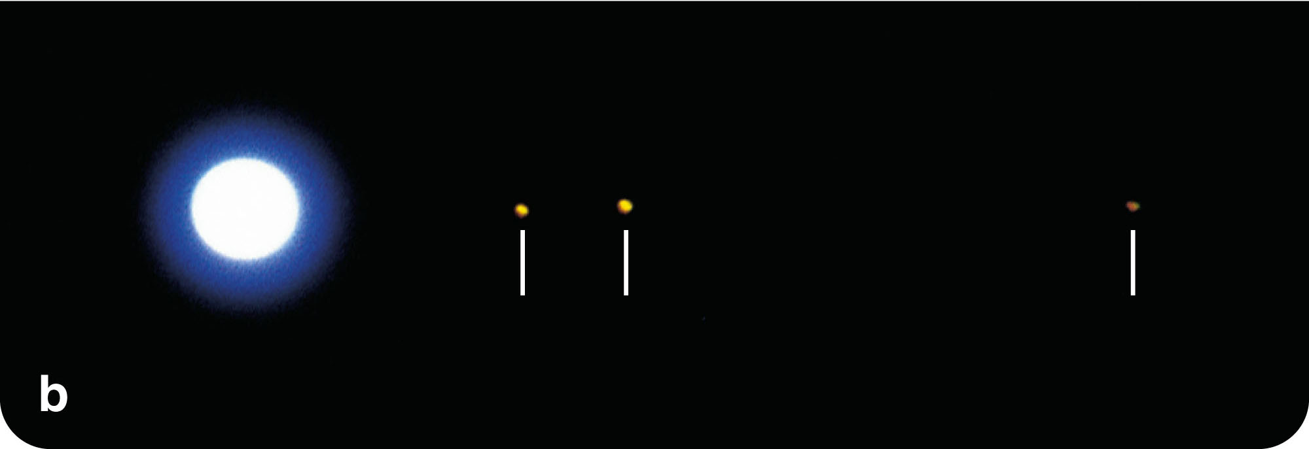
Telescopic Observations
Second, Galileo’s telescope revealed four new ‘planets’ circling Jupiter.
Today, these ‘planets’ are known to be the Galilean moons of Jupiter.

Slide 58
Telescopic Observations
The moons of Jupiter supported the Copernican model over the Ptolemaic model.
Critics of Copernicus had said Earth could not move—because the moon would be left behind.
However, Jupiter moved and kept its satellites.
Galileo's discovery suggested that Earth, too, could move and keep its moon.

Slide 59
Telescopic Observations
Also, Aristotle’s philosophy included the belief that all heavenly motion was centered on Earth.
Galileo showed that Jupiter's moons revolve around Jupiter.
So, there could be centers of motion other than Earth.

Slide 60
Telescopic Observations
Later, after the Messenger was published, Galileo noticed that Jupiter's innermost moon had the shortest orbital period and the moons further from Jupiter had proportionally longer periods.
In this way, Jupiter’s moons made up a harmonious system ruled by Jupiter—just as the planets in the Copernican universe were a harmonious system ruled by the sun.

Slide 61
Telescopic Observations
This similarity didn’t constitute proof.
Nevertheless, Galileo saw it as an indication that the solar system could be sun-centered and not Earth-centered.

Slide 62
Telescopic Observations
In the years of further exploration with his telescope, Galileo made additional fundamental discoveries.
When he observed Venus, he saw that it was going through phases like those of the moon.

Slide 63
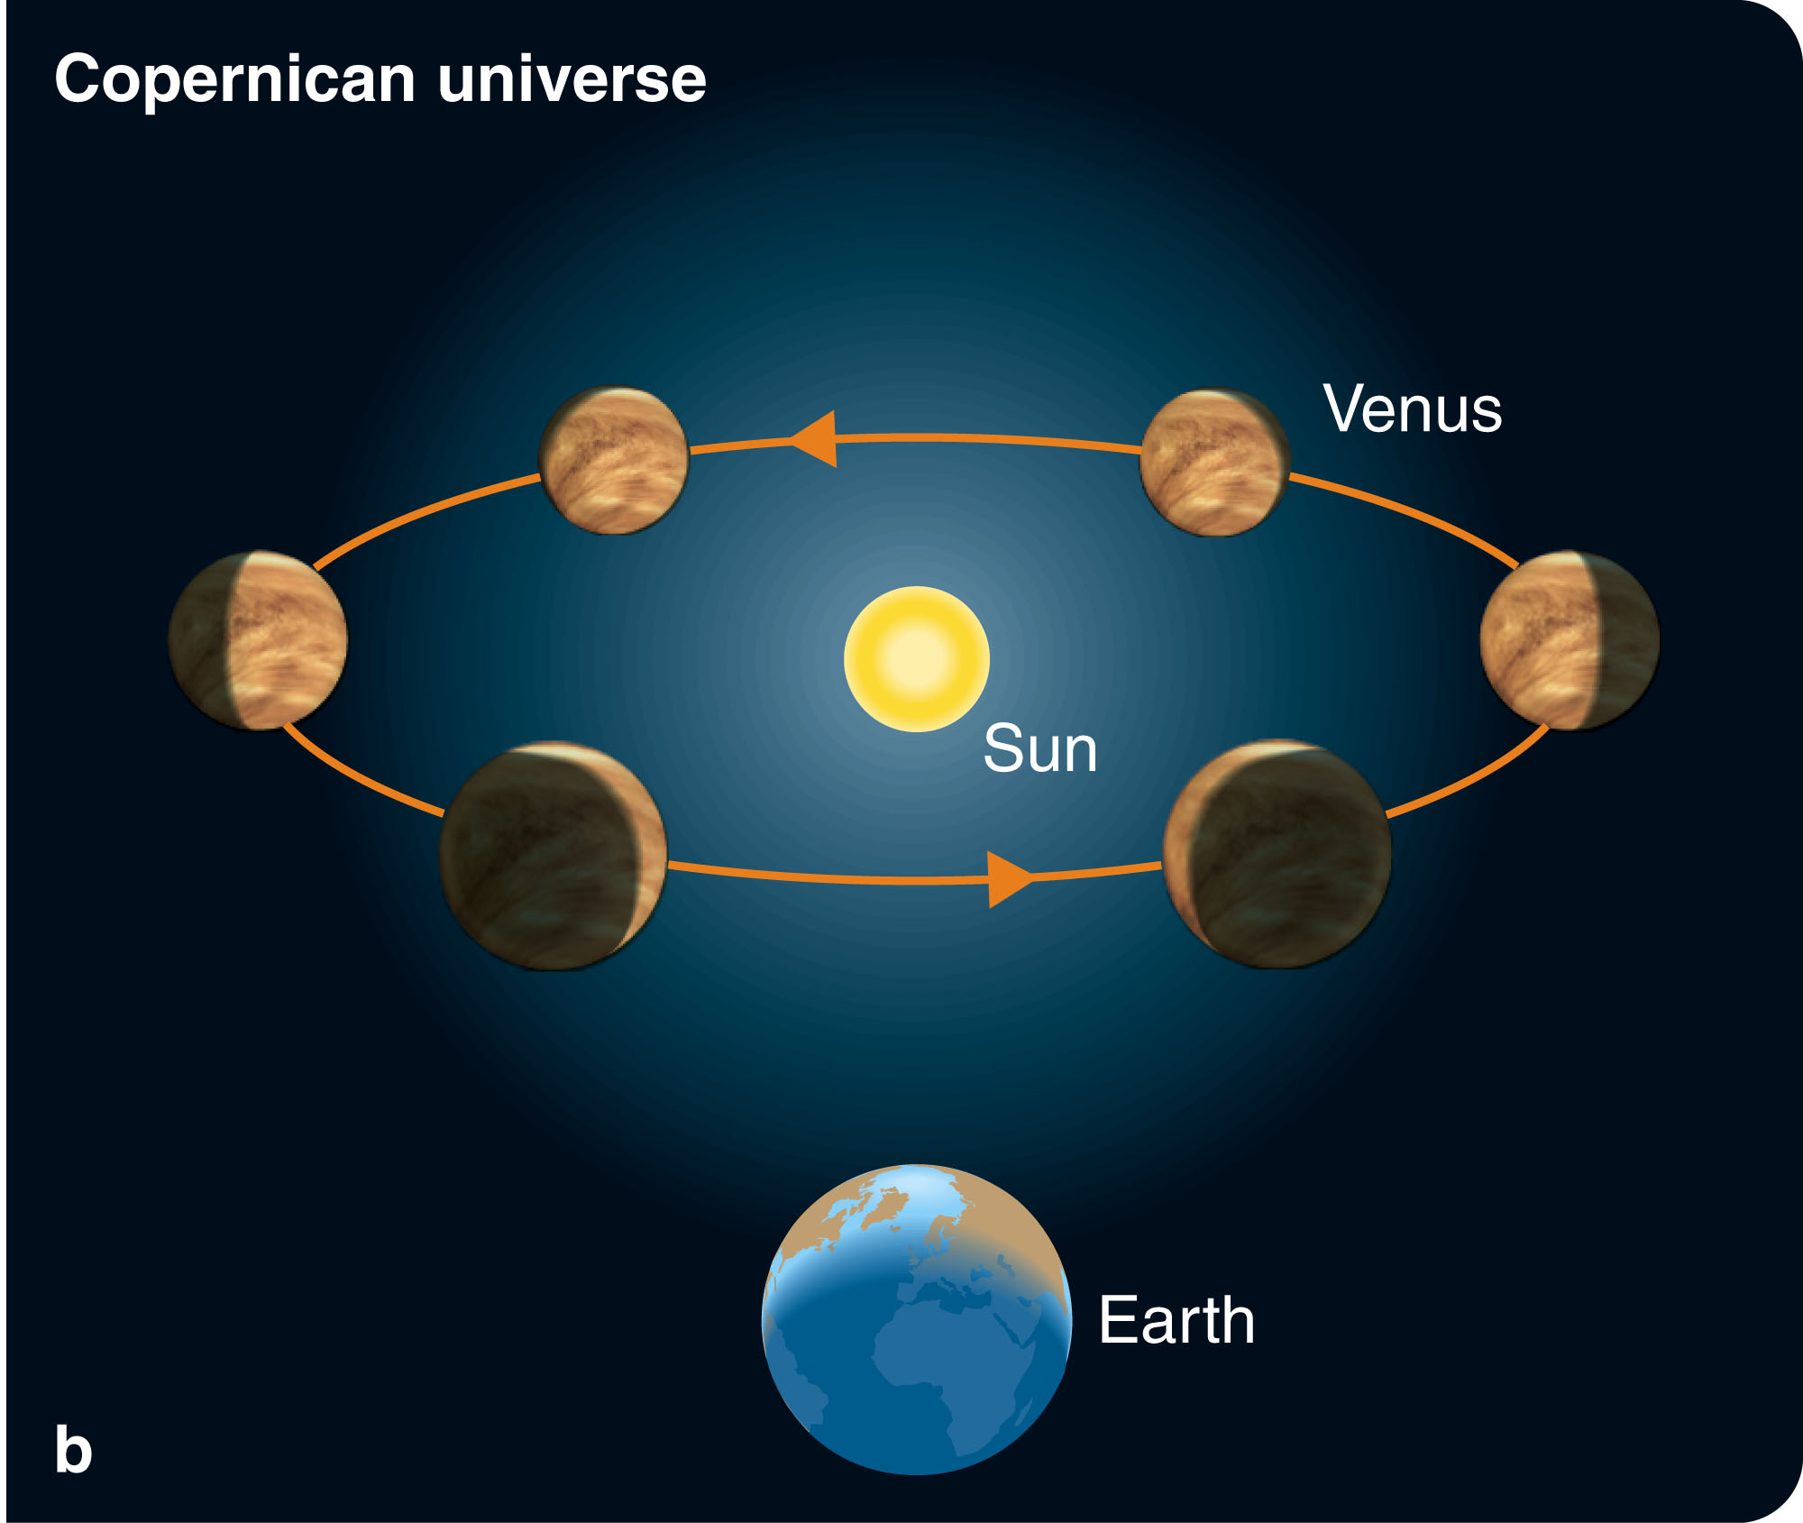
Telescopic Observations
In the Ptolemaic model, Venus moves around an epicycle centered on a line between Earth and the sun.
If that were true, it would always be seen as a crescent.
However, Galileo
saw Venus go through
a complete set of
phases—including
full and gibbous.
This proved that it did indeed
revolve around the sun.

Slide 64
Telescopic Observations
Sidereus Nuncius was popular and made Galileo famous.
In 1611, Galileo visited Rome and was treated with great respect.
He had friendly discussions with the powerful Cardinal Barberini.

Slide 65
Telescopic Observations
However, as he was outspoken, forceful, and sometimes tactless, he offended important people who questioned his telescopic discoveries.
Some critics said he was wrong.
Others said he was lying.
Some refused to look through a telescope lest it mislead them.
Others looked and claimed to see nothing—hardly surprising given the awkwardness of those first telescopes.

Slide 66
Telescopic Observations
When Galileo visited Rome again in 1616, Cardinal Bellarmine interviewed him privately and ordered him to cease public debate about models of the universe.
Galileo appears to have mostly followed the order.

Slide 67
Telescopic Observations
The Inquisition (formally named the Congregation of the Holy Office) banned books relevant to the Copernican hypothesis.

Slide 68
Telescopic Observations
De Revolutionibus itself was only suspended pending revision—because it was recognized as useful for its predictions of planet positions.
Everyone who owned a copy of the book was required to cross out certain statements and add handwritten corrections—stating that Earth’s motion and the central location of the sun were only theories and not facts.
This is a a situation that you will recognize as recurring today in connection with textbooks discussing biological evolution.

Slide 69
Dialogo and Trial
In 1623 Galileo’s friend Cardinal Barberini became pope, taking the name Urban VIII.
Galileo went to Rome in an attempt to have the 1616 order to cease debate lifted.
The attempt was unsuccessful.

Slide 70
Dialogo and Trial
Nevertheless, Galileo began to write a massive defense of Copernicus’s model, completing it in 1629.
After some delay, Galileo’s book was approved by both the local censor in Florence and the head censor of the Vatican in Rome.
It was printed in 1632.

Slide 71
Dialogo and Trial
The book is called Dialogo Dei Due Massimi Sistemi (Dialogue Concerning the Two Chief World Systems).
It confronts the ancient astronomy of Aristotle and Ptolemy with the Copernican model.

Slide 72
Dialogo and Trial
The book was a clear defense of Copernicus.
Also, either intentionally or unintentionally, Galileo exposed the pope’s authority to ridicule.

Slide 73
Dialogo and Trial
Galileo placed the pope’s argument in the mouth of Simplicio.
The pope took offense and ordered Galileo to face the Inquisition.

Slide 74
Dialogo and Trial
Galileo was interrogated by the Inquisition and threatened with torture.
He must have thought of Giordano Bruno—a monk who was tried, condemned, and burned at the stake in Rome in 1600 for, among other offenses, supporting Copernicus.

Slide 75
Dialogo and Trial
However, Galileo’s trial did not center on his belief in Copernicus’s model.
Dialogo had been approved by two censors.
Rather, the trial centered on a record of the meeting in 1616 between Galileo and Cardinal Bellarmine that included the statement that Galileo was “not to hold, teach, or defend in any way” the principles of Copernicus.

Slide 76
Dialogo and Trial
Many historians believe that this document—which was signed neither by Galileo nor by Bellarmine nor by a legal secretary—was a forgery, or perhaps a draft that was never used.
By that time, Bellarmine was dead and could not testify about the meeting or the document.
The Inquisition condemned Galileo not primarily for heresy but for disobeying the orders given him in 1616.

Slide 77
Dialogo and Trial
In 1633, at the age of 70, kneeling before the Inquisition, Galileo read a recantation admitting his errors.
Tradition has it that as he rose he whispered, “E pur si muove” (“Still it moves”)—referring to Earth.
Although he was sentenced to life imprisonment, he was actually confined at his villa for the next 10 years—perhaps through the intervention of the pope.
He died there in 1642, 99 years after the death of Copernicus.

Slide 78
Two Ways to Understand the World
Galileo was tried and condemned on a charge you might call a technicality.
Why then is his trial so important that historians have studied it for almost four centuries?
Why have some of the world’s greatest authors, including Bertolt Brecht, written about Galileo’s trial?
Why in 1979 did Pope John Paul II create a commission to reexamine the case against Galileo?

Slide 79
Two Ways to Understand the World
To understand the trial, you must recognize that it was the result of a conflict between two ways of understanding the universe.

Slide 80
Two Ways to Understand the World
The significance of Galileo’s trial is about the birth of modern science as a new way to understand the universe.

Slide 81
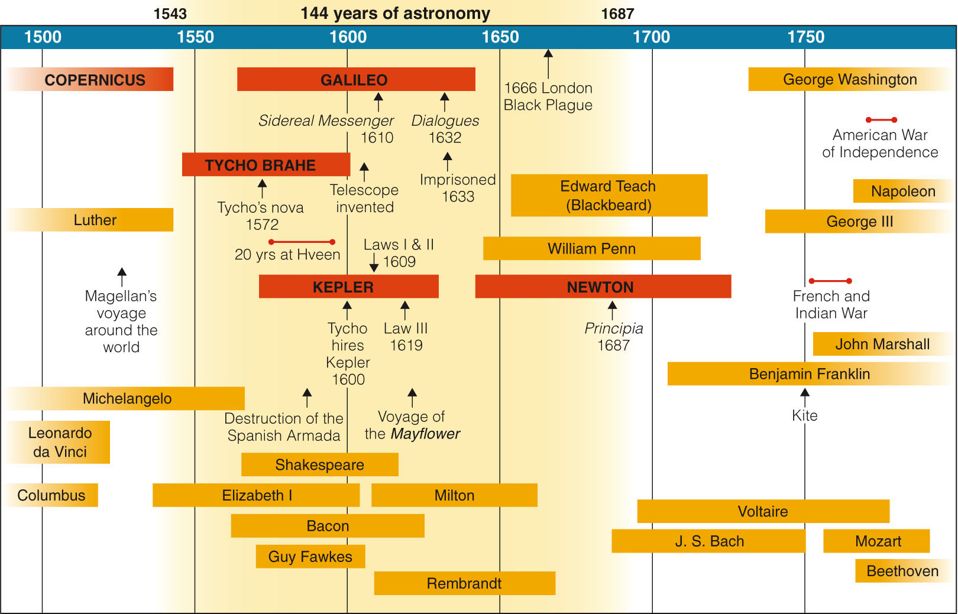
Isaac Newton, Gravity, and Orbits
The birth of modern astronomy and of modern science dates from the 144 years between the publication of Copernicus’s book in 1543 and Newton’s book in 1687.

Slide 82
Isaac Newton, Gravity, and Orbits
The problem of the place of Earth was resolved by the Copernican Revolution.
The problem of planetary motion, though, was only partly solved by Kepler’s laws.

Slide 83
Isaac Newton, Gravity, and Orbits
For the last 10 years of his life, Galileo studied the nature of motion—especially the accelerated motion of falling bodies.
Although he made some important progress, he was not able to relate his discoveries about motion to the heavens.
That final step was taken by Isaac Newton.

Slide 84
Isaac Newton
Newton’s life represented the flowering of the seeds planted by the previous four astronomers in this story—Copernicus, Tycho, Kepler, and Galileo.

Slide 85
Isaac Newton
Newton was a quiet child from a farming family.
However, his work at school was so impressive that his uncle financed his education at Trinity College—where he studied mathematics and physics.

Slide 86
Isaac Newton
In 1665, plague swept through England, and the colleges were closed.
During 1665 and 1666, Newton spent his time back home in Woolsthorpe—thinking and studying.

Slide 87
Isaac Newton
It was during these years that he made most of his scientific discoveries.
Among other things, he studied optics, developed three laws of motion, probed the nature of gravity, and invented differential calculus.
The publication of his work in his book Principia in 1687 placed the fields of physics and astronomy on a new firm base.

Slide 88
Isaac Newton
It is beyond the scope here to analyze all of Newton’s work.
However, his laws of motion and gravity had an important impact on the future of astronomy.

Slide 89
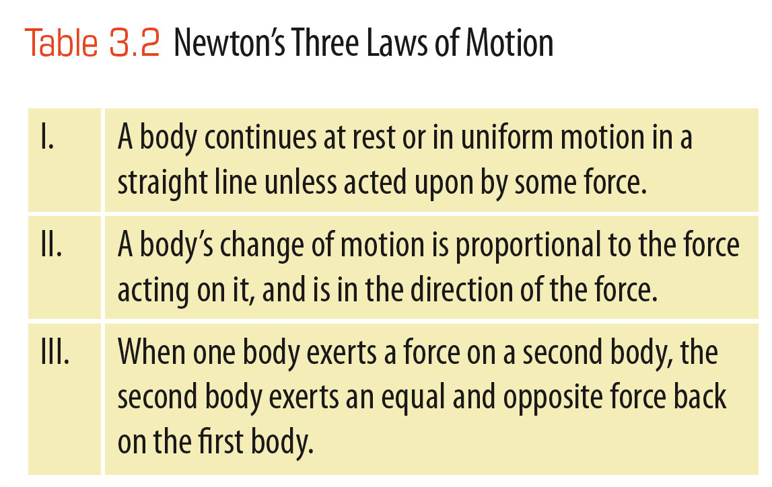
Isaac Newton
From his study of the work of Galileo, Kepler, and others, Newton extracted three laws that relate the motion of a body to the forces acting on it.

Slide 90
Isaac Newton
These laws made it possible to predict exactly how a body would move if the forces were known.

Slide 91
Isaac Newton
When Newton thought carefully about motion, he realized that some force must pull the moon toward Earth’s center.
If there were no such force altering the moon’s motion, it would continue moving in a straight line and leave Earth forever.
It can circle Earth only if Earth attracts it.

Slide 92
Isaac Newton
Newton’s insight was to recognize that the force that holds the moon in its orbit is the same as the force that makes apples fall from trees.
Newtonian gravitation is sometimes called universal mutual gravitation.

Slide 93
Isaac Newton
Newton’s third law points out that forces occur in pairs.
If one body attracts another, the second body must also attract the first.
Thus, gravitation must be mutual.
Furthermore, gravity must be universal.
That is, all objects that contain mass must attract all other masses in the universe.

Slide 94
Isaac Newton
The mass of an object is a measure of the amount of matter in the object—usually expressed in kilograms.
Mass is not the same as weight.
An object’s weight is the force that Earth’s gravity exerts on the object.
Thus, an object in space far from Earth might have no weight.
However, it would contain the same amount of matter and would thus have the same mass that it has on Earth.

Slide 95
Isaac Newton
Newton also realized that the distance between the objects is important.
In other words, the gravitational force between two bodies depends not only on the masses of the bodies but also on the distance between them.

Slide 96
Isaac Newton
He recognized that the force of gravity decreases as the square of the distance between the objects increases.
Specifically, if the distance from, for example, Earth to the moon were doubled, the gravitational force between them would decrease by a factor of 2², or 4.
If the distance were tripled, the force would decrease by a factor of 3², or 9.
This relationship is known as the inverse square relation.

Slide 97
Isaac Newton
Newton guessed that gravity works by an inverse square relation because he had already discovered that light behaves this way.
To summarize, the force of gravity attracting two objects to each other equals a constant times the product of their masses divided by the square of the distance between the objects.

Slide 98
Isaac Newton
Gravity is universal.
Your mass affects Neptune, the galaxy M31, and every other object in the universe.
Their masses affect you—although not much, because they are so far away and your mass is relatively very small.
Newton’s laws of motion and gravitation make it possible for you to:
Understand why and how the moon orbits Earth and the planets orbit the sun
Discover why Kepler’s laws work

Slide 99
Orbital Motion
To understand how an object can orbit another object, you need to see orbital motion as Newton did.
Objects in orbit are falling.

Slide 100
Orbital Motion
There are three important ideas to note about the orbiting Earth.
One, an object orbiting Earth is actually falling (being accelerated) toward Earth’s center.
An object in a stable orbit continuously misses Earth because of its orbital velocity.
Notes:
http://galileo.phys.virginia.edu/classes/109N/more_stuff/Applets/newt/newtmtn.html

Slide 101
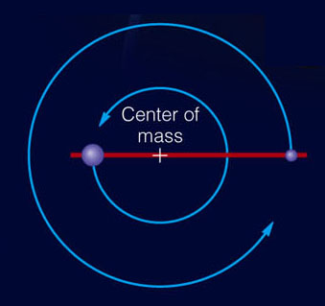
Orbital Motion
Two, objects orbiting each other actually revolve around their mutual center of mass.
Three, notice the
difference between
closed orbits and
open orbits

Slide 102
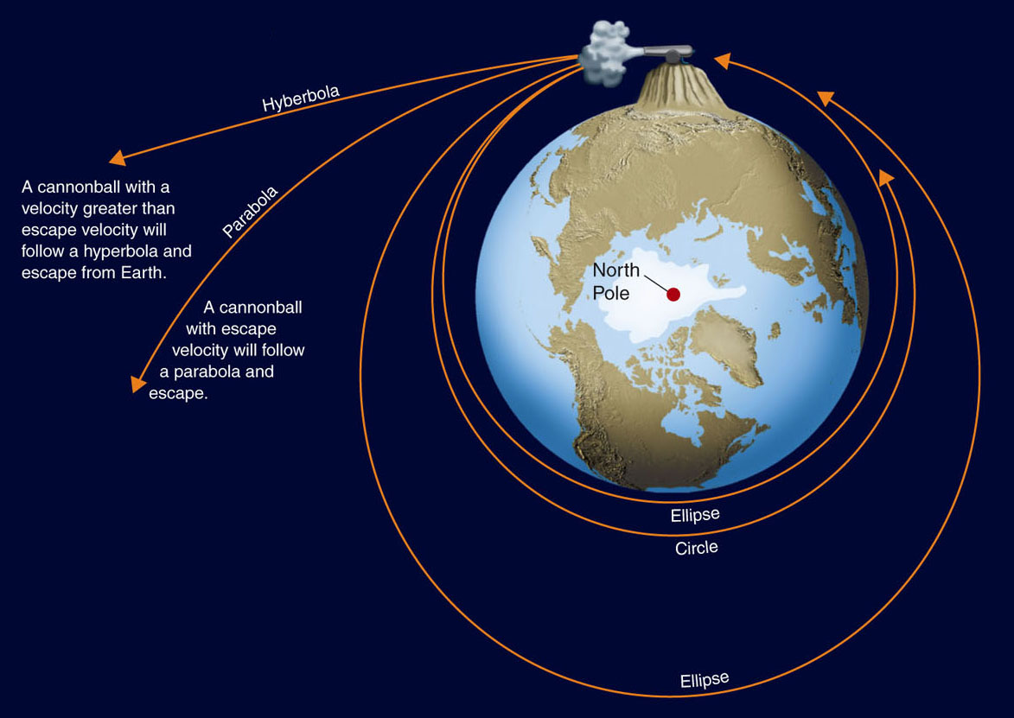
Orbital Motion
If you want to leave Earth never to return, you must give your spaceship a high enough velocity so it will follow an open orbit.

Slide 103
Orbital Motion
When the captain of a spaceship says to the pilot, “Put us into a standard orbit,” the ship’s computers must quickly calculate the velocity needed to achieve a circular orbit.
That circular velocity depends only on the mass of the planet and the distance from the center of the planet.

Slide 104
Orbital Motion
Once the engines fire and the ship reaches circular velocity, the engines can shut down.
The ship is in orbit and will fall around the planet forever—so long as it is above the atmosphere’s friction.
No further effort is needed to maintain orbit—thanks to the laws Newton discovered.

Slide 105
Tides: Gravity in Action
Newton understood that gravity is mutual.
That means the moon’s gravity can explain the ocean tides.
However, he also realized that gravitation is universal.
That means there is much more to tides than just Earth’s oceans.

Slide 106
Tides: Gravity in Action
Tides are caused by small differences in gravitational forces.
As the Earth and moon orbit around each other, they attract each other gravitationally.
Because the side of Earth toward the moon is a bit closer, the moon pulls on it more strongly and that pulls up a bulge.

Slide 107
Tides: Gravity in Action
Also, the moon pulls on Earth a bit more than it pulls on Earth’s far side and that produces a bulge on the far side.
The oceans are deeper in these bulges, and as Earth rotates and carries you into a bulge, you see the tide creeping up the beach.

Slide 108
Tides: Gravity in Action
Because there are two bulges, there are two high tides each day, although the exact pattern of tides at any given locality depends on details such as ocean currents, the shape of the shore, etc.

Slide 109
Tides: Gravity in Action
The sun also produces tides on Earth.
However, they are smaller than lunar tides.
At new and full moons, the lunar and solar tides add together to produce extra high and extra low tides that are called spring tides.

Slide 110
Tides: Gravity in Action
At first and third quarter moons, the solar tides cancel out part of the lunar tides so that high and low tides are not extreme.
These are called neap tides.

Slide 111
Tides: Gravity in Action
Although the oceans flow easily into tidal bulges, the nearly rigid bulk of Earth flexes into tidal bulges and the plains and mountains rise and fall a few centimeters twice a day.
Friction is gradually slowing Earth’s rotation, and fossil evidence shows that Earth used to rotate faster.
In the same way, Earth’s gravity produces tidal bulges in the moon.
Although the moon used to rotate faster, friction has slowed it down and it now keeps the same side facing Earth.

Slide 112
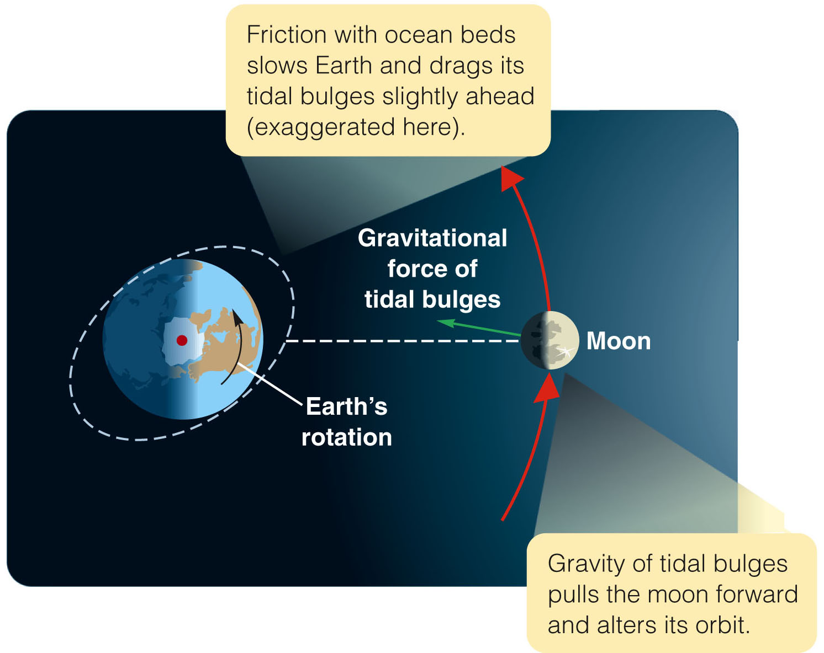
Tides: Gravity in Action

Slide 113
Tides: Gravity in Action
Tides can also affect orbits.
The rotation of Earth drags the tidal bulges slightly ahead of the moon, and the gravitation of the bulges of water pull the moon forward in its orbit.
This makes the moon’s orbit grow larger by about 4 cm a year, an effect that astronomers can measure by bouncing lasers off reflectors left on the moon by the Apollo astronauts.

Slide 114
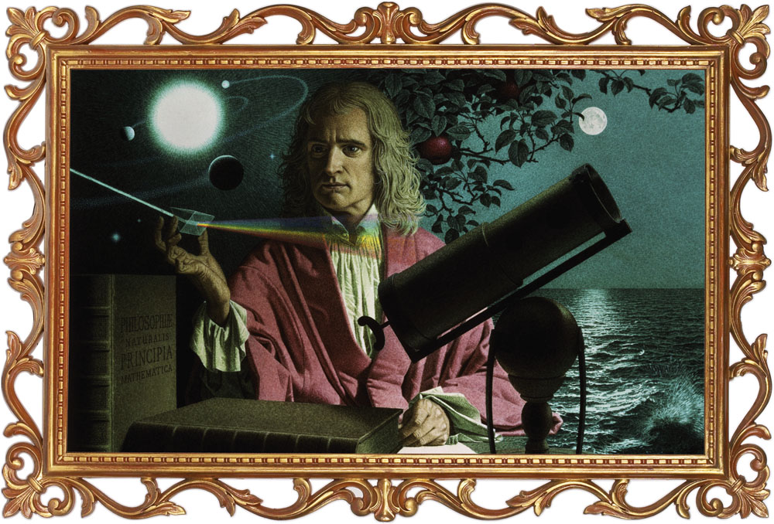
Newton’s Universe
Newton’s insight gave the world a new conception of nature.

Slide 115
Newton’s Universe
His laws of motion and gravity were general laws that described the motions of all bodies under the action of external forces.
In addition, the laws were predictive because they made possible specific calculations of predictions that could be tested by observation.
For example, Newton’s laws of motion can be used to derive Kepler’s third law from the law of gravity.

Slide 116
Newton’s Universe
Newton’s discoveries remade astronomy into an analytical science.
Astronomers could measure the positions and motions of celestial bodies, calculate the gravitational forces acting on them, and predict their future motion.

Slide 117
Newton’s Universe
One of the most often used and least often stated principles of science is cause and effect.
You could argue that Newton’s second law of motion was the first clear statement of that principle.

Slide 118
Newton’s Universe
Ancient philosophers such as Aristotle believed that objects moved because of innate tendencies.
For example, objects made of earth or water had a natural tendency to move toward Earth at the center of the universe.
In contrast, Newton’s second law states that, if an object changes its motion by an acceleration, then it must have been acted on by a force.

Slide 119
Newton’s Universe
The principle of cause and effect gives scientists confidence that every effect has a cause.
Hearing loss in certain laboratory rats or explosions on certain stars are both effects that scientists believe must have causes.

Slide 120
Newton’s Universe
If the universe were not rational, then you could never expect to discover causes.
Newton’s second law of motion was arguably the first explicit statement that the behavior of the universe is rational and depends on causes.

