Slide 1
The Cosmic Redshift
Distance is the separation between two points in space.
Time is the separation between two events.

Slide 2
The Cosmic Redshift
Einstein’s theories of special relativity and general relativity (published respectively in 1905 and 1916) describe how space and time are related and can be considered together as the fabric of the universe.
This is called space-time.
You can think of space-time as the canvas on which the universe is painted.

Slide 3
The Cosmic Redshift
Einstein’s theories predict that the canvas of space-time can potentially expand (or contract).
Amazingly, that has been confirmed by observations.

Slide 4
The Cosmic Redshift
The stretching of space-time explains one of the most important observations in cosmology:
Cosmological redshifts

Slide 5
The Cosmic Redshift
Modern astronomers understand that, except for small local motions within clusters of galaxies, the galaxies are basically at rest.
They have kept approximately the same “address” in space since the big bang.
The distances between them increase as space-time expands.

Slide 6
The Cosmic Redshift
Furthermore, as space-time expands, it stretches any photon traveling through space to longer wavelengths.

Slide 7
The Cosmic Redshift
Photons from distant galaxies spend more time traveling through space and are stretched more than photons from nearby galaxies.
That is why redshift depends on distance.

Slide 8
The Cosmic Redshift
Note that objects—such as the Milky Way, Earth, and you—that are held together by gravity or electromagnetic forces do not expand as the universe expands.

Slide 9
The Cosmic Redshift
Astronomers often express redshifts as if they were radial velocities.
However, the redshifts of the galaxies are not Doppler shifts.
That is why this book is careful to refer to a galaxy’s apparent velocity of recession.

Slide 10
The Cosmic Redshift
All a cosmological redshift shows you directly is how much the universe has expanded since the light began its journey to Earth.
The formula to calculate the distance a photon has traveled, given its redshift, is complicated.
Also, not all the parameters have been measured precisely.
Nevertheless, the Hubble law does apply, and redshifts can be used to estimate the distances to galaxies.

Slide 11
Model Universes
Almost immediately after Einstein published his theory, theorists were able to solve the highly sophisticated mathematics to compute simplified descriptions of the behavior of space-time and matter.
Those “model universes” dominated cosmology throughout the 20th century.

Slide 12
Model Universes
The equations allowed three general possibilities.
Space-time might be curved in ways that are called an open universe or a closed universe.
Space-time might have no overall curvature at all—a situation that is called a flat universe.

Slide 13
Model Universes
Most people find these curved models difficult to imagine.
Fortunately, modern observations have shown that the flat universe model is almost certainly correct.
So, you don’t have to wrap your brain around the curved models.

Slide 14
Model Universes
Note that “flat” does not mean two-dimensional.
Rather, it means that the familiar rules of geometry you learned in elementary and middle school are true on the largest scales.
Different rules of geometry would apply on large scales if the universe were curved.

Slide 15
Model Universes
A main criterion separating the three models is the average density of the universe.
This, according to general relativity, determines the overall curvature of space-time.

Slide 16
Model Universes
If the average density matter and energy in the universe equals what is called the critical density, space-time will be flat.
The critical density is calculated to be about 9 x 10⁻³⁰ g/cm³ (depending on the exact value of Hubble constant).

Slide 17
Model Universes
If the average density is more than the critical density, the universe must be closed.
If it is less, the universe must be open.

Slide 18
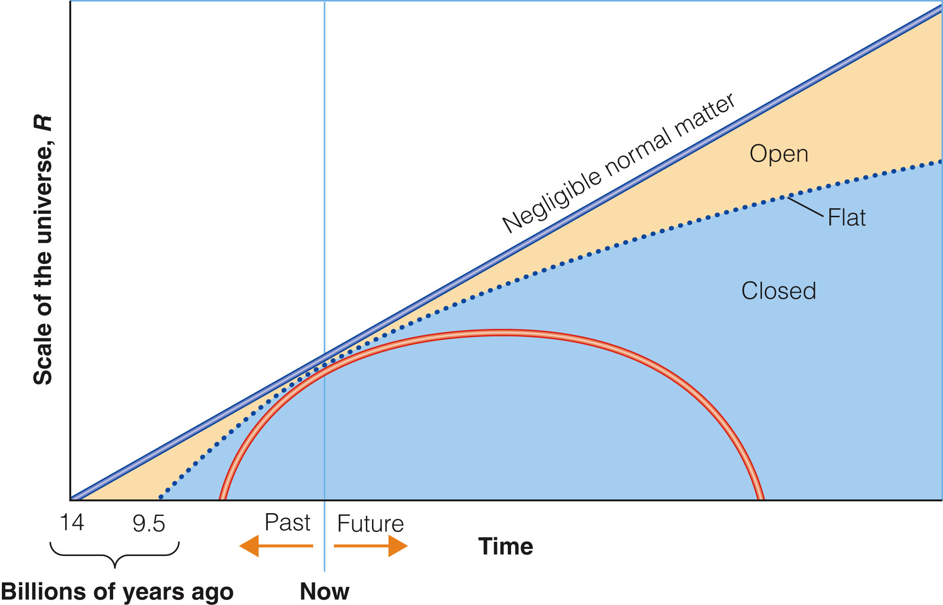
Model Universes
The expansions versus time of the three different models are compared in the figure.

Slide 19
Model Universes
The parameter R on the vertical axis is a measure of the extent to which the universe has expanded.
You could think of it, essentially, as the average distance between galaxies.

Slide 20
Model Universes
Closed universes expand and then contract.
In contrast, flat and open universes expand forever.

Slide 21
Model Universes
You can’t find the actual age of the universe—the distance on the horizontal axis from the present to the beginning, when R was zero—from the expansion rate alone.
You also need to know whether the universe is open, closed, or flat.

Slide 22
Model Universes
The Hubble time is actually the age the universe would be if it were totally open.
This means it would have to contain almost no matter at all.

Slide 23
Dark Matter in Cosmology
If the universe is flat, then its average density must equal the critical density.
Yet, when astronomers added up the matter they could detect, they found only a few percent of the critical density.
They wondered if the dark matter made up the rest.

Slide 24
Dark Matter in Cosmology
You have learned that our galaxy, other galaxies, and galaxy clusters have much stronger gravitational fields than you would expect based on the amount of visible matter.
Even when you add in the nonluminous gas and dust that you expect to find, their gravitational fields are stronger than expected.

Slide 25
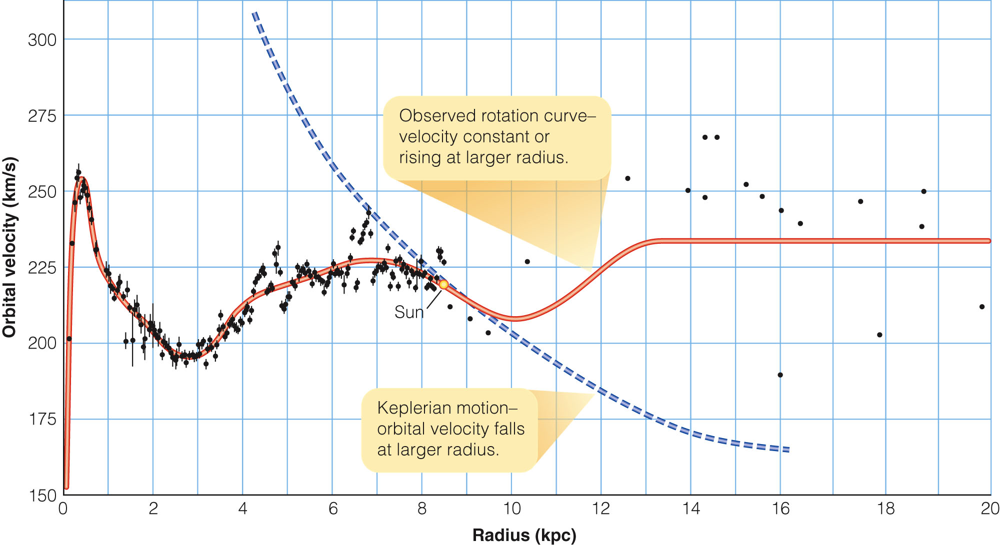
Dark Matter in Cosmology
Galaxies must contain dark matter.
In fact, they must contain much more dark matter than normal matter.

Slide 26
Dark Matter in Cosmology
The protons and neutrons that make up normal matter—including Earth and you—belong to a family of subatomic particles called baryons.

Slide 27
Dark Matter in Cosmology
Modern evidence based on what can be determined about the products of nuclear reactions in the first few minutes after the big bang shows that the dark matter is not baryonic.

Slide 28
Dark Matter in Cosmology
If there were lots of baryons present during those early moments, they would have undergone two collision processes:
Colliding with and destroying deuterium nuclei
Colliding with some of the helium to make lithium

Slide 29
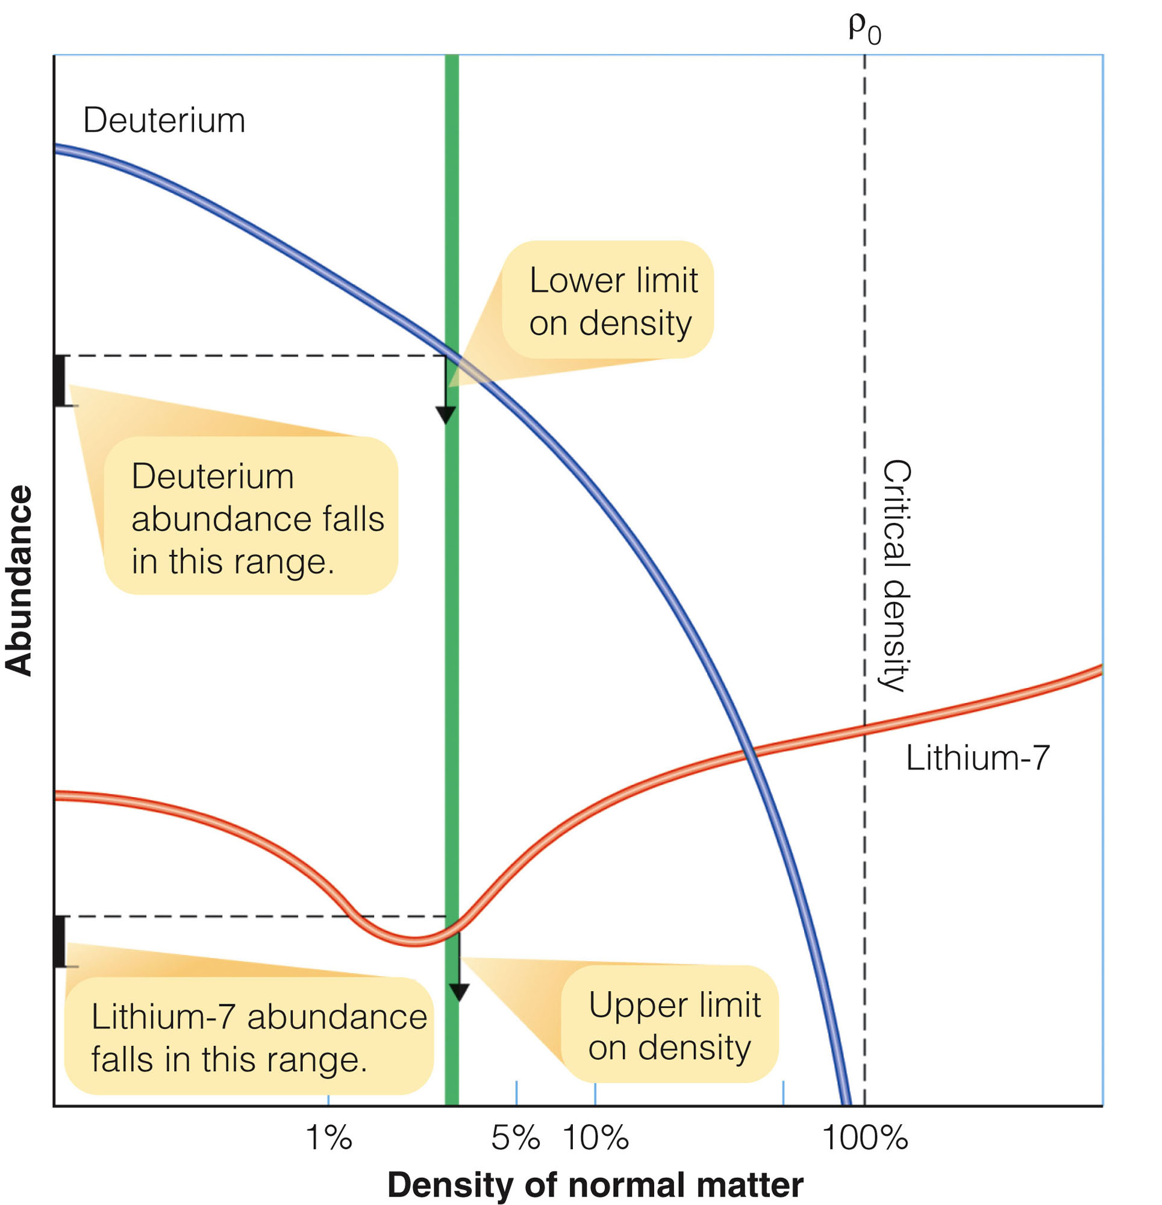
Dark Matter in Cosmology
The observed amount of deuterium sets a lower limit on the density of the universe.
The observed abundance of lithium-7 sets an upper limit.

Slide 30
Dark Matter in Cosmology
Those limits indicate that the baryons you, Earth, and the stars are made of cannot add up to more than four percent of the critical density.

Slide 31
Dark Matter in Cosmology
Yet, observations show that galaxies and galaxy clusters contain as much as 30 percent of the critical density in the form of dark matter.
Only a small amount of the matter in the universe can be baryonic.
So, the dark matter must be nonbaryonic matter.

Slide 32
Dark Matter in Cosmology
The true nature of dark matter remains one of the mysteries of astronomy.
The most successful models of galaxy formation require that the dark matter be made up of cold dark matter.
That is, the particles should move slowly and clump into structures with sizes that explain the galaxies and galaxy clusters you see today.

Slide 33
Dark Matter in Cosmology
Although the evidence is very strong that dark matter exists, it is not abundant enough by itself to make the universe flat.
Dark matter appears to constitute no more than about 30 percent of the critical density.

Slide 34
Dark Matter in Cosmology
There is more to the universe than meets the eye and more even than dark matter.

Slide 35
Modern Cosmology
A little dizzy from the weirdness of expanding space-time and dark matter?
Make sure you are sitting down before you read much further.

Slide 36
Modern Cosmology
As the 21st century began, cosmologists made a startling discovery.
To get a running start on these new discoveries, you’ll have to go back a couple of decades.

Slide 37
Inflation
By 1980, the big bang model was widely accepted.
However, it faced two problems that led to the development of an improved theory:
A big bang model with an important addition

Slide 38
Inflation
One of the problems is called the flatness problem.
The curvature of space-time seems to be near the transition between an open and a closed universe.
That is, the universe seems approximately flat.

Slide 39
Inflation
It seems peculiar that the actual density of the universe is anywhere near the critical density that would make it flat.
To be so near critical density now, the density of the universe during its first moments must have been very close—within 1 part in 10⁴⁹ of the critical density.

Slide 40
Inflation
Why is the universe so close to exactly flat, with no space-time curvature, at the time of the big bang?

Slide 41
Inflation
The second problem with the original big bang theory is called the horizon problem.
When astronomers correct for the motion of Earth, they find that the CMB is very isotropic.
It is the same in all directions to a precision of better than 1 part in 1,000.

Slide 42
Inflation
Yet, background radiation coming from two points in the sky separated by more than an angle of 1° is from two parts of the big bang far enough apart that they should not have been connected at any previous time.

Slide 43
Inflation
That is, when the CMB photons were released, the universe was not old enough for energy to have traveled at the speed of light from one of those regions to the other.
The regions should always have been beyond each other’s “horizon.”
They could not have exchanged heat to make their temperatures equal.

Slide 44
Inflation
How did every part of the observable universe get to be so nearly the same temperature by the time of recombination?

Slide 45
Inflation
The key to these two problems—and to other problems with the simple big bang model—may lie with a modified model called the inflationary big bang.

Slide 46
Inflation
The theory predicts there was a sudden extra expansion when the universe was very young.
This expansion was even more extreme than that predicted by the original big bang model.

Slide 47
Inflation
According to the inflationary universe model, the universe expanded and cooled until about 10⁻³⁵ second after the big bang.
Then, the universe became cool enough that the forces of nature—which at earlier extremely high temperatures would have behaved identically—began to differ from each other.

Slide 48
Inflation
Physicists calculate that this would have released tremendous amounts of energy.
It would have suddenly inflated the universe by a factor of 10⁵⁰ or larger.

Slide 49
Inflation
As a result, the part of the universe that is now visible from Earth—the entire observable universe—expanded rapidly from no larger than the volume of an atom to the volume of a cherry pit.
Then, it continued a slower expansion to its present state.

Slide 50
Inflation
That sudden inflation can solve the flatness problem and the horizon problem.
The inflation of the universe would have forced whatever curvature it had toward zero—just as inflating a balloon makes a small spot on its surface flatter.
Thus, you now live in a universe that is almost perfectly flat space-time geometry because of that sudden inflation long ago.

Slide 51
Inflation
In addition, because the observable part of the universe was no larger in volume than an atom before inflation, it was small enough to have equalized its temperature by then.
Now, you live in a universe with the same CMB temperature in all directions.

Slide 52
Inflation
The inflationary theory predicts that the universe is almost perfectly flat.
Observations, however, seem to show that the masses scientists know about—baryonic matter plus dark matter—add up only to about 30 percent of the amount needed to make space-time flat.

Slide 53
Inflation
Can there be more to the universe than baryonic matter and dark matter?
What could be weirder than dark matter?

Slide 54
The Acceleration of the Universe
Both common sense and mathematical models suggest that, as the galaxies recede from each other, the expansion should be slowed by gravity trying to pull the galaxies toward each other.

Slide 55
The Acceleration of the Universe
How much the expansion is slowed should depend on the amount of matter in the universe.
If the density of matter is less than the critical density, the expansion should be slowed only slightly.
Thus, the universe should expand forever.
If the density of matter is greater than the critical density, the expansion should be slowing down dramatically.
Thus, the universe should eventually begin contracting.

Slide 56
The Acceleration of the Universe
For decades, astronomers struggled to measure the distance to very distant galaxies directly, compare distances with redshifts, and thereby detect the slowing of the expansion.
The rate of slowing would, in turn, reveal the true curvature of the universe.

Slide 57
The Acceleration of the Universe
This was one of the key projects for the Hubble Space Telescope.
Two teams of astronomers spent years in competition making the measurements using the same technique.

Slide 58
The Acceleration of the Universe
They calibrated type Ia supernovae as standard candles.
They did this by locating such supernovae occurring in nearby galaxies whose distances were known from Cepheid variables and other reliable distance indicator.

Slide 59
The Acceleration of the Universe
Once the peak luminosity of type Ia supernovae had been determined, they could be used to find the distances of much more distant galaxies.

Slide 60
The Acceleration of the Universe
Both teams announced their results in 1998.
They agreed that the expansion of the universe is not slowing down.
It is speeding up!

Slide 61
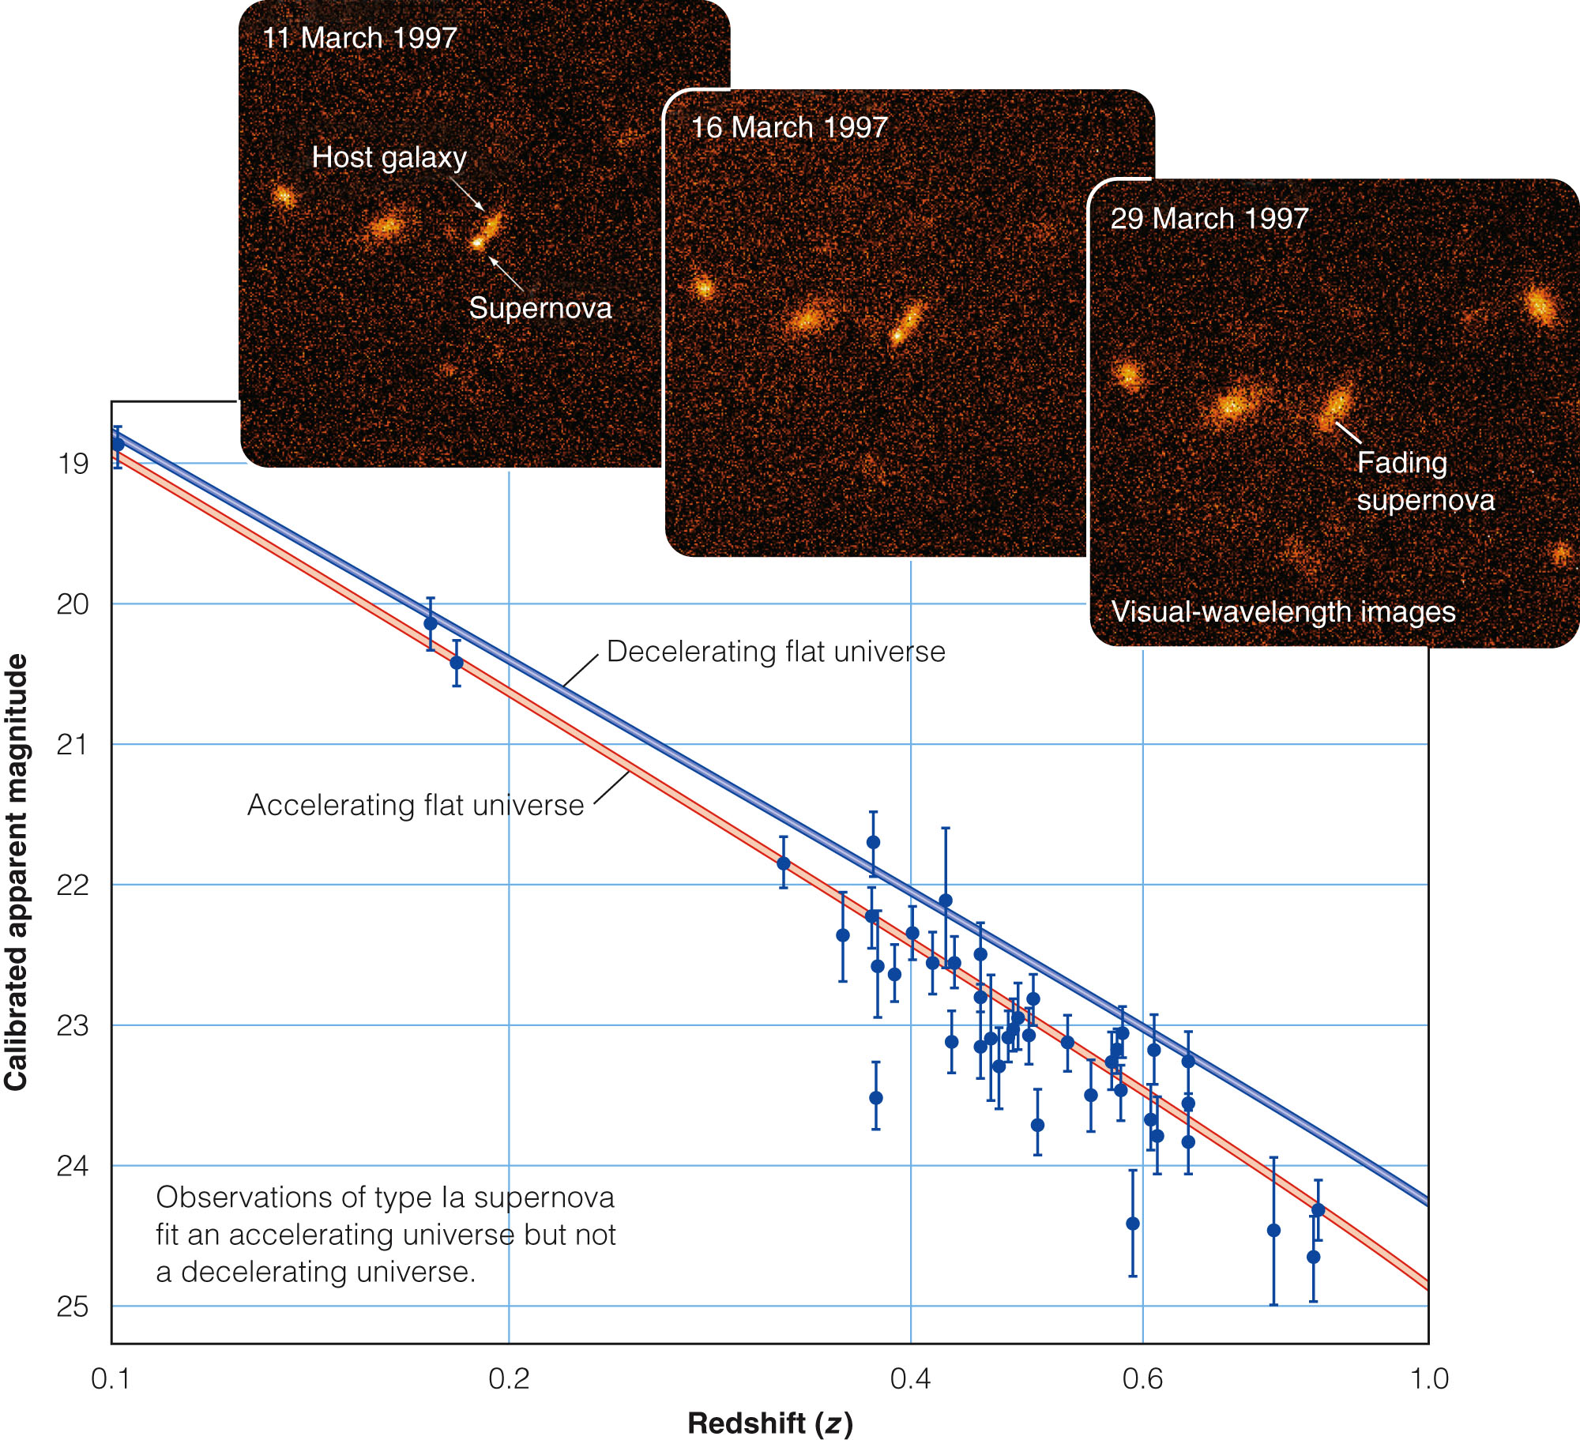
The Acceleration of the Universe
That is, the expansion of the universe is accelerating.

Slide 62
The Acceleration of the Universe
The announcement that the expansion of the universe is accelerating was totally unexpected.
Astronomers immediately began testing it.

Slide 63
The Acceleration of the Universe
The most likely problem was thought to be that the calibration of the supernovae by the original teams might be incorrect.
However, that has been ruled out by measurements of more recently discovered supernovae at very great distances.

Slide 64
The Acceleration of the Universe
Other possible problems have been checked and seem to have been eliminated.
The universe really does seem to be expanding faster and faster.

Slide 65
Dark Energy and Acceleration
If the expansion of the universe is accelerating, then there must be a force of repulsion in the universe.
Astronomers are struggling to understand what it could be.
One possibility leads back to Albert Einstein.

Slide 66
Dark Energy and Acceleration
When Einstein published his theory of general relativity in 1916, he noticed that his equations describing space-time implied that the universe should contract because of the gravitational attraction of galaxies for each other.

Slide 67
Dark Energy and Acceleration
In 1916, astronomers did not yet know that the universe was expanding.
So, Einstein thought he needed to balance the attractive force of gravity.

Slide 68
Dark Energy and Acceleration
He did this by adding a constant to his equations—called the cosmological constant.
This represents a force of repulsion that would make the universe hold still.

Slide 69
Dark Energy and Acceleration
13 years later, in 1929, Edwin Hubble announced that the universe was expanding.
Einstein then said that introducing the cosmological constant was his biggest blunder.
Modern astronomers, though, aren’t so sure.

Slide 70
Dark Energy and Acceleration
One explanation for the acceleration of the universe is that there is a cosmological constant after all.
It represents a real force that drives a continuing acceleration in the expansion of the universe.
The cosmological constant, as its name implies, would be constant in strength over time.

Slide 71
Dark Energy and Acceleration
Another possibility is a type of energy that is not constant in strength over time.
Astronomers have begun referring to this type of energy as quintessence.

Slide 72
Dark Energy and Acceleration
In either case, the observed acceleration is evidence that some form of energy—either a cosmological constant or quintessence—is spread throughout space.

Slide 73
Dark Energy and Acceleration
Astronomers refer to this as dark energy.
This energy drives the acceleration of the universe.
It, however, does not contribute to the formation of starlight or the CMB.

Slide 74
Dark Energy and Acceleration
You have learned that acceleration and dark energy were first discovered when astronomers found that supernovae a few billion light-years away were slightly fainter than expected.

Slide 75
Dark Energy and Acceleration
Since then, even more distant supernovae have been determined to be a bit brighter than expected.
So, they are not as far away as the redshifts of their galaxies would seemingly indicate.

Slide 76
Dark Energy and Acceleration
This means that, sometime about 6 billion years ago, the universe shifted gears from deceleration to acceleration.
The careful calibration of type Ia supernovae allows astronomers to observe this change from deceleration to acceleration.
The careful calibration of type Ia supernovae allow astronomers to observe this change from deceleration to acceleration.
This discovery has the important consequence of increasing previous estimates of the age of the universe by several billion years.

Slide 77
Dark Energy and Acceleration
Furthermore, dark energy can help you understand the lack of curvature of space-time.
The theory of inflation makes the specific prediction that the universe is flat.
Dark energy seems to confirm that prediction.

Slide 78
Dark Energy and Acceleration
You have learned that energy and matter are equivalent.
So, dark energy is equivalent to mass spread through space.

Slide 79
Dark Energy and Acceleration
Baryonic matter plus dark matter make up a third of the critical density.
Dark energy appears to make up two-thirds.
That is, when you include dark energy, the total mass-plus-energy density of the universe seems to equal the critical density.
That means that the universe is flat.

Slide 80
The Fate of the Universe
For many years, cosmologists have enjoyed saying, “Geometry is destiny.”
Thinking about models of open, closed, and flat universes, they concluded that the density of a model universe determines it geometry—and its geometry determines its fate.
In other words, they were sure that an open universe must expand forever and a closed universe must eventually begin contracting.

Slide 81
The Fate of the Universe
That, however, is true only if the universe is ruled by gravity.
If the power of dark energy dominates gravity, then geometry is not destiny.
Even a closed universe might expand forever.

Slide 82
The Fate of the Universe
The ultimate fate of the universe depends on the nature of dark energy.

Slide 83
The Fate of the Universe
If dark energy is described by the cosmological constant, then the force driving acceleration does not change with time—and our flat universe will expand forever.
The galaxies will get farther and farther apart.
They will use up their gas and dust making stars.
Ultimately, the stars will all die.
Each galaxy will be isolated, burnt out, dark, and alone.

Slide 84
The Age and Fate of the Universe
If dark energy is described by quintessence, then its strength could increase with time—and the universe expansion may accelerate faster and faster.
Space will pull the galaxies away from each other and, eventually, pull them apart.
Then, it will rip the stars apart.
Finally, it will rip individual atoms apart.

Slide 85
The Age and Fate of the Universe
That has been called the big rip.
Don’t worry, though.
Even if a big rip is in the future, nothing will happen for at least 30 billion years.
There will probably be no big rip.

Slide 86
The Age and Fate of the Universe
Critically important observations made by the Chandra X-Ray Observatory have been used to measure the amount of hot gas and dark matter in 25 galaxy clusters.
These observations are critical for two reasons.

Slide 87
The Age and Fate of the Universe
First, the redshifts and distances of these galaxies confirm that the universe expansion initially slowed down—but shifted gears about 6 billion years ago and is now accelerating.

Slide 88
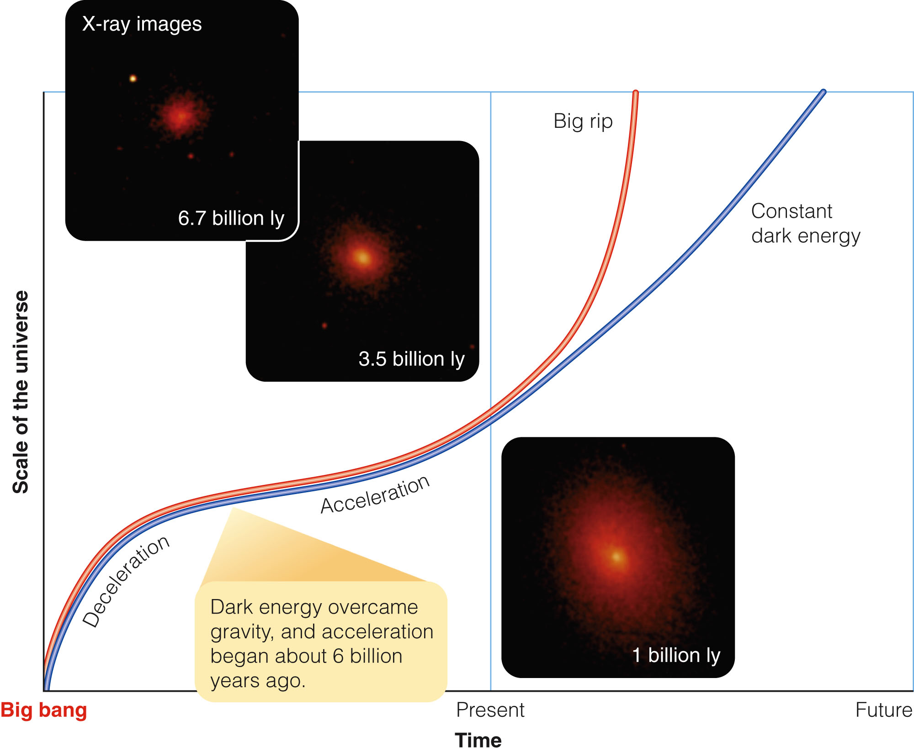
The Age and Fate of the Universe
Second, the results are almost good enough to rule out quintessence.
If dark energy is described by the cosmological constant and not by quintessence, then there will be no big rip.

Slide 89
The Age and Fate of the Universe
Notice that this method does not depend on type Ia supernovae at all.
It is independent confirmation that acceleration is real.
When a theory is confirmed by observations of many different types, scientists have much more confidence that it is a true description of nature.

Slide 90
The Origin of Structure
On the largest scales, the universe is isotropic.
On smaller scales, though, there are irregularities.

Slide 91
The Origin of Structure
Galaxies are grouped in clusters ranging from a few galaxies to thousands.
Those clusters appear to be grouped into superclusters.
The Local Supercluster, in which we live, is a roughly disk-shaped swarm of galaxy clusters 50 to 75 pc in diameter.

Slide 92
The Origin of Structure
Astronomers have measured the redshifts and positions of over thousands of galaxies in great slices across the sky.
Thus, they have been able to create maps revealing that the superclusters are not scattered at random.

Slide 93
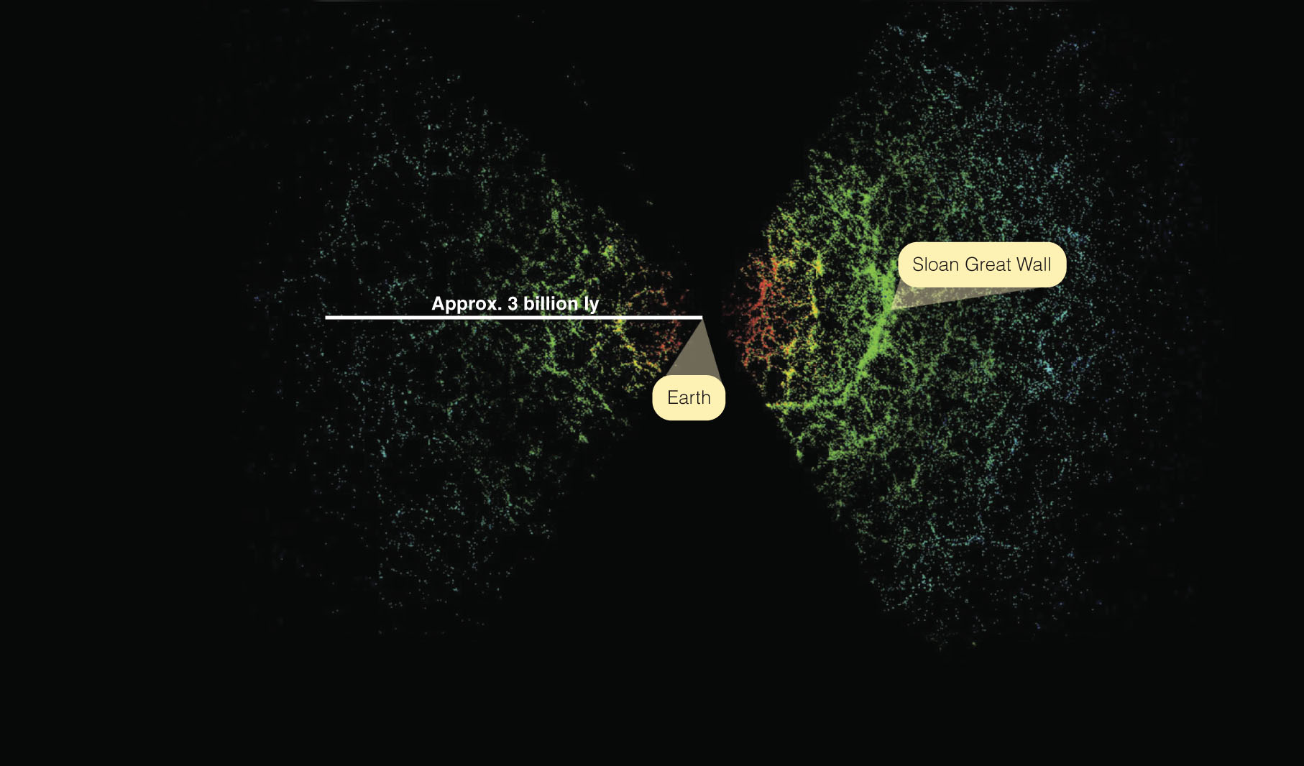
The Origin of Structure
Superclusters are distributed in long, narrow filaments and thin walls that outline great voids nearly empty of galaxies.

Slide 94
The Origin of Structure
These aggregations and gaps are referred to as large-scale structure.

Slide 95
The Origin of Structure
This large-scale structure is a problem.
The CMB radiation is very uniform.
That means the gas of the big bang must have been extremely uniform at the time of recombination.
Yet, the look-back time to the farthest known galaxy clusters, galaxies, and quasars is about 95 percent of the way back to the big bang.

Slide 96
The Origin of Structure
How did the uniform gas at the time of recombination coagulate so quickly to form galaxy clusters, galaxies, and supermassive black holes in the centers of galaxies so early in the history of the universe?
The answer appears to lie in the characteristics of dark matter.

Slide 97
The Origin of Structure
Baryonic matter is so rare in the universe that it does not have enough gravity to pull itself together quickly after the big bang.
As you have learned, astronomers propose that dark matter is nonbaryonic.
Thus, it is immune to the smoothing effect of the intense radiation that prevented normal matter from contracting.

Slide 98
The Origin of Structure
Dark matter was able to collapse into clouds.
Then, it pulled in the normal matter—to begin the formation of galaxies, clusters, and superclusters.

Slide 99
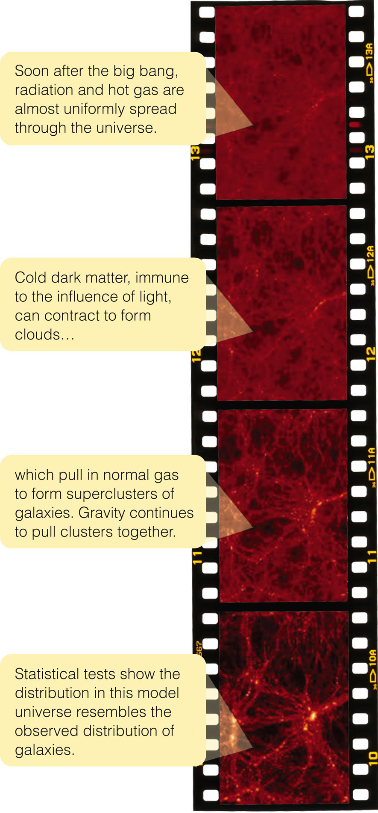
The Origin of Structure
Mathematical models have attempted to describe this process.
Cold dark matter does seem capable of jumpstarting the formation of structure.

Slide 100
The Origin of Structure
What started the clumping of the dark matter?
Theorists say that space is filled with tiny, random quantum mechanical fluctuations smaller than the smallest atomic particles.
At the moment of inflation, those tiny fluctuations would have been stretched to very large, but very subtle, variations in gravitational fields.
These could have later led to the formation of clusters, filaments, and walls.

Slide 101
The Origin of Structure
This structure may be the ghostly traces of quantum fluctuations in the infant universe.

Slide 102
CMB Irregularities and the Curvature of Space-Time
Observations of tiny irregularities in the background radiation can also reveal details about inflation and acceleration.

Slide 103
CMB Irregularities and the Curvature of Space-Time
In fact, the inflationary theory of the universe makes very specific predictions about the sizes of the irregularities an observer on Earth should see in the CMB.
The Wilkinson Microwave Anisotropy Probe (WMAP)—a space infrared telescope—has made extensive observations of the type required to test those predictions.

Slide 104
CMB Irregularities and the Curvature of Space-Time
The background radiation is very isotropic.
However, when the average intensity is subtracted from each spot on the sky, small irregularities are evident.

Slide 105
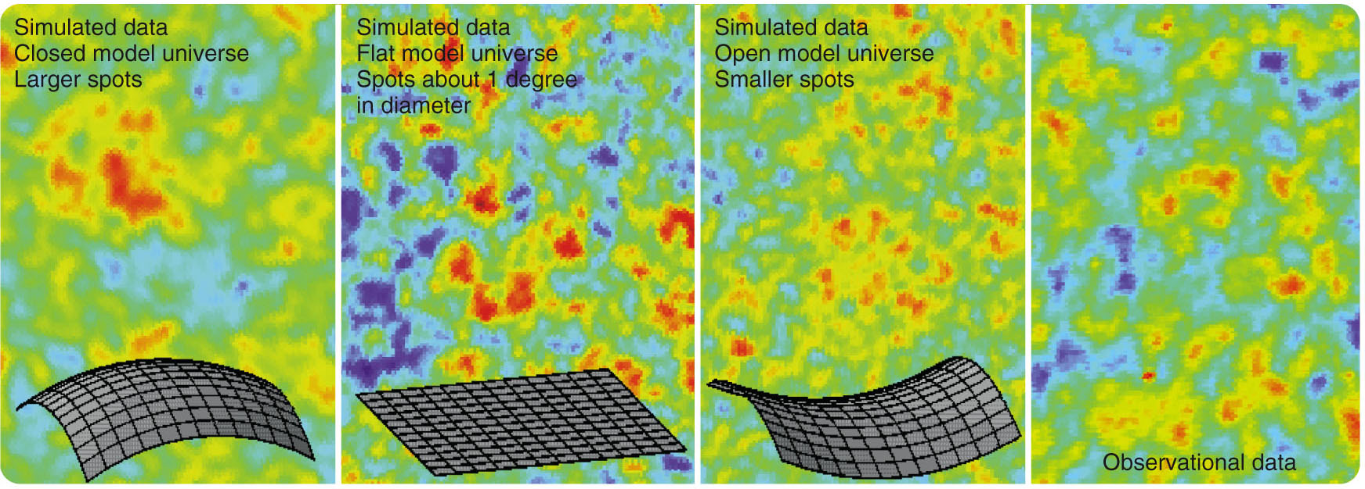
CMB Irregularities and the Curvature of Space-Time
That is, some spots on the sky look a tiny bit hotter and brighter than other spots.

Slide 106
CMB Irregularities and the Curvature of Space-Time
Cosmologists can analyze the irregularities in the intensity of the CMB using sophisticated mathematics to find out how often spots of different sizes recur.
The analysis confirm that spots about 1° in diameter are the most common.
However, spots of other sizes recur as well.

Slide 107
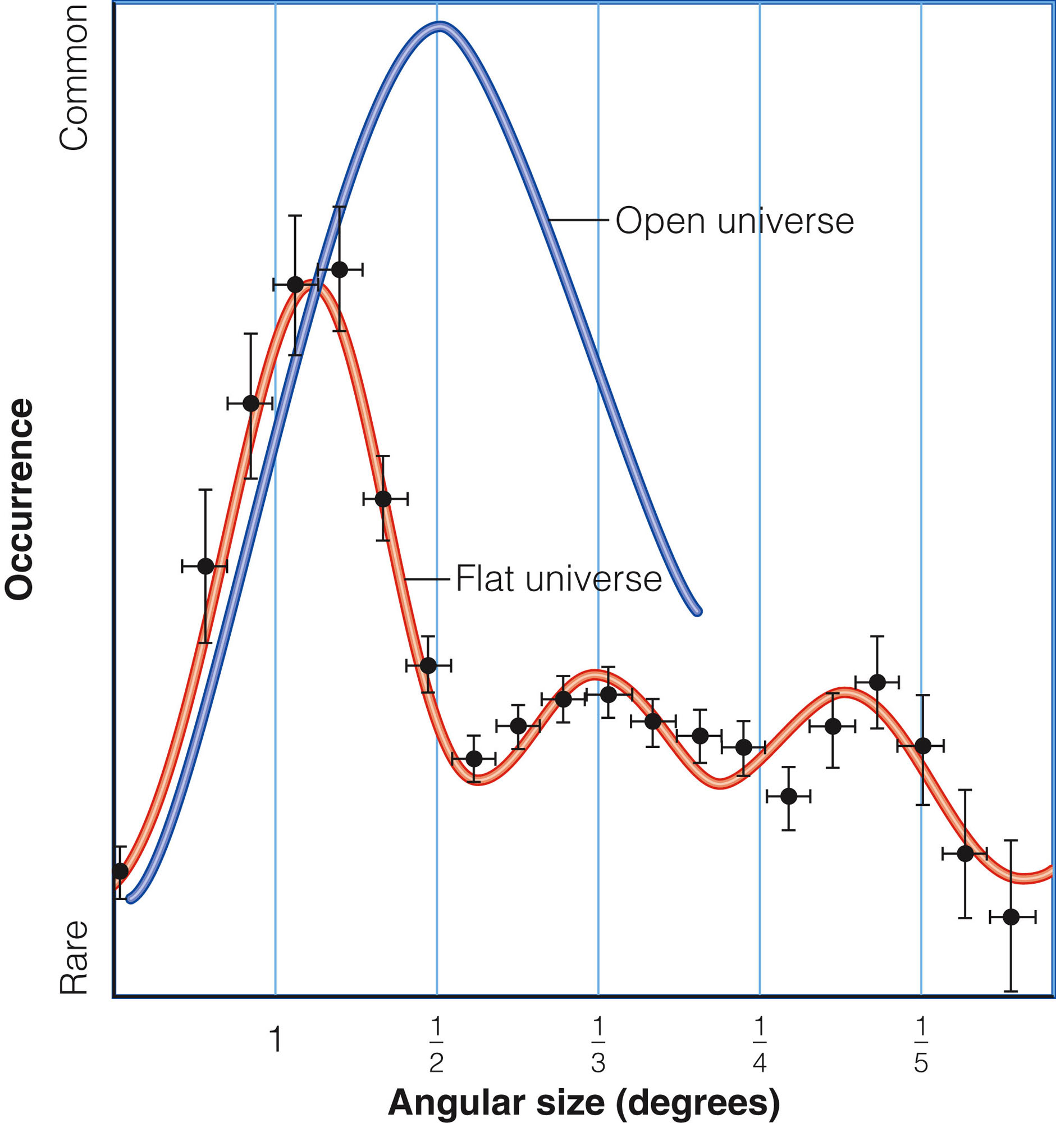
CMB Irregularities and the Curvature of Space-Time
A graph can be plotted to show how common different size irregularities are.

Slide 108
CMB Irregularities and the Curvature of Space-Time
Theory predicts that most of the irregularities in the hot gas of the big bang should be about 1° in diameter if the universe is flat.
If the universe were open, the most common irregularities would be smaller.

Slide 109
CMB Irregularities and the Curvature of Space-Time
The size of the irregularities in the cosmic background radiation show that the observations fit the flat universe model well.

Slide 110
CMB Irregularities and the Curvature of Space-Time
The theory of inflation is supported—an exciting result itself.
The data also show that the universe is flat.
This indirectly confirms the existence of dark energy and the acceleration of the universe.

Slide 111
CMB Irregularities and the Curvature of Space-Time
The results from the WMAP observations make a complicated curve in the figure.
Details of the wiggles inform cosmologists a great deal about the universe.

Slide 112
CMB Irregularities and the Curvature of Space-Time
The curve shows that the universe is flat, accelerating, and will expand forever.
The age of the universe derived from the data is 13.7 billion years.

Slide 113
CMB Irregularities and the Curvature of Space-Time
The smaller peaks in the curve reveal that the universe contains 4 percent baryonic (normal) matter, 23 percent dark matter, and 73 percent dark energy.

Slide 114
CMB Irregularities and the Curvature of Space-Time
The Hubble constant is confirmed to be 71 km/s/Mpc.

Slide 115
CMB Irregularities and the Curvature of Space-Time
The inflationary theory is confirmed.
The data also support the cosmological constant version of dark energy.

Slide 116
CMB Irregularities and the Curvature of Space-Time
Quintessence, though, is not ruled out.
The dark matter needs to be cold (in this context,
slowly-moving) in order to clump together rapidly enough after the big bang to make the first galaxies, quasars, and galaxy clusters.

Slide 117
CMB Irregularities and the Curvature of Space-Time
WMAP and other studies of the CMB radiation and the distribution of galaxies have revolutionized cosmology.
At last, astronomers have accurate observations against which to test theories.
The basic constants are known to a precision of a few percent.

Slide 118
CMB Irregularities and the Curvature of Space-Time
On reviewing these results, one cosmologist announced, “Cosmology is solved!”
That may be premature.
Scientists don’t understand dark matter or the dark energy that drives the acceleration.
So, over 95 percent of the universe is not understood.

Slide 119
CMB Irregularities and the Curvature of Space-Time
Hearing that, another astronomer suggested a better phrase was “Cosmology in crisis!”
Certainly, there are further mysteries to be explored.
However, cosmologists are growing more confident that they can describe the origin and evolution of the universe.

