Slide 1
Temperature Spectral Classification
Learning to recognize the pattern of spectral lines produced in the atmospheres of stars of different temperatures means there is no need to do a full analysis every time each type of spectrum is encountered.
Time can be saved by classifying stellar spectra rather than analyzing each spectrum individually.

Slide 2
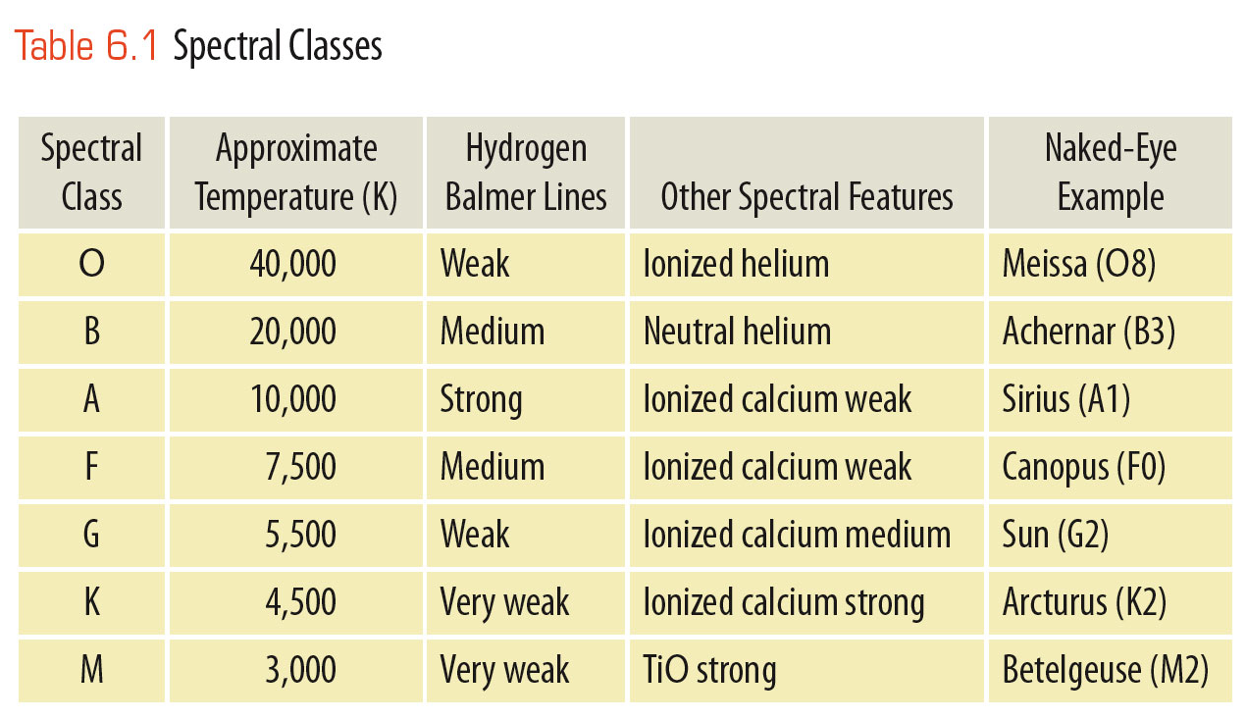
Temperature Spectral Classification
Astronomers classify stars by the lines and bands in their spectra.
For example, if it has weak Balmer lines and lines of ionized helium, it must be an O star.

Slide 3
Temperature Spectral Classification
The star classification system now used by astronomers was devised at Harvard during the 1890s and 1900s.
One of the astronomers there, Annie J. Cannon, personally inspected and classified the spectra of over 250,000 stars.

Slide 4
Temperature Spectral Classification
The spectra were first classified in groups labeled A through Q.
Later, some groups were dropped, merged with others, or reordered.

Slide 5
Temperature Spectral Classification
The final classification includes seven main spectral classes or types that are still used today:
O, B, A, F, G, K, and M

Slide 6
Temperature Spectral Classification
This set of star types—called the spectral sequence—is important because it is a temperature sequence.
The O stars are the hottest.
The temperature continues to decrease down to the M stars, the coolest.

Slide 7
Temperature Spectral Classification
For further precision, astronomers divide each spectral class into 10 subclasses.
For example, spectral class A consists of the subclasses A0, A1, A2, . . . A8, and A9.
Next come F0, F1, F2, and so on.

Slide 8
Temperature Spectral Classification
These finer divisions define a star’s temperature to a precision of about 5 percent.
Thus, the sun is not just a G star.
It is a G2 star, with a temperature of 5,800 K.

Slide 9
Temperature Spectral Classification
Generations of astronomy students have remembered the spectral sequence by using various mnemonics.
Oh Boy, An F Grade Kills Me.
Only Bad Astronomers Forget Generally Known Mnemonics.

Slide 10
Meteoroids, Meteors, and Meteorites
Unlike the stately comets, meteors flash across the sky in momentary streaks of light.
They are commonly called “shooting stars.”

Slide 11
Meteoroids, Meteors, and Meteorites
They are not stars but small bits of rock and metal falling into Earth’s atmosphere.
They burst into incandescent vapor about 80 km (50 mi) above the ground because of friction with the air.
This hot vapor condenses to form dust, which settles slowly to the ground—adding about 40,000 tons per year to the planet’s mass.

Slide 12
Meteoroids, Meteors, and Meteorites
Technically, the word meteor refers to the streak of light in the sky.
In space, before its fiery plunge, the object is called a meteoroid.

Slide 13
Meteoroids, Meteors, and Meteorites
Most meteoroids are specks of dust, grains of sand, or tiny pebbles.
Almost all the meteors you see in the sky are produced by meteoroids that weigh less than 1 g.
Only rarely is one massive enough and strong enough to survive its plunge, reach Earth’s surface, and become what is called a meteorite.

Slide 14
Meteoroids, Meteors, and Meteorites
Meteorites can be divided into three broad categories.
Iron
Stony
Stony-iron

Slide 15
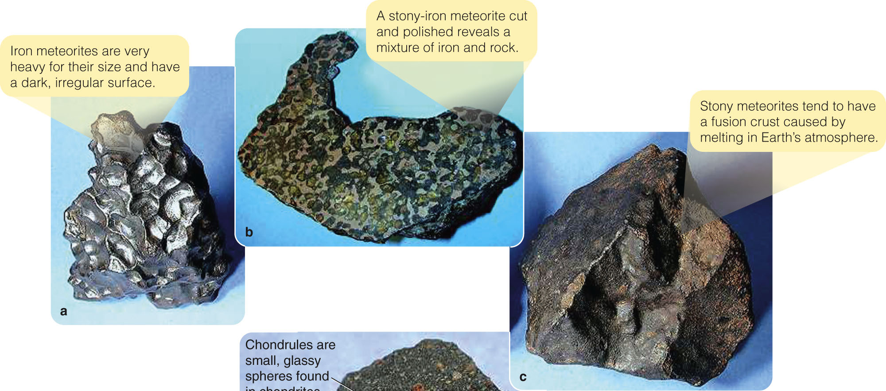
Meteoroids, Meteors, and Meteorites
Iron meteorites are solid chunks of iron and nickel.
Stony meteorites are silicate masses that resemble Earth rocks.
Stony-iron meteorites are iron-stone mixtures.

Slide 16
Meteoroids, Meteors, and Meteorites
You can find evidence of the origin of meteors through one of the most pleasant observations in astronomy.
You can watch a meteor shower, a display of meteors that are clearly related by a common origin.

Slide 17
Meteoroids, Meteors, and Meteorites
For example, the Perseid meteor shower occurs each year in August.
During the height of the shower, you might see as many as 40 meteors per hour.
The shower is so named because all its meteors appear to come from a point in the constellation Perseus.

Slide 18
Meteoroids, Meteors, and Meteorites
Meteor showers are seen when Earth passes near the orbit of a comet.
The meteors in meteor showers must be produced by dust and debris released from the icy head of the comet.
In contrast, the orbits of some meteorites have been calculated to lead back into the asteroid belt.

Slide 19
The Story of Planet Formation
An important reason to mention meteorites here is for one specific clue they can give you concerning the solar nebula: Meteorites can reveal the age of the solar system.
The challenge for modern planetary astronomers is to compare the characteristics of the solar system with the solar nebula theory and tell the story of how the planets formed.

Slide 20
The Age of the Solar System
According to the solar nebula theory, the planets should be about the same age as the sun.

Slide 21
The Age of the Solar System
The most accurate way to find the age of a rocky body is to bring a sample into the laboratory and determine its age by analyzing the radioactive elements it contains.
When a rock solidifies, the process of cooling causes it to incorporate known proportions of the chemical elements.

Slide 22
The Age of the Solar System
A few of those elements are radioactive and can decay into other elements—called daughter elements or isotopes.
The half-life of a radioactive element is the time it takes for half of the radioactive atoms to decay into the daughter elements.

Slide 23
The Age of the Solar System
For example, potassium-40 decays into daughter isotopes calcium-40 and argon-40 with a half-life of 1.3 billion years.
Also, uranium-238 decays with a half-life of 4.5 billion years to lead-206 and other isotopes.

Slide 24
The Age of the Solar System
As time passes, the abundance of a radioactive element in a rock gradually decreases, and the abundances of the daughter elements gradually increase.

Slide 25
The Age of the Solar System
You can estimate the original abundances of the elements in the rock from:
Rules of chemistry
Observations of rock properties in general

Slide 26
The Age of the Solar System
Thus, measuring the present abundances of the parent and daughter elements allows you to find the age of the rock.
This works best if you have several radioactive element “clocks” that can be used as independent checks on each other.

Slide 27
The Age of the Solar System
To find a radioactive age, you need a sample in the laboratory.
The only celestial bodies from which scientists have samples are Earth, the moon, Mars, and meteorites.

Slide 28
The Age of the Solar System
The oldest Earth rocks so far discovered and dated are tiny zircon crystals from Australia, 4.4 billion years old.

Slide 29
The Age of the Solar System
The surface of Earth is active, and the crust is continually destroyed and reformed from material welling up from beneath the crust.
The age of these oldest rocks informs you only that Earth is at least 4.4 billion years old.

Slide 30
The Age of the Solar System
Unlike Earth’s surface, the moon’s surface is not being recycled by constant geologic activity.
So, you can guess that more of it might have survived unaltered since early in the history of the solar system.
The oldest rocks brought back by the Apollo astronauts are 4.48 billion years old.
That means the moon must be at least 4.48 billion years old.

Slide 31
The Age of the Solar System
Although no one has yet been to Mars, over a dozen meteorites found on Earth have been identified by their chemical composition as having come from Mars.
The oldest has an age of approximately 4.5 billion years.
Mars must be at least that old.

Slide 32
The Age of the Solar System
That is in agreement with the age of the sun—which is estimated to be 5 billion years plus or minus 1.5 billion years.
This has been calculated using mathematical models of the sun’s interior that are completely independent of meteorite radioactive ages.
Apparently, all the bodies of the solar system formed at about the same time, some 4.6 billion years ago.

Slide 33
Chemical Composition of the Solar Nebula
Everything astronomers know about the solar system and star formation suggests that the solar nebula was a fragment of an interstellar gas cloud.
Such a cloud would have been mostly hydrogen with some helium and minor traces of the heavier elements.

Slide 34
Chemical Composition of the Solar Nebula
That is precisely what you see in the composition of the sun.
Analysis of the solar spectrum shows that the sun is mostly hydrogen, with a quarter of its mass being helium.
Only about 2 percent are heavier elements.

Slide 35
Chemical Composition of the Solar Nebula
Of course, nuclear reactions have fused some hydrogen into helium.
This, however, happens in the core and has not affected its surface composition.
Thus, the composition revealed in its spectrum is essentially the same composition of the solar nebula gases from which it formed.

Slide 36
Chemical Composition of the Solar Nebula
You can see that same solar nebula composition is reflected in the chemical compositions of the planets.

Slide 37
Chemical Composition of the Solar Nebula
The composition of the Jovian planets resembles the composition of the sun.
Furthermore, if you allowed low-density gases to escape from a blob of sun-stuff, the remaining heavier elements would resemble the composition of the other terrestrial planets—as well as meteorites.

Slide 38
Condensation of Solids
The key to understanding the process that converted the nebular gas into solid matter is:
The observed variation in density among solar system objects

Slide 39
Condensation of Solids
The four inner planets are high-density, terrestrial bodies.
The outer, Jupiter-like planets are low-density, giant planets.
This division is due to the different ways gases are condensed into solids in the inner and outer regions of the solar nebula.

Slide 40
Condensation of Solids
Even among the terrestrial planets, you find a pattern of slight differences in density.
The uncompressed densities—the densities the planets would have if their gravity did not compress them—can be calculated from the actual densities and masses of each planet.

Slide 41
Condensation of Solids
In general, the closer a planet is to the sun, the higher is its uncompressed density.
This density variation is understood to have originated when the solar system first formed solid grains.
The kind of matter that is condensed in a particular region would depend on the temperature of the gas there.

Slide 42
Condensation of Solids
In the inner regions, the temperature seems to have been 1,500 K or so.
The only materials that can form grains at this temperature are compounds with high melting points—such as metal oxides and pure metals.
These are very dense, corresponding to the composition of Mercury.

Slide 43
Condensation of Solids
Farther out in the nebula, it was cooler.
Silicates (rocky material) could condense.
These are less dense than metal oxides and metals, corresponding more to the compositions of Venus, Earth, and Mars.

Slide 44
Condensation of Solids
Somewhere further from the sun, there was a boundary called the ice line—beyond which the water vapor could freeze to form ice.

Slide 45
Condensation of Solids
Not much farther out, compounds such as methane and ammonia could condense to form other ices.
Water vapor, methane, and ammonia were abundant in the solar nebula.
So, beyond the ice line, the nebula was filled with a blizzard of ice particles.
Those ices have low densities like the Jovian planets.

Slide 46
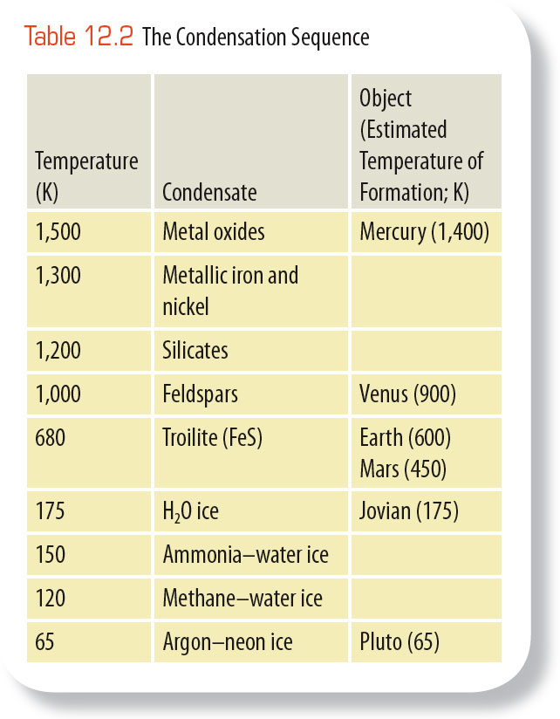
Condensation of Solids
The sequence in which the different materials condense from the gas as you move away from the sun is called the condensation sequence.
It suggests that the planets, forming at different distances from the sun, accumulated from different kinds of materials.

Slide 47
Condensation of Solids
The original chemical composition of the solar nebula should have been roughly the same throughout the nebula.

Slide 48
Condensation of Solids
The important factor was temperature.
The inner nebula was hot, and only metals and rock could condense there.
The cold outer nebula could form lots of ices in addition to metals and rocks.
The ice line seems to have been between Mars and Jupiter—it separates the formation of the dense terrestrial planets from that of the low-density Jovian planets.

Slide 49
Formation of Planetesimals
In the development of a planet, three groups of processes operate to collect solid bits of matter—rock, metal, or ices—into larger bodies called planetesimals.
Eventually, they build the planets.

Slide 50
Formation of Planetesimals
The study of planet building is the study of three groups of processes:
Condensation
Accretion
Gravitational collapse

Slide 51
Formation of Planetesimals
According to the solar nebula theory, planetary development in the solar nebula began with the growth of dust grains.
These specks of matter, whatever their composition, grew from microscopic size by two processes—condensation and accretion.

Slide 52
Formation of Planetesimals
A particle grows by condensation when it adds matter, one atom or molecule at a time, from a surrounding gas.
Snowflakes, for example, grow by condensation in Earth’s atmosphere.
In the solar nebula, dust grains were continuously bombarded by atoms of gas—and some of these stuck to the grains.

Slide 53
Formation of Planetesimals
Accretion is the sticking together of solid particles.
You may have seen accretion in action if you have walked through a snowstorm with big, fluffy flakes.
If you caught one of those “flakes” on your mitten and looked closely, you saw that it was actually made up of many tiny, individual flakes.
They had collided as they fell and accreted to form larger particles.

Slide 54
Formation of Planetesimals
Model calculations indicate that, in the solar nebula, the dust grains were on the average no more than a few centimeters apart.
So, they collided frequently and accreted into larger particles.

Slide 55
Formation of Planetesimals
There is no clear distinction between a very large grain and a very small planetesimal.
However, you can consider an object a planetesimal when its diameter approaches a kilometer or so, like the size of a typical small asteroid or comet.

Slide 56
Formation of Planetesimals
Objects larger than a centimeter were subject to new processes that tended to concentrate them.
For example, collisions with the surrounding gas and with each other would have caused growing planetesimals to settle into a thin disk.
This is estimated to have been only about 0.01 AU thick in the central plane of the rotating nebula.
This concentration of material would have made further planetary growth more rapid.

Slide 57
Formation of Planetesimals
Computer models show that the rotating disk of particles should have been gravitationally unstable.
It would have been disturbed by spiral density waves—much like those found in spiral galaxies.
This would have further concentrated the planetesimals and helped them coalesce into objects up to 100 km (60 mi) in diameter.

Slide 58
Formation of Planetesimals
Through these processes, the nebula became filled with trillions of solid particles ranging in size from pebbles to small planets.
As the largest began to exceed 100 km in diameter, new processes began to alter them.
A new stage of planet building began, the formation of protoplanets

Slide 59
Growth of Protoplanets
The coalescing of planetesimals eventually formed protoplanets—massive objects destined to become planets.
As these larger bodies grew, new processes began making them grow faster and altered their physical structure.

Slide 60
Growth of Protoplanets
If planetesimals collided at orbital velocities, it is unlikely that they would have stuck together.
The average orbital velocity in the solar system is about 10 km/s (22,000 mph).
Head-on collisions at this velocity would have vaporized the material.

Slide 61
Growth of Protoplanets
However, the planetesimals were all moving in the same direction in the nebular plane and didn’t collide head-on.
Instead, they merely rubbed shoulders at low relative velocities.
Such gentle collisions would have been more likely to fuse them than to shatter them.

Slide 62
Growth of Protoplanets
The largest planetesimals would grow the fastest—they had the strongest gravitational field.
Also, they easily attract additional material.
Computer models indicate that these planetesimals grew quickly to protoplanetary dimensions, sweeping up more and more material.

Slide 63
Growth of Protoplanets
Protoplanets had to begin growing by accumulating solid material.
This is because they did not have enough gravity to capture and hold large amounts of gas.

Slide 64
Growth of Protoplanets
In the warm solar nebula, the atoms and molecules of gas were traveling at velocities much larger than the escape velocities of modest-size protoplanets.
Thus, in their early development, the protoplanets could grow only by attracting solid bits of rock, metal, and ice.

Slide 65
Growth of Protoplanets
Once a protoplanet approached a mass of 15 Earth masses or so, it could begin to grow by gravitational collapse.
This is the rapid accumulation of a large amount of infalling gas.

Slide 66
Growth of Protoplanets
In its simplest form, the theory of terrestrial protoplanet growth supposes that all the planetesimals had about the same chemical composition.

Slide 67
Growth of Protoplanets
The planetesimals accumulated gradually to form a planet-size ball of material that was of homogeneous composition throughout.

Slide 68
Growth of Protoplanets
As a planet formed, heat began to accumulate in its interior from the decay of short-lived radioactive elements.
This heat eventually melted the planet and allowed it to differentiate.
Differentiation is the separation of material according to density.

Slide 69
Growth of Protoplanets
When the planet melted, the heavy metals such as iron and nickel settled to the core.
The lighter silicates floated to the surface to form a low-density crust.

Slide 70
Growth of Protoplanets
This process depends on the presence of short-lived radioactive elements whose rapid decay would have released enough heat to melt the interior of planets.

Slide 71
Growth of Protoplanets
Astronomers know such elements were present because very old rock from meteorites contains daughter isotopes such as magnesium-26.
– That isotope is produced by the decay of aluminum-26 in a reaction that has a half-life of only 0.74 million years.

Slide 72
Growth of Protoplanets
The aluminum-26 and similar short-lived radioactive isotopes are gone now.
However, they must have been produced in a supernova explosion that occurred no more than a few million years before the formation of the solar nebula.

Slide 73
Growth of Protoplanets
In fact, many astronomers suspect that this supernova explosion compressed nearby gas and triggered the formation of stars—one of which became the sun.
Thus, our solar system may exist because of a supernova explosion that occurred about 4.6 billion years ago.

Slide 74
Growth of Protoplanets
If planets formed and were later melted by radioactive decay, gases released from the planet’s interior would have formed an atmosphere.
The creation of a planetary atmosphere from a planet’s interior is called outgassing.

Slide 75
Growth of Protoplanets
Models of the formation of Earth indicate that the local planetesimals would not have included much water.
So, some astronomers now think that Earth’s water and some of its present atmosphere accumulated late in the formation of the planets.
Then, Earth swept up volatile-rich planetesimals forming in the cooling solar nebula.

Slide 76
Growth of Protoplanets
Such icy planetesimals may have formed in the outer parts of the solar nebula.
They have been scattered by encounters with the Jovian planets in a bombardment of comets.

Slide 77
Growth of Protoplanets
According to the solar nebula theory, the Jovian planets began growing by the same processes that built the terrestrial planets.
The outer solar nebula not only contained solid bits of metals and silicates—it also included abundant ices.
The Jovian planets grew rapidly and quickly became massive enough to grow by gravitational collapse—drawing in large amounts of gas from the solar nebula.

Slide 78
Growth of Protoplanets
Ices could not condense as solids at the locations of the terrestrial planets.
So, those planets developed slowly and never became massive enough to grow by gravitational collapse.

Slide 79
Growth of Protoplanets
The Jovian planets must have grown to their present size in about 10 million years.
Astronomers calculate that the sun then became hot and luminous enough to blow away the gas remaining in the solar nebula.

Slide 80
Growth of Protoplanets
The terrestrial planets grew from solids and not from the gas.
So, they continued to grow by accretion from solid debris left behind when the gas was blown away.

Slide 81
Growth of Protoplanets
Model calculations indicate the process of planet formation was almost completely finished by the time the solar system was 30 million years old.

Slide 82
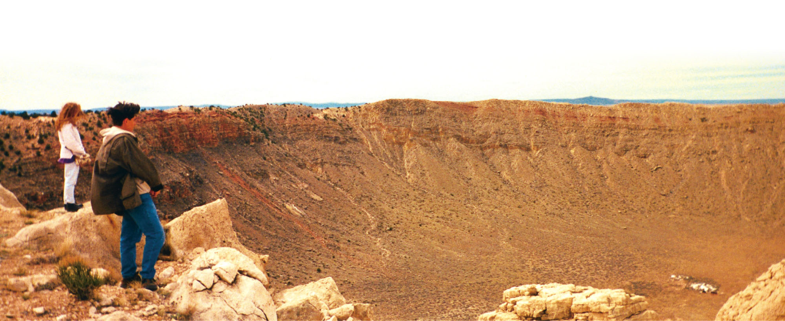
Continuing Bombardment of the Planets
Astronomers have good reason to believe that comets and asteroids can hit planets.

Slide 83
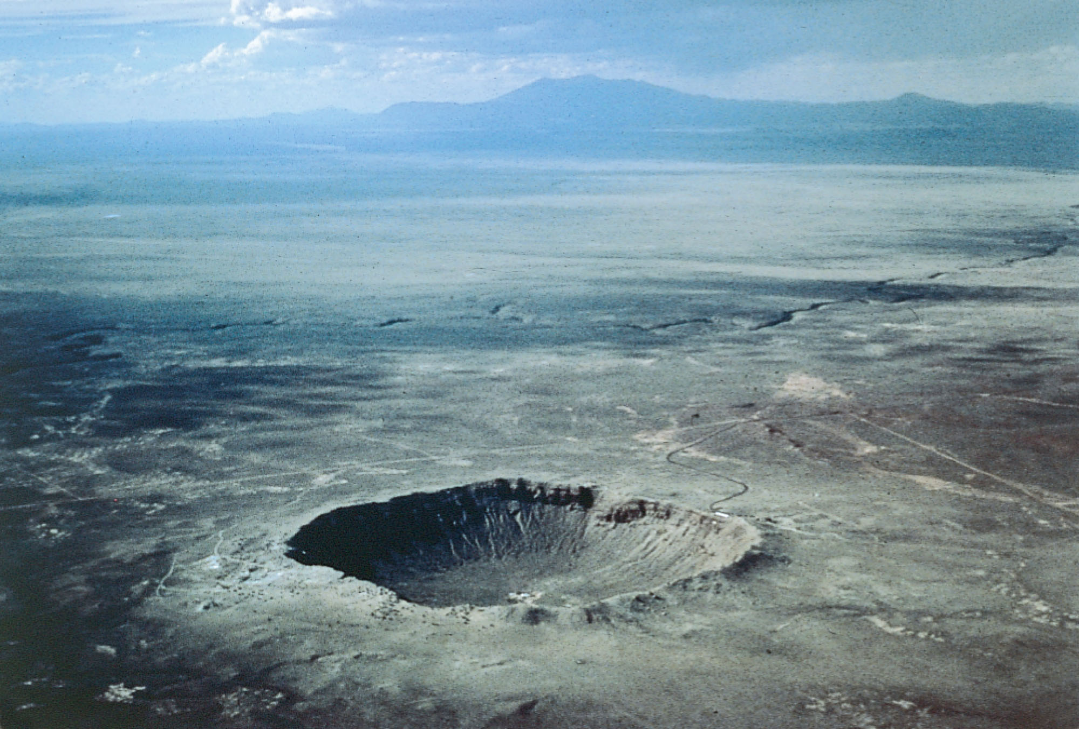
Continuing Bombardment of the Planets
Meteorites hit Earth every day, and occasionally a large one can form a crater.
Earth is marked by about 150 known meteorite craters.

Slide 84
Continuing Bombardment of the Planets
In a sense, this bombardment represents the slow continuation of the accretion of the planets.
Earth’s moon, Mercury, Venus, Mars, and most of the moons in the solar system are covered with craters.

Slide 85
Continuing Bombardment of the Planets
A few of these craters have been formed recently by the steady rain of meteorites that falls on all the planets in the solar system.

Slide 86
Continuing Bombardment of the Planets
However, most of the craters you see appear to have been formed roughly 4 billion years ago as the last of the debris in the solar nebula was swept up by the planets.
This is called the heavy bombardment.

Slide 87
Continuing Bombardment of the Planets
65 million years ago, at the end of the Cretaceous period, over 75 percent of the species on Earth, including the dinosaurs, went extinct.

Slide 88
Continuing Bombardment of the Planets
Scientists have found a thin layer of clay all over the world that was laid down at that time.
It is rich in the element iridium—common in meteorites, but rare in Earth’s crust.
This suggests that a large impact altered Earth’s climate and caused the worldwide extinction.

Slide 89
Continuing Bombardment of the Planets
Mathematical models indicate that a major impact would eject huge amounts of pulverized rock high above the atmosphere.

Slide 90
Continuing Bombardment of the Planets
As this material fell back, Earth’s atmosphere would be turned into a glowing oven of red-hot meteorites streaming through the air.
This heat would trigger massive forest fires around the world.
Soot from such fires has been found in the final Cretaceous clay layers.

Slide 91
Continuing Bombardment of the Planets
Once the firestorms are cooled, the remaining dust in the atmosphere would block sunlight and produce deep darkness for a year or more— killing off most plant life.

Slide 92
Continuing Bombardment of the Planets
Other effects, such as acid rain and enormous tsunamis (tidal waves), are also predicted by the models.

Slide 93
Continuing Bombardment of the Planets
Geologists have located a crater at least 150 km in diameter centered near the village of Chicxulub in the northern Yucatán region of Mexico.

Slide 94
Continuing Bombardment of the Planets
Although the crater is completely covered by sediments, mineral samples show that it contains shocked quartz typical of impact sites and that it is the right age.

Slide 95
Continuing Bombardment of the Planets
The impact of an object 10 to 14 km in diameter formed the crater about 65 million years ago, just when the dinosaurs and many other species died out.
Most Earth scientists now believe that this is the scar of the impact that ended the Cretaceous period.

Slide 96
Continuing Bombardment of the Planets
Earthlings watched in awe during six days in the summer of 1994 as 20 or more fragments from the head of comet Shoemaker-Levy 9 slammed into Jupiter.
This produced impacts equaling millions of megatons of TNT.

Slide 97
Continuing Bombardment of the Planets
Each impact created a fireball of hot gases and left behind dark smudges that remained visible for months afterward.

Slide 98
Continuing Bombardment of the Planets
Such impacts on Jupiter probably occur once every century or two.
Major impacts on Earth occur less often because Earth is smaller, but they are inevitable.

Slide 99
Continuing Bombardment of the Planets
We are sitting ducks.
All of human civilization is spread out over Earth’s surface and exposed to anything that falls out of the sky.
Meteorites, asteroids, and comets bombard Earth, producing impacts that vary from dust settling on rooftops to blasts capable of destroying all life.

Slide 100
Continuing Bombardment of the Planets
In this case, the scientific evidence is conclusive and highly unwelcome.
Statistically, you are quite safe.
The chance that a major impact will occur during your lifetime is so small that it is hard to estimate.

Slide 101
Continuing Bombardment of the Planets
However, the consequences of such an impact are so severe that humanity should be preparing.
One way to prepare is to find those NEOs (Near Earth Objects) that could hit this planet, map their orbits in detail, and identify any that are dangerous.

Slide 102
The Jovian Problem
The solar nebula theory has been very successful in explaining the formation of the solar system.
However, there are some problems.
The Jovian planets are the troublemakers.
The gas and dust disks around newborn stars don’t last long.

Slide 103
The Jovian Problem
Earlier, you saw images of dusty gas disks around the young stars in the Orion nebula.
Those disks are being evaporated by the intense ultraviolet radiation from hot stars within the nebula.

Slide 104
The Jovian Problem
Astronomers estimate that most stars form in clusters containing some massive stars.
So, this evaporation process must happen to most disks.

Slide 105
The Jovian Problem
Even if a disk did not evaporate quickly, model calculations predict that the gravitational influence of the crowded stars in a cluster should quickly strip away the outer parts of the disk.

Slide 106
The Jovian Problem
This is a troublesome observation.
It seems to mean that planet-forming disks around young stars are unlikely to last longer than a few million years, and many must evaporate within 100,000 years or so.
That’s not long enough to grow a Jovian planet by the processes in the solar nebula theory.
Yet, Jovian planets are common in the universe.

Slide 107
The Jovian Problem
A modification to the solar nebula theory has come from mathematical models of the solar nebula.

Slide 108
The Jovian Problem
The results show that the rotating gas and dust of the solar nebula may have become unstable and formed outer planets by direct gravitational collapse.
That is, massive planets may have been able to form from the gas without first forming a dense core by accretion.
Jupiters and Saturns form in these calculated models within a few hundred years.

Slide 109
The Jovian Problem
If the Jovian planets formed in this way, they could have formed quickly—before the solar nebula disappeared.

Slide 110
The Jovian Problem
This new insight into the formation of the outer planets may help explain the formation of Uranus and Neptune.
They are so far from the sun that accretion could not have built them rapidly.
It is hard to understand how they could have reached their present mass in a region where the material should have been sparse and orbital speeds are slow.

Slide 111
The Jovian Problem
Theoretical calculations show that Uranus and Neptune might instead have formed closer to the sun, in the region of Jupiter and Saturn.
They then moved outward by gravitational interactions with the other planets or with planetesimals in the Kuiper belt.
In any case, the formation of Uranus and Neptune is part of the Jovian problem.

Slide 112
The Jovian Problem
The traditional solar nebula theory proposes that the planets formed by accreting a core and then, if they became massive enough, by gravitational collapse of nebula gas.
The new theories suggest that some of the outer planets could have skipped the core accretion phase.

Slide 113
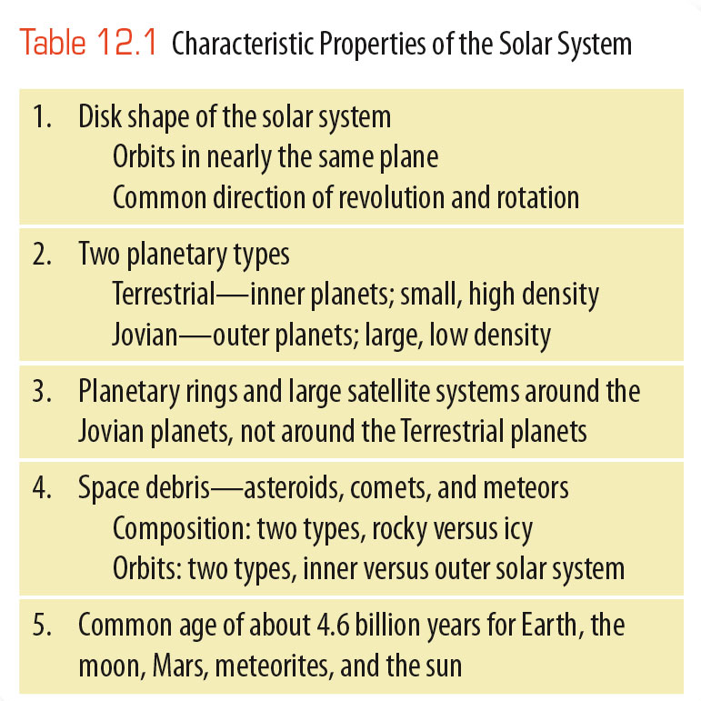
Explaining the Characteristics
of the Solar System
Now, you have learned enough to put all the pieces of the puzzle together and explain the distinguishing characteristics of the
solar system in the
table.

Slide 114
Explaining the Characteristics
of the Solar System
The disk shape of the solar system is inherited from the solar nebula.
The sun and planets revolve and rotate in
the same direction
because they formed
from the same rotating gas cloud.

Slide 115
Explaining the Characteristics
of the Solar System
The orbits of the planets lie in the same plane because the rotating solar nebula collapsed into a disk, and the
planets formed
in that disk.

Slide 116
Explaining the Characteristics
of the Solar System
The solar nebula hypothesis calls on continuing evolutionary processes to gradually build the planets.
Scientists call this type of explanation an evolutionary theory.

Slide 117
Explaining the Characteristics
of the Solar System
In contrast, a catastrophic theory invokes special, sudden, even violent, events.

Slide 118
Explaining the Characteristics
of the Solar System
Uranus rotates on its side.
Venus rotates backward.
Both these peculiarities could have been caused by off-center impacts of massive planetesimals they were forming.
This is an explanation of the catastrophic type.

Slide 119
Explaining the Characteristics
of the Solar System
On the other hand, computer models suggest that the sun can produce tides in the thick atmosphere of Venus and eventually reverse the planet’s rotation.
an explanation of the evolutionary type

Slide 120
Explaining the Characteristics
of the Solar System
The division of the planets into terrestrial and Jovian worlds can be understood through the condensation sequence.

Slide 121
Explaining the Characteristics
of the Solar System
The terrestrial planets formed in the inner part of the solar nebula.
Here, the temperature was high.
Only compounds such as the metals and silicates could condense to form solid particles.
That produced the small, dense terrestrial planets.

Slide 122
Explaining the Characteristics
of the Solar System
In contrast, the Jovian planets formed in the outer solar nebula.
Here, the lower temperature allowed the gas to form large amounts of ices—perhaps three times more ices than silicates.
This allowed the planets to grow rapidly and become massive low-density worlds.

Slide 123
Explaining the Characteristics
of the Solar System
Also, Jupiter and Saturn are so massive they have been able to grow even larger by drawing in the cool gas directly from the solar nebula.
The terrestrial planets could not do this because they never became massive enough.

Slide 124
Explaining the Characteristics
of the Solar System
The heat of formation—the energy released by infalling matter—was tremendous for these massive planets.
Jupiter must have grown hot enough to glow with a luminosity of about 1 percent that of the present sun.
However, because it never got hot enough to start nuclear fusion as a star would, it never generated its own energy.

Slide 125
Explaining the Characteristics
of the Solar System
Jupiter is still hot inside.
In fact, both Jupiter and Saturn radiate more heat than they absorb from the sun.
So, they are evidently still cooling.

Slide 126
Explaining the Characteristics
of the Solar System
A glance at the solar system suggests that you should expect to find a planet between Mars and Jupiter at the present location of the asteroid belt.

Slide 127
Explaining the Characteristics
of the Solar System
Mathematical models show that Jupiter grew into a massive planet.
It was able to gravitationally disturb the motion of nearby planetesimals.

Slide 128
Explaining the Characteristics
of the Solar System
The bodies that should have formed a planet between Mars and Jupiter were broken up, thrown into the sun, or ejected from the solar system.
This was due to the gravitational influence of massive Jupiter.
The asteroids seen today are the last remains of those rocky planetesimals.

Slide 129
Explaining the Characteristics
of the Solar System
In contrast, the comets are evidently the last of the icy planetesimals.
Some may have formed in the outer solar nebula beyond Neptune and Pluto.
However, many probably formed among the Jovian planets—where ices could condense easily.

Slide 130
Explaining the Characteristics
of the Solar System
Mathematical models show that the massive Jovian planets could have ejected some of these icy planetesimals into the far outer solar system.
This region is called the Oort cloud.
Comets come from here with very long periods and orbits highly inclined to the plane of the solar system.

Slide 131
Explaining the Characteristics
of the Solar System
The icy Kuiper belt objects, including Pluto, appear to be ancient planetesimals.
They formed in the outer solar system but were never incorporated into a planet.
They orbit slowly far from the light and warmth of the sun.
Except for occasional collisions, they have not changed much since the solar system was young.
Notes:
Edit this page

Slide 132
Explaining the Characteristics
of the Solar System
All four Jovian worlds have ring systems.
You can understand this
by considering the large
mass of these worlds and
their remote location in
the solar system.

Slide 133
Explaining the Characteristics
of the Solar System
A large mass makes it easier for a planet to hold onto orbiting ring particles.
Also, being farther from the sun, the ring particles are not as easily swept away by the pressure of sunlight and the solar wind.
It is hardly surprising, then, that the terrestrial planets—low-mass worlds located near the sun—have no planetary rings.

Slide 134
Explaining the Characteristics
of the Solar System
The solar nebula theory has no difficulty explaining the common ages of solar system bodies.
If the hypothesis is correct,
then the planets formed at the same time as the sun.
Thus, they should have roughly the same age.

Slide 135
Planets Orbiting Other Stars
Are there planets orbiting other stars?
Are there planets like Earth?
The evidence so far makes that seem likely.

Slide 136
Planet-Forming Disks Around Other Suns
You have already learned about dense disks of gas and dust around stars that are forming.
For example, at least 50 percent of the stars in the Orion nebula are encircled by dense disks of gas and dust.
They have more than enough mass to make planetary systems like ours.

Slide 137
Planet-Forming Disks Around Other Suns
The Orion star-forming region is only a few million years old.
So, it does not seem likely that planets have finished forming in these disks yet.

Slide 138
Planet-Forming Disks Around Other Suns
Nevertheless, the important point for astronomers is:
Disks of gas and dust that could become planetary systems are a common feature of star formation.

Slide 139
Debris Disks
Also, infrared astronomers have found very cold, low-density dust disks around older stars such as Vega and Beta Pictoris.
Although much younger than the sun, these stars are on the main sequence and have completed their formation.
So, they are clearly in a later stage than the newborn stars in Orion.

Slide 140
Debris Disks
These low-density disks generally have innermost zones with even lower-density places where planets may have formed.

Slide 141
Debris Disks
Such tenuous dust disks are sometimes called debris disks.
This is because they are understood to be dusty debris released in collisions among small bodies such as comets, asteroids, and Kuiper belt objects.

Slide 142
Debris Disks
Our own solar system is known to contain such dust.
Astronomers believe the sun has an extensive debris disk of cold dust extending far beyond the orbits of the planets.

Slide 143
Debris Disks
Few planets orbiting stars with debris disks have been detected so far.
However, the presence of dust particles with lifetimes shorter than the ages of the stars assures you that remnant planetesimals like asteroids and comets are present as the sources of the dust.

Slide 144
Debris Disks
If planetesimals are there, then you can expect that there are also planets orbiting those stars.
Many of the debris disks have details of structure and shape that are probably caused by the gravity of planets orbiting within or at the edges of the debris.

Slide 145
Debris Disks
Notice the difference between the two kinds of disks that astronomers have found.
The low-density dust disks such as the one around Beta Pictoris are produced by dust from collisions among comets, asteroids, and Kuiper belt objects.
Such disks are evidence that planetary systems have already formed.
The dense disks of gas and dust such as those seen around the stars in Orion are sites where planets could be forming right now.

Slide 146
Extrasolar Planets
A planet orbiting another star is called an extrasolar planet.
Such a planet would be quite faint and difficult to detect so close to the glare of its star.
However, there are ways to find these planets.
To see how, all you have to do is imagine walking a dog.

Slide 147
Extrasolar Planets
You will remember that Earth and its moon orbit around their common center of mass.
When a planet orbits a star, the star moves very slightly as it orbits the center of mass of the planet-star system.

Slide 148
Extrasolar Planets
Think of someone walking a poorly trained dog on a leash.
The dog runs around pulling on the leash.
Even if it were an invisible dog, you could plot its path by watching how its owner was jerked back and forth.

Slide 149
Extrasolar Planets
In the same way, astronomers can detect a planet orbiting another star—by watching how the star moves as the planet tugs on it.

Slide 150
Extrasolar Planets
The first planet detected this way was discovered in 1995.
It orbits the star 51 Pegasi.
As the planet circles the star, the star wobbles slightly.

Slide 151
Extrasolar Planets
The very small motions of the star are detectable as Doppler shifts in the star’s spectrum.
This is the same technique used to study spectroscopic binary stars.

Slide 152
Extrasolar Planets
From the motion of the star and estimates of the star’s mass, astronomers can deduce that the planet has half the mass of Jupiter and orbits only 0.05 AU from the star.
Half the mass of Jupiter amounts to 160 Earth masses.
This is a large planet, larger than Saturn.

Slide 153
Extrasolar Planets
Astronomers were not surprised by the announcement that a planet orbits 51 Pegasi.
For years, they had assumed that many stars had planets.

Slide 154
Extrasolar Planets
Nevertheless, they greeted the discovery with typical skepticism.
That skepticism led to careful tests of the data and further observations that confirmed the discovery.

Slide 155
Extrasolar Planets
Over 400 planets have been discovered in this way—including at least three planets orbiting the star Upsilon Andromedae, and five orbiting 55 Cancri—true planetary system.
More than 40 such multiple-planet systems have been found.

Slide 156
Extrasolar Planets
Another way to search for planets is to look for changes in the brightness of a star when the orbiting planet crosses in front of or behind it.
The decrease in light is very small—but it is detectable.

Slide 157
Extrasolar Planets
Astronomers have used this technique to detect a few planets as they crossed in front of their stars.
From the amount of light lost, astronomers can tell that these planets are roughly the size of Jupiter.

Slide 158
Extrasolar Planets
The Spitzer Infrared Space Telescope has detected two planets when they passed behind their stars.
These planets are hot and emit significant infrared radiation.
As they orbit their parent stars, astronomers detect variation in the amount of infrared from the system.
This further confirms the existence of extrasolar planets and indicates the temperatures and sizes of the planets.
Notes:
edit

Slide 159
Extrasolar Planets
Measurements of these and other planets that pass in front of and behind their stars reveal that they have Jupiter-like diameters as well as masses.
So, astronomers conclude they have Jovian densities and compositions.

Slide 160
Extrasolar Planets
The planets discovered so far tend to be massive and have short periods.
This is because lower-mass planets or longer-period planets are harder to detect.
Low-mass planets don’t tug on their stars very much.
Present-day spectrographs can’t detect the very small velocity changes that these gentle tugs produce.

Slide 161
Extrasolar Planets
Planets with longer periods are harder to detect because Earth’s astronomers have not been making high-precision observations for a long enough time yet.
Jupiter takes 11 years to circle the sun once.
So, it will take years for astronomers to see the longer-period wobbles produced by planets lying farther from their stars.

Slide 162
Extrasolar Planets
You should not be surprised that the first extrasolar planets discovered are massive and have short periods.
This is called a selection effect.

Slide 163
Extrasolar Planets
The new planets may seem odd for another reason.
In our own solar system, the large planets formed farther from the sun where the solar nebula was colder and ices could condense.

Slide 164
Extrasolar Planets
How could big planets form so near their stars?
Model calculations predict that planets that form in an especially dense disk of matter could spiral inward as they sweep up gas or planetesimals.
That means it is possible for a few planets to become the massive, short-period planets that are detected most easily.

Slide 165
Extrasolar Planets
Actually getting an image of a planet orbiting another star is about as easy as photographing a bug crawling on the bulb of a searchlight miles away.
Planets are small and dim and get lost in the glare of the stars they orbit.

Slide 166
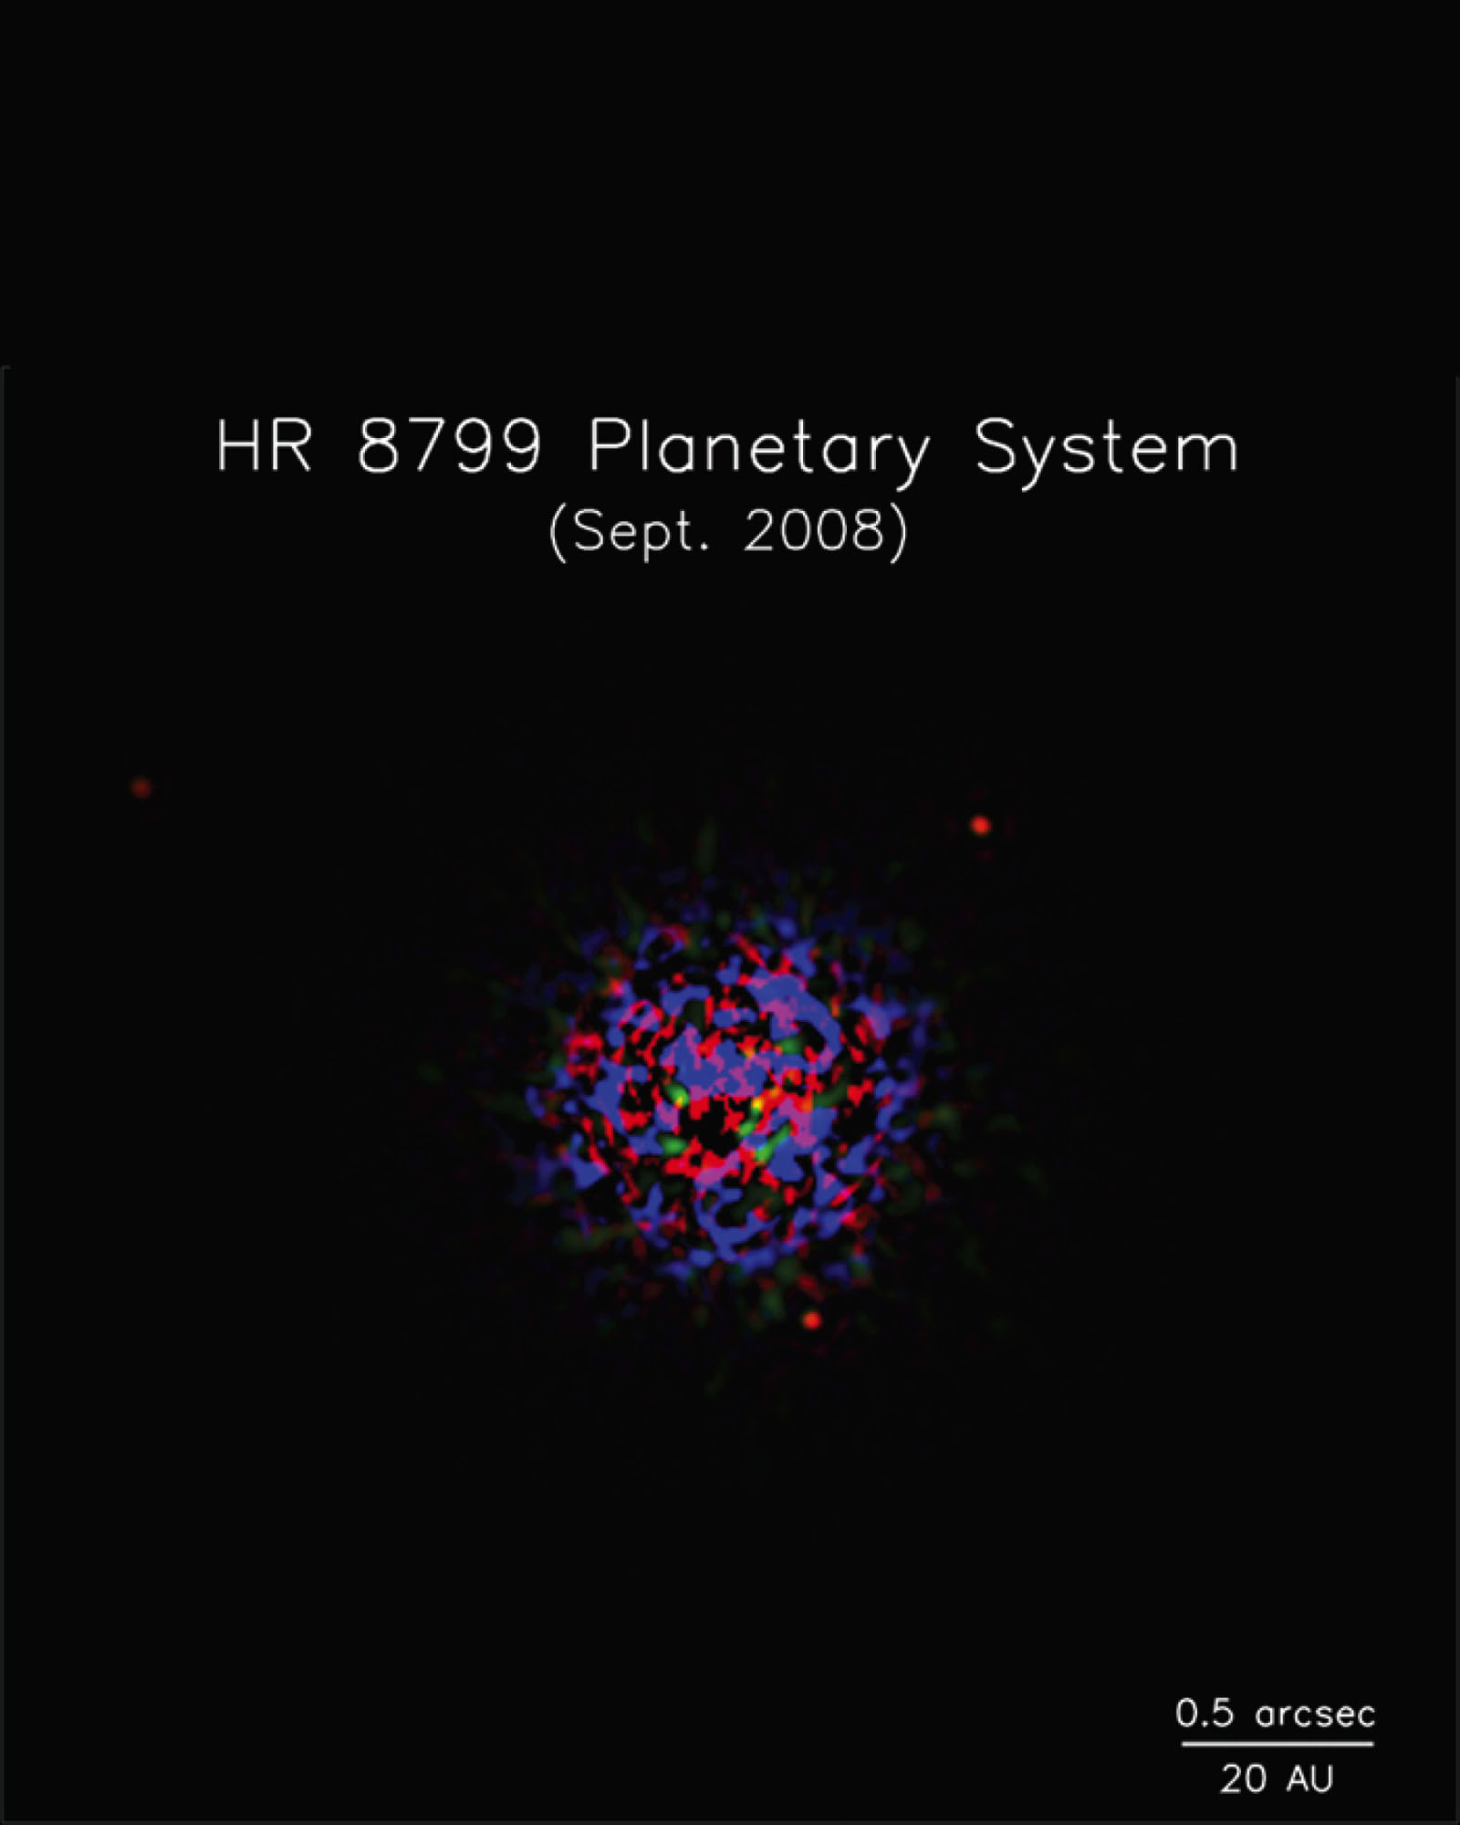
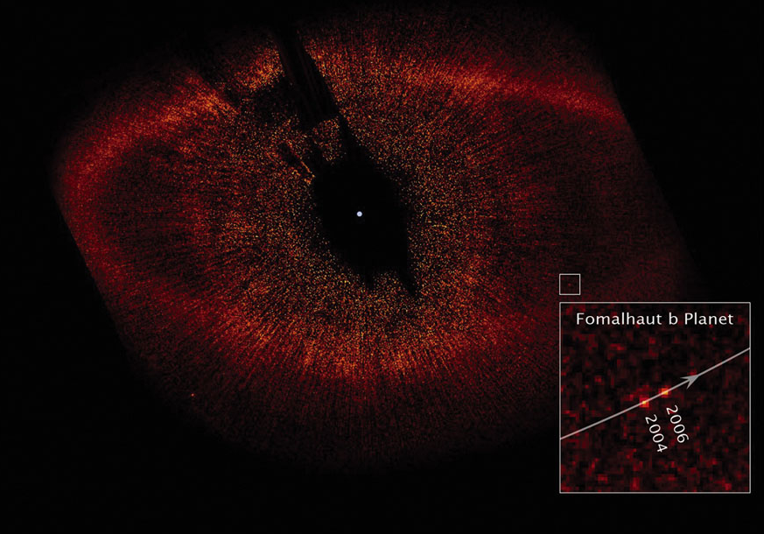
Extrasolar Planets
Nevertheless, during 2008 astronomers managed to image planets around two A-type stars using Gemini and Keck telescopes on the ground and the Hubble Space Telescope.

Slide 167
Extrasolar Planets
The discovery of extrasolar planets gives astronomers added confidence in the solar nebula theory.
The theory predicts that planets are common.
Astronomers are finding them orbiting many stars.

