Slide 2
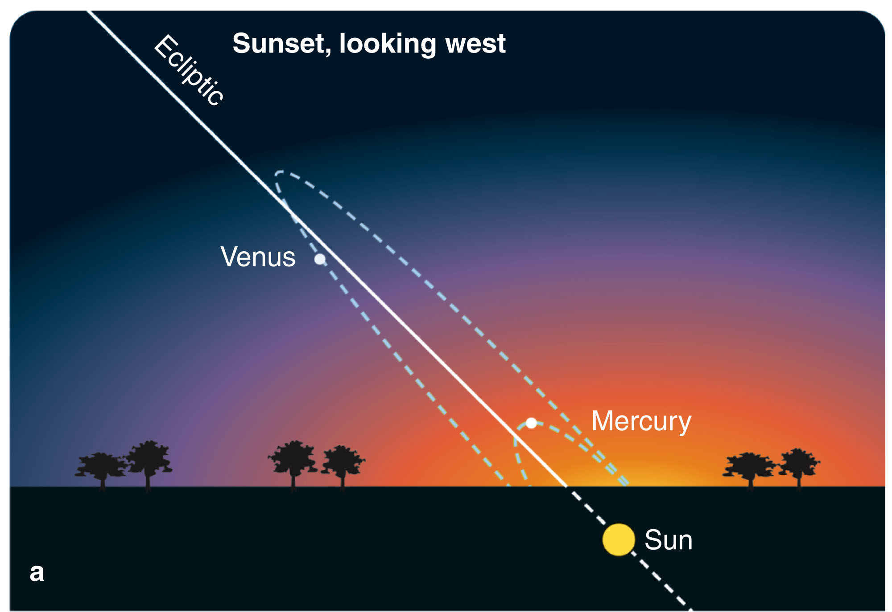
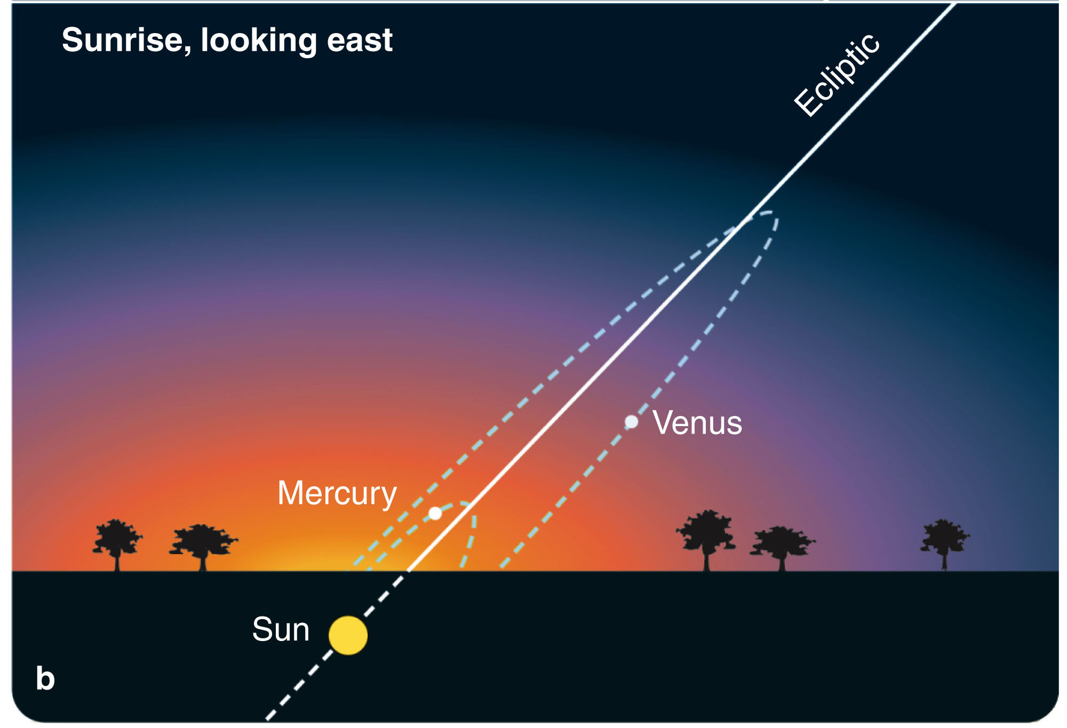
The Seasons
As Venus and Mercury orbit inside Earth’s orbit, they never get far from the sun and are visible in the west after sunset or in the east before sunrise.
Venus can be very bright, but Mercury is difficult to see near the horizon.

Slide 3
The Seasons
By tradition, any planet in the sunset sky is called an evening star.
Any planet in the dawn sky is called a morning star.

Slide 4
The Cycles of the Moon
The moon orbits eastwards around Earth once a month.

Slide 6
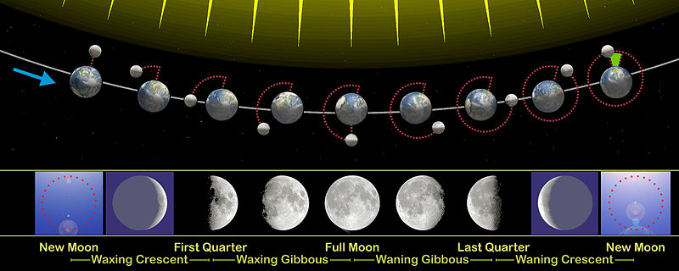

Slide 7
The Sidereal Period of the Moon
The amount of time it takes the moon to orbit the Earth and appear at the same place on the Celestial Sphere is called the sidereal period of the moon. This amount of time is not the same as the lunar month. The lunar month is the amount of time between successive new moons, or full moons, or any two successive, similar phases. Phases of the moon, however, depend on the relative positions of the Earth, moon, and Sun. Since the Earth is orbiting the Sun, these alignments occur at different absolute places in the moon's orbit each month.

Slide 9
The Cycle of Moon Phases
First, the moon always keeps the same side facing Earth, and you never see the far side of the moon.
‘The man in the moon’ (some cultures see ‘the rabbit in the moon’ instead) is produced by familiar features on the moon’s near side.
Notes:
9

Slide 10
The Cycle of Moon Phases
Second, the changing shape of the moon as it passes through its cycle of phases is produced by sunlight illuminating different parts of the side of the moon you can see.
Notes:
10

Slide 11
The Cycle of Moon Phases
You always see the same side of the moon looking down on you.
The Moon is in synchronous rotation: it rotates about its axis in about the same time it takes to orbit Earth. This results in it nearly always keeping the same face turned towards Earth.
The changing shadows, though, make the ‘man in the moon’ shift moods as the moon cycles through its phases.

Slide 12
The Cycle of Moon Phases
Finally, the orbital period of the moon around Earth is not the same as the length of a moon phase cycle.

Slide 14
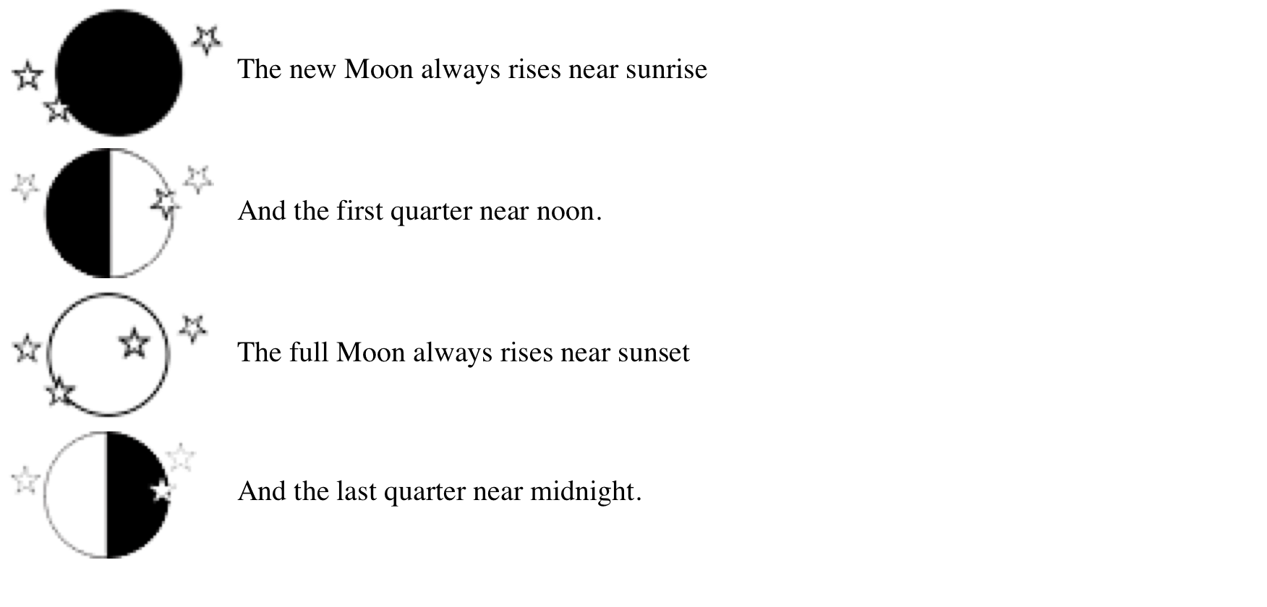

Slide 15
Eclipses
Eclipses are due to a seemingly complicated combination of apparent motions of the sun and moon.
Yet, they are actually easy to predict once all the cycles are understood.

Slide 16
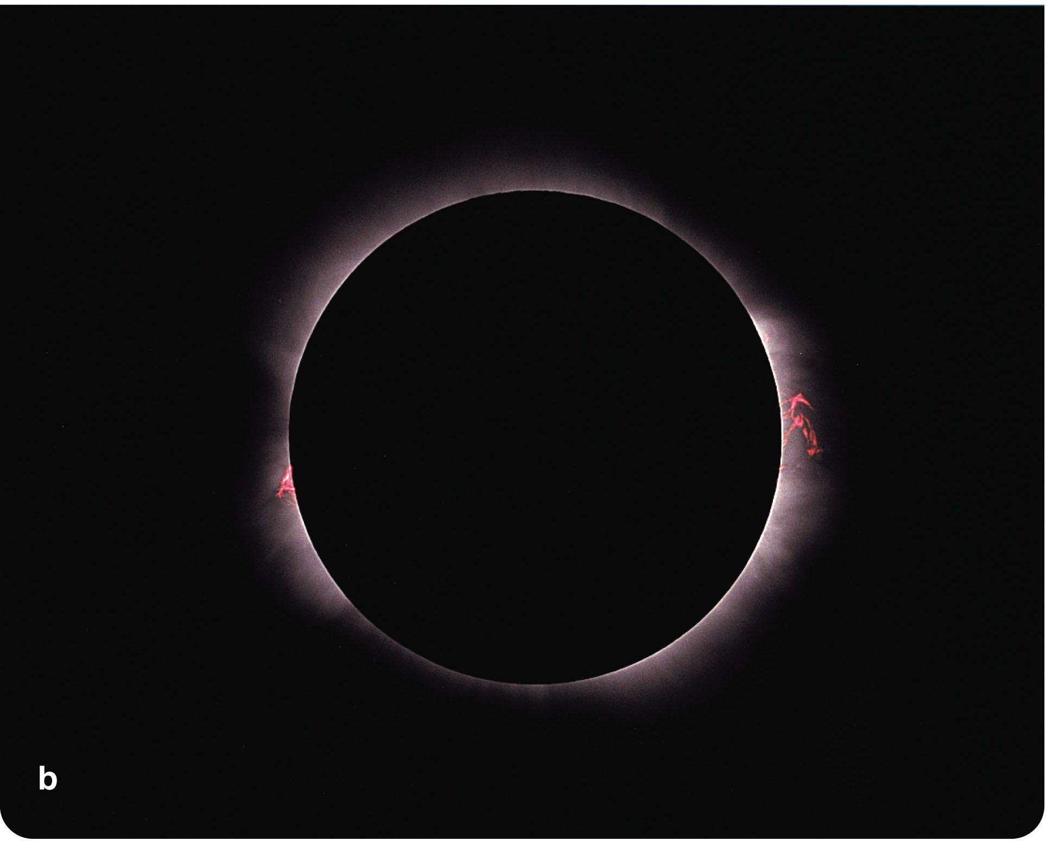
Eclipses
Eclipses are also among the most spectacular of nature’s sights you might witness.

Slide 17
Solar Eclipses
From Earth, you can see a phenomenon that is not visible from most planets.
It happens that the sun is 400 times larger than our moon and, on the average, 390 times farther away.
So, the sun and moon have nearly equal angular apparent diameters.
Thus, the moon is just about the right size to cover the bright disk of the sun and cause a solar eclipse.
In a solar eclipse, it is the sun that is being hidden (eclipsed) and the moon that is ‘in the way.’

Slide 18
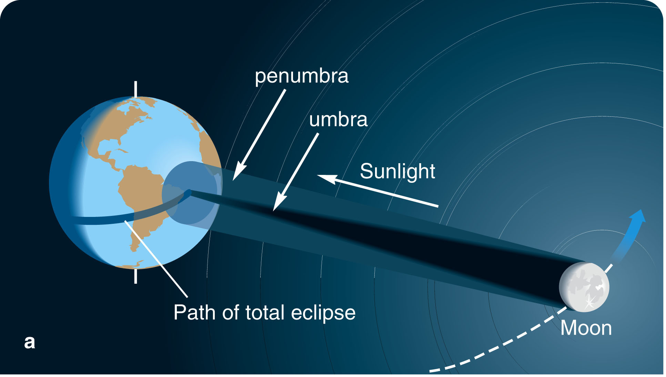
Solar Eclipses
A shadow consists of two parts.
The umbra is the region of total shadow.
For example, if you were in the umbra of the moon’s shadow, you would see no portion of the sun.
The umbra of the
moon’s shadow
usually just barely
reaches Earth’s
surface and covers
a relatively small
circular zone.

Slide 19
Solar Eclipses
Standing in that umbral zone, you would be in total shadow—unable to see any part of the sun’s surface.
This is called a total eclipse.

Slide 20
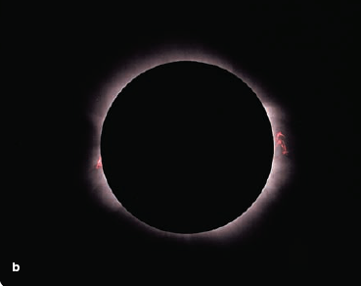
Solar Eclipses
When the umbra of the moon’s shadow sweeps over you, you see one of the most dramatic sights in the sky—the
totally eclipsed
sun.

Slide 21
Solar Eclipses
If you moved into the penumbra, you would be in partial shadow, but could also see part of the sun peeking around the edge of the moon.
This is called a partial eclipse.
If you are outside
the penumbra, you
see no eclipse at all.

Slide 22
Solar Eclipses
The darkness lasts only a few minutes.
This is because the umbra is never more than 270 km (170 miles) in diameter on Earth’s surface and sweeps across the landscape at over 1,600 km/hr (1,000 mph).
The period of totality lasts on average only 2 or 3 minutes and never more than 7.5 minutes.

Slide 23
Solar Eclipses
Sometimes, when the moon crosses in front of the sun, it is too small to fully cover the sun.
Then, you would witness an annular eclipse.
This is a solar eclipse in which an annulus (‘ring’) of the sun’s disk is visible around the disk of the moon.

Slide 24
Solar Eclipses
Annular eclipses occur because the moon follows a slightly elliptical orbit around Earth.
If the moon is in the farther part of its orbit during totality, its apparent diameter will be less than the apparent diameter of the sun—and you see an annular eclipse.
Also, Earth’s orbit is slightly elliptical.
So, the Earth-to-sun distance varies slightly.
So does the apparent diameter of the solar disk.
These contribute to the effect of the moon’s varying apparent size.

Slide 25
Solar Eclipses
If you plan to observe a solar eclipse, remember that the sun is bright enough to burn your eyes and cause permanent damage if you look at it directly.
This is true whether there is an eclipse or not.
Solar eclipses can be misleading—tempting you to look at the sun in spite of its brilliance and thus risking your eyesight.

Slide 26
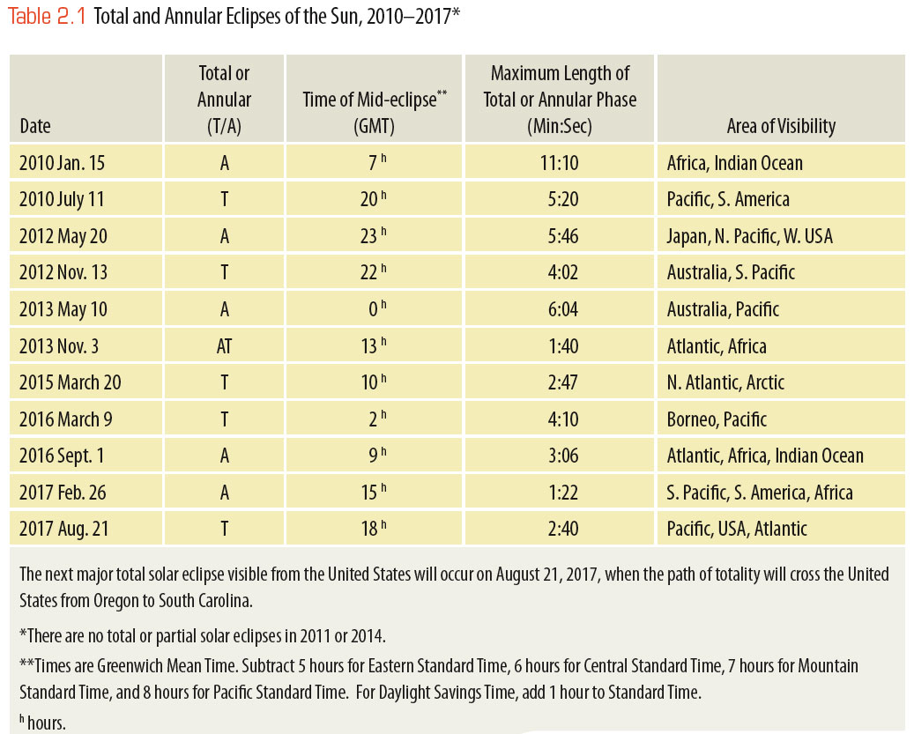
The table will allow you to determine when some upcoming solar eclipses will be visible from your location.

Slide 27
Lunar Eclipses
Occasionally, you can see the moon darken and turn copper-red in a lunar eclipse.

Slide 28
Lunar Eclipses
A lunar eclipse occurs at full moon when the moon moves through Earth’s shadow.
As the moon shines only by reflected sunlight, you see the moon gradually darken as it enters the shadow.
If you were on the moon and in the umbra of Earth’s shadow, you would see no portion of the sun.

Slide 29
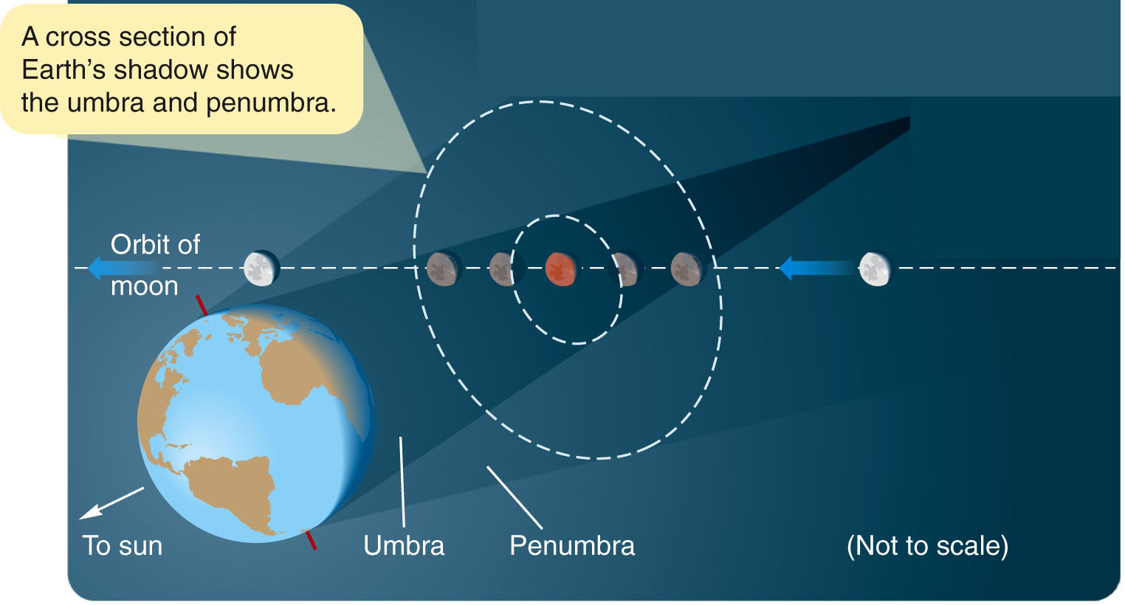

Slide 30
Lunar Eclipses
If you moved into the penumbra, you would be in partial shadow and would see part of the sun peeking around the edge of Earth—so the sunlight would be dimmed but not extinguished.
In a lunar eclipse, it is the moon that is being hidden in the Earth’s shadow and Earth that is ‘in the way’ of the sunlight.
If the orbit of the moon carries it through the umbra of Earth’s shadow, you see a total lunar eclipse.

Slide 31
Lunar Eclipses
As you watch the moon, it first moves into the penumbra and dims slightly.
The deeper it moves into the penumbra, the more it dims.

Slide 32
Lunar Eclipses
In about an hour, the moon reaches the umbra, and you see the umbral shadow darken part of the moon.
It takes about an hour for the moon to enter the umbra completely and become totally eclipsed.

Slide 33
Lunar Eclipses
The period of total eclipse may last as long as 1 hour 45 minutes.
However, the timing of the eclipse depends on where the moon crosses the shadow.
When the moon is totally eclipsed, it does not disappear completely.
Although it receives no direct sunlight, the moon in the umbra does receive some sunlight that is refracted (bent) through Earth’s atmosphere.

Slide 34
Lunar Eclipses
If you were on the moon during totality, you would not see any part of the sun—as it would be entirely hidden behind Earth.
However, you would be able to see Earth’s atmosphere illuminated from behind by the sun.

Slide 35
Lunar Eclipses
The red glow from this ring consisting of all the Earth’s simultaneous sunsets and sunrises illuminates the moon during totality and makes it glow coppery red.

Slide 36
Lunar Eclipses
The part of the moon that remains outside the umbra in the penumbra receives some direct sunlight.
The glare is usually great enough to prevent your seeing the faint coppery glow of the part of the moon in the umbra.

Slide 37
Lunar Eclipses
Lunar eclipses always occur at full moon but not at every full moon.
The moon’s orbit is tipped about 5 degrees to the ecliptic.
So, most full moons cross the sky north or south of Earth’s shadow and there is no lunar eclipse that month.

Slide 38
Lunar Eclipses
For the same reason, solar eclipses always occur at new moon but not at every new moon.
The orientation of the moon’s orbit in space varies slowly.
As a result, solar and lunar eclipses repeat in a pattern called the Saros cycle lasting 18 years 11 1/3 days.
Ancient peoples who understood the Saros cycle could predict eclipses without understanding what the sun and moon really were.

Slide 39
Lunar Eclipses
Although there are usually no more than one or two lunar eclipses each year, it is not difficult to see one.
You need only be on the dark side of Earth when the moon passes through Earth’s shadow.
That is, the eclipse must occur between sunset and sunrise at your location to be visible.

Slide 40
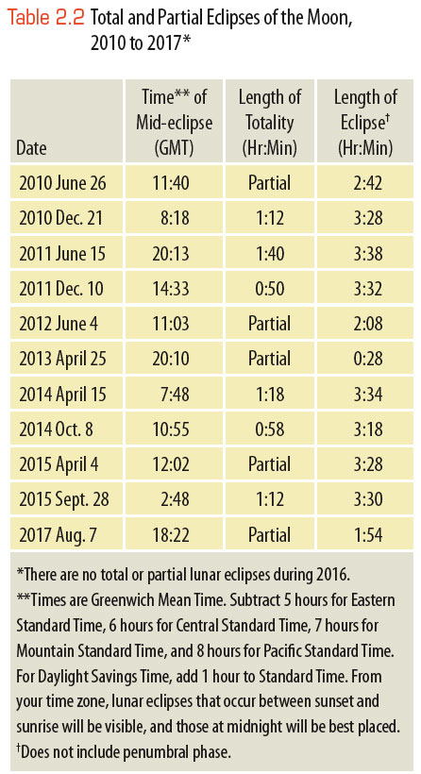
Lunar Eclipses
The table will allow you to determine when some upcoming lunar eclipses will be visible from your location.

