Slide 1
Chapter2:User’s Guide to
The Sky : Patterns and Cycles

Slide 2
Guidepost
How can you refer to stars by name, constellation, and by brightness?
How does the sky appear to move as Earth rotates and revolves?
What cause the seasons?
How does the motion of the moon produce phases and eclipses?

Slide 3
Constellations
Groups of stars that ancient cultures celebrated them as heroes, gods, and all mythical beasts.
The constellations named within Western culture originated in Mesopotamia, Babylon, Egypt, and Greece beginning as much as 5,000 years ago.
Of these ancient constellations, 48 are still in use

Slide 4
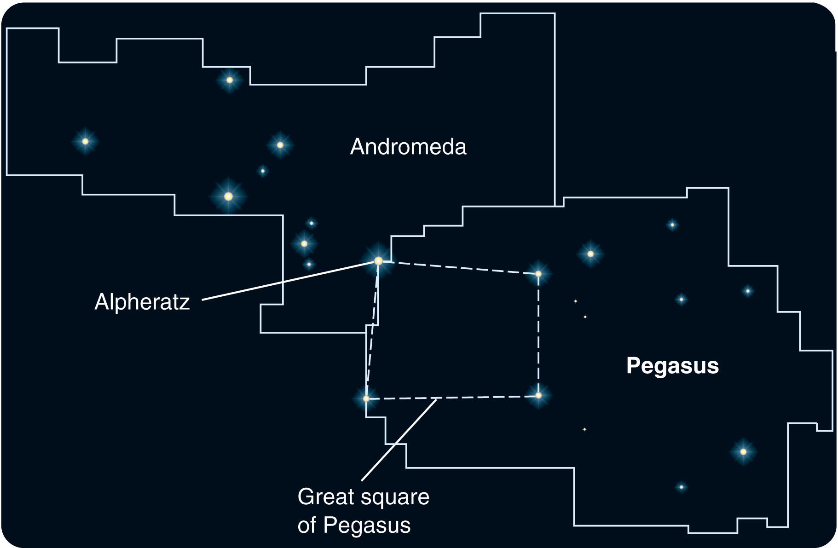
Constellation boundaries, when they were defined at all, were only approximate.
So, a star like Alpheratz
could be thought of as
part of Pegasus and also part of Andromeda.

Slide 5
In 1928, the International Astronomical Union (IAU) established 88 official constellations with clearly defined permanent boundaries that together cover the entire sky.
A constellation now represents not a group of stars but a section of the sky a viewing direction.
Any star within the region belongs to only that one constellation.

Slide 6
In addition to the 88 official constellations, the sky contains a number of less formally defined groupings known as asterisms.
For example, the Big Dipper is an asterism you probably recognize that is part of the constellation Ursa Major (the Great Bear).

Slide 7
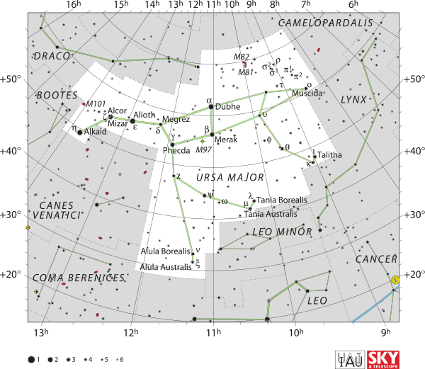

Slide 8
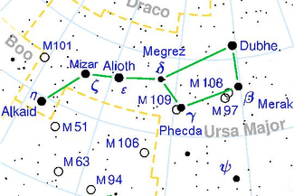
The Big Dipper

Slide 9
Another asterism is the Great Square of Pegasus that includes three stars from Pegasus and Alpheratz, now considered to be part of Andromeda only

Slide 10
Although constellations and asterisms are named as if they were real groupings, most are made up of stars that are not physically associated with one another.
Some stars may be many times farther away than others in the same constellation and moving through space in different directions.

Slide 11
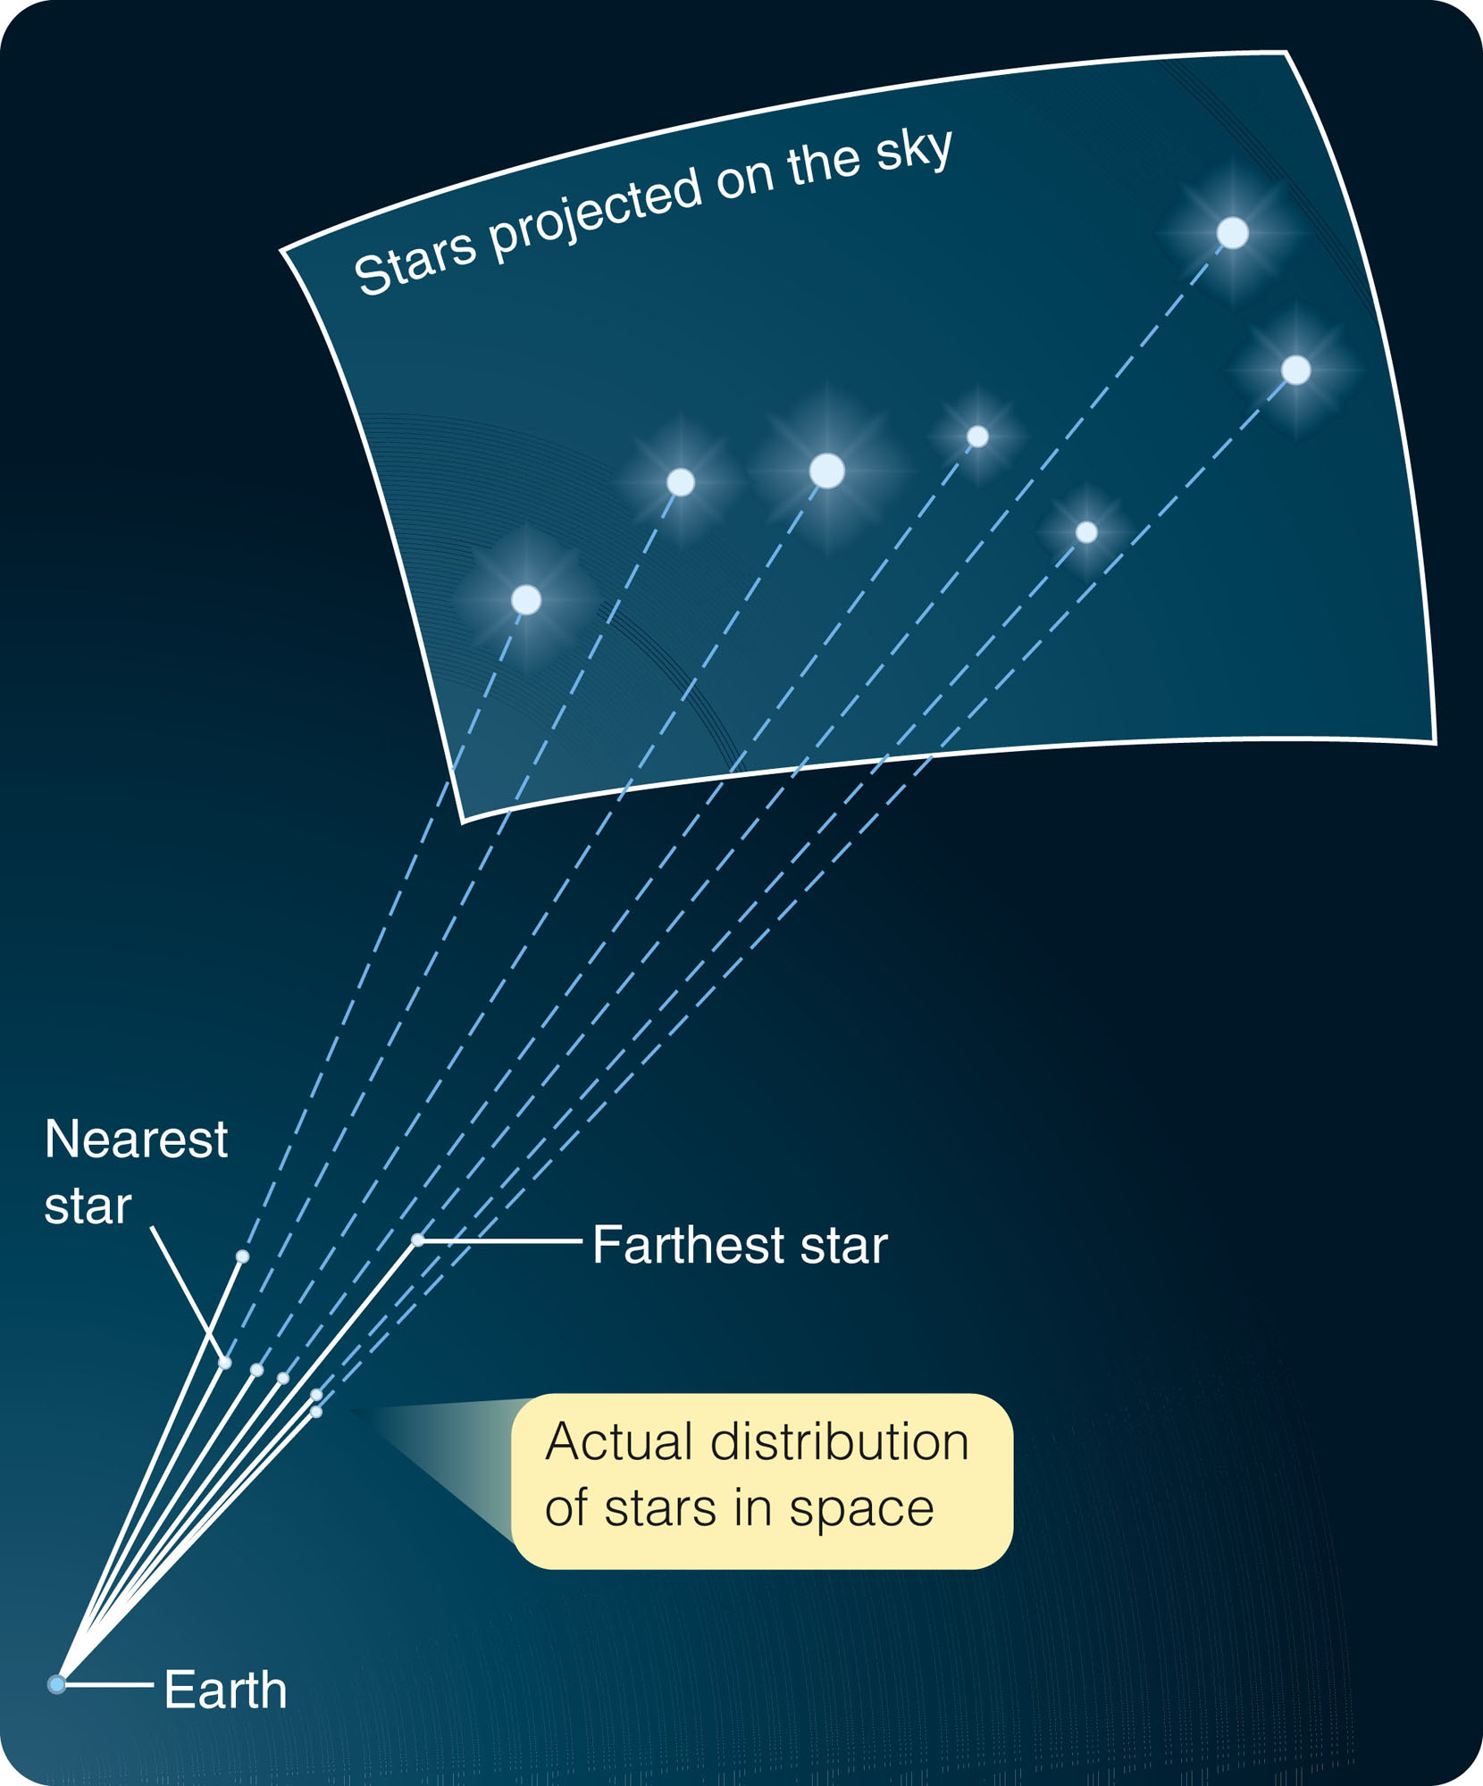
The only thing they have in common is that they lie in approximately the same
direction from Earth.

Slide 12
The Names of the Stars
Most individual star names derive from ancient Arabic, much altered over centuries.
The name of Betelgeuse, the bright red star in Orion, comes from the Arabic phrase ‘yad aljawza,’ meaning ‘armpit of Jawza (Orion).’
Aldebaran, the bright red eye of Taurus the bull, comes from the Arabic ‘aldabar an,’ meaning ‘the follower.’

Slide 13
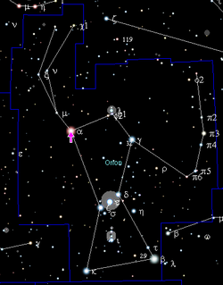

Slide 14
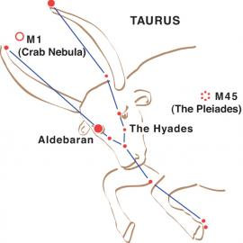

Slide 15
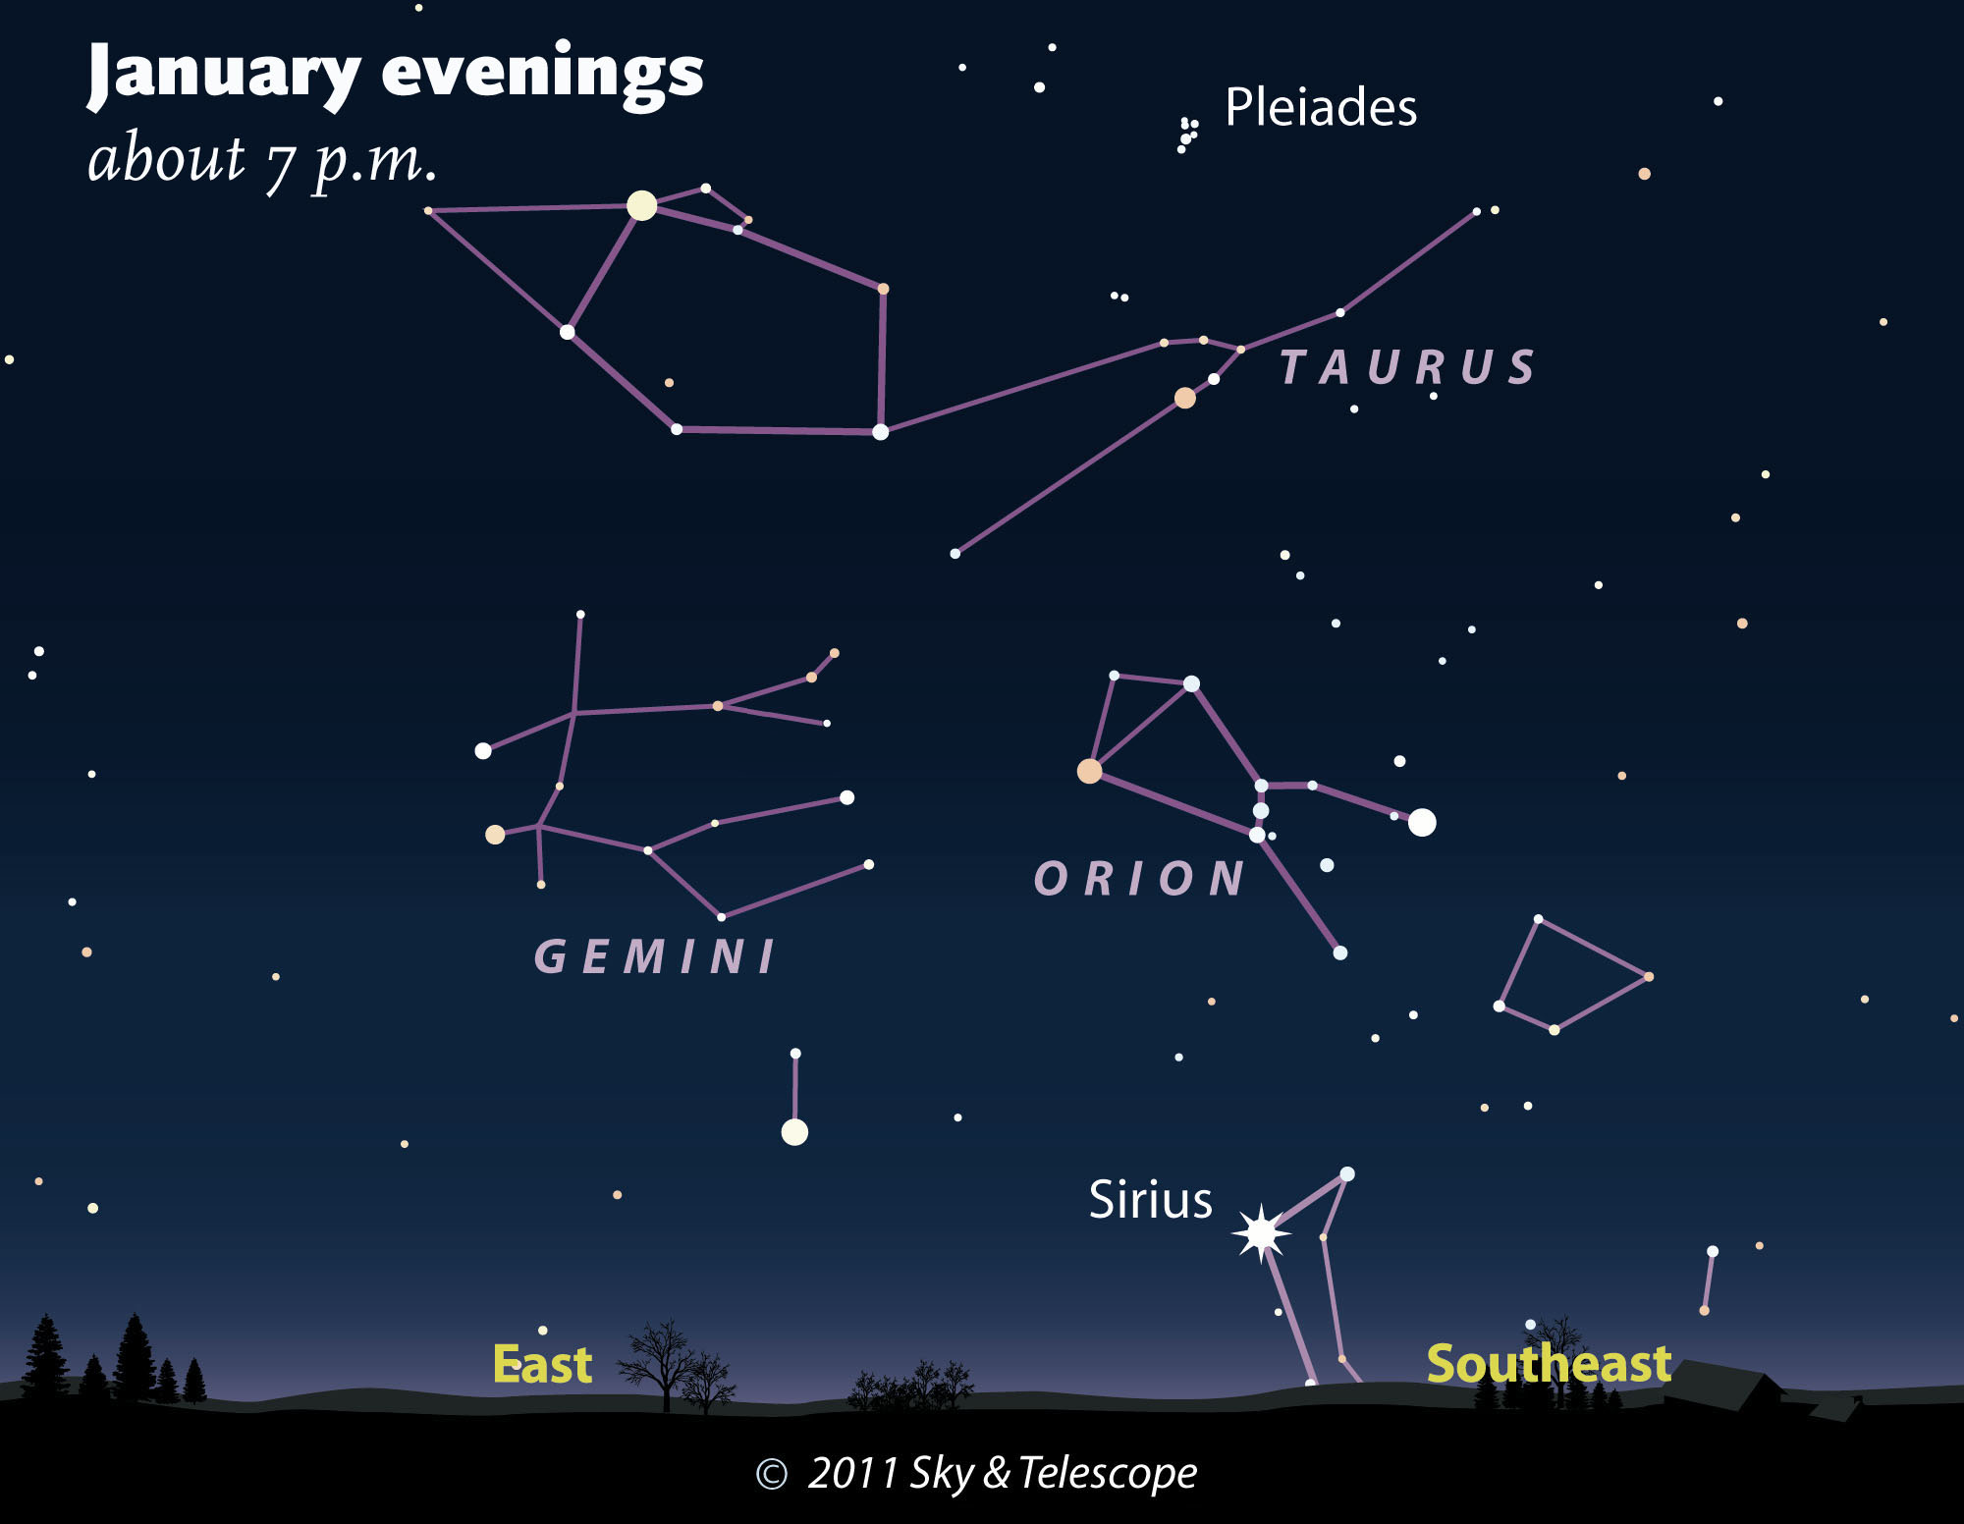

Slide 16
The Names of the Stars
Another way to identify stars is to assign Greek letters to the bright stars in a constellation in the approximate order of brightness.
Thus, the brightest star is usually designated alpha (α), the second brightest beta (β), and so on. For many constellations, the letters follow the order of brightness. However, some constellations are exceptions

Slide 17
The Names of the Stars
A Greek-letter star name also includes the possessive form of the constellation name.
For example, the brightest star in the constellation Canis Major is alpha Canis Majoris.
This name identifies the star and the constellation and gives a clue to the relative brightness of the star.
Compare this with the ancient individual name for that star, Sirius, which tells you nothing about its location or brightness.

Slide 18
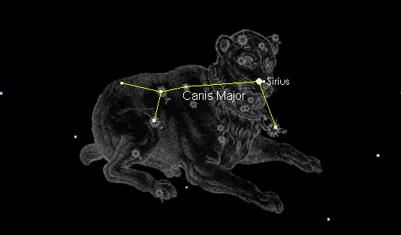

Slide 19
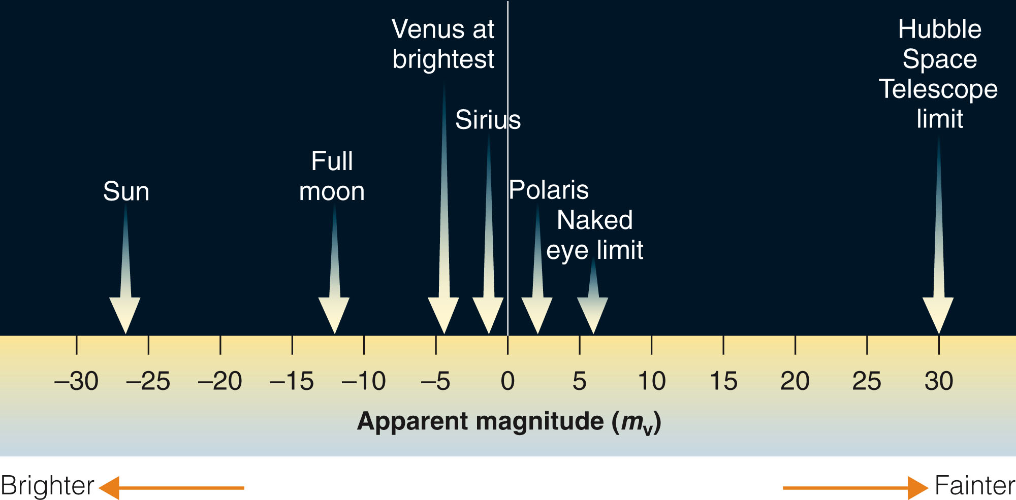
The Brightness of Stars
Astronomers measure the brightness of stars using the magnitude scale.

Slide 20
The Brightness of Stars
The ancient astronomers divided the stars into six brightness groups.
The brightest were called first-magnitude stars.
The scale continued downward to sixth-magnitude stars the faintest visible to the human eye.

Slide 21
The Brightness of Stars
Thus, the larger the magnitude number, the fainter the star.
This makes sense if you think of the bright stars as first-class stars and the faintest stars visible as sixth-class stars.
Star brightness expressed in this system are known as apparent visual magnitudes (m_{V}).
These describe how the stars look to human eyes observing from Earth.

Slide 22
The Brightness of Stars
Brightness is quite subjective.
It depends on both the physiology of human eyes and the psychology of perception.
To be scientifically accurate, you should refer to flux.
This is a measure of the light energy from a star that hits one square meter in one second.

Slide 23
The Brightness of Stars
Limitations of the apparent visual magnitude system have motivated astronomers to supplement it in various ways.

Slide 24
One, some stars are so bright that the scale must extend into negative numbers.
Sirius, the brightest star in the sky, has a magnitude of –1.47.

Slide 25
Two, with a telescope, you can find stars much fainter than the limit for your unaided eyes.
Thus, the magnitude system has also been extended to include numbers larger than sixth magnitude to include fainter stars.

Slide 26
Three, although some stars emit large amounts of infrared or ultraviolet light, those types of radiation are invisible to human eyes.
The subscript ‘V’ in m_{V} is a reminder that you are counting only light that is visible.
Other magnitudes systems have been invented to express the brightness of invisible light arriving at Earth from the stars.
Four, an apparent magnitude informs you only how bright the star is as seen from Earth.
It doesn’t reveal anything about a star’s true power output—because the star’s distance is not included.

Slide 27
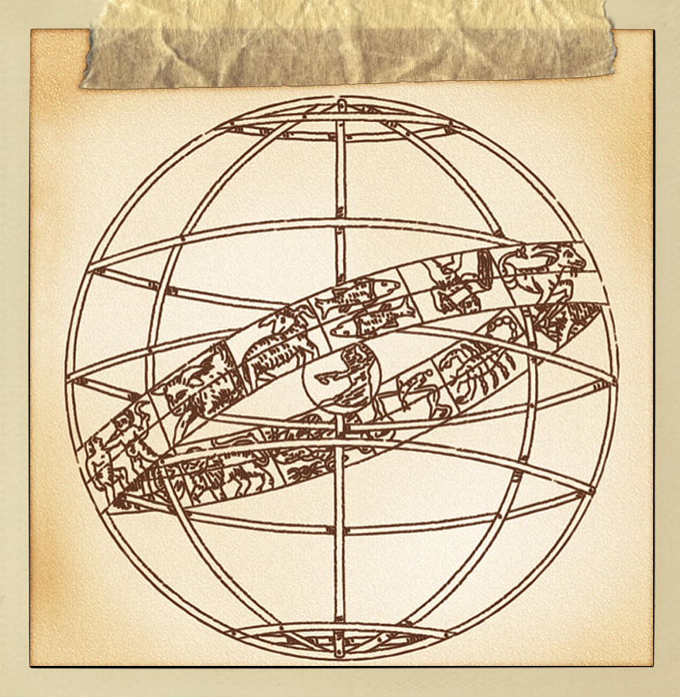
The Celestial Sphere
The celestial sphere is an example of a scientific model, a
common feature of
scientific thought.
You can use the celestial sphere as
a convenient model of the sky.

Slide 28
One, sky objects appear to rotate westward around Earth each day, but that is a consequence of Earth’s eastward rotation.
This produces day and night.

Slide 29
Two, what you can see of the sky depends on where you are on Earth.
For example, Australians see many constellations and asterisms invisible from North America, but they never see the Big Dipper.

Slide 30
Three, astronomers measure distances across the sky as angles.
These are expressed in units of degrees and subdivisions of degrees called arc minutes and arc seconds.

Slide 31
Precession
In addition to the daily motion of the sky, Earth’s rotation adds a second motion to the sky that can be detected only over centuries.

Slide 32
Precession
More than 2000 years ago, Hipparchus compared a few of his star positions with those made by other astronomers nearly two centuries before him.
He realized that the celestial poles and equator were slowly moving relative to the stars.

Slide 33
Later astronomers understood that this apparent motion is caused by a special motion of Earth called precession.

Slide 34
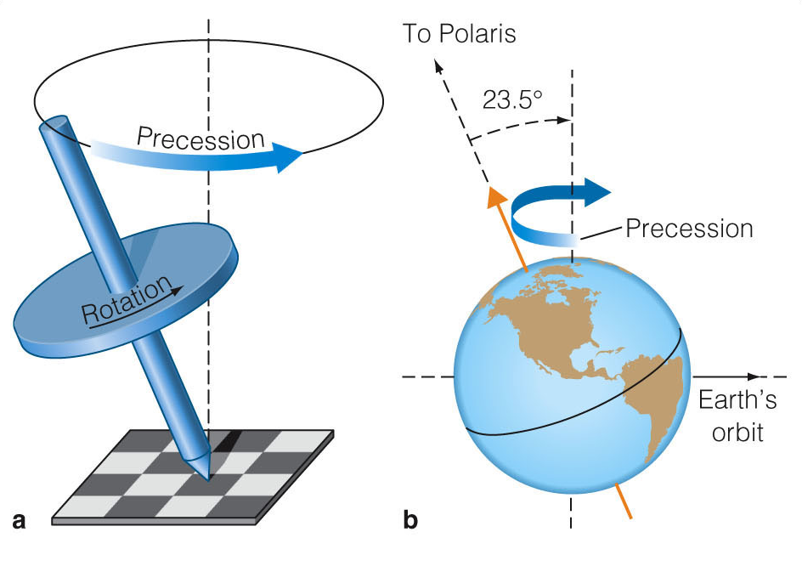
Precession
Earth spins like a giant top, but it does not spin upright relative to its orbit around the sun.
You can say either that Earth’s axis is tipped 23.5° from vertical or that Earth’s equator is tipped 23.5° relative to its orbit.

Slide 35
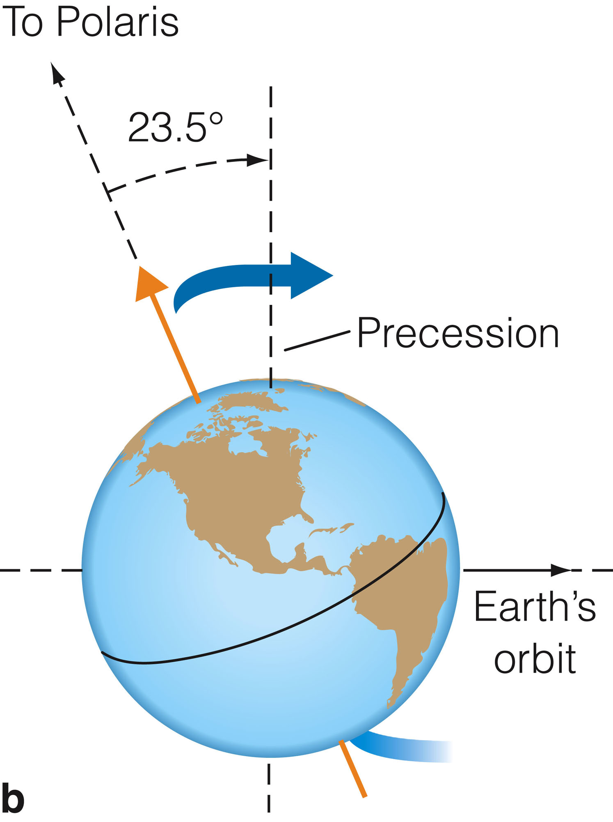
Precession
Earth’s large mass and rapid rotation keep its axis of rotation pointed toward a spot near Polaris (alpha Ursa Minoris).
Its axis direction would not move if Earth were a perfect sphere.
Notes:
Polaris (α UMi, α Ursae Minoris, Alpha Ursa Minoris, commonly North Star, Northern Star or Pole Star, also Lodestar, sometimes Guiding star) is the brightest star in the constellation Ursa Minor. It is very close to the north celestial pole, making it the current northern pole star.

Slide 36
Precession
However, Earth has a slight bulge around its middle.
The gravity of the sun and moon pull on this bulge, tending to twist Earth’s axis upright relative to its orbit.

Slide 37
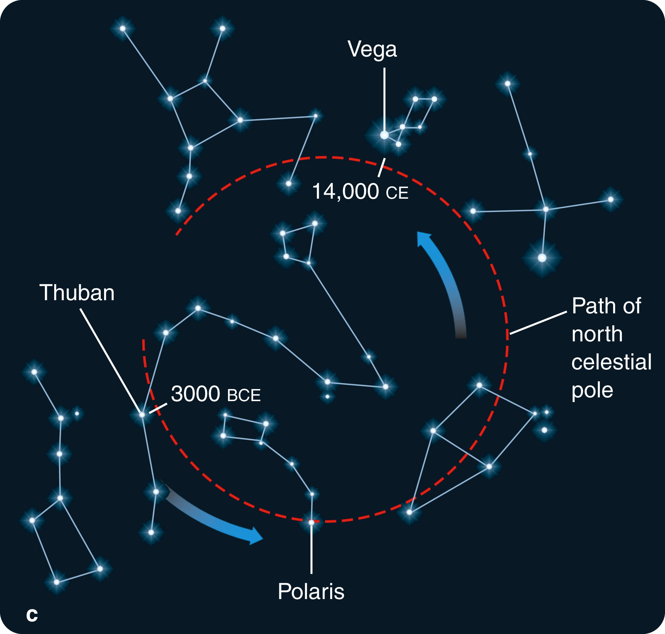
Precession
The combination of these forces and Earth’s rotation causes Earth’s axis to precess in a slow circular sweep—taking about 26,000 years for one cycle.

Slide 38
The Cycle of the Sun
Rotation is the turning of a body on its axis.
Revolution means the motion of a body around a point outside the body.
Earth rotates on its axis—and that produces day and night.
Earth also revolves around the sun—and that produces the yearly cycle.

Slide 39
The Annual Motion of the Sun
If the sun were fainter and you could see the stars in the daytime, you would notice that the sun appears to be moving slowly eastward relative to the background of the distant stars.
This apparent motion is caused by the real orbital motion of Earth around the sun.

Slide 40
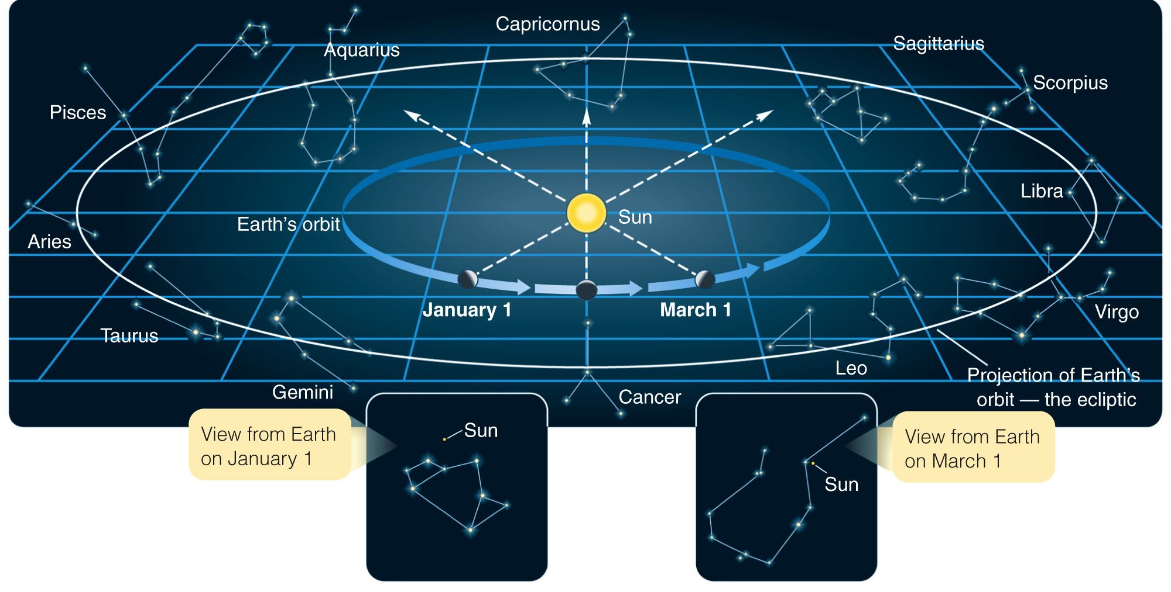
The Annual Motion of the Sun
In January, you would see the sun in front of the constellation Sagittarius.
By March, it is in front of Aquarius.

Slide 41
The Annual Motion of the Sun
Note that your angle of view in the figure makes the Earth’s orbit seem very elliptical when it is really almost a perfect circle.

Slide 42
The Annual Motion of the Sun
Through the year, the sun moves eastward among the stars following a line called the ecliptic—the apparent path of the sun among the stars.
If the sky were a great screen, the ecliptic would be the shadow cast by Earth’s orbit.
In other words, you can call the ecliptic the projection of Earth’s orbit on the celestial sphere.
Earth circles the sun in 365.26 days and, consequently, the sun appears to go once around the sky in the same period.
You don’t notice this motion because you cannot see the stars in the daytime.

Slide 43
The Annual Motion of the Sun
However, the motion of the sun caused by a real motion of Earth has an important consequence that you do notice—the seasons.

Slide 44
The Seasons
The seasons are caused by the revolution of Earth around the sun combined with a simple fact you have already encountered.
Earth’s equator is tipped 23.5° relative to its orbit.

Slide 45
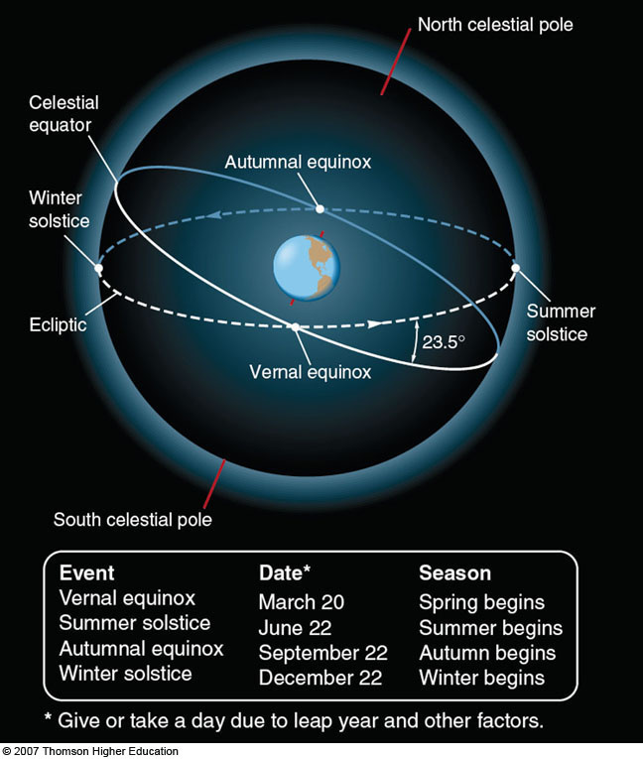
The Seasons
There are two important principles to note about the cycle of seasons.

Slide 46
The Seasons
One, the seasons are not caused by variation in the distance between Earth and the sun.
Earth’s orbit is nearly circular, so it is always about the same distance from the sun.

Slide 47
The Seasons
Two, the seasons are caused by changes in the amount of solar energy that Earth’s northern and southern hemispheres receive at different times of the year—resulting from the tip of the Earth’s equator and axis relative to its orbit.

Slide 48
The Seasons
The seasons are so important as a cycle of growth and harvest that cultures around the world have attached great significance to the ecliptic.
It marks the center line of the zodiac (‘circle of animals’).
Also, the motion of the sun, moon, and the five visible planets (Mercury, Venus, Mars, Jupiter, and Saturn) are the basis of the ancient superstition of astrology.

