Slide 1
Chapter 34: Nuclear Fission and Fusion

Slide 2
This lecture will help you understand:
Nuclear Fission
Nuclear Fission Reactors
Breeder Reactor
Fission Power
Mass–Energy Equivalence
Nuclear Fusion
Controlling Fusion

Slide 3
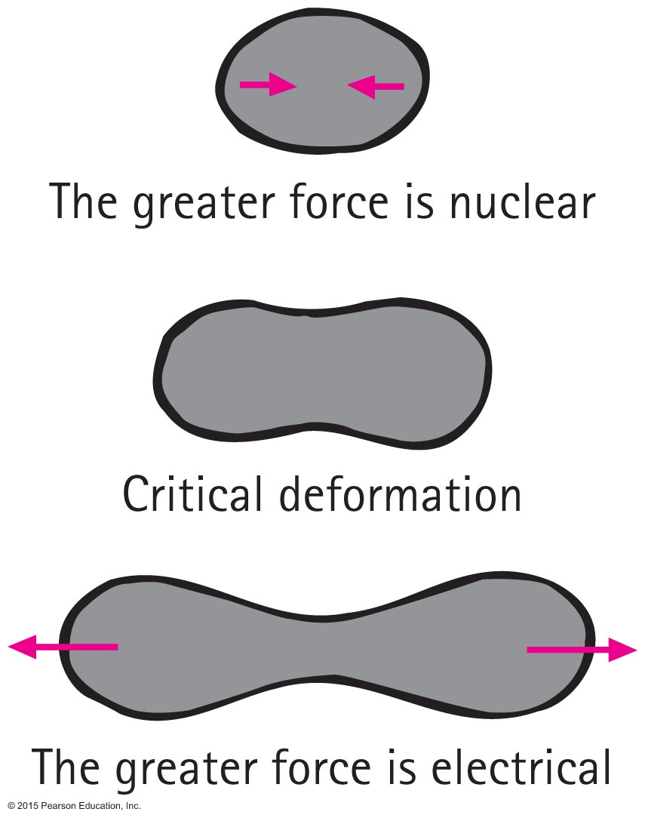
Nuclear Fission
German scientists Otto Hahn and Fritz Strassmann in 1938 accidentally discovered nuclear fission.
Lise Meitner and Otto Frisch explained the process and gave it the name nuclear fission.

Slide 4
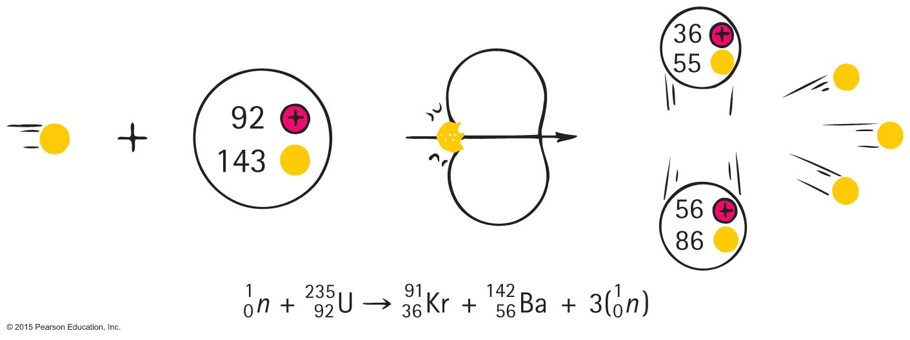
Nuclear Fission
A typical uranium fission reaction:
Note the mass number as well as atomic numbers balance.

Slide 5
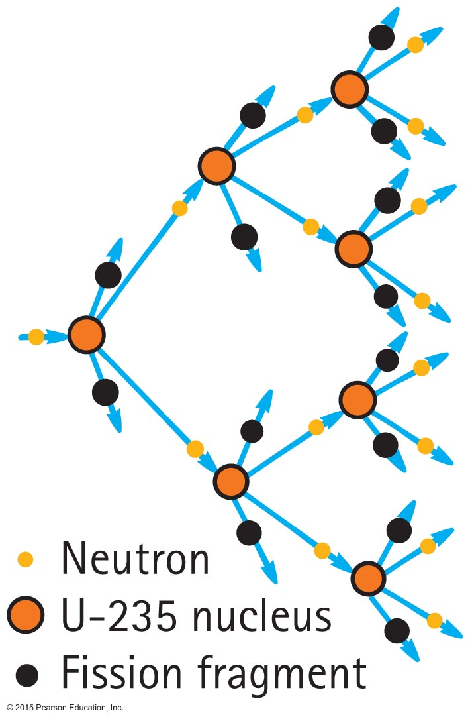
Nuclear Fission
Chain reaction—a self-sustaining reaction in which the products of one reaction event stimulate further reaction events

Slide 6
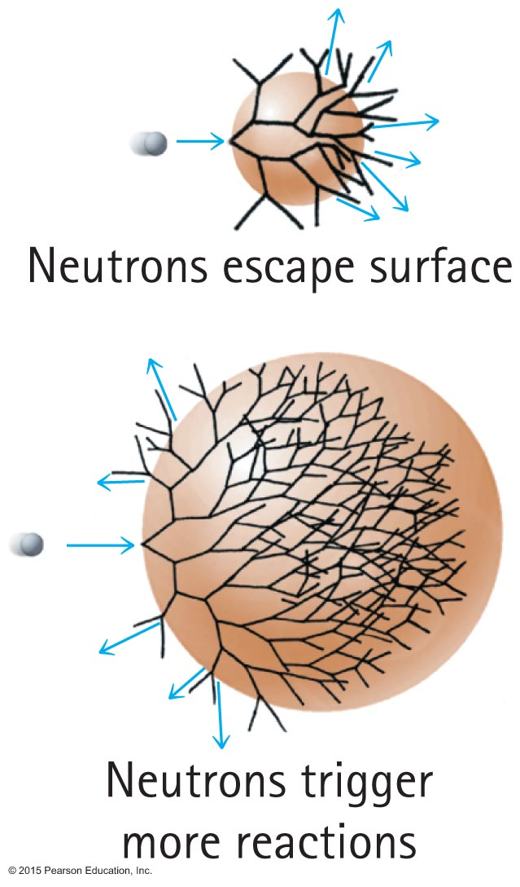
Nuclear Fission
Chain reaction in uranium
Small amount, chain reaction fizzles.
Critical amount, chain reaction produces an explosion.

Slide 7
Nuclear Fission CHECK YOUR NEIGHBOR
The greater the surface area of a piece of fission material, the
less likely an explosion.
more likely an explosion.
Neither A nor B; mass, rather than surface area is significant.
None of the above.
Notes:
A. less likely an explosion.

Slide 8
Nuclear Fission CHECK YOUR ANSWER
The greater the surface area of a piece of fission material, the
less likely an explosion.
more likely an explosion.
Neither A nor B; mass, rather than surface area is significant.
None of the above.
Explanation:
When a chain reaction occurs, it fizzles out when neutrons escape a surface. Therefore, the greater the surface area, the less likely an explosion will occur.
Notes:
A. less likely an explosion.

Slide 9
Nuclear Fission CHECK YOUR NEIGHBOR
Which of these nuclei has the greatest mass?
Hydrogen
Iron
Lead
Uranium
Notes:
D. Uranium

Slide 10
Nuclear Fission CHECK YOUR ANSWER
Which of these nuclei has the greatest mass?
Hydrogen
Iron
Lead
Uranium
Notes:
D. Uranium

Slide 11
Nuclear Fission CHECK YOUR NEIGHBOR
In which of these nuclei does the proton have the greatest mass?
Hydrogen
Iron
Lead
Uranium
Notes:
A. Hydrogen

Slide 12
Nuclear Fission CHECK YOUR ANSWER
In which of these nuclei does the proton have the greatest mass?
Hydrogen
Iron
Lead
Uranium
Notes:
A. Hydrogen

Slide 13
Nuclear Fission CHECK YOUR NEIGHBOR
In which of these nuclei does the proton have the least mass?
Hydrogen
Iron
Lead
Uranium
Notes:
B. Iron

Slide 14
Nuclear Fission CHECK YOUR ANSWER
In which of these nuclei does the proton have the least mass?
Hydrogen
Iron
Lead
Uranium
Explanation:
A look at the curves of Figures 34.16–34.17 shows this. Iron has the least mass per nucleon, but the strongest binding energy.
Notes:
B. Iron

Slide 15
Nuclear Fission CHECK YOUR NEIGHBOR
When a uranium nucleus undergoes fission, the energy released is primarily in the form of
gamma radiation.
kinetic energy of fission fragments.
kinetic energy of ejected neutrons.
All of the above about equally.
Notes:
B. kinetic energy of fission fragments.

Slide 16
Nuclear Fission CHECK YOUR ANSWER
When a uranium nucleus undergoes fission, the energy released is primarily in the form of
gamma radiation.
kinetic energy of fission fragments.
kinetic energy of ejected neutrons.
All of the above about equally.
Explanation:
Kinetic energy of fragments is what becomes heat energy. Interestingly, gamma-ray energy is tiny in comparison. Neutrons, although important for the chain reaction, contribute a small part of the energy release. Choice D is likely a guess.
Notes:
B. kinetic energy of fission fragments.

Slide 17
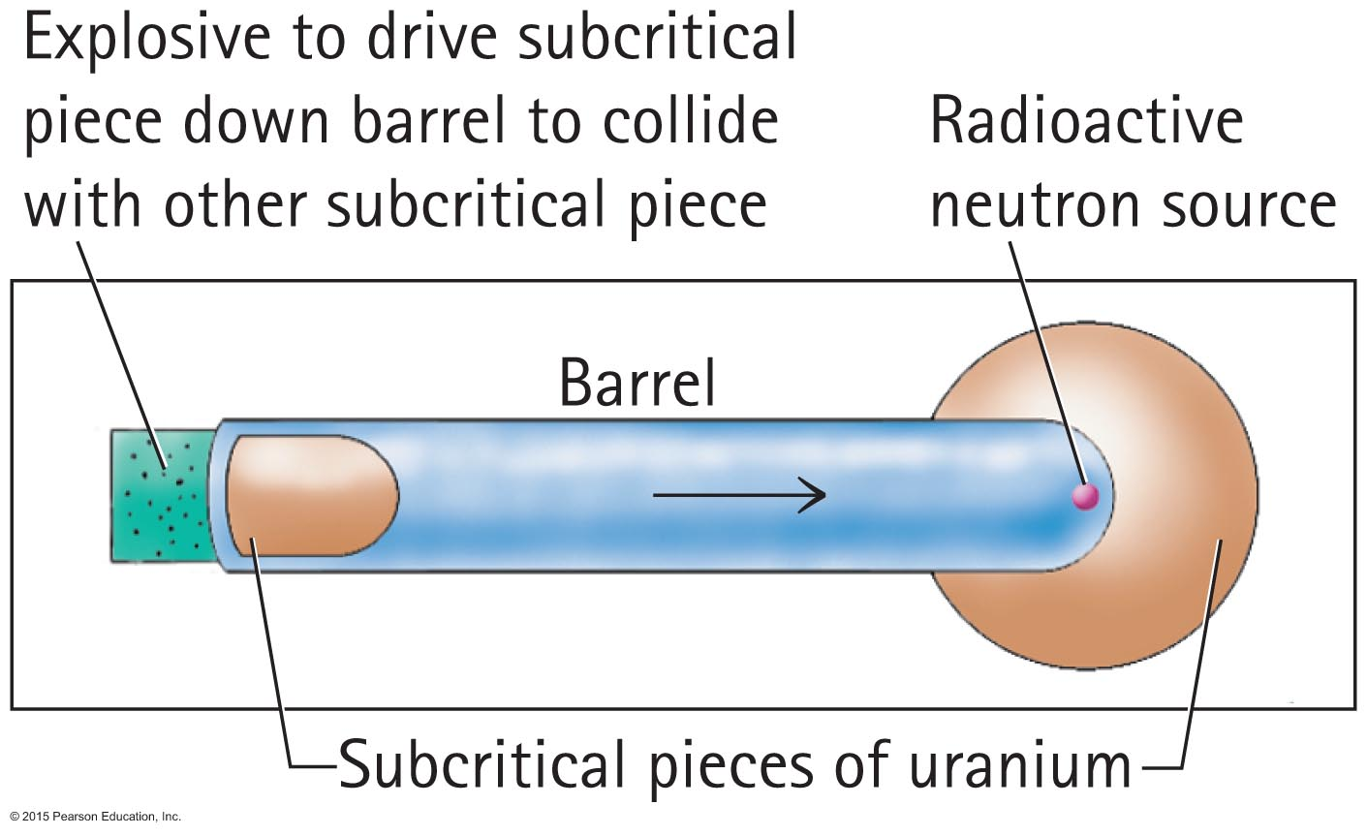
Nuclear Fission
Fission bomb
A bomb in which pieces of uranium are driven together is a so-called "gun-type" weapon, as opposed to the now more common "implosion weapon."
Constructing a fission bomb is a formidable task. The difficulty is separating enough U-235 fuel.

Slide 18
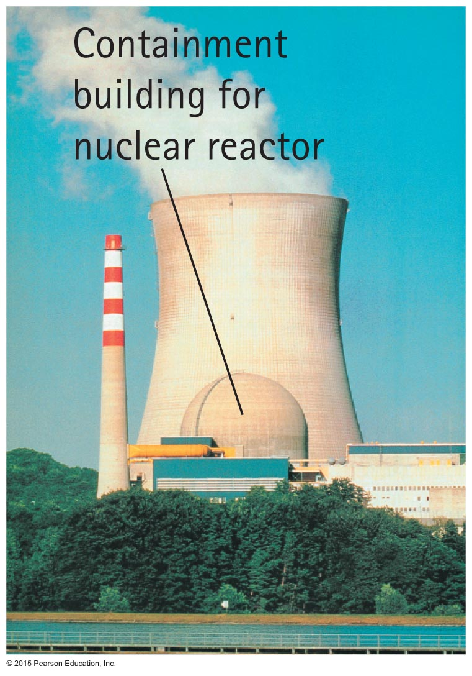
Nuclear Fission Reactors
Nuclear fission reactors
About 20% of electric energy in the United States is generated by nuclear fission reactors.
More in some other countries—about 75% in France.
Reactors are simply nuclear furnaces that boil water to operate steam-driven generators.

Slide 19
Nuclear Fission Reactors
Today's fission reactors contain three components:
The nuclear fuel is primarily U-238 plus about 3% U-235.
The control rods are made of a neutron-absorbing material, usually cadmium or boron.
Water surrounding the nuclear fuel is kept under high pressure to keep it at a high temperature without boiling.

Slide 20
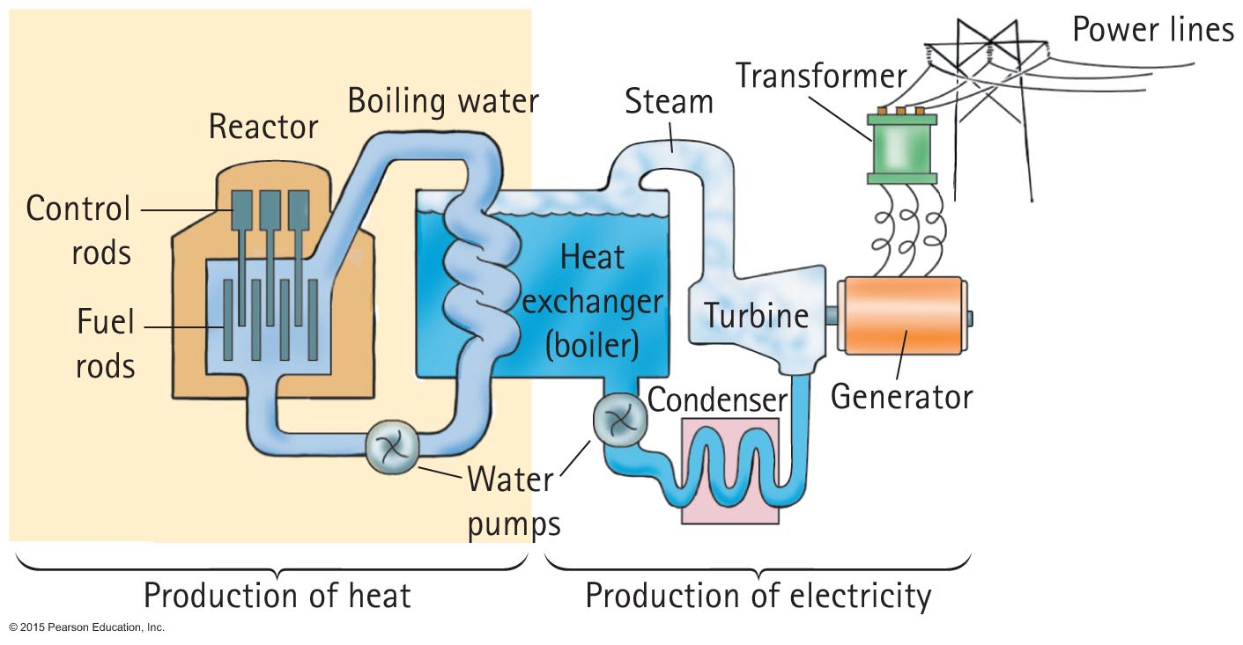
Nuclear Fission Reactors
Diagram of a typical power plant:

Slide 21
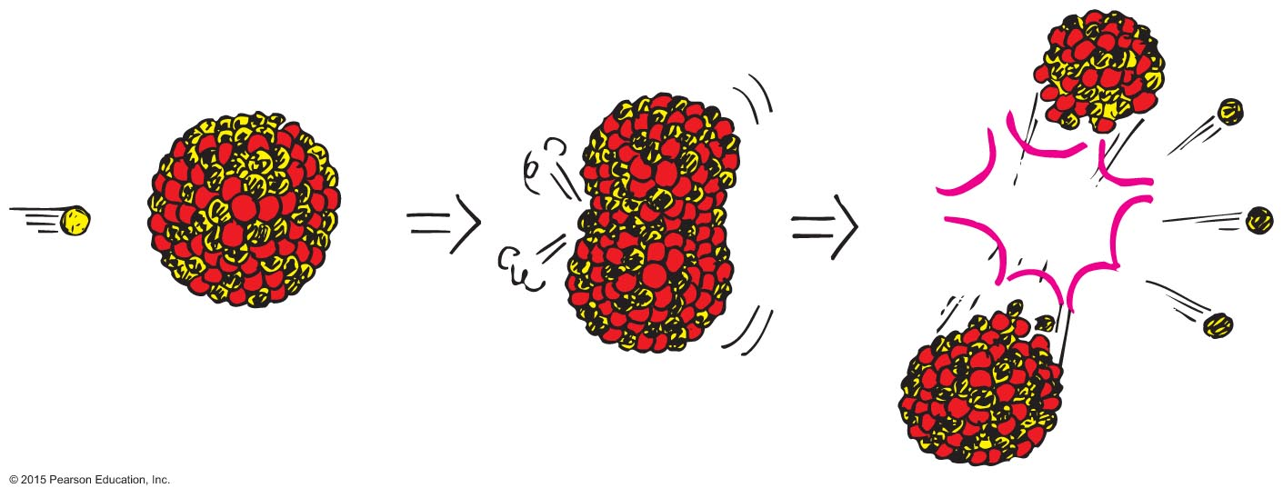
Breeder Reactor
Plutonium-239, like uranium-235, undergoes fission when it captures a neutron.

Slide 22
Breeder Reactor
The breeder reactor
A breeder reactor breeds Pu-239 from U-238 while "burning" U-235.
Occurs in all reactors to some extent.
In a few years can produce twice as much fissionable fuel as it begins with.
A more attractive alternative when U-235 reserves are limited.
Fuel for a breeder may be today's radioactive wastes.

Slide 23
Fission Power
The benefits are plentiful electricity, conservation of billions of tons of fossil fuels every year that are converted to heat and smoke (which in the long run may be far more precious as sources of organic molecules than as sources of heat), and the elimination of megatons of carbon dioxide, sulfur oxides, and other deleterious substances put into the air each year by the burning of fossil fuels.
Drawbacks include risks of release of radioactive isotopes into the atmosphere, by accident or by terrorist activities. Radioactive waste disposal is a problem (although not for some countries that monitor it for potential use later).

Slide 24
Mass–Energy Equivalence—E = mc²
Early in the early 1900s, Albert Einstein discovered that mass is actually "congealed" energy.
Enormous work is required to pull nucleons from a nucleus. This work is energy added to the nucleon that is pulled out.

Slide 25
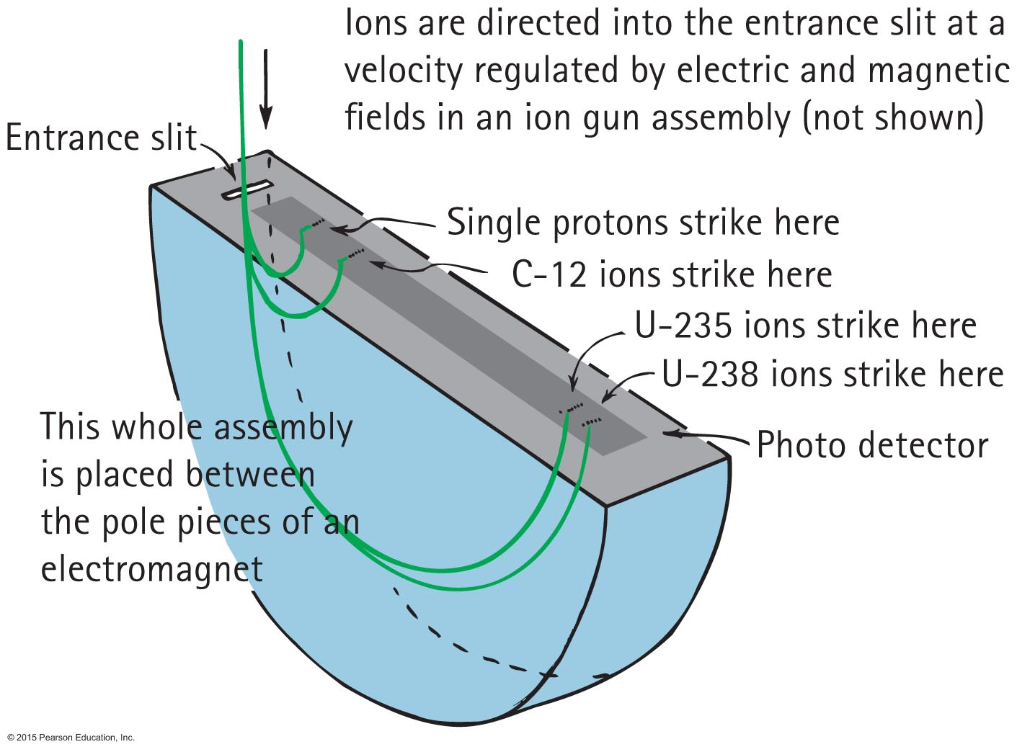
Mass–Energy Equivalence—E = mc²
Measurements of atomic mass are made with this device.

Slide 26
Mass–Energy Equivalence—E = mc²
Electrically charged isotopes directed into the semicircular "drum" are forced into curved paths by a strong magnetic field. Lighter isotopes with less inertia (mass) easily change direction and follow curves of smaller radii. Heavier isotopes with greater inertia (mass) follow larger curves. Mass of an isotope ~ distance from entrance slit.

Slide 27
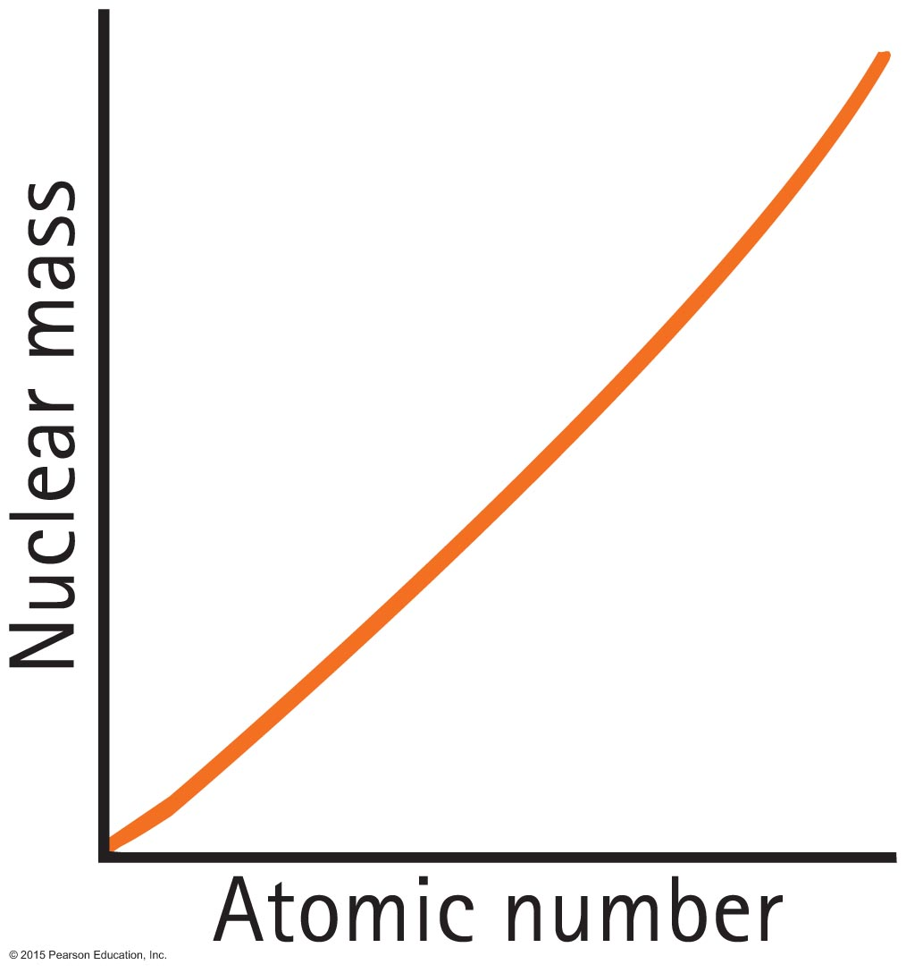
Mass–Energy Equivalence—E = mc²
The plot shows how nuclear mass increases with increasing atomic number.

Slide 28
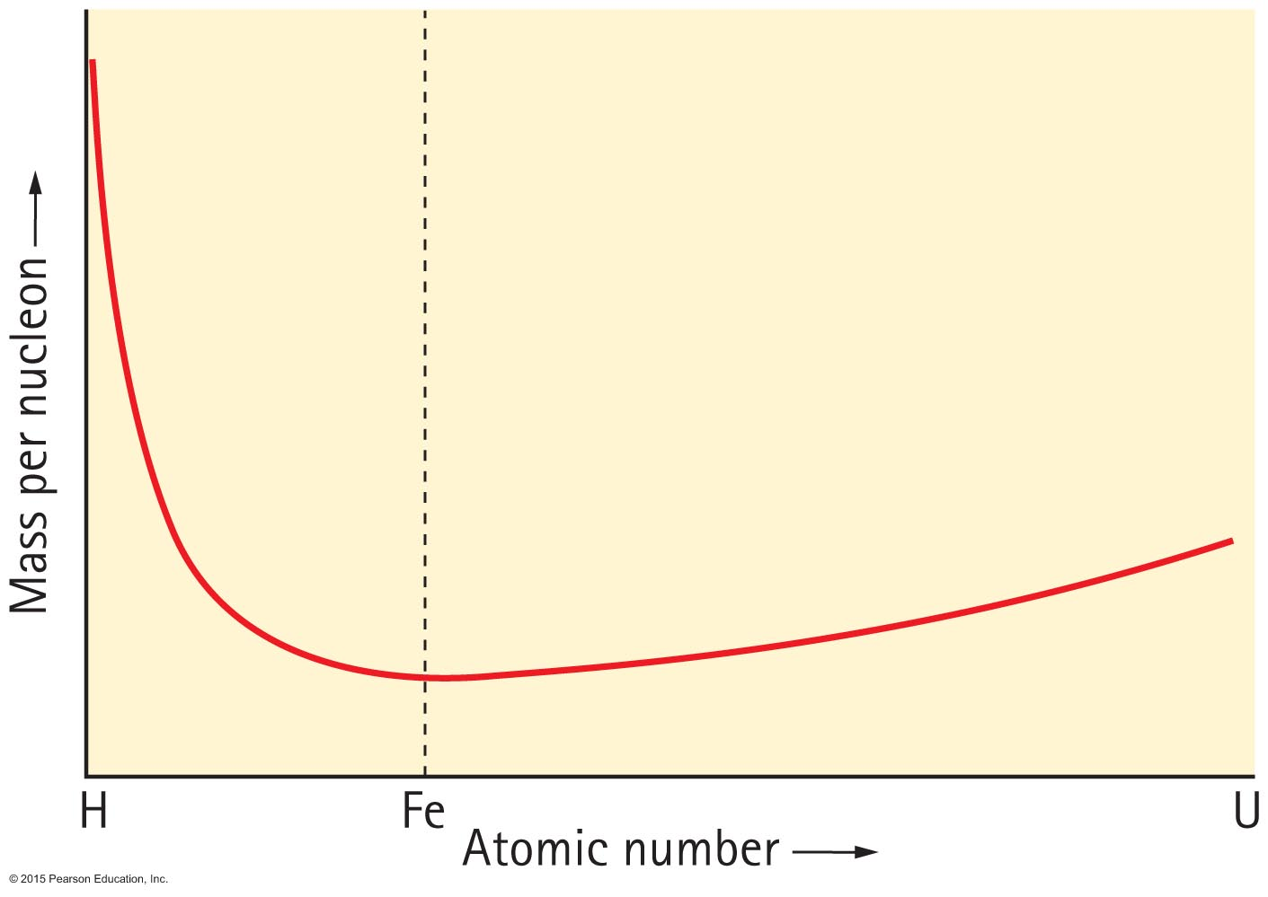
Mass–Energy Equivalence—E = mc²
A very important graph results from the plot of nuclear mass per nucleon from hydrogen through uranium.

Slide 29
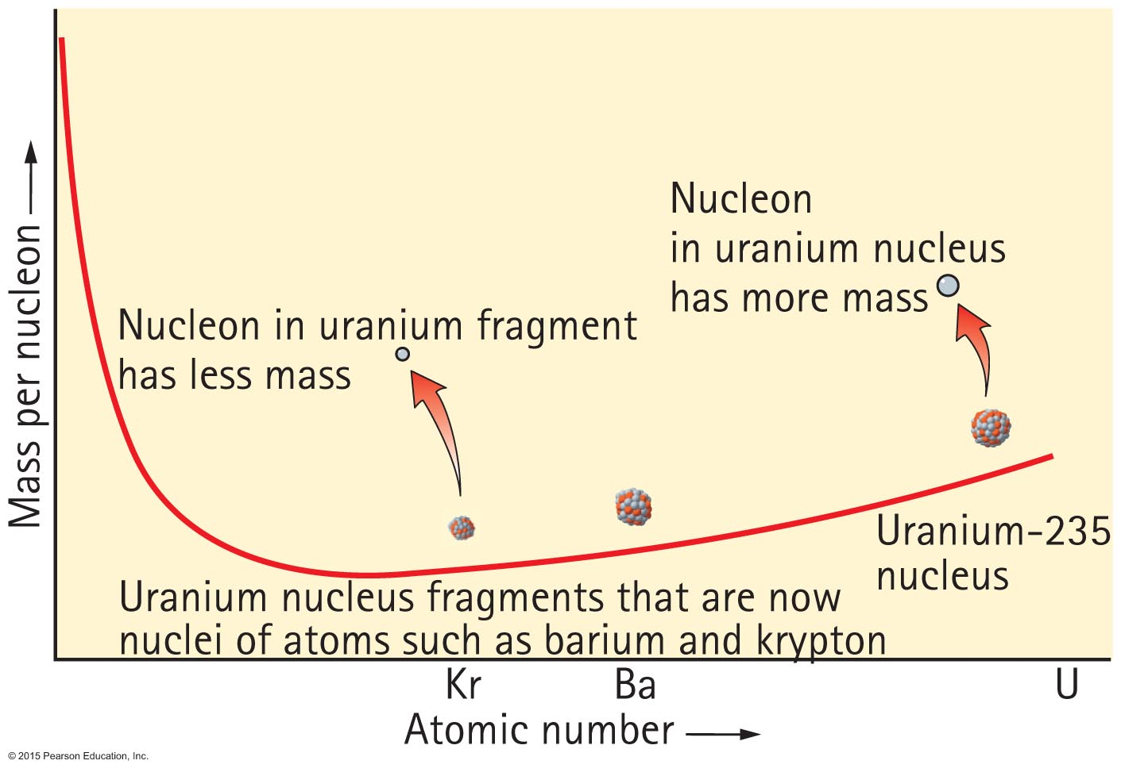
Mass–Energy Equivalence—E = mc²
The same graph, with emphasis on nuclear fission:

Slide 30
Nuclear Fusion
Nuclear fusion is the opposite of nuclear fission.
Fission: nuclei "fizz" apart.
Fusion: nuclei fuse together.
Each releases energy in accord with Figures 34.17 and 34.19.

Slide 31
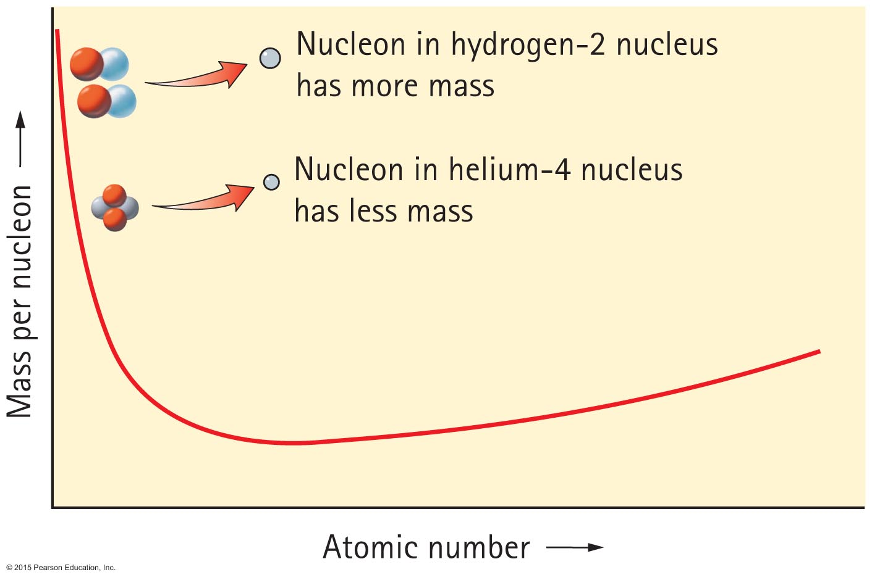
Nuclear Fusion

Slide 32
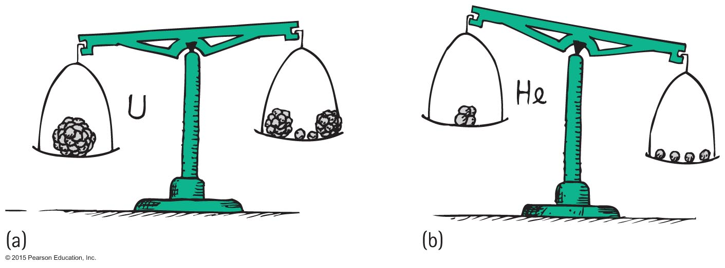
Nuclear Fusion
Fission and fusion compared
Less mass per nucleon occurs in both processes.

Slide 33
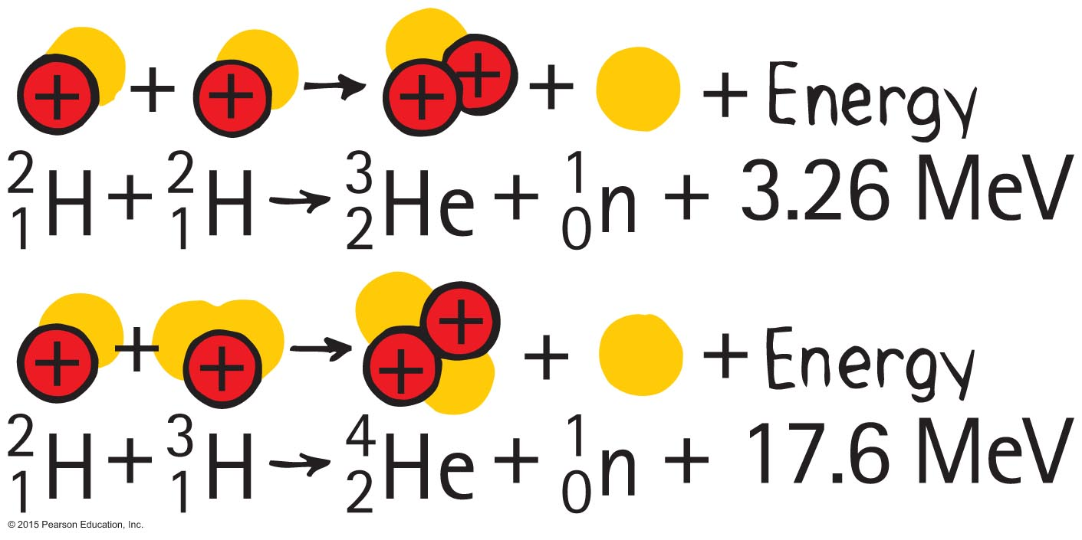
Nuclear Fusion
Typical fusion reactions:

Slide 34
Nuclear Fusion CHECK YOUR NEIGHBOR
When a fusion reaction converts a pair of hydrogen isotopes to an alpha particle and a neutron, most of the energy released is in the form of
gamma radiation.
kinetic energy of the alpha particle.
kinetic energy of the neutron.
All of the above about equally.
Notes:
C. kinetic energy of the neutron.

Slide 35
Nuclear Fusion CHECK YOUR ANSWER
When a fusion reaction converts a pair of hydrogen isotopes to an alpha particle and a neutron, most of the energy released is in the form of
gamma radiation.
kinetic energy of the alpha particle.
kinetic energy of the neutron.
All of the above about equally.
Explanation:
By momentum conservation, the ejected neutrons have a high speed compared with the alpha particle, and therefore much kinetic energy. It is the kinetic energy of the neutrons that becomes the heat needed for power. Gamma rays play a small energy role, as they do in fission.
Notes:
C. kinetic energy of the neutron.

Slide 36
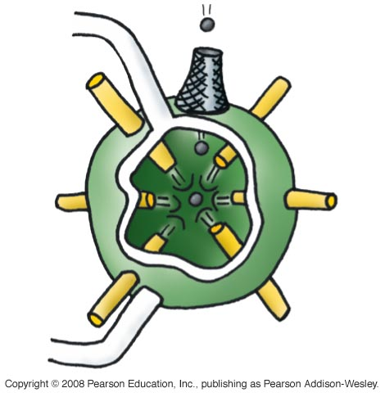
Controlling Fusion
Carrying out fusion is more difficult than thought when fission succeeded.
Plasma reactors have not been successful.
Other schemes, including lasers, are being considered.
Deuterium pellets rhythmically dropped into synchronized laser crossfire; heat used to produce steam:

Slide 37
Nuclear Fission CHECK YOUR NEIGHBOR
In either a fission event or a fusion event, the quantity that remains unchanged is
energy.
the mass of nucleons.
the number of nucleons.
None of the above.
Notes:
C. the number of nucleons.

Slide 38
Nuclear Fission CHECK YOUR ANSWER
In either a fission event or a fusion event, the quantity that remains unchanged is
energy.
the mass of nucleons.
the number of nucleons.
None of the above.
Explanation:
This is a premise of reaction equations, whether nuclear or chemical. Although energy and mass undergo changes, the number of particles and amount of charge remain unchanged.
Notes:
C. the number of nucleons.

