Slide 1
Chapter 33: The Atomic Nucleus and Radioactivity

Slide 2
This lecture will help you understand:
X-Rays and Radioactivity
Alpha, Beta and Gamma Rays
Environmental Radiation
The Atomic Nucleus and the Strong Force
Radioactive Half-Life
Radiation Detectors
Transmutation of Elements
Radiometric Dating

Slide 3
X-Rays and Radioactivity
Roentgen discovered X-rays produced by a beam of electrons striking the glass surface of a gas-discharge tube.
He found that X-rays could pass through solid materials, could ionize the air, showed no refraction in glass, and were undeflected by magnetic fields.

Slide 4
X-Rays and Radioactivity
X-rays are high-frequency electromagnetic waves, usually emitted by the de-excitation of the innermost orbital electrons of atoms.
An energetic beam of electrons striking a solid surface excites the innermost electrons and produces higher-frequency photons of X-radiation.

Slide 5
X-Rays and Radioactivity
X-ray photons have high energy and can penetrate many layers of atoms before being absorbed or scattered.
X-rays do this when they pass through your soft tissue to produce an image of the bones inside your body.

Slide 6
X-Rays and Radioactivity
Radioactivity
Radioactivity is the process of nuclear decay (radioactive decay).
Nothing new in the environment; it's been going on since time zero.
It warms Earth's interior, is in the air we breathe, and is present in all rocks (some in trace amounts).
It is natural.

Slide 7
X-Rays and Radioactivity CHECK YOUR NEIGHBOR
The radioactive decay of nature's elements occurs in the
soil we walk on.
air we breathe.
interior of Earth.
All of the above.
Notes:
D. All of the above.

Slide 8
X-Rays and Radioactivity CHECK YOUR ANSWER
The radioactive decay of nature's elements occurs in the
soil we walk on.
air we breathe.
interior of Earth.
All of the above.
Notes:
D. All of the above.

Slide 9
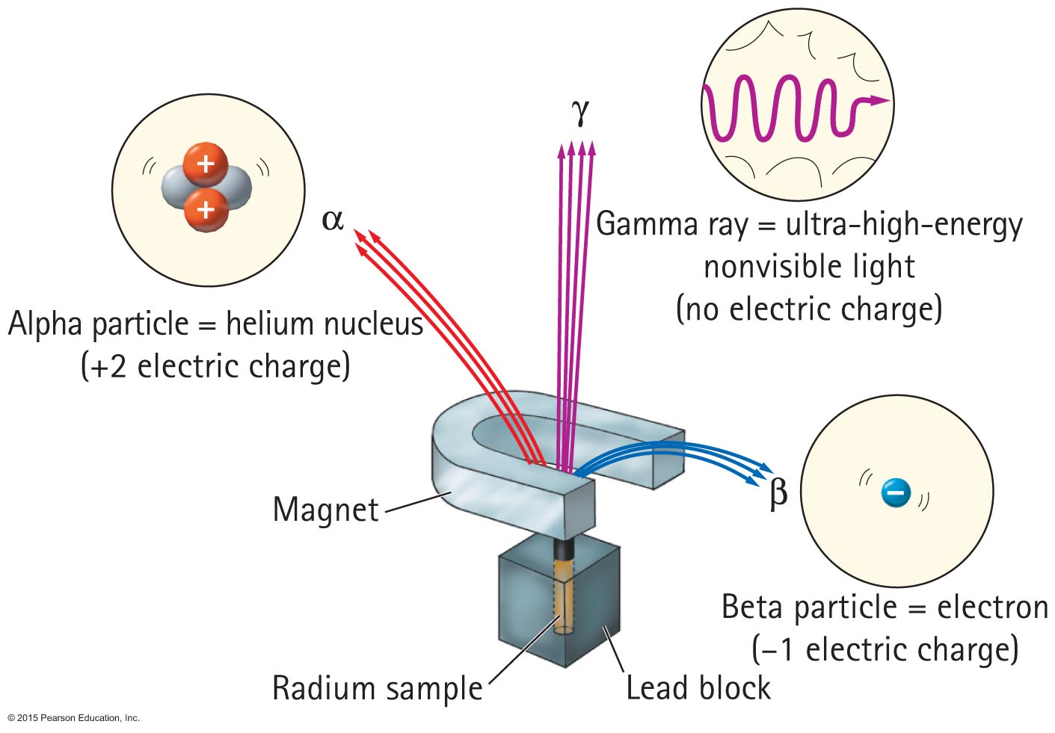
Alpha, Beta, and Gamma Rays
Radioactive elements emit three distinct types of radiation:
α —alpha: positively charged (helium nuclei)
β —beta: negatively charged (electrons)
γ —gamma (electromagnetic radiation)

Slide 10
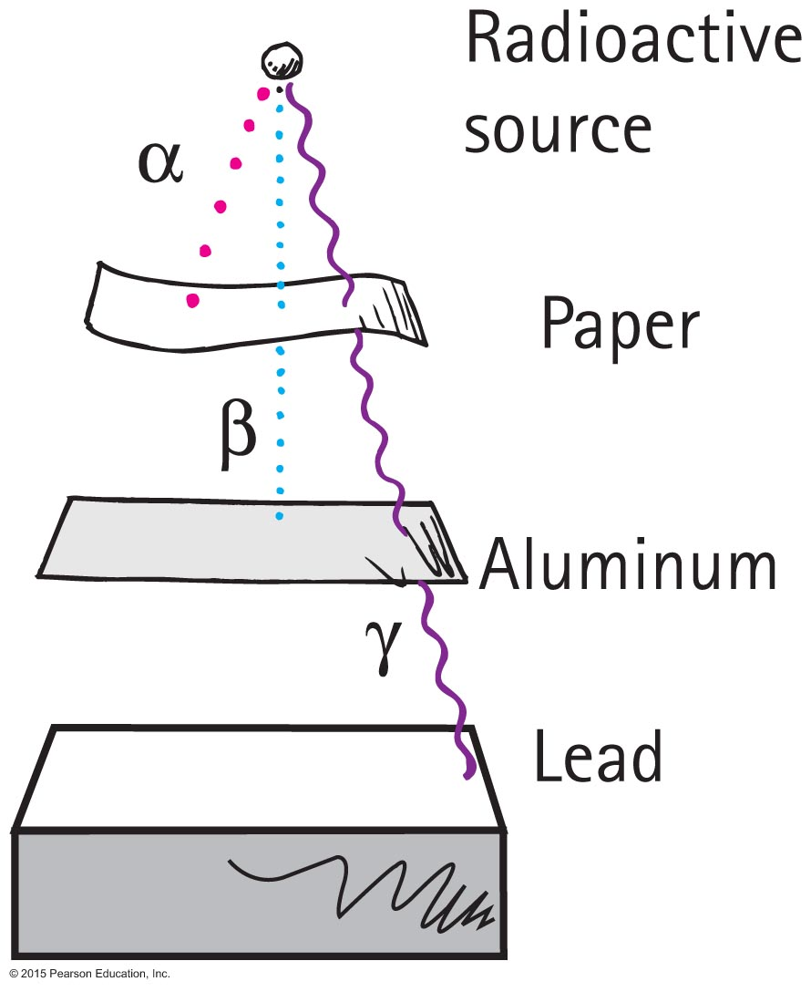
Alpha, Beta, and Gamma Rays
Relative penetrations

Slide 11
Alpha, Beta, and Gamma Rays CHECK YOUR NEIGHBOR
The origins of radioactivity go back to
military activities in the mid-20th century.
the Industrial Revolution two centuries ago.
the beginning of human error.
before humans emerged on Earth.
Notes:
D. before humans emerged on Earth.

Slide 12
Alpha, Beta, and Gamma Rays CHECK YOUR ANSWER
The origins of radioactivity go back to
military activities in the mid-20th century.
the Industrial Revolution two centuries ago.
the beginning of human error.
before humans emerged on Earth.
Notes:
D. before humans emerged on Earth.

Slide 13
Alpha, Beta, and Gamma Rays CHECK YOUR NEIGHBOR
Any atom that emits an alpha particle or beta particle
becomes an atom of a different element, always.
may become an atom of a different element.
becomes a different isotope of the same element.
increases its mass.
Notes:
A. becomes an atom of a different element, always.

Slide 14
Alpha, Beta, and Gamma Rays CHECK YOUR ANSWER
Any atom that emits an alpha particle or beta particle
becomes an atom of a different element, always.
may become an atom of a different element.
becomes a different isotope of the same element.
increases its mass.
Explanation:
Contrary to the failures of alchemists of old to change elements from one to another, this was going on all around them—unnoticed.
Notes:
A. becomes an atom of a different element, always.

Slide 15
Alpha, Beta, and Gamma Rays
Food irradiation kills microbes.
Doesn't make the food radioactive.
There is no diarrhea with astronauts in space (their food is first irradiated).

Slide 16
Alpha, Beta, and Gamma Rays CHECK YOUR NEIGHBOR
Which of these is the nucleus of the helium atom?
Alpha
Beta
Gamma
All are different forms of helium.
Notes:
A. Alpha

Slide 17
Alpha, Beta, and Gamma Rays CHECK YOUR ANSWER
Which of these is the nucleus of the helium atom?
Alpha
Beta
Gamma
All are different forms of helium.
Notes:
A. Alpha

Slide 18
Alpha, Beta, and Gamma Rays CHECK YOUR NEIGHBOR
Which of these is actually a high-speed electron?
Alpha
Beta
Gamma
All are high speed.
Notes:
B. Beta

Slide 19
Alpha, Beta, and Gamma Rays CHECK YOUR ANSWER
Which of these is actually a high-speed electron?
Alpha
Beta
Gamma
All are high speed.
Explanation:
Choice D may be true, but doesn't directly answer the question.
Notes:
B. Beta

Slide 20
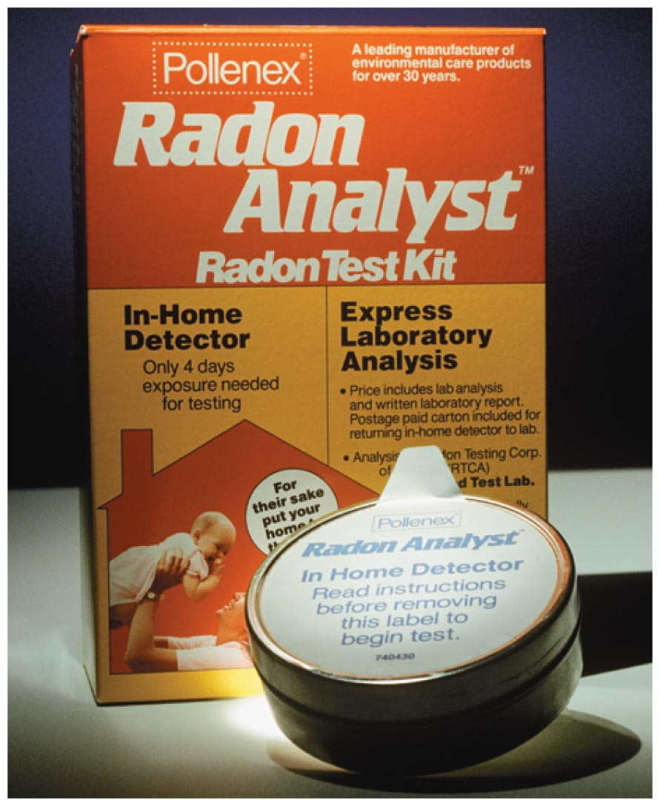
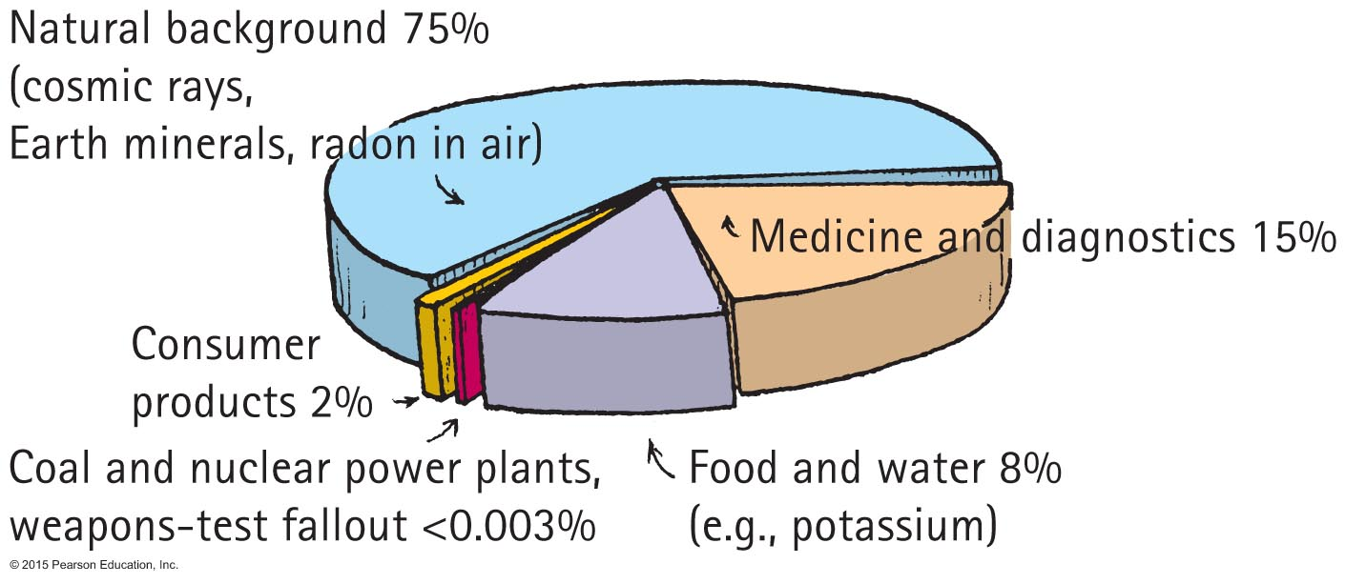
Environmental Radiation
Radon, a common environmental hazard
Most radiation from natural background
About 1/5 from nonnatural sources

Slide 21
Environmental Radiation
Units of radiation
Particle Radiation Dosage Factor Health effect
alpha 1 rad x 10 = 10 rems
beta 10 rad x 1 = 10 rems
Doses of radiation
Lethal doses of radiation begin at 500 rems.

Slide 22
Environmental Radiation
Source received annually Typical dose (mrem)
Natural origin
Cosmic radiation 26
Ground 33
Air (Radon-222) 198
Human tissues (K-40; Ra-226) 35

Slide 23
Environmental Radiation
Doses of radiation Typical dose (mrem)
Human origin
Medical procedures
Diagnostic X-rays 40
Nuclear diagnostics 15
TV tubes, other consumer products 11
Weapons-test fallout 1
Commercial fossil-fuel power plants <1
Commercial nuclear power plants <<1

Slide 24
Environmental Radiation
Radioactive tracers
Radioactive isotopes used to trace such pathways are called tracers.

Slide 25
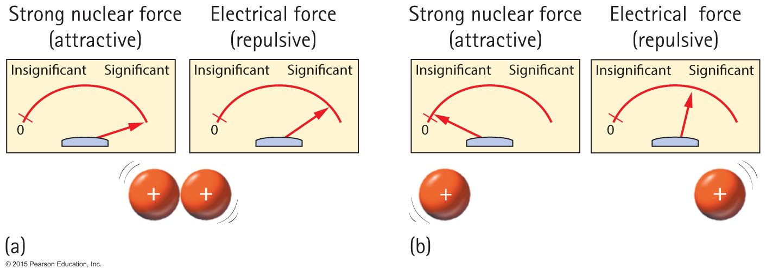
The Atomic Nucleus and the Strong Force
The strong force holds nucleons together.

Slide 26
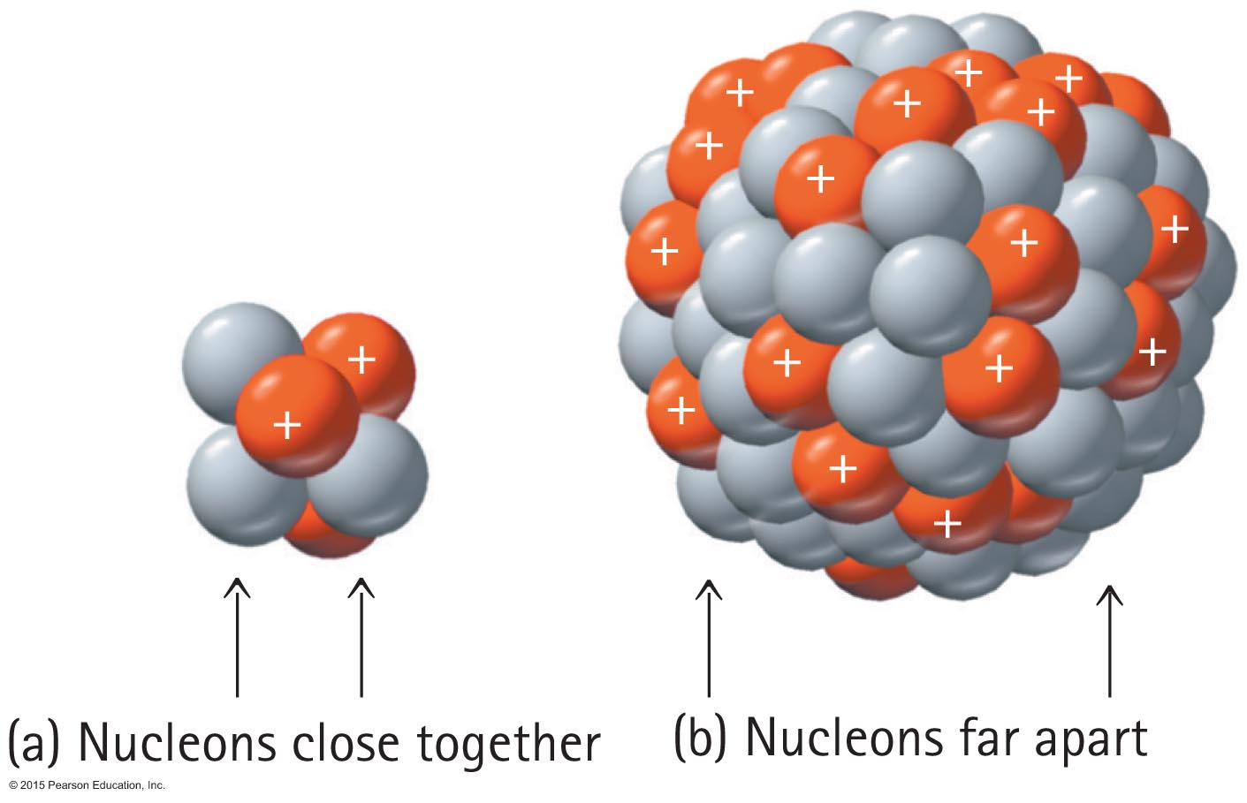
The Atomic Nucleus and the Strong Force
The strong force is more effective with smaller nuclei.

Slide 27
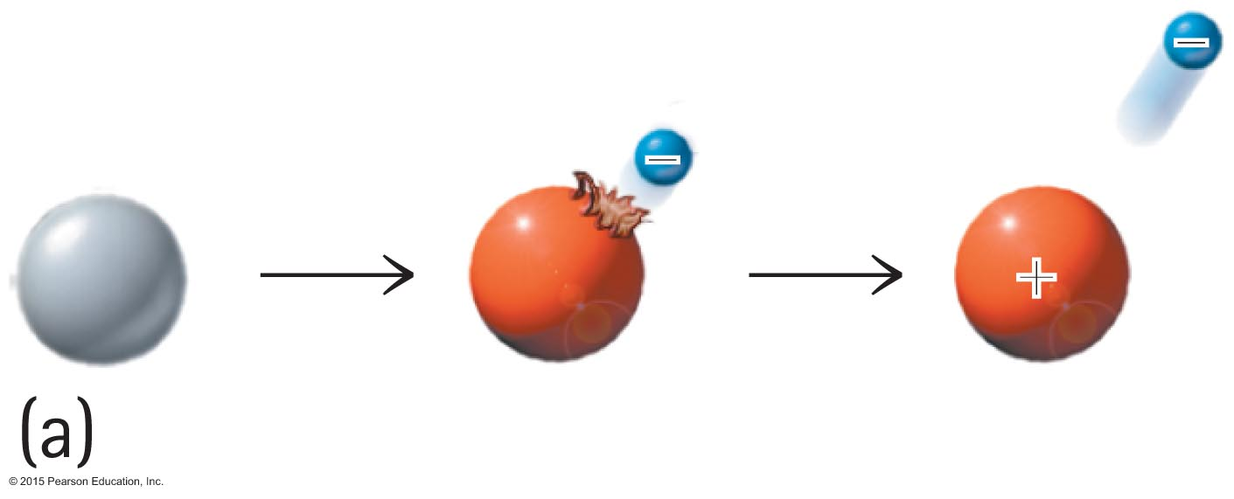
The Atomic Nucleus and the Strong Force
A lone neutron is radioactive and spontaneously transforms to a proton and an electron.
A neutron needs protons around to keep this from happening.

Slide 28
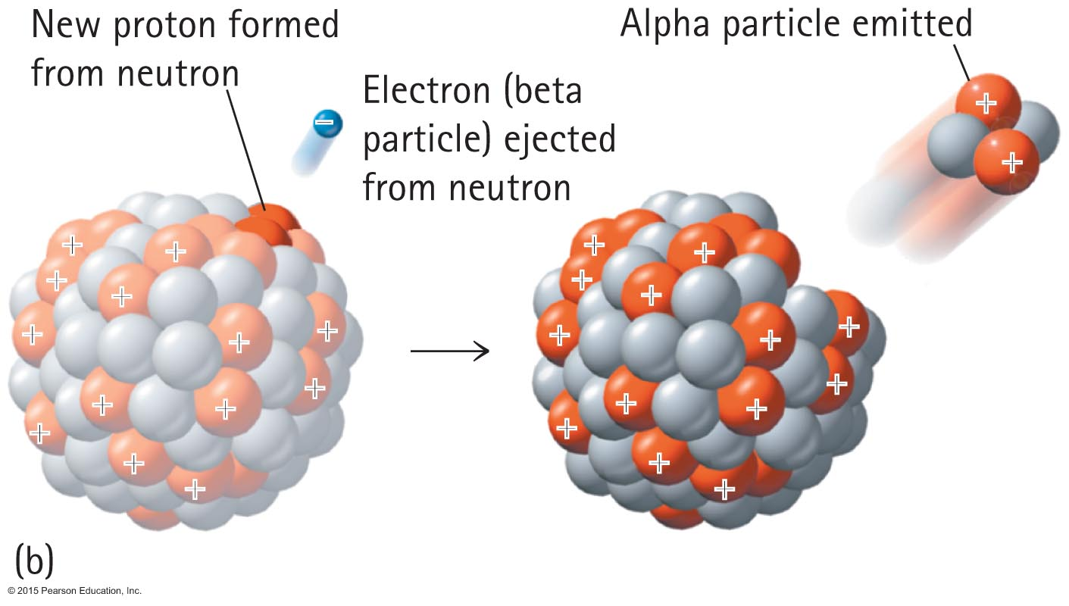
The Atomic Nucleus and the Strong Force
Alpha emission

Slide 29
The Atomic Nucleus and the Strong Force CHECK YOUR NEIGHBOR
The strong force is a force in the
atom that holds electrons in orbit.
nucleus that holds nucleons together.
Both A and B.
Neither A nor B.
Notes:
B. nucleus that holds nucleons together.

Slide 30
The Atomic Nucleus and the Strong Force CHECK YOUR ANSWER
The strong force is a force in the
atom that holds electrons in orbit.
nucleus that holds nucleons together.
Both A and B.
Neither A nor B.
Notes:
B. nucleus that holds nucleons together.

Slide 31
The Atomic Nucleus and the Strong Force CHECK YOUR NEIGHBOR
In the nucleus of an atom, the strong force is a relatively
short-range force.
long-range force.
unstable force.
neutralizing force.
Notes:
A. short-range force.

Slide 32
The Atomic Nucleus and the Strong Force CHECK YOUR ANSWER
In the nucleus of an atom, the strong force is a relatively
short-range force.
long-range force.
unstable force.
neutralizing force.
Notes:
A. short-range force.

Slide 33
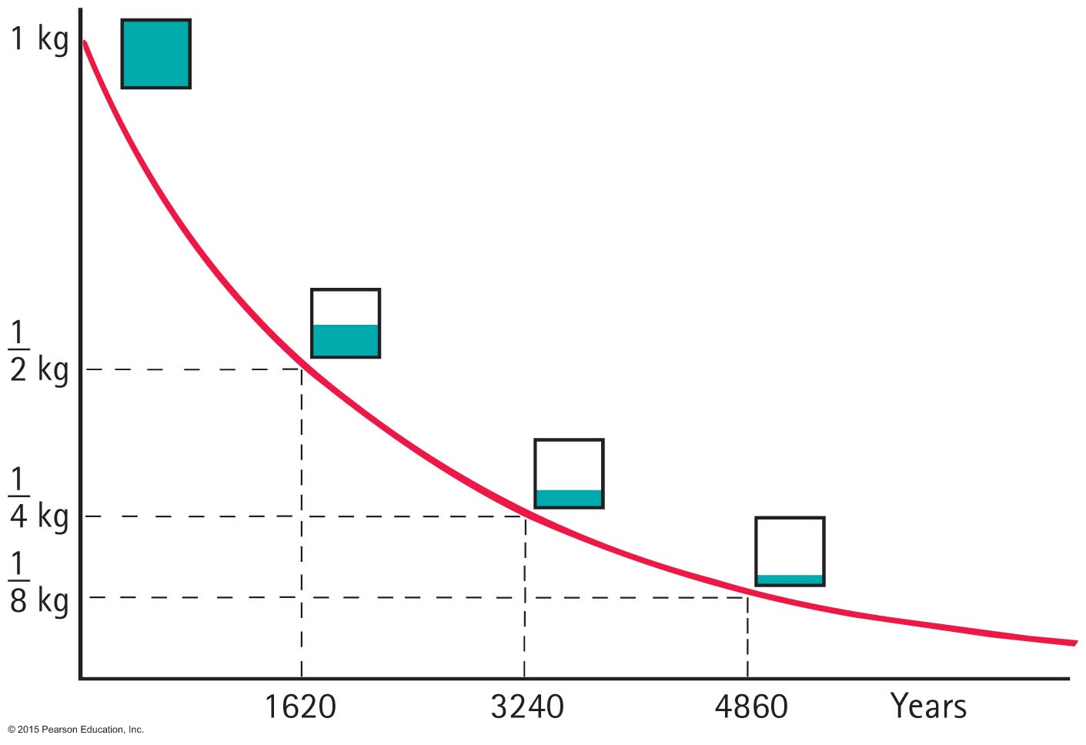
Radioactive Half-Life
The rate of decay for a radioactive isotope is measured in terms of a characteristic time, the half-life, the time for half of an original quantity of an element to decay.

Slide 34
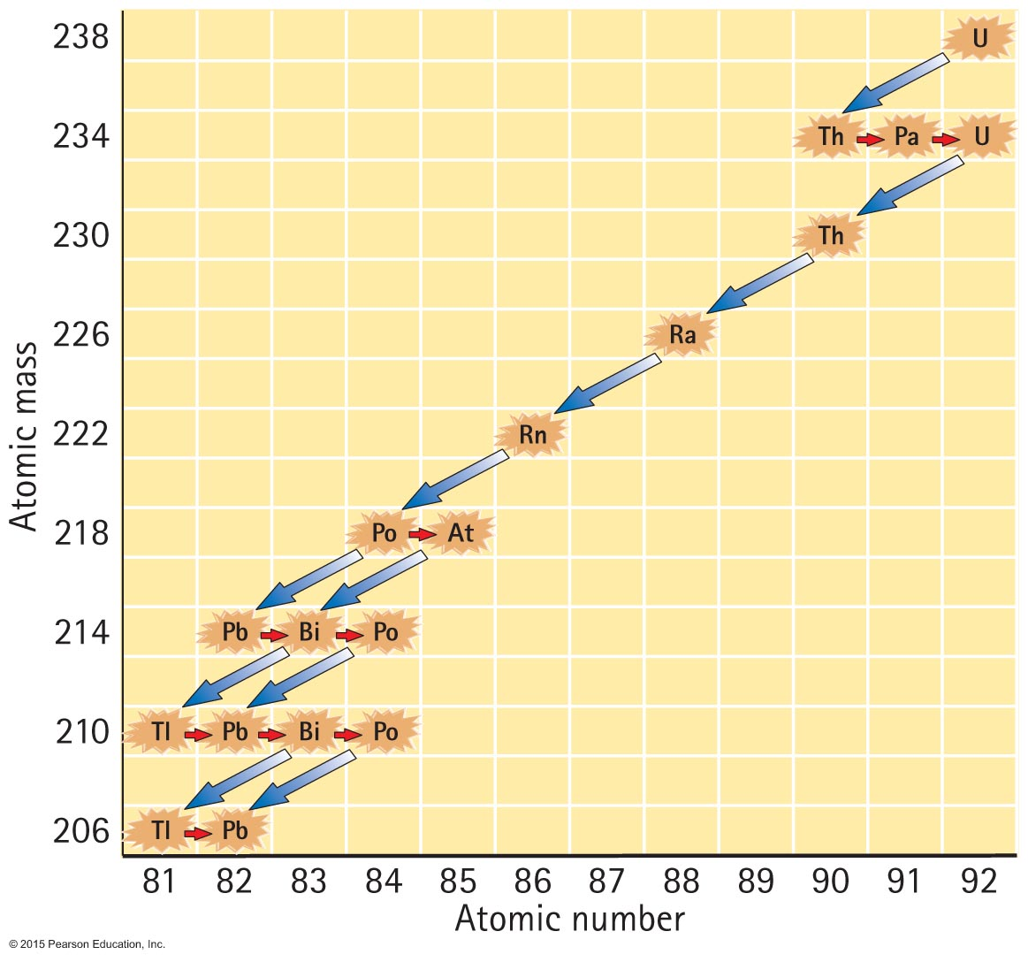
Radioactive Half-Life
Uranium-238 to lead-206 through a series of alpha and beta decays. In 4.5 billion years, half the uranium presently in Earth will be lead.

Slide 35
Radioactive Half-Life CHECK YOUR NEIGHBOR
A certain isotope has a half-life of 10 years. This means the amount of that isotope remaining at the end of 10 years will be
zero.
one-quarter.
half.
the same.
Notes:
C. half.

Slide 36
Radioactive Half-Life CHECK YOUR ANSWER
A certain isotope has a half-life of 10 years. This means the amount of that isotope remaining at the end of 10 years will be
zero.
one-quarter.
half.
the same.
Notes:
C. half.

Slide 37
Radioactive Half-Life A challenge…
Suppose the number of neutrons in a reactor that is starting up doubles each minute, reaching 1 billion neutrons in 10 minutes. When did the number of neutrons reach half a billion?
1 minute
2 minutes
5 minutes
9 minutes
Notes:
D. 9 minutes

Slide 38
Radioactive Half-Life CHECK YOUR ANSWER
Suppose the number of neutrons in a reactor that is starting up doubles each minute, reaching 1 billion neutrons in 10 minutes. When did the number of neutrons reach half a billion?
1 minute
2 minutes
5 minutes
9 minutes
Explanation:
This question would be appropriate with Appendix E, Exponential Growth and Doubling Time. Can you see that working backward, each minute has half the number of neutrons?
Notes:
D. 9 minutes

Slide 39
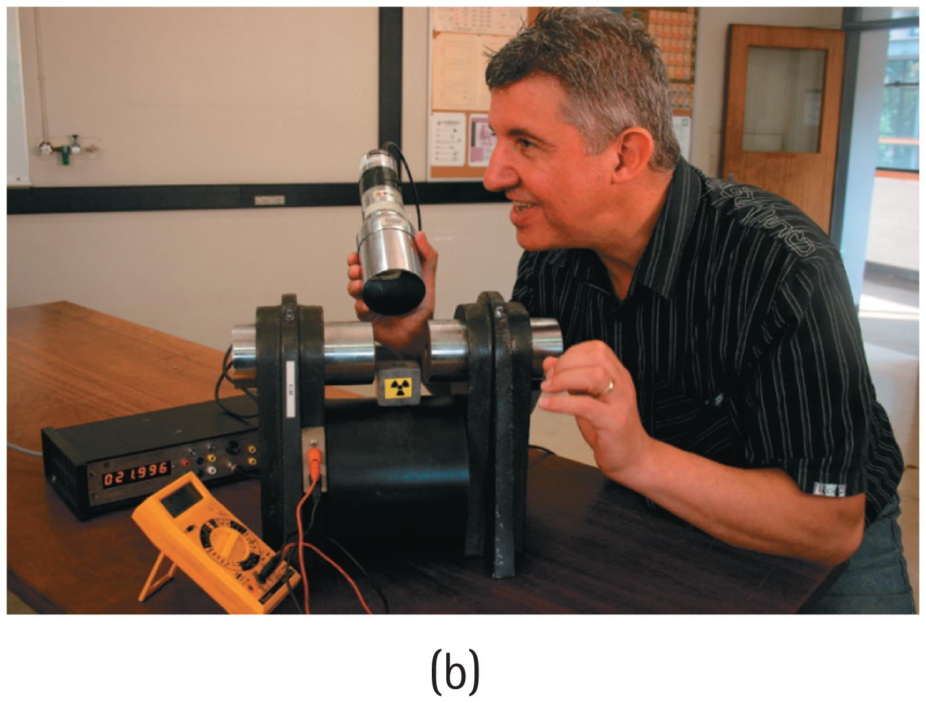
Radiation Detectors
Geiger counter detects incoming radiation by a short pulse of current triggered when radiation ionizes a gas in the tube.
Scintillation counter indicates incoming radiation by flashes of light produced when charged particles or gamma rays pass through the counter.

Slide 40
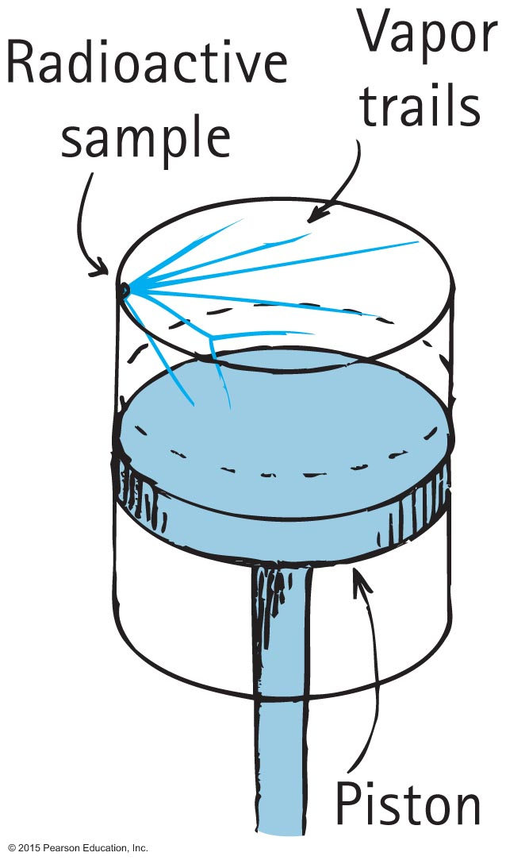
Radiation Detectors
Cloud chamber:
Charged particles moving through supersaturated vapor leave trails.
When the chamber is in a strong electric or magnetic field, bending of the tracks provides information about the charge, mass, and momentum of the particles.

Slide 41
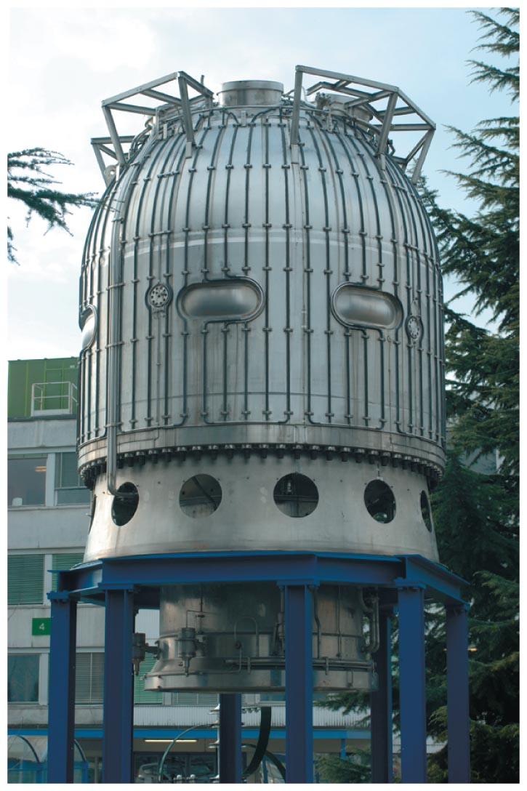
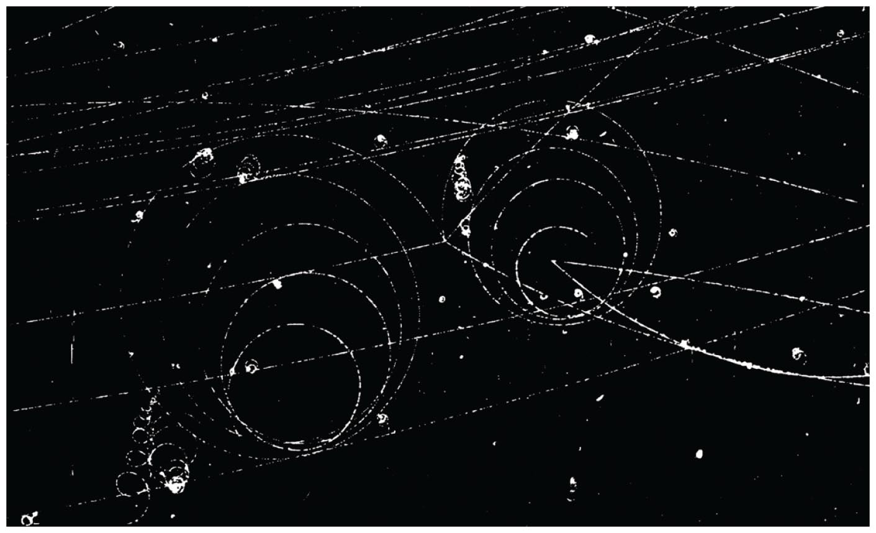
Radiation Detectors
Bubble chamber:
Liquid hydrogen is heated under pressure in a glass and stainless steel chamber to a point just short of boiling.
If the pressure in the chamber is suddenly released at the moment an ion-producing particle enters, a thin trail of bubbles is left along the particle's path.

Slide 42
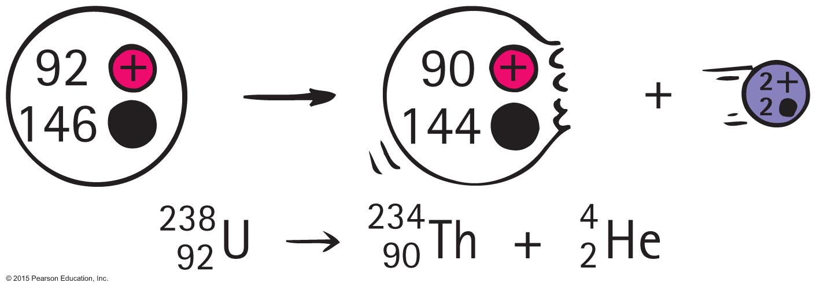
Transmutation of the Elements
With alpha or beta particle, a different element is formed. This is transmutation, which occurs in natural events and is also initiated artificially in the laboratory.
Uranium naturally transmutes to thorium when an alpha particle is emitted.

Slide 43
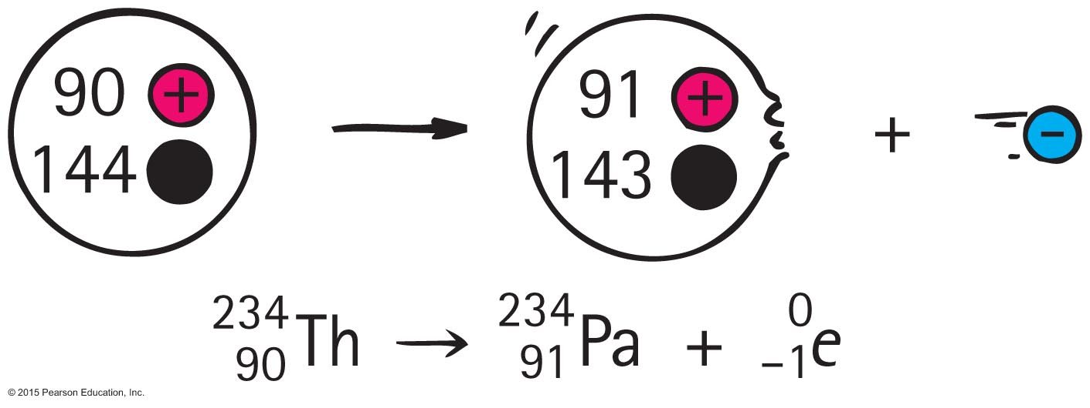
Transmutation of the Elements
Natural transmutation
Thorium naturally transmutes to protactinium when a beta particle is emitted.
An electron is e.
Superscript 0 indicates electron's mass is insignificant compared with nucleons.
Subscript –1 is the electric charge of the electron.

Slide 44
Transmutation of the Elements CHECK YOUR NEIGHBOR
When an element ejects an alpha particle and a beta particle, the atomic number of the resulting element
reduces by 2.
reduces by 4.
increases by 2.
increases by 4.
Notes:
A. reduces by 2.

Slide 45
Transmutation of the Elements CHECK YOUR ANSWER
When an element ejects an alpha particle and a beta particle, the atomic number of the resulting element
reduces by 2.
reduces by 4.
increases by 2.
increases by 4.
Explanation:
An alpha particle (a helium nucleus) has atomic number 2. Ejection of an alpha particle means a loss of 2 protons, so the atomic number of the element is lowered by 2.
Notes:
A. reduces by 2.

Slide 46
Transmutation of the Elements CHECK YOUR NEIGHBOR
When an element ejects an alpha particle and a beta particle, the atomic number of that element
reduces by 1.
increases by 1.
reduces by 2.
increases by 2.
Notes:
A. reduces by 1.

Slide 47
Transmutation of the Elements CHECK YOUR ANSWER
When an element ejects an alpha particle and a beta particle, the atomic number of that element
reduces by 1.
increases by 1.
reduces by 2.
increases by 2.
Explanation:
Alpha emission reduces atomic number by 2, and beta emission increases atomic number by 1, so net result is –1.
Notes:
A. reduces by 1.

Slide 48
Transmutation of the Element
Artificial transmutation
An alpha particle fired at and impacting on a nitrogen atom, which transmutes to oxygen and hydrogen

Slide 49
Transmutation of the Elements CHECK YOUR NEIGHBOR
Atoms can transmute into completely different atoms in
nature.
laboratories.
Both A and B.
Neither A nor B.
Notes:
C. Both A and B.

Slide 50
Transmutation of the Elements CHECK YOUR ANSWER
Atoms can transmute into completely different atoms in
nature.
laboratories.
Both A and B.
Neither A nor B.
Explanation:
Atomic transmutation occurs in nature, in laboratories, and as far as we know, throughout the cosmos.
Notes:
C. Both A and B.

Slide 51
Transmutation of the Elements CHECK YOUR NEIGHBOR
An element emits 1 beta particle, and its product then emits 1 alpha particle. The atomic number of the resulting element is changed by
0.
–1.
–2.
None of the above.
Notes:
B. –1.

Slide 52
Transmutation of the Elements CHECK YOUR ANSWER
An element emits 1 beta particle, and its product then emits 1 alpha particle. The atomic number of the resulting element is changed by
0.
–1.
–2.
None of the above.
Explanation:
Beta emission increases atomic number by 1, then alpha emission decreases atomic number by 2, so the net change is –1.
Notes:
B. –1.

Slide 53
Radiometric Dating
Earth's atmosphere is continuously bombarded by cosmic rays, which causes many atoms in the upper atmosphere to transmute. These transmutations result in many protons.
A nitrogen that captures a neutron and becomes an isotope of carbon by emitting a proton:

Slide 54
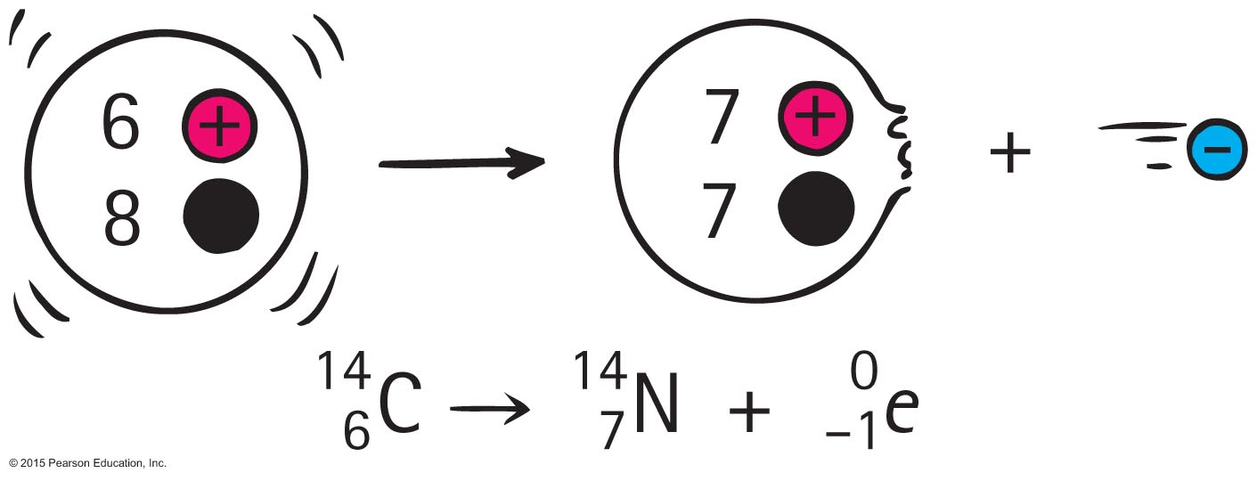
Radiometric Dating
Carbon-14 is a beta emitter and decays back to nitrogen.
Because living plants take in carbon dioxide, any C-14 lost by decay is immediately replenished with fresh C-14 from the atmosphere.
Dead plants continue emitting C-14 without replenishment.

Slide 55
Radiometric Dating
Relative amounts of C-12 to C-14 enable dating of organic materials.

Slide 56
Radiometric Dating CHECK YOUR NEIGHBOR
The half-life of carbon-14 is about 5730 years, which means that the present amount in your bones will reduce to zero
when you die.
in about 5730 years.
in about twice 5730 years.
None of the above.
Notes:
D. None of the above.

Slide 57
Radiometric Dating CHECK YOUR ANSWER
The half-life of carbon-14 is about 5730 years, which means that the present amount in your bones will reduce to zero
when you die.
in about 5730 years.
in about twice 5730 years.
None of the above.
Explanation:
In theory, the amount never reaches zero. In eons to come, trace amounts of the carbon-14 in your bones, even if completely dissolved, will still exist.
Notes:
D. None of the above.

