Slide 1
Chapter 28: Reflection and Refraction

Slide 2
This lecture will help you understand:
Reflection
Principle of Least Time
Law of Reflection
Refraction
Cause of Refraction
Dispersion
Rainbows
Total Internal Reflection
Lenses
Lens Defects

Slide 3
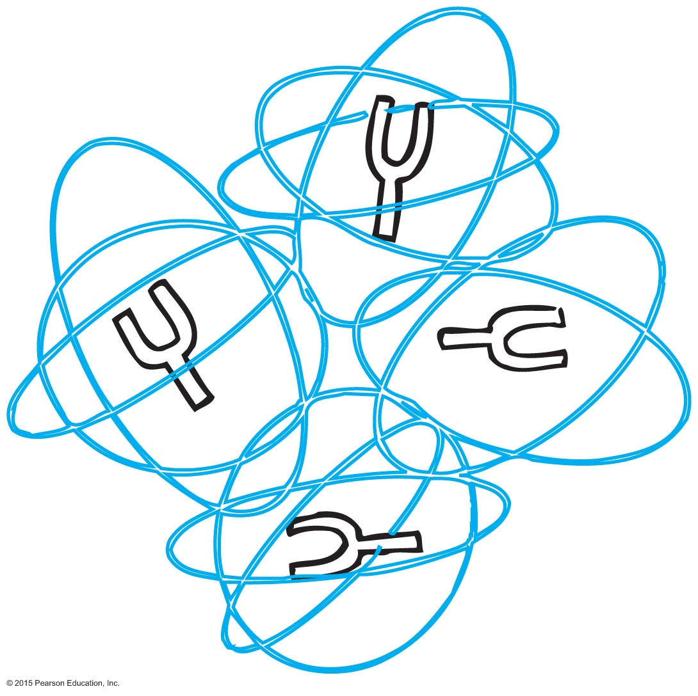
Reflection
We say light is reflected when it is returned into the medium from which it came—the process is reflection.
When light illuminates a material, electrons in the atoms of the material move more energetically in response to the oscillating electric fields of the illuminating light.
The energized electrons re-emit the light by which you see the material.

Slide 4
Principle of Least Time
The idea that light takes the quickest path in going from one place to another is called Fermat's principle of least time.

Slide 5
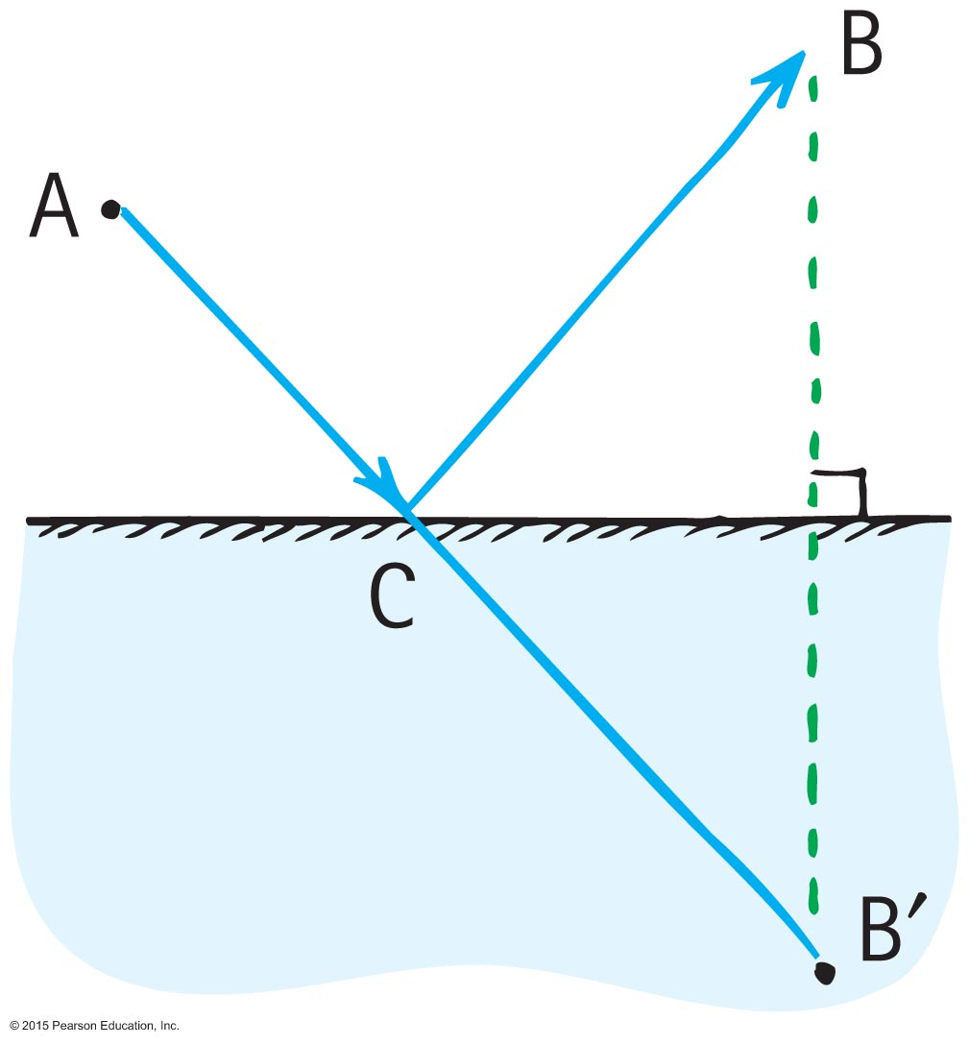
Principle of Least Time
Finding the shortest time for light to go from A to B by reflecting off the mirror
Construct, on the opposite side of the mirror, an artificial point, which is the same distance "through" and below the mirror as the point B is above the mirror.
The shortest distance between A and this artificial point is a straight line.
This straight line intersects the mirror at a point C, the precise point of reflection for least time from A to B.

Slide 6
Law of Reflection
Angle of incidence
Angle made by the incoming ray and the perpendicular
Angle of reflection
Angle made by the reflected ray and the perpendicular
Normal
Imaginary line perpendicular to the plane of the reflecting surface
Lies in the same plane as the incident and reflected rays

Slide 7
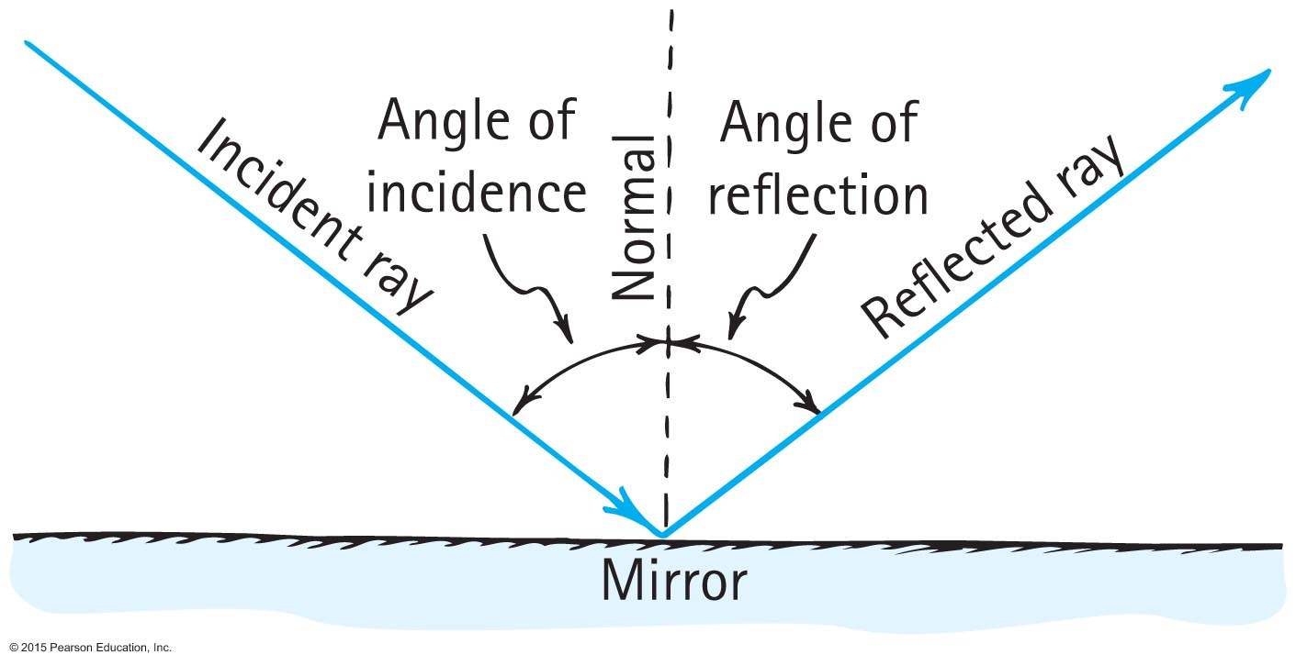
Law of Reflection
Law of reflection
The angle of reflection equals the angle of incidence.

Slide 8
Law of Reflection CHECK YOUR NEIGHBOR
The law of reflection applies to
light.
sound.
Both A and B.
None of the above.
Notes:
C. Both A and B.

Slide 9
Law of Reflection CHECK YOUR ANSWER
The law of reflection applies to
light.
sound.
Both A and B.
None of the above.
Notes:
C. Both A and B.

Slide 10
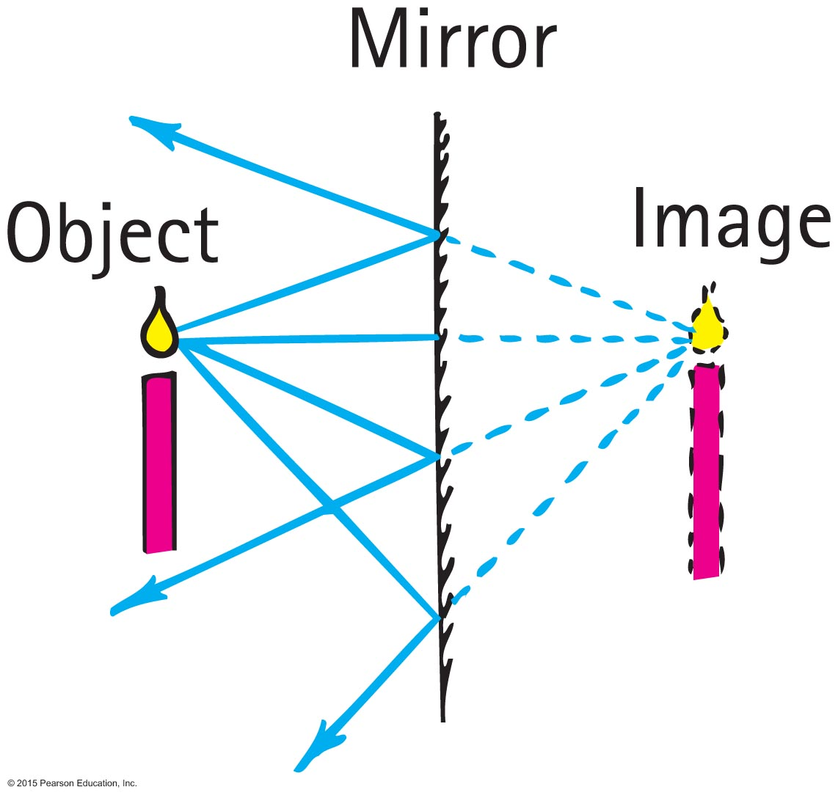
Law of Reflection
Virtual image
is same size as object, formed behind a mirror, and located at the position where the extended reflected rays converge.
is as far behind the mirror as the object is in front of the mirror.

Slide 11
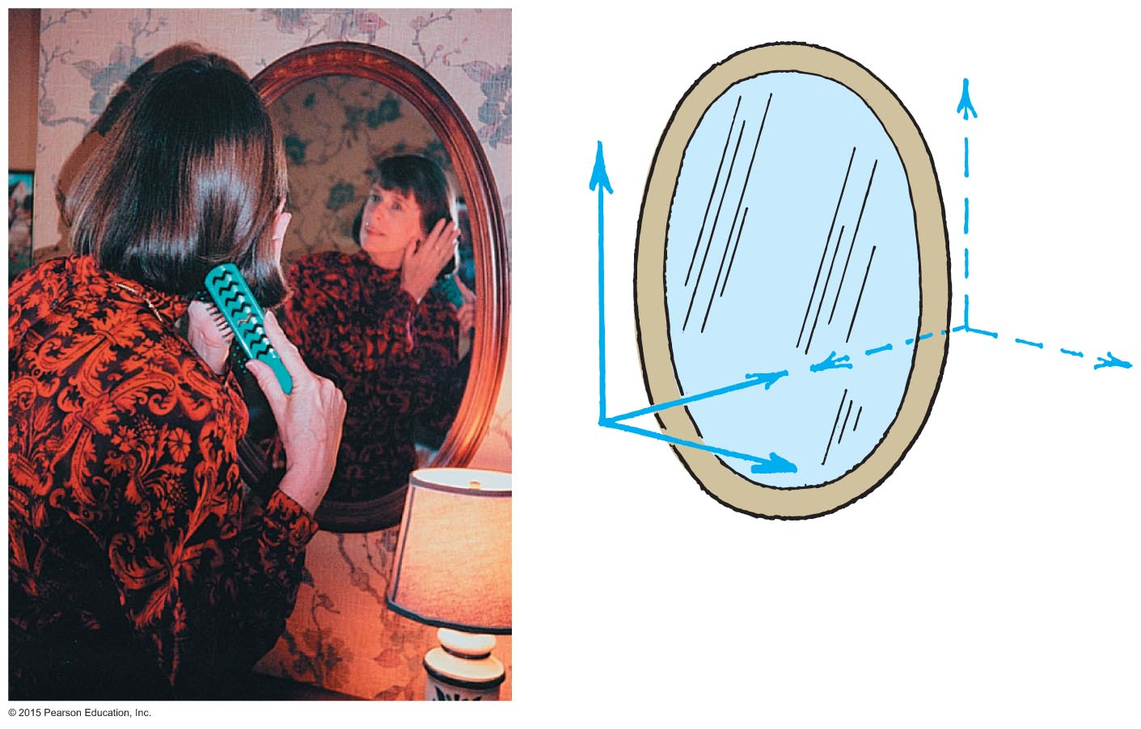
Law of Reflection
Plane mirror
Note: the only axis reversed in an image is the front-back axis.

Slide 12
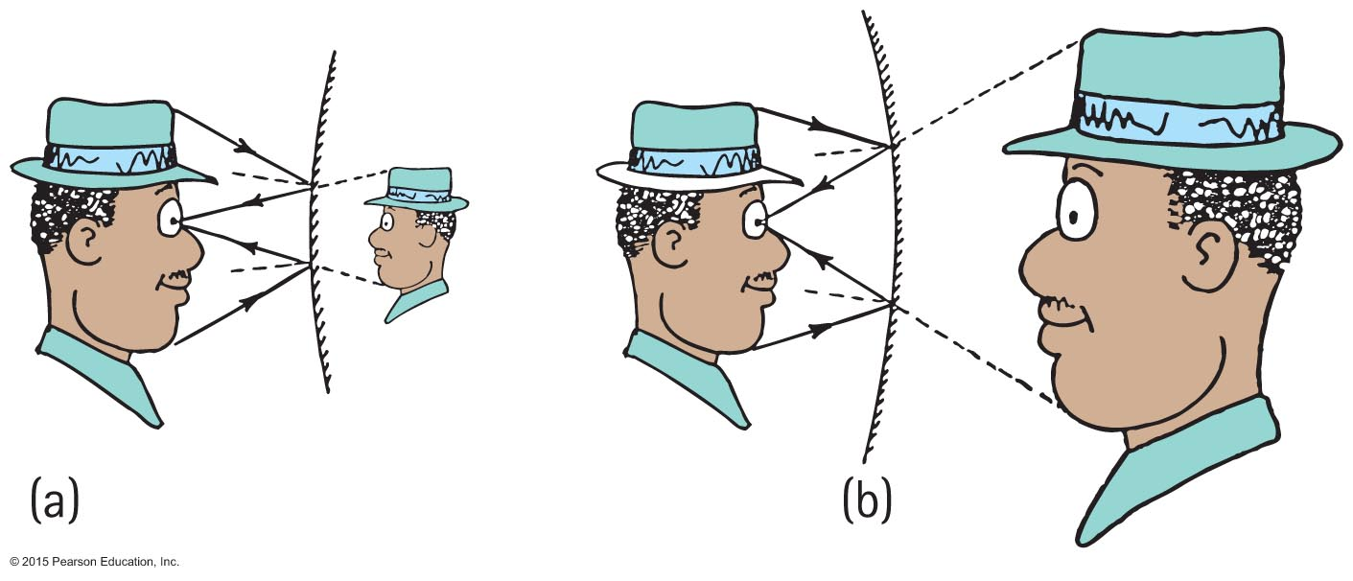
Law of Reflection
Shape of mirror forms a different virtual image.
Convex mirror (that curves outward): virtual image is smaller and closer to the mirror than the object.
Concave mirror (that curves inward): virtual image is larger and farther away than the object.

Slide 13
Law of Reflection CHECK YOUR NEIGHBOR
Light reflecting from a smooth surface undergoes a change in
frequency.
speed.
wavelength.
None of the above.
Notes:
D. None of the above.

Slide 14
Law of Reflection CHECK YOUR ANSWER
Light reflecting from a smooth surface undergoes a change in
frequency.
speed.
wavelength.
None of the above.
Notes:
D. None of the above.

Slide 15
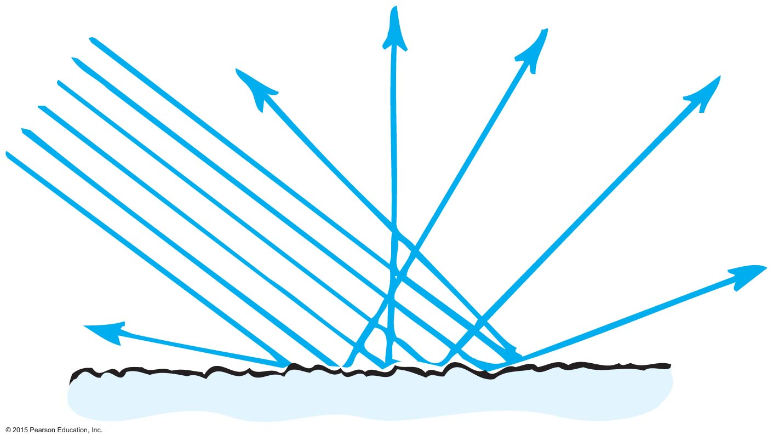
Law of Reflection
Diffuse reflection
When light strikes a rough or irregular surface and reflects in many directions
An undesirable circumstance is the ghost image that occurs on a TV set when TV signals bounce off buildings and other obstructions.

Slide 16
Law of Reflection
Different road surfaces determine amount of diffuse reflection
Rough road surface—because of diffuse reflection, see road ahead of car at night.
Wet road surface is smooth—because of less diffuse, reflection, difficult to see.

Slide 17
Law of Reflection CHECK YOUR NEIGHBOR
Diffuse reflection occurs when the sizes of surface irregularities are
small compared with the wavelength of reflected radiation.
large compared with the wavelength of reflected radiation.
Both A and B.
None of the above.
Notes:
B. large compared with the wavelength of reflected radiation.

Slide 18
Law of Reflection CHECK YOUR ANSWER
Diffuse reflection occurs when the sizes of surface irregularities are
small compared with the wavelength of reflected radiation.
large compared with the wavelength of reflected radiation.
Both A and B.
None of the above.
Explanation:
Diffuse reflection occurs for rougher surfaces.
Notes:
B. large compared with the wavelength of reflected radiation.

Slide 19
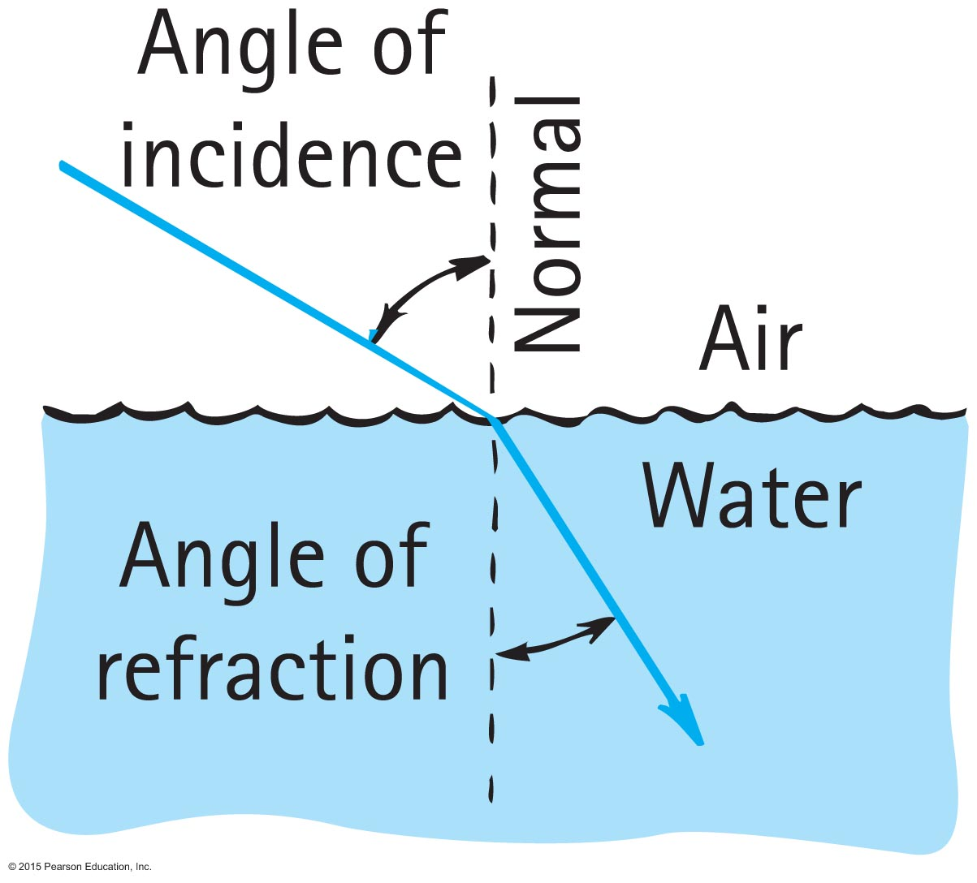
Refraction
When light bends in going obliquely from one medium to another, we call this process refraction.

Slide 20
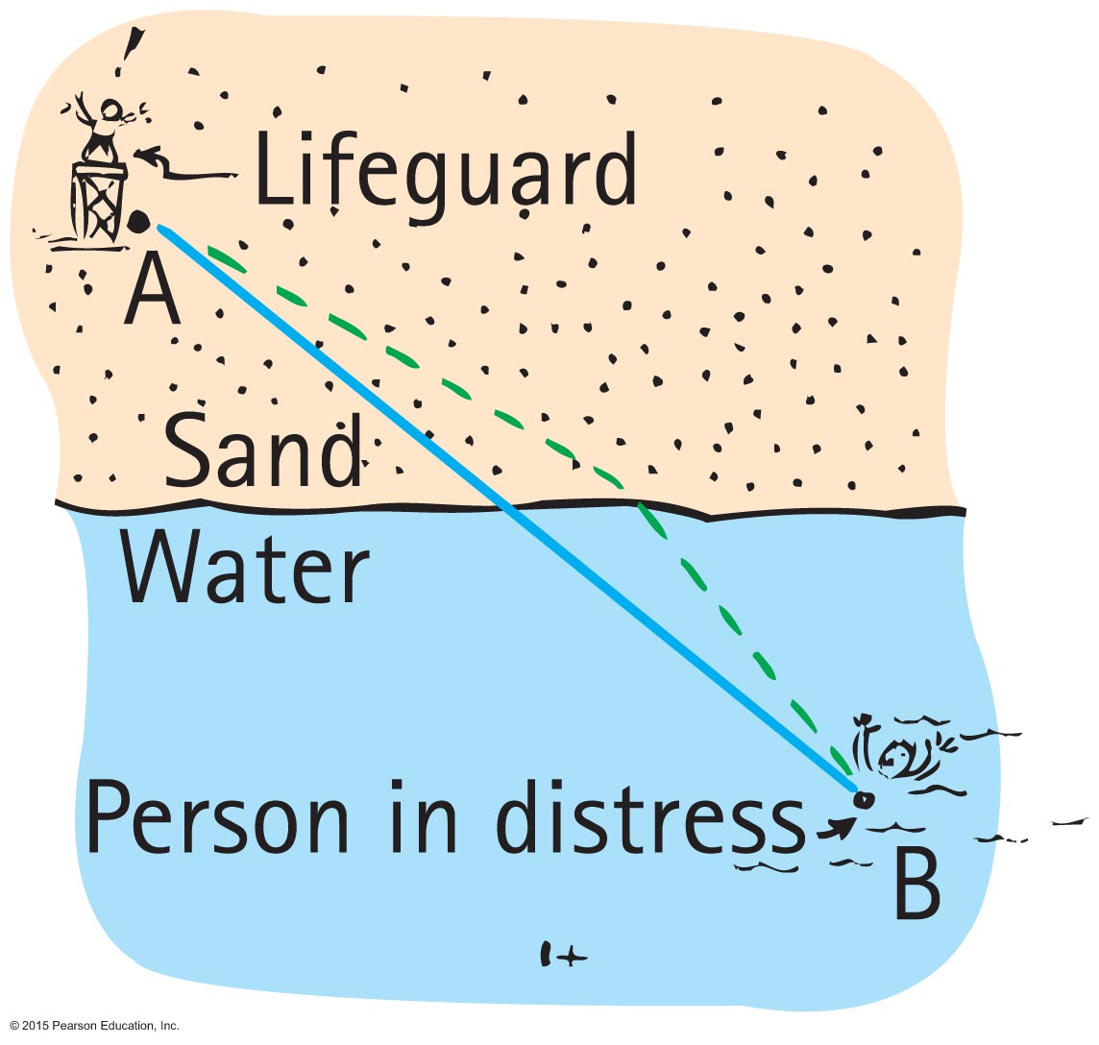
Refraction
Refraction occurs to minimize the time taken by light to travel from A to B.
Just as if you wanted to save someone from drowning, the quickest path would not be a straight line – it would be the dashed path shown.

Slide 21
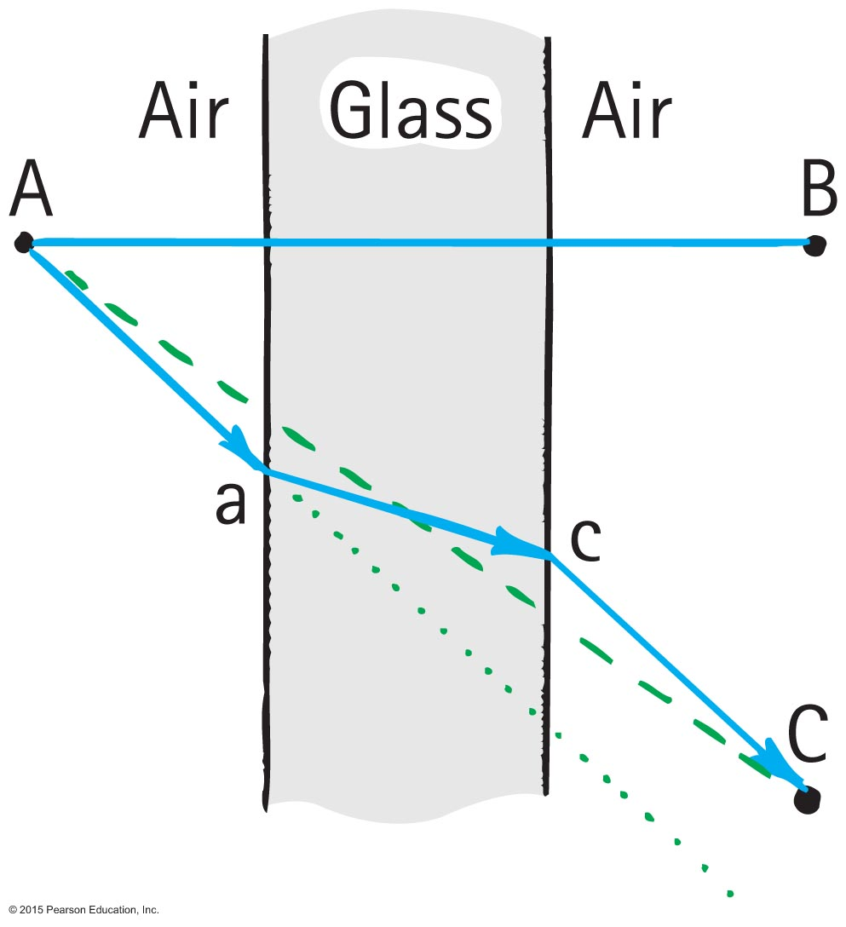
Refraction
Light follows a less inclined path in the glass.
Light travels slower in glass than in air, so it minimizes the time it spends in the glass.

Slide 22
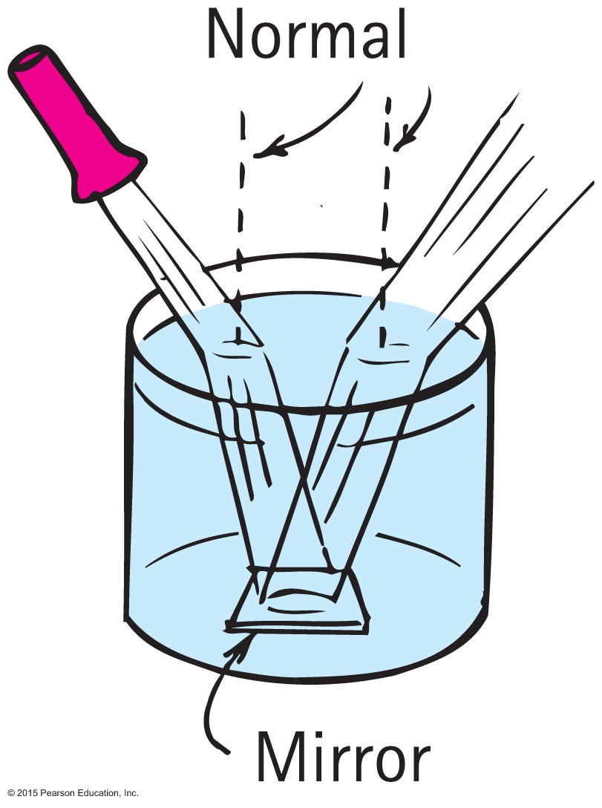
Refraction
Light rays pass from air into water and water into air.
Pathways are reversible for both reflection and refraction.

Slide 23
Refraction
Refractive index:
Index of refraction, n, of a material
indicates how much the speed of light differs from its speed in a vacuum.
indicates the extent of bending of rays.
ratio of speed of light in a vacuum to the speed in a material.

Slide 24
Refraction
Refractive index (continued):
In equation form:
Medium with a high index means high bending effect and greatest slowing of light.
speed of light in vacuum
n =
speed of light in material

Slide 25
Refraction CHECK YOUR NEIGHBOR
Refracted light that bends toward the normal is light that has
slowed down.
sped up.
nearly been absorbed.
diffracted.
Notes:
A. slowed down.

Slide 26
Refraction CHECK YOUR ANSWER
Refracted light that bends toward the normal is light that has
slowed down.
sped up.
nearly been absorbed.
diffracted.
Notes:
A. slowed down.

Slide 27
Refraction CHECK YOUR NEIGHBOR
Refracted light that bends away from the normal is light that has
slowed down.
sped up.
nearly been absorbed.
diffracted.
Notes:
B. sped up.

Slide 28
Refraction CHECK YOUR ANSWER
Refracted light that bends away from the normal is light that has
slowed down.
sped up.
nearly been absorbed.
diffracted.
Explanation:
This question is a consistency check with the question that asks about light bending toward the normal when slowing.
Notes:
B. sped up.

Slide 29
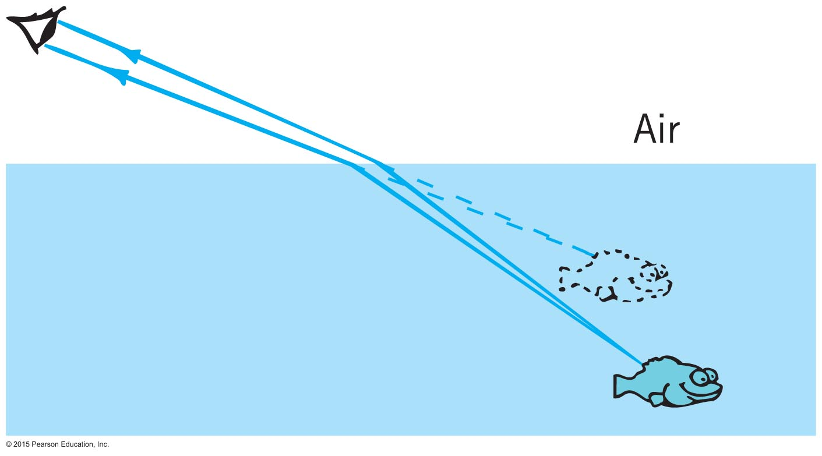
Refraction
Illusions caused by refraction
Objects submerged in water appear closer to the surface.

Slide 30
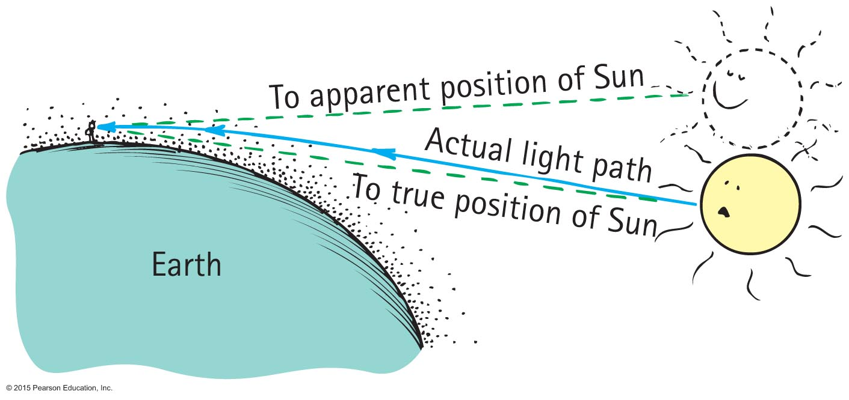
Refraction
Illusions caused by refraction (continued)
Objects such as the Sun seen through air are displaced because of atmospheric refraction.

Slide 31
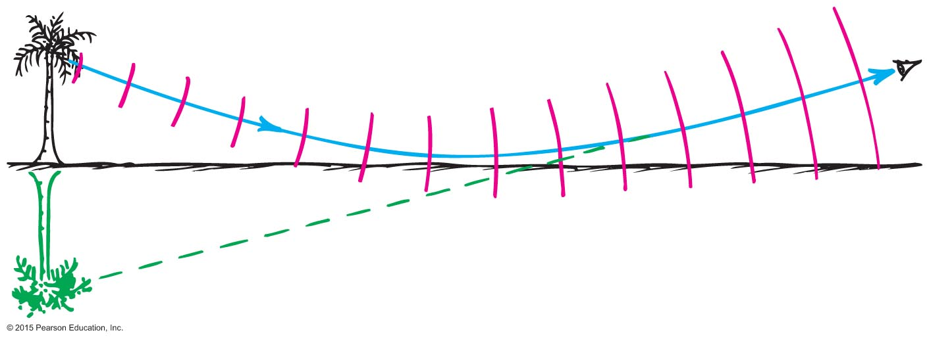
Refraction
Illusions caused by refraction (continued)
Atmospheric refraction is the cause of mirages.

Slide 32
Refraction CHECK YOUR NEIGHBOR
When light travels from one medium to another and changes speed in doing so, we call the process
reflection.
interference.
dispersion.
refraction.
Notes:
D. refraction.

Slide 33
Refraction CHECK YOUR ANSWER
When light travels from one medium to another and changes speed in doing so, we call the process
reflection.
interference.
dispersion.
refraction.
Notes:
D. refraction.

Slide 34
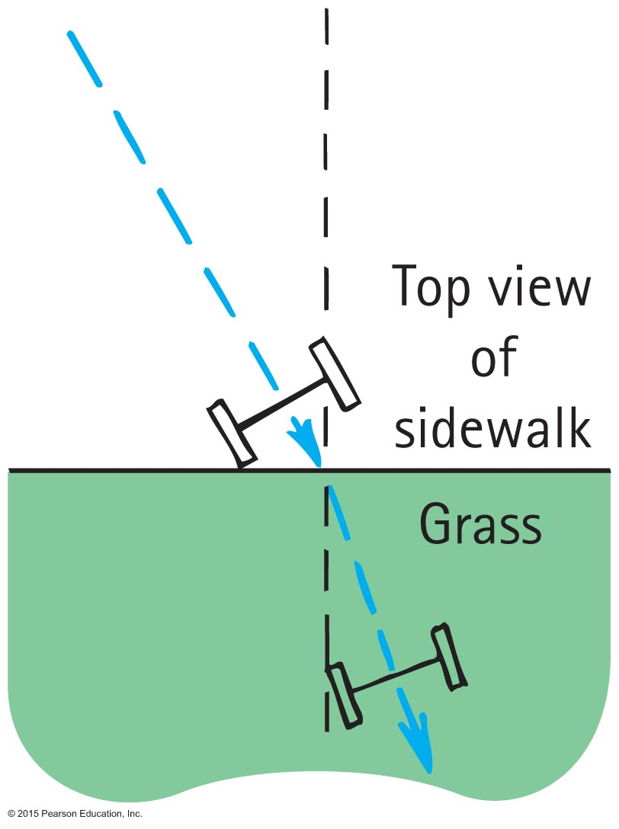
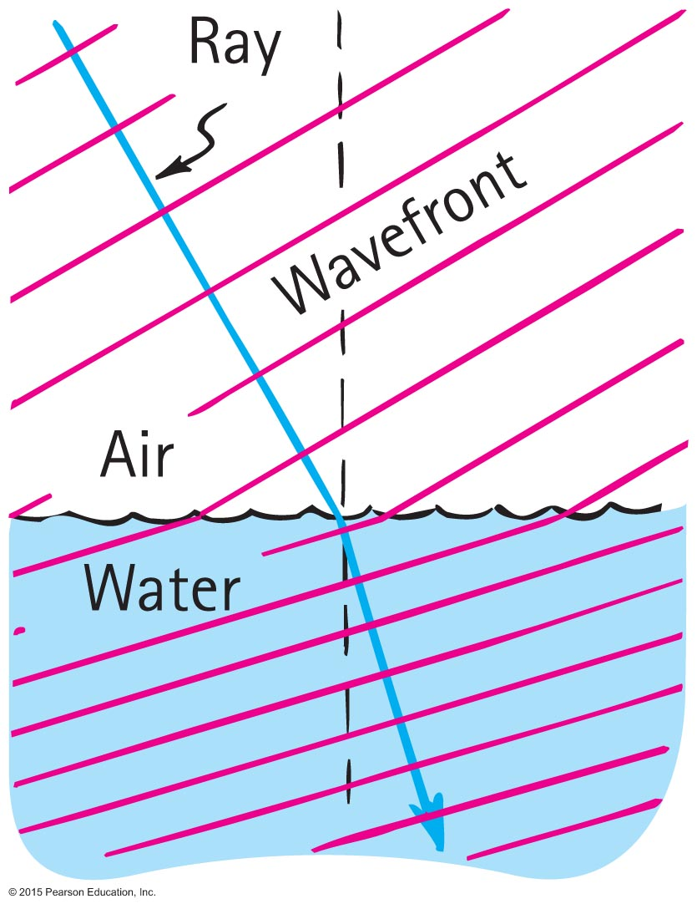
Cause of Refraction
Refraction
Bending of light when it passes from one medium to another
Caused by change in speed of light

Slide 35
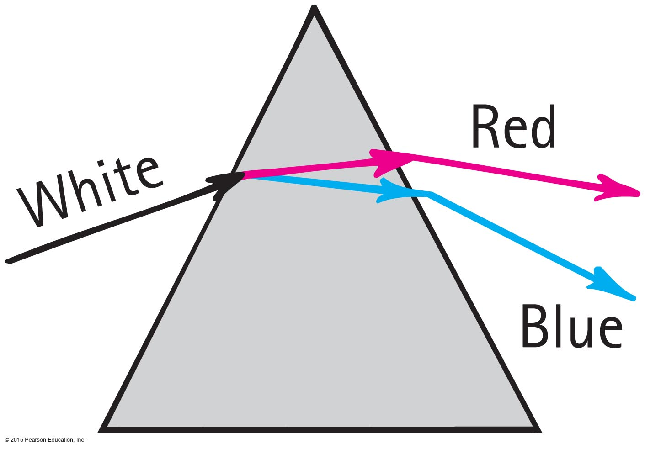
Dispersion
Dispersion
Process of separation of light into colors arranged by frequency
Components of white light are dispersed in a prism (and in a diffraction grating).

Slide 36
Dispersion CHECK YOUR NEIGHBOR
When white light passes through a prism, green light is bent more than
blue light.
violet light.
red light.
None of the above.
Notes:
C. red light.

Slide 37
Dispersion CHECK YOUR ANSWER
When white light passes through a prism, green light is bent more than
blue light.
violet light.
red light.
None of the above.
Notes:
C. red light.

Slide 38
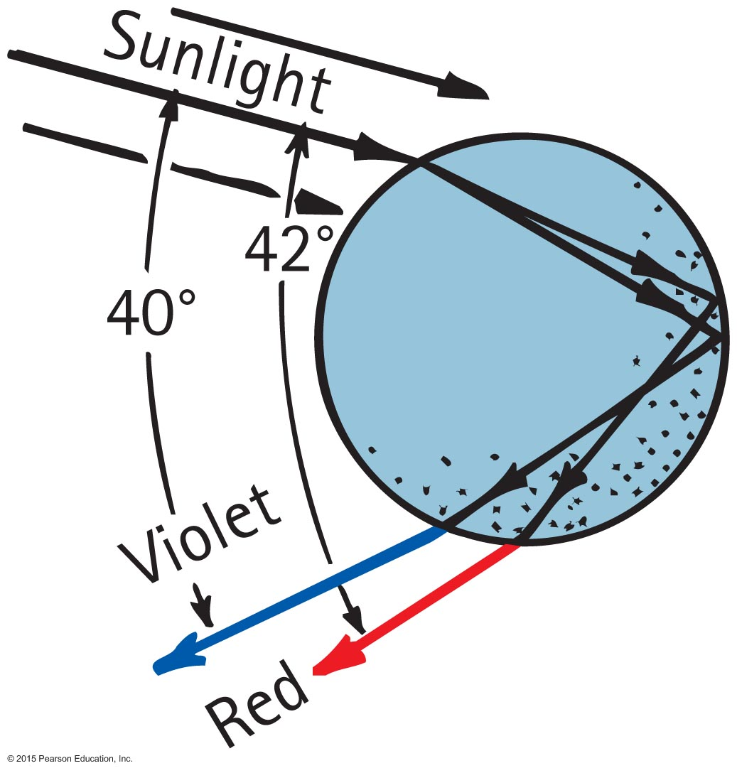
Rainbows
Rainbows are a result of dispersion by many drops.
Dispersion of light by a single drop

Slide 39
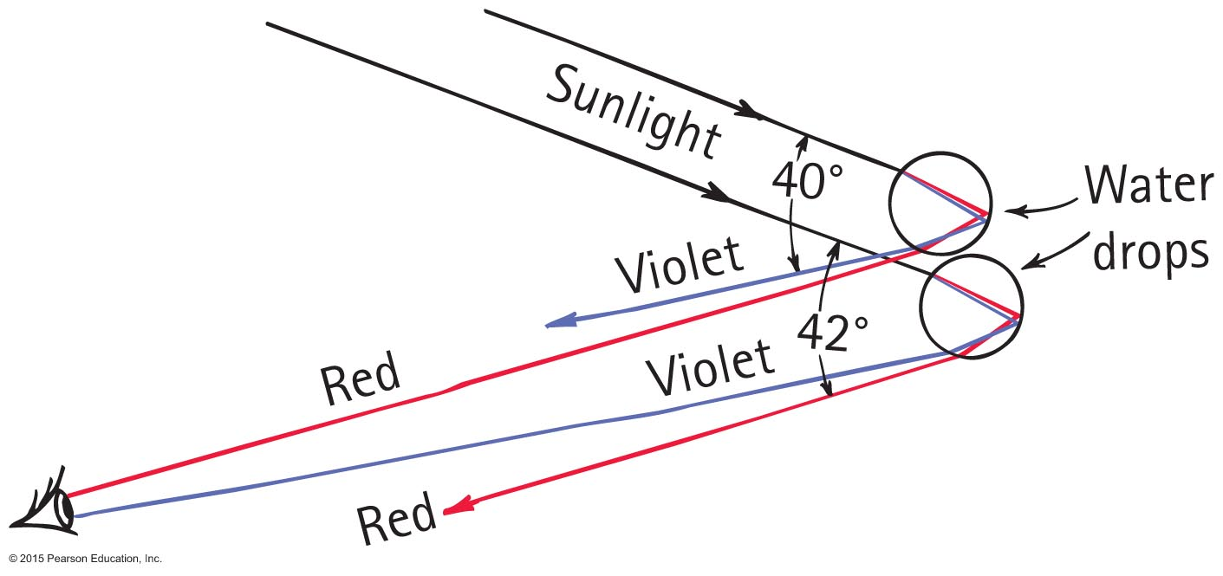
Rainbows
Sunlight incident on two sample raindrops, as shown, emerges from them as dispersed light.
The observer sees the red light from the upper drop and the violet light from the lower drop.
Millions of drops produce the whole spectrum of visible light.

Slide 40
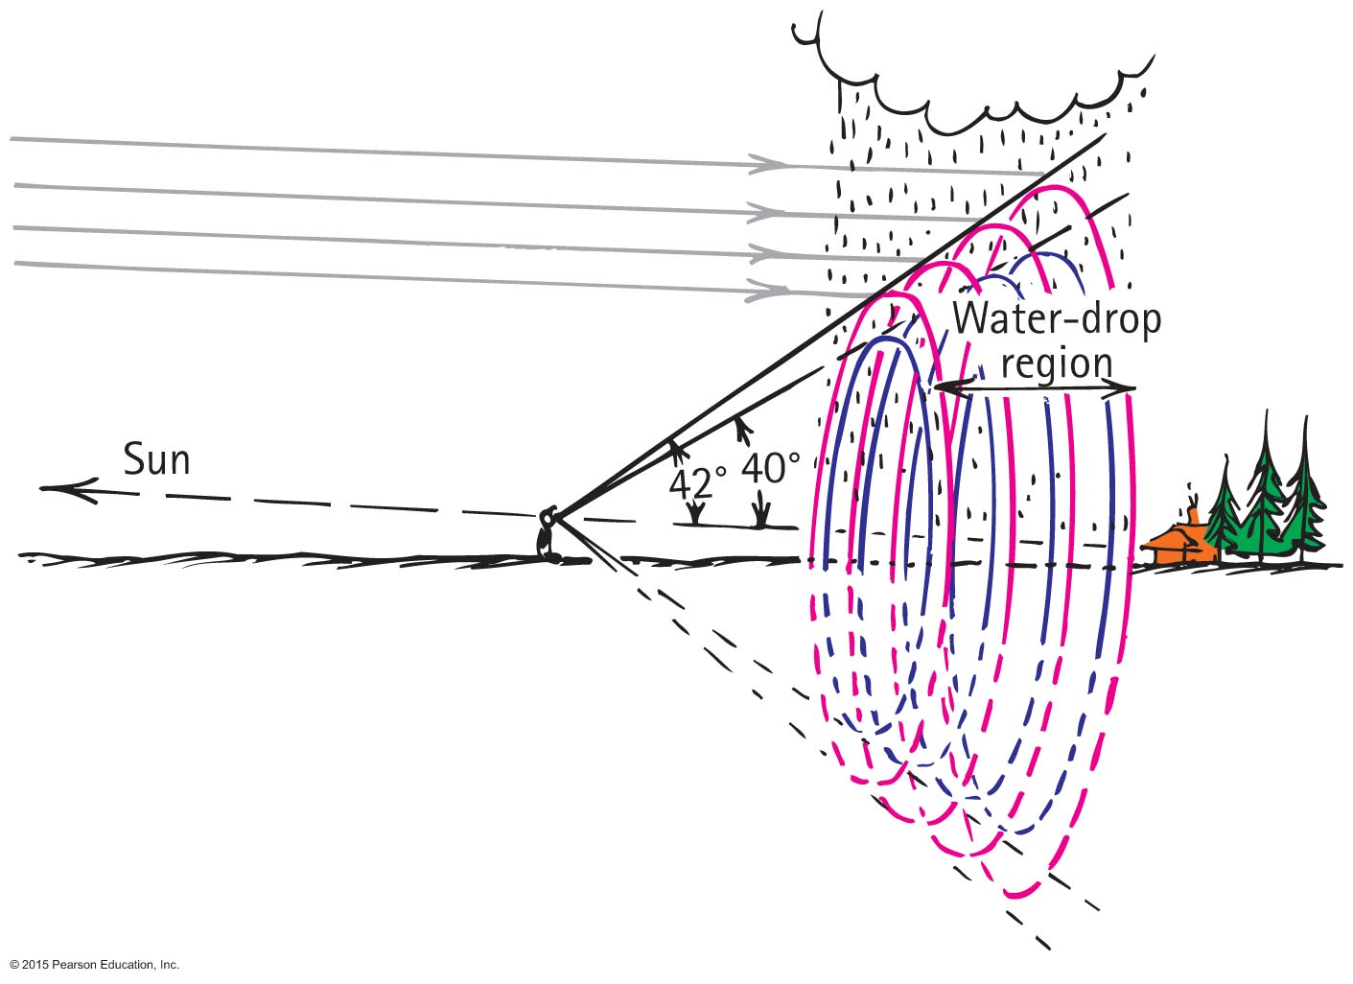
Rainbows
When your eye is located between the Sun (not shown off to the left) and a water drop region, the rainbow you see is the edge of a three-dimensional cone that extends through the water drop region.

Slide 41
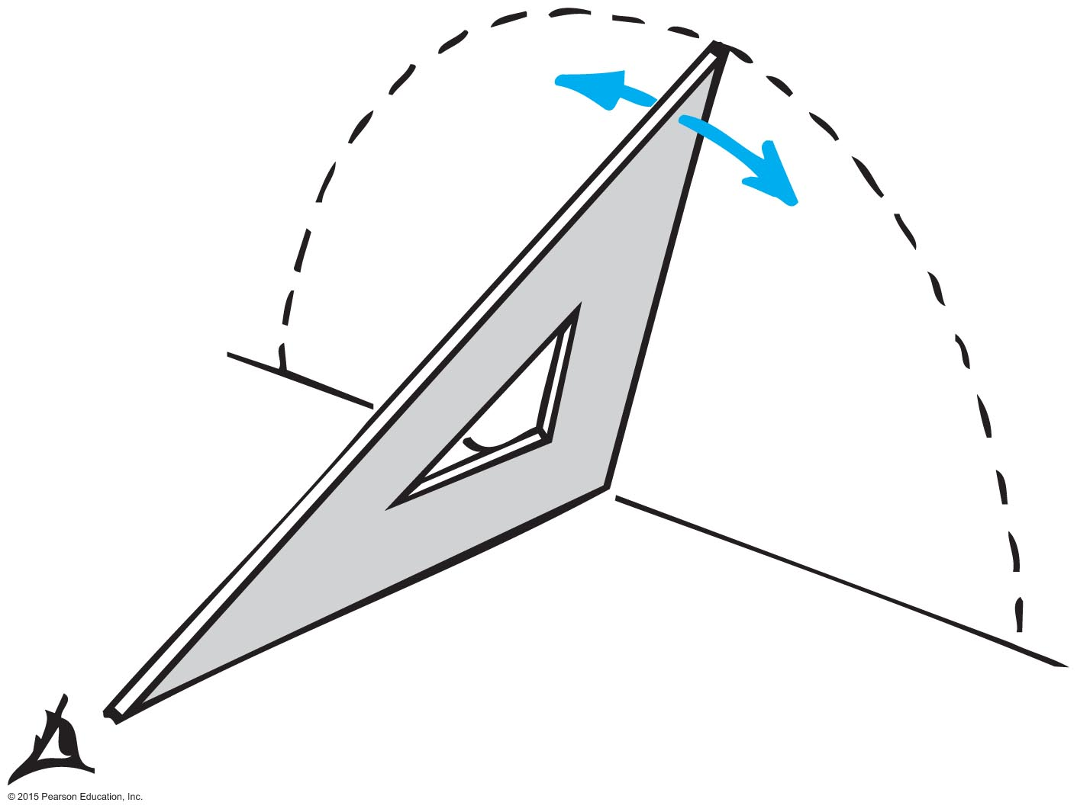
Rainbows
All the drops that disperse the rainbow's light toward you lie in the shape of a cone—a cone of different layers with drops that disperse red to your eye on the outside, orange beneath the red, yellow beneath the orange, and so on, all the way to violet on the inner conical surface.
The thicker the region containing water drops, the thicker the conical edge you look through, and the more vivid the rainbow.
Only raindrops along the dashed line disperse red light to the observer at an angle; hence, the light forms a bow.

Slide 42
Rainbows
Rainbow facts
An observer is in a position to see only a single color from any one droplet of water.
Your rainbow is slightly different from the rainbow seen by others.
Your rainbow moves with you.
Disk within the bow is brighter because of overlapping of multiple refractions (which don't occur outside the disk).

Slide 43
Rainbows
Rainbow facts (continued)
Secondary rainbow is fainter (due to two internal reflections and refracted light loss).
Secondary bow is reversed in color (due to the extra internal reflection).

Slide 44
Rainbows CHECK YOUR NEIGHBOR
Compared with the primary rainbow, the secondary bow
is dimmer.
has colors reversed.
is caused by two internal reflections.
All of the above.
Notes:
D. All of the above.

Slide 45
Rainbows CHECK YOUR ANSWER
Compared with the primary rainbow, the secondary bow
is dimmer.
has colors reversed.
is caused by two internal reflections.
All of the above.
Notes:
D. All of the above.

Slide 46
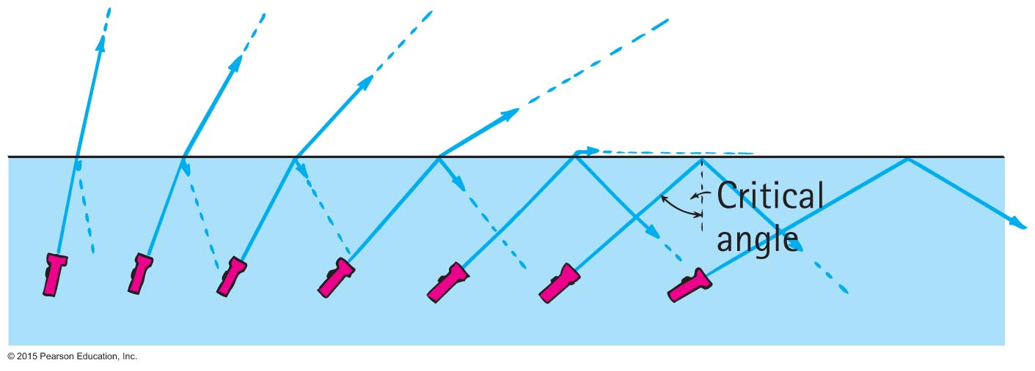
Total Internal Reflection
Total internal reflection
Total reflection of light traveling within a medium that strikes the boundary of another medium at an angle at, or greater than, the critical angle

Slide 47
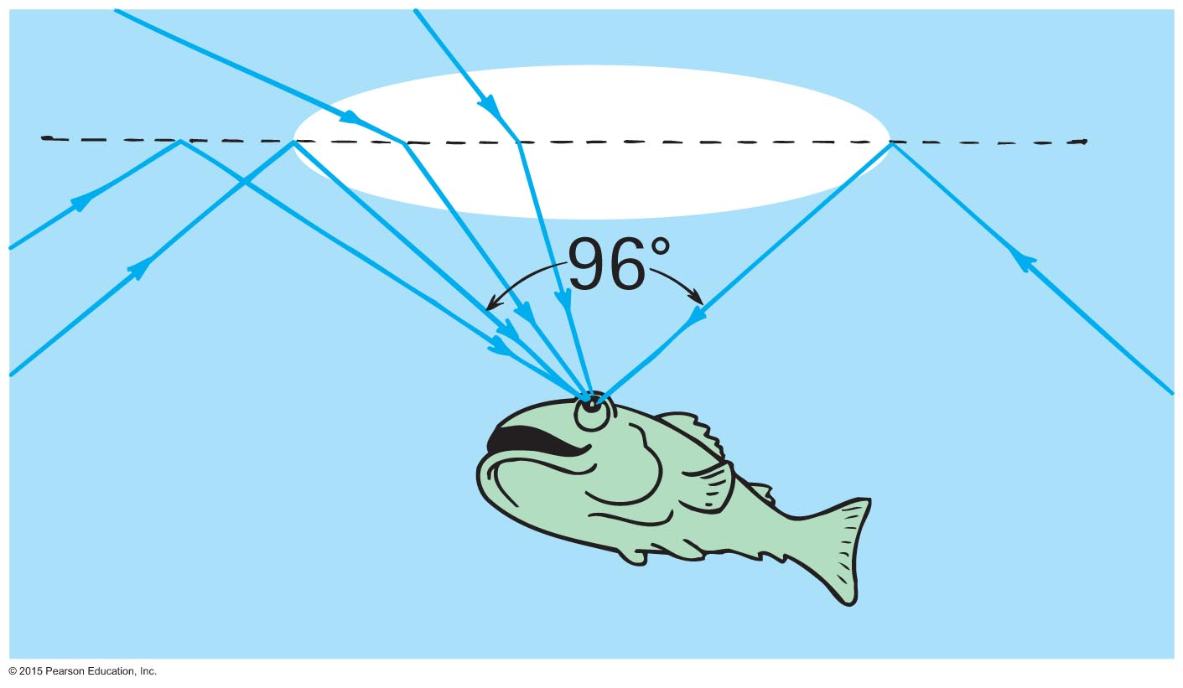
Total Internal Reflection
Critical angle
Minimum angle at which beam of light no longer emerges into the air above the surface; varies for different materials

Slide 48
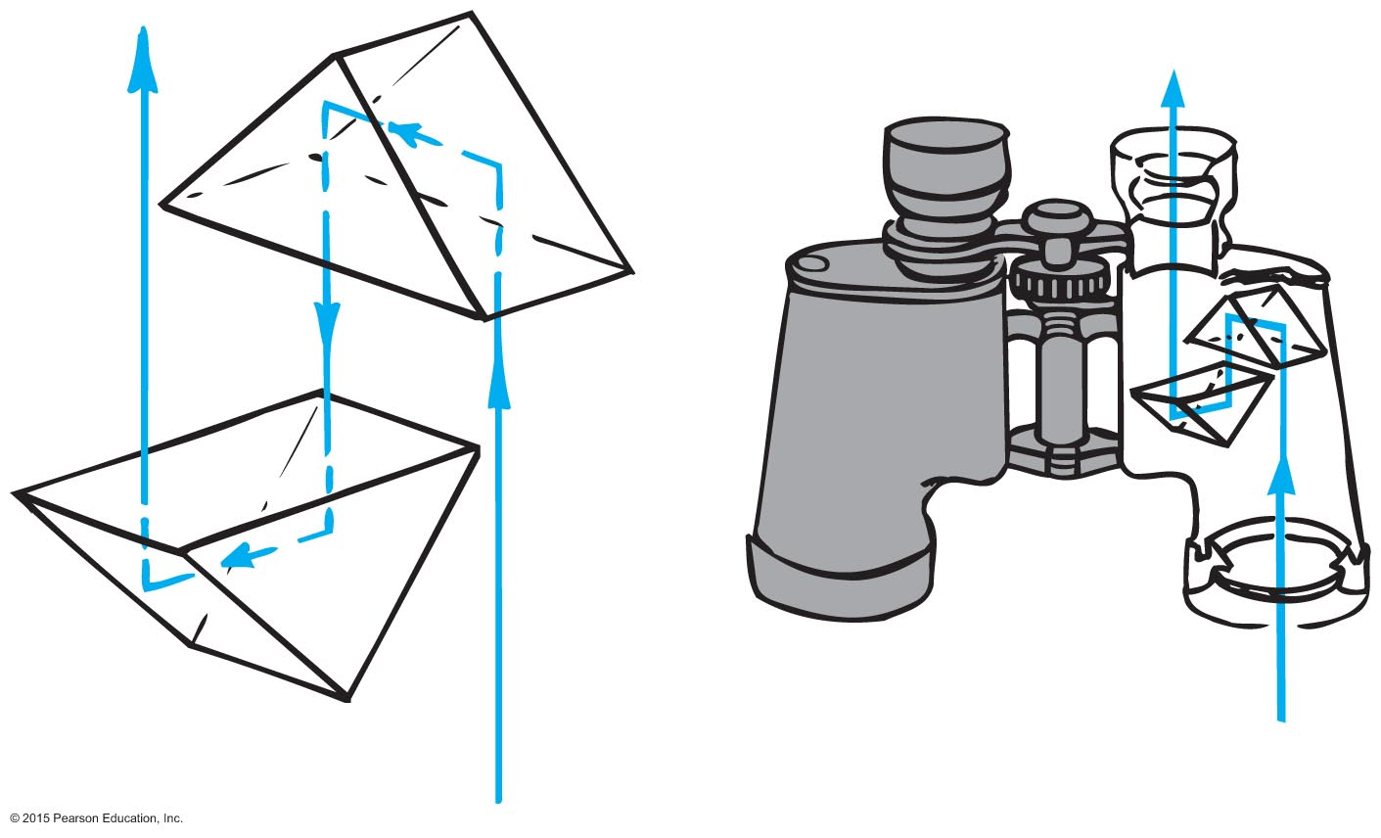
Total Internal Reflection
Advantages of glass prisms
Internally reflect 100%, which is the principal reason for use in many optical instruments
Lengthen the light path between lenses, thus eliminating the need for long barrels in binoculars
Reflection by prisms reinverts the image in binoculars

Slide 49
Total Internal Reflection
Optical fibers or light pipes
Thin, flexible rods of special glass or transparent plastic.
Light from one end of the fiber is total internally reflected to the other end, resulting in nearly the same brightness of light.

Slide 50
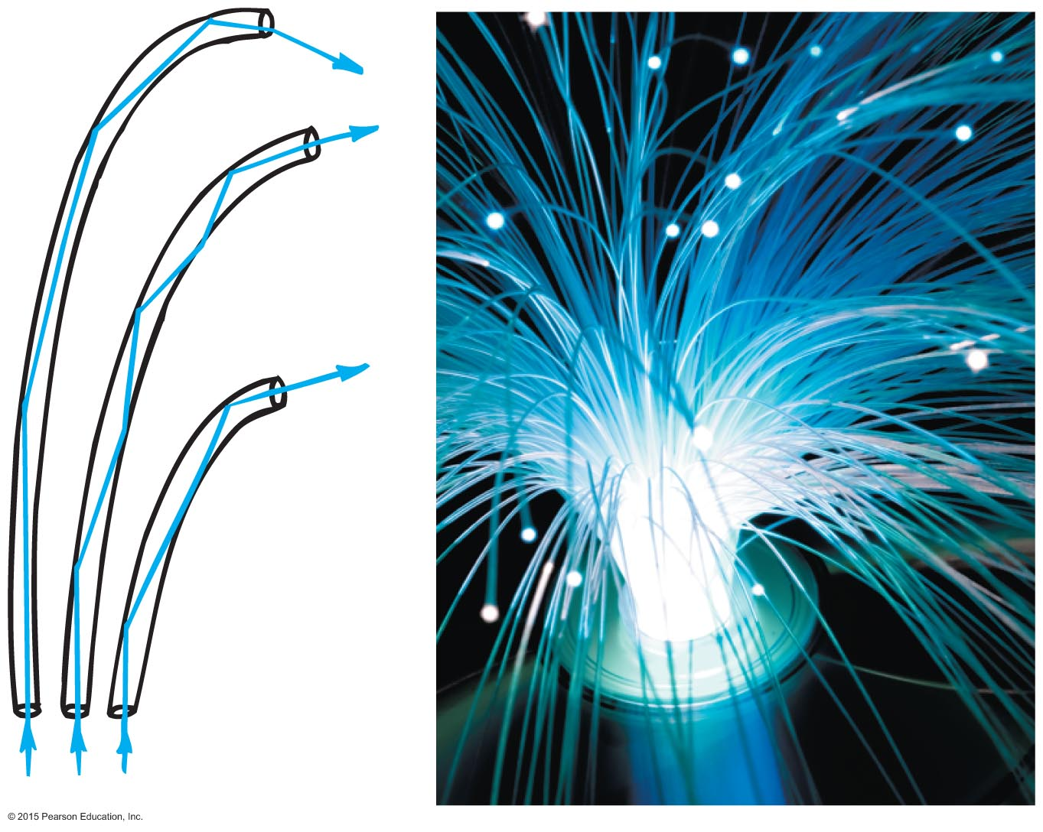
Total Internal Reflection
Optical fibers or light pipes (continued)
Used in
illuminating instrument displays
concentrating light in dental procedures
viewing of inaccessible regions of organs and other devices
communications

Slide 51
Lenses
Lenses
Two common types:
Converging (convex) lens
thicker at the center than edges
converges light
Diverging (concave) lens
thinner at the center than edges
diverges light

Slide 52
Lenses
Key features of lenses
Principal axis
line joining the centers of curvature of the two lens surfaces
Focal point
point at which all the light rays come together
Focal length
distance between the center of the lens and either focal point

Slide 53
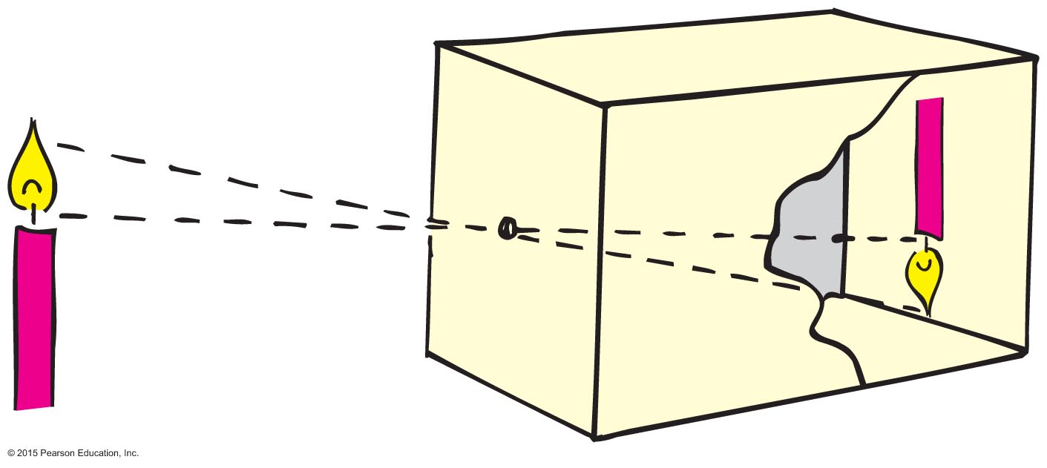
Lenses
Image formation is a consequence of light traveling in straight lines.
The first camera—the pinhole camera— illustrates this fact.

Slide 54
Lenses
Pinhole images are caused by small openings in the leaves above.

Slide 55
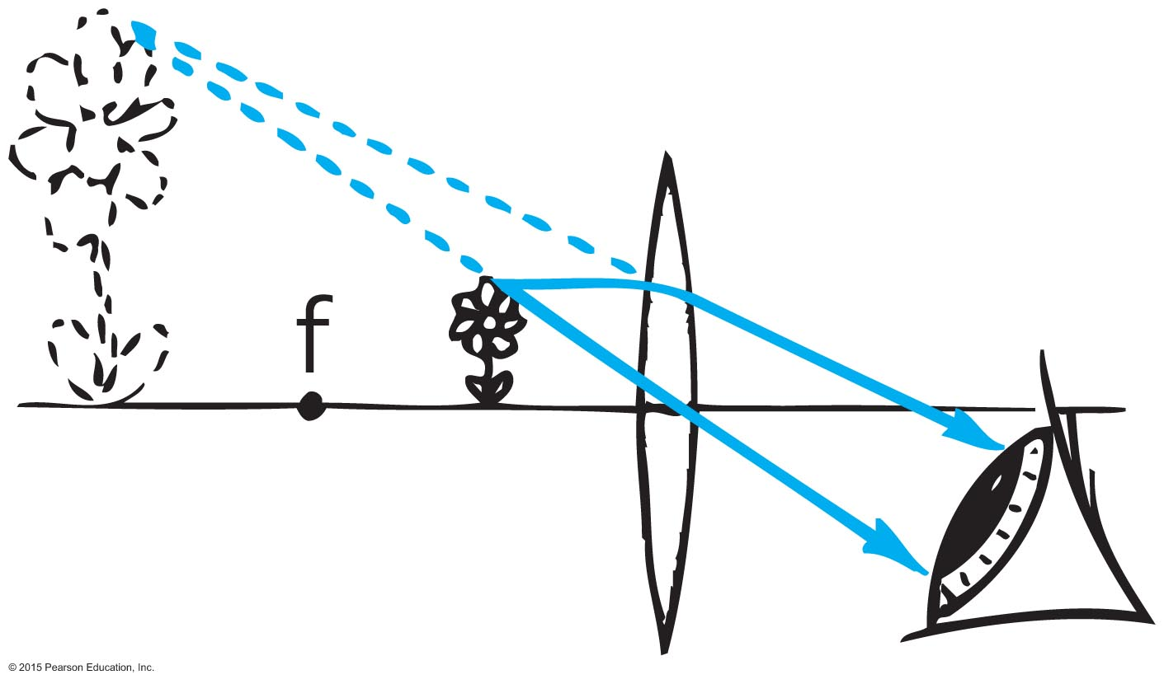
Lenses
A lens nicely bends the straight-line paths of light.

Slide 56
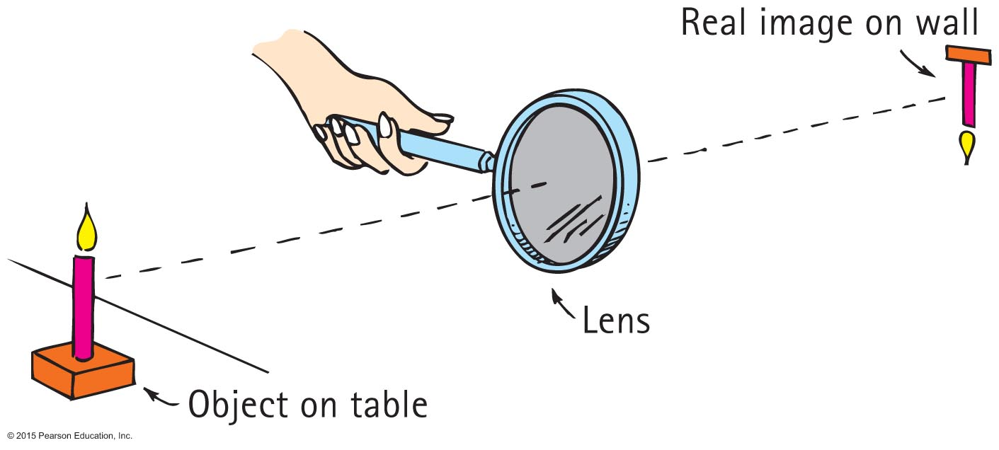
Lenses
A converging lens can project an image.

Slide 57
Lenses CHECK YOUR NEIGHBOR
The action of lenses depends mainly on
reflection.
refraction.
Both A and B.
Neither A nor B.
Notes:
B. refraction.

Slide 58
Lenses CHECK YOUR ANSWER
The action of lenses depends mainly on
reflection.
refraction.
Both A and B.
Neither A nor B.
Notes:
B. refraction.

Slide 59
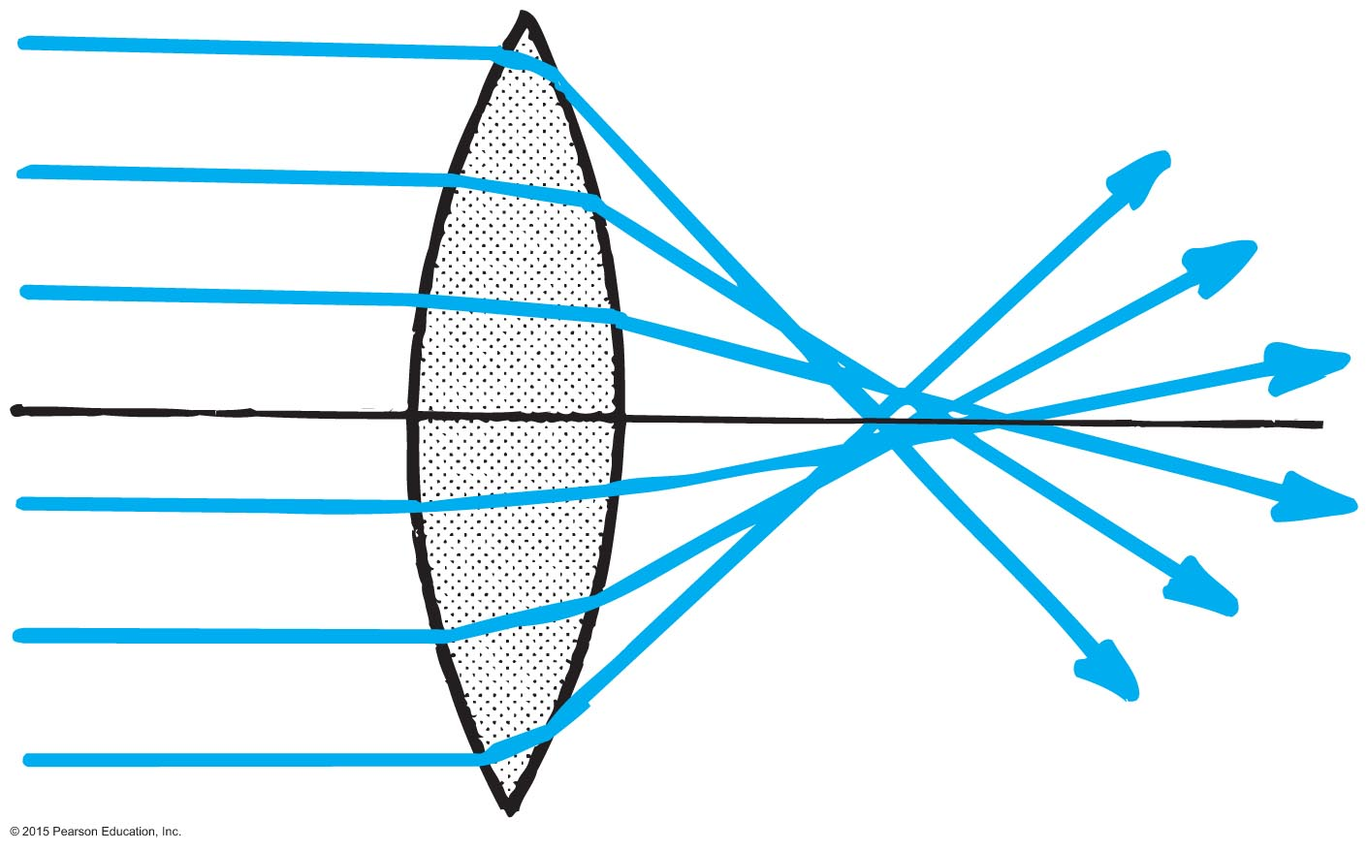
Lens Defects
Aberration
distortion in an image
types of aberrations
Spherical aberration
result of light passing through the edges of a lens and focusing at a slightly different place from where light passing through the center of the lens focuses

Slide 60
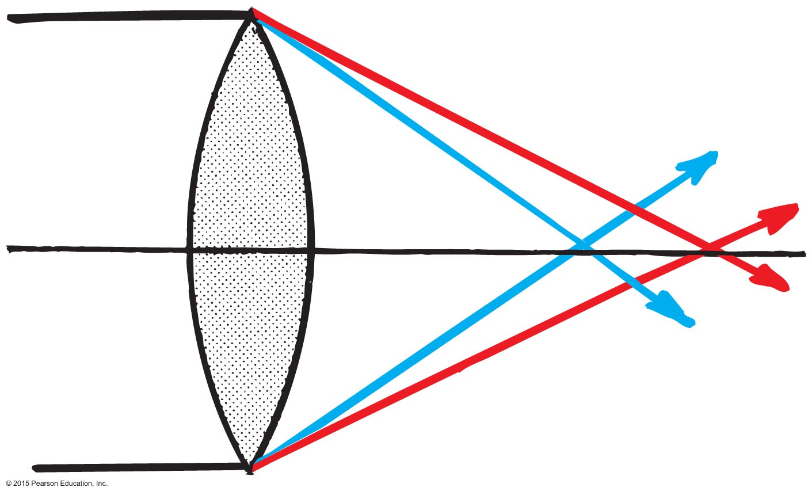
Lens Defects
Aberration (continued)
Chromatic aberration
result of various colors having different speeds and different refractions in the lens
Astigmatism
front surface of the eyeball is unequally curved

