Slide 1
Chapter 26: Properties of Light

Slide 2
This lecture will help you understand:
Electromagnetic Waves
The Electromagnetic Spectrum
Transparent Materials
Opaque Materials
Seeing Light—The Eye

Slide 3
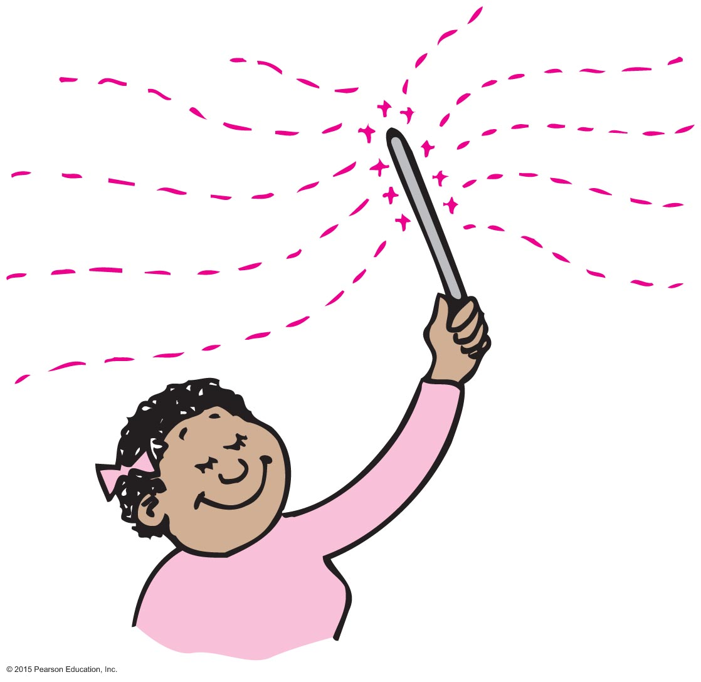
Electromagnetic Waves
Light is the only thing we can see.
Originates from the accelerated motion of electrons
Electromagnetic phenomenon

Slide 4
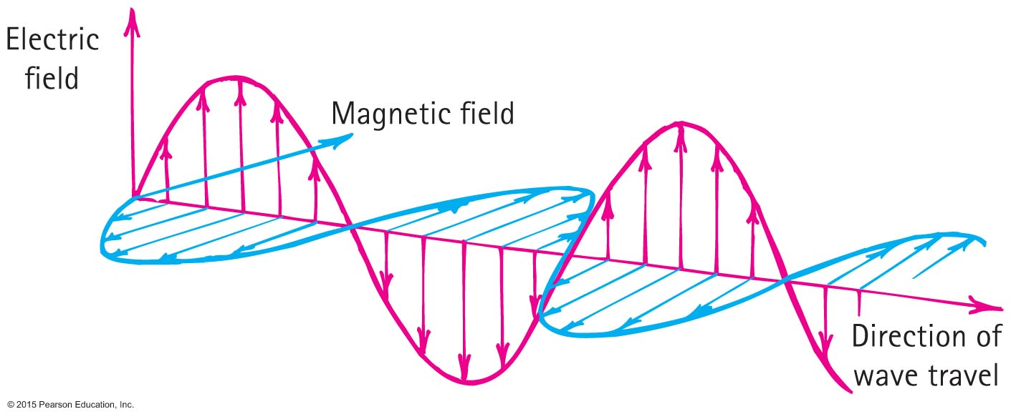
Electromagnetic Waves
Electromagnetic wave
Made up of vibrating electric and magnetic fields

Slide 5
Electromagnetic Waves CHECK YOUR NEIGHBOR
If an electron vibrates up and down 1000 times each second, it generates an electromagnetic wave with a
period of 1000 s.
speed of 1000 m/s.
wavelength of 1000 m.
None of the above.
Notes:
D. None of the above.

Slide 6
Electromagnetic Waves CHECK YOUR ANSWER
If an electron vibrates up and down 1000 times each second, it generates an electromagnetic wave with a
period of 1000 s.
speed of 1000 m/s.
wavelength of 1000 m.
None of the above.
Explanation:
The vibrating electron would emit a wave with a frequency of 1000 Hz, which is not in the list above.
Notes:
D. None of the above.

Slide 7
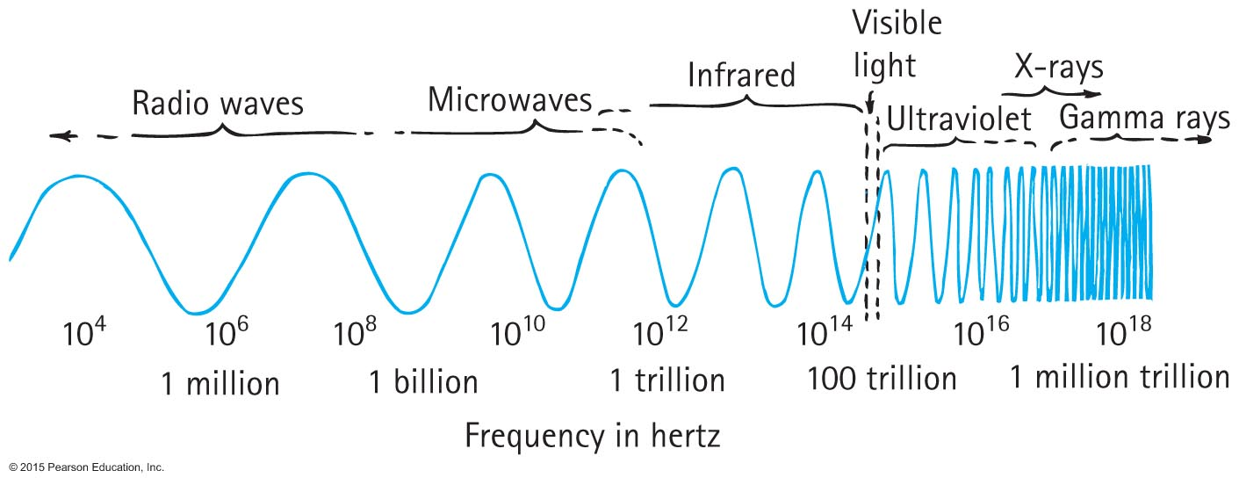
Electromagnetic Spectrum
Electromagnetic spectrum
Classification of electromagnetic waves according to frequency
Lowest frequency of light we can see appears red.
Highest frequency of light we can see appears violet.
Higher frequency of light is ultraviolet—more energetic and causes sunburns.
Beyond are X-ray and gamma ray.
No sharp boundary between regions

Slide 8
Electromagnetic Spectrum CHECK YOUR NEIGHBOR
The electromagnetic spectrum spans waves ranging from lowest to highest frequencies. The smallest portion of the electromagnetic spectrum is that of
radio waves.
microwaves.
visible light.
gamma rays.
Notes:
C. visible light.

Slide 9
Electromagnetic Spectrum CHECK YOUR ANSWER
The electromagnetic spectrum spans waves ranging from lowest to highest frequencies. The smallest portion of the electromagnetic spectrum is that of
radio waves.
microwaves.
visible light.
gamma rays.
Notes:
C. visible light.

Slide 10
Electromagnetic Spectrum CHECK YOUR NEIGHBOR
Which of these is fundamentally different from the others?
Sound waves
Light waves
Radio waves
X-rays
Notes:
A. Sound waves

Slide 11
Electromagnetic Spectrum CHECK YOUR ANSWER
Which of these is fundamentally different from the others?
Sound waves
Light waves
Radio waves
X-rays
Explanation:
All are electromagnetic waves except sound, which is a mechanical wave.
Notes:
A. Sound waves

Slide 12
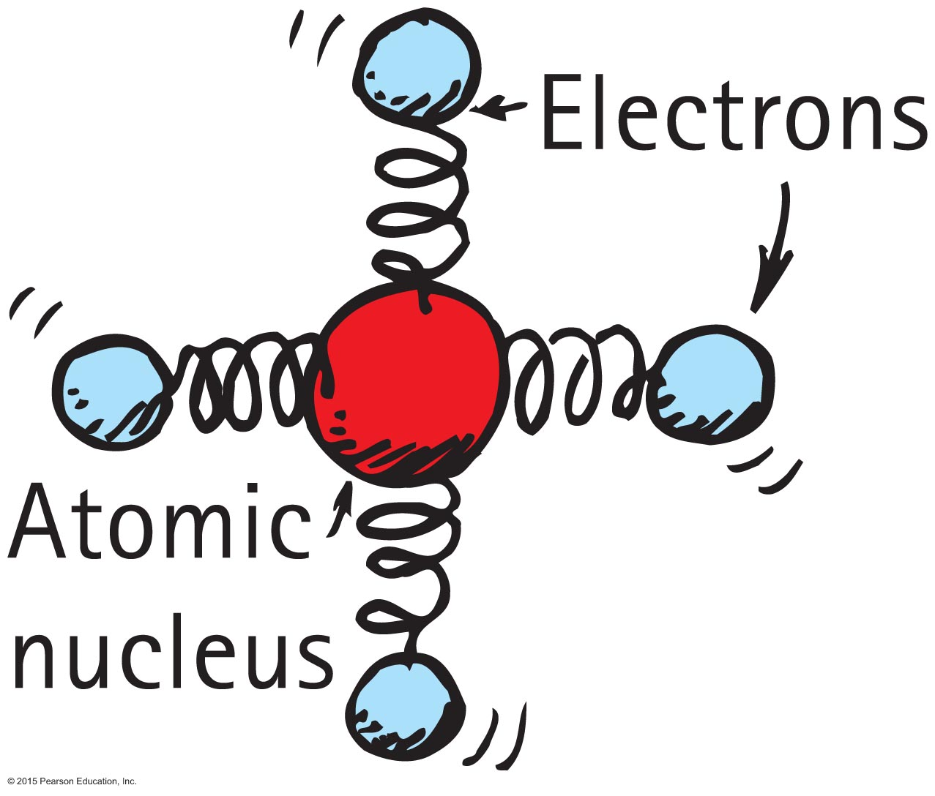
Transparent Materials
Light is transmitted similarly to sound.
Both are vibrations due to a vibrating source.

Slide 13
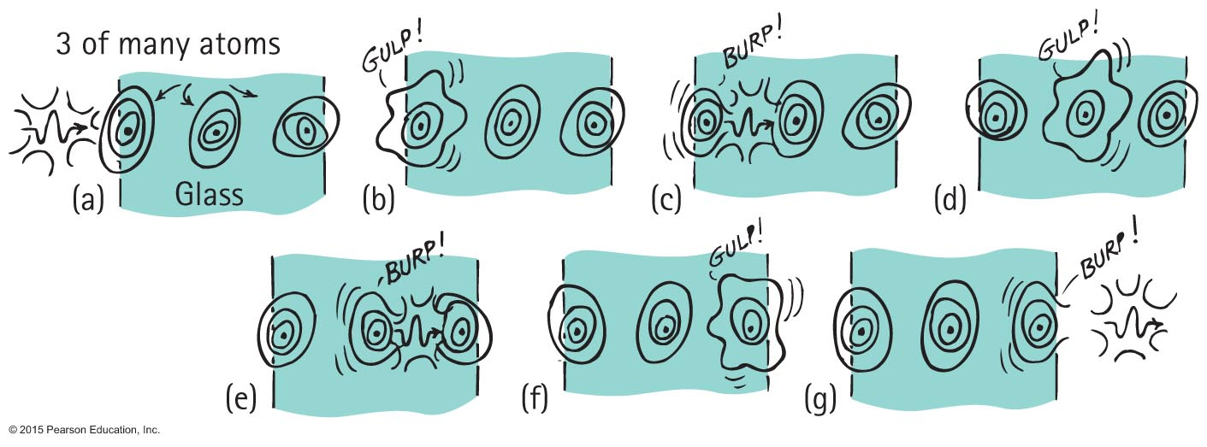
Transparent Materials
How light penetrates transparent material such as glass:

Slide 14
Transparent Materials
How light penetrates transparent material such as glass (continued)
Electrons or molecules in the glass are forced into vibration.
Energy is momentarily absorbed and vibrates the electrons in the glass.
This vibrating electron either emits a photon (a corpsucle of light) or transfers the energy as heat.
Time delay between absorption and re-emission of energy of vibrating electrons results in a lower average speed of light through a transparent material.

Slide 15
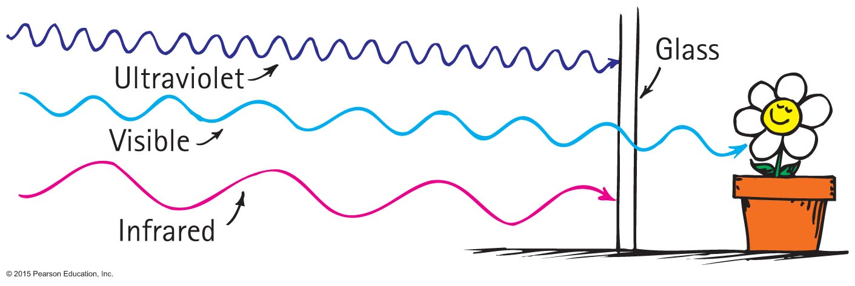
Transparent Materials
In glass, infrared waves, with frequencies lower than those of visible light, cause not only the electrons but entire atoms or molecules to vibrate, increasing the temperature of the structure.
So we see that glass is transparent to visible light, but not to ultraviolet and infrared light.

Slide 16
Transparent Materials
Average speed of light through different materials
vacuum—c (300,000,000 m/s)
atmosphere—slightly less than c (but rounded off to c)
water—0.75 c
glass—0.67 c, depending on material
diamond—0.41 c

Slide 17
Transparent Materials CHECK YOUR NEIGHBOR
Strictly speaking, the photons of light incident on glass are
also the ones that travel through and exit the other side.
not the ones that travel through and exit the other side.
absorbed and transformed to thermal energy.
diffracted.
Notes:
B. not the ones that travel through and exit the other side.

Slide 18
Transparent Materials CHECK YOUR ANSWER
Strictly speaking, the photons of light incident on glass are
also the ones that travel through and exit the other side.
not the ones that travel through and exit the other side.
absorbed and transformed to thermal energy.
diffracted.
Explanation:
Figure 26.8 illustrates this nicely. The light that exits the glass is not the same light that begins the process of absorption and re-emission.
Notes:
B. not the ones that travel through and exit the other side.

Slide 19
Transparent Materials CHECK YOUR NEIGHBOR
Compared with the frequency of illuminating light on a sheet of transparent plastic, the frequency of light that is transmitted
is slightly less.
is the same.
is slightly higher.
depends on the type of plastic.
Notes:
B. is the same.

Slide 20
Transparent Materials CHECK YOUR ANSWER
Compared with the frequency of illuminating light on a sheet of transparent plastic, the frequency of light that is transmitted
is slightly less.
is the same.
is slightly higher.
depends on the type of plastic.
Explanation:
Speed of light in plastic may vary, but the frequency transmitted doesn't.
Notes:
B. is the same.

Slide 21
Transparent Materials CHECK YOUR NEIGHBOR
The average speed of light is less in
air before entering glass.
glass.
air after emerging from glass.
None of the above.
Notes:
B. glass.

Slide 22
Transparent Materials CHECK YOUR ANSWER
The average speed of light is less in
air before entering glass.
glass.
air after emerging from glass.
None of the above.
Notes:
B. glass.

Slide 23
Opaque Materials
Most things around us are opaque—they absorb light without re-emitting it.
Books, desks, chairs, and people are opaque.
Vibrations given by light to their atoms and molecules are turned into random kinetic energy—into internal energy.
These materials become slightly warmer.

Slide 24
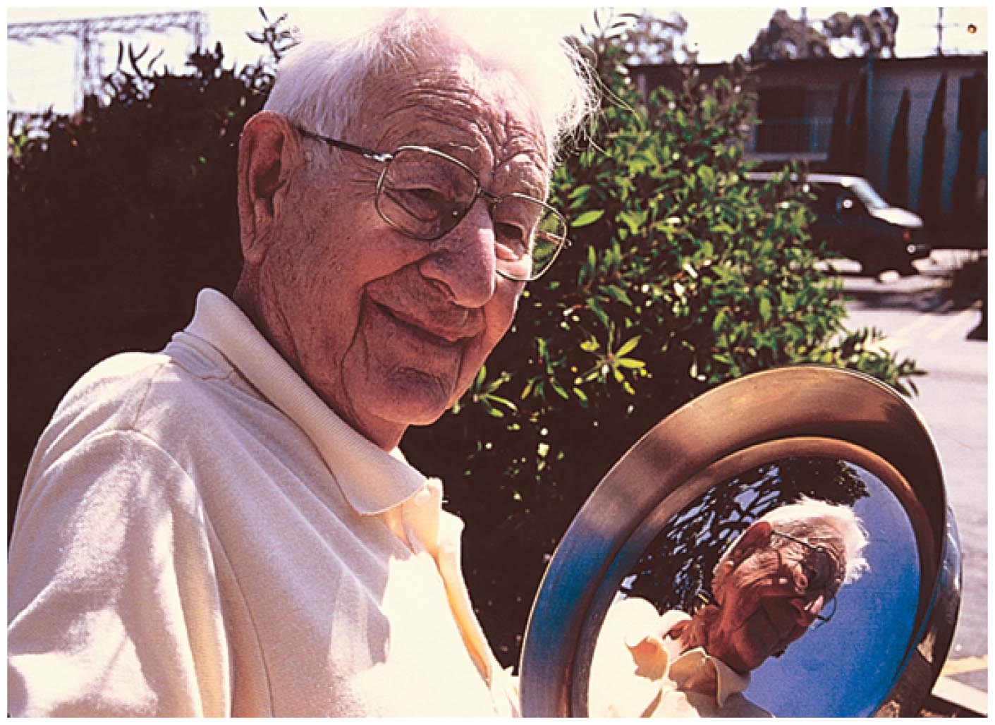
Opaque Materials
Metals
Light shining on metal forces free electrons in the metal into vibrations that emit their own light as reflection.

Slide 25
Opaque Materials
Light incident on
dry surfaces bounces directly to your eye.
wet surfaces bounces inside the transparent wet region, absorbing energy with each bounce, and reaches your eye darker than from a dry surface.

Slide 26
Opaque Materials
Shadows
A thin beam of light is often called a ray.
When we stand in the sunlight, some of the light is stopped while other rays continue in a straight-line path.
We cast a shadow—a region where light rays do not reach.

Slide 27
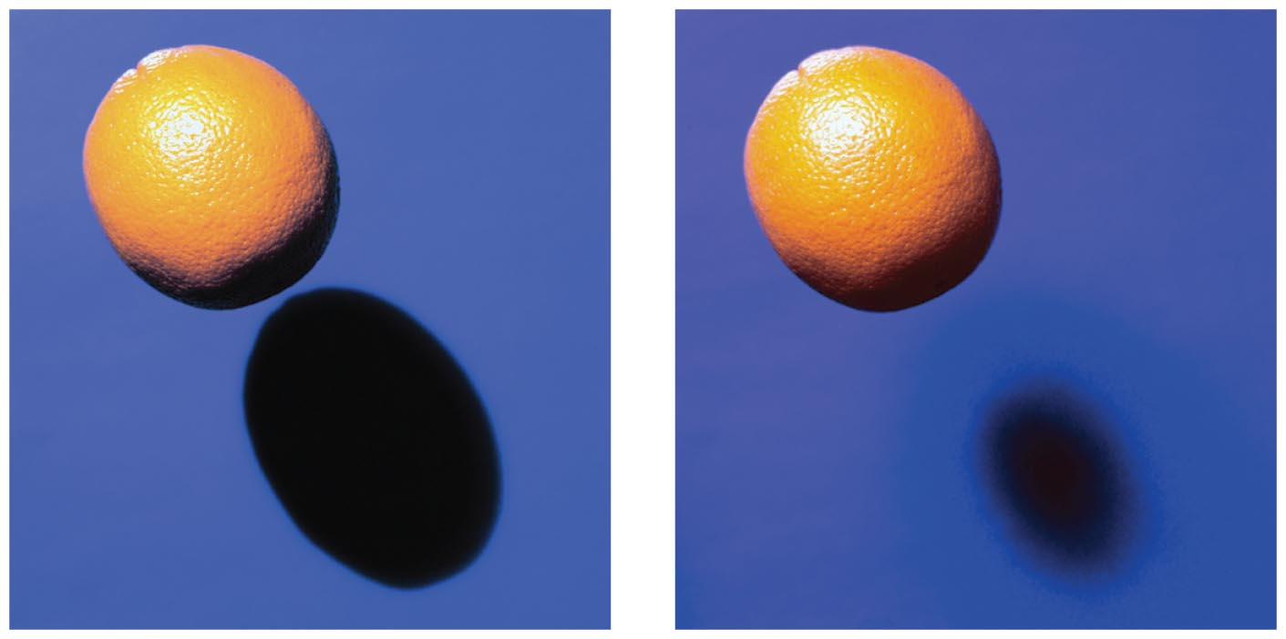
Opaque Materials
Either a large, far-away light source or a small, nearby light source will produce a sharp shadow.
A large, nearby light source produces a somewhat blurry shadow.

Slide 28
Opaque Materials
There is usually a dark part on the inside and a lighter part around the edges of a shadow.
A total shadow is called an umbra and
A partial shadow is called a penumbra.
A penumbra appears where some of the light is blocked but where other light fills it in.
A penumbra also occurs where light from a broad source is only partially blocked.

Slide 29
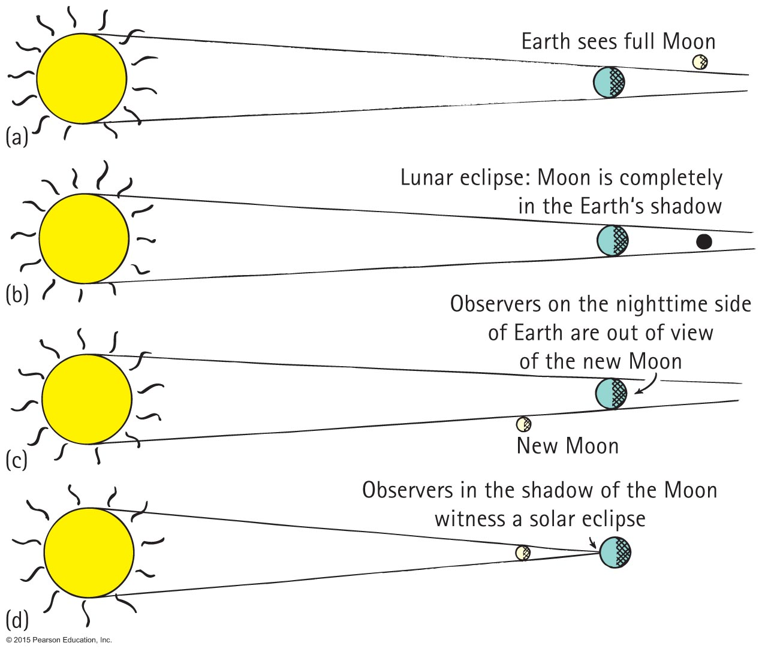
Opaque Materials
In a solar eclipse, because of the large size of the Sun, the rays taper to provide an umbra (total eclipse) and a surrounding penumbra (partial eclipse).
In a lunar eclipse, the Moon passes completely into the shadow of Earth.

Slide 30
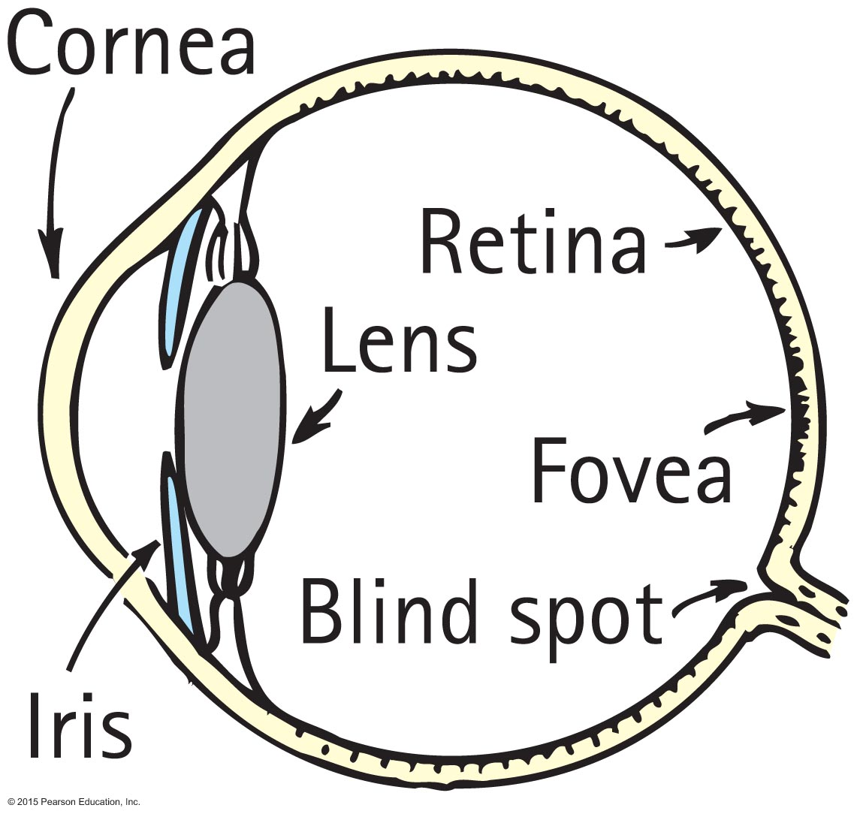
Seeing Light – The Eye
Light is the only thing we see with the most remarkable optical instrument known—the eye.
As light enters the eye, it moves through the transparent cover called the cornea, which does about 70% of the necessary bending of the light before it passes through an opening in the iris (colored part of the eye).

Slide 31
Seeing Light – The Eye
The opening is called the pupil.
The light then reaches the crystalline lens, which fine- tunes the focusing of light that passes through a gelatinous fluid called vitreous humor.
Light then passes to the retina, which covers the back two-thirds of the eye and is responsible for the wide field of vision that we experience.

Slide 32
Seeing Light – The Eye
For clear vision, light must focus directly on the retina.
The retina is not uniform.
In the middle is the macula, and a small depression.
in the center is the fovea, the region of most distinct vision.
Behind the retina is the optic nerve, which transmits signals from the photoreceptor cells to the brain.
There is also a spot in the retina where optic nerves are connected; this is the blind spot.

Slide 33
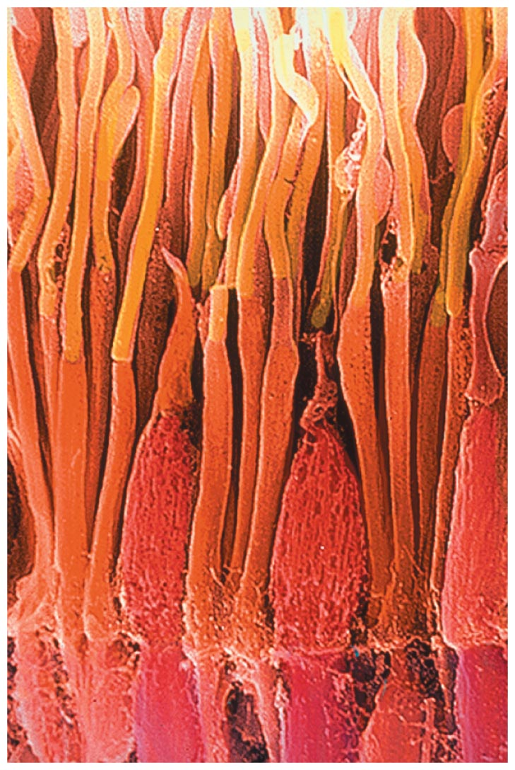
Seeing Light – The Eye
The retina is composed of tiny antennae that resonate to the incoming light.
Rods handle vision in low light.
They predominate toward the periphery of the retina.
Cones handle color vision and detail.
They are denser toward the fovea.
There are three types of cones, stimulated by low, intermediate and high frequencies of light.

Slide 34
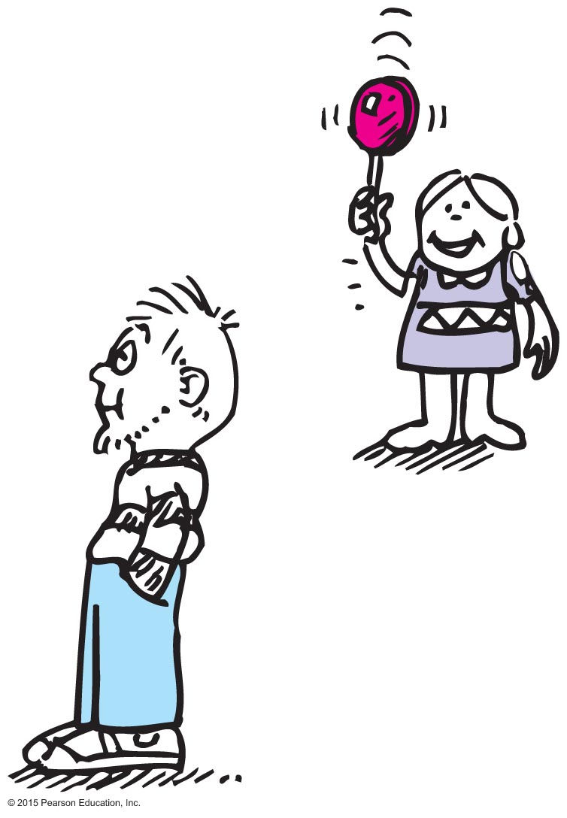
Seeing Light – The Eye
Although our vision is poor from the corner of our eye, we are sensitive to anything moving there.

Slide 35
Seeing Light – The Eye
The brightest light that the human eye can perceive without damage is some 500 million times brighter than the dimmest light that can be perceived.
Lateral inhibition: We don't perceive the actual differences in brightness. The brightest places in our visual field are prevented from outshining the rest.

Slide 36
Seeing Light – The Eye
The brightest light that the human eye can perceive without damage is some 500 million times brighter than the dimmest light that can be perceived.
Lateral inhibition: We don't perceive the actual differences in brightness. The brightest places in our visual field are prevented from outshining the rest.

Slide 37
Seeing Light – The Eye

Slide 38
Seeing Light – The Eye

Slide 39
Seeing Light – The Eye

Slide 40
Seeing Light – The Eye

Slide 41
Seeing Light – The Eye

Slide 42
Seeing Light – The Eye

