Slide 1
Chapter 25: Electromagnetic Induction

Slide 2
This lecture will help you understand:
Electromagnetic Induction
Faraday's Law
Generators and Alternating Current
Power Production
Self-Induction
Power Transmission
Field Induction

Slide 3
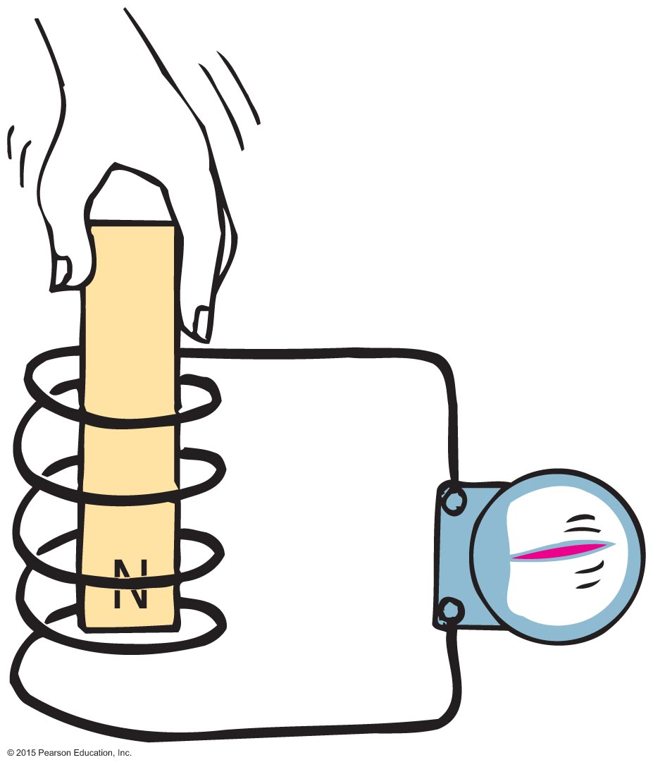
Electromagnetic Induction
Electromagnetic induction
Discovered by Faraday and Henry
Induces voltage by changing the magnetic field strength in a coil of wire

Slide 4
Electromagnetic Induction
Electromagnetic induction (continued)
Induced voltage can be increased by
increasing the number of loops of wire in a coil.
increasing the speed of the magnet entering and leaving the coil.
Slow motion produces hardly any voltage.
Rapid motion produces greater voltage.

Slide 5
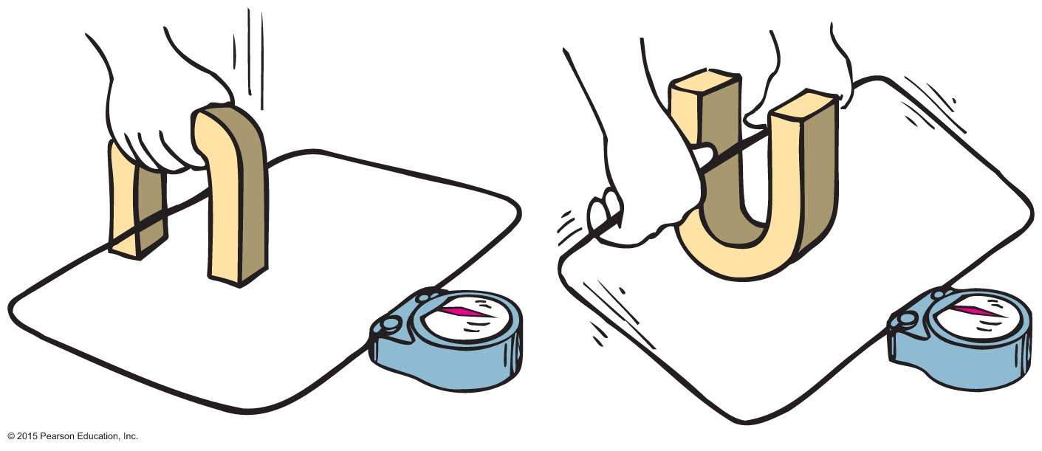
Electromagnetic Induction
Voltage is induced in the wire loop whether the magnetic field moves past the wire or the wire moves through the magnetic field.

Slide 6
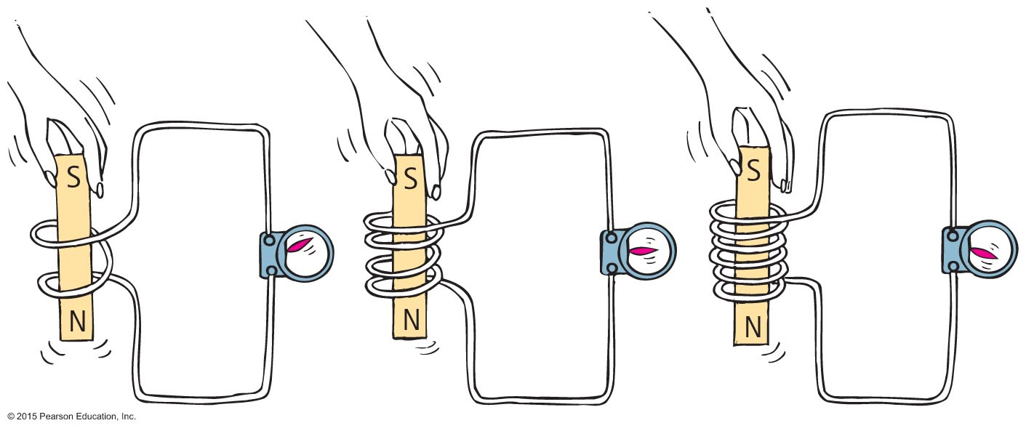
Electromagnetic Induction
When a magnet is plunged into a coil with twice as many loops as another, twice as much voltage is induced. If the magnet is plunged into a coil with 3 times as many loops, 3 times as much voltage is induced.

Slide 7
Faraday's Law
Faraday's law
States that the induced voltage in a coil is proportional to the number of loops, multiplied by the rate at which the magnetic field changes within those loops.
Amount of current produced by electromagnetic induction is dependent on
resistance of the coil,
circuit that it connects,
induced voltage.

Slide 8
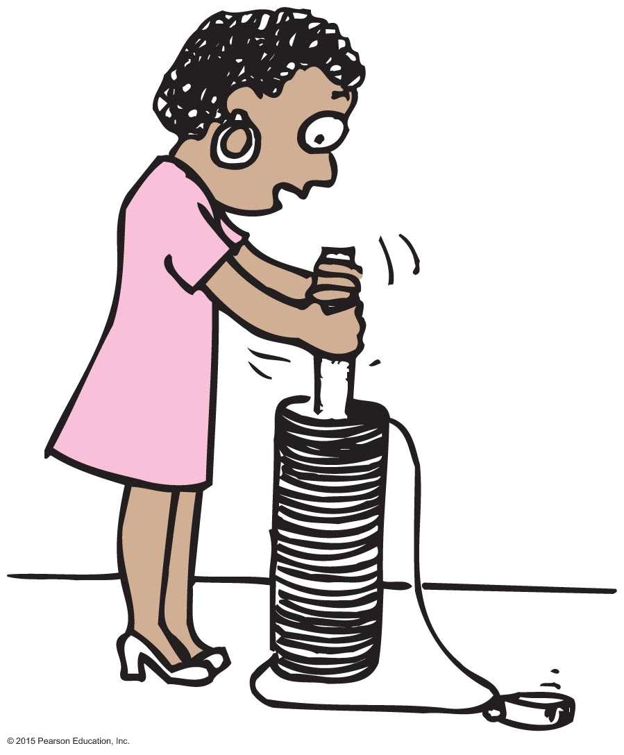
Faraday's Law
It is more difficult to push the magnet into a coil with many loops because the magnetic field of each current loop resists the motion of the magnet.

Slide 9
Faraday's Law CHECK YOUR NEIGHBOR
The resistance you feel when pushing a piece of iron into a coil involves
repulsion by the magnetic field you produce.
energy transfer between the iron and coil.
Newton's third law.
resistance to domain alignment in the iron.
Notes:
A. repulsion by the magnetic field you produce.

Slide 10
Faraday's Law CHECK YOUR ANSWER
The resistance you feel when pushing a piece of iron into a coil involves
repulsion by the magnetic field you produce.
energy transfer between the iron and coil.
Newton's third law.
resistance to domain alignment in the iron.
Notes:
A. repulsion by the magnetic field you produce.

Slide 11
Faraday's Law
Voltage induced in a wire requires changing magnetic field in the loop by
moving the loop near a magnet,
moving a magnet near a loop,
changing the current in a nearby loop.

Slide 12
Faraday's Law
Application of Faraday's law
Activation of traffic lights by a car moving over underground coils of wire
Triggering security system at the airport by altering magnetic field in the coils as one walks through
Scanning magnetic strips on back of credit cards
Recording of sound on tape
Electronic devices in computer hard drives, iPods

Slide 13
Faraday's Law CHECK YOUR NEIGHBOR
More voltage is induced when a magnet is thrust into a coil
more quickly.
more slowly.
Both A and B.
Neither A nor B.
Notes:
A. more quickly.

Slide 14
Faraday's Law CHECK YOUR ANSWER
More voltage is induced when a magnet is thrust into a coil
more quickly.
more slowly.
Both A and B.
Neither A nor B.
Notes:
A. more quickly.

Slide 15
Faraday's Law CHECK YOUR NEIGHBOR
Not only is voltage induced when a magnet is thrust into a coil of wire but ________ is also induced.
current
energy
power
None of the above.
Notes:
A. current

Slide 16
Faraday's Law CHECK YOUR ANSWER
Not only is voltage induced when a magnet is thrust into a coil of wire but ________ is also induced.
current
energy
power
None of the above.
Comment:
Don't say energy or power, which are conservation-of-energy no-no's! Energy can be transferred but not created by induction.
Notes:
A. current

Slide 17
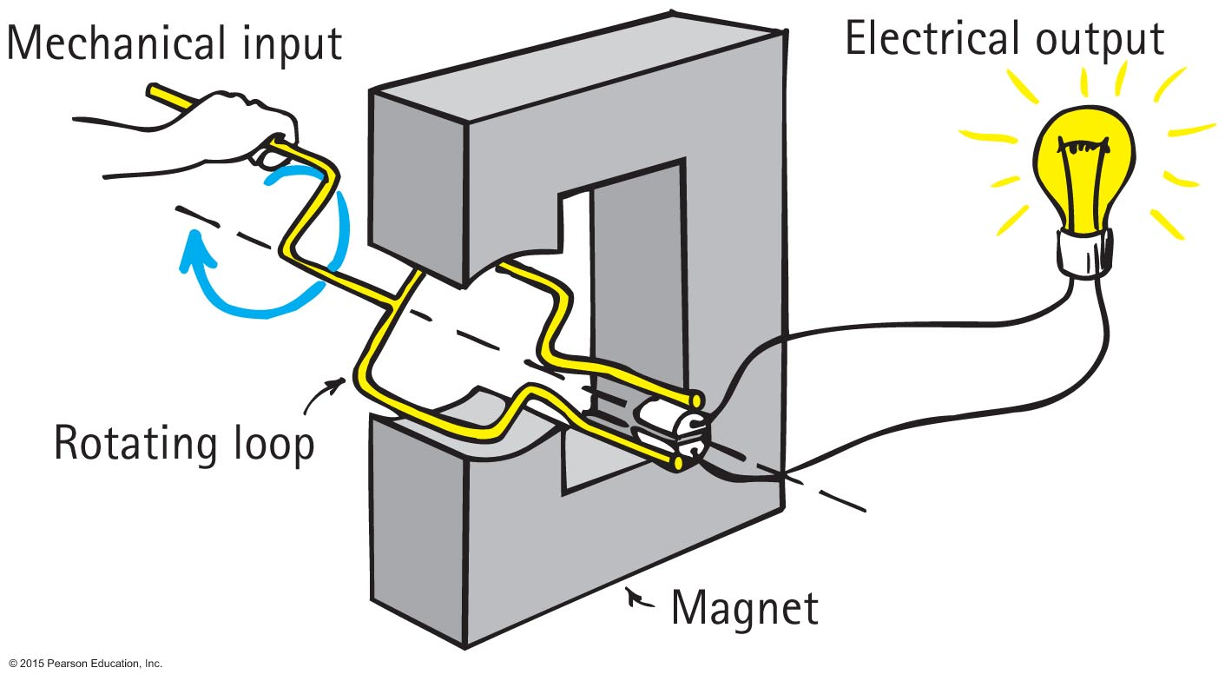
Generators and Alternating Current
Generator
Opposite of a motor
Converts mechanical energy into electrical energy via coil motion
Produces alternating voltage and current

Slide 18
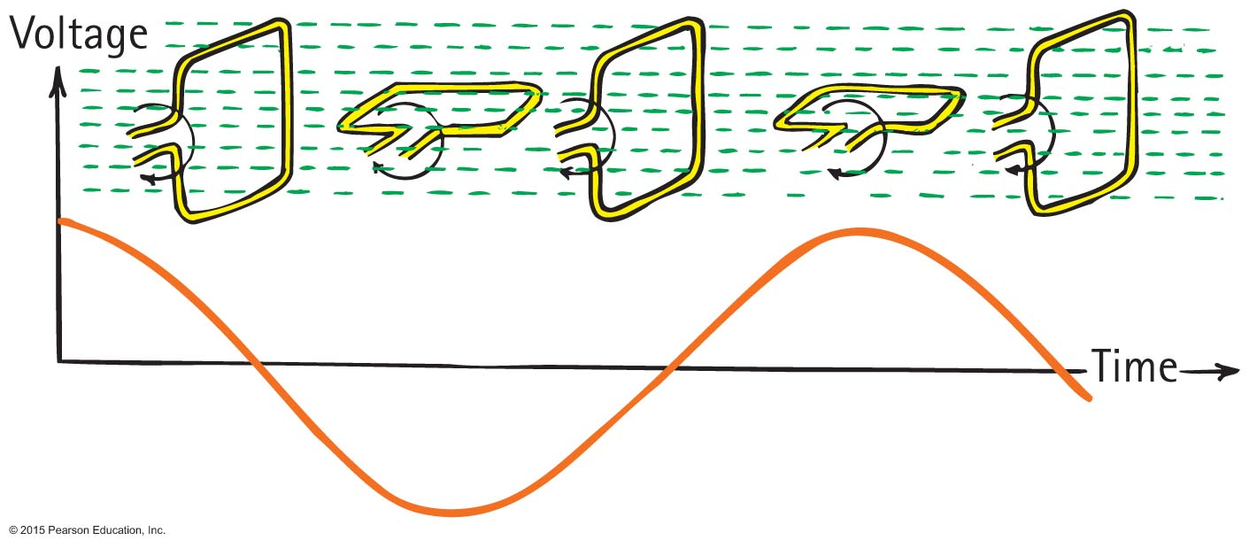
Generators and Alternating Current
The frequency of alternating voltage induced in a loop is equal to the frequency of the changing magnetic field within the loop.

Slide 19
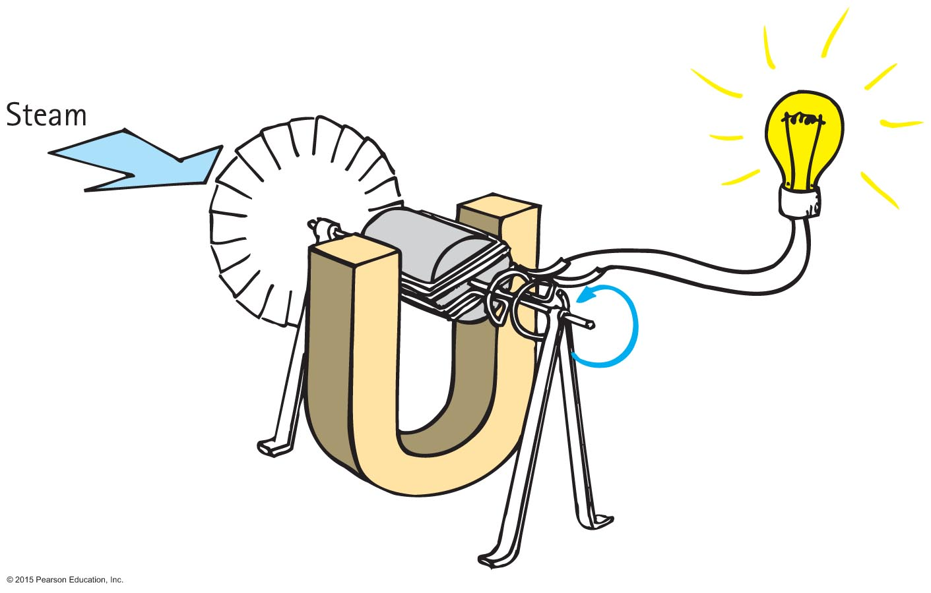
Power Production
Using Faraday and Henry's discovery of electromagnetic induction, Nikola Tesla and George Westinghouse showed that electricity could be generated in sufficient quantities to light cities.

Slide 20
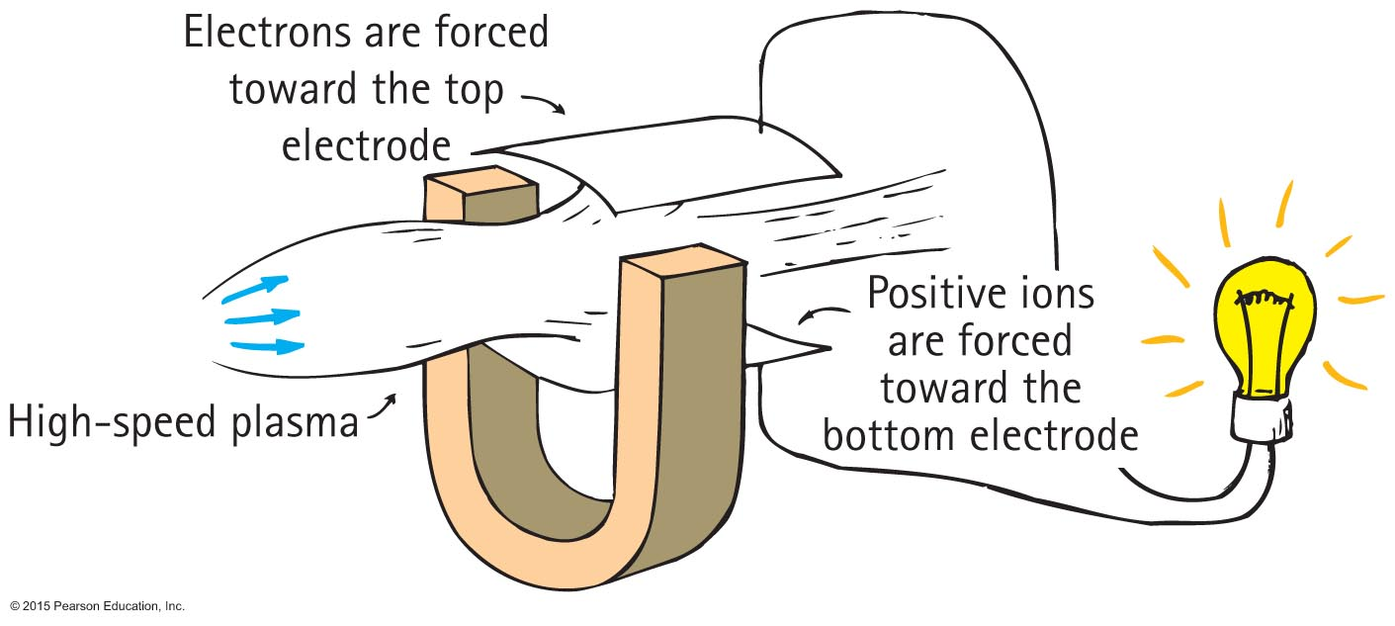
Power Production
MHD (MagnetoHydroDynamic) generator
Eliminates the turbine and spinning armature altogether.
A plasma of electrons and positive ions expands through a nozzle and moves at supersonic speed through a magnetic field.
The motion of charges through a magnetic field gives rise to a voltage and flow of current as per Faraday's law.

Slide 21
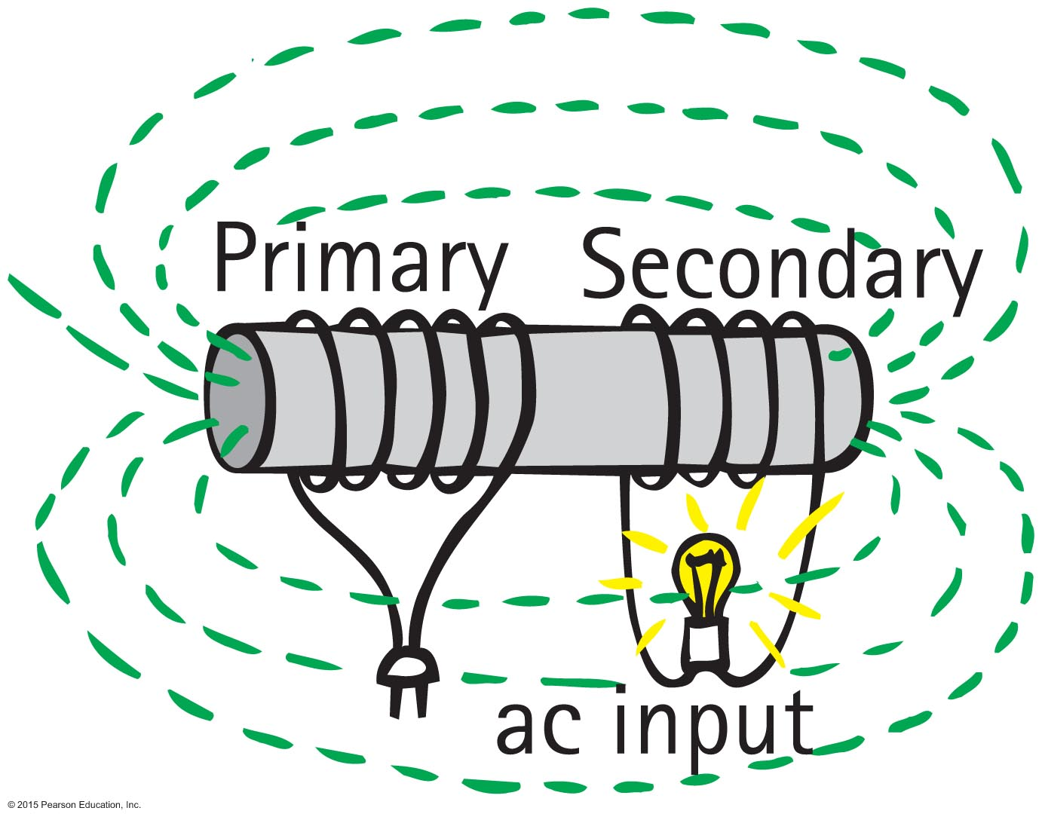
Power Production
Transformer
Input coil of wire—the primary powered by ac voltage source
Output coil of wire—the secondary connected to an external circuit

Slide 22
Power Production
Transformer (continued)
Both wound on a common iron core so that the magnetic field of the primary passes through the secondary
Uses an alternating current and voltage in one coil to induce an alternating current and voltage in a second coil

Slide 23
Power Production
Transformers can be step-up or step-down voltage.
Step-up transformer
produces a greater voltage in the secondary than supplied by the primary
secondary has more turns in coil than the primary
Step-down transformer
produces a smaller voltage in the secondary than supplied by the primary
secondary has less turns in coil than the primary

Slide 24
Power Production
Transformer relationship:
Primary voltage
secondary voltage
=
Number of primary turns
number of secondary turns

Slide 25
Power Production
Transformer transfers energy from one coil to another.
Rate of energy transfer is power.
Power into primary = power into secondary or
(Voltage x current)_{primary} = (voltage x current)_{secondary}

Slide 26
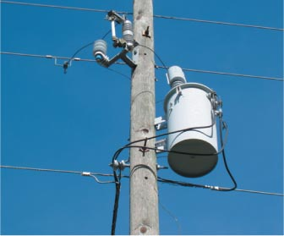
Power Production
Transformer transfers energy from one coil to another. (continued)
Example:
voltage stepped up before leaving power station
voltage stepped down for distribution near cities by cables that feed power to the grid
voltage stepped down again before being supplied to businesses and consumers through substations

Slide 27
Power Production CHECK YOUR NEIGHBOR
A step-up transformer in an electrical circuit can step up
voltage.
energy.
Both A and B.
Neither A nor B.
Notes:
A. voltage.

Slide 28
Power Production CHECK YOUR ANSWER
A step-up transformer in an electrical circuit can step up
voltage.
energy.
Both A and B.
Neither A nor B.
Explanation:
Stepping up energy is a conservation of energy no-no!
Notes:
A. voltage.

Slide 29
Power Production CHECK YOUR NEIGHBOR
An efficient transformer in an ac electric circuit can change
current.
energy.
power.
All of the above.
Notes:
A. current.

Slide 30
Power Production CHECK YOUR ANSWER
An efficient transformer in an ac electric circuit can change
current.
energy.
power.
All of the above.
Notes:
A. current.

Slide 31
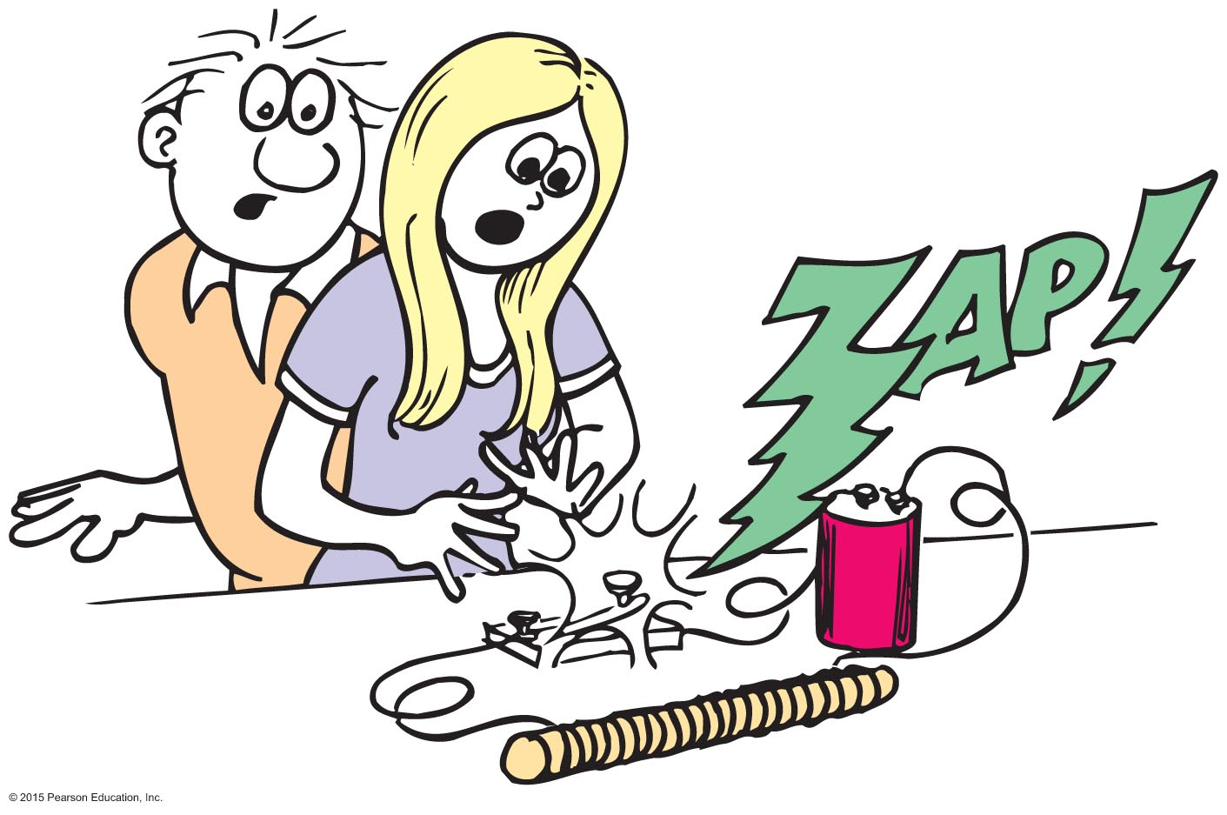
Self-Induction
Current-carrying loops in a coil interact not only with loops of other coils but also with loops of the same coil.
Each loop in a coil interacts with the magnetic field around the current in other loops of the same coil. This is self-induction.
When the switch is opened, the magnetic field of the coil collapses. This sudden change in the field can induce a huge voltage.

Slide 32
Power Transmission
Almost all electric energy sold today is in the form of ac because of the ease with which it can be transformed from one voltage to another.
Large currents in wires produce heat and energy losses, so power is transmitted great distances at high voltages and low currents.
Power is generated at 25,000 V or less and is stepped up near the power station to as much as 750,000 V for long-distance transmission.
It is then stepped down in stages at substations and distribution points to voltages needed in industrial applications (often 440 V or more) and for the home (240 and 120 V).

Slide 33
Field Induction
Electromagnetic induction is a "two-way street."
Faraday's law
States that an electric field is induced in any region of space in which a magnetic field is changing with time
Maxwell's counterpart to Faraday's law
States that a magnetic field is induced in any region of space in which an electric field is changing with time

Slide 34
Field Induction CHECK YOUR NEIGHBOR
The mutual induction of electric and magnetic fields can produce
light.
energy.
sound.
None of the above.
Notes:
A. light.

Slide 35
Field Induction CHECK YOUR ANSWER
The mutual induction of electric and magnetic fields can produce
light.
energy.
sound.
None of the above.
Notes:
A. light.

Slide 36
Field Induction
Light is produced by the mutual induction of electric and magnetic fields.
Speed of light is the speed of emanation of these fields.
Too slow, the regenerating fields die out.
Too fast, fields build up in a crescendo of ever-increasing energy.
At speed c, just right! And, there is light!

