Slide 1
Chapter 24: Magnetism

Slide 2
This lecture will help you understand:
Magnetic Forces
Magnetic Poles
Magnetic Fields
Magnetic Domains
Electric Currents and Magnetic Fields
Electromagnets
Magnetic Force on Moving Charged Particles
Magnetic Force on Current Carrying Wires
Earth's Magnetic Field
Biomagnetism

Slide 3
Magnetism
The term magnetism comes from the name Magnesia, a coastal district of ancient Thessaly, Greece.
Unusual stones were found by the Greeks more than 2000 years ago.
These stones, called lodestones, had the intriguing property of attracting pieces of iron.
Magnets were first fashioned into compasses and used for navigation by the Chinese in the 12th century.

Slide 4
Magnetic Forces
The force between any two charged particles depends on the magnitude of the charge on each and their distance of separation, as specified in Coulomb's law. But Coulomb's law is not the whole story!
When the charged particles are moving with respect to each other, the electrical force between electrically charged particles depends also, in a complicated way, on their motion.
There is a force due to the motion of the charged particles that we call the magnetic force.

Slide 5
Magnetic Poles
Magnetic force between a pair of magnets
Force of attraction or repulsion between a pair of magnets depends on which end of the magnet is held near the other.
Behavior similar to electrical forces.
Strength of interaction depends on the distance between the two magnets.

Slide 6
Magnetic Poles
Magnetic poles
Give rise to magnetic force
Two types interacting with each other
north pole (north-seeking pole)
south pole (south-seeking pole)
Rule for magnetic forces between magnetic poles:
Like poles repel; opposite poles attract.

Slide 7
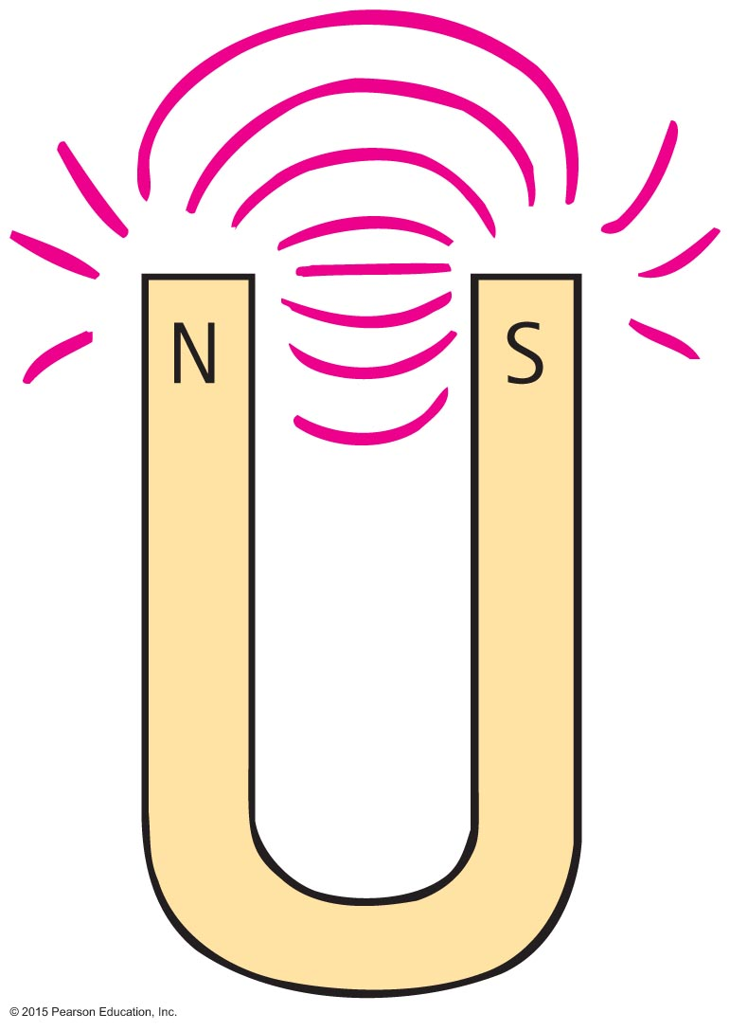
Magnetic Poles
Magnetic poles (continued)
In all magnets—can't have one pole without the other
No single pole known to exist
Example:
simple bar magnet—poles at the two ends
horseshoe magnet: bent U shape—poles at ends

Slide 8
Magnetic Poles CHECK YOUR NEIGHBOR
A weak and strong magnet repel each other. The greater repelling force is by the
stronger magnet.
weaker magnet.
Both the same.
None of the above.
Notes:
C. Both the same.

Slide 9
Magnetic Poles CHECK YOUR ANSWER
A weak and strong magnet repel each other. The greater repelling force is by the
stronger magnet.
weaker magnet.
Both the same.
None of the above.
Explanation:
Remember Newton's third law!
Notes:
C. Both the same.

Slide 10
Magnetic Fields
Magnetic fields
Region of magnetic influence surrounding magnetic poles
Shape revealed by lines that spread from one pole to the other
By convention, direction is from the north pole to the south pole, produced by motions of electric charge in atoms

Slide 11
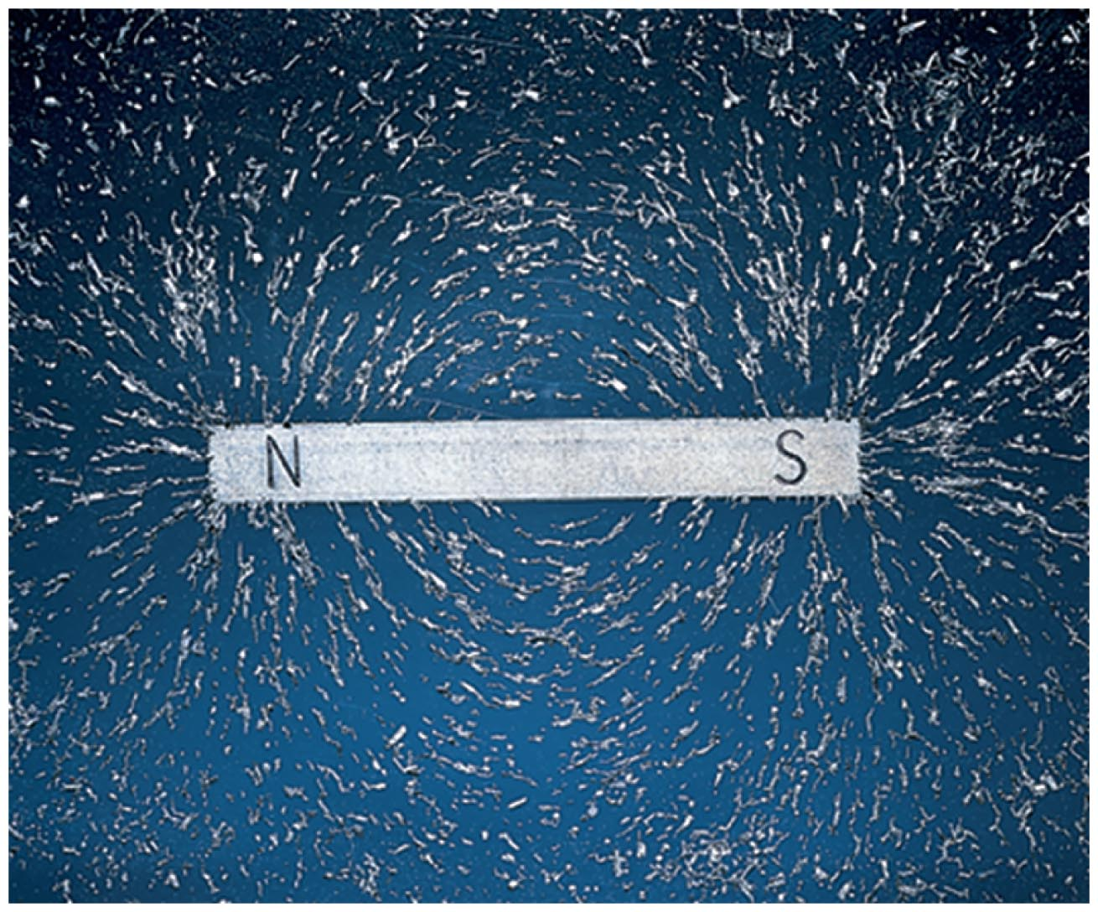
Magnetic Fields
Magnetic fields (continued)
Strength indicated by closeness of the lines
lines close together; strong magnetic field
lines farther apart; weak magnetic field

Slide 12
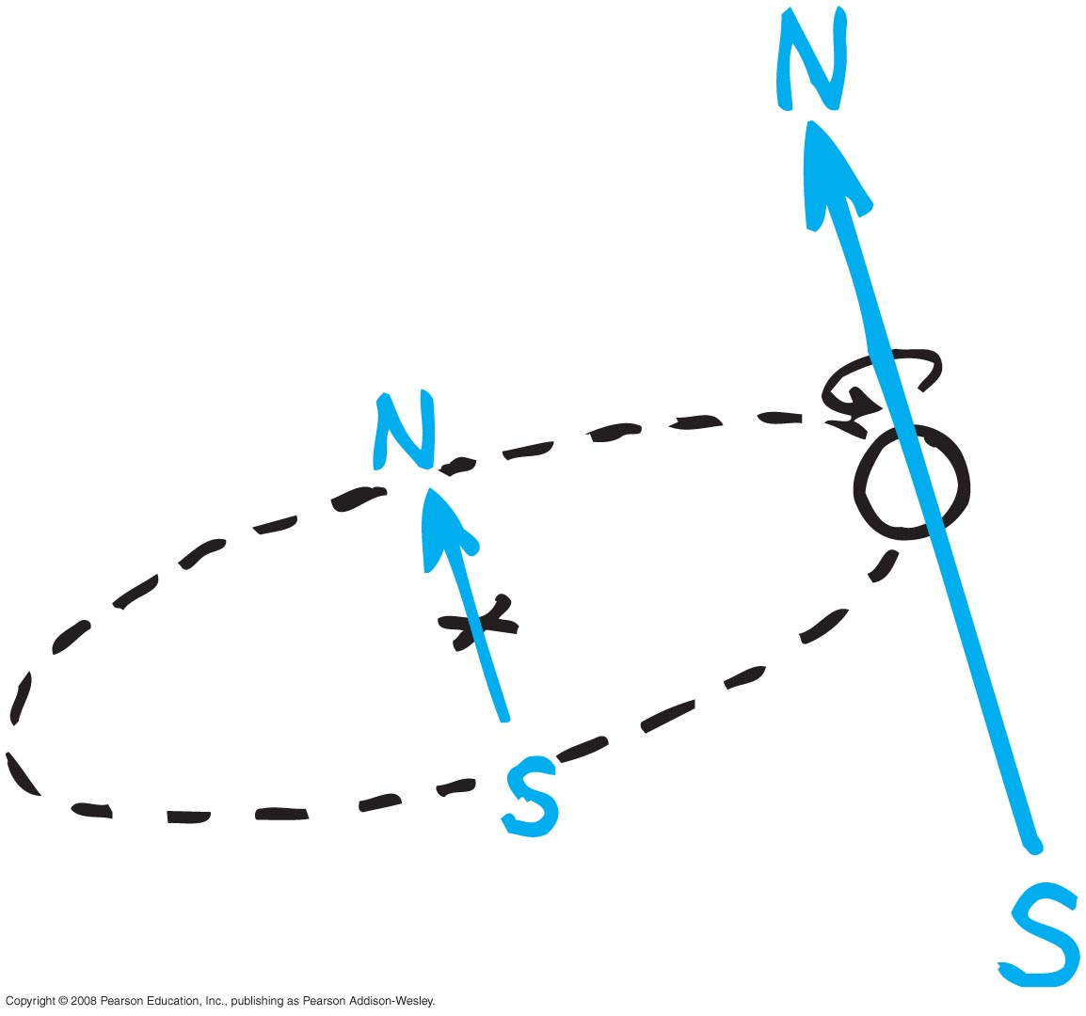
Magnetic Fields
Magnetic fields (continued)
Produced by two kinds of electron motion
electron spin
main contributor to magnetism
pair of electrons spinning in same direction creates a stronger magnet
pair of electrons spinning in opposite direction cancels magnetic field of the other
electron revolution

Slide 13
Magnetic Fields CHECK YOUR NEIGHBOR
The source of all magnetism is
electrons rotating around an atomic nucleus.
electrons spinning around internal axes.
either or both A and B.
tiny bits of iron.
Notes:
C. either or both A and B.

Slide 14
Magnetic Fields CHECK YOUR ANSWER
The source of all magnetism is
electrons rotating around an atomic nucleus.
electrons spinning around internal axes.
either or both A and B.
tiny bits of iron.
Notes:
C. either or both A and B.

Slide 15
Magnetic Fields CHECK YOUR NEIGHBOR
Where magnetic field lines are more dense, the field there is
weaker.
stronger.
Both A and B.
Neither A nor B.
Notes:
B. stronger.

Slide 16
Magnetic Fields CHECK YOUR ANSWER
Where magnetic field lines are more dense, the field there is
weaker.
stronger.
Both A and B.
Neither A nor B.
Notes:
B. stronger.

Slide 17
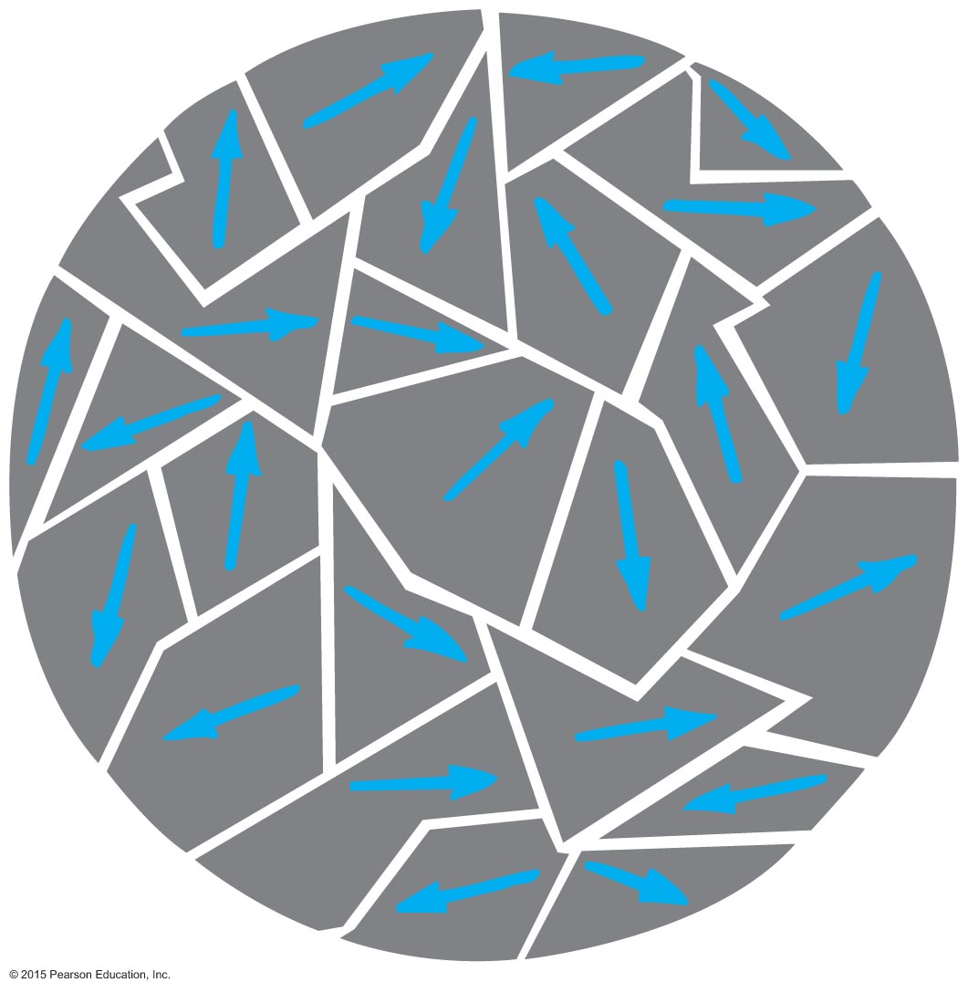
Magnetic Domains
Magnetic domains
Magnetized clusters of aligned magnetic atoms
Permanent magnets made by
placing pieces of iron or similar magnetic materials in a strong magnetic field.
stroking material with a magnet to align the domains.

Slide 18
Magnetic Domains
Difference between permanent magnet and temporary magnet
Permanent magnet
alignment of domains remains once external magnetic field is removed
Temporary magnet
alignment of domains returns to random arrangement once external magnetic field is removed

Slide 19
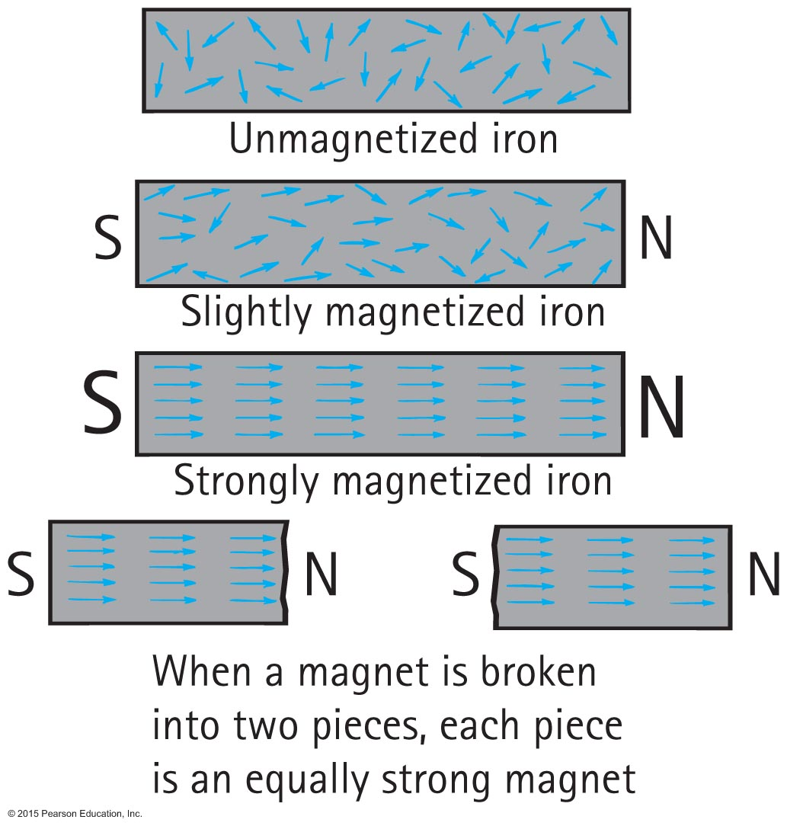
Magnetic Domains

Slide 20
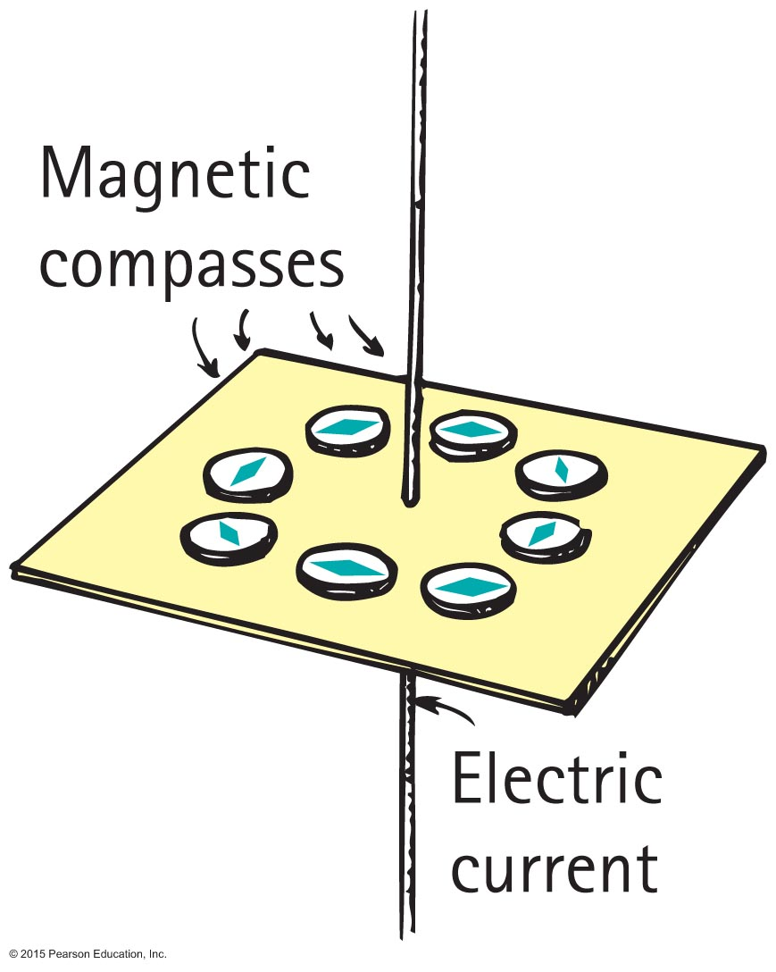
Electric Currents and Magnetic Fields
Connection between electricity and magnetism
Magnetic field forms a pattern of concentric circles around a current-carrying wire.
When current reverses direction, the direction of the field lines reverse.

Slide 21
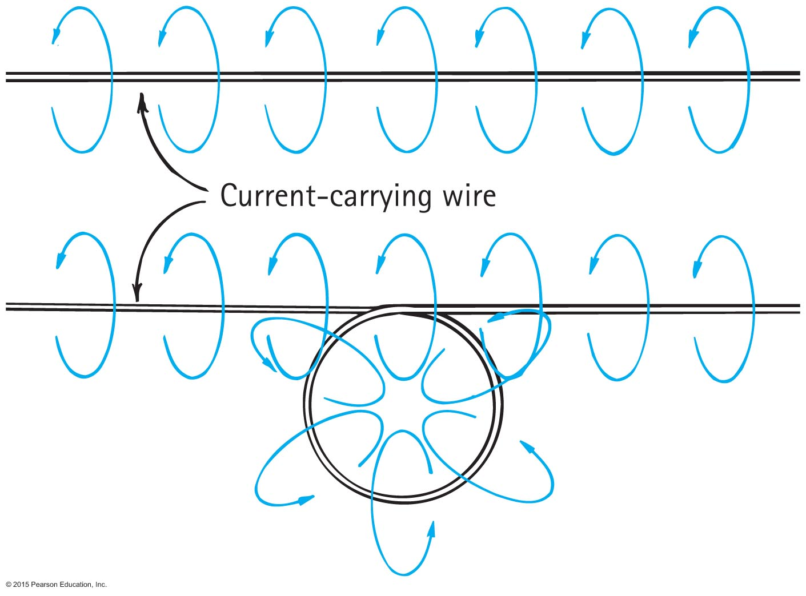
Electric Currents and Magnetic Fields

Slide 22
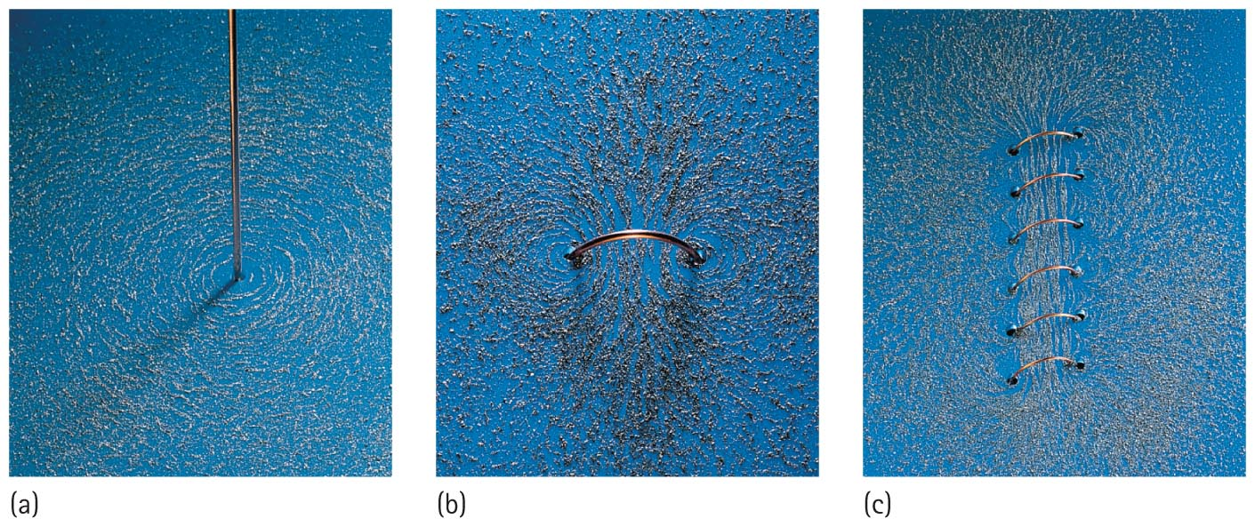
Electric Currents and Magnetic Fields
Magnetic field intensity
increases as the number of loops increase in a current-carrying coil temporary magnet.

Slide 23
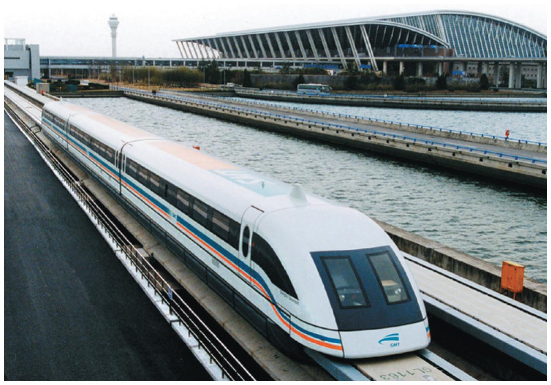
Electric Currents and Magnetic Fields
Electromagnet
Iron bar placed in a current-carrying coil
Most powerful—employs superconducting coils that eliminate the core
Applications
control charged-particle beams in high-energy accelerators
lift automobiles and other iron objects
levitate and propel high-speed trains

Slide 24
Electric Currents and Magnetic Fields CHECK YOUR NEIGHBOR
An electromagnet can be made stronger by
increasing the number of turns of wire.
increasing the current in the coil.
Both A and B.
None of the above.
Notes:
C. Both A and B.

Slide 25
Electric Currents and Magnetic Fields CHECK YOUR ANSWER
An electromagnet can be made stronger by
increasing the number of turns of wire.
increasing the current in the coil.
Both A and B.
None of the above.
Notes:
C. Both A and B.

Slide 26
Electromagnets
A current-carrying coil of wire is an electromagnet.
The strength of an electromagnet is increased by
increasing the current through the coil and
increasing the number of turns in the coil. Industrial magnets gain additional strength by
having a piece of iron within the coil.
Magnetic domains in the iron core are induced into alignment, adding to the field.

Slide 27
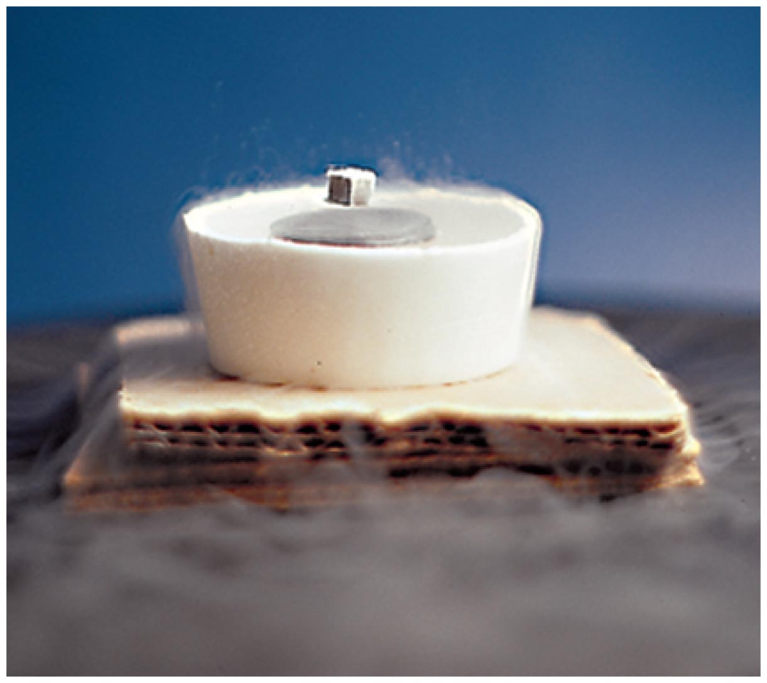
Electromagnets
Electromagnets without iron cores are used in magnetically levitated, or "maglev," transportation.
Levitation is accomplished by magnetic coils that run along the track, called a guideway.
The coils repel large magnets on the train's undercarriage.
Continually alternating electric current fed to the coils continually alternates their magnetic polarity, pulling and pushing the train forward.
Electromagnets that utilize superconducting coils produce extremely strong magnetic fields—and they do so very economically because there are no heat losses.

Slide 28
Magnetic Forces on Moving Charges
Moving charges in a magnetic field experience a deflecting force.
Greatest force
particle movement in direction perpendicular to the magnetic field lines
Least force
particle movement other than perpendicular to the magnetic field lines
No force
particle movement parallel to the magnetic field lines

Slide 29
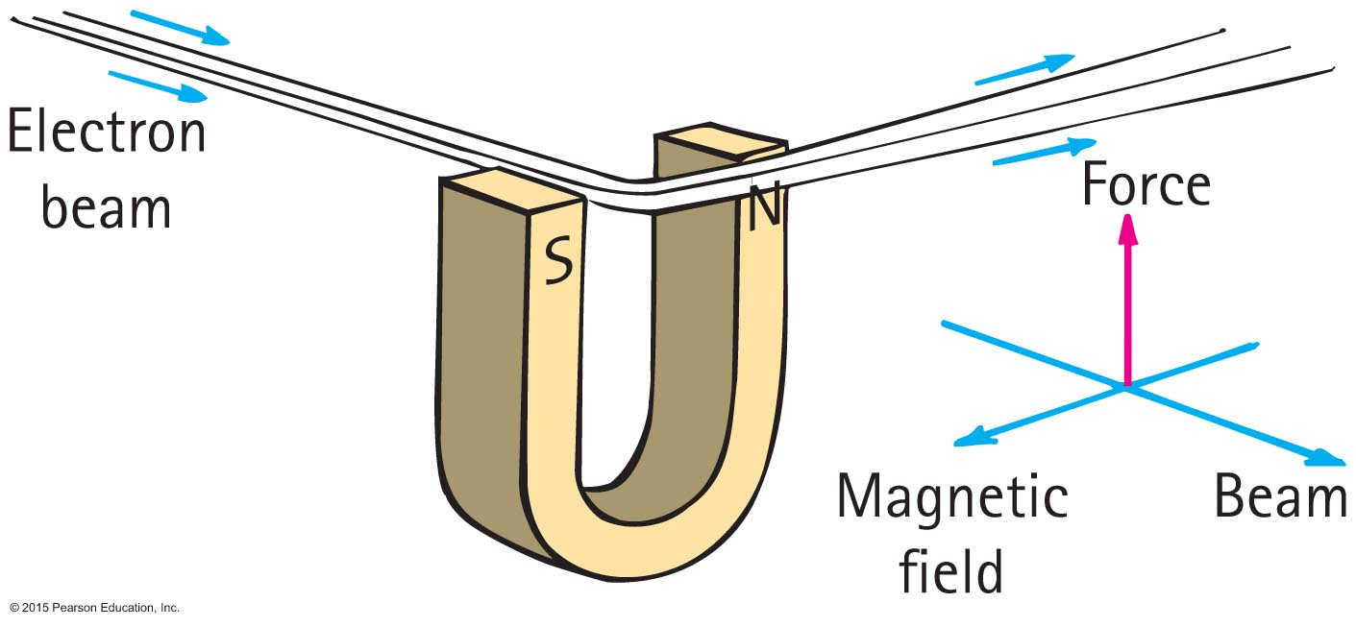
Magnetic Forces on Moving Charges
Moving charges in a magnetic field experience a deflecting force. (continued)

Slide 30
Magnetic Force on Moving Charges CHECK YOUR NEIGHBOR
The reason that an electron moving in a magnetic field doesn't pick up speed is
magnets only divert them.
only electric fields can change the speed of a charged particle.
the magnetic force is always perpendicular to its motion.
All of the above.
Notes:
C. the magnetic force is always perpendicular to its motion.

Slide 31
Magnetic Force on Moving Charges CHECK YOUR ANSWER
The reason that an electron moving in a magnetic field doesn't pick up speed is
magnets only divert them.
only electric fields can change the speed of a charged particle.
the magnetic force is always perpendicular to its motion.
All of the above.
Explanation:
Although all statements are true, the reason is given only by C. With no component of force in the direction of motion, speed doesn't change.
Notes:
C. the magnetic force is always perpendicular to its motion.

Slide 32
Magnetic Force on Moving Charges CHECK YOUR NEIGHBOR
The magnetic force on a moving charged particle can change the particle's
speed.
direction.
Both A and B.
Neither A nor B.
Notes:
B. direction.

Slide 33
Magnetic Force on Moving Charges CHECK YOUR ANSWER
The magnetic force on a moving charged particle can change the particle's
speed.
direction.
Both A and B.
Neither A nor B.
Notes:
B. direction.

Slide 34
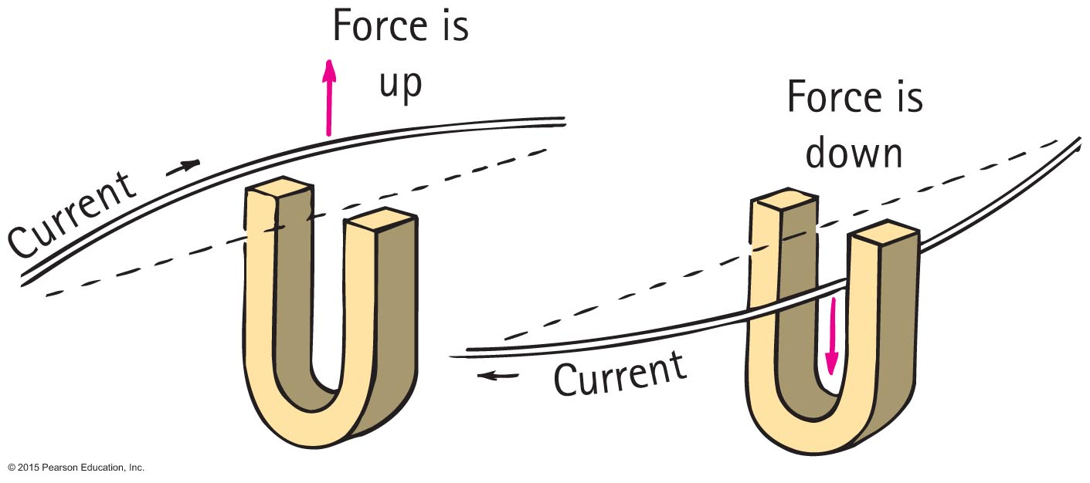
Magnetic Force on Current-Carrying Wires
Magnetic force on current-carrying wires
Current of charged particles moving through a magnetic field experiences a deflecting force.
Direction is perpendicular to both magnetic field lines and current (perpendicular to wire).
Strongest when current is perpendicular to the magnetic field lines.

Slide 35
Magnetic Force on Current-Carrying Wires
Electric meters detect electric current
Example:
magnetic compass
compass in a coil of wires

Slide 36
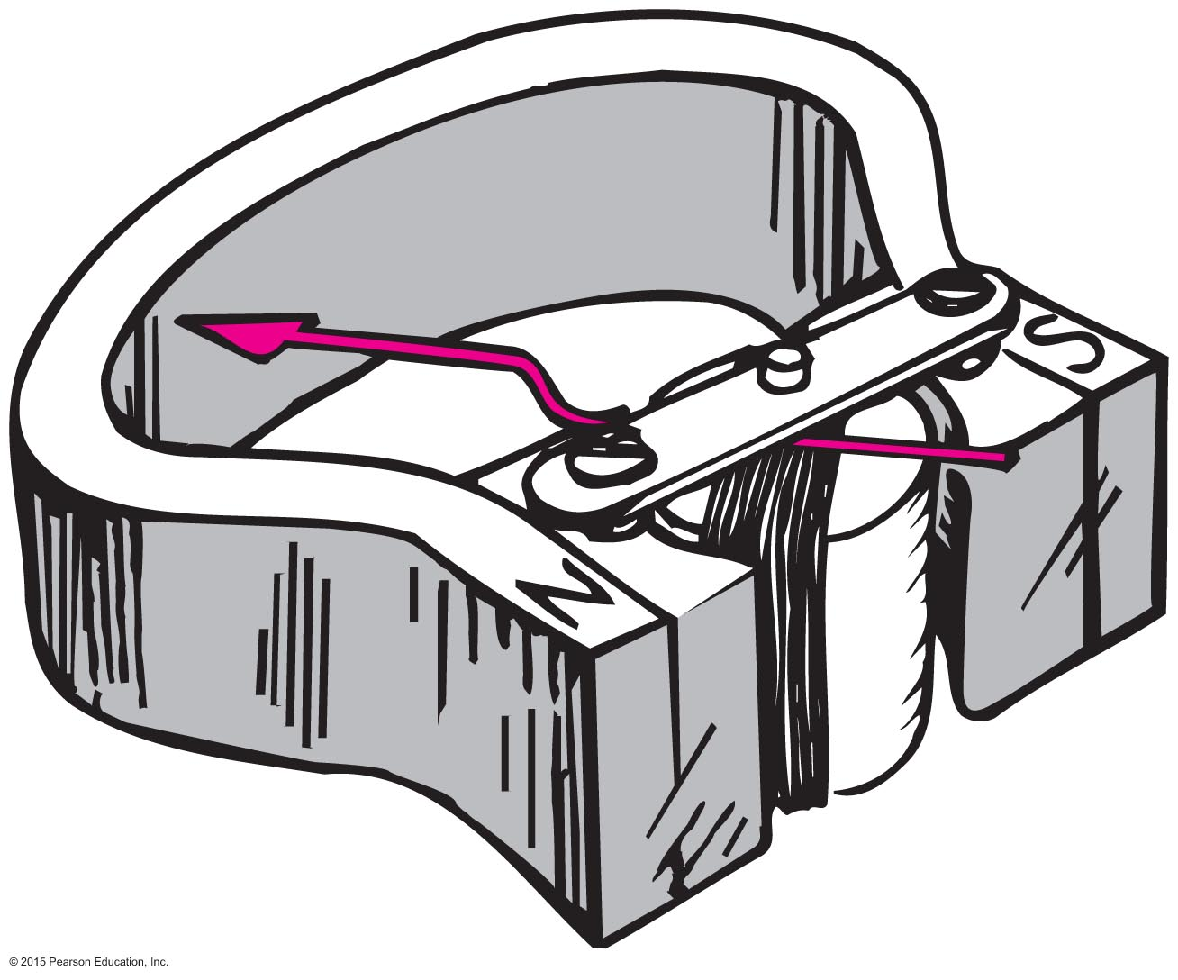
Magnetic Force on Current-Carrying Wires
Galvanometer
Current-indicating device named after Luigi Galvani
Called ammeter when calibrated to measure current (amperes)
Called voltmeter when calibrated to measure electric potential (volts)

Slide 37
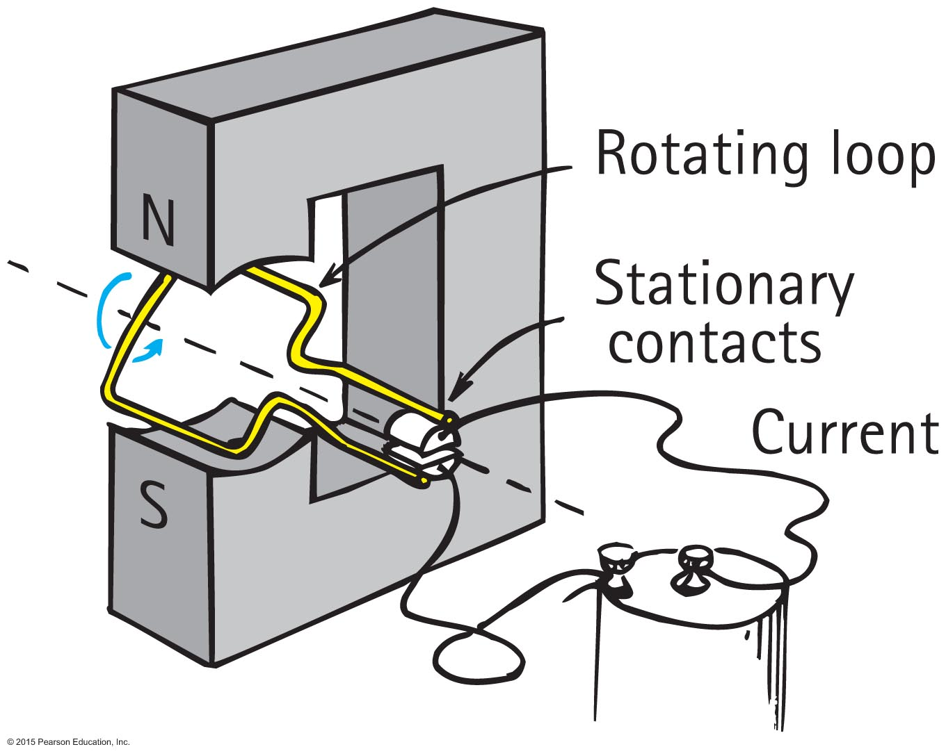
Magnetic Force on Current-Carrying Wires
Electric motor
Different from galvanometer in that each time the coil makes a half rotation, the direction of the current changes in cyclic fashion to produce continuous rotation

Slide 38
Magnetic Force on Current-Carrying Wires CHECK YOUR NEIGHBOR
A motor and a generator are
similar devices.
very different devices with different applications.
forms of transformers.
energy sources.
Notes:
A. similar devices.

Slide 39
Magnetic Force on Current-Carrying Wires CHECK YOUR ANSWER
A motor and a generator are
similar devices.
very different devices with different applications.
forms of transformers.
energy sources.
Notes:
A. similar devices.

Slide 40
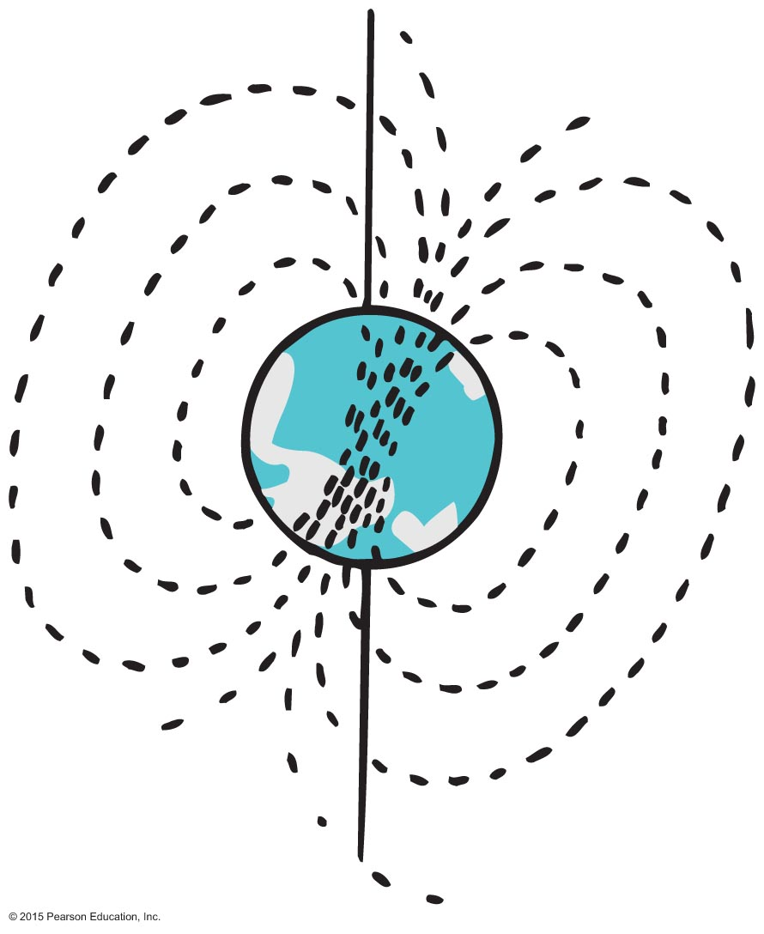
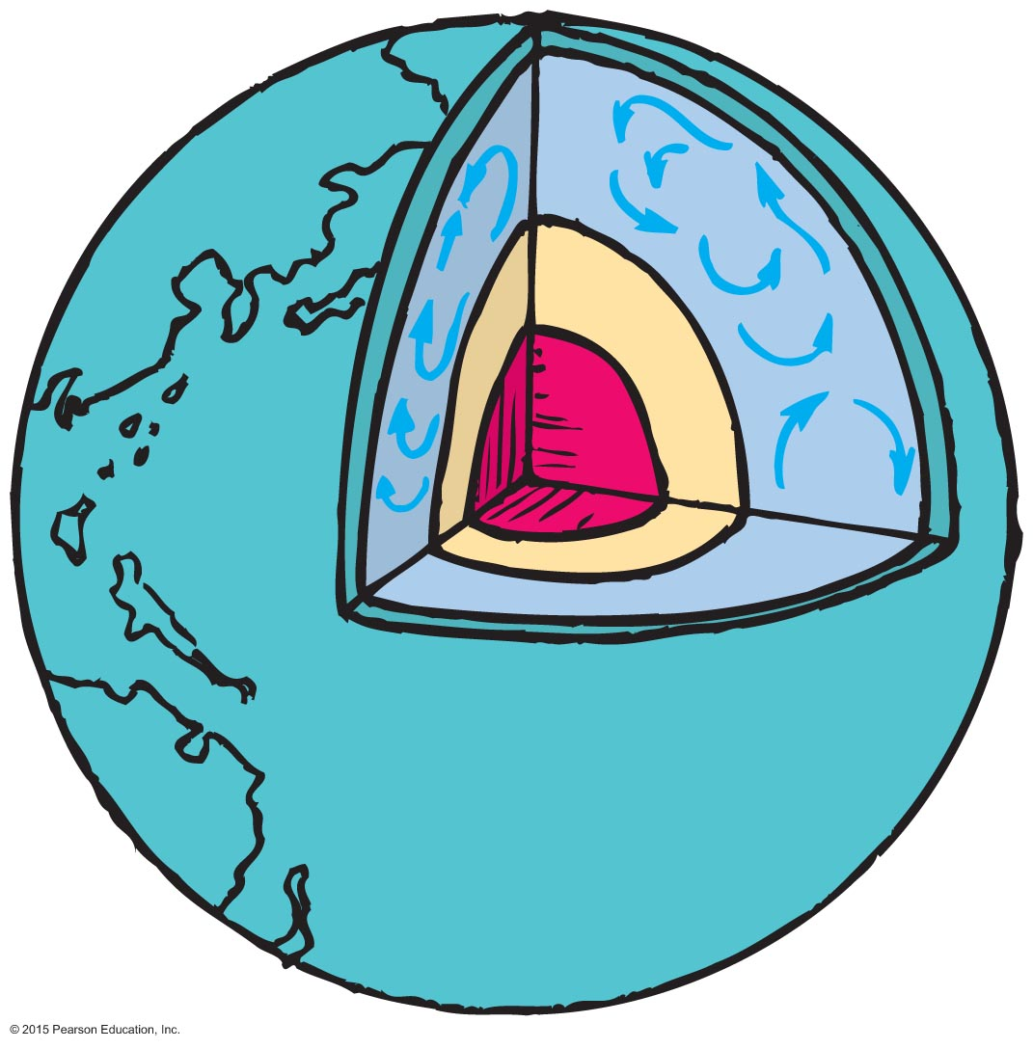
Earth's Magnetic Field
Earth is itself a huge magnet.
The magnetic poles of Earth are widely separated from the geographic poles.
The magnetic field of Earth is not due to a giant magnet in its interior—it is due to electric currents.
Most Earth scientists think that moving charges looping around within the molten part of Earth create the magnetic field.
Earth's magnetic field reverses direction: 20 reversals in last 5 million years.

Slide 41
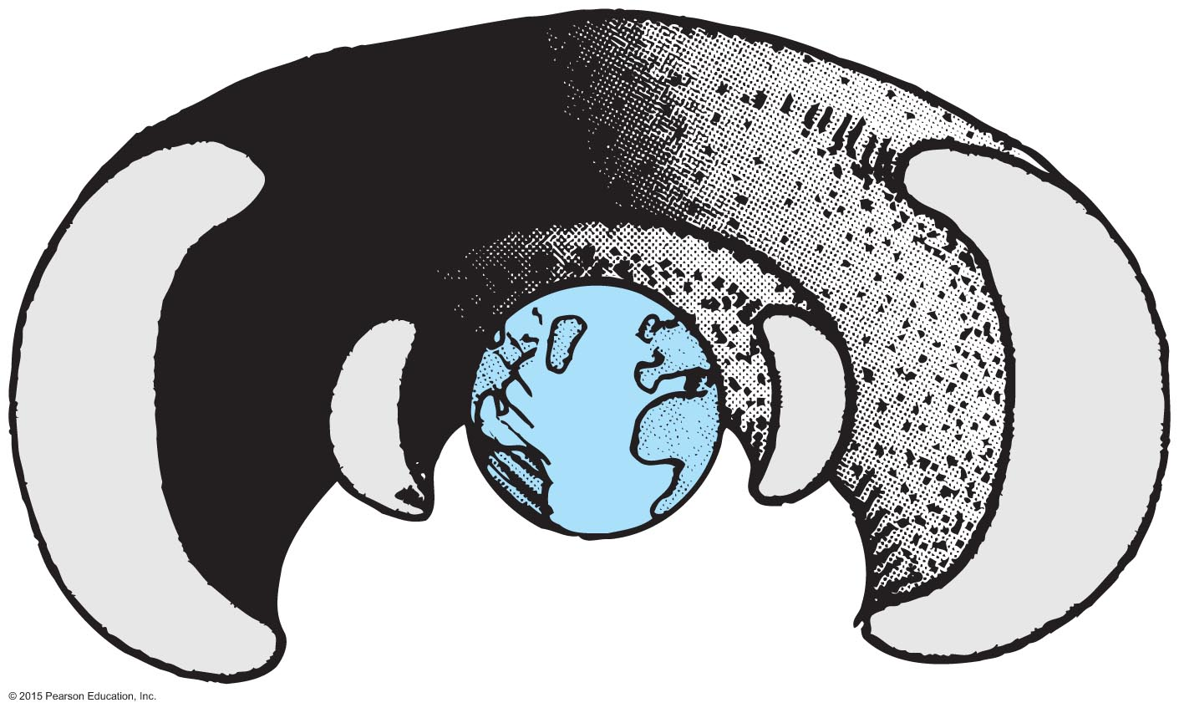
Earth's Magnetic Field
Universe is a shooting gallery of charged particles called cosmic rays.
Cosmic radiation is hazardous to astronauts.
Cosmic rays are deflected away from Earth by Earth's magnetic field.
Some of them are trapped in the outer reaches of Earth's magnetic field and make up the Van Allen radiation belts

Slide 42
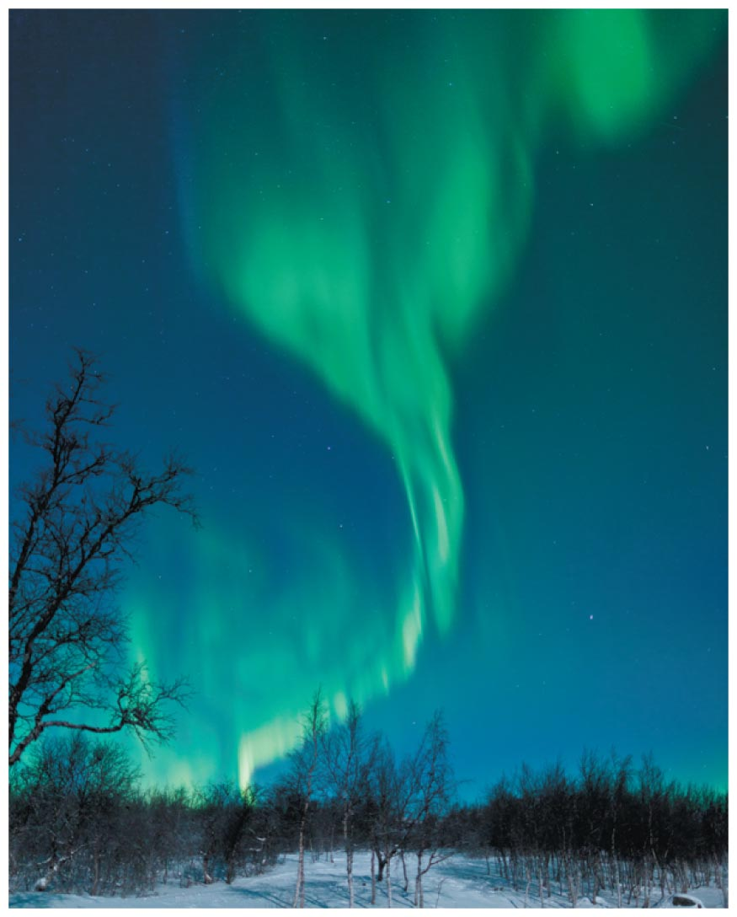
Earth's Magnetic Field
Storms on the Sun hurl charged particles out in great fountains, many of which pass near Earth and are trapped by its magnetic field. The trapped particles follow corkscrew paths around the magnetic field lines of Earth and bounce between Earth's magnetic poles high above the atmosphere.
Disturbances in Earth's field often allow the ions to dip into the atmosphere, causing it to glow like a fluorescent lamp. Hence the aurora borealis or aurora australis.

Slide 43
Biomagnetism
Certain bacteria biologically produce single-domain grains of magnetite (a compound equivalent to iron ore) that they string together to form internal compasses.
They then use these compasses to detect the dip of Earth's magnetic field.
Equipped with a sense of direction, the organisms are able to locate food supplies.
Pigeons have multiple domain magnetite magnets within their skulls that are connected with a large number of nerves to the pigeon brain.
Pigeons have a magnetic sense, and not only can they discern longitudinal directions along Earth's magnetic field, they can also detect latitude by the dip of Earth's field.
Other similar animals: Bees, butterflies, sea turtles and fish.

