Slide 1
Chapter 22: Electrostatics

Slide 2
This lecture will help you understand:
Electrical Forces and Charges
Conservation of Charge
Coulomb's Law
Conductors and Insulators
Superconductors
Charging
Charge Polarization
Electric Field
Electric Potential
Electric Energy Storage

Slide 3
Electricity
Electricity is the name given to a wide range of electrical phenomena, such as
lightning.
spark when we strike a match.
what holds atoms together.
Electrostatics involves electric charges,
the forces between them,
the aura that surrounds them, and
their behavior in materials.

Slide 4
Electric Force and Charges
Central rule of electricity
Opposite charges attract one another; like charges repel.

Slide 5
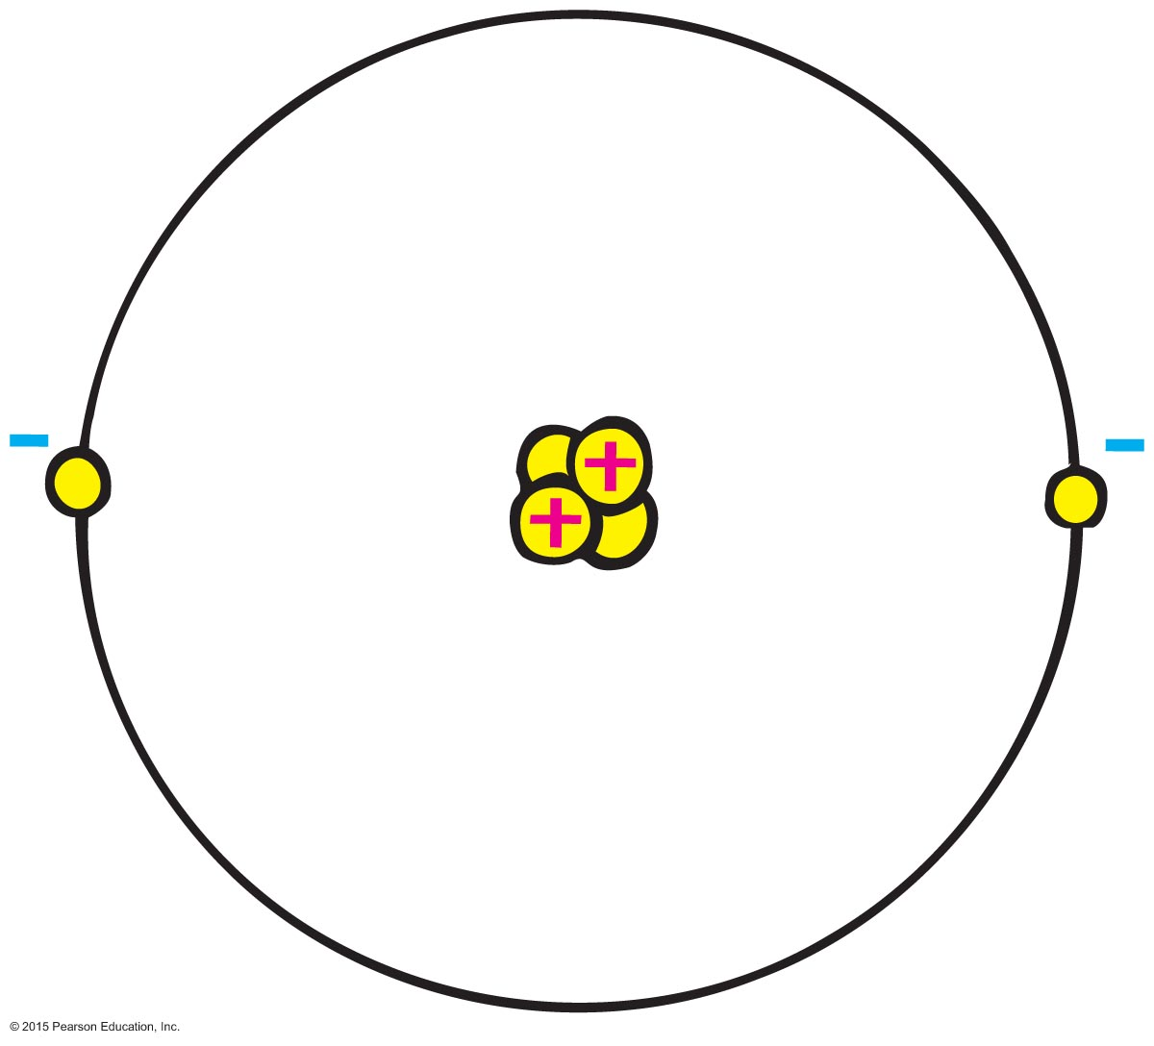
Electric Force and Charges
Protons
Positive electric charges
Repel positives, but attract negatives
Electrons
Negative electric charges
Repel negatives, but attract positives
Neutrons
Neutral electric charge

Slide 6
Electric Force and Charges
Fundamental facts about atoms
Every atom is composed of a positively charged nucleus surrounded by negatively charged electrons.
Each of the electrons in any atom has the same quantity of negative charge and the same mass.

Slide 7
Electric Force and Charges
Fundamental facts about atoms (continued)
Protons and neutrons compose the nucleus. Protons are about 1800 times more massive than electrons, but each one carries an amount of positive charge equal to the negative charge of electrons. Neutrons have slightly more mass than protons and have no net charge.
Atoms usually have as many electrons as protons, so the atom has zero net charge.

Slide 8
Electric Force and Charges
Ion
Positive ion—atom losing one or more electrons has positive net charge.
Negative ion—atom gaining one or more electrons has negative net charge.

Slide 9
Electric Force and Charges
Electrons in an atom
Innermost—attracted very strongly to oppositely charged atomic nucleus
Outermost—attracted loosely and can be easily dislodged

Slide 10
Electric Force and Charges
Electrons in an atom
Examples:
When rubbing a comb through your hair, electrons transfer from your hair to the comb. Your hair has a deficiency of electrons (positively charged).
When rubbing a glass rod with silk, electrons transfer from the rod onto the silk and the rod becomes positively charged.

Slide 11
Electric Force and Charges CHECK YOUR NEIGHBOR
When you brush your hair and scrape electrons from your hair, the charge of your hair is
positive.
negative.
Both A and B.
Neither A nor B.
Notes:
A. positive.

Slide 12
Electric Force and Charges CHECK YOUR ANSWER
When you brush your hair and scrape electrons from your hair, the charge of your hair is
positive.
negative.
Both A and B.
Neither A nor B.
Comment:
And if electrons were scraped off the brush onto your hair, your hair would have a negative charge.
Notes:
A. positive.

Slide 13
Conservation of Charge
Conservation of charge
In any charging process, no electrons are created or destroyed. Electrons are simply transferred from one material to another.

Slide 14
Coulomb's Law
Coulomb's law
Relationship among electrical force, charge, and distance discovered by Charles Coulomb in the 18th century
States that for a pair of charged objects that are much smaller than the distance between them, the force between them varies directly, as the product of their charges, and inversely, as the square of the separation distance

Slide 15
Coulomb's Law
Coulomb's law (continued)
If the charges are alike in sign, the force is repelling; if the charges are not alike, the force is attractive.
In equation form:
Unit of charge is coulomb, C
Similar to Newton's law of gravitation for masses
Underlies the bonding forces between molecules
k = 9,000,000,000 Nm²/C²

Slide 16
Coulomb's Law CHECK YOUR NEIGHBOR
According to Coulomb's law, a pair of particles that are placed twice as far apart will experience forces that are
half as strong.
one-quarter as strong.
twice as strong.
4 times as strong.
Notes:
B. one quarter as strong.

Slide 17
Coulomb's Law CHECK YOUR ANSWER
According to Coulomb's law, a pair of particles that are placed twice as far apart will experience forces that are
half as strong.
one-quarter as strong.
twice as strong.
4 times as strong.
Notes:
B. one quarter as strong.

Slide 18
Coulomb's Law
Differences between gravitational and electrical forces
Electrical forces may be either attractive or repulsive.
Gravitational forces are only attractive.

Slide 19
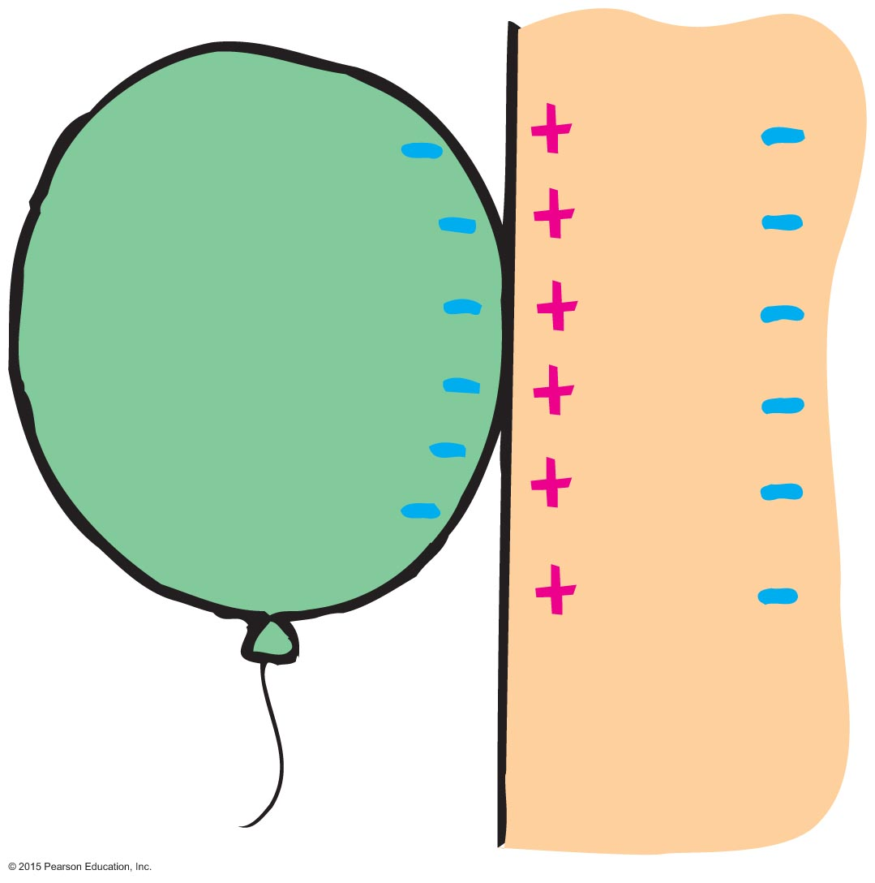
Coulomb's Law
Charge polarization
Atom or molecule in which the charges are aligned with a slight excess of positive charge on one side and slight excess of negative charge on the other
Example: Rub an inflated balloon on your hair and place the balloon on the wall. The balloon sticks to the wall due to charge polarization in the atoms or molecules of the wall.

Slide 20
Conductors and Insulators
Conductor: Materials in which one or more of the electrons in the outer shell of its atoms are not anchored to the nuclei of particular atoms but are free to wander in the material
Example: Metals such as copper and aluminum
Insulators: Materials in which electrons are tightly bound and belong to particular atoms and are not free to wander about among other atoms in the material, making them flow
Example: Rubber, glass

Slide 21
Conductors and Insulators
Semiconductors: A material that can be made to behave sometimes as an insulator and sometimes as a conductor.
Fall in the middle range of electrical resistivity between insulators and conductors.
They are insulators when they are in their pure state.
They are conductors when they have impurities.
Semiconductors conduct when light shines on it.
If a charged selenium plate is exposed to a pattern of light, the charge will leak away only from the areas exposed to light.

Slide 22
Conductors and Insulators CHECK YOUR NEIGHBOR
When you buy a water pipe in a hardware store, the water isn't included. When you buy copper wire, electrons
must be supplied by you, just as water must be supplied for a water pipe.
are already in the wire.
may fall out, which is why wires are insulated.
None of the above.
Notes:
B. are already in the wire.

Slide 23
Conductors and Insulators CHECK YOUR ANSWER
When you buy a water pipe in a hardware store, the water isn't included. When you buy copper wire, electrons
must be supplied by you, just as water must be supplied for a water pipe.
are already in the wire.
may fall out, which is why wires are insulated.
None of the above.
Notes:
B. are already in the wire.

Slide 24
Superconductors
Superconductors: Materials acquire zero resistance (infinite conductivity) to the flow of charge.
Once electric current is established in a superconductor, the electrons flow indefinitely.
With no electrical resistance, current passes through a superconductor without losing energy.
No heat loss occurs when charges flow.

Slide 25
Charging
Charging by friction and contact.
Example:
Stroking cats fur, combing your hair, rubbing your shoes on a carpet
Electrons transfer from one material to another by simply touching. For example,
when a negatively charged rod is placed in contact with a neutral object, some electrons will move to the neutral object.

Slide 26
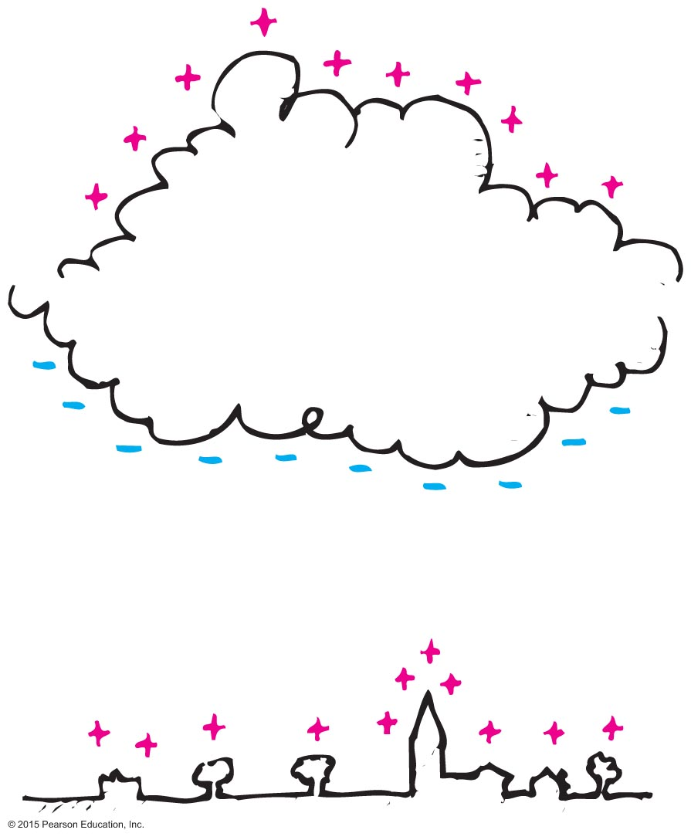
Charging
Charging by induction
If you bring a charged object near a conducting surface, electrons are made to move in the surface material, even without physical contact.
Example: The negative charge at the bottom of the cloud induces a positive charge on the buildings below.

Slide 27
Charging
Induction: Consider two insulated metal spheres A and B.
They touch each other, so in effect they form a single uncharged conductor.
When a negatively charged rod is brought near A, electrons in the metal, being free to move, are repelled as far as possible until their mutual repulsion is big enough to balance the influence of the rod. The charge is redistributed.
If A and B are separated while the rod is still present, each will be equal and oppositely charged.

Slide 28
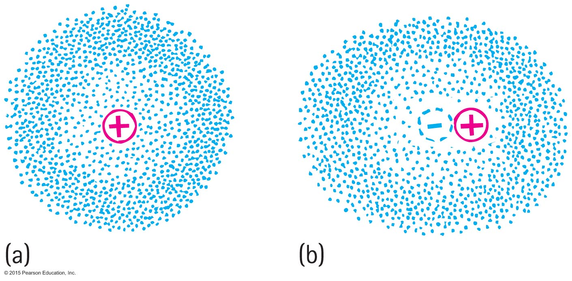
Charge Polarization
One side of the atom or molecule is induced into becoming more negative (or positive) than the opposite side. The atom or molecule is said to be electrically polarized.
An electron buzzing around the atomic nucleus produces an electron cloud.
The center of the negative cloud normally coincides with the center of the positive nucleus in an atom.
When an external negative charge is brought nearby to the right, the electron cloud is distorted so that the centers of negative and positive charge no longer coincide. The atom is now electrically polarized

Slide 29
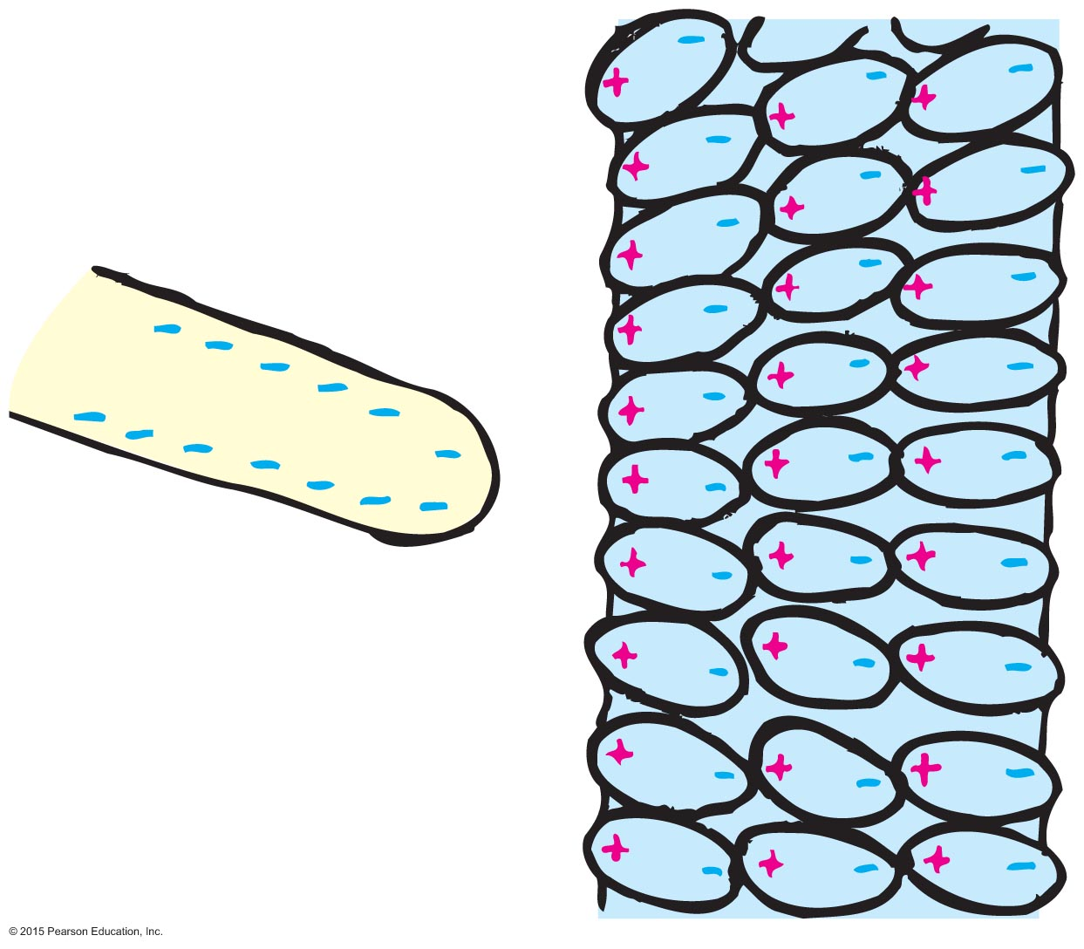
Charge Polarization
If the charged rod is negative, then the positive part of the atom or molecule is tugged in a direction toward the rod, and the negative side of the atom or molecule is pushed in a direction away from the rod.
The positive and negative parts of the atoms and molecules become aligned. They are electrically polarized.

Slide 30
Charge Polarization
When a charged comb is brought nearby, molecules in the paper are polarized.
The sign of charge closest to the comb is opposite to the comb's charge.
Charges of the same sign are slightly more distant. Closeness wins, and the bits of paper experience a net attraction.

Slide 31
Charge Polarization
Rub an inflated balloon on your hair, and it becomes charged.
Place the balloon against the wall, and it sticks.
This is because the charge on the balloon induces an opposite surface charge on the wall.
Again, closeness wins, for the charge on the balloon is slightly closer to the opposite induced charge than to the charge of same sign

Slide 32
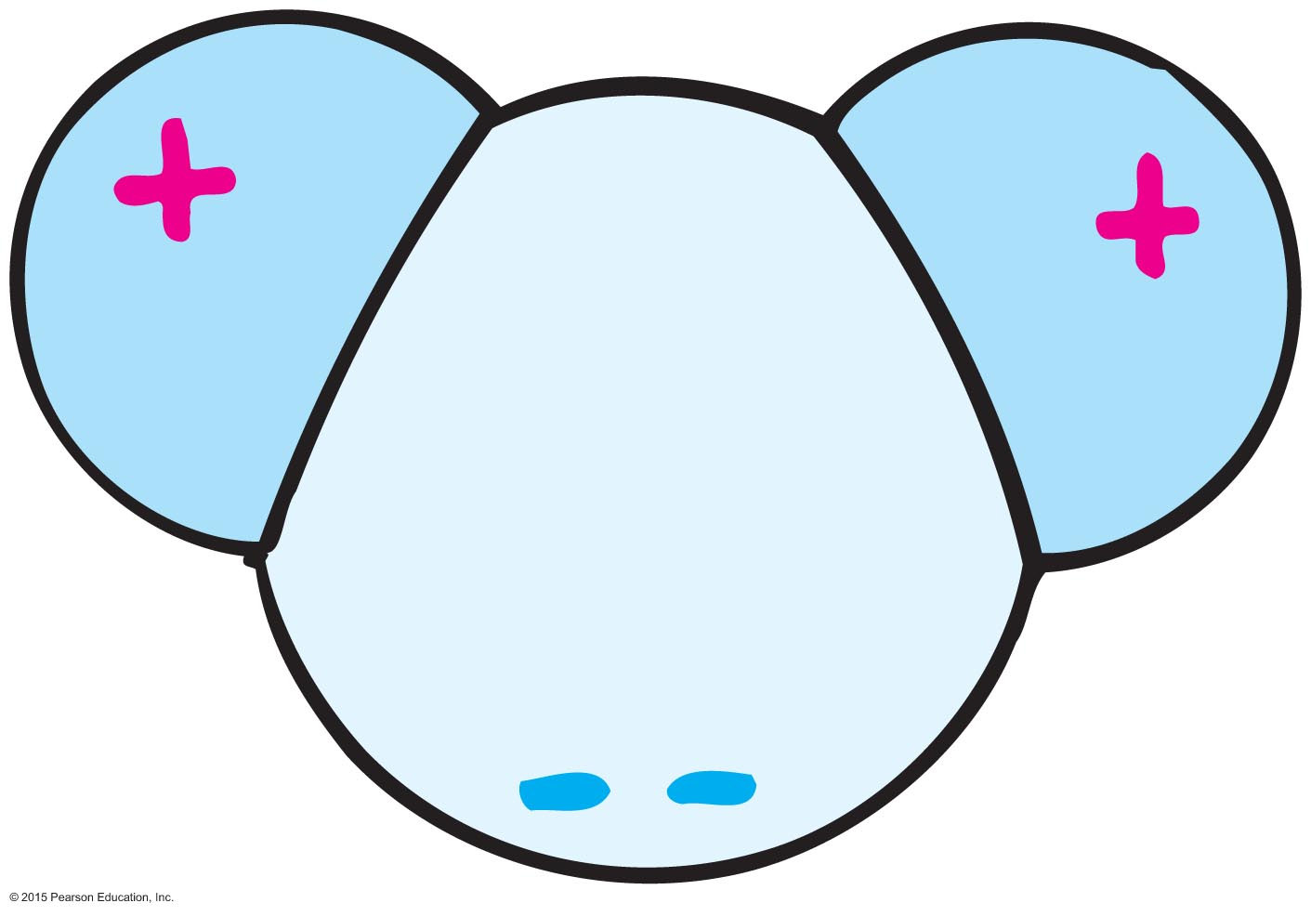
Charge Polarization
Many molecules—H₂O, for example—are electrically polarized in their normal states.
The distribution of electric charge is not perfectly even.
There is a little more negative charge on one side of the molecule than the other.
Such molecules are said to be electric dipoles.

Slide 33
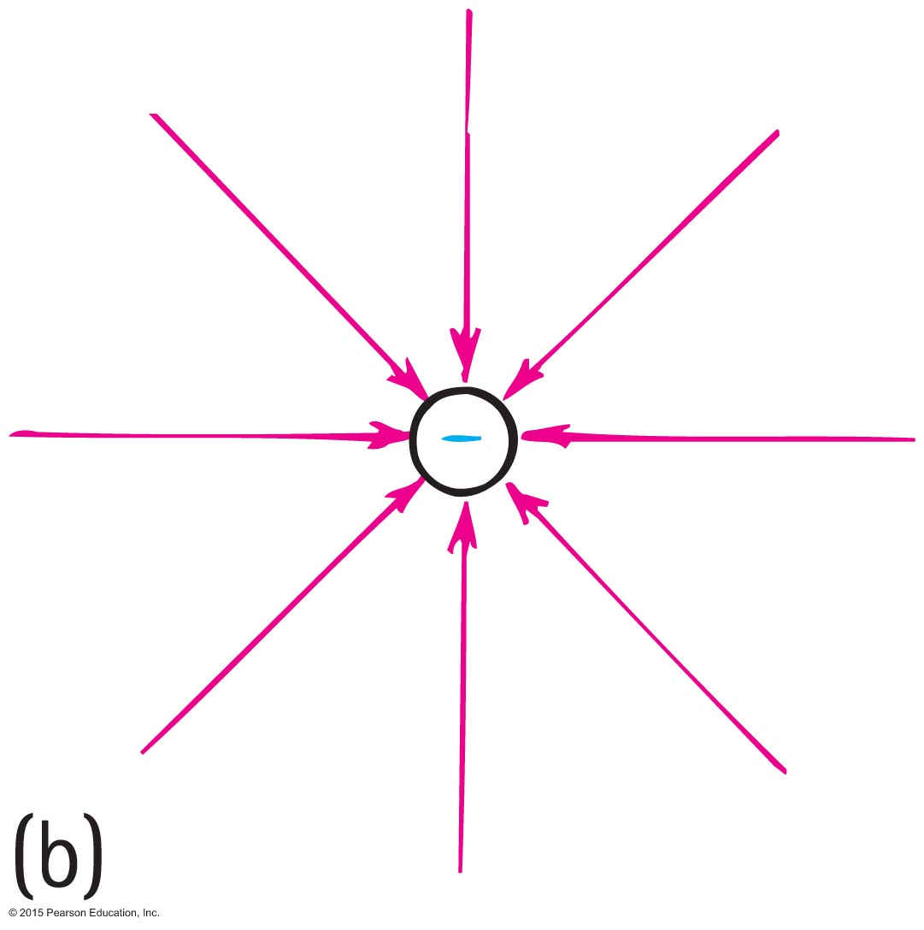
Electric Field
Electric field
Space surrounding an electric charge (an energetic aura)
Describes electric force
Around a charged particle obeys inverse-square law
Force per unit charge

Slide 34
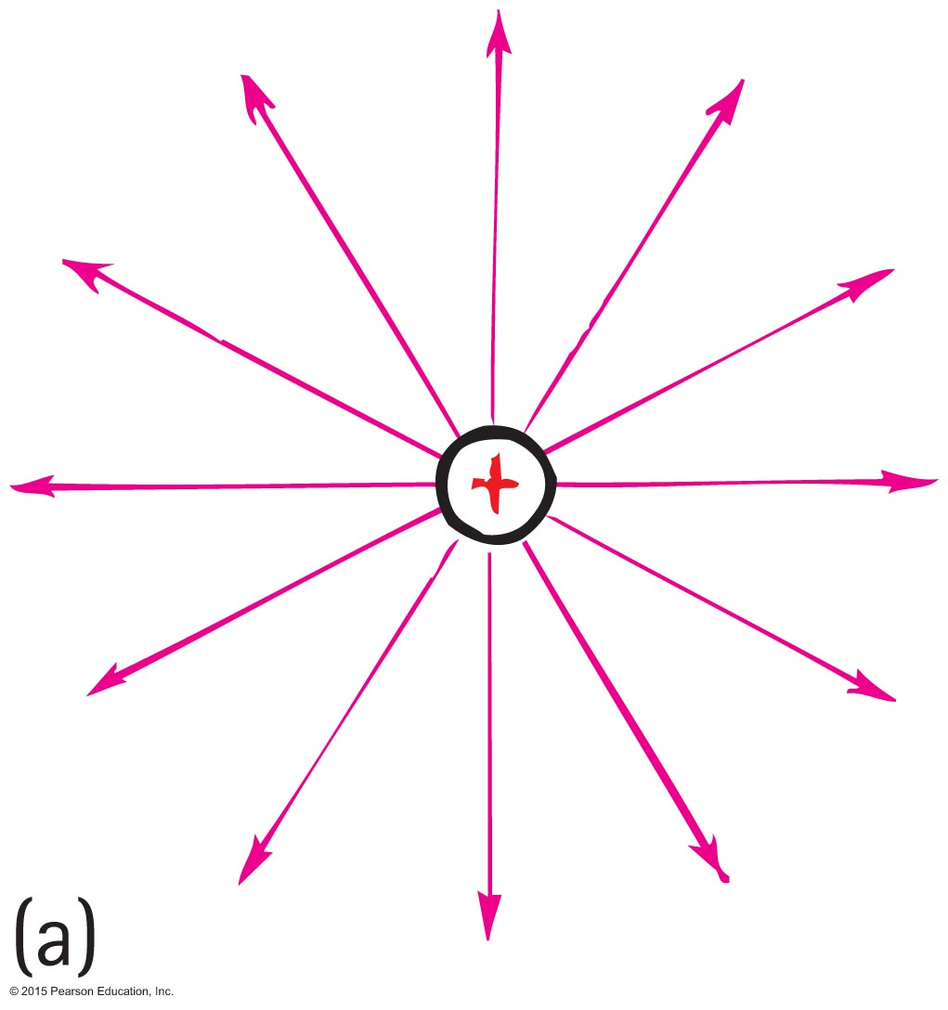
Electric Field
Electric field direction
Same direction as the force on a positive charge
Opposite direction to the force on an electron

Slide 35
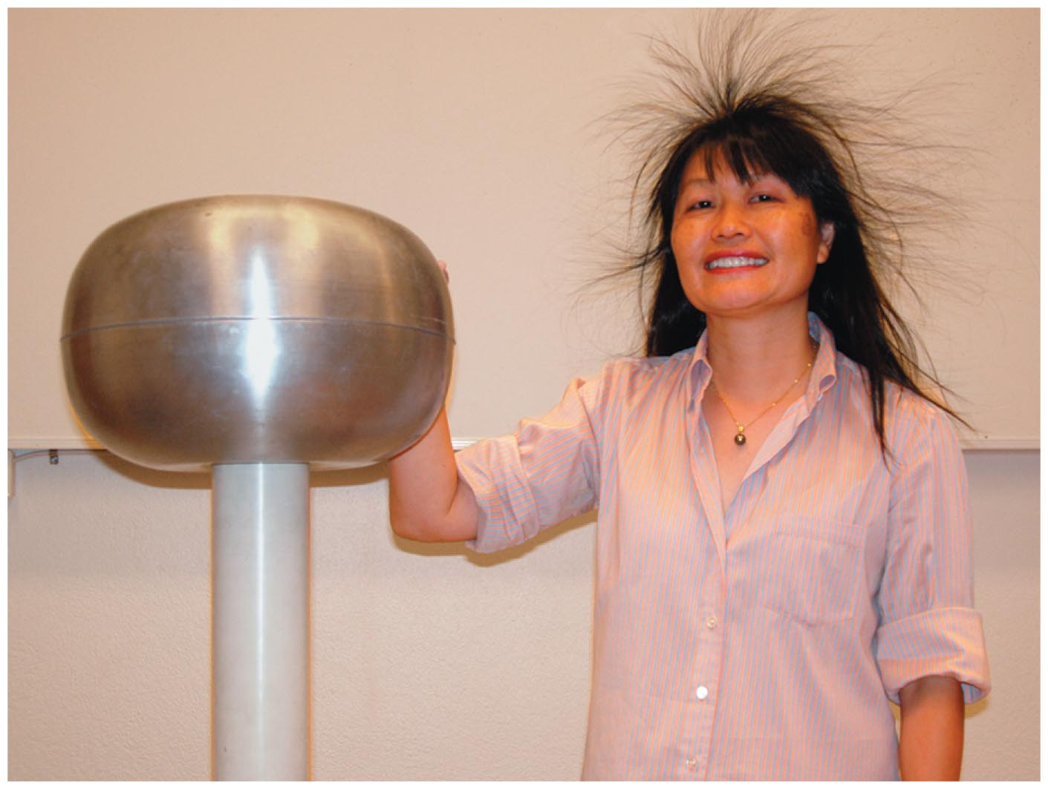
Electric Field
Both Lillian and the spherical dome of the Van de Graaff generator are electrically charged.

Slide 36
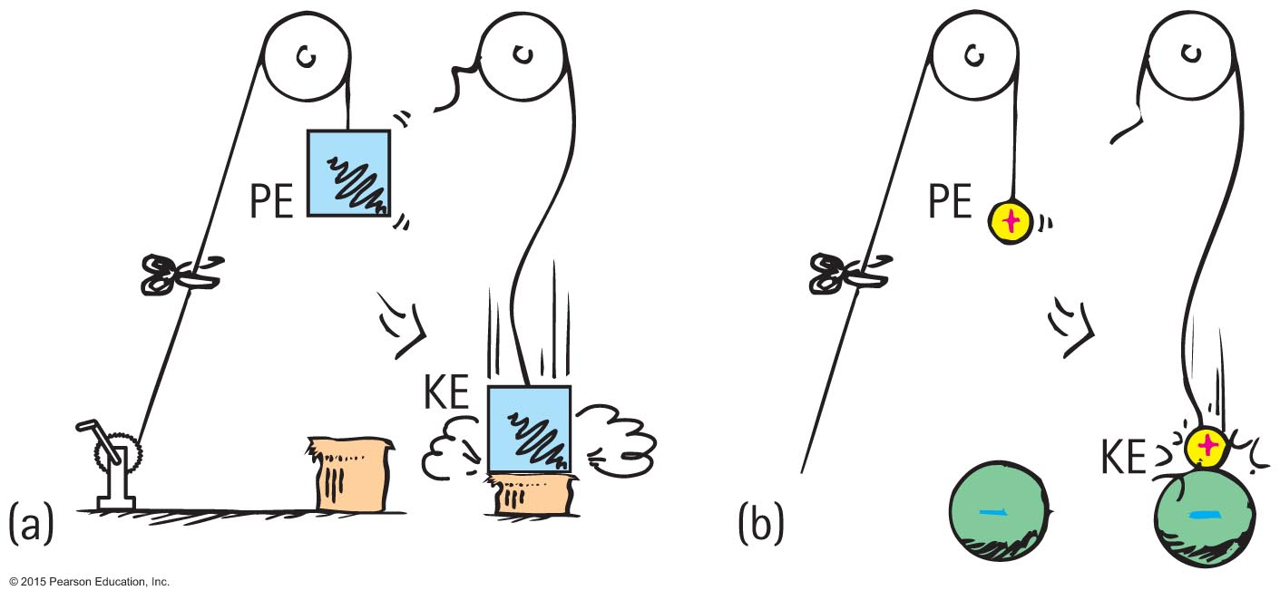
Electric Potential
Electric potential energy
Energy possessed by a charged particle due to its location in an electric field. Work is required to push a charged particle against the electric field of a charged body.

Slide 37
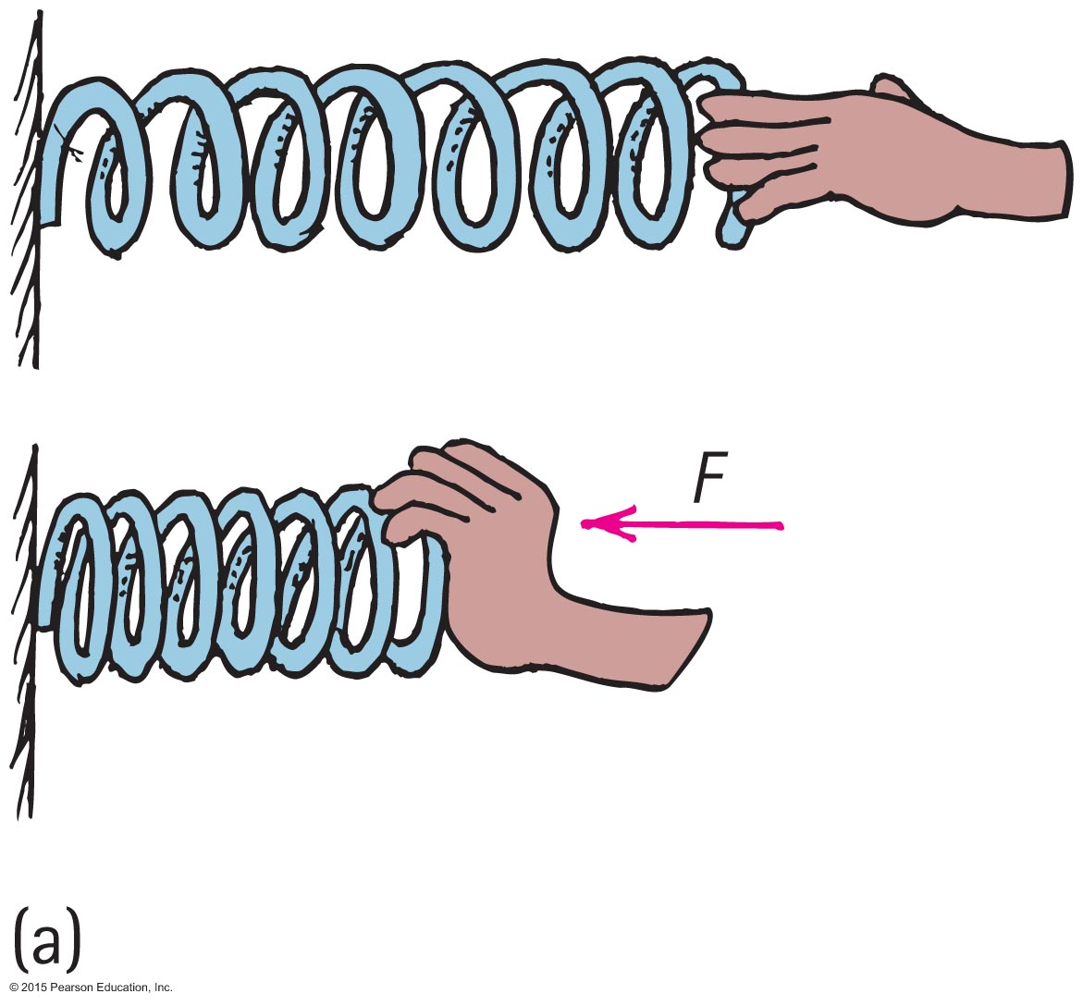
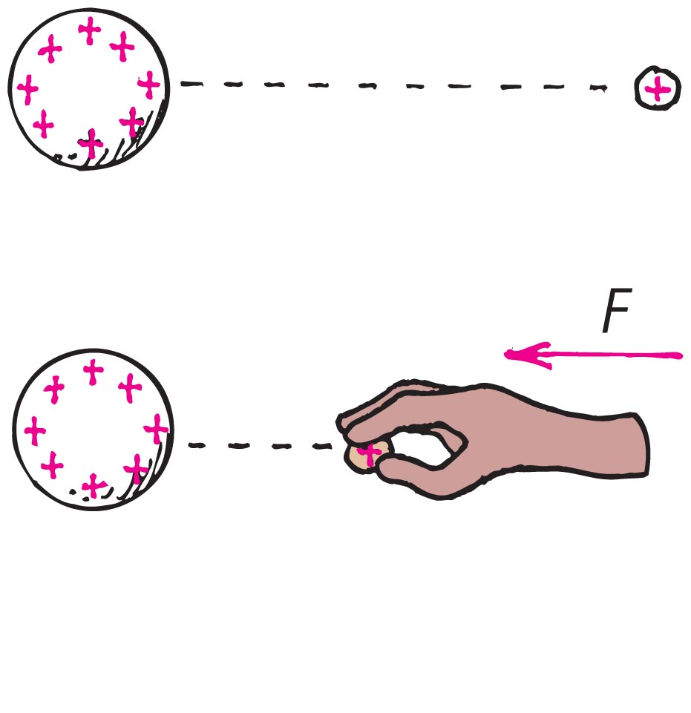
Electric Potential
(a) The spring has more mechanical PE when compressed. (b) The charged particle similarly has more electric PE when pushed closer to the charged sphere. In both cases, the increased PE is the result of work input.

Slide 38
Electric Potential
Electric potential (voltage)
Energy per charge possessed by a charged particle due to its location
May be called voltage—potential energy per charge
In equation form:
electric potential energy
Electric potential =
amount of charge

Slide 39
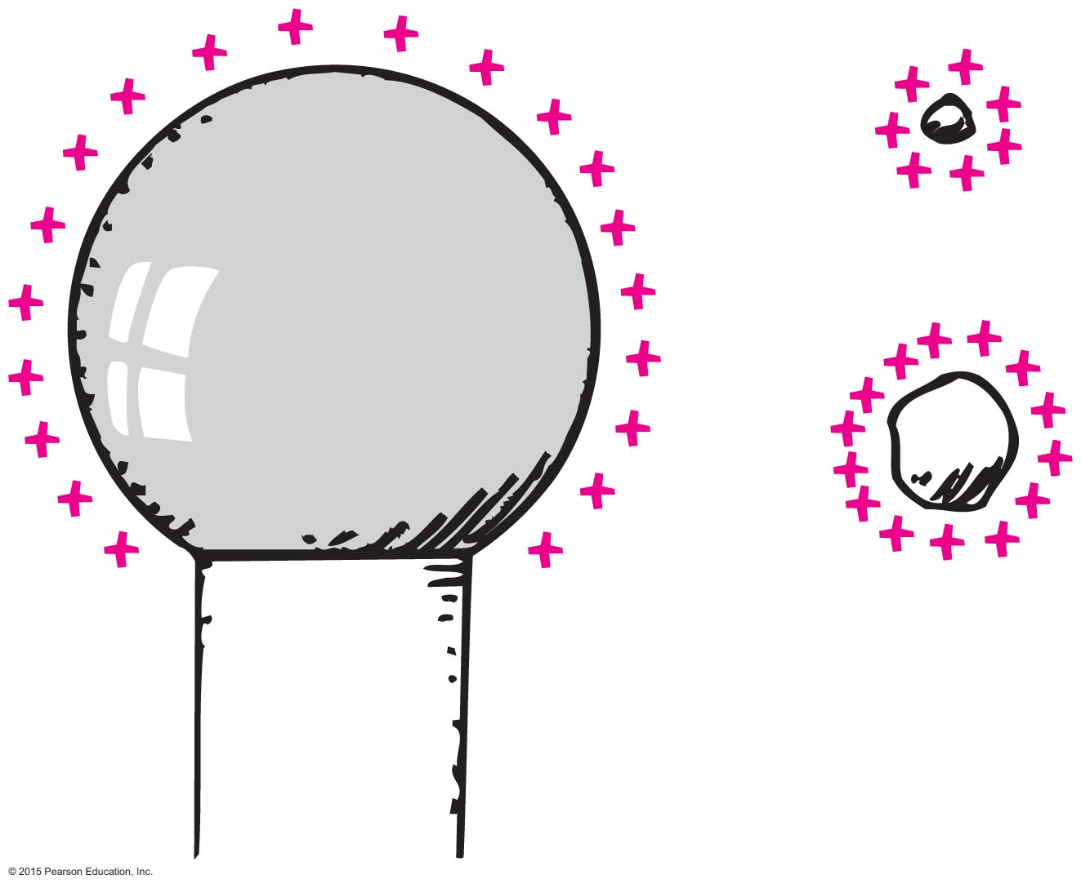
Electric Potential
Electric potential (voltage) (continued)
Unit of measurement: volt, 1 volt =
Example:
Twice the charge in same location has twice the electric potential energy but the same electric potential.
3 times the charge in same location has 3 times the electric potential energy but the same electric potential (2 E/2 q = 3 E/3 q = V)
1 joule
1 coulomb

Slide 40
Electric Potential CHECK YOUR NEIGHBOR
Electric potential energy is measured in joules. Electric potential, on the other hand (electric potential energy per charge), is measured
in volts.
in watts.
in amperes.
also in joules.
Notes:
A. in volts.

Slide 41
Electric Potential CHECK YOUR ANSWER
Electric potential energy is measured in joules. Electric potential, on the other hand (electric potential energy per charge), is measured
in volts.
in watts.
in amperes.
also in joules.
Notes:
A. in volts.

Slide 42
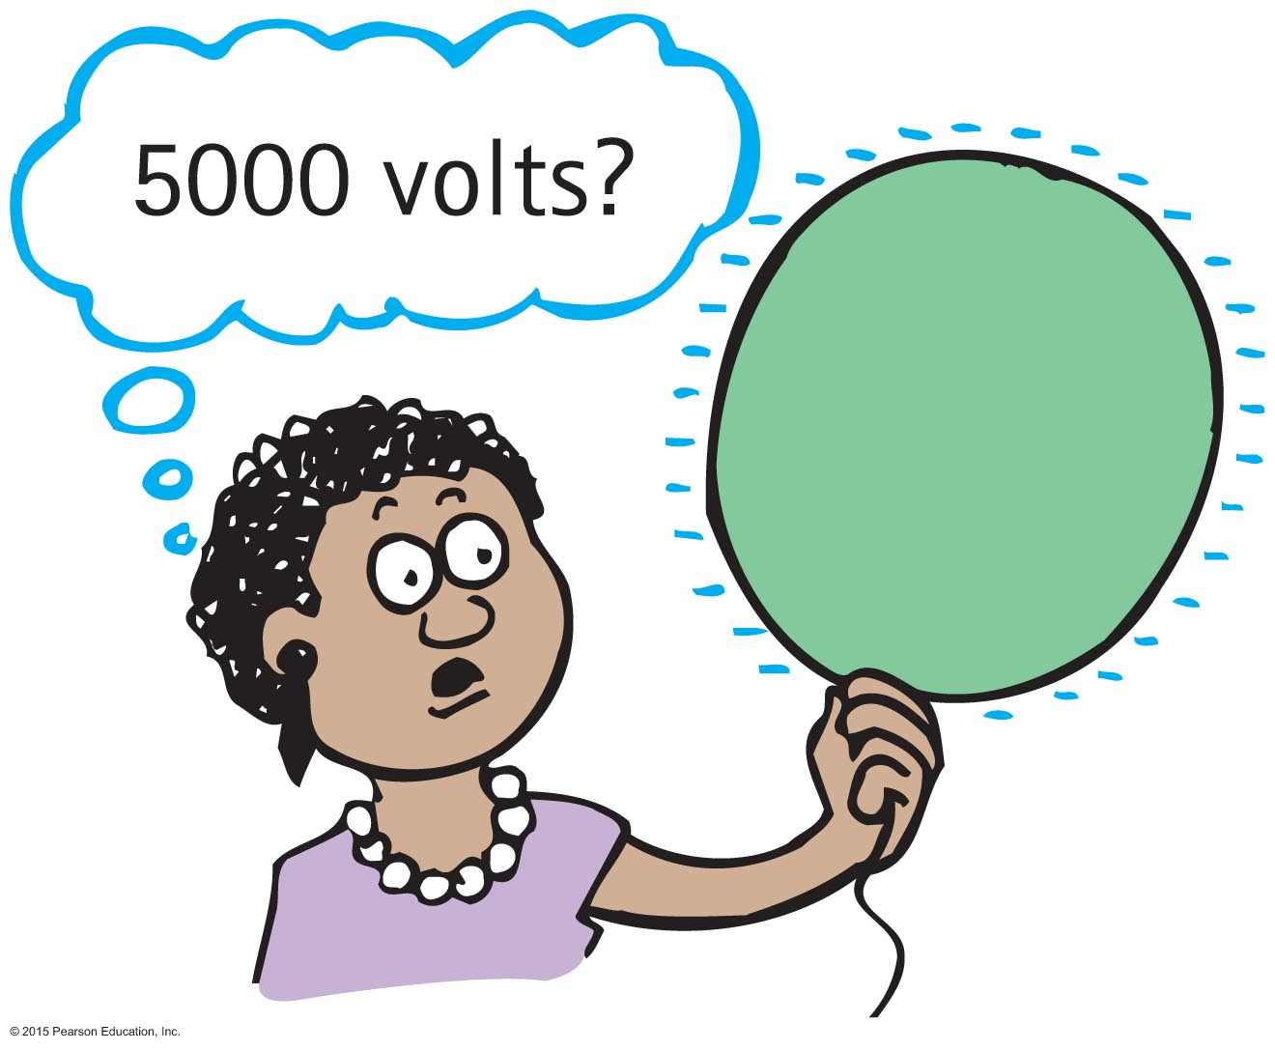
Electric Potential
Electric potential (voltage) (continued)
High voltage can occur at low electric potential energy for a small amount of charge.
High voltage at high electric potential energy occurs for lots of charge.

Slide 43
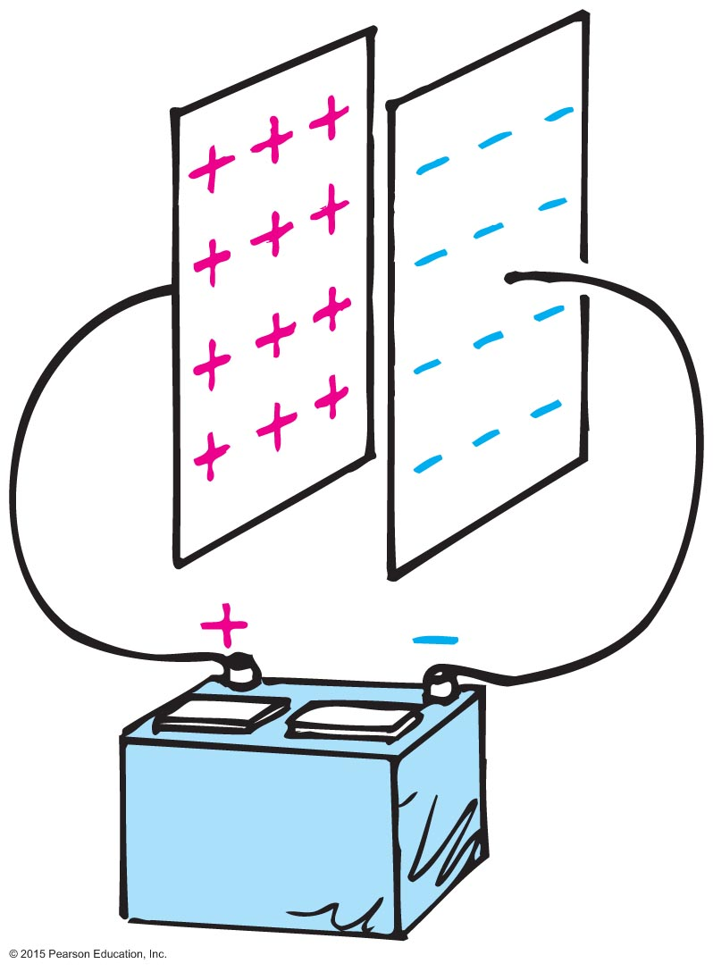
Electric Energy Storage
Electrical energy can be stored in a common device called a capacitor.
The simplest capacitor is a pair of conducting plates separated by a small distance, but not touching each other.
When the plates are connected to a charging device, such as the battery, electrons are transferred from one plate to the other.

Slide 44
Electric Energy Storage
This occurs as the positive battery terminal pulls electrons from the plate connected to it.
These electrons, in effect, are pumped through the battery and through the negative terminal to the opposite plate.
The capacitor plates then have equal and opposite charges:
The positive plate connected to the positive battery terminal, and
The negative plate connected to the negative terminal.

Slide 45
Electric Energy Storage
The charging process is complete when the potential difference between the plates equals the potential difference between the battery terminals—the battery voltage.
The greater the battery voltage, and the larger and closer the plates, the greater the charge that can be stored.
The energy stored in a capacitor comes from the work required to charge it.
Discharging a charged capacitor can be a shocking experience if you happen to be the conducting path.

Slide 46
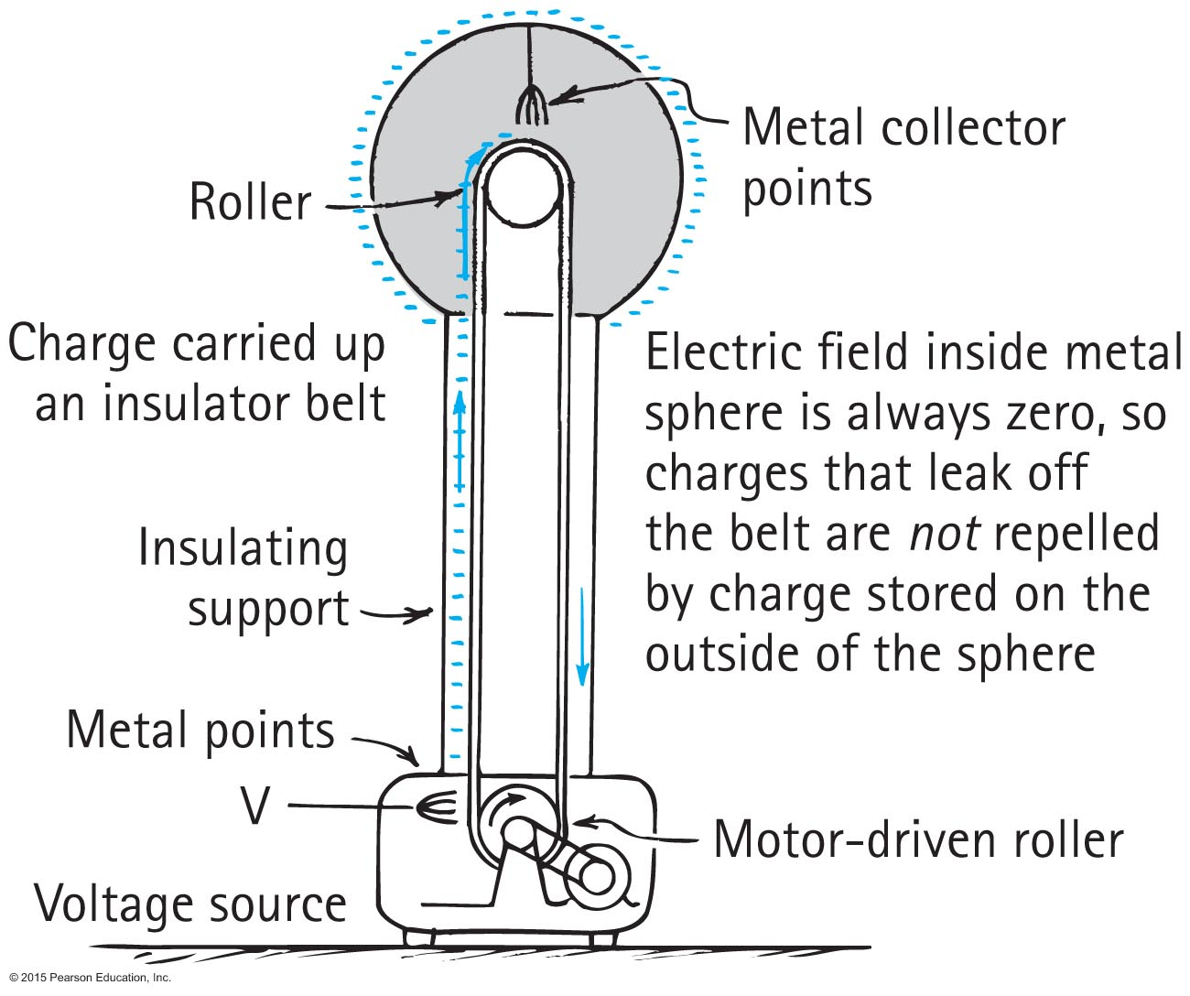
Electric Energy Storage
A common laboratory device for producing high voltages and creating static electricity is the Van de Graaff generator.

