Slide 1
The Big Bang
Dr. Mike MacCallum Long Beach City College mmaccallum@lbcc.edu

Slide 2
Astronomy Picture of the Day
✤
http://apod.nasa.gov/apod/

Slide 3
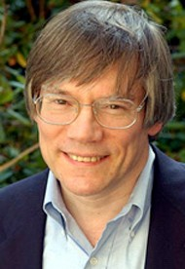
Astronomer of the Week
✤
Alan H. Guth
✤
Victor F. Weisskopf Professor of Physics Massachusetts Institute of Technology
✤
✤
S.B., S.M., and PhD degrees in physics Massachusetts Institute of Technology
✤
✤
Postdoctoral positions
✤
Princeton Cornell
Columbia Stanford
✤
✤
Created the concept of inflation
✤
http://web.mit.edu/physics/people/faculty/guth_alan.html

Slide 4
News of the Week
✤
Astronomy News of the Week
✤
http://www.lbcc.edu/Astronomy/News.cfm
✤
The sky this week
✤
http://www.starhustler.com/JHSG_DNLD.html

Slide 5
Study Tip of the Week
✤
Find a study-buddy
✤
Everything we do here in college must be your own work
Yet in the work world, you must collaborate and work with others Form a study group
Take classes with your friends Help each other out
Push each other to do well
✤
✤
✤
✤
✤

Slide 6
Questions from Last Week
The Universe

Slide 7
Lecture
The Big Bang

Slide 8
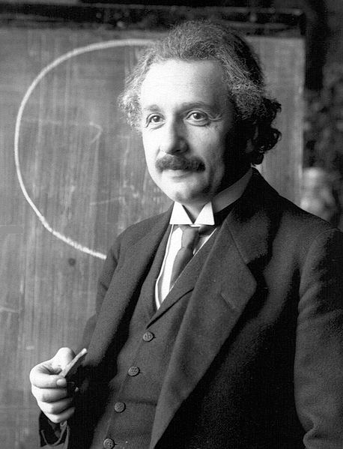

Einstein’s Cosmological Constant
✤
Capital Greek letter lambda "
✤
Added to create a stable, balanced universe Hubble found that the universe is expanding
The cosmological constant was thought to be unnecessary because the universe is not stable
Einstein said it was his biggest blunder
✤
✤
✤
✤
http://en.wikipedia.org/wiki/Cosmological_constant

Slide 9
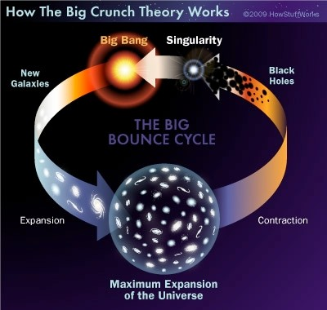
Three Possible Endings
✤
Closed
✤
Gravity is stronger than the expansion The expansion slows
Gravity pulls the universe back together Universe ends in a “Big Crunch”
✤
✤
✤

Slide 10
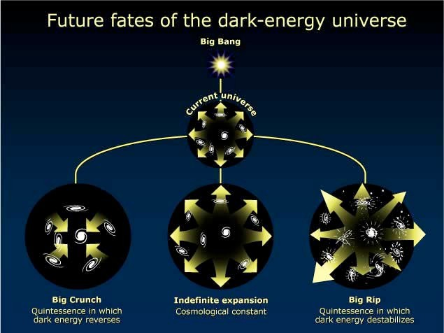
Three Possible Endings
✤
Balanced
✤
The expansion of the universe is slowed by gravity The universe expands out to a certain point Expansion just balances gravity
The Law of Entropy becomes most important Universe ends in a “Big Freeze”
✤
✤
✤
✤

Slide 11
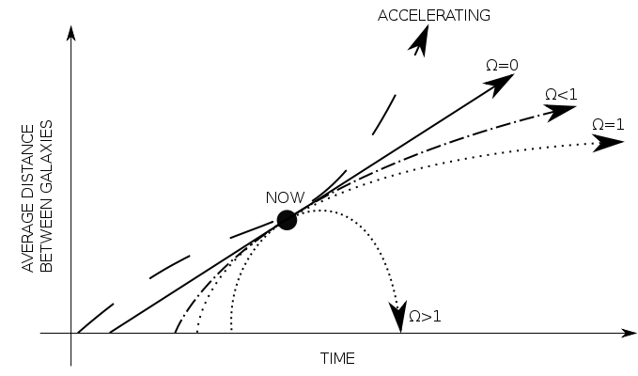
Three Possible Endings
✤
Open--most likely possibility today
✤
Expansion overwhelms gravity
The expansion continues to increase Other galaxies can no longer be seen
Other stars within our own galaxy can no longer be seen The expansion tears apart the atoms
Universe ends in a “Big Rip”
✤
✤
✤
✤
✤
✤
http://imagine.gsfc.nasa.gov/Images/map/geometry.jpg

Slide 12
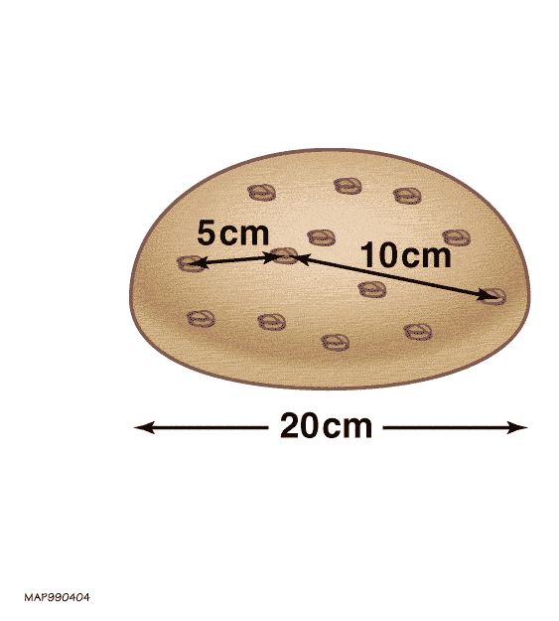
Expanding Universe
✤
The universe (space-time) was created with the Big Bang It is not really an explosion
The universe itself is expanding No edge, no middle
✤
✤
✤
✤
http://en.wikipedia.org/wiki/Metric_expansion_of_space

Slide 13
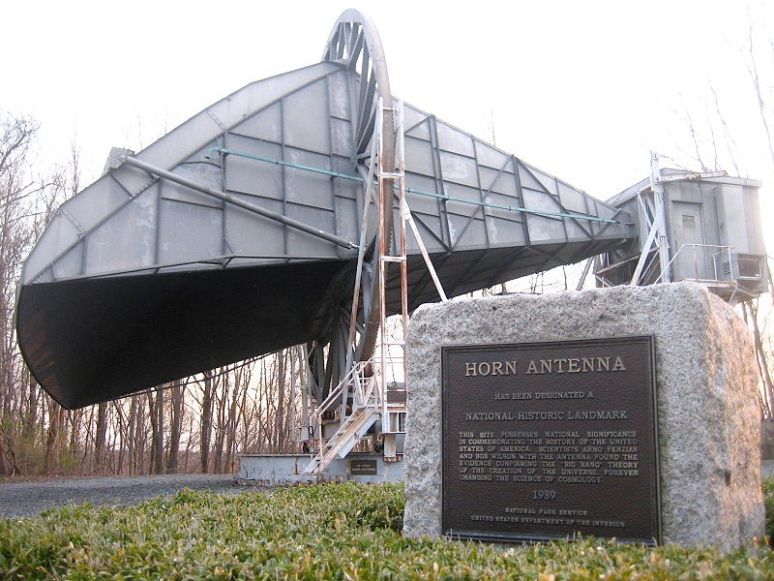
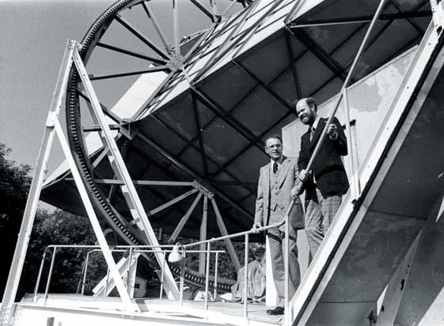
Arno Penzias & Robert Wilson
✤
Researchers with the Bell Labs in New Jersey
In 1965, they discovered static coming from all over the sky
They had discovered the Cosmic Microwave Background (CMB), the remnant radiation from the Big Bang
They received the Nobel Prize for their discovery in 1978
Robert Dicke had predicted the existence of the CMB, and was just getting ready to search for it with some other researchers
✤
✤
✤
✤
✤
http://www.bell-labs.com/project/feature/archives/cosmology/

Slide 14
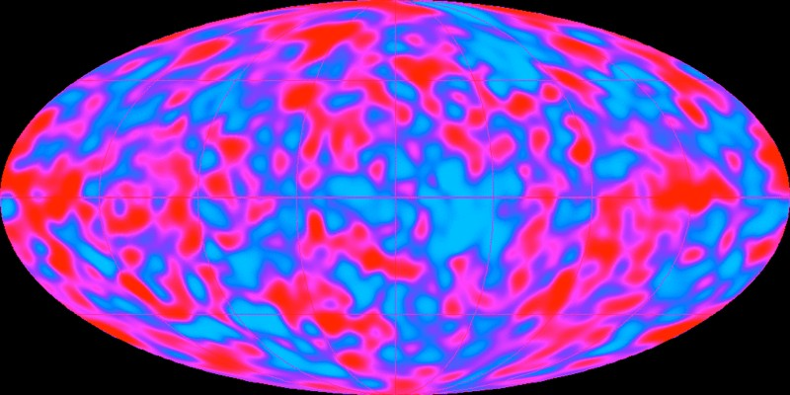
Cosmic Microwave Background
✤
Anisotropies, slight fluctuations, were imprinted on the CMB about 380,000 years after the Big Bang
Those fluctuations provide information of the amount and the arrangement of matter, dark matter, and dark energy at that time Average temperature: 2.725° K
First explored by the Cosmic Background Explorer (COBE) 1989-1993
✤
✤
✤
✤
http://science.nasa.gov/missions/cobe/

Slide 15
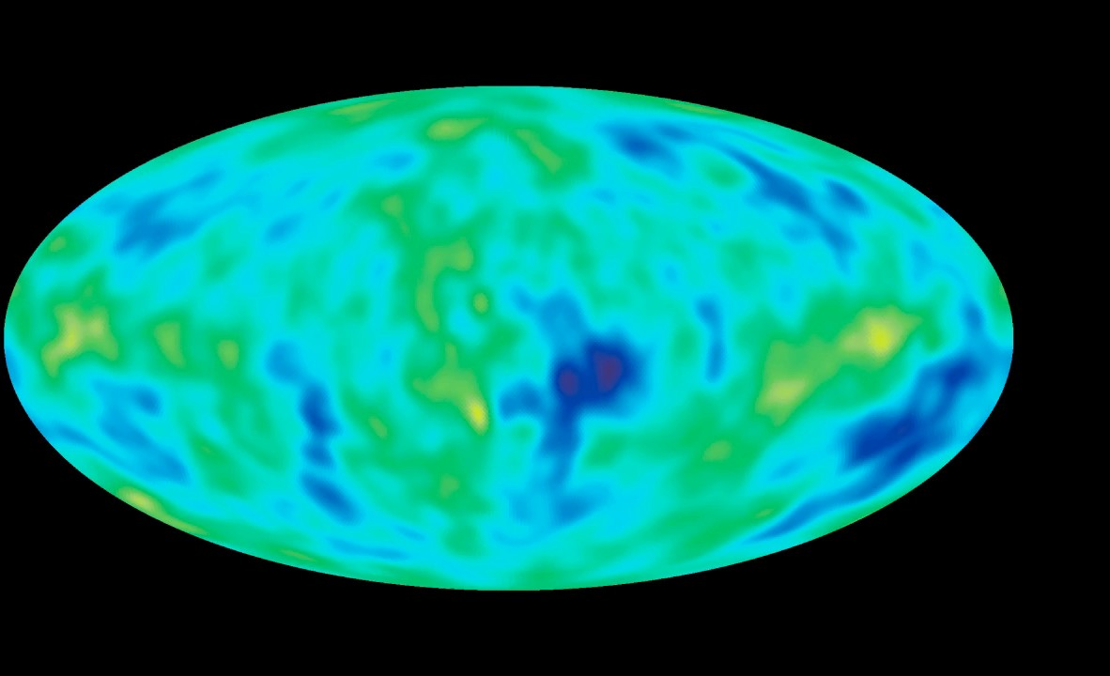
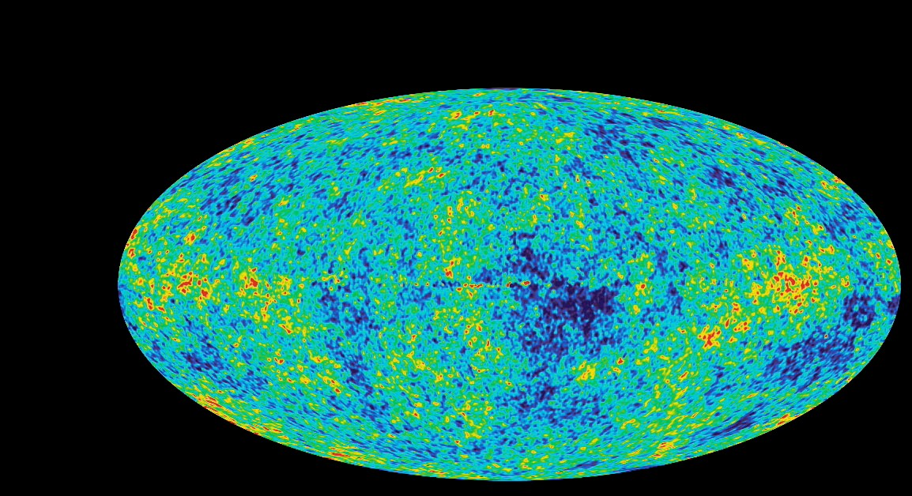
From COBE to WMAP

Slide 16
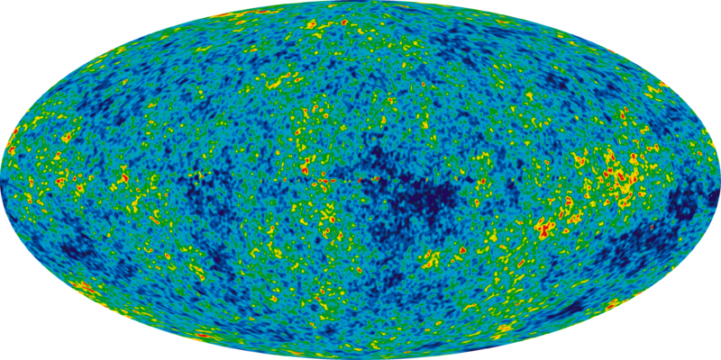
Cosmic Microwave Background
✤
Measured with more precision by the Wilkinson Microwave Anisotropy Probe (WMAP) 2001-2006
✤
http://map.gsfc.nasa.gov/news/

Slide 17
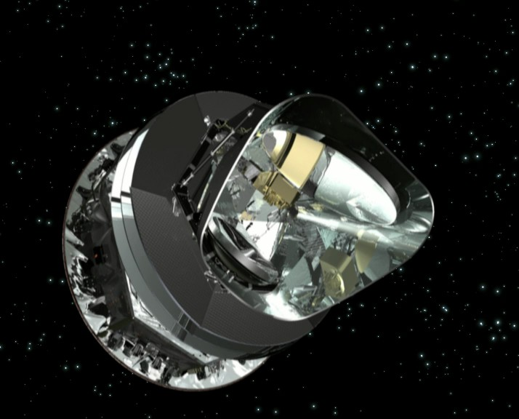
The Planck Mission
✤
Planck Spacecraft (ESA)
✤
Launched August 19, 2009
Observing the CMB with even greater resolution
✤
✤
http://www.rssd.esa.int/index.php?project=planck

Slide 18
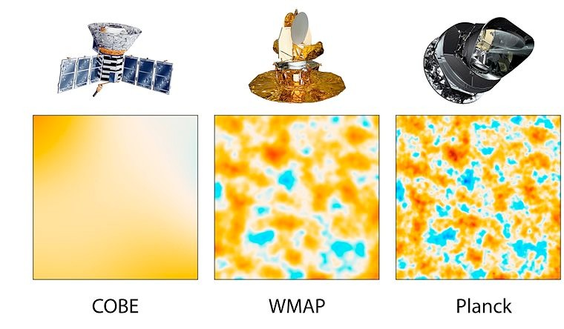
Planck First Results
✤
Age of the universe = 13.798 billion years
✤
CMB comes from 370,000 years after the Big Bang Ordinary (baryonic) matter = 4.9%
Dark matter = 26.8% Dark energy = 68.3%
The universe is within 1% of flatness (WMAP)
✤
✤
✤
✤
✤
http://map.gsfc.nasa.gov http://www.astro.ucla.edu/~wright/CMB-DT.html http://www.esa.int/Our_Activities/Space_Science/Planck/Planck_reveals_an_almost_perfect_Universe
✤
✤

Slide 19
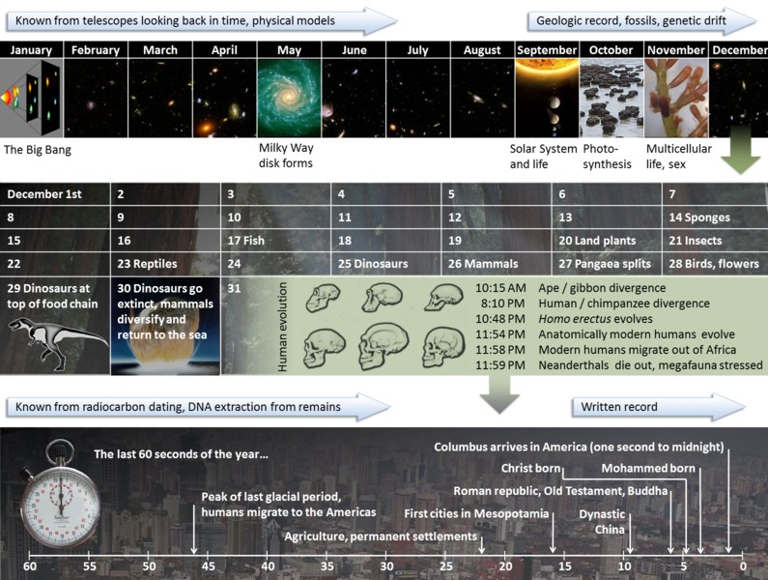
The Cosmic Calendar
✤
Age of the universe = 13.798 billion years
✤
If the age of the universe is equated to one year
✤
May 11--the Milky Way forms September 1--the sun forms
All human history occurred during the last 15 minutes of 12/31 The average life expectancy (80 years) = 0.18 seconds
✤
✤
✤
✤
http://www.youtube.com/watch?v=Ln8UwPd1z20 http://en.wikipedia.org/wiki/Cosmic_Calendar
✤

Slide 20

The Remnant of the Big Bang
✤
Like going to the beach on Sunday morning
✤
Measuring the heat in the sand around a fire pit Concluding the size of the fire and when it went out
✤
✤
We look at the size, density and temperature of the universe
✤
Extrapolate backwards in time
✤
Smaller size Increased density
Increased temperature
✤
✤

Slide 21
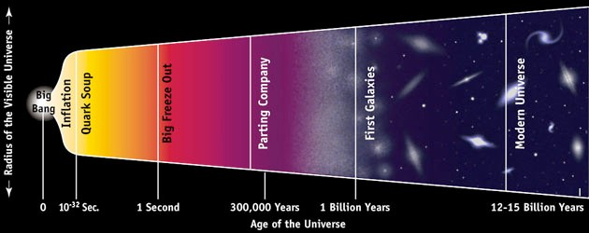
The Big Bang Timeline
✤
Planck Epoch
✤
To 10⁻⁴³ seconds About 10³⁰ degrees K
Too hot, too dense for the laws of physics to apply
✤
✤
✤
Grand Unification Epoch
✤
From 10⁻⁴³ to 10⁻³⁶ seconds About 10²⁷ degrees K
Three of the four fundamental forces separate from each other
✤
✤

Slide 22
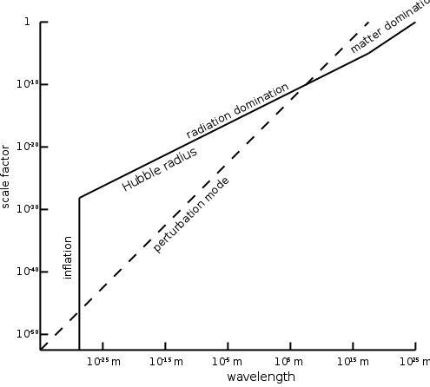
The Big Bang Timeline
✤
Inflation
✤
From 10⁻³⁶ to 10⁻³² seconds About 10²⁵ degrees K
A period of very great expansion of the universe
✤
✤
✤
Perhaps powered by the separation of the fundamental forces
✤
Electroweak Epoch
✤
From 10⁻³⁶ to 10⁻¹² seconds About 10¹⁵ degrees K
The electromagnetic and the weak force separate from each other
✤
✤

Slide 23
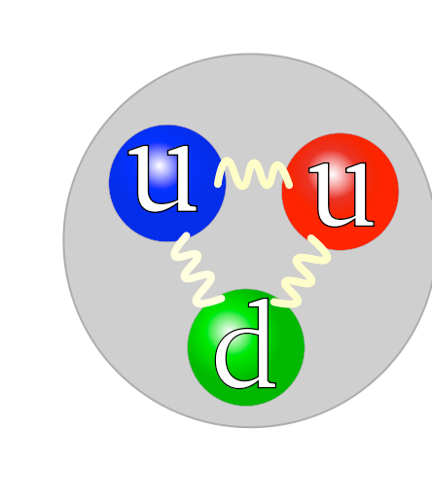
The Big Bang Timeline
From 10⁻¹² to 10⁻⁶ seconds About 10¹² degrees K
It is still too hot for quarks to bind together to form protons and neutrons (hadrons)
✤
Quark Epoch
✤
✤
✤
✤
Hadron Epoch
✤
From 10⁻⁶ to one second About 10⁹ degrees K
Neutrons and protons (hadrons) form--both normal and anti Neutrinos are released across the universe
✤
✤
✤

Slide 24
The Big Bang Timeline
✤
Lepton Epoch
✤
From 1 to 10 seconds About 10⁹ degrees K
Hadrons and anti-hadrons annihilate each other
The universe is dominated by leptons (electrons and anti-electrons)
✤
✤
✤
✤
Photon Epoch
✤
From 10 seconds to 380,000 years About 10⁷ degrees K
Leptons and anti-leptons annihilate each other
Photons are released across the universe forming the CMB
✤
✤
✤

Slide 25
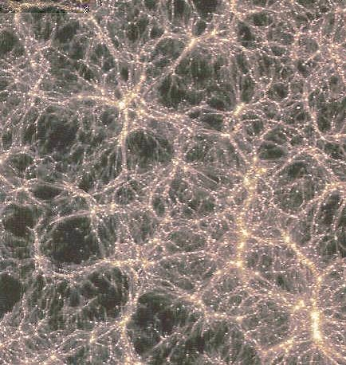
Inflation
✤
Solves the following problems
✤
Homogeneity/isotropic
✤
The universe looks essentially the same in all directions Inflation distributes the early mass uniformly in all directions
✤
✤
Flatness
Universe was fine-tuned during inflation to be with a few percent of flatness
Monopole magnetic particles should have been produced
✤
✤
✤
Should have been created by the heat of the Big Bang None have ever been found
Inflation quickly reduces the temperature of the early universe
✤
✤

Slide 26
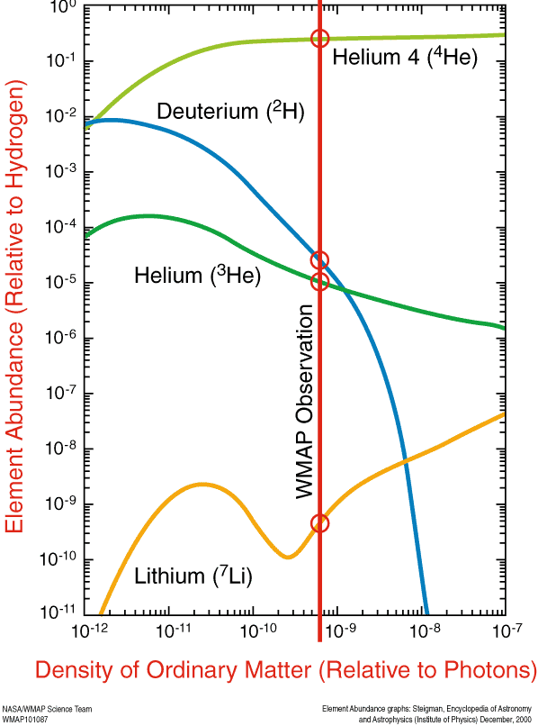
Nucleosynthesis
✤
The universe began with
✤
About 75% hydrogen
About 25% helium
About 0.01% deuterium
About 0.001% helium-3 Less the 0.0000001% lithium
✤
✤
✤
✤
✤
http://map.gsfc.nasa.gov/universe/bb_tests_ele.html http://www.webelements.com/
✤

Slide 27
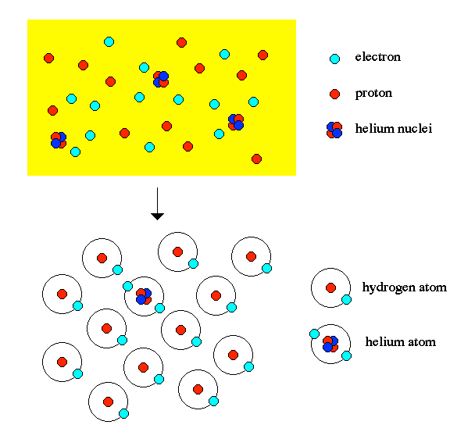
Recombination
✤
End of the Dark Ages Recombination
✤
✤
The universe cooled enough for electrons and protons to form atoms
Photons were released
The CMB was created about 370,000 years after the Big Bang
✤
✤

Slide 28
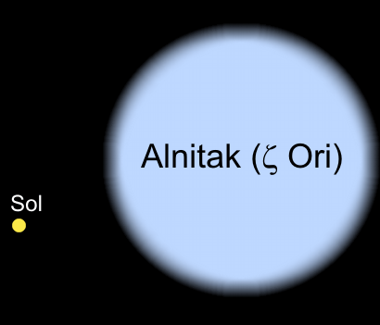
The First Stars
✤
Formed about 300 million years after the Big Bang
✤
Large, unstable Short lives
Their supernovae seeded the early universe with heavy elements
✤
✤
✤
The oldest star discovered to date
✤
HE 1523-0901
13.2 billion years old Metal poor star
1/1000th the iron of our Sun
Measured radioactive elements uranium and thorium
✤
✤
✤
✤
✤
http://discovermagazine.com/2007/aug/raw-data-oldest-star

Slide 29
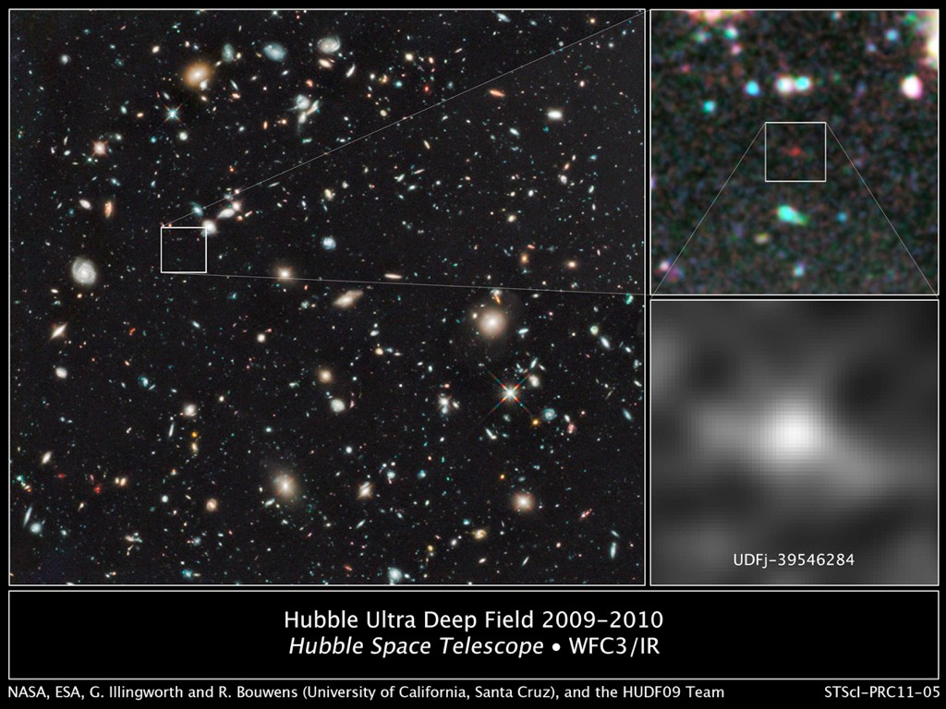
The Highest Redshift
✤
UDFj-39546284
✤
Redshift: z = 10.3
13.2 billion light years from Earth
480-500 million years after the Big Bang
✤
✤
✤
http://www.space.com/10691-oldest-galaxy-discovered-hubble-space-telescope.html

Slide 30
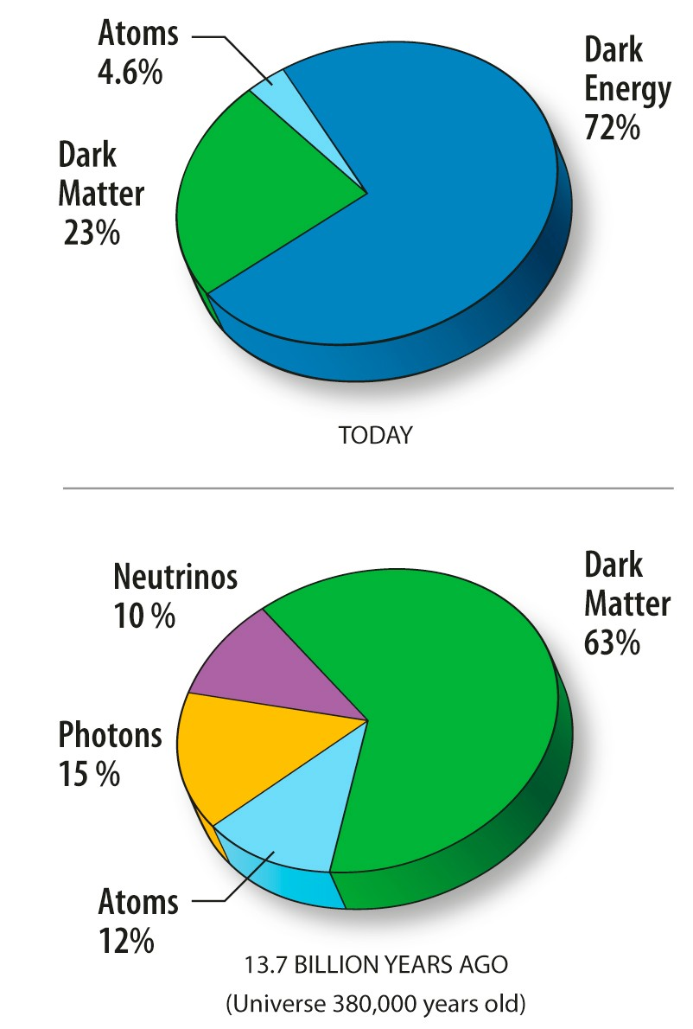
The Composition of the Universe
✤
Baryonic matter
✤
4.9% of the universe
✤
Dark matter
✤
26.8% of the universe
✤
Dark energy
✤
68.3% of the universe
✤
http://www.rssd.esa.int/index.php?project=planck

Slide 31
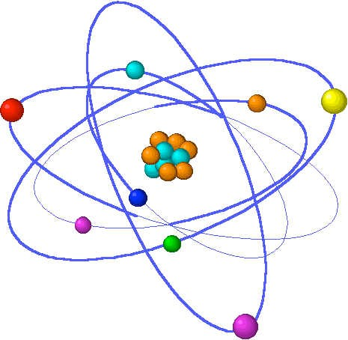
Baryonic Matter
✤
Baryons
✤
Protons Neutrons Electrons
Baryonic matter makes up 4.9%
✤
✤
✤
✤
Includes all the visible matter in the universe
✤
Stars and planets Gas and dust White dwarfs Neutron stars
✤
✤
✤

Slide 32
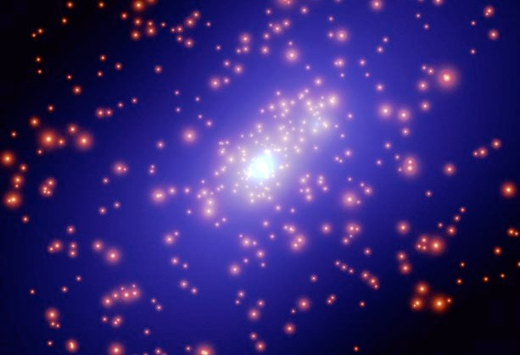
Dark Matter
✤
Does not absorb or emit light Observed by its gravitational effects
Could be made up of unseen normal, baryonic matter--massive compact halo objects (MACHOs)
✤
✤
✤
Free planets
Brown dwarfs, white dwarfs, black dwarfs Neutron stars, black holes
Dark clouds of rock, dust, etc
The Optical Gravitational Lensing Experiment (OGLE) has not found the expected number of objects
✤
✤
✤
✤
✤
http://ogle.astrouw.edu.pl/

Slide 33
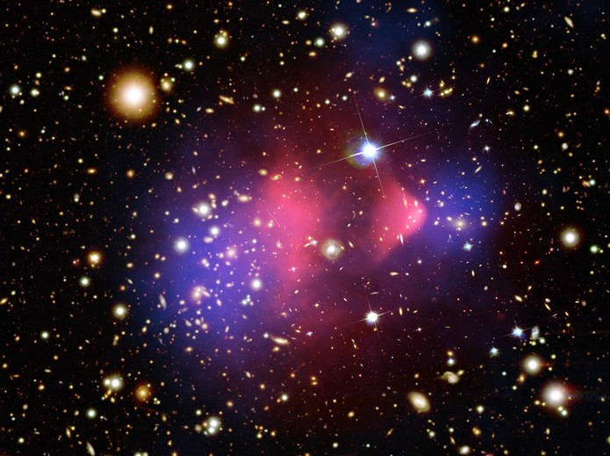
Dark Matter
✤
Could consist of exotic particles
✤
Axions
Higgs boson--recently discovered Massive neutrinos
WIMPS (Weakly Interacting Massive Particles)
✤
✤
✤
✤
http://nasascience.nasa.gov/astrophysics/what-is-dark-energy http://map.gsfc.nasa.gov
✤

Slide 34
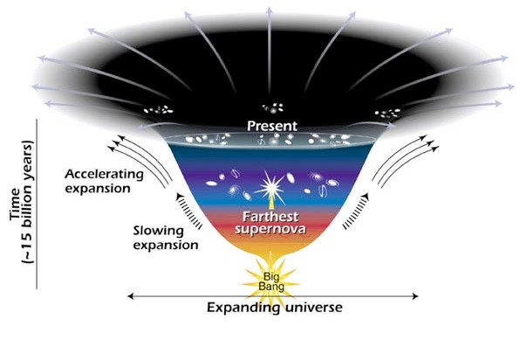
Dark Energy
✤
Acts in opposition to gravity
Responsible for the increasing expansion of the universe Could be Einstein’s cosmological constant
✤
✤
✤
Energy inherent in empty space
✤
Quantum mechanical effects
✤
Virtual particles
Calculated vacuum energy = 10¹²⁰
✤
✤
Quintessence
✤
A kind of new field

Slide 35
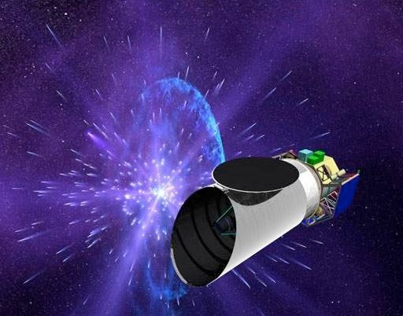
Dark Energy
✤
Our theory of gravity is wrong
✤
Modified Newtonian Dynamics (MOND)
✤
http://en.wikipedia.org/wiki/Modified_Newtonian_dynamics
✤
Metric or f(R) gravity
✤
http://en.wikipedia.org/wiki/F(R)_gravity

Slide 36
Big Bang--Alternative Theories

Slide 37
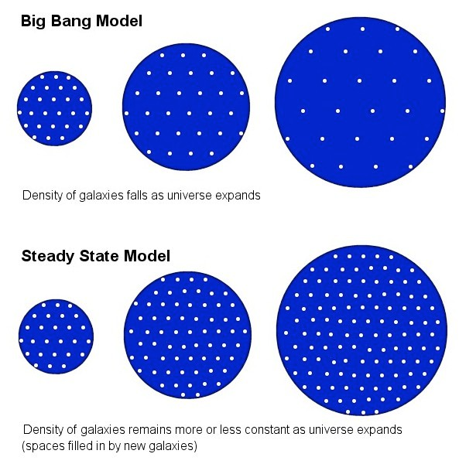
Steady State Theory
✤
Proposed by Fred Hoyle, Thomas Gold, and Hermann Bondi in the late 1940s
Infinite universe with no beginning
Expansion of the universe explained by the spontaneous creation of matter in the empty spaces between galaxies
The discovery of the CMB basically overturned the theory
✤
✤
✤
✤
http://en.wikipedia.org/wiki/Steady_State_theory

Slide 38
Next Week: The Theories of Relativity and Quantum Mechanics
✤
The special theory of relativity
✤
The speed of light as a constant
The relativity of time, length, and mass
✤
✤
The general theory of relativity
✤
Einstein’s theory of gravity
✤
Proofs of Einstein’s theories
Position vs. momentum at the quantum level Virtual particles
The standard model
The discovery of the Higgs boson Quarks and neutrinos
The large hadron collider at CERN String theory
✤
✤
✤
✤
✤
✤
✤

Slide 39
Some Things to Think About
✤
Why can’t the speed of light change?
If the speed of light is constant, what implications does that have for time, length, and mass?
Can we ever travel as fast as the speed of light?
How do we know that Einstein’s theories are correct? Is an electron a particle or a wave?
If we know where an electron is, what can we know about its momentum?
If we know an electron’s momentum, what can we know about its position?
How can virtual particles appear out of nothing?
Will string theory unify relativity and quantum mechanics?
✤
✤
✤
✤
✤
✤
✤
✤

Slide 40
See you next week!!

