Slide 1
Chapter 10: Projectile and Satellite Motion

Slide 2
This lecture will help you understand:
Projectile Motion
Fast-Moving Projectiles – Satellites
Circular Satellite Orbits
Elliptical Orbits
Kepler's Laws of Planetary Motion
Energy Conservation and Satellite Motion
Escape Speed

Slide 3
Projectile Motion
Without gravity, a tossed object follows a straight-line path.
With gravity, the same object tossed at an angle follows a curved path.
Projectile:
Any object that moves through the air or space under the influence of gravity, continuing in motion by its own inertia

Slide 4
Projectile Motion
Projectile motion is a combination of
a horizontal component, and
a vertical component.

Slide 5
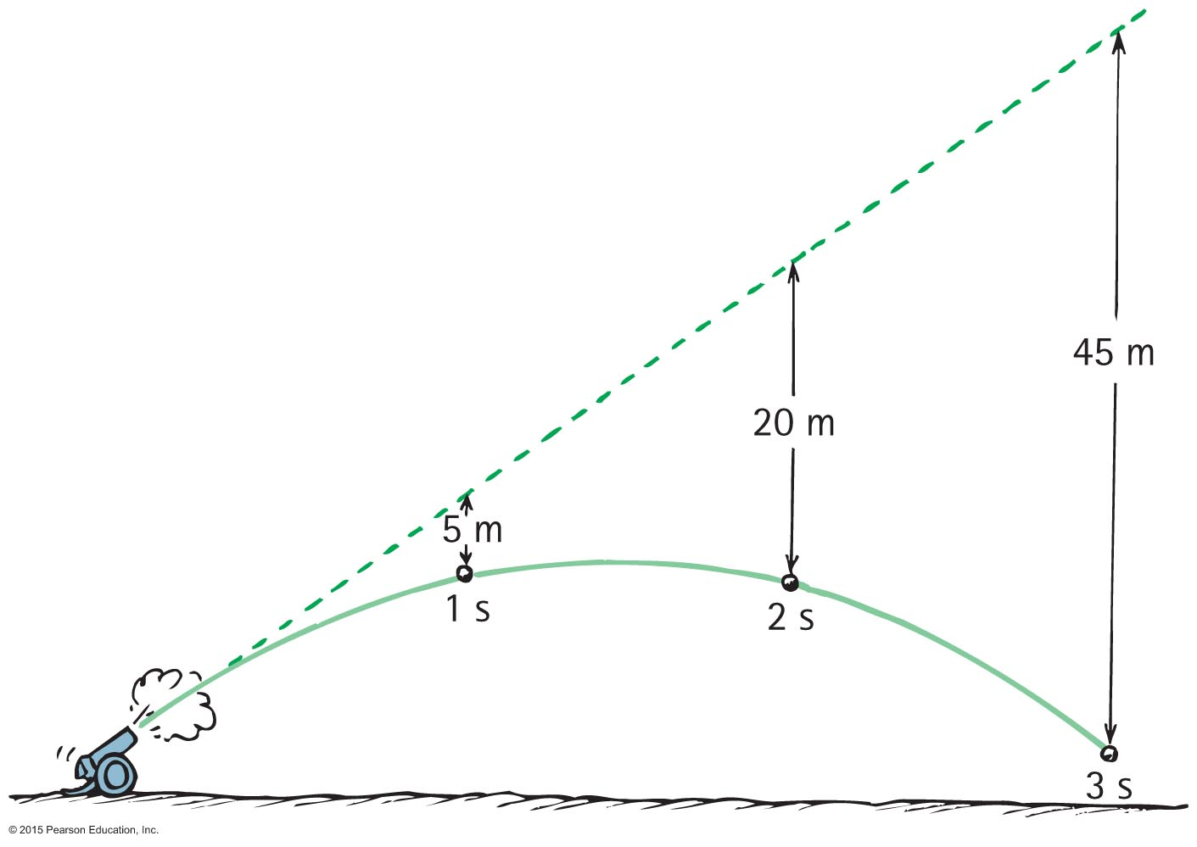
Projectile Motion
Projectiles launched horizontally
Important points:
Horizontal component of velocity doesn't change (when air drag is negligible).
Ball travels the same horizontal distance in equal times (no component of gravitational force acting horizontally).
Remains constant.

Slide 6
Projectile Motion
Vertical positions become farther apart with time.
Gravity acts downward, so ball accelerates downward.
Curvature of path is the combination of horizontal and vertical components of motion.

Slide 7
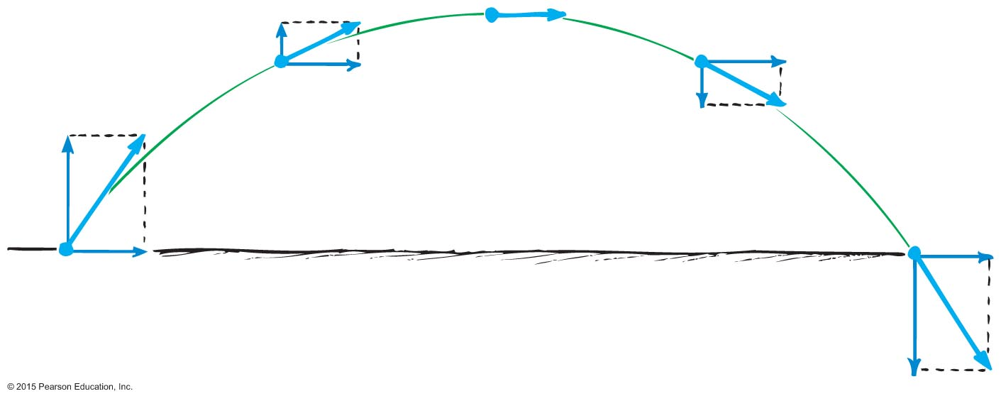
Projectile Motion
Parabola:
Curved path of a projectile that undergoes acceleration only in the vertical direction, while moving horizontally at a constant speed

Slide 8
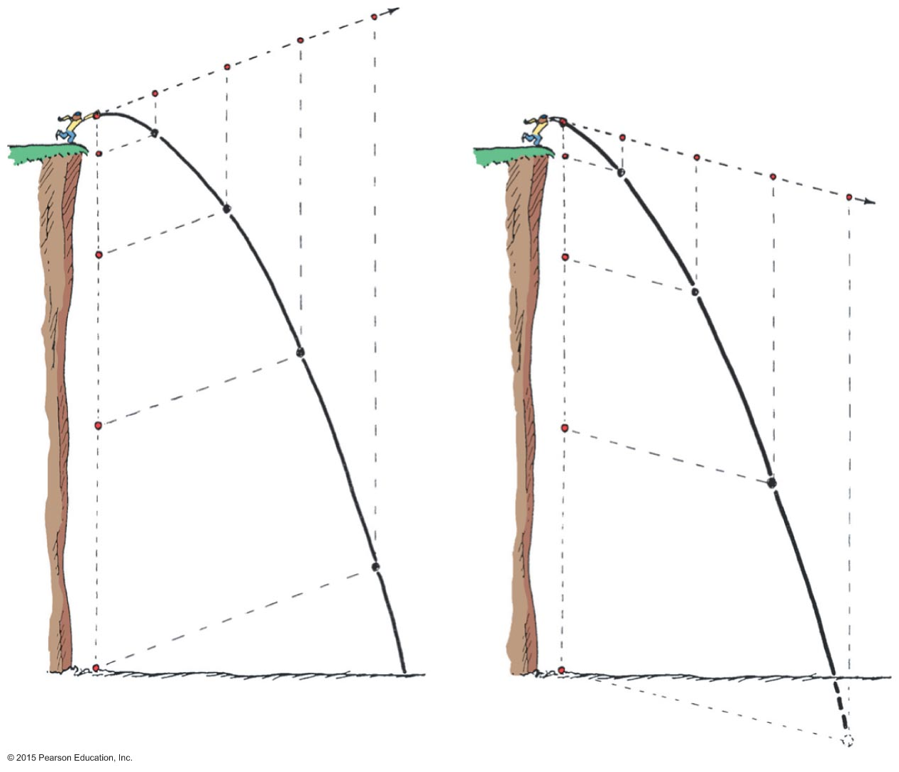
Projectile Motion
Projectiles launched at an angle:
Paths of stone thrown at an angle upward and downward
Vertical and horizontal components are independent of each other.

Slide 9
Projectile Motion
Paths of a cannonball shot at an upward angle
Vertical distance that a stone falls is the same vertical distance it would have fallen if it had been dropped from rest and been falling for the same amount of time (5t²).

Slide 10
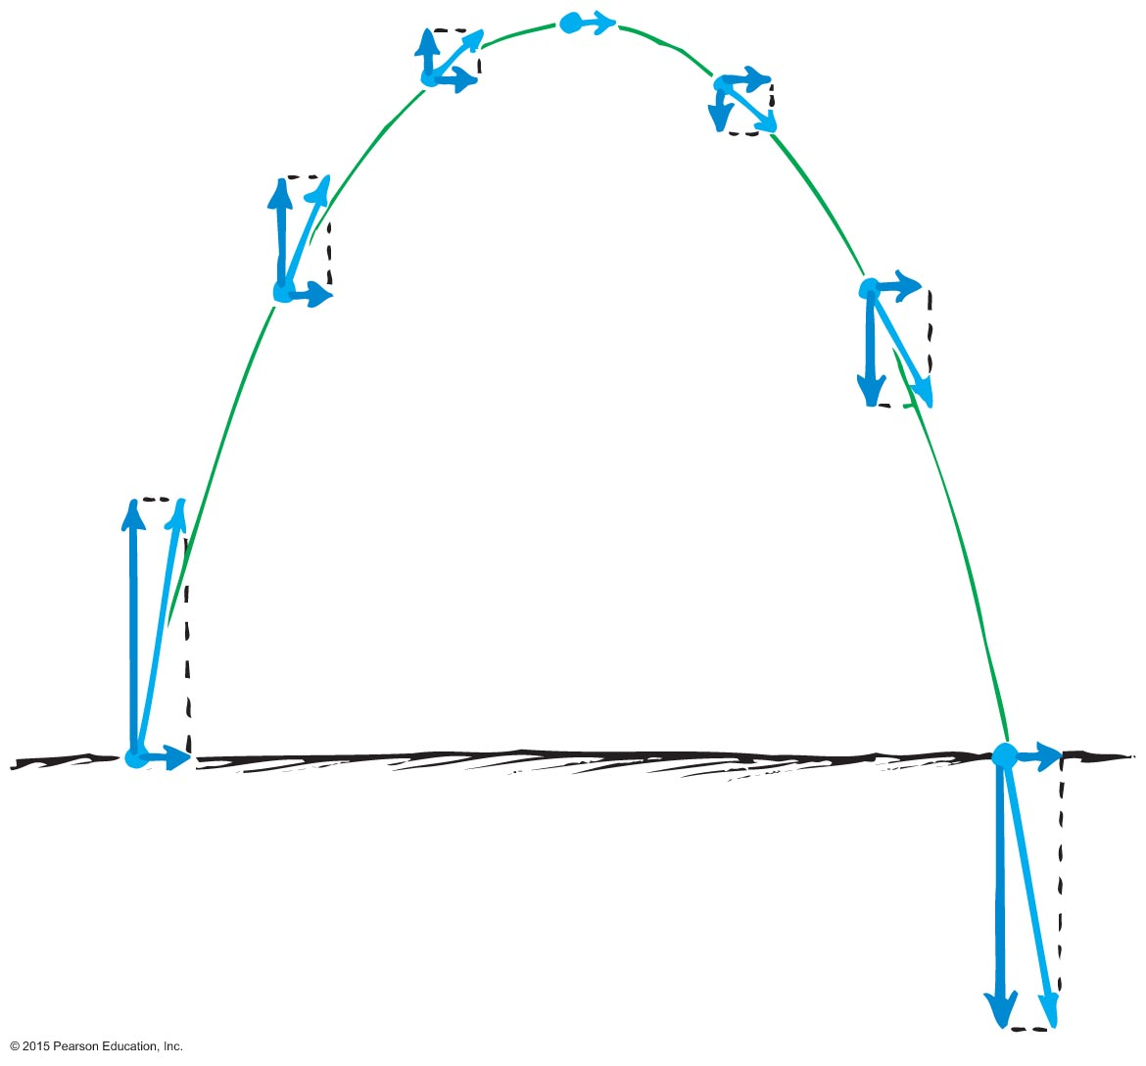
Projectile Motion
Paths of projectile following a parabolic trajectory
Horizontal component along trajectory remains unchanged.
Only vertical component changes.
Velocity at any point is computed with the Pythagorean theorem (diagonal of rectangle).

Slide 11
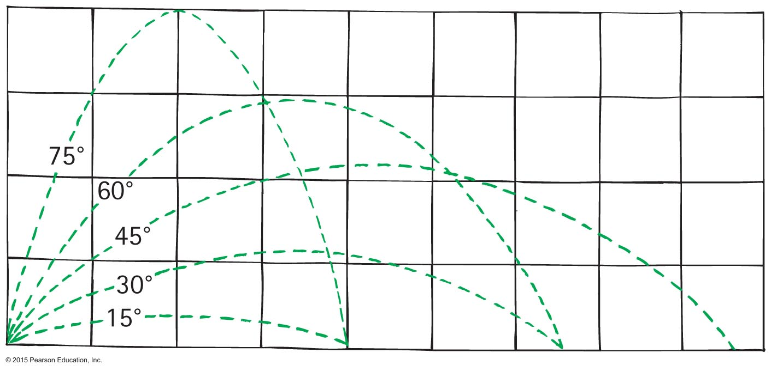
Projectile Motion
Different horizontal distances
Same range is obtained from two different launching angles when the angles add up to 90 °.
Object thrown at an angle of 60° has the same range as if it were thrown at an angle of 30 ° .

Slide 12
Projectile Motion
Different horizontal distances (continued)
Maximum range occurs for ideal launch at 45 °.
With air resistance, the maximum range occurs for a baseball batted at less than 45 ° above the horizontal (~25 °−34 °).
With air resistance the maximum range occurs when a golf ball is hit at an angle less than 38 °.

Slide 13
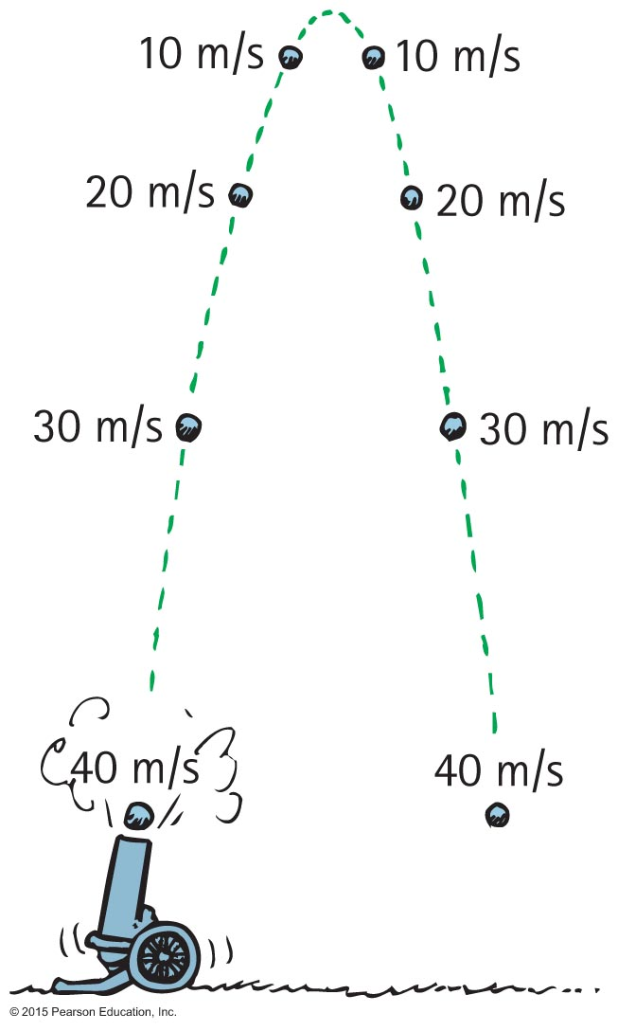
Projectile Motion
Without air resistance, the time for a projectile to reach maximum height is the same as the time for it to return to its initial level.

Slide 14
Projectile Motion CHECK YOUR NEIGHBOR
The velocity of a typical projectile can be represented by horizontal and vertical components. Assuming negligible air resistance, the horizontal component along the path of the projectile
increases.
decreases.
remains the same.
Not enough information.
Notes:
C. remains the same.

Slide 15
Projectile Motion CHECK YOUR ANSWER
The velocity of a typical projectile can be represented by horizontal and vertical components. Assuming negligible air resistance, the horizontal component along the path of the projectile
increases.
decreases.
remains the same.
Not enough information.
Explanation:
Since there is no force horizontally, no horizontal acceleration occurs.
Notes:
C. remains the same.

Slide 16
Projectile Motion CHECK YOUR NEIGHBOR
When no air resistance acts on a fast-moving baseball, its acceleration is
downward, g.
a combination of constant horizontal motion and accelerated downward motion.
opposite to the force of gravity.
centripetal.
Notes:
A. downward, g.

Slide 17
Projectile Motion CHECK YOUR ANSWER
When no air resistance acts on a fast-moving baseball, its acceleration is
downward, g.
a combination of constant horizontal motion and accelerated downward motion.
opposite to the force of gravity.
centripetal.
Notes:
A. downward, g.

Slide 18
Projectile Motion CHECK YOUR NEIGHBOR
Neglecting air drag, a ball tossed at an angle of 30 ° with the horizontal will go as far downrange as one that is tossed at the same speed at an angle of
45 °.
60 °.
75 °.
None of the above.
Notes:
B. 60°.

Slide 19
Projectile Motion CHECK YOUR ANSWER
Neglecting air drag, a ball tossed at an angle of 30 ° with the horizontal will go as far downrange as one that is tossed at the same speed at an angle of
45°.
60 °.
75 °.
None of the above.
Explanation:
Same initial-speed projectiles have the same range when their launching angles add up to 90° . Why this is true involves a bit of trigonometry—which, in the interest of time, we'll not pursue here.
Notes:
B. 60°.

Slide 20
Fast-Moving Projectiles—Satellites
Satellite motion is an example of a high-speed projectile.
A satellite is simply a projectile that falls around Earth rather than into it.
Sufficient tangential velocity needed for orbit.
With no resistance to reduce speed, a satellite goes around Earth indefinitely.

Slide 21
Fast-Moving Projectiles—Satellites CHECK YOUR NEIGHBOR
As the ball leaves the girl's hand, 1 second later it will have fallen
10 meters.
5 meters below the dashed line.
less than 5 meters below the straight-line path.
None of the above.
Notes:
B. 5 meters below the dashed line.

Slide 22
Fast-Moving Projectiles—Satellites CHECK YOUR ANSWER
As the ball leaves the girl's hand, 1 second later it will have fallen
10 meters.
5 meters below the dashed line.
less than 5 meters below the straight-line path.
None of the above.
Comment:
Whatever the speed, the ball will fall a vertical distance of 5 meters below the dashed line.
Notes:
B. 5 meters below the dashed line.

Slide 23
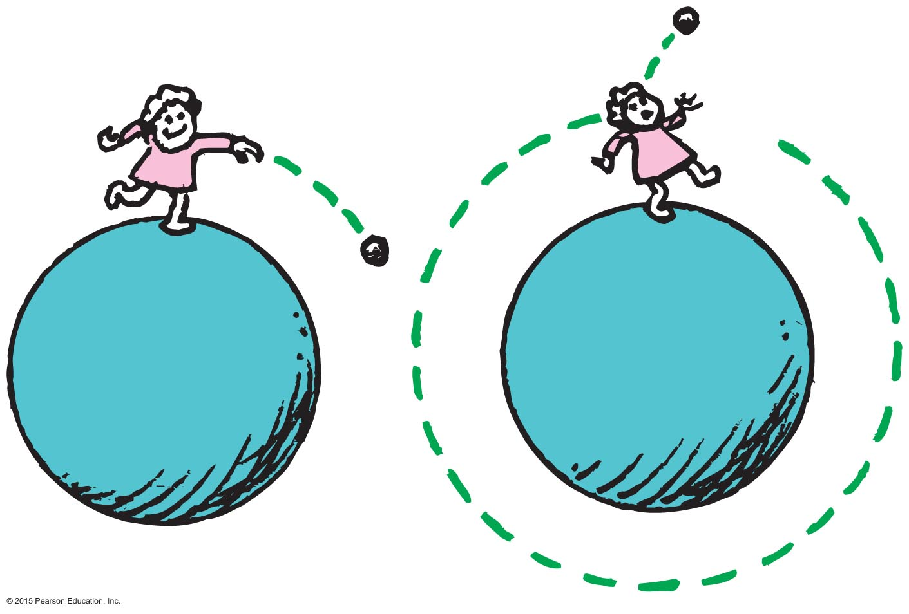
Circular Satellite Orbits
Satellite in circular orbit
Speed
must be great enough to ensure that its falling distance matches Earth's curvature.
is constant—only direction changes.
is unchanged by gravity.

Slide 24
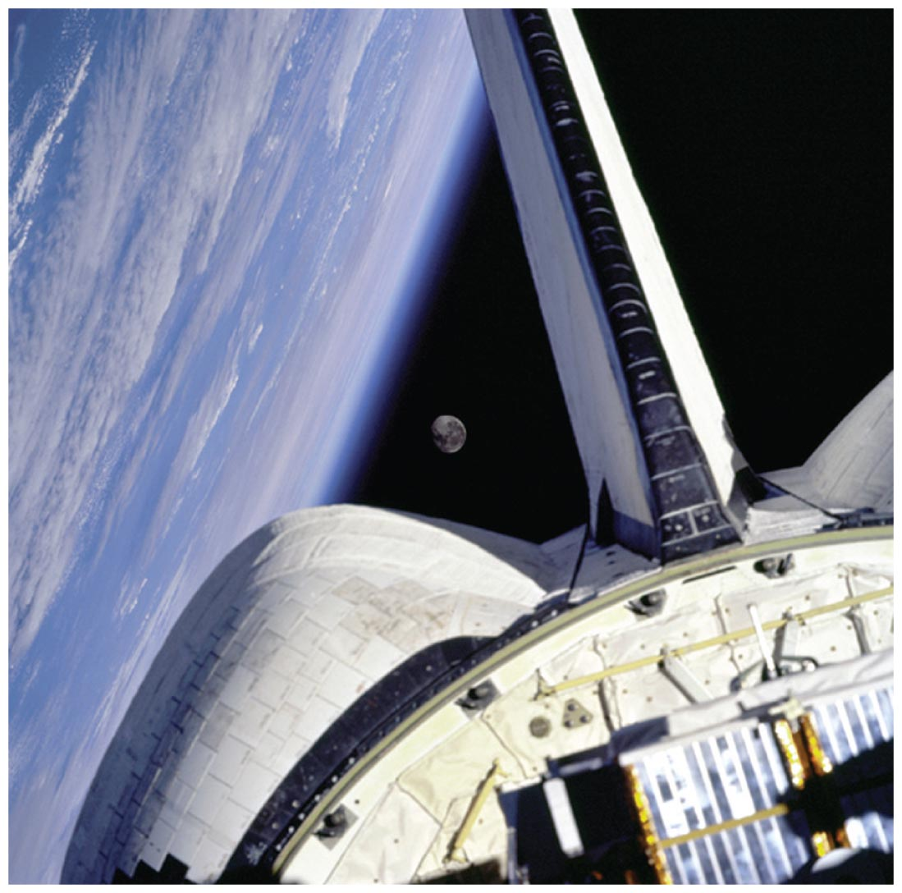
Circular Satellite Orbits
Positioning:
beyond Earth's atmosphere, where air resistance is almost totally absent
Example: Space shuttles are launched to altitudes of 150 kilometers or more, to be above air drag (But even the ISS, as shown experiences some air drag, which is compensated for with periodic upward boosts.)

Slide 25
Circular Satellite Orbits
Motion
moves in a direction perpendicular to the force of gravity acting on it
Period for complete orbit about Earth
for satellites close to Earth—about 90 minutes
for satellites at higher altitudes—longer periods

Slide 26
Circular Satellite Orbits
Curvature of Earth
Earth surface drops a vertical distance of 5 meters for every 8000 meters tangent to the surface

Slide 27
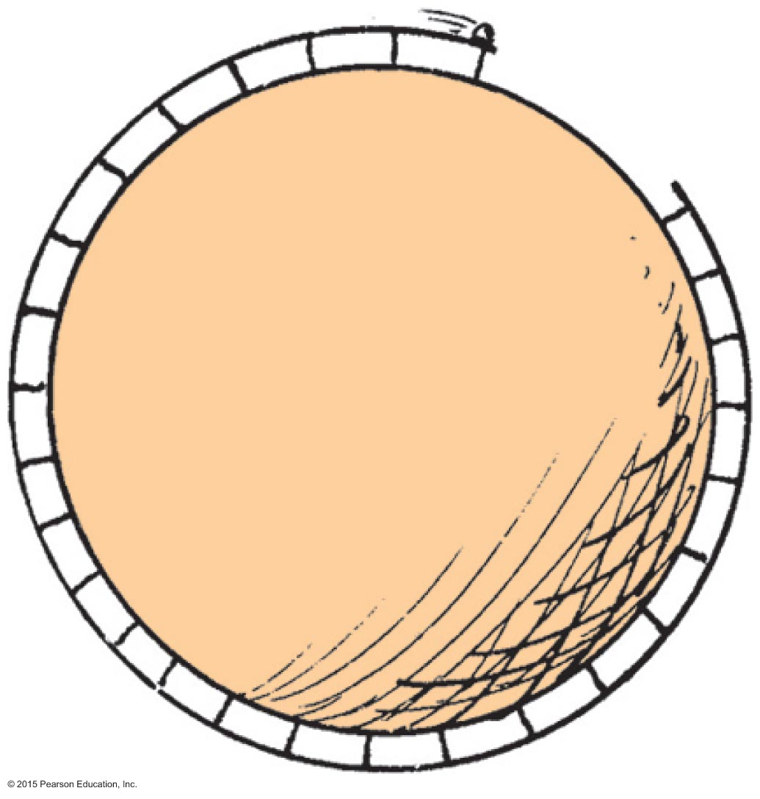
Circular Satellite Orbits
What speed will allow the ball to clear the gap?

Slide 28
Circular Satellite Orbits CHECK YOUR NEIGHBOR
When you toss a projectile sideways, it curves as it falls. It will be an Earth satellite if the curve it makes
matches the curved surface of Earth.
results in a straight line.
spirals out indefinitely.
None of the above.
Notes:
A. matches the curved surface of Planet Earth.

Slide 29
Circular Satellite Orbits CHECK YOUR ANSWER
When you toss a projectile sideways, it curves as it falls. It will be an Earth satellite if the curve it makes
matches the curved surface of Earth.
results in a straight line.
spirals out indefinitely.
None of the above.
Explanation:
For an 8-km tangent, Earth curves downward 5 m. Therefore, a projectile traveling horizontally at 8 km/s will fall 5 m in that time, and follow the curve of Earth.
Notes:
A. matches the curved surface of Planet Earth.

Slide 30
Circular Satellite Orbits CHECK YOUR NEIGHBOR
When a satellite travels at a constant speed, the shape of its path is
a circle.
an ellipse.
an oval that is almost elliptical.
a circle with a square corner, as seen throughout your book.
Notes:
A. a circle.

Slide 31
Circular Satellite Orbits CHECK YOUR ANSWER
When a satellite travels at a constant speed, the shape of its path is
a circle.
an ellipse.
an oval that is almost elliptical.
a circle with a square corner, as seen throughout your book.
Notes:
A. a circle.

Slide 32
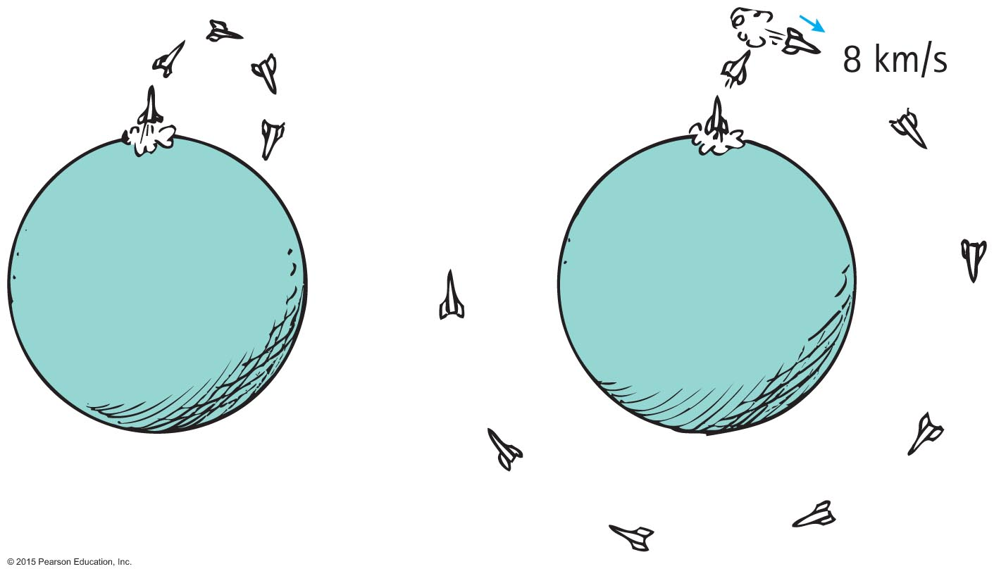
Circular Satellite Orbits
A payload into orbit requires control over
direction of rocket.
Initially, rocket is fired vertically, then tipped.
Once above the atmosphere, the rocket is aimed horizontally.
speed of rocket
Payload is given a final thrust to orbital speed of 8 km/s to fall around Earth and become an Earth satellite.

Slide 33
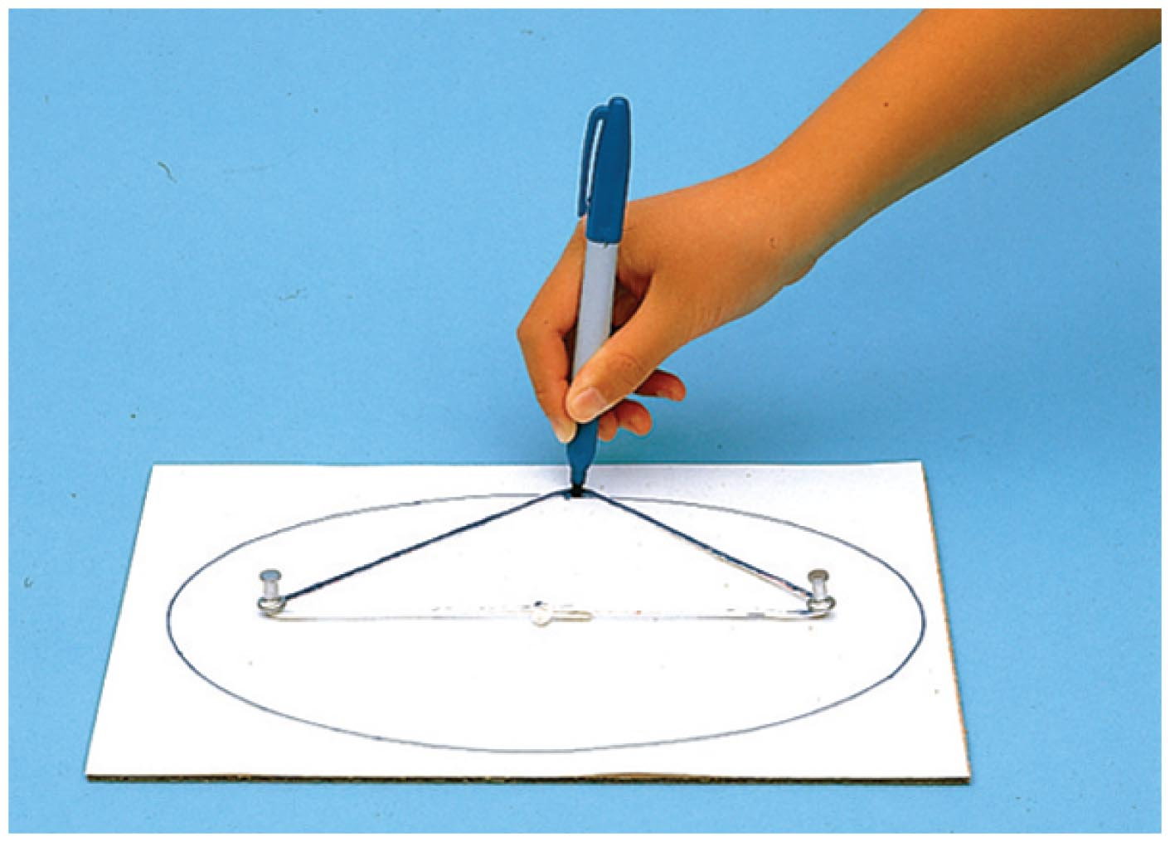
Elliptical Orbits
A projectile just above the atmosphere will follow an elliptical path if given a horizontal speed greater than 8 km/s.
Ellipse
specific curve, an oval path
Example: A circle is a special case of an ellipse when its two foci coincide.

Slide 34
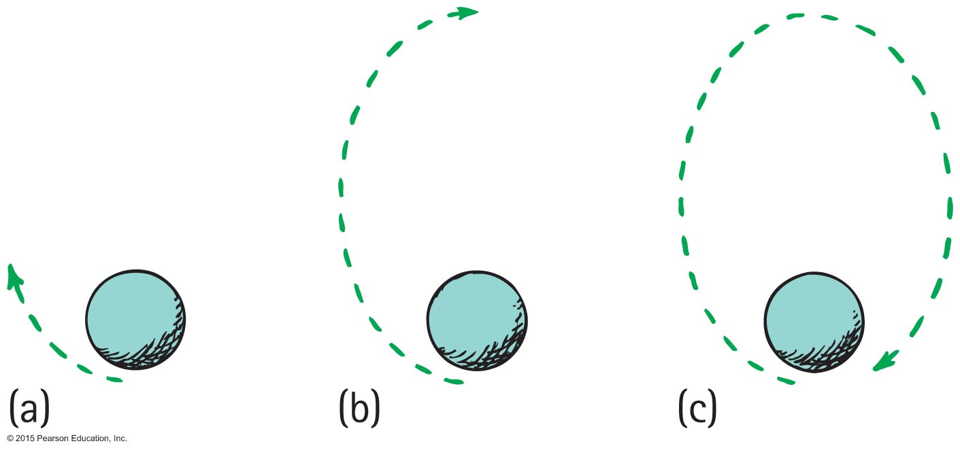
Elliptical Orbits
Elliptical orbit
Speed of satellite varies.
Initially, if speed is greater than needed for circular orbit, satellite overshoots a circular path and moves away from Earth.
Satellite loses speed and then regains it as it falls back toward Earth.
It rejoins its original path with the same speed it had initially.
Procedure is repeated.

Slide 35
Elliptical Orbits CHECK YOUR NEIGHBOR
The speed of a satellite in an elliptical orbit
varies.
remains constant.
acts at right angles to its motion.
All of the above.
Notes:
A. varies.

Slide 36
Elliptical Orbits CHECK YOUR ANSWER
The speed of a satellite in an elliptical orbit
varies.
remains constant.
acts at right angles to its motion.
All of the above.
Comment :
A satellite in an elliptical orbit half the time recedes from Earth and loses speed and half the time approaches Earth and gains speed.
Notes:
A. varies.

Slide 37
Kepler's Laws of Planetary Motion
Kepler was assistant to the famous astronomer Brahe, who directed the world's first observatory.
He used data his mentor Brahe had collected on planetary motion to figure out the motion of planets.
He found that the motion of planets was not circular; rather, it was elliptical.

Slide 38
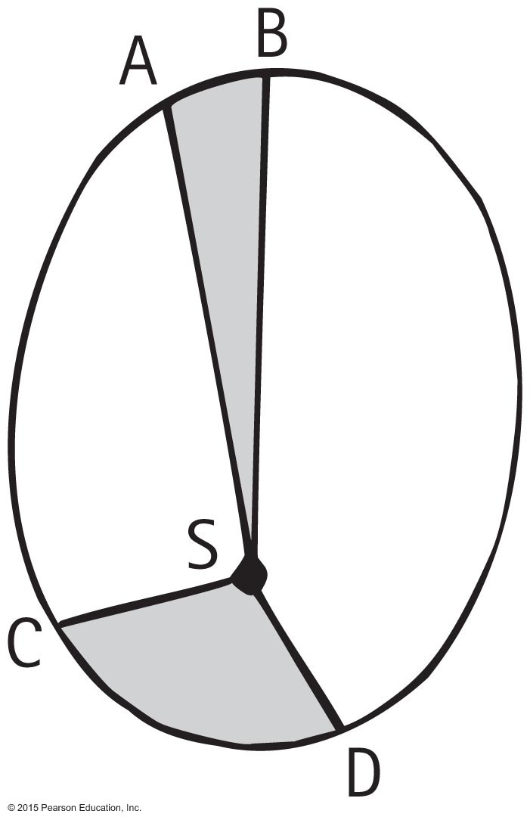
Kepler's Laws of Planetary Motion
1st Law: The path of each planet around the Sun is an ellipse with the Sun at one focus.
2nd Law: The line from the Sun to any planet sweeps out equal areas of space in equal time intervals.
3rd Law: The square of the orbital period of a planet is directly proportional to the cube of the average distance of the planet from the Sun (for all planets).

Slide 39
Energy Conservation and Satellite Motion
Recall the following:
Object in motion possesses KE due to its motion.
Object above Earth's surface possesses PE by virtue of its position.
Satellite in orbit possesses KE and PE.
Sum of KE and PE is constant at all points in the orbit.

Slide 40
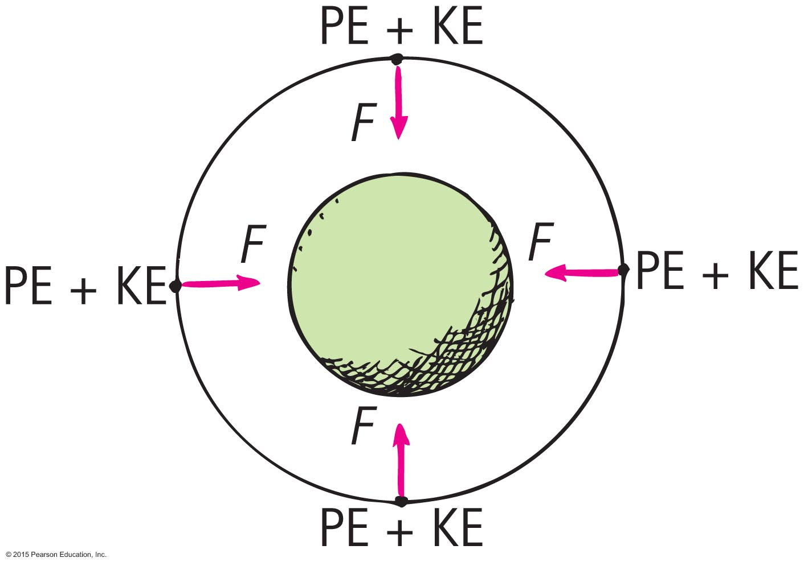
Energy Conservation and Satellite Motion
PE, KE, and speed in circular orbit:
Unchanged.
distance between the satellite and center of the attracting body does not change—PE is the same everywhere.
no component of force acts along the direction of motion—no change in speed and KE.

Slide 41
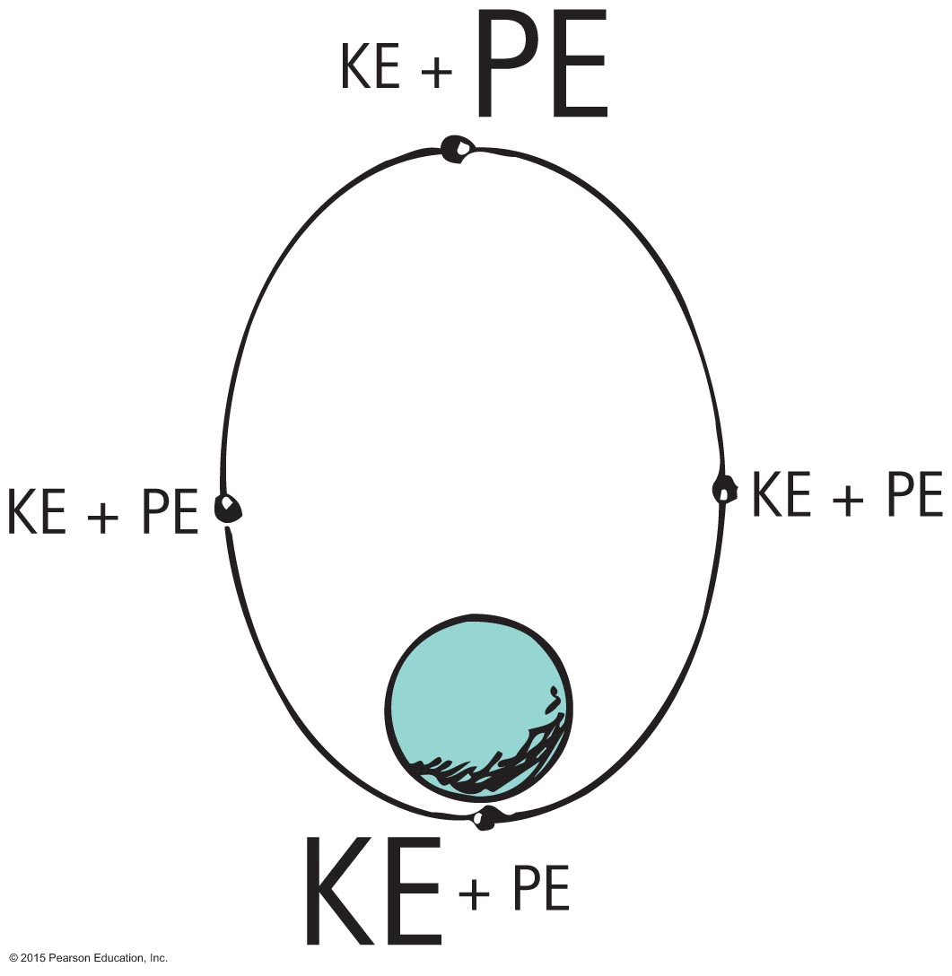
Energy Conservation and Satellite Motion
Elliptical Orbit Varies.
PE is greatest when the satellite is farthest away (apogee).
PE is least when the satellite is closest (perigee).
KE is least when PE is the most and vice versa.
At every point in the orbit, sum of KE and PE is the same.

Slide 42
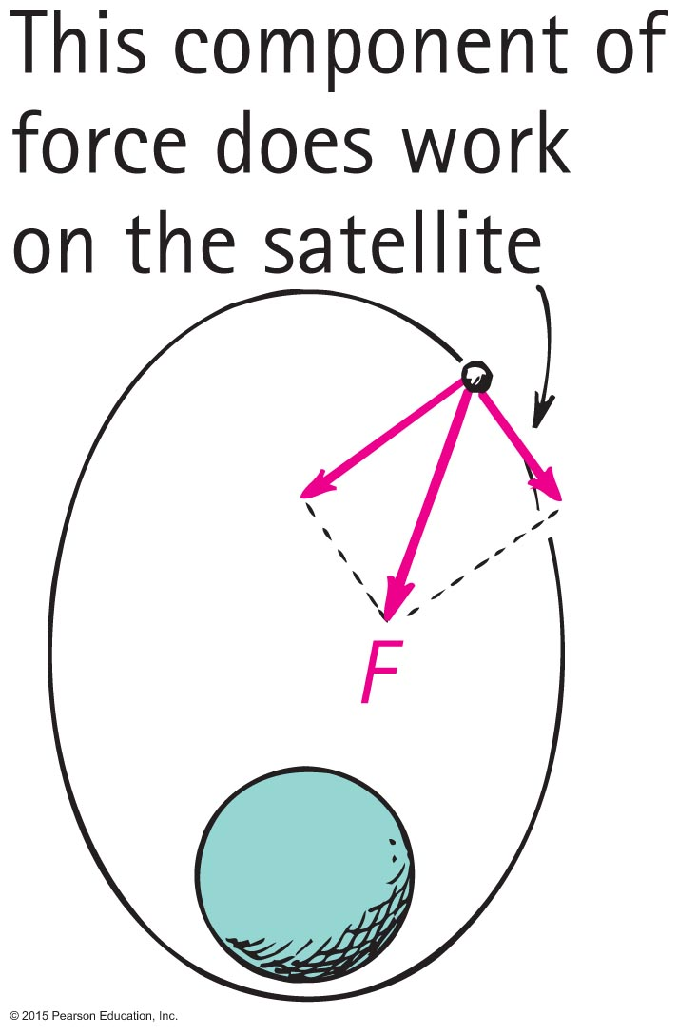
Energy Conservation and Satellite Motion
When satellite gains altitude and moves against gravitational force, its speed and KE decrease and decrease continues to the apogee.
Past the apogee, satellite moves in the same direction as the force component and speed and KE increase. Increase continues until past the perigee and cycle repeats.

Slide 43
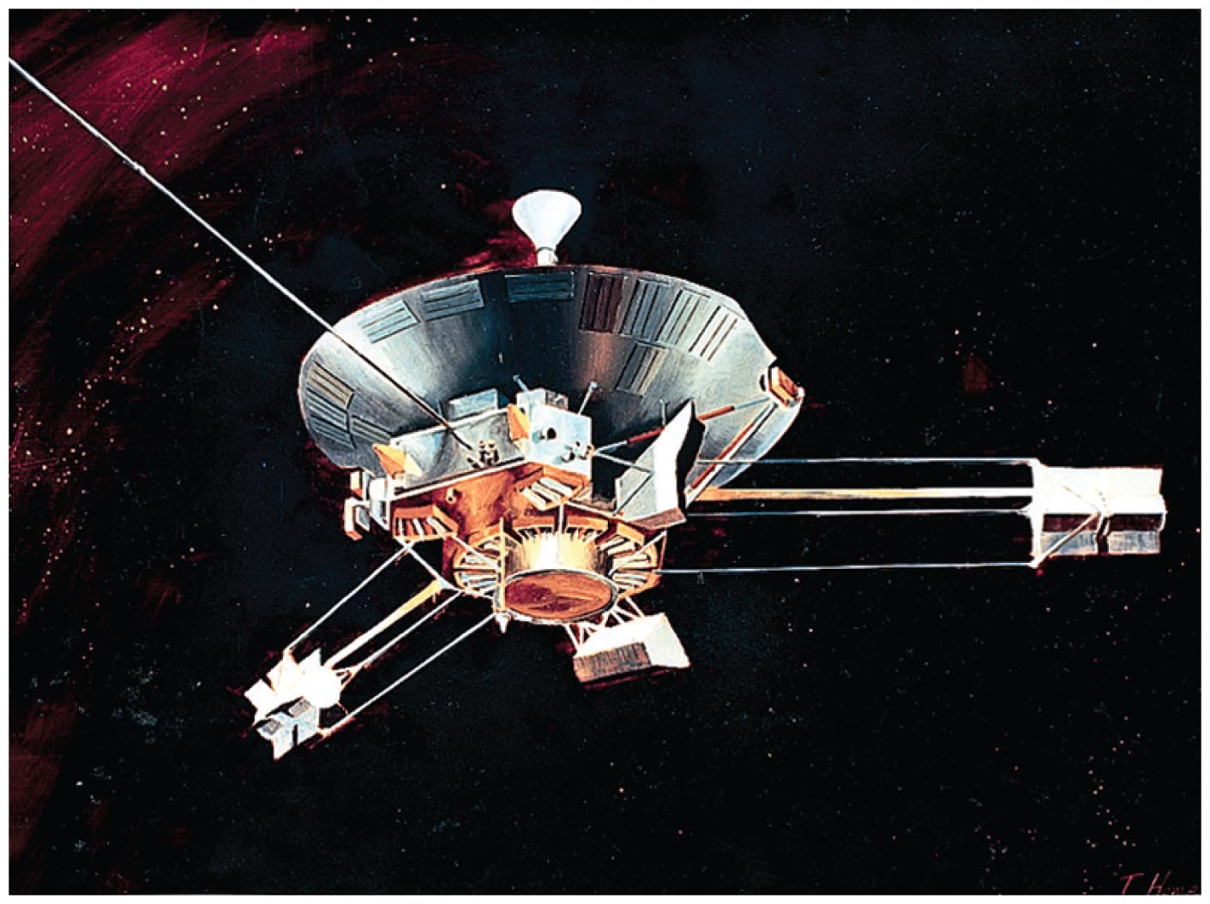
Escape Speed
First probe to escape the solar system was Pioneer 10, launched from Earth in 1972.
Accomplished by directing the probe into the path of oncoming Jupiter

Slide 44
Escape Speed CHECK YOUR NEIGHBOR
When a projectile achieves escape speed from Earth, it
forever leaves Earth's gravitational field.
outruns the influence of Earth's gravity, but is never beyond it.
comes to an eventual stop, returning to Earth at some future time.
All of the above.
Notes:
B. outruns the influence of Earth's gravity, but is never beyond it.

Slide 45
Escape Speed CHECK YOUR ANSWER
When a projectile achieves escape speed from Earth, it
forever leaves Earth's gravitational field.
outruns the influence of Earth's gravity, but is never beyond it.
comes to an eventual stop, returning to Earth at some future time.
All of the above.
Notes:
B. outruns the influence of Earth's gravity, but is never beyond it.

Slide 46
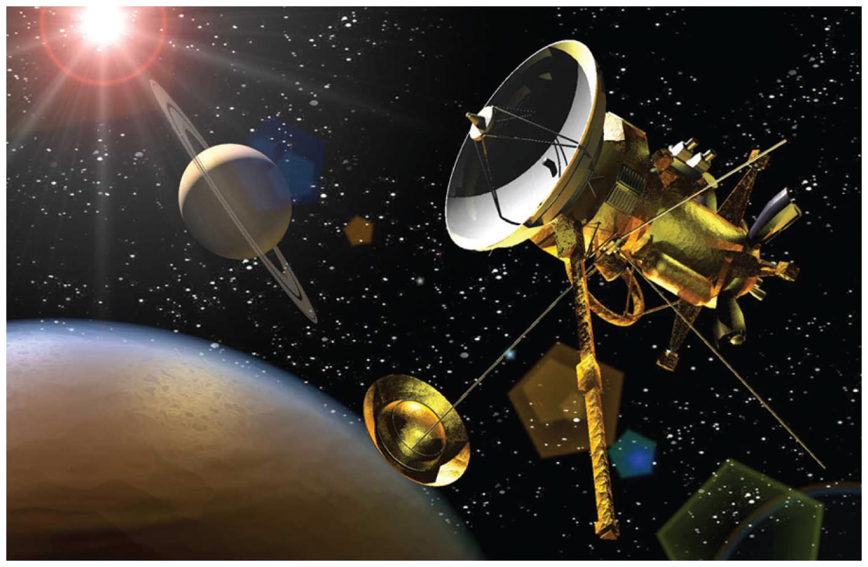
Escape Speed
Voyages to the Moon, Mars, and beyond begin with launches that exceed escape speed from Earth.

