Slide 1
Chapter 9: Gravity

Slide 2
This lecture will help you understand:
The Newtonian Synthesis
The Universal Law of Gravity
The Universal Gravitational Constant
Gravity and Distance: Inverse-Square Law
Weight and Weightlessness
Ocean Tides
Gravitational Fields
Einstein's Theory of Gravitation
Black Holes
Universal Gravitation

Slide 3
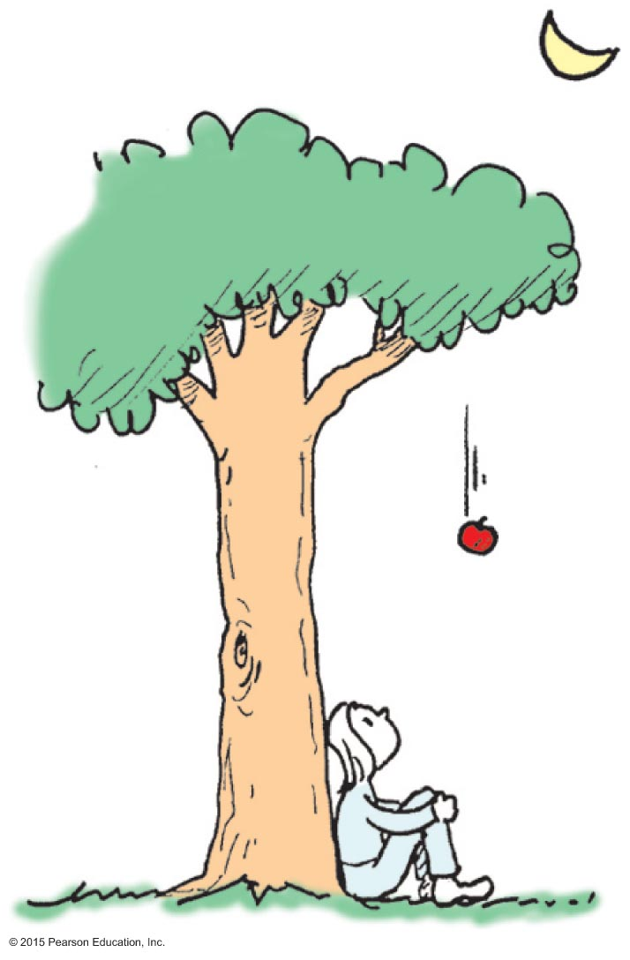
The Newtonian Synthesis
Newton was not the first to discover gravity. Newton discovered that gravity is universal.
Legend—Newton, sitting under an apple tree, realizes that the Earth's pull on an apple extends also to pull on the Moon.

Slide 4
The Newtonian Synthesis
In Aristotle's time, motion of planets and stars was natural – not governed by the same laws as objects on Earth.
Newton recognized that a force directed toward the Sun must act on planets
This is similar to force that Earth exerts on an apple that falls toward it.
Newtonian synthesis: The same set of laws apply to both celestial and terrestrial objects.

Slide 5
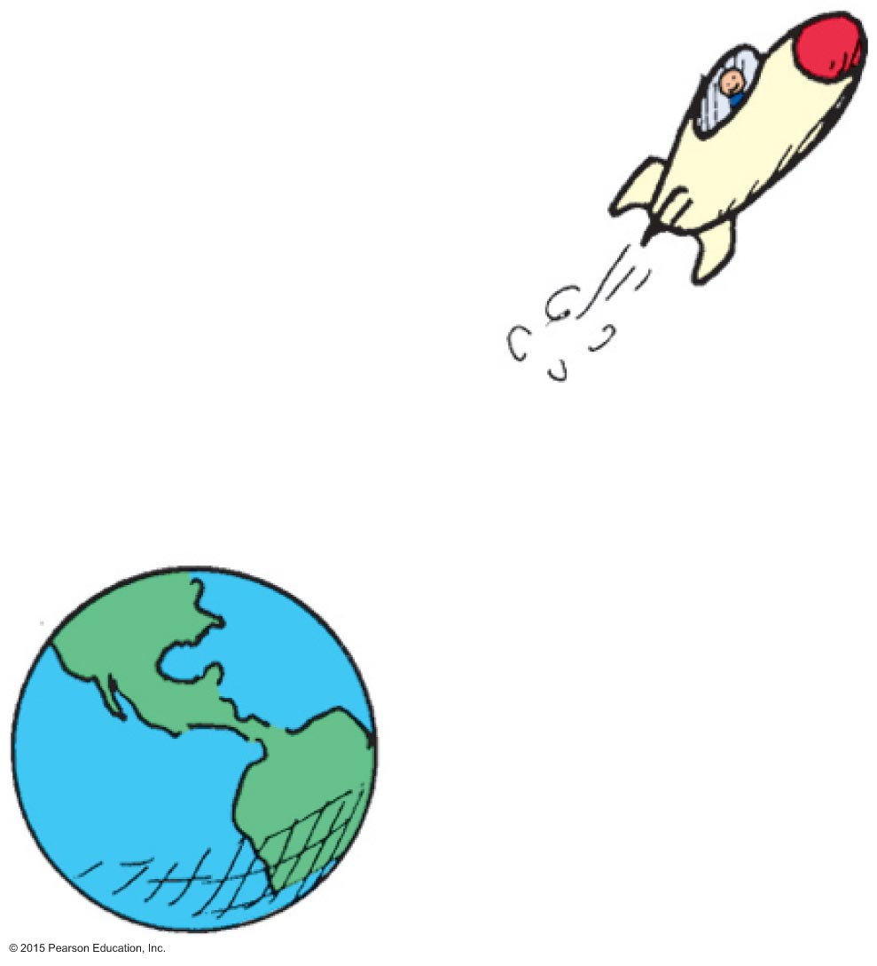
The Universal Law of Gravity
Law of universal gravitation:
Everything pulls on everything else.
Every body attracts every other body with a force that is directly proportional to the product of their masses and inversely proportional to the square of the distance separating them.

Slide 6
The Universal Law of Gravity
In equation form:
where m is the mass of the objects and d is the distance between their centers.
Examples:
The greater the masses m₁ and m₂ of two bodies, the greater the force of attraction between them.
The greater the distance of separation d, the weaker the force of attraction.
mass₁ x mass₂
m₁m₂
Force ~
or
F ~
distance²
d²

Slide 7
The Universal Law of Gravity CHECK YOUR NEIGHBOR
Newton's most celebrated synthesis was and is of
earthly and heavenly laws.
weight on Earth and weightlessness in outer space.
masses and distances.
the paths of tossed rocks and the paths of satellites.
Notes:
A. earthly and heavenly laws.

Slide 8
The Universal Law of Gravity CHECK YOUR ANSWER
Newton's most celebrated synthesis was and is of
earthly and heavenly laws.
weight on Earth and weightlessness in outer space.
masses and distances.
the paths of tossed rocks and the paths of satellites.
Comment:
This synthesis provided hope that other natural phenomena followed universal laws and ushered in the "Age of Enlightenment."
Notes:
A. earthly and heavenly laws.

Slide 9
The Universal Gravitational Constant, G
Gravity is the weakest of four known fundamental forces
With the gravitational constant G, we have the equation
Universal gravitational constant: G = 6.67 x 10^{–11} Nm²/kg²
Once the value was known, the mass of Earth was calculated as 6 x 10²⁴ kg
m₁m₂
F = G
d²

Slide 10
The Universal Gravitational Constant, G CHECK YOUR NEIGHBOR
The universal gravitational constant, G, which links force to mass and distance, is similar to the familiar constant
𝜋.
B. g.
acceleration due to gravity.
speed of uniform motion.
Notes:
A. π.

Slide 11
The Universal Gravitational Constant, G CHECK YOUR ANSWER
The universal gravitational constant, G, which links force to mass and distance, is similar to the familiar constant
𝝅.
B. g.
acceleration due to gravity.
speed of uniform motion.
Explanation:
Just as π relates the circumference of a circle to its diameter, G relates force to mass and distance.
Notes:
A. π.

Slide 12
Gravity and Distance: The Inverse-Square Law
Inverse-square law:
relates the intensity of an effect to the inverse-square of the distance from the cause.
in equation form: intensity = 1/distance².
for increases in distance, there are decreases in force.
even at great distances, force approaches but never reaches zero.

Slide 13
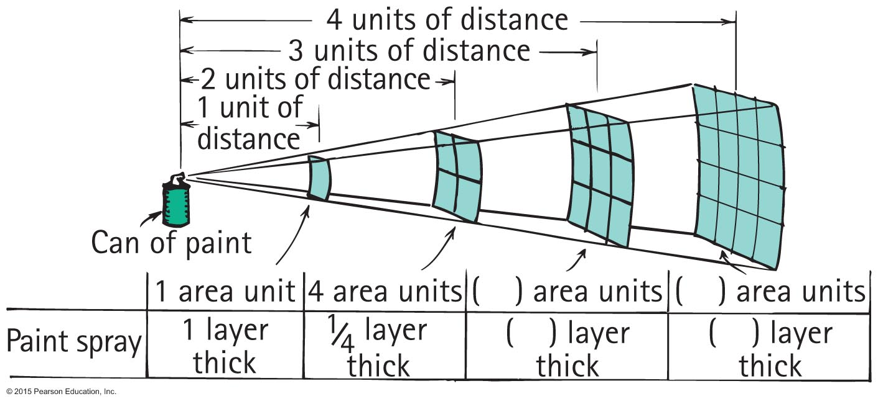
Inverse-Square Law

Slide 14
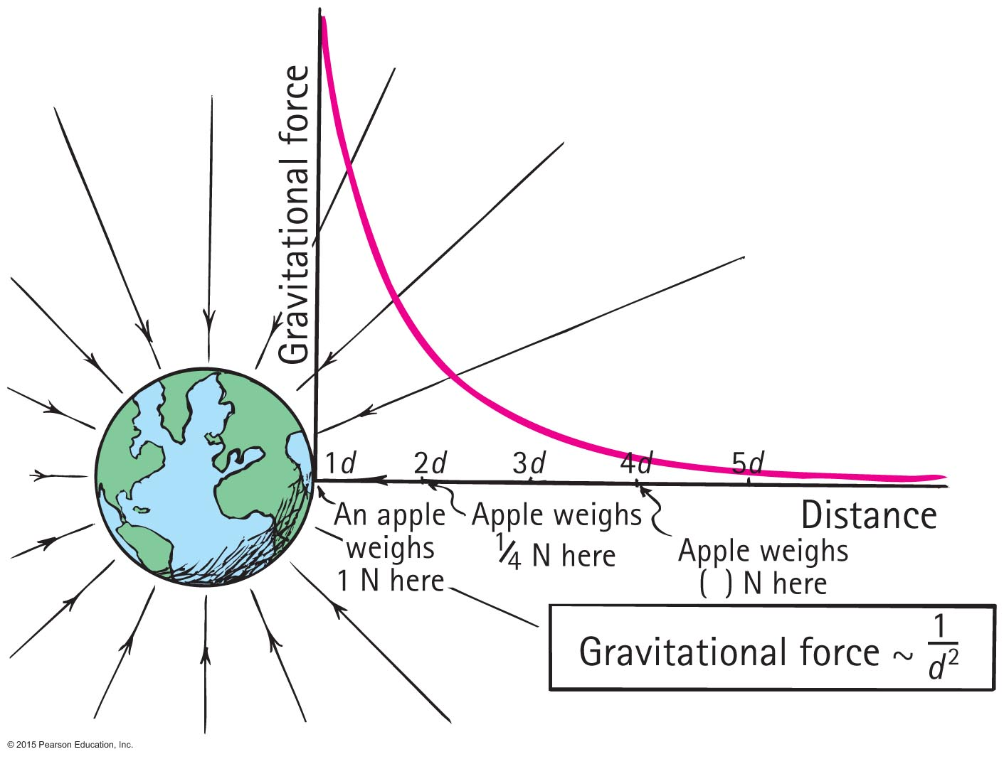
Inverse-Square Law

Slide 15
Gravity and Distance: The Inverse-Square Law CHECK YOUR NEIGHBOR
The force of gravity between two planets depends on their
masses and distance apart.
planetary atmospheres.
rotational motions.
All of the above.
Notes:
A. masses and distance apart.

Slide 16
Gravity and Distance: The Inverse-Square Law CHECK YOUR ANSWER
The force of gravity between two planets depends on their
masses and distance apart.
planetary atmospheres.
rotational motions.
All of the above.
Explanation:
The equation for gravitational force, cites only masses and distances as variables. Rotation and atmospheres are irrelevant.
m₁m₂
F = G
d²
Notes:
A. masses and distance apart.

Slide 17
Gravity and Distance: The Inverse-Square Law CHECK YOUR NEIGHBOR
If the masses of two planets are each somehow doubled, the force of gravity between them
doubles.
quadruples.
reduces by half.
reduces by one-quarter.
Notes:
B. quadruples.

Slide 18
Gravity and Distance: The Inverse-Square Law CHECK YOUR ANSWER
If the masses of two planets are each somehow doubled, the force of gravity between them
doubles.
quadruples.
reduces by half.
reduces by one-quarter.
Explanation:
Note that both masses double. Then, double x double = quadruple.
Notes:
B. quadruples.

Slide 19
Gravity and Distance: The Inverse-Square Law CHECK YOUR NEIGHBOR
If the mass of one planet is somehow doubled, the force of gravity between it and a neighboring planet
doubles.
quadruples
reduces by half.
reduces by one-quarter.
Notes:
A. doubles.

Slide 20
Gravity and Distance: The Inverse-Square Law CHECK YOUR ANSWER
If the mass of one planet is somehow doubled, the force of gravity between it and a neighboring planet
doubles.
quadruples
reduces by half.
reduces by one-quarter.
Explanation:
Let the equation guide your thinking:
Note that if one mass doubles, then the force
between them doubles.
m₁m₂
F = G
d²
Notes:
A. doubles.

Slide 21
Weight and Weightlessness
Weight:
force an object exerts against a supporting surface
Examples:
standing on a scale in an elevator accelerating downward, less compression in scale springs; weight is less
standing on a scale in an elevator accelerating upward, more compression in scale springs; weight is greater
at constant speed in an elevator, no change in weight

Slide 22
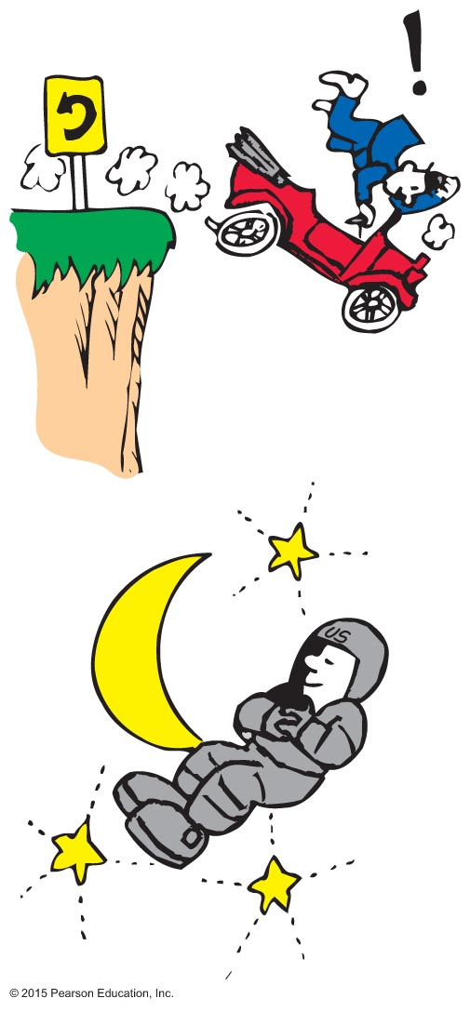
Weight and Weightlessness
Weightlessness:
no support force, as in free fall
Example: Astronauts in orbit are without support forces and are in a continual state of weightlessness.

Slide 23
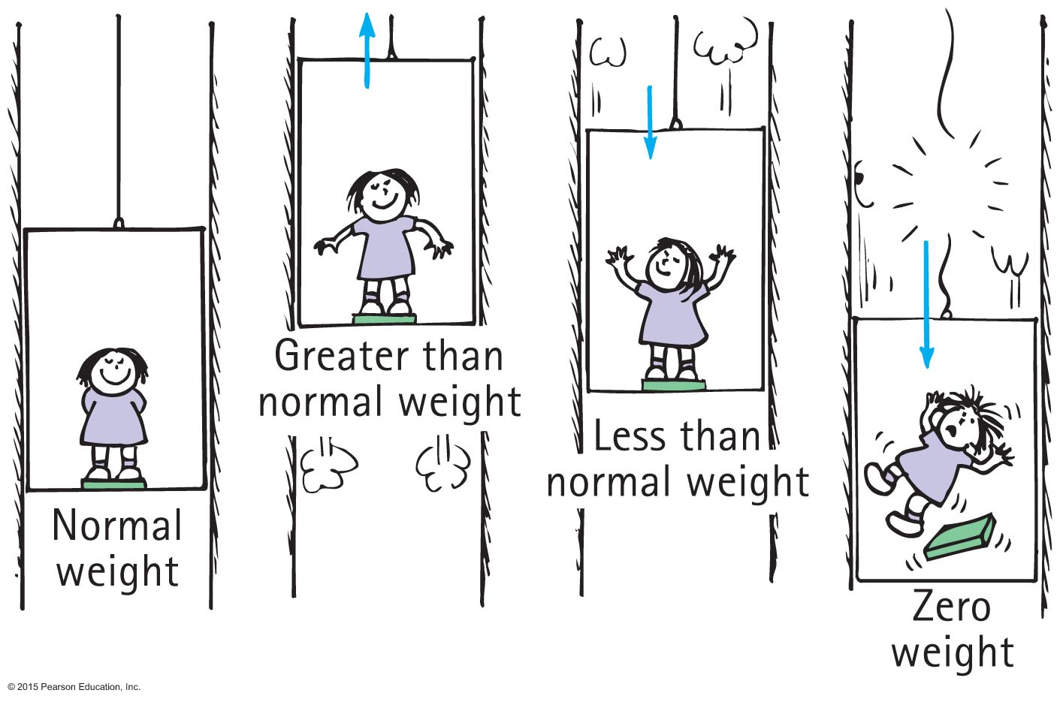
Weight and Weightlessness

Slide 24
Weight and Weightlessness CHECK YOUR NEIGHBOR
When an elevator accelerates upward, your weight reading on a scale is
greater.
less.
zero.
the normal weight.
Notes:
A. greater.

Slide 25
Weight and Weightlessness CHECK YOUR ANSWER
When an elevator accelerates upward, your weight reading on a scale is
greater.
less.
zero.
the normal weight.
Explanation:
The support force pressing on you is greater, so you weigh more.
Notes:
A. greater.

Slide 26
Weight and Weightlessness CHECK YOUR NEIGHBOR
When an elevator accelerates downward, your weight reading is
greater.
less.
zero.
the normal weight.
Notes:
B. less.

Slide 27
Weight and Weightlessness CHECK YOUR ANSWER
When an elevator accelerates downward, your weight reading is
greater.
less.
zero.
the normal weight.
Explanation:
The support force pressing on you is less, so you weigh less. Question: Would you weigh less in an elevator that moves downward at constant velocity?
Notes:
B. less.

Slide 28
Weight and Weightlessness CHECK YOUR NEIGHBOR
When the elevator cable breaks, the elevator falls freely, so your weight reading is
greater.
less.
zero.
the normal weight.
Notes:
C. zero.

Slide 29
Weight and Weightlessness CHECK YOUR ANSWER
When the elevator cable breaks, the elevator falls freely, so your weight reading is
greater.
less.
zero.
the normal weight.
Explanation:
There is still a downward gravitational force acting on you, but gravity is not felt as weight because there is no support force, so your weight is zero.
Notes:
C. zero.

Slide 30
Weight and Weightlessness CHECK YOUR NEIGHBOR
If you weigh yourself in an elevator, you'll weigh more when the elevator
moves upward.
moves downward.
accelerates upward.
All of the above.
Notes:
C. accelerates upward.

Slide 31
Weight and Weightlessness CHECK YOUR ANSWER
If you weigh yourself in an elevator, you'll weigh more when the elevator
moves upward.
moves downward.
accelerates upward.
All of the above.
Explanation:
The support provided by the floor of an elevator is the same whether the elevator is at rest or moving at constant velocity. Only accelerated motion affects weight.
Notes:
C. accelerates upward.

Slide 32
Ocean Tides
The differences between ocean levels at different times of the day are called tides.
There are typically two high tides and two low tides each day.

Slide 33
Ocean Tides
Ocean tides are caused due to the gravitational attraction of the Moon.
Unequal tugs on Earth's oceans causes a stretching effect that produces a pair of ocean bulges.
Because the two bulges are on opposite sides, high tides occur every 12 hours.

Slide 34
Ocean Tides
During the new Moon or full Moon, the effects of Moon and Sun add up, causing most pronounced spring tides.
When the Moon is halfway between a new and full Moon, the tides due to Sun and Moon partly cancel each other, causing least pronounced neap tides.

Slide 35
Gravitational Fields
Interaction between Earth and Moon is action at a distance. How do they interact without touching?
One way to think of this:
Earth is surrounded by a gravitational field.
Moon interacts with this gravitational field.
Gravitational field is an alteration of space around Earth (or any object with mass).
Gravitational field is an example of a force field (another example: magnetic field).

Slide 36
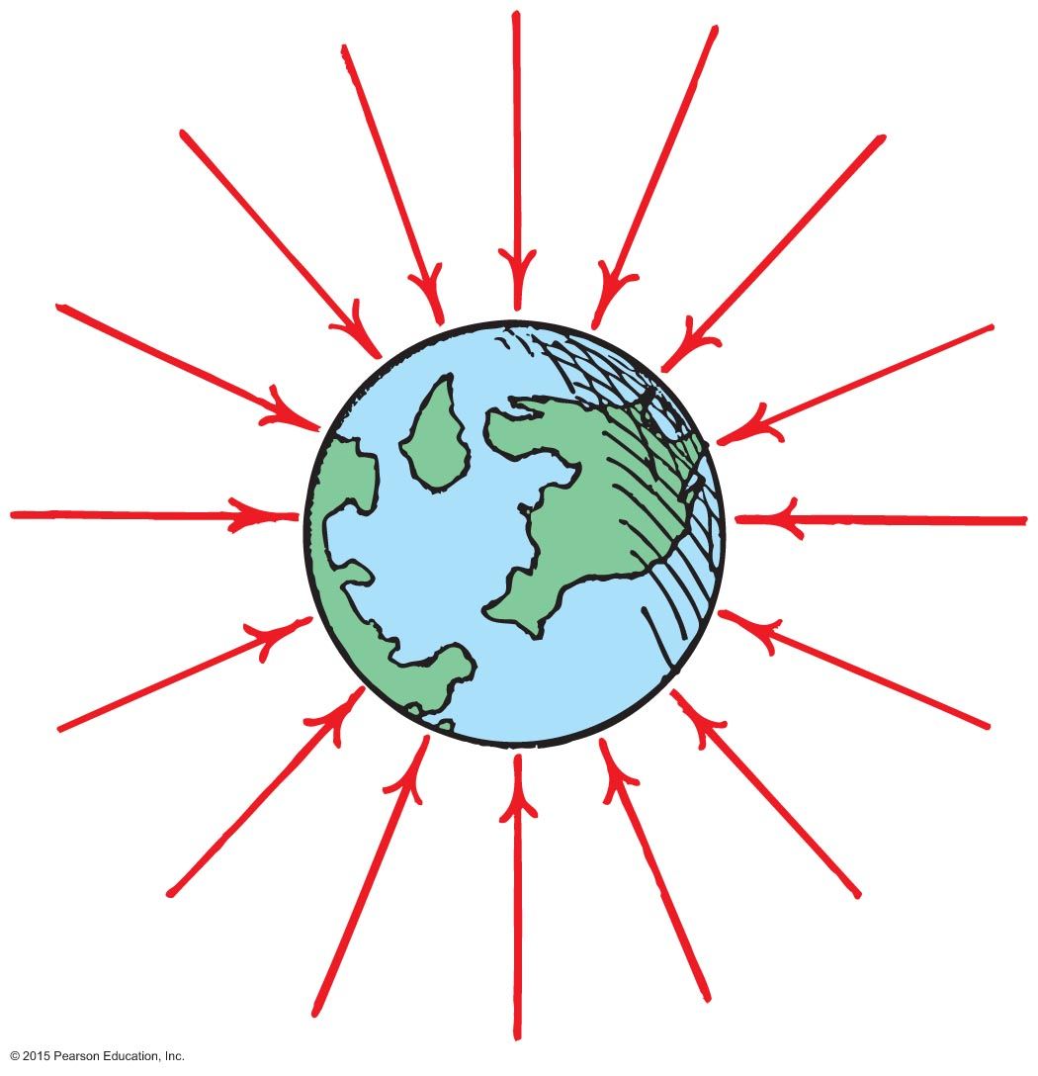
Gravitational Fields
Fields are represented by field lines radiating into the object (Earth).
The inward direction of arrows indicates that the force is always attractive to Earth.
The crowding of arrows closer to Earth indicates that the magnitude of the force is larger closer to Earth.

Slide 37
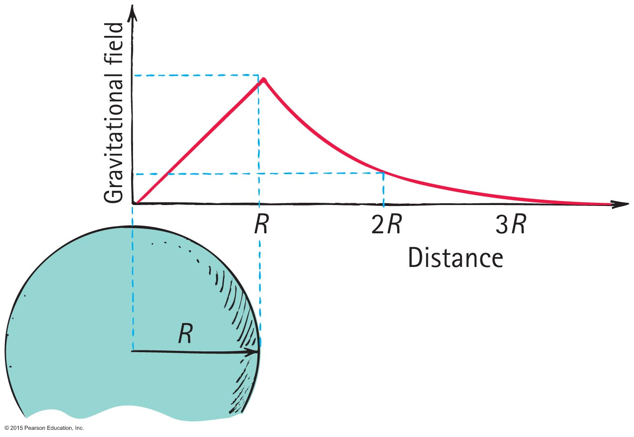
Gravitational Fields
Inside a planet, it decreases to zero at the center
because pull from the mass of Earth below you is partly balanced by what is above you.
Outside a planet, it decreases to zero (not at the same rate as inside), at infinity
because you are farther away from planet.

Slide 38
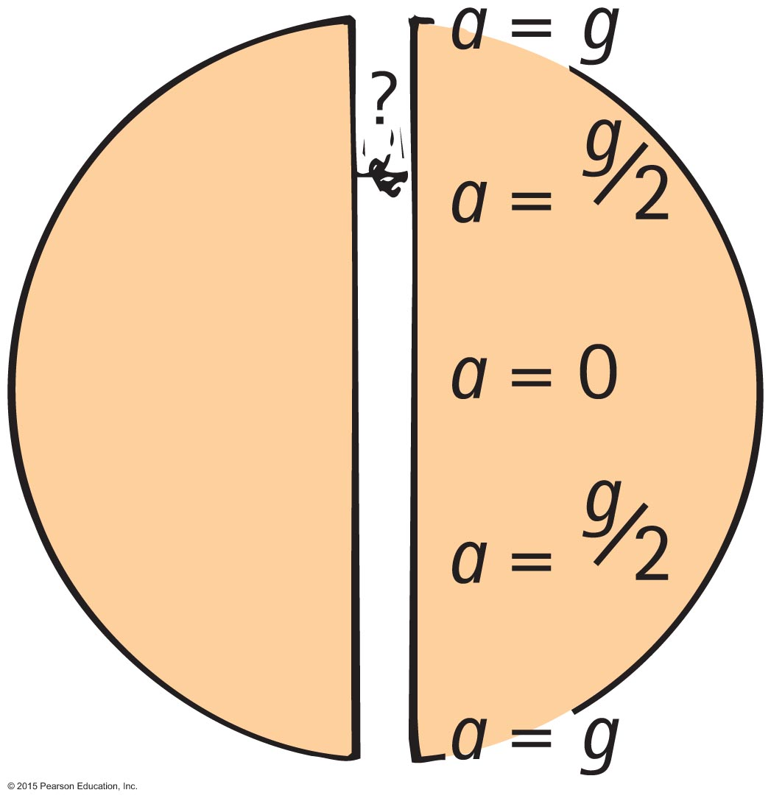
Gravitational Fields
Suppose you dig a hole through Earth to the other side and jump through it.
As you fall, your acceleration toward the center will go on decreasing.
At the center, your acceleration will be zero.
Past the center you will be pulled back up, but because you have acquired sufficient speed you will get to the other side.

Slide 39
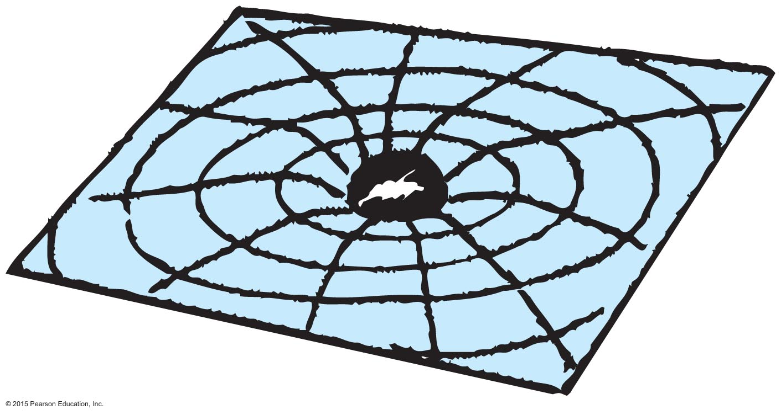
Einstein's Theory of Gravitation
Gravitational field is a warping of space-time by a planet
just as a massive ball would make a dent on the surface of a waterbed.
The warped space-time affects the motion of other objects
just as a marble rolling on the waterbed "gravitates" to the dent.

Slide 40
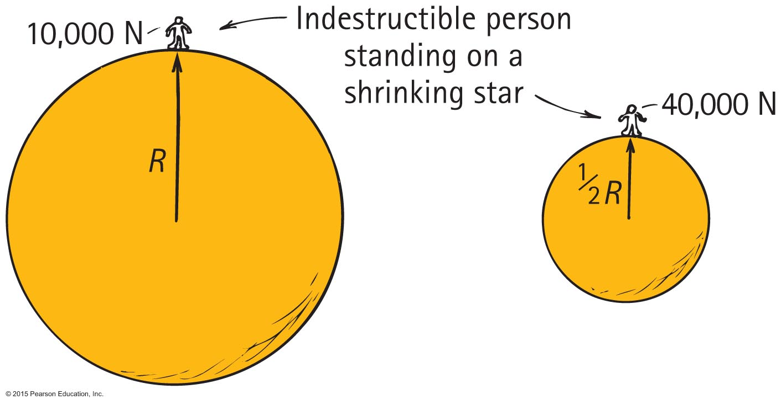
Black Holes
When a star shrinks, all of its mass is now concentrated in a smaller radius.
So gravitational force on the surface increases because
When d decreases, F increases.
m₁m₂
F = G
d²

Slide 41
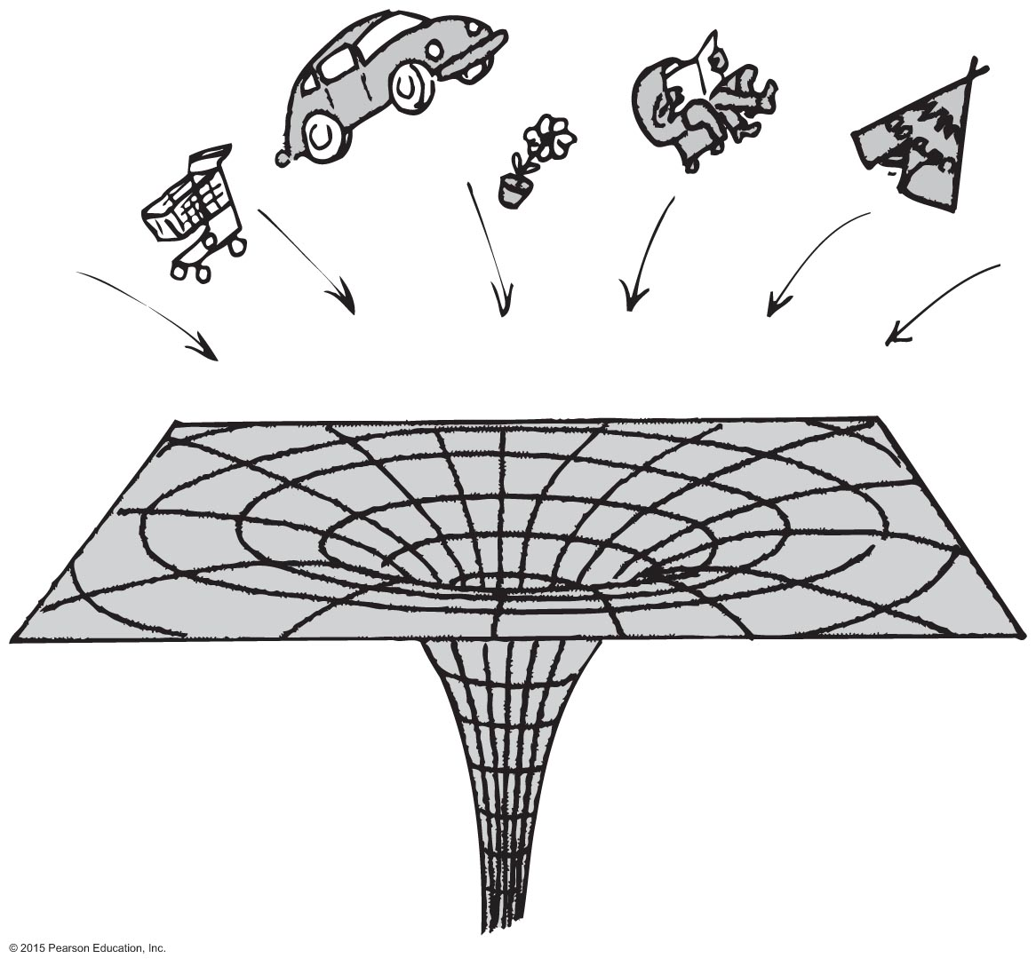
Black Holes
Black Hole: When the star becomes so small and the gravitational force at the surface becomes so large that even light cannot escape the surface, anything in its vicinity will be attracted by warped space-time and lost forever.

Slide 42
Black Holes CHECK YOUR NEIGHBOR
What would happen to Earth if the Sun became a black hole?
It would break away from the attraction of the Sun.
It would be pulled into the Sun.
It would become a black hole too.
None of the above.
Notes:
D. None of the above.

Slide 43
Black Holes CHECK YOUR ANSWER
What would happen to Earth if the Sun became a black hole?
It would break away from the attraction of the Sun.
It would be pulled into the Sun.
It would become a black hole too.
None of the above.
Explanation:
Letting the equation for gravity guide our thinking, we see that no mass changes, no distance from center to center changes, so there would be NO change in force between the shrunken Sun and Earth.
Notes:
D. None of the above.

Slide 44
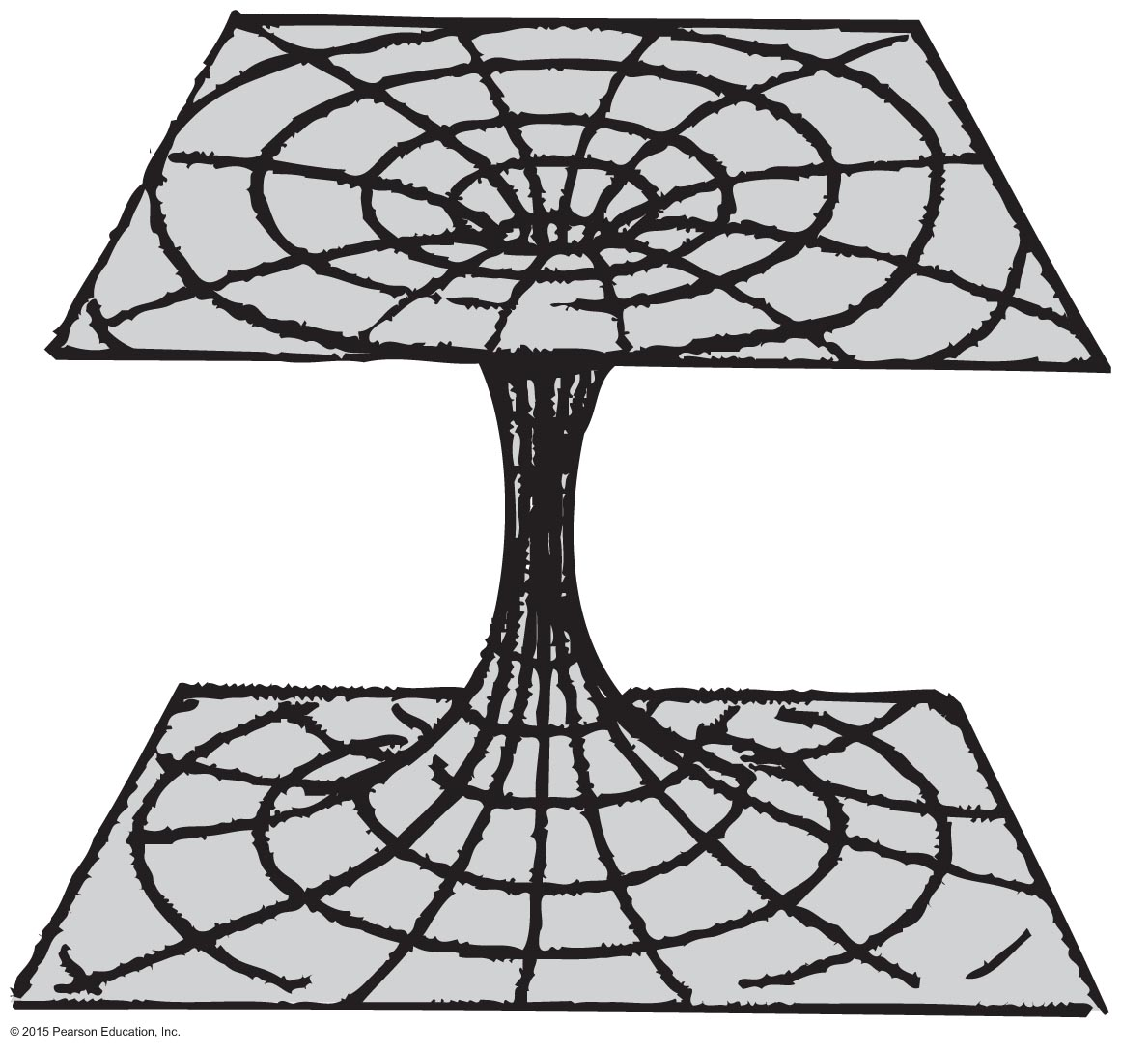
Wormhole
Wormhole: An enormous distortion of space-time,
but instead of collapsing toward an infinitely dense point, the wormhole opens out again in some other part of the universe or different universe!
No wormholes have been found yet.

Slide 45
Universal Gravitation
Universal gravitation
Everything attracts everything else.
Example: Earth is round because of gravitation—all parts of Earth have been pulled in, making the surface equidistant from the center.
The universe is expanding and accelerating outward.

