Slide 1
Chapter 5: Newton's Third Law of Motion

Slide 2
This lecture will help you understand:
Forces and Interactions
Newton's Third Law of Motion
Vectors and the Third Law
Summary of Newton's Three Laws of Motion

Slide 3
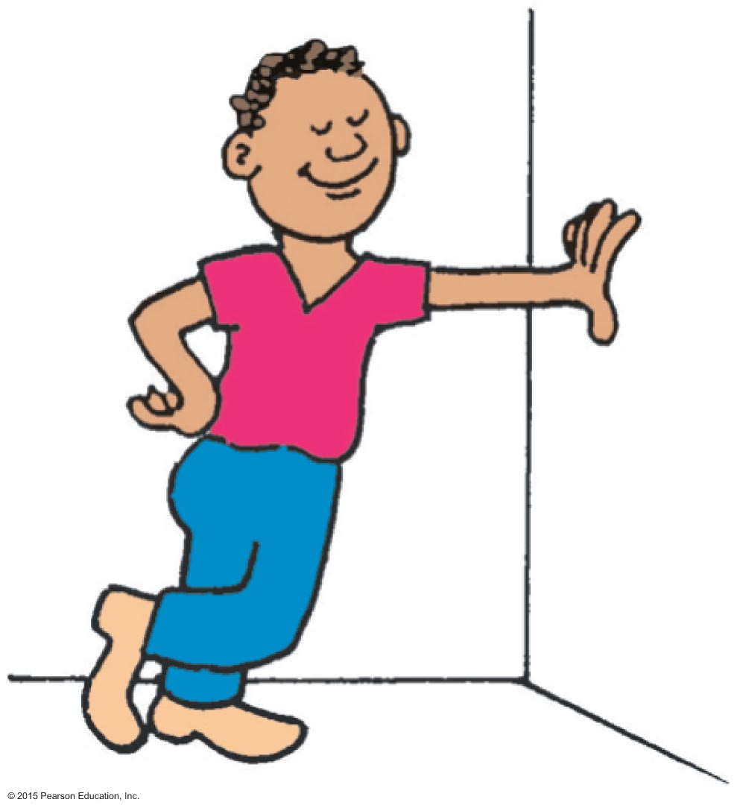
Forces and Interactions
Interaction
is between one thing and another.
requires a pair of forces acting on two objects.
Example: interaction of hand and wall pushing on each other Force pair—you push on wall; wall pushes on you.

Slide 4
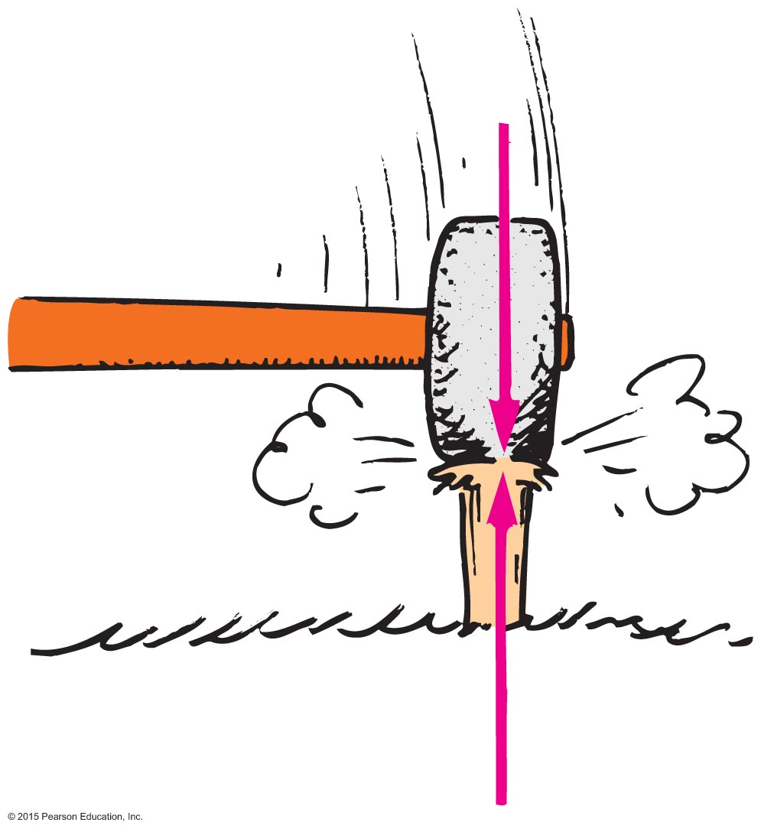
Newton's Third Law of Motion
Whenever one object exerts a force on a second object, the second object exerts an equal and opposite force on the first.

Slide 5
Newton's Third Law of Motion CHECK YOUR NEIGHBOR
A soccer player kicks a ball with 1500 N of force. The ball exerts a reaction force against the player's foot of
somewhat less than 1500 N.
1500 N.
somewhat more than 1500 N.
None of the above.
Notes:
B. 1500 N.

Slide 6
Newton's Third Law of Motion CHECK YOUR ANSWER
A soccer player kicks a ball with 1500 N of force. The ball exerts a reaction force against the player's foot of
somewhat less than 1500 N.
1500 N.
somewhat more than 1500 N.
None of the above.
Notes:
B. 1500 N.

Slide 7
Newton's Third Law of Motion
Action and reaction forces
one force is called the action force; the other force is called the reaction force.
are co-pairs of a single interaction.
neither force exists without the other.
are equal in strength and opposite in direction.
always act on different objects.

Slide 8
Newton's Third Law of Motion
Re-expression of Newton's third law:
To every action there is always an opposed equal reaction.
Example: Tires of car push back against the road while the road pushes the tires forward.

Slide 9
Newton's Third Law of Motion
Simple rule to identify action and reaction
Identify the interaction—one thing interacts with another
Action: Object A exerts a force on object B.
Reaction: Object B exerts a force on object A.
Example: Action—rocket (object A) exerts force on gas (object B). Reaction—gas (object B) exerts force on rocket (object A).

Slide 10
Newton's Third Law of Motion CHECK YOUR NEIGHBOR
When you step off a curb, Earth pulls you downward. The reaction to this force is
a slight air resistance.
nonexistent in this case.
you pulling Earth upward.
None of the above.
Notes:
C. you pulling Earth upward.

Slide 11
Newton's Third Law of Motion CHECK YOUR ANSWER
When you step off a curb, Earth pulls you downward. The reaction to this force is
a slight air resistance.
nonexistent in this case.
you pulling Earth upward.
None of the above.
Comment:
Due to the enormous mass of Earth, don't look for evidence of the upward pull on Earth!
Notes:
C. you pulling Earth upward.

Slide 12
Newton's Third Law of Motion CHECK YOUR NEIGHBOR
When you step off a curb, Earth pulls you downward and you pull Earth upward. Why do you not sense Earth moving upward toward you?
Earth is fixed, so it cannot move.
Earth can move, but other objects on it prevent it from moving.
It moves, but by an imperceptible amount.
None of the above.
Notes:
C. It moves, but by an imperceptible amount.

Slide 13
Newton's Third Law of Motion CHECK YOUR ANSWER
When you step off a curb, Earth pulls you downward and you pull Earth upward. Why do you not sense Earth moving upward toward you?
Earth is fixed, so it cannot move.
Earth can move, but other objects on it prevent it from moving.
It moves, but by an imperceptible amount.
None of the above.
Explanation:
The force you exert on Earth is just as much as the force Earth exerts on you. You move more than Earth does because Earth's mass is enormously greater than your mass. Earth's tiny motion is less than you can perceive. (Can you accept what you can't see?)
Notes:
C. It moves, but by an imperceptible amount.

Slide 14
Newton's Third Law of Motion
Action and Reaction on Different Masses
Cannonball:
Cannon:
The same force exerted on a small mass produces a large acceleration.
The same force exerted on a large mass produces a small acceleration.
F
m
= a
F
m
= a

Slide 15
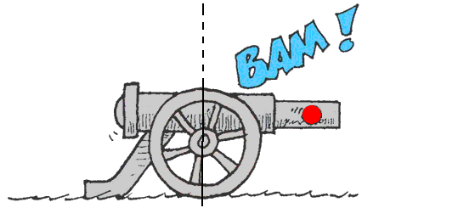
Newton's Third Law of Motion CHECK YOUR NEIGHBOR
When a cannon is fired, the accelerations of the cannon and cannonball are different because the
forces don't occur at the same time.
forces, although theoretically the same, in practice are not.
masses are different.
ratios of force to mass are the same.
Notes:
C. masses are different.

Slide 16
Newton's Third Law of Motion CHECK YOUR ANSWER
When a cannon is fired, the accelerations of the cannon and cannonball are different because the
forces don't occur at the same time.
forces, although theoretically the same, in practice are not.
masses are different.
ratios of force to mass are the same.
Notes:
C. masses are different.

Slide 17
Newton's Third Law of Motion CHECK YOUR NEIGHBOR
Consider a high-speed bus colliding head-on with a flying bug. The force of impact splatters the unfortunate bug over the windshield. Which is greater, the force on the bug or the force on the bus?
Bug
Bus
Both the same amount.
Cannot say
Notes:
C. Both the same amount.

Slide 18
Newton's Third Law of Motion CHECK YOUR ANSWER
Consider a high-speed bus colliding head-on with a flying bug. The force of impact splatters the unfortunate bug over the windshield. Which is greater, the force on the bug or the force on the bus?
Bug
Bus
Both the same amount.
Cannot say
Comment:
Although the forces are equal in magnitude, the effects are very different. Do you know why?
Notes:
C. Both the same amount.

Slide 19
Newton's Third Law of Motion CHECK YOUR NEIGHBOR
Two people of equal mass on slippery ice push off from each other. Will both move at the same speed in opposite directions?
Yes
Yes, but only if both push equally.
No
No, unless acceleration occurs.
Notes:
A. Yes

Slide 20
Newton's Third Law of Motion CHECK YOUR ANSWER
Two people of equal mass on slippery ice push off from each other. Will both move at the same speed in opposite directions?
Yes
Yes, but only if both push equally.
No
No, unless acceleration occurs.
Explanation:
In whatever way they push, equal-magnitude forces acting on equal masses produce equal accelerations; therefore, both undergo equal changes in speed.
Notes:
A. Yes

Slide 21
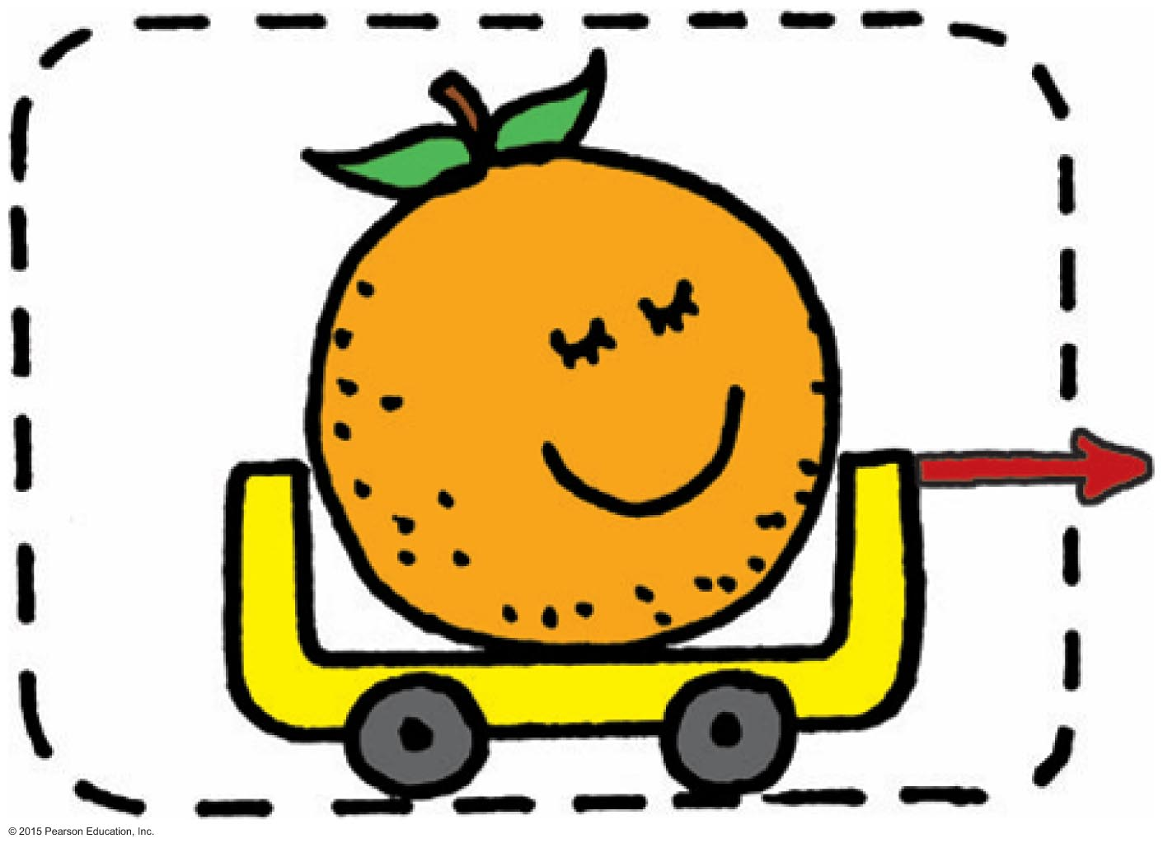
Newton's Third Law of Motion
Defining Your System
Consider a single enclosed orange.
Applied external force causes the orange to accelerate in accord with Newton's second law.
We see here only the action force (red vector).

Slide 22
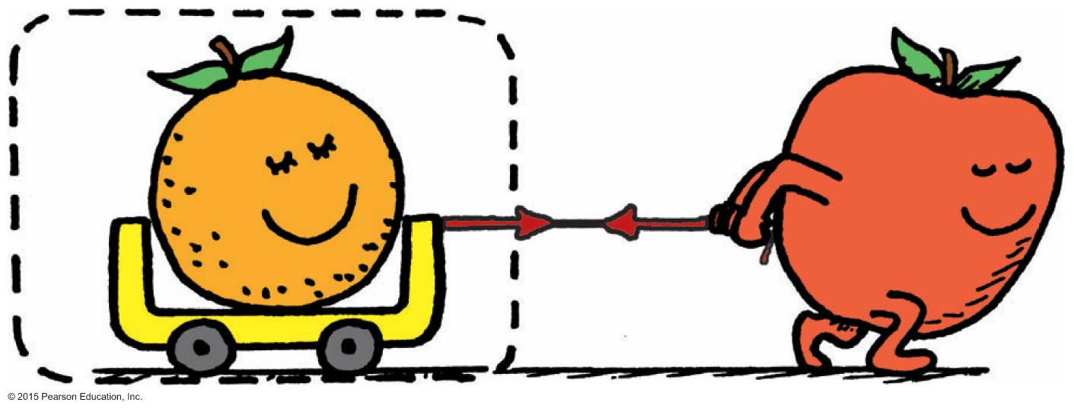
Newton's Third Law of Motion
Consider the orange and the apple pulling on it.
Action and reaction do not cancel (because they act on different objects).
External force by apple accelerates the orange.

Slide 23
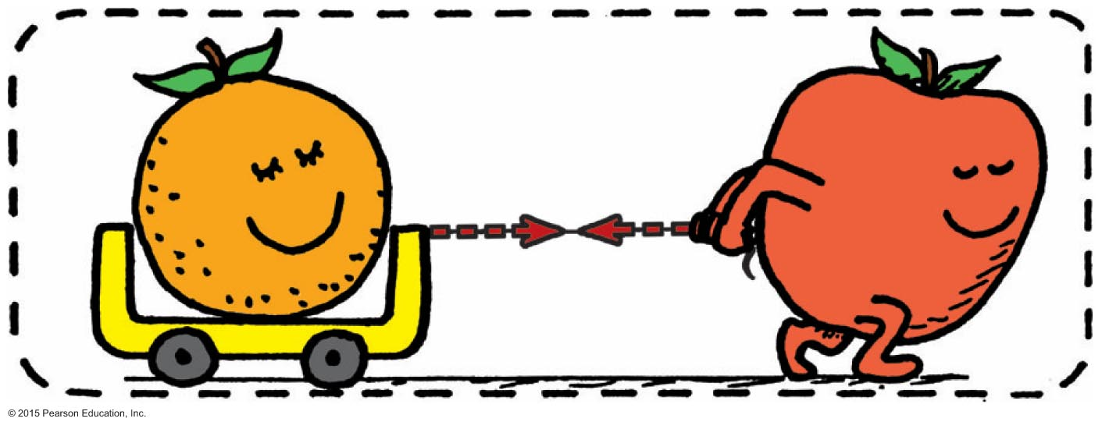
Newton's Third Law of Motion
Consider a system comprising both the orange and the apple.
The apple is no longer external to the system.
Force pair is internal to the system, which doesn't cause acceleration.
Action and reaction within the system cancel.
With no external forces, there is no acceleration of the system.

Slide 24
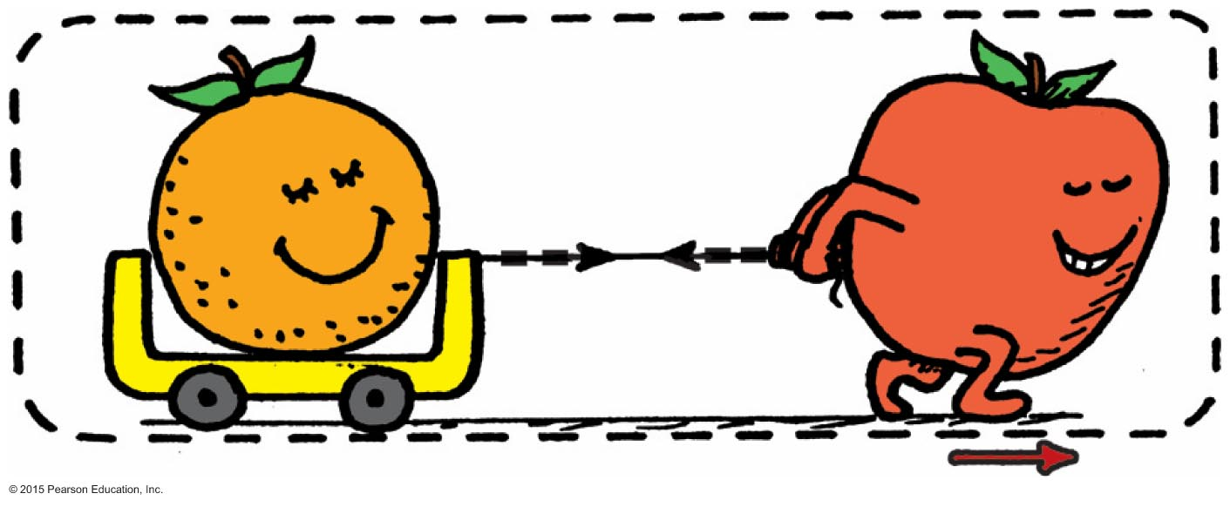
Newton's Third Law of Motion
Aha! Here's the same system, but with external force of friction on it (friction between the apple's feet and the floor).
External frictional force of the floor accelerates the system.

Slide 25
Newton's Third Law of Motion CHECK YOUR NEIGHBOR
The apple-orange system will move with constant speed if
the orange loses mass.
the apple gains mass.
a force equal and opposite to the friction force occurs.
None of the above.
Notes:
C. a force equal and opposite to the friction force occurs.

Slide 26
Newton's Third Law of Motion CHECK YOUR ANSWER
The apple-orange system will move with constant speed if
the orange loses mass.
the apple gains mass.
a force equal and opposite to the friction force occurs.
None of the above.
Comment:
Such a force may be floor friction on the cart wheels, or even a force produced by an opposing wind.
Notes:
C. a force equal and opposite to the friction force occurs.

Slide 27
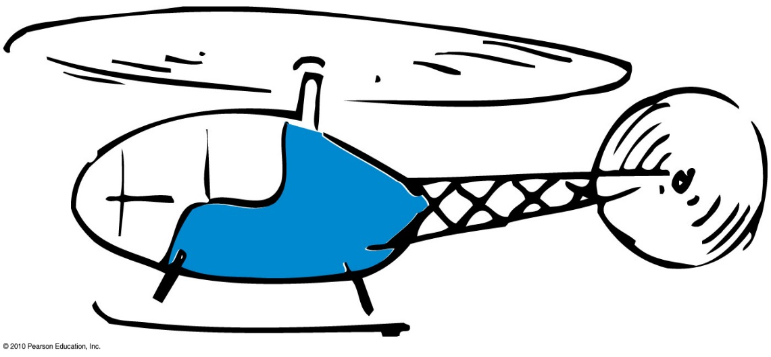
Newton's Third Law of Motion CHECK YOUR NEIGHBOR
Consider the flight of a helicopter. When lift is greater than the helicopter's weight, the helicopter
moves downward.
moves upward.
hovers in midair.
None of the above.
Notes:
B. moves upward.

Slide 28
Newton's Third Law of Motion CHECK YOUR ANSWER
Consider the flight of a helicopter. When lift is greater than the helicopter's weight, the helicopter
moves downward.
moves upward.
hovers in midair.
None of the above.
Notes:
B. moves upward.

Slide 29
Newton's Third Law of Motion CHECK YOUR NEIGHBOR
A bird flies by
flapping its wings.
pushing air down so that the air pushes it upward.
hovering in midair.
inhaling and exhaling air.
Notes:
B. pushing air down so that the air pushes it upward.

Slide 30
Newton's Third Law of Motion CHECK YOUR ANSWER
A bird flies by
flapping its wings.
pushing air down so that the air pushes it upward.
hovering in midair.
inhaling and exhaling air.
Notes:
B. pushing air down so that the air pushes it upward.

Slide 31
Newton's Third Law of Motion CHECK YOUR NEIGHBOR
Slightly tilted wings of airplanes deflect
oncoming air downward to produce lift.
oncoming air upward to produce lift.
Both A and B.
Neither A nor B.
Notes:
A. oncoming air downward to produce lift.

Slide 32
Newton's Third Law of Motion CHECK YOUR ANSWER
Slightly tilted wings of airplanes deflect
oncoming air downward to produce lift.
oncoming air upward to produce lift.
Both A and B.
Neither A nor B.
Explanation:
When a wing diverts air downward, it exerts a downward force on the air. The air simultaneously exerts an upward force on the wing. The vertical component of this upward force is lift. (The horizontal component is drag.)
Notes:
A. oncoming air downward to produce lift.

Slide 33
Newton's Third Law of Motion CHECK YOUR NEIGHBOR
Compared with a lightweight glider, a heavier glider would have to push air
downward with greater force.
downward with the same force.
downward with less force.
None of the above.
Notes:
A. downward with greater force.

Slide 34
Newton's Third Law of Motion CHECK YOUR ANSWER
Compared with a lightweight glider, a heavier glider would have to push air
downward with greater force.
downward with the same force.
downward with less force.
None of the above.
Explanation:
The force on the air deflected downward must equal the weight of the glider.
Notes:
A. downward with greater force.

Slide 35
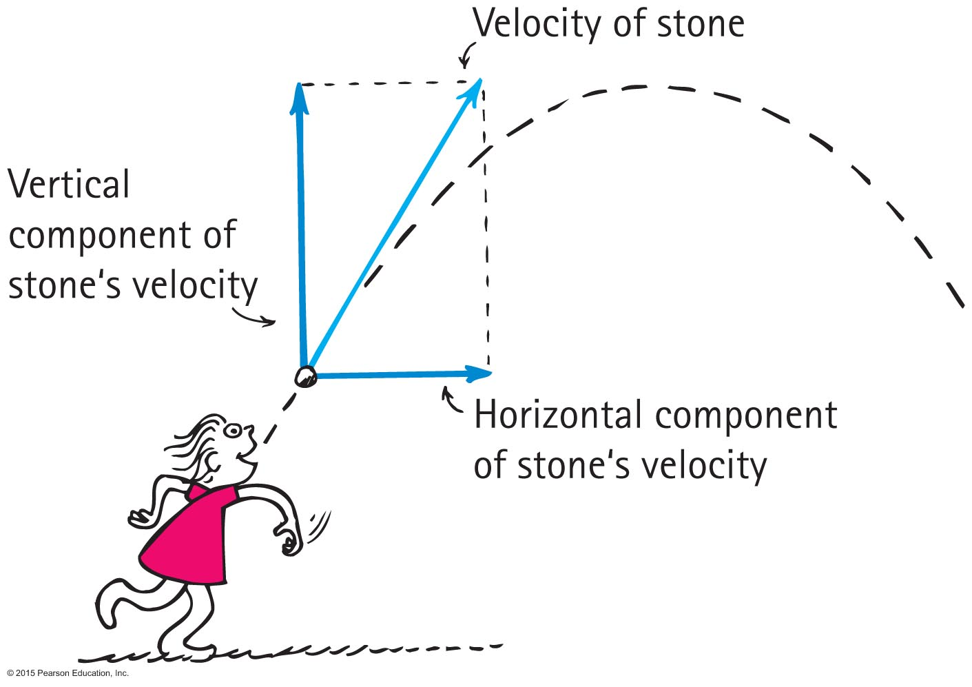
Vectors
Vector components
Vertical and horizontal components of a vector are perpendicular to each other.
Determined by resolution.

Slide 36
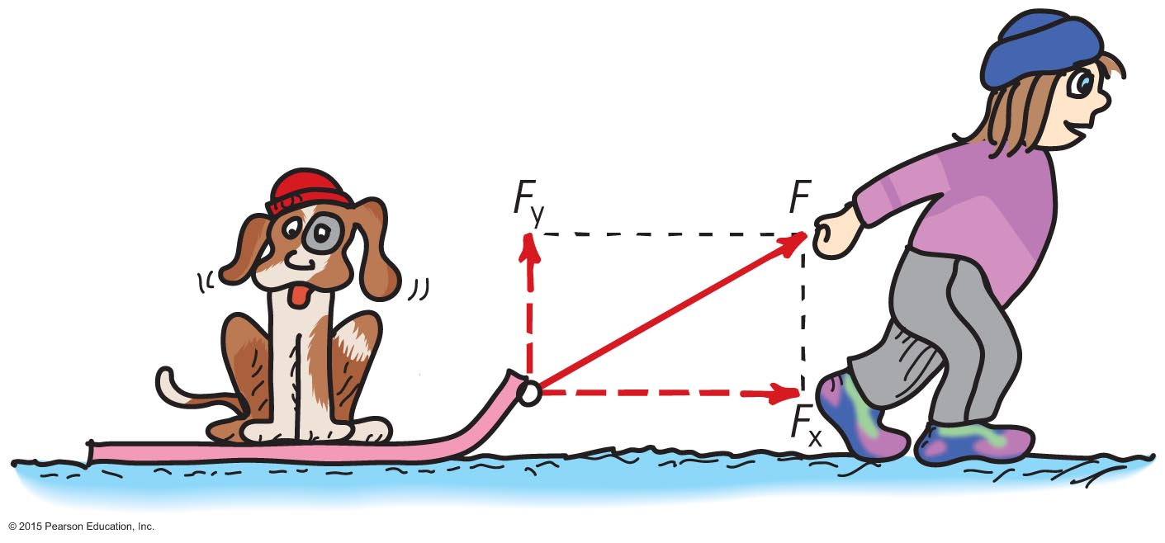
Vectors
Nellie Newton pulls on the sled as shown.
Which component of her force F is greater?
What two other forces (not shown) act on the sled?

Slide 37
Vectors
Nellie Newton pulls on the sled as shown.
Which component of her force F is greater?
The horizontal component F_{x} is greater.
What two other forces (not shown) act on the sled?
Weight mg and normal N also act on the sled.

Slide 38
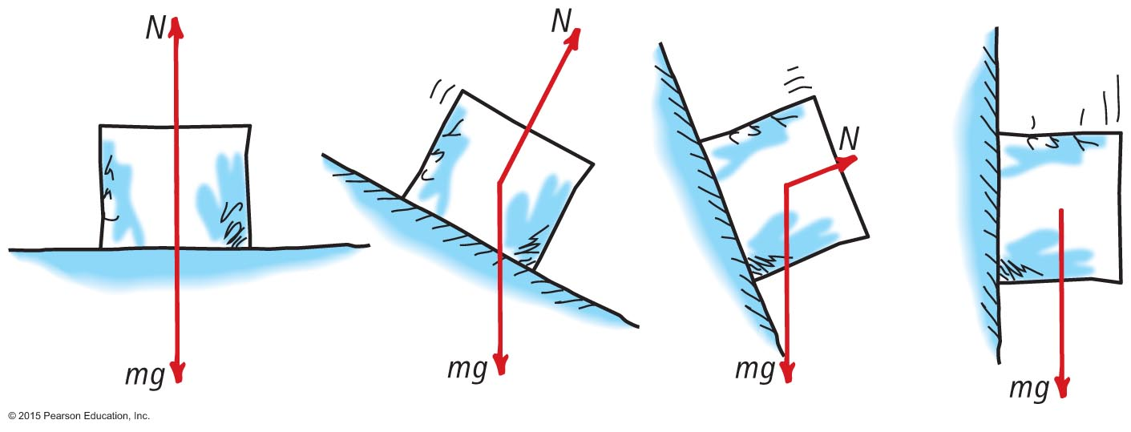
Vectors
Two forces act on the block of ice.
As the ramp is raised, which force remains constant?
As the ramp is raised, how does the magnitude of N change?
When the ramp is raised 90 degrees (vertical) what is the net force on the block?

Slide 39
Vectors
Two forces act on the block of ice.
As the ramp is raised, which force remains constant? mg
As the ramp is raised, how does the magnitude of N change? N decreases with increased angle of the ramp.
When the ramp is raised 90 degrees (vertical) what is the net force on the block? The net force is mg!

Slide 40
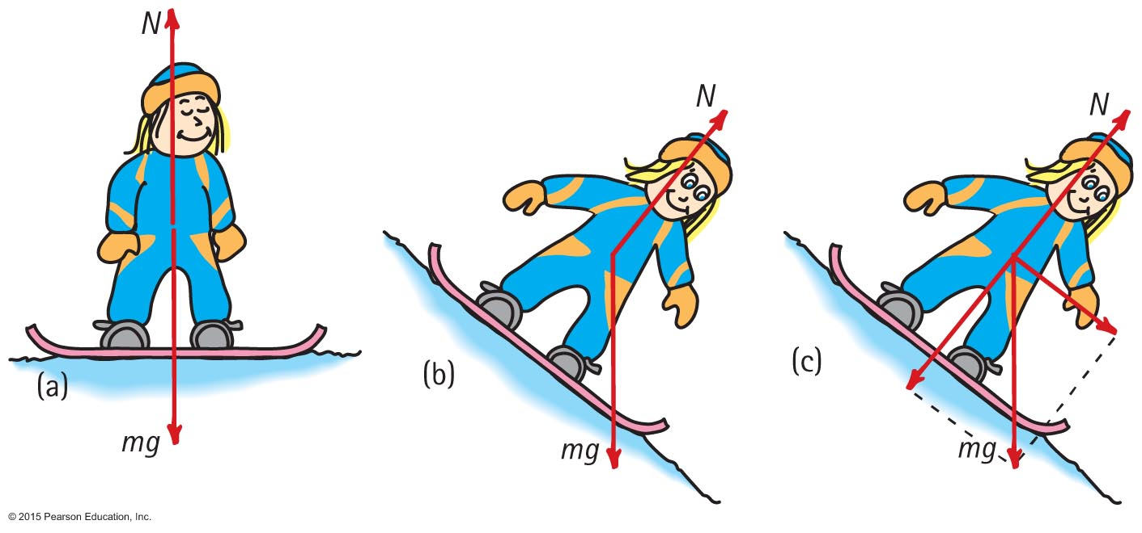
Vectors
(a) Can you see that N and mg are equal and opposite?
(b) Can you see that N is less on the incline?
(c) Can you see that the resultant of N and mg is the force propelling Nellie down the hill? And can you see which component of mg is equal and opposite to N?

Slide 41
Summary of Newton's Three Laws of Motion
Newton's first law of motion (the law of inertia)
An object at rest tends to remain at rest; an object in motion tends to remain in motion at constant speed along a straight-line path.
Newton's second law of motion (the law of acceleration)
When a net force acts on an object, the object will accelerate. The acceleration is directly proportional to the net force and inversely proportional to the mass.
Newton's third law of motion (the law of action and reaction)
Whenever one object exerts a force on a second object, the second object exerts an equal and opposite force on the first.

