Slide 1
Chapter 4: Newton's Second Law of Motion

Slide 2
This lecture will help you understand:
Force Causes Acceleration
Friction
Mass and Weight
Newton's Second Law of Motion
Free Fall
Nonfree Fall

Slide 3
Force Causes Acceleration
Acceleration is directly proportional to net force.
To increase the acceleration of an object, increase the net force acting on it.
Acceleration ~ net force

Slide 4
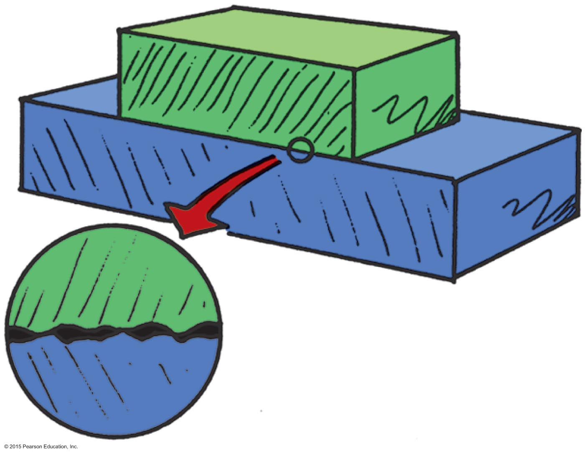
The Force of Friction
Depends on the kinds of material and how much they are pressed together.
Is due to tiny surface bumps and to "stickiness" of the atoms on a material's surface.
Example: Friction between a crate on a smooth wooden floor is less than that on a rough floor.

Slide 5
The Force of Friction CHECK YOUR NEIGHBOR
The force of friction can occur
with sliding objects.
in water.
in air.
All of the above.
Notes:
D. all of the above.

Slide 6
The Force of Friction CHECK YOUR ANSWER
The force of friction can occur
with sliding objects.
in water.
in air.
All of the above.
Comment:
Friction can also occur for objects at rest. If you push horizontally on your book and it doesn't move, then friction between the book and the table is equal and opposite to your push.
Notes:
D. all of the above.

Slide 7
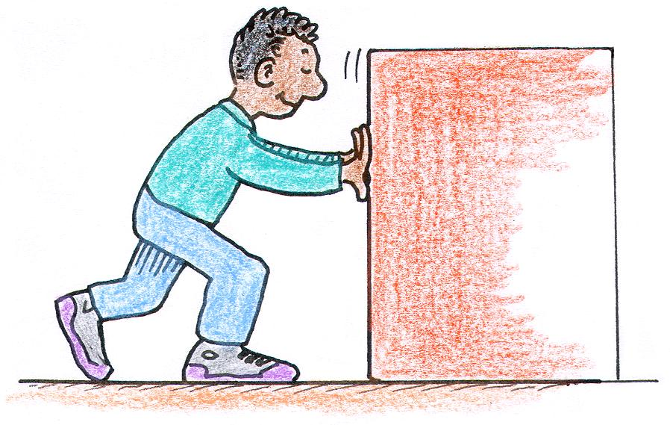
The Force of Friction CHECK YOUR NEIGHBOR
When Sanjay pushes a refrigerator across a kitchen floor at a constant speed, the force of friction between the refrigerator and the floor is
less than Sanjay's push.
equal to Sanjay's push.
equal and opposite to Sanjay's push.
more than Sanjay's push.
Notes:
C. equal and opposite to Sanjay's push.

Slide 8
The Force of Friction CHECK YOUR ANSWER
When Sanjay pushes a refrigerator across a kitchen floor at a constant speed, the force of friction between the refrigerator and the floor is
less than Sanjay's push.
equal to Sanjay's push.
equal and opposite to Sanjay's push.
more than Sanjay's push.
Notes:
C. equal and opposite to Sanjay's push.

Slide 9
The Force of Friction CHECK YOUR NEIGHBOR
When Sanjay pushes a refrigerator across a kitchen floor at an increasing speed, the amount of friction between the refrigerator and the floor is
less than Sanjay's push.
equal to Sanjay's push.
equal and opposite to Sanjay's push.
more than Sanjay's push.
Notes:
A. less than Sanjay's push.

Slide 10
The Force of Friction CHECK YOUR NEIGHBOR
When Sanjay pushes a refrigerator across a kitchen floor at an increasing speed, the amount of friction between the refrigerator and the floor is
less than Sanjay's push.
equal to Sanjay's push.
equal and opposite to Sanjay's push.
more than Sanjay's push.
Explanation:
The increasing speed indicates a net force greater than zero. The refrigerator is not in equilibrium.
Notes:
A. less than Sanjay's push.

Slide 11
Mass and Weight
Mass: The quantity of matter in an object. It is also the measure of the inertia or sluggishness that an object exhibits in response to any effort made to start it, stop it, or change its state of motion in any way.
Weight: Usually the force upon an object due to gravity.
Notes:
We say weight is usually the force due to gravity. We shall see later that weight can be simulated in a rotating system, where gravity isn't a factor.

Slide 12
Mass and Weight
Mass
A measure of the inertia of a material object
Independent of gravity Greater inertia ⇒ greater mass
Unit of measurement is the kilogram (kg)
Weight
Usually the force on an object due to gravity
Scientific unit of force is the newton (N)
Unit is also the pound (lb)
Notes:
Again, weight may be due to a rotating system. Much later we'll learn that weight can be the result of acceleration, a cornerstone of Einstein's General Theory of Relativity.

Slide 13
Mass—A Measure of Inertia CHECK YOUR NEIGHBOR
If the mass of an object is halved, the weight of the object is
halved.
twice.
depends on location.
None of the above.
Notes:
A. halved.

Slide 14
Mass—A Measure of Inertia CHECK YOUR ANSWER
If the mass of an object is halved, the weight of the object is
halved.
twice.
depends on location.
None of the above.
Comment:
Weight and mass are directly proportional to each other.
Notes:
A. halved.

Slide 15
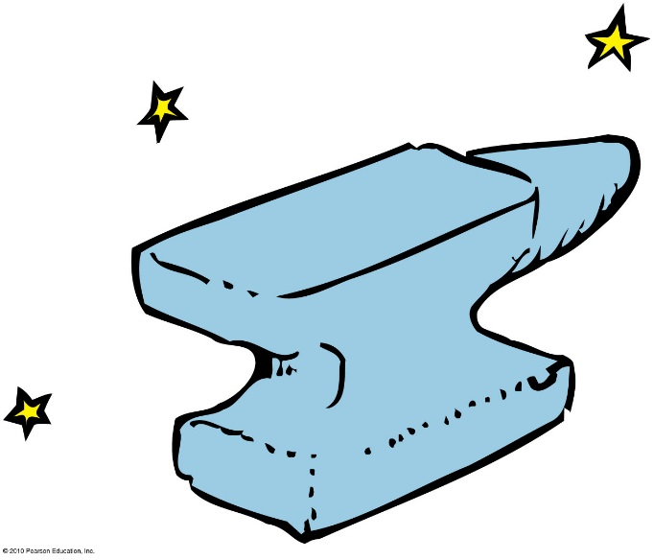
Mass and Weight
Mass and weight in everyday conversation are interchangeable.
Mass, however, is different and more fundamental than weight.
Mass versus weight
On the Moon and Earth:
Weight of an object on the Moon is less than on Earth.
Mass of an object is the same in both locations.

Slide 16
Mass and Weight
1 kilogram weighs 10 newtons (9.8 newtons, to be precise).
Relationship between kilograms and pounds:
1 kg = 2.2 lb = 10 N at Earth's surface
1 lb = 4.45 N

Slide 17
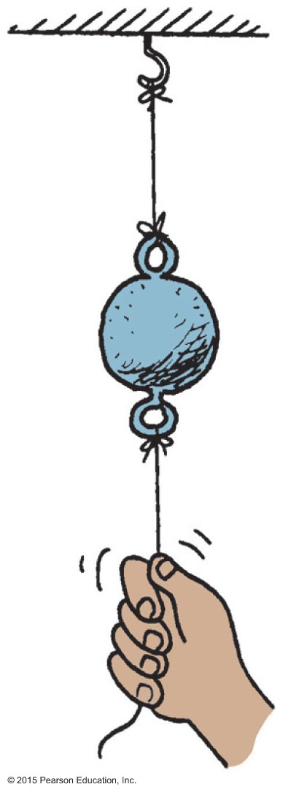
Mass and Weight CHECK YOUR NEIGHBOR
When the string is pulled down slowly, the top string breaks, which best illustrates the
weight of the ball.
mass of the ball.
volume of the ball.
density of the ball.
Notes:
A. weight of the ball.

Slide 18
Mass and Weight CHECK YOUR ANSWER
When the string is pulled down slowly, the top string breaks, which best illustrates the
weight of the ball.
mass of the ball.
volume of the ball.
density of the ball.
Explanation:
Tension in the top string is the pulling tension plus the weight of the ball, both of which break the top string.
Notes:
A. weight of the ball.

Slide 19
Mass and Weight CHECK YOUR NEIGHBOR
When the string is pulled down quickly, the bottom string breaks, which best illustrates the
weight of the ball.
mass of the ball.
volume of the ball.
density of the ball.
Notes:
B. mass of the ball.

Slide 20
Mass and Weight CHECK YOUR ANSWER
When the string is pulled down quickly, the bottom string breaks, which best illustrates the
weight of the ball.
mass of the ball.
volume of the ball.
density of the ball.
Explanation:
It is the "laziness" of the ball that tends to keep it at rest, resulting in the breaking of the bottom string.
Notes:
B. mass of the ball.

Slide 21
Mass Resists Acceleration
The same force applied to
twice the mass produces half the acceleration.
3 times the mass, produces 1/3 the acceleration.
Acceleration is inversely proportional to mass.

Slide 22
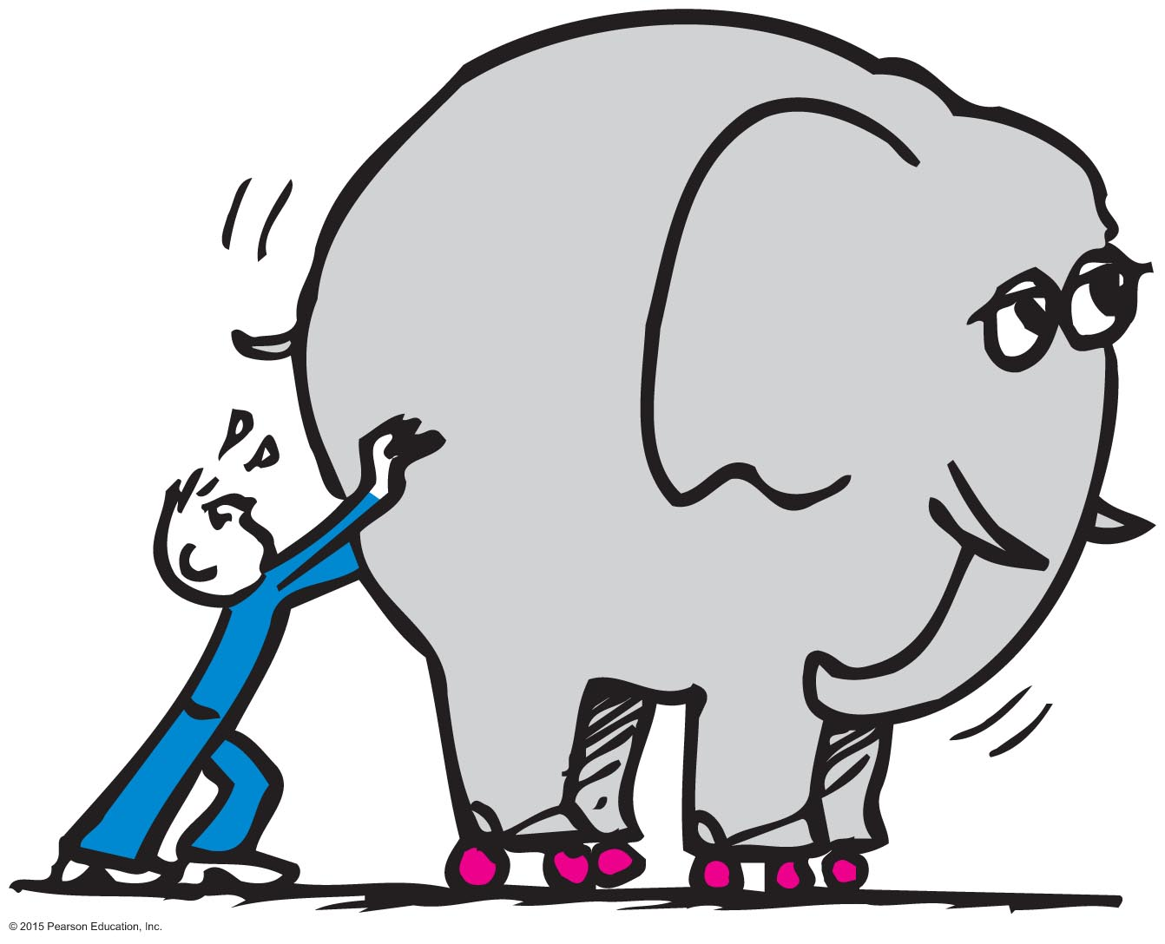
Newton's Second Law of Motion
Isaac Newton was the first to connect the concepts of force and mass to produce acceleration.

Slide 23
Newton's Second Law of Motion
Newton's second law (the law of acceleration) relates acceleration and force.
The acceleration produced by a net force on an object is directly proportional to the net force, is in the same direction as the net force, and is inversely proportional to the mass of the object.

Slide 24
Newton's Second Law of Motion
In equation form:
Example:
If net force acting on object is doubled ⇒ object's acceleration will be doubled.
If mass of object is doubled ⇒ object's acceleration will be halved.
net force
Acceleration =
mass

Slide 25
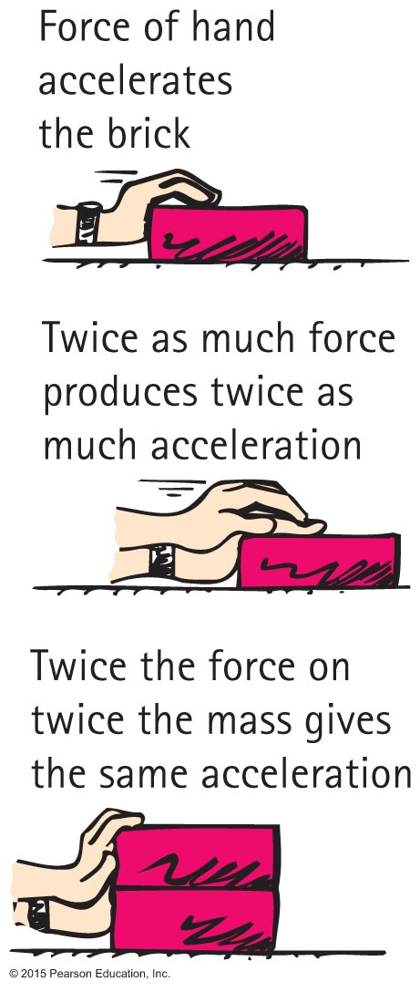
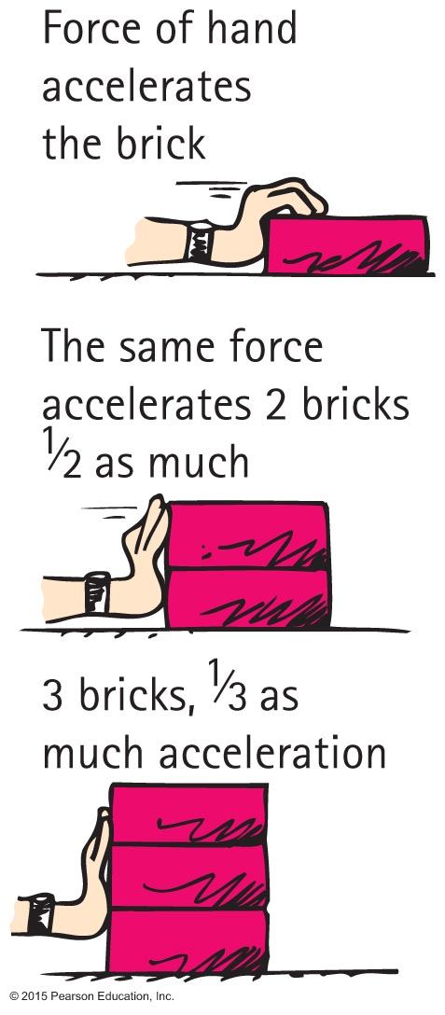
Newton's Second Law of Motion

Slide 26
Newton's Second Law of Motion CHECK YOUR NEIGHBOR
Consider a cart pushed along a track with a certain force. If the force remains the same while the mass of the cart decreases to half, the acceleration of the cart
remains relatively the same.
halves.
doubles.
changes unpredictably.
Notes:
26
C. doubles.

Slide 27
Newton's Second Law of Motion CHECK YOUR ANSWER
Consider a cart pushed along a track with a certain force. If the force remains the same while the mass of the cart decreases to half, the acceleration of the cart
remains relatively the same.
halves.
doubles.
changes unpredictably.
Explanation:
Acceleration = net force / mass
Because, mass is in the denominator, acceleration increases as mass decreases. So, if mass is halved, acceleration doubles.
Notes:
27
Explanation:
Acceleration = Net Force / Mass.
So, if…
Mass is halved i.e., Mass is now ½ Mass
Net Force is kept the same i.e., Net Force
New Acceleration = New Net Force / New Mass

Slide 28
Newton's Second Law of Motion CHECK YOUR NEIGHBOR
Push a cart along a track so twice as much net force acts on it. If the acceleration remains the same, what is a reasonable explanation?
The mass of the cart doubled when the force doubled.
The cart experiences a force that it didn't before.
The track is not level.
Friction reversed direction.
Notes:
28
A. The mass of the cart doubled when the force doubled.

Slide 29
Newton's Second Law of Motion CHECK YOUR ANSWER
Push a cart along a track so twice as much net force acts on it. If the acceleration remains the same, what is a reasonable explanation?
The mass of the cart doubled when the force doubled.
The cart experiences a force that it didn't before.
The track is not level.
Friction reversed direction.
Explanation:
Acceleration = net force / mass
If force doubles, acceleration will also double. But it does not, so mass must also double to cancel the effects of force doubling.
Notes:
29
A. The mass of the cart doubled when the force doubled.

Slide 30
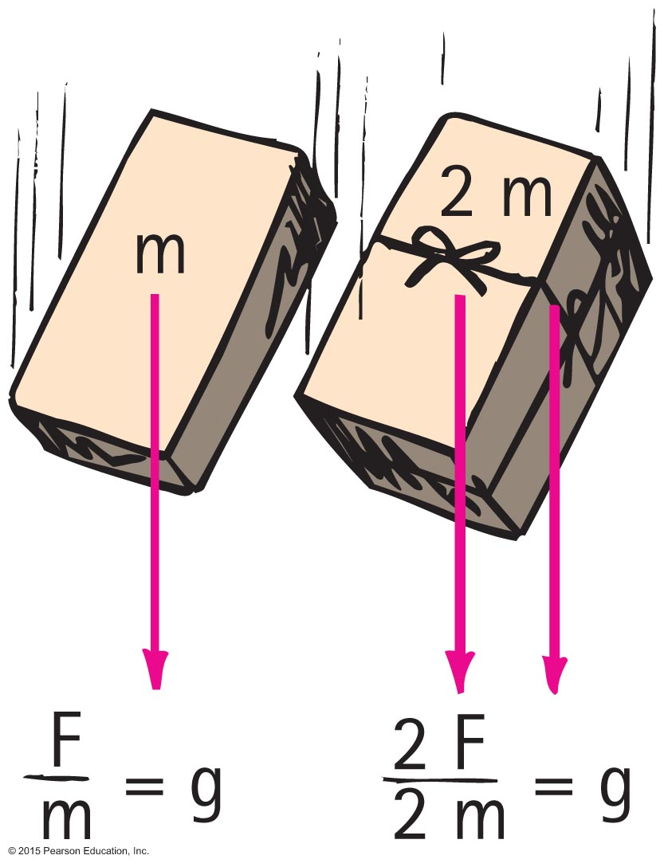
Free Fall
The greater the mass of the object…
the greater its force of attraction toward the Earth.
the smaller its tendency to move, that is, the greater its inertia.
So, acceleration of both sets of bricks is the same. (Twice the force on twice the mass gives the same acceleration g!)
The acceleration of both sets of bricks is the same, 10 m/s² (more precisely, 9.8 m/s²).

Slide 31
Free Fall CHECK YOUR NEIGHBOR
At one instant, an object in free fall has a speed of 40 m/s. Its speed 1 second later is
also 40 m/s.
45 m/s.
50 m/s.
None of the above.
Notes:
C. 50 m/s.

Slide 32
Free Fall CHECK YOUR ANSWER
At one instant, an object in free fall has a speed of 40 m/s. Its speed 1 second later is
also 40 m/s.
45 m/s.
50 m/s.
None of the above.
Comment: We assume the object is falling downward. If it were traveling upward with no force on it but gravity, it would nevertheless be in "free fall." Then 1 second later its speed would be 30 m/s.
Notes:
C. 50 m/s.

Slide 33
Free Fall CHECK YOUR NEIGHBOR
A 5-kg iron ball and a 10-kg iron ball are dropped from rest. For negligible air resistance, the acceleration of the heavier ball will be
less.
the same.
more.
undetermined.
Notes:
B. the same.

Slide 34
Free Fall CHECK YOUR ANSWER
A 5-kg iron ball and a 10-kg iron ball are dropped from rest. For negligible air resistance, the acceleration of the heavier ball will be
less.
the same.
more.
undetermined.
Notes:
B. the same.

Slide 35
Free Fall CHECK YOUR NEIGHBOR
A 5-kg iron ball and a 10-kg iron ball are dropped from rest. When the free-falling 5-kg ball reaches a speed of 10 m/s, the speed of the free-falling 10-kg ball is
less than 10 m/s.
10 m/s.
more than 10 m/s.
undetermined.
Notes:
B. 10 m/s.

Slide 36
Free Fall CHECK YOUR ANSWER
A 5-kg iron ball and a 10-kg iron ball are dropped from rest. When the free-falling 5-kg ball reaches a speed of 10 m/s, the speed of the free-falling 10-kg ball is
less than 10 m/s.
10 m/s.
more than 10 m/s.
undetermined.
Comment: Note both are in "free fall." Hence their equal speeds.
Notes:
B. 10 m/s.

Slide 37
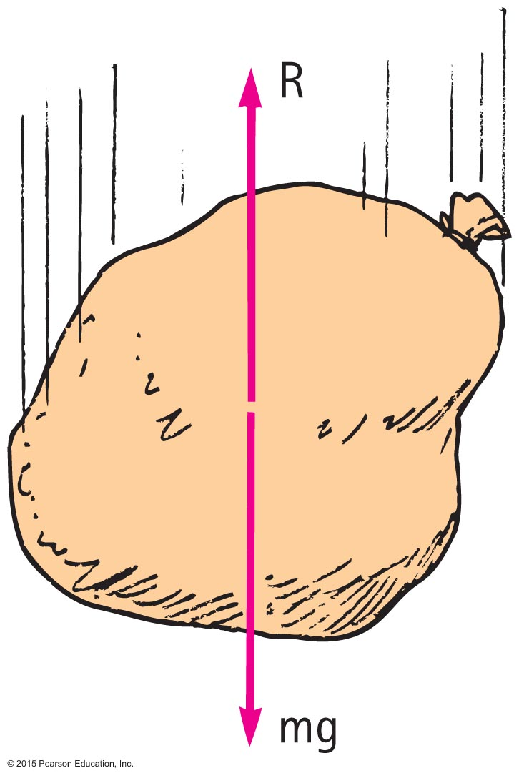
Nonfree Fall
When an object falls downward through the air it experiences
force of gravity pulling it downward.
air drag force acting upward.

Slide 38
Nonfree Fall
The condition of nonfree fall
occurs when air resistance is nonnegligible.
depends on two things:
speed and
frontal surface area.

Slide 39
Nonfree Fall
When the object is moving fast enough so that air resistance builds up to equal the force of gravity.
Then no net force
No acceleration
Velocity does not change

Slide 40
Nonfree Fall
Terminal speed
occurs when acceleration terminates (when air resistance equals weight and net force is zero).
Terminal velocity
same as terminal speed, with direction implied or specified.

Slide 41
Nonfree Fall—Example
A skydiver in fall after jumping from a plane.
Weight and air resistance act on the falling object.
As falling speed increases, air resistance on diver builds up, net force is reduced, and acceleration becomes less.
When air resistance equals the diver's weight, net force is zero and acceleration terminates.
Diver reaches terminal velocity, then continues the fall at constant speed.

Slide 42
Nonfree Fall CHECK YOUR NEIGHBOR
When a 20-N falling object encounters 5 N of air resistance, its acceleration of fall is
A. less than g.
B. more than g.
C. g.
D. terminated.
Notes:
A. less than g.

Slide 43
Nonfree Fall CHECK YOUR ANSWER
When a 20-N falling object encounters 5 N of air resistance, its acceleration of fall is
A. less than g.
B. more than g.
C. g.
D. terminated.
Comment:
Acceleration of a nonfree fall is always less than g. Acceleration will actually be (20 N – 5 N)/2 kg = 7.5 m/s².
Notes:
A. less than g.

Slide 44
Nonfree Fall CHECK YOUR NEIGHBOR
If a 50-N person is to fall at terminal speed, the air resistance needed is
less than 50 N.
50 N.
more than 50 N.
None of the above.
Notes:
B. 50 N.

Slide 45
Nonfree Fall CHECK YOUR ANSWER
If a 50-N person is to fall at terminal speed, the air resistance needed is
less than 50 N.
50 N.
more than 50 N.
None of the above.
Explanation:
Then, ΣF = 0 and acceleration = 0.
Notes:
B. 50 N.

Slide 46
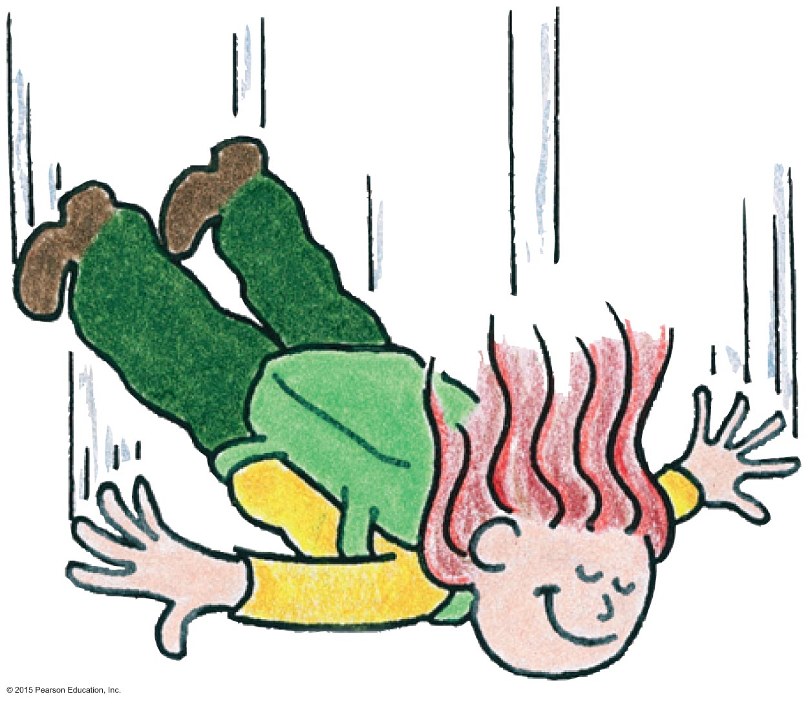
Nonfree Fall CHECK YOUR NEIGHBOR
As the skydiver falls faster and faster through the air, air resistance
increases.
decreases.
remains the same.
Not enough information.
Notes:
A. increases.

Slide 47
Nonfree Fall CHECK YOUR ANSWER
As the skydiver falls faster and faster through the air, air resistance
increases.
decreases.
remains the same.
Not enough information.
Notes:
A. increases.

Slide 48
Nonfree Fall CHECK YOUR NEIGHBOR
As the skydiver continues to fall faster and faster through the air, net force
increases.
decreases.
remains the same.
Not enough information.
Notes:
B. decreases.

Slide 49
Nonfree Fall CHECK YOUR ANSWER
As the skydiver continues to fall faster and faster through the air, net force
increases.
decreases.
remains the same.
Not enough information.
Notes:
B. decreases.

Slide 50
Nonfree Fall CHECK YOUR NEIGHBOR
As the skydiver continues to fall faster and faster through the air, her acceleration
increases.
decreases.
remains the same.
Not enough information.
Notes:
B. decreases.

Slide 51
Nonfree Fall CHECK YOUR ANSWER
As the skydiver continues to fall faster and faster through the air, her acceleration
increases.
decreases.
remains the same.
Not enough information.
Comment:
If this question were asked first in the sequence of skydiver questions, many would answer it incorrectly. Would this have been you?
Notes:
B. decreases.

Slide 52
Nonfree Fall CHECK YOUR NEIGHBOR
Consider a heavy and a light person jumping together with same-size parachutes from the same altitude. Who will reach the ground first?
The light person
The heavy person
Both will reach at the same time.
Not enough information.
Notes:
B. The heavy person.

Slide 53
Nonfree Fall CHECK YOUR ANSWER
Consider a heavy and a light person jumping together with same-size parachutes from the same altitude. Who will reach the ground first?
The light person
The heavy person
Both will reach at the same time.
Not enough information.
Explanation:
They both have the same drag force (for the same speed).
The heavier person has a greater downward force than the lighter person.
The heavier one has to drop farther to receive a drag force equal to the downward force, and so has a higher terminal velocity.
Notes:
B. The heavy person.

Slide 54
Free Fall Versus Nonfree Fall
Coin and feather fall while air is present
Feather reaches terminal velocity very quickly and falls slowly at constant speed, reaching the bottom after the coin does.
Coin falls very quickly and air resistance doesn't build up to its weight over short-falling distances, which is why the coin hits the bottom much sooner than the falling feather.

Slide 55
Nonfree Fall CHECK YOUR NEIGHBOR
When the air is removed by a vacuum pump and the coin and feather activity is repeated,
the feather hits the bottom first, before the coin hits.
the coin hits the bottom first, before the feather hits.
both the coin and feather drop together side by side.
Not enough information.
Notes:
C. both the coin and feather drop together side by side.

Slide 56
Nonfree Fall CHECK YOUR ANSWER
When the air is removed by a vacuum pump and the coin and feather activity is repeated,
the feather hits the bottom first, before the coin hits.
the coin hits the bottom first, before the feather hits.
both the coin and feather drop together side by side.
Not enough information.
Notes:
C. both the coin and feather drop together side by side.

Slide 57
Free Fall Versus Nonfree Fall
Coin and feather fall in vacuum
There is no air, because it is vacuum.
So, no air resistance.
Coin and feather fall together.

