Slide 1
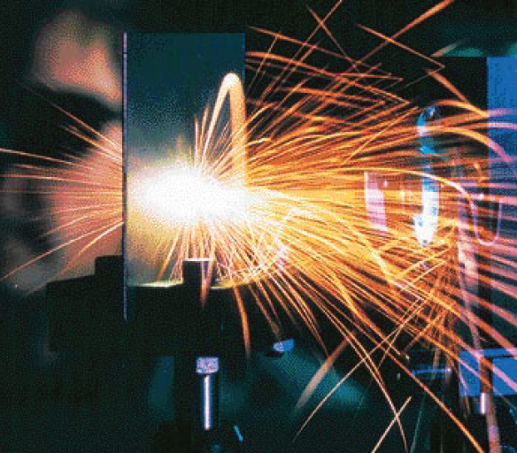
PowerPoint Lectures to accompany Physical Science, 9e
Chapter 4
Heat and Temperature
Copyright © The McGraw-Hill Companies, Inc. Permission required for reproduction or display.

Slide 2
Core Concepts
A relationship exists between heat, temperature, and the motion and position of molecules.

Slide 3
Overview
Thermodynamics
Study of macroscopic processes involving heat, mechanical and other forms of energy
Applications - systems with energy inputs and outputs: heat engines, heat pumps, refrigerators, …
Based upon but not concerned with microscopic details
Approach here
Discuss underlying microscopic processes
Relate microscopic and macroscopic views
Study the laws of thermodynamics

Slide 4
Kinetic Molecular Theory
Collective hypotheses about the particulate nature of matter and the surrounding space
Greeks - earliest written ideas on atoms
Current view
Matter comprised of microscopic particles - atoms
Atoms combine to form molecules
Many macroscopic phenomena can be traced to interactions on this level.

Slide 5
Molecules
Chemical elements - defined by each unique type of atom
Compounds - pure substances made up of two or more atoms chemically bonded
Molecules
Smallest unit retaining the properties of a compound
Shorthand here: “molecules” can stand for either atoms (monatomic molecules) or molecules
Molecular interactions
Usually attractive, causing materials to cling together
Cohesion - attractive forces between like molecules
Adhesion
Attractive forces between unlike molecules
Water wetting skin
Glue mechanism; adhesives
Interactions can also be repulsive
Water beading on wax

Slide 6
Phases of Matter - Solids
Definite shape and volume
Rigid 3-D structure
Atoms/molecules bonded in place
Allowed motions restricted to vibration in place only

Slide 7
Phases of Matter - Liquids
Definite volume, indefinite shape
Only weak cohesive bonds between component molecules
Constituent molecules mostly in contact
Allowed motions
Vibration
Rotation
Limited translation

Slide 8
Phases of Matter - Gases
Indefinite volume and shape
Molecules mostly not in contact
Allowed motions
Vibration and rotation (molecules with more than one atom)
Translation on random, mostly free paths

Slide 9
Molecular Motions
Characterized by average kinetic energy in a large sample
Temperature
Measure of average kinetic energy on the molecules making up a substance
Proportional to average KE
Evidence
Gases diffuse quicker at higher temperatures
Expansion/contraction with increasing/decreasing temperature

Slide 10
Temperature
A measure of the internal energy of an object
Thermometers
Used to measure temperature
Rely on thermometric properties
Example: bimetallic strips and thermostats

Slide 11
Temperature Scales
Defined w.r.t various reference points
Fahrenheit
Celsius
Kelvin

Slide 12
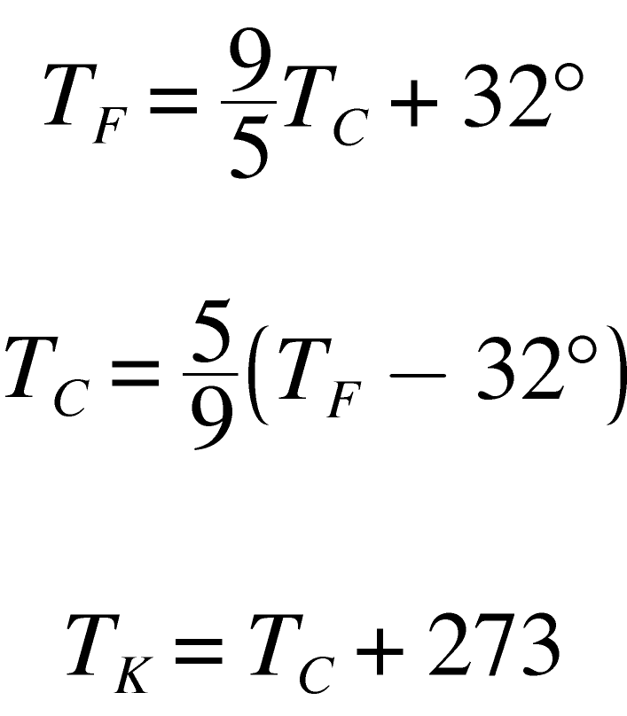
Temperature Scales
Conversion formulas
Fahrenheit to Celsius
Celsius to Fahrenheit
Celsius to Kelvin

Slide 13
Heat
A form of energy transfer between two objects
External energy - total potential and kinetic energy of an everyday-sized object
Internal energy - total kinetic energy of the molecules in that object
External can be transferred to internal, resulting in a temperature increase

Slide 14
Heat versus Temperature
Temperature
A measure of hotness or coldness of an object
Based on average molecular kinetic energy
Heat
Based on total internal energy of molecules
Doubling amount at same temperature doubles heat

Slide 15
Heat
Definition
A measure of the internal energy that has been absorbed or transferred from another object
Two related processes
“Heating” = increasing internal energy
“Cooling” = decreasing internal energy
Heating methods
Temperature difference: Energy always moves from higher temperature regions to lower temperature regions
Energy-form conversion: Transfer of heat by doing work

Slide 16
Measures of Heat
Metric units
calorie (cal) - energy needed to raise temperature of 1 g of water 1 degree Celsius
kilocalorie (kcal, Calorie, Cal) - energy needed to raise temperature of 1 kg of water 1 degree Celsius
English system
British thermal unit (BTU) - energy needed to raise the temperature of 1 lb of water 1 degree Fahrenheit
Mechanical equivalence
4.184 J = 1 cal

Slide 17
Specific Heat
Variables involved in heating
Temperature change
Mass
Type of material
Different materials require different amounts of heat to produce the same temperature change
Measure = specific heat
Summarized in one equation

Slide 18
Heat Flow
Three mechanisms for heat transfer due to a temperature difference
Conduction
Convection
Radiation
Natural flow is always from higher temperature regions to cooler ones

Slide 19
Conduction
Heat flowing through matter
Mechanism
Hotter atoms collide with cooler ones, transferring some of their energy
Direct physical contact required; cannot occur in a vacuum
Poor conductors = insulators (Styrofoam, wool, air…)

Slide 20
Sample Conductivities
Material | Relative conductivity
Silver | 0.97
Iron | 0.11
Water | 1.3x10⁻³
Styrofoam | 1.0x10⁻⁴
Air | 6.0x10⁻⁵
Vacuum | 0

Slide 21
Convection
Energy transfer through the bulk motion of hot material
Examples
Space heater
Gas furnace (forced)
Natural convection mechanism - “hot air rises”

Slide 22
Radiation
Radiant energy - energy associated with electromagnetic waves
Can operate through a vacuum
All objects emit and absorb radiation
Temperature determines
Emission rate
Intensity of emitted light
Type of radiation given off
Temperature determined by balance between rates of emission and absorption
Example: Global warming

Slide 23
Energy, Heat, and Molecular Theory
Two responses of matter to heat
Temperature increase within a given phase
Heat goes mostly into internal kinetic energy
Specific heat

Slide 24
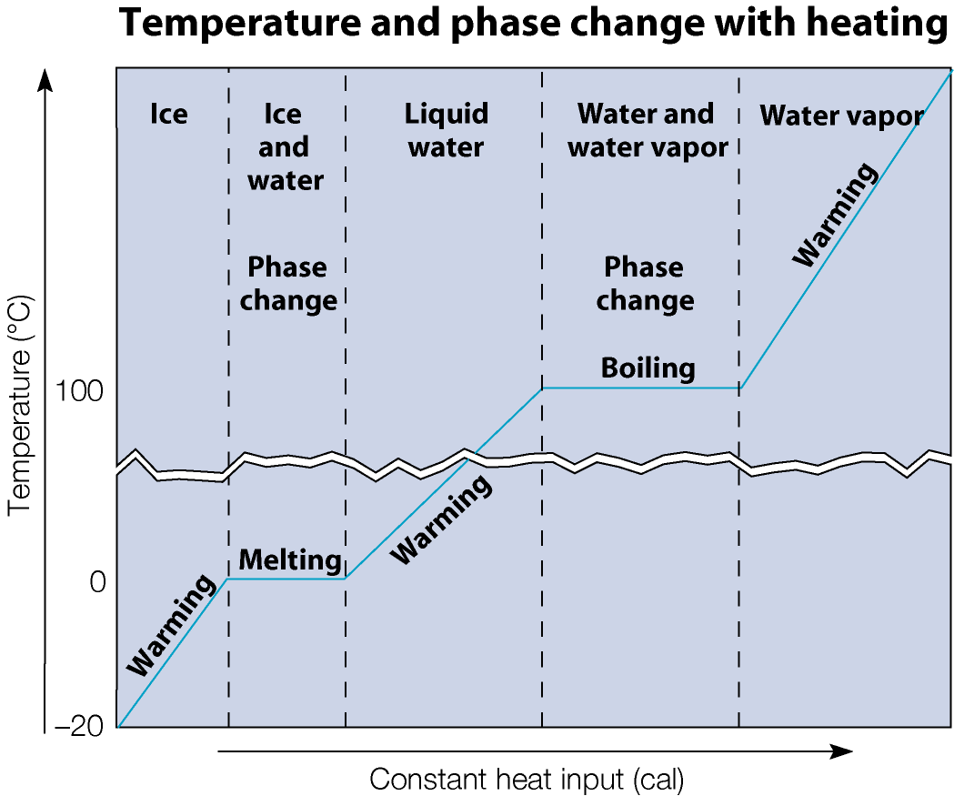
Energy, Heat, and Molecular Theory
Two responses of matter to heat
2. Phase change at constant temperature
Related to changes in internal potential energy
Latent heat

Slide 25
Phase Changes
 | Solid/liquid | Liquid/gas | Solid/gas
Latent heat | Fusion | Vaporization | Sublimation
Temperature (Direction ->) | Melting point | Boiling point | Sublimation
Temperature (Direction <-) | Freezing point | Condensation point | Sublimation

Slide 26
Evaporation and Condensation
Individual molecules can change phase any time
Evaporation:
Energy required to overcome phase cohesion
Higher energy molecules near the surface can then escape
Condensation:
Gas molecules near the surface lose KE to liquid molecules and merge

Slide 27
Thermodynamics
The study of heat and its relationship to mechanical and other forms of energy
Thermodynamic analysis includes
System
Surroundings (everything else)
Internal energy (the total internal potential and kinetic energy of the object in question)
Energy conversion
Friction - converts mechanical energy into heat
Heat engines - devices converting heat into mechanical energy
Other applications: heat pumps, refrigerators, organisms, hurricanes, stars, black holes … virtually any system with energy inputs and outputs

Slide 28
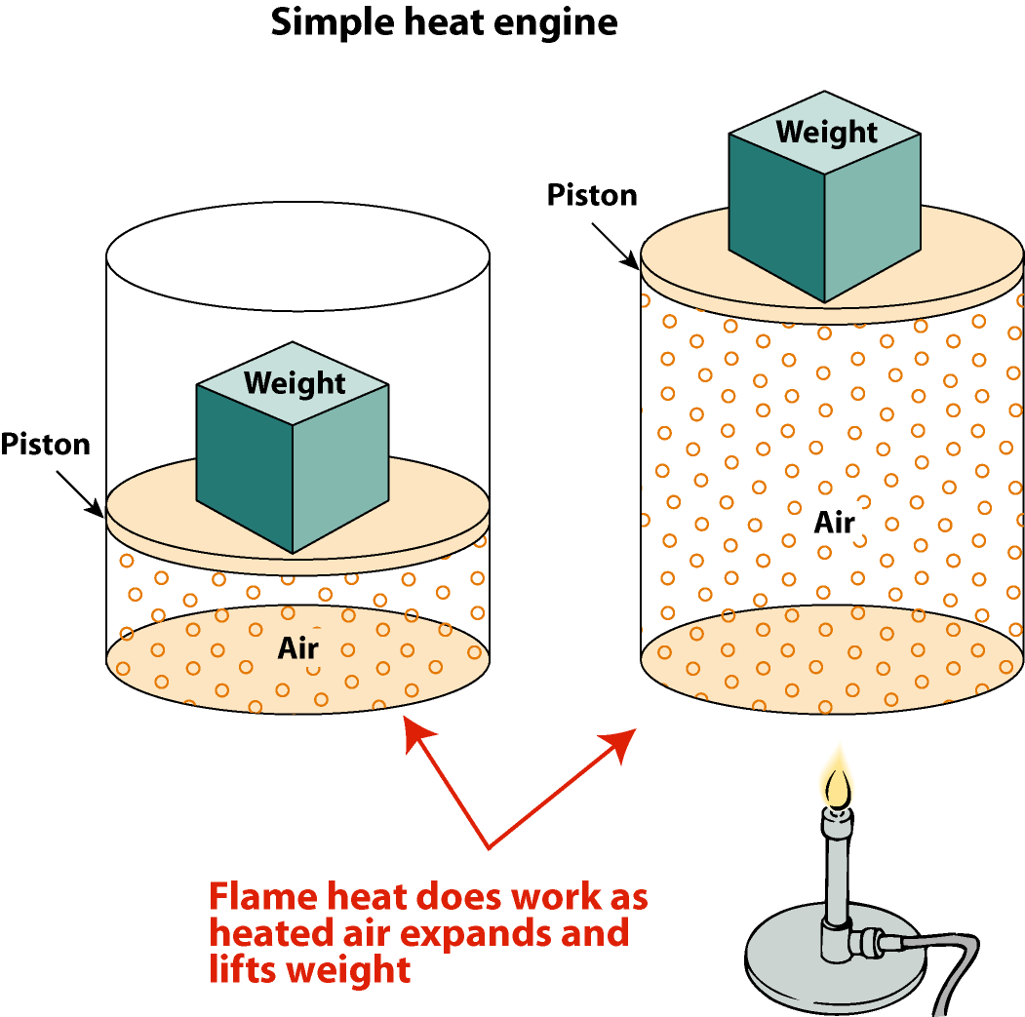
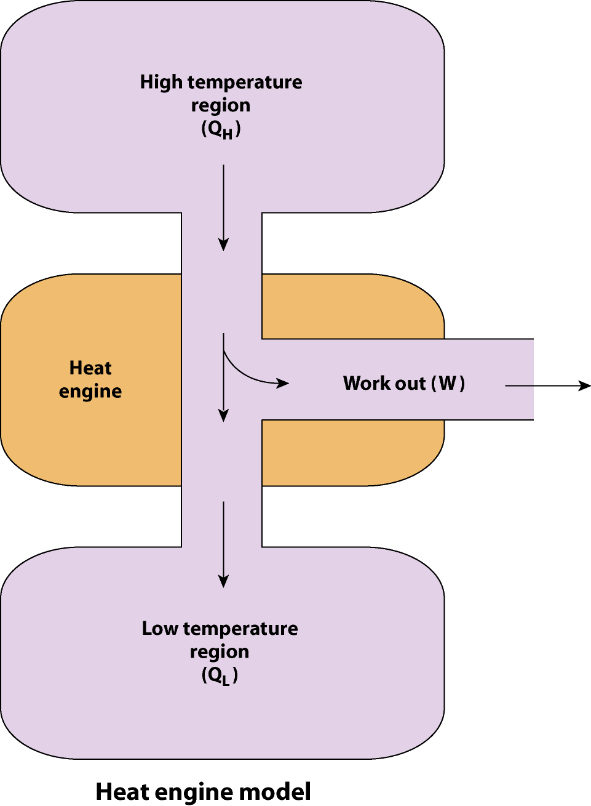
The First Law of Thermodynamics
Conservation of energy
Components
Internal energy
Heat
Work
Stated in terms of changes in internal energy
Application: heat engines

Slide 29
The Second Law of Thermodynamics
Equivalent statements:
No process can solely convert a quantity of heat to work (heat engines)
Heat never flows spontaneously from a cold object to a hot object (refrigerators)
Natural processes tend toward a greater state of disorder (entropy)
Two reference scales:
An object’s external energy
Energy of global, coherent motion
Associated with work
An object’s internal energy
Energy of microscopic, chaotic, incoherent motion
Associated with heat

Slide 30
Second Law, First Statement
Conservation of energy, heat engine
Input energy = output energy
Efficiency of a heat engine
Work done per unit input energy
Second law:
Efficiency cannot equal 1
Some energy always degraded

Slide 31
Second Law, Second Statement
Conservation of energy, heat pump
Energy arriving in high temperature region = energy from low temperature region + work needed to move it
Upgrading of energy by heat pump accompanied by greater degradation of energy elsewhere

Slide 32
Second Law, Third Statement
Real process = irreversible process
Measure of disorder = entropy
Second law, in these terms:
The total entropy of the Universe continually increases
Natural processes degrade coherent, useful energy
Available energy of the Universe diminishing
Eventually: “heat death” of the Universe
Direction of natural processes
Toward more disorder
Spilled milk will never “unspill” back into the glass!

