Slide 1
Chapter 3: Linear Motion

Slide 2
This lecture will help you understand:
Motion Is Relative
Speed
Velocity
Acceleration
Free Fall
Velocity Vectors

Slide 3
Motion Is Relative
Motion of objects is always described as relative to something else. For example:
You walk on the road relative to Earth, but Earth is moving relative to the Sun.
So your motion relative to the Sun is different from your motion relative to Earth.

Slide 4
Speed
Defined as the distance covered per amount of travel time.
Units are meters per second.
In equation form:
Example: A girl runs 4 meters in 2 s. Her speed is 2 m/s.

Slide 5
Average Speed
The total distance covered divided by the total travel time.
Doesn't indicate various instantaneous speeds along the way.
In equation form:
Example: Drive a distance of 200 km in 2 h and your average speed is 100 km/h.

Slide 6
Average Speed CHECK YOUR NEIGHBOR
The average speed of driving 30 km in 1 hour is the same as the average speed of driving
30 km in 1/2 hour.
30 km in 2 hours.
60 km in 1/2 hour.
60 km in 2 hours.
Notes:
6
D. 60 km in 2 hours.

Slide 7
Average Speed CHECK YOUR ANSWER
The average speed of driving 30 km in 1 hour is the same as the average speed of driving
30 km in 1/2 hour.
30 km in 2 hours.
60 km in 1/2 hour.
60 km in 2 hours.
Explanation:
Average speed = total distance / time So, average speed = 30 km / 1 h = 30 km/h.
Now, if we drive 60 km in 2 hours: Average speed = 60 km / 2 h = 30 km/h
Same
Notes:
7
D. 60 km in 2 hours.

Slide 8
Instantaneous Speed
Instantaneous speed is the speed at any instant.
Example:
When you ride in your car, you may speed up and slow down with speed at any instant that is normally quite different than your average speed.
Your instantaneous speed is given by your speedometer.

Slide 9
Velocity
A description of both
the instantaneous speed of the object.
the direction of travel.
Velocity is a vector quantity. It has
Magnitude (speed) and Direction.
Velocity is "directed" speed.

Slide 10
Speed and Velocity
Constant speed is steady speed, neither speeding up nor slowing down.
Constant velocity is
constant speed and
constant direction (straight-line path with no acceleration).
Motion is relative to Earth, unless otherwise stated.

Slide 11
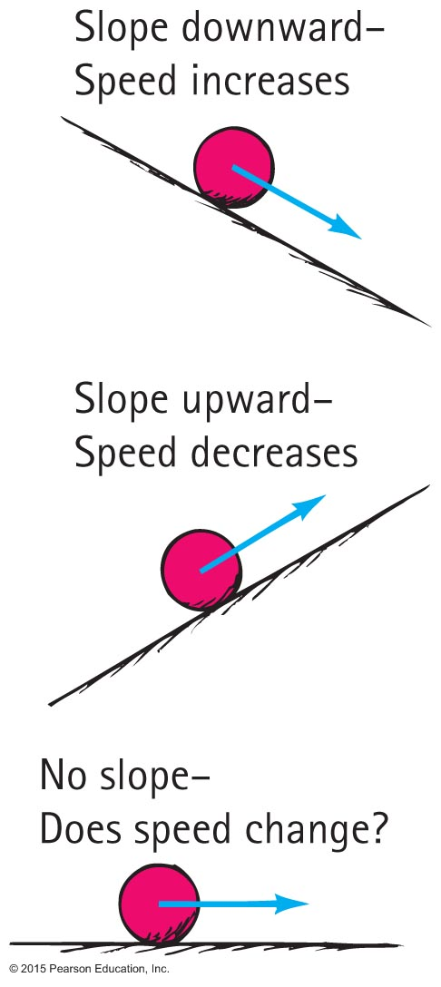
Acceleration
Formulated by Galileo based on his experiments with inclined planes.
Rate at which velocity changes over time.

Slide 12
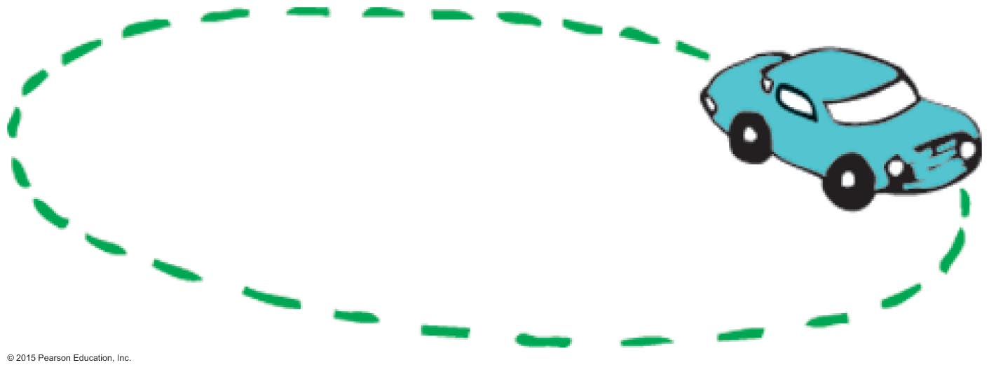
Acceleration
Involves a
change in speed, or
change in direction, or
both.
Example: Car making a turn.

Slide 13
Acceleration
In equation form:
Unit of acceleration is unit of velocity / unit of time.
Example:
Your car's speed may presently be 40 km/h.
Your car's speed 5 s later is 45 km/h.
Your car's change in speed is 45 – 40 = 5 km/h.
Your car's acceleration is 5 km/h·5 s = 1 km/h·s.

Slide 14
Acceleration CHECK YOUR NEIGHBOR
An automobile is accelerating when it is
slowing down to a stop.
rounding a curve at a steady speed.
Both of the above.
Neither of the above.
Notes:
14
C. Both of the above.

Slide 15
Acceleration CHECK YOUR ANSWER
An automobile is accelerating when it is
slowing down to a stop.
rounding a curve at a steady speed.
Both of the above.
Neither of the above.
Explanation:
Change in speed (increase or decrease) per time is acceleration, so slowing is acceleration.
Change in direction is acceleration (even if speed stays the same), so rounding a curve is acceleration.
Notes:
15
Acceleration occurs due to a change in either speed or direction (or both).
When a car slows down it changes its speed, so it is accelerating.
When a car rounds a curve, although its speed is steady it is accelerating because it is changing direction.

Slide 16
Acceleration CHECK YOUR NEIGHBOR
Acceleration and velocity are actually
the same.
rates but for different quantities.
the same when direction is not a factor.
the same when an object is freely falling.
Notes:
16
B. rates but for different quantities.

Slide 17
Acceleration CHECK YOUR ANSWER
Acceleration and velocity are actually
the same.
rates but for different quantities.
the same when direction is not a factor.
the same when an object is freely falling.
Explanation:
Velocity is the rate at which distance traveled changes over time,
Acceleration is the rate at which velocity changes over time.
Notes:
17
B. rates but for different quantities.

Slide 18
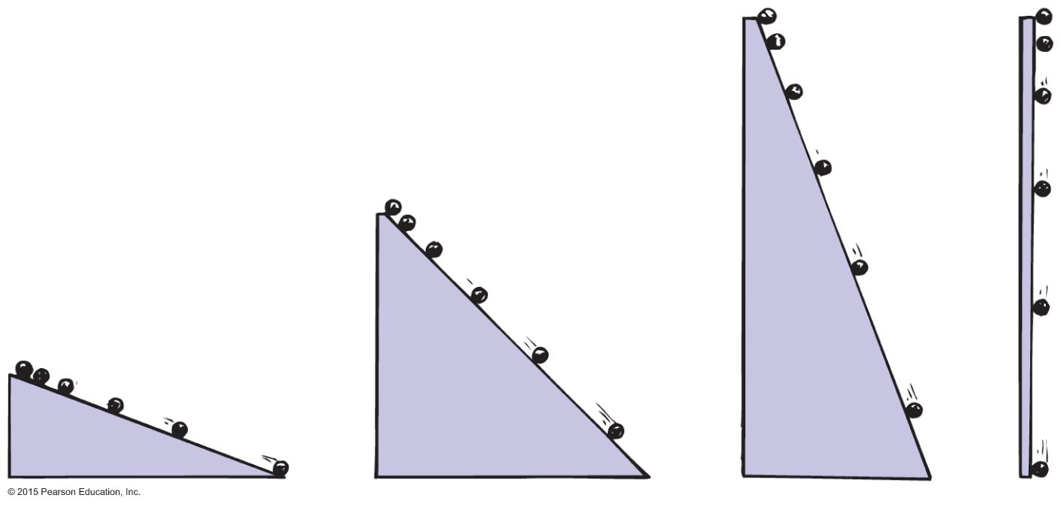
Acceleration
Galileo increased the inclination of inclined planes.
Steeper inclines result in greater accelerations.
When the incline is vertical, acceleration is at maximum, the same as that of a falling object.
When air resistance is negligible, all objects fall with the same unchanging acceleration.

Slide 19
Free Fall
Falling under the influence of gravity only-with no air resistance
Freely falling objects on Earth accelerate at the rate of 10 m/s·s, that is, 10 m/s² (more precisely, 9.8 m/s²).

Slide 20
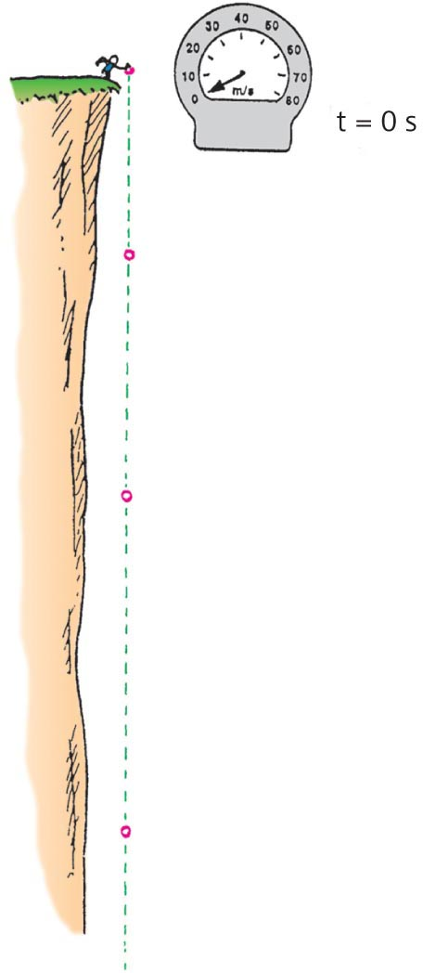
Free Fall—How Fast?
The velocity acquired by an object starting from rest is
So, under free fall, when acceleration is 10 m/s², the speed is
10 m/s after 1 s.
20 m/s after 2 s.
30 m/s after 3 s.
And so on.

Slide 21
Free Fall—How Fast? CHECK YOUR NEIGHBOR
At a particular instant a free-falling object has a speed of 30 m/s. Exactly 1 s later its speed will be
the same.
35 m/s.
more than 35 m/s.
60 m/s.
Notes:
21
C. more than 35 m/s

Slide 22
Free Fall—How Fast? CHECK YOUR ANSWER
At a particular instant a free-falling object has a speed of 30 m/s. Exactly 1 s later its speed will be
the same.
35 m/s.
more than 35 m/s.
60 m/s.
Explanation:
One second later its speed will be 40 m/s, which is more than 35 m/s.
Notes:
22
The object gains 10 m/s after every second.
So, at a given instance, if its speed is 30 m/s, then a second later it will be 10 m/s greater than that, that is, 30 m/s + 10 m/s = 40 m/s
So, its speed a second later is 40 m/s which is more than 35 m/s.

Slide 23
Free Fall—How Far?
The distance covered by an accelerating object starting from rest is
Under free fall, when acceleration is 10 m/s², the distance fallen is
5 m/s after 1 s.
20 m/s after 2 s.
45 m/s after 3 s.
And so on.

Slide 24
Free Fall—How Far? CHECK YOUR NEIGHBOR
What is the distance fallen after 4 s for a freely falling object starting from rest?
4 m
16 m
40 m
80 m
Notes:
24
D. 80 m

Slide 25
Free Fall—How Far? CHECK YOUR ANSWER
What is the distance fallen after 4 s for a freely falling object starting from rest?
4 m
16 m
40 m
80 m
Explanation:
Distance = (1/2) × acceleration × time × time
So: Distance = (1/2) × 10 m/s² × 4 s × 4 s
So: Distance = 80 m
Notes:
25
D. 80 m

Slide 26
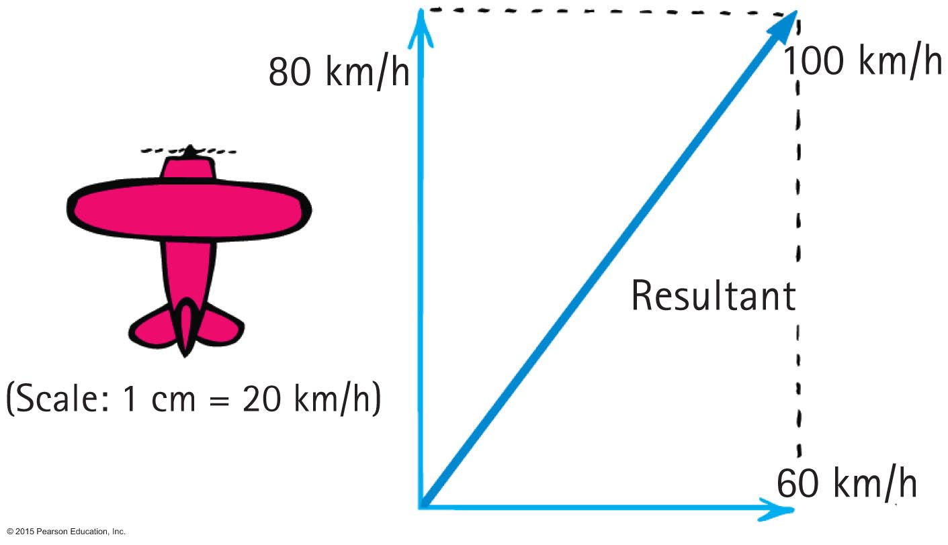
Vectors CHECK YOUR NEIGHBOR
The 60-km/h crosswind blows the 80-km/h airplane off course at 100 km/h. If the crosswind were 80 km/h, the airplane would travel at 113 km/h at an angle of
less than 45 degrees.
45 degrees.
more than 45 degrees.
None of the above are correct.
Notes:
26
B. 45 degrees

Slide 27
Vectors CHECK YOUR ANSWER
The 60-km/h crosswind blows the 80-km/h airplane off course at 100 km/h. If the crosswind were 80 km/h, the airplane would travel at 113 km/h at an angle of
less than 45 degrees.
45 degrees.
more than 45 degrees.
None of the above are correct.
Comment:
The parallelogram would then be a square with a 45-degree diagonal.
Notes:
27
B. 45 degrees

Slide 28
Vectors CHECK YOUR NEIGHBOR
You run horizontally at 4 m/s in a vertically falling rain that falls at 4 m/s. Relative to you, the raindrops are falling at an angle of
0°.
45°.
53°.
90°.
Notes:
B. 45°.

Slide 29
Vectors CHECK YOUR ANSWER
You run horizontally at 4 m/s in a vertically falling rain that falls at 4 m/s. Relative to you, the raindrops are falling at an angle of
0°.
45°.
53°.
90°.
Explanation: The horizontal 4 m/s and vertical 4 m/s combine by the parallelogram rule to produce a resultant of 5.6 m/s at 45°. Again, the parallelogram is a square.
Notes:
B. 45°.

