Slide 1
Chapter 1: About Science

Slide 2
This lecture will help you understand:
What Science Is
Scientific Measurements
Mathematics—The Language of Science
Scientific Methods
The Scientific Attitude
Science, Art, and Religion
Science and Technology
Physics—The Basic Science

Slide 3
What Science Is
Science
is a body of knowledge.
is an ongoing human activity.
has beginnings that precede recorded history.

Slide 4
Scientific Measurements
Measurements are a hallmark of good science.
"I often say that when you can measure something and express it in numbers, you know something about it. When you cannot measure it, when you cannot express it in numbers, your knowledge is of a meager and unsatisfactory kind. It may be the beginning of knowledge, but you have scarcely in your thoughts advanced to the stage of science, whatever it may be."
—Lord Kelvin

Slide 5
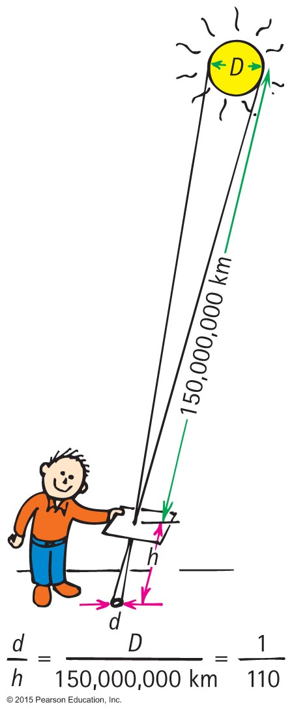
Scientific Measurements
Measurements
relate to how much you know about something.
of pinhole images of the Sun nicely lead to a calculation of the Sun's diameter.

Slide 6
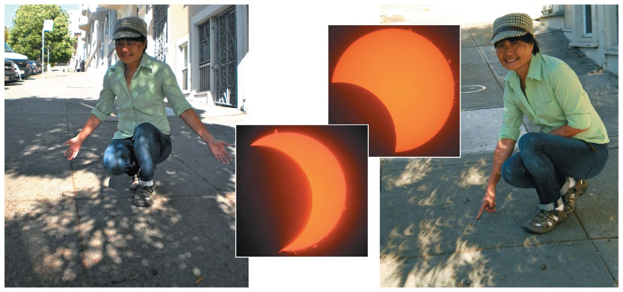
Scientific Measurements
These round images of the Sun are crescent shaped during a partial solar eclipse.

Slide 7
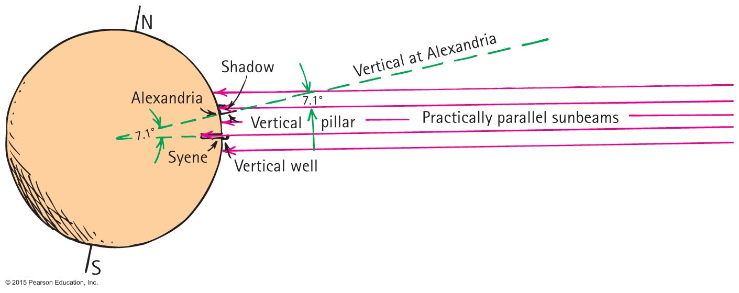
Some Early Scientific Measurements
Eratosthenes—Diameter of Earth

Slide 8
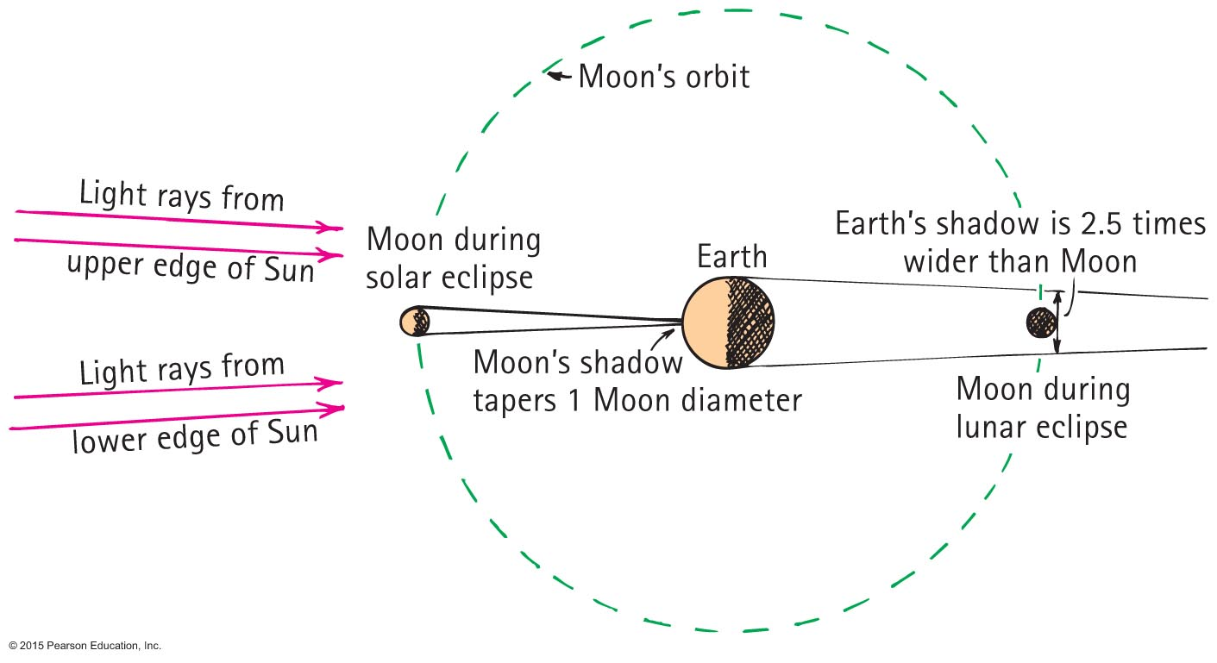
Some Early Scientific Measurements
Aristarchus—Distance and Size of the Moon

Slide 9
Mathematics—The Language of Science
Integration of science and mathematics
Occurred some four centuries ago.
Ideas of science are unambiguous when expressed in mathematical terms.
Equations of science provide expressions of relationships between concepts
Equations are "guides to thinking."

Slide 10
Scientific Methods
There is no one scientific method.
In general, scientific methods refer to principles and procedures for the systematic pursuit of knowledge involving the recognition and formulation of a problem, the collection of data through observation and experiment, and the formulation and testing of hypotheses.

Slide 11
Scientific Methods—Common Steps
Recognize a question, a puzzle, or an unexplained fact.
Make a hypothesis (educated guess) to resolve the puzzle.
Predict consequences of the hypothesis.
Perform experiments or make calculations to test the predictions.
Formulate the simplest general rule that organizes the three main steps.

Slide 12
The Scientific Attitude
The scientific attitude is one of
inquiry.
experimentation.
willingness to admit error.

Slide 13
The Scientific Attitude
Scientists
are experts at changing their minds.
must accept experimental findings
test for erroneous beliefs
understand objections and positions of antagonists.

Slide 14
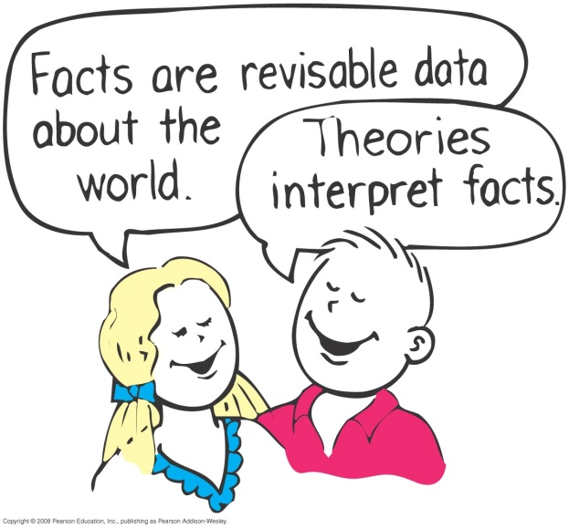
The Scientific Attitude
Fact is a close agreement by competent observers who make a series of observations about the same phenomenon.
A scientific hypothesis is an educated guess that is only presumed to be factual until supported by experiment.

Slide 15
The Scientific Attitude CHECK YOUR NEIGHBOR
Which of these is a scientific hypothesis?
The Moon is made of green cheese.
Atomic nuclei are the smallest particles in nature.
A magnet will pick up a copper penny.
Cosmic rays cannot penetrate the thickness of your Conceptual Physics textbook.
Notes:
A. The Moon is made of green cheese.
B. Atomic nuclei are the smallest particles in nature.
C. A magnet will pick up a copper penny.
D. Cosmic rays cannot penetrate the thickness of your Conceptual Physics textbook.

Slide 16
The Scientific Attitude CHECK YOUR ANSWER
Which of these is a scientific hypothesis?
The Moon is made of green cheese.
Atomic nuclei are the smallest particles in nature.
A magnet will pick up a copper penny.
Cosmic rays cannot penetrate the thickness of your Conceptual Physics textbook.
Explanation: All are scientific hypotheses! All have tests for proving wrongness, so they pass the test of being a scientific hypothesis.
Notes:
All are scientific hypotheses! All choices not only have tests for proving wrongness, but have been proved wrong. Nevertheless, they still pass the test of being a scientific hypothesis

Slide 17
The Scientific Attitude CHECK YOUR NEIGHBOR
Which of these is not a scientific hypothesis?
Protons carry an electric charge.
Undetectable particles are some of nature's secrets.
Charged particles bend when in a magnetic field.
All of the above are scientific hypotheses.
Notes:
B. Undetectable particles are some of nature's secrets.

Slide 18
The Scientific Attitude CHECK YOUR ANSWER
Which of these is not a scientific hypothesis?
Protons carry an electric charge.
Undetectable particles are some of nature's secrets.
Charged particles bend when in a magnetic field.
All of the above are scientific hypotheses.
Explanation: Choices A and C can be disproved by experiments.
Choice B has no test for wrongness, so it is not a scientific hypothesis.
Notes:
If protons didn't carry electric charge, they wouldn't be deflected when crossing a magnetic field. This would be a test for showing the hypothesis wrong. So both A and C are capable of being proved wrong, which makes them scientific. Statement B, however, has no test for wrongness. It is reasonable speculation—but not a scientific hypothesis.

Slide 19
The Scientific Attitude
Law or principle
A hypothesis that has been tested repeatedly and has not been contradicted
Theory
A synthesis of a large body of information that encompasses well-tested and verified hypotheses about certain aspects of the natural world

Slide 20
The Scientific Attitude CHECK YOUR NEIGHBOR
Which of these often changes over time with further study?
Facts.
Theories.
Both of the above.
Neither of the above.
Notes:
C. Both of the above.

Slide 21
The Scientific Attitude CHECK YOUR ANSWER
Which of these often changes over time with further study?
Facts.
Theories.
Both of the above.
Neither of the above.
Explanation: Both can change. As we learn new information, we refine our ideas; likewise in science.
Notes:
Both can change. Is this a weakness or strength of science? For example, if everything a child holds true is unchanged when that child grows up, with years of study, even receiving advanced degrees, then either nothing was learned or the child was unusually gifted from the start—or was part of a closed system. As we learn new information, we refine our ideas. Likewise with the fields of science.

Slide 22
The Scientific Attitude CHECK YOUR NEIGHBOR
A person who says, "that's only a theory" likely doesn't know that a scientific theory is a
guess.
number of facts.
hypothesis of sorts.
vast synthesis of well-tested hypotheses and facts.
Notes:
D. vast synthesis of well-tested hypotheses and facts.

Slide 23
The Scientific Attitude CHECK YOUR ANSWER
A person who says, "that's only a theory" likely doesn't know that a scientific theory is a
guess.
number of facts.
hypothesis of sorts.
vast synthesis of well-tested hypotheses and facts.
Explanation: The word "theory" in everyday speech is different than its use in science.
In science, only a vast, experimentally verifiable body of knowledge is a theory.
Notes:
Theory in everyday speech is vastly different than its use in science. A vast and verifiable body of knowledge isn't only a theory; if it passes all its tests, it is elevated to that status! Newton's theory of gravity and Einstein's theory of relativity, for example, are not idle hypotheses—both are supported by innumerable experiments. They are more than only theories.

Slide 24
Science, Art, and Religion
Comparison of science, art, and religion by domain:
Science is of the natural order and involves the discovery and recording of natural phenomena.
Art is the interpretation and expression of human experience.
Religion involves faith and worship of a supreme being.

Slide 25
Science, Art, and Religion
Similarities between art and in science
Knowledge of what is possible in human experience and in nature.
Knowledge of both affects our views and decisions about the world.
Similarities between religion and in science
Both deal with unanswered questions.

Slide 26
The Scientific Attitude CHECK YOUR NEIGHBOR
Between a pilot and a priest, who do you think should fly a commercial jet airplane? Who should perform a marriage? (Although the questions are no-brainers, they have a point.)
The pilot should fly and the priest should perform a marriage.
The priest should fly and the pilot should perform a marriage.
The pilot should do both.
The priest should do both.
Notes:
A. The pilot should fly and the priest should perform a marriage.

Slide 27
The Scientific Attitude CHECK YOUR ANSWER
Between a pilot and a priest, who do you think should fly a commercial jet airplane? Who should perform a marriage? (Although the questions are no-brainers, they have a point.)
The pilot should fly and the priest should perform a marriage.
The priest should fly and the pilot should perform a marriage.
The pilot should do both.
The priest should do both.
Explanation: The pilot and priest have different skills for different tasks, and each can do their thing well.
Notes:
The point of the questions is that the pilot and priest have nurtured different skills for different tasks, and each can do their thing well. Okay, one could argue that a pilot could adequately do both. But it would be a stretch to say a priest could do both, unless the priest also had training as a pilot.

Slide 28
Science and Technology
Science is concerned with gathering and organizing knowledge.
Technology is the use of scientific knowledge for practical purposes and to provide tools for further exploration.

Slide 29
Physics—The Basic Science
Physical sciences include geology, astronomy, chemistry, and physics.
Life sciences include biology, zoology, and botany.
Physics underlies all the sciences.

Slide 30
The Scientific Attitude CHECK YOUR NEIGHBOR
Although physics may be the most difficult science course in certain schools, when compared with the fields of chemistry, biology, geology, and astronomy, it is
the simplest.
still the hardest!
the central science, between chemistry and biology.
simple enough, but only for especially intelligent people.
Notes:
A. the simplest.

Slide 31
The Scientific Attitude CHECK YOUR ANSWER
Although physics may be the most difficult science course in certain schools, when compared with the fields of chemistry, biology, geology, and astronomy, it is
the simplest.
still the hardest!
the central science, between chemistry and biology.
simple enough, but only for especially intelligent people.
Explanation: Your physics text has fewer terms than biology or chemistry texts. Physics is a much more basic science than other fields.
Notes:
Just compare the list of terms in the physics chapters of this book with the lists in chapters of other textbooks. Which lists are shortest? Chemistry, and especially biology, are enormously more complex than physics. Physics is much more understood than the other fields. It is a foundation for chemistry, biology, geology, and astronomy.

